Slide 1

Theoretical overview of XYZ structures
郭奉坤
中国科学院理论物理研究所
第7届XYZ粒子研讨会
2021.05.14-18 青岛

Slide 2

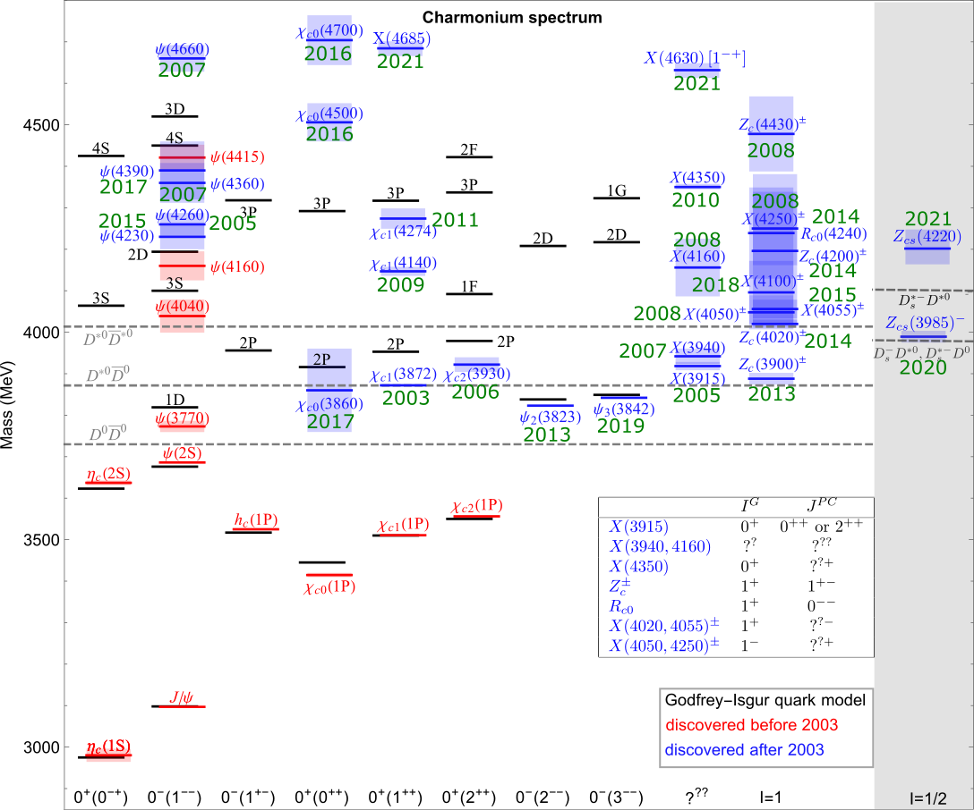









Charmonium(-like) structures

Slide 3




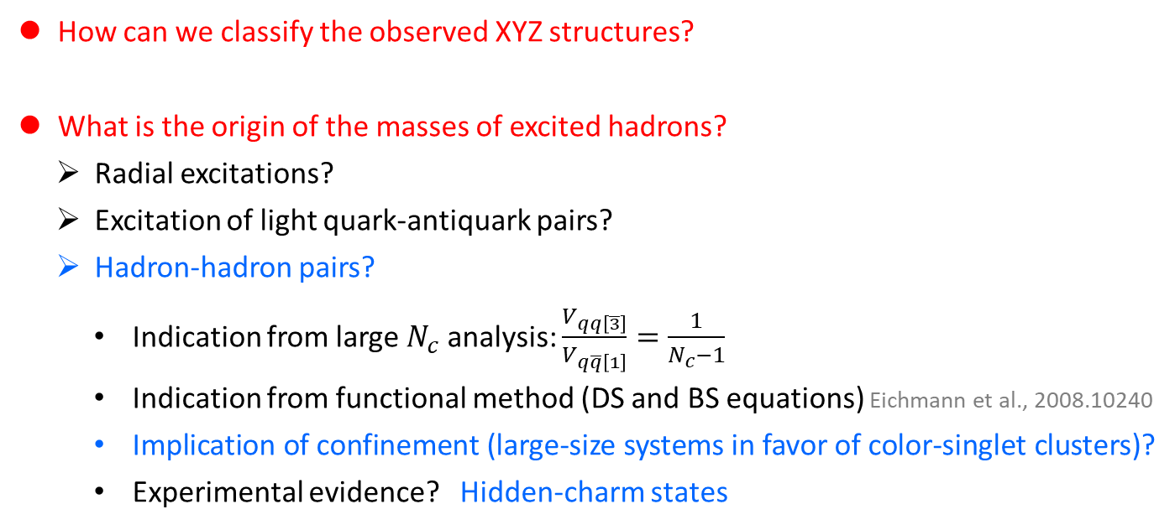

XYZ: central questions
How can we classify the observed XYZ structures?
What is the origin of the masses of excited hadrons?
  Radial excitations?
  Excitation of light quark-antiquark pairs?
  Hadron-hadron pairs?
    Indication from large $N_{c}$ analysis: $\frac{V_{qq\left[\overline{3}\right]}}{V_{q\overline{q}\left[1\right]}}=\frac{1}{N_{c}−1}$
    Indication from functional method (DS and BS equations) Eichmann et al., 2008.10240
    Implication of confinement (large-size systems in favor of color-singlet clusters)?
    Experimental evidence? Hidden-charm states
$$\overline{c}$$
$$q$$
$$c$$
$$\overline{q}$$

Slide 4
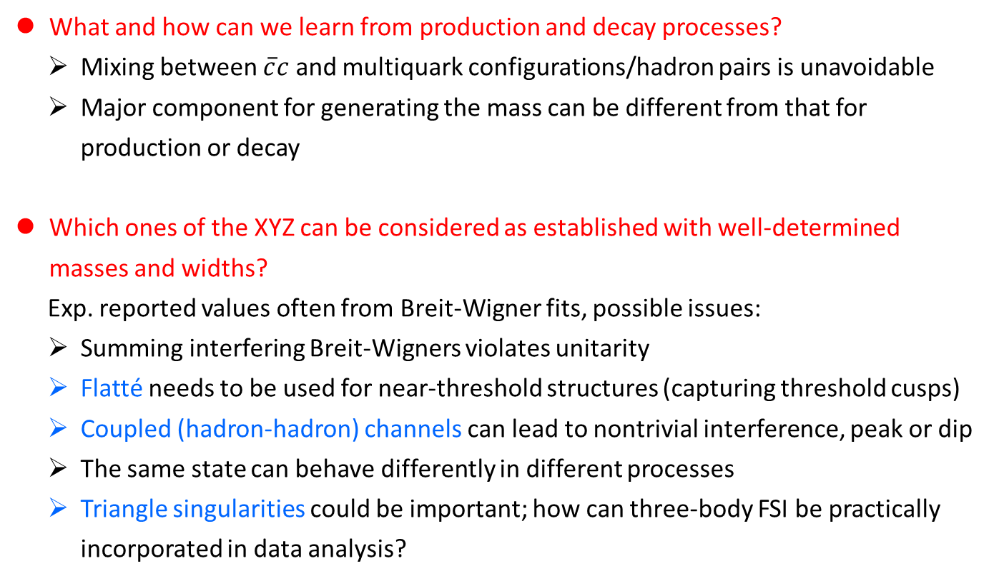
XYZ: central questions
What and how can we learn from production and decay processes?
  Mixing between $\overline{c}c$ and multiquark configurations/hadron pairs is unavoidable
  Major component for generating the mass can be different from that for production or decay
Which ones of the XYZ can be considered as established with well-determined masses and widths?
  Exp. reported values often from Breit-Wigner fits, possible issues:
  Summing interfering Breit-Wigners violates unitarity
  Flatté needs to be used for near-threshold structures (capturing threshold cusps)
  Coupled (hadron-hadron) channels can lead to nontrivial interference, peak or dip
  The same state can behave differently in different processes
  Triangle singularities could be important; how can three-body FSI be practically incorporated in data analysis?

Slide 5
Theoretical methods
Hadronic level: nonrelativistic EFT
  nonrelativistic expansion + heavy quark symmetry, with and w/o pion exchange
  poles correspond to hadronic molecules (purely molecules with only constant contact terms in single channel)
  mixing with charmonia can change the pole positions
  Low-energy constants unknown
Hadronic level: meson exchange model
  unknown/poorly known couplings
  cutoff dependence and ambiguous treatment of the short-distance potential
Quark level: quark model
  models based on chromomagnetic interactions
  diquark model
  unquenched quark model
  screened potential B.-Q. Li, K.-T. Chao (2009); …
Quark level: QCD sum rules
Kinematical triangle singularities
  Talks by 蒋军、张振华、杨智、吴天伟
E. Cincioglu, J. Nieves et al. (2016); Friedrichs model: Z.-Y. Zhou, Z.-G. Xiao (2016-2000); …
  Talks by 朱俊韬、王福来、陈锐
  Talks by 陈晓云、谭悦、刘风萧、王国利、吴雨衡
  Talk by 安洪涛
  Talk by 罗肆强
Y. Lu, N. Anwar, B.-S. Zou (2017); P. Ortega, J. Segovia, D. Entem, F. Fernandez (2018); …
  Talks by 陈伟、王志刚
  Talks by 景豪杰、刘晓海、杜蒙川

Slide 6
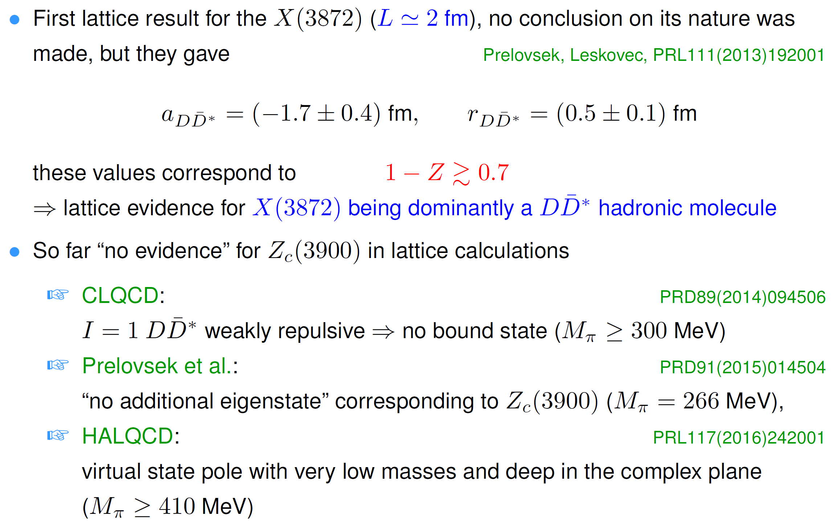

Theoretical methods: lattice QCD
So far only limited systems studied
Coupled channels always involved, interpretation of the results needs refined analysis
; strong $J/ψπ$-$\overline{D}D^{∗}$ and $η_{c}ρ$-$\overline{D}D^{∗}$ channel coupling
CPC43(2019)103103
Two channels $J/ψπ$-$\overline{D}D^{∗}$, disfavoring a near-threshold pole at $3σ$

Slide 7
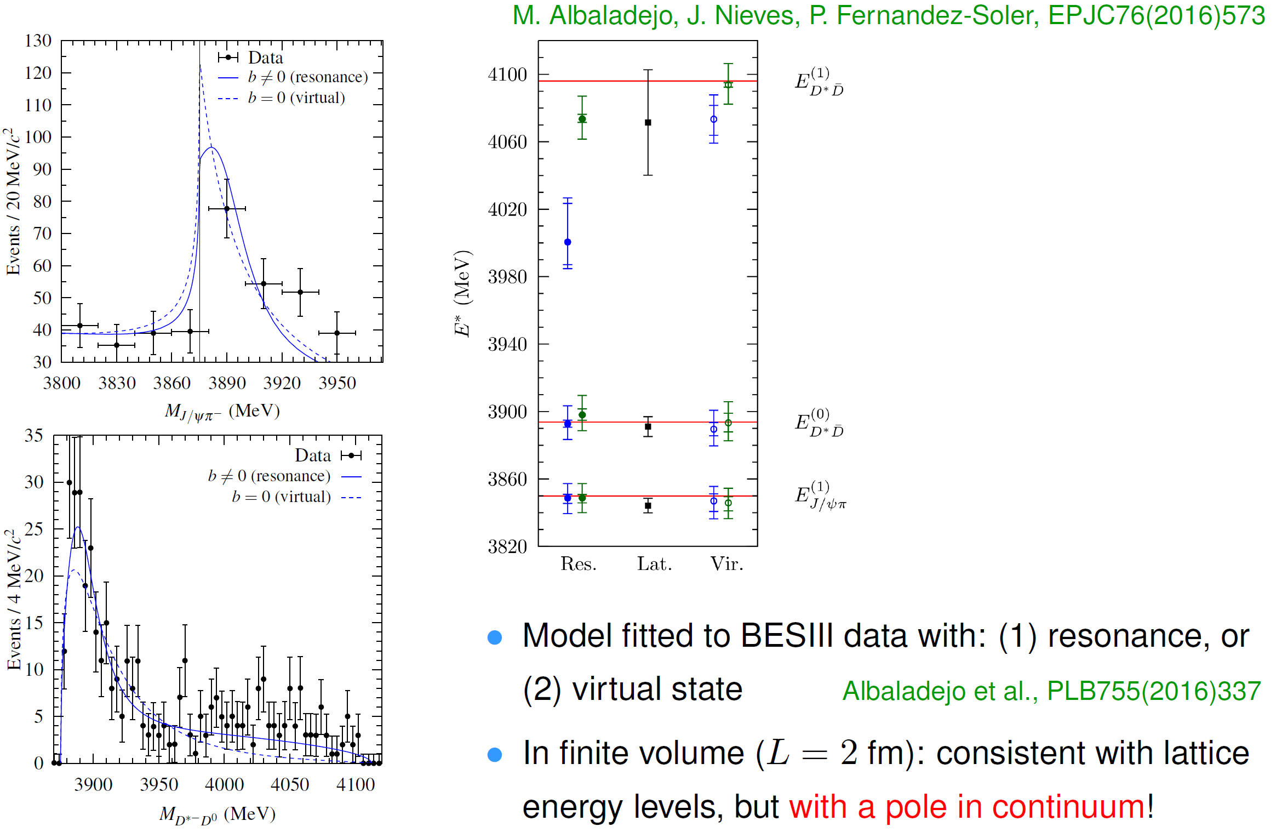
Theoretical methods: lattice QCD

Slide 8
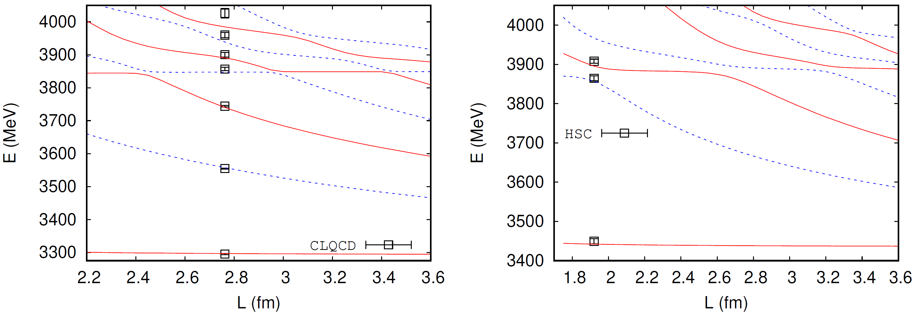
Theoretical methods: lattice QCD
The CLQCD lattice results are also consistent with a near-threshold pole in a remote Riemann sheet, producing a cusp threshold-enhancement behavior
Z.-H. Guo et al., in preparation
Preliminary
Preliminary
Lattice data: CLQCD, CPC43(2019)103103; HSC, JHEP11(2017)033
Fig. courtesy of Z.-H. Guo

Slide 9
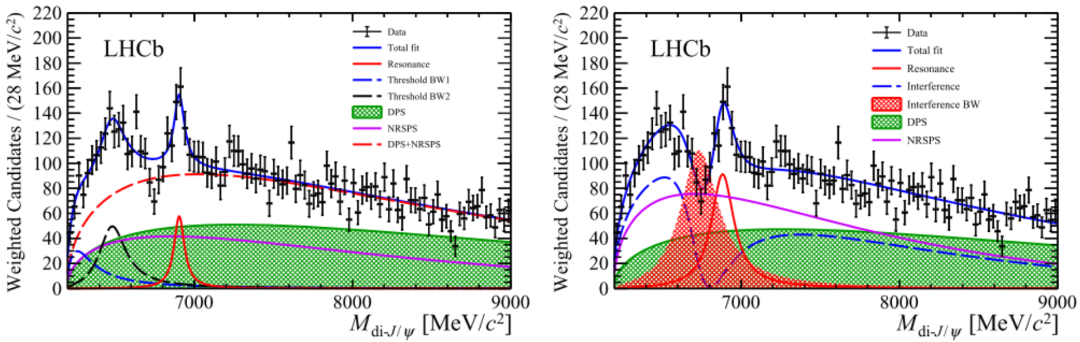
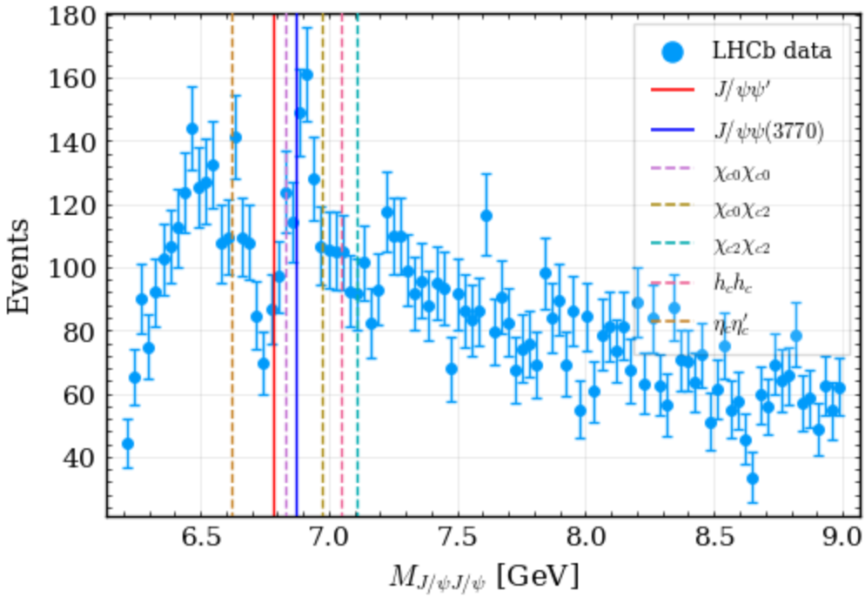
Coupled channels: X(6900)
Necessity of coupled-channel analysis taking into account relevant thresholds: pole position can largely differ from BW parameters
Example: X(6900)
  LHCb, Sci.Bull.65(2020)1983
Thresholds below 7.2 GeV:

Slide 10
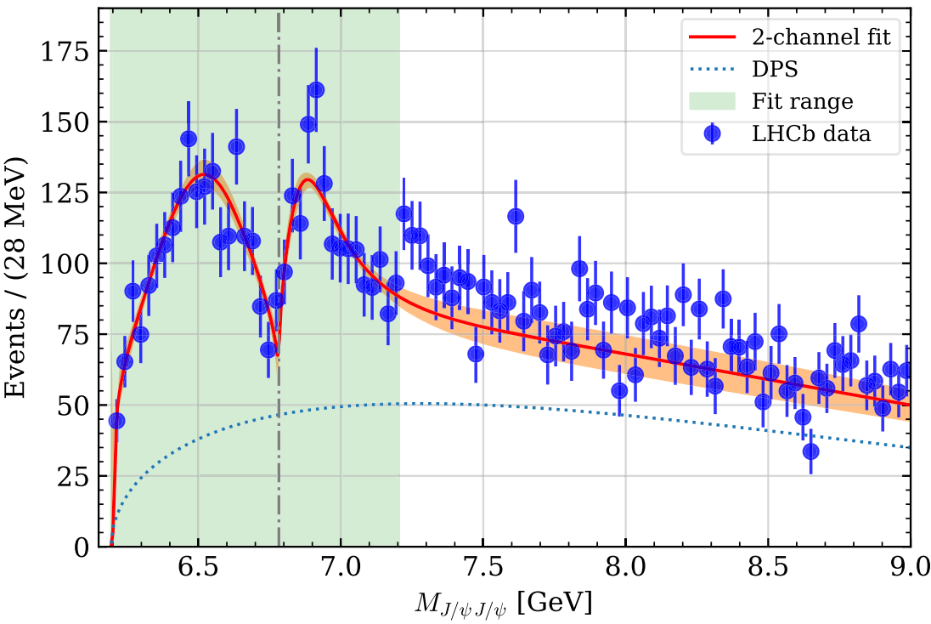
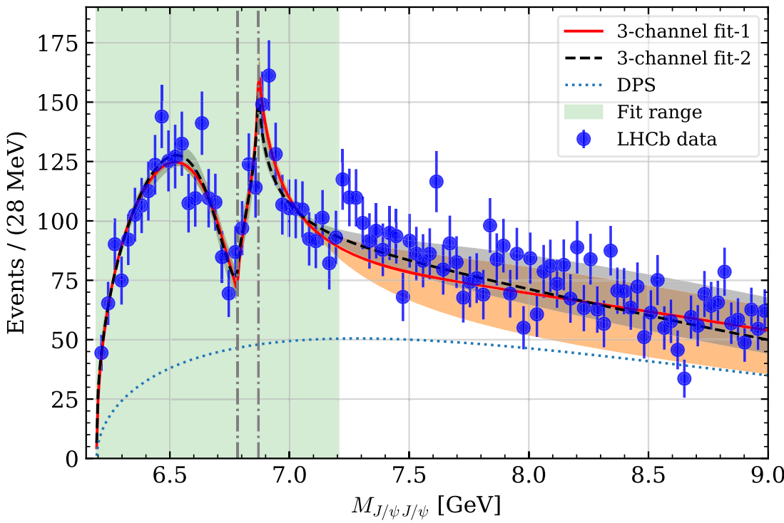
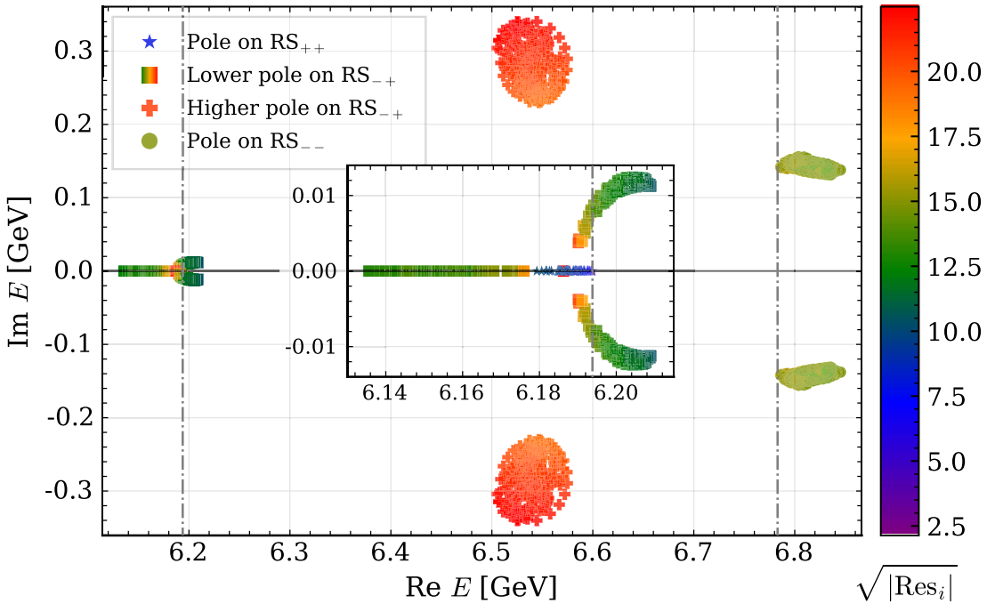
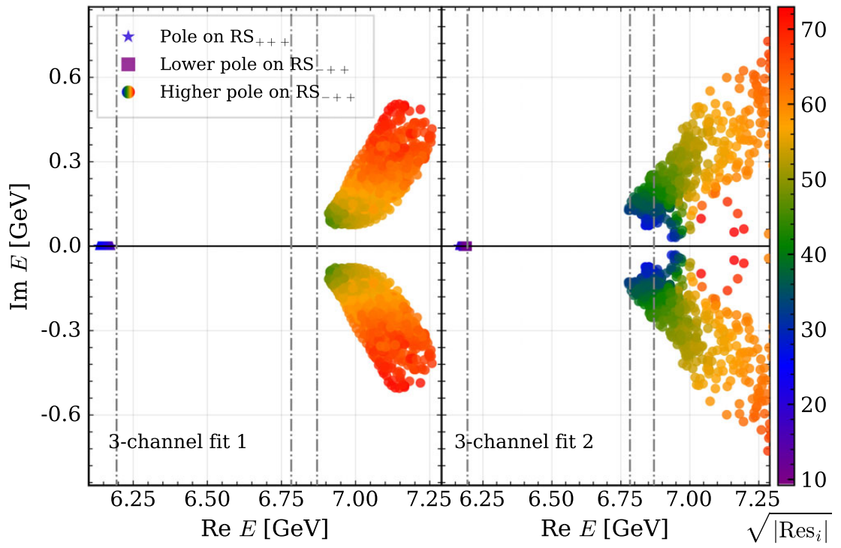
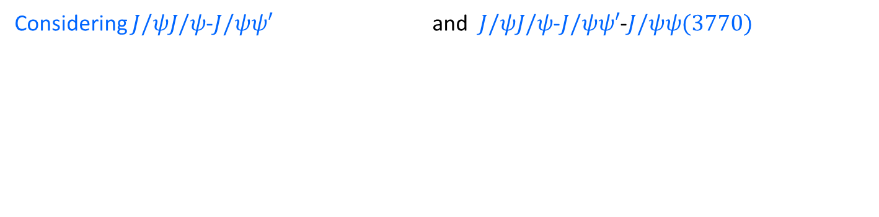
Coupled channels: X(6900)
X.-K. Dong, Baru, FKG, Hanhart, Nedefiev, PRL126 (2021) 132001
Considering $J/ψJ/ψ$-$J/ψψ′$ and $J/ψJ/ψ$-$J/ψψ′$-$J/ψψ(3770)$
Pole positions differ from the LHCb X(6900) resonance parameters

Slide 11
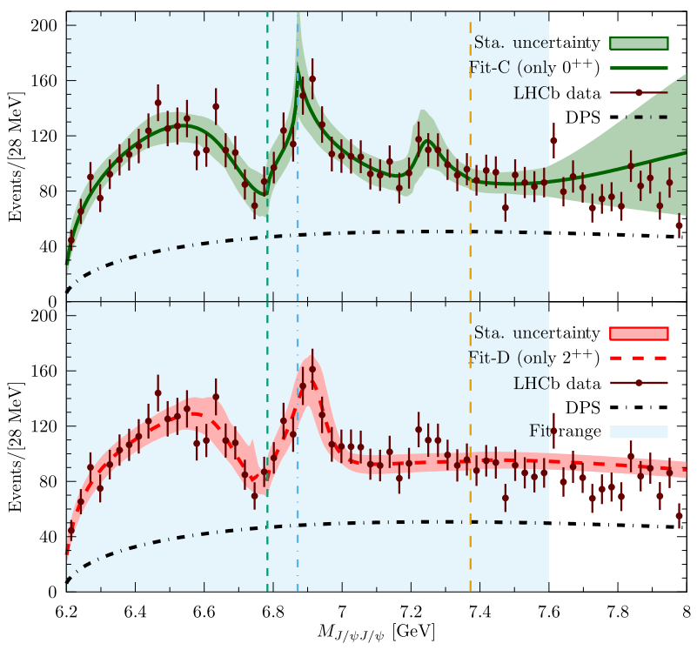
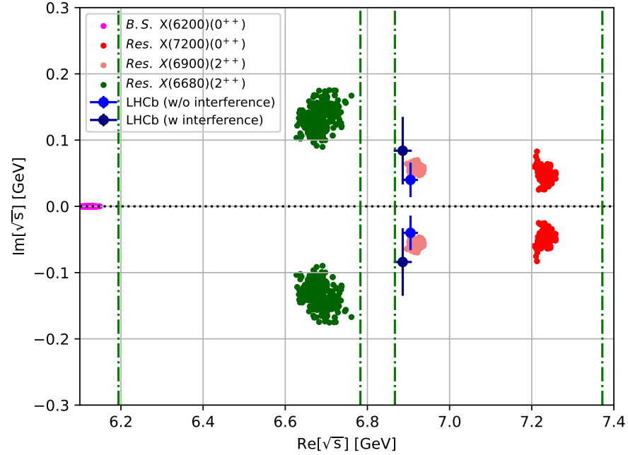
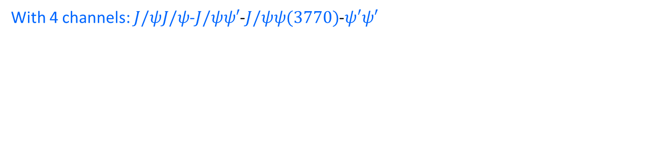
Coupled channels: X(6900)
With 4 channels: $J/ψJ/ψ$-$J/ψψ′$-$J/ψψ(3770)$-$ψ′ψ′$
Z.-R. Liang, X.-Y. Wu, D.-L. Yao, arXiv:2104.08589
Pole positions:
Fit-C
Fit-D
Coupled-channel analysis using Flatté parameterization:
Complex phase motion can hardly be modeled by summing BWs with a constant phase
Q.-F. Cao, H. Chen, H.-R. Qi, H.-Q. Zheng, arXiv:2011.04347; talk by 陈皓

Slide 12
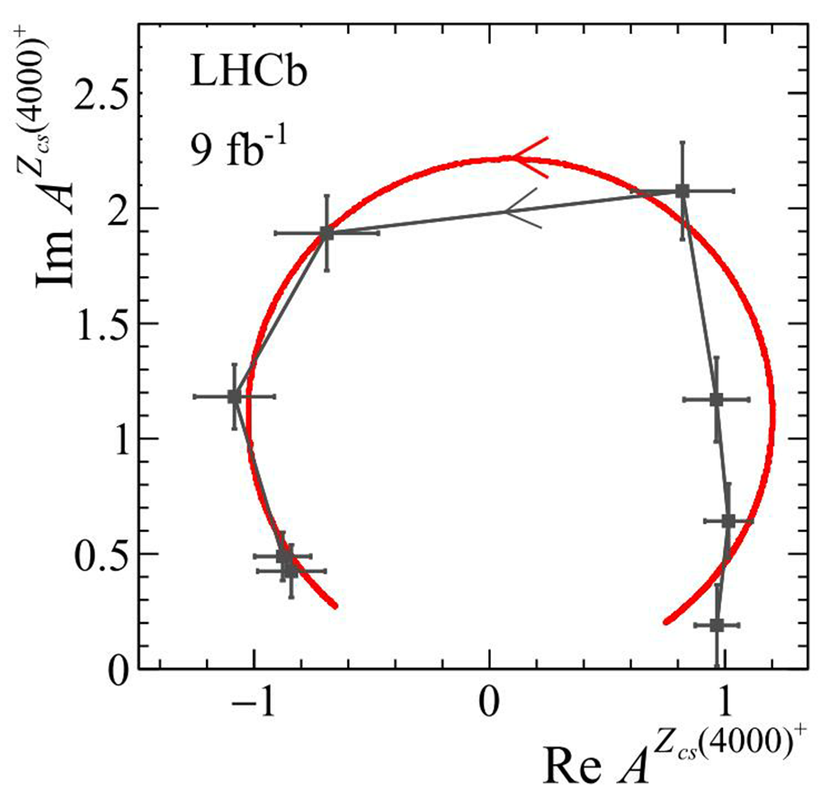
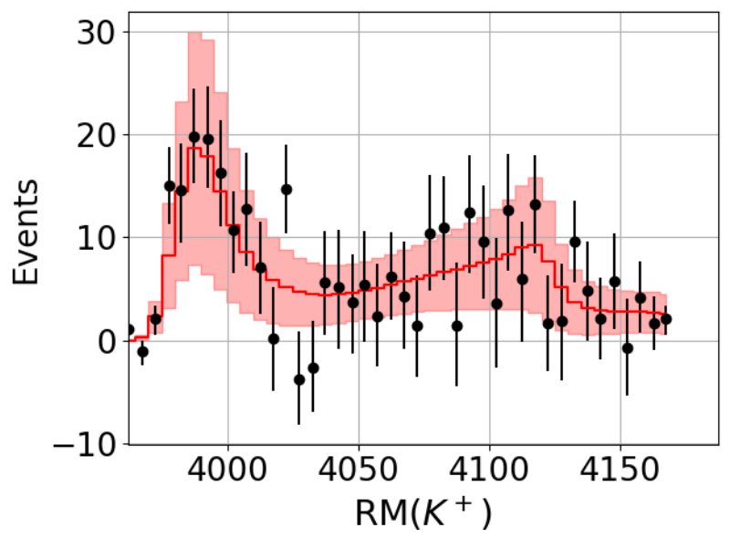
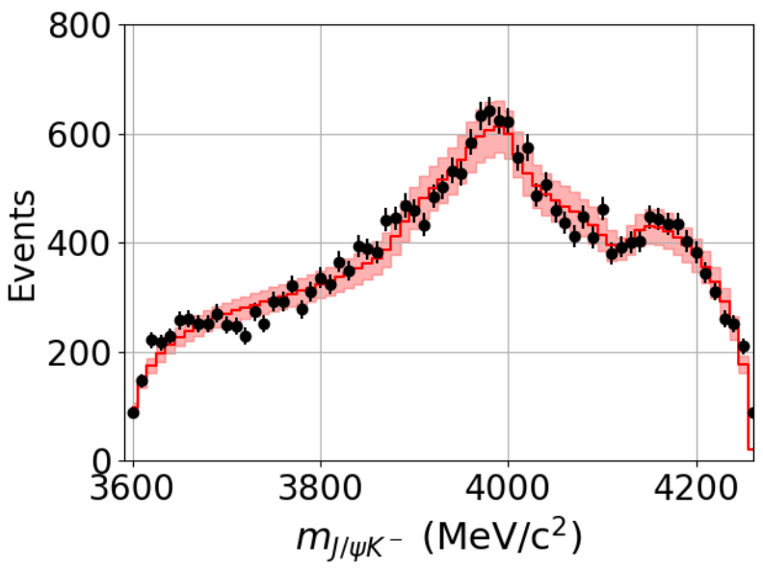
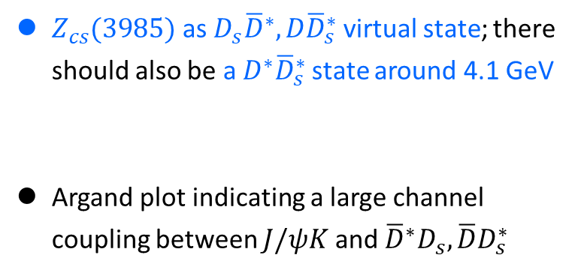


Coupled channels: $Z_{cs}$
$Z_{cs}(3985)$ as $D_{s}{\overline{D}}^{∗},D{\overline{D}}_{s}^{∗}$virtual state; there should also be a $D^{∗}{\overline{D}}_{s}^{∗}$state around 4.1 GeV
Argand plot indicating a large channel coupling between $J/ψK$ and ${\overline{D}}^{∗}D_{s}, \overline{D}D_{s}^{∗}$
Threshold behavior with a strong coupling
Z. Yang, X. Cao, FKG, J. Nieves, M. Pavon Valderrama, PRD103(2021)074029; talk by 杨智
Argand plot: LHCb, arXiv:2103.01803
Simultaneous fit to the BESIII and LHCb $Z_{cs}$ data: $Z_{cs}$ as virtual states $∼3985, 4110$ MeV
Ortega, Entem, Fernandez, arXiv: 2103.07781
$$D{\overline{D}}_{s}^{∗}$$
$$D^{∗}{\overline{D}}_{s}^{∗}$$

Slide 13
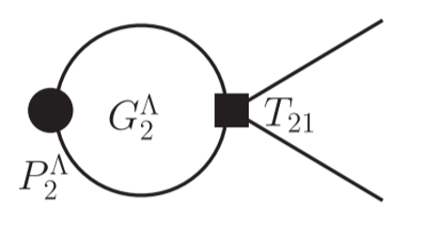
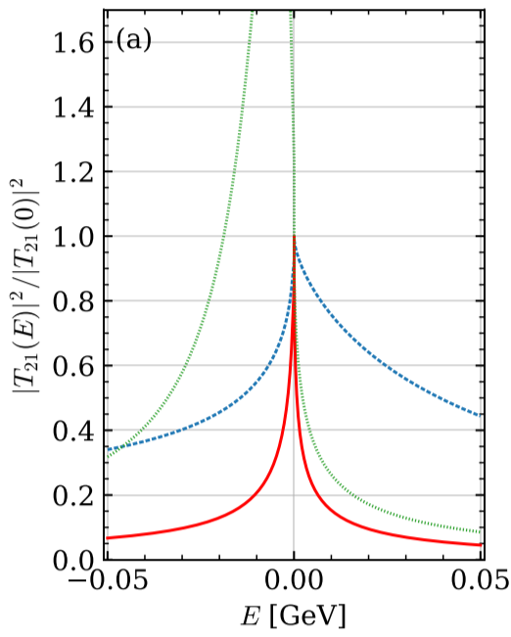
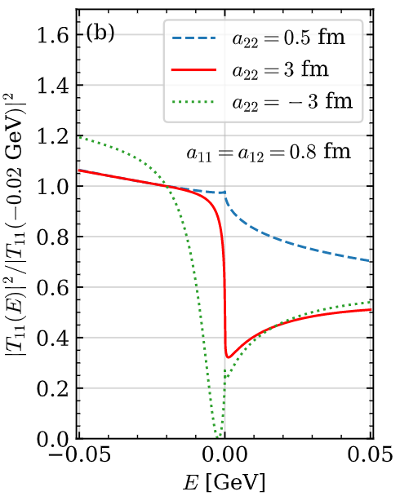
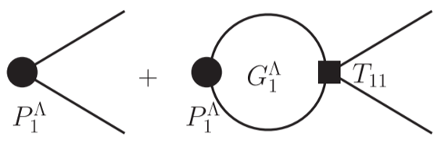
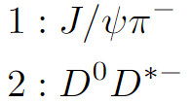
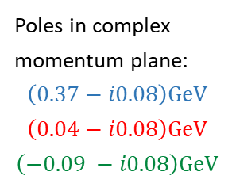
(Near-)threshold structures in coupled channels
Unitarity: (near-)threshold structures (S-wave)
  There must be nontrivial (near-)threshold structures for attractive interaction
  Either threshold cusp or below-threshold peak
  Peak more pronounced for heavier hadrons and stronger interaction
  That’s why many (near-)threshold structures were observed in hidden-charm and hidden-bottom spectra
  Structures are process dependent
X.-K. Dong, FKG, B.-S. Zou, PRL 126 (2021) 152001
Poles in complex momentum plane:
$$\left(0.37−i0.08\right)GeV$$
$$\left(0.04−i0.08\right)GeV$$
$$\left(−0.09 −i0.08\right)GeV$$

Slide 14
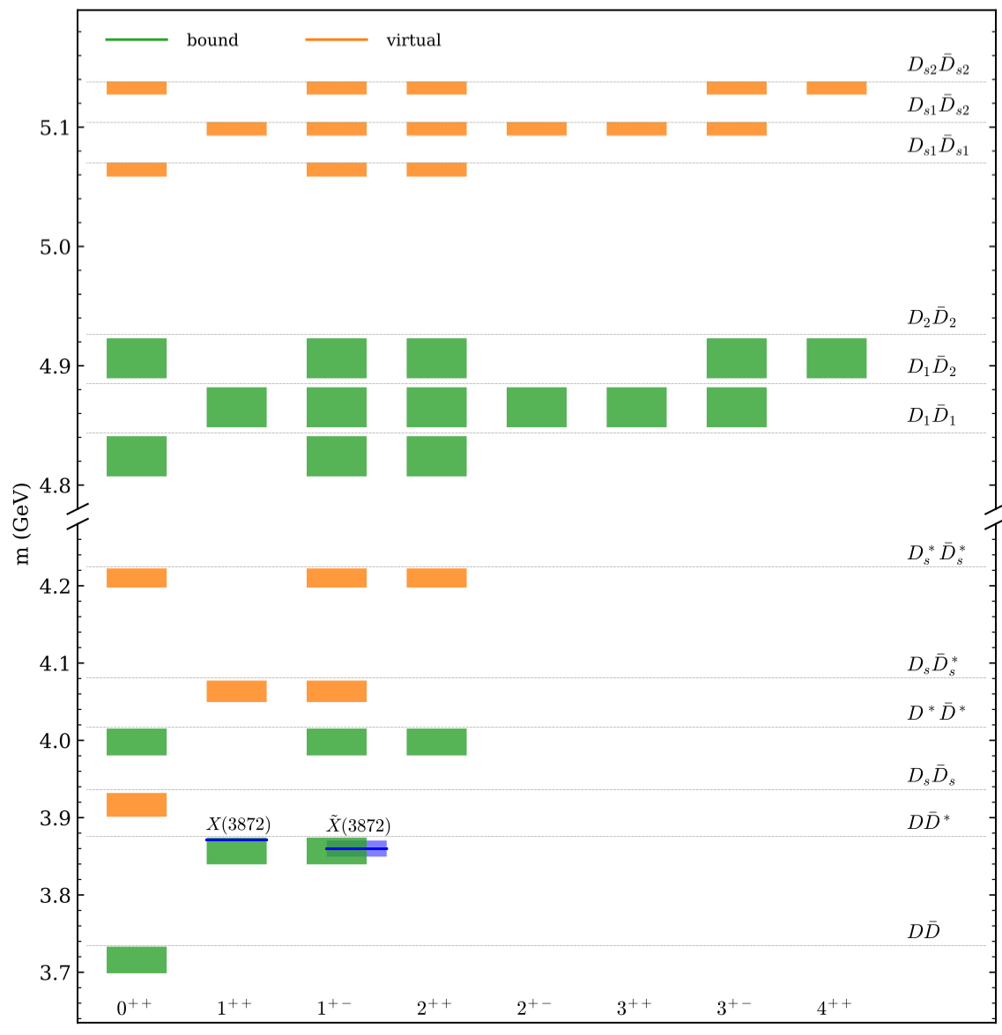
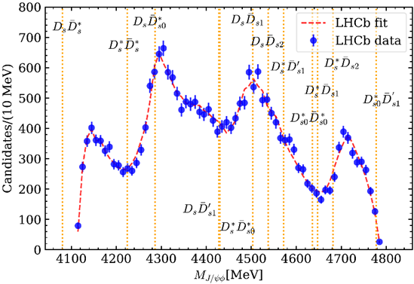


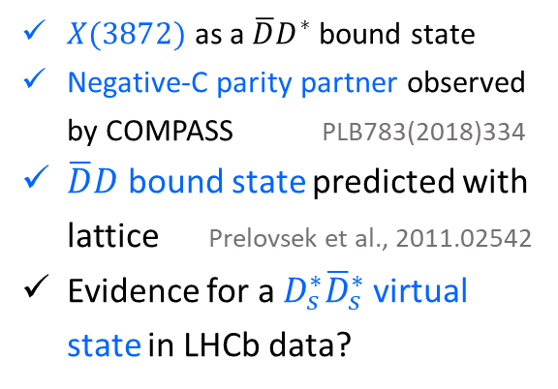

Survey of hadronic molecules
Simple VMD model:
X.-K. Dong, FKG, B.-S. Zou, 物理学进展 41 (2021) 65 [arXiv:2101.01021]
$$\left(I,S\right)=(0,0)$$
$X(3872)$ as a $\overline{D}D^{∗}$ bound state
Negative-C parity partner observed by COMPASS PLB783(2018)334
$\overline{D}D$ bound state predicted with lattice Prelovsek et al., 2011.02542
Evidence for a $D_{s}^{∗}{\overline{D}}_{s}^{∗}$ virtual state in LHCb data?
LHCb data: arXiv:2103.01803

Slide 15
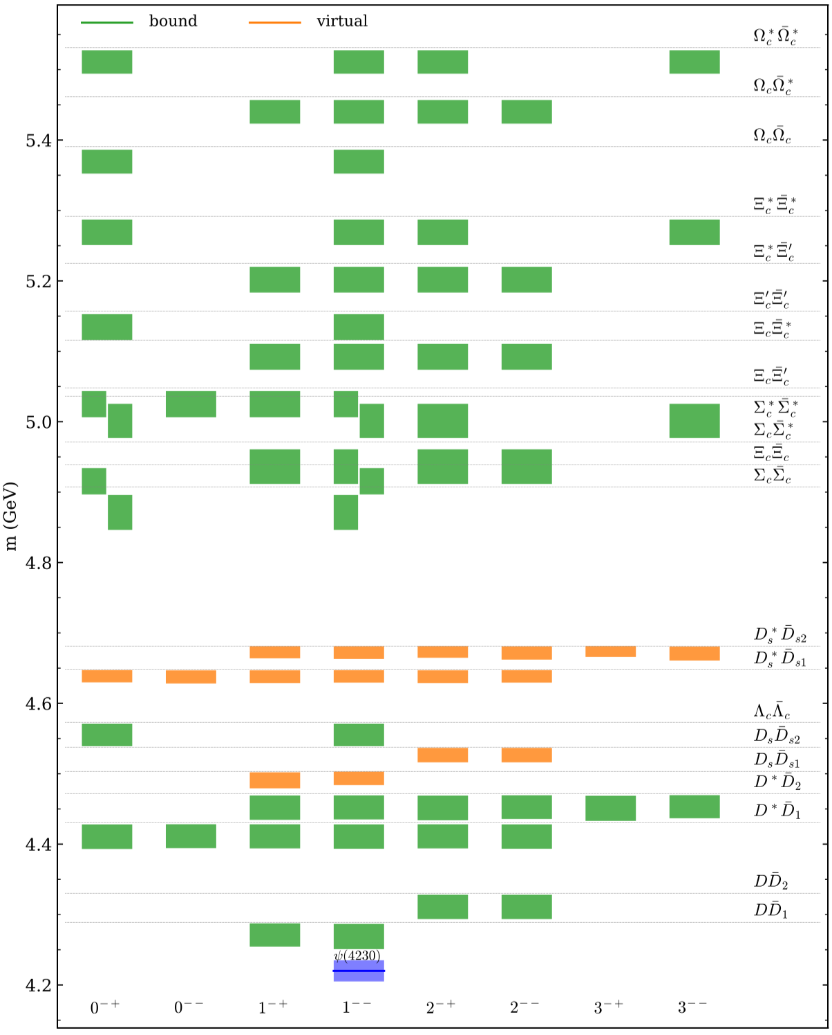
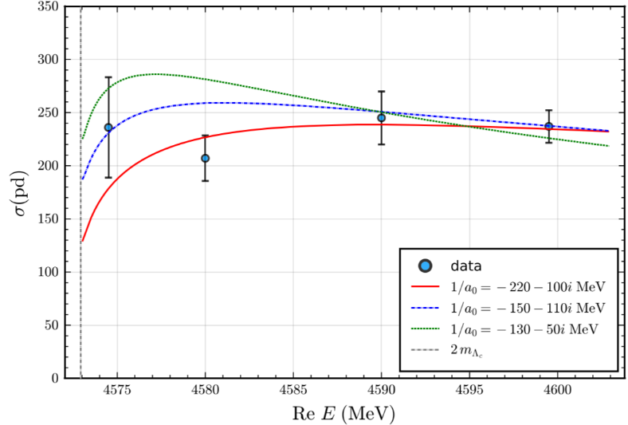


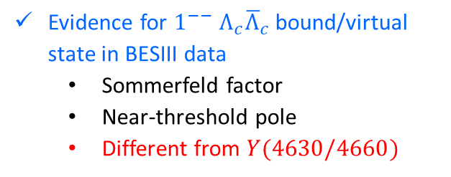

Survey of hadronic molecules
$$\left(I,S\right)=(0,0)$$
Evidence for ${1^{−−} Λ}_{c}{\overline{Λ}}_{c}$ bound/virtual state in BESIII data
  Sommerfeld factor
  Near-threshold pole
  Different from $Y(4630/4660)$
Data taken from BESIII, PRL120(2018)132001
A virtual state pole to explain the BESIII data proposed first in Q.-F. Cao, H.-R. Qi, Y.-F. Wang, H.-Q. Zheng, PRD100(2019)054040
Many $1^{−−}$ states above 4.8 GeV:
Belle-II, BEPC-III, STCF

Slide 16
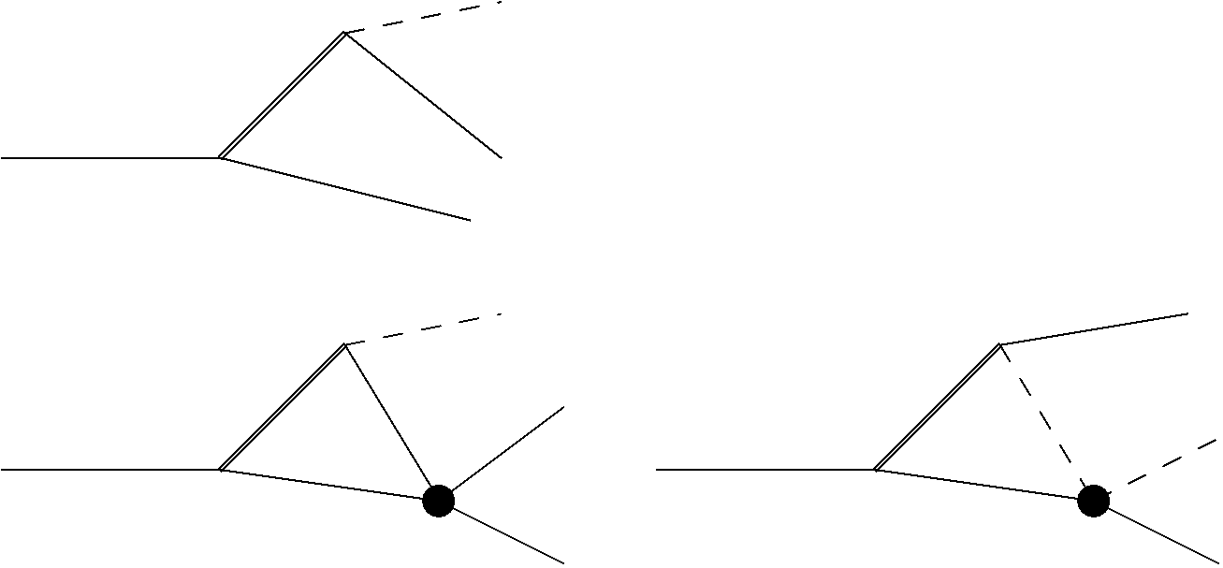
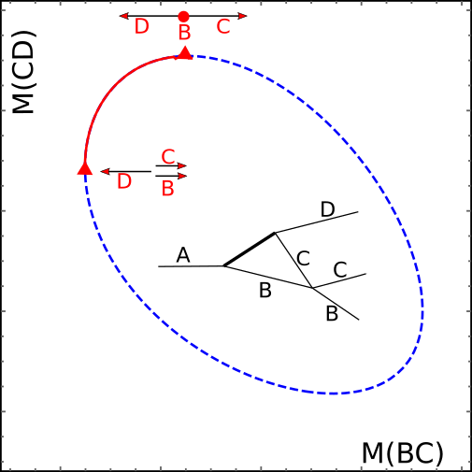
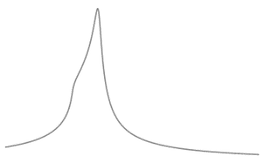









Complications in three-body final states
Difficulties for multi-hadron final states
Many resonances from the cross channel: branching fractions often unknown, interference between overlapping resonances, …
Complicated 3-body FSI:
$$K$$
$$B$$
$$ψ$$
$$K$$
$$B$$
$$B$$
$$K$$
$$ψ$$
$$ψ$$
intermediate states can be different from external ones; threshold cusps; triangle singularities (TS) singularities

Slide 17
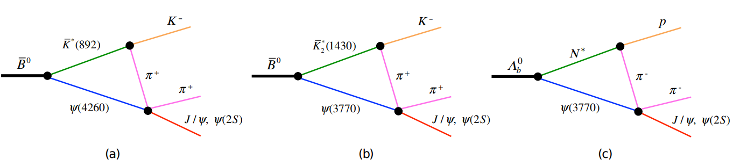
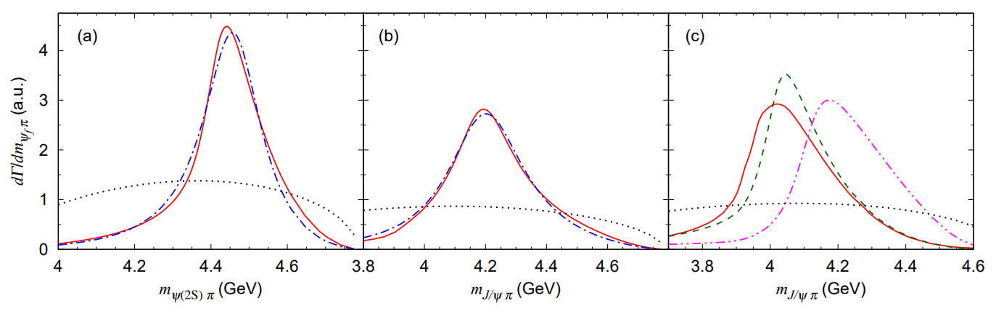
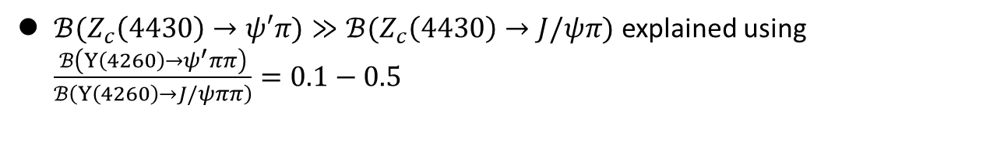
Ambiguity due to TS: $Z_{c}(4430,4200)$
S.X. Nakamura, K. Tsushima, PRD100(2019)051502
Peaks produced at the right energy
$ℬ(Z_{c}\left(4430\right)→ψ′π)≫ℬ(Z_{c}\left(4430\right)→J/ψπ)$ explained using $\frac{ℬ\left(Y\left(4260\right)→ψ^{′}ππ\right)}{ℬ\left(Y\left(4260\right)→J/ψππ\right)}=0.1−0.5$
From a combined fit by J. Zhang, L. Yuan, EPJC77(2017)727

Slide 18
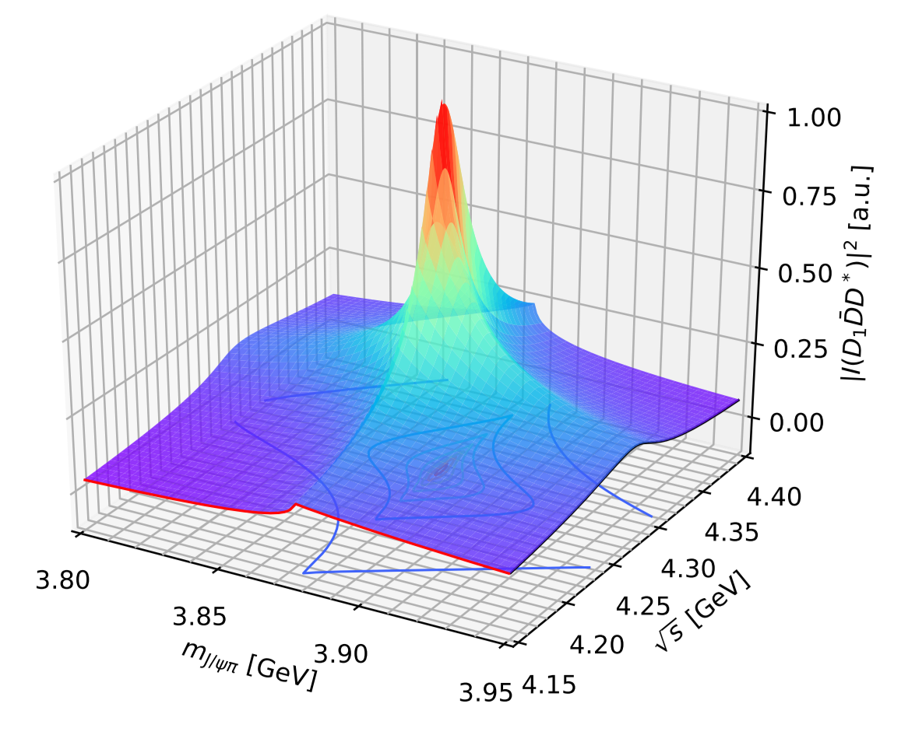
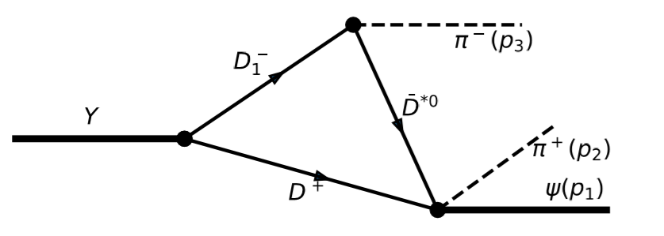
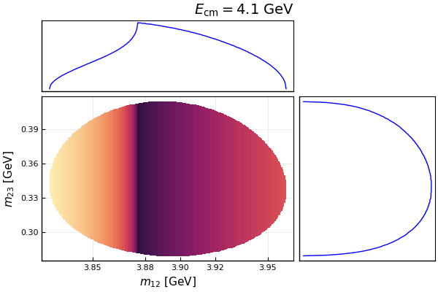
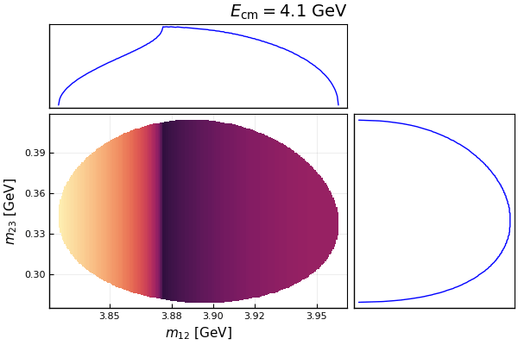


TS: nontrivial energy dependence
TS structures are sensitive to energy!
For a review, FKG, X.-H. Liu, S. Sakai, PPNP112(2020)103757
Scalar 3-point $D_{1}\overline{D}D^{∗}$ loop
Sum of $D_{1}\overline{D}D^{∗},D_{1}{\overline{D}}^{∗}D^{∗},D_{2}{\overline{D}}^{∗}D^{∗}$loops
For more discussions about TS:
  talks by 景豪杰、刘晓海、杜蒙川

Slide 19
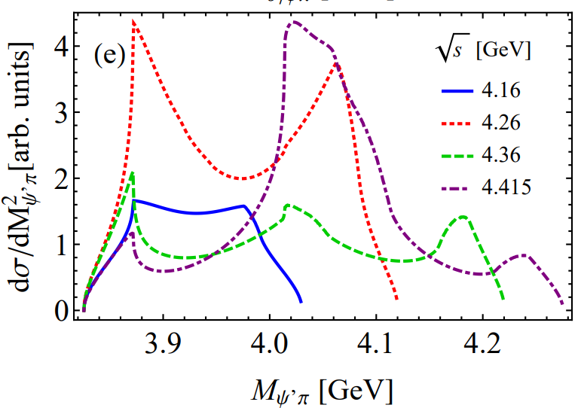
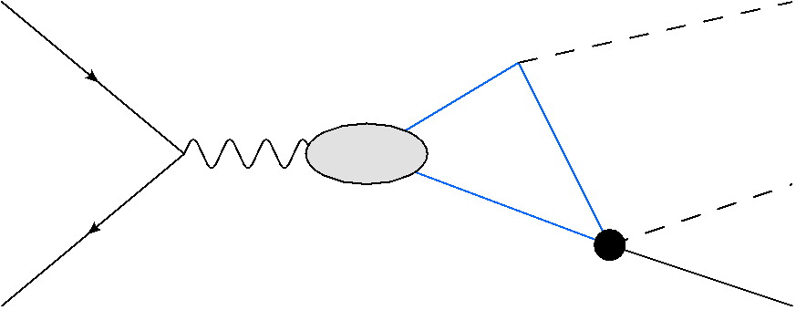
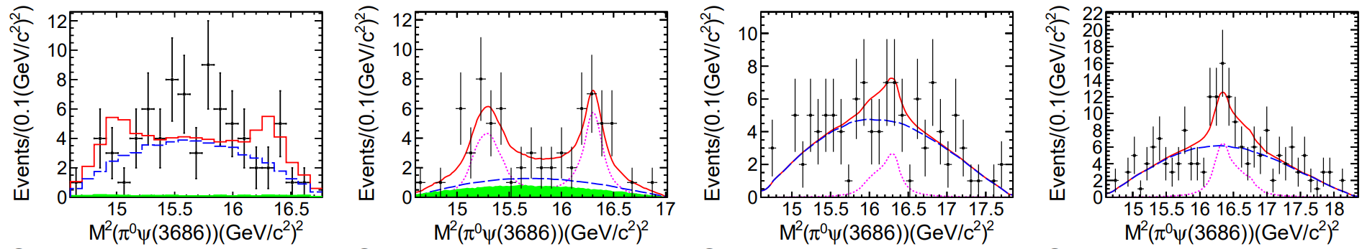












TS: nontrivial energy dependence
Highly nontrivial energy dependence in $e^{+}e^{−}→ψ′π^{+}π^{−}$
$$e^{−}$$
$$π$$
$$D_{1,2}$$
$$D^{(∗)}$$
$$π$$
$$D$$
$$e^{+}$$
$$c\overline{c}$$
X.-H. Liu, PRD90(2014)074004
$$\sqrt{s}=4.226 GeV$$
$$\sqrt{s}=4.258 GeV$$
$$\sqrt{s}=4.358 GeV$$
$$\sqrt{s}=4.416 GeV$$
BESIII measurement of $e^{+}e^{−}→ψ′π^{0}π^{0}$ BESIII, PRD97(2018)052001

Slide 20
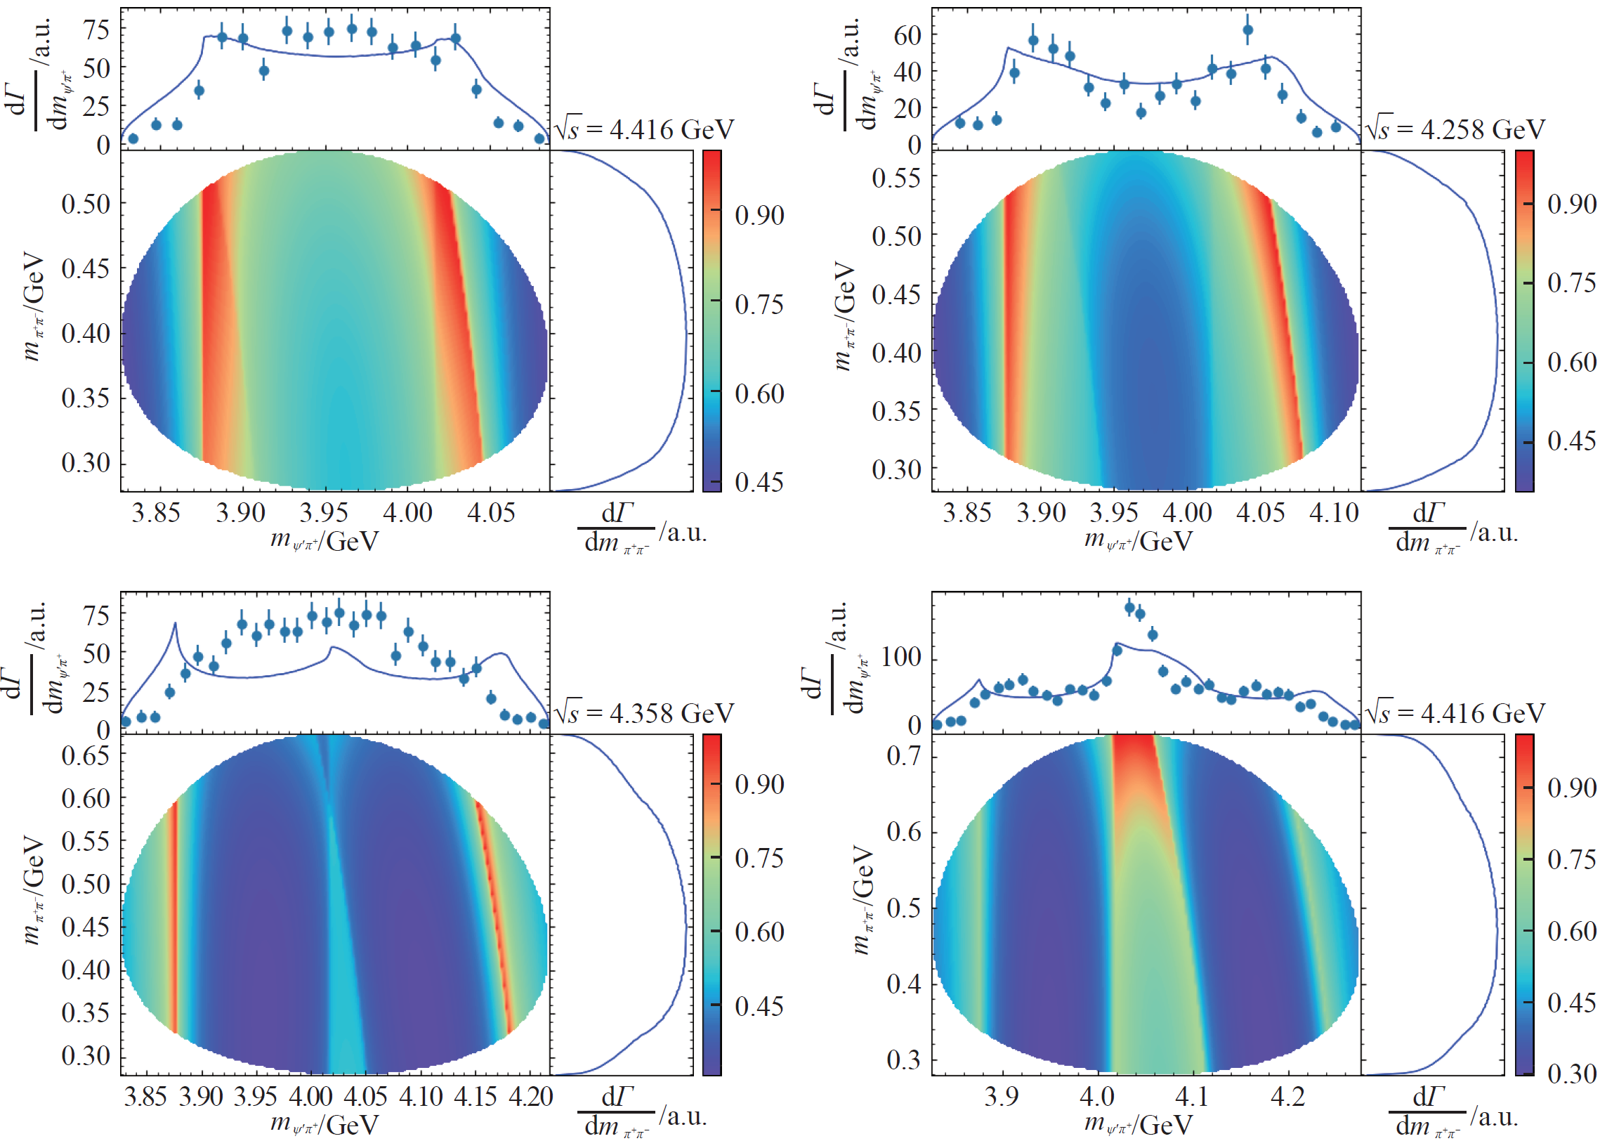
TS: nontrivial energy dependence
FKG, 原子核物理评论37(2020)406 [arXiv:2001.05884]
Data: BESIII, PRD96(2017)032004

Slide 21
Conclusions
Importance of hadron-hadron coupled channels: for both the spectrum and getting proper resonance poles
Threshold structures (threshold cusp or near-threshold peak) are generally expected for a pair of heavy hadrons with attractive interaction; strong attraction, then hadronic molecules below threshold, otherwise threshold cusps (still a virtual state pole)
Request for data with higher statistics and at higher energies
  Higher statistics for energy region below ~4.8 GeV (BESIII, B decays)
  Higher energies covering charmed baryon-antibaryon thresholds (up to 5.6 GeV)
Kinematical singularities and resonances are NOT exclusive
  Strong threshold cusp implies a near-threshold virtual state
  TS can coexist with resonances and may enhance their productions

Slide 22
Some recent reviews
H.-X. Chen, W. Chen, X. Liu, S.-L. Zhu, The hidden-charm pentaquark and tetraquark states, Phys. Rept. 639 (2016) 1
R. F. Lebed, R. E. Mitchell, E. Swanson, Heavy-quark QCD exotica, Prog. Part. Nucl. Phys. 93 (2017)143
A. Esposito, A. Pilloni, A. D. Polosa, Multiquark resonances, Phys. Rept. 668 (2017) 1.
FKG, C. Hanhart, U.-G. Meißner, Q. Wang, Q. Zhao, B.-S. Zou, Hadronic molecules, Rev. Mod. Phys. 90 (2018) 015004
S. L. Olsen, T. Skwarnicki, Nonstandard heavy mesons and baryons: Experimental evidence, Rev. Mod. Phys. 90 (2018) 015003
Y.-R. Liu, H.-X. Chen, W. Chen, X. Liu, S.-L. Zhu, Pentaquark and tetraquark states, Prog. Part. Nucl. Phys. 107 (2019) 237
N. Brambilla, S. Eidelman, C. Hanhart, A. Nefediev, C.-P. Shen, C. Thomas, A. Vairo, C.-Z. Yuan, The XYZ states: experimental and theoretical status and perspectives, Phys. Rept. 873 (2020) 154
FKG, X.-H. Liu, S. Sakai, Threshold cusps and triangle singularities in hadronic reactions, Prog. Part. Nucl. Phys. 112 (2020) 103757
G. Yang, J. Ping, J. Segovia, Tetra- and penta-quark structures in the constituent quark model, Symmetry 12 (2020) 1869
…

Slide 23
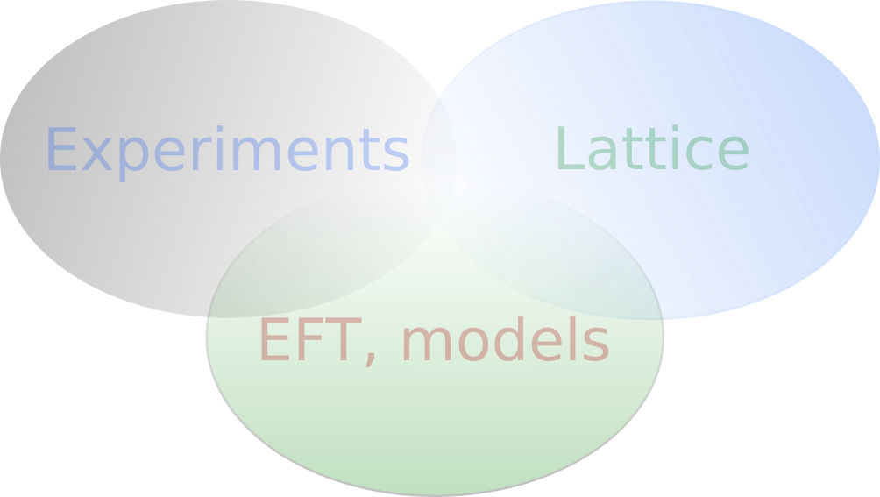
Thank you for your attention!

Slide 24
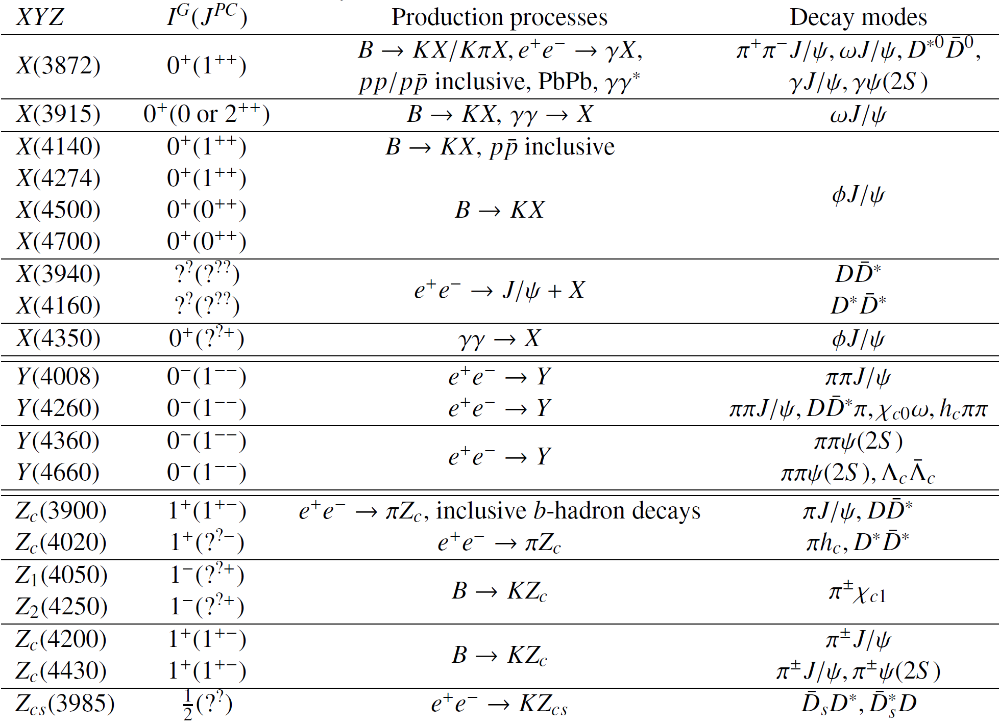
XYZ: production/decay processes
(?)

Slide 25
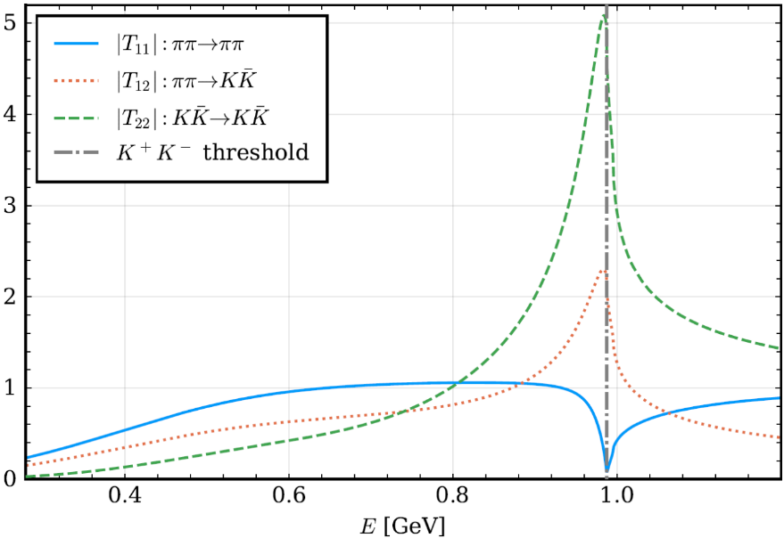
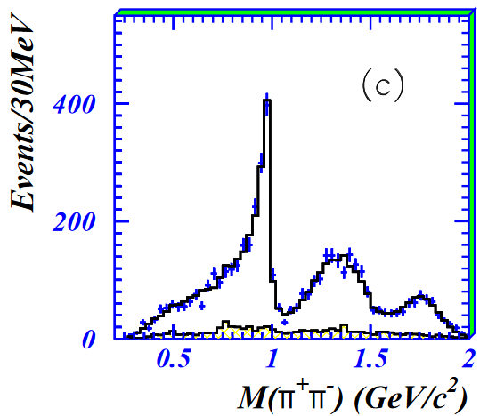






Peak or dip
$T$-matrix for $ππ$ and $K\overline{K}$ coupled channels
with the T-matrix from
L.-Y. Dai, M. R. Pennington, PRD90(2014)036004
$f_{0}\left(980\right)$ in $J/ψ→φπ^{+}π^{−}$ and $J/ψ→ωπ^{+}π^{−}$
Channels: $ππ$ and $K\overline{K}$
BES,
PLB607(2005)243
BES,
PLB598(2004)149
Driving channel:$K\overline{K}$
$$J/ψ→φ{K\overline{K}→φπ}^{+}π^{−}$$
Driving channel:$ππ$
$$J/ψ→ω{ππ→ωπ}^{+}π^{−}$$

Slide 26




Bound state, virtual state and resonance
Bound state: pole below threshold on real axis of the first Riemann sheet of complex energy plane
Virtual state: pole below threshold on real axis of the second Riemann sheet
Resonance: pole in the complex plane on the second Riemann sheet
Plots from Matuschek, Baru, FKG, Hanhart, 2007.05329; M.-L. Du et al., PRD98(2018)094018
$$\frac{1}{1/a_{0}−i k}$$
For , only bound or virtual state poles are possible

