Slide 1
X(3872) as a Molecule State
Jun Jiang
Shandong University
In collabaration with Eric Braaten, Liping He and Kevin Ingles (The Ohio State University)
Braaten, He, Ingles, Jiang, PRD 103, L071901 (2021);
Braaten, He, Jiang, PRD 103, 036014 (2021);
Braaten, He, Ingles, Jiang, PRD 101, 096020 (2020).

Slide 2
Outline
1. Introduction: X(3872)
2. Triangle Singularity in
3. New Formulation of Galilean-invariant XEFT at NLO
4. Production of X(3872) at High Multiplicity in pp Collision
5. Summary
Notes:
then introduce the three works

Slide 3
Introduction
First exotic hadron discovered [Belle, 2003; CDF, 2003]
J^{PC} = 1⁺⁺ [LHCb, 2013]
E_{X} = M_{X} - (M_{D*0}+M_{D0}) = (-0.07±0.12) MeV, |E_{X}| < 0.22 MeV at 90% CL [LHCb, 2020]
First measurement of width: Γ_{BW} = (1.19±0.19) MeV [LHCb, 2020]
7 different decay modes
The internal structure of X(3872) is under debate.
Compact tetraquark state, χ_{c1}(2P) charmonium,
molecule state, mixed molecule-charmonium state
J^{PC} = 1⁺⁺ implies S-wave coupling to and
Short-range interactions with a range of order 1/m_{π}
|E_{X}| < 0.22 MeV implies the coupling is resonant coupling
Loosely bound molecule of neutral charm mesons
Small probabilities of other components.
Notes:
First exotic hadron discovered by the Belle Collaboration in 2003 in the J/ψπ+π- mass spectrum from B decay.

Slide 4
Introduction
Important properties for loosely bound S-wave molecule
large scattering length: a = . Large mean separation:〈r〉 = a/2, |E_{X}| < 0.22 MeV implies〈r〉> 4.8 fm. In contrast, the separation of constituents of a tetraquark is similar to that of charmonium state, less than 1 fm.
Prove it:
Observation of Triangle Singularity X(3872) being Molecule State

Slide 5
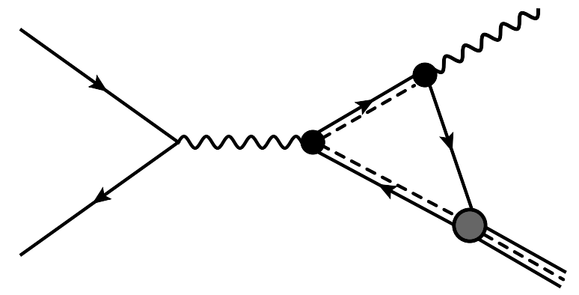
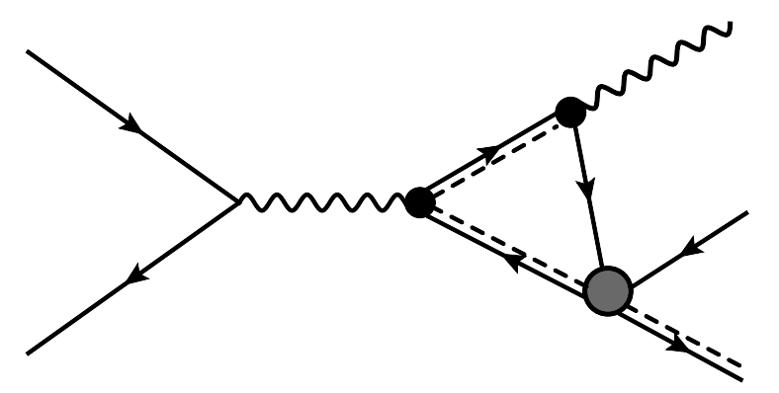
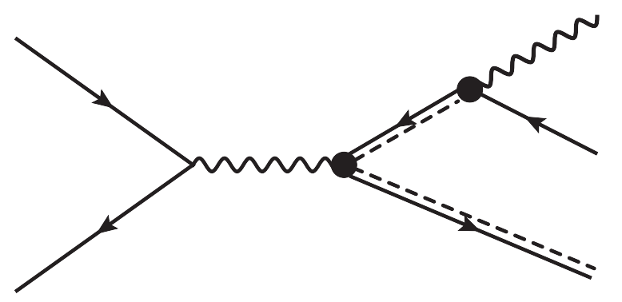
Triangle Singularity in
In both caces,
Matrix element has logarithmic branch cut when the three particles forming the triangle simultaneously on shell
Cross section diverges as log² at center-of-momentum energy determined by masses of those particles
For
Schmid Cancellation: if the differential cross section integrated over the invariant mass of , the log² divergence cancels, but log divergence remains.
Log² divergence is cancelled by the interference term of the tree diagram and the triangle loop diagram.
Schmid [PR 154, 1363 (1967)],
Anisovish, Anisovish [PLB 354, 321 (1995)]

Slide 6
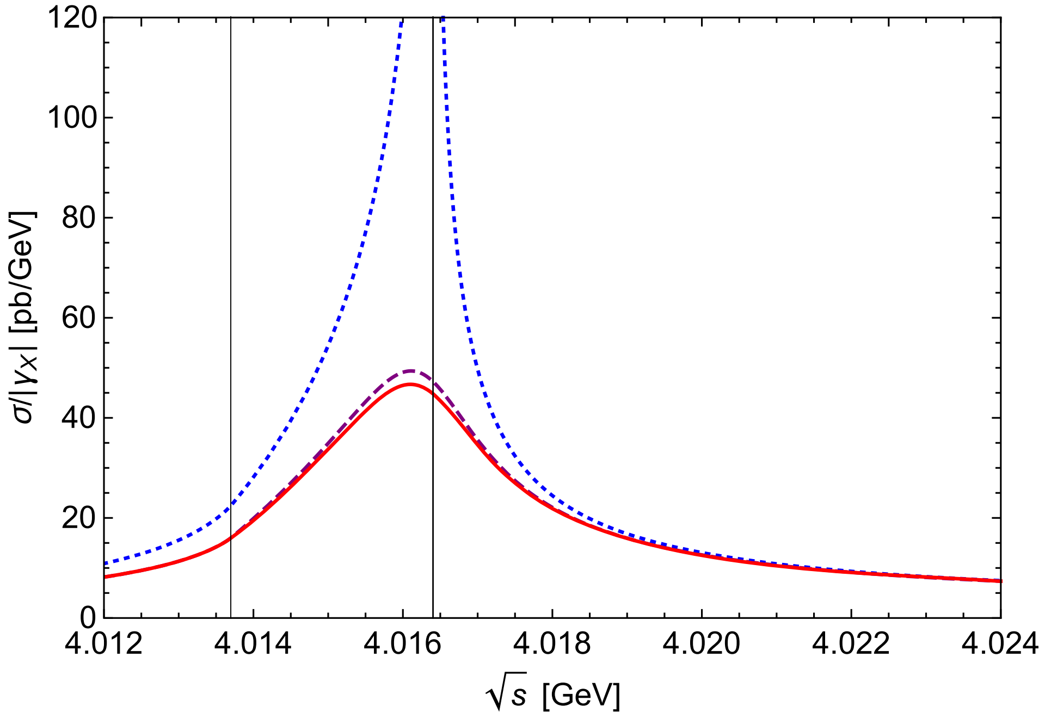
Triangle Singularity in
Two charm mesons forming X(3872) can be on shell when binding energy E_{X}=0 and Γ_{X}=Γ_{*0}=0.
The other D* meson can be on shell when Γ_{*0}=0 at specific value s_{Δ}.
Within relativistic framework
|E_{X}|=0 MeV,Γ_{X} =0
|E_{X}|=0.05 MeV,Γ_{X} =0
Loop amplitude F(s, M²_{X} - i M_{X} Γ_{X}) has a log divergence proportional to
log|s-s_{Δ}| with Γ_{*0,} Γ_{X} and E_{X}=0.
|E_{X}|=0.05 MeV,Γ_{X} =Γ_{*0}
2.7 MeV above the threhold.
Braaten, He & Ingles [PRD 100, 031501 (2019)];
Braaten, He & Ingles [PRD 101, 014021 (2020)];
Braaten, He, Ingles, Jiang, [PRD 101, 096020 (2020)]
√s: center-of-mass energy γ_{X}: binding momentum of X
Γ_{X}: decay width of X E_{X}: binding energy of X

Slide 7
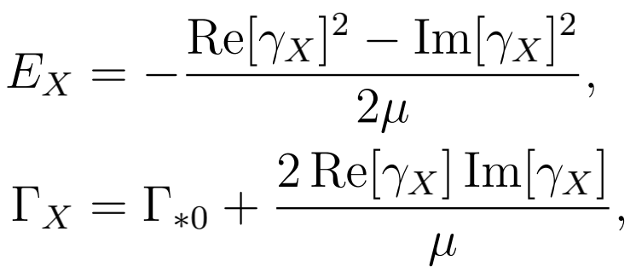
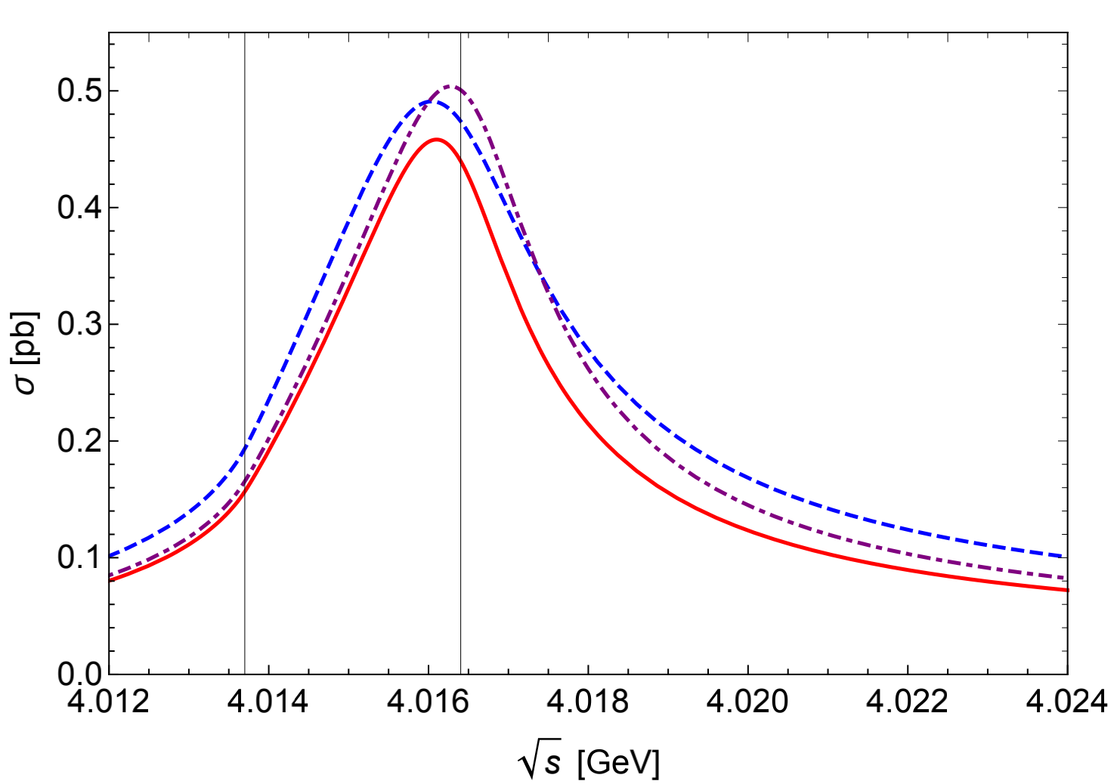
Triangle Singularity in
|E_{X}| = 0.05 MeV, Γ_{X} = Γ_{∗0} (solid red curve),
|E_{X}| = 0.10 MeV, Γ_{X} = Γ_{∗0} (dashed blue curve)
|E_{X}| = 0.05 MeV, Γ_{X} = 2Γ_{∗0} (dot-dashed purple curve).
Triangle singularity produces narrow peak in cross section at energy near √s∆, about 2.7 MeV above the threhold.
The observation of the narrow peak would support the identification of X(3872) as a weakly bound charm-meson molecule state.

Slide 8
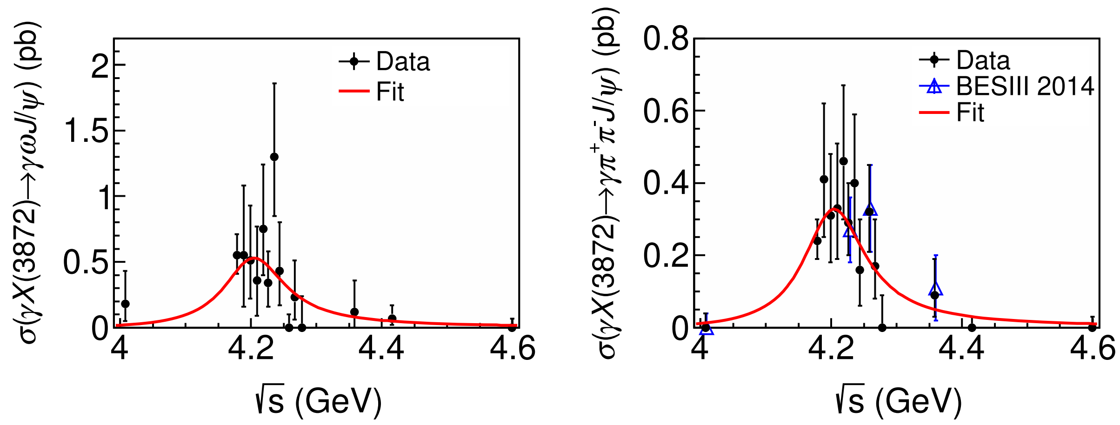
Triangle Singularity in
[周航's talk this morning]
BHIJ, 2020
BESIII, 2014 and 2019
2011: 482 pb⁻¹ at 4.01 GeV [王子一's talk this morning]
Other works on Charm-meson Triangle Singularity (TS):
Review on TS: Guo, Liu, Sakai [Prog. Part. Nucl. Phys. 112, 103757 (2020)];
TS in e⁺e⁻ → X + γ : Dubynskiy and Voloshin [PRD 74, 094017 (2006)], Guo [PRL 112, 202002 (2019)];
TS in e⁺e⁻ → π + (Xγ) : Sakai, Jing, Guo [PRD 102, 114041(2020)];
TS in B meson decay B → K + (Xπ): Braaten, He, Ingles [PRD 100, 074028 (2019)], Sakai, Oset, Guo [PRD 101, 054030 (2020)];
TS in prompt production of Xπ in pp collision: Braaten, He, Ingles [PRD 100, 094006(2019)].

Slide 9
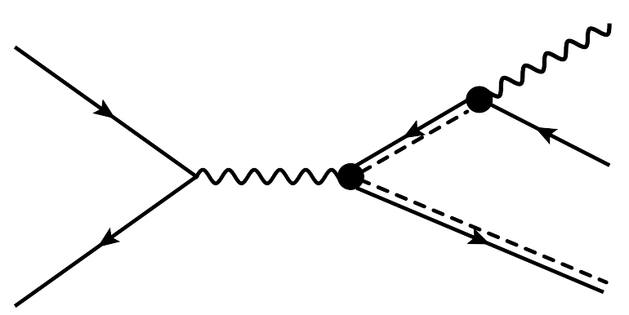
Triangle Singularity in
√s: center-of-mass energy
√u: invariant mass of
Conditions for triangle singularity
(1)
All 3 legs of triangle are on-shell
(2)
and move into the same direction
(3)
Velocity of >= velocity of

Slide 10
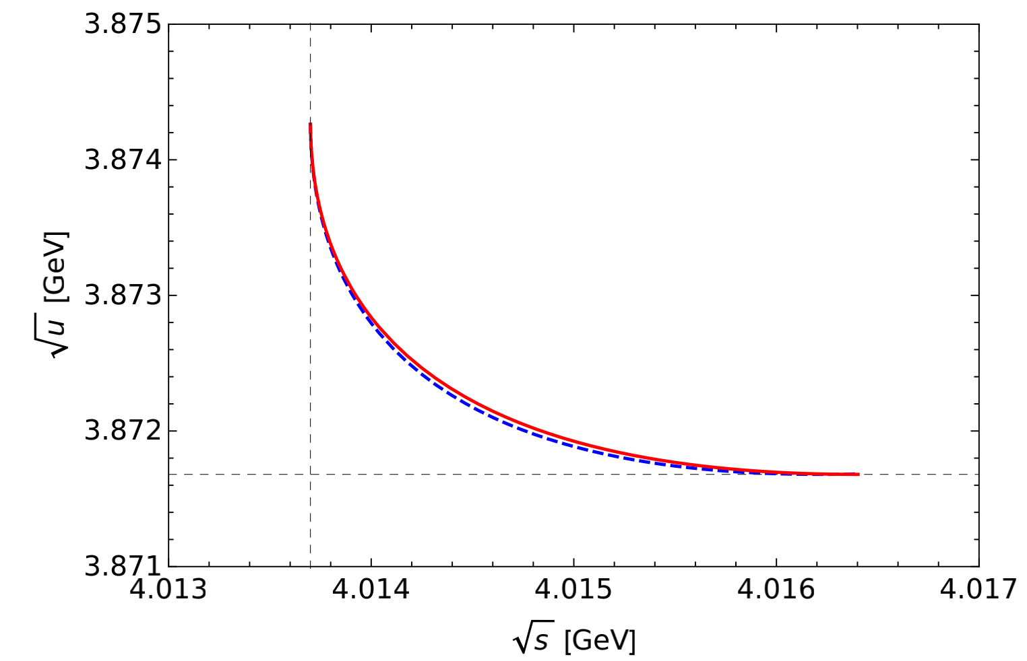
Triangle Singularity in
√s: center-of-mass energy
√u: invariant mass of
√s: 4013.7~4016.4 MeV
u: 15.010~14.990 GeV²
Triangle singularity range
M_{*0}: mass of D^{*0}
M₀: mass of D⁰

Slide 11
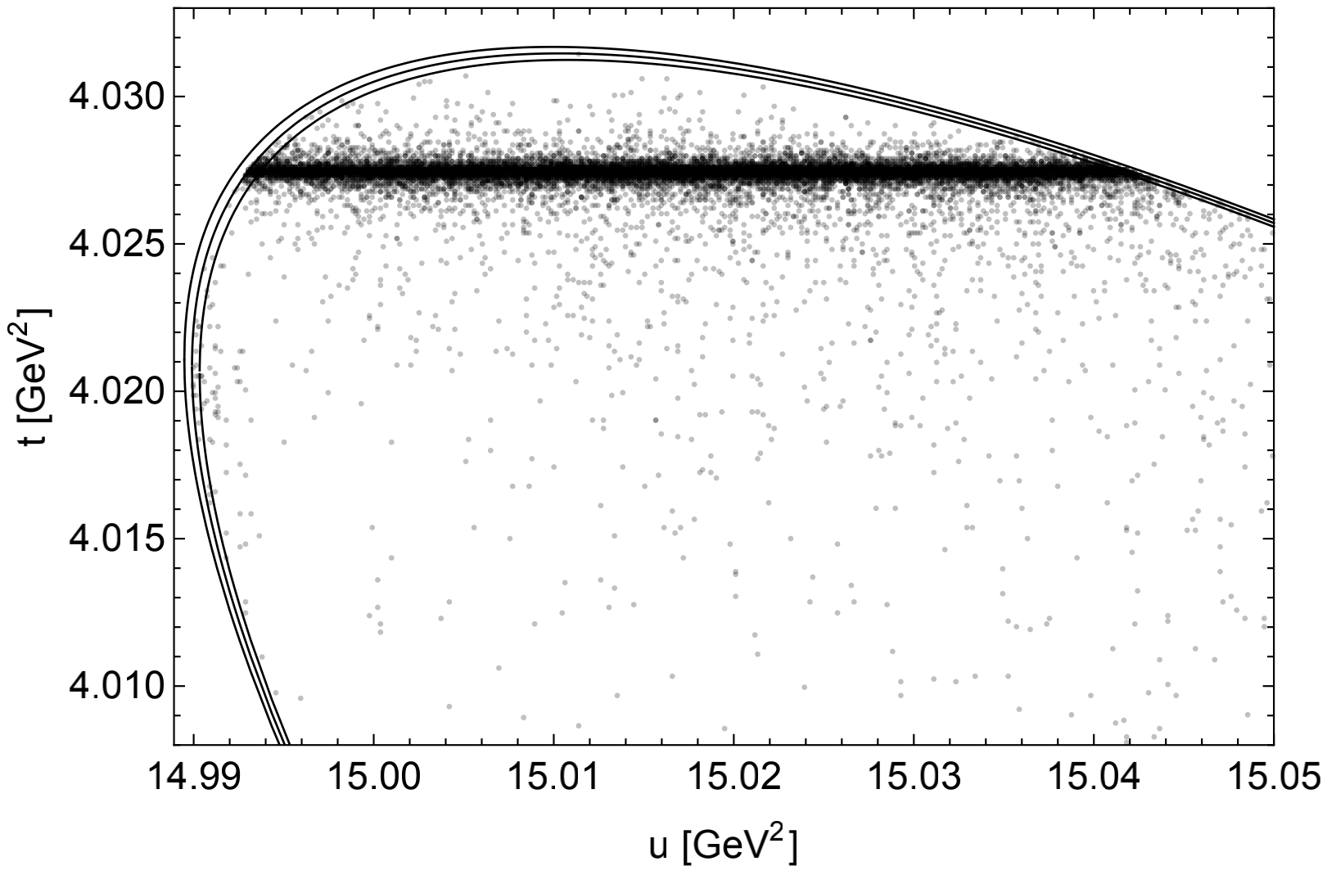
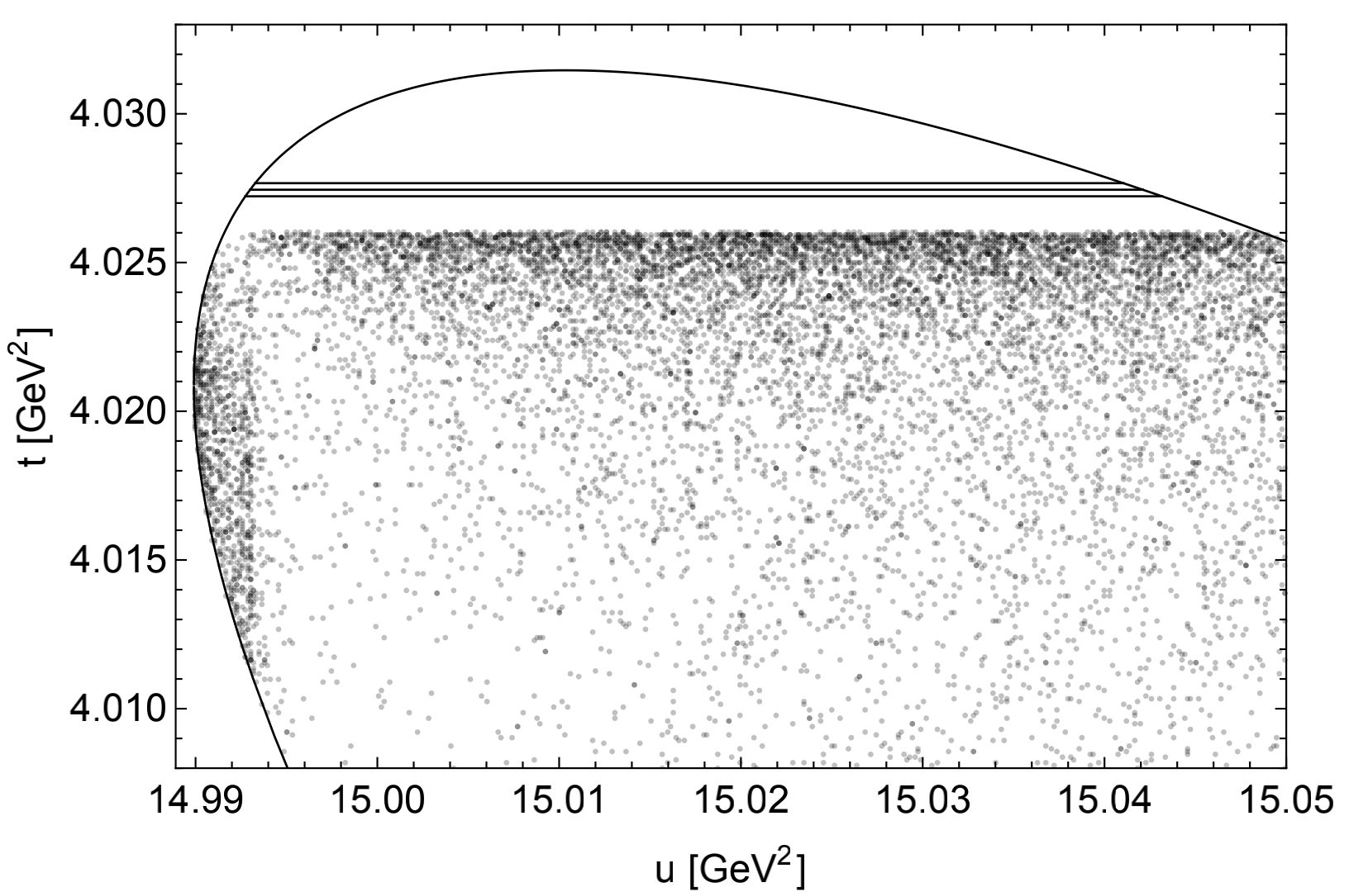
Triangle Singularity in
Dalitz plot for √s = 4014.7 MeV with physical D^{*0} width (55 keV)
Dalitz plot for √s = 4014.7 MeV with zero D^{*0} width
Obvious resonance band from tree diagram
Besides the band, we have the narrow triangle singularity band at u∆=14.993 GeV²
Smaller density when t approaches to the band along the triangle singularity line.
√s: center-of-mass energy, √u: invariant mass of , √t: invariant mass of

Slide 12
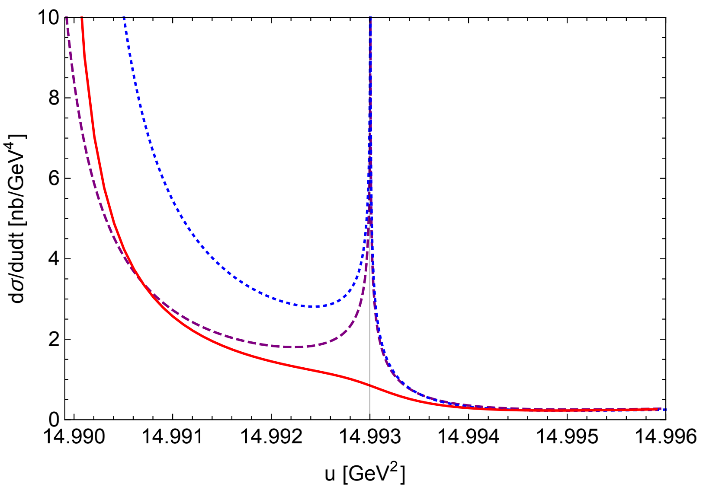
Triangle Singularity in
Differential cross section dσ/dudt for √s = 4014.7 MeV, t = 4.0209 GeV²
|E_{X}| = 0, Γ_{X} =Γ_{∗0}= 0 (dotted blue)
|E_{X}| = 0.05 MeV, Γ_{X} =Γ_{∗0}=0 (dashed purple)
|E_{X}| = 0.05 MeV, Γ_{X} = Γ_{∗0}=55 keV (solid red)
Triangle singularity: u∆=14.993 GeV²
Log² divergence for Γ_{X} = Γ_{∗0}=0, E_{X}=0
For |E_{X}| = 0.05 MeV, Γ_{X} = Γ_{∗0}=55 keV, local maximum near u∆ from triangle singularity disappears.
Notes:
The suppression from the physical D∗0 width is large enough that there is not even a local maximum near u∆.

Slide 13
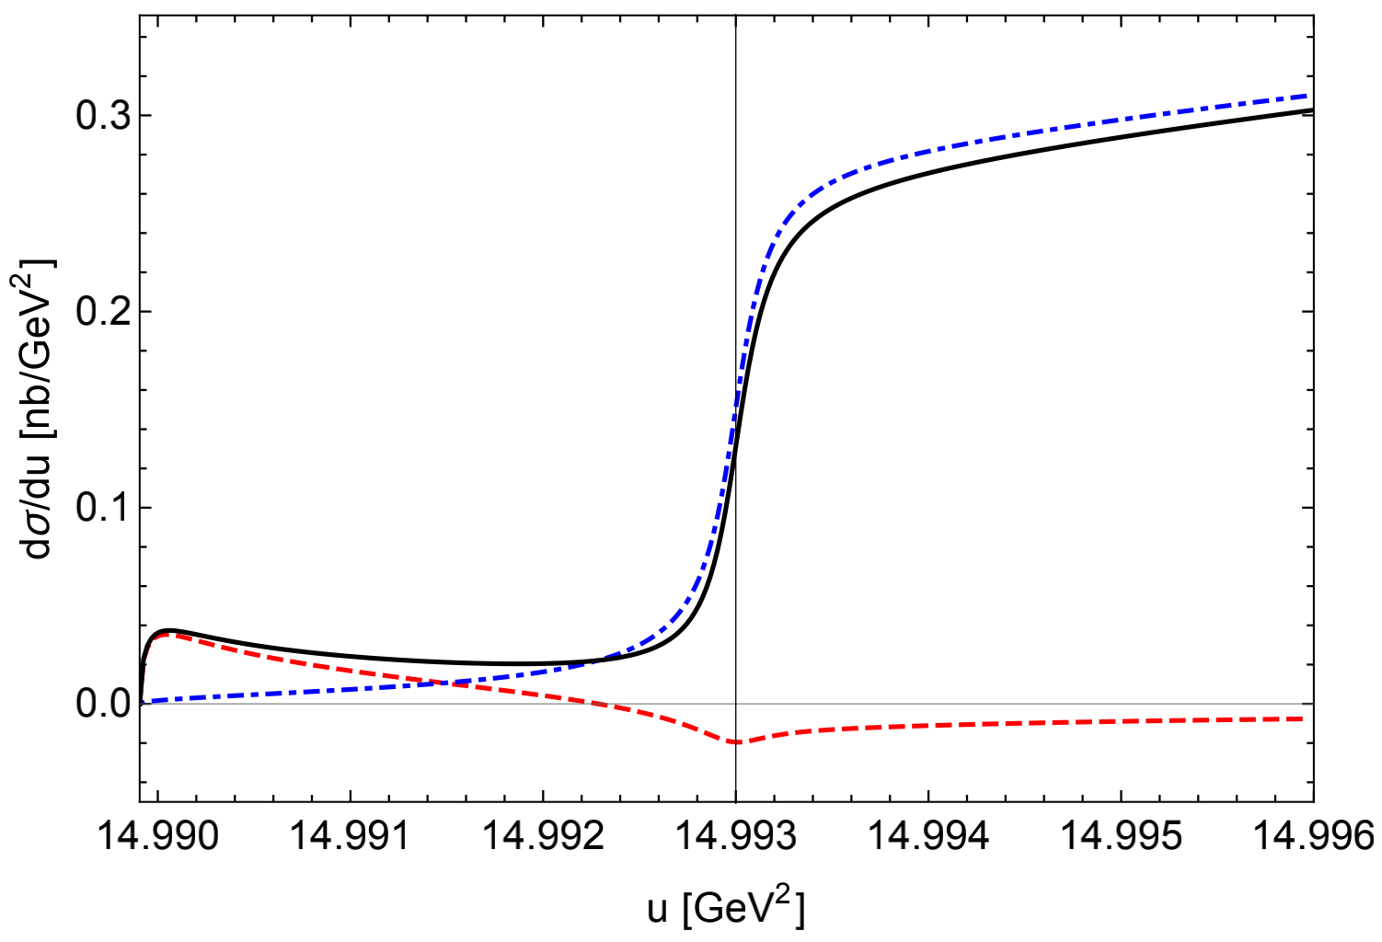
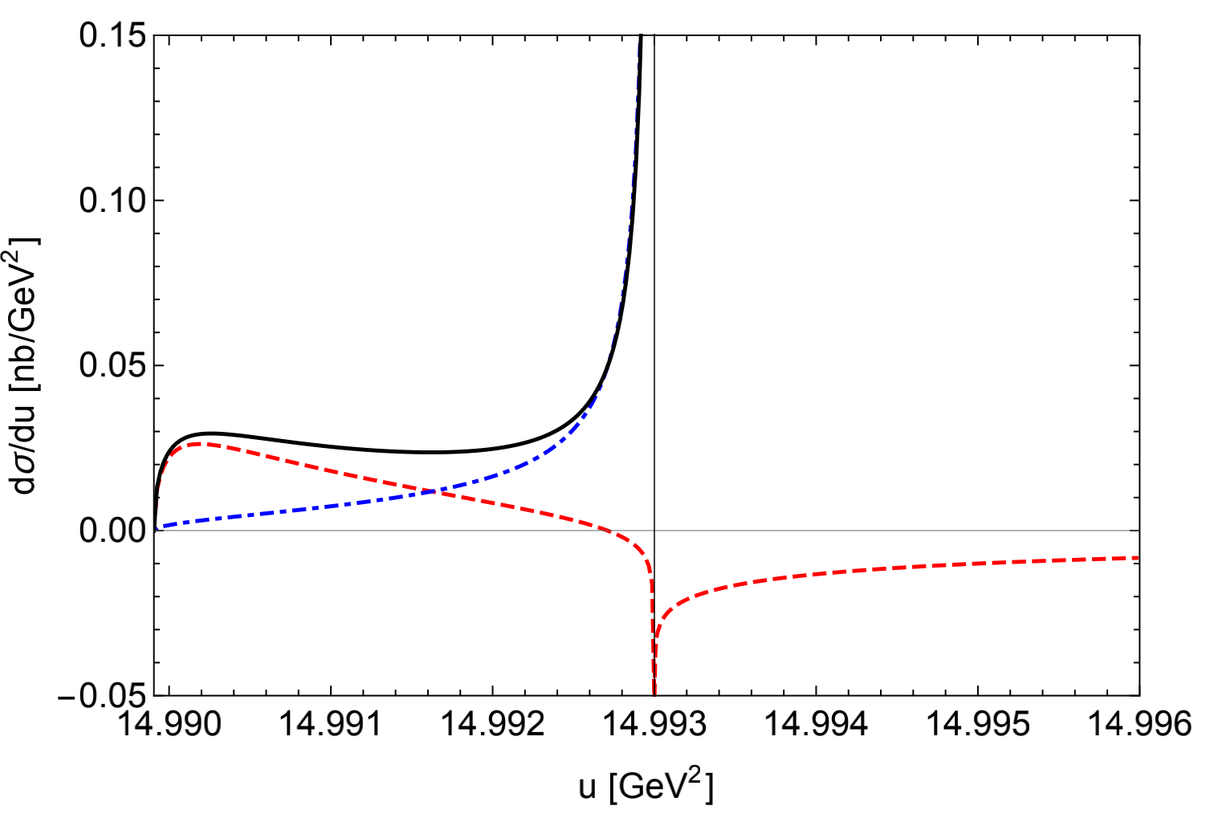
Triangle Singularity in
Differential cross section dσ/du for √s = 4014.7 MeV
with physical D^{*0} width
Differential cross section dσ/du for √s = 4014.7 MeV
with zero D^{*0} width
Interference+Loop (dashed red)
Tree (dot-dashed blue)
Total (black solid)
Tree dominates, no peak from triangle singularity.
Tree diverges as 1/Γ_{*0}
Interference+Loop diverge as log
No peak from triangle singularity
Triangle singularity: u∆=14.993 GeV²

Slide 14
Triangle Singularity in
Schmid Cancellation
dσ/dudt, log² divergences when γ_{X} and Γ_{*0} → 0
Survival
Cancellation
dσ/du, log² cancellation ,
log divergence survives
In dσ/du, tree terms also has log divergence.
All log divergences are completely overwhelmed by the rapidly increasing contribution from the opening up of the resonance from tree diagram.
s₋ : s-4M_{*0}²
u₋ : u-(M_{*0}+M₀)²
t₋ : t-M_{*0}²
δ : M_{*0}-M₀
x : s₋ / δ

Slide 15
Triangle Singularity in
No peak in dσ/dudt for physical Γ_{*0} width
No peak in dσ/du for physical/zero Γ_{*0} width
Can we identify the charm-meson triangle singularity?
This matters, because it supports for the identification of X as a weakly bound charm-meson molecule.

Slide 16
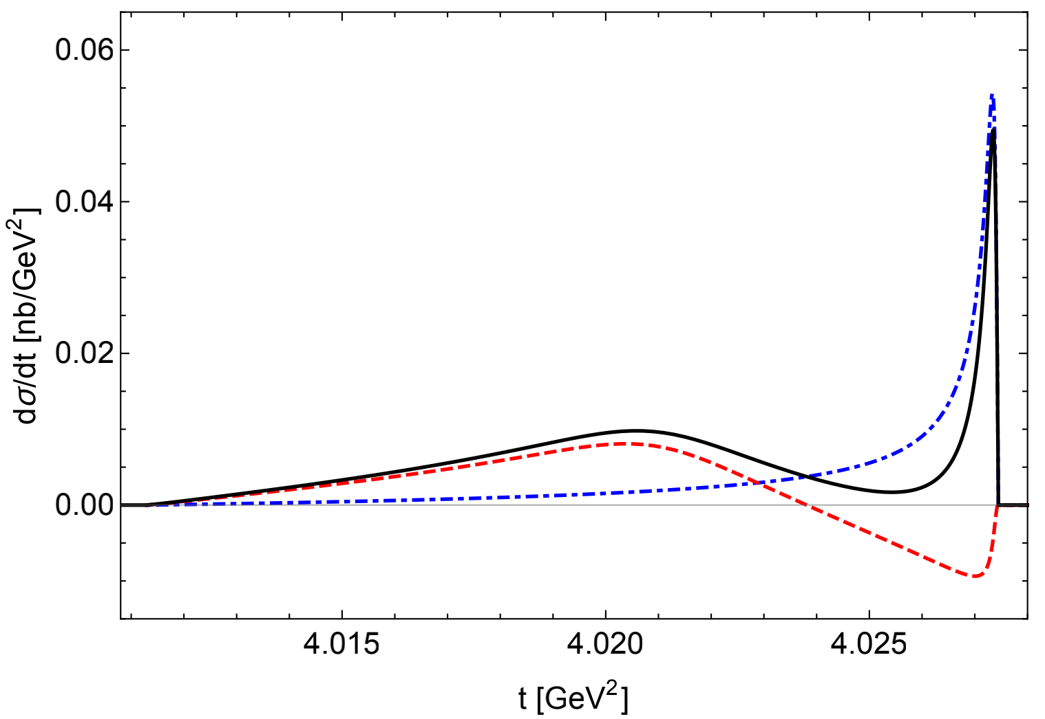
Triangle Singularity in
Differential cross section dσ/dt for √s = 4014.7 MeV with u<u∆
Dalitz plot for √s = 4014.7 MeV with zero D^{*0} width
Interference+Loop (dashed red)
Tree (dot-dashed blue)
Total (black solid)

Slide 17
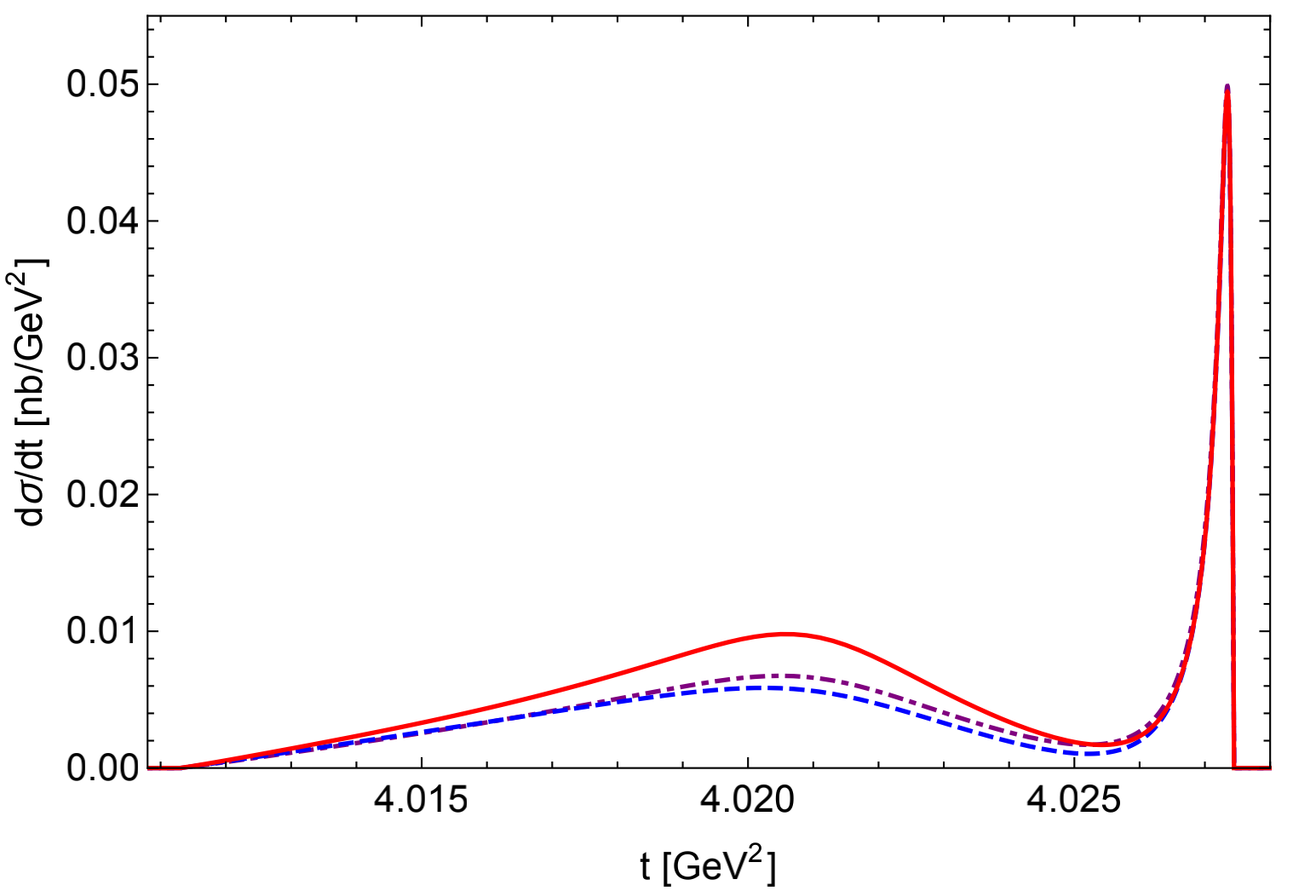
Triangle Singularity in
Differential cross section dσ/dt for √s = 4014.7 MeV with u<u∆
|E_{X}| = 0.05 MeV, Γ_{X} = Γ_{∗0} (solid red)
|E_{X}| = 0.10 MeV, Γ_{X} = Γ_{∗0} (dashed blue)
|E_{X}| = 0.05 MeV, Γ_{X} = 2 Γ_{∗0} (dotdashed purple)
local minimum provides support for X being a weakly bound charm-meson molecule.

Slide 18
New Formulation of Galilean-invariant XEFT at NLO
XEFT is a nonrelativistic effective field theory for charm mesons and pions in the QCD sector of
Fleming, Kusunoki, Mehen & van Kolck [PRD 76, 034006 (2007)]
Galilean-invariant XEFT
Invariance under a Galilean boost , which requries exact conservation of kinemetic mass.
Imposing conservation of (anti-)charm quarks and pion numbers.
Systematic treatment of and requring a complex binding momentum .
Complex on-shell (COS) renormalization.
Braaten [PRD 91, 114007 (2015)]
New formulation of Galilean-invariant XEFT
Braaten, He & Jiang [PRD 103, 036014 (2021)]
The first three features of the old formulation.
Introducing additional vector field, pair field, that aninihilates a pair in the resonant channel.
New Feynman rules with coupling to the resonant channel only through the pair propagator.
Complex threshold (CT) renormalization.
Notes:
The invariant energy E − p^2/(2m) is invariant under Galilean boosts (invariance under a Galilean boost with an arbitrary velocity vector v.
COS: E_X - i Gamma_X/2, the pole energy E_pole has the same value and same residue as at LO.
3 ajustable real interaction parameters: E_X, Gamma_X (these two are related to Re[gamma] and Im[gamma]), and R0. E_X and Gamma_X are not ideal parameters since they are not well determined by LHCb experiment, so one might also use Re[gamma] and Im[gamma] as parameters.
CT: E=E_*=\delta - i Gamma_{*0}/2, remove the first two terms of the kappaE expansion (there are d-3 poles in the coefficients), and partial subtraction of kappaE^2 term (this gives an additional parameter).
4 ajustable real interaction parameters: Re[gamma], Im[gamma], F2 and C2/C0=R0/(2gamma). In COS, F2 is not recognized since “deltaZphi (kappa(Epole)-gamma_X)”is zero under COS, thus deltaZphi can not be determined.

Slide 19
New Formulation of Galilean-invariant XEFT at NLO
Advantages of the new formulation
Braaten, He & Jiang [PRD 103, 036014 (2021)]
New Feynman rules simplify the calculation at NLO by making some UV divergences cancellation automatic.
In CT renormalization scheme, it reveals an additional adjustable interaction parameter in the calculation of pair propagator at NLO, which was not recognized in the old formulation.
Another insight is that the renormalization of scattering amplitude requries renormalization constant , which was not recognized in the old formulation.
Our new CT renormalization scheme might provide a possible solution to the large NLO correction in
Fleming, Kusunoki, Mehen & van Kolck [PRD 76, 034006 (2007)];
Dai, Guo & Mehen [PRD 101, 054024 (2020)].
Better formulation,
Simpler and more accurate caculation,
Better understanding on the nature of X(3872)!
Notes:
Two illustration:
pole energy of X at NLO;
D*0 Dbar0 scattering amplitude at NLO (breakdown of effective range expansion)
Some of the large NLO corrections can be attributed to expanding LO results to first order in the correction to the binding momentum. The suppression factor associated with an imaginary correction to the binding momentum is Γ*0/|EX|. In the CT scheme, this correction is absorbed into the parameter gamma. The calculation of the decay rate of X into D0Dbar0π0 at NLO using the CT scheme would involve a subtraction of part of the NLO corrections in Refs. [11,16]. If the remaining NLO corrections are suppressed by gamma/sqrt{2mu delta}, the problem of large NLO corrections would be solved

Slide 20
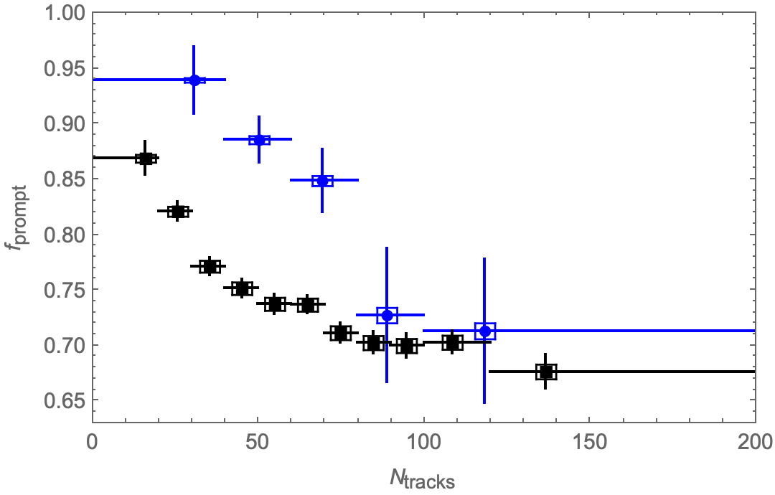
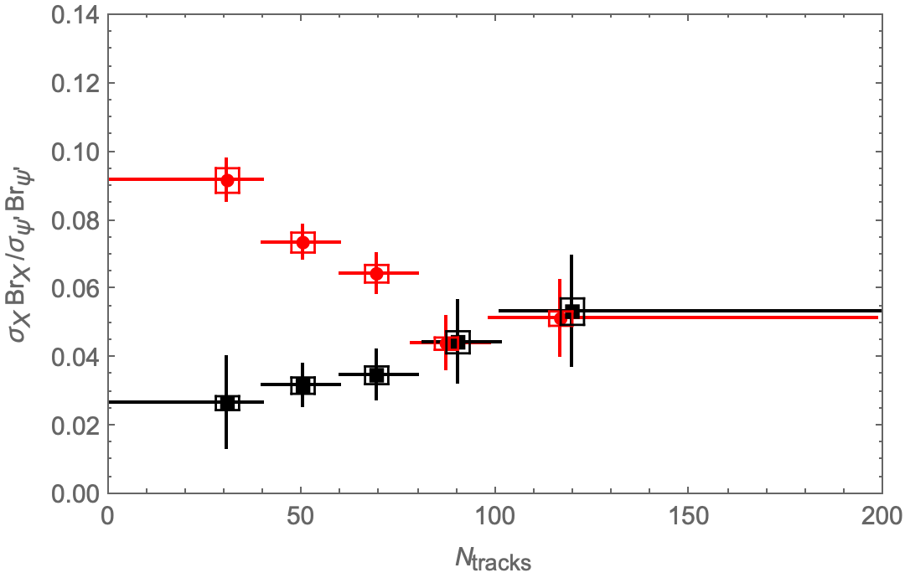
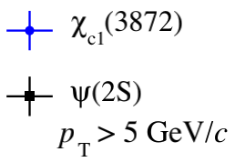
Production of X(3872) at High Multiplicity in pp Collision
In hadron colliders, X(3872) can be produced by
Prompt production: strong interaction at primary vertex, hundreds of additional hadrons may also emerge. Number of charged particles: N_{ch} ~ 100's, dN_{ch}/dy ~ 10’s, comoving hadrons could break up X.
B-decay: weak decays of b hardrons at displaced secondary vertex, a few additional hadrons. For example,
The different behaviours of these two modes might provide evidence for the nature of X(3872).

Slide 21
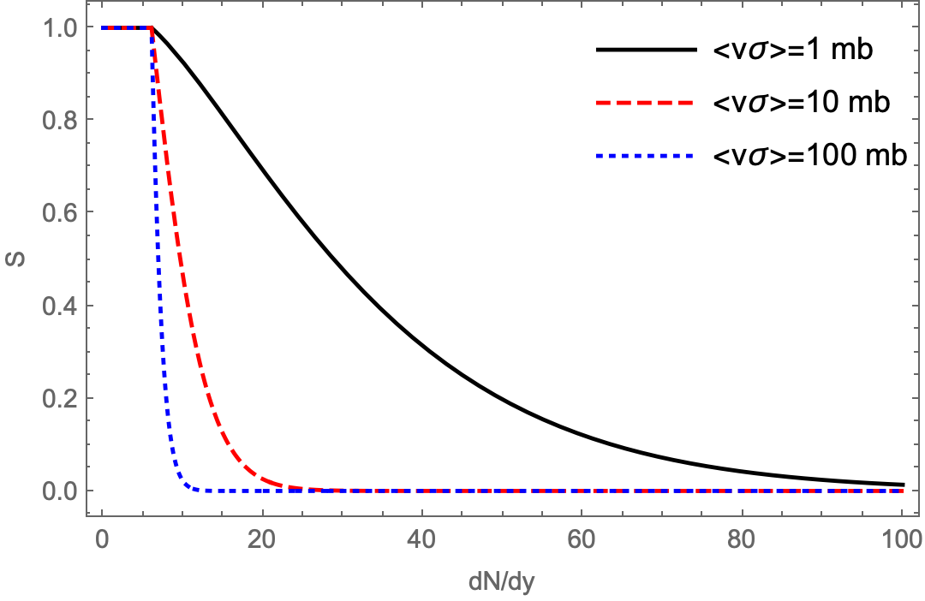
Production of X(3872) at High Multiplicity in pp Collision
Comover Interaction Model (CIM)
It was developed to describe suppression of J/ψ and ψ(2S) in pp, p-nucleus, nucleus-nucleus collisions.
A more elaborate version was developed to describe suppression of ϒ(2S), ϒ(3S) compared to ϒ.
A modified version was developed to describe the production of X(3872) in pp collision.
Capella et al., Gavin and Vogt, Kharzeev et al., (1997); Ferreiro, (2015).
Ferreiro & Lansberg, (2018).
Esposito et. al., [arXiv:2006.15044].
In CIM, the meson can be broken up by scattering with comoving pions or gluons, so its production rate decreases as the light hadron multiplicity per rapidity dN/dy increases.
The survival prosibility
BHIJ, PRD 103, L071901 (2021)
-- reaction rate for breakup of averaged over comovers,
-- nondiffractive cross section,
-- below which the effects of comovers are negligible.

Slide 22
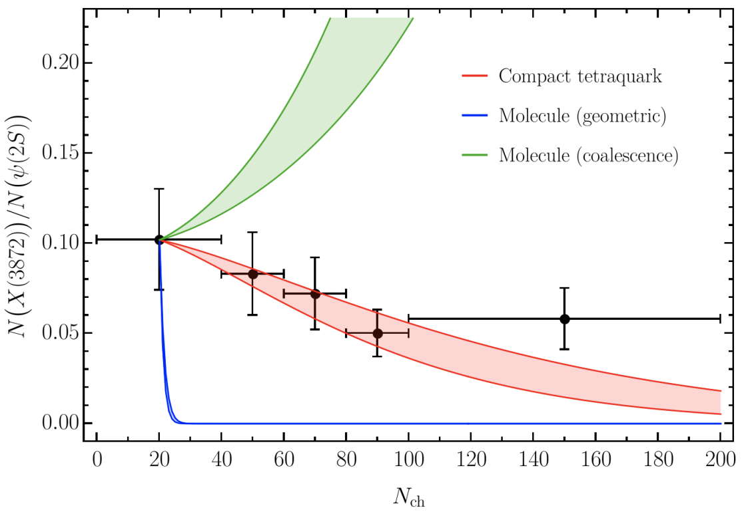
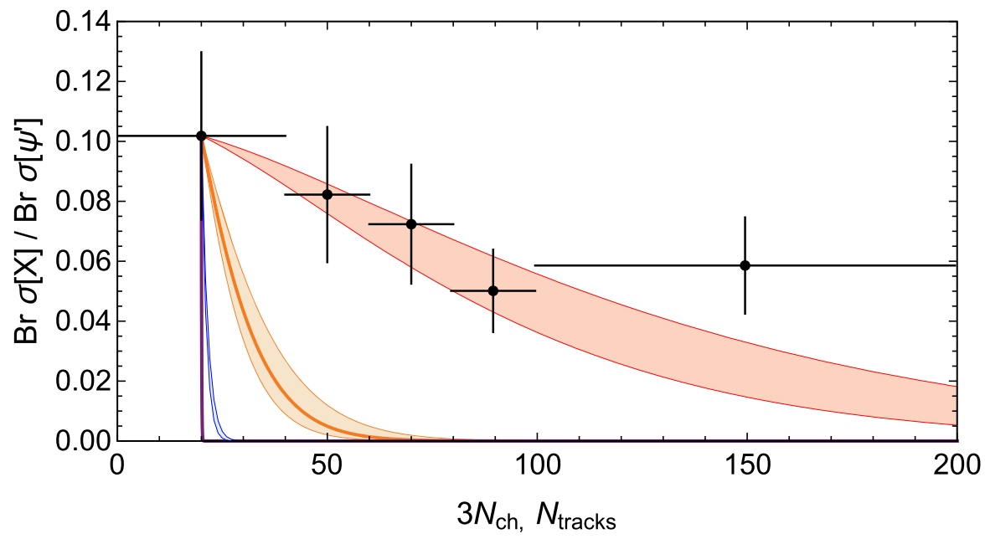
Production of X(3872) at High Multiplicity in pp Collision
breakup reaction rates ≈ geometric cross section
Esposito et. al., [arXiv:2006.15044]
Clearly supports X being a tetraquark state
Strongly disfavors the molecular interpretation
BHIJ, PRD 103, L071901 (2021)
Their results if X is a molecule were based in part on the incorrect assumption , but should instead be approximated by cross sections for scattering from constituents of X.
The survival possibility S only can neither reproduce Esposito's plots nor the LHCb data. There must be something not captured by the survival probability S.

Slide 23
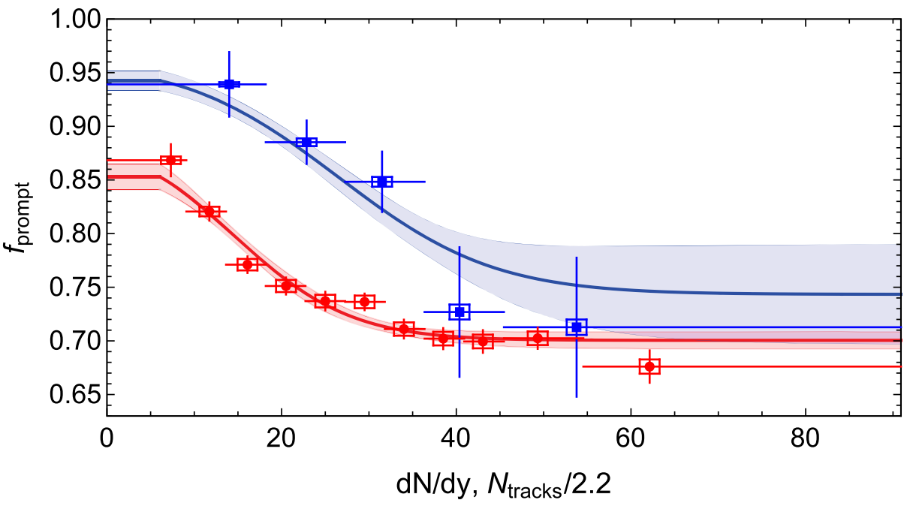
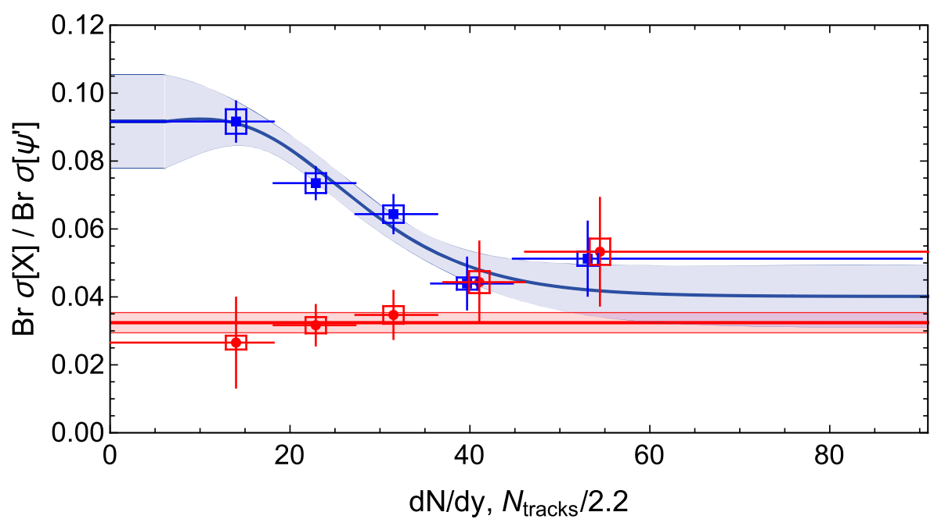
Production of X(3872) at High Multiplicity in pp Collision
Simple Fit to the LHCb Data
Assumption: (1) prompt cross section is sum of term with survival probability
and term with S=1 where X(3872) is out of the reach of comovers;
(2) b decay cross section is constant.
BHIJ, PRD 103, L071901 (2021)
X(3872)
prompt
ψ(2S)
b-decay
7 fitting parameters
26 data points
χ²/d.o.f. = 0.99
Fitted breakup reaction rates:
Orders of magnitude smaller than = 636 mb with r_{X} = 4.5 fm.
Notes:
Pi*r^2*10^27(*1cm^2=10^24barn*)/. r -> 4.5*(10^-13)(*fm2cm*)(*units: mb*) = 636.173 mb

Slide 24
Production of X(3872) at High Multiplicity in pp Collision
πX Scattering Cross Section in XEFT
Low energy pions:
High energy pions:
For example, P-wave contributions of to decrease from 0.2 to 0.04 to 0.02 mb as effective temperature increase from 100 to 200 to 300 MeV.
We are working on this. Based on our current progress, the expected/predicted values are consistant with the fitted breakup reaction rates. If so, this would be a support for X being a loosely bound charm meson molecule.
Note: CMS observes the X(3872) production in PbPb collisions. The prompt X(3872) to ψ(2S) yield ratio is found to be , which is an order of magnitude larger than the typical values of 0.1 for pp collision.
[易凯's talk this afternoon]
CMS, [arXiv:2102.13048]

Slide 25
Summary
The available information on X(3872) make us believe that it should be a weakly bound charm-meson molecule.
The observation of the narrow peak of charm-meson triangle singularity in
would be a direct support, and the observation of Schmid Cancellation in may provide additional support. BESIII experiments might give us the conclusive answer.
Advertisement: New formulation of Galilean-invariant XEFT, simpler and more accurate NLO calculation!
A simple fit to the LHCb data on multiplicity dependence gives a breakup cross section orders of magnitudes smaller than geometric approximation. XEFT might give correct predictions on X high multiplicy production.
Thank You!

