Slide 1
Photon Reconstruction Test
Yuzhi CHE
2021年1月组会

Slide 2
Review of the last meeting

Slide 3
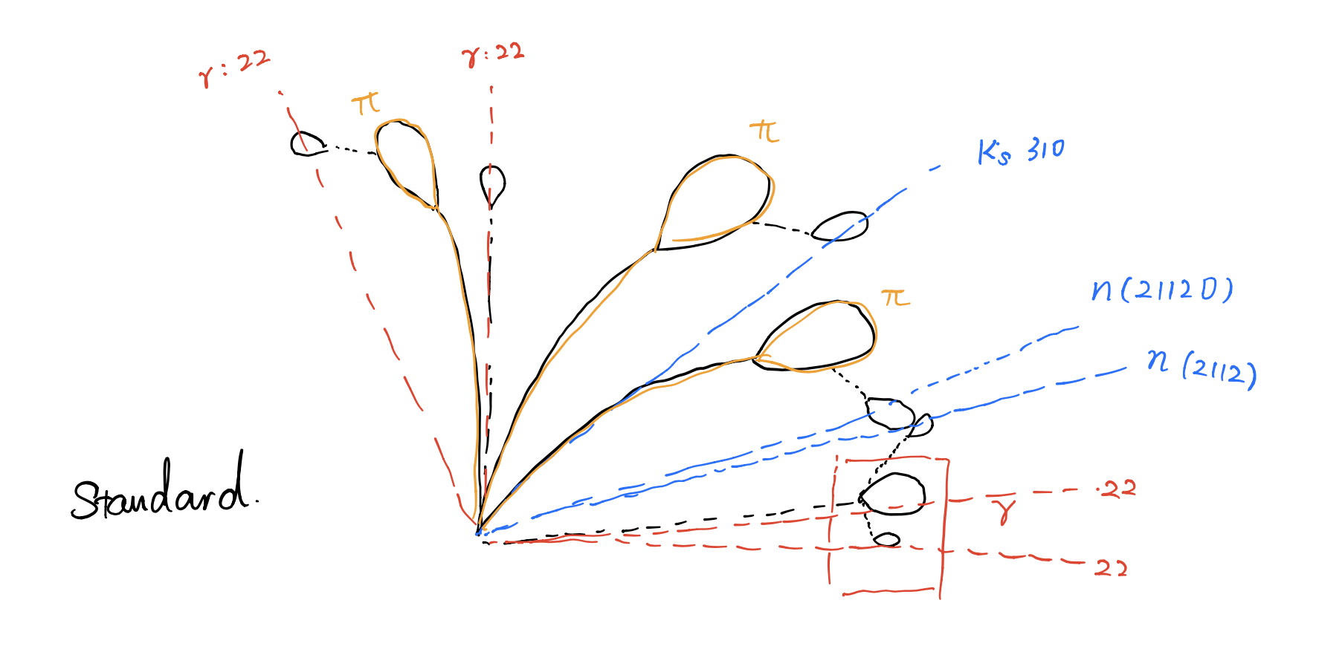
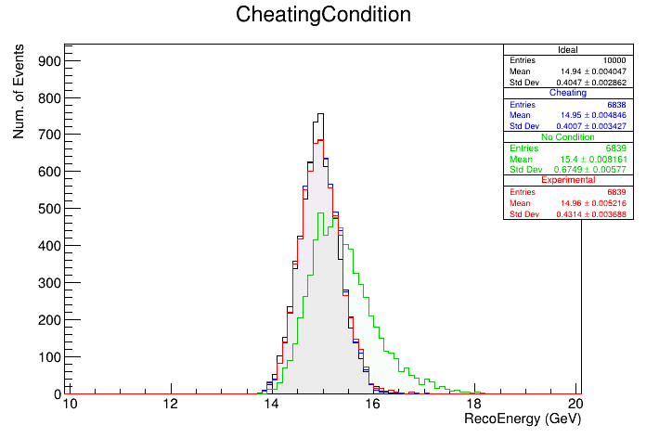
Review of the last meeting
Motivation
Arbor
Merge clusters
Link cluster & track
Reconstruct particles
  Charged particle
  Photon id
  Fragment veto

Slide 4
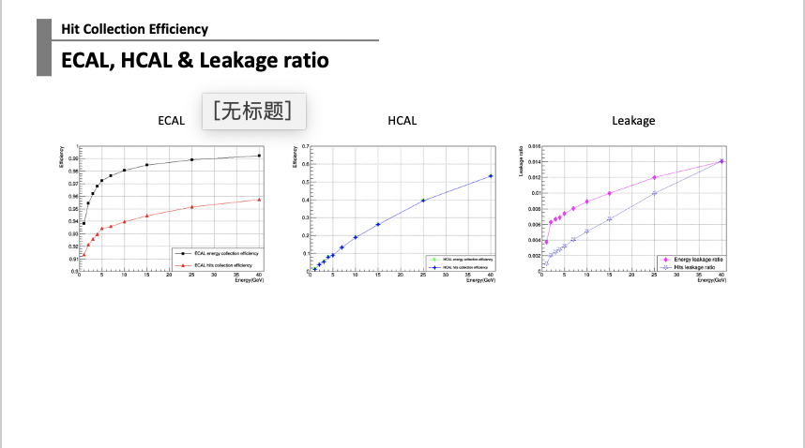
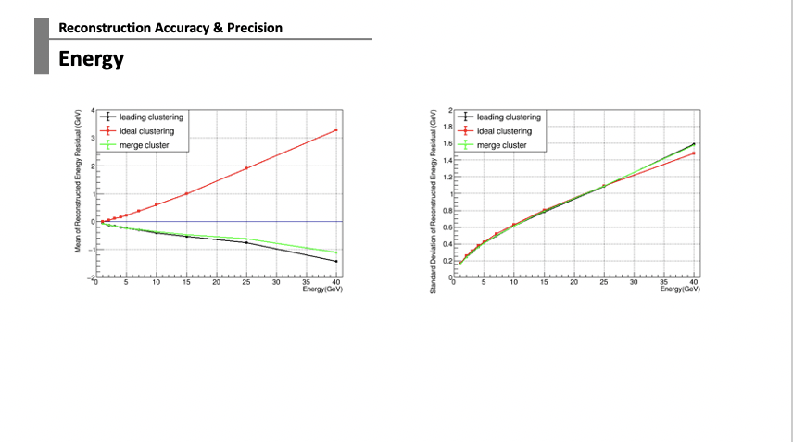
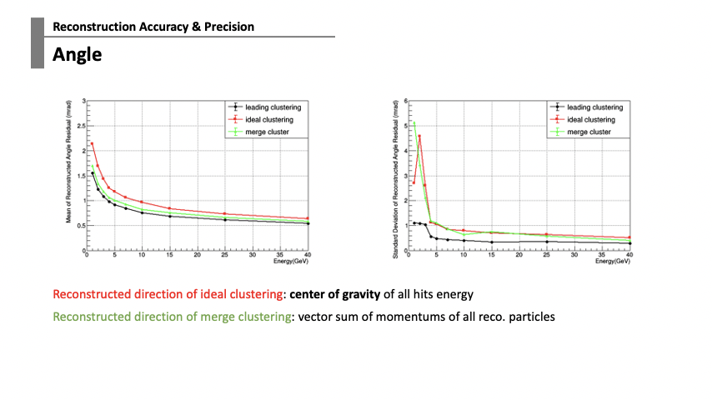
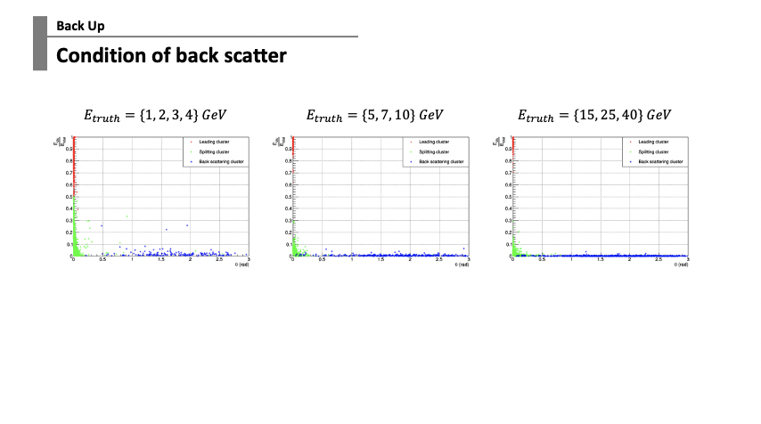
Review of the last meeting
Rough statistics

Slide 5
Motivation
A test of photon reconstruction algorithm
Hit collection efficiency
Overview of split: #cluster vs. photon energy
  1-1 Reconstruction:
    Energy accuracy & resolution
    Position (angular) distribution
  1-N Reconstruction:
    Leading cluster: similar with 1-1 case
    Sub-leading cluster: energy & position distribution

Slide 6
Sample

Slide 7
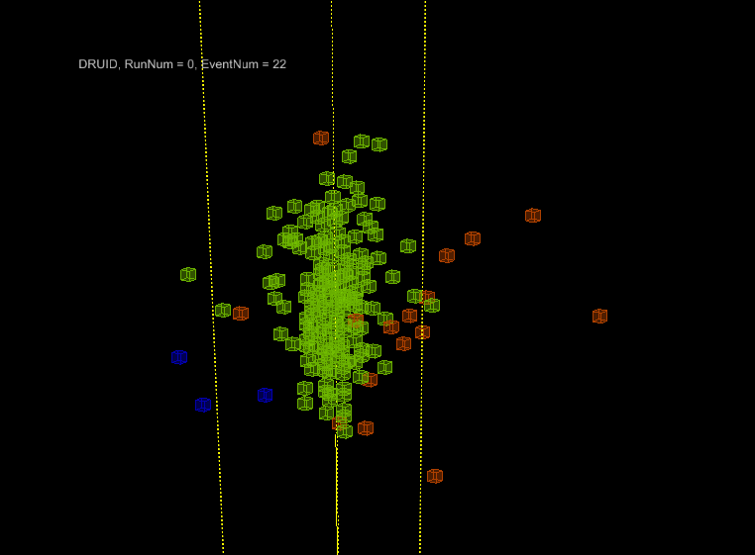
0. Sample
Single $γ$ in every event
10 energy points:
  {1, 2, 3, 4, 5, 7, 10, 15, 25, 40} GeV
10k events at each energy
Remove pre-interacted events before analyze
Statistics without pre-interaction
E(GeV) | 1.0 | 2.0 | 3.0 | 4.0 | 5.0 | 7.0 | 10.0 | 15.0 | 25.0 | 40.0 | 60.0 | 90.0 | 110.0
N | 9288 | 9208 | 9197 | 9175 | 9133 | 9084 | 9036 | 9001 | 8819 | 8525 | 8296 | 7961 | 7740

Slide 8
Hit Collection Efficiency

Slide 9
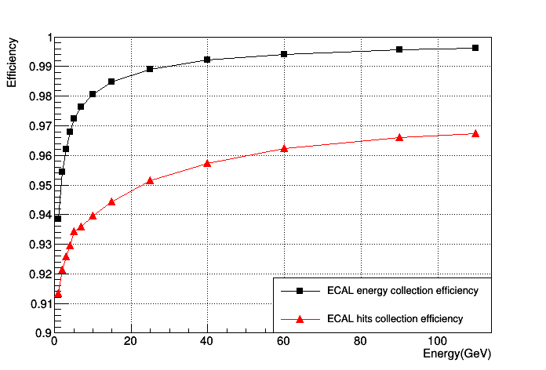
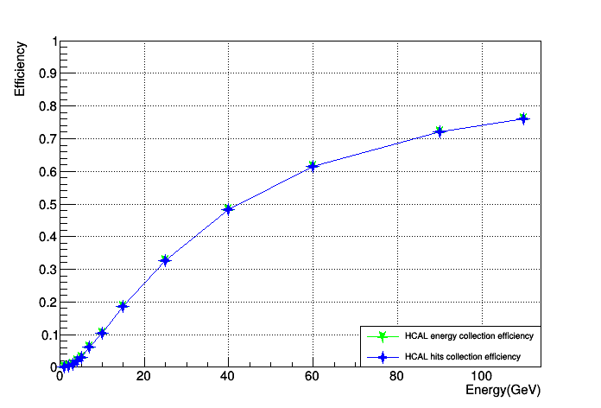
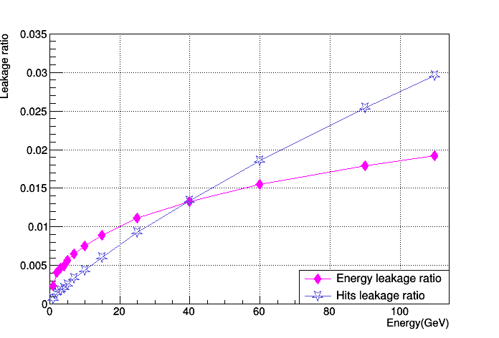
1. Hit Collection Efficiency
ECAL, HCAL & Leakage ratio
ECAL
HCAL
Leakage
$$ε_{ECAL}=\frac{\sum_{clu}{E_{hit}^{in ECAL}}}{∑E_{hit}^{in ECAL}}$$
$$ε_{HCAL}=\frac{\sum_{clu}{E_{hit}^{in HCAL}}}{∑E_{hit}^{in HCAL}}$$
$$R_{leakage}=\frac{\sum{E_{hit}^{in HCAL}}}{∑E_{hit}^{in ECAL}+{∑E}_{hit}^{in HCAL}}$$

Slide 10
Cluster Split
Overview: Number of Cluster
1-1 Reconstruction
  Accuracy of Energy & Angular
1-N Reconstruction
  Leading Cluster
  Sub-leading Cluster

Slide 11
2. Cluster Split
Num. of Cluster vs. Energy
Statistics without pre-interaction
Energy | 1.0 | 2.0 | 3.0 | 4.0 | 5.0 | 7.0 | 10.0 | 15.0 | 25.0 | 40.0
Statistic | 9288 | 9208 | 9197 | 9175 | 9133 | 9084 | 9036 | 9001 | 8819 | 8525
Notes:
相邻的hit数

Slide 12
1-1 Reconstruction
Cluster Split

Slide 13
2.1. 1-1 Reconstruction
Energy Resolution & Accuracy

Slide 14
2.1. 1-1 Reconstruction
Angular Accuracy

Slide 15
1-N Reconstruction
Cluster Split

Slide 16
2.2. 1-N Reconstruction
Split & Back Scatter
Leading Cluster: The clusters with highest energy
Split: The clusters that split from leading cluster because of Arbor algorithm
Back Scatter: The clusters that created by back scattering particles, such as photon or neutron.
Kernel
or
Leading
Split
Back Scatter

Slide 17
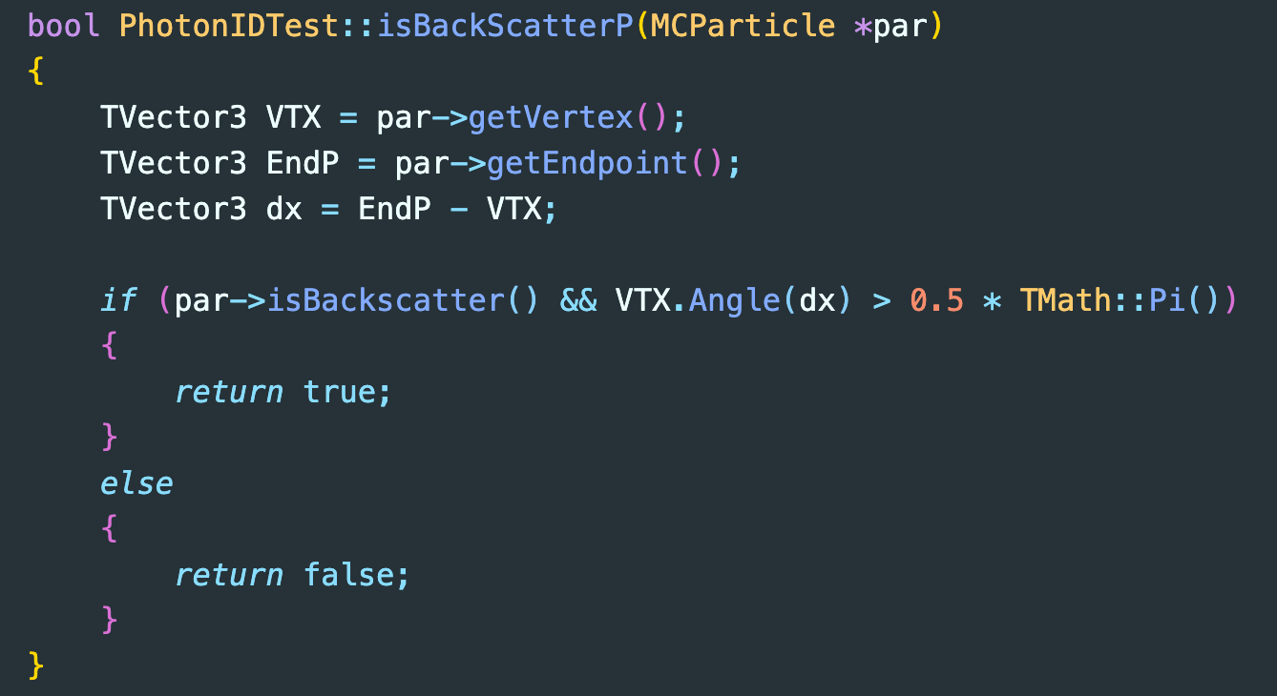
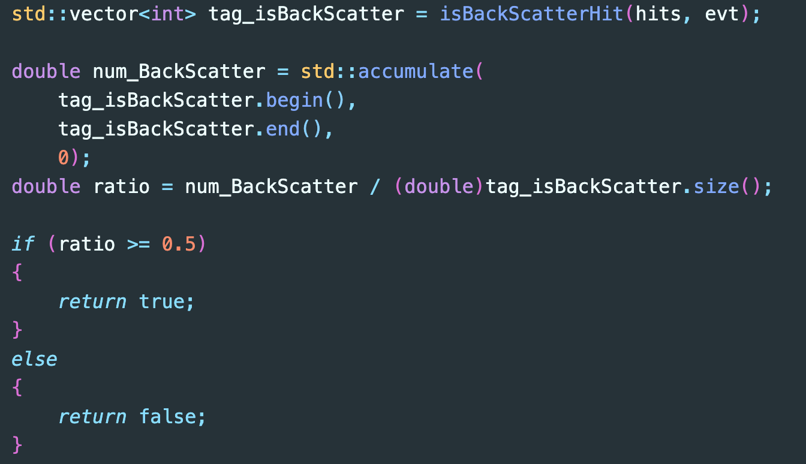
2.2. 1-N Reconstruction
Condition of back scatter
Identify back scatters from MC Truth:
Back scatter hit:
  cased by a back scatter particle
  obtuse angle between fly direction and born direction of this particle
Back scatter cluster or reco. particle:
  include >50% back scattering hits

Slide 18
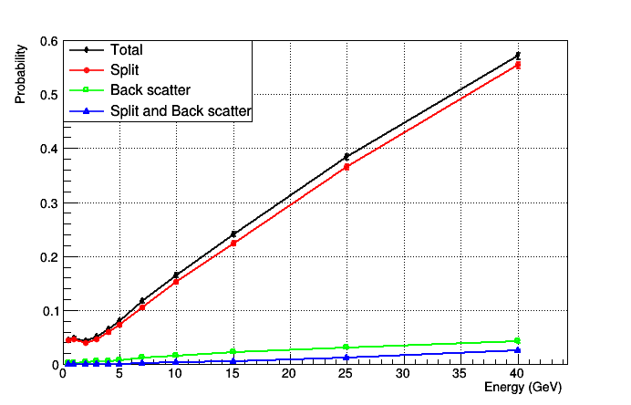
2.2. 1-N Reconstruction
Split & Back Scatter Chance
  $$P\left(Split\right)=\frac{N_{event}^{split}}{N_{event}^{all}}$$
$P\left(Back Scatter\right)=\frac{N_{event}^{back}}{N_{event}^{all}}$
$P\left(Split and Back Scatter\right)=\frac{N_{event}^{split \&\& back}}{N_{event}^{all}}$
$P\left(Total\right)=\frac{N_{event}^{split or back}}{N_{event}^{all}}$
$=P\left(Split\right)+P\left(Back Scatter\right)−P\left(Split and BackScatter\right)$

Slide 19
2.2. 1-N Reconstruction
Angle of Split apart from Truth
$$E_{truth}=\{1, 2, 3, 4\} GeV$$
$$E_{truth}=\{5, 7, 10\} GeV$$
$$E_{truth}=\{15, 25, 40\} GeV$$
In 1-N events, leading cluster always include most of energy and be close to the truth photon, while sub-leading clusters carry less energy and be farther from the truth photon.
back scattering cluster can be considered as sub-leading cluster together with splitting cluster since its small statistic and the arbitrary condition.

Slide 20
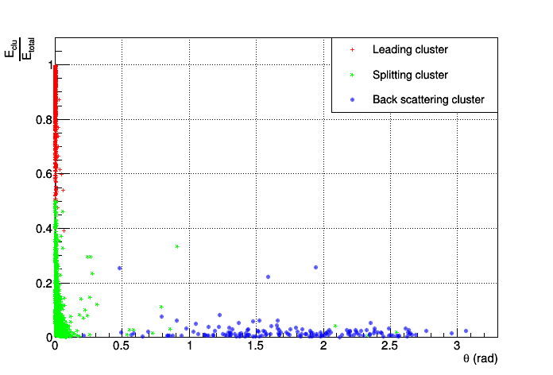
2.2. 1-N Reconstruction: Leading cluster
Energy Distribution
Comparing to 1-1 reconstruction,
1-N reconstruction (leading cluster) gives lower energy & worse energy resolution,
but these differences disappear with photon energy grows to 40 GeV

Slide 21
Back Up
Energy Reconstruction
1st line represents performance of clusters in 1-1 case while 2nd line represents that of leading cluster in 1-N case

Slide 22
2.2. 1-N Reconstruction: Leading cluster
Angular Distribution

Slide 23
2.2. 1-N Reconstruction: Split & Back Scatter
Angular Distribution
$$E_{truth}=\{1, 2, 3, 4\} GeV$$
$$E_{truth}=\{5, 7, 10\} GeV$$
$$E_{truth}=\{15, 25, 40\} GeV$$

Slide 24
Future
Future
Single gamma with different direction or move to $Z→ττ$sample
  split probability as a function of polar angle
  energy resolution as a function of polar angle
  angle resolution as a function of polar angle

Slide 25
Back Up

Slide 26
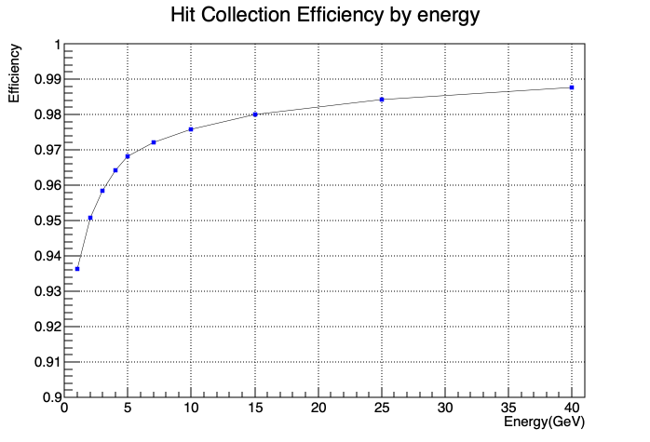
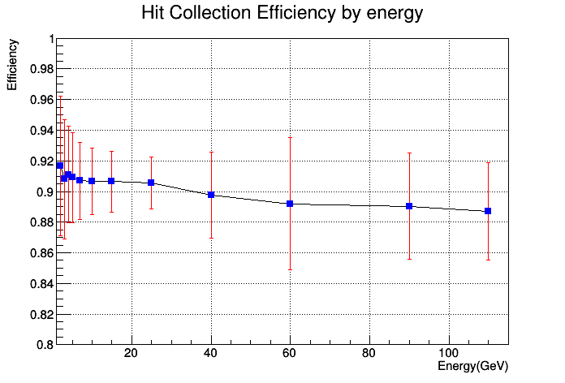
Hit Collection Efficiency
Photon Energy Correction
left: $ε_{l}=\frac{\sum_{clu}{E_{hit}}}{∑E_{hit}}$; right: $ε_{r}=\frac{\sum{E_{clu}}}{∑E_{hit}}$
Is photon energy correction OK?

Slide 27
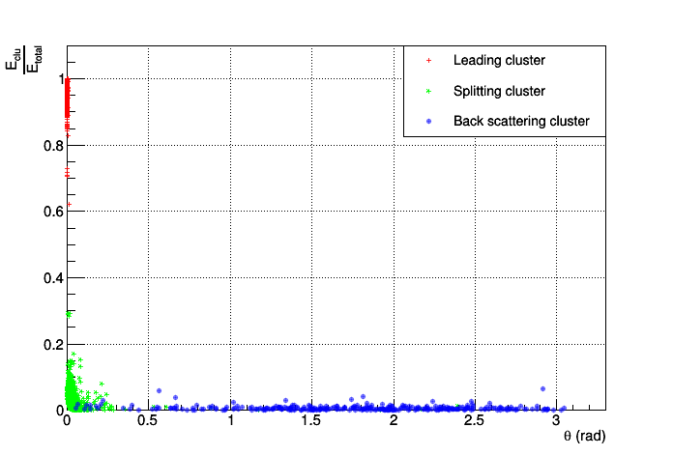
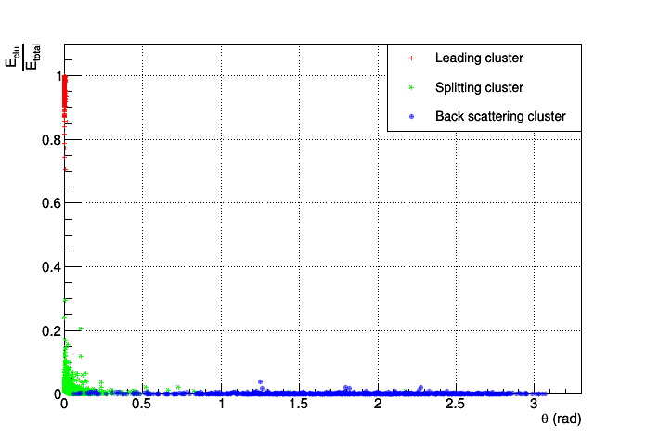
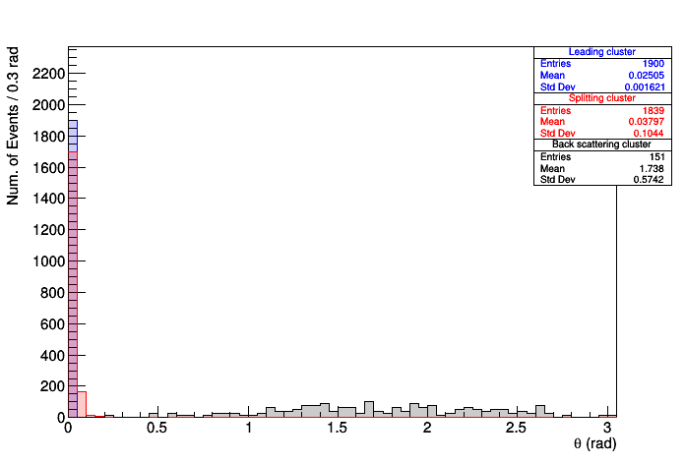
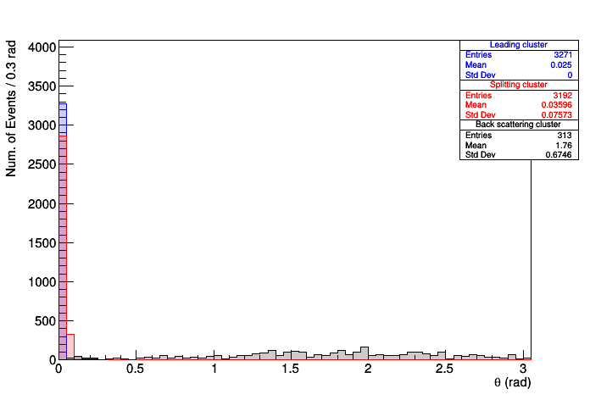
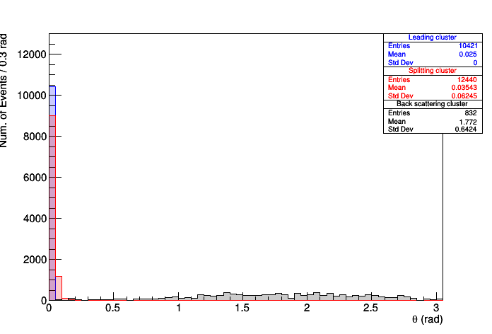
2.2. 1-N Reconstruction
Angle of Split apart from Leading
$$E_{truth}=\{1, 2, 3, 4\} GeV$$
$$E_{truth}=\{5, 7, 10\} GeV$$
$$E_{truth}=\{15, 25, 40\} GeV$$
2nd line: every histogram has been normalized to the number of leading cluster.

Slide 28
Angular Distribution
2.2. 1-N Reconstruction: Sub-Leading cluster
Sub-Leading
Kernel
or
Leading
Split
Back Scatter

Slide 29
2.2. 1-N Reconstruction
Angle of Split apart from Truth
$$E_{truth}=\{1, 2, 3, 4\} GeV$$
$$E_{truth}=\{5, 7, 10\} GeV$$
$$E_{truth}=\{15, 25, 40\} GeV$$
In 1-N events, leading cluster always include most of energy and be close to the truth photon, while sub-leading clusters carry less energy and be farther from the truth photon.
2nd line: every histogram has been normalized to the number of leading cluster.
back scattering cluster can be considered as sub-leading cluster together with splitting cluster since its small statistic and the arbitrary condition.

Slide 30
2.2. 1-N Reconstruction: Split & Back Scatter
Angular Distribution
$$E_{truth}=\{1, 2, 3, 4\} GeV$$
$$E_{truth}=\{5, 7, 10\} GeV$$
$$E_{truth}=\{15, 25, 40\} GeV$$

Slide 31
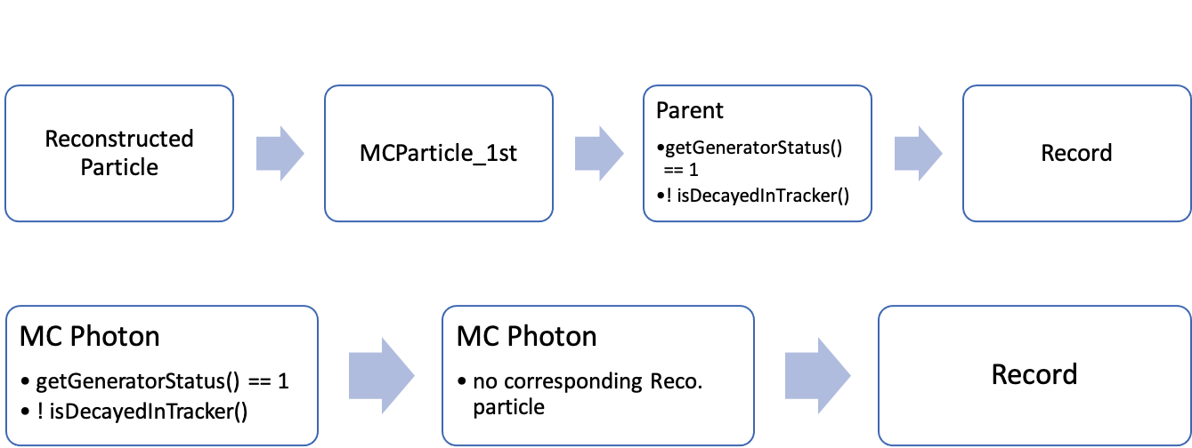
Check Generator Status
Back Up

Slide 32
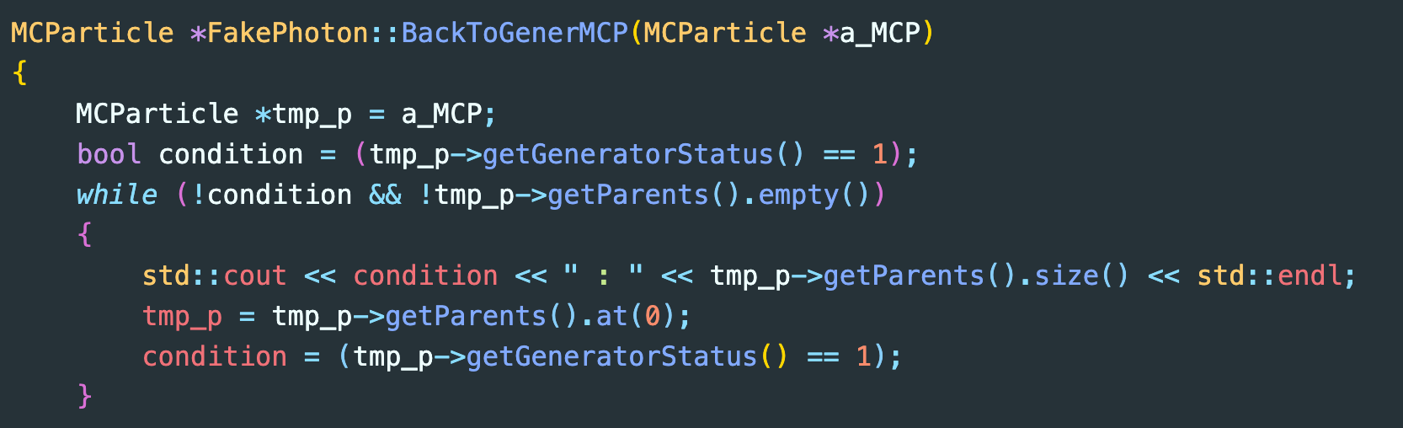
Check Generator Status
Final State Selection
From the particle which directly contributed energy to a specific hit, getGeneratorStatus() leads us to find the final state particle on generator level.
Using $Z→ττ$ Sample (~ 1000 events) to check the reliability of this member function of class MCParticle.

Slide 33
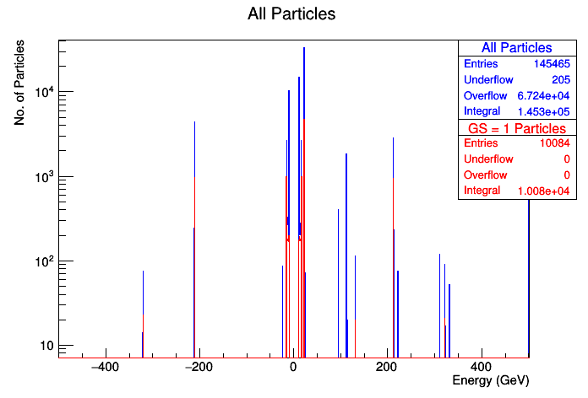
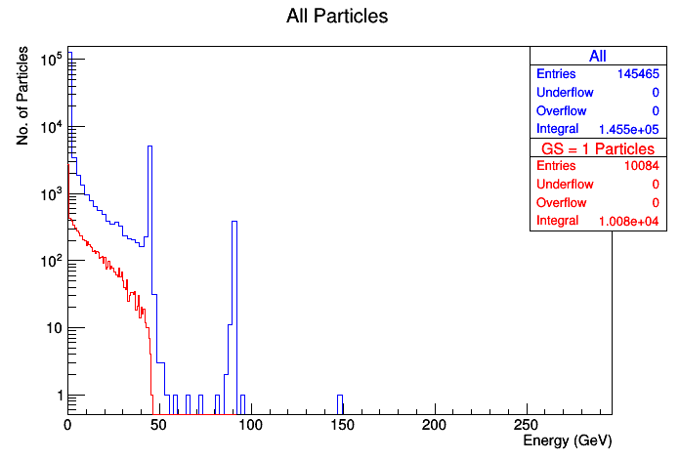
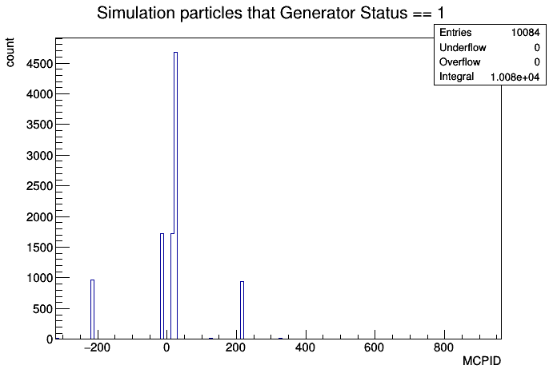
Check Generator Status
Overview of Particle ID in Simulation Sample
After setting GS( Generator Status ) == 1, about 6.8% particles has been selected as final state particle.

Slide 34
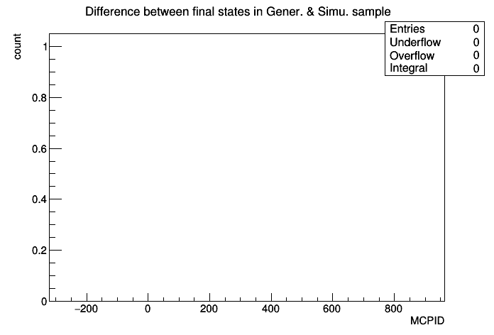
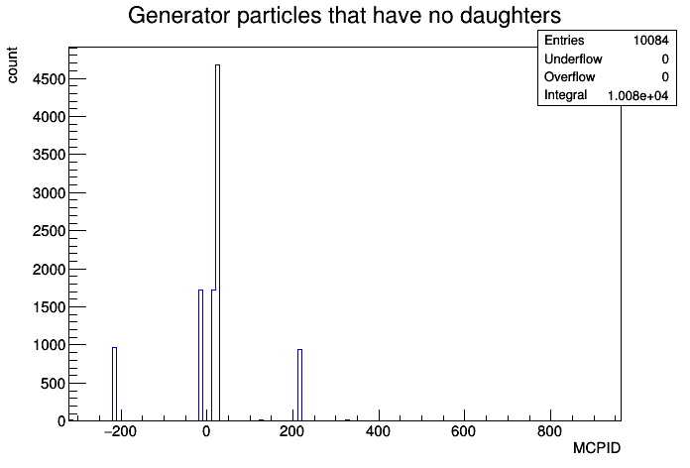
Check Generator Status
Particle ID
Left: Selected final state candidates in simulation sample
Middle: Left - Right
Right: Final state particles in generator sample

Slide 35
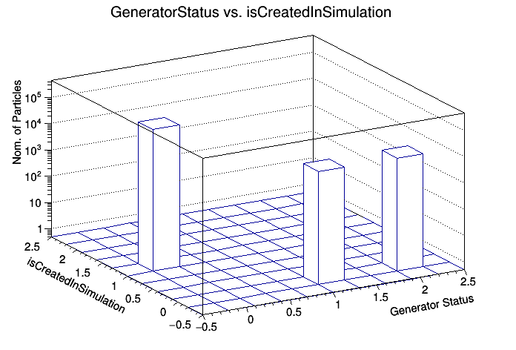
Check Generator Status
Generator Status vs. isCreatedInSimulation
GeneratorStauts = !(isCreatedInSimulation)

Slide 36
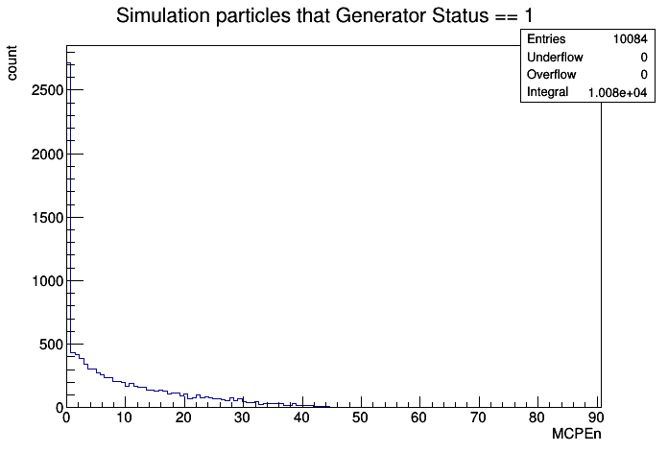
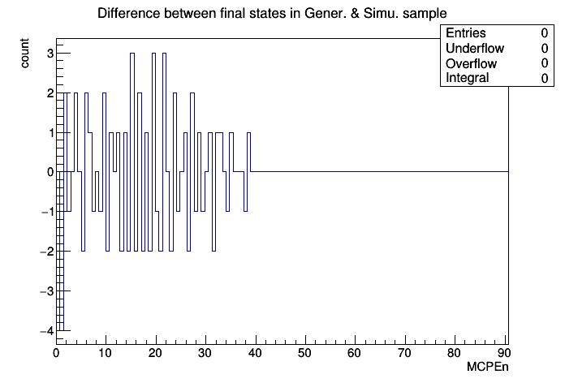
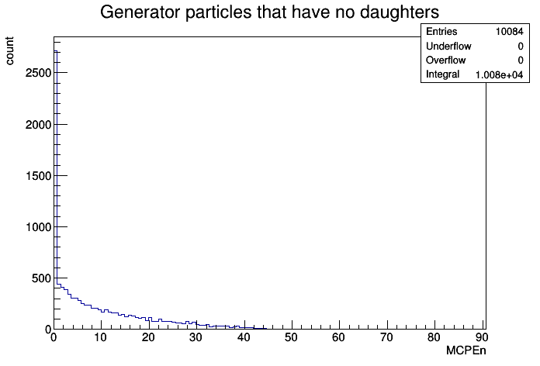
Check Generator Status
Energy Distribution
Left: Selected final state candidates in simulation sample
Middle: Left - Right
Right: Final state particles in generator sample
getGeneratorStatus() is reliable ☺

Slide 37
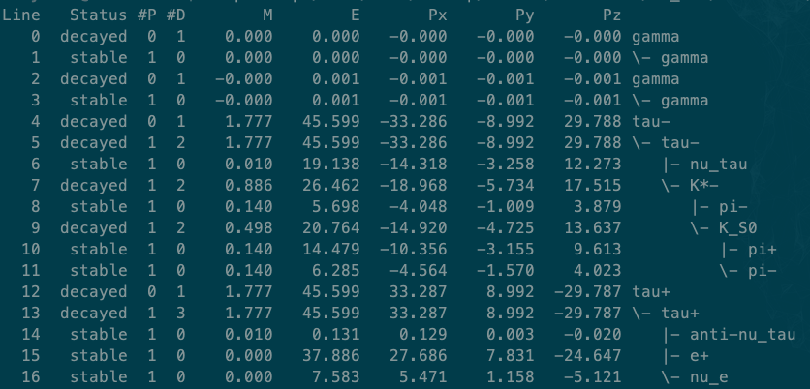
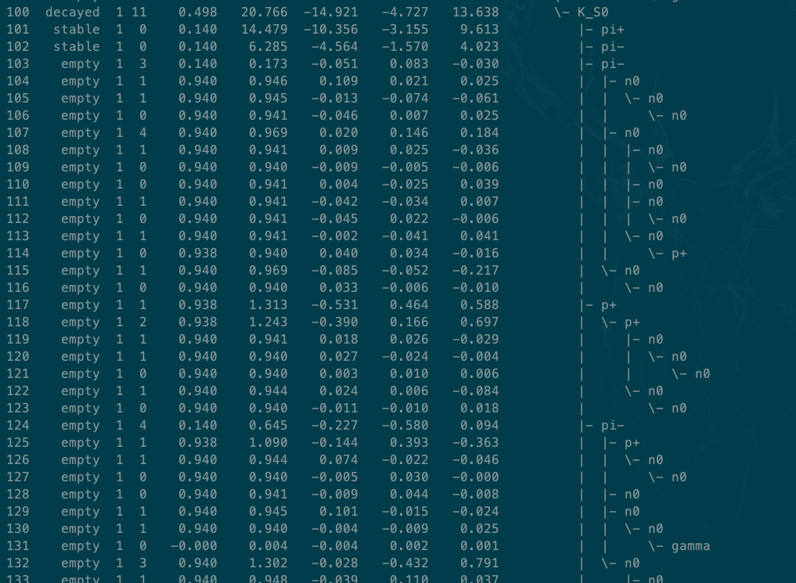
Check Generator Status
One can not always find final state using this function
After simulation, decayed particles (GS = 2) in generator may have more daughters whose GS = 0, and one can not find a GS = 1 parent particle.

