Slide 1
Electronic Games’ echoes in SEUers
Presenters ：Deng Jianpeng Su Bingyuan Wang Yujie Zhao Siqi Wu Yifan
Advisor：Liang Wenyan
Notes:
亮亮图文旗舰店
https://liangliangtuwen.tmall.com

Slide 2
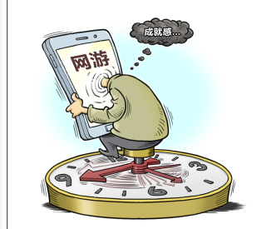
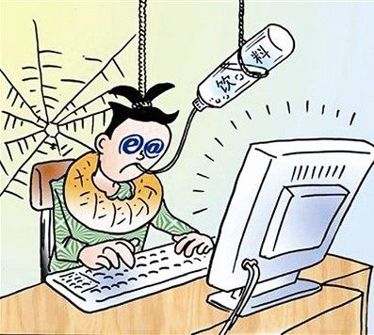
PART 1
INTRODUCTION

Slide 3
1
INTRODUCTION
2
READING AND SPORTS
CONTENTS
Echoes in
3
FINANCIAL SITUATION
4
SOCIAL CONTACT
5
SUGGESTIONS

Slide 5
Project Background：
• Quite a few SEUers paly Electronic games.
• The persisitent myth that SEUers can balance the games and lives, rejecting the bad influences.

Slide 6
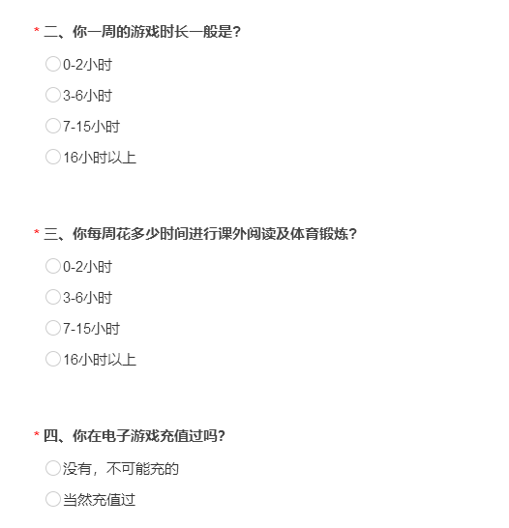
Questionnaire：

Slide 7
PART 2
The Influence of Electronic Games on College Students’ Extracurricular Exercise and Extracurricular Reading
Introduction
Details
Conclusion

Slide 8
Video game time Reading and exercise time | 0-2 hours 35 | 3-6 hours 31 | 7-15 hours 21 | Over 16 hours 13
0-2 hours | 17 | 17 | 14 | 9
3-6 hours | 10 | 6 | 4 | 3
9-15 hours | 4 | 5 | 2 | 1
Over 16 hours | 4 | 3 | 1 | 0

Slide 9
Reading and
exercise time

Slide 10
Conclusion
Video games have a certain influence on students' extracurricular recreational and sports activities.
01
The more time spent on video games, the greater the impact on extracurricular activities.
02
Spending too much time playing video games will reduce our cultural and physical qualities.
03

Slide 11
PART 3
Charging for video games and its impact on quality of life
The phenomenon : With the general improvement of living standards , more and more college students are willing to charge for games.

Slide 13
Conclusion
one
charge a little or nothing for games
two
charge some money but not a lot
three
charge too much money

Slide 14
PART 4
The influence of video games on the social contact of college students
Introduction
Details(column diagrams)
Conclusions

Slide 15
Changes in the way students’
communication
Face to face communication
1.Communicate with people directly
2. Communicate based on daily expression
3.Express your meaning with languages, gestures, facial expressions etc.
4. Almost the same as the human relationship in reality
Video games
man-machine-man conversation
1.Communicate through machines
2. Communicate based on Internet languages
3.Express your meaning only with languages
4. Quite different from the human relationship in reality

Slide 16
Relationship between playing time and making friends

Slide 17
Relationship between playing time and having heterosexual(异性的) friends

Slide 18
Conclusion
First
Playing games in moderation is good for making friends(especially for boys)
Second
Playing games too much is bad for us real life relationships(especially for heterosexual friends)
Conclusions
Third
The effect of gaming on girls’ social skills is generally higher than that of boys

Slide 19
PART 5
SUGGESTIONS
Some suggestions are put forward for college students about the above survey conclusions

Slide 20
SOME SUGGESTIONS
Suggestion one
Put down your phone and computer
Suggestion three
Suggestion two
Put the money you recharge in the game to good use
Find something that interests you
Suggestion four
Talk to people around you

Slide 21
SHORTCOMINGS
SUBJECTIVITY
01
There is no strict mathematical model and analysis of sample data
LACK OF UNIVERSALITY
02
The number of people surveyed is too small
03
LACK OF ELASTICITY
The scope of the answer is limited

Slide 22
Thank you for listening

