Slide 1




Noise distribution of TaichuPix1
Tianya Wu
CEPC Meeting
twu@ifae.es
01-02-2021
1

Slide 2
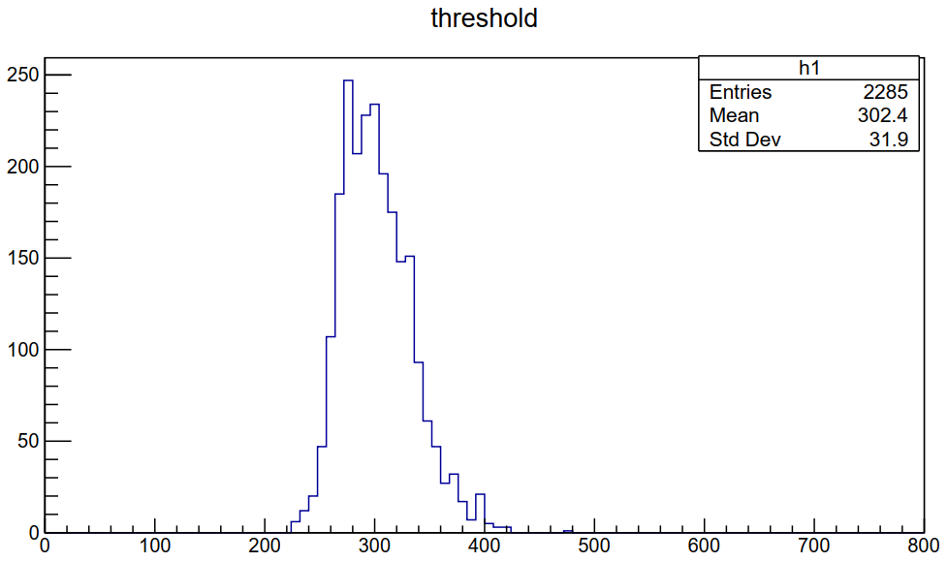
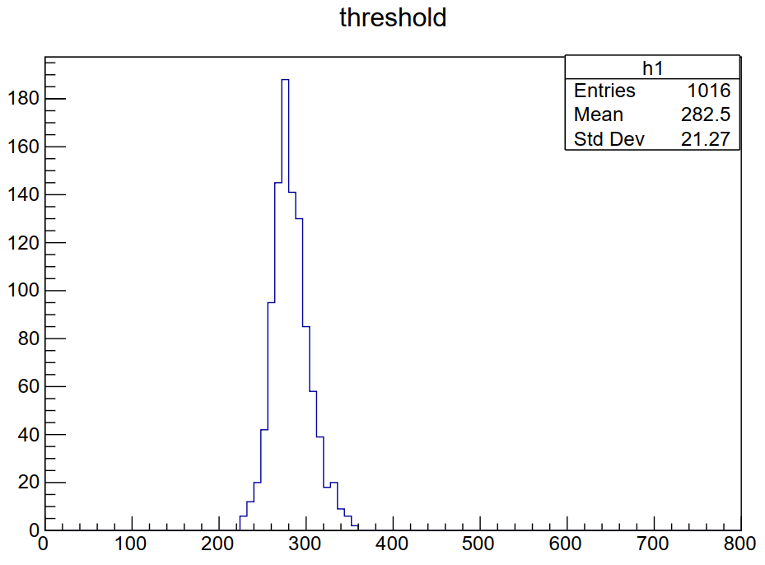
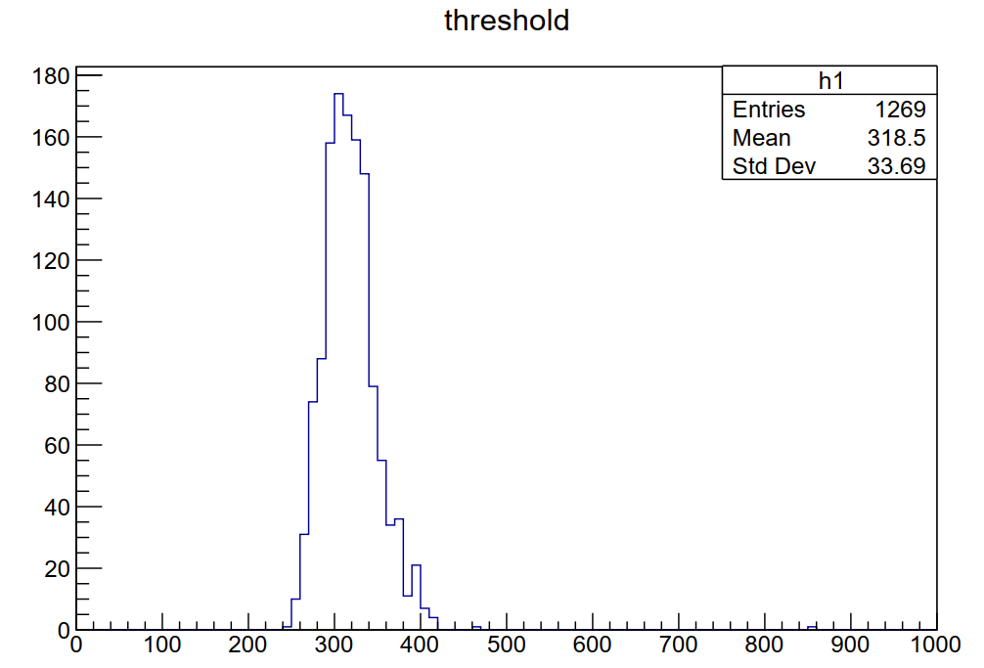
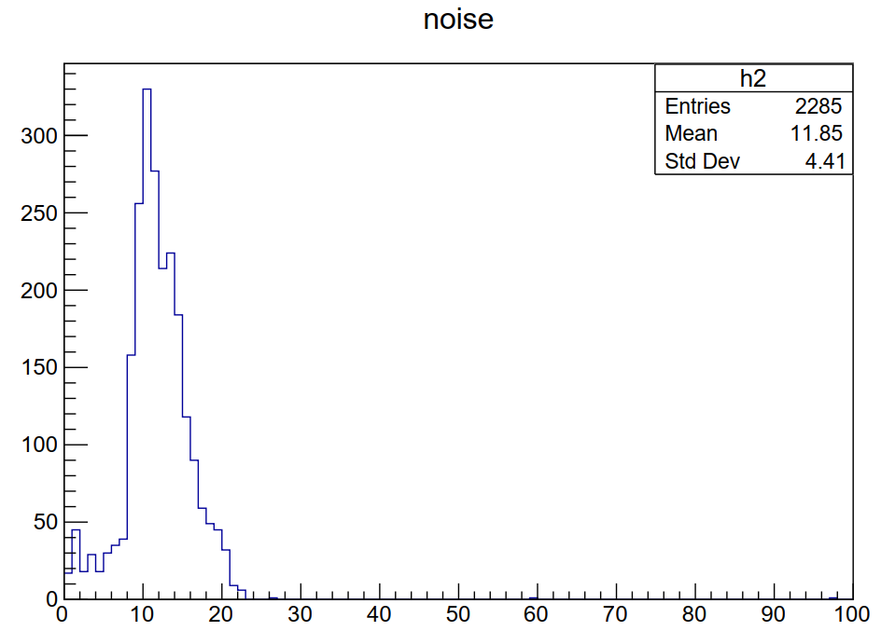
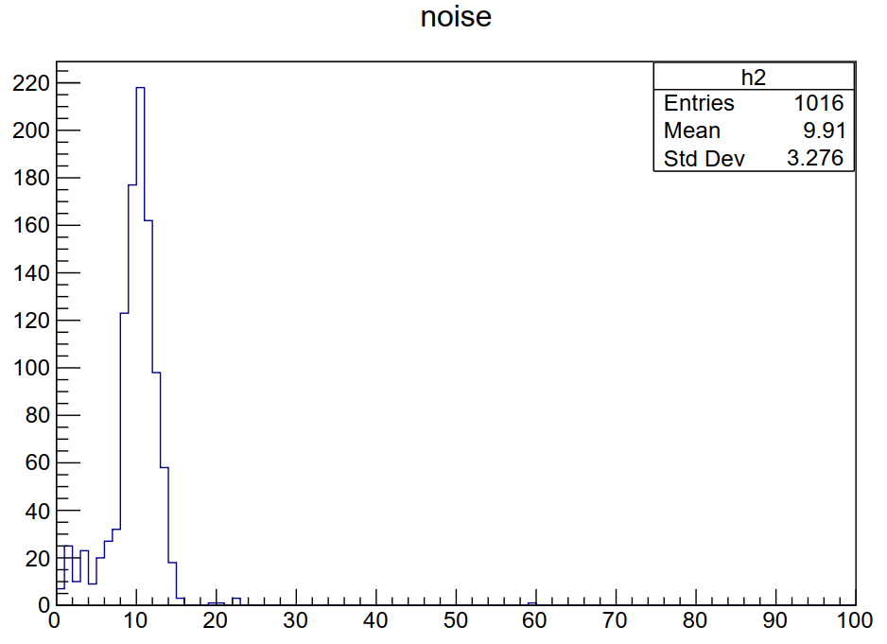
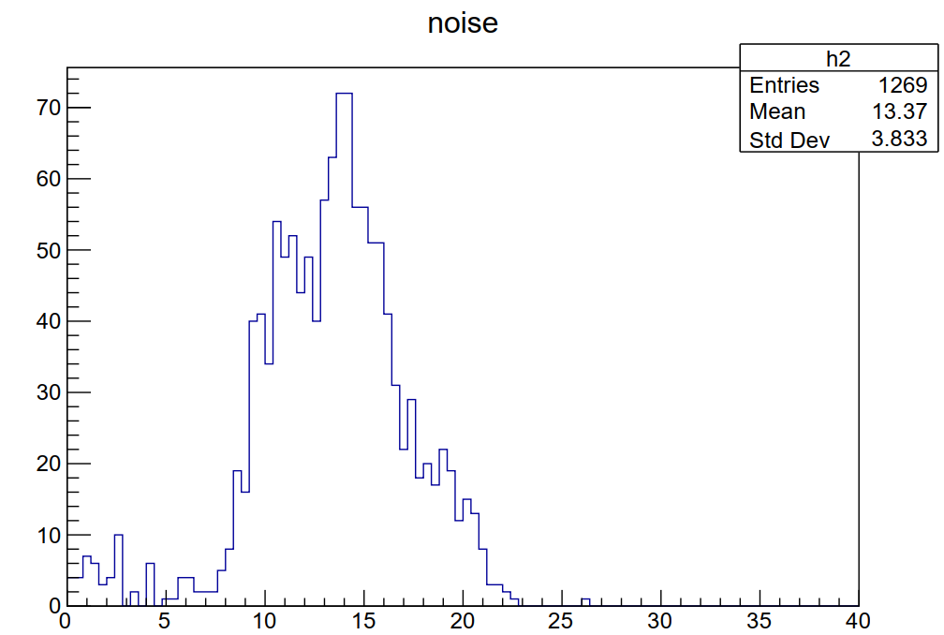
Sector2
Sector1
Sector1+Sector2
DBCOL24~31
DBCOL0~7
+
DBCOL15/23
Measure several columns by hand and analyze the distribution.
With the same fitting parameters, results looks fine but not so perfect. Some curves will be failed to the fitting function.
There are 4 different analog pixels design, the performance of Sector2 seems better.
Sector1
Sector2
Sector1+Sector2
DBCOL0~7
DBCOL15/23
DBCOL24~31

Slide 3
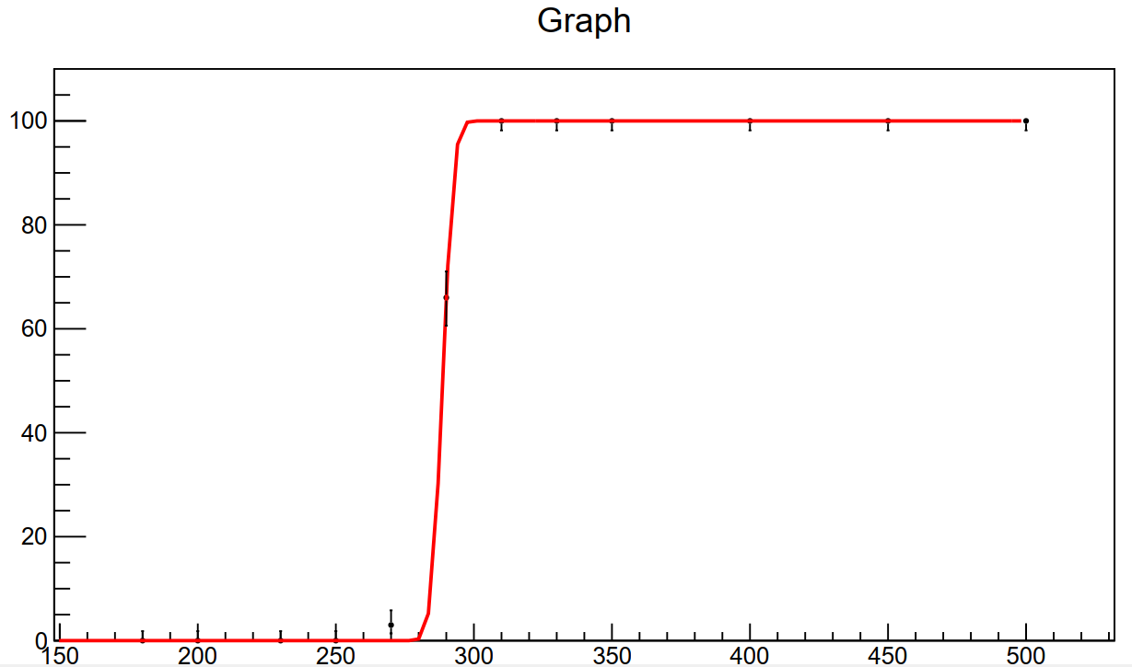
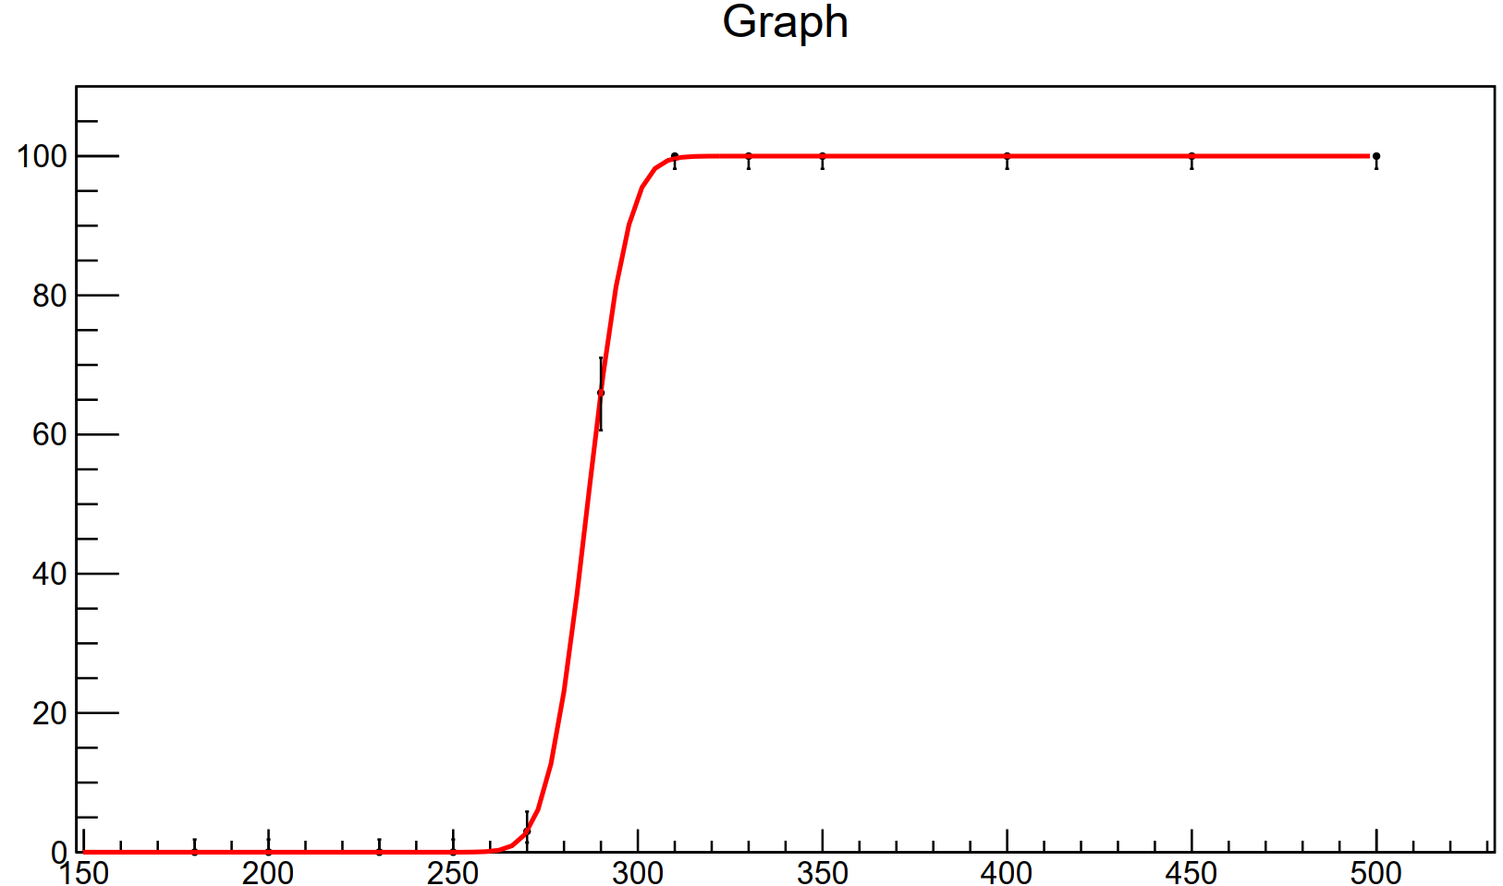
μ= 288.69 mV
sigma= 3.18mV
μ= 286.38mV
sigma= 8.68 mV
DBCOL7-R28
DBCOL7-R28
Fitting Failure
Fitting Success
Fitting parameter：
μ= 310 mV
sigma= 9mV
Fitting parameter：
μ= 295 mV
sigma= 9mV

Slide 4
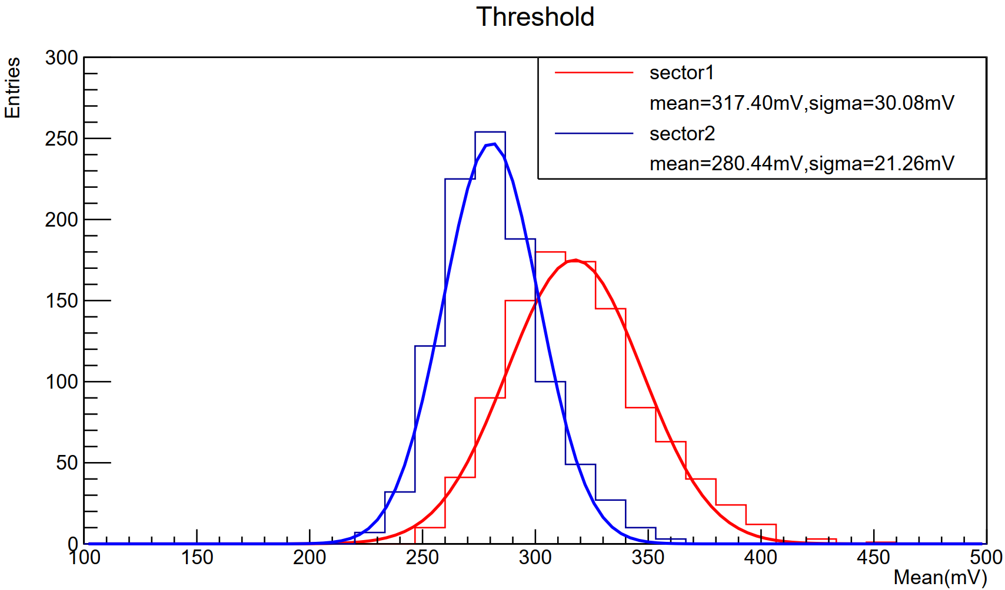
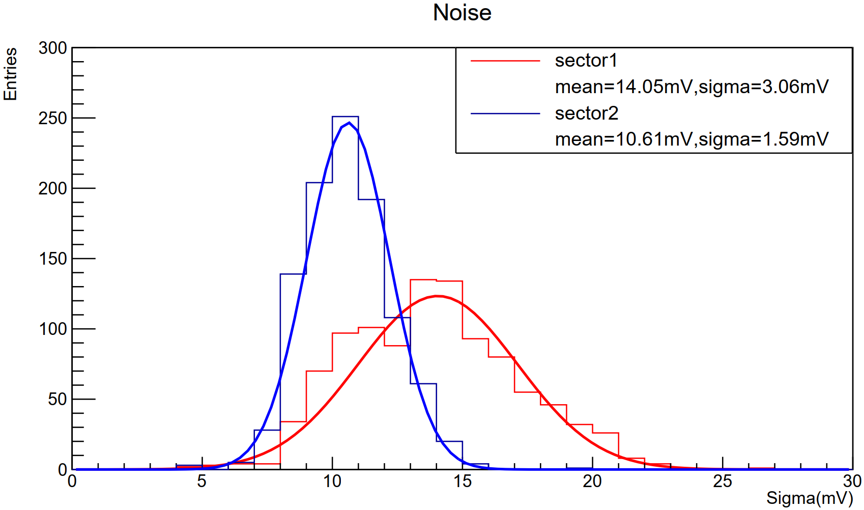
Fig.1 Threshold
distribution
Sector1：DBCOL0~7
Sector2：
DBCOL24~31
Use two kinds of the fitting parameter, the histogram seems better.
Fig.2 noise
distribution
Fig.1 shows the threshold distribution, the FPN for sector1 is ~35e- and ~24.15e- for sector2 .
Fig.2 depicts the noise distribution, the TN noise for sector1 is 15.96e- and 12e- for sector2.
Sector1：DBCOL0~7
Sector2：
DBCOL24~31

