Slide 1
Beam beam simulations with High luminosity parameters (tt, H, W, and Z)
Zhang, Yuan
Feb. 25, 2021
CEPC Working Day

Slide 2
Introduction
2021-HK-IAS version parameter (2021, by Dou Wang)
Updated by Yiwei Wang referencing to real lattice
IBB (by Yuan Zhang) is used

Slide 3
Try to answer: if the machine parameter is reasonable
Limit of bunch population by beam-beam interaction
Beamstrahlung lifetime
If X-Z instability is suppressed
If asymmetric bunch current collision is stable (not considered here)
If there exist large enough stable working point space
If beam-beam parameter is safe enough
Notes:
We do not focus on the optimization of the machine parameter

Slide 4
ttbar
Very strong SR damping (longitudinal damping time: 20 turns)
Instability may be suppressed?
Medium Piwinski Angle ~ 1, BEPCII/KEKB: 0.5， CEPC-Z: 8
Beam-beam resonance could not be suppressed well by Crab-Waist
Horizontal beam-beam parameter： 0.07, still very large
It is totally different from H/W/Z

Slide 5
ttbar: smooth synchrotron oscillation of arc
CW=0
$ν_{s}=0.0388$, half-ring
Design Lum=0.5e34

Slide 6
ttbar: local RF cavity in arc
CW=0
CW=0

Slide 7
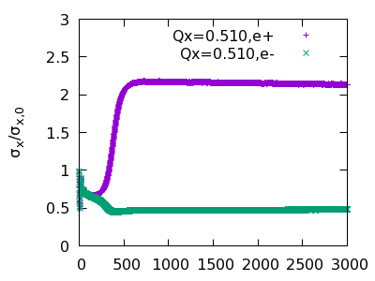
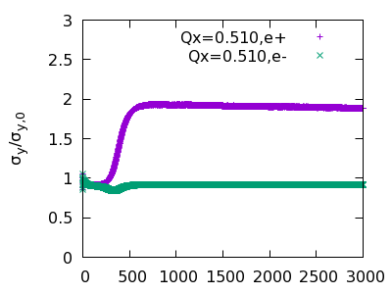
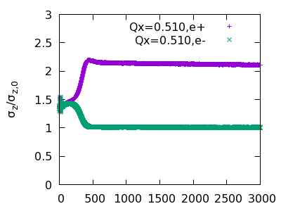
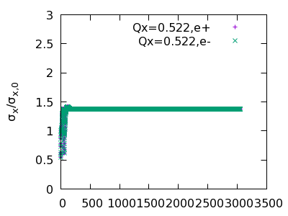
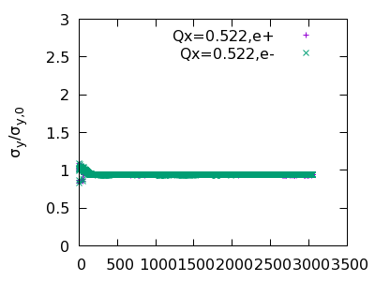
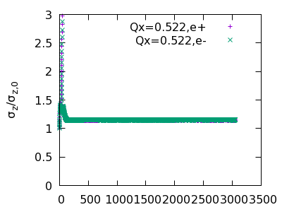
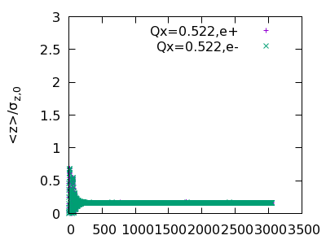
ttbar: local RF cavity in arc
CW=0
$$σ_{x}$$
$$σ_{y}$$
$$σ_{z}$$
<z>
Qx=0.510
Qx=0.522

Slide 8
ttbar: local RF cavity in arc, CW=0.4

Slide 9
ttbar: local RF cavity in arc, CW=0.4,
with Longitudinal Impedance
Stable working point: 0.562-0.570

Slide 10
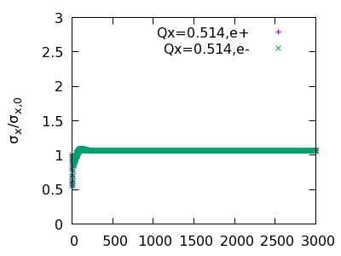
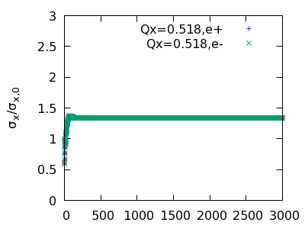
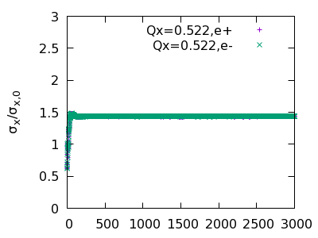
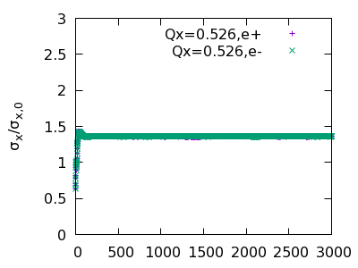
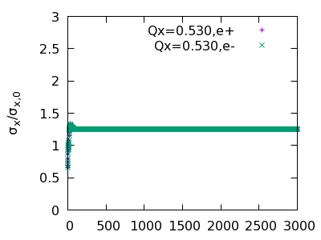
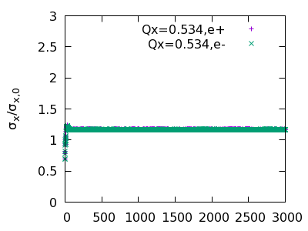
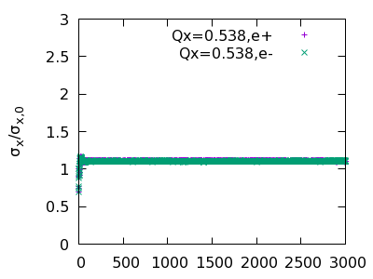
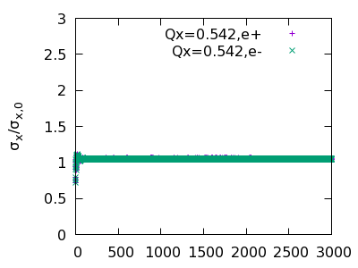
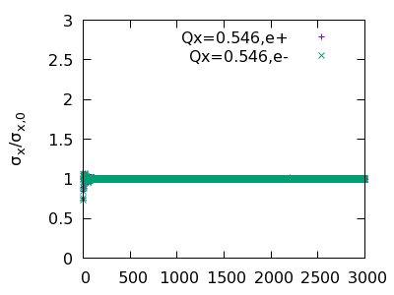
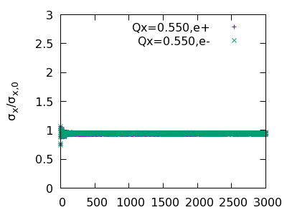
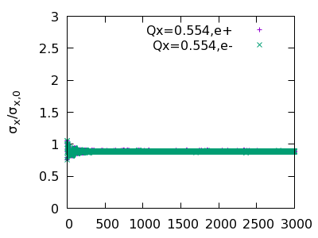
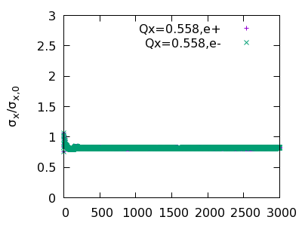
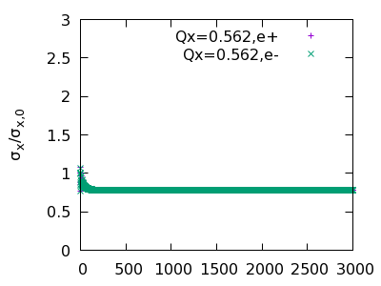
Ttbar: crab waist strength =0.4, cav, rmsx+ZL

Slide 11
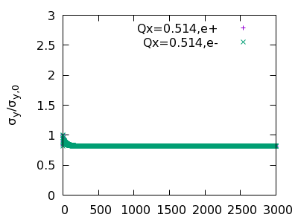
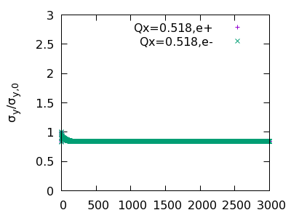
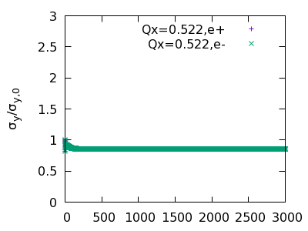
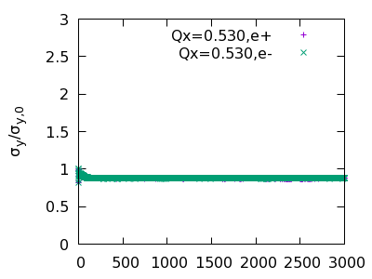
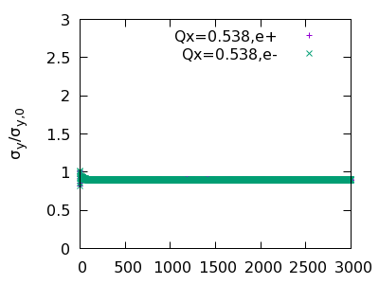
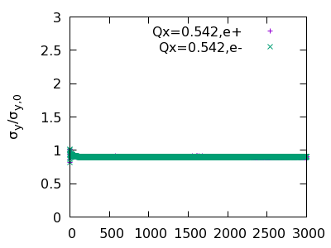
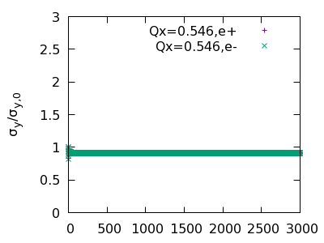
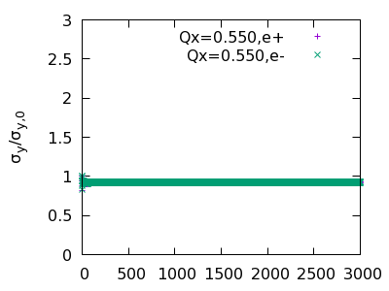
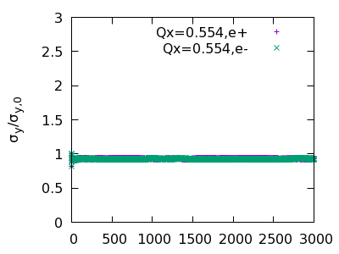
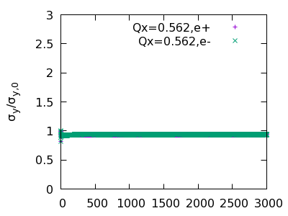
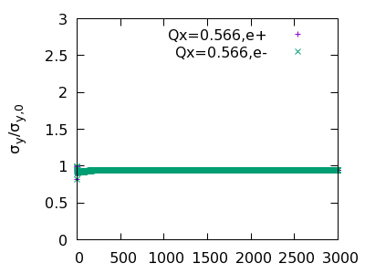
Ttbar: crab waist strength =0.4, cav, rmsy+ZL

Slide 12
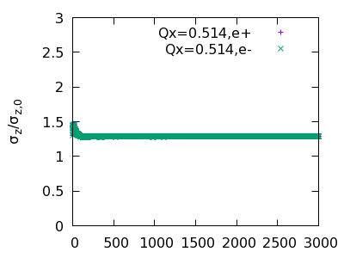
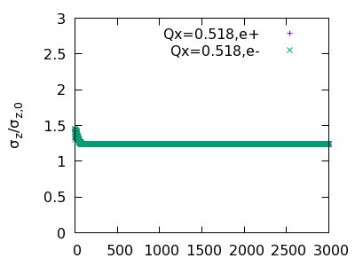
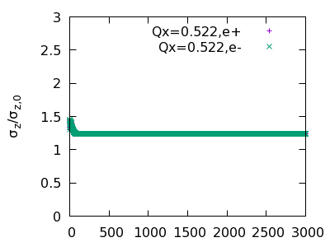
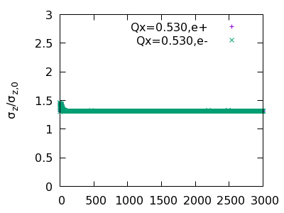
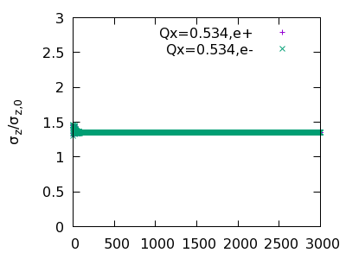
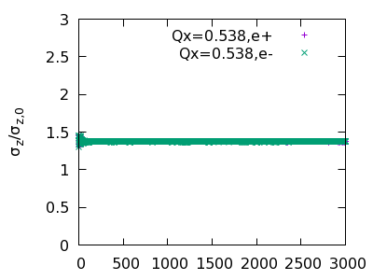
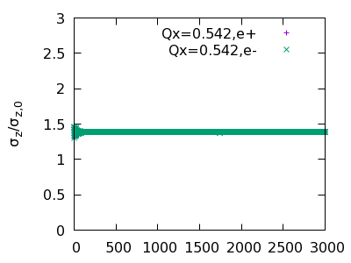
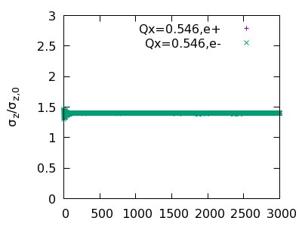
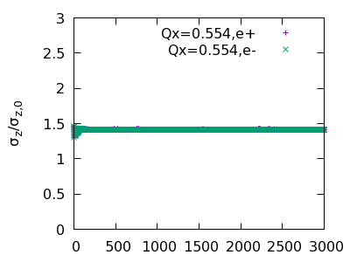
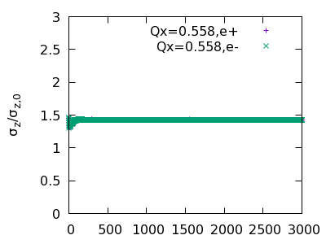
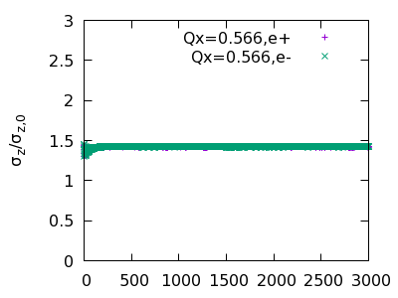
Ttbar: crab waist strength =0.4, cav, rmsz+ZL

Slide 13
Ttbar: Crab Waist strength

Slide 14
ttbar: Beamstrahlung Lifetime (Qx=0.564), cw=0.4

Slide 15
ttbar: Beam energy distribution
One turn data
Max: 0.0153
Min: -0.0202
FCC:

Slide 16
Higgs: w/o ZL (betax*=0.39 m), CW=0.8

Slide 17
Higgs, w/ ZL (bx=0.39 m)

Slide 18
Higgs, w/o ZL (betax*=0.33 m)

Slide 19
Higgs, w/ ZL (betax*=0.33 m)

Slide 20
Higgs, w/ ZL (betax*=0.33 m)， Ne=15e10, 216->232 bunches

Slide 21
Higgs, w/ ZL (bx=0.33 m)， Ne=14e10, 216->248 bunches

Slide 22
Higgs: Beamstrahlung Lifetime

Slide 23
Higgs: Crab waist strength
Previous Higgs results are all obtained with CW=0.8

Slide 24
W: HK-IAS version, w/o ZL

Slide 25
W: HK version, w/ ZL

Slide 26
Comment on W and recent advances
Following the work for Z mode, W lattice should also be changed from ${90}^{O}$ cell to ${60}^{O}$. (2020-July, CEPC Day)
Dou and Yiwei has updated machine parameters
Simulation work not finished yet

Slide 27
Z(CW=1), w/o ZL

Slide 28
Z(CW=1), w/ ZL
考虑共振 qx+2*qy=N, qx~0.558， not 0.572

Slide 29
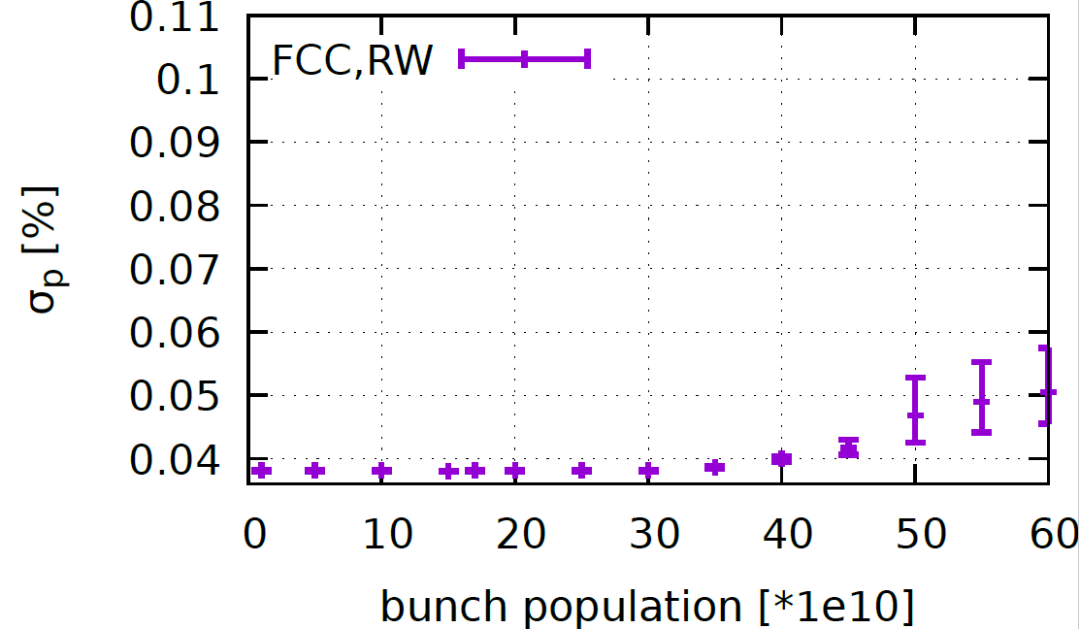
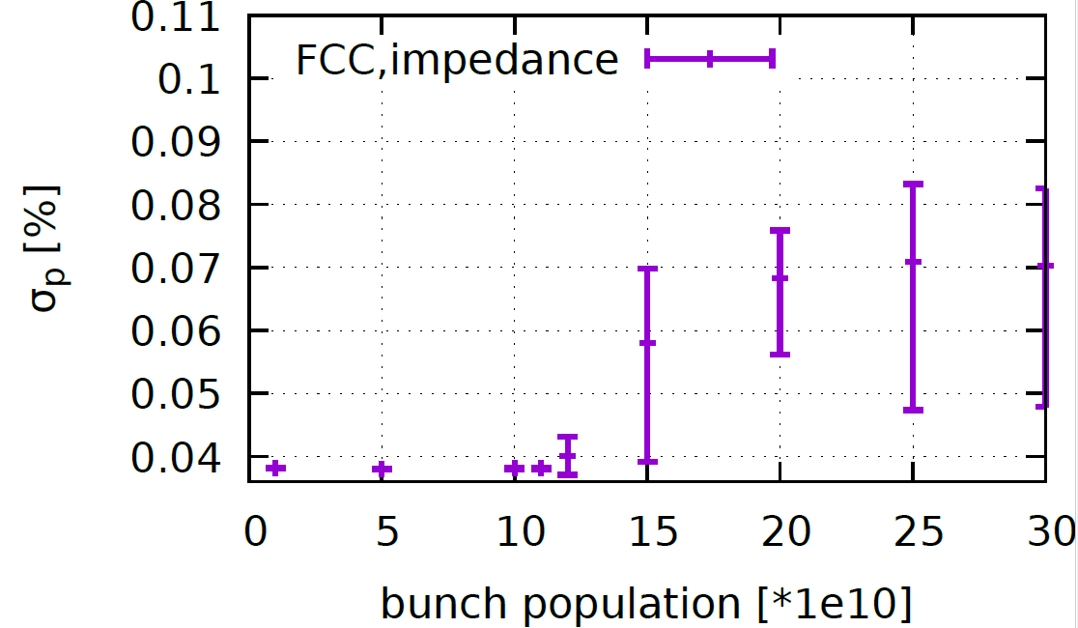
More on FCC
Courtesy of Mauro Migliorati for Impedance data
FCC impedance is being updated
FCC-Z, Collision off

Slide 30
More on FCC-Z, RW impedance

Slide 31
More on FCC-z, new impedance data

Slide 32
Summary
Ttbar:
even with strong SR damping, 3D flip-flop appear easily without CW and longitudinal impedance
With momentum acceptance 0.023, beamstrahlung lifetime is only 23min
Real lattice design should consider asymmetric energy distribution (K. Oide)
Higgs:
HK-IAS version of betax*=0.33m is preferred
Ne=14e10 is preferred considering beamstrahlung lifetime
W has been updated and need check
Z is OK.
All stable working point is near 0.560
More check should be done, including code itself (especially ttbar)

Slide 33
Backup

Slide 34
Parameters presented at IAS2021, by D. Wang
 | tt | Higgs | W | Z
Number of IPs | 2 | 2 | 2 | 2
Energy (GeV) | 180 | 120 | 80 | 45.5
Circumference (km) | 100 | 100 | 100 | 100
SR loss/turn (GeV) | 8.53 | 1.73 | 0.33 | 0.036
Half crossing angle (mrad) | 16.5 | 16.5 | 16.5 | 16.5
Piwinski angle | 1.16 | 4.87 | 9.12 | 24.9
N_{e}/bunch (10¹⁰) | 20.1 | 16.3 | 11.6 | 15.2
Bunch number (bunch spacing) | 37 (4.45μs) | 214 (0.7us) | 1588 (0.2μs) | 3816 (86ns) | 11498 (26ns)
Beam current (mA) | 3.5 | 16.8 | 88.5 | 278.8 | 839.9
SR power /beam (MW) | 30 | 30 | 30 | 10 | 30
Bending radius (km) | 10.7 | 10.7 | 10.7 | 10.7
Phase advance of arc cell | 90°/90° | 90°/90° | 90°/90° | 60°/60°
Momentum compaction (10⁻⁵) | 0.73 | 0.73 | 0.73 | 1.48
β_{IP} x/y (m) | 1.0/0.0027 | 0.33/0.001 | 0.33/0.001 | 0.15/0.001
Emittance x/y (nm) | 1.45/0.0047 | 0.68/0.0014 | 0.28/0.00084 | 0.27/0.00135
Transverse σ_{IP} (um) | 37.9/0.11 | 15.0/0.037 | 9.6/0.029 | 6.36/0.037
ξ_{x}/ξ_{y}/IP | 0.076/0.106 | 0.018/0.115 | 0.014/0.13 | 0.0046/0.131
V_{RF} (GV) | 9.52 | 2.27 | 0.47 | 0.1
f _{RF} (MHz) (harmonic) | 650 (216816) | 650 (216816) | 650 (216816) | 650 (216816)
Nature bunch length σ_{z} (mm) | 2.23 | 2.25 | 2.4 | 2.75
Bunch length σ_{z} (mm) | 2.66 | 4.42 | 5.3 | 9.6
HOM power/cavity (kw) | 0.45 (5cell) | 0.48 (2cell) | 0.79 (2cell) | 2.0 (2cell) | 3.02 (1cell)
Energy spread (%) | 0.17 | 0.19 | 0.11 | 0.12
Energy acceptance requirement (DA) (%) | 2.0 | 1.7 | 1.2 | 1.3
Energy acceptance by RF (%) | 2.61 | 2.5 | 1.83 | 1.48
Lifetime (hour) | 0.59 | 0.35 | 1.3 | 1.7 | 1.4
L_{max}/IP (10³⁴cm⁻²s⁻¹) | 0.5 | 5.0 | 18.7 | 35.0 | 105.5

Slide 35
Parameters 2021/2/21
by Yiwei Wang and Dou Wang
 | ttbar | Higgs | W | Z
Number of IPs | 2
Circumference [km] | 100.0
SR power per beam [MW] | 30
Half crossing angle at IP [mrad] | 16.5
Bending radius [km] | 10.7
Energy [GeV] | 180 | 120 | 80 | 45.5
Energy loss per turn [GeV] | 9.1 | 1.8 | 0.357 | 0.037
Piwinski angle | 1.21 | 4.58 | 6.08 | 24.68
Bunch number | 35 | 216 | 1297 | 11951
Bunch population [10^10] | 20 | 16.1 | 13.5 | 14
Beam current [mA] | 3.3 | 16.7 | 84.1 | 803.5
Momentum compaction [10^-5] | 0.71 | 0.71 | 1.43 | 1.43
Beta functions at IP (bx/by) [m/mm] | 1.043/2.7 | .388/1 | .208/1 | .125/.9
Emittance (ex/ey) [nm/pm] | 1.444/4.693 | .643/1.286 | .865/1.73 | .27/1.348
Beam size at IP (sigx/sigy) [um/nm] | 38.815/112.56 | 15.795/35.855 | 13.417/41.594 | 5.805/34.833
Bunch length (SR/total) [mm] | 2.198/2.857 | 2.193/4.387 | 2.47/4.94 | 2.481/8.683
Energy spread (SR/total) [%] | .152/.197 | .101/.202 | .067/.135 | .038/.134
Energy acceptance (DA/RF) [%] | 2/2.6 | 1.7/2.5 | 1.2/2.5 | 1.3/1.7
Beam-beam parameters (ksix/ksiy) | .071/.1 | .022/.116 | .012/.113 | .004/.127
RF voltage [GV] | 10.12 | 2.23 | 0.714 | 0.119
RF frequency [MHz] | 650 | 650 | 650 | 650
HOM power per cavity (5/2/1cell)[kw] | .4/.2/.1 | 1.2/.5/.2 | -/1.8/.9 | -/-/5.8
Beam lifetime (bb/bs)[min] | 80.9/103.9 | 38.5/45.8 | 59.7/716.5 | 79.8/182202
Beam lifetime [min] | 45 | 21 | 55 | 80
Hour glass Factor | 0.89 | 0.87 | 0.9 | 0.97
Luminosity per IP[1e34/cm^2/s] | 0.5 | 5 | 16.1 | 115

Slide 36
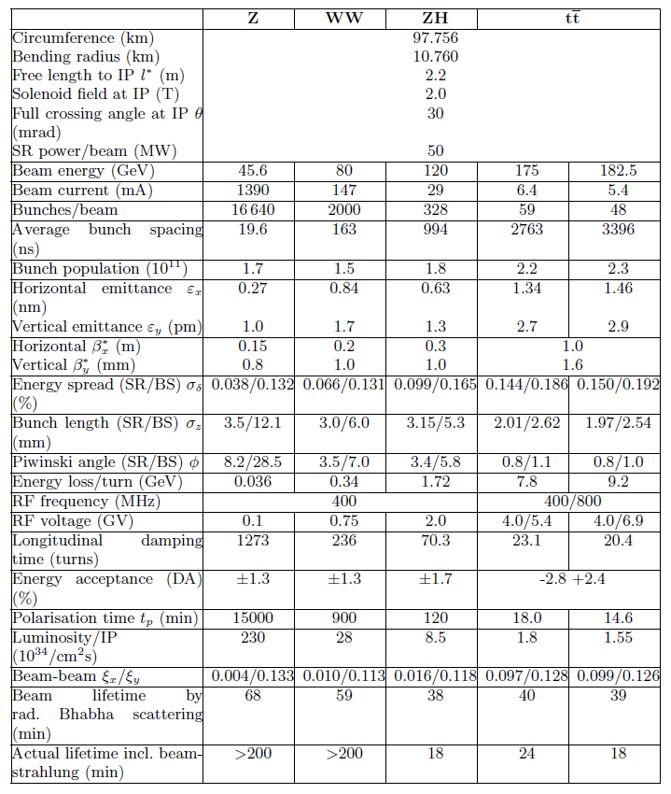
FCC-ee CDR

