Slide 1
CEPC MDI SC Quadrupole designs option comparisons, recommendation and plan
Yingshun Zhu, Chuang Shen
Institute of High Energy Physics, Chinese Academy of Sciences
Feb. 25, 2021
CEPC working day

Slide 2
Outline
Introduction
CEPC SC Quadrupole designs option comparisons and recommendation
R&D paths and actual status
Summary

Slide 3
Introduction
Last month, many discussions on the design of CEPC Q1a magnet with Professors. (J. Gao. Y. Li, Q. Xu, W. kang)
Focused on reducing the magnet weight of Q1a.
Paths:
1 Relax the dipole field requirement of crosstalk (<30Gs)
2 Use special iron material (FeCoV)
using 1+2, Weight: 78.9Kg (55% of original value 143.6kg)
3 Reduce coil layer to 1
using 1+2+3, Weight: 60.2Kg (42% of original value)

Slide 4
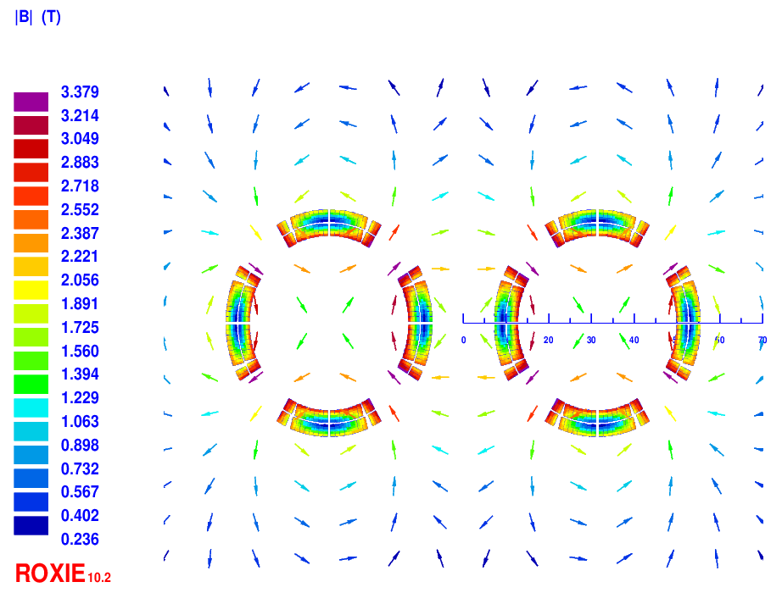
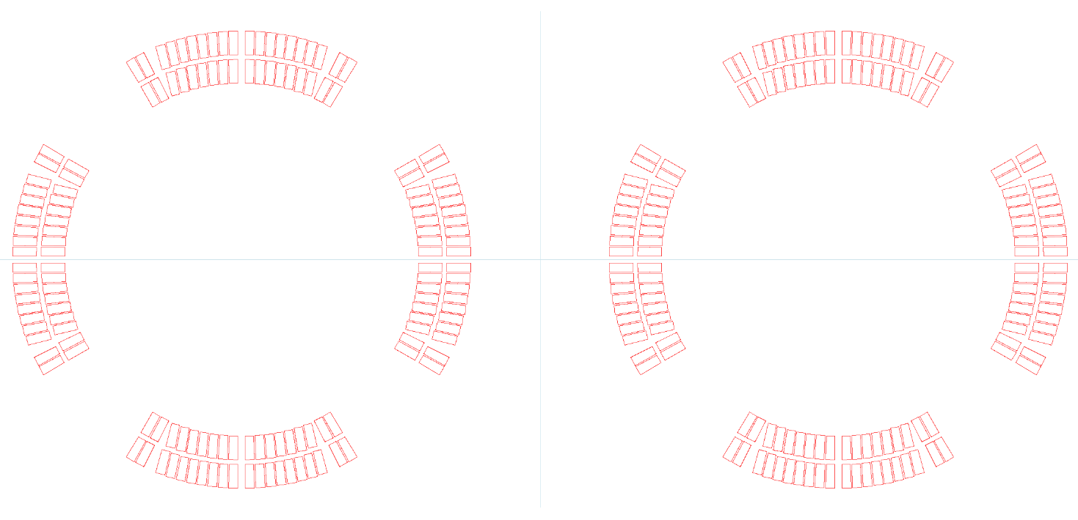
CEPC SC Quadrupole designs option comparisons and recommendation
Option 1: iron-free magnet
HTS Bi-2212 0.5mm wire or other conductor. Q1a: two layers cos2θ quadrupole coil. (highest magnetic efficiency and cooling capacity, good stability)
Inner diameter 37mm, 141T/m.
Smallest weight (36kg)
Problem:
Excitation current increases by 20% (compared to iron option);
Can not meet the requirements of dipole field and field harmonics.
(using anti-symmetric coil, add corrector coil, etc. )

Slide 5
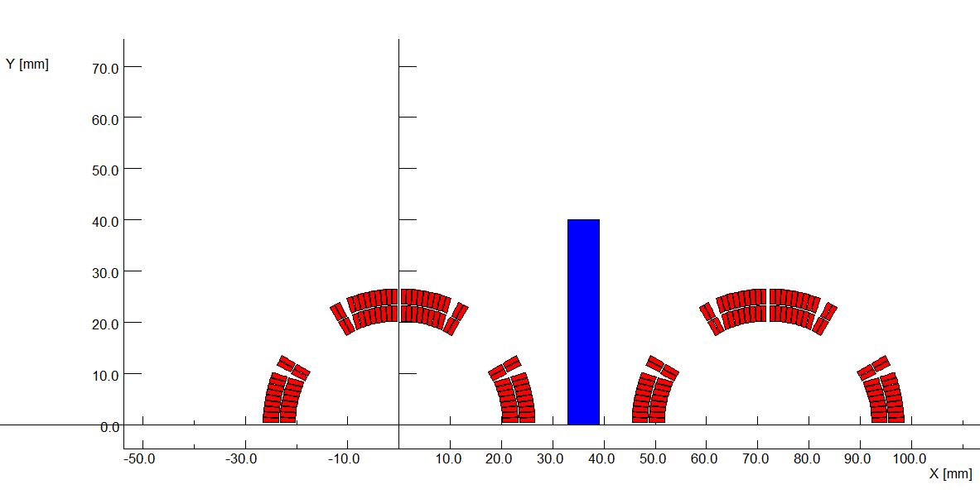
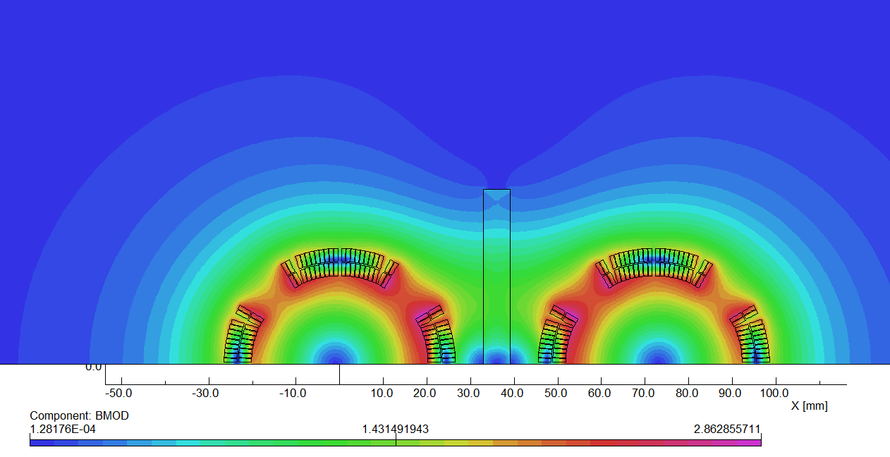
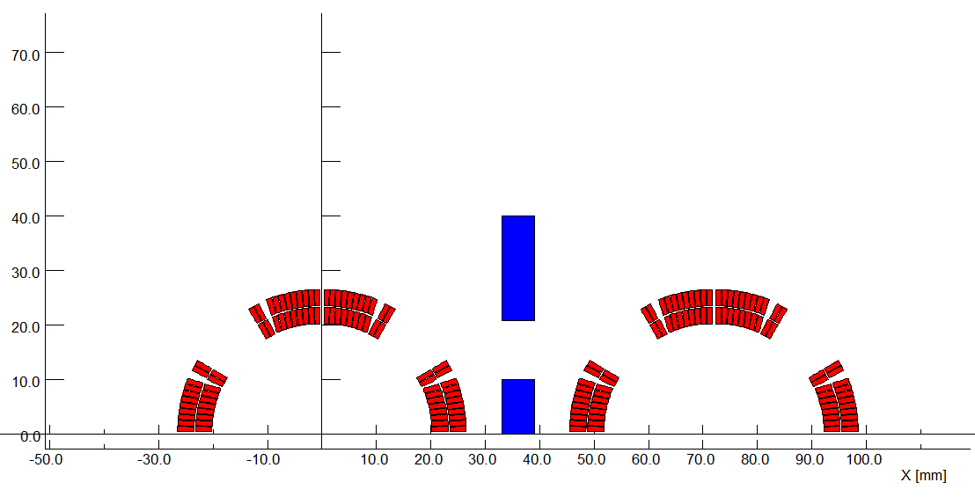
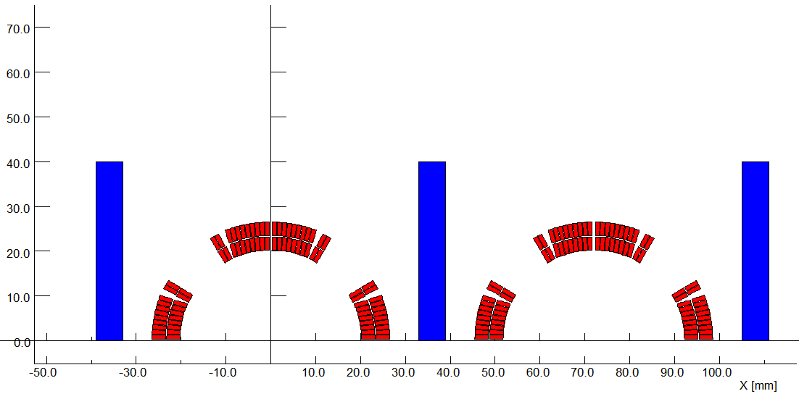
Option 1: iron-free magnet
Place iron in the middle of the two apertures: also can not meet the field requirements. Dipole field at aperture center: around 1000 Gs.

Slide 6
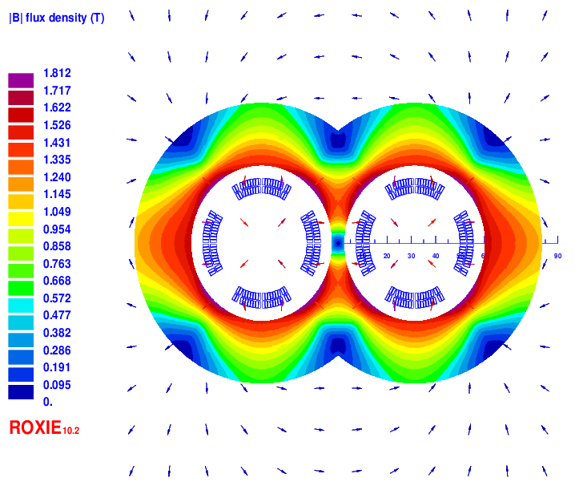
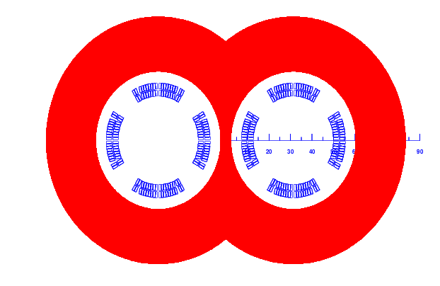
Option 2: Add iron DT4
Option 2: Add iron DT4.
Field gradient: 141T/m.
Field cross talk between two apertures can be negligible with more iron.
19 turns in each pole, excitation current 1970A.

Slide 7
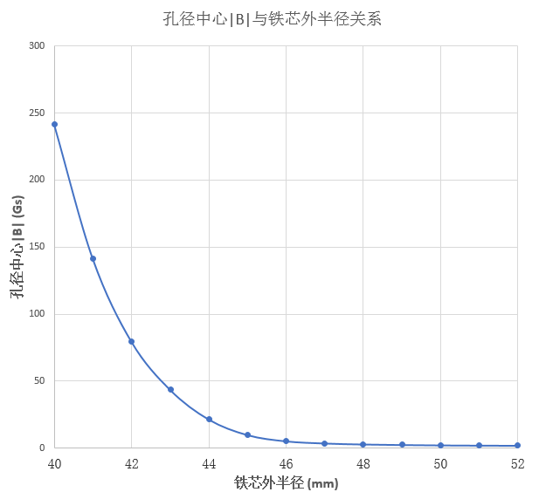
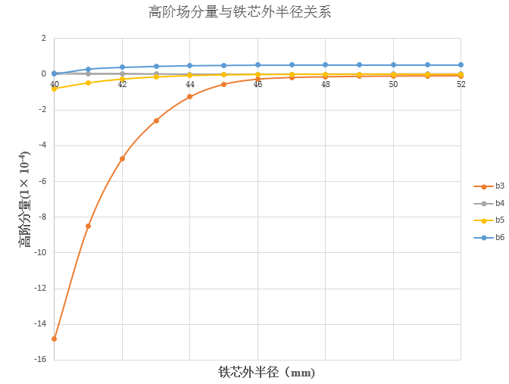
Iron yoke: DT4
Dipole <30Gs, radius of the iron: 44mm, weight 96.9kg. (67% of r=52mm)

Slide 8
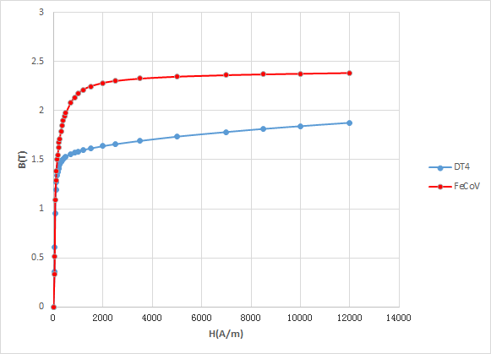
Option 3: Iron yoke FeCoV
Option 3: Add iron FeCoV
The saturation magnetic induction of FeCoV is about 2.35T (highest in all materials), and the magnetic shielding effect is better.
Compared with DT4, the thickness of the iron core can be further reduced.
BH curve of DT4 and FeCoV

Slide 9
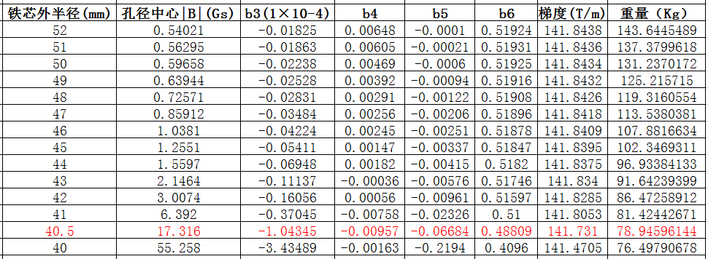
Iron yoke: FeCoV
Iron yoke material: FeCoV
Dipole field <30Gs, radius of the iron: 40.5mm.
Weight: 78.9Kg (55% of r=52mm)

Slide 10
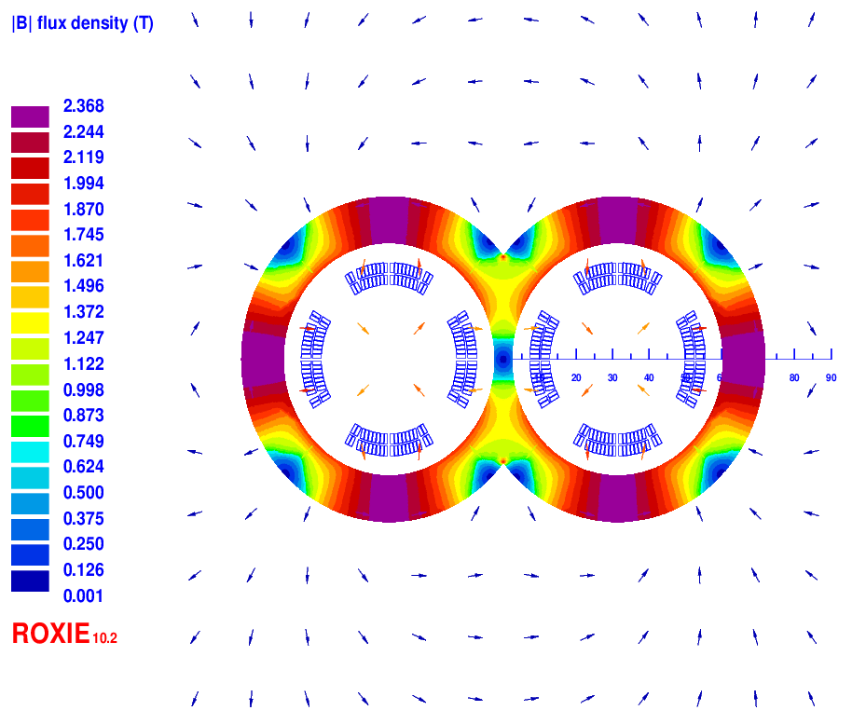
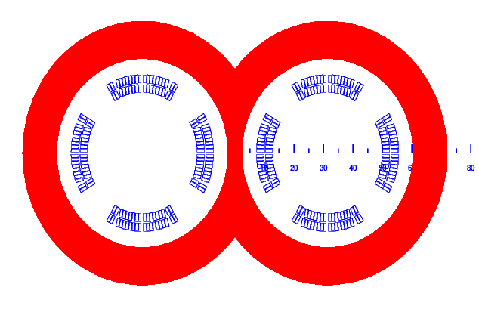
Iron yoke: FeCoV
Iron yoke material: FeCoV; radius of the iron: 40.5mm

Slide 11
Comparison of DT4 and FeCoV yoke
DT4, iron: 52mm.
FeCoV, iron: 40.5mm.

Slide 12
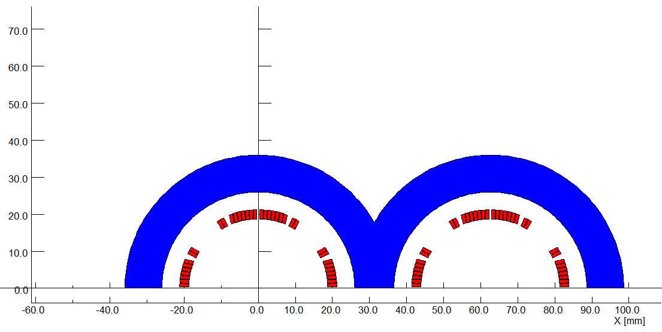
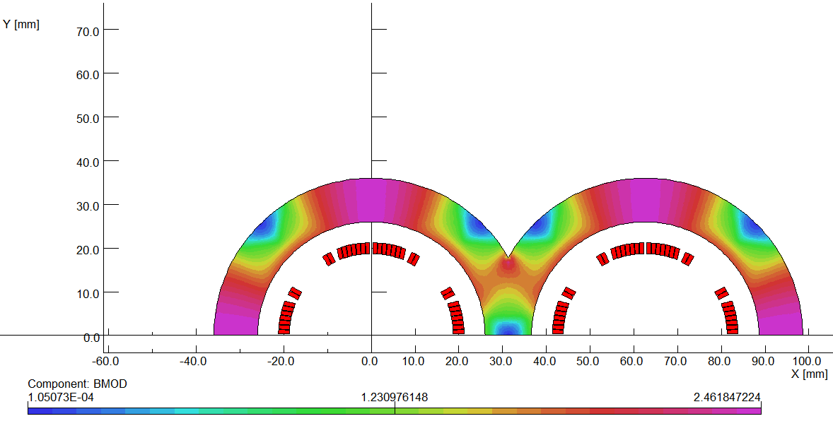
Option 4: one layer coil
Option 4: one layer coil
Iron yoke material: FeCoV; one layer coil. HTS round 0.5mm Bi-2212.
<30Gs Dipole field, radius of the iron: 36.5mm.
Weight: 60.2Kg (42% of r=52mm)
9 turns in each pole, excitation current 3585A.
Large current carrying capacity of conductor is required; working current doubled, the cryogenic system and power supply will be affected.
After five years, the current carrying performance of Bi-2212 may meet the requirement.

Slide 13
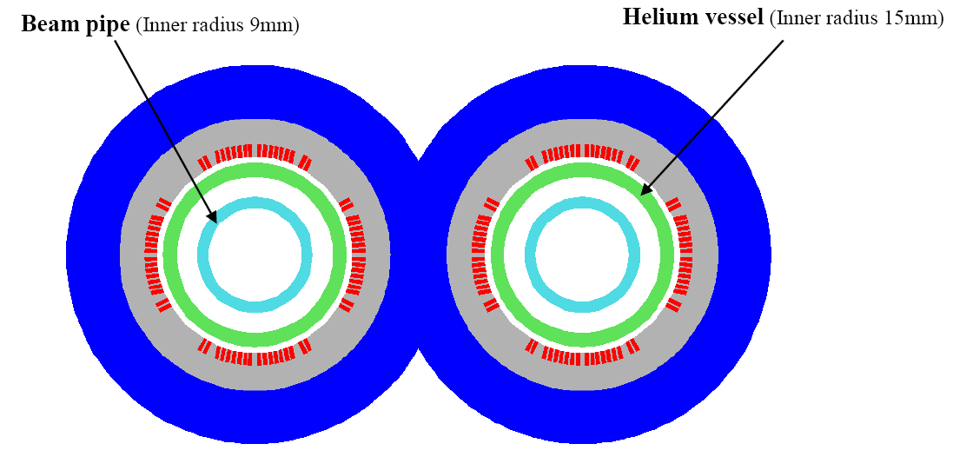
Option 4: one layer coil
One layer coil Layout
Iron yoke material: FeCoV.

Slide 14
Design options comparisons and recommendation
HTS Bi-2212 0.5mm wire or other conductor; Field gradient 141T/m.
Recommendation
Option 3 as baseline design, Option 4 as alternative design.
 | Main features | Performance | Weight (kg) | Remark
Option 1 | 2 layers coil, iron-free | Large dipole field, 20% larger current | 36 | Smallest weight, field crosstalk not solved
Option 2 | 2 layers coil, DT4 iron | Meet all requirements (Dipole <30Gs) | 96.9 | Largest weight
Option 3 | 2 layers coil, FeCoV iron | Meet all requirements (Dipole <30Gs) | 78.9 | Manufacture cost increases slightly
Option 4 | 1 layer coil, FeCoV iron | Meet all requirements (Dipole <30Gs) | 60.2 | Double current carrying capacity, 5 years later

Slide 15
R&D paths and actual status
Superconducting quadrupole is key device of CEPC MDI SC magnets.
So far, there is almost no SC quadrupole magnet developed in China.
R&D paths proposed (LTS, HTS)
1) 0.5m single aperture SC quadrupole model
2) 0.5m double aperture SC quadrupole magnet
3) 1.2m double aperture SC quadrupole magnet
Comparison of LTS and HTS option (field around 3T):
 | Advantages | Disadvantages
LTS | Conductor and magnet production process relative mature | Poor heat load resistant
HTS | heat load resistant, Higher operating temperature, Large critical current in the future (light magnet weight) | HTS conductor not mature now, expensive, Poor mechanical properties, Large diameter of filament

Slide 16
R&D paths and actual status
Actual R&D status
Study and research on key technologies of SC quadrupole magnet in CEPC IR has started in 2020, in collaboration with HeFei KEYE Company.
Firstly, develop a 0.5m short single aperture SC quadrupole model
(LTS NbTi, 136T/m).
Most of the key technologies can be applied to HTS Magnet, such as design, magnet manufacturing, stress control, cryogenic test and field measurement.
Status
Mechanical design of 0.5m single aperture quadrupole model and coil winding machine has been finished.
Mechanical design of quadrupole coil heating and curing system is completed.
Manufacture has begun.

Slide 17
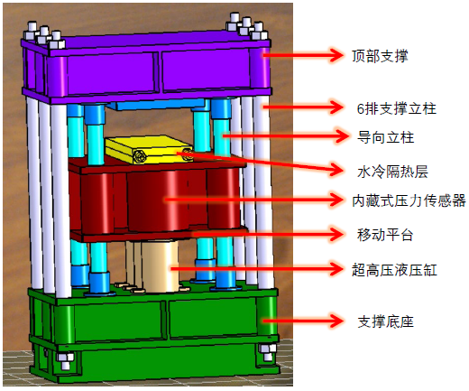
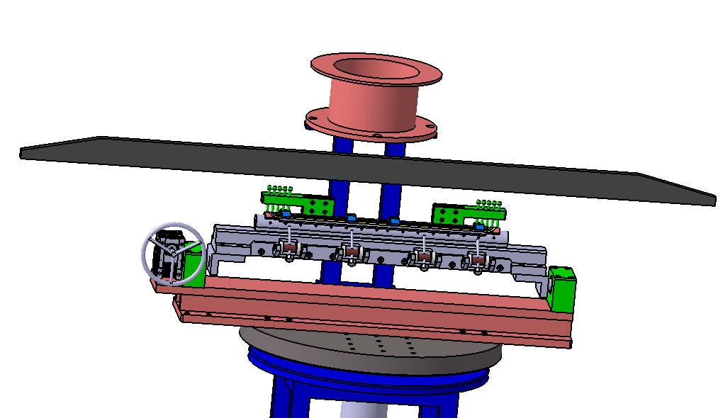
Actual status
Some design of 0.5m magnet and hardware device:

Slide 18
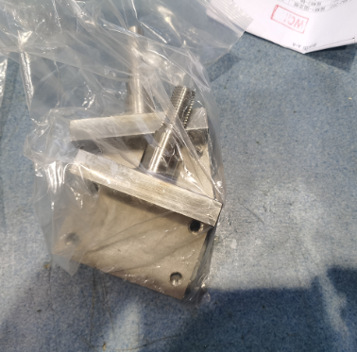
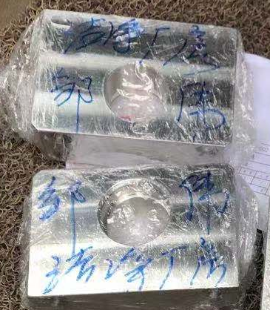
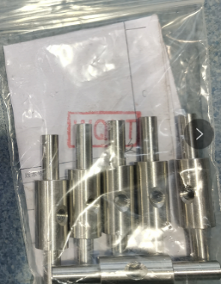
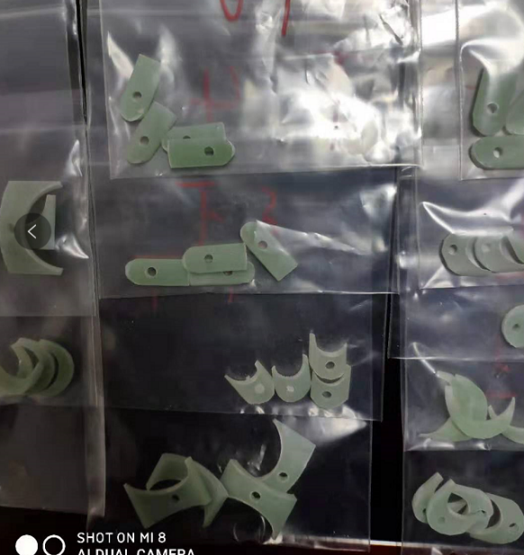
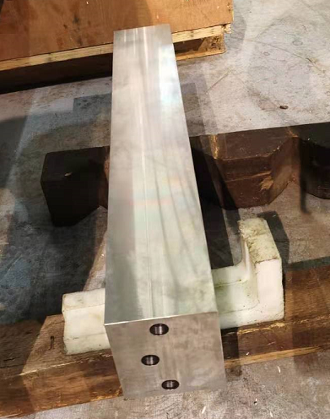
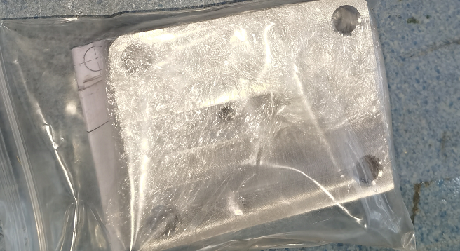
Actual status
Manufacture of 0.5m single aperture SC quadrupole model has begun:

Slide 19
Summary
Different design options of CEPC Q1a have been studied and compared.
Because of field cross-talk, the requirements of dipole and field harmonics in iron-free option can not be met. (continue to research)
With relaxed dipole field and use FeCoV yoke, the magnet weight can be significantly reduced (55% of origin).
Using one layer coil, magnet weight can be further reduced. (42% of origin)
Recommendation:
Baseline design: 2 layers coil, FeCoV yoke;
Alternative design: 1 layer coil, FeCoV yoke.
R&D path of CEPC MDI SC quadrupole is proposed.
Research on key technologies of 0.5m single aperture SC quadrupole model has started, in collaboration with HeFei KEYE Company. Study and accumulate experience for the next step magnet development.

Slide 20
Thanks for your attention!
CEPC Working day

