Slide 1
CEPC Z-pole polarization study status
Zhe Duan
On behalf of CEPC Polarization Working Group
CEPC Day, 2021. 02. 25

Slide 2
Outline
Motivation and wish list
Key questions and where we are
Summary

Slide 3
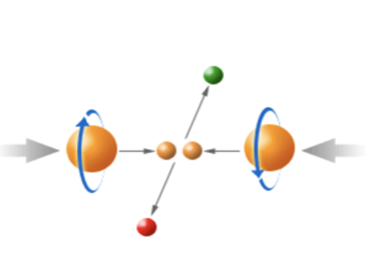
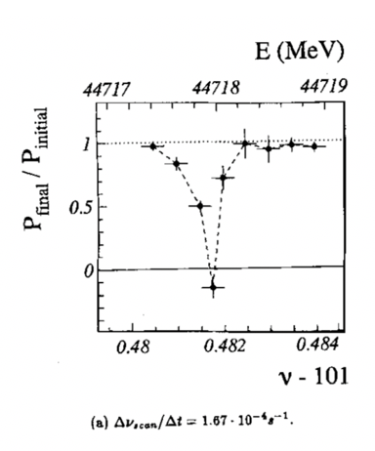
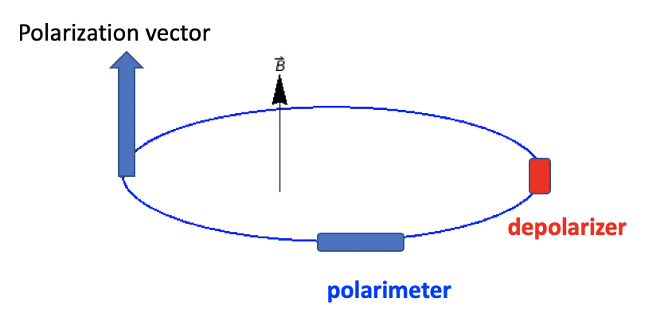
Motivation of CEPC Z-pole polarized beam program
Vertically polarized beams in the arc
Beam energy calibration via the resonant depolarization technique
Essential for precision measurements of Z and W properties
At least 5% ~ 10% vertical polarization, for both e+ and e- beams
Longitudinally polarized beams at IPs
Beneficial to colliding beam physics programs at Z, W and Higgs
Figure of merit: Luminosity * f( P_{e+}, P_{e-} )
~50% or more longitudinal polarization is desired, for one beam, or both beams
L. Arnaudon, et al., Z. Phys. C 66, 45-62 (1995).
Final deliverable: a detailed design report of polarized beam operation @ Z-pole

Slide 4
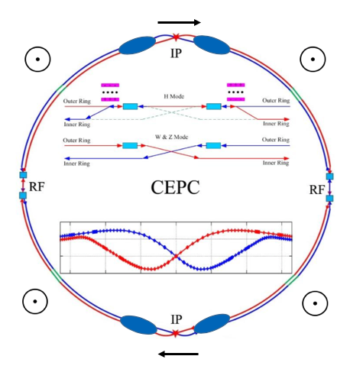
Wish list and key questions
Wish list
A small fraction of non-colliding bunches with at least 5% vertical polarization in the arc, depolarize one-by-one to carry out resonant depolarization
All colliding bunches have > 50% time-averaged longitudinal polarization at IPs
Luminosity is not significantly affected
Beam lifetime is sufficient long so that top-up injection is feasible
Spin rotators
Key questions
How to polarize the beams?
How to adjust the polarization direction?
How to reach a high luminosity, a high polarization and a reasonable beam lifetime?
depolarizer
polarimeter

Slide 5
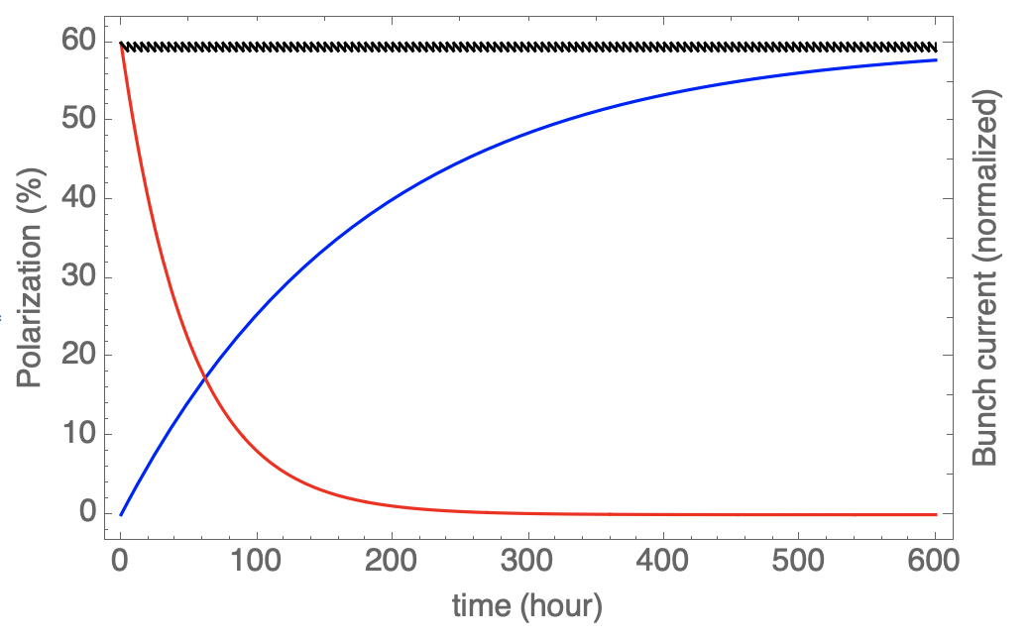
How to polarize the e+/e- beam?
Self-polarization: a schematic plot of polarization evolution at Z-pole
Colliding, top-uped bunch current
1
Polarization of non-colliding bunches
Non-colliding, decaying bunch current
0
Add simulation results

Slide 6
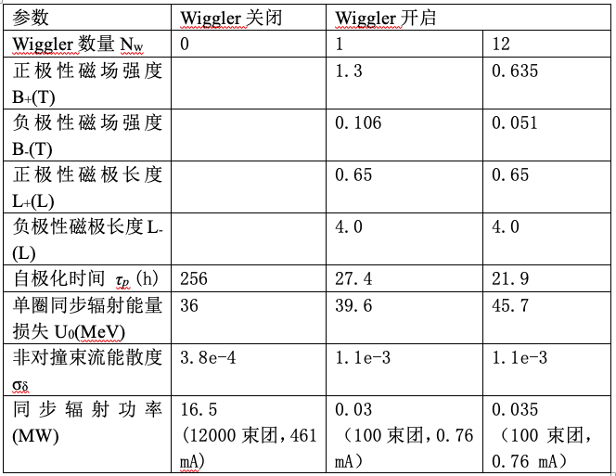
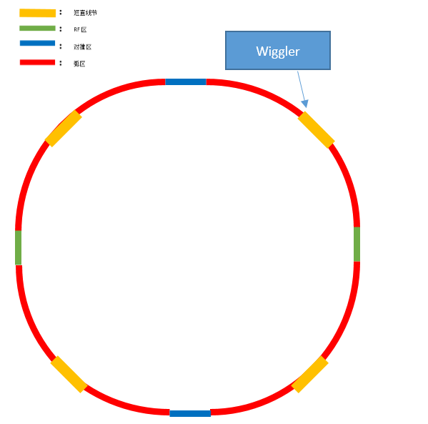
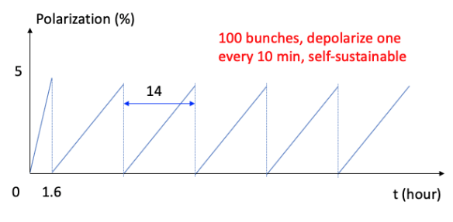
How to polarize the e+/e- beam?
Self-polarization: for resonant depolarization
Employ asymmetric wigglers to boost the polarization build-up, down to ~ 20 hr
These wigglers cost more power, increase energy spread
Therefore, they are turned-on initially only to set up polarization for ~100 non-colliding bunches and then turned-off, minimal influence on colliding bunches and luminosity

Slide 7
How to polarize the e+/e- beam?
Self-polarization vs injection of polarized beam: for colliding beam experiments
Top-up injection -> competition of polarization build-up & beam decay/inject
$$P_{avg}=P_{ens,DK}\frac{1}{{1+τ}_{DK}/τ_{b}}+P_{0}\frac{1}{{1+τ}_{b}/τ_{DK}}$$
$τ_{DK}$ > 100 hr >> $τ_{b}$= 2~3 hr
Using self-polarization -> decrease $τ_{DK}$ && increase $τ_{b}$ -> hurt polarization and luminosity
Inject polarized beam -> our choice
the realization condition of average beam polarization > 50% during colliding beam experiments
top-up injection
Injected beam polarization > 50% (simulations must reserve some margin)
Polarization time >> beam lifetime

Slide 8
How to polarize the e+/e- beam?
Injection of polarized beam, source?
Polarized e- source capable to provide 80%~90% polarization is quite matured
Polarized e+ sources suffer from low e+/e- conversion rate
A proposal of positron polarizing ring is under study
Polarized electron sources (Li Xiaoping)
Parameters of CEPC polarized electron source
Gun type | Photocathode DC Gun
Cathode material | Super-lattice GaAs/GaAsP
HV | 150-200kV
QE | 0.5%
Polarization | ≥85% (90%???)
Electrons/bunch | 2×10¹⁰
Repetition rate | 100Hz
Drive laser | 780nm (±20nm), 10μJ@1ns
Parameter | ILC(TDR) | CLIC(3TeV) | CEPC
Electrons/microbunch | 2×10¹⁰ | 0.6×10¹⁰ | >0.94×10¹⁰
Charge / microbunch | 3.2nC | 1nC | 1.5nC
Number of microbunches | 1312 | 312 | 1
Macropulse repetition rate | 5 | 50 | 100
Average current from gun | 21μA | 15μA | 0.15μA
Polarization | >80% | >80% | >80%

Slide 9
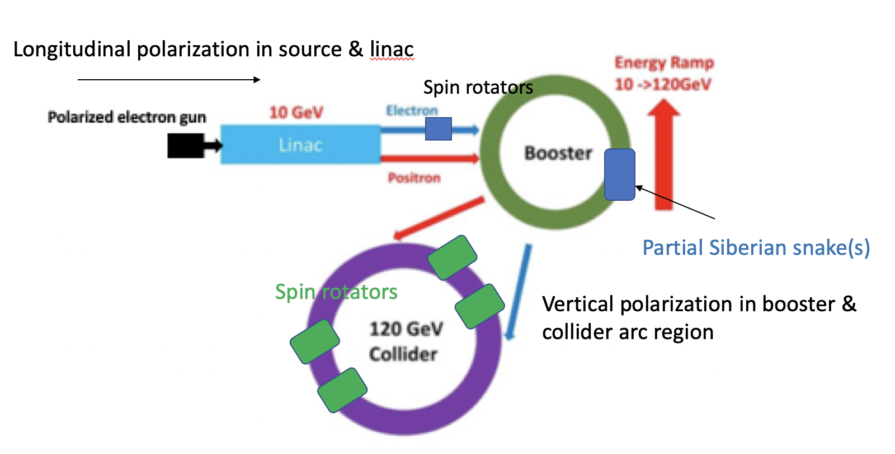
How to polarize the e+/e- beam?
Injection of polarized beam, transport and maintenance?

Slide 10
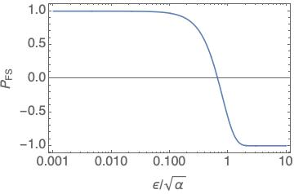
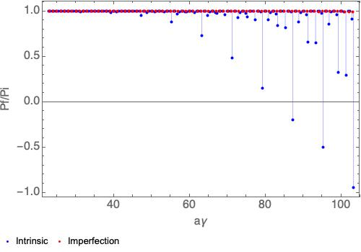
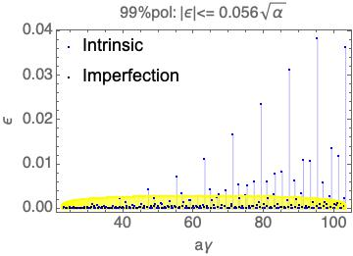
How to polarize the e+/e- beam?
Depolarization resonances in the booster
In a planar ring, the closed orbit spin tune $υ_{s}≈aγ$, two families of important spin resonances:
Imperfection resonance $aγ=K$ , K is integer
Intrinsic resonance $aγ=K±ν_{y}$ , K is integer
Adjacent imperfection and intrinsic resonances are well separated
$υ_{y}−\left[υ_{y}\right]=0.21≫max⁡(|ε|)$
Implementation of Siberian snake could be a viable solution

Slide 11
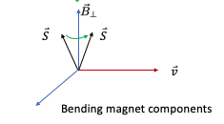
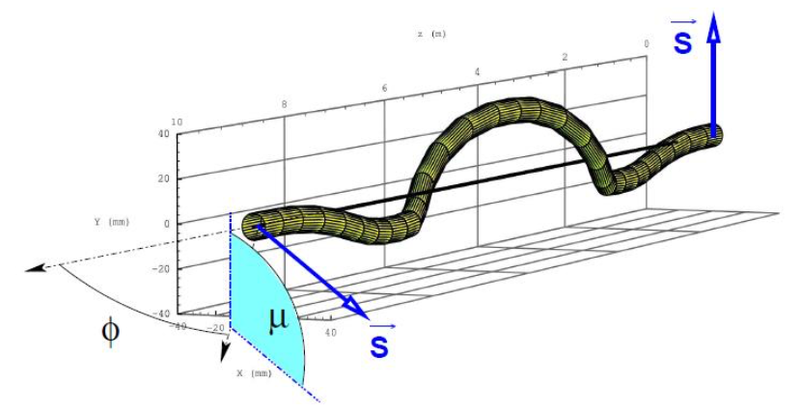
How to adjust the polarization direction?
Devices to rotate spin around a direction in horizontal plane by a certain angle θ
Transverse magnetic field (Not favored for CEPC energies)
$\int{B_{⊥}}dl$ independent of energy (approximately)
Vertical orbit excursion $∝1/γ$, $∝L$
synchrotron radiation power $∝γ^{2}$, $∝1/L$
Examples: helical dipole, interleaved H&V bends
Longitudinal magnetic field(Under study)
No orbit excursion, no radiation problem
$\int{B_{⊥}}dl$ $∝1/γ$
Need quadrupoles to decouple the beam

Slide 12
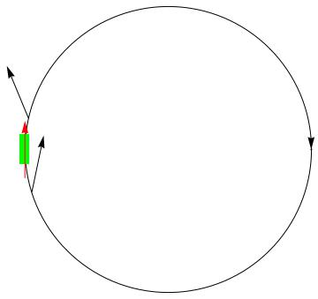
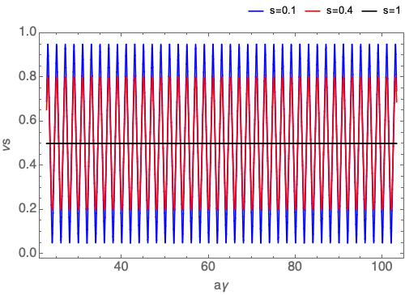
How to adjust the polarization direction?
Siberian snake in the booster
An equipment that rotates the spin around a horizontal axis by 180 degree
W/ one or more snakes, $υ_{s}=0.5$, independent of beam energy, no crossing of major spin resonances during acceleration
A partial snake rotates the spin vector by s*180 degree, s is the percentage of the snake, the integral strength scales like $∝$s
Closed orbit spin tune for partial snake with different s
A single full snake, $υ_{s}=0.5$

Slide 13
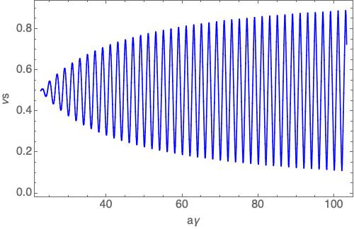
How to adjust the polarization direction?
Siberian snake in the booster
Solenoid-based spin rotator
$\int{B_{SOL}dl}≃\frac{10.479}{1+a}p \left(\frac{GeV}{c}\right) : 105 T∙m @ 10GeV \sim 476T∙m@ 45.5GeV$
Apply constant field superconducting solenoids, full snake at injection energy, partial snake at higher energies.
To avoid depolarization due to the intrinsic resonances, the betatron tunes need to be in [0, 0.1], more study is under way.
Closed orbit spin tune for a no-ramping solenoid snake with decreasing s over the beam energy

Slide 14
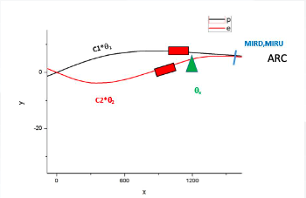
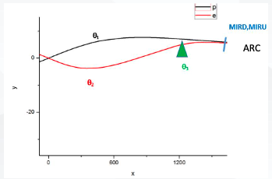
How to adjust the polarization direction?
Spin rotators in the collider ring CDR lattice (by Xia Wenhao, Wang Yiwei and Duan Zhe)
Solenoid spin rotators can be implemented at the first short straight sections next to IR
Modified the ring layout -> $θ_{bend}=15mrad$
Keep the IR geometry
Keep the transverse distance between e+ and e- rings D=0.35m
Scale the bending angle before and after the short straight section

Slide 15
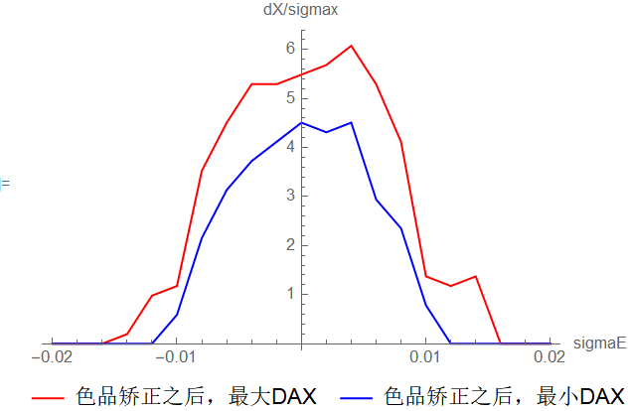
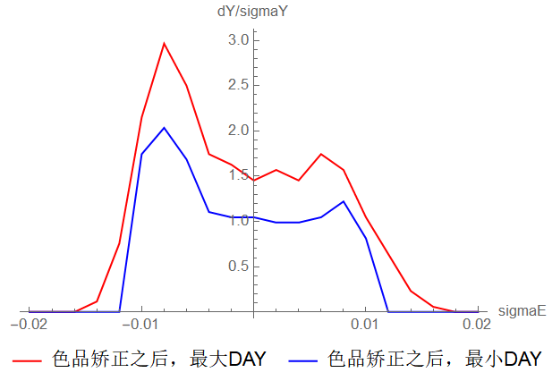
How to adjust the polarization direction?
Spin rotators in the collider ring CDR lattice (by Xia Wenhao, Wang Yiwei and Duan Zhe)
Solenoid spin rotators can be implemented at the first short straight sections next to IR
Modified the ring layout -> $θ_{bend}=15mrad$
Dynamic aperture descrease substantially
Decrease in Dx @ sextupoles for local chrom corr
Scale up the sextupole strength to keep the
thromaticity
Lattice nonlinearity increases
 | nuz | U0(MeV) | EMITX(nm)
original | 0.0281 | 35.744 | 0.177
new | 0.0308 | 39.296 | 1.096

Slide 16
How to adjust the polarization direction?
Spin rotators in the collider ring CDR lattice (by Xia Wenhao, Wang Yiwei and Duan Zhe)
Each spin rotator $\int{B_{SOL}dl}≃$ $240 T∙m$
Assume each solenoid is 8 T, ~1.5m
Each unit cell contains two solenoids and matching quads, total length ~ 10 m
Replace the existing drifts in the lattice by such unit cells
Each spin rotator consists of 10 unit cells

Slide 17
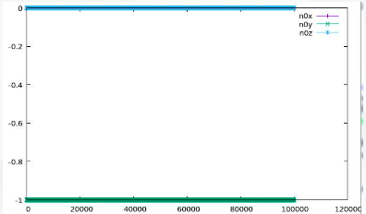
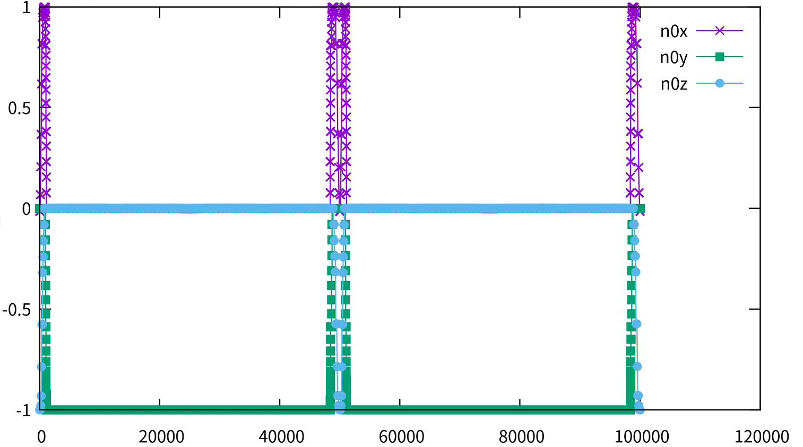
How to adjust the polarization direction?
Spin rotators in the collider ring CDR lattice (by Xia Wenhao, Wang Yiwei and Duan Zhe)
Spin rotators as expected
The local chromacity contribution is too large, no DA
w/o spin rotators
w/ spin rotators

Slide 18
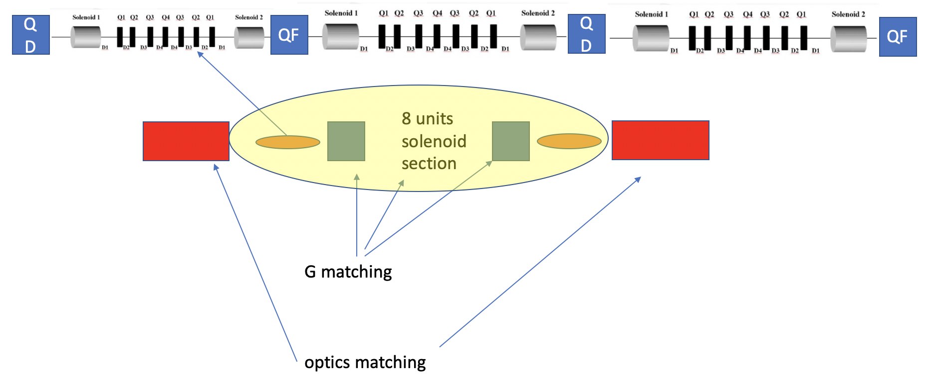
How to adjust the polarization direction?
Spin rotators in the collider ring CDR lattice (by Xia Wenhao, Wang Yiwei and Duan Zhe)
Lesson learned
Spin rotators should be located in a longer straight section with proper spin rotator angle from IP
Influence to orbital motion need careful examination: local chromaticity contribution
Modular design of spin rotators (total length ~ 300 m each)
Weaker quadrupoles are favored: Assume 1T pole face strength, 56 mm gap, 35T/m, Κ1 < 0.2 m^(-2), assume 3m
More compact design with even stronger solenoids: 8Τ, 1.5m -> 10T, 1.5m; 10 cells -> 8 cells
Separate spin matching and optics matching
Control of local chromaticity contribution
Similar design can be applied for Booster snakes

Slide 19
How to realize a high luminosity, polarization and a reasonable lifetime?
Luminosity inversely correlated with lifetime, limited by allowed SR power
Very short lifetime & top-up injection imposes stringent requirement on the injector
Mitigation of depolarization in the collider rings
Spin rotators introduce depolarization
Plan:
will study spin matching conditions to mitigate it
Iterative lattice optimization for luminosity and polarization
Yet open question to address
Beam-beam on polarization

Slide 20
Summary
Made some progress in the polarized electron source, electron beam polarization maintenance in the booster.
Implemented spin rotators in the collider ring CDR lattices, spin rotation as expected, perturbations to orbital motion are identified
On-going work:
Summarize equilibrium beam polarization simulation results
Modular spin rotator (snake) section design, in line with new lattice development by WANG Yiwei
Next step:
Simulate the beam polarization maintenance in the booster, w/ zero-length Siberian snakes
Implement the new snake design into the booster lattice.

