Slide 1
Polarized electron source for CEPC Linac
Li Xiaoping

Slide 2
Background
CEPC Linac design
Polarized Linac scheme:
Polarization >80% for e- and @ the end of Linac
Baseline：S-band: 4GeV → 10GeV
Alternative：C-band: 4GeV → 20GeV
Unpolarized
Parameter | Symbol | Unit | Baseline | Alternative
e⁻ /e⁺ beam energy | E_{e-}/E_{e+} | GeV | 10 | 20
Repetition rate | f_{rep} | Hz | 100 | 100
Bunches/pulse |  |  | 1 | 1
e⁻ /e⁺ bunch population | Ne-/Ne+ |  | >9.4×10⁹ | >9.4×10⁹
 |  | nC | >1.5 (3) | >1.5 (3)
Energy spread (e⁻ /e⁺ ) | σ_{E} |  | <2×10⁻³
Emittance (e⁻ /e⁺ ) Req. | ε_{r} | nm | <120 | <60
 |  |  | 40* | 20*
Length | L | m | 1200 | 1400

Slide 3
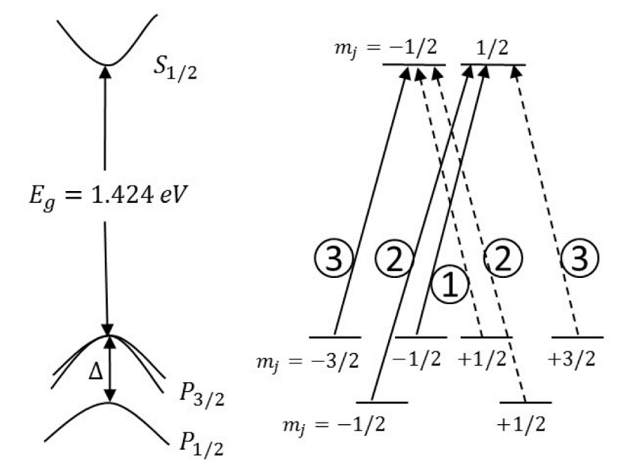
Polarized Electron Source (PES)
1）价带中的电子吸收光子，进而跃迁到导带；
2）导带中的激发电子从阴极内部传输到阴极表面；
3）表面电子发射进入真空。
极化电子源一般只有一种方式：
光阴极电子枪
阴极材料GaAs类光阴极材料
驱动激光780nm附近波长的圆偏振光
GaAs光阴极产生极化电子的本质在于其价带底和导带顶的电子分别属于P态和S态，由于自旋‐轨道耦合使价带的6重简并分裂为四重简并的P3/2 和二重简并的P1/2 态，其能量差为0.34eV

Slide 4
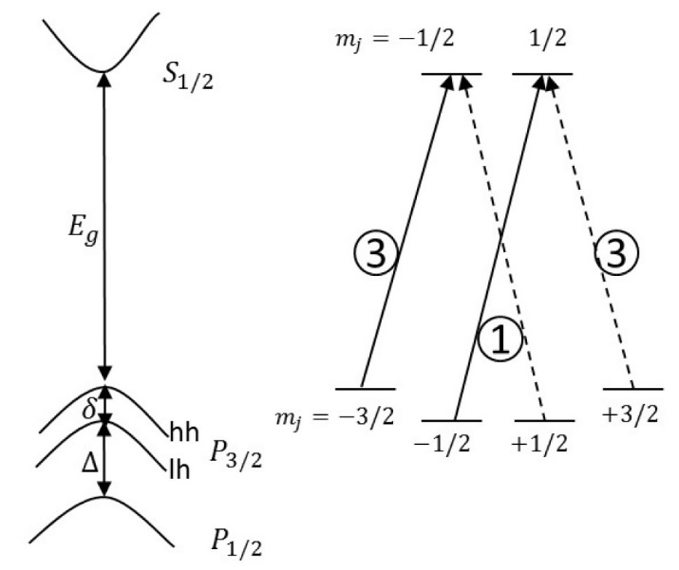
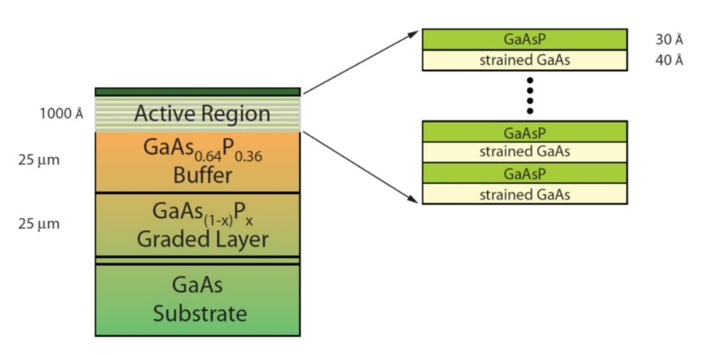
Polarized Electron Source (PES)
将GaAs 生长在与之晶格常数不同的晶体结构上从而在其内部将产生一个单轴应变，在应变力的作用下， GaAs子能带P3/2 的轻重空穴的简并态被消除，从而使导带上电子的极化度理论值完全达到了100%，大大提高出射电子的极化度，称之为应变GaAs光阴极

Slide 5
Polarized Electron Source (PES)

Slide 6
Polarized Electron Source (PES)
The baseline design for both ILC and CLIC apply PES for e- generation
Requirements comparison for ILC, CLIC and CEPC
Parameter | ILC(TDR) | CLIC(3TeV) | CEPC
Electrons/microbunch | 2×10¹⁰ | 0.6×10¹⁰ | >0.94×10¹⁰
Charge / microbunch | 3.2nC | 1nC | 1.5nC
Number of microbunches | 1312 | 312 | 1
Macropulse repetition rate | 5 | 50 | 100
Average current from gun | 21μA | 15μA | 0.15μA
Polarization | >80% | >80% | >80%

Slide 7
Polarized Electron Source (PES)
ILC极化电子源技术参数
参数名称 | 数值
电子源类型 | 光阴极DC-Gun
直流高压 | 200kV
光阴极材料 | 超晶格GaAs光阴极
驱动激光波长 | 790±20 nm (波长可调)
量子效率 | 0.5%
电子束极化度 | ≥80%
束团电荷量 | 4.5-5nC
束团长度 | 1ns
单脉冲激光能量 | 5μJ

Slide 8
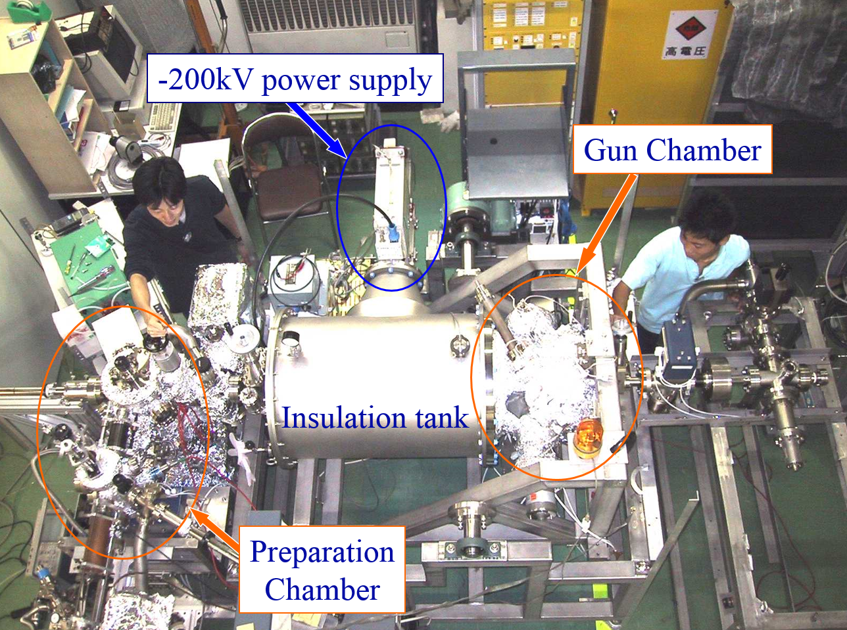
Polarized Electron Source (PES)
120kV polarized gun at SLAC
200kV polarized gun at Jlab
200kV polarized gun at Nagoya
Successful verification during ILC and CLIC R&D
(KEK, Nagoya, JLAB, SLAC……)
Low laser requirements in CEPC according to the low Laser energy on photocathode (E_{L}) at a low total charge from cathode

Slide 9
Polarized Electron Source (PES)
Low average current from gun means long lifetime operation for cathode
Conclusion:
PES has been demonstrated that the bunch charge, polarization and cathode lifetime are feasible
Low laser requirements and easy to build up in CEPC
Polarization measurement and its accuracy
Parameters of CEPC polarized electron source
Gun type | Photocathode DC Gun
Cathode | Super-lattice GaAs/GaAsP photocathode
HV | 150-200kV
QE | 0.5%
Polarization | ≥85% (90%???)
Electrons per bunch | 2×10¹⁰
Repetition rate | 100Hz
Drive laser | 780nm（±20nm），10μJ@1ns

