Slide 1
CepC Detector Description in CEPCSW
Chengdong FU
2021/02/22

Slide 2
Geometry Migration
MokkaC → CEPCSW
CEPCSW detector description based on DD4hep
compact parameters are parsed from XML, contrasting with DB and steering command in MokkaC
Geant4
compact
construction
DD4hep API
CEPCSW SimCore
…

Slide 3
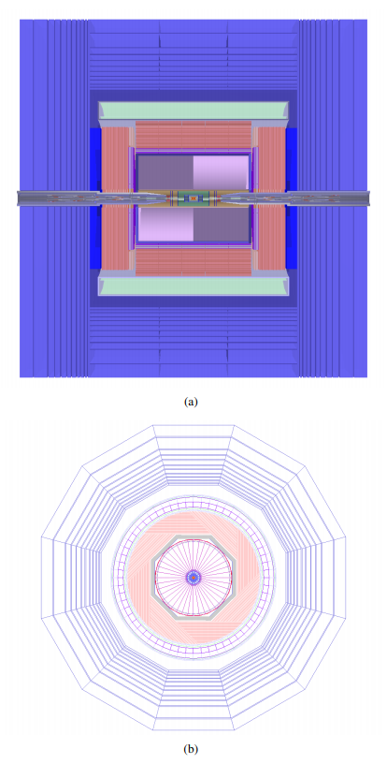
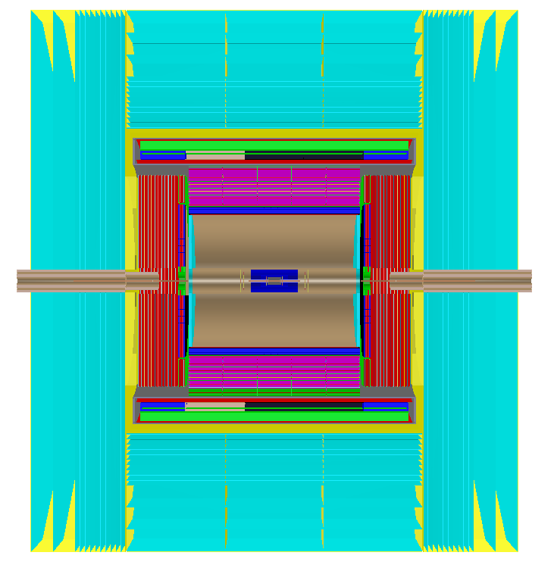
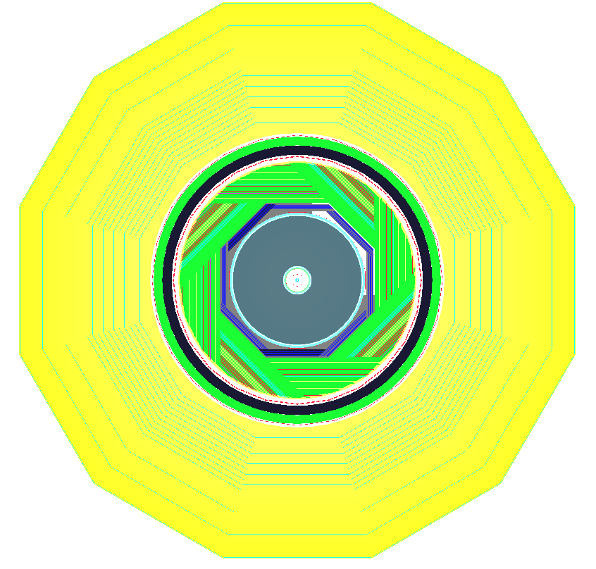
CEPC_v4
Beam pipe
default CEPC_v4: Z=0-700mm keep same for general physical analysis
new MDI patch: code ready, needs new DD4hep commit (waiting to be imported into Key4hep)
Keep same
VXD, SIT, TPC, SET, FTD, Ecal, Hcal, Coil, Yoke
LumiCal ⎯ TODO?
Validation
material scan
hit distribution
performance: ongoing
CDR Detector (by CEPCSW)
CDR Detector (by MokkaC)

Slide 4
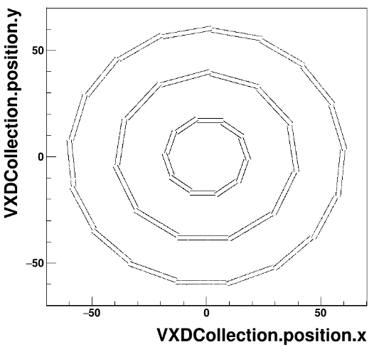
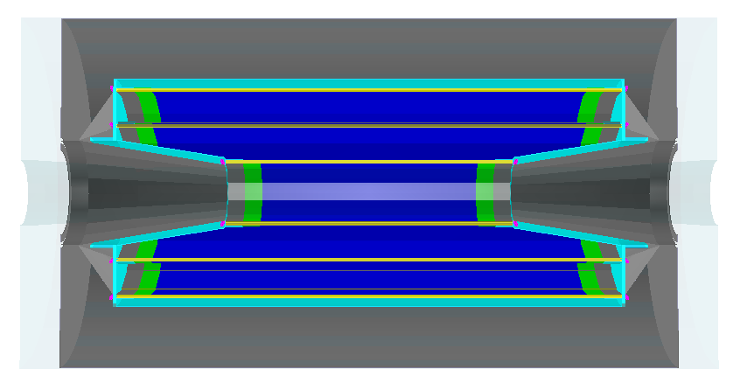
VXD
layer
support
sensor
electronics endplate
side electronics plate
outer support tube
end support plate
electronics
material scan check

Slide 5
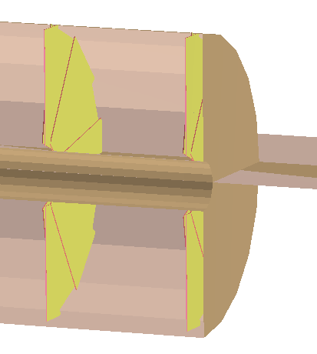
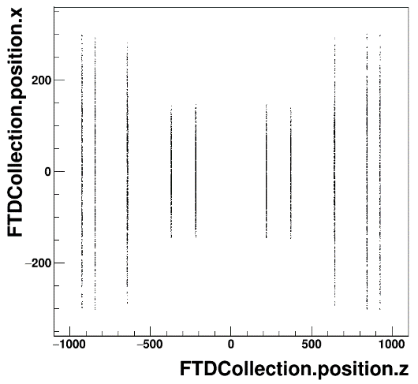
FTD
overlap existing in Mokka fixed
overlap if too wide
material scan check

Slide 6
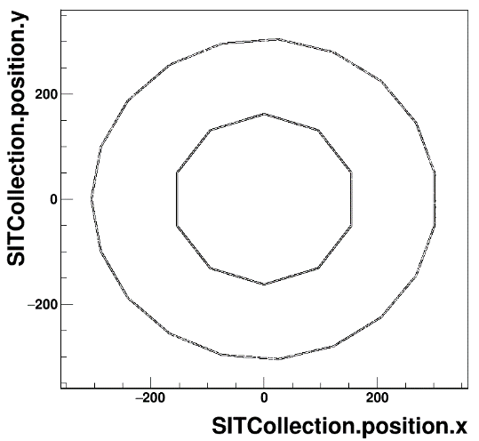
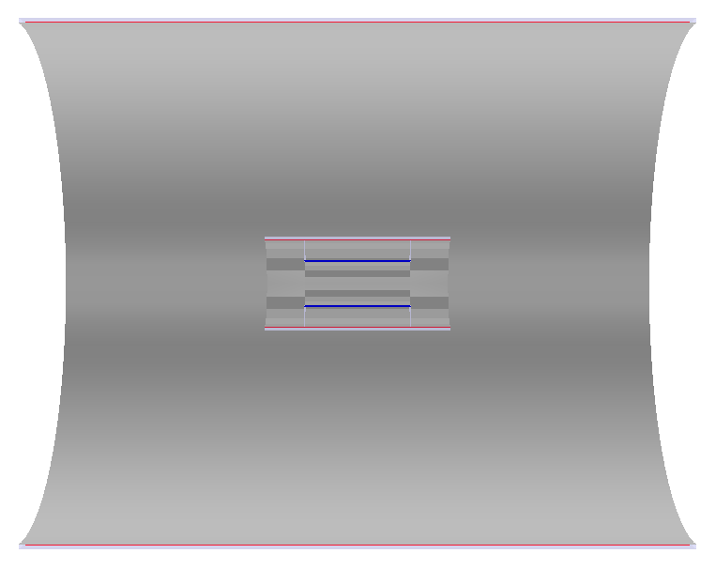
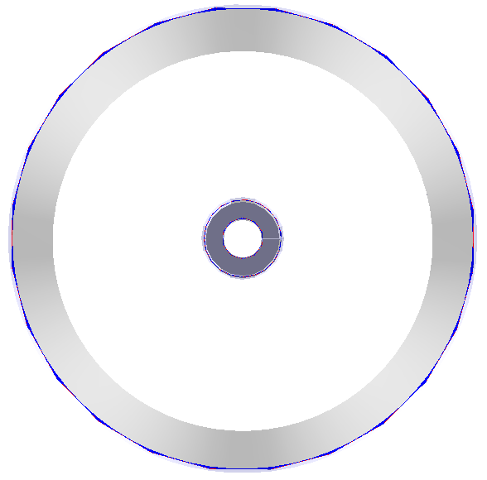
SIT & SET
same as MokkaC’s
material scan check

Slide 7
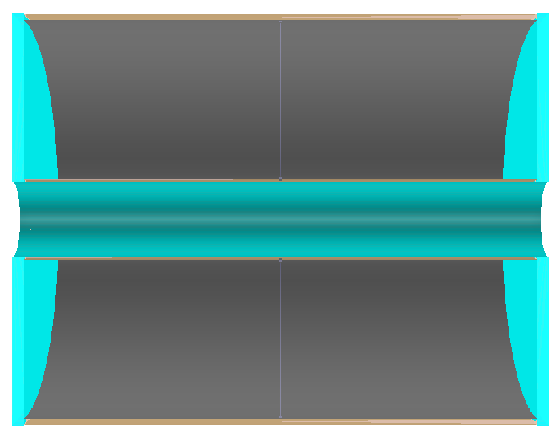
TPC
same as MokkaC’s
material scan check

Slide 8
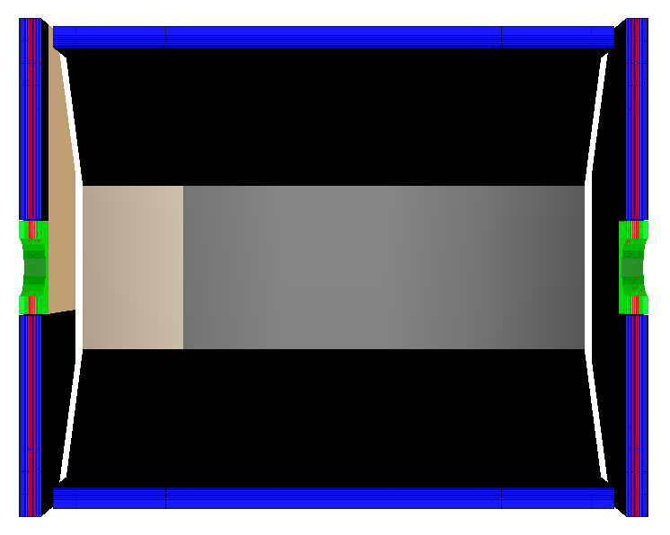
Ecal
EcalBarrel
EcalEndcaps
EcalECRing
Tolerance gap to avoid overlap removed
about 1e-9~2e-9 mm thick between layers and slices
material scan check

Slide 9
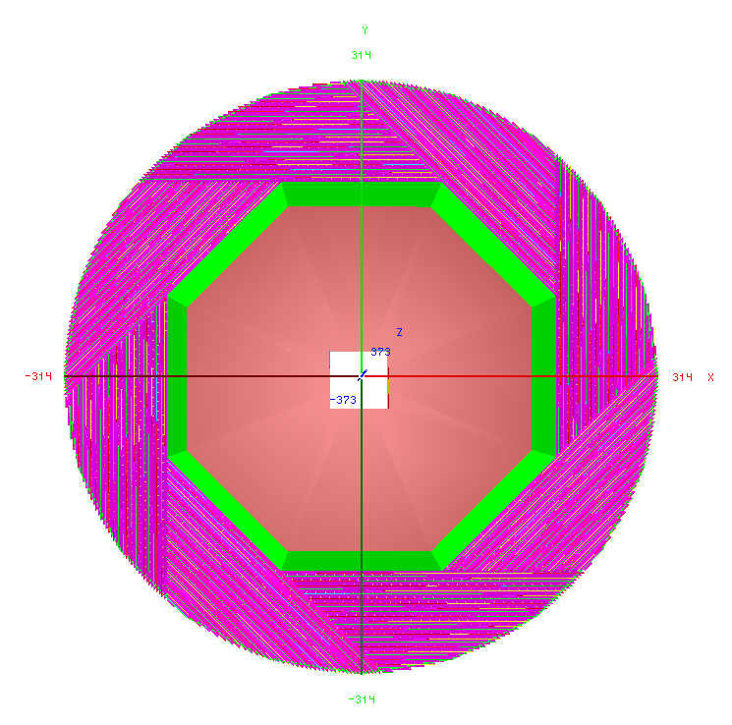
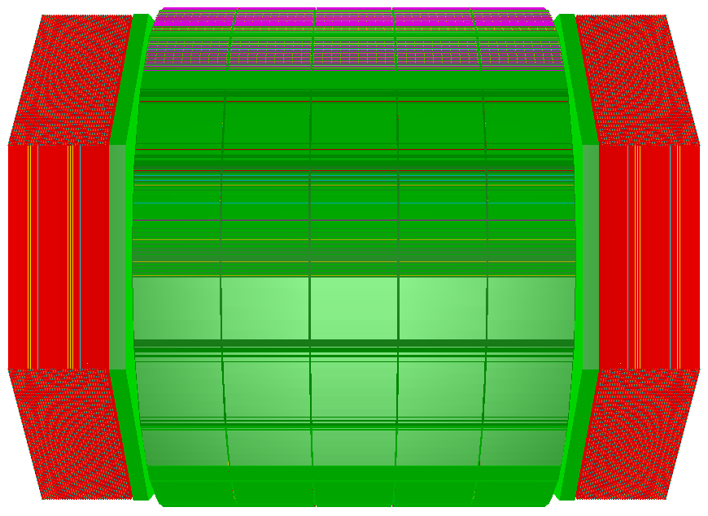
Hcal
HcalBarrel
HcalEndcaps
HcalEndcapRing
material scan check

Slide 10
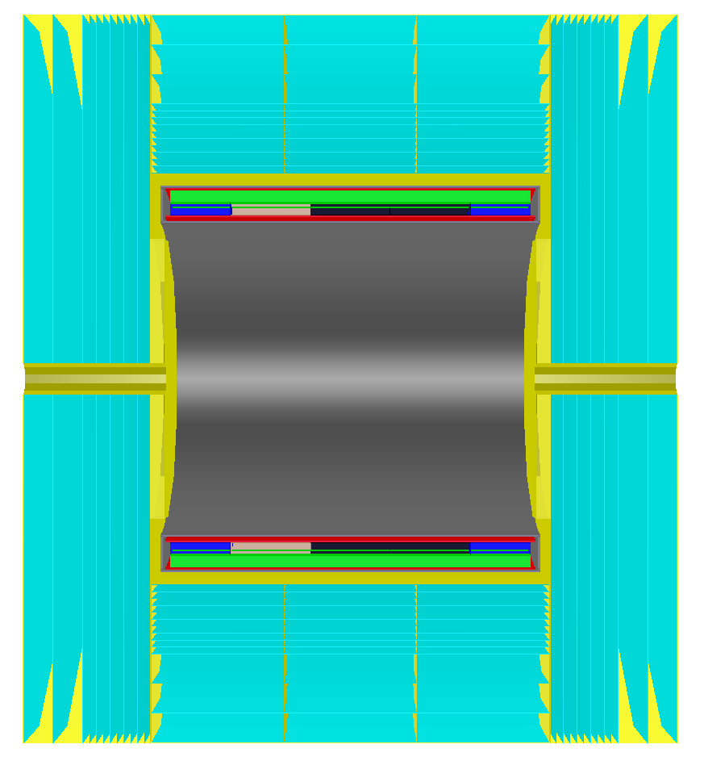
Coil & Yoke
material scan check
Coil
YokeBarrel
YokeEndcaps
YokePlug

Slide 11
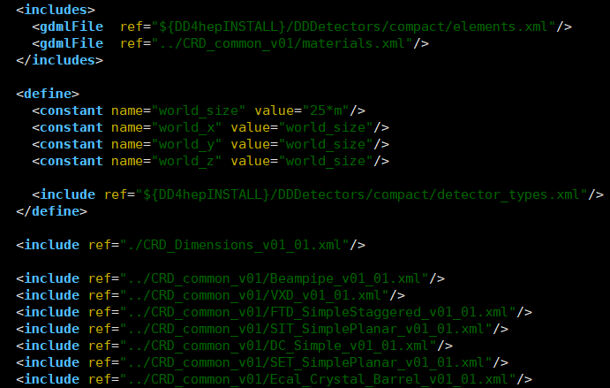
Detector Manager
Version
CRD_o1_v01
detector name main version minor version
construction to build geometry and compact files [XML] carry parameters
current: simulation and reconstruction use same compact files
considering:
simulated data carry compact file
simulated data carry version and save compact file into DB
compact files
Main : CRD_o1_v01.xml
include:
elements.xml
materials.xml
CRD_Dimensions_v01_01.xml
for envelopment size of each sub-detector
Hcal_Rpc_Barrel_v01_01.xml
name type [tag] construction version parameter version
…

Slide 12
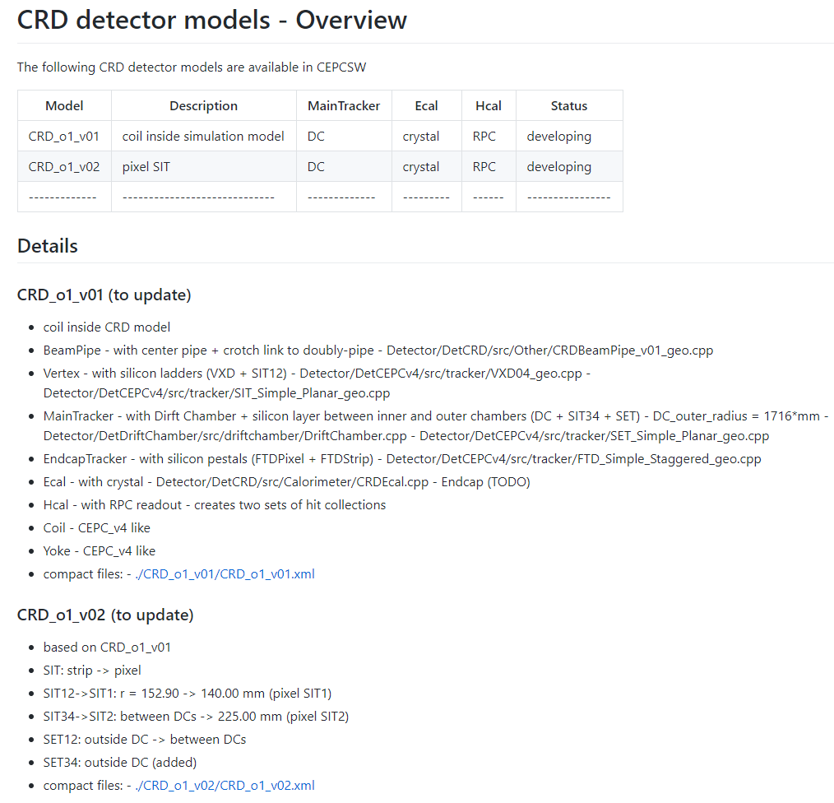
Released Detector Information (README.md)

Slide 13
Suggestion on Update Rule
preliminary official version
preliminary study to optimize
official
user modified version – user manage by self
froze version
official production
new preliminary official version based on previous frozen version or new idea

Slide 14
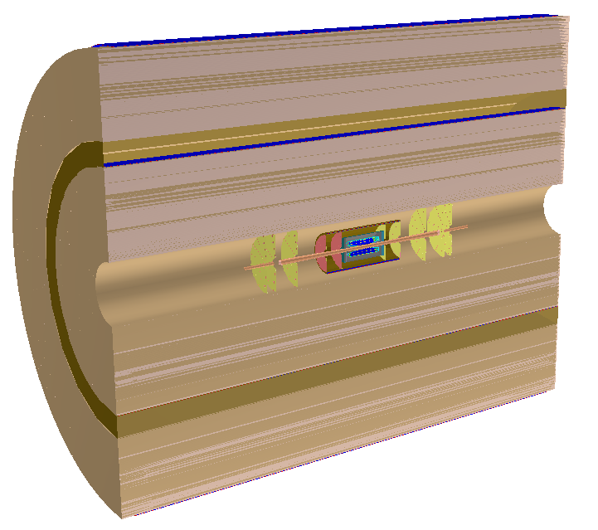
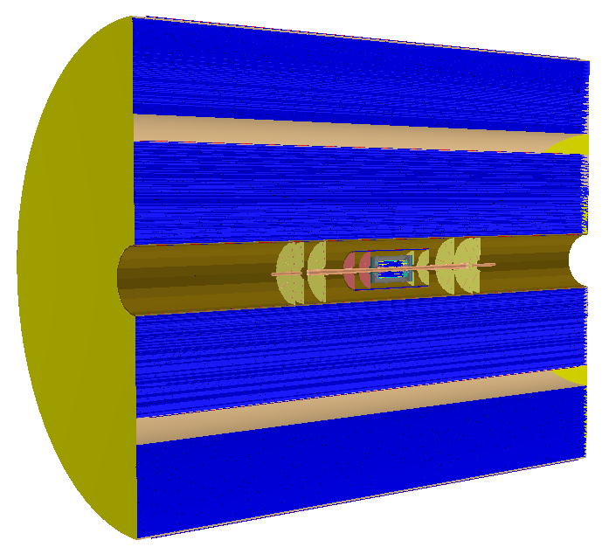
CRD_o1_v01 and CRD_o1_v02
CRD_o1_v01
coil inside Hcal
Drift Chamber
Crystal Ecal
new MDI
others CEPC_v4 like
VXD, FTD, SIT, SET, Hcal, Coil, Yoke
dimension re-defined
CRD_o1_v02 (pixel SIT)
SIT12 (double strip)→ SIT1 (pixel) + SIT2 (pixel)
one SET → two SETs
SET
SIT

Slide 15
Plan
optimization
new detector module

Slide 16
Tracking in CEPCSW

Slide 17
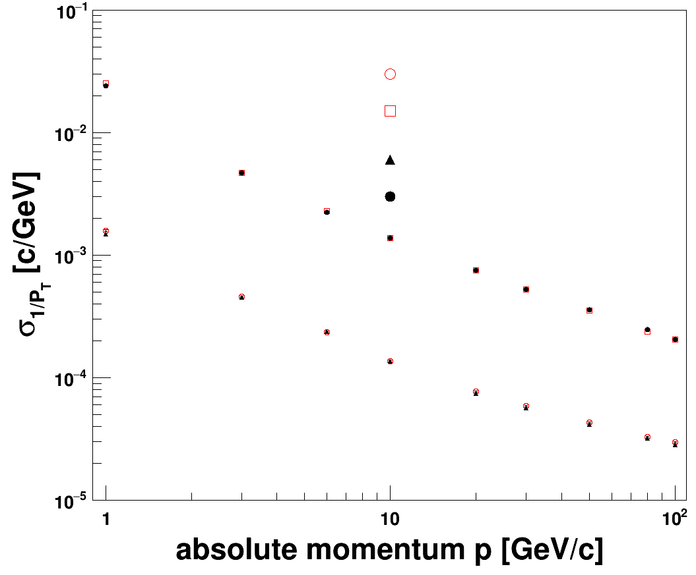
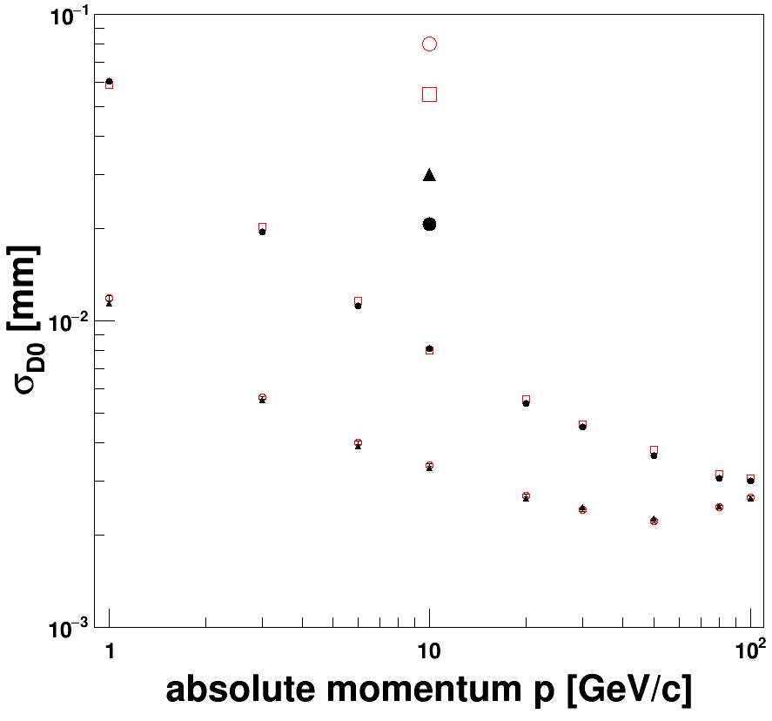
Progress
CEPC_v4’s tracker has been implemented into CEPCSW, and there are two reconstruction chains, in release plan
(database)→Mokka→(saved LCIO, Gear file)→Digi→Tracking→Fitting
(compact)→Sim →Digi→Tracking→Fitting
Validation
single muon
CEPC_v4
CEPCSW (LCIO) θ=85°
CEPCSW (LCIO) θ=20°
CEPCSW full θ=85°
CEPCSW full θ=20°
CEPCSW (LCIO) θ=85°
CEPCSW (LCIO) θ=20°
CEPCSW full θ=85°
CEPCSW full θ=20°

Slide 18
TODO
KalTest → DDKalTest
background/noise

Slide 19
Full Sim-Rec Process
Simulate
DD4hep description
DetSimCore ⇒ Geant4
Digitize
PlanarDigiAlg for silicon
TPCDigiAlg for TPC
Tracking
Silicon tracking
Fitting
EDM4hep SimTrackerHit
TPC tracking (DC tracking)
KalTest as Kalman filter
EDM4hep TrackerHit
Merge
Track candidate
EMD4hep Track
Simulate
Full silicon description
Tracking
ConformalTracking
Fitting
KalTest too
Digitize
Only silicon digitization
Full Silicon tracker
TPC+Silicon ⇒ DC+Silicon

Slide 20
Clupatra for DC
modified CRD_o1_v01
single DC
148 layers: 235 mm -1715 mm
SIT:
layer1/2: radius = 140 mm
layer3/4: radius = 222 mm
keep algorithms and cheat them (input DC hits as TPC hits)
DCHDigiAlg
σx=110 μm, σy=110 μm, σx=1 mm
deal DC geometry as TPC (preliminary)
gear::TPCParametersImpl
job work now

Slide 21
Full Tracking Chain
SiliconTracking (VXD+SIT, FTD)
ForwardTracking (FTD)
TrackSubset (combine)
Clupatra (DC)
FullLDCTracking (combine)

Slide 22
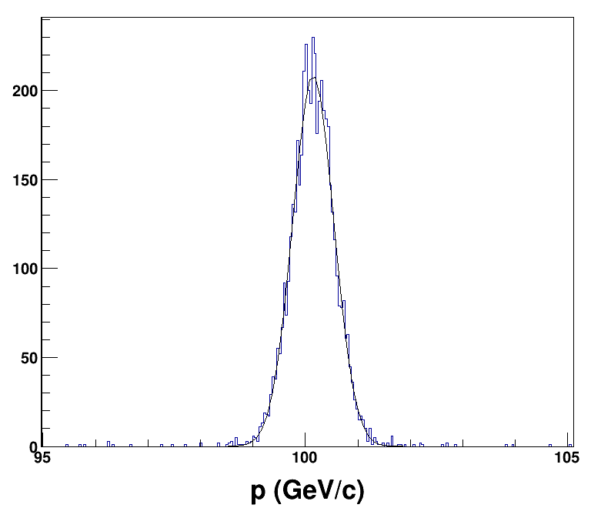
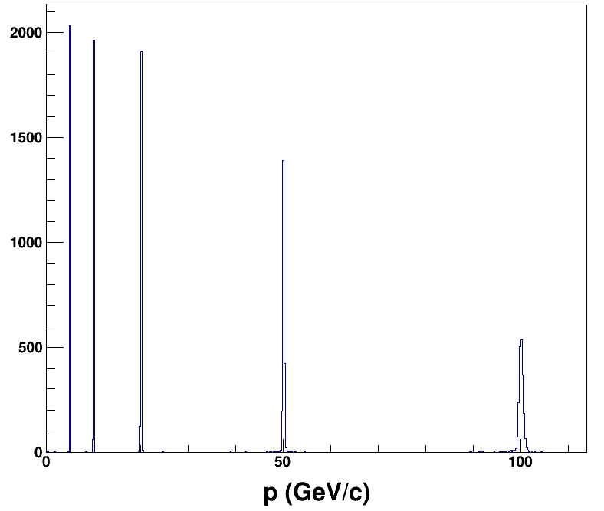
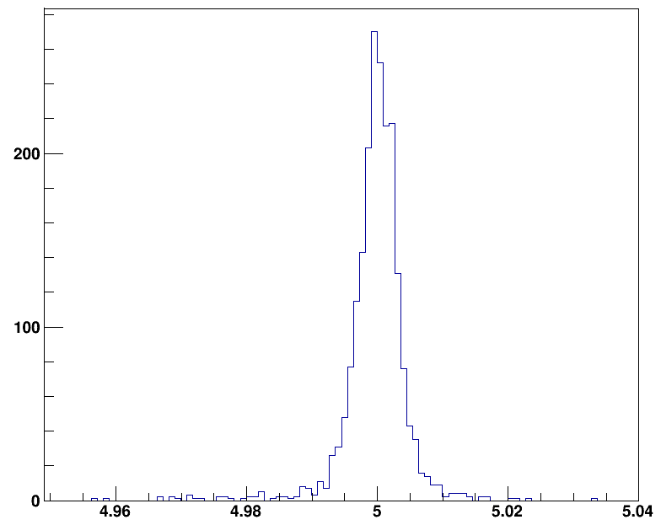
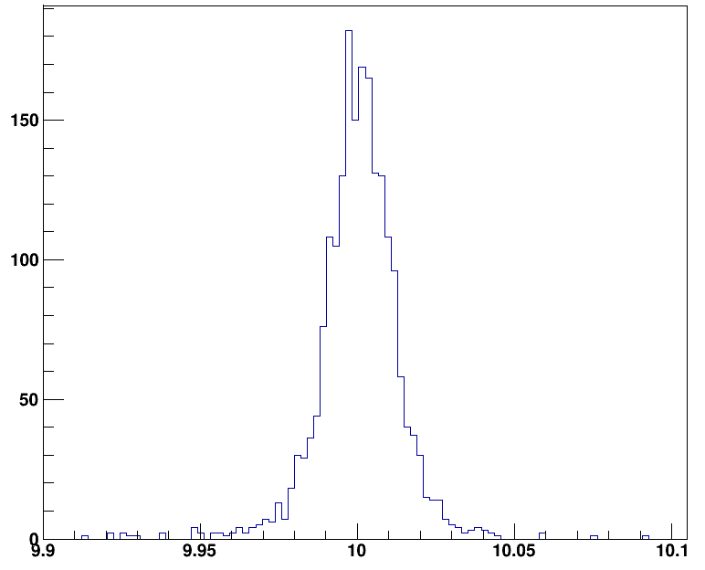
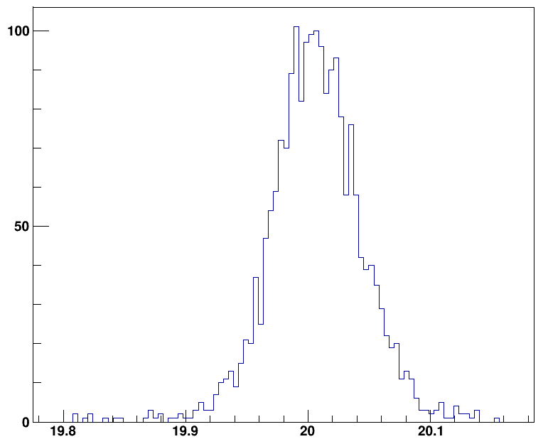
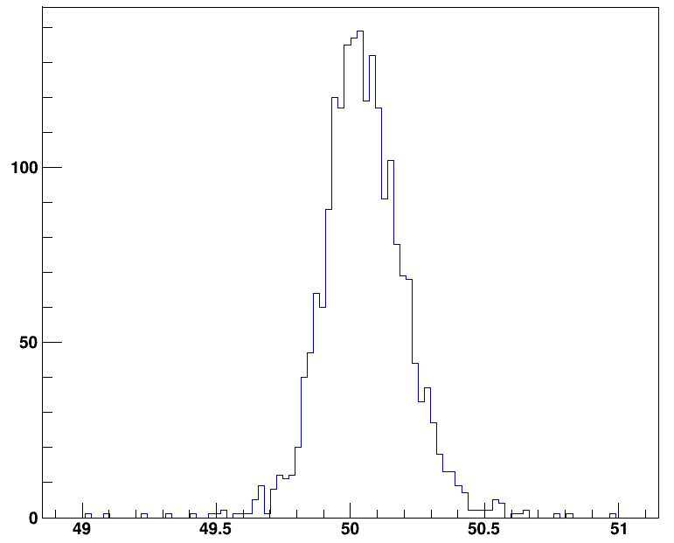
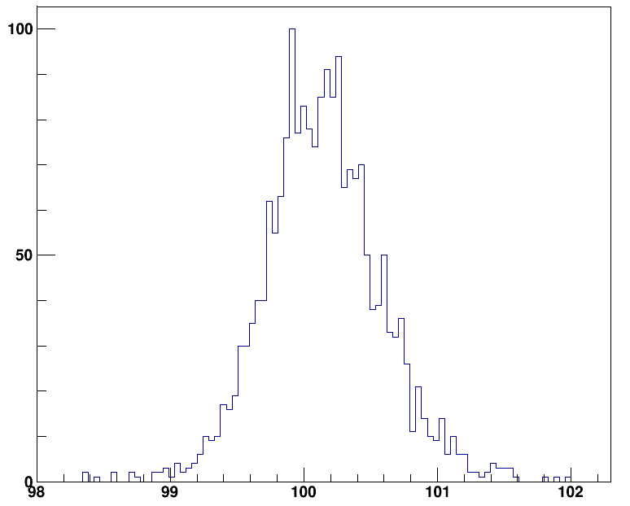
Quick Test
single muon (5000 events)
100 GeV
θ=85°
σ_{p}=0.394±0.005 GeV/c
cut p∈(95,105)GeV/c
5035 tracks for 5000 particle
10 muon in each event (1000events)
5 GeV, 10 GeV, 20GeV, 50GeV, 100GeV μ± pairs ()
θ∈[60°, 120°]
ω>0: 5103
ω<0: 5119
(4.95,5.05) ( 9.9, 10.1) (19.8, 20.2) (49,51) (98,102)
2026 2020 2024 2038 2020

Slide 23
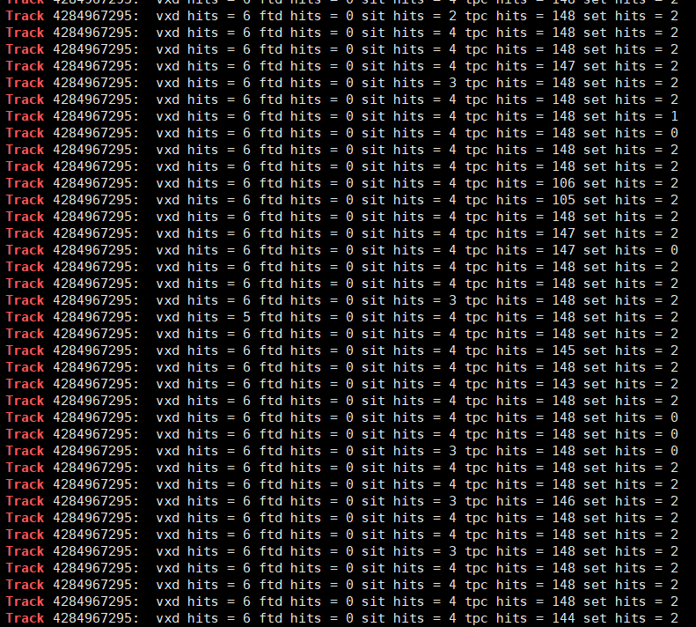
One Possible Roadmap
tracking
SiliconTracking
ForwardTracking
TrackSubset
Clupatra
Full(LDC)Tracking
Kalman filter
MarlinKalTestTrack
GenFit

Slide 24
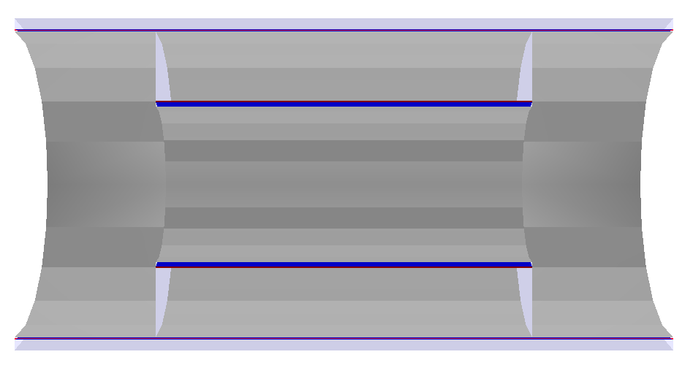
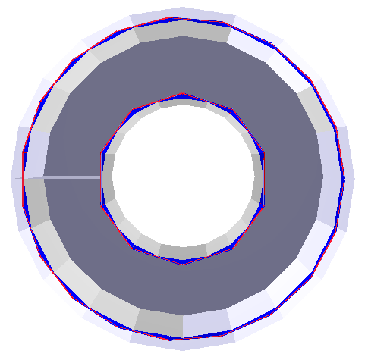
backup

