Slide 1

EW measurement at the CEPC
Zhijun Liang
(IHEP, Chinese Academy of Sciences)
Notes:
Annual strategy planning session for the joint Key Lab for Particle Detectors and Electronics.
You can present an overview of the CEPC Detector design, the R&D program, and go over the key technologies to be pursued during the next five years for CEPC. Aim for about 30‘+10’ approximately.

Slide 2
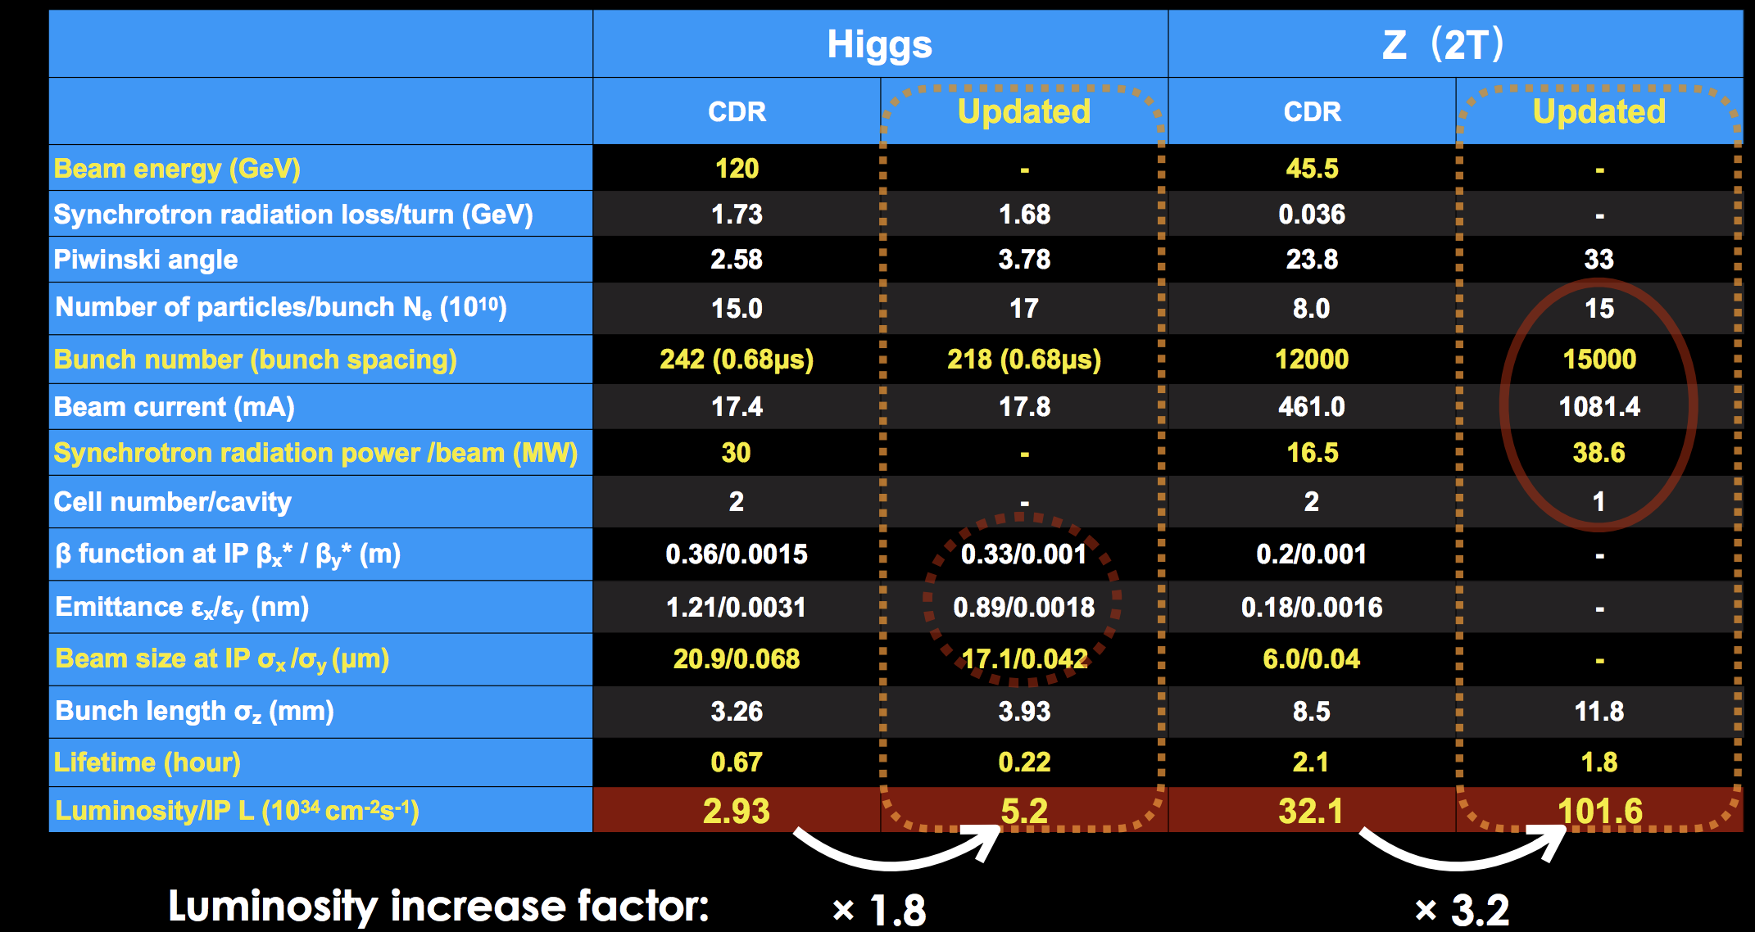
Updated
Updated CEPC collider parameters since CDR

Slide 3
The CEPC Program
100 km e⁺e⁻ collider
Z: 1.5 × 10¹² events (~45 ab⁻¹)
Luminosity per IP [10³⁴cm⁻²s⁻¹]
2 IPs
W: 2 × 10⁷ events (2.6 ab⁻¹)
Higgs: ~2 × 10⁶ events
(~10 ab⁻¹)

Slide 4
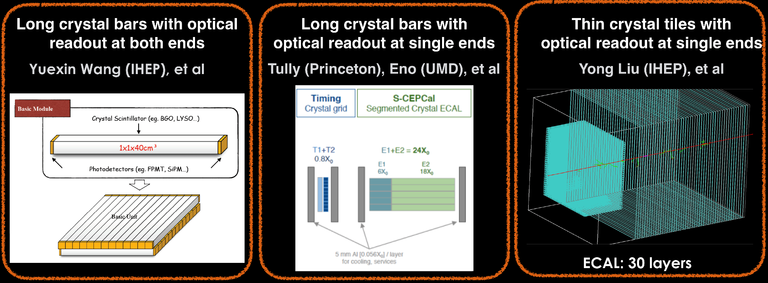

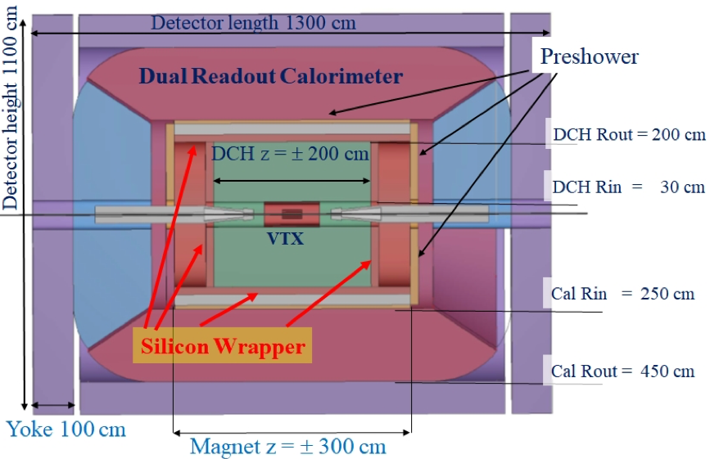
CEPC: Detector Concepts
CEPC plans for
2 interaction points
New！Crystal calorimeter concept is being studied.
  Higher precision on EM energy scale
  Useful for precision measurements
  More in Calorimetry section tomorrow
  Tracking 2 Tesla magnetic field
  Performance to be revised
Particle Flow Approach
IDEA Concept
Low
magnetic field
concept
(2 Tesla)
Baseline detector
ILD-like
(3 Tesla)
Notes:
Need to update figures

Slide 5
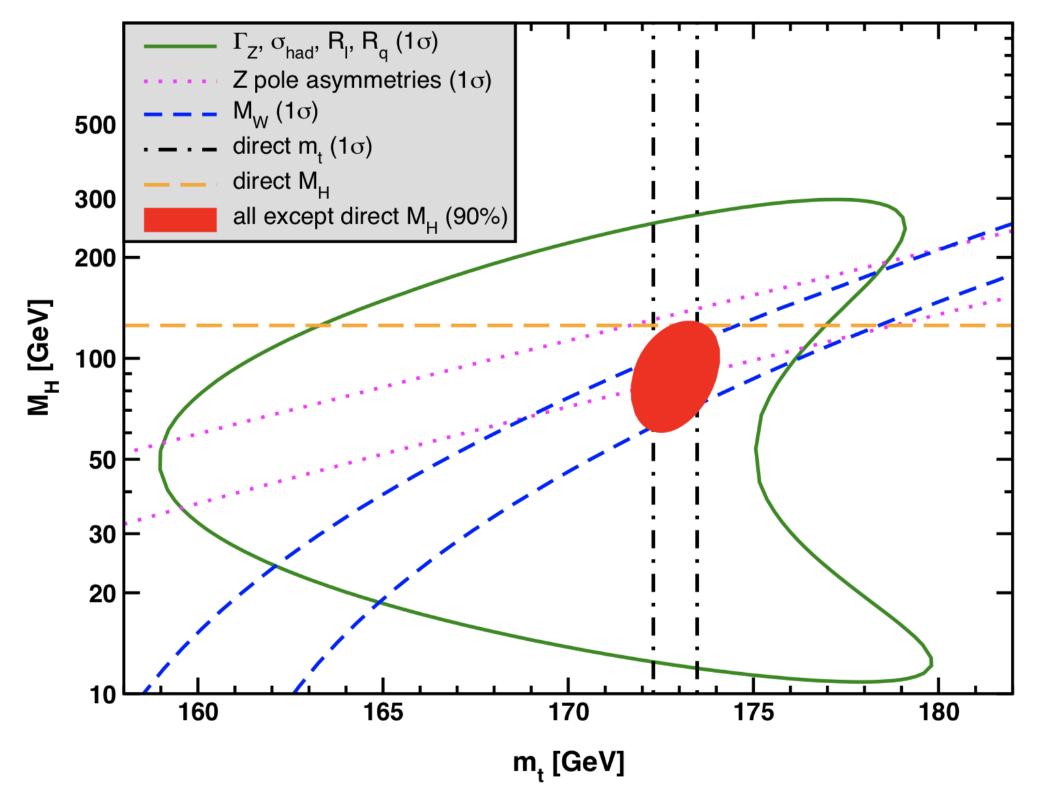
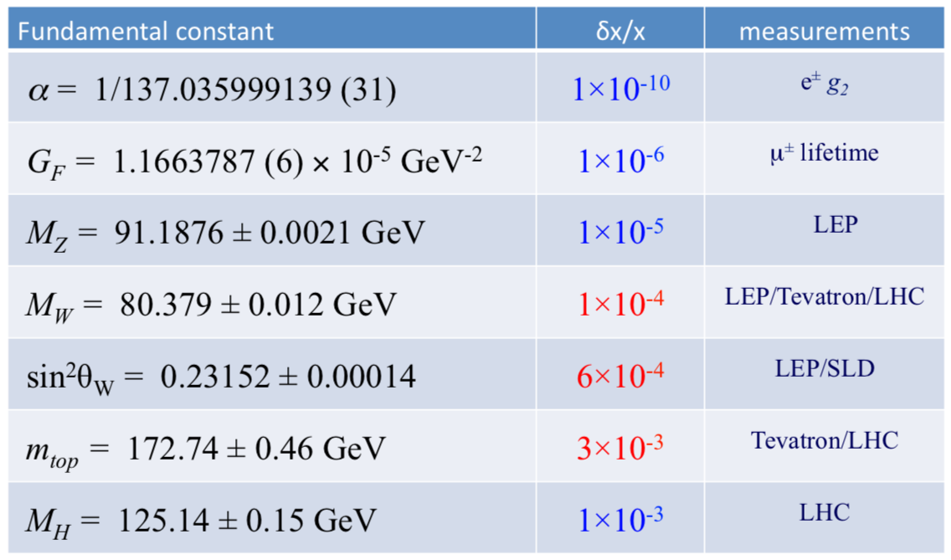
The status of electroweak global fit
7 key observables in electroweak global fit
  Consistency study of the standard model electroweak section
  Small conflict in Higgs mass (2σ) between direct measurement and EWK fit.
  Need CEPC Z pole and WW runs : Precise measurements on EWK observables.
PDG 2020
Higgs mass M_{H}
sin²θ_{W}
M_{W}

Slide 6
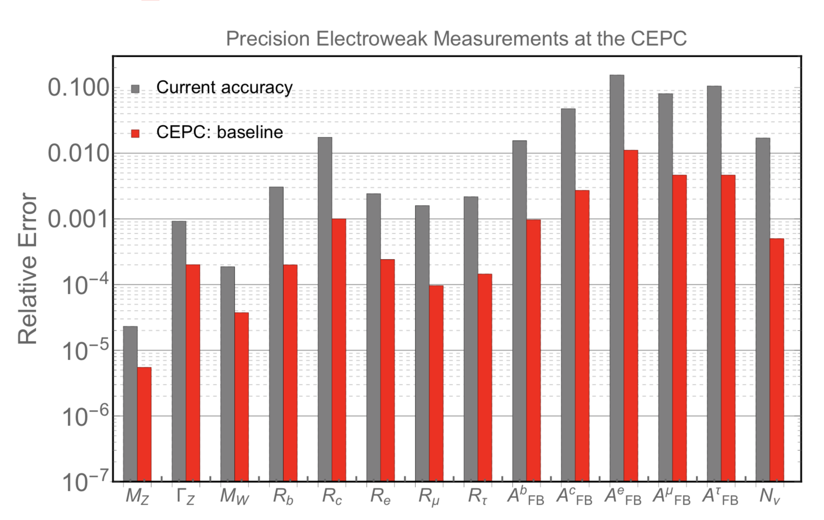
Prospect of CEPC EWK physics
Prospect of CEPC EWK physics was estimated by extrapolations from LEP
Expect to have 1~2 order of magnitude better than current precision
More study with simulation or more realistic estimation of systematics is needed

Slide 7
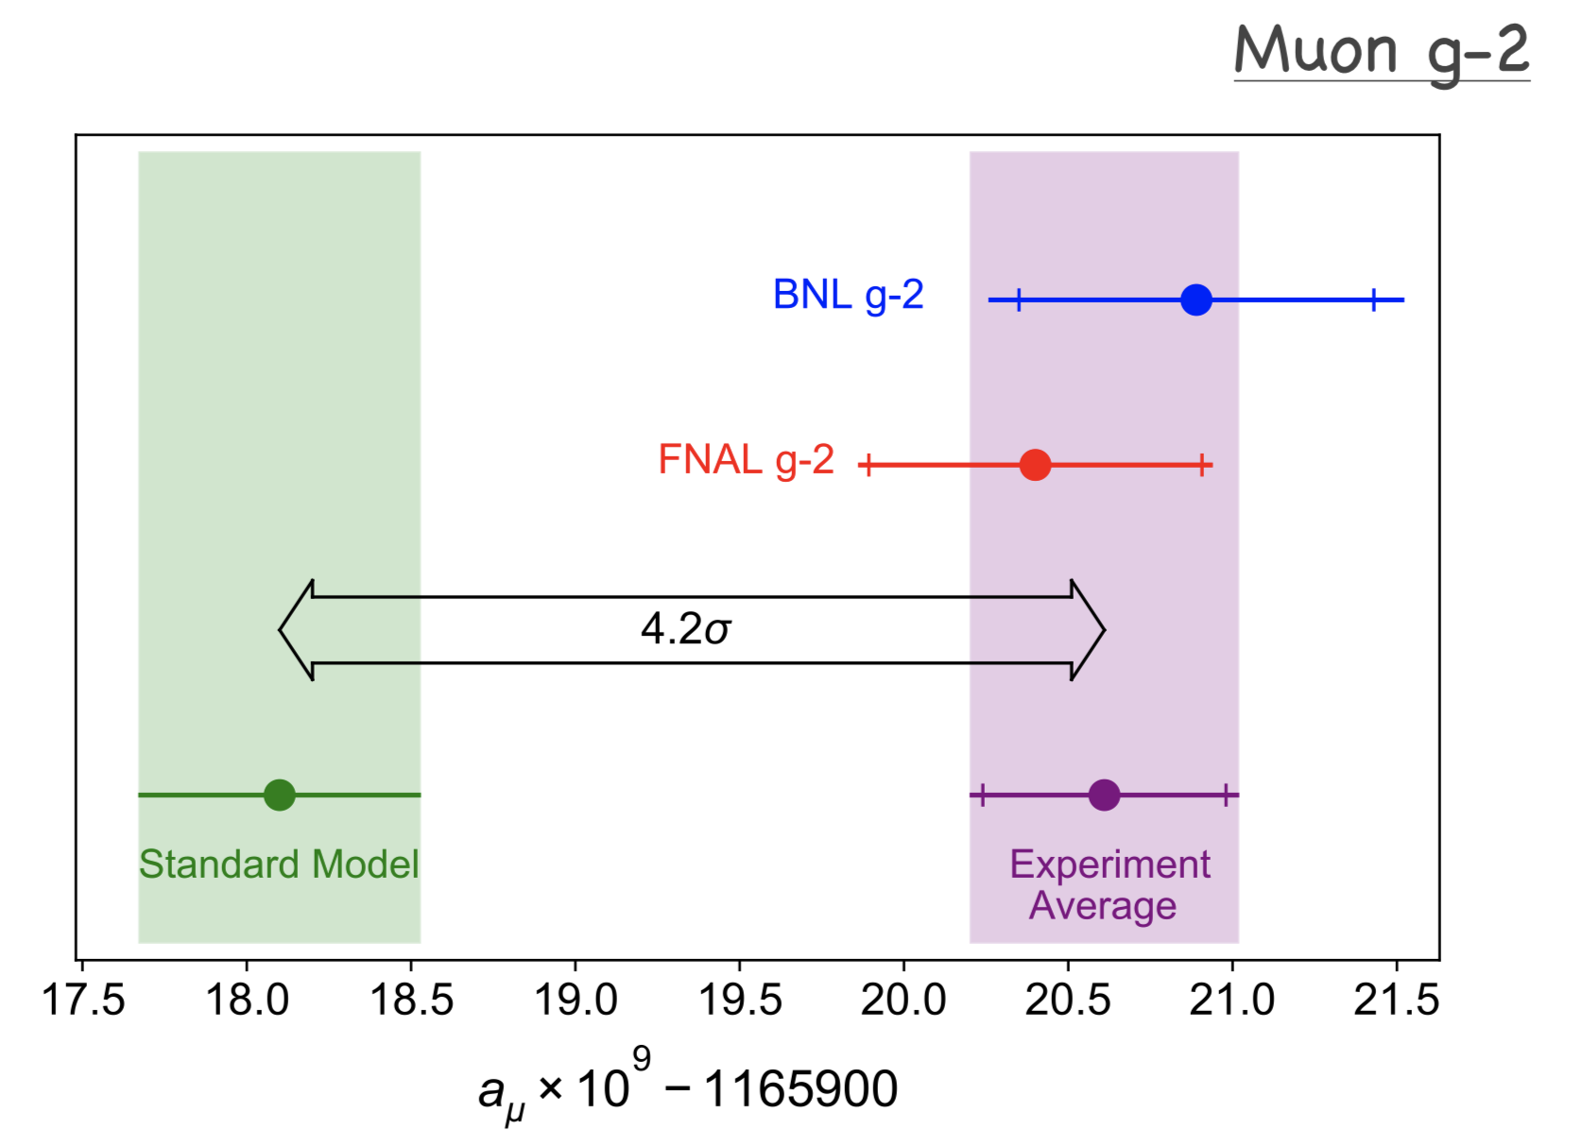
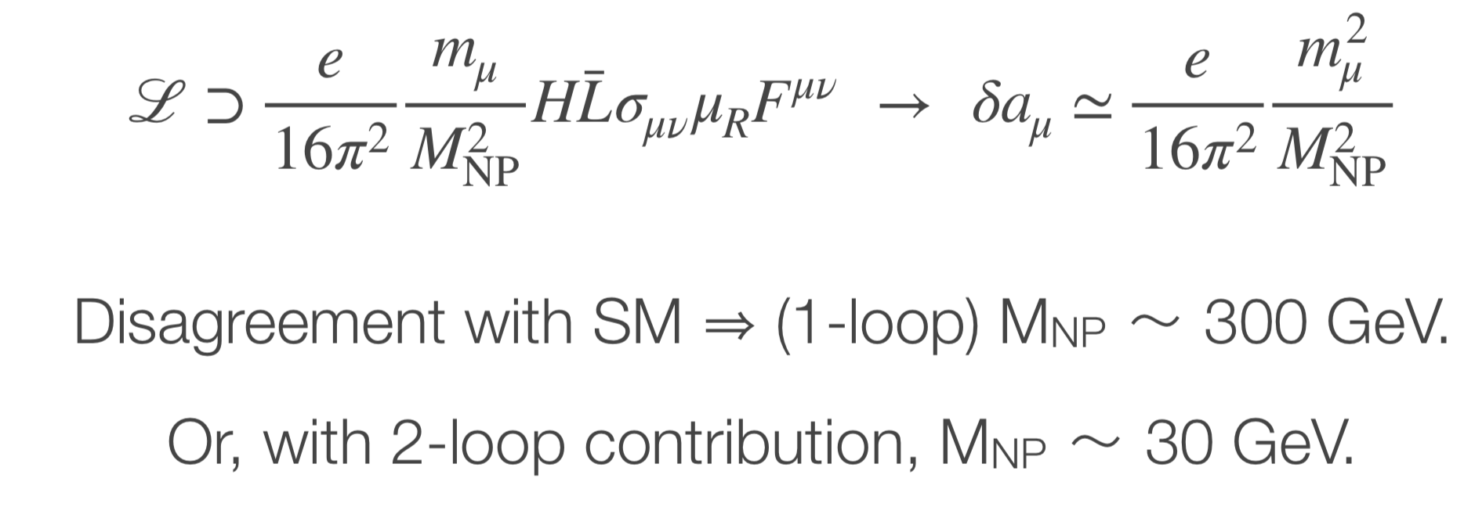
Motivation of precision measurement
Muon g-2 → in-direct search for new physics with precision measurement
Liantao predicted that CEPC could probe the new physics behind muon g-2
Plenary Talk by Liantao in this workshop
https://indico.ihep.ac.cn/event/13888/session/0/contribution/5/material/slides/0.pdf

Slide 8
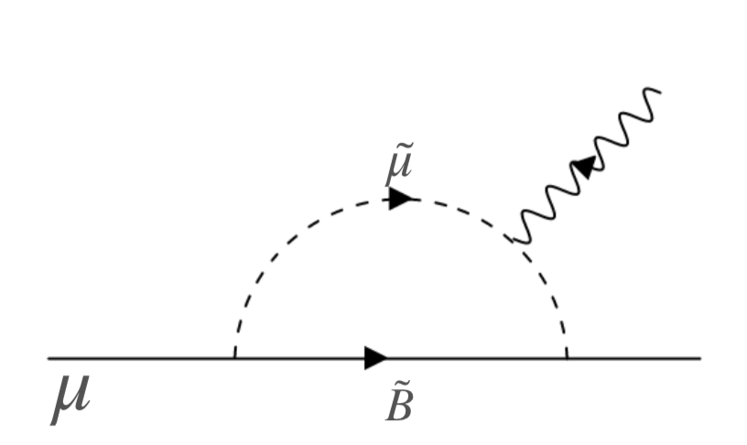
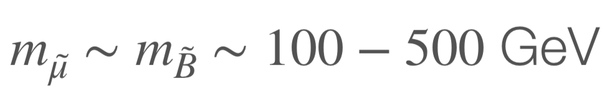
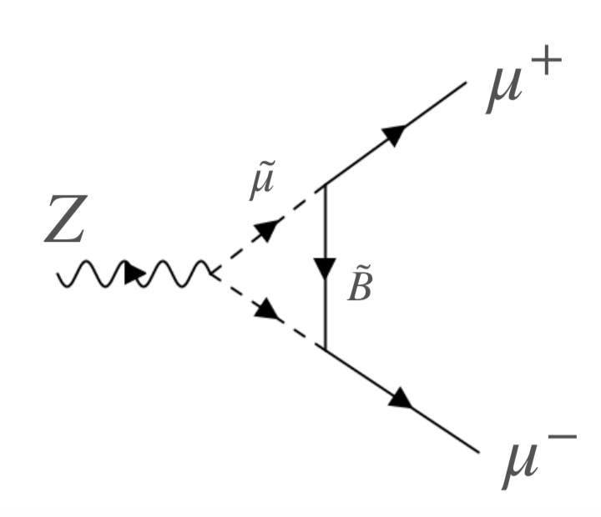
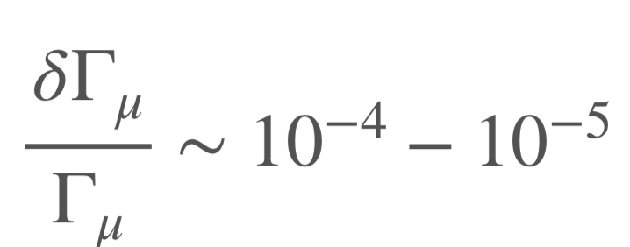
Probing new physics behind muon g-2 at CEPC
From Liantao, if new physics behind muon g-2 @ one loop
Expect to see disagreement with SM at Z->μ μ branching ratio at 10⁻⁴ to 10⁻⁵
Within the reach of CEPC Z pole physics
More details in Bo Liu’s talk later
From Plenary Talk by Liantao

Slide 9
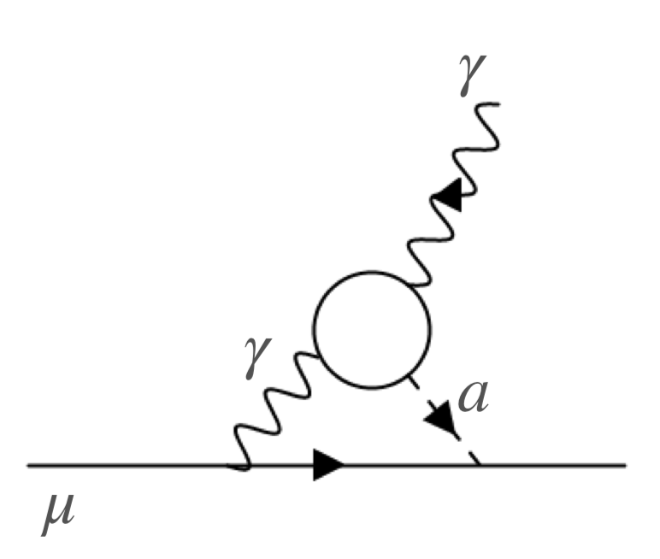
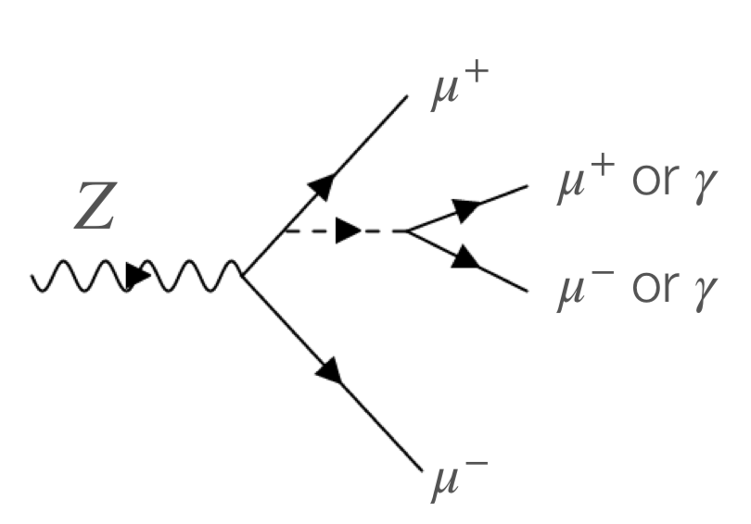
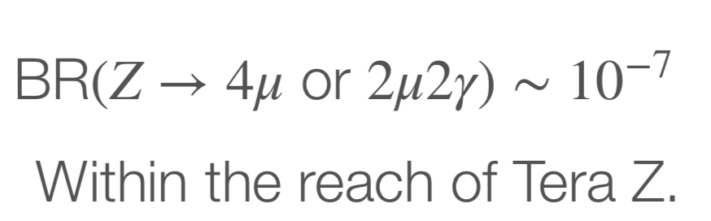
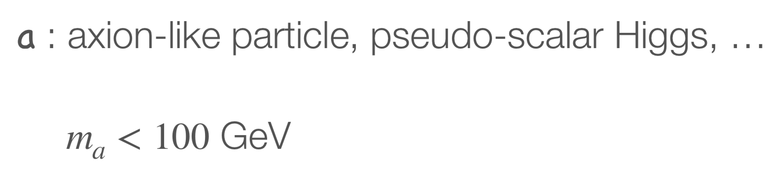
Probing new physics behind muon g-2 at CEPC
From Liantao, if new physics behind muon g-2 @ two loop
Expect to see disagreement with SM at Br(Z->4μ) and Br(Z->2μ2γ) at ~10⁻⁷
  Within the reach of CEPC Z pole physics
From Plenary Talk by Liantao
 | Current precision | CEPC
Br(Z->4μ) | ~3*10⁻⁷ ATLAS/CMS | ~10⁻⁹
Br(Z->2μ2γ) | < 6*10⁻⁷ @ 95% CL By LEP | <2*10⁻⁹
Phys. Rev. Lett. 112, 231806 (2014)
Phys.Lett.B 311 (1993) 391-407

Slide 10
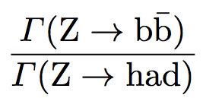
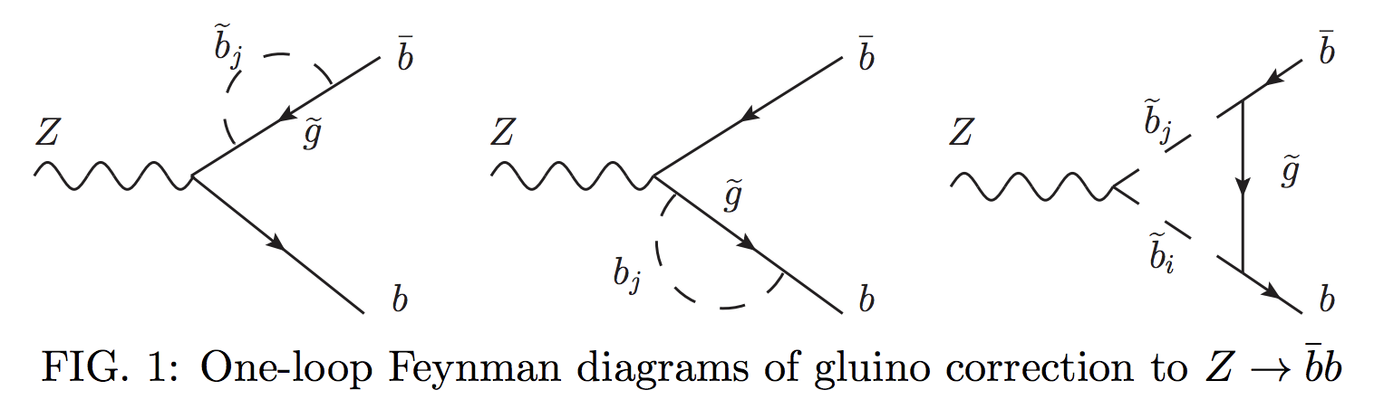
Branching ratio ( R^{b}): motivation
At LEP measurement 0.21594 ±0.00066
CEPC aim to improve the precision by a factor 10~20 (0.02%)
R^{b} measurement is sensitive to New physics models (SUSY)
  SUSY predicts corrections to Z→ bb vertex
  Through gluino and chargino loop …
Arxiv:1601.07758v2

Slide 11
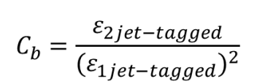
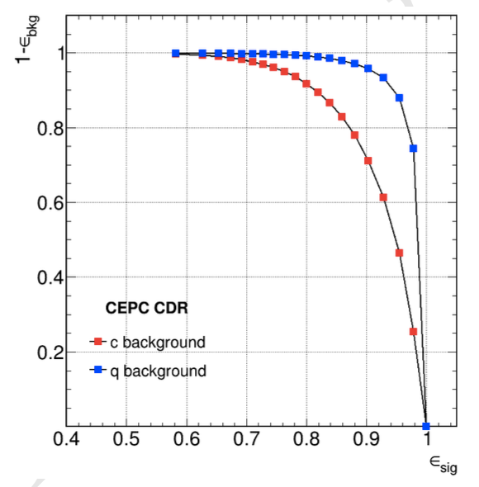
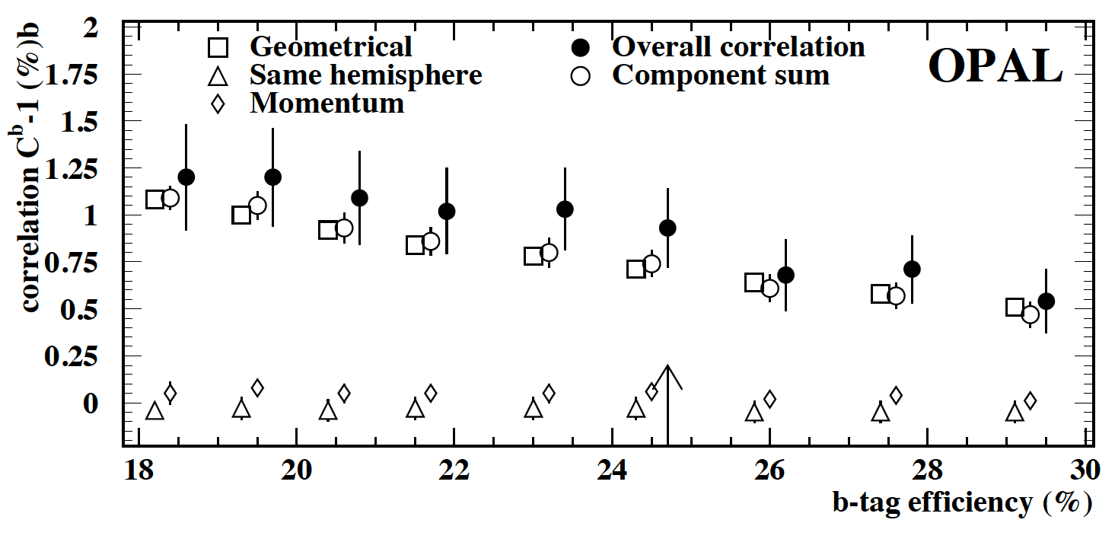
R^{b}: b tagging hemisphere correlations
  Hemisphere correlations depends on b tagging efficiency
    with 95% purity working points efficiency> 70% in CEPC
    This systematics will not be dominated
CEPC b tagging ROC curve
OPAL collaboration, Eur.Phys.J.C8:217-239,1999

Slide 12
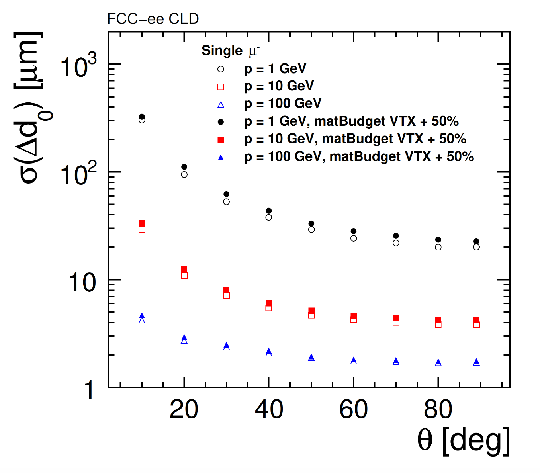
R^{b}: tracker systematics
Alignment systematics:
  LEP study : 20μm mis-alignment → 0.04% systematics
  CEPC aim for 2um mis-alignment (at least 5μm) → <0.005% syst.
Hit Efficiency :
  LEP study 1% syst. → 0.007% syst. In R^{b}
  CEPC <0.5% syst. → 0.003% syst. In R^{b}
Lepton efficiency
  LEP: 3% syst. → 0.03% systematics in R^{b}
  CEPC: 0.5% syst→ 0.005% syst. in Rb

Slide 13
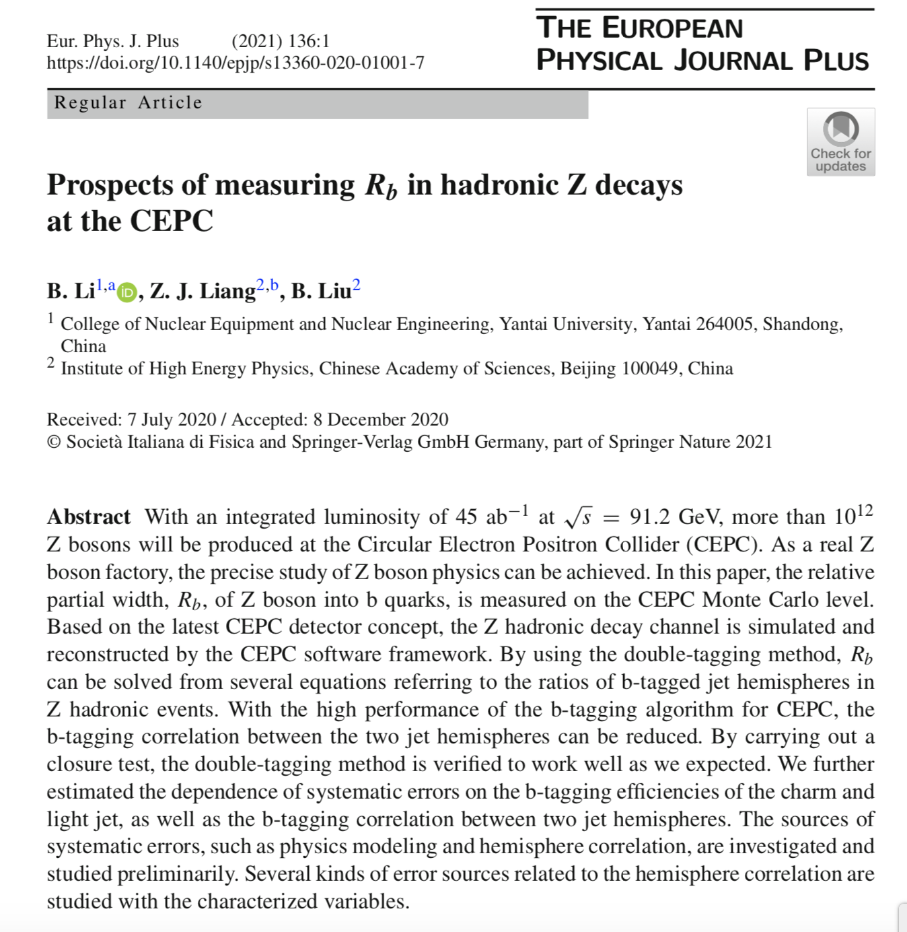
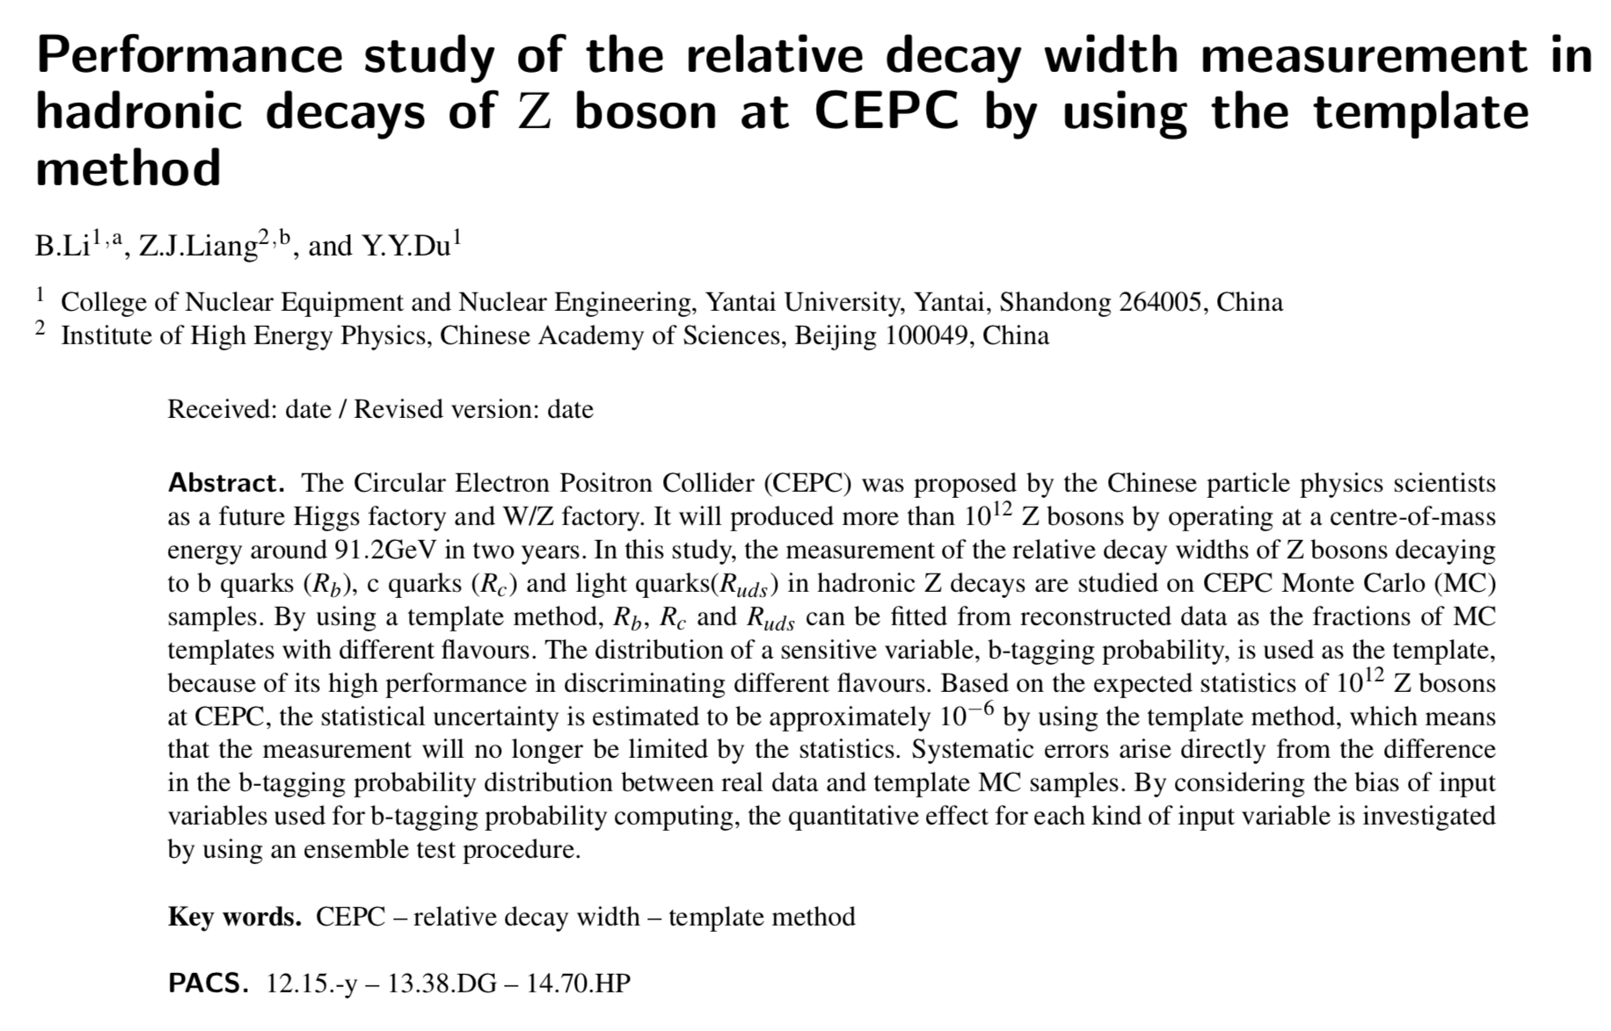
R^{b}: publication
Published at EPJP
By Li Bo (Yantai University)
B Tagging matrix approach
New study with template fit in preparation
By Li Bo (Yantai University)

Slide 14
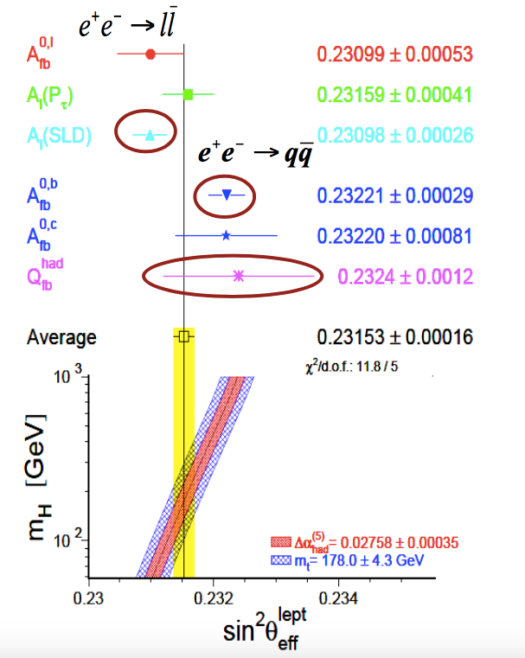
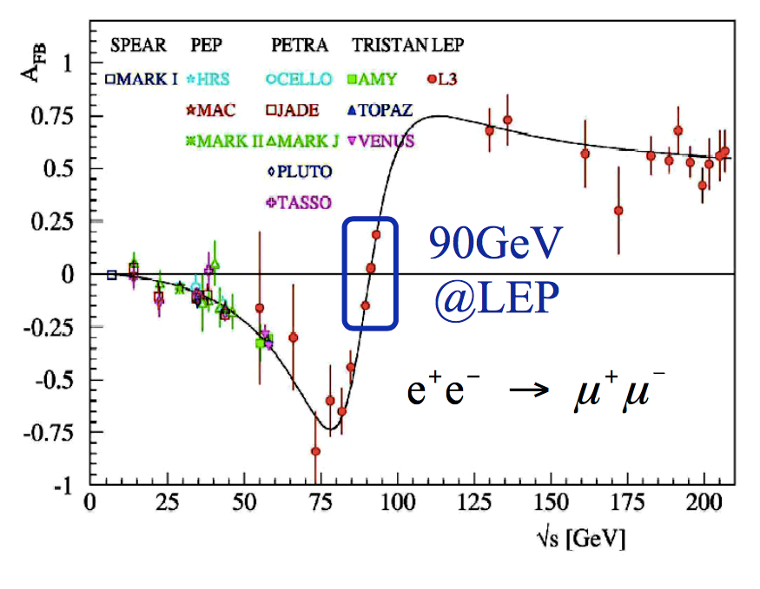
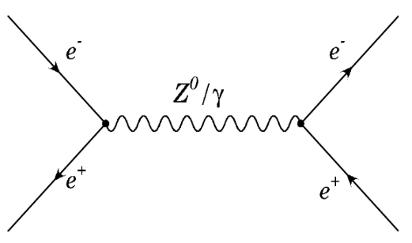
Weak mixing angle measurements (Sin²θ_{W} )
Weak mixing angle measurement is well motivated
  ~3σ tension between LEP and SLC measurements
  Experimental syst. much larger than theory syst.
 | Sin²θ_{W}
LEP | 0.23221 ± 0.00029
SLC | 0.23098 ± 0.00026
Theory | 0.23121 ± 0.00004

Slide 15
Weak mixing angle measurements (Sin²θ_{W} )
Stat. Unc. dominated in LEP and Tevatron measurements
Syst. Unc. (PDF) will become dominated systematics for LHC measurements
CEPC has potential to improve Sin²θ_{W} by two order of magnitudes
Theory unc. is about 4×10⁻⁵ level with two loop calculation
more inZhenyu ’s
Talk later
Experiment | Stat. (10⁻⁵) | Syst. (10⁻⁵) | Theory unc. (PDF+QCD) (10⁻⁵) | Total unc. (10⁻⁵) δsin²θ_{W}
LEP | 29 | ~ 1 | ~0 | 29
Tevatron | 27 | 5 | 18 | 33
LHC 8TeV | 36 | 18 | 35 | 53
LHC 13TeV By Projection | ~15 | > 20 | > 25 | ~ 20
CEPC By LEP Projection | ~0.2 | ~0.2 | 4 (Today) | ~0.3

Slide 16
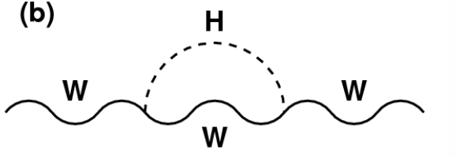
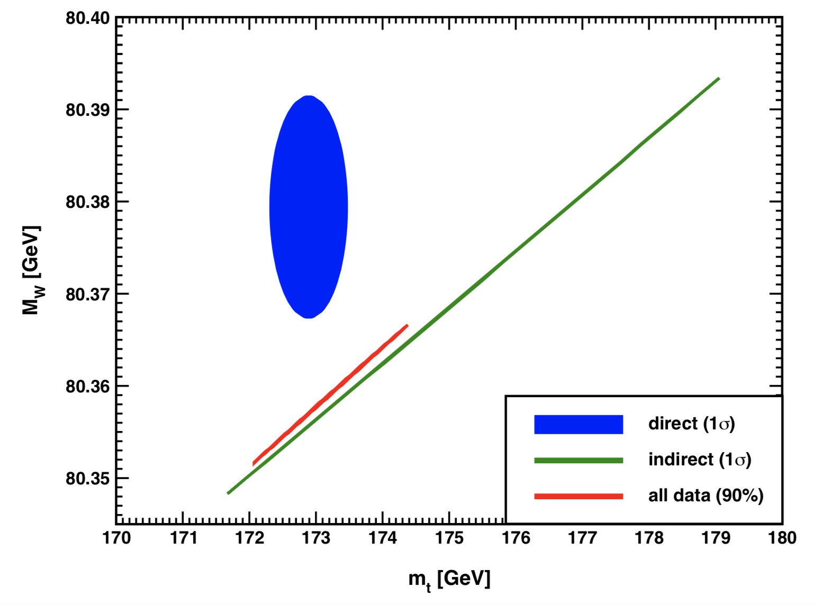
W mass measurements
W mass measurement is well motivated
  ~2σ tension between direct measurements and EWK global fit
  Indirect search for new physics
W mass (m_{W}) vs Top mass (m_{t})
Chi2 distribution of W mass in EWK fit

Slide 17
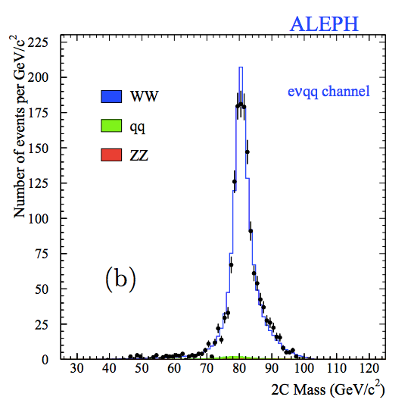
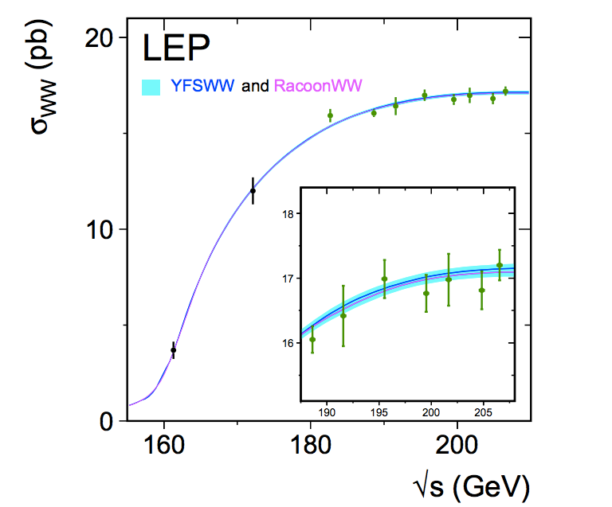
W mass measurement in lepton collider
Two approaches to measure W mass at lepton collider （developed by LEP)
Direct measurement
performed in ZH runs (240GeV)
Precision 2~3MeV
WW threshold scan
WW threshold runs (157~172GeV)
Expected Precision 1MeV level

Slide 18
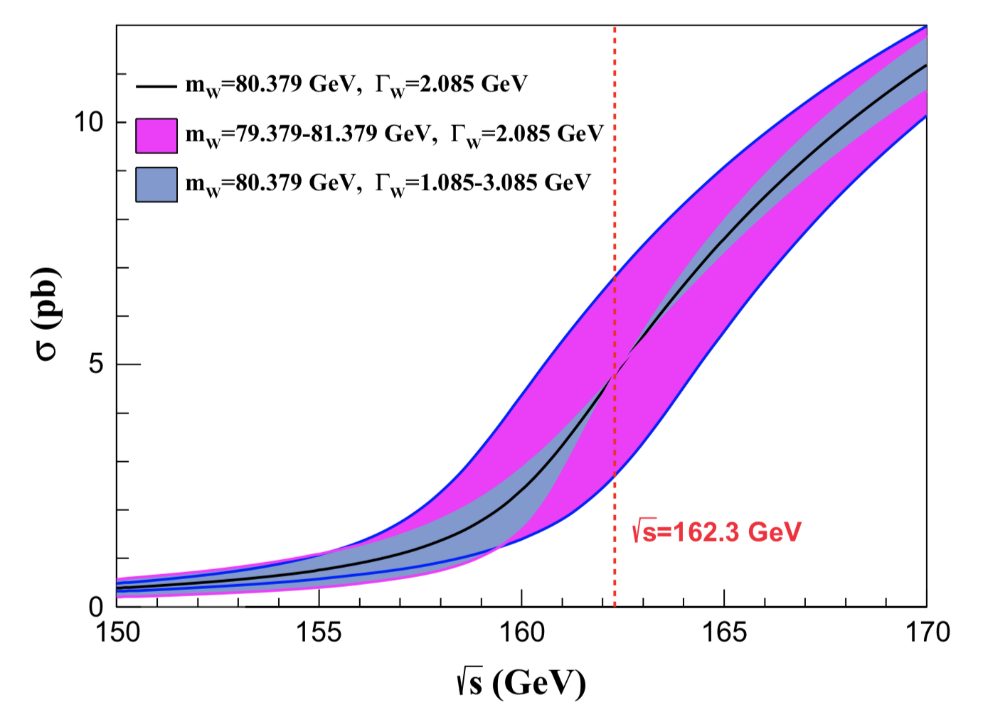
W mass measurement in lepton collider
Optimization of data taking strategy in WW threshold scan
Assuming one year data taking in WW threshold (2.6 ab⁻¹)
Four energy scan points:
  157.5, 161.5, 162.5( W mass, W width measurements)
  172.0 GeV (⍺_{QCD} (m_{W}) measurement, Br (W->had) , CKM |Vcs|)
  14M WW events in total(400 times larger than LEP2 comparing WW runs)
E_{cm} (GeV) | Lumiosity (ab⁻¹) | Cross section (pb) | Number of WW pairs (M)
157.5 | 0.5 | 1.25 | 0.6
161.2 | 0.2 | 3.89 | 0.8
162.3 | 1.3 | 5.02 | 6.5
172.0 | 0.5 | 12.2 | 6.1

Slide 19
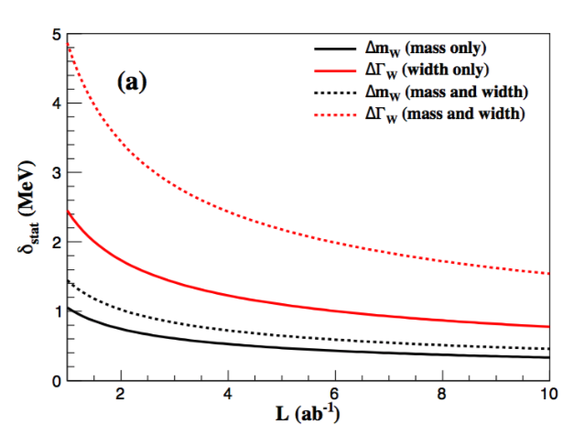
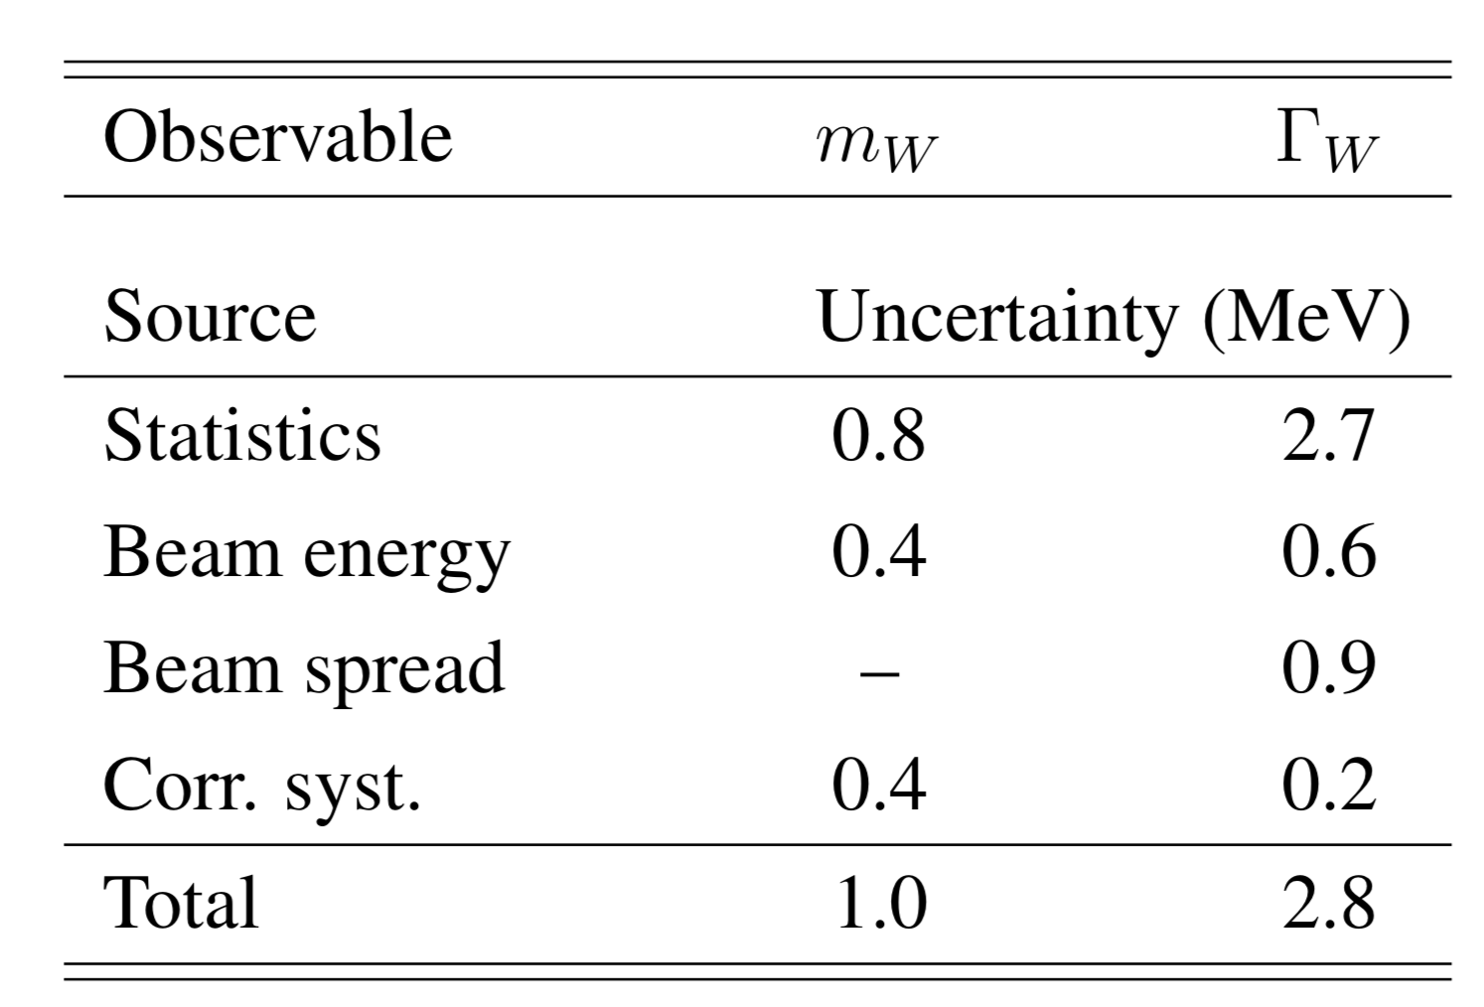
W mass measurements
Expect to reach 1MeV precision on W mass ( 12 MeV unc. in PDG fit in PDG2020)
Four energy scan points:
  157.5, 161.5, 162.5( W mass, W width measurements)
  172.0 GeV (⍺_{QCD} (m_{W}), Br (W->had) , CKM |Vcs|)
  14M WW events in total
  400 times larger than LEP2 WW runs)
P.X.Shen, P.Azzuri , G.Li et,al,
Eur.Phys.J.C 80 (2020) 1, 66
Joint study of CEPC/Fcc-ee

Slide 20
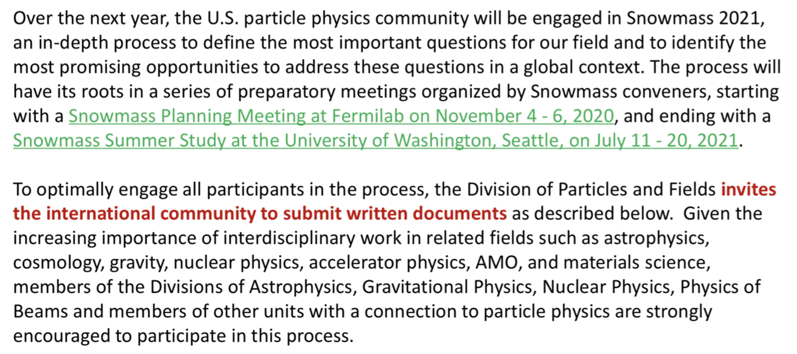
Contribution to Snowmass
CEPC electroweak community is very active in Snowmass
One working group in snowmass (EF04) is for precision measurements
More details about snowmass in Ayres Freitas’s talk
https://snowmass21.org/

Slide 21
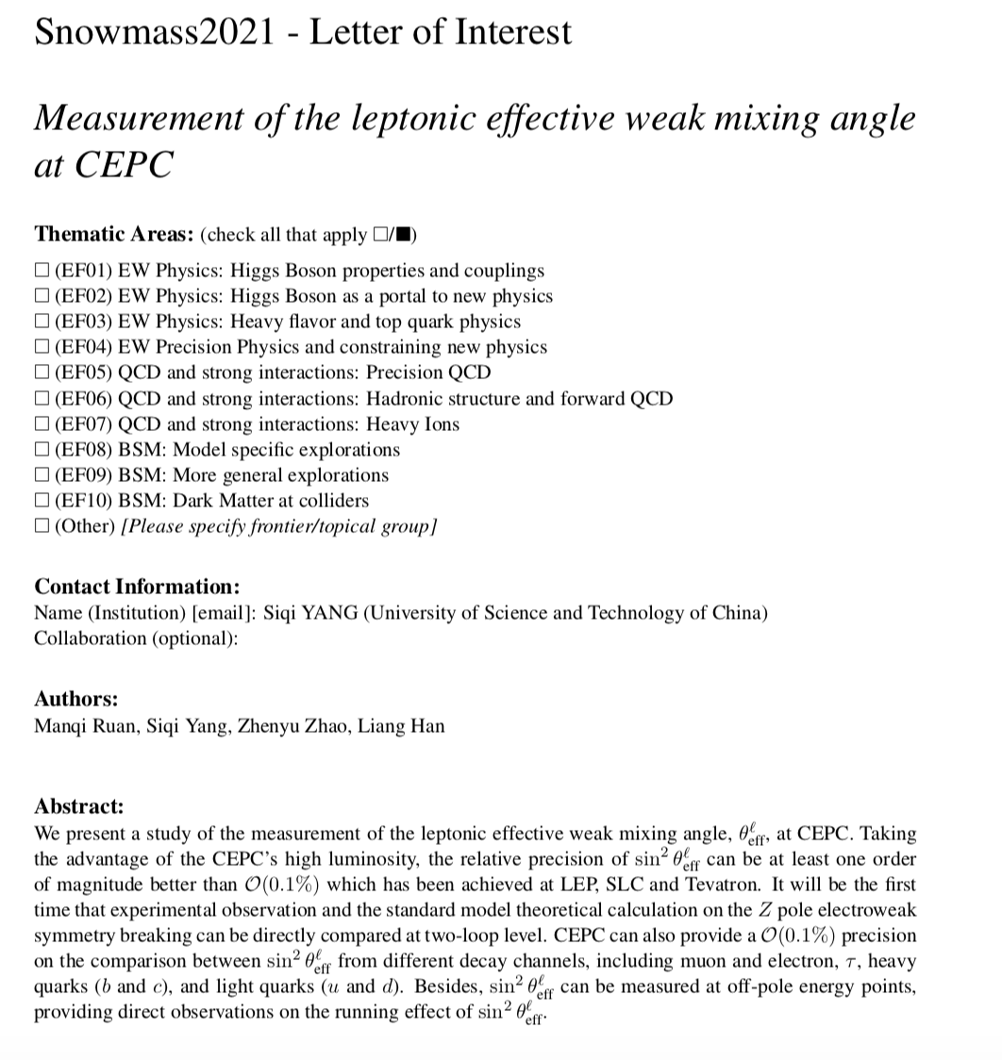
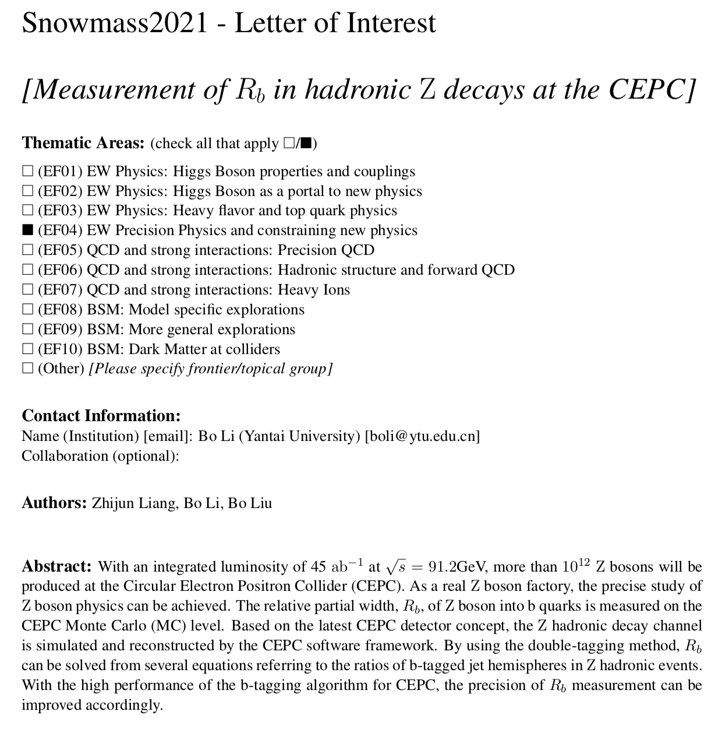
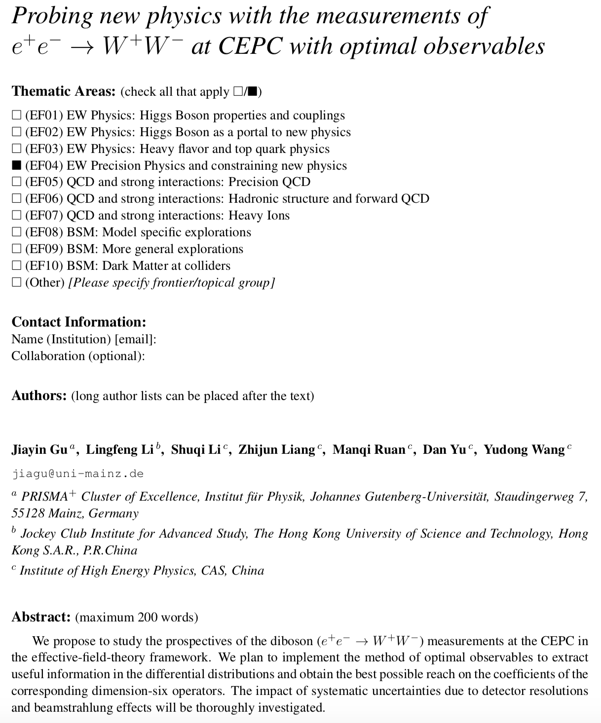
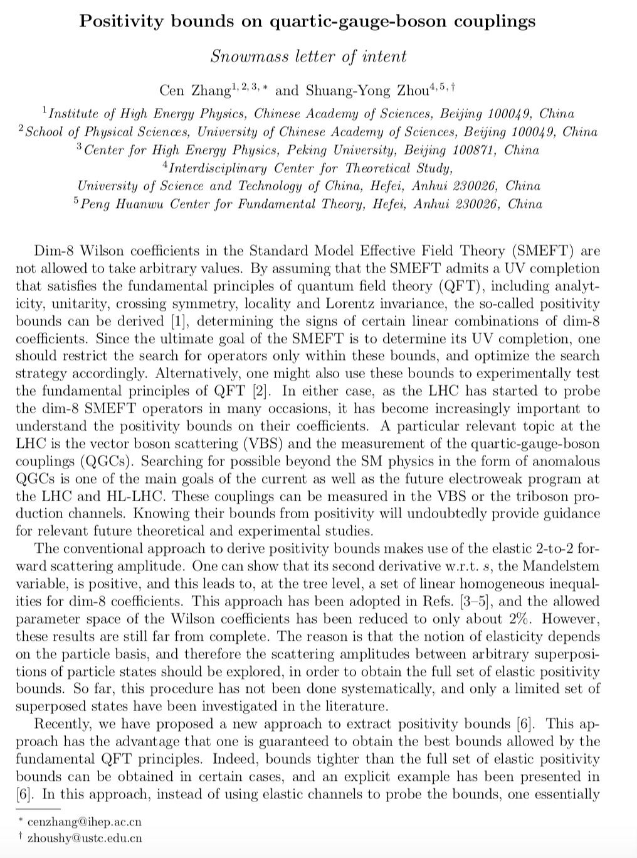
Snowmass 2021
Submit five letter of intent (LOI) in snowmass 2021
Weak mixing angle measurements at Z pole
  More study with more realistic simulations
  More detailed study on experimental and theory systematics
High order EWK calculation (NNLO EWK corrections )
aTGCs/QGCs in WW events
Bounds in aQGCs
Z->bb branching ratio
CEPC LOI of Sin²θ_{W}
CEPC LOI : Z->bb
CEPC LOI : TGC in WW
CEPC LOI : unitarity

Slide 22
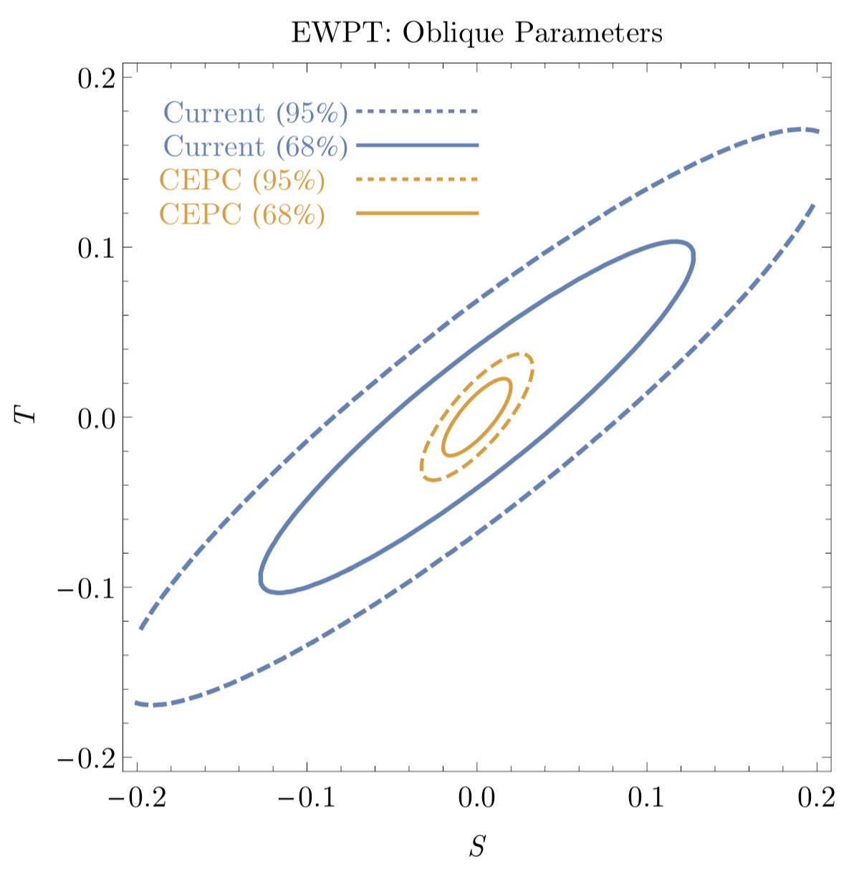
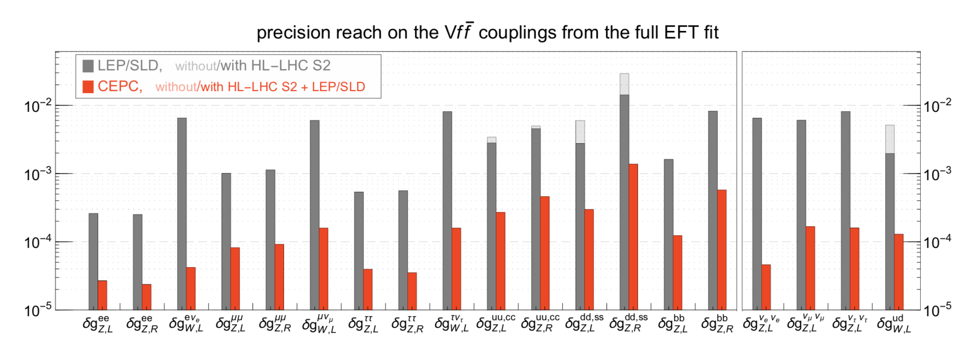
EWK white paper
Plan to have EWK white paper in one year , welcome for contributions
Prospects study of CEPC EWK precision measurements
implication study of EWK measurements.
Current draft on git.
  http://cepcgit.ihep.ac.cn/CEPC-White-Paper/electroweak-physics.git/
See more detail in Jiayin’s talk about EFT

Slide 23
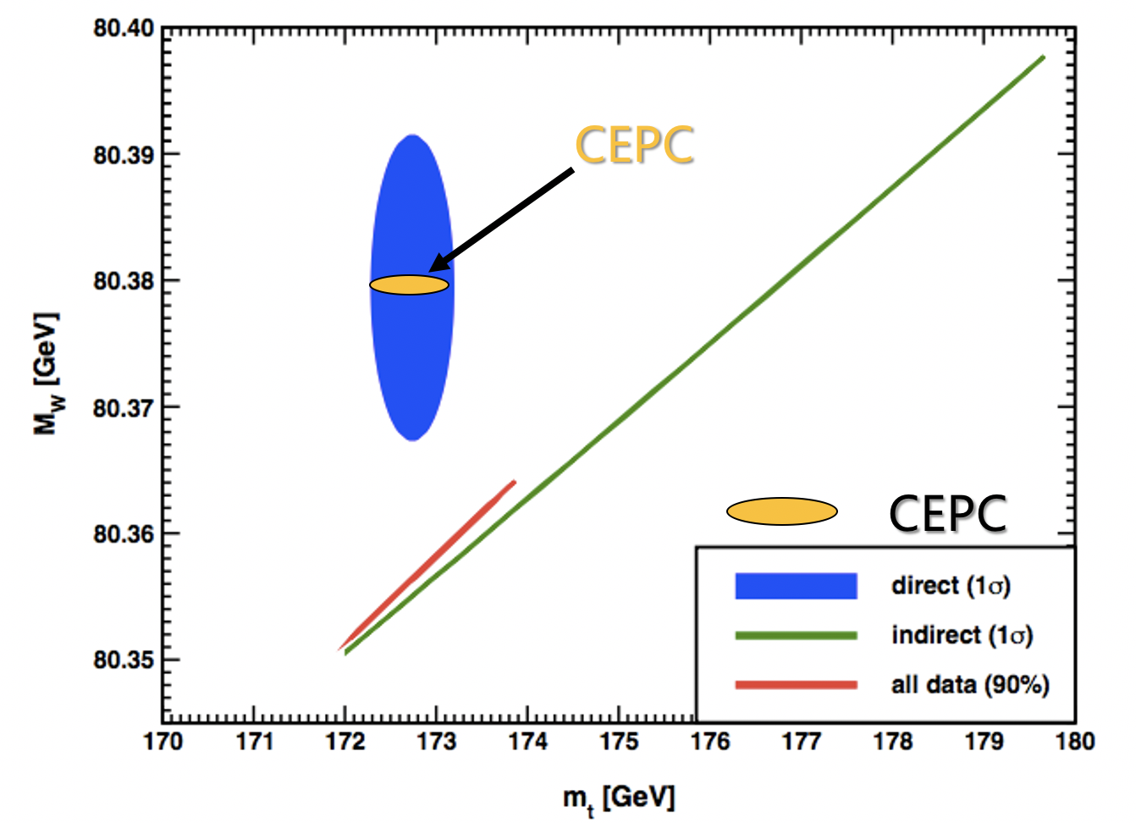
Summary
Luminosity @ Z pole is now 3.2 times higher compared to CDR design
Instant luminosity > 100*10³⁴cm⁻²s⁻¹
>1.5 X10¹² Z boson (Two year Z pole running )
Potential of electroweak measurement at CEPC
1~2 order of magnitude better than current precision
May solve the puzzle in muon g-2, W mass and Sin²θ_{W}
Please join us !

Slide 24
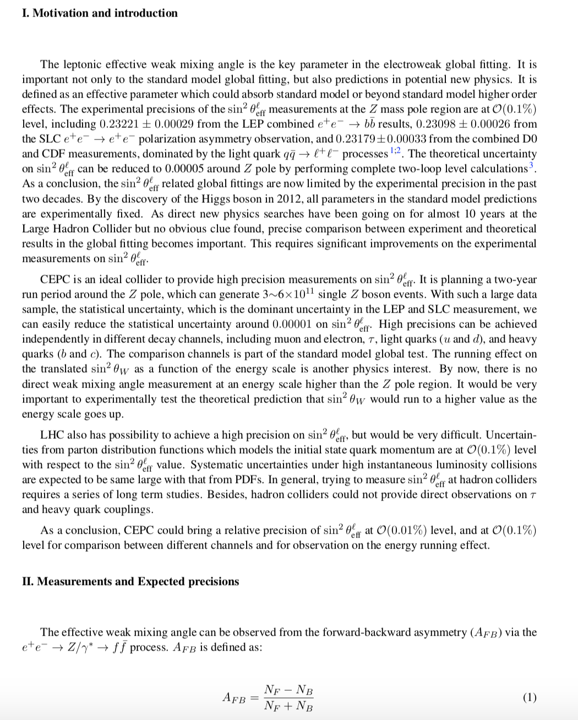
Weak mixing angle measurement at Z pole sin²θeff and AFB
By Dr. Siqi Yang (USTC)

Slide 25
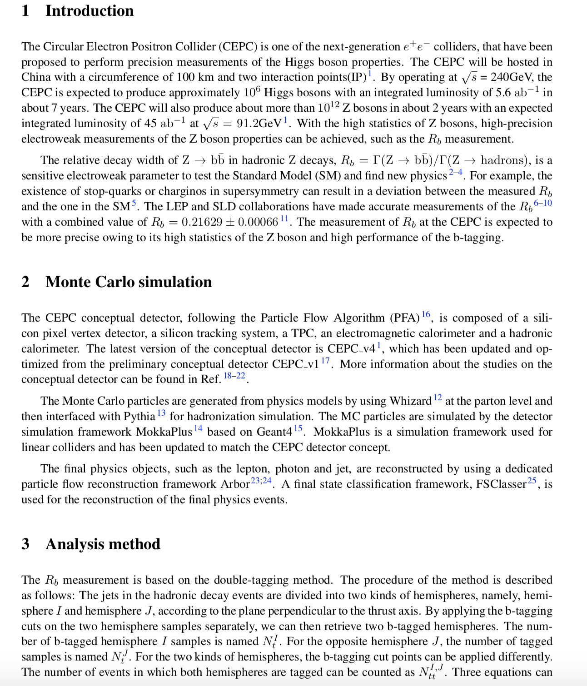
R^{b} measurements
By Dr. Bo Li (Yantai U.)

Slide 26
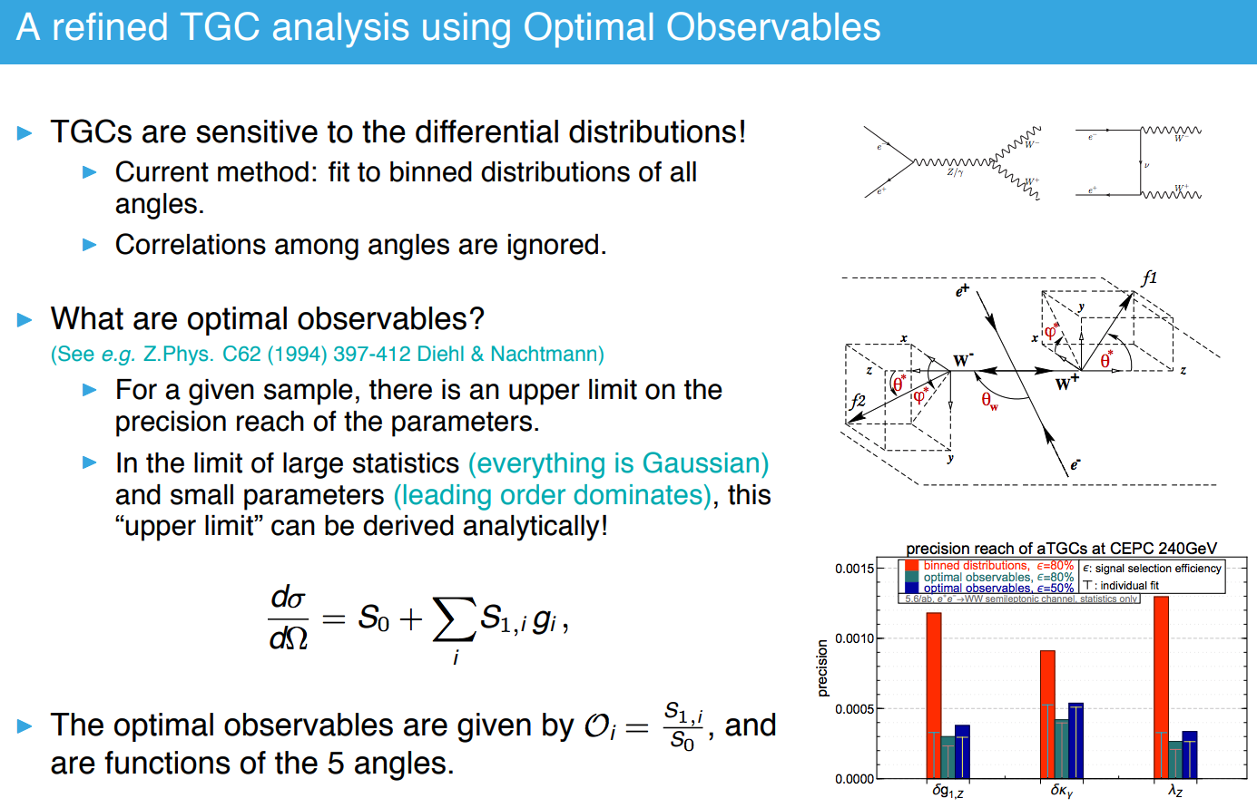
By jiaYing Gu,lingfeng Li
Dan Yu, Shuqi Li, Manqi, Zhijun
TGC with optimal observables

Slide 27
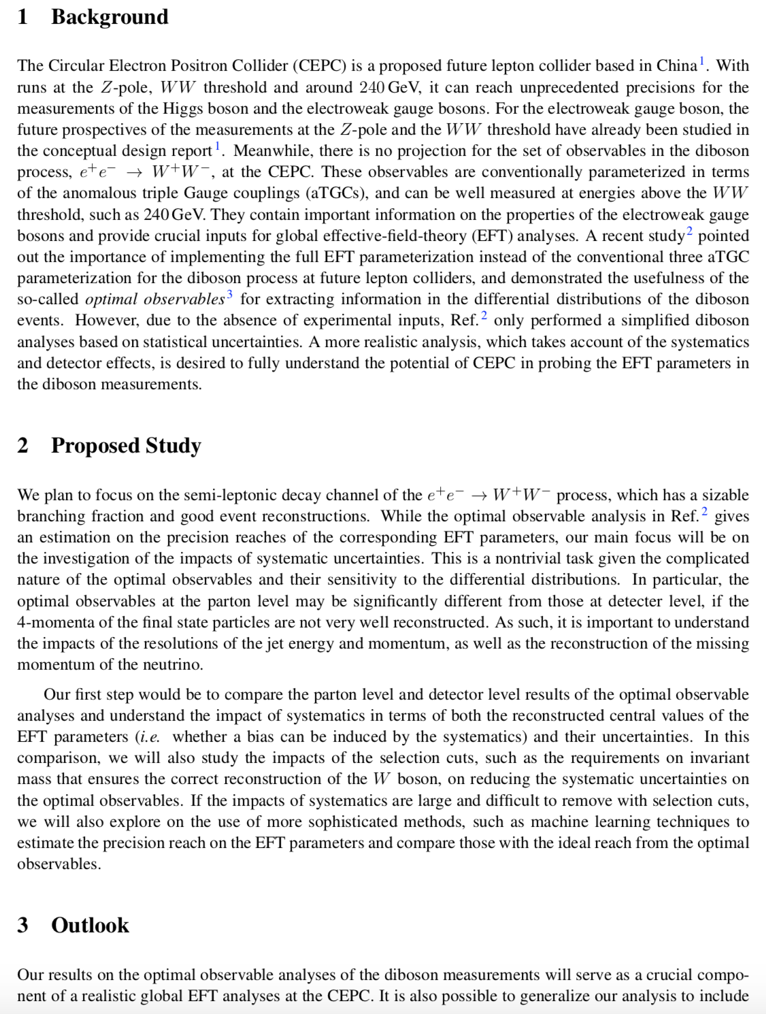
By jiaYing Gu,lingfeng Li
Dan Yu, Shuqi Li, Manqi, Zhijun
TGC with optimal observables

Slide 28
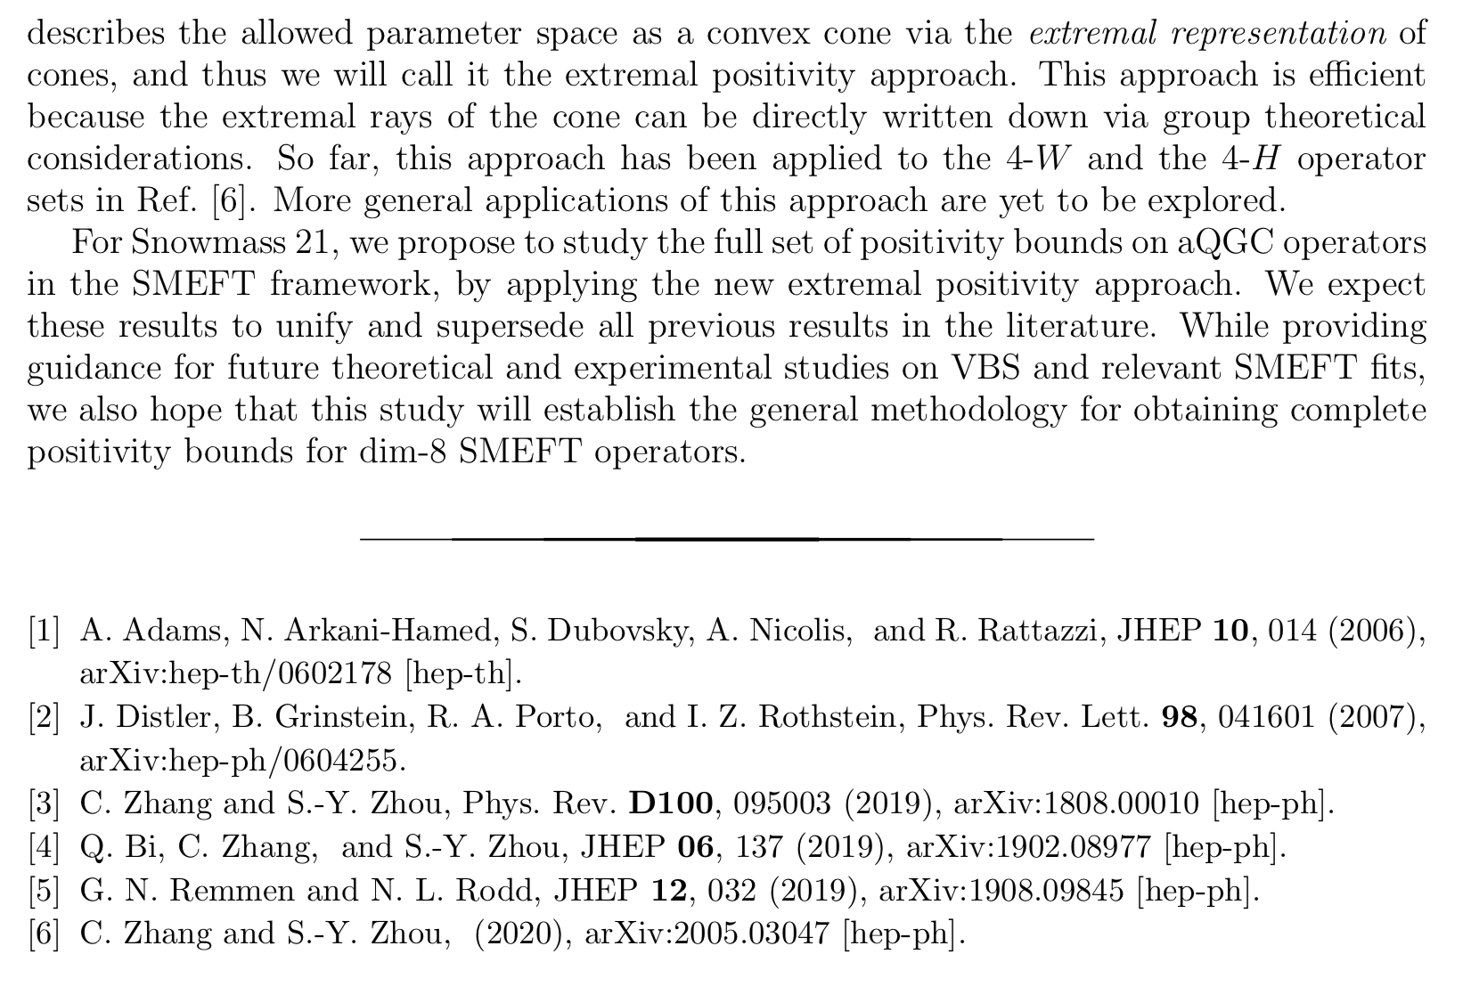
Bounds in aQGCs (by Cen Zhang)

Slide 29
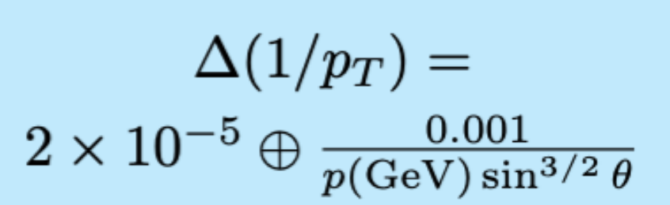
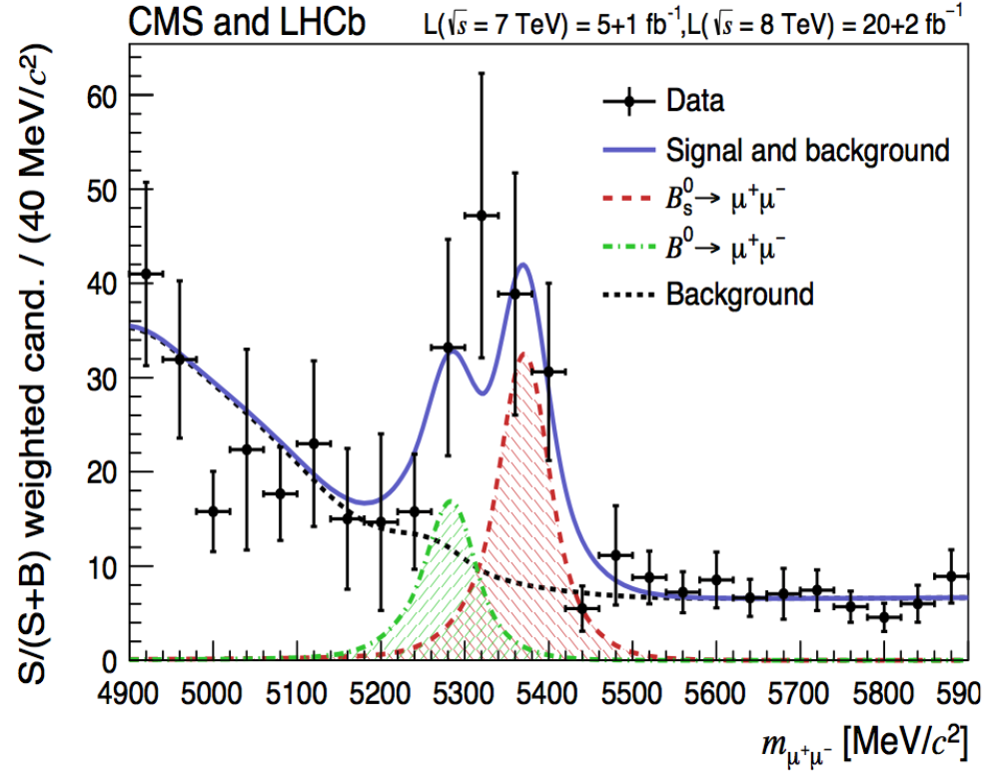
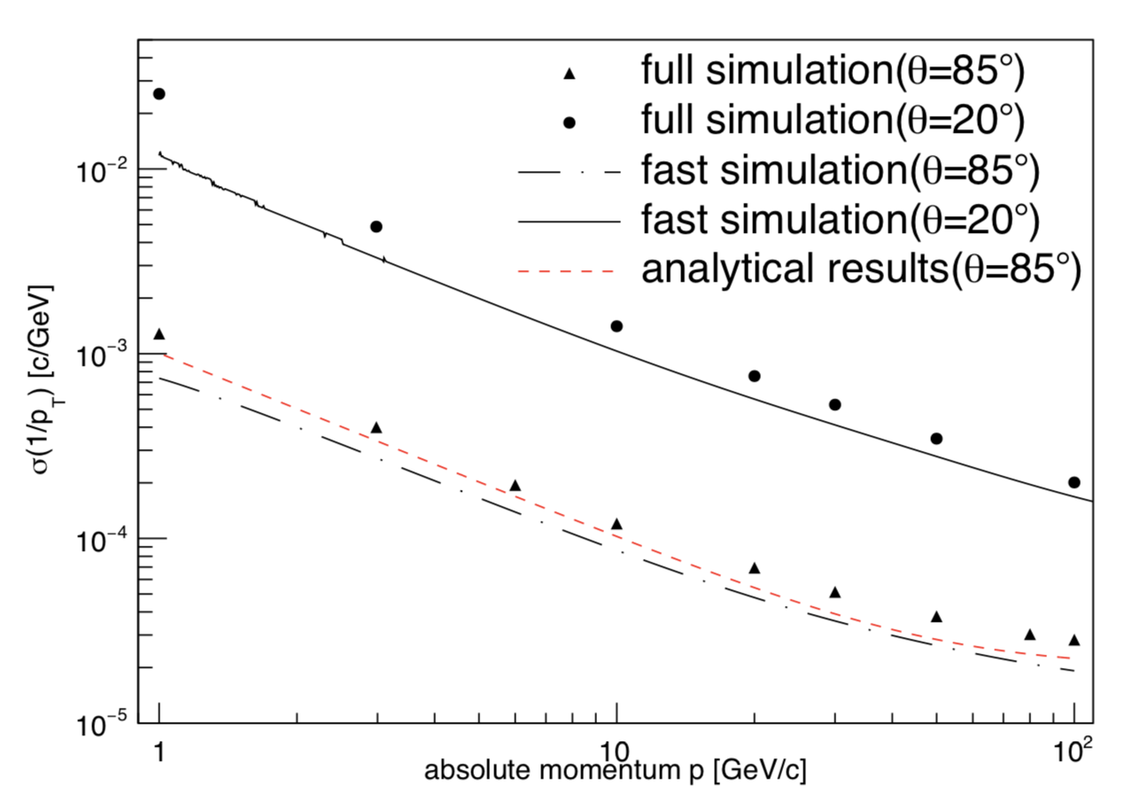
Backup: Track momentum resolution @ Z pole
Current optimization based on ZH runs @ 240GeV
Most demanding case for low momentum track resolution is flavor physics
Current design is good enough for EWK and flavor physics at Z pole
B_{s} /B⁰-> μ μ by CMS and LHCb
Momentum resolution in CEPC
From
CEPC CDR

Slide 30

Z mass measurement
LEP precision : 91.1876±0.0021 GeV
CEPC goal : 0.5 MeV (CDR) → 0.1MeV (TDR)
Beam energy uncertainty is major systematics (0.1MeV)
Luminosity measurement

Slide 31

Branching ratio ( R^{b}): theory systematics
QCD related systematics
  High order QCD corrections gives impact to hemisphere correlations
  Impact to Backward-forward asymmetry

Slide 32



R^{b}: gluon splitting
Gluon splitting systematics is estimated by comparing data and MC simulation
DELPHI Z->4b analysis
Gluon splitting measurements

Slide 33

R^{b}: charm modelling and lepton ID
Charm modelling : depends on input from flavor experiments (BELLEII…)
  C hadron fractions (factions of D⁺, D⁰, D⁺_{s}) → 0.2% syst. In R^{b}
  LEP: Tagging efficiency for D+ is three times higher than D0
  Need more study to check D meson tagging efficiency in Fcc-ee/CEPC

Slide 34


Branching ratio ( R^{b}): systematics
Tracker resolution and efficiency(~0.1%)
Lepton identification (~0.1%)
Charm modeling (~0.4%)
Gluon splitting (~0.1%)
Background (~0.2%)
b-tagging corrections (~0.3%)
OPAL collaboration, Eur.Phys.J.C8:217-239,1999

Slide 35

R^{b}: b tagging hemisphere correlations
Hemisphere is taken to be tagged
  if it is tagged by either one or both of the secondary vertex and lepton tags.
Major systematics: hemisphere correlations
  The tagging efficiency correlation between the two hemispheres in one event:
    Angular effects : due to inefficient regions of detector
    QCD effects (g->bb )
    Vertex effects : due to vertex fitting
are
Single (N_{t}) and double tagged events (N_{tt})

Slide 36




Weak mixing angle measurements
Sin²θ_{W} can be extracted very precisely from A_{e} and A_{𝛕} using tau polarization
Major systematics of A_{e} precisely:
Tau ID efficiency and fake rate (expected to be comparable to stat. unc.)
Tau purity was already very good in LEP
even better at CEPC with better tau performance

Slide 37



Branching ratio ( R^{b}): detector requirement
Two ways to tag the b quarks in Z->qq events
  Secondary Vertex tag (Average decay length of b meson of 2mm level at Z pole)
    Multi-variant analysis : Impact parameter in R/ϕ and Z , mass of vertex …
  Lepton tag
  High momentum Electron and muon with pT>1GeV in a jet …
Vertex distance to IP
Vertex distance significance
SLD, Ann.Rev.Nucl.Part.Sci.46:395-469,1996

