Slide 1



Simulation of particle identification with cluster counting technique
F.Cuna ^{a,c}, G.F.Tassielli ^{b,c}, F.Grancagnolo^{c}, N.De Filippis ^{d,e}
ª Università del Salento
^{b} Università degli Studi di Bari
^{c} INFN-Lecce
^{d} INFN-Bari
^{e} Politecnico di Bari

Slide 2
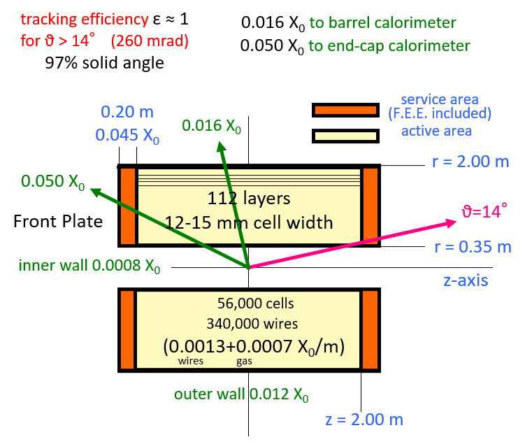
IDEA DRIFT CHAMBER
The IDEA drift chamber (DCH) is the tracker of FCC-ee and CEPC.
It is designed to provide efficient tracking, high precision momentum measurement and excellent particle identification by exploiting the application of the cluster counting technique.
MAIN GOALS
Gas containment – wire support functions separation:
  the total amount of material in radial direction, towards the barrel calorimeter, is of the order of 1.6% X0, whereas in the forward and backward directions it is equivalent to about 5.0% X0, including the endplates instrumented with front end electronics.
Feed-through-less wiring:
  allows to increase chamber granularity and field/sense wire ratio to reduce multiple scattering and total tension on end plates due to wires by using thinner wires
Cluster timing:
  allows to reach spatial resolution < 100 μm for 8 mm drift cells in He based gas mixtures (such a technique is going to be implemented in the MEG-II drift chamber under construction)
Cluster counting:
  allows to reach dN_{cl}/dx resolution < 3% for particle identification (a factor 2 better than dE/dx as measured in a beam test)
He based gas mixture
(90% He – 10% i-C₄H₁₀)
Full stereo configuration with alternating sign stereo angles ranging from 50 to 250 mrad
12÷14.5 mm wide square cells 5 : 1 field to sense wires ratio
56,448 cells
14 co-axial super-layers, 8 layers each (112 total) in 24 equal azimuthal (15º) sectors
MORE INFORMATION:
https://indico.cern.ch/event/656491/contributions/2939121/attachments/1629781/2597342/IDEA-CDCH_FCCweek18.pdf

Slide 3
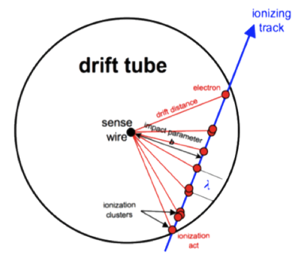
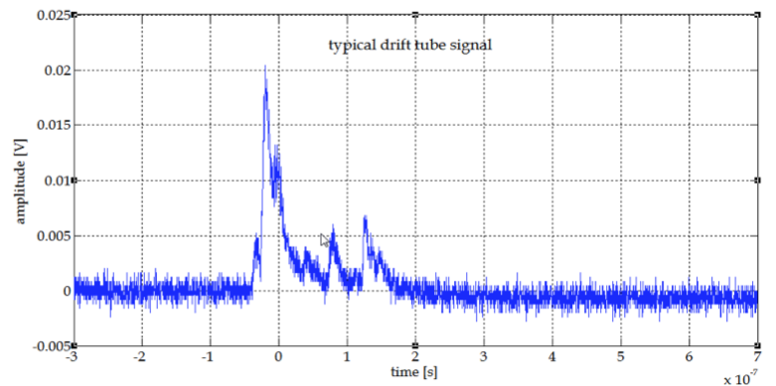
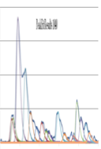
Cluster Counting/Timing and P.Id. expected performance
Gaseous counters provide signals with pulse height proportional to the numbers of electron liberated during the ionization process along the track length inside the sensitive volume and proportional to the energy deposit .
Using the information about energy deposit particle identification can be performed, but the large and inherent uncertainties in total energy deposition represent a limit to the particle separation capabilities.
Cluster counting technique can improve the particle separation capabilities.
The method consists in singling out, in ever recorded detector signal, the isolated structures related to the arrival on the anode wire of the electrons belonging to a single ionization act (dN/dx).
acquired signal
identified peaks
dE/dx dN_{cl}/dx
Truncated mean cut (70-80%) reduces the amount of collected information
n ≈ 100 and a 2m track at 1 atm give
σ ≈ 4.3%
δ_{cl} = 12.5/cm for He/iC₄H₁₀=90/10 and a 2m track give
σ ≈ 2.0%
Moreover, C.C. may improve the
spatial resolution < 100 μm for 8 mm drift cells in He based gas mixtures

Slide 4
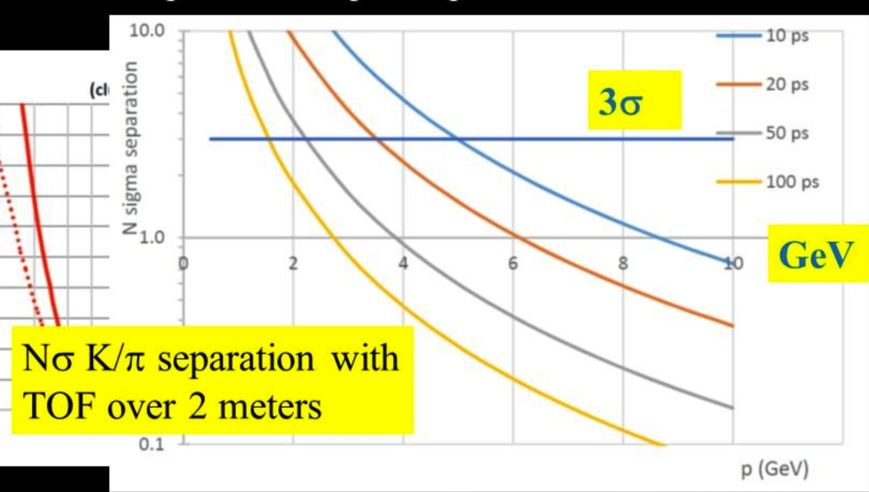
Cluster Counting/Timing and P.Id. expected performance
80% cluster counting efficiency.
Expected excellent K/π separation over the entire range except 0.85<p<1.05 GeV (blue lines)
Could recover with timing layer
dN/dx
e/μ
dE/dx
μ/π
K/π
K/p
Nσ K/π separation with TOF over 2 m
3σ
Analytic evaluation, prof F.Grancagnolo
To be checked with test beam and simulations

Slide 5
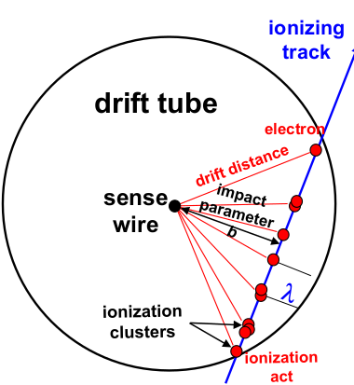
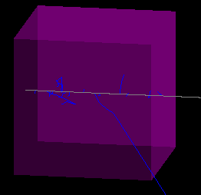
Drift Chamber simulation - Cluster Counting/Timing simulation
To investigate the potential of the Cluster Counting technique (for He based drift chamber) on physics events a reasonable simulation/parameterization of the ionization clusters generation in Geant4 is needed.
Garfield/Garfield++:
(Heed) simulates the ionization process in the gasses (not only) in a detailed way.
(Magboltz) computes the gas properties (drift and diffusion coefficients as function of the fields value)
solves the electrostatic planar configuration and simulates the free charges movements and collections on the electrodes.
So Garfield can study and characterize the properties and performance of single cell or drift chamber with simple geometry, but it is not designed to simulate a full detector neither study collider events.
Geant4:
Simulates the elementary particle interaction with material of a full detector
Studies colliders events
It doesn’t simulate (normally) the ionization clustering process
It doesn’t simulate (normally) the free charges movements and collections on the electrodes.
It is very useful to simulate the elementary particle interaction with the material of a full (complex) detector and to study collider events. The fundamental properties and performance of the sensible elements (drift cells) have to be parametrized or ad-hoc physics models have to be defined.

Slide 6
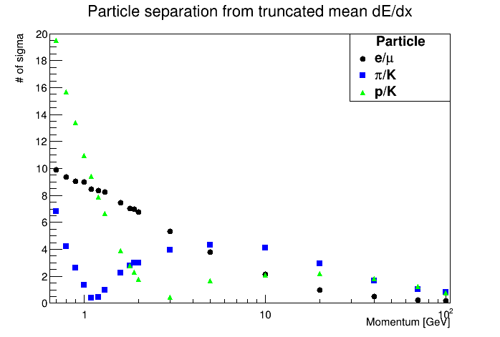
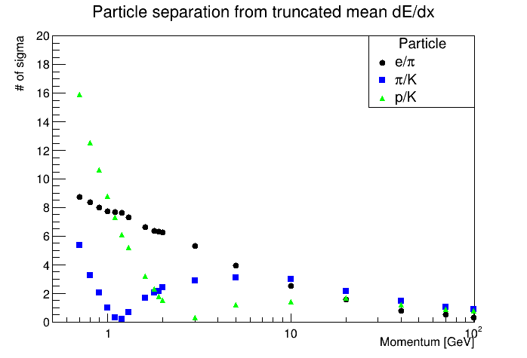
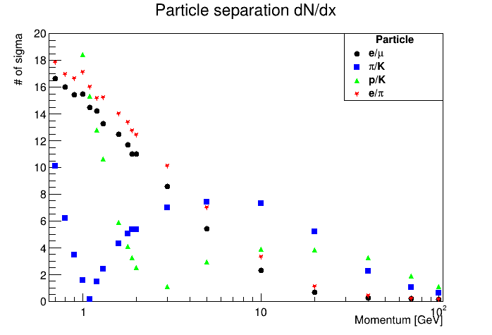

Drift Chamber simulation - Cluster Counting/Timing simulation-PID
Garfield
Geant
Truncated mean at 70%
We are simulating tracks crossing 200 cells (1 cm long side) of 90% He and 10% iC₄H₁₀ with Garfield and Geant
$$n_{σ}=\frac{∆_{A}−∆_{B}}{\left\langle σ_{A,B}\right\rangle }$$
<σ_{A,B}> is the average of the two resolutions.
Garfield
Cluster counting leads to an improvement on particle separation power.
As example, around 5 GeV the power separation of a pion from kaon obtained with traditional method is about 4, the one obtained with cluster counting is around 8.

Slide 7
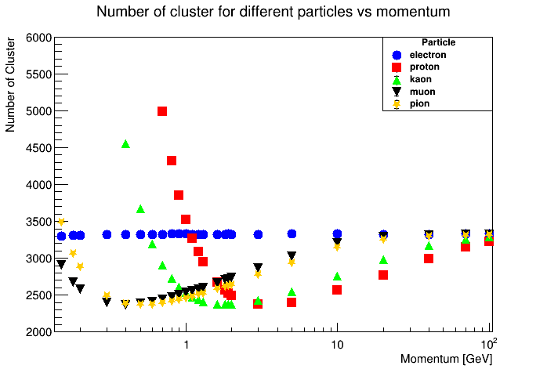
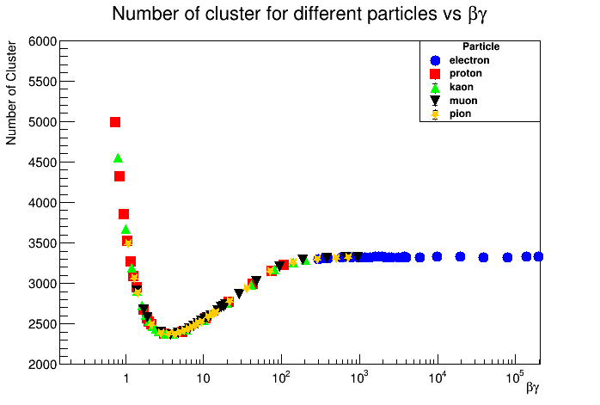
Drift Chamber simulation - Cluster Counting/Timing simulation-Garfield analysis
Studying the results from Garfield++ simulations, we can interpret correctly the results obtained from Geant4 simulations with the goal of reconstruct the number of clusters and the cluster size generated from different particles with different momenta passing through the tracker detector.
The goal is to extract from Garfield++ the relevant parameters to create models to convert the energy loss to cluster and then extract them as function of the primary particle βγ.
Number of cluster from Garfield++
Here the distribution of number of cluster produced by different
particle at different momenta, obtained with Garfield++

Slide 8
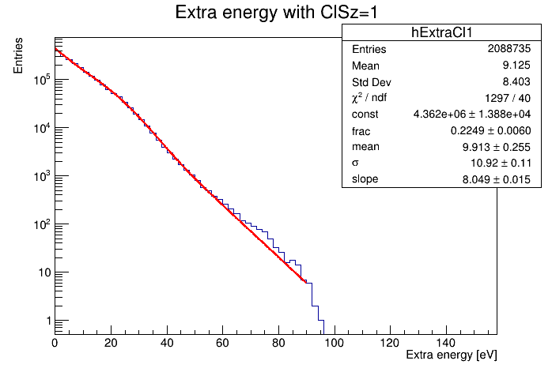
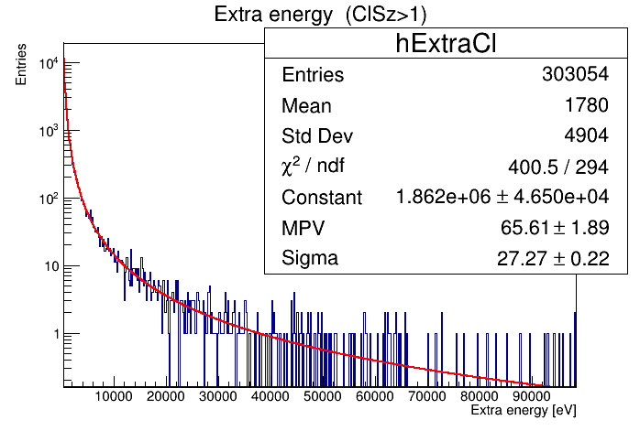
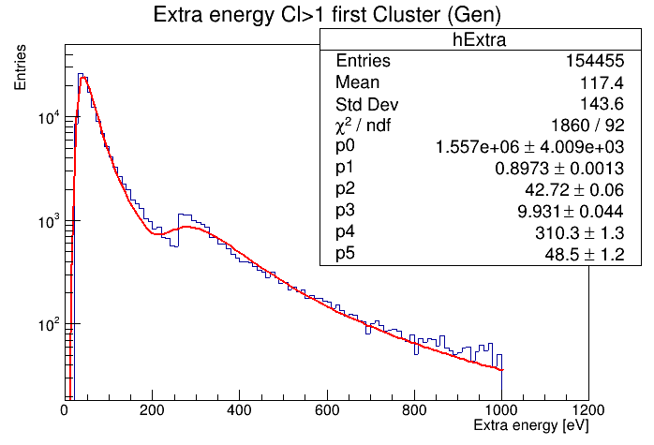
Drift Chamber simulation - Cluster Counting/Timing simulation-Kinetic energy
Kinetic energy distribution for cluster with cluster size equal to 1.
The fit is the sum of an exponential function plus a Gaussian function.
Kinetic energy distribution for cluster with cluster size higher than 1 (left) and up to 1keV cut (right).
The fits are performed with a Landau functions.
1keV cut is equivalent to the single interaction range cut set (by default) in Geant4
The goal is to create two different models for kinetic energy of clusters with cluster size equal to 1 and higher than 1, to interpret correctly the total energy loss by different particles in a single cell.

Slide 9
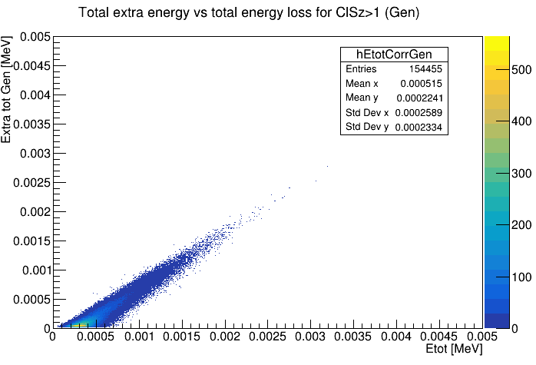
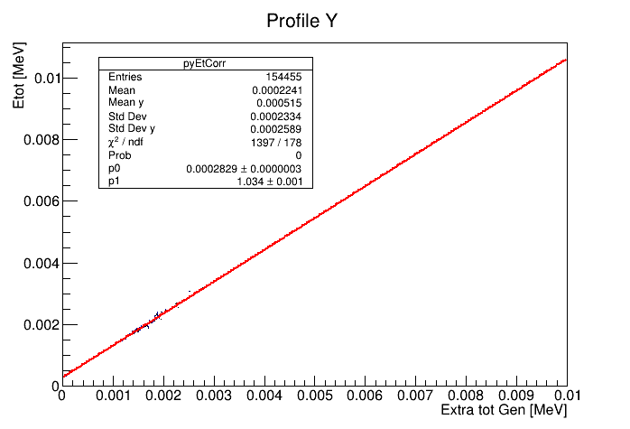
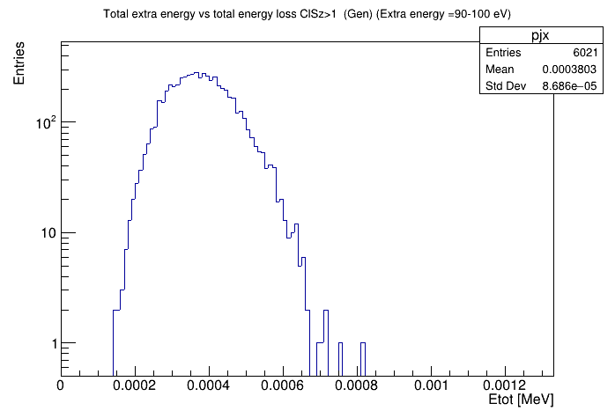

Drift Chamber simulation - Cluster Counting/Timing simulation-kinetic energy for cluster with cluster size higher than 1
maxExEcl = total kinetic energy spent to create cluster with cluster size
higher than 1
MaxEx0 is the first parameter of the linear fit
MaxExSlp is the second parameter of linear fit
ExSgm is the average of the sigma of each point in the correlation trend.
$$maxExECl=\frac{\left(Etot−maxEx0+gRandom→Gaus\left(0,ExSgm\right)\right)}{maxExSlp}$$
The figure shows an example of distribution of total energy loss for extra energy between 90 and 100 eV for cluster with cluster size higher than one.

Slide 10
Drift Chamber simulation - Cluster Counting/Timing simulation-The algorithms
We implemented seven different algorithms trying to reproduce the number of cluster and the cluster size.
The first step common to all algorithm is the evaluation of the total kinetic energy for cluster with cluster size higher than one (maxExEcl) event by event.
1) The first algorithm uses a reference value of the ratio between clusters containing a single electron and clusters containing more than one electron (Rt). Using the Rt value, the algorithm chooses to create cluster with cluster size one or higher. Then, it assigns the kinetic energy to each cluster by using the proper distributions. If the cluster has more than one electron, a check on the total kinetic energy is performed and its cluster size is evaluated. The procedure is repeated until the sum of primary ionization energy and kinetic energy per cluster saturate the energy loss of the event.
2) The second algorithm, if maxExEcl is higher than zero, generates the kinetic energy for clusters with cluster size higher than one by using its distribution and evaluates cluster size. This procedure is repeated until the sum of primary ionization energy and kinetic energy per cluster saturate the maxExEcl of the event.
Then, using the remaining energy (Eloss-maxExEcl), the algorithm creates clusters with cluster size equal to one by assigning their kinetic energy according to the proper distribution.
The reconstruction of clusters with cluster size equal to one remains the same for all next algorithms.
3) The third algorithm (similar to the previous), during the generation of cluster with cluster size higher than one, assigns the kinetic energy to them, choosing the best over five extractions that makes the total kinetic energy for cluster with cluster size higher than one approximating better the maxExEcl.
To correct a systematic underestimation of the mean number of clusters, an additional correction to the residual energy for generating cluster with cluster size equal to one can be used.

Slide 11
Drift Chamber simulation - Cluster Counting/Timing simulation-The algorithms
4)The fourth algorithm (similar to the previous), during the generation of cluster with cluster size higher than one, assigns (by extracting from the proper distribution) the kinetic energy to them, until the total kinetic energy better approximates the maxExEcl.
5)The fifth algorithm is similar to the fourth with almost differences in the technical implementation.
6)The sixth algorithm follows a different methodology. Indeed it uses the total kinetic energy of the event to evaluate a priori the number of cluster, applying the most likelihood criterium.
7)The last algorithm is similar to the second algorithm but generates the kinetic energy for cluster with cluster size higher than one by using the fit of kinetic energy distribution.
List of variables
maxExEcl : total kinetic energy spent to create clusters with cluster size higher than 1
ExECl : kinetic energy generated per cluster
Ncl1 : number of clusters with cluster size equal to one
Nclp : number of clusters with cluster size higher than one
maxCut : energy value equivalent to the range cut set in Geant4
totExECl : total kinetic energy reconstructed to create clusters with cluster size higher than one
Eloss : energy loss from a track passing through the cell
ClSz : cluster size
Eizp : primary ionization energy, 15.8 eV
Eizs : secondary ionization energy, 25.6 eV

Slide 12
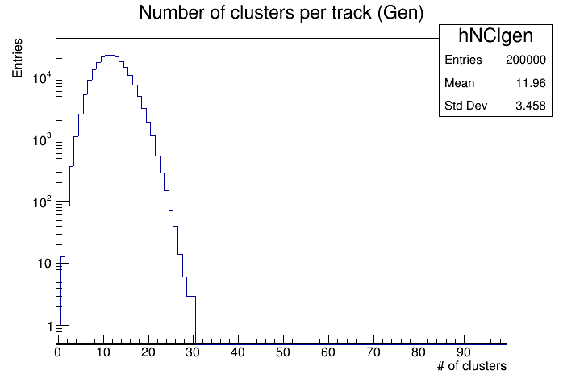
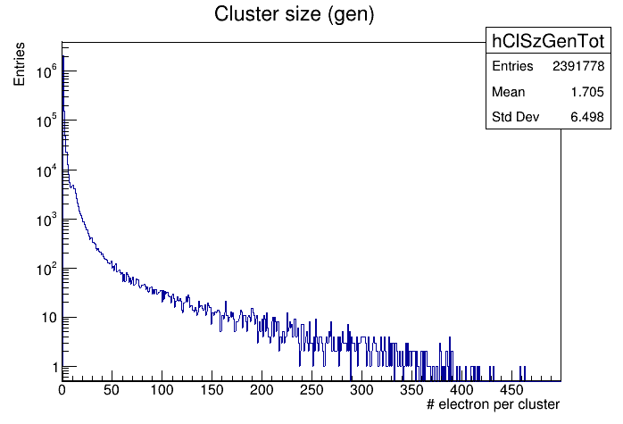
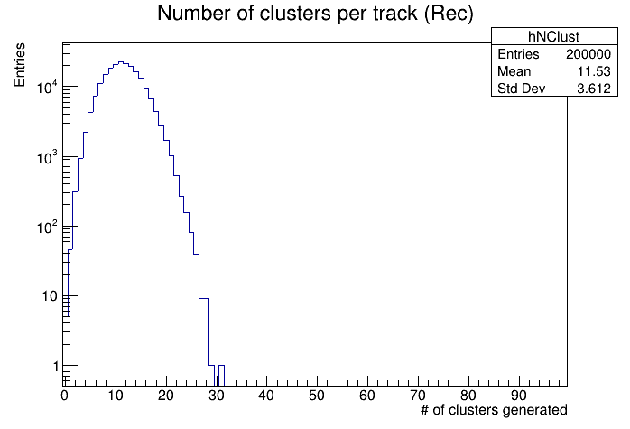
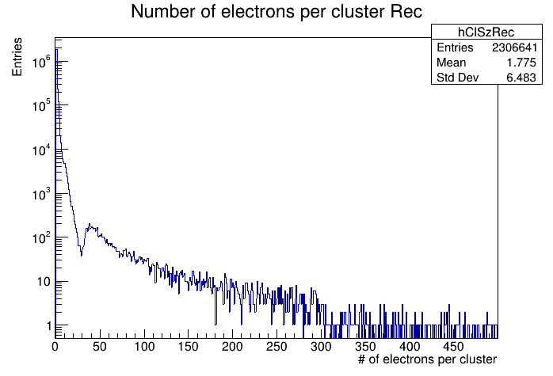
Drift Chamber simulation - Cluster Counting/Timing simulation-Results
MC Truth
Case of study: muon at 300 MeV
2st algorithm

Slide 13
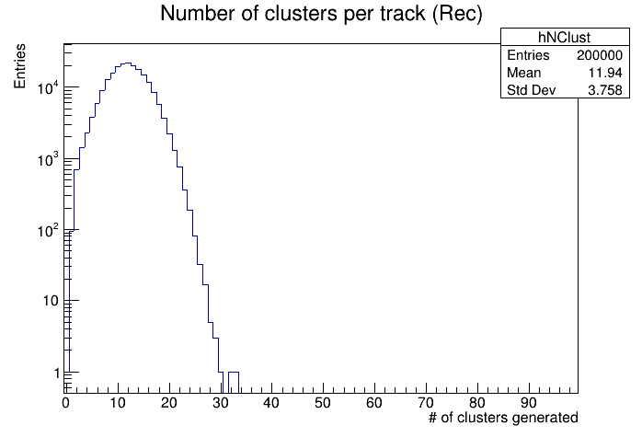
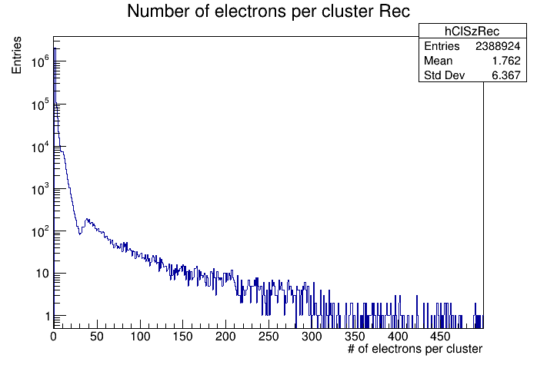
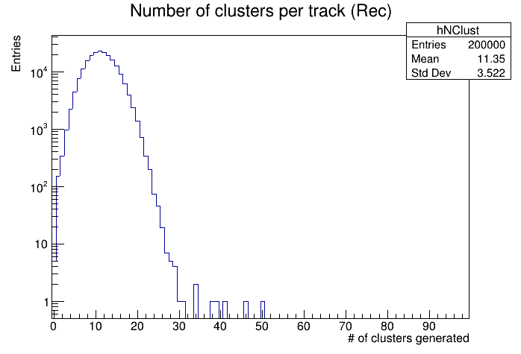
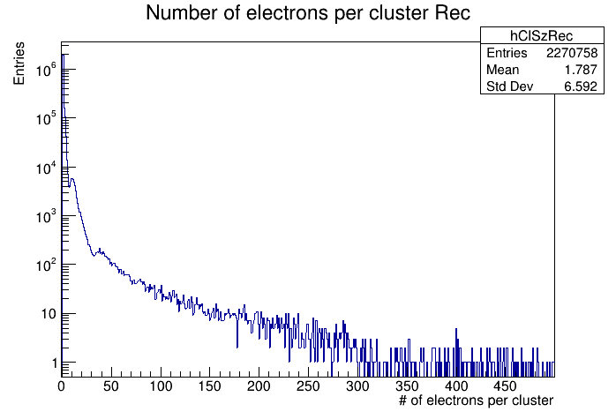
Drift Chamber simulation - Cluster Counting/Timing simulation-Results
3st algorithm
6st algorithm

Slide 14
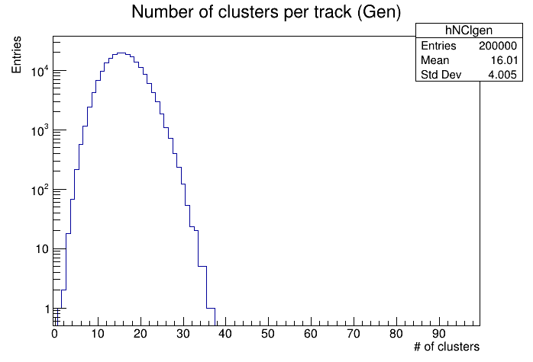
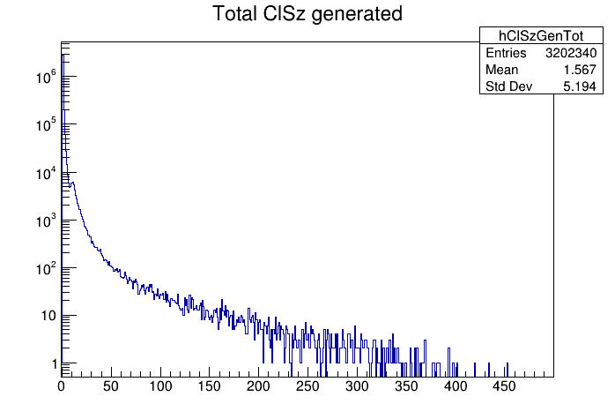
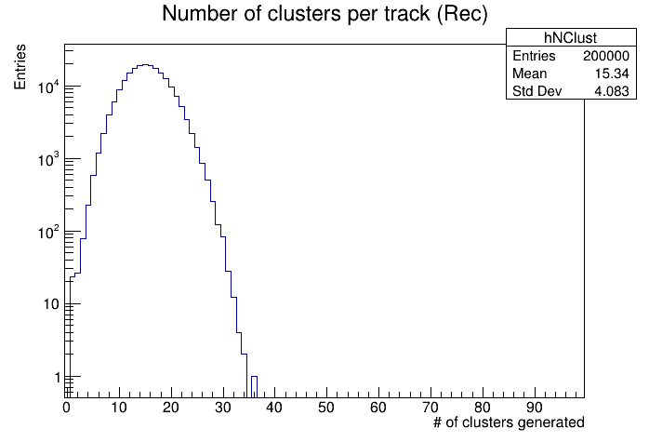
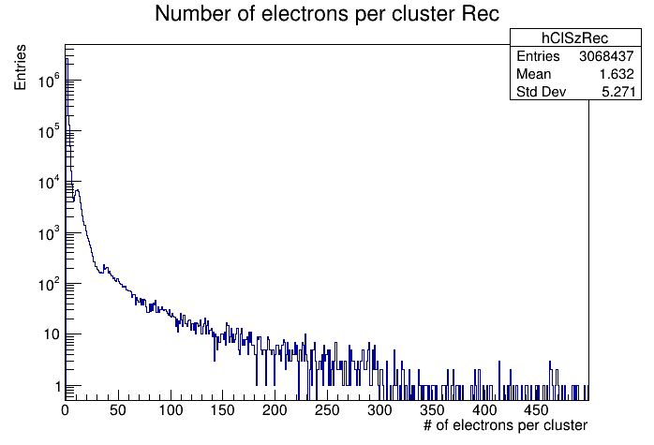
Drift Chamber simulation - Cluster Counting/Timing simulation-Test on different momenta and different particles
Garfield
Garfield
Case of study: muon at 10 GeV
09/02/2021
14

Slide 15
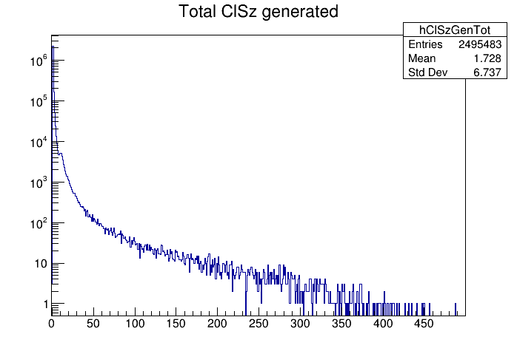
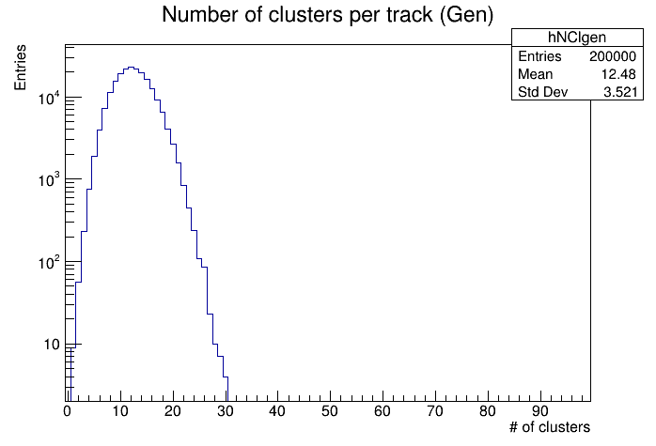
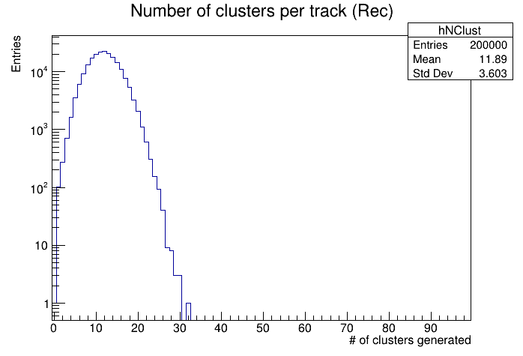
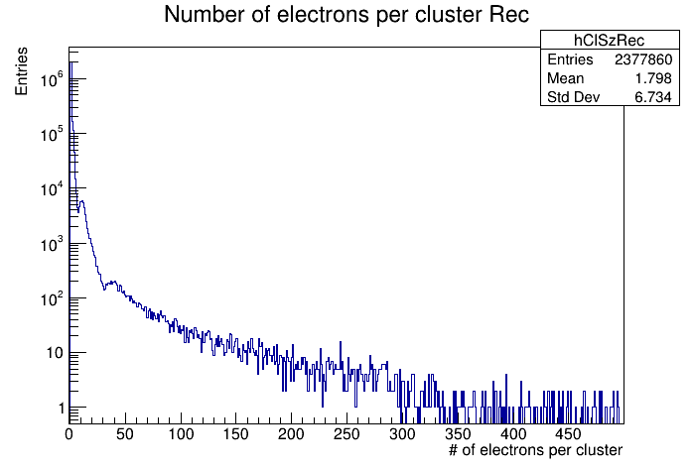
Drift Chamber simulation - Cluster Counting/Timing simulation-Test on different momenta and different particles
Garfield
Garfield
Case of study: pion at 300 MeV
09/02/2021

Slide 16
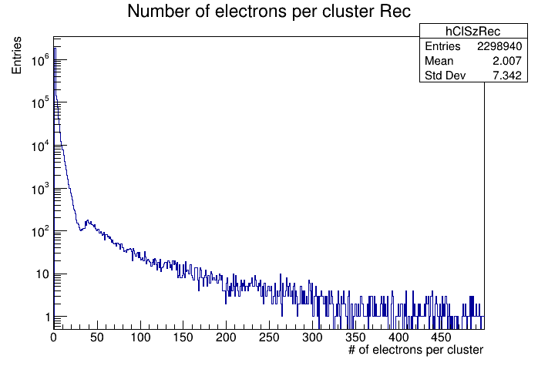
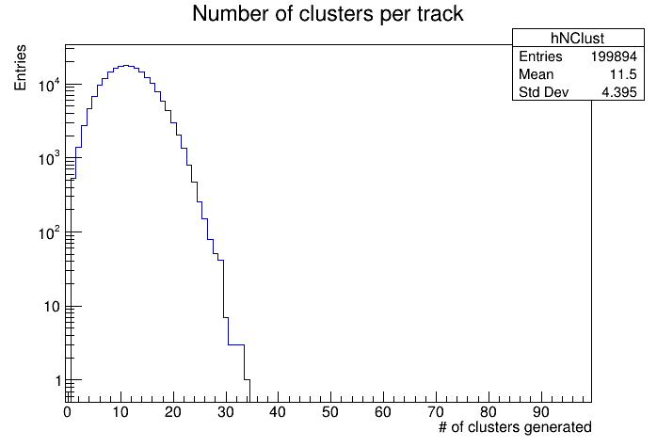
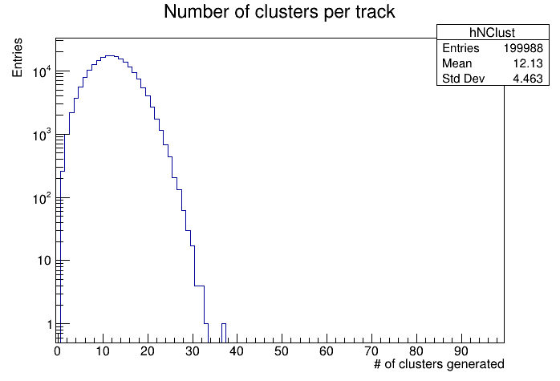
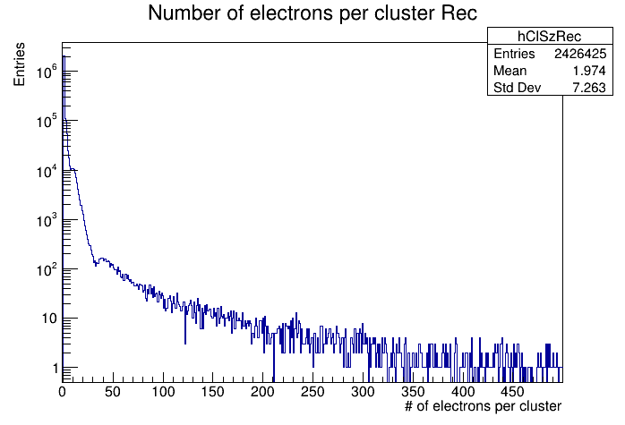
Drift Chamber simulation - Cluster Counting/Timing-Geant4
The algorithm is tested with Geant4 simulations and the results obtained are compatible with the ones obtained with Garfield++.
2st algorithm
Case of study: muon at 300 MeV
3st algorithm

Slide 17
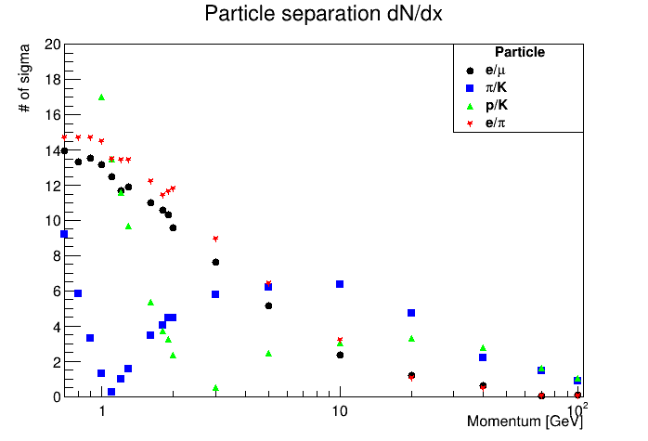

Drift Chamber simulation - Cluster Counting/Timing-PID in Geant4
Geant4
2st algorithm
Garfield++
Geant4
3st algorithm
We are simulating tracks crossing 200 cell (1 cm long side) of 90% He and 10% iC₄H₁₀ with Garfield and Geant.
We are assuming a cluster counting efficiency of 100%.

Slide 18
Conclusions
Cluster counting improves particle separation capabilities respect to the traditional dE/dx method.
Reasonable algorithms to simulate the Ionization Clusters by using the Geant4 data are developed.
The algorithm was tested on different cell size, providing consistent results.
A first fast Cluster Finder algorithm was developed, implemented on an FPGA and tested on a test bench.
We are working on importing the algorithm in the drift chamber full simulation.
To do list
Continue to develop the full simulation and perform physics studies
Perform PID studies with the full detector simulation
Improve Clustering algorithm validation with measurements
Continue to develop the DAQ prototype and test it
Construct the monitor chamber and ad hoc prototypes
Thanks for your attention

Slide 19
BACKUP

Slide 20
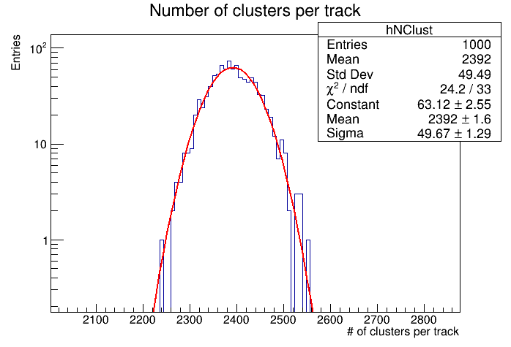
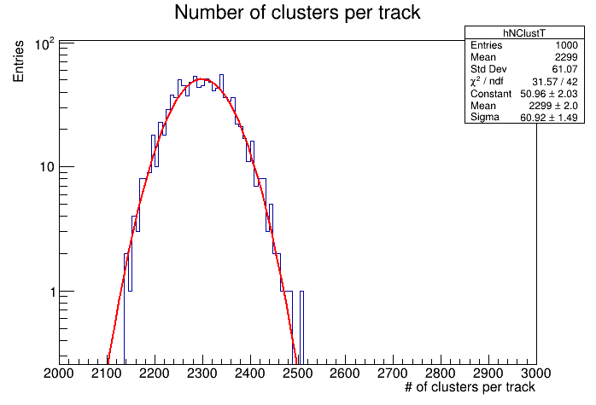
Number of cluster for muon 300 MeV in 200 cells
Geant4
Garfield++

Slide 21
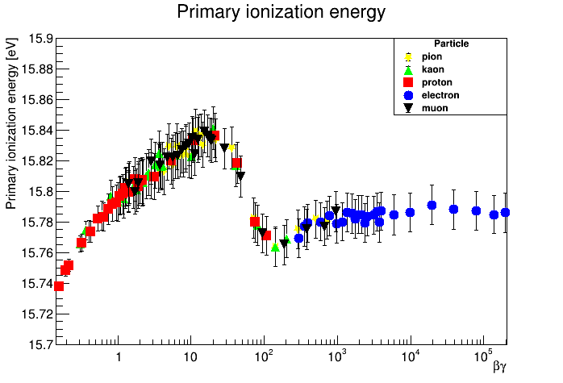
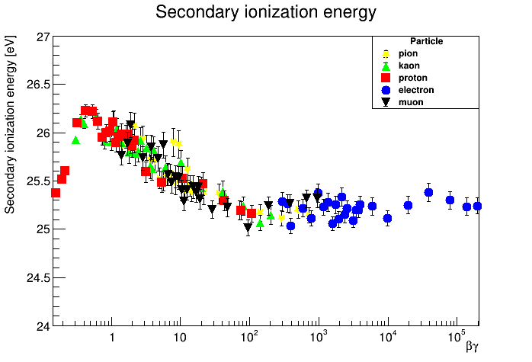
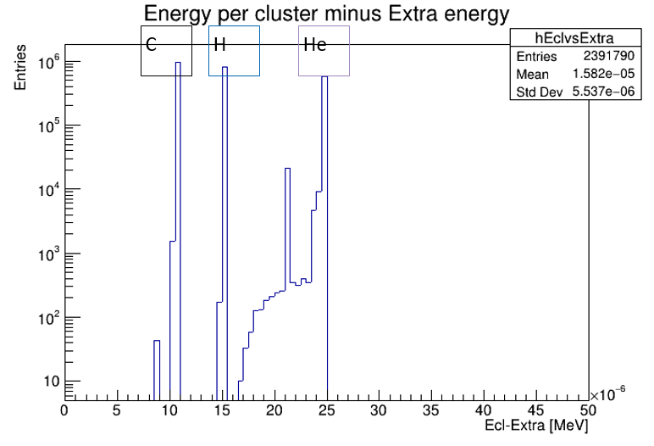
Drift Chamber simulation - Cluster Counting/Timing simulation
Average value (Eizp) = 15.8 eV
Average value (Eizs) = 25.6 eV
Primary ionization
energy for
the He-iC₄H₁₀ mixture
First step to the algorithm implementation is the evaluation of primary and secondary ionization energy
09/02/2021

Slide 22
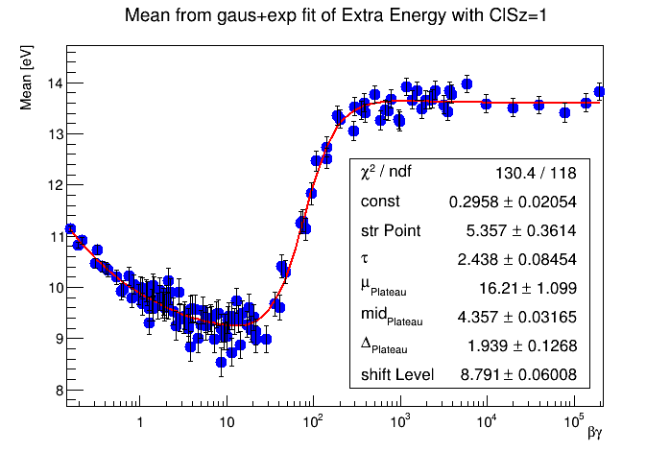
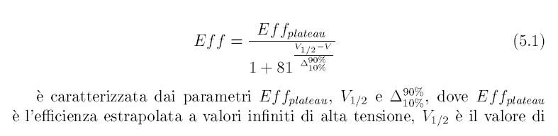
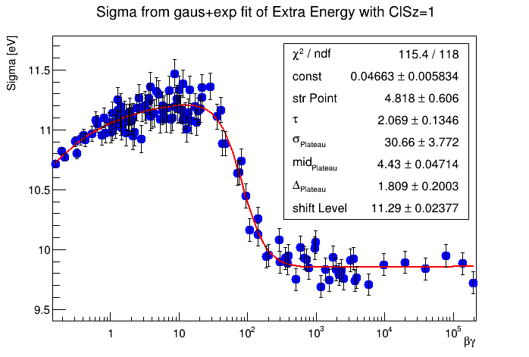
Fit parameters for kinetic energy
distribution
for cluster with cluster size equal to 1
Here the distribution of mean value (top left) and sigma value (bottom right ) for different particles with different momenta.
The distributions are fitted with an exponential function plus an efficiency function.
Other parameters studied are:
Slope and fraction for exp+gaus fit
Most probable value and sigma for landau fit
The two MPV and sigma for double landau fit

Slide 23
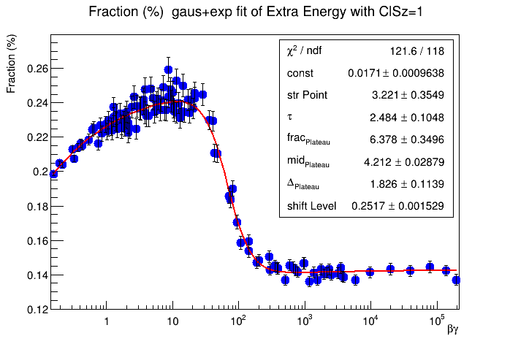
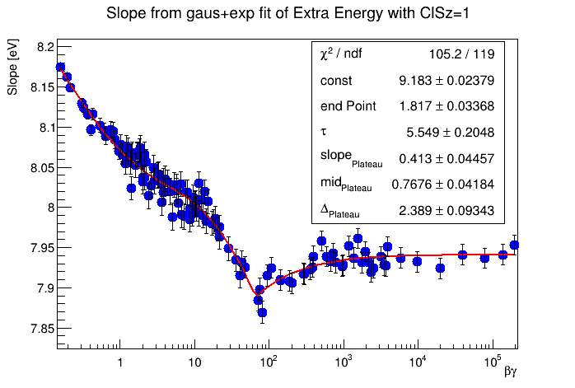
Here the distribution of the fraction value from fit,
fitted with a decreasing exponential function plus an efficiency function.
Here the distribution of the slope value of fit,
fitted with a 1-exponential function plus an efficiency function.

Slide 24
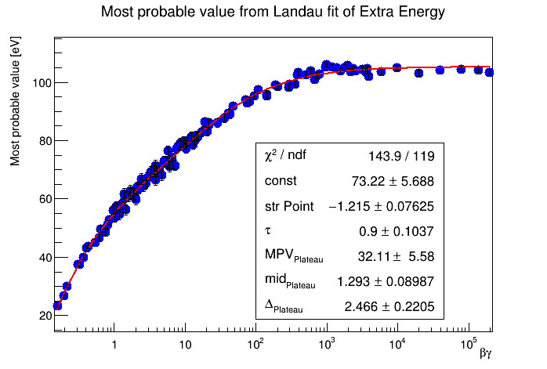

Fit parameters for kinetic energy
distribution for cluster with cluster
size higher than 1
Here the distribution of the most probable value,
fitted with 1- decreasing exponential function plus an efficiency function.
Here the distribution of the sigma value, fitted with 1- decreasing
exponential function plus an efficiency function.

Slide 25

Rt value
Here the ratio between the cluster
containing a single electron and
the cluster containing more than an electron.
The distribution is fitted with 1- decreasing
exponential function plus two decreasing exponential
functions.

Slide 26


Slide 27


Slide 28



Second try: reconstruction of cluster size
We studied the relation between extra energy and cluster size for cluster with cluster size higher than 1 (delta rays are included).
We fit the correlation trend with a first degree polynomial and save the parameter
p0 and p1.
To evaluate the cluster size for cluster with more than one electron, we study
the dispersion for different slice of extra energy up to delta rays cut range (1000 eV):
(Extra energy*p1+p0)-ClSz.
The figure shows an example for extra energy between 900 and 1000 eV.
At the end, the cluster size is evaluated as :
(Extra energy*p1+p0) minus hPCorrp->GetRandom().

Slide 29

Same evaluation is performed for cluster size generated by delta rays.
We study the dispersion for different slice of extra energy above the
value of delta rays cut range (1000 eV):
(Extra energy*p1+p0)-ClSz.
The figure shows a example for extra energy between 9 and 10 keV.
At the end, the cluster size is evaluated as :
(Extra energy*p1+p0) minus hPCorrd->GetRandom().
The result is better than the first try, besides the depression remains.
The evaluation of cluster size remains the same for all next attempts.

Slide 30


Slide 31


Slide 32


Slide 33


Slide 34


Slide 35


Slide 36


Slide 37
From the ordered sequence of the electrons arrival times, considering the average time separation between clusters and their time spread due to diffusion, reconstruct the most probable sequence of clusters drift times:
dE/dx dN_{cl}/dx
n=number of sampling layers
from Walenta parameterization (1980)
from Poisson distribution
truncated mean cut (70-80%) reduces the amount of collected information n = 112 and a 2m track at 1 atm give
σ ≈ 4.3%
Increasing P to 2 atm improves resolution by 20% (σ ≈3.4%) but at a considerable cost of multiple scattering contribution to momentum and angular resolutions.
δ_{cl} = 12.5/cm for He/iC₄H₁₀=90/10 and a 2m track give
σ ≈ 2.0%
A small increment of iC₄H₁₀ from 10% to 20% (δ_{cl} = 20/cm) improves resolution by 20% (σ ≈1.6%) at only a reasonable cost of multiple scattering contribution to momentum and angular resolutions.

