Slide 1
The Status of CEPCSW Software Framework
Zou Jiaheng
On behalf of the CEPCSW software framework working group
2021.04.16

Slide 2
Outline
Key4HEP and CEPCSW
The Framework and Core Components
Functions in Progress and Plans
Summary

Slide 3
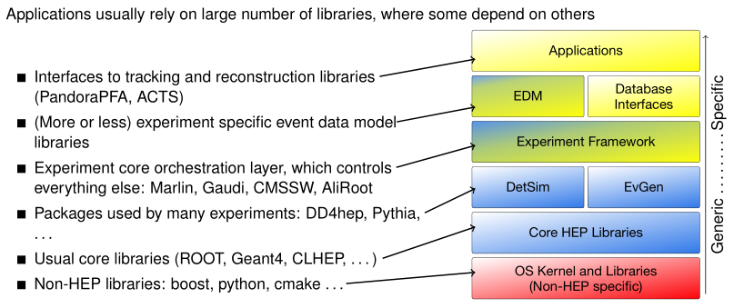
Key4HEP
Turnkey Software for Future Colliders
[Ref]: André Sailer, etc. , CHEP2019
https://indico.cern.ch/event/773049/contributions/3474763/attachments/1938664/3213633/191105_sailer_key4hep.pdf
An agreement at a workshop in June, 2019
CEPC
CLIC
FCC
ILC
SCTF
Software components sharing between different experiments

Slide 4
Key4HEP Status
https://github.com/key4hep
Main components
Key4hep-spack
k4FWCore
k4MarlinWrapper
EDM4hep
k4LCIOReader
k4SimDelphes
k4ActsTracking
k4Pandora
Weekly meeting: experts from CERN, DESY, IHEP, INFN …
For software building/packaging
Core software to facilitate the usage of Gaudi (and Marlin, too)
Generic event data model for HEP collider experiments
Read LCIO format data in Gaudi
Generic simulation & reconstruction algorithms

Slide 5
CEPCSW
Based on Key4HEP
Reuse existing components
Gaudi, EDM4hep, DD4hep, ROOT …
Implement the specific components for CEPC
Detectors, simulation and reconstruction algorithms, data model, etc.
Provide a ready-to-work environment to algorithm developers and physicists
Porting algorithms from iLCSoft to CEPCSW
Integrate/develop more algorithms and features

Slide 6
Outline
Key4HEP and CEPCSW
The Framework and Core Components
Functions in Progress and Plans
Summary

Slide 7
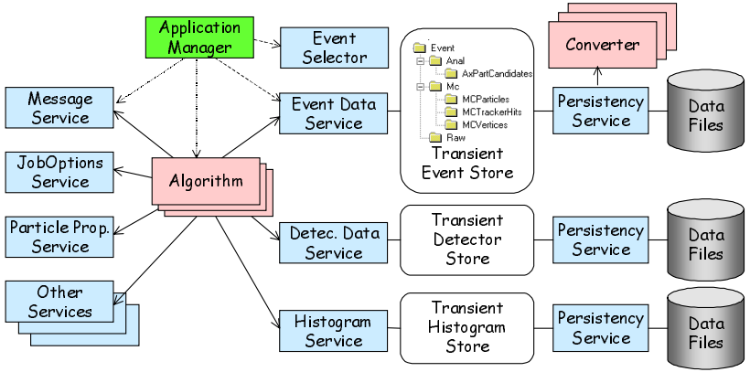
Framework: Gaudi
Various algorithms and unified data
Transient data in memory and persistent data on disk
Event loop
PODIO
DD4HEP

Slide 8
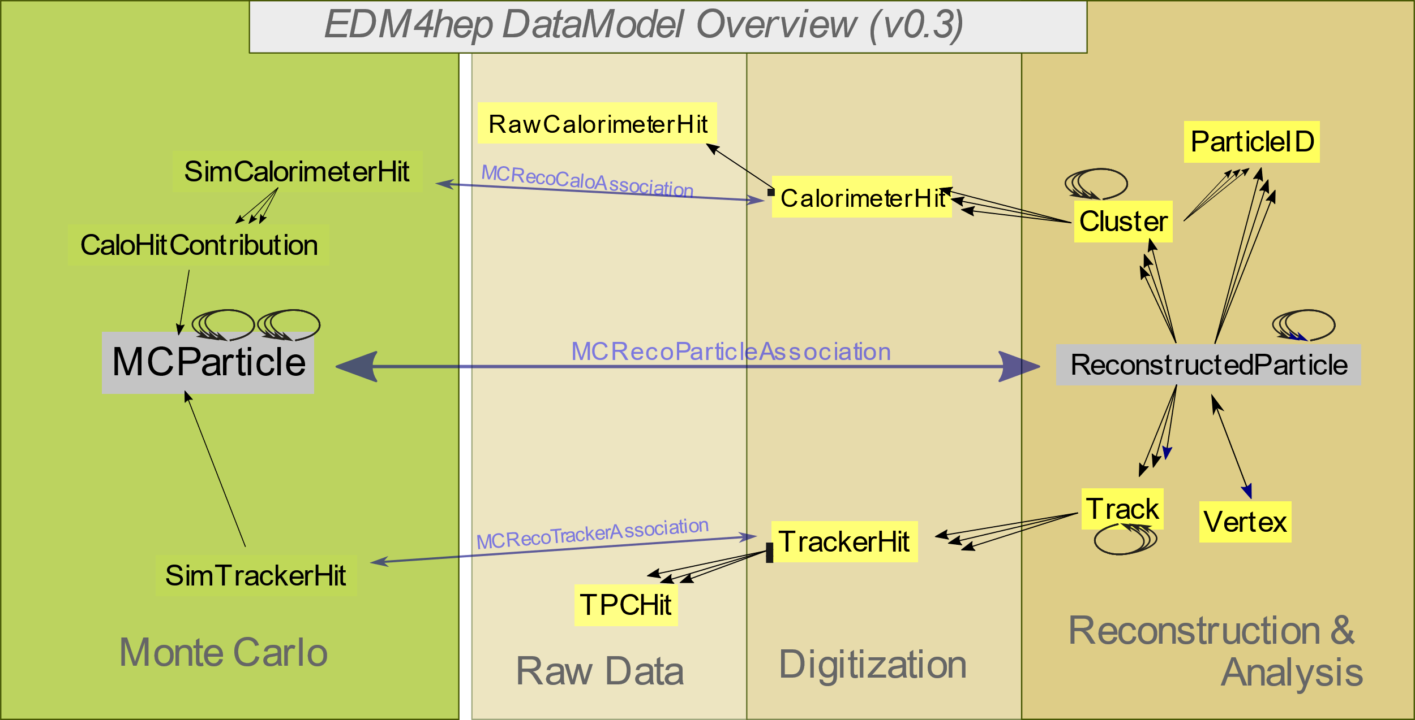
Data Model: EDM4hep
The code is generated by PODIO from a yaml file
An event is described by a set of data collections
The default storage backend is ROOT
The first version, v0.1 is released in April, 2020. (Current version is v0.3)

Slide 9
Data I/O
The default EDM4hep data format: ROOT
k4FWCore: the default data I/O components
PodioDataSvc: read/write podio data collections in ROOT
DataHandler: register data collections to Gaudi
k4LCIOReader: read LCIO data generated by Marlin
Data converters
DataWrapper
[PLCIO Objs]
User
Algorithm
DataHandle
DataWrapper
[PLCIO Objs]
PodioDataSvc
ROOT Data
DataWrapper
[EDM4hep Objs]
Gaudi TES
EDM4hep Objs
LCIO Objs
LCIO Data
k4LCIOReader
Data I/O in CEPCSW
LCIO Library

Slide 10
Outline
Key4HEP and CEPCSW
The Framework and Core Components
Functions in Progress and Plans
Summary

Slide 11
Data Model Extension
Based on podio
EDM for CEPC specific detectors, such as drift chamber
A parallel package to EDM4hep
In a different namespace (“cepc” for example)
Link to EDM4hep data types by external data associations
Workload
Yaml
Generate C++ code with podio
Data I/O: be compatible with PodioDataSvc
Depend on our requirements
EDM4cepc
EDM4hep
podio

Slide 12
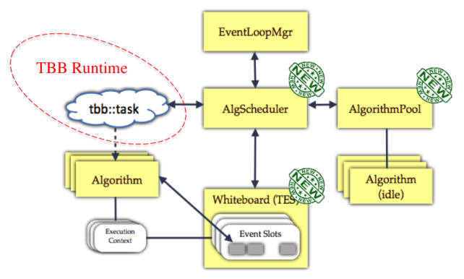
Parallel Computing
GaudiHive
A component in Gaudi now
Concurrency in event & alg level
Works to be done in Key4HEP
Thread-safe I/O components
Other core services (DB, Geom …)
Performance testing and optimization
Challenges to users
Thread-safe algorithms
Suitable job types
From: http://iopscience.iop.org/1742-6596/513/5/052028

Slide 13
More Features Being Considered
Database accessing and management
Interfaces to machine learning and GPU
Framework for data analysis

Slide 14
Software Building and Management
Common tools
CMake: Build & deployment
Gaudi cmake macros
Git: version control
https://github.com/cepc/cepcsw
CVMFS: software distribution
CEPC specific: /cvmfs/cepcsw.ihep.ac.cn/prototype
In current software release
Build by ourselves: Gaudi, k4FWCore, EDM4hep, GEAR, GenFit, podio, LCIO, k4LCIOReader, Pandora
Re-use the LCG software stack for other external libraries

Slide 15
Summary
Take part in the collaboration of Key4HEP
Most high priority core components are in their place
Framework, data model, I/O, etc.
CEPCSW has been developed based on Key4HEP
4 preliminary versions have been released
More advanced features is being in progress

Slide 16
Thanks!

