Slide 1
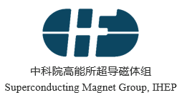
Solenoid magnet progress
Ning Feipeng
On behalf of superconducting magnet group

Slide 2
Outline
Introduction of new solenoid magnet version;
Progress of physical design of solenoid magnet;
Progress of LTS and HTS cable development;
Magnetic force of yoke;
Conclusion

Slide 3
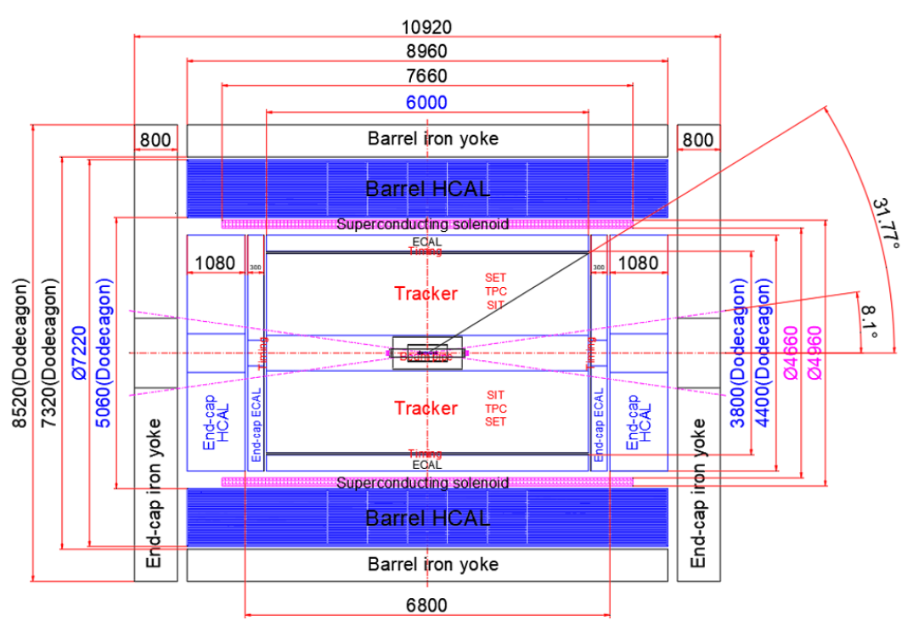
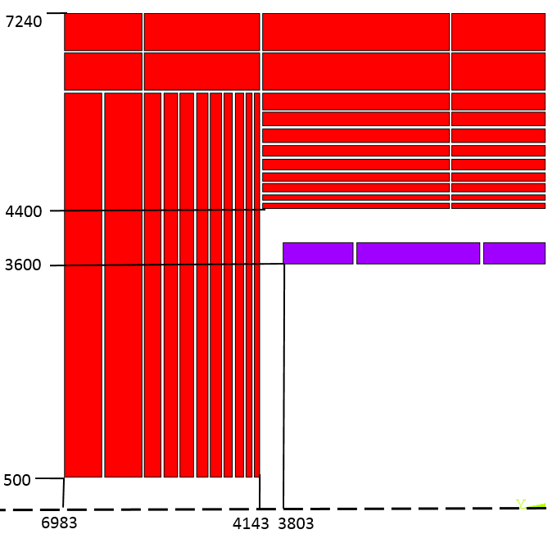
1. Introduction of new solenoid magnet version
HCAL
ECAL
Tracker
HCAL
ECAL
CDR version
new version

Slide 4
1. Introduction of new solenoid magnet version
Requirements: A huge Low mass & ultra-thin solenoid magnet
Inner diameter: 4660mm，
  length: < 8m，
  central magnetic field: 3 T；
Magnet radial thickness: < 150 mm；
Mass of magnet: < 1.5X₀（134 mm aluminum）
Use new materials, new processes.
Need to do a lot of researches.

Slide 5
The parameters of different Detector magnets
 | CMS | BESIII | ALEPH | BESS-POLAR | WASA | SDC PROTOTYPE | IDEA* | CDR(CEPC) | CEPC NEW DESIGN
Central field (T) | 4 | 1 | 1.5 | 0.8 | 1.3 | 1.5 | 2 | 3 | 3
Operating current (A) | 19600 | 3369 | 5000 | 380 | 900 | 12000 | 20000 | 16796 | 30000
Inner diameter of coil (mm) | 6360 | 2960 | 5300 | 900 | 553.6 |  | 2200 | 7200 | 4658
Length of coil (mm) | 12480 | 3520 | 6350 | 1400 | 465 | 1900 | 6000 | 7606 | 6300
Outer shell external diameter(mm) | 7600 | 3292 | 5840 | 1060 | 650 | 4012 |  | 8700 | 4960
Inner shell inside diameter(mm) | 5940 | 2750 | 4960 | 800 | 490 | 3400 | 4200 | 6800 | 4660
Thickness of cryostat (mm) | 830 | 271 | 440 | 130 | 80 | 306 | 300? | 950 | 150?

Slide 6
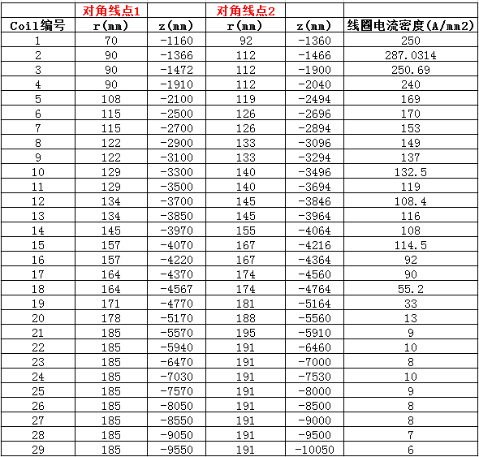
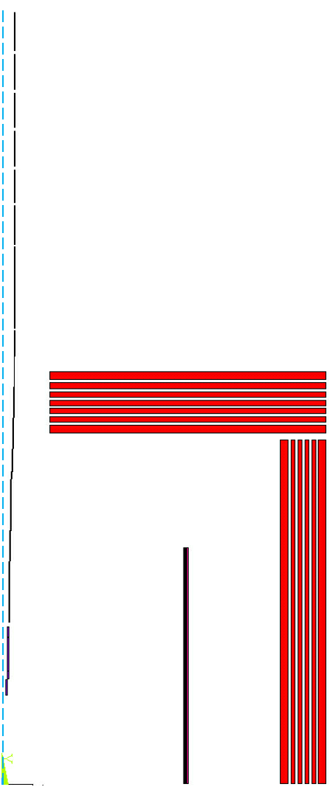
2. Progress of physical design of magnet
Solenoid add anti-solenoids
Anti-solenoid coils
Solenoid
29 pairs of Anti-Solenoids (designed by Yingshun Zhu)
Central field (T) | 3
Operating current (A) | 29700
Length of coil (mm) | 6300
Outer diameter(mm) | 4960
Inner diameter(mm) | 4660
Thickness of cryostat (mm) | 150
Inductance (H) | 0.53
Stored energy (J) | 2.34e8
Solenoid coil

Slide 7
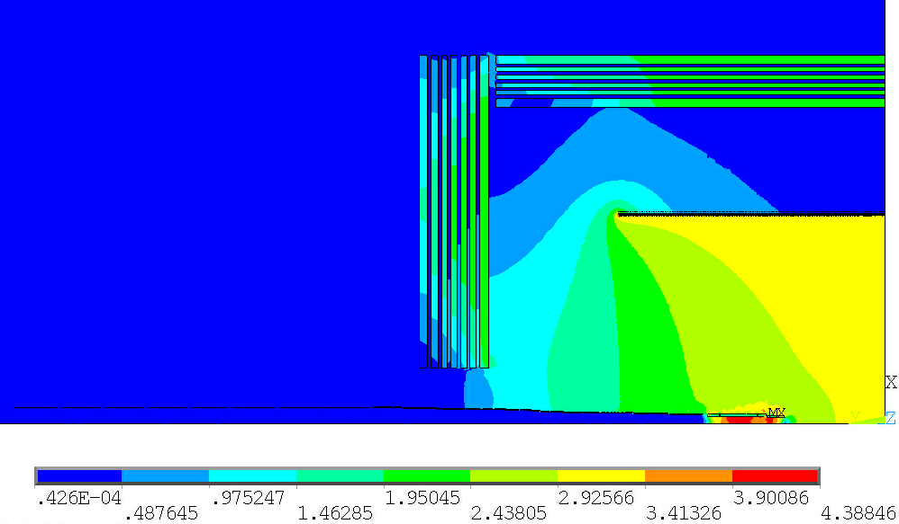
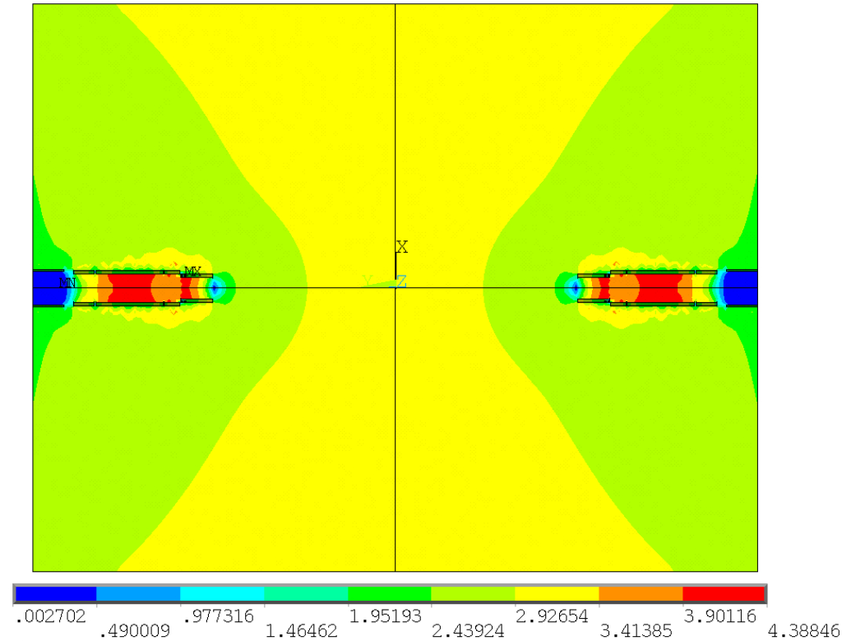
2. Progress of physical design of magnet
Magnetic field distribution
Magnetic field distribution (R 1.8m and L ±2.3m)

Slide 8
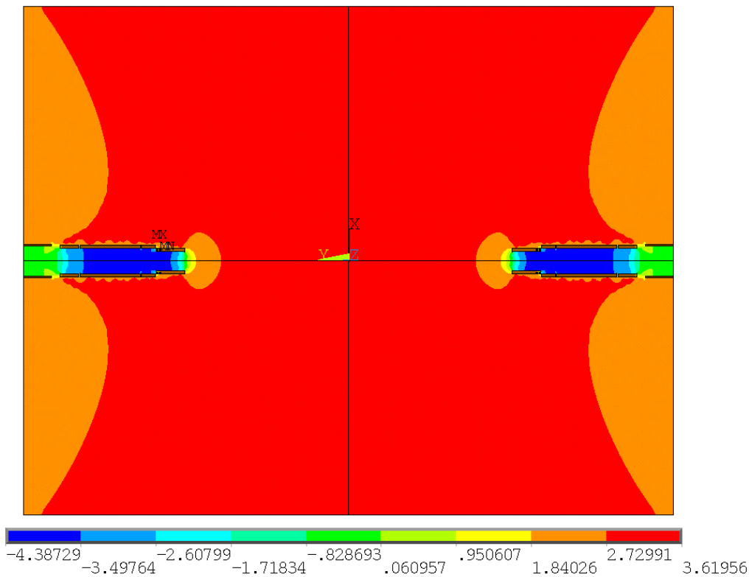
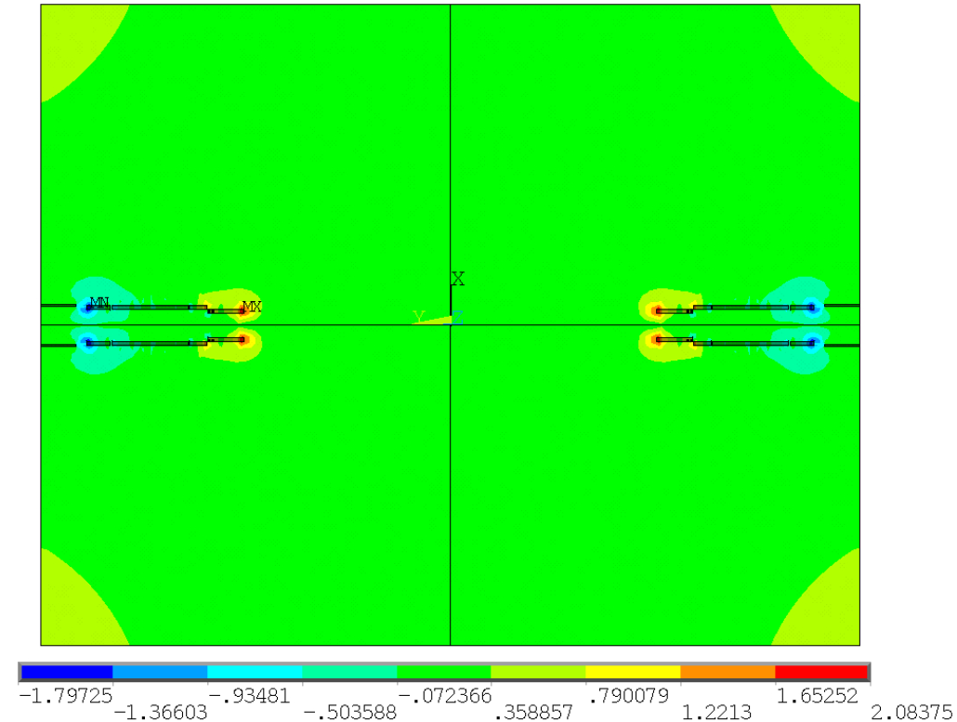
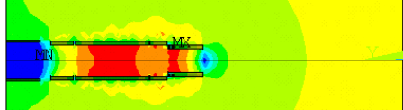
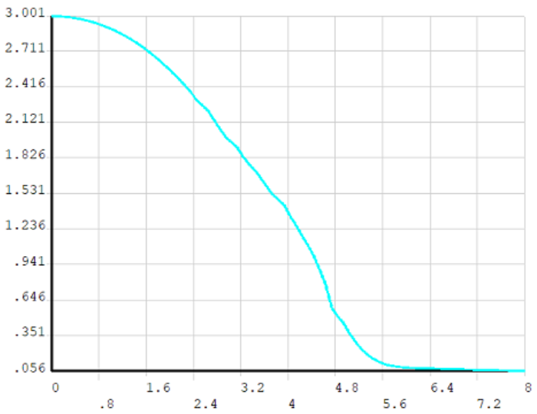
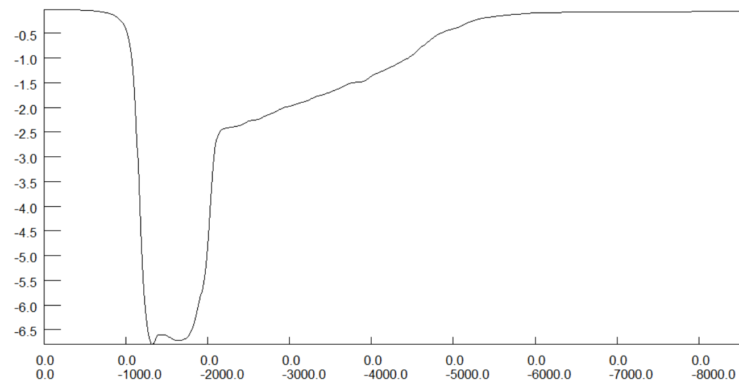
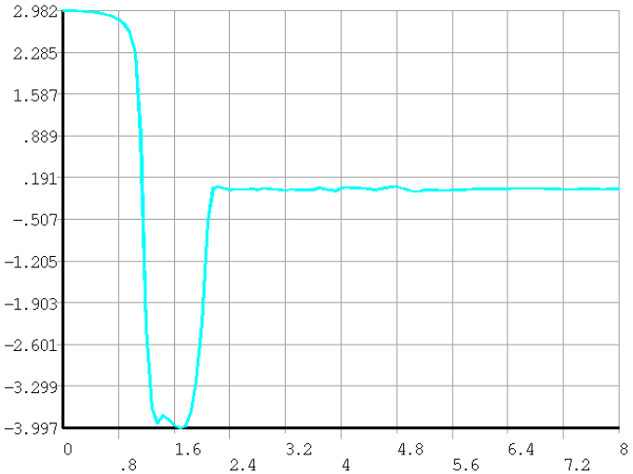
2. Progress of physical design of magnet
Magnetic field distribution of solenoid add anti-solenoids
The effect of Quadrupole magnets QD0 and QF1 will be considered recently.
Axial magnetic field distribution
Radial magnetic field distribution
solenoid
Anti-solenoids

Slide 9
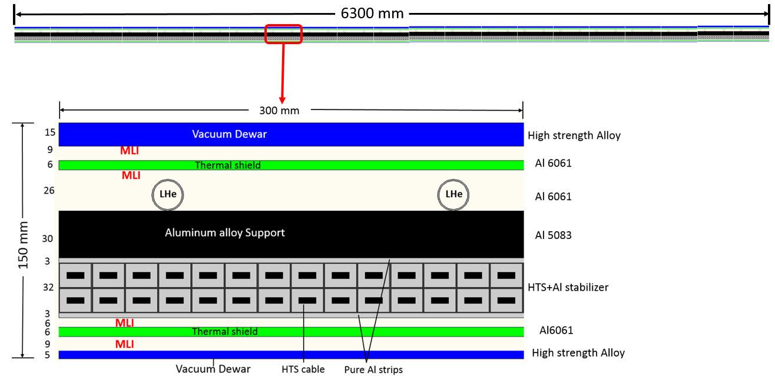
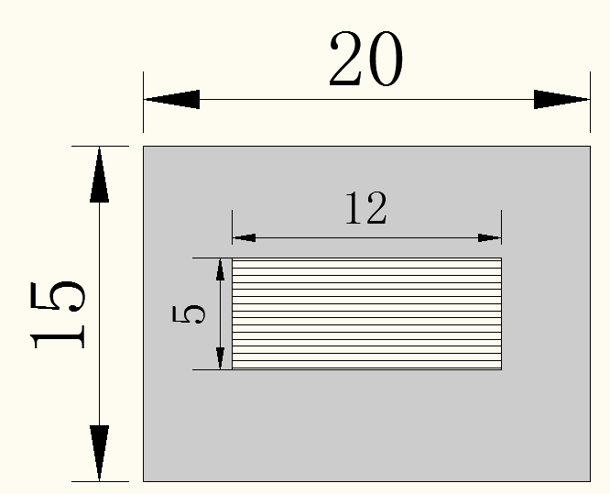
Concept details of HTS solenoid magnet
HTS cable length (km) | 9
Cold mass weight (t) | 20
Total weight (t) | 35

Slide 10
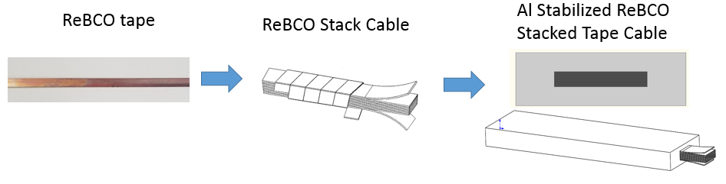
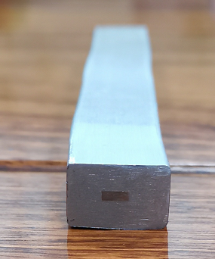
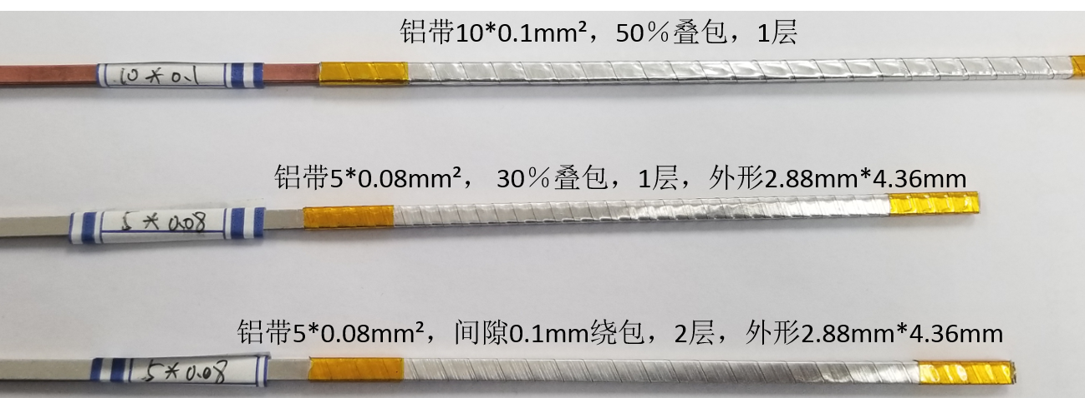
3.Progress of LTS and HTS cable development
Under development
HTS cable

Slide 11
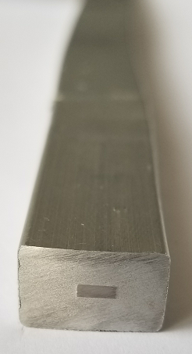
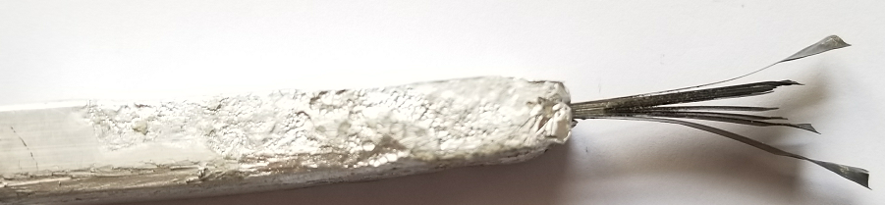
HTS cable(Al Stabilized stack Tape Cable)
The core broke when processing the long dummy HTS cable.
We are solving this problem, adjust the machine, changing the winding material……
plan to produce a real short HTS cable before July this year
Short Dummy HTS cable

Slide 12
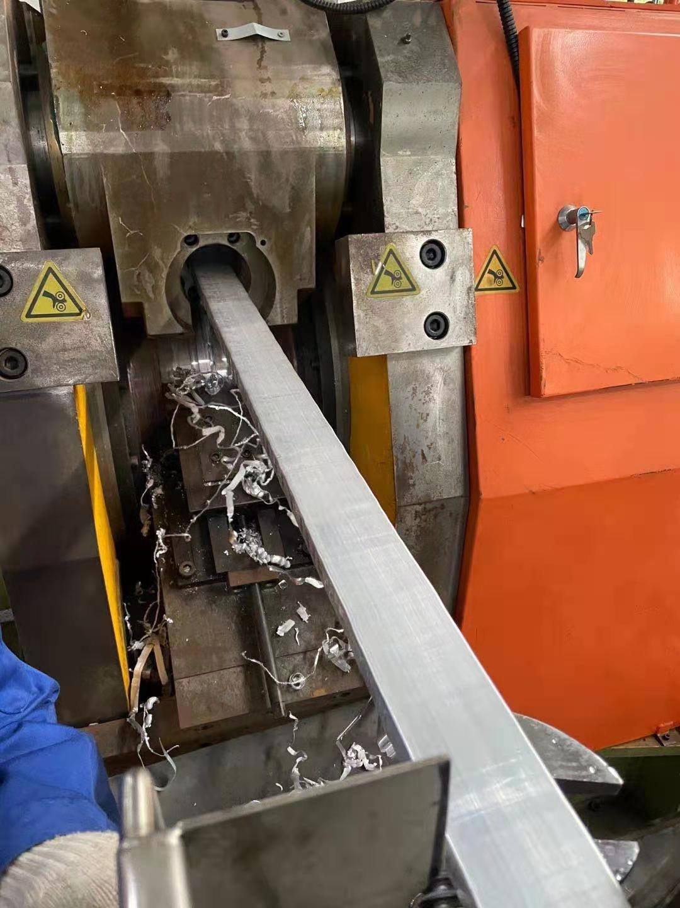
LTS conductor
CMS
Pure Al+Alloy
CEPC
Pure Al+Alloy
32 NbTi strands
22 mm × 56 mm
Pure aluminum
stabilizer
Aluminum alloy
reinforcement
Shor sample of dummy cable has been developed successfully.
1000m long dummy cable will be completed recently.
Dummy cable（copper+ 6061alloy aluminum）

Slide 13
LTS conductor
High strength superconducting cable---Development of Al-Ni alloy materials
Cooperation with Xinjiang Zhonghe company on doping process of high purity aluminum
First batch of samples have been completed and tested. The mechanical properties meet the requirements, but the RRR value was lower, as shown in the table below.
The doping process is being adjusted and waiting for the second batch.
 | condition | sample | tensile strength | yield strength | extensibility | Resistivity | RRR
1 | Annealed （Ø9.5mm） | 3#（0.1%Ni） | 67/65/65 | 40/39/40 | 35/36/35 | 0.0263027 | 308
 |  | 5#（0.2%Ni） | 69/69/69 | 41/41/42 | 31/31/32 | 0.0263532 | 301
2 | Cold working （Ø8.5mm） | 3#（0.1%Ni） | 83/87/83 | 73/74/74 | 10/7/10 | 0.0271910 | 141
 |  | 5#（0.2%Ni） | 87/88/88 | 83/85/95 | 8/8/8 | 0.0272114 | 181
3 | Aging （130℃，15h）Ø8.5mm | 3#（0.1%Ni） | 79/79/79 | 70/71/70 | 10/12/13 | 0.0271016 | 212
 |  | 5#（0.2%Ni） | 86/85/86 | 79/80/82 | 9/10/8 | 0.0270946 | 234
Test device of RRR value

Slide 14
Research on inner winding process
General view of inner winding process
Winding platform
Cooperated with KeYe company.
The design has been completed, and in the process of processing and assembly.
Dummy coil winding will start in August to September.

Slide 15
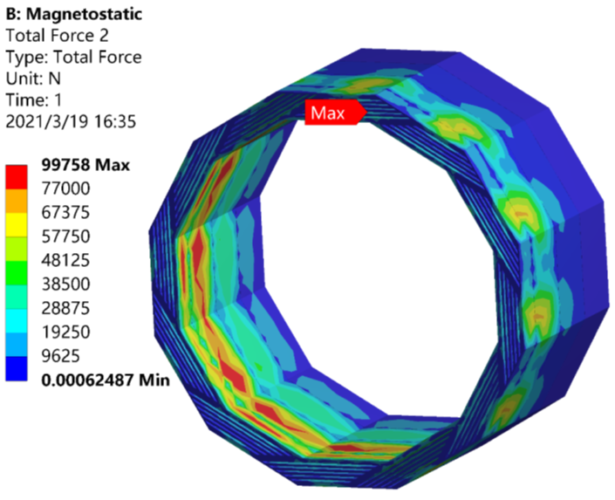
4. Magnetic force of yoke
In order to satisfy the Muon detector, the yoke has a spiral structure.(designed by Ji Quan)
1/2 model

Slide 16
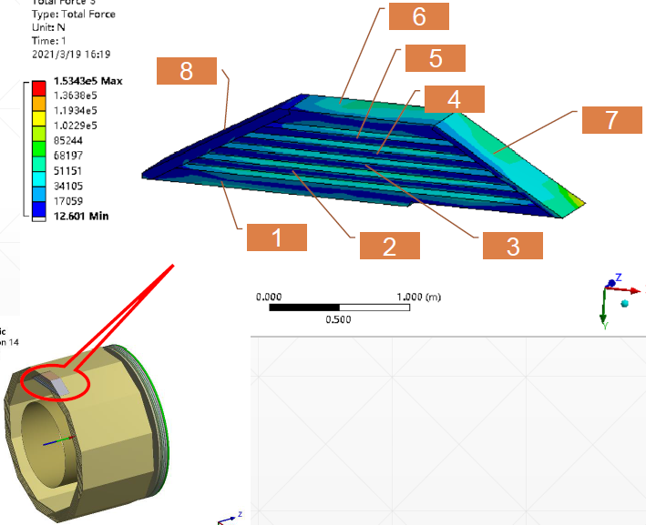
4. Magnetic force of barrel yoke
Magnetic force of barrel yoke (640 mm long)
/(unit, ton)
Barrel yoke | X Axis | Y Axis | Z Axis
1 | -1.060 | -46.005 | 3.212
2 | 0.058 | 13.621 | 1.740
3 | 0.044 | 13.001 | 1.425
4 | 0.038 | 12.623 | 1.163
5 | 0.026 | 12.231 | 0.925
6 | 0.028 | 11.803 | 1.042
7 | 22.150 | -38.210 | 0.483
8 | 14.804 | 24.012 | 0.924

Slide 17
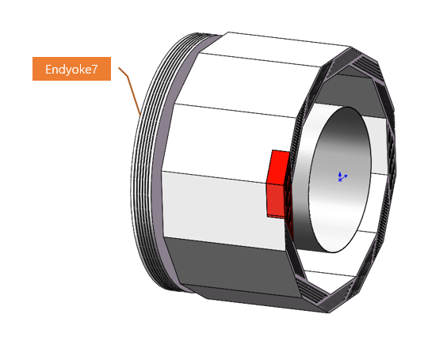
4. Magnetic force of end yoke
Summary force of end yoke (Z Axis) /（unit, t）
End yoke | Z Axis
1 | -243
2 | -98
3 | -55.6
4 | -27.6
5 | -9.26
6 | -5.24
7 | 3.7

Slide 18
Conclusion and plan
1. The magnetic field distribution is provided considering the anti-solenoids, and quadrupole magnets will be considered in the future.
2. LTS and HTS cables are developing on time. The real cable will be produced and tested this year.
3. Cooperate with Ji Quan to design the yoke. Magnetic force is considered to optimize the yoke structure. Muon detector will also be considered recently.
4. Mechanical and cryostat design of the magnet are also started.
Thanks

