Slide 1

Status of the Muon detector
Hongyu Zhang, Baosheng Gao, Yuxin Liu,
Xu Dong, Xiyang Wang， Xiaolong Wang
Fudan University, Shanghai
CEPC PhyDet Meeting，10/3/2021

Slide 2
Outline
CEPCSW and Geant4 simulation
    CEPCSW on cluster
    Simulation using Geant4
Study of Scintillator
    Attenuation length of Scintillator
    Time resolution

Slide 3
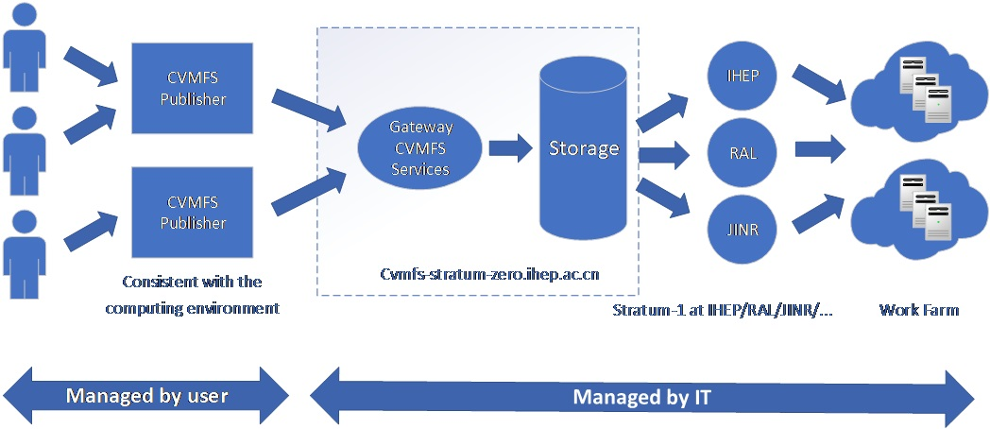
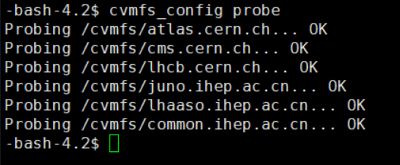
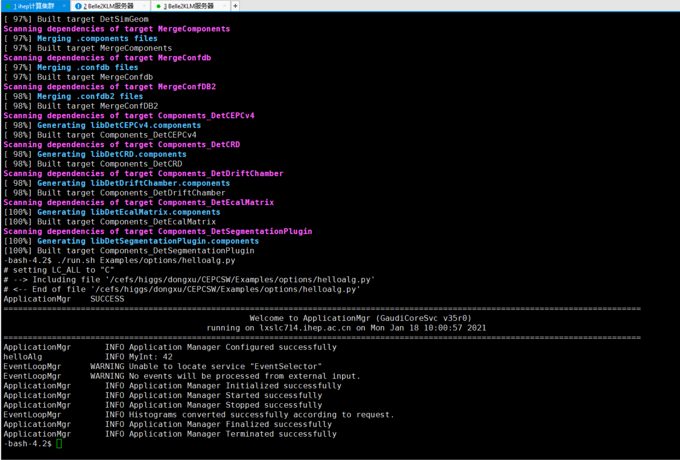
CEPCSW and Geant4 simulation
CEPCSW on cluster
by Xu Dong,
Baosheng Gao
check CVMFS
$ git clone git@github.com:cepc/CEPCSW.git
$ cd CEPCSW
$ git checkout master # branch name
$ source setup.sh
$ ./build.sh
$ ./run.sh Examples/options/helloalg.py
CEPCSW installed
Notes:
在高能所计算集群使用CernVM File System(CVMFS)安装新版本CEPCSW

Slide 4
CEPCSW and Geant4 simulation
    Implement of muon detector in CEPCSW
Scintillator + SiPM readout
  Set up
    Geometry
    Scintillator parameters
    WLS fiber
  Simulation
    Detector efficiency for muon
    Behavior of long-lived particle
    Tail of hadron cluster from HCAL
    Spatial resolution
    Time resolution
collaboration with
SJTU

Slide 5
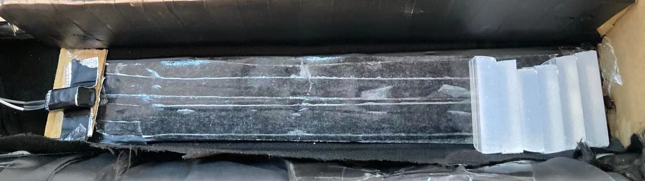
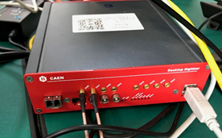
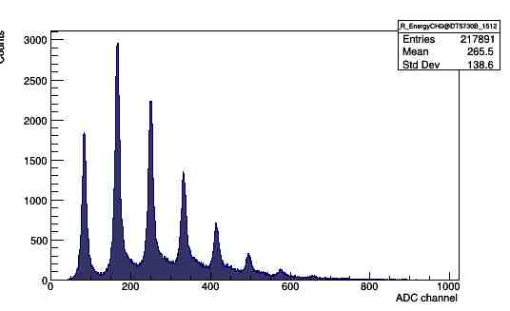
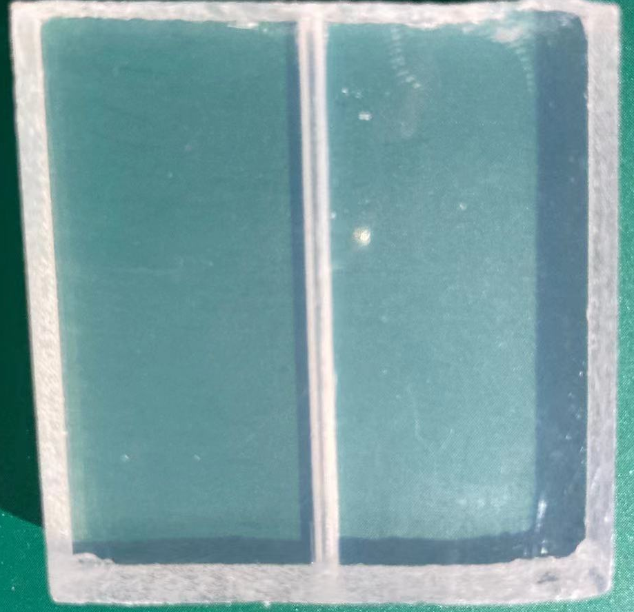
Study of Scintillator
Measurement on attenuation length(L) of Scintillator
by Xiyang Wang,
Hongyu Zhang
oscilloscope
Add scintillator between LED and MPPC
light
Pulse generator
LED
light
scintillator
MPPC
Digital analyzer
DT5725
Scintillator blocks
LED
x
MPPC
Trigger:
2 channel coincidence
reduce dark count
Smooth surface
Multiphoton spectrum from MPPC

Slide 6
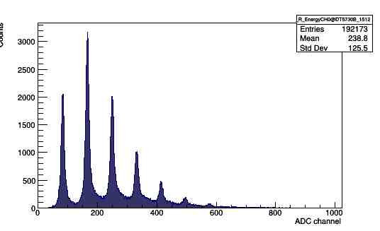
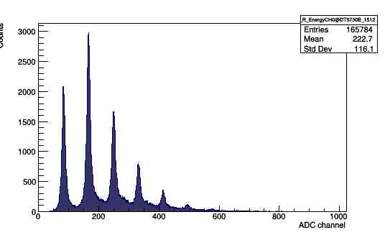
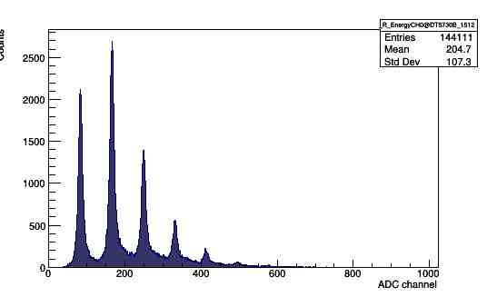
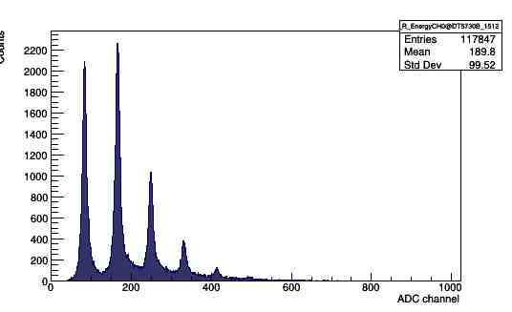
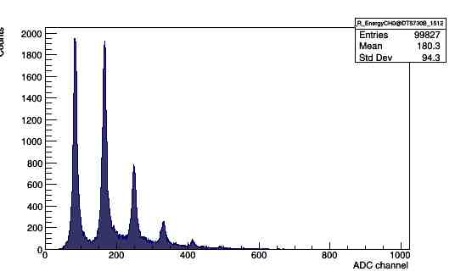
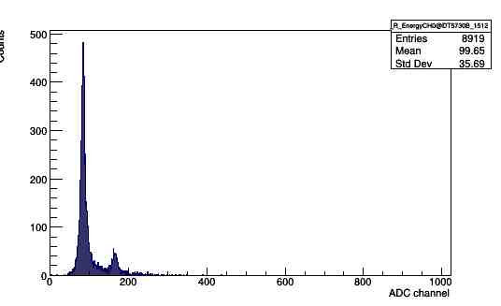
Study of Scintillator
Measurement on attenuation length of Scintillator
Testing time: 5min
the detected photon reduced
as the blocks of scintillator increased
1
2
3
When LED off
4
5
6
background
……

Slide 7
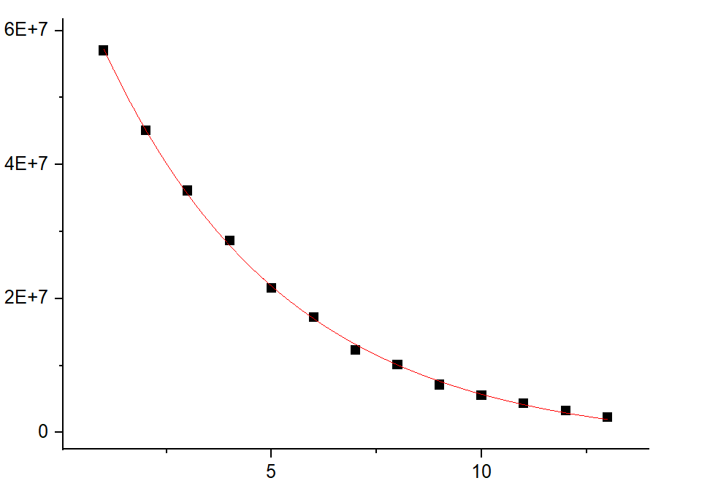
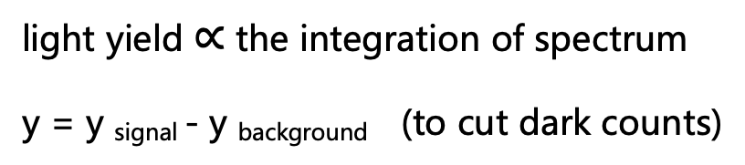
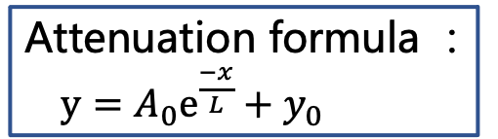

Study of Scintillator
Measurement on attenuation length of Scintillator strips
y
light yield $∝$ the integration of spectrum
y = y _{signal} - y _{background} (to cut dark counts)
Attenuation formula ：
$y=A_{0}e^{\frac{−x}{L}}+y_{0}$
blocks of scintillator
$L=\text{(4.37}\text{±}\text{0.11}$) cm
Need study of more samples……

Slide 8

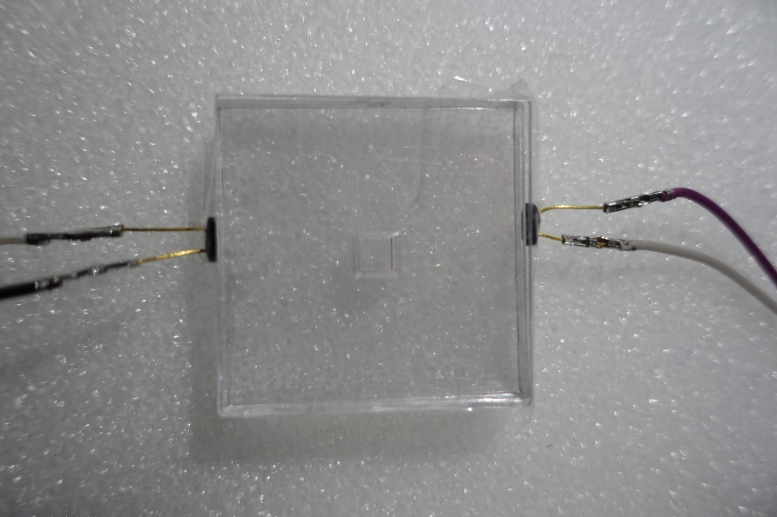
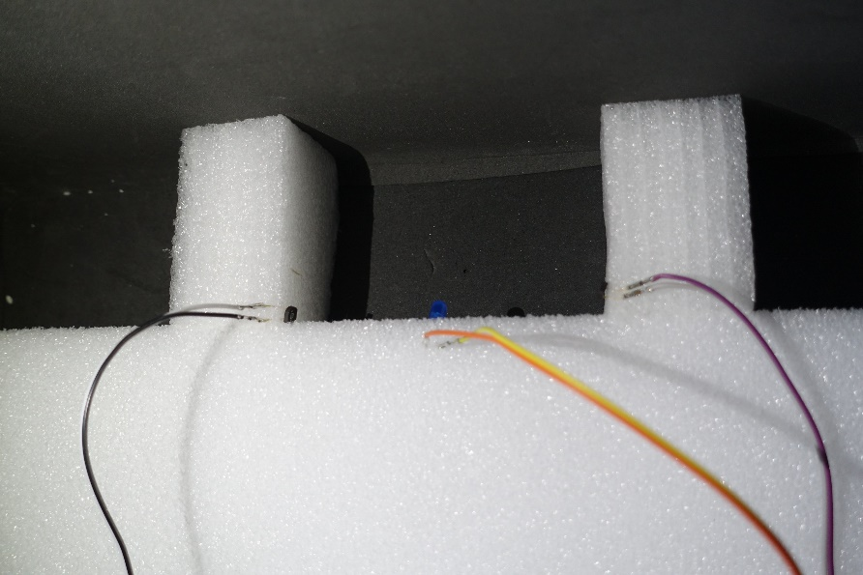
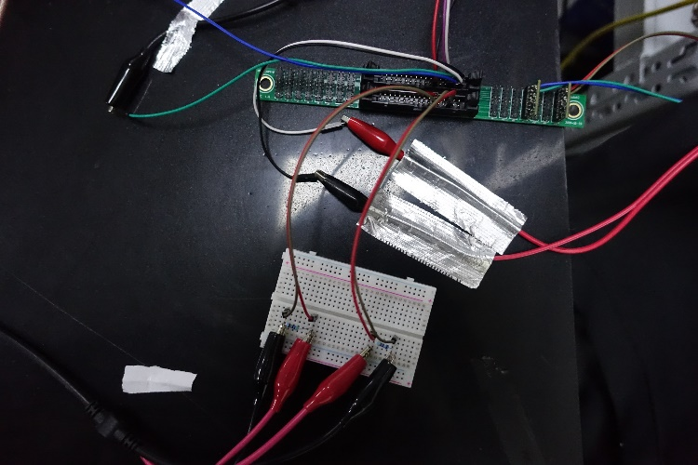


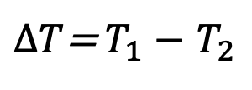

Study of Scintillator
Measurement of time resolution (𝛿𝑇)
by
Hongyu Zhang,
Yuxin Liu
scintillator
HV
LV
Photon signal 1
MPPC1
preamplifier
Generator driving LED
signal 1
DAQ
Photon signal 2
MPPC2
preamplifier
signal 2
HV
LV
signal 1
signal 2
HV
LV
$∆T$= $T_{1}−$ $T_{2}$
discriminator 1
discriminator 2
$$δT=\frac{∆T}{\sqrt{2}}$$
signal 1
signal 2
$$T_{1}$$
$$T_{2}$$

Slide 9
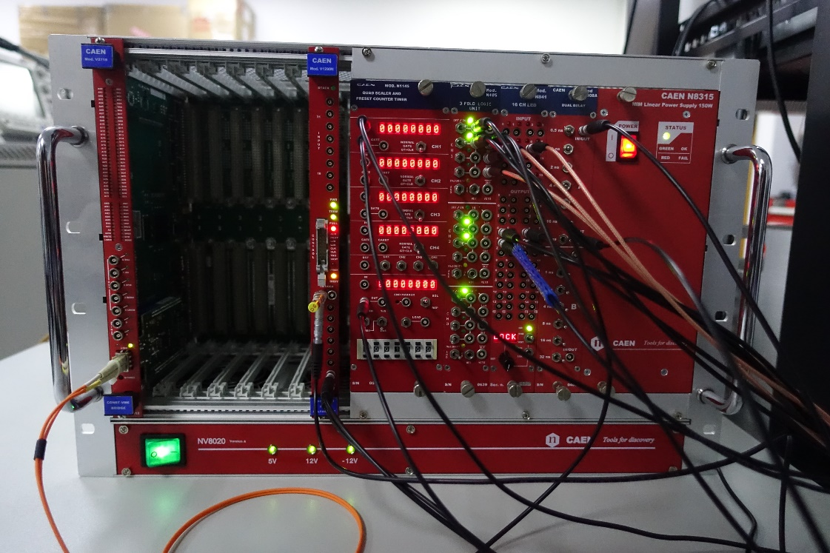
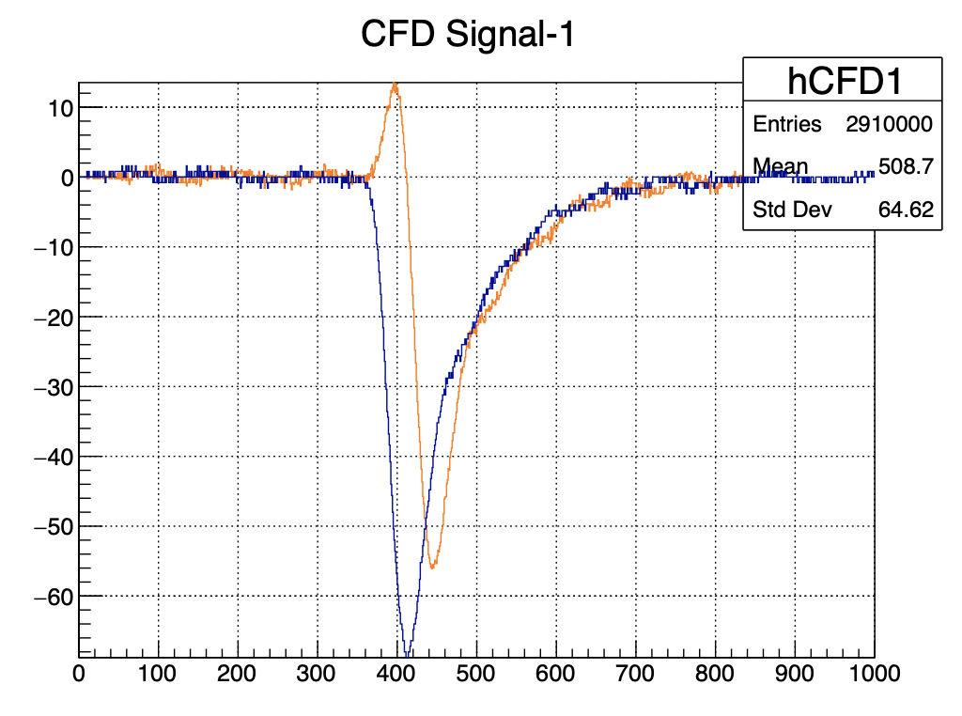
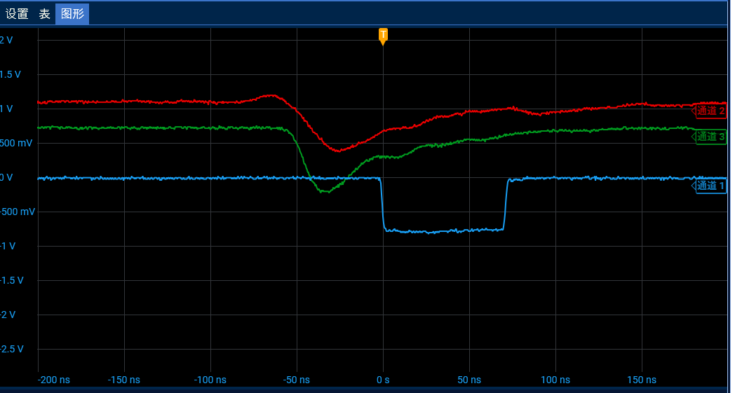
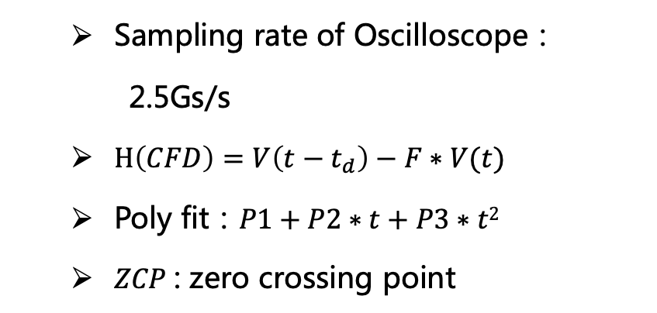



Study of Scintillator
DAQ： two kinds of discriminator
Leading edge：LE（N841）+TDC（V1290）
TDC resolution：
25 ps
  Trigger：coincidence of two signal
$$∆T=T_{1}− T_{2}$$
$$δT=\frac{∆T}{\sqrt{2}}$$
CFD：Oscilloscope（startkick）+CFD
  Sampling rate of Oscilloscope：
  2.5Gs/s
  $H\left(CFD\right)=V\left(t−t_{d}\right)−F∗V(t)$
  Poly fit：$P1+P2∗t+P3∗t2$
  $ZCP$: zero crossing point
V / mV
Waveform from Oscilloscope
40 ns /div
$∆T$= ${ZCP}_{1}−$ ${ZCP}_{2}$

Slide 10
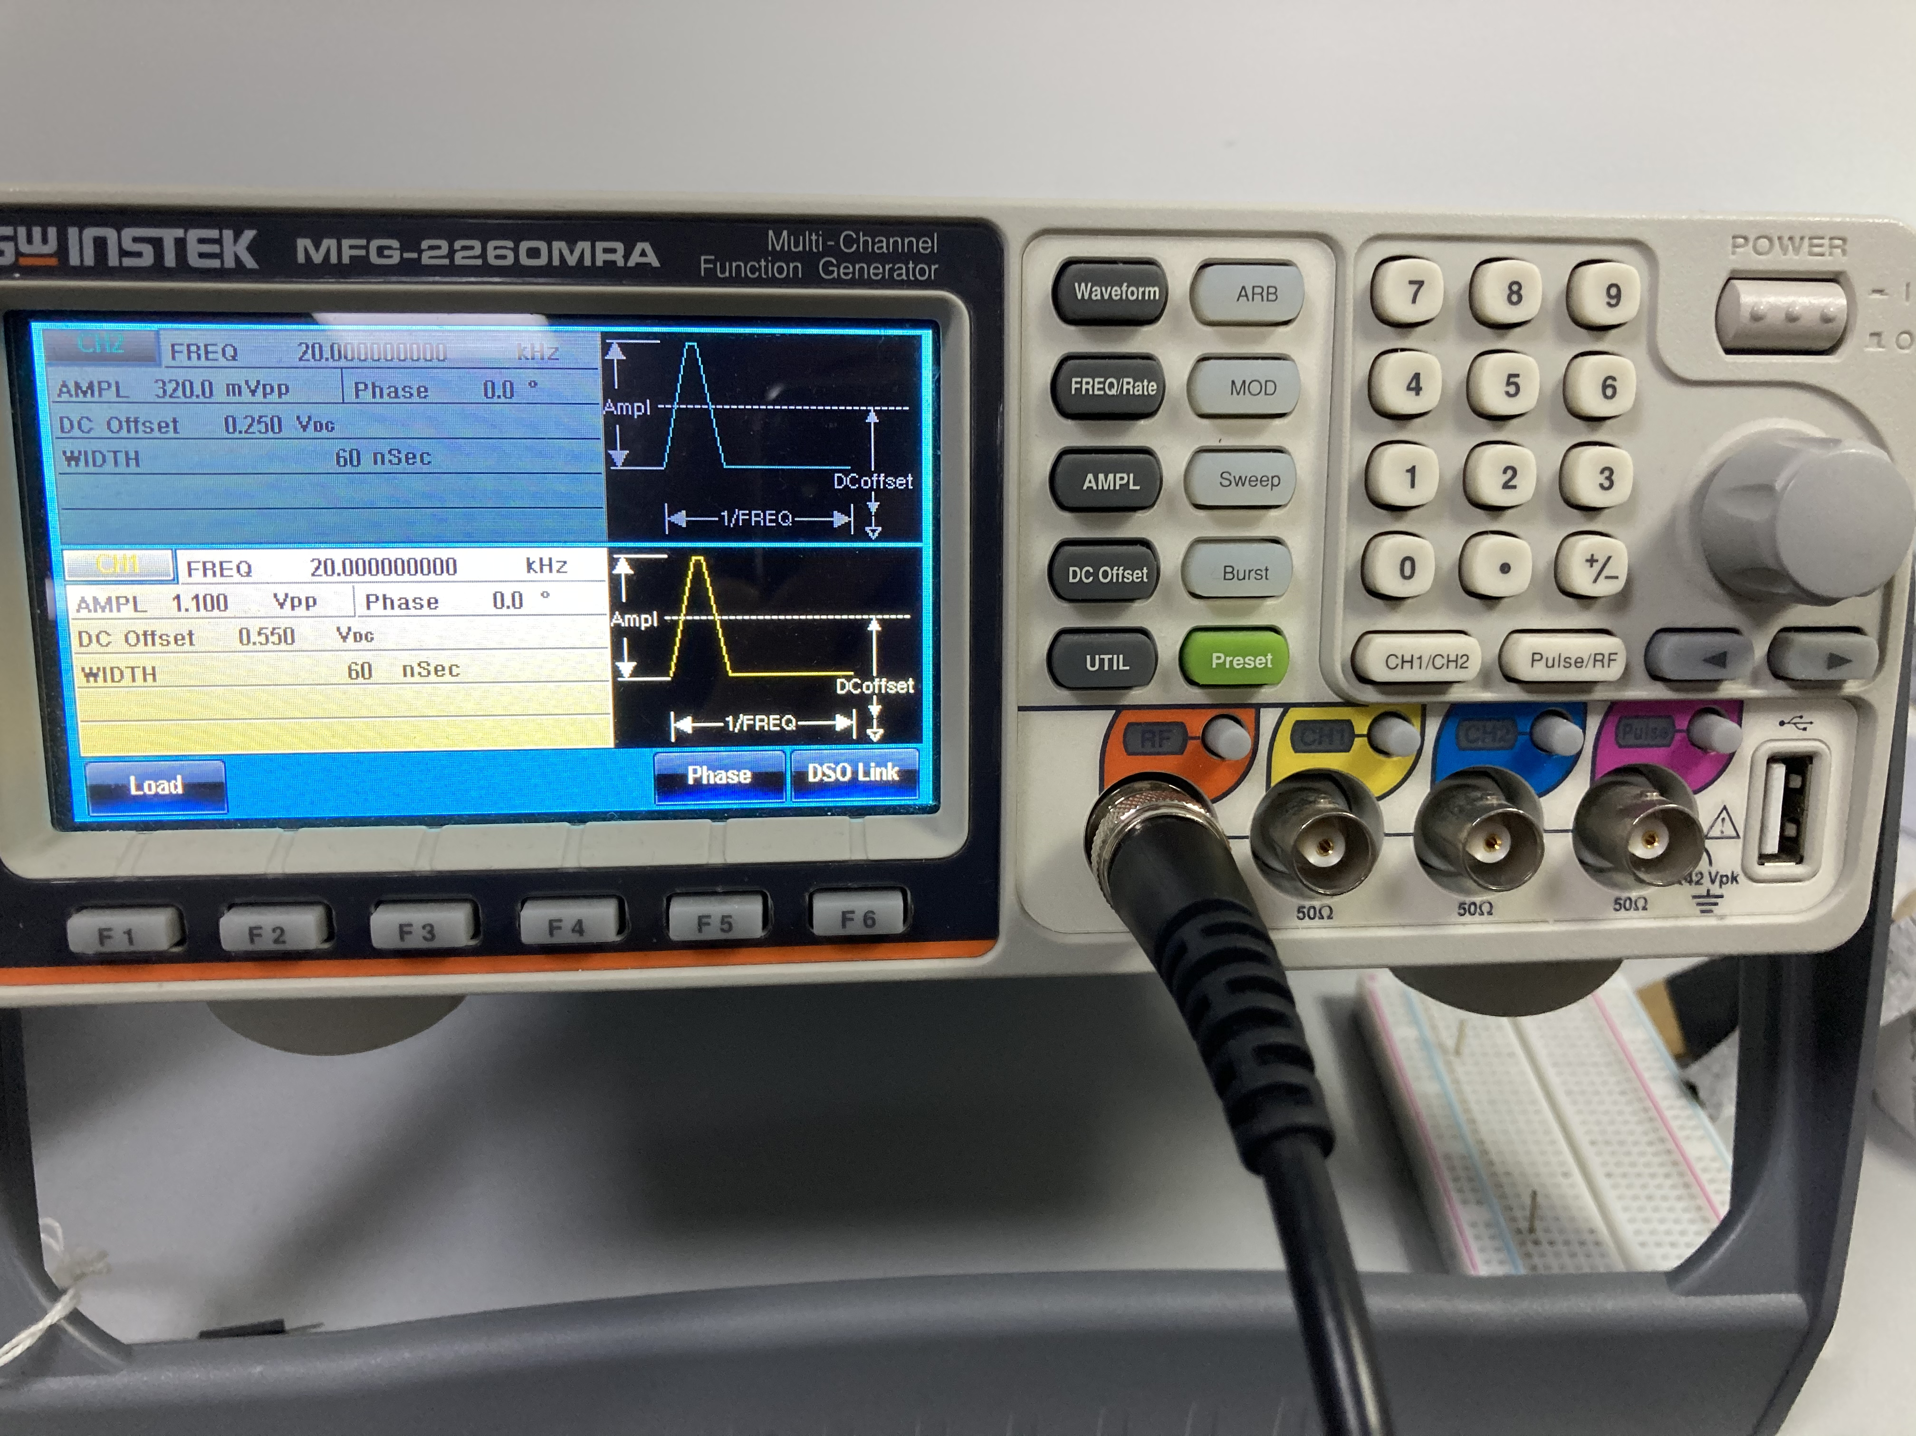
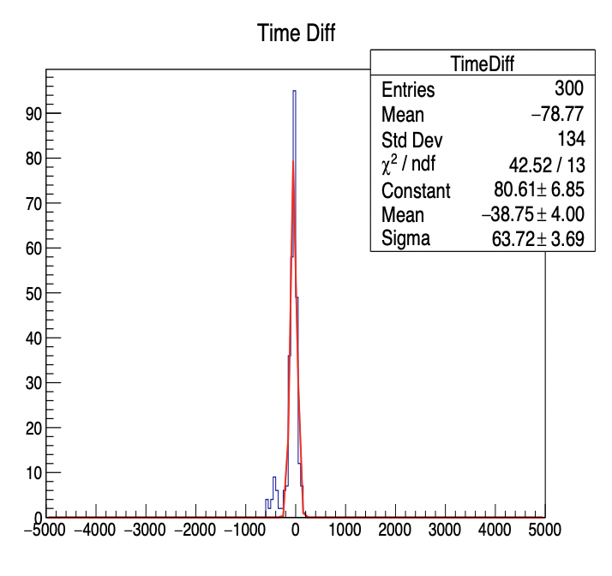
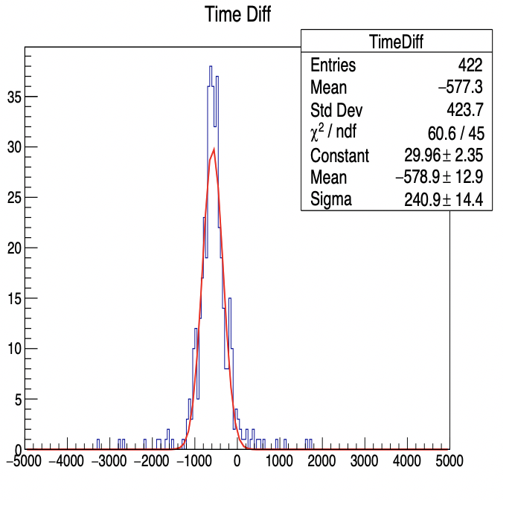

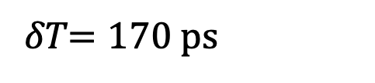
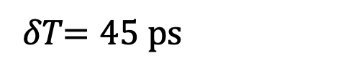

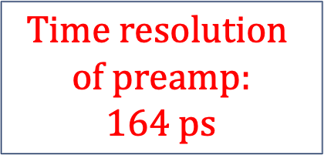
Study of Scintillator
Time Difference of Pulse signal and preamp
Pulse generator signal
（CFD）
Gen + preamp
(CFD)
$$Time resolution$$
$$of preamp:$$
$$164 ps$$
$$∆T=64 ps$$
$$∆T=241 ps$$
𝛿𝑇$=45 ps$
𝛿𝑇$=170 ps$

Slide 11
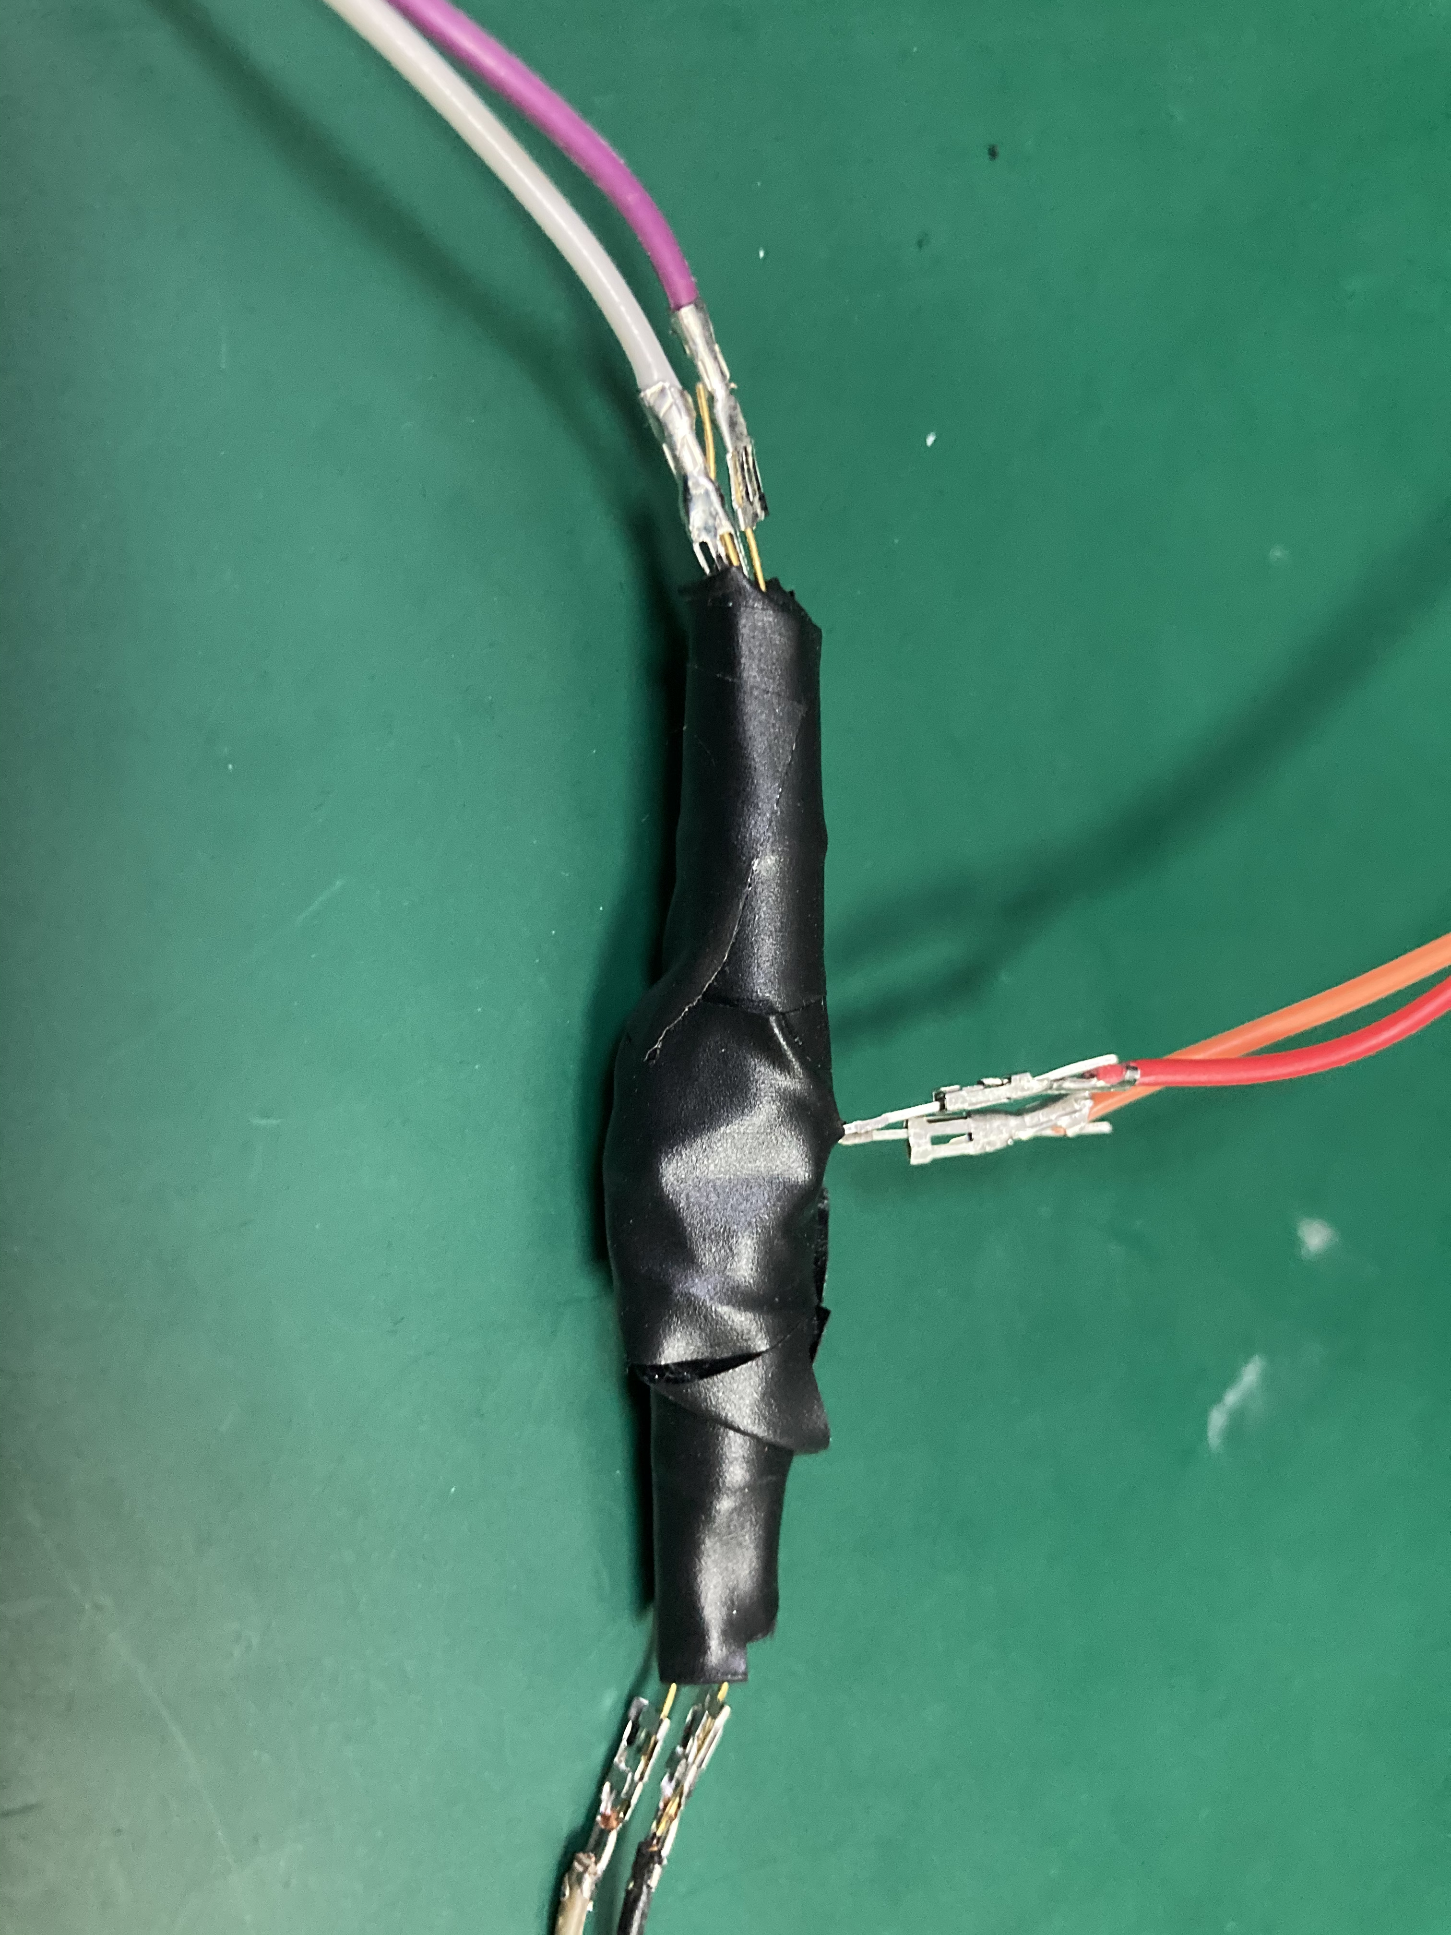
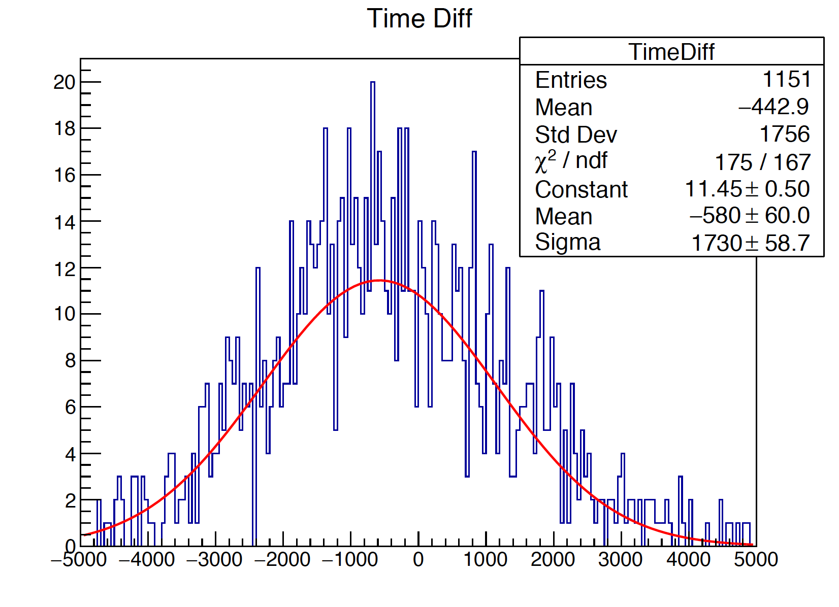
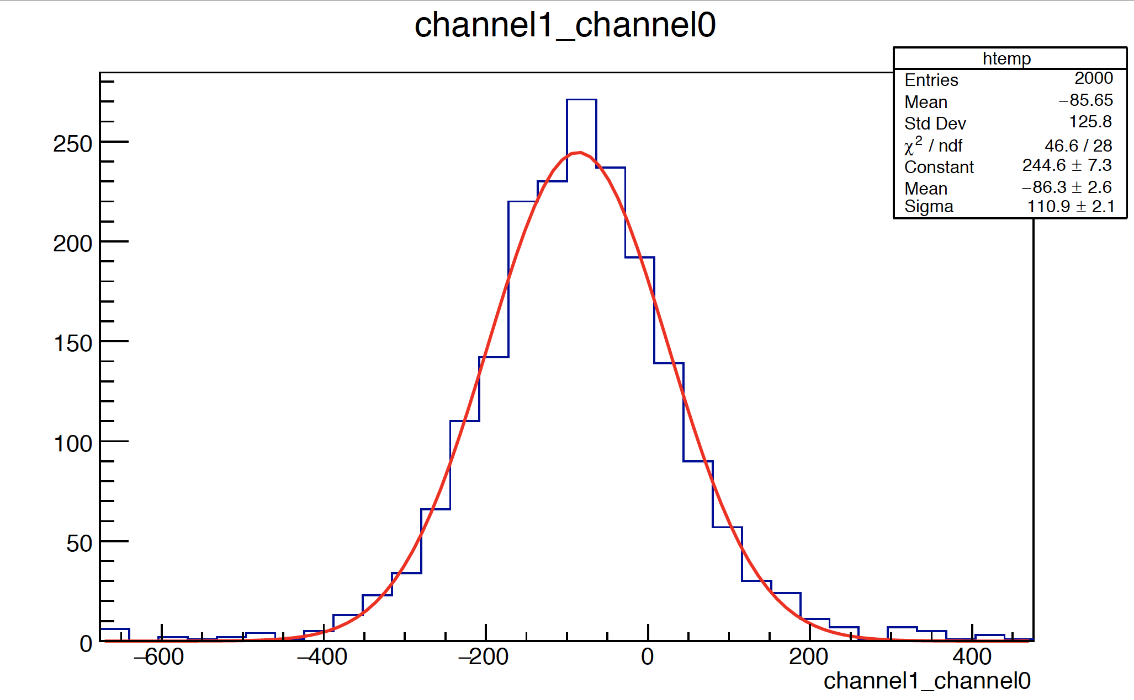


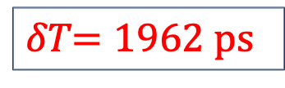
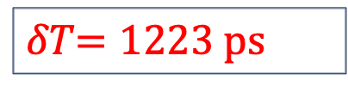
Study of Scintillator
Time Difference of MPPC
LED
MPPC
MPPC
Noise caused bad resolution
MPPC
MPPC
LED
LED+MPPC（LE）
LED+MPPC（CFD）
Need low threshold
Noise caused worse resolution
𝛿𝑇$=1962 ps$
𝛿𝑇$=1223 ps$
$$∆T=2775 ps$$
$$∆T=1730 ps$$

Slide 12
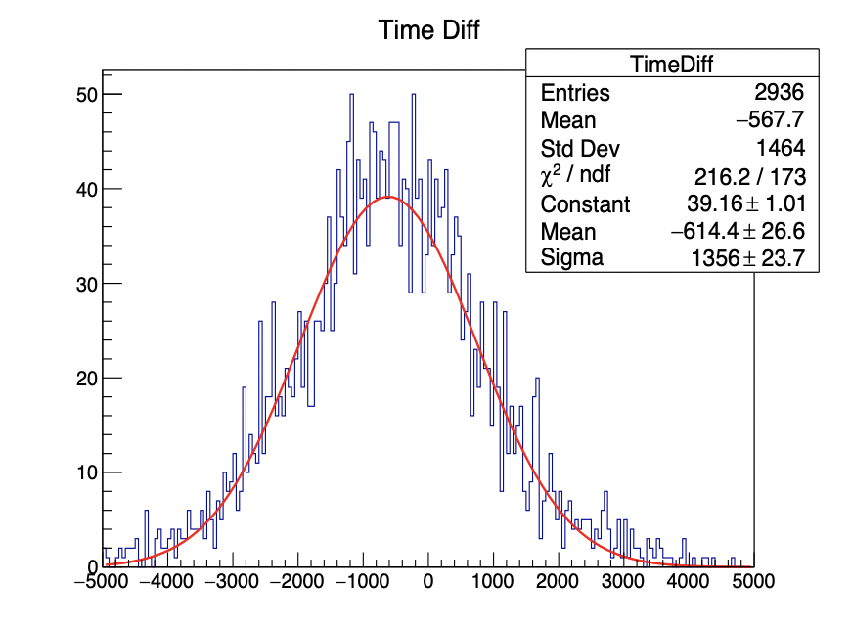

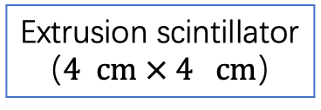
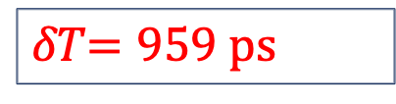
Study of Scintillator
Time Difference of scintillator
Cosmic ray
Scintillator (CFD)
MPPC
MPPC
Extrusion scintillator
（$4 cm × 4 cm$）
$$∆T=1356 ps$$
Better than LED + MPPC
𝛿𝑇$=959 ps$

Slide 13
summary
    Progress:
    Install CEPCSW
    Measure the attenuation length: 4.37 cm
    Measure the time resolution
      Preamp: 164 ps good!
      MPPC: 1223 ps
      scintillator: 959 ps
    Plan:
    Simulation using Geant4
    Measure attenuation length of more samples
    Reduce noise to get better time resolution
    Measure time resolution of other type of scintillator

Slide 14
Thanks for listening!

Slide 15
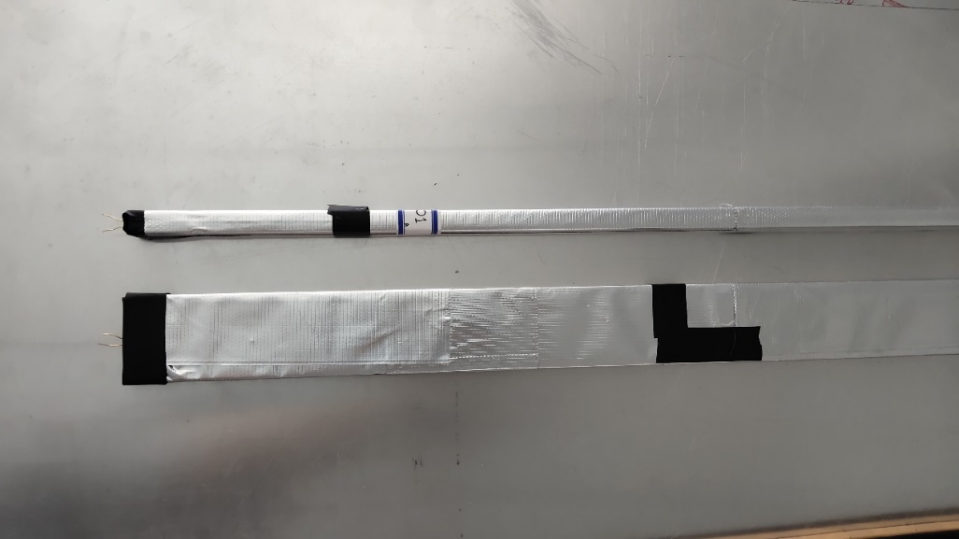
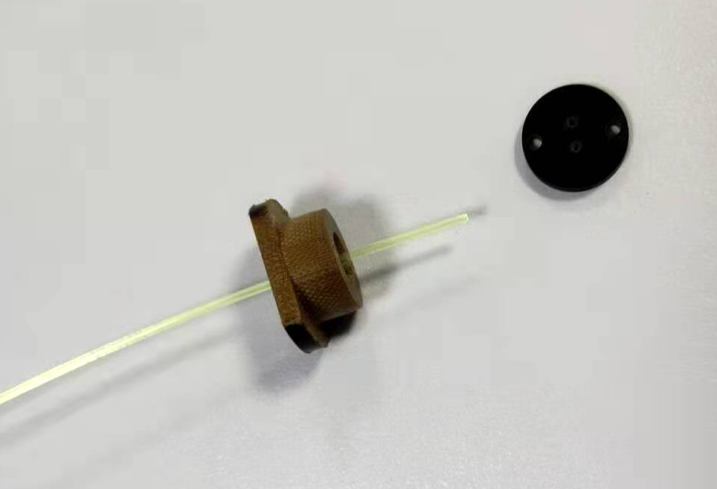
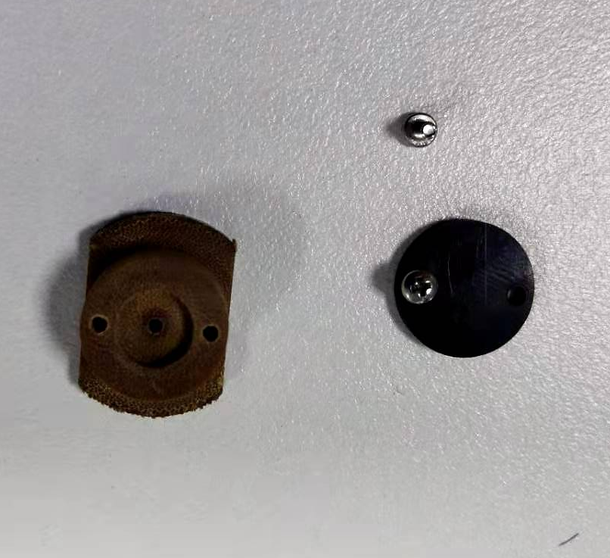
Study of Scintillation detector
Composition of Scintillation detector
Scintillator：Gao Neng Ke Di company
with TiO2/Teflon reflective coating
Geometry : 1 cm x 4 cm x 1.5 m.
wavelength-shifting fibre

Slide 16
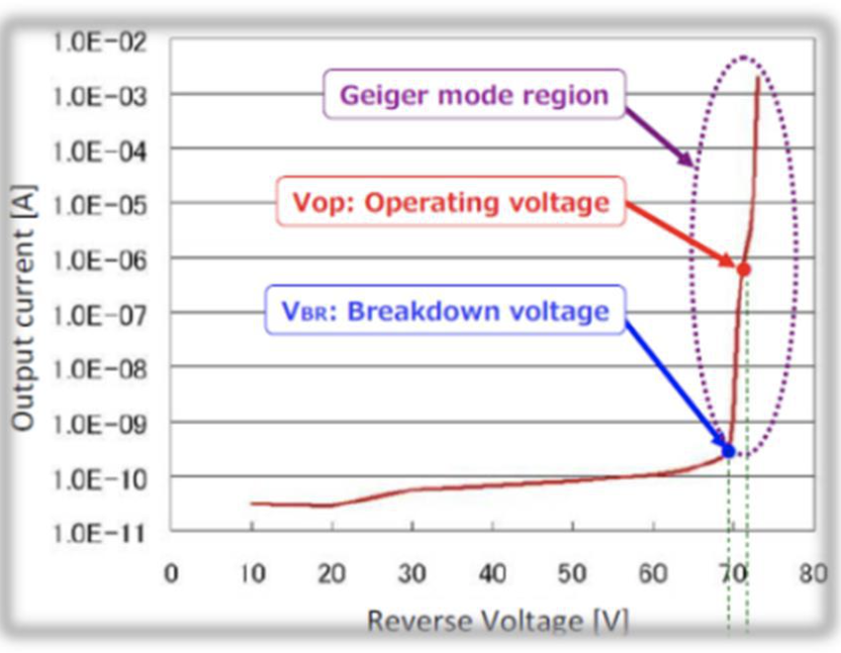
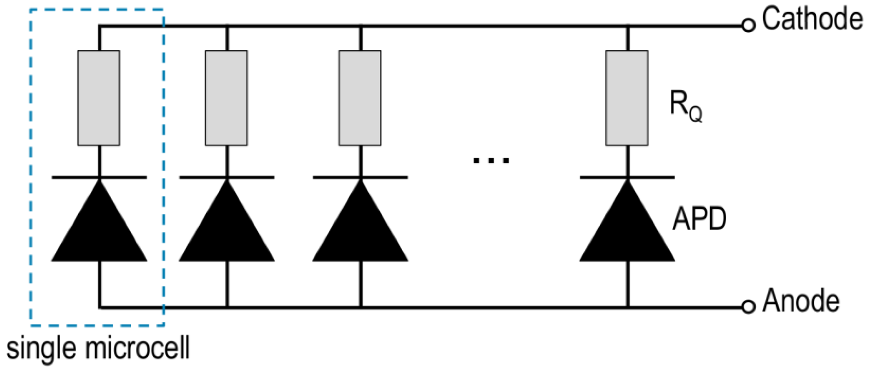
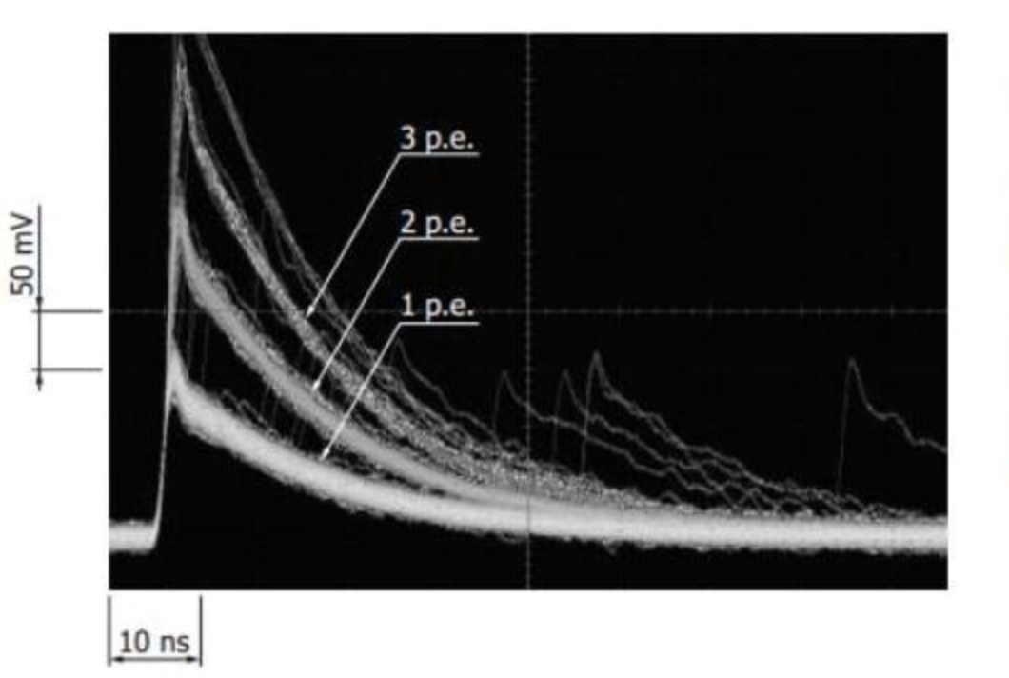
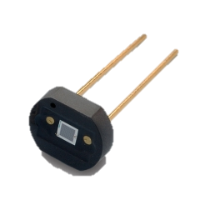
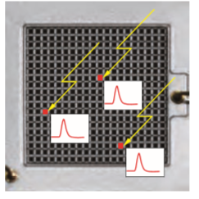
Study of Scintillation detector
Readout: SiPM
work in Geiger mode
1.3×1.3mm²
667 pixels
MPPC

Slide 17
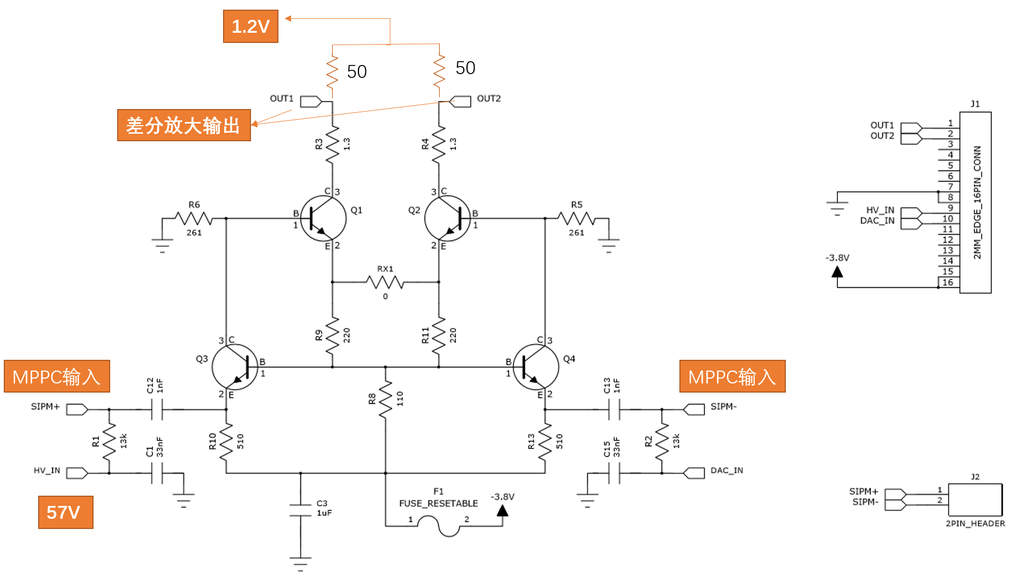
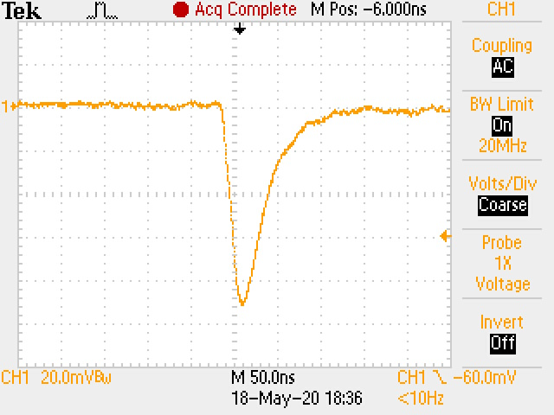
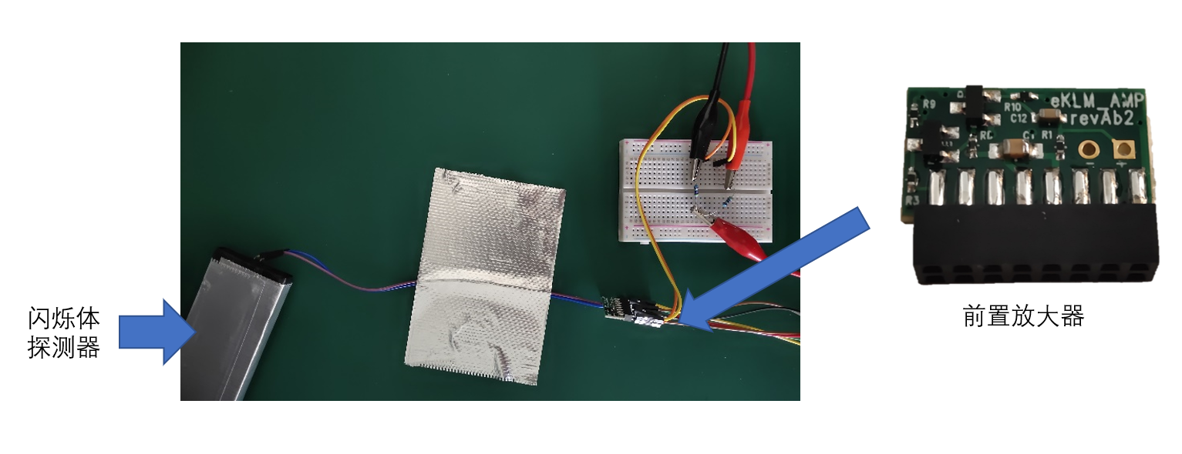
Study of Scintillation detector
Readout: Preamplifier & carrier
Preamplifier & carrier
Circuit diagram of preamplifier
Scintillation
detector
preamplifier

Slide 18

backup
Study of MPPC parameters
Gain
Dark count rate

Slide 19





backup
efficiency

Slide 20
backup
ADC distribution
Number of fired pixels
Belle2 TDR
Scintillator in lab

Slide 21


Study of Scintillation detector
Gen + preamp (CFD)
LED+MPPC
Pulse generator signal
(CFD_delay_24ns,F_0.4)
 | T _{diff} ( ps )
Pulse generator | 64
Generator + preamp | 241
LED+MPPC | 1730
KLM scint. | 1822
Injection scint. | 1356
KLM scint. module
scintillation
$$∆T=T_{diff}/\sqrt{2}$$

