Slide 1
Gauge/Gravity Correspondence (AdS/CFT correspondence)
Bin Chen (PKU)
17-03-2021

Slide 2
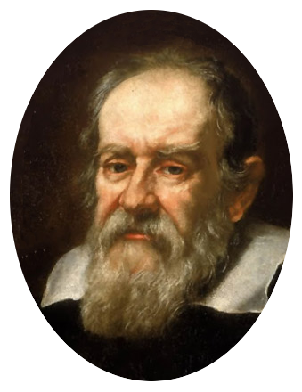
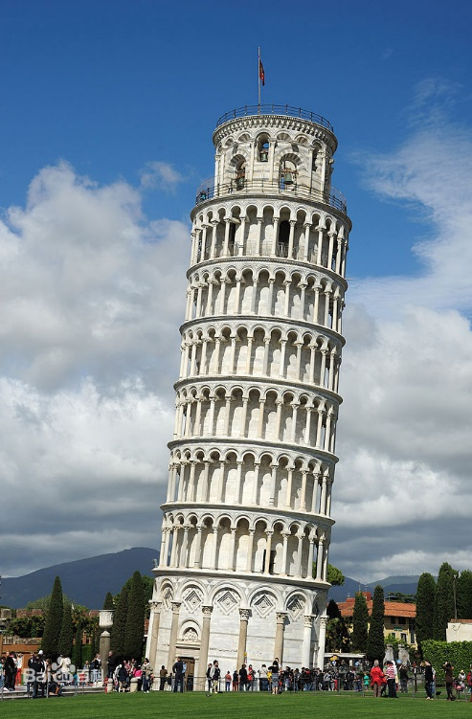
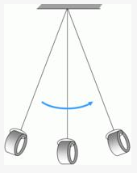
Gravity on Earth
The acceleration of gravity is uniform
(Weak) Equivalence Principle
Relativistic Principle
Galileo Galilei (1564-1642)

Slide 3
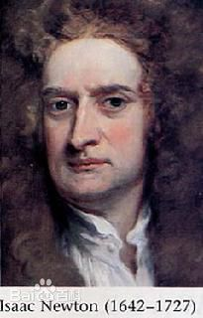
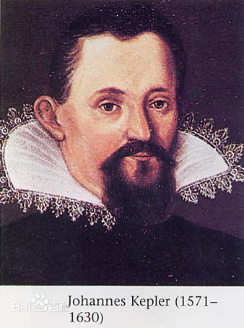
Newton’s gravity
Kepler’s laws on planets
Newton: gravity is universal
Inverse-square law

Slide 4
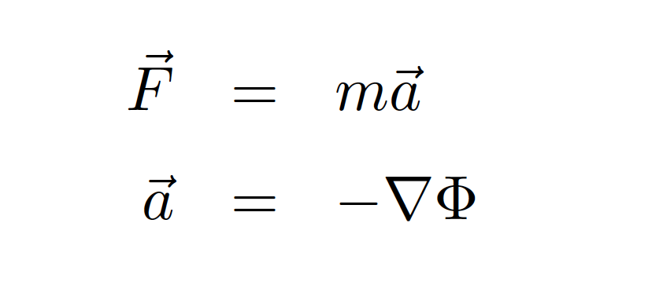
Newton’s gravity II:
Well developed in 18th-19th：Newton, Laplace, Poisson, Hamilton …
Solar system: a triumph
Newton’s gravity successfully explained all the available data, and continued to do so for 200 years
Tidal force:
a real signature of gravity

Slide 5
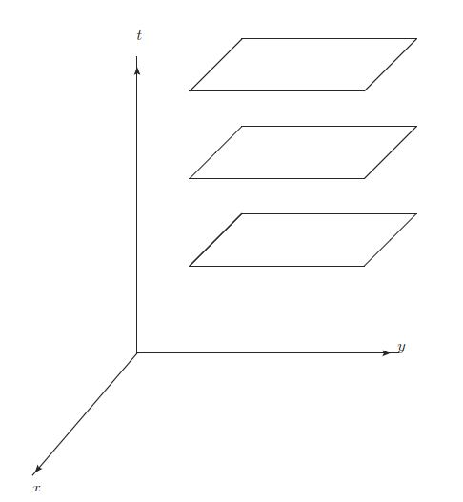
Inconsistency: Newton’s gravity & SR
Absolute time
Instantaneous
Nonrelativistic
A relativistic theory of gravity?

Slide 6
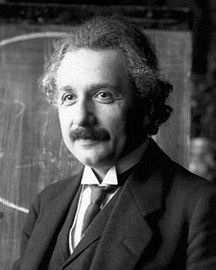
General Relativity: Einstein theory about time, space and gravity
Special Relavity（1905）：
Flat space-time
General relativity（1915）：Relativistic theory of gravity
Curved space-time
The most beautiful theory in classical physics

Slide 7
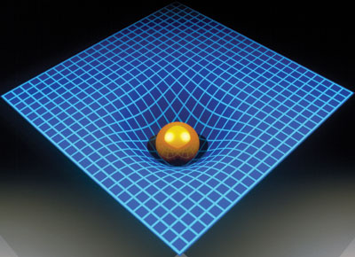
Gravity is spacetime
Gravity=Curvature
Spacetime is dynamic
Applications：
GPS, Astrophysics (Black holes, Pulsars, Quasars, etc.), Cosmology

Slide 8
Gravitational wave (2015～)

Slide 11
Image of BH

Slide 12
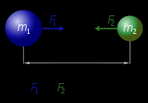
Features of Gravity
Everywhere
Only attraction, no repulsion
Long-range force
Weakest force
Untamable

Slide 13
Cornerstones of physics in 20th Century
Relativity
Special relativity, General Relativity
Quantum theory
QM, QFT (QED,QCD, SM)

Slide 14
Fundamental interactions: EM, Weak and Strong
In the framework of QFT, these three interactions are unified in the principle of gauge symmetry

Slide 15
Grand Unification: Einstein’s dream
EM, weak and Strong: gauge particle spin 1
Gravity：graviton spin 2
How to unify gravity with other three forces?

Slide 16
Quantum gravity
How to unify gravity with other forces?
How to quantize gravity? Ultraviolet completeness?
Why we need quantum gravity?

Slide 17
Very early universe
Significant effects of QG near the cosmological singularity:
berth, evolution and fate of the universe?
Dark energy and dark matter?

Slide 19
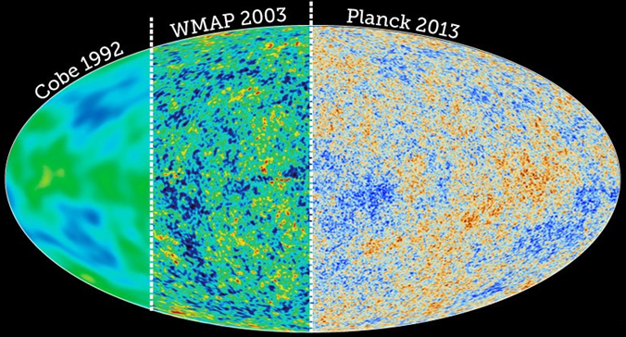
Large scale structure: CMB anisotropy

Slide 21
Dark Energy?
Dark Matter?

Slide 23
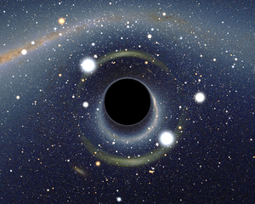
Black hole：window to probe QG!
Simple system:
M, J, Q
Rich physics:
Entropy: area law
microscopic interpretation?
Hawking radiation: blackbody radiation
Information loss?
Physics near BH singularity?

Slide 25
String theory： a theory of Quantum gravity
String theory unifies all the elementary particles and fundamental forces in nature in an elegant way

Slide 26
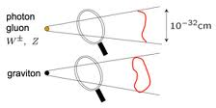
Basic picture of string theory
All elementary particles are the excitations of string
gauge particle -> open string
graviton -> closed string
In string theory, four fundamental interactions get unified

Slide 27
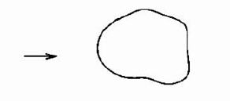
Open and closed strings
+
？
=
Photon/gluon (gauge particle)
Graviton
Relation between gauge theory and Gravity?

Slide 28
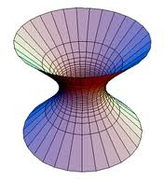
Open/Close duality
D-膜
Open string picture：Gauge theory
Close string picture：Gravity in higher dim.
Equivalence between two pictures is referred to as duality or correspondence
Due to the presence of large number of D-branes,
spacetime is curved and becomes
Anti-de Sitter(AdS) spacetime.
(AdS spacetime: pseudo sphere, a spacetime
with negative constant curvature)
==
==

Slide 29
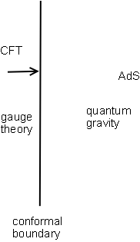
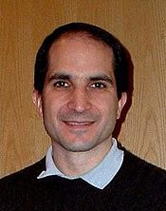
AdS/CFT correspondence
String theory/M-theory in Anti-de-Sitter spacetime is dual (equivalent) to Conformal field theory (CFT) at AdS boundary
（J. Maldacena 1997）

Slide 30
AdS/CFT Correspondence II
(Quantum)Gravity/Gauge correspondence
AdS₅/SYM₄:Maldacena 1997
IIB superstring in AdS₅ x S⁵ spacetime with RR background = large N limit of N=4 SU(N) supersymmetric Yang-Mills theory
AdS₄/ABJM, AdS₃/CFT₂, AdS₇/CFT₆, AdS₂/SYK
No proof but no contradiction
A wealth of supporting evidence
symmetries, state/operator correspondence, correlation funtions, ……

Slide 31
Physical Implications
Rich physics: Holographic principle, Large N limit of YM, Open/Close duality
A novel way to define string theory (M-theory)
A powerful tool to study strongly coupled problems in QFT

Slide 32
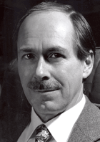
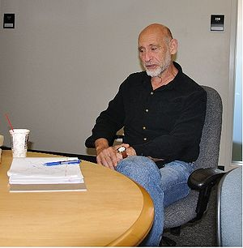
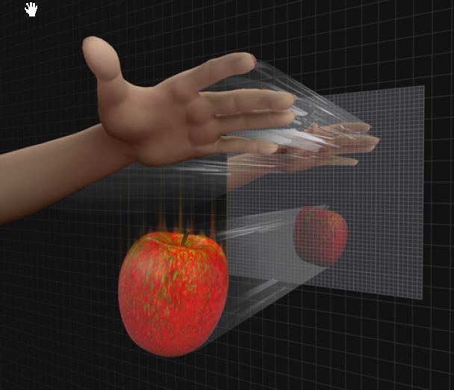
Holographic Principle： （’t Hooft, L.Susskind，1993)
In a gravity system, the maximal entropy
in a region V is proportional to the
area of the boundary of V, rather
than the volume of V
The physics in V can be described
by some theory on the holographic
screen at the boundary
=>Holographic description of BH
AdS/CFT is a successful
realization of holographic principle

Slide 33
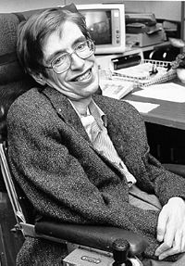
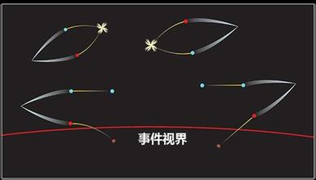
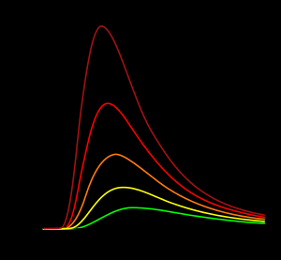
Hawking radiation
No-hair theorem： J, M, Q
Hawking radiation as blackbody radiation

Slide 34
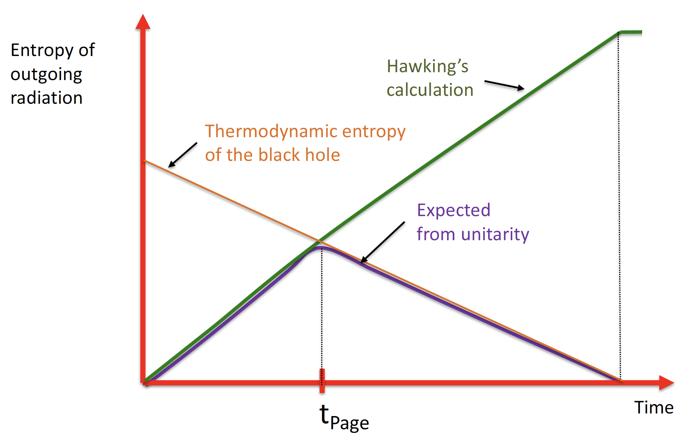
Information loss and unitarity
Pure state becomes mixed state
Entanglement between the radiated particles and their partners in the horizon

Slide 35
AdS/CFT: unitarity is intact

Slide 36
Information loss in AdS/CFT
How unitarity is kept？
How to probe the interior of blackhole?
……

Slide 37
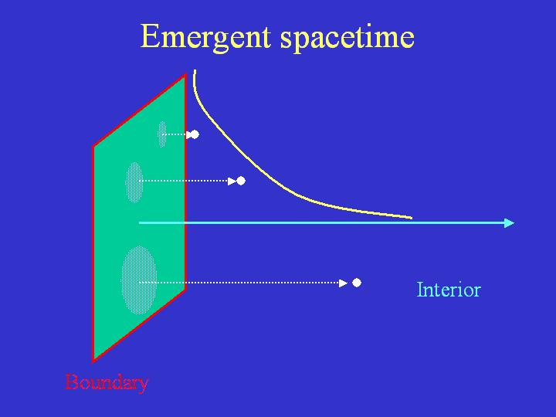
Emergence of spacetime

Slide 38
Emergent spacetime
Space and time are emergent
The notion of locality is not fundamental
Diffeomorphism is a derived concept
A fundamental theory does not need a background spacetime
Nature of gravity?

Slide 39
Applied AdS/CFT
Strong/weak duality: typical feature of AdS/CFT
One theory at strong coupling is equivalent to the other theory at weak coupling
A new tool to study strongly coupled system: from QCD at low energy to various strongly coupled condensed matter systems

Slide 40
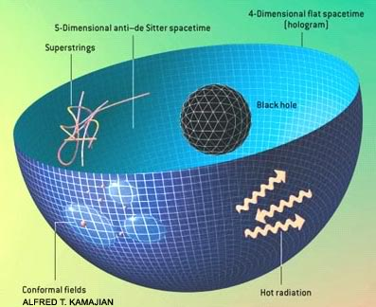
AdS/QCD
At low energy, QCD is strongly coupled
Weakly coupled gravity for help
AdS/QCD: various strongly coupled problems in QCD

Slide 41
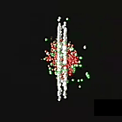
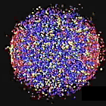
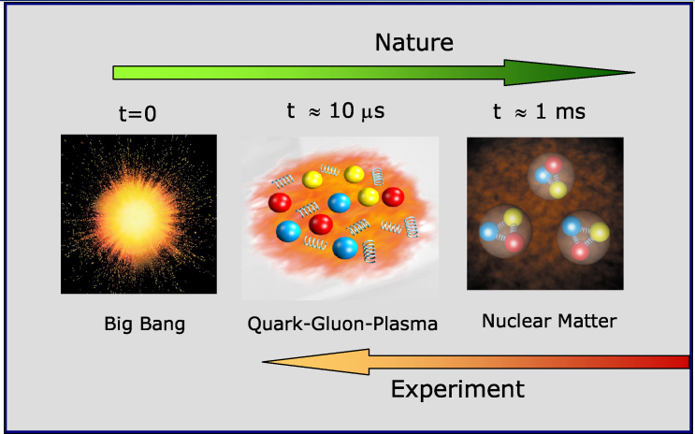
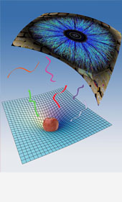
QGP: a perfect fluid?
Exp.: nearly perfect fluid
Pert. QCD: weakly coupling
Lattice QCD：Euclidean
AdS/CFT:
An efficient way to study transport property of QGP
Phys.Rev.Lett. 106 (2011) 192301
Phys.Rev.Lett. 94 (2005) 111601
Notes:
夸克胶子等离子体（QGP)在极早期宇宙大爆炸后形成，现在已经在实验室中通过重核的高速碰撞形成。实验表明QGP是一种近理想流体，粘滞性很小，其粘滞系数与 熵密度之比是1/4pi的1到2.5倍，但仍处于QCD的强耦合区域，微扰QCD无能为力，而格点QCD无法处理实时输运过程。引力/规范场论对应提供了目前唯一有效的手段来研究QGP的实时输运过程。通过在引力理论中计算黑洞的散射振幅，得到了粘滞系数与 熵密度之比1/4pi， 非常接近于实验值。

Slide 42
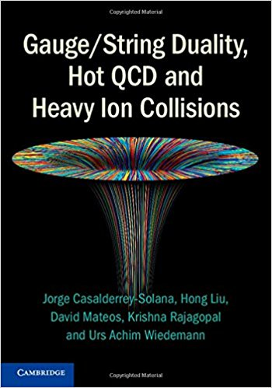
Other problems in AdS/QCD
The calculation of quenching parameter;
Energy loss via drag force;
Disassociation length;
Wake of the quark: Mach cone …;
Thermalization
Anomalous transport
Meson spectrum
……

Slide 43
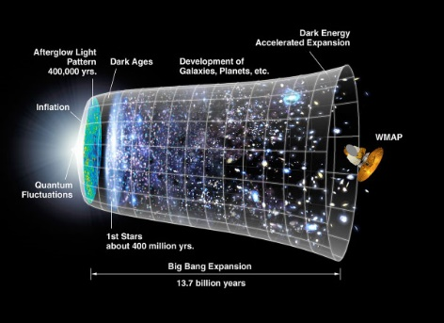
Questions：
Universality of gravity/gauge correspondence?
How to establish a holographic picture?
Holographic universe?
What kind of QFT can have
gravity description?
How to set up a more precise correspondence to describe experiments?
Better understanding of holography
Notes:
尽管引力/规范对应的研究取得了很大的进展（12000+），其影响扩展到了物理学的很多领域，但这个对应关系本身存在着一些基本问题亟待解决。在理论上，我们希望更好地 理解引力/规范对应的普适性问题，比如说，对于一个一般的引力系统，如何建立它的全息描述？对于非AdS的时空，如我们的宇宙，它具有暗能量，可以看作是具有一个正的宇宙学常数，是渐近dS，它们的全息描述是什么？AdS/CFT说明量子引力可以通过对偶的场论来定义，这让我们重新思考引力和时空的本质，它们是否是基本的，还是只是一种呈展现象？对于量子场论而言，什么样的量子场论可以有引力的描述，以及如何建立更加准确的对应关系来描述实验现象？这些基本问题都需要我们对引力的全息性有更加深入的理解。

Slide 44
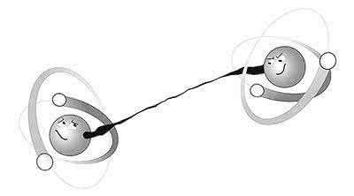
It from Qubit? --Simons Center of Geometry and Physics
Entanglement could be the key to understand holography
Entanglement is a typical feature of QM: EPR
Entanglement entropy is a measure of entanglement
Notes:
近年来的研究发现，纠缠熵也许是理解引力全息性的关键。（美国Simons几何和物理中心资助了该方向的研究）纠缠是量子系统的典型特征，而纠缠熵是对纠缠程度的度量。考虑一个双粒子系统，粒子具有自旋1/2。如果系统的波函数可以分解成两个粒子波函数的直积，说明这两个粒子没有纠缠，纠缠熵为0.而如果这个系统的波函数是EPR态，则这两个粒子互相纠缠，纠缠熵是log2.

Slide 45
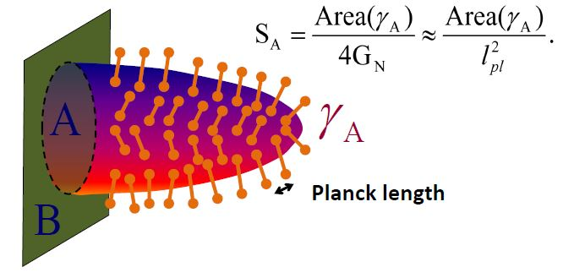
Holographic entanglement Ryu-Takayanagi (2006)
spacetime=bit of quantum entanglement?
Notes:
纠缠熵在量子多体物理、量子场论中有多方面的应用：。。。
更为重要的是纠缠熵提供了研究引力/规范对应的新窗口。2006年ryu和Takayanagi提出，边界场论中的纠缠熵可以通过引力来计算：边界上区域A与B间的纠缠熵可以由高维时空中边界为A的最小曲面的面积给出。反过来，最小曲面gammaA可以看作是来自于量子纠缠的比特。

Slide 46
C. Herzog’s talk at “AdS/CFT 20 years”

Slide 47
Thank you!

