Slide 1
Silicon Tracking
Chengdong FU
2021-03-08

Slide 2
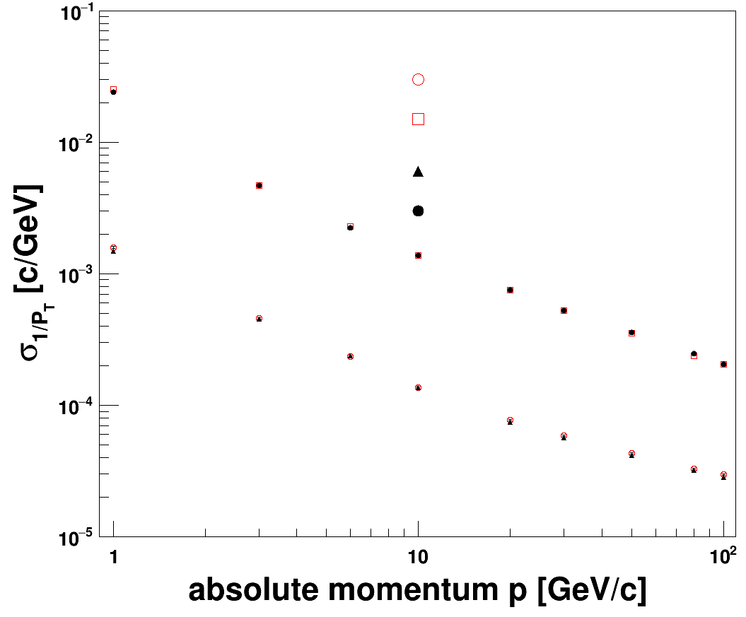
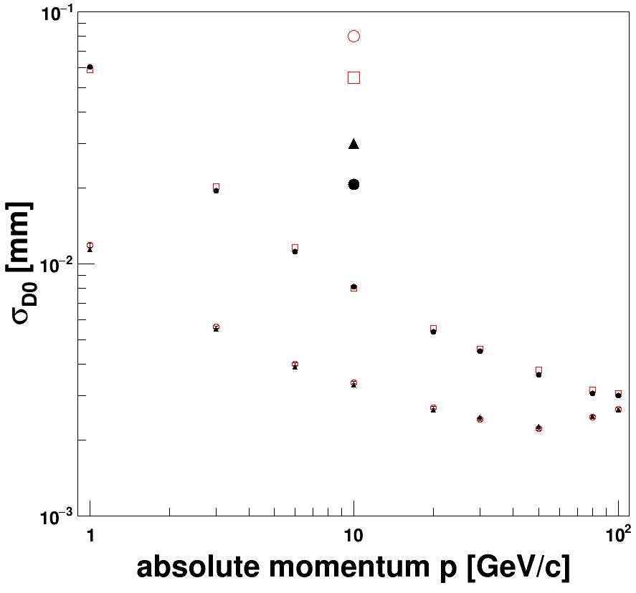
Progress
CEPC_v4’s tracker has been implemented into CEPCSW, and there are two reconstruction chains, in release plan
(database)→Mokka→(saved LCIO, Gear file)→Digi→Tracking→Fitting
(compact)→Sim →Digi→Tracking→Fitting
Validation
single muon
CEPC_v4
CEPCSW (LCIO) θ=85°
CEPCSW (LCIO) θ=20°
CEPCSW full θ=85°
CEPCSW full θ=20°
CEPCSW (LCIO) θ=85°
CEPCSW (LCIO) θ=20°
CEPCSW full θ=85°
CEPCSW full θ=20°

Slide 3
Performance for CRD
Yao Zhang feedback that current silicon track (SET not included) can not be used as initial track for extrapolating
To include SET, by FullLDCTracking
VXD+SIT+FTD (section search）
For Silicon Tracker
Merge silicon tracks
Merge silicon and TPC tracks
FTD (pattern recognition)
don’t load
VXD+SIT+FTD
VXD+SIT+FTD+SET

Slide 4
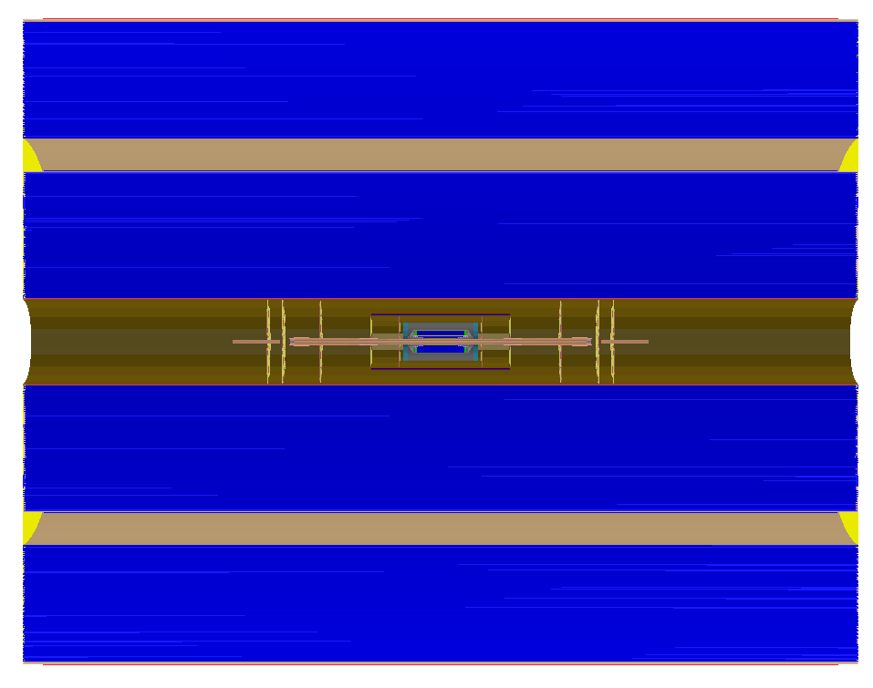
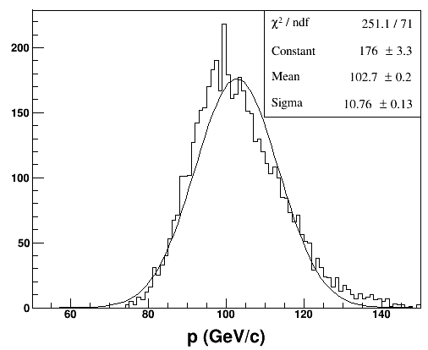
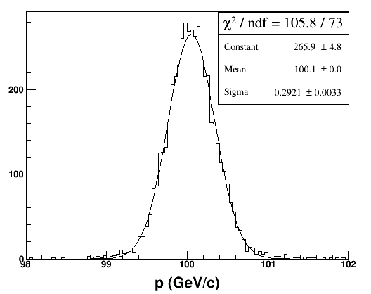
Resolution
SET
SIT
VXD
DC
FTD
CRD_o1_v02
θ=85°
p=100 GeV/c
VXD+SIT VXD+SIT+SET
bad resolution

Slide 5
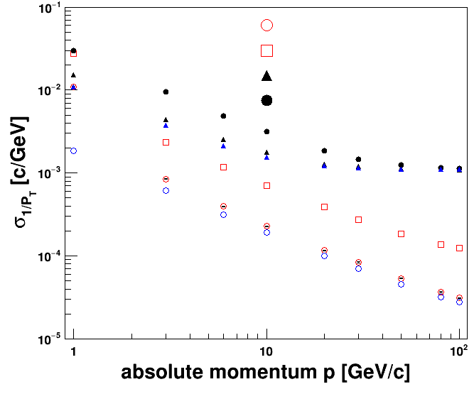
Comparison
Fast estimation: V(θ)=(A^{T}V⁻¹A)⁻¹
at p= 100 GeV/c, 0.29 GeV/c VS 0.27 GeV/c
Adding SET hits by FullLDCTracking algorithm is effective
Ο fast estimation
VXD+SIT+SET+FTD 85°
VXD+SIT+SET+FTD 35°
VXD+SIT+FTD 85°
VXD+SIT+FTD 35°
lost one group of SETs
large difference:
current estimation does not consider helix in magnetic field (straight)

