Slide 1
Modification suggestion of vacuum chamber for the collider ring
Liu Yu Dong for CEPC accelerator physical group
2021/3/25

Slide 2
Outline
The vacuum chamber in pre-CDR and CDR Design
The physical reason for modification on chamber shape
Advantage and challenge
Summary

Slide 3
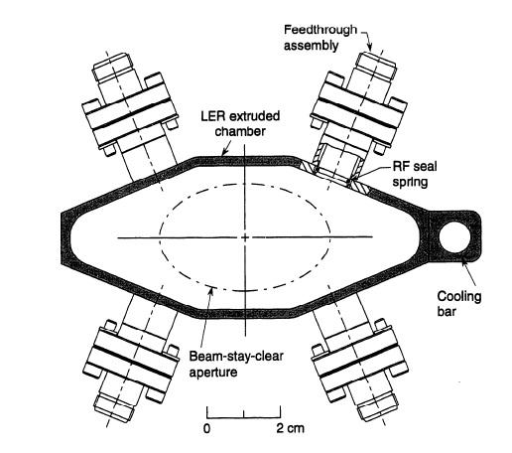
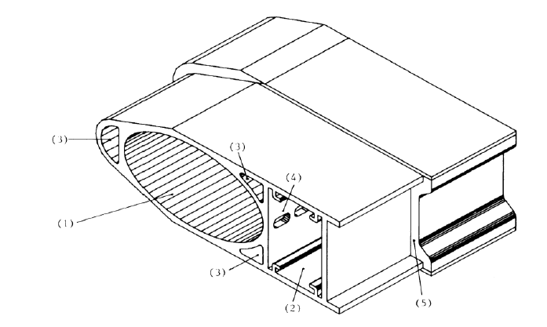
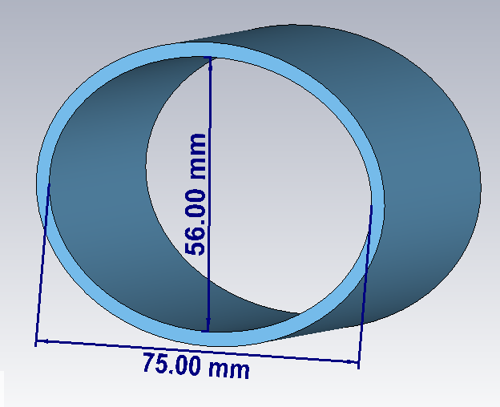
The vacuum chamber in pre-CDR
Single Ring (50km) and Pretzel Orbit in pre-CDR phase
The two beams need to be separated horizontally at parasitic crossing points. ~3mm
The maximums horizontal beam-stay-clear region ~45mm;
Injection region aperture: >30mm
Referened from PEPII and LEP vacuum chamber
chamber aperture in pre-CDR
95mm*55mm
131mm*70mm

Slide 4
The Vacuum chamber from pre-CDR to CDR
CDR: electron and positron beam stored in separate rings
The maximums horizontal beam-stay-clear region ~26.85mm;
Injection region aperture: >26mm
Elliptical chamber (75mm*56mm) is satisfied for CDR design
Maintain the aperture size and shape

Slide 5
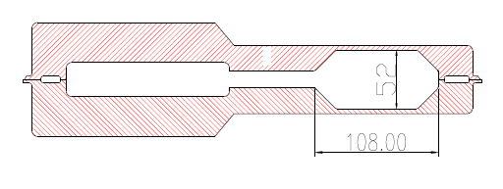
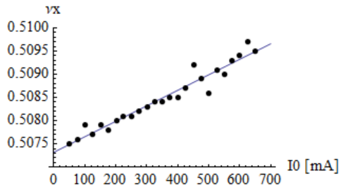
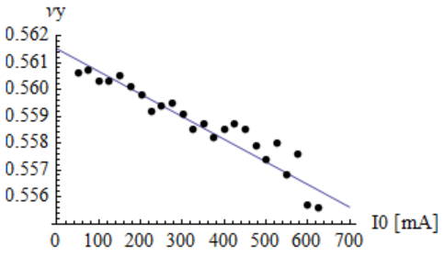
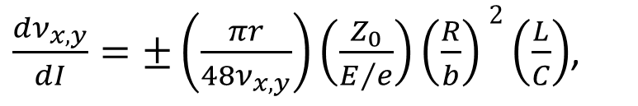
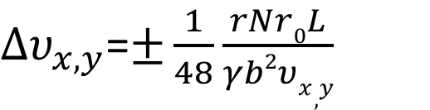
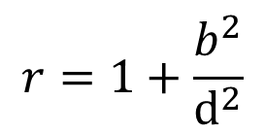
The physical reason for modification on chamber shape
Higher beam current for Z mode operation after CDR
Tune shift contribution from quadrupolar wakes of noncircular vacuum chamber
Alexander Chao, Samuel Heifets, and Bruno Zotter, PHYSICAL REVIEW SPECIAL TOPICS - ACCELERATORS AND BEAMS,VOLUME 5, 111001 (2002)
$∆υ_{x,y}$=$±\frac{1}{48}\frac{rNr0L}{γb2υx,y}$
$\frac{{dν}_{x,y}}{dI}=±\left(\frac{πr}{{48ν}_{x,y}}\right)\left(\frac{Z_{0}}{E/e}\right)\left(\frac{R}{b}\right)2\left(\frac{L}{C}\right)$,
$$r=1+\frac{b^{2}}{d^{2}}$$
Confirmation in PEPII and BEPCII experiments
王娜，王九庆，田赛克，杜冲冲，段哲，刘瑜冬，于程辉，麻惠洲，尹頔， BEPCII对撞模式工作点频移测量与分析， BEPC'18第二十三届年会文集

Slide 6
Betatron Tune shift in CEPC
 | BEPCII | PEPII | CEPC
C (m) | 237.5 | 2219 | 100000
E (GeV) | 1.89 | 9 | 120（Higgs） | 80（W） | 45.5（Z）
I（mA） | 930 | 986 | 16.8 | 88.5 | 278.8 | 839.9（high Luminosity）
b (m) | 0.026 | 0.025 | 0.028
d (m) | 0.054 | 0.0354 | 0.0375
L/C | 0.7 | 0.59 | 0.8
ν_{x}/ν_{y} | 6.51/5.60 | 24.62/24.64 | 445.12/445.22 | 319.12/319.22
dν_{x}/dI (A⁻¹) | 0.0037 | 0.0197 | 0.1860 | 0.3891 | 0.6841
dν_{y}/dI (A⁻¹) | -0.0042 | -0.0196 | -0.1859 | -0.3890 | -0.6839
Max Δν_{x} | 0.0034 | 0.0194 | 0.00312 | 0.03443 | 0.19072 | 0.57457
Max Δν_{y} | -0.0039 | -0.0193 | -0.00312 | -0.03442 | -0.19067 | -0.57440
That will be difficult for global tune correction for Z mode operation in CEPC!

Slide 7
Chamber modification
28mm
37.5mm
This tune shift can be eradicated by round chamber such as in KEKB and sperKEKB!

Slide 8
Advantage on round vacuum chamber
Elimination on quadrupolar wakes from elliptical structure
Aperture reduction for power consumption on quadrupole and sextupole magnets
quadrupole magnet power: P(Q)∝r⁴
Power decrease 20%
Cost saving ￥80 M（equipment manufacture ￥ 60M,
operation ￥20M）
sextupole magnet power: P(Q)∝r⁶
Power decrease 30%
Materials and manufacture for round pipe
Materials saving: Cu& 82 tons, Al& 26 tons
Manufacture simplification
Cost saving ￥7.61 M

Slide 9
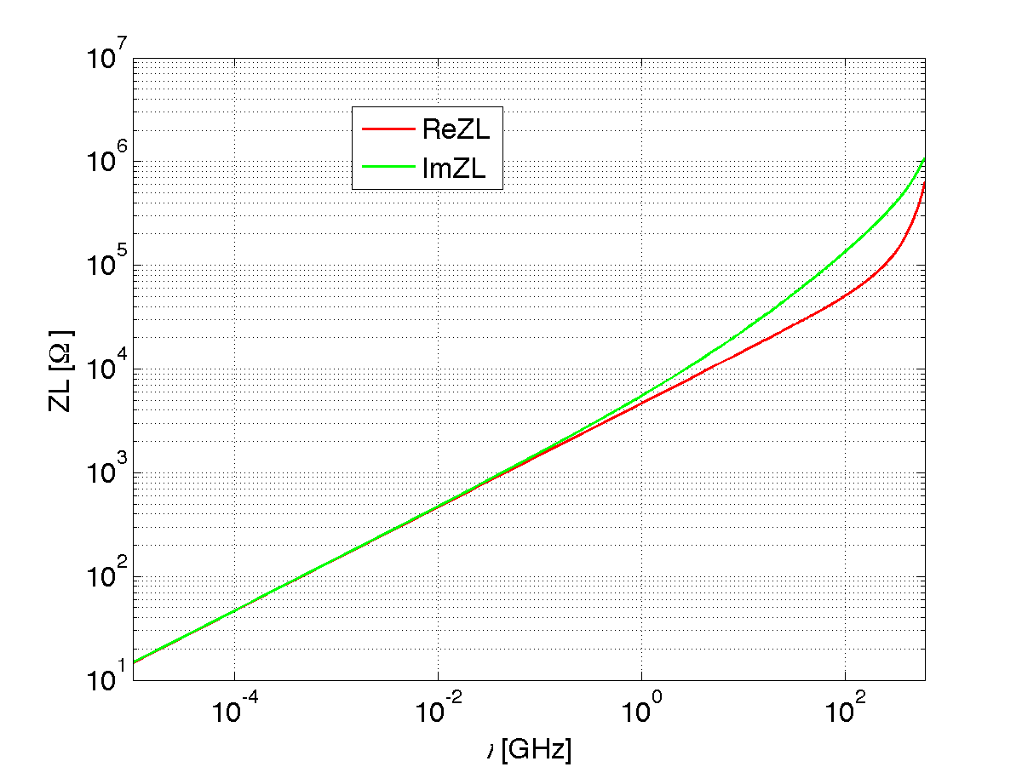
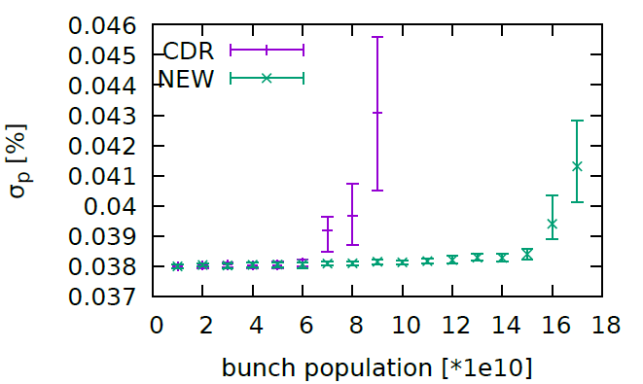
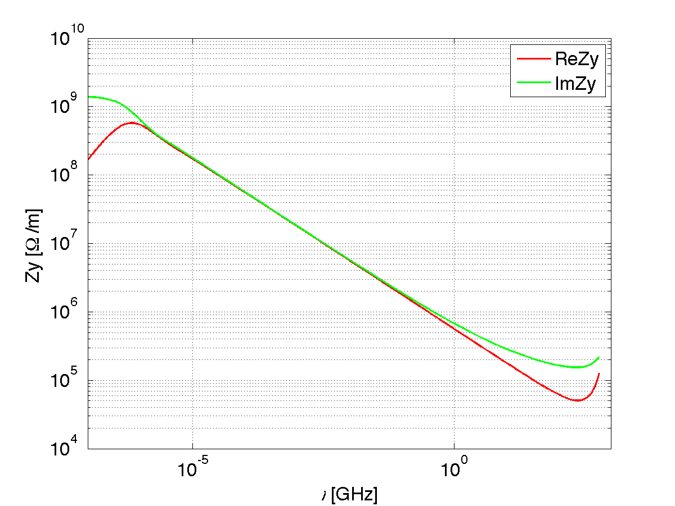
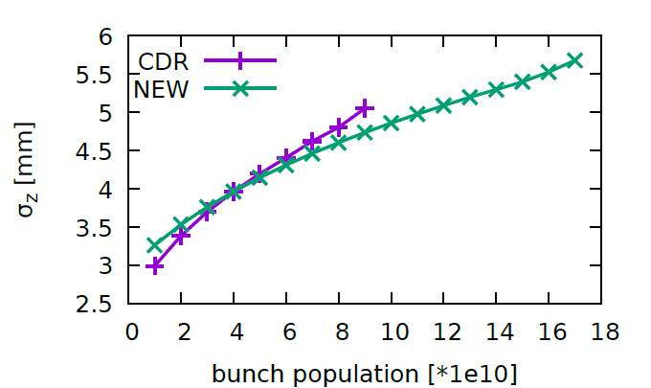
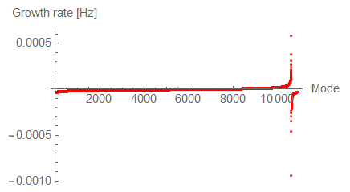
Challenge and Response : Resistive wall impedance instability
Resistive wall impedance
  Round pipe of Copper (3mm) with NEG coating (200nm)
N. Wang’s talk on last CEPD Day
Coupled bunch instability
Instability growth time 1.7ms, more efficient feedback for its suppression
High luminosity Z operation:
Bunch lengthening 90%;
Energy spread increasing 4%
Strictly control on the coating thickness for impedance source to restrain the instability!

Slide 10
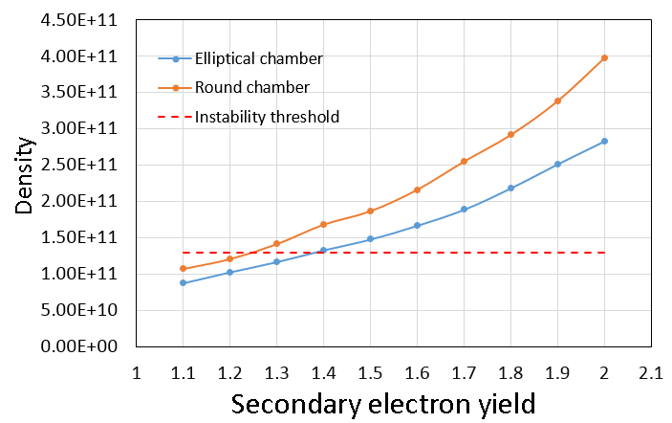
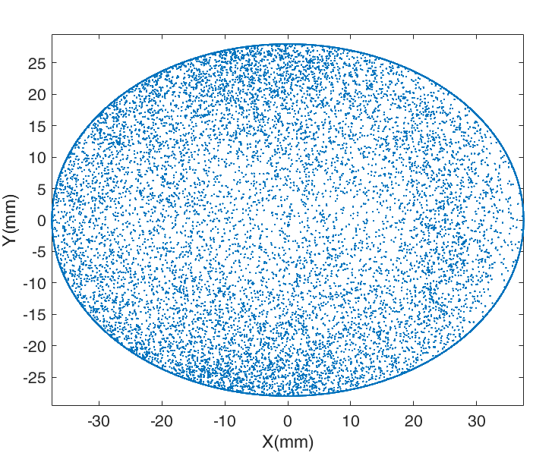
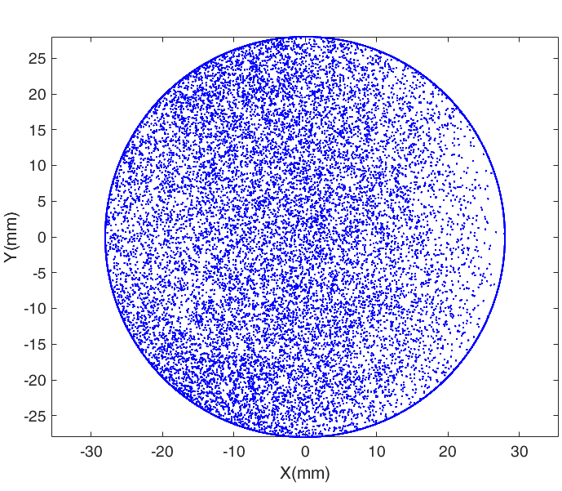
Challenge and Response : Electron Cloud
Elliptical chamber: SEY<1.3
Round chamber: SEY<1.2
NEG coating : effective method on control SEY

Slide 11





Summary
Shrinking of the pipe aperture:
Beam physics:
Solution on quadrupolar wakes and Betatron tune correction
Serious instability caused by resistive wall impedance
Electron cloud density increase
Strictly restriction on NEG coating and its impedance!
Technique on vacuum, magnets and power supply:
Manufacture easily
Lower power consumption
More cost saving
28mm
OR
37.5mm
28mm
28mm

Slide 12
Backup slides

Slide 13
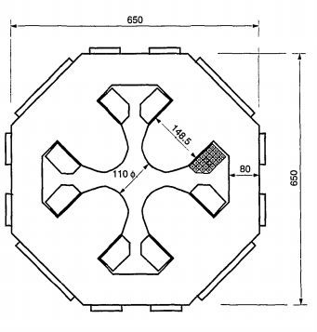
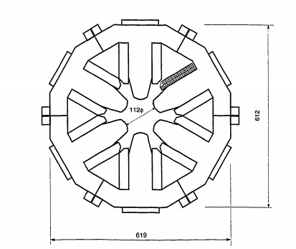
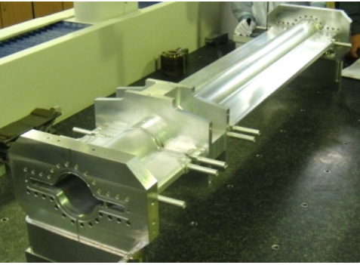
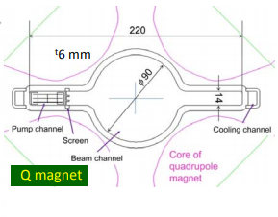
vacuum chamber of KEKB and superKEKB

Slide 14
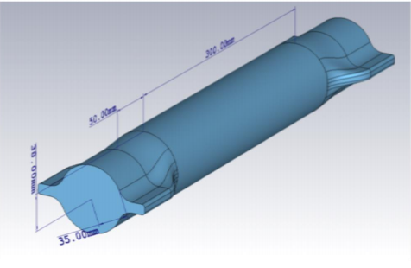
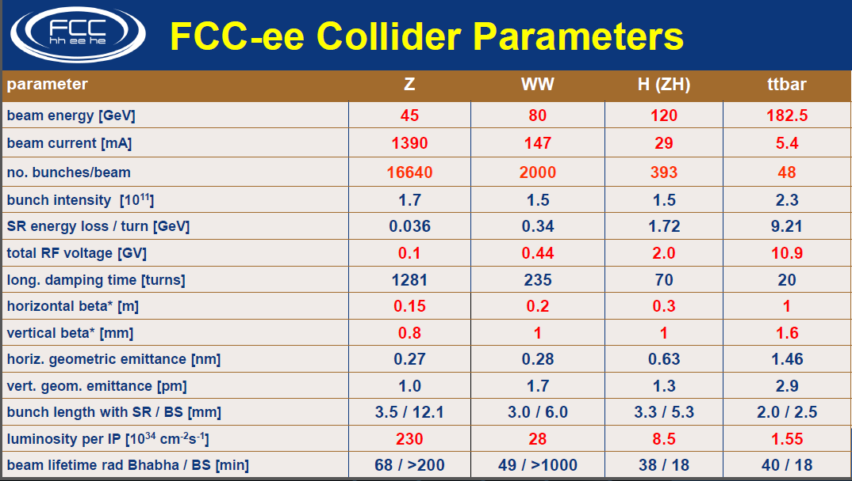
Vacuum chamber in FCC design

Slide 15
CEPC high luminosity Parameters-IAS2021
From Dou Wang
 | tt | Higgs | W | Z
Number of IPs | 2 | 2 | 2 | 2
Energy (GeV) | 180 | 120 | 80 | 45.5
Circumference (km) | 100 | 100 | 100 | 100
SR loss/turn (GeV) | 8.53 | 1.73 | 0.33 | 0.036
Half crossing angle (mrad) | 16.5 | 16.5 | 16.5 | 16.5
Piwinski angle | 1.16 | 4.87 | 9.12 | 24.9
N_{e}/bunch (10¹⁰) | 20.1 | 16.3 | 11.6 | 15.2
Bunch number (bunch spacing) | 37 (4.45μs) | 214 (0.7us) | 1588 (0.2μs) | 3816 (86ns) | 11498 (26ns)
Beam current (mA) | 3.5 | 16.8 | 88.5 | 278.8 | 839.9
SR power /beam (MW) | 30 | 30 | 30 | 10 | 30
Bending radius (km) | 10.7 | 10.7 | 10.7 | 10.7
Phase advance of arc cell | 90°/90° | 90°/90° | 90°/90° | 60°/60°
Momentum compaction (10⁻⁵) | 0.73 | 0.73 | 0.73 | 1.48
β_{IP} x/y (m) | 1.0/0.0027 | 0.33/0.001 | 0.33/0.001 | 0.15/0.001
Emittance x/y (nm) | 1.45/0.0047 | 0.68/0.0014 | 0.28/0.00084 | 0.27/0.00135
Transverse σ_{IP} (um) | 37.9/0.11 | 15.0/0.037 | 9.6/0.029 | 6.36/0.037
ξ_{x}/ξ_{y}/IP | 0.076/0.106 | 0.018/0.115 | 0.014/0.13 | 0.0046/0.131
V_{RF} (GV) | 9.52 | 2.27 | 0.47 | 0.1
f _{RF} (MHz) (harmonic) | 650 (216816) | 650 (216816) | 650 (216816) | 650 (216816)
Nature bunch length σ_{z} (mm) | 2.23 | 2.25 | 2.4 | 2.75
Bunch length σ_{z} (mm) | 2.66 | 4.42 | 5.3 | 9.6
HOM power/cavity (kw) | 0.45 (5cell) | 0.48 (2cell) | 0.79 (2cell) | 2.0 (2cell) | 3.02 (1cell)
Energy spread (%) | 0.17 | 0.19 | 0.11 | 0.12
Energy acceptance requirement (DA) (%) | 2.0 | 1.7 | 1.2 | 1.3
Energy acceptance by RF (%) | 2.61 | 2.5 | 1.83 | 1.48
Lifetime (hour) | 0.59 | 0.35 | 1.3 | 1.7 | 1.4
L_{max}/IP (10³⁴cm⁻²s⁻¹) | 0.5 | 5.0 | 18.7 | 35.0 | 105.5

