Slide 1


CEPC collider ring dual aperture quadrupole design progress
Mei Yang
IHEP, CAS
20210325 CEPC DAY

Slide 2
Outline
DAQ parameter and prototype
F/F design
F/D design and optimization
Summary

Slide 3
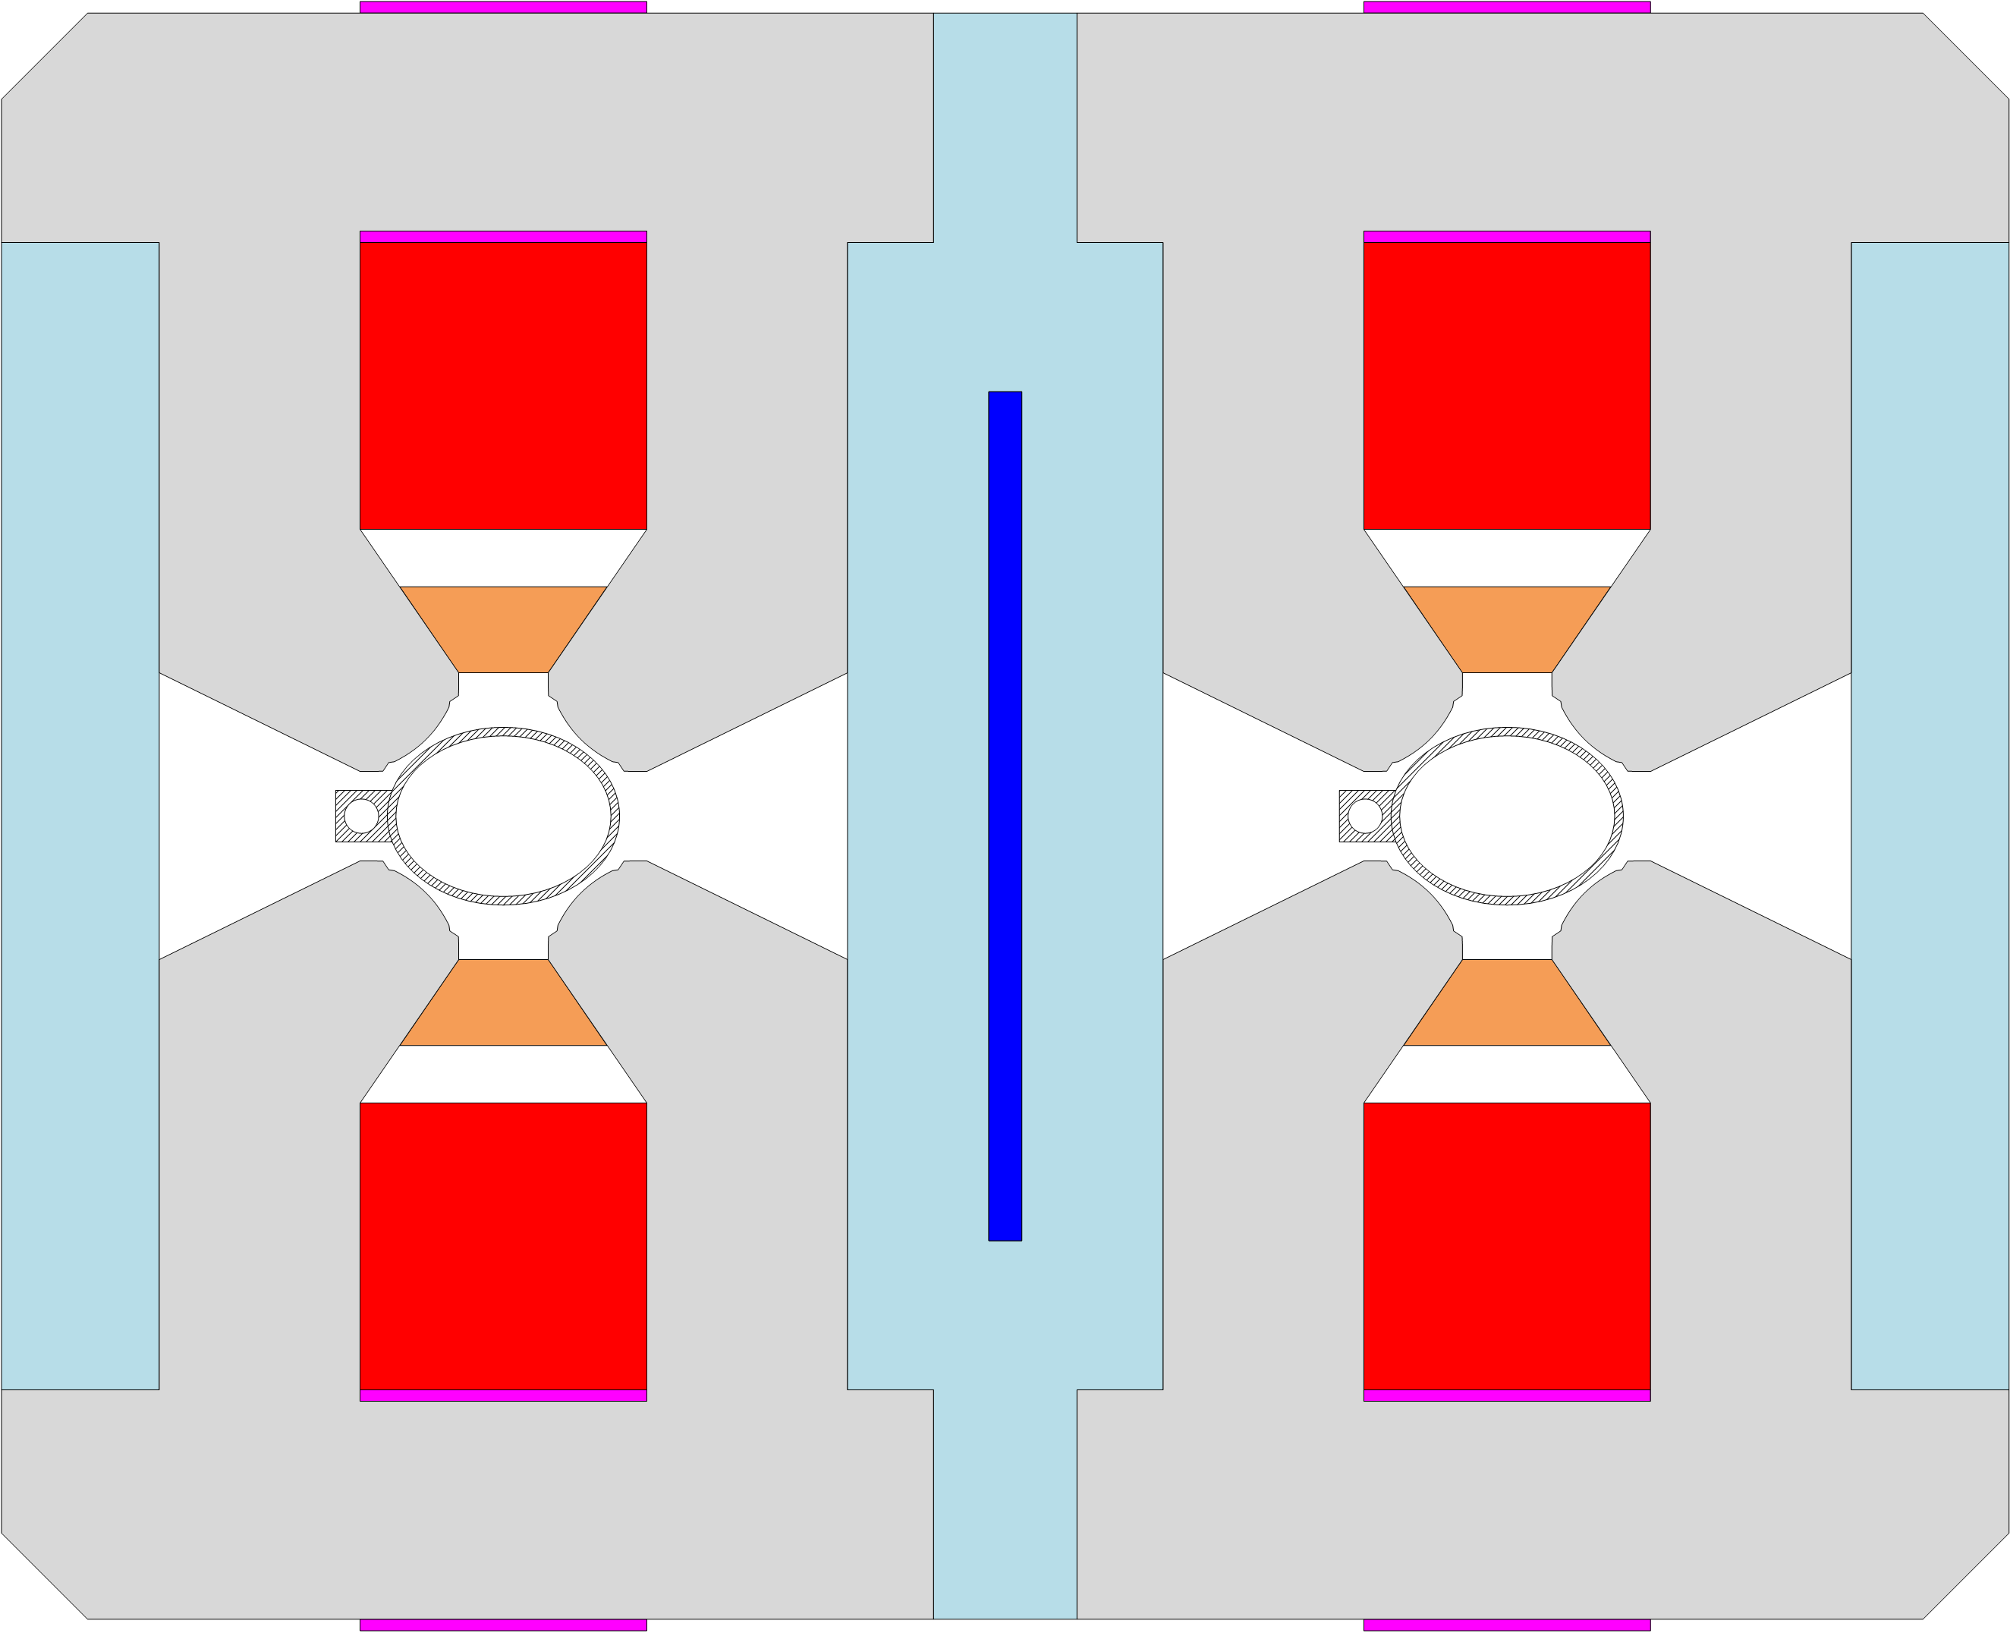
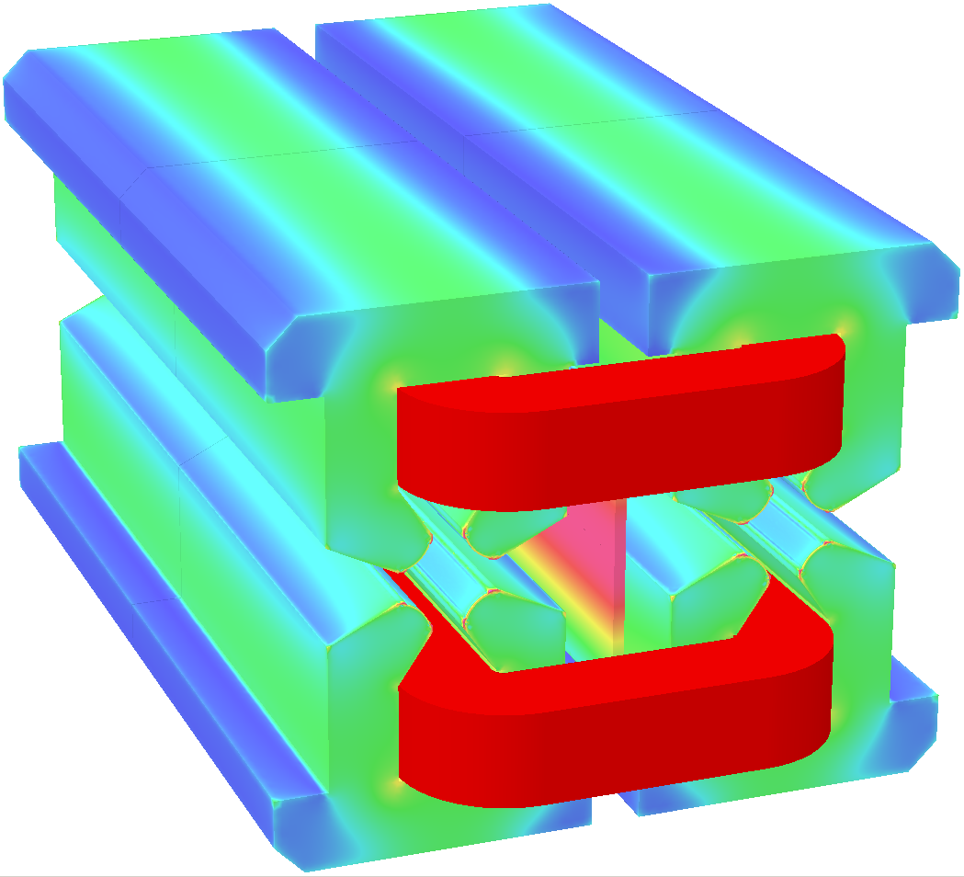
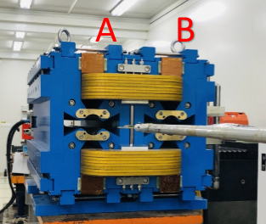
Collider ring dual aperture quadrupole(DAQ)
Basic parameters of DAQ
  Apertures：76mm
  Beam separation is 350mm
  Gradient range: 3.20T/m@45.5GeV~12.8T/m@182.5GeV
  Trim coil:+-1.5%
  Good field region: 5×10⁻⁴@Rref=12.2mm
First prototype F/D

Slide 4
Prelimary measurement results of prototype
Magnetic axis shift
  The magnetic center in horizontal direction is shown below. The Xcen shift by 2mm in aperture A and by -1.7mm in aperture B when the energy rises from 45GeV to 182.5GeV. The magnetic center distance between the two apertures is less than 350mm and shifted by 3.7mm in the ramping process.
Aperture A
G<0
Aperture B
G>0
350mm

Slide 5
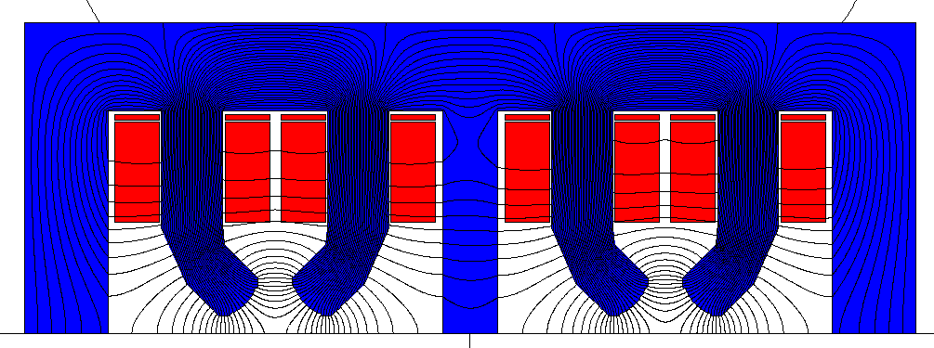
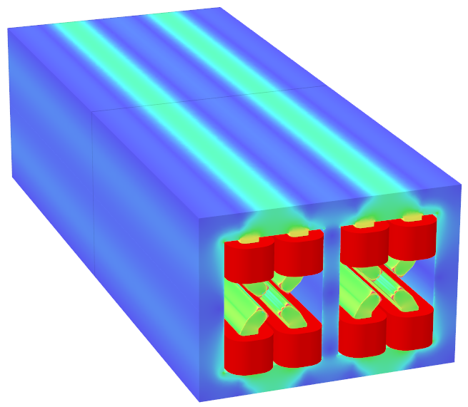
F/F design
F/F scheme features:
  For strict space, the middle yoke is shared.
  The power consumption increases a lot.
  Nearly no cross talk effect between the two apertures.
  The results show that it can meet the requirement.
  The field harmonics change are acceptable.
  3D end field has little effect on the integral field harmonics.
 | 45GeV | 45GeV+tr | 120GeV+tr | 182.5GeV | 182.5GeV+tr
 | Right-bn | Right-bn | Right-bn | Right-bn | Left-bn | Right-bn
1 | -7.43 | -7.35 | -3.78 | 0.69 | 0.38 | 1.84
2 | 10000 | 10000 | 10000 | 10000 | 10000 | 10000
3 | -0.91 | -0.89 | -0.60 | -0.25 | 0.59 | -0.15
4 | -0.25 | -0.25 | -0.21 | -0.20 | -0.20 | -0.20
5 | -0.28 | -0.28 | -0.28 | -0.27 | -0.18 | -0.27
6 | -0.25 | -0.26 | -0.26 | -0.27 | -0.20 | -0.27
10 | -0.03 | -0.03 | -0.03 | -0.03 | -0.02 | -0.03

Slide 6
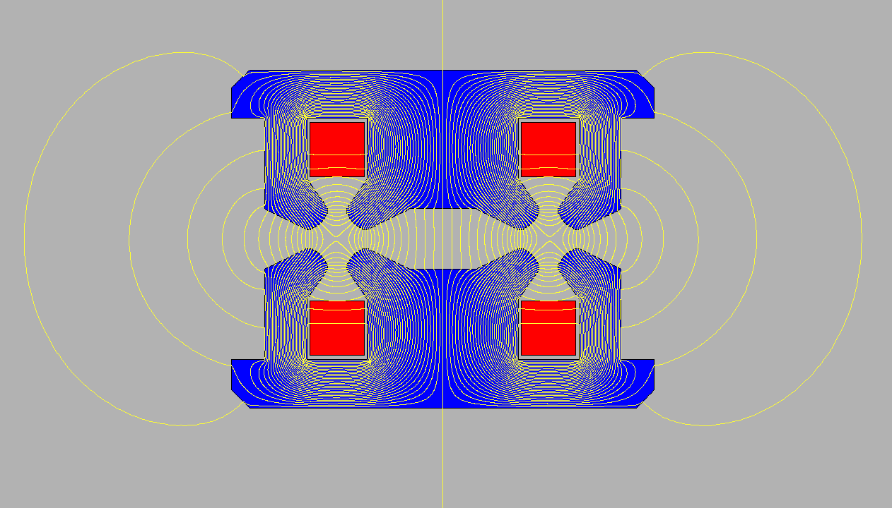
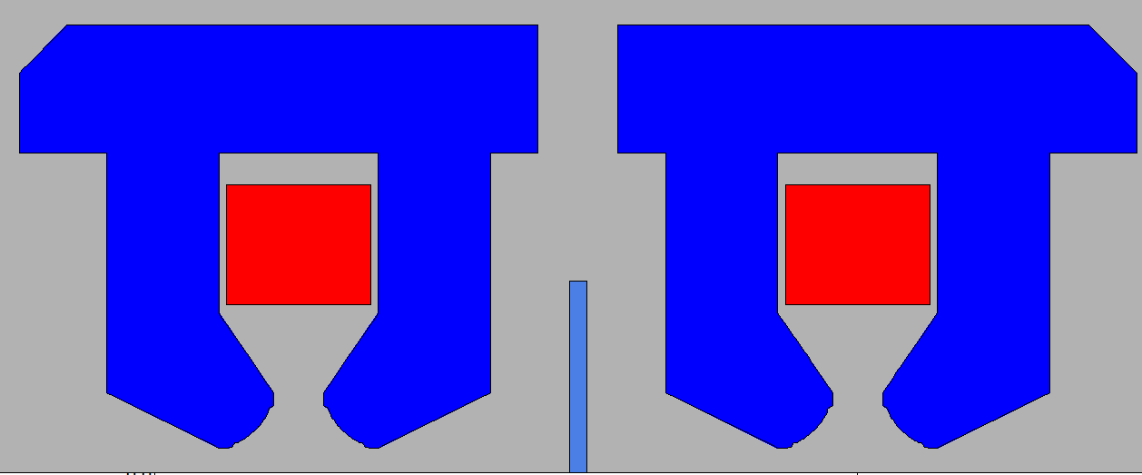
F/D scheme features
F/D design features:
  Save about 50% power consumption.
  Strong cross talk effect at the two apertures.
  Large leakage field at the outside and the middle of the magnet.
  Complex end field.

Slide 7
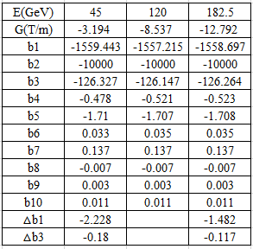
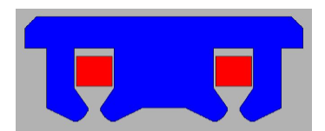
2D simulation: F/D design
DT4 sheet design
  The field in DT4 sheet varies a lot at different energies cause large magnetic shift in x axis.
J23 only scheme:
  The b1 and b3 varies little at four energies without trim coil.
E(GeV) | 45.5 | 120 | 182.5
G(T/m) | 3.49 | 8.53 | 12.94
 | Bn/B2*10000 (units）
b1 | 423.143 | -7.976 | -602.69
b2 | -10000 | -10000 | -10000
b3 | 34.28 | -0.65 | -48.829
b4 | -0.479 | -0.521 | -0.532
b5 | 0.465 | -0.009 | -0.662
b6 | 0.013 | 0.014 | 0.015
b10 | 0.011 | 0.011 | 0.011

Slide 8
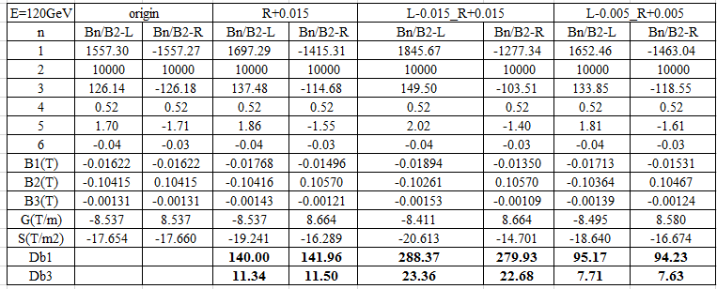
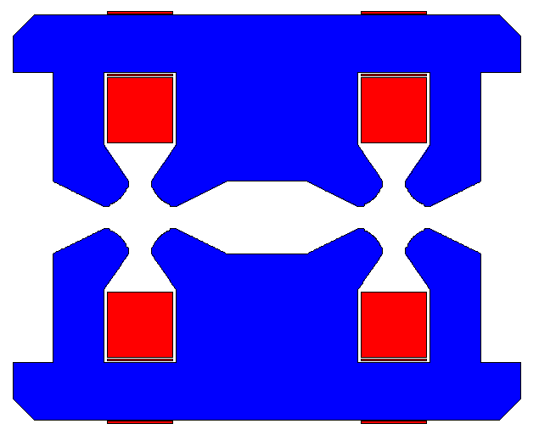
F/D design
With trim coils
  1.5% : b1 varies 288 units, x0 shifts 0.36mm.
  The harmonic changes are linear to the field difference.

Slide 9
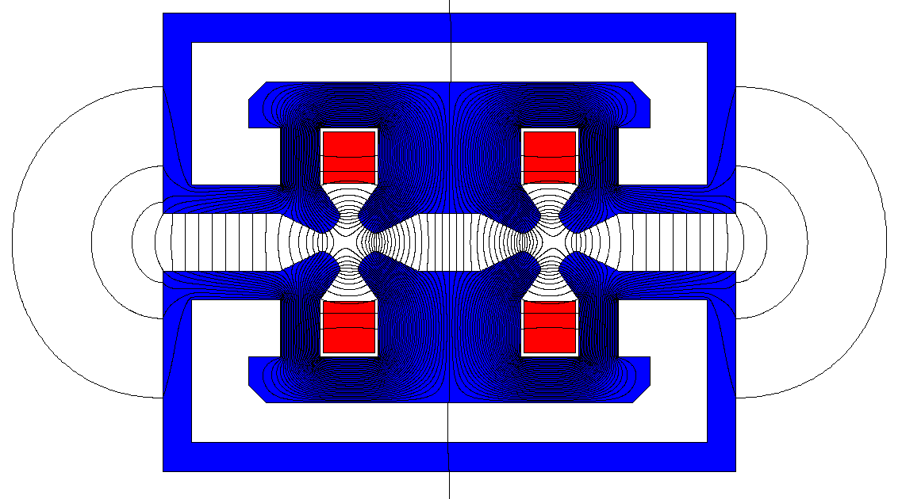
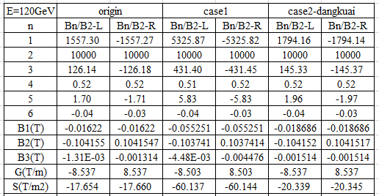
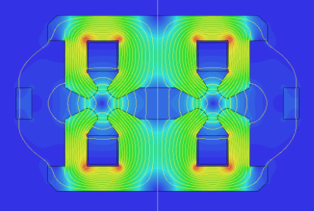
Optimization of F/D design
Reduce b1 and b3
  Outside loop
  block

Slide 10
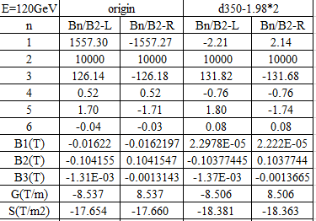
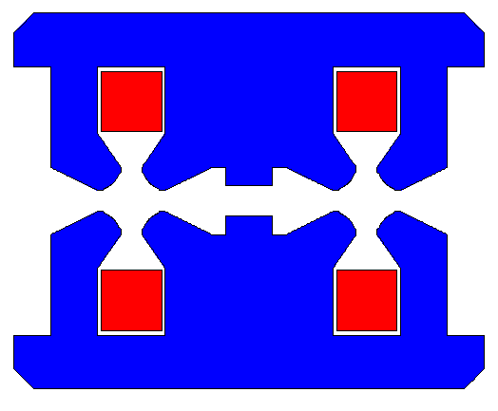
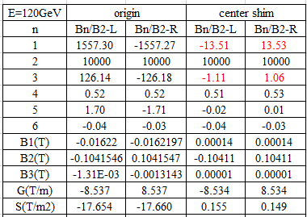
Optimization of F/D design-2
Reduce b1 and b3
  Beam separation change
  Different shim at the pole face
  Pole shift
  Pole rotate
  Shim at the center

Slide 11
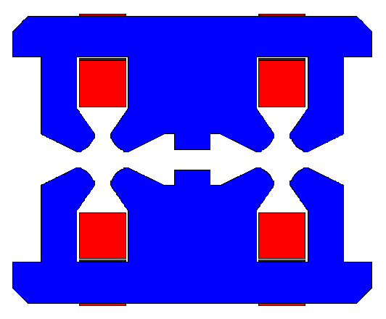
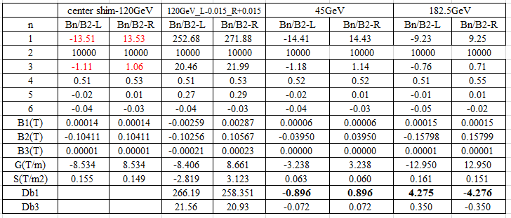
Optimization of F/D design-2
Final scheme with trim coil
  Without trim coil, from Z to TT, b1 varies about 5units.
  1.5% trim coil: b1 varies about 260units, b3 varies 20 units.

Slide 12
Summary
F/D design with J23 only
  Without trim coil, the 2D results show the harmonic variation are acceptable.
  Trim coils with 1.5% adjustability result in b1 and b3, which cause the magnetic center shift by 0.36mm in x axis in one aperture.
  The end effect and large leakage field affect the 3D field distribution, cause the b1 and b3 change.
  More simulations need to do in 3D.

Slide 13
Thanks for your attention!

