Slide 1
Static and stability study of MDI SC cryostat
Haijing Wang
CEPC DAY, 2021/3/25

Slide 2
Outline
Background
Structure of cryostat
Static and stability calculation
  Location optimization of support rods
  Connection method of vacuum vessels
  Effect of magnet supports
  Performance with different QD0/QF1 magnets
  Auxiliary support of cryostat
  Harmonic response
Discussion

Slide 3
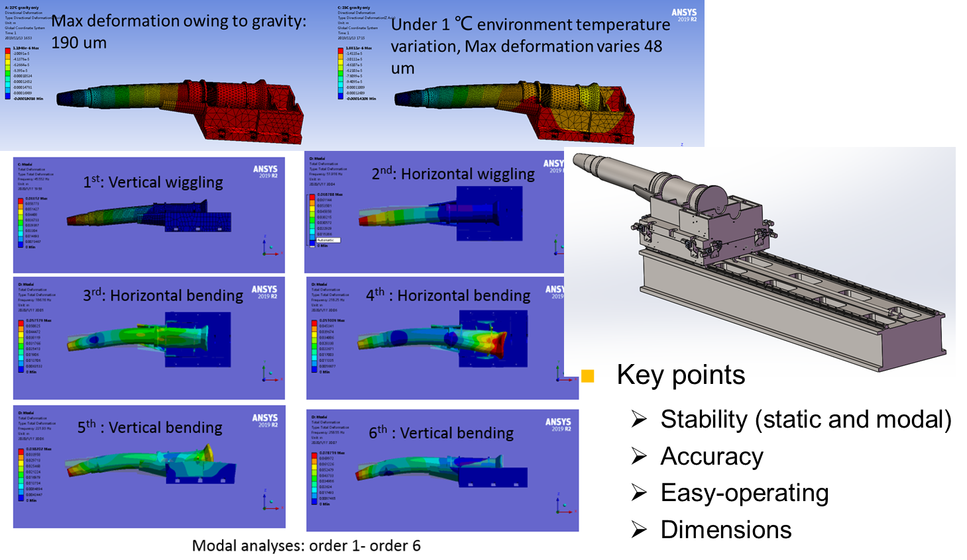
Background
On CEPC MDI workshop in 2020, the very preliminary calculation was presented, showing it needed stability study.
Cantilever length was 3.6 m, based on the yoke length of 9.2 m.
The cryostat was 5 meters long with18 mm thick stainless wall. The maximum deformation was 190 um.
Only the cryostat vacuum vessel weighting 2 tons was considered.

Slide 4
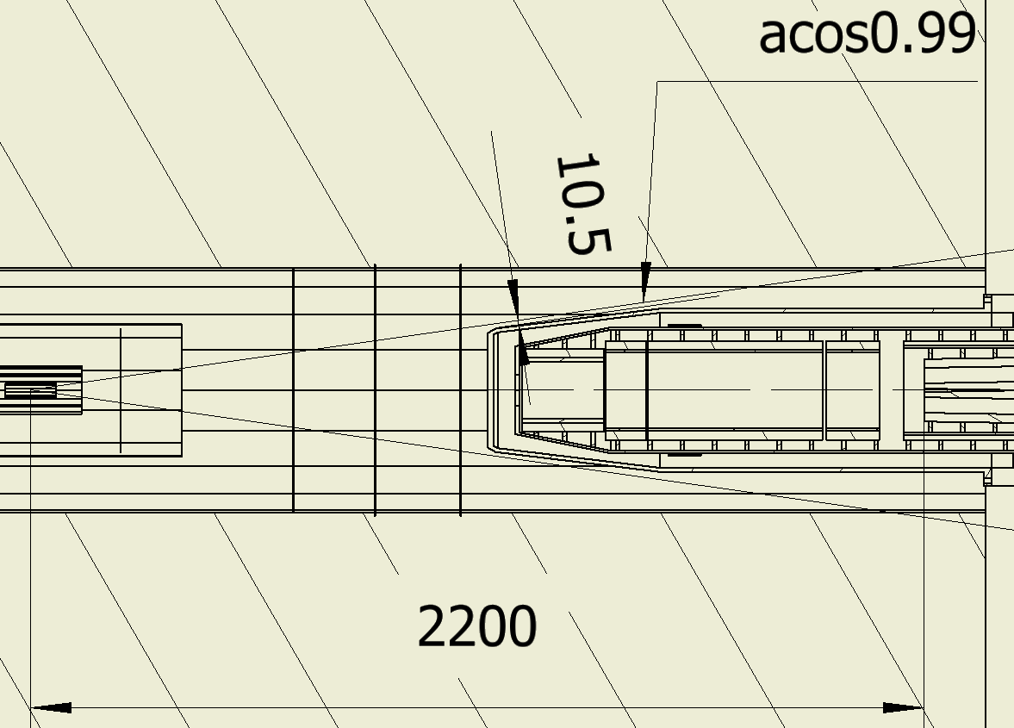
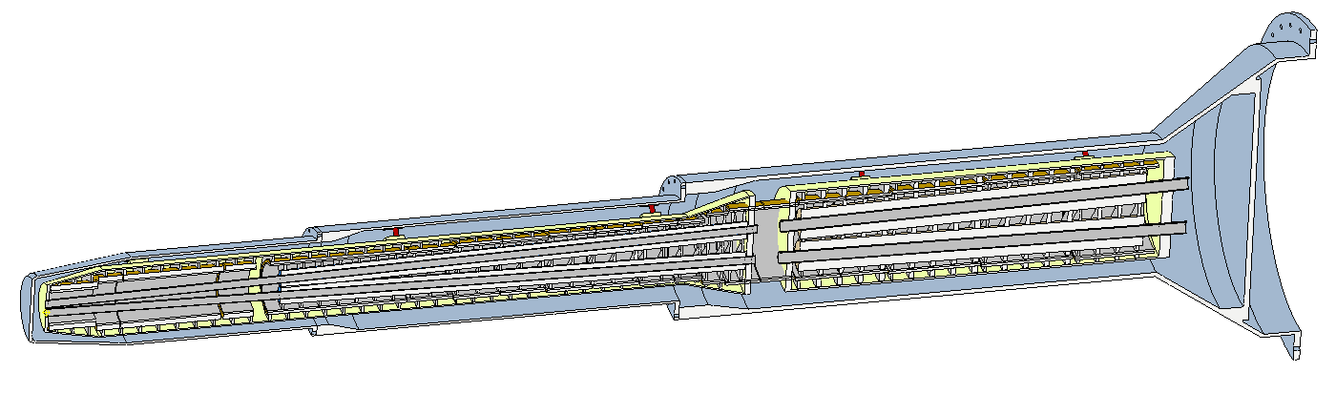
Structure of cryostat
The model has been upgraded.
Total length: 5486 mm. Position along Z direction: 1125mm~6611mm.
Min. distance to acos0.99 angle: 10.5 mm
The cryostat dimensions in different cases remain the same, basing on the CDR magnets (option 1, the smallest).
IP
Cryostat dimensions are from M. Xu
Helium vessel
Vacuum vessel
QF1
QD0
Support rods
Anti-solenoid

Slide 5
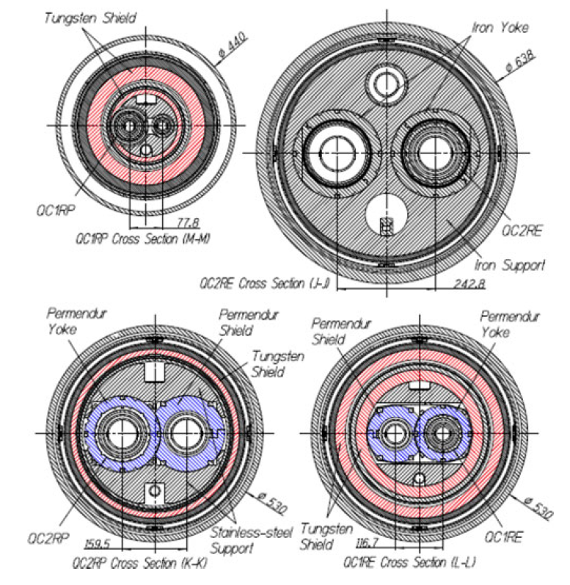
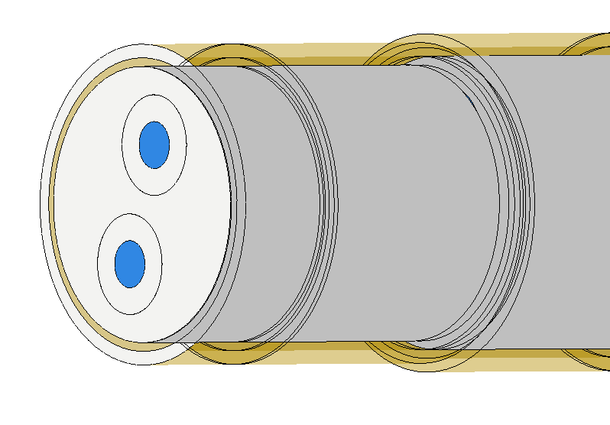
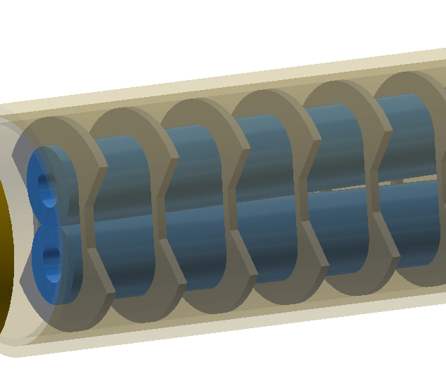
Structure of cryostat
Cooling shields are neglected in the analyses.
The magnets are supported to the helium vessels.
Two kinds of magnet supports are considered.
  Solid support similar to SKEKB.
  Skeleton support to minimize weight.
Iron support of SKEKB
Sketch of solid support
Sketch of skeleton support

Slide 6
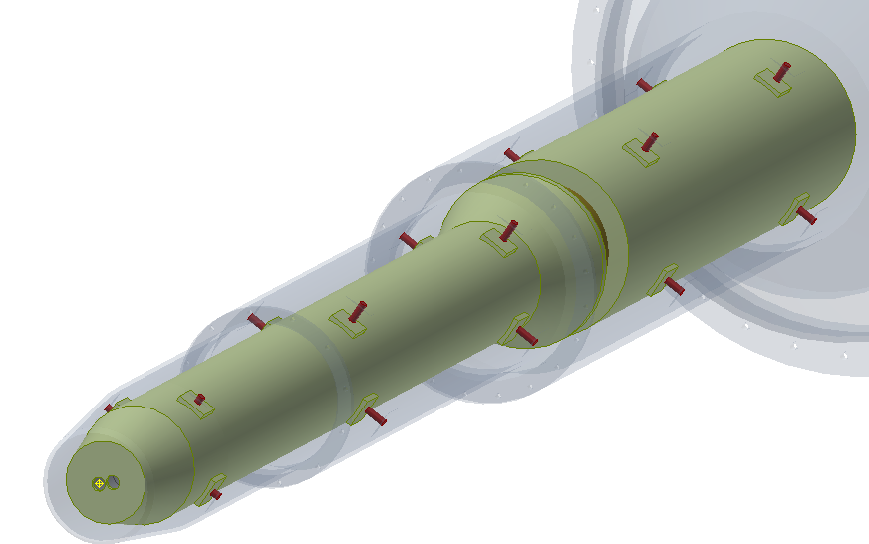
Structure of cryostat
The magnets needs to be adjusted individually.
Two helium vessels are considered corresponding to QD0 and QF1, respectively.
Support rods similar to SKEKB are considered, with larger stiffness.
  Diameter in SKEKB: 15/11/8 mm
  Diameters in CEPC: 20 mm
Support rods in SKEKB
Sketch of support rods

Slide 7
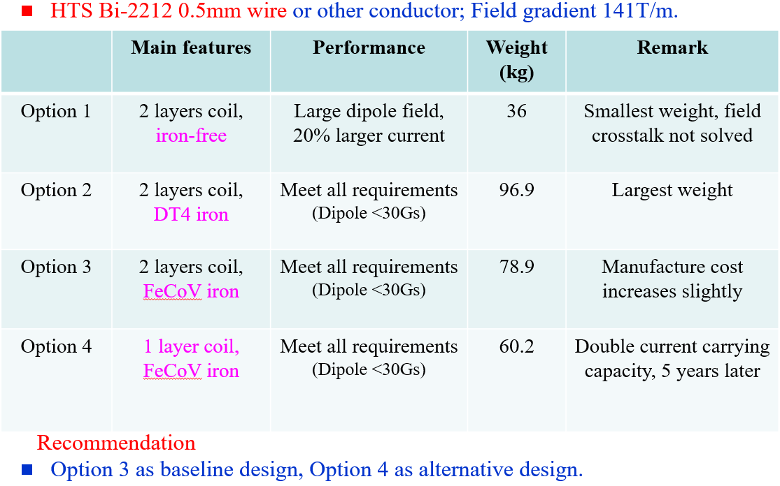
Static and stability calculation
Location optimization of support rods
  Aim: minimize the deformation deference between QD0/QF1 and helium vessel
  Model: QD0/QF1 to helium vessel， option 3 from Y. Zhu as the baseline

Slide 8
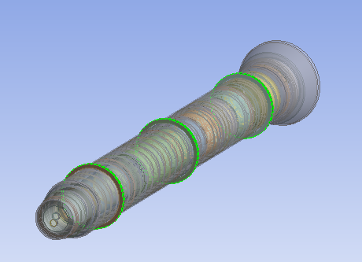
Static and stability calculation
Location optimization of support rods
  High stiffness, low density materials/ structure are preferred.
Candidate materials for supports
Material | Ti-6Al-4V | 316L | carbon fiber | CF/Al
Young's modulus (GPa) | 113.8 | 193 | 35.9 | 230(平行), 36(垂直)
density (kg/cm^3) | 4430 | 8000 | 1750 | 2100-2200
Ulti-strength (MPa) | 950 | 560 | 103 | 974 (平行), 60(垂直)
magnetic permeability | 1.00005 | 1.008
Models | materials
QD0/QF1 | Fe-Co-V
Anti-solenoid | Fe
Anti-solenoid inner pipe | SS
Helium vessel | SS
Magnet supports | SS for solid and Ti-6Al-4V for skeleton

Slide 9
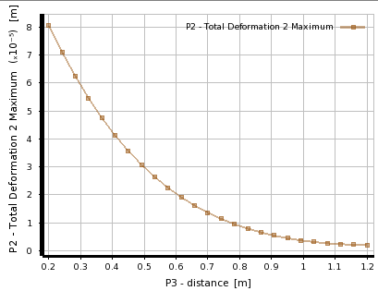
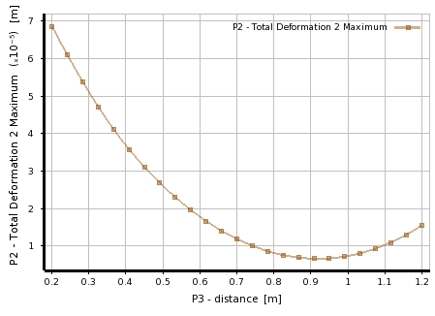
Static and stability calculation
Location optimization of support rods
  The CDR magnet length are used.
  Locations of support rods are optimized by response surface
Deformation calculation, QD0/QF1 to helium vessel
Magnet | Support | Weight (kg) |  | Optimized uneven deformation (um)
 |  | Support | Total | 2 support locations | 3 support locations
QD0 | Skeleton | 47 | 691 | 6.6 | 2.1
 | Solid | 806 | 1441 | ---- | 3.2
QF1 | skeleton | 104 | 865 | 0.8 | ----

Slide 10
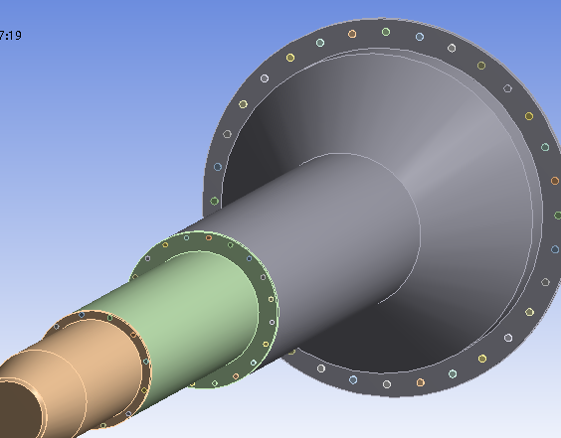
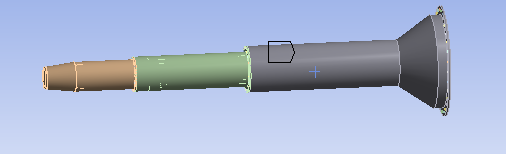
Static and stability calculation
Connection method of vacuum vessels
  Model: QD0/QF1 to vacuum vessel (the whole cryostat).
  Constraint: fixed constrained at mounting bolts (experience from SKEKB)
  Length of cantilever is 5486 mm, in accord with the new yoke length of 12 m.
  Loads：gravity, Lorentz force Fz with detector solenoid operation
Fz1
Fz2
Fz3
G
Two connection methods
Connect bolts: three parts of vacuum vessel bolted together.
Bounded: the vacuum vessel is an integral vessel.
Connect bolts
Constraint bolts

Slide 11
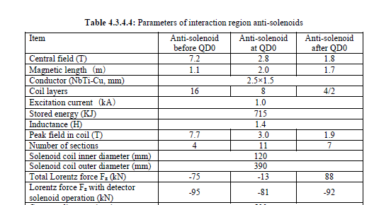
Static and stability calculation
Connection method of vacuum vessels
The integral vacuum vessel is better
Loads | Vacuum vessel | Uneven deformation (mm) |  |  | Frequency of 1st mode (Hz)
 |  | Cryostat | QD0 | QF1
Gravity | Three parts bolted together | V: 4.095 | V: 2.220 | V: 0.588 | 10.2 Holistic swing
Gravity + Fz |  | V: 4.071 H: -1.573 | V: 2.210 H: 0.111 | V: 0.588 H: 0.054
Gravity | Integral | V: -2.774 | V: 1.251 | V: 0.588 | 12.7 Holistic swing
Gravity + Fz |  | V: -2.774 H: 1.195 | V: 1.252 H: 0.073 | V: 0.588 H: 0.054
V: Vertical
H: Horizontal

Slide 12
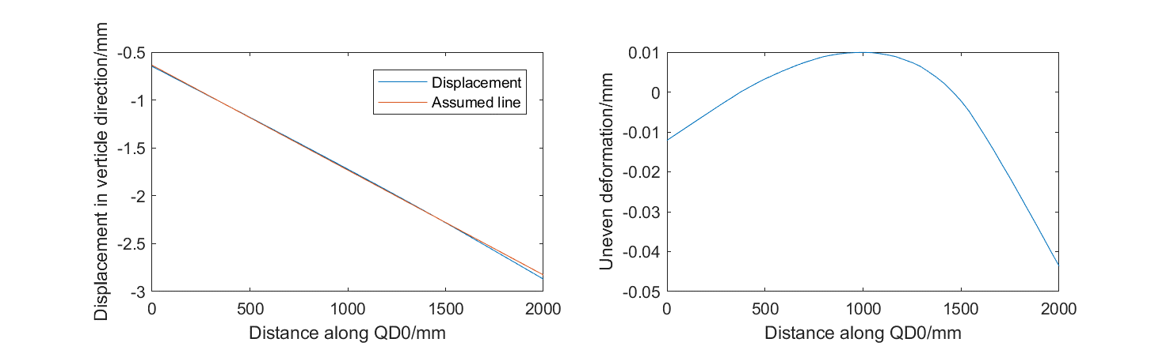
Static and stability calculation
Connection method of vacuum vessels
  Alignment cannot based on the displacement.
  An alternative method is to pre-align the magnet to certain position to compensate the absolute deformation.
  An assumed line is made, then the uneven deformation relative to the line is calculated.
  The uneven deformation is the same in integral and bolted vacuum vessel.

Slide 13
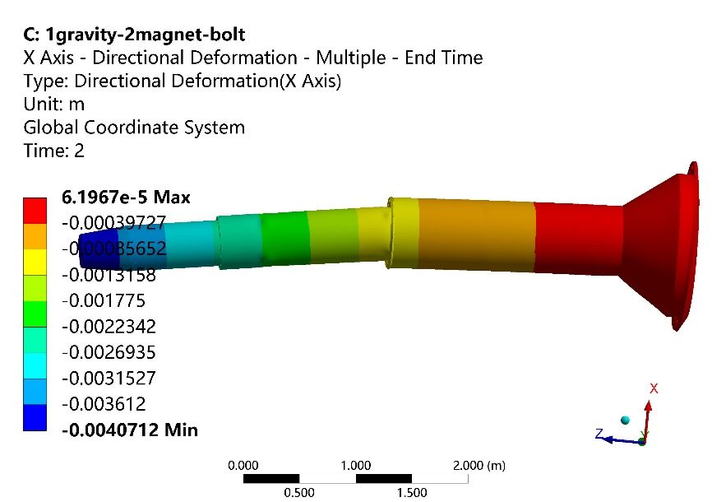
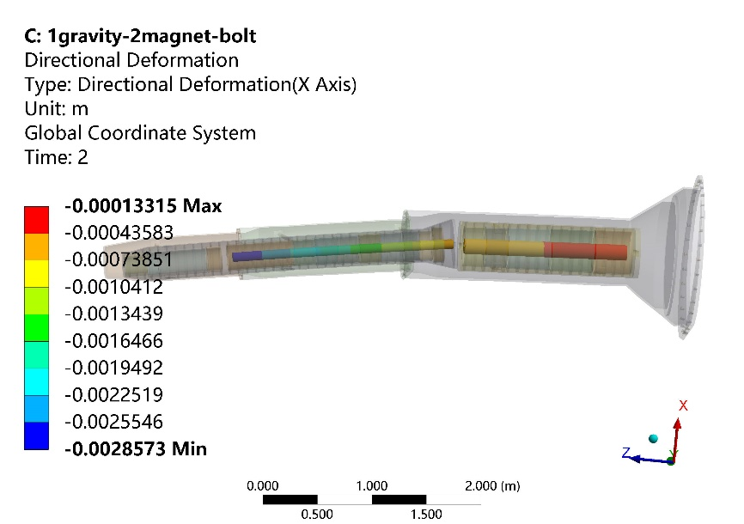
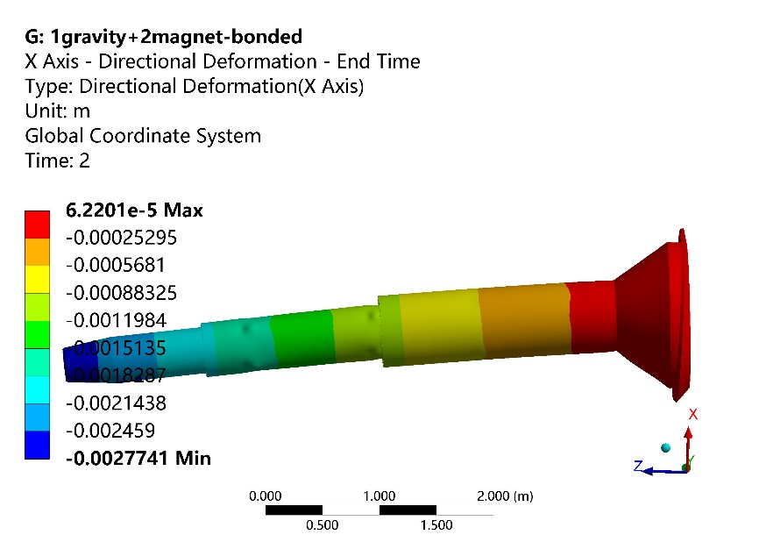
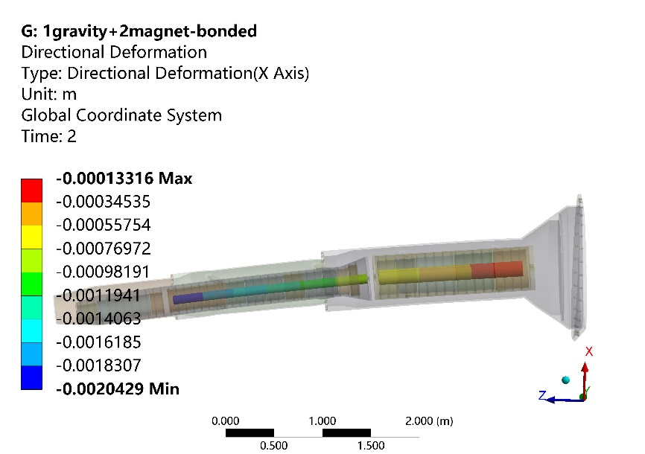
Static and stability calculation
Displacement, three parts bolted together
Displacement, integral vacuum vessel

Slide 14
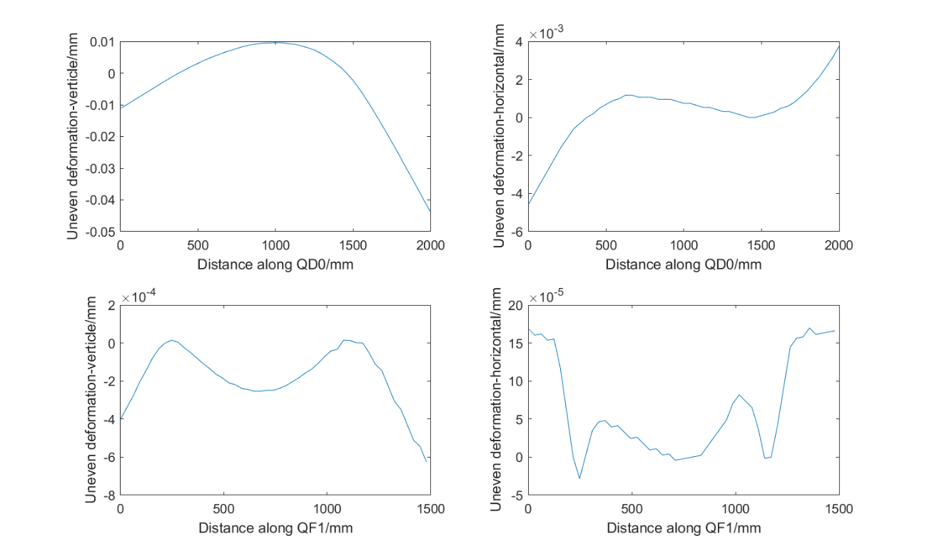
Static and stability calculation
Effect of magnet supports
Magnet support | uneven deformation in QD0 (um) |  | uneven deformation in QF1 (um) |  | Total weight (kg) | Frequency of 1st mode (Hz)
 | Vertical | Horizontal | Vertical | Horizontal
Skeleton | 44 | 5 | 0.6 | 0.2 | 3244 | 12.7
Solid | 7.3 | 0.6 | 0.3 | 0.2 | 5041 | 11.3
Uneven deformation is much smaller in case of solid support.
  Solid support has better stiffness.
  There may have a structure with less weight and comparable stiffness.
Natural frequency is a little lower in case of solid support.
Uneven deformation in QD0 and QF1 in case of skeleton support

Slide 15
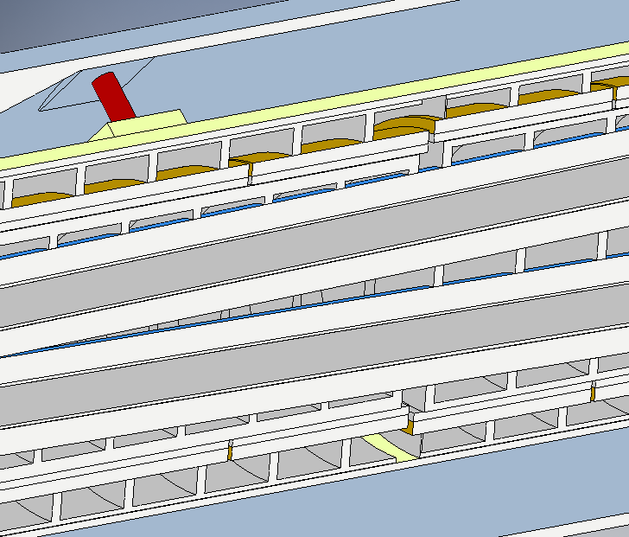
Static and stability calculation
Effect of magnet supports
  Add outer ring to enhance stiffness
  Add inner ring to enhance stiffness (equals to enlarge outer diameter of QD0/QF1)
Outer ring
S-o support: skeleton support with outer ring
Add an outer ring decrease the uneven deformation largely.
Magnet support | uneven deformation in QD0 (um) |  | uneven deformation in QF1 (um) |  | Total weight (kg) | Frequency of 1st mode (Hz)
 | Vertical | Horizontal | Vertical | Horizontal
Skeleton | 44 | 5 | 0.6 | 0.2 | 3244 | 12.7
Solid | 7.3 | 0.6 | 0.3 | 0.2 | 5041 | 11.3
S-o support | 27 | 1.6 | 0.7 | 0.5 | 3477 | 13.7

Slide 16
Static and stability calculation
Performance with different QD0/QF1 magnets
  Outer radius of QD0: from 40.5 to 44 mm;
  Outer radius of QF1: from 68 to 72 mm;
  Equals to adding a inner ring support for option 3.
Option 2 in Zhu’s report
Modified approximately
Magnet | Magnet support | uneven deformation in QD0 (um) |  | uneven deformation in QF1 (um) |  | Total weight (kg) | Frequency of 1st mode (Hz)
 |  | Vertical | Horizontal | Vertical | Horizontal
Option 3 | Skeleton | 44 | 5 | 0.6 | 0.2 | 3244 | 12.7
 | Solid | 7.3 | 0.6 | 0.3 | 0.2 | 5041 | 11.3
 | S-o support | 27 | 1.6 | 0.7 | 0.5 | 3477 | 13.7
Option 2 | S-o support | 12.5 | 0.5 | 0.7 | 0.4 | 3542 | 14.0
The larger diameter of magnets can decrease the uneven deformation further.

Slide 17
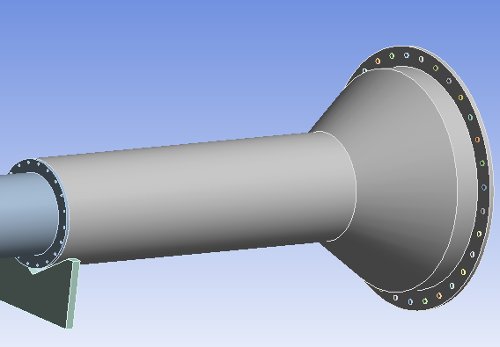
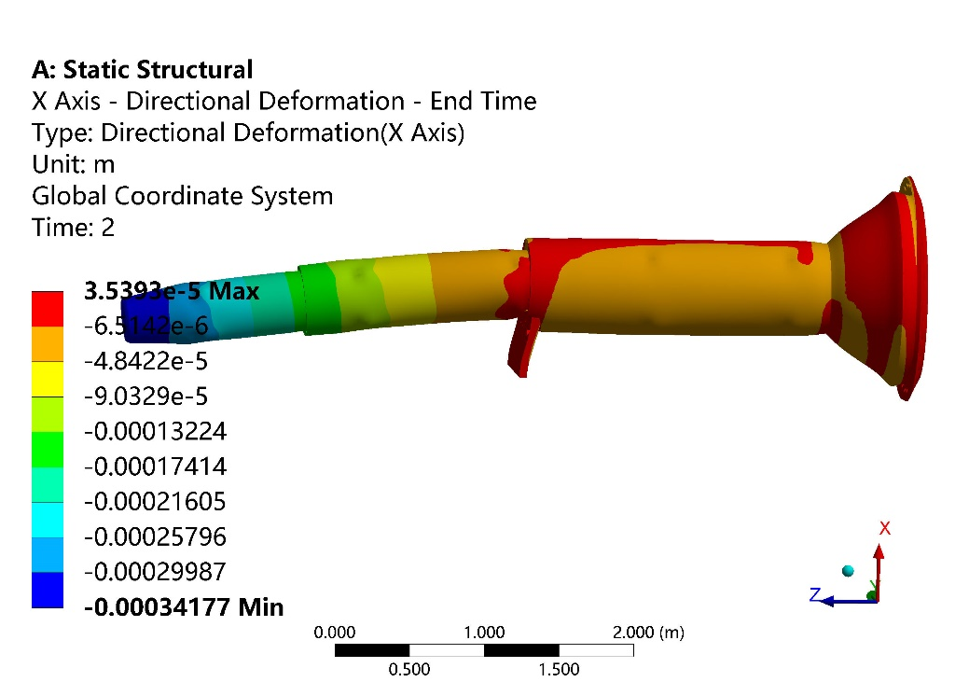
Static and stability calculation
Auxiliary support of cryostat
  Magnet: option 3
  Auxiliary constraint: V groove, translational in beam direction
  Range: 4 m to 5.9 m from IP (on inner wall of detector yoke)
Auxiliary support

Slide 18
Static and stability calculation
Auxiliary support of cryostat
  Can decrease the uneven deformation as well as enhance natural frequency largely.
1st natural frequency vs V groove location
Maximum deformation of QD0 vs V groove location
Magnet support | uneven deformation in QD0 (um) |  | uneven deformation in QF1 (um) |  | Frequency of 1st mode (Hz)
 | Vertical | Horizontal | Vertical | Horizontal
S-o support | 12.7 | 0.5 | 0.6 | 0.4 | 27.9
Solid | 8 | 0.5 | 0.5 | 0.2 | 23.4

Slide 19
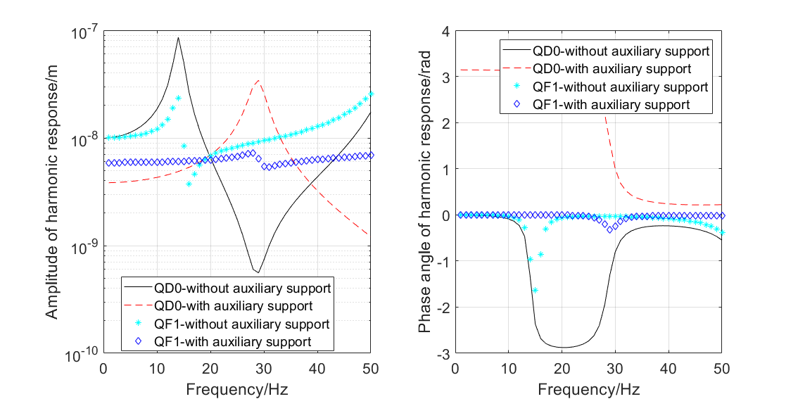
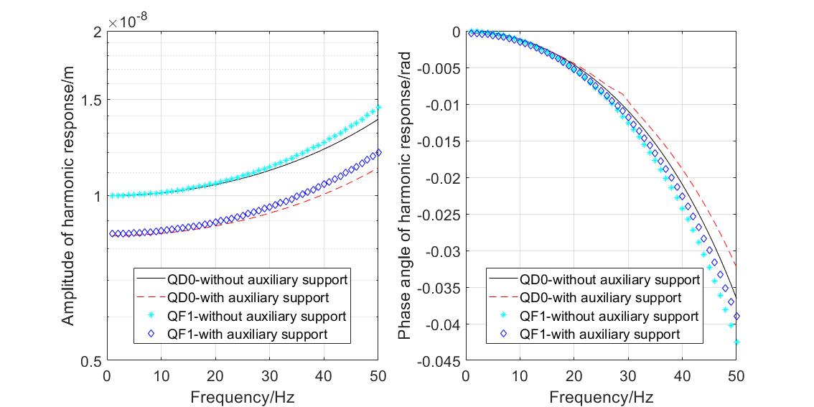
Static and stability calculation
Harmonic response
  Frequency 1~50 Hz.
  Displacement at constraint bolts, 10 nm is X, Y, Z directions.
  Responses in X and Y directions are similar.
  The auxiliary support can reduce the response amplitude largely.
  QD0 and QF1 has phase angles in vibration.

Slide 20



Discussion
Comparison with cryostat of SKEKB
  Deformation is proportional to the 4th power of cantilever length.
$$ω_{max}=−\frac{ql^{4}}{8EI}$$
$$I=\frac{π}{64}(D^{4}−d^{4})$$
$$q∝D^{2}−d^{2}$$
 | CEPC-solid support | CEPC s-o support | SKEKB-QCS-R
Vacuum vessel length (mm) | 5486 | 5486 | 3287
Vacuum vessel mass (kg) | 1691 | 1691 | 1472
Front magnets and others (kg) | 1441 | 794 | 805
Tungsten radiation shield (kg) | 0 | 0 | 1271
Rear magnets and others (kg) | 1909 | 992 | 1063
Total mass (kg) | 5041 | 3477 | 4611
Calculated max. displacement (mm) | 3.4 | 2.4 | 0.9
Calculated max. displacement with auxiliary support (mm) | 0.55 | 0.34

Slide 21
Discussion
The position accuracy of SC magnets is 100 um. If the uneven deformation is less than 20 um, it has no big effect on other requirement.
The solid support of QD0/QF1 has the minimized uneven deformation.
There should be a skeleton support with less weight and comparable stiffness, saving some space for shielding structure.
The cross section of the vacuum vessel has not been optimized, which may have effects on the deformation or stability.
The support system of cryostat has not been considered, which may weaken the static and stability performance.

Slide 22
Discussion
Work lists to be done
  Add the cryostat support system to evaluate static and stability performance.
  Optimization of cryostat system, including the dimensions, materials…
  FEA to mechanical design.
  …

Slide 23
Thanks

