Slide 1
Progress of CEPC vacuum system
Ma Yongsheng, Dong Haiyi, Huang Tao, Wang Pengcheng, Liu Jiaming
3/25/2021

Slide 2
Contents
Preview of CEPC vacuum system
R&D of RF shielding bellows
R&D of vacuum chambers
NEG coating inside of vacuum chambers
Summary

Slide 3
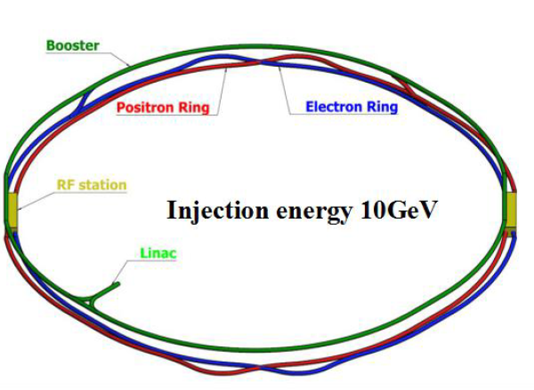
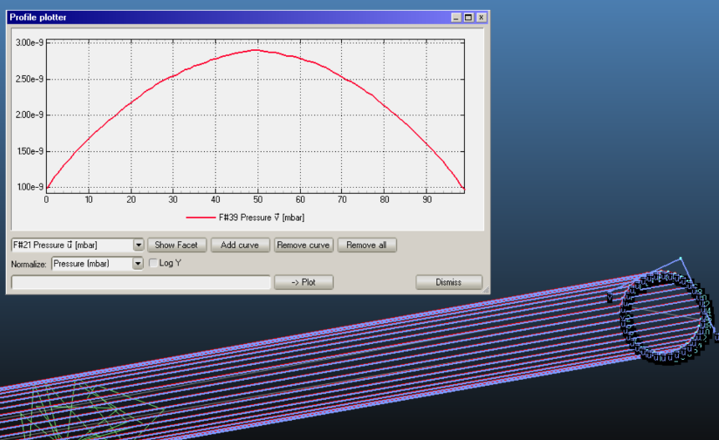
Preview of CEPC vacuum system
Vacuum of Electron Ring 6m long pipe simulation
 | Material | Vacuum/ Torr | Cross Section
Booster | Extruded aluminum 6061 | 3 × 10⁻⁸ | φ56
Electron Ring | Extruded aluminum 6061 | 3 × 10⁻⁹ | 56×75
Positron Ring | Extruded copper, NEG film |  | 56×75
MDI | Copper/tungsten alloy, NEG film | 3 × 10⁻¹⁰ | φ20
Notes:
Vacuum of Booster 、storage ring, MDI are all considered and under technical design. Conventional technical such as ion pump /Al will be used in CEPC. There is no especial issue exceed our control, except to balance the impedance and gas absorb ability of NEG film

Slide 4
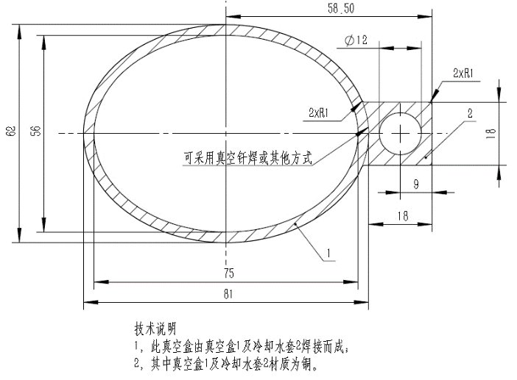
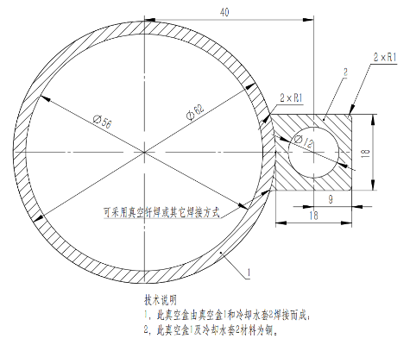

Ellipse VS Circle of vacuum chamber
Comparison cross section between ellipse and circle of the vacuum chamber of storage ring.
Synchrotron radiation gas load Q_{LS} = 1.5×10⁻⁸
Thermal load gas q= 1.0×10⁻¹¹
Suppose every 6 meters put an ion pump of 100L/s;
Vacuum value deterioration is about 28%;
The cost will reduce about 7.61 million yuan.
Notes:
（1）在技术上没有困难； 但在相同泵的配置上，真空度最大位置真空降低（变差）约28%，真空度最大位置为2.16E-9Torr，但满足CEPC 3E-9Torr的要求。（molflow 计算结果）
（2）经调研，圆管（56mm）能够节约铜材料82吨，节省572万元材料，拉制费用节约113万元；铝材料25吨节省42万元材料，拉制费用节约34万元；合计节约761万元（按现价格计算）。

Slide 5
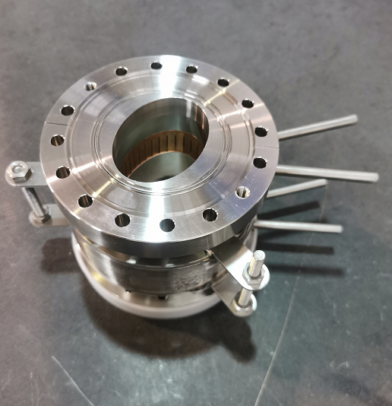
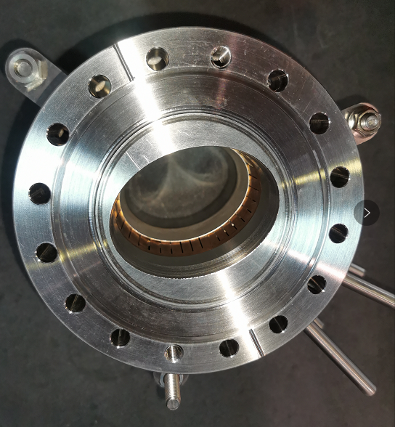
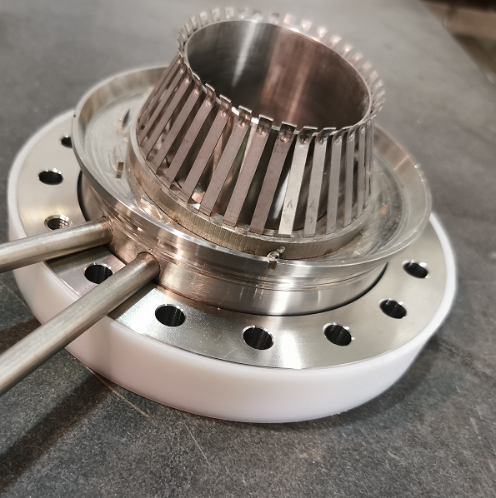
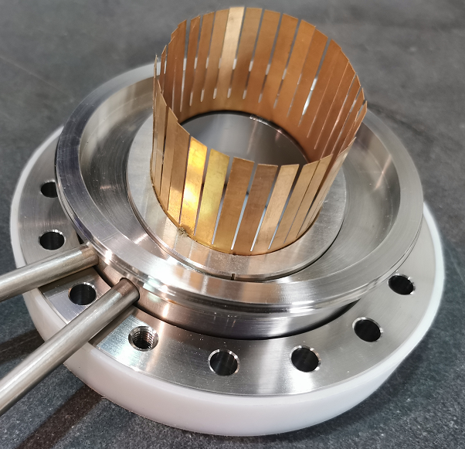
Porotype of RF shielding bellows
Porotype I：
Porotype II：
Contact force is uniformly from different fingers and meets the target of 125±25g. Two prototypes of RF shielding bellows have been fabricated

Slide 6
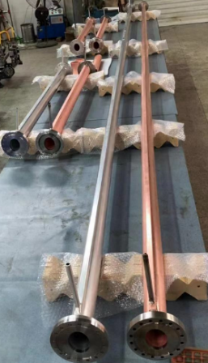
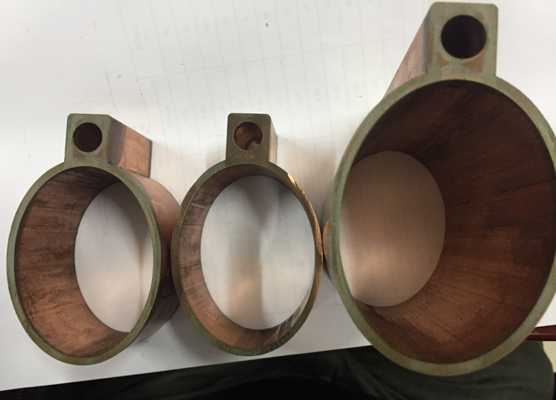
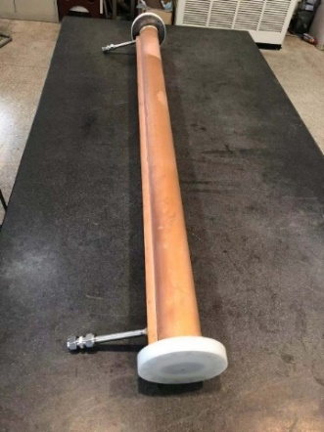
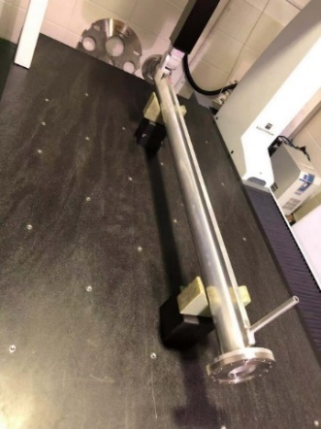
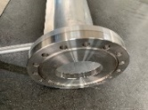
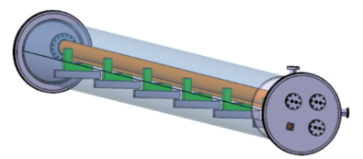
Cu and Al vacuum chamber prototypes
A 6 m long simple vacuum furnace is fabricated, which is used to weld the water cooling channels of Cu chambers through low temperature brazing solder.
The welding seams are checked by wire-electrode cutting. The welding joints are smooth and have good contacting.
The prototypes of copper & aluminum vacuum chambers with a length of 6 m have been fabricated and tested, which meet the engineering requirements.

Slide 7
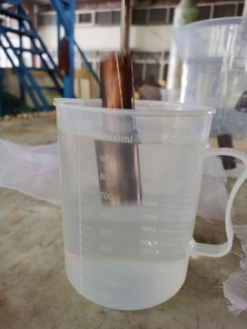
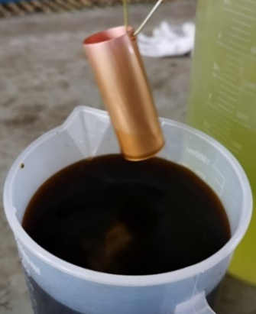
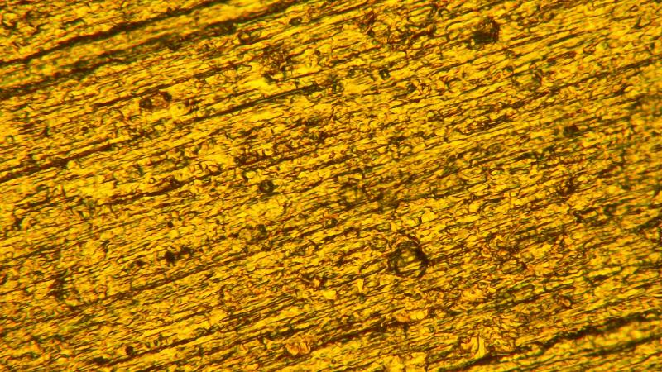
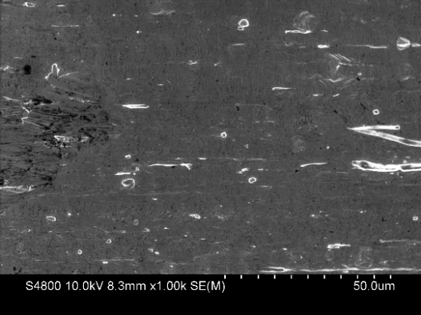
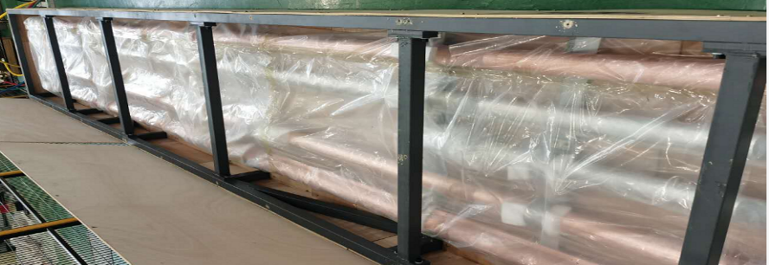
Preparation of Cu substrate for NEG coating
Vacuum pipes fabricated for NEG coating
5 um
etching
passivation
Vacuum pipes will be degreasing,
The content of oxygen decreases as depth of Cu surface
Notes:
Because of NEG coating, Preparation of Cu substrate is very important, which processing contains degreasing, etching about 30min to remove the oxidized layer of Cu surface, and the passivation by chromic acid to prevent oxidized again

Slide 8
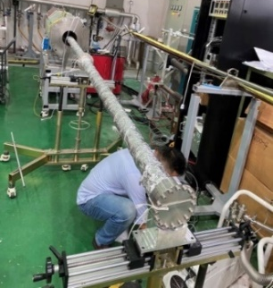
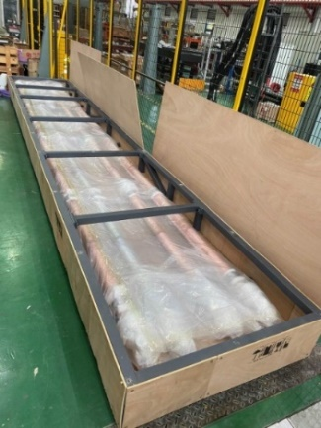
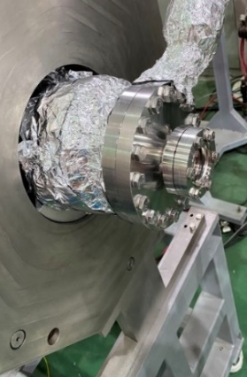
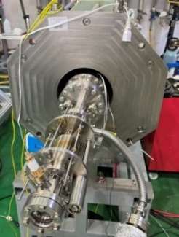
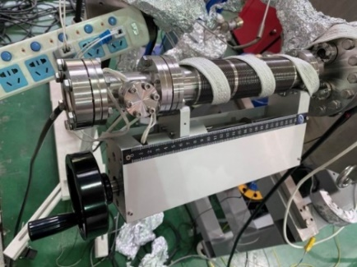
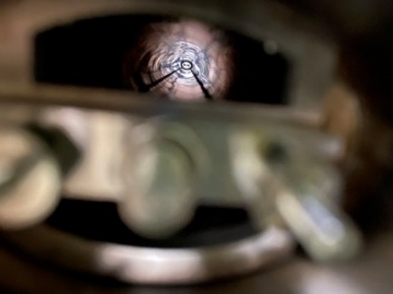
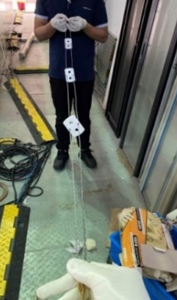
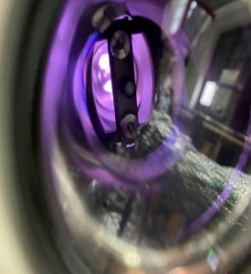
6 m vacuum pipe NEG coating
6 m vacuum pipe have been installed on the coating setup carefully, and there are two cathodes in it to uniform the thickness of film.
视窗位置
无支撑丝靶
调节波纹管优化
陶瓷支撑
Notes:
实验用6米和2米长椭圆截面铜管到货；
期间，采用双丝靶对椭圆截面2米长铜管镀膜进行了四次镀膜；
根据实验过程中遇到的问题对镀膜工装做了以下几点优化：
增加管道内部丝靶支撑，解决放电不稳易短路问题；
更换优化丝靶调节波纹管，便于预紧管内丝靶
优化视窗安装位置，直观观察放电 情况
改造之后镀膜系统能够实现稳定放电；

Slide 9
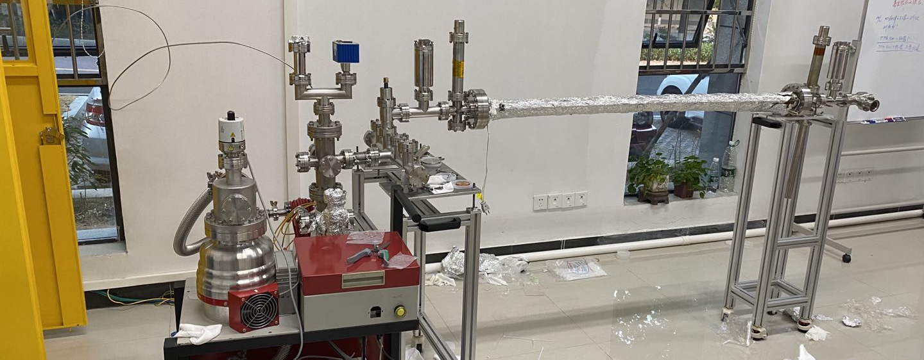
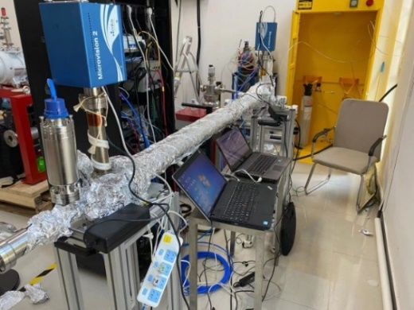
Pumping speed test setup in Dongguan
RGA2
RGA1
P2
P1
P3
氢气罐
小孔4mm
TMP
Rent one house from an enterprise near Dongguan, which can use H₂ and CO
Facility of pumping speed test have been finished
Currently, some tests have been carried out, and the platform hardware and test process need to be further optimized
Notes:
租用东莞周边一个企业的场地，可以使用氢气和CO
完成极限真空及薄膜抽速测试平台搭建
目前已进行了三次管道测试，平台硬件和测试流程有待继续优化

Slide 10
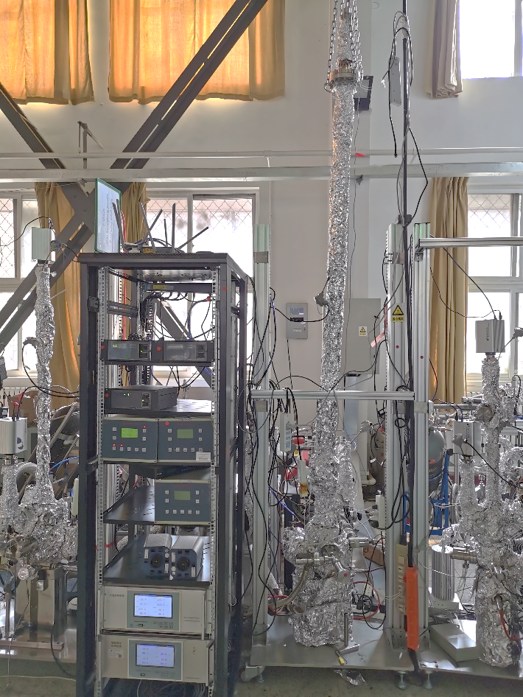
Pumping speed test of NEG coating
Pumping speed test of 2 meters long CEPC Cu pipe of NEG coating in Beijing

Slide 11
Lifetime test of NEG coating
HEPS NEG coating

Slide 12
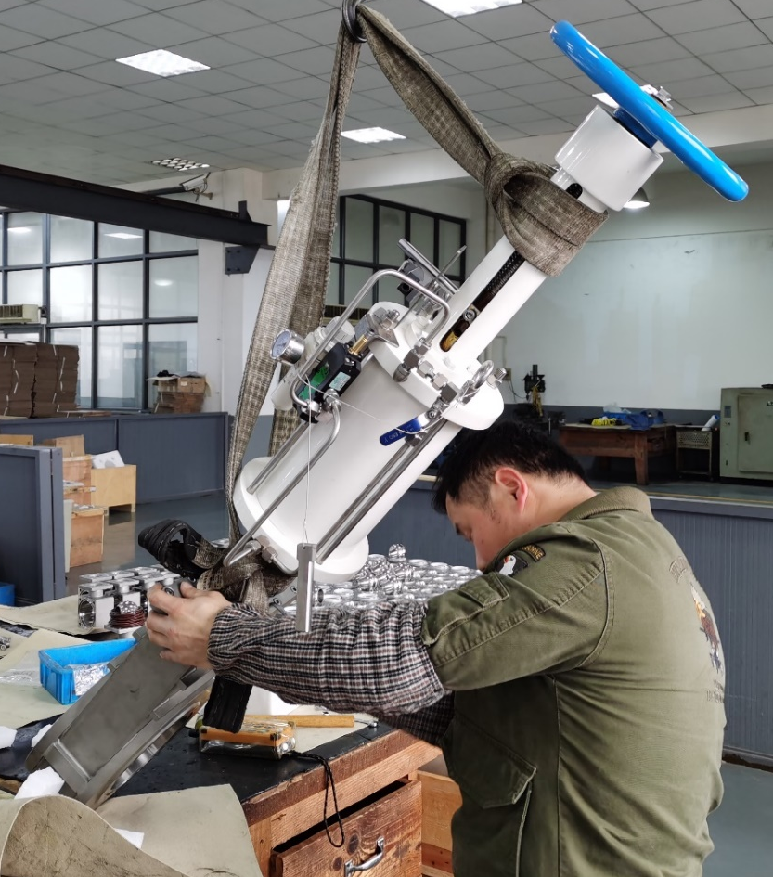
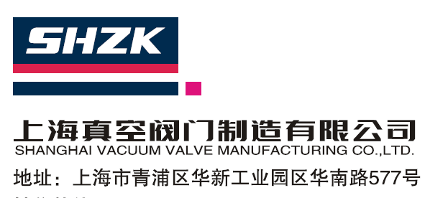
All metal gate valve develop
SHZK developed a new type of structure, which is different from VAT
After testing the first Porotype of All metal gate valve, some causes of leakage have been found.

Slide 13
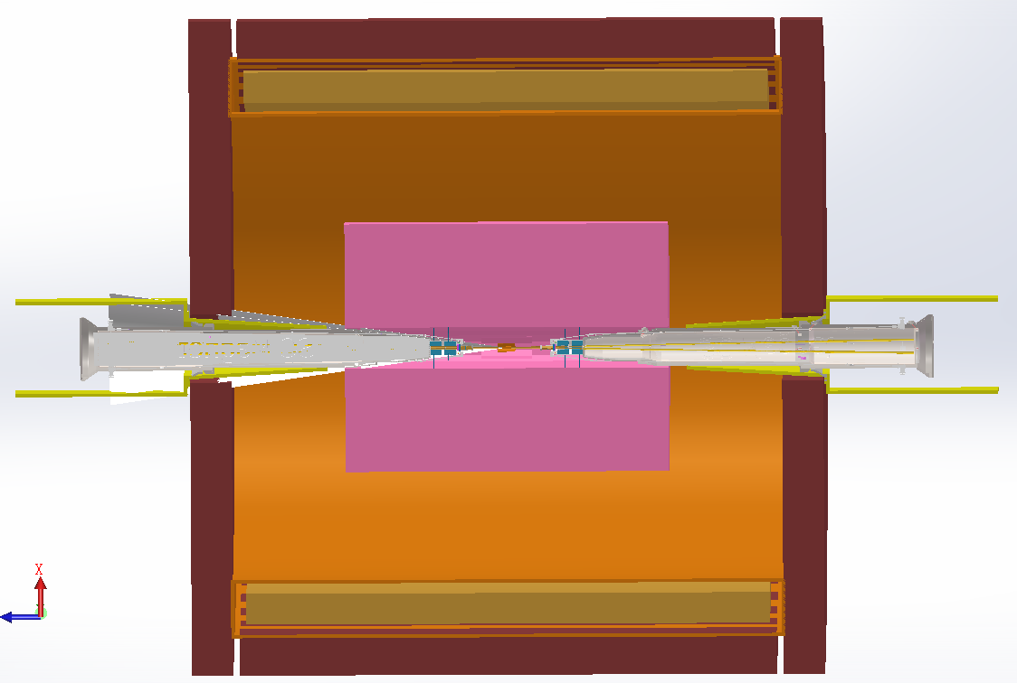
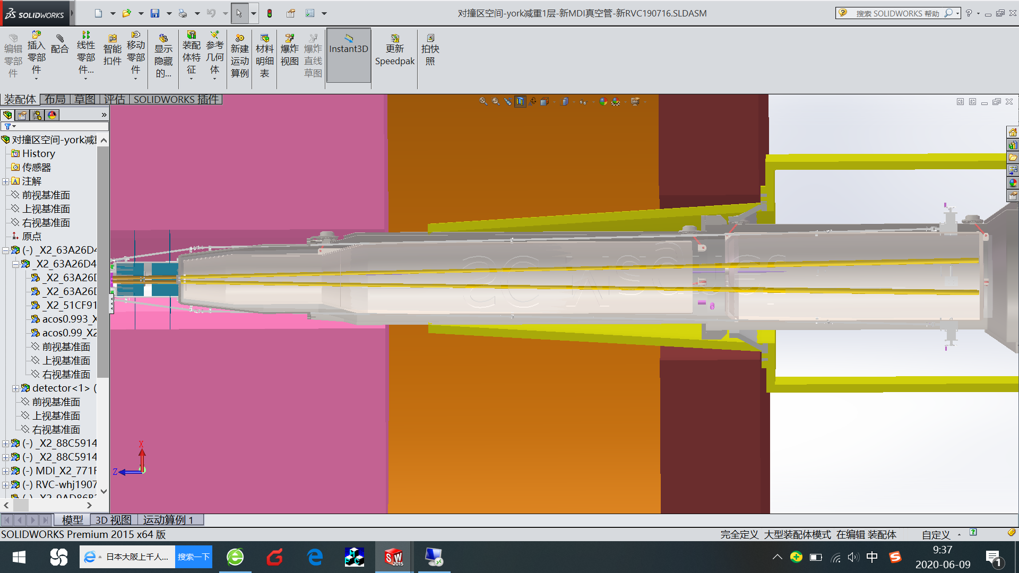
MDI vacuum
Conception design
OFE copper or tungsten alloy will be used to made the fork vacuum chamber of MDI
NEG coating is suggested to the fork vacuum chambers
Water cooling pipe is designed due to the high thermal load of impedance at high light Z model.

Slide 14
Summary
The prototypes of copper & aluminum vacuum chambers with a length of 6 m have been fabricated and tested, which meet the engineering requirements. Surface treatment of copper is undertaking.
The key components experiments such as spring fingers and contact fingers have been carried out. Contact force is uniformly from different fingers and meets the target of 125±25g. The prototypes of RF shielding bellows have been fabricated.
2m long vacuum pipe have been coated to explore the coating parameter at geometrical shape of 56×75. 6m long vacuum chambers will be coated by moving the solenoid by a horizontal coating equipment .
After testing the first Porotype of valve, some causes of leakage were found.

Slide 15
Thank you！

