Slide 1
UNIVERSITY OF SOUTH CHINA
$ρ^{0}−ω$ mixing contribution to the measured CP asymmetry of $B^{±}→ωK^{±}$
Sheng Yang(杨晟)
University of South China（南华大学）
In collaboration with :Zhen-Hua Zhang(张振华) & Xin-Heng Guo(郭新恒)
Based on: JHEP 10 (2020) 020, [arXiv:2005.09157]
第三届重味物理和量子色动力学研讨会 天津 2021/5/3
1/21

Slide 2
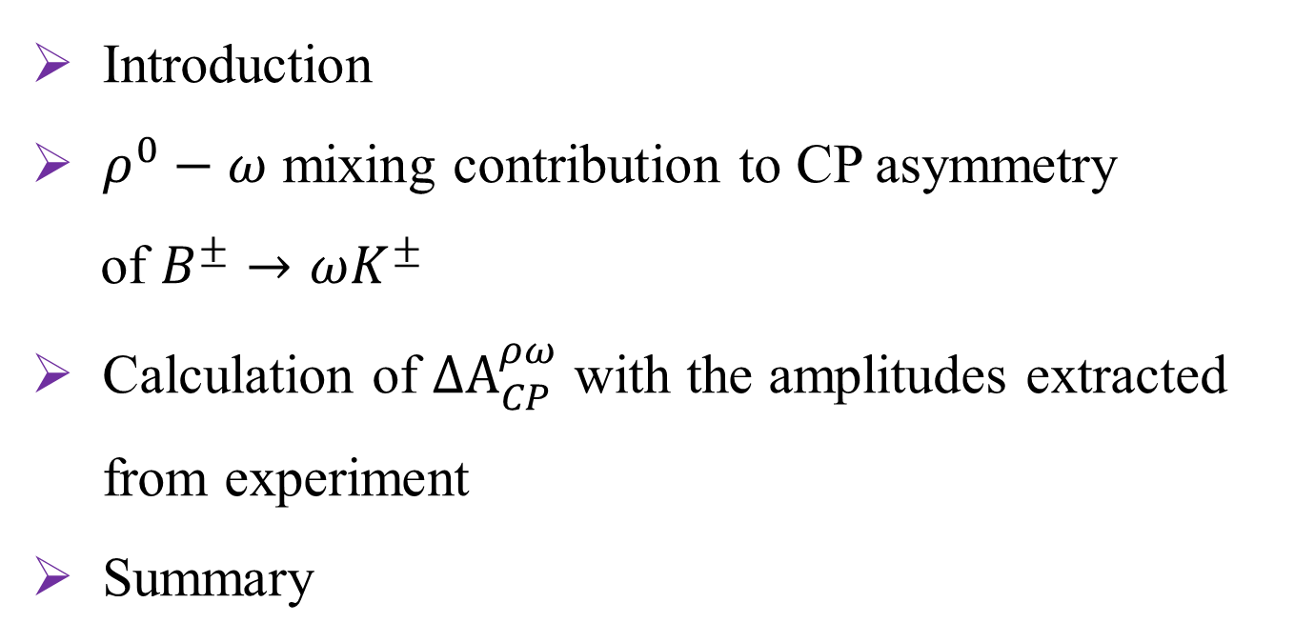
Outline
Introduction
$ρ^{0}−ω$ mixing contribution to CP asymmetry
of $B^{±}→ωK^{±}$
Calculation of ${∆A}_{CP}^{ρω}$ with the amplitudes extracted from experiment
Summary
2/21

Slide 3
Introduction
3/21

Slide 4
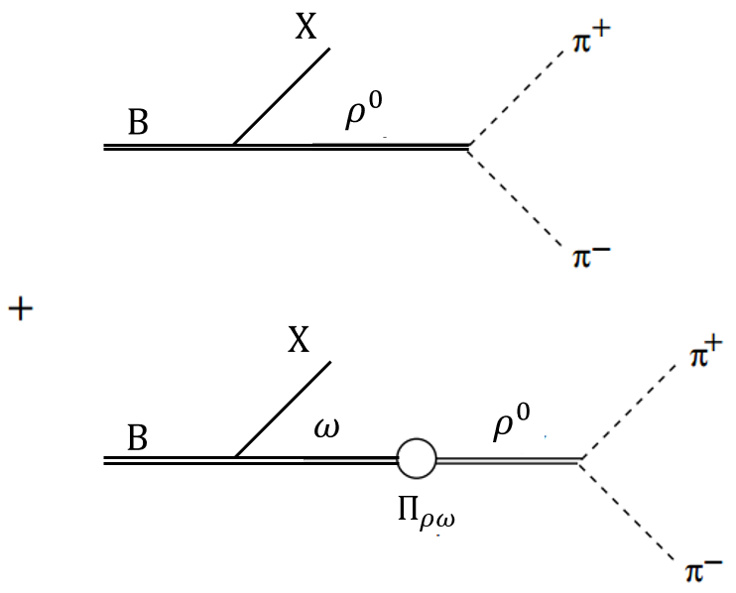
$ρ^{0}−ω$ mixing contributions to CPV
$Α=\frac{Α_{ρ→2π}}{s_{ρ}}\left[Α_{B→ρX}+Α_{B→ωX}\frac{{\tilde{Π}}_{ρω}}{s_{ω}}\right]$ (1)
CPV in $B→π^{+}π^{−}X$: around the vicinity of $ρ^{0}$(770)
X.-H. Guo et al., PRD 63(2001)056012
C. wang, Z.-H. Zhang et al., EPJC 75(2015)536
Interference of $ρ^{0}→π^{+}π^{−}$ and $ω(782)→ρ^{0}→π^{+}π^{−}$
Decay amplitudes of $B→π^{+}π^{−}X$
$$𝔑\left(Π_{ρω}\left(m_{ρ}^{2}\right)\right)=−4620±{220}_{model}±{170}_{data}MeV^{2}$$
$$s_{V}=s−m_{V}^{2}+im_{V}Γ_{V}(V=ω,ρ)$$
$$ℑ\left(Π_{ρω}\left(m_{ρ}^{2}\right)\right)=−6100±{1800}_{model}±{1110}_{data}MeV^{2}$$
C. Wolfe et al, PRD 83 (2011) 077301
$ρ^{0}−ω$ mixing contributions to $Β→π^{+}π^{−}X$
Strong phase $δ$ from: ${\tilde{Π}}_{ρω}$ and $s_{ω}$: $δ=δ(s)$
S. Gardner et al., PRL. 80(1998)1834
4/21

Slide 5
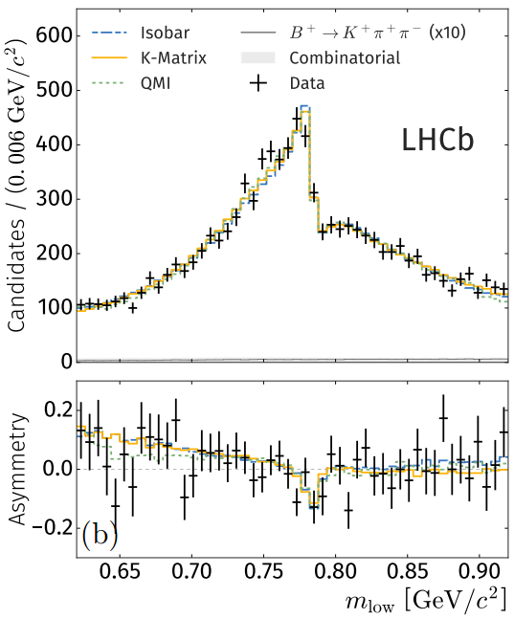
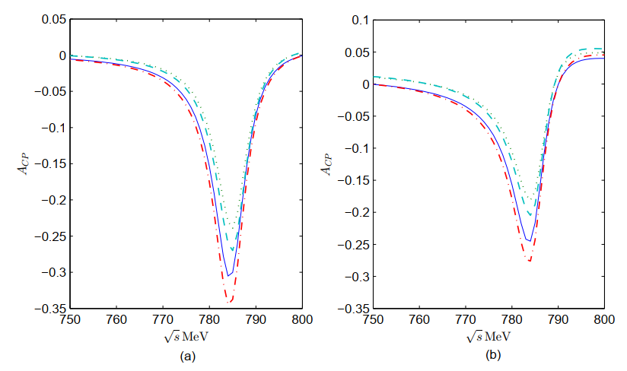
$$B^{±}→π^{+}π^{−}π^{±}$$
C. Wang, ZHZ, Z.-Y. Wang, and X.-H. Guo, EPJC75（2015)11, 536 [arXiv: 1506.00324]
LHCb, PRL.124(2020)031801 [arXiv: 1909.05211]
5/21

Slide 6
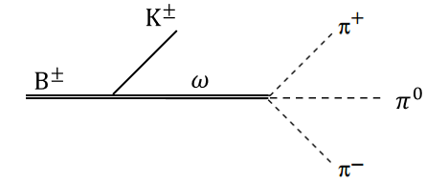
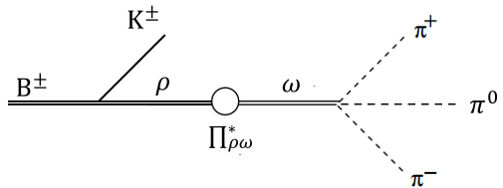
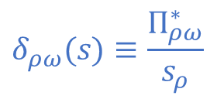
4-body B meson decay $B^{±}→K^{±}3π:$ the invariant mass of $π^{+}π^{−}π^{0}$ around $ω(782)$
Motivation
Play with $ρ^{0}−ω$ mixing in an inverse way
Interference of $ω→3π$ and $ρ^{0}→ω→3π.$
Decay amplitudes of${ B}^{±}→3πK^{±}$:
$A^{±}=\left[ℱ_{B^{±}→ωK^{±}}+δ_{ρω}\left(s\right)ℱ_{B^{±}→ρK^{±}}\right]⋅\frac{χ_{ω→3π}}{s_{ω}}$ (2)
$$δ_{ρω}(s)≡\frac{Π_{ρω}^{∗}}{s_{ρ}}$$
+
$\hat{δ}ρω$ very small, for $Γ_{B^{±}→ωK^{±}}$ negligible，
but for $A_{CP}^{exp}$ non-negligible.
6/21

Slide 7
Our result
CPV of $B^{±}→ωK^{±}$
${∆A}_{CP}^{ρω}$: The $ρ^{0}−ω$ mixing effect contributing to $A_{cp}^{exp}$.
$A_{CP}^{exp}=A_{CP}^{con}+{∆A}_{CP}^{ρω}$ (3)
$A_{CP}^{exp}$: Experimental value measured by Bell and BaBar;
$$A_{cp}^{exp}=−0.02±0.04$$
PDG
$A_{CP}^{con}$: the conventionally defined CPV of $B^{±}→ωK^{±}$, excluding $ρ^{0}−ω$ mixing contribution;
$${∆A}_{CP}^{ρω}≈{0.01}_{−0.02}^{+0.01}$$
This work
7/21

Slide 8
$ρ^{0}−ω$ mixing contribution to CP asymmetry of $B^{±}→ωK^{±}$
8/21

Slide 9
The derivation of $A_{CP}^{exp}$
For the CPV of $B^{±}→ωK^{±}$ ($A_{CP}^{exp}$ ) including $ρ^{0}−ω$ mixing contributions
$ω$ meson reconstructed through $ω→π^{+}π^{−}π^{0}$ in experience
$A_{CP}^{exp}$ measured with the invariant mass of $π^{+}π^{−}π^{0}$ around $ω(782)$;
$A_{CP}^{exp}≡\frac{\int_{{(m_{ω}−∆_{ω})}^{2}}^{{(m_{ω}+∆_{ω})}^{2}}{\left[\int{\left({\left|A^{−}\right|}^{2}−{\left|A^{+}\right|}^{2}\right){ds}_{+0}{ds}_{−0}}\right]ds}}{\int_{{(m_{ω}−∆_{ω})}^{2}}^{{(m_{ω}+∆_{ω})}^{2}}{\left[\int{\left({\left|A^{−}\right|}^{2}+{\left|A^{+}\right|}^{2}\right){ds}_{+0}{ds}_{−0}}\right]ds}}$ (4)
$A^{±}$:the decay amplitude of $B^{±}→π^{+}π^{−}π^{0}K^{±}$; $s_{+0}$, $s_{−0}$, and s: $m_{π^{+}π^{0}}^{2}$, $m_{π^{−}π^{0}}^{2}$, $m_{π^{+}π^{−}π^{0}}^{2}$ respectively.
9/21

Slide 10
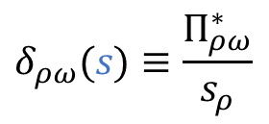
The derivation of $A_{CP}^{exp}$
$A_{B^{±}→π^{+}π^{−}π^{0}K^{±}}^{±}$ parameterized:
$A_{B^{±}→π^{+}π^{−}π^{0}K^{±}}^{±}=\left[ℱ_{B^{±}→ωK^{±}}+δ_{ρω}\left(s\right)∗ℱ_{B^{±}→ρK^{±}}\right]⋅\frac{χ_{ω→3π}}{s_{ω}}$ (2)
Integral for Eq. (4) :
$A_{CP}^{exp}≈\frac{{\left|ℱ_{B^{−}→ωK^{−}}+\hat{δ}ρωℱ_{B^{−}→ρK^{−}}\right|}^{2}−{\left|ℱ_{B^{+}→ωK^{+}}+{\hat{δ}ρωℱ}_{B^{+}→ρK^{+}}\right|}^{2}}{{\left|ℱ_{B^{−}→ωK^{−}}+{\hat{δ}ρωℱ}_{B^{−}→ρK^{−}}\right|}^{2}+{\left|ℱ_{B^{+}→ωK^{+}}+{\hat{δ}ρωℱ}_{B^{+}→ρK^{+}}\right|}^{2}}$ (5)
$$δ_{ρω}(s)≡\frac{Π_{ρω}^{∗}}{s_{ρ}}$$
Strong phase $\hat{δ}ρω≡δ_{ρω}\left(m_{ω}^{2}\right)$; $ℱ_{B^{±}→ρK^{±}}$and $ℱ_{B^{±}→ρK^{±}}$：the rest part of amplitudes, respectively.
10/21

Slide 11
The derivation of ${∆A}_{CP}^{ρω}$
$$\hat{δ}ρω≈\left(0.049±0.018\right)+\left(0.045±0.003\right)i$$
C. Wolfe and K. Maltman., PRD, 83(2011)077301
A Taylor expansion of $A_{CP}^{exp}$(Eq. (5)) up to $𝒪(\hat{δ}ρω$),
$A_{CP}^{exp}=A_{CP}^{con}+{∆A}_{CP}^{ρω}$ (3)
$A_{CP}^{con}=\frac{{\left|ℱ_{B^{−}→ωK^{−}}\right|}^{2}−{\left|ℱ_{B^{+}→ωK^{+}}\right|}^{2}}{{\left|ℱ_{B^{−}→ωK^{−}}\right|}^{2}+{\left|ℱ_{B^{+}→ωK^{+}}\right|}^{2}}$ (6)
${∆A}_{CP}^{ρω}=\left(1−{A_{CP}^{con}}^{2}\right)∗ℜ[(\frac{ℱ_{B^{−}→ρK^{−}}}{ℱ_{B^{−}→ωK^{−}}}−\frac{ℱ_{B^{+}→ρK^{+}}}{ℱ_{B^{+}→ωK^{+}}})\hat{δ}ρω]$ (7)
${∆A}_{CP}^{ρω}$: the contribution of $ρ^{0}−ω$ mixing effect to $A_{CP}^{exp}$;
$A_{CP}^{con}$: the conventionally defined CPV of $B^{±}→ωK^{±}$ , excluding $ρ^{0}−ω$ mixing contribution.
11/21

Slide 12
Calculation of ${∆A}_{CP}^{ρω}$ with the amplitudes extracted from experiment
12/21

Slide 13
Select decay channel $B^{±}→π^{+}π^{−}K^{±}$ instead of $B^{±}→π^{+}π^{−}π^{0}K^{±}$
Pick a suitable channel
Decay amplitudes of $B^{±}→π^{+}π^{−}K^{±}$
$A\left(B^{±}→π^{+}π^{−}K^{±}\right)|_{s∼m_{ω}^{2}}∝\left(ℱ_{B^{±}→ρK^{±}}+\frac{\tilde{∏}ρω}{s_{ω}}∗ℱ_{B^{±}→ωK^{±}}\right)∗\frac{1}{s_{ρ}}$ (1)
Decay amplitudes of $B^{±}→π^{+}π^{−}π^{0}K^{±}$
$A_{B^{±}→π^{+}π^{−}π^{0}K^{±}}^{±}=\left[ℱ_{B^{±}→ωK^{±}}+\frac{∏_{ρω}^{∗}(s)}{s_{ρ}}∗ℱ_{B^{±}→ρK^{±}}\right]∗\frac{χ_{ω→3π}}{s_{ω}}$ (2)
$Γ_{ρ}=$149.1$±0$.8MeV; $Γ_{ω}$=8.49$±0$.08MeV.
13/21

Slide 14
The amplitudes extracted
${∆A}_{CP}^{ρω}≈ℜ[(\frac{c_{ρ}^{−}}{c_{ω}^{−}}−\frac{c_{ρ}^{+}}{c_{ω}^{+}})∗\frac{\tilde{∏}ρω(m_{ω}^{2})∏_{ρω}^{∗}(m_{ω}^{2})}{{(m_{ω}^{2}−m_{ρ}^{2}+im_{ρ}Γ_{ρ})}^{2}}]$ (8)
BaBar collaboration, PRD 78 (2008) 012004
${∆A}_{CP}^{ρω}≈−2ℜ[(\frac{{∆x}_{ρ}+{i∆y}_{ρ}}{x_{ω}+iy_{ω}})∗\frac{\tilde{∏}ρω(m_{ω}^{2})∏_{ρω}^{∗}(m_{ω}^{2})}{{(m_{ω}^{2}−m_{ρ}^{2}+im_{ρ}Γ_{ρ})}^{2}}]$ (9)
The latest amplitude analysis of $B^{±}→π^{+}π^{−}K^{±}$ by BaBar, extract four amplitudes of $B^{±}→ωK^{±}$ and $B^{±}→ρK^{±}$ simultaneously，$c_{ω}^{±}$、 $c_{ρ}^{±};$
put into Eq. (7):
$c_{ω(ρ)}^{±}=\left(x_{ω\left(ρ\right)}±Δx_{ω\left(ρ\right)}\right)+i(y_{ω(ρ)}±Δy_{ω\left(ρ\right)})$, simplified：
14/21

Slide 15
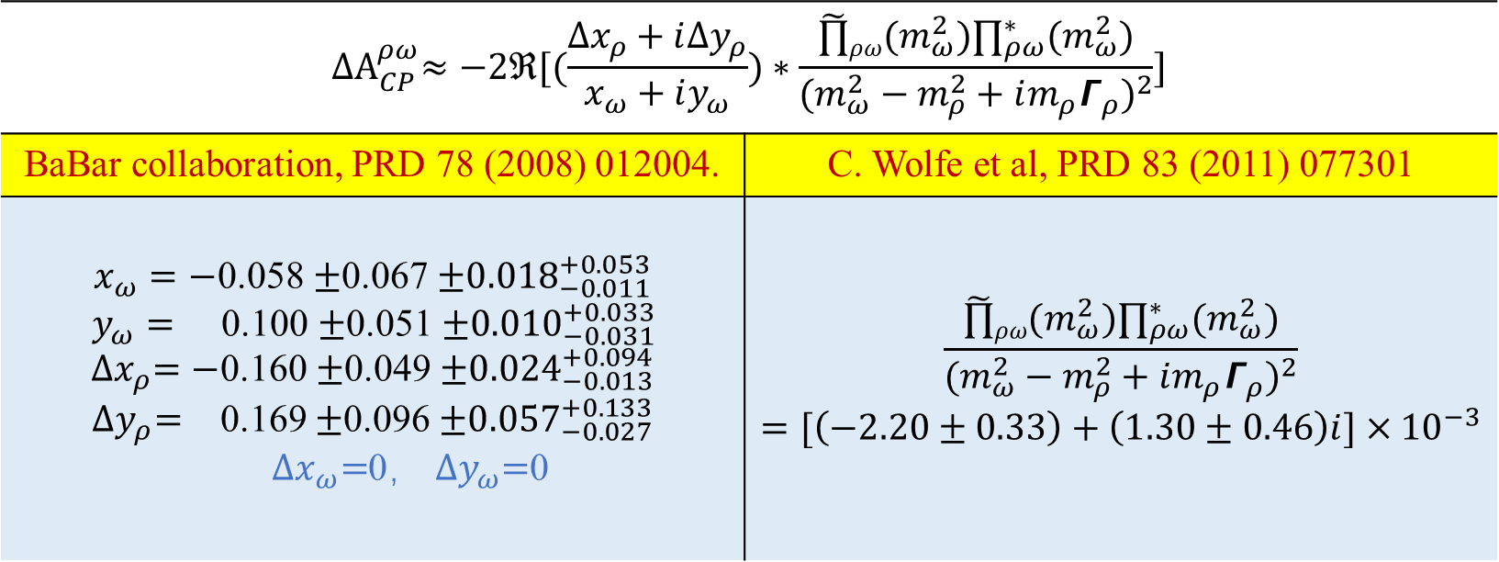
Calculate ${∆A}_{CP}^{ρω}$
Calculate ${∆A}_{CP}^{ρω}$
$${∆A}_{CP}^{ρω}≈−2ℜ[(\frac{{∆x}_{ρ}+{i∆y}_{ρ}}{x_{ω}+iy_{ω}})∗\frac{\tilde{∏}ρω(m_{ω}^{2})∏_{ρω}^{∗}(m_{ω}^{2})}{{(m_{ω}^{2}−m_{ρ}^{2}+im_{ρ}Γ_{ρ})}^{2}}]$$
BaBar collaboration, PRD 78 (2008) 012004. | C. Wolfe et al, PRD 83 (2011) 077301
$x_{ω}=−$0.058 $±$0.067 $±{0.018}_{−0.011}^{+0.053}$ $y_{ω}=$ 0.100 $±$0.051 $±{0.010}_{−0.031}^{+0.033}$ ${∆x}_{ρ}=−$0.160 $±$0.049 $±{0.024}_{−0.013}^{+0.094}$ ${∆y}_{ρ}=$ 0.169 $±$0.096 $±{0.057}_{−0.027}^{+0.133}$ ${∆x}_{ω}=$0， ${∆y}_{ω}=$0 | $$\frac{\tilde{∏}ρω(m_{ω}^{2})∏_{ρω}^{∗}(m_{ω}^{2})}{{(m_{ω}^{2}−m_{ρ}^{2}+im_{ρ}Γ_{ρ})}^{2}}=[\left(−2.20±0.33\right)+\left(1.30±0.46\right)i]×{10}^{−3}$$
15/21

Slide 16
The $ρ^{0}−ω$ mixing effect contributing to $A_{cp}^{exp}$：
The result
$${∆A}_{CP}^{ρω}≈{0.01}_{−0.02}^{+0.01}$$
Experimental value measured by Bell and BaBar;
$$A_{cp}^{exp}=−0.02±0.04$$
PDG
16/21

Slide 17
Summary
17/21

Slide 18
Summary
CPV in $B^{±}→ωK^{±}$ ($A_{CP}^{exp}$): compared with $A_{CP}^{con}$ is different. And $A_{CP}^{exp}=A_{CP}^{con}+{∆A}_{CP}^{ρω}$, with $ρ^{0}−ω$ mixing contributing ${∆A}_{CP}^{ρω}$ to $A_{CP}^{exp}$ non-negligible.
$${∆A}_{CP}^{ρω}≈{0.01}_{−0.02}^{+0.01}$$
$$A_{cp}^{exp}=−0.02±0.04$$
$$A_{CP}^{con}=−0.03±{0.04}_{−0.01}^{+0.02}$$
$ρ^{0}−ω$ mixing contributing should be careful considered in CPV of $B→ωX$ ($X$ represents one or more particles), instead of neglect.
18/21

Slide 19
The end
Thank you !
19/21

Slide 20
Back up
I

Slide 21
The conventionally defined CPV of $B^{±}→ωK^{±}$ :
$$A_{CP}^{con}=−0.03±{0.04}_{−0.01}^{+0.02}$$
Theoretical predictions $\left\{\begin{aligned}\text{QCDf}\text{ : }A_{cp}={0.221}_{−0.128−0.130}^{+0.137+0.140} \\ \text{PQCD}\text{ : }A_{cp}={0.116}_{−0.204−0.011}^{+0.182+0.011} \\ \text{SCET} \text{:} A_{cp}={0.123}_{−0.173−0.011}^{+0.166+0.080} \end{aligned}\right.$
H.-Y. Cheng and C.-K.,PRD 80(2009)114008;
H.-n. Li et al., PRD 74(2006)094020
W. Wang ,Y.-M et al., PRD 78(2008)034011
Note, extracted amplitudes from BaBar：
1、CPV of $B^{±}→ωK^{±}$ set to be zero by hand;
2、The extracted amplitudes of $B^{±}→ωK^{±}$suffer from large uncertainties.
II

