Slide 1
Silicon Tracking for 4th Concept Detector
Chengdong FU
2021-03-022

Slide 2
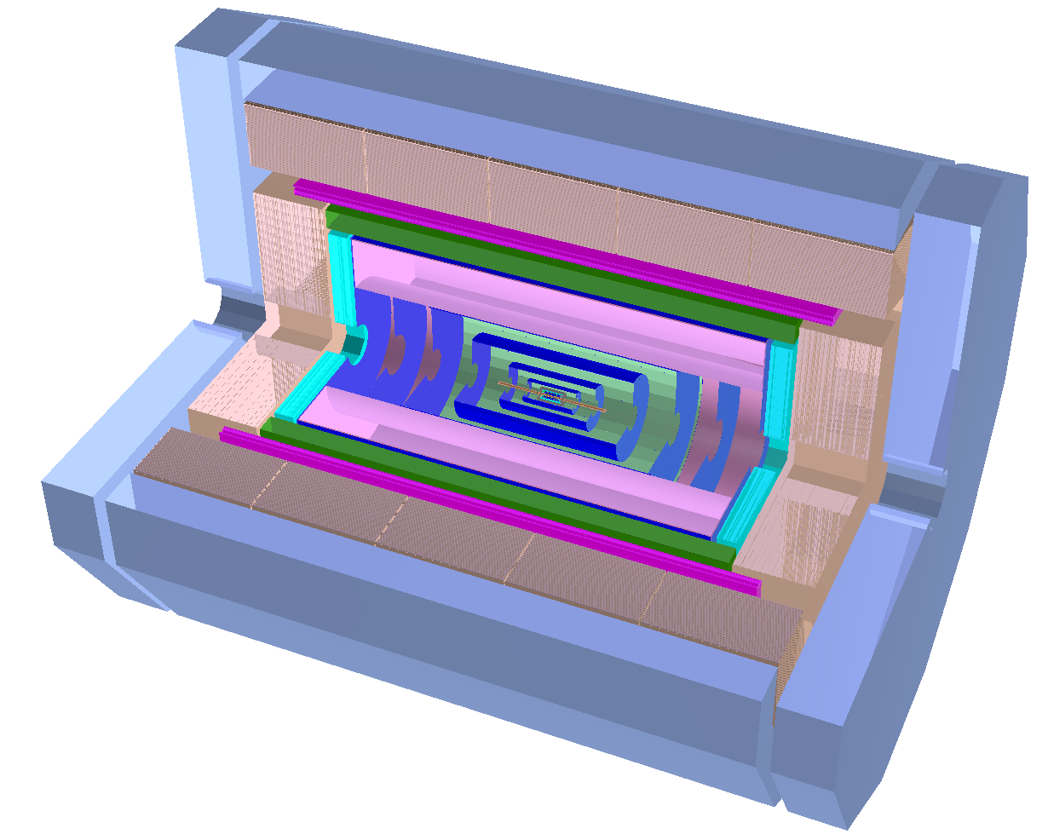
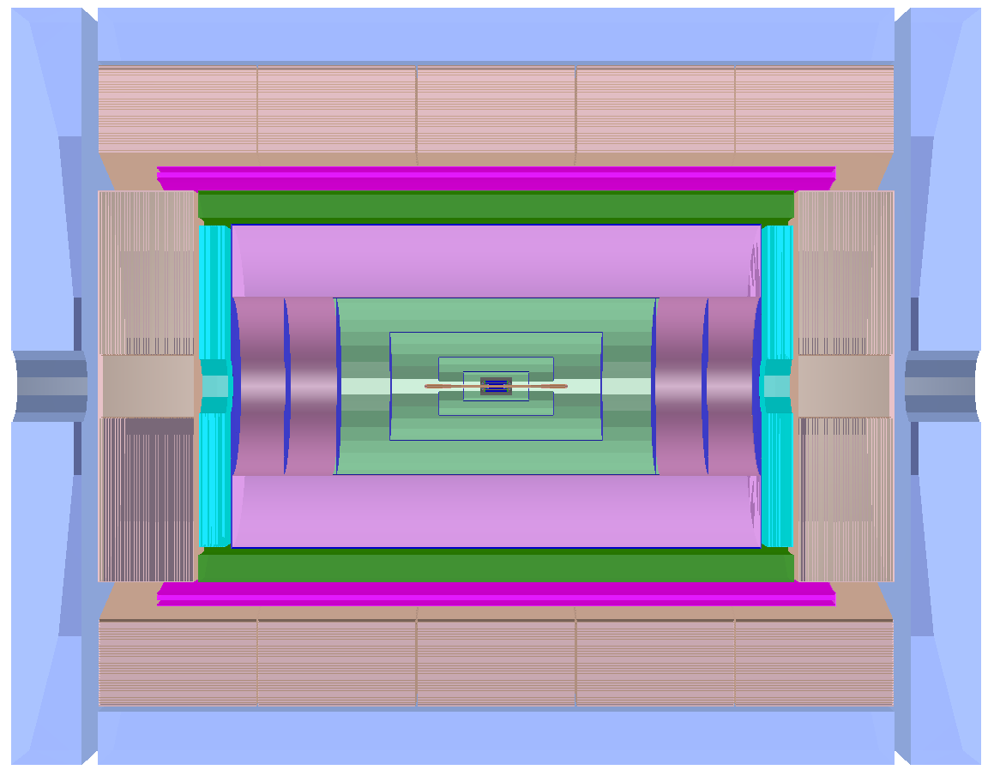
Introduction
4th concept detector (preliminary)
4+1 outer silicon layers (SOT)
~3000mm
~31°
~1000mm

Slide 3
Tracking for silicon tracker
To include SET, by FullLDCTracking
VXD+SIT+FTD (section search）
For Silicon Tracker
Merge silicon tracks
Merge silicon and TPC tracks
FTD (pattern recognition)
For Drift Chamber
VXD+SIT+FTD
VXD+SIT+FTD+DC+SET

Slide 4
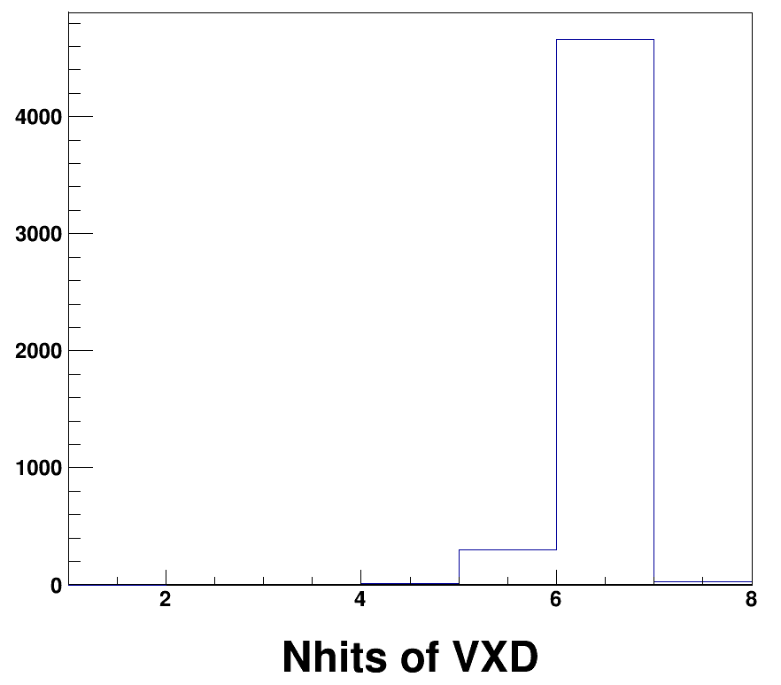
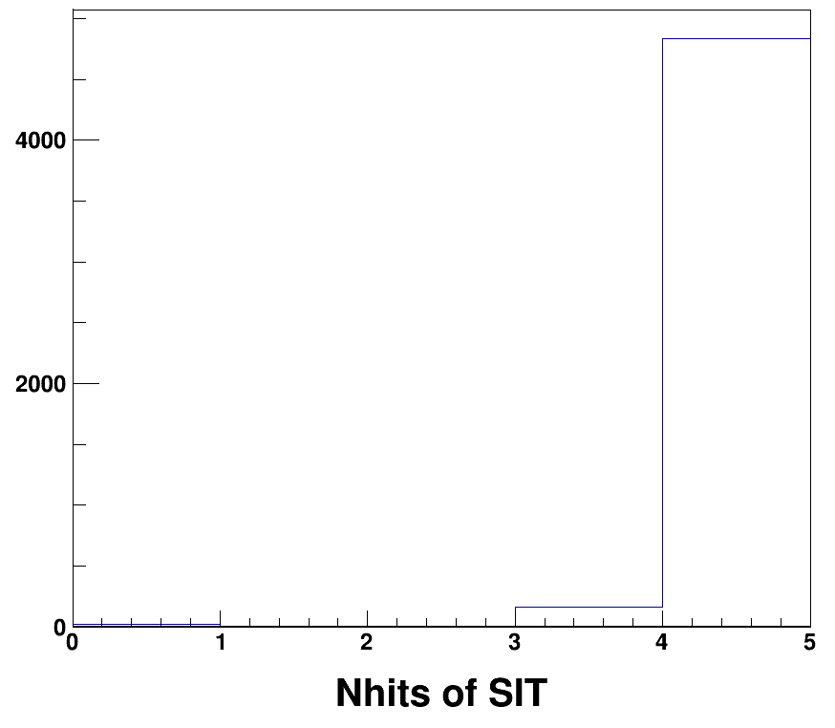
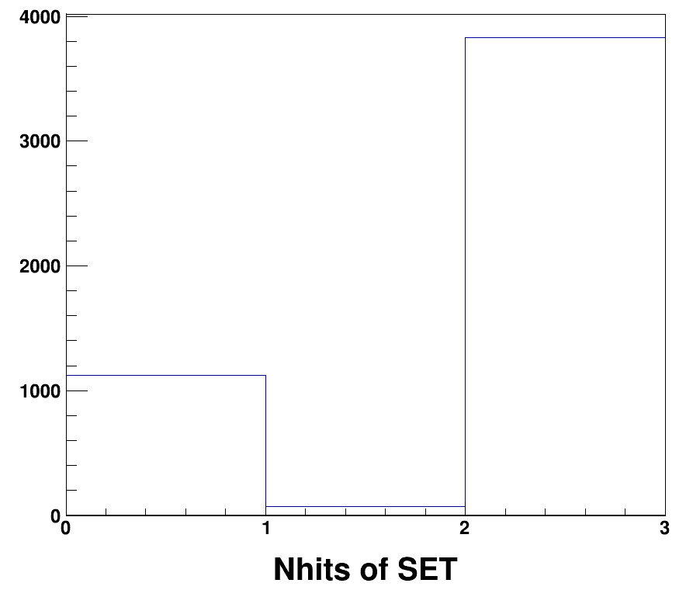
Hits Number
CRD_o2_v01
θ=35°~145°
p=100 GeV/c
failure to build space point
TODO: confirm lost hits
update SpacePointBuilder
reduce gap of two strip
pixel SET
x
x
x

Slide 5
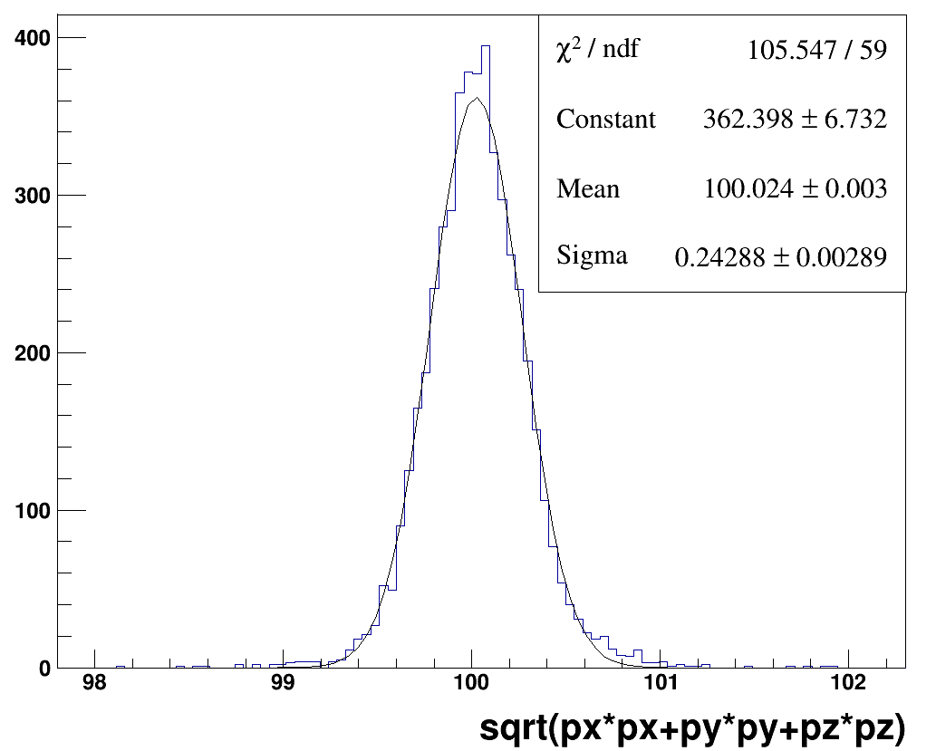
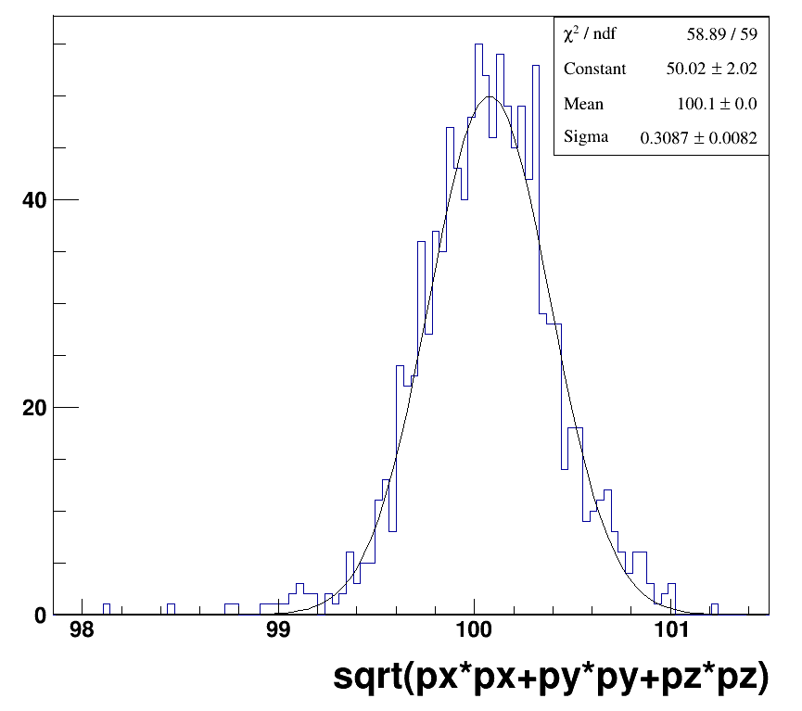
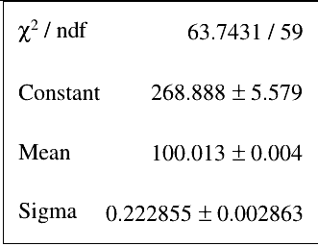
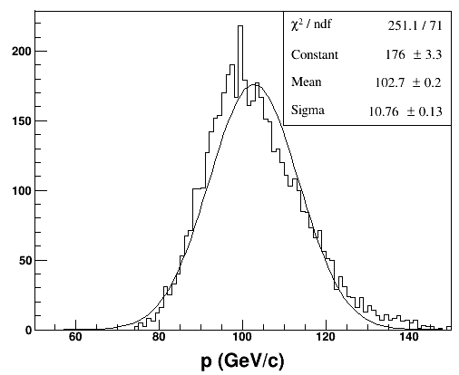
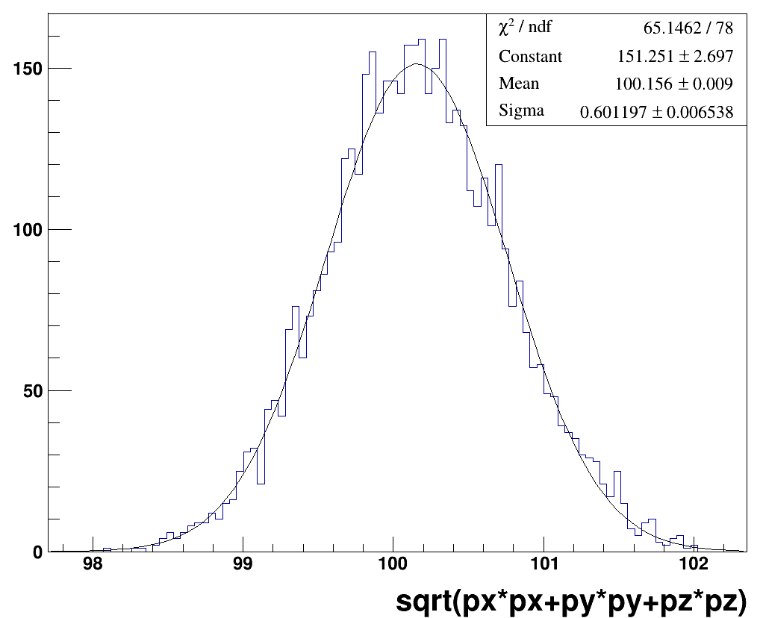
Resolution
VXD+SIT+DC+SET
ALL
NSET==0
NSET==2
VXD+SIT
CRD_o1_v02:
2 SIT
CRD_o2_v01:
4 SIT
VS

