Slide 1
Performance study in tracking

Slide 2
Marlin: use previous chain
Sim + Reco + Analysis
Gaudi:
Sim with MokkaC
reco and analysis with in gaudi framework

Slide 3
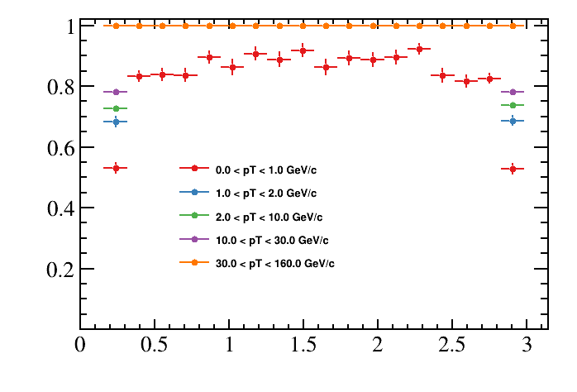
Efficiency
Marlin
Gaudi

Slide 4
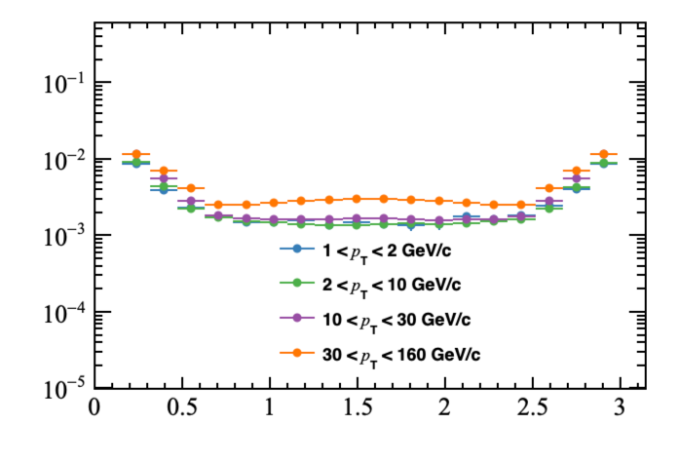
Pt resolution Dpt/pt
Dpt: pt-pt_{true} distribution fit with gaussian
Marlin
Gaudi

