Slide 1
BESIII Software and Computing for BEPC3 L and E Upgrades
A summary of Mini-Workshop on BESIII Software and Computing for BEPC3 Upgrade https://indico.ihep.ac.cn/event/14106/
Sun Shengsen
On behalf of BESIII software group
2021. 4. 25.

Slide 2
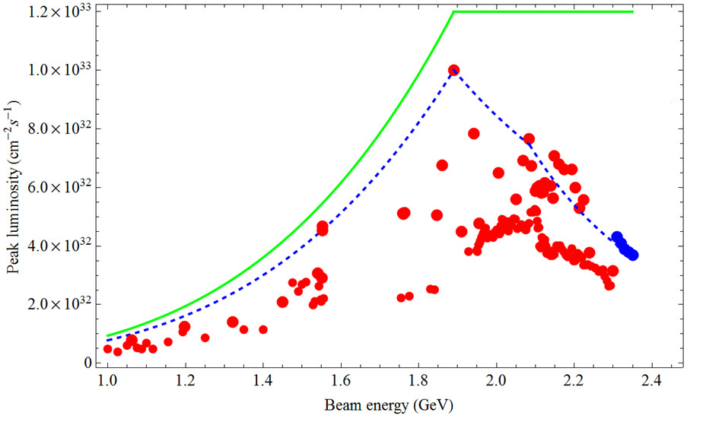
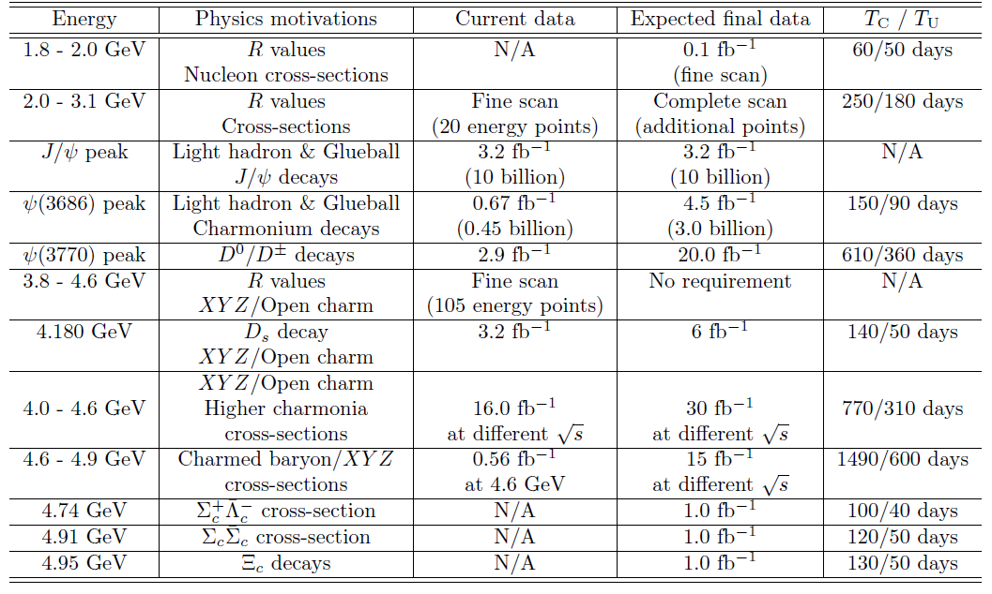
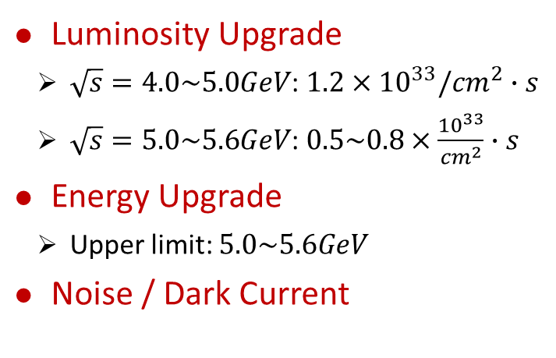

Motivation: BEPC3 Upgrade
BEPC3 vs BEPCII
Lum: $×3$
Energy:
5.0~5.6GeV
5.6
Luminosity Upgrade
    $\sqrt{s}=4.0\sim 5.0GeV$: $1.2×{10}^{33}/{cm}^{2}∙s$
    $\sqrt{s}=5.0\sim 5.6GeV$: $0.5\sim 0.8×\frac{{10}^{33}}{{cm}^{2}}∙s$
Energy Upgrade
    Upper limit: $5.0\sim 5.6GeV$
Noise / Dark Current
Future Physics Programme of BESIII
Chin. Phys. C 44, 040001(2020)

Slide 3


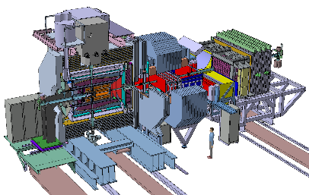

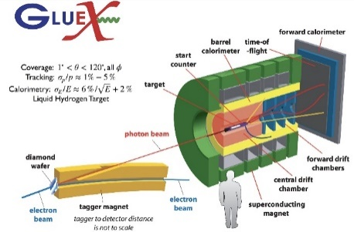
Advantage and Competition/Complementary
Advantage
  Clean data sample, low background/noise
  High efficiency and resolution
  Known initial state of event (quantum number and four momentum)
  Pair production near threshold
  Quantum coherent effect
Competition and Complementary
  Belle II Experiment: high luminosity, ISR production, low efficiency
  LHCb Experiment: extremely high cross section, all quantum state, small acceptance region
  PANDA Experiment: start data taking in 2026
  GlueX Experiment: spectrum of light-mass hybrid mesons

Slide 4
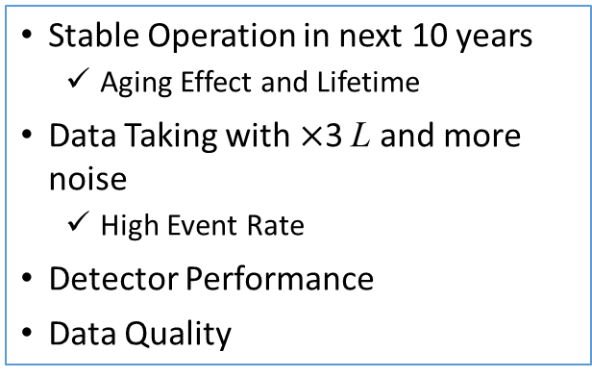
Challenges for BESIII
Most are Software, not Just Software, but also Detector and Physics.
BESIII Detector
Software and Computing
Stable Operation in next 10 years
  Aging Effect and Lifetime
Data Taking with $×$3 L and more noise
  High Event Rate
Detector Performance
Data Quality
Prediction of Detector Aging Effect
Stable and Efficient Data Taking
  Regular Detector Performance Check
  Online Data Quality Monitoring
  Offline Top-Up Event Filter
Optimization of Reconstruction Alg.
  Improve ability to eliminate noise
Fine Calibration and Alignment
Accurate Simulation and Common Systematic Error Study
CGEM Software
Stable Software System for >10 yrs
  Gaudi, GEANT, Git, CMake, …
Advanced Technology Application
  Detection Performance
  Physics Analyses Speed
Computing and Storage Plan
Enhance Cooperation
Physics Research
High Efficiency / Low Noise or BG
Low Systematic Error
Improve Detection Performance
Speed up Physics Analyses
Low Noise/BG; High Efficiency; High Precision

Slide 5
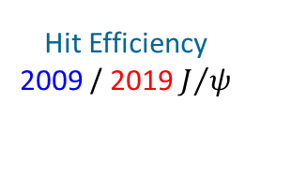
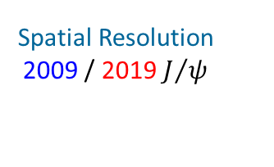
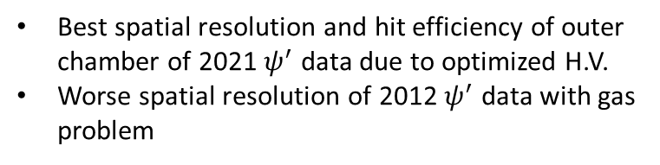


Performance and Aging Effect — MDC
Aging effect of inner drift chamber: gain decreasing year by year
Performance degradation
  Spatial Resolution
  Hit Efficiency
Spatial Resolution
2009 / 2019 $J/ψ$
Hit Efficiency
2009 / 2019 $J/ψ$
Spatial Resolution
2009/ 2012/ 2021 $ψ^{′}$
Hit Efficiency
2009/ 2012/ 2021 $ψ^{′}$
Best spatial resolution and hit efficiency of outer chamber of 2021 $ψ^{′}$ data due to optimized H.V.
Worse spatial resolution of 2012 $ψ^{′}$ data with gas problem

Slide 6
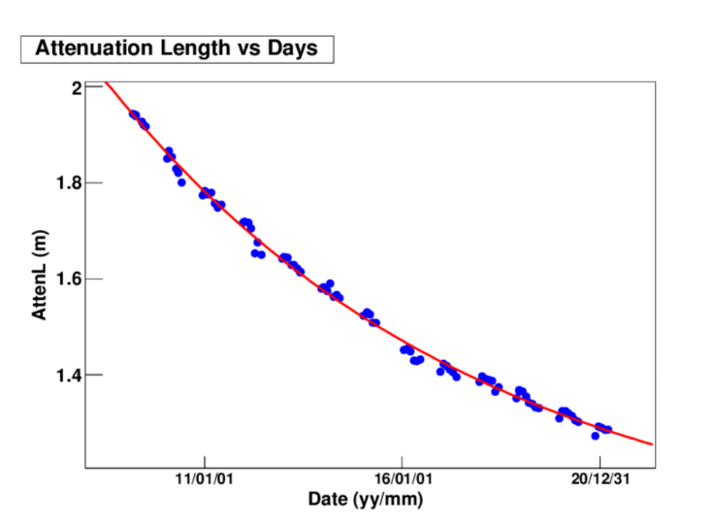
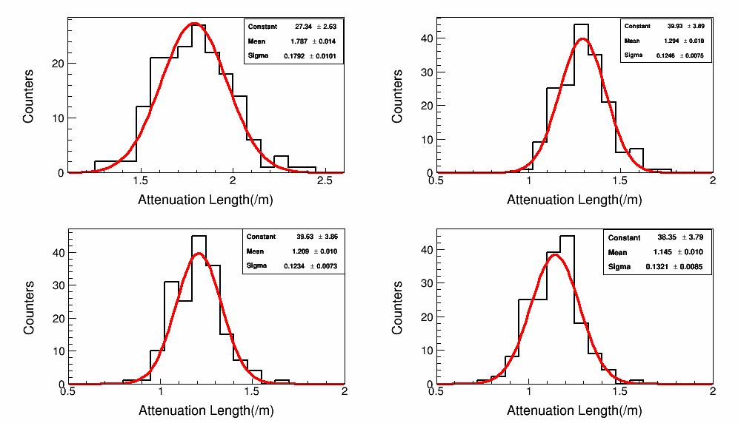
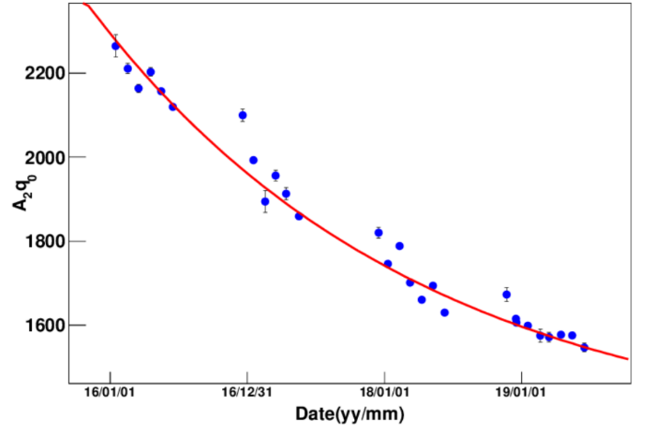
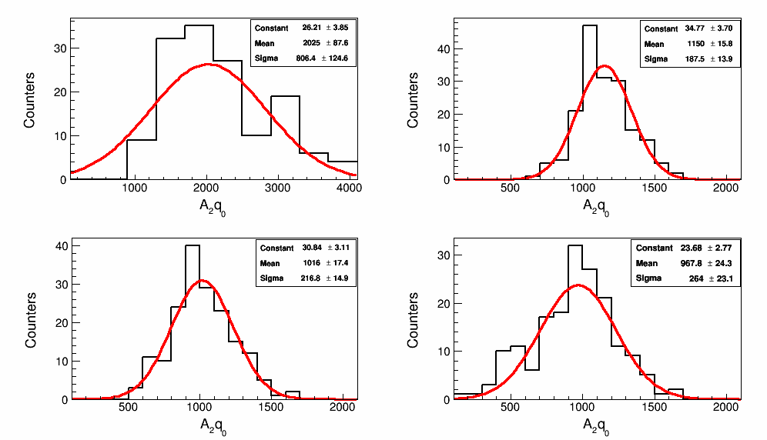
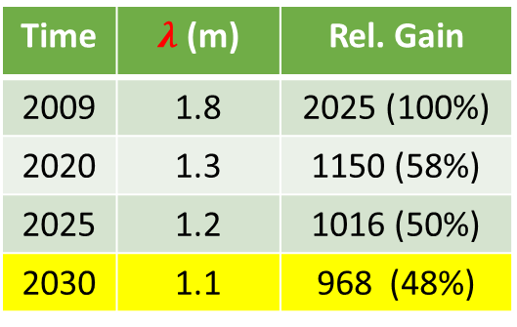
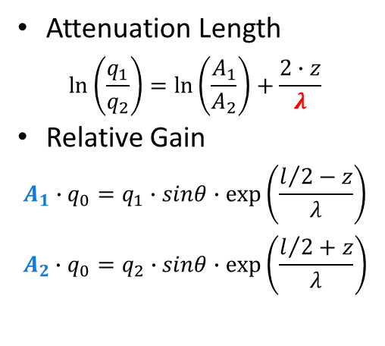

Performance and Aging Effect — Barrel TOF
Attenuation Length
$$\ln\left(\frac{q_{1}}{q_{2}}\right)=\ln\left(\frac{A_{1}}{A_{2}}\right)+\frac{2∙z}{λ}$$
Relative Gain
$$A_{1}∙q_{0}=q_{1}∙sinθ∙\exp\left(\frac{l/2−z}{λ}\right)$$
$$A_{2}∙q_{0}=q_{2}∙sinθ∙exp⁡\left(\frac{l/2+z}{λ}\right)$$
$λ$ vs Time
2009
2020
2025
2030
Time | $λ$ (m) | Rel. Gain
2009 | 1.8 | 2025 (100%)
2020 | 1.3 | 1150 (58%)
2025 | 1.2 | 1016 (50%)
2030 | 1.1 | 968 (48%)
Gain vs Time
2009
2020
2025
2030
Integrated charge of PMT is far smaller than the limit of lifetime of PMTs.
Increasing H.V. of PMT every 3 years to compensate the reduced efficiency.

Slide 7
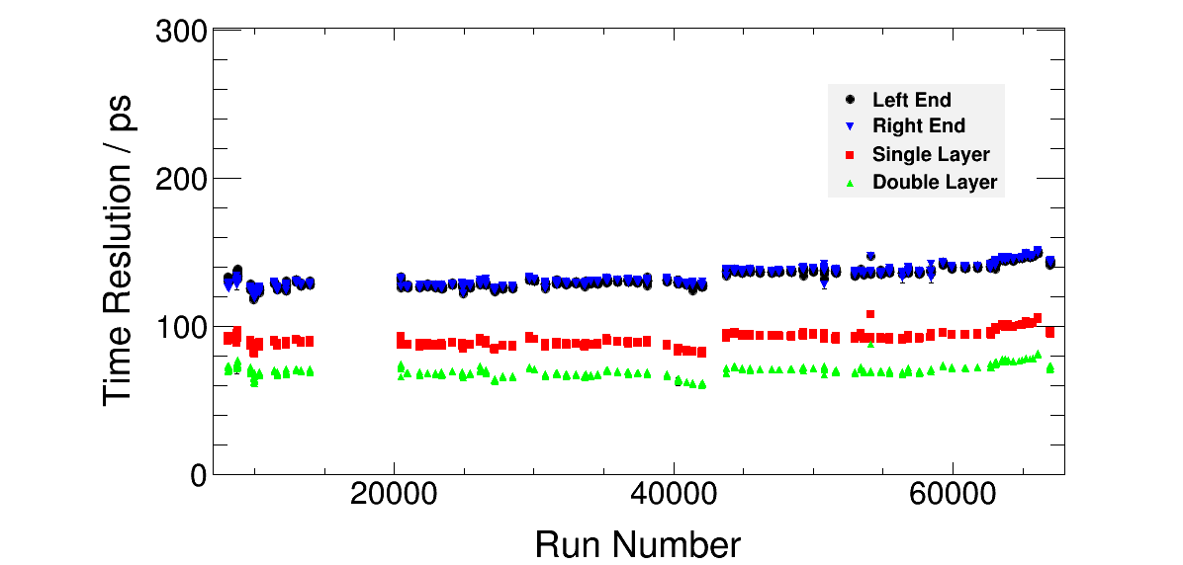
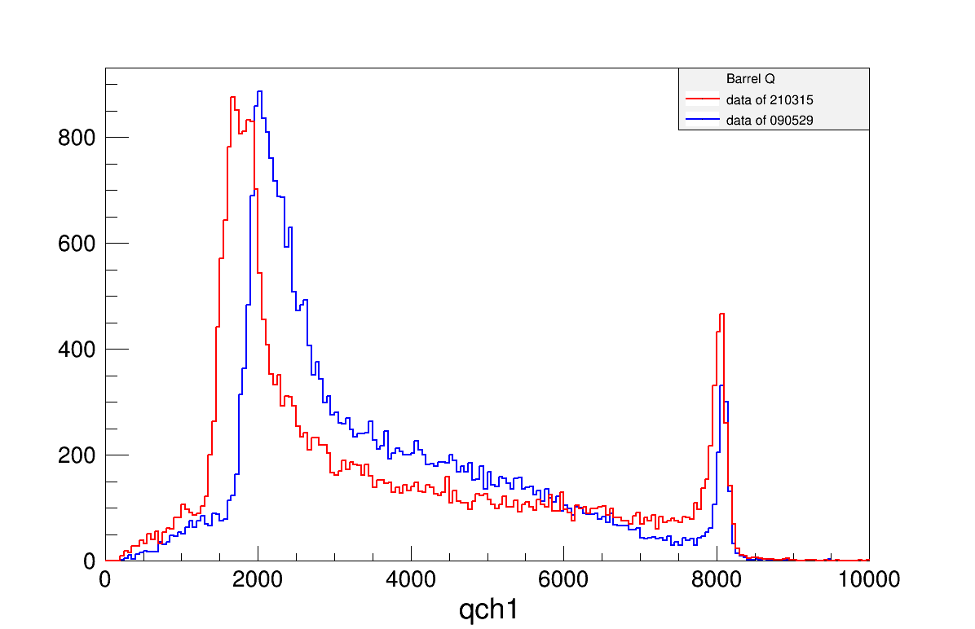
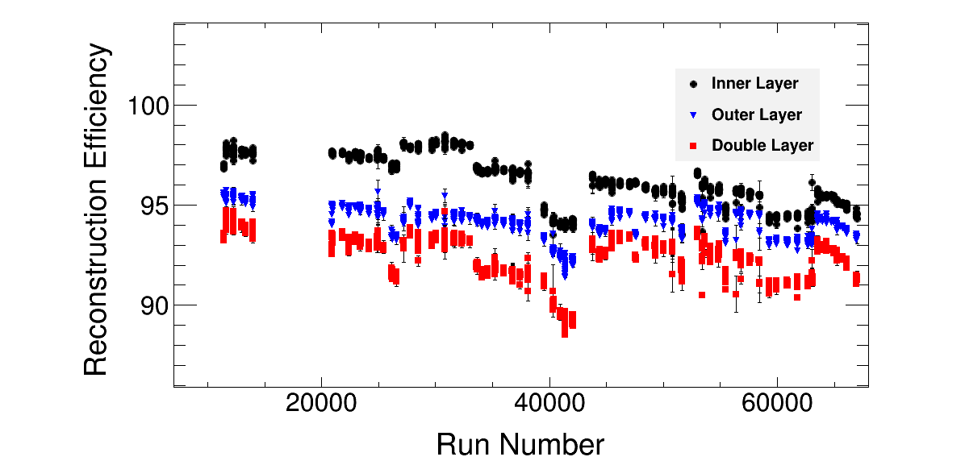
Performance and Aging Effect — Barrel TOF
Time Resolution
Efficiency
Electronics Saturation
No obvious time resolution degradation is observed. Beam quality may contribute
H.V. adjustment may compensate efficiency
Electronics saturation will become serious with aging effect

Slide 8
Performance and Aging Effect — EMC
Too low temperature caused “Photodiode unglued”， light output dropped 60-70%
NO dead detection unit ( 2PD / crystal )
Time | Number of PD unglued
2009 | 15
2010 | 2
2017 | 10
Machine Study
Normalized Calibration Constants
Represent Light Yield of crystal
Lum. Opt.
Machine Study
PD Unglued
PD Unglued
Normalized RMS of Calibration Constants
Represent Difference between crystals

Slide 9
Known Issues
High systematic error level from dE/dx PID
  Complicated and tedious process; time consuming
  Lack of experts and volunteers
Electronics saturation and “special dead channel” of EMC
  Energy measurement range is beyond expectation
  Saturation energy is different for each crystal
  A large signal ➔ Electronics chip works abnormal ➔ Signal Lost
Pion Simulation
Kaon Simulation
Speical Dead Channel
Ecm (MeV) | Barrel (5280) |  | East endcap (480) Elec-Satu | West endcap (480) Elec-Satu
 | Elec-Satu | ‘Special’ Dead （占饱和晶体比例）
4680 | 3682(~70%) | 1247(~34%) | 306(~64%) | 220(~46%)
4944 | 4299(~81%) | 1974(~46%) | 342(~71%) | 264(~55%)

Slide 10
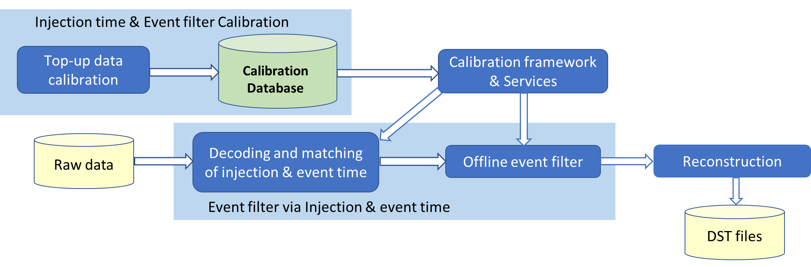
Stable and Efficient Detector Operation
Top-Up pattern is an advanced technology which provide extra >30% integral luminosity
Data quality is not satisfied the requirement of physics analyses in a specific short time range after beam injection
Online trigger shielding and offline event filters works together to guarantee the satisfied data quality
“50Hz noise” will be filtered in offline data processing, improve 3-5% data taking efficiency
Beam Current
MDC Dark Current

Slide 11
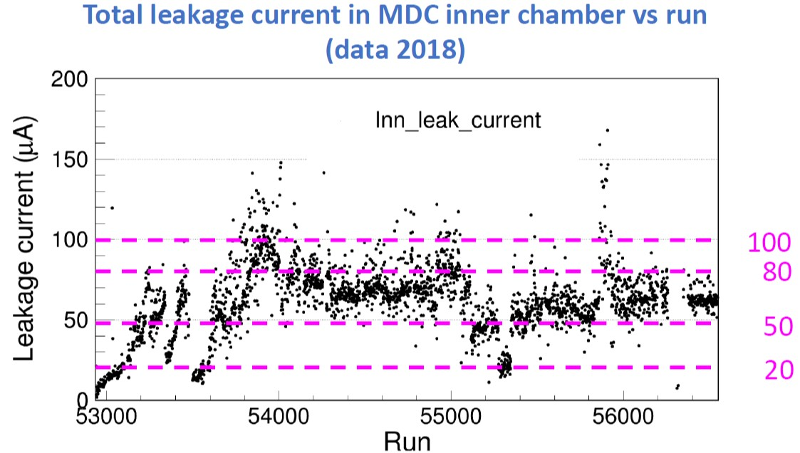
Impact of Noise and Background
Random trigger data is employed to simulate noise/background in MC
High / Low levels of MDC occupancies are selected
MDC leakage current is related to the beam background level
Performance check with different leakage current level

Slide 12
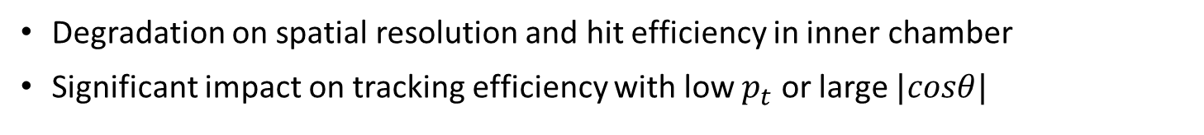
Impact of Noise and Background—MDC
Degradation on spatial resolution and hit efficiency in inner chamber
Significant impact on tracking efficiency with low $p_{t}$ or large $|cosθ|$

Slide 13
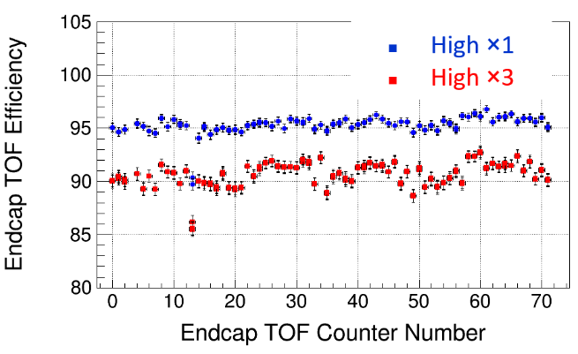
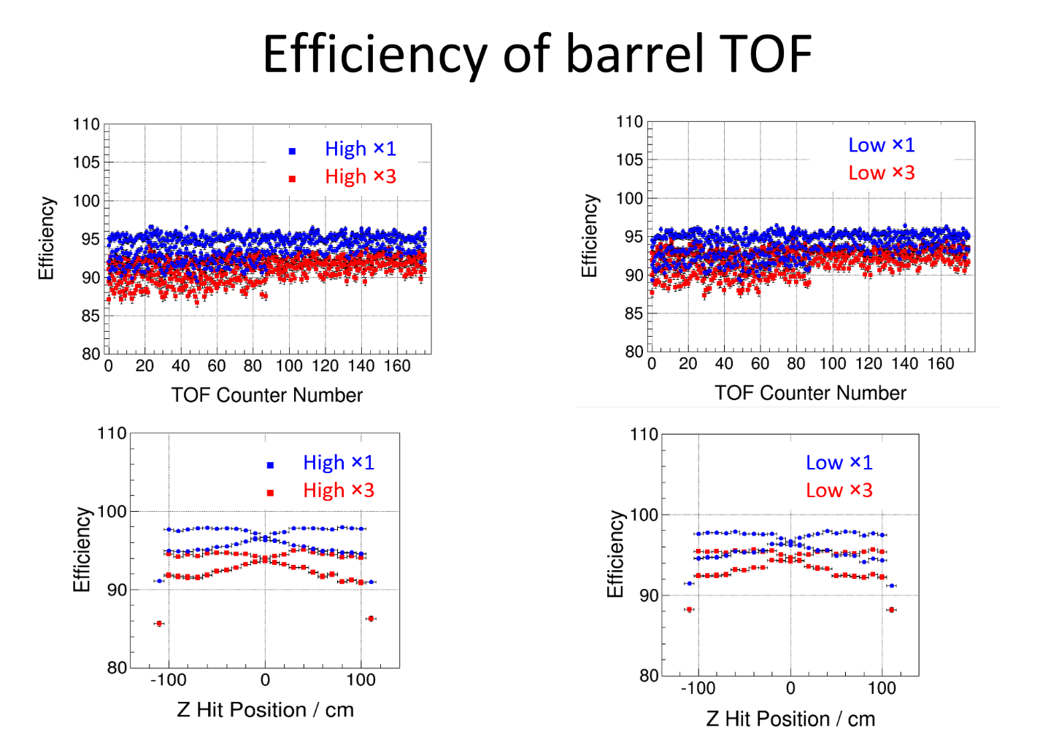
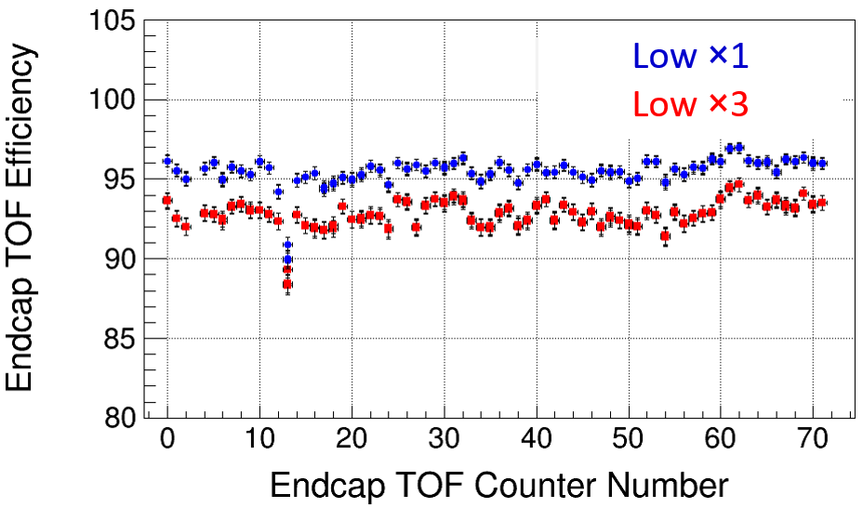
Impact of Noise and Background—TOF
BARREL | Low ×1 | Low ×3 | High ×1 | High ×3
Single end | 148 | 149 | 148 | 150
Single layer | 101 | 101 | 101 | 101
Double layer | 77 | 77 | 77 | 77
Endcap TOF
Time resolution become worse
Significant impact on efficiency
Barrel TOF
Time resolution keep stable
Significant impact on efficiency
ENDCAP | Low ×1 | Low ×3 | High ×1 | High ×3
East end | 78 | 81 | 79 | 84
West end | 78 | 81 | 79 | 84
Double end | 53 | 56 | 54 | 57

Slide 14
Impact of Noise and Background—EMC
Number of fake photons increase with noise or background
Slight impact on the peak of energy deposition
Energy resolution degradation

Slide 15
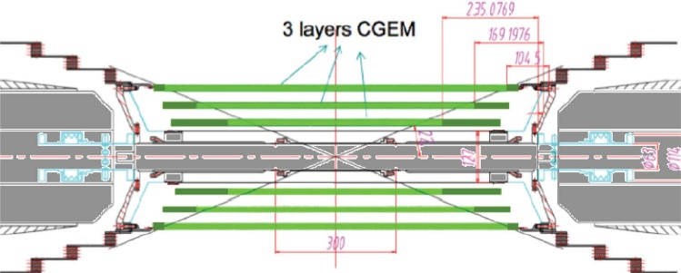
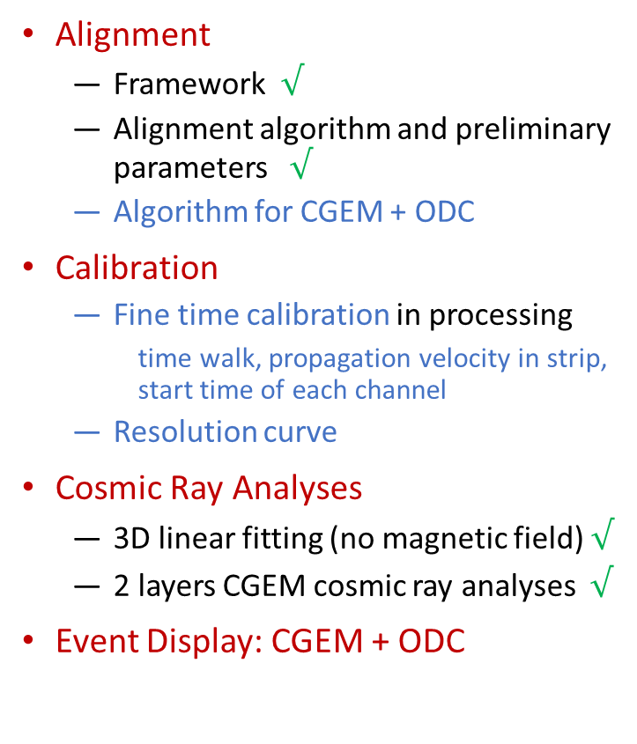
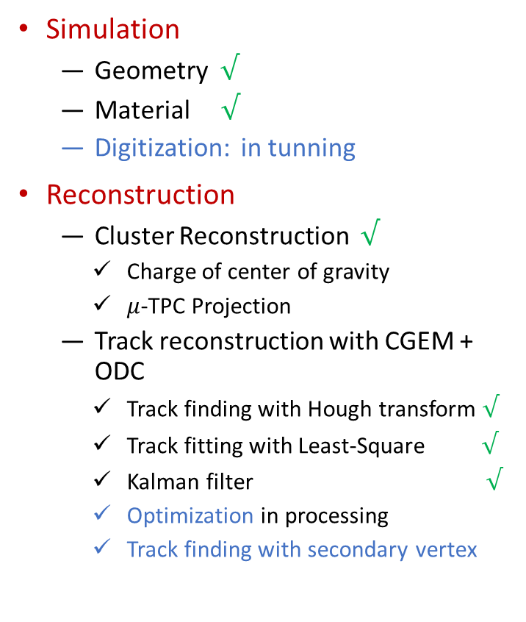
Status of CGEM Software
Simulation
  Geometry $√$
  Material $√$
  Digitization: in tunning
Reconstruction
  Cluster Reconstruction $√$
    Charge of center of gravity
    $μ$-TPC Projection
  Track reconstruction with CGEM + ODC
    Track finding with Hough transform $√$
    Track fitting with Least-Square $√$
    Kalman filter $√$
    Optimization in processing
    Track finding with secondary vertex
Alignment
  Framework $√$
  Alignment algorithm and preliminary parameters $√$
  Algorithm for CGEM + ODC
Calibration
  Fine time calibration in processing
    time walk, propagation velocity in strip, start time of each channel
  Resolution curve
Cosmic Ray Analyses
  3D linear fitting (no magnetic field) $√$
  2 layers CGEM cosmic ray analyses $√$
Event Display: CGEM + ODC

Slide 16
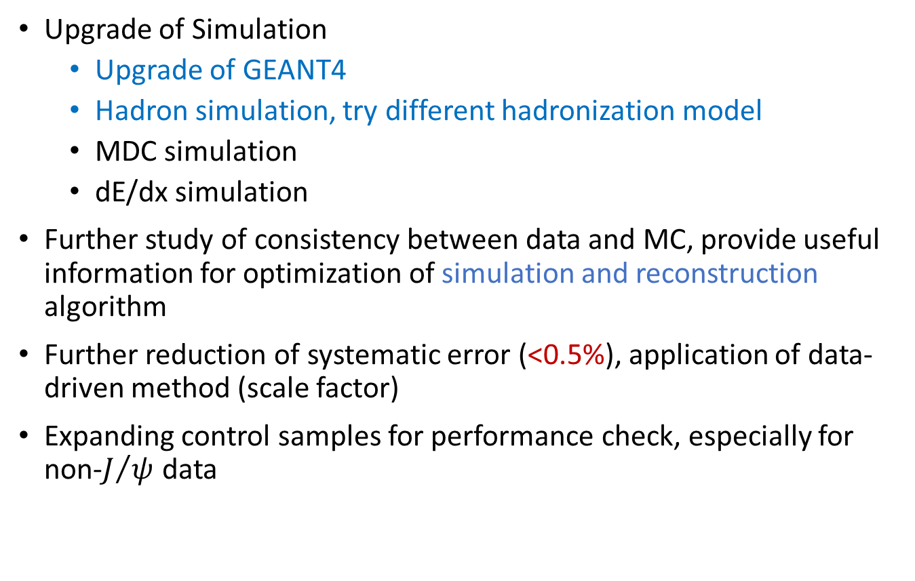
Accurate Simulation
Upgrade of Simulation
  Upgrade of GEANT4
  Hadron simulation, try different hadronization model
  MDC simulation
  dE/dx simulation
Further study of consistency between data and MC, provide useful information for optimization of simulation and reconstruction algorithm
Further reduction of systematic error (<0.5%), application of data-driven method (scale factor)
Expanding control samples for performance check, especially for non-$J/ψ$ data

Slide 17


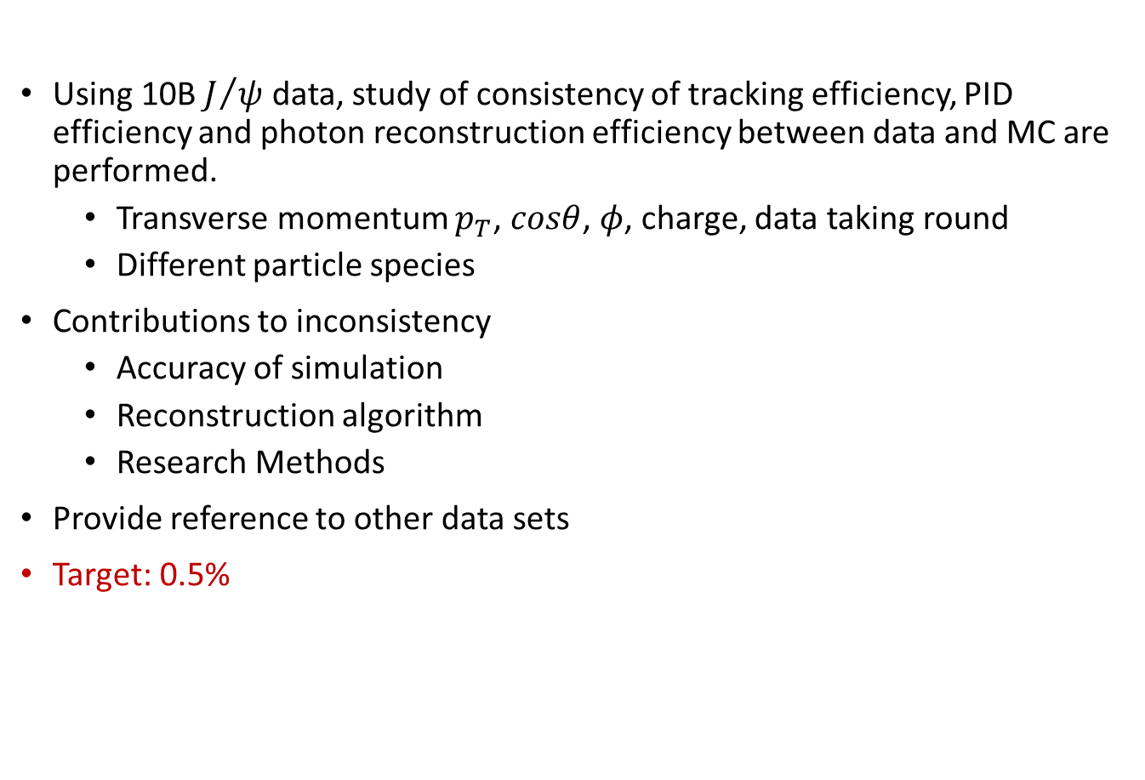
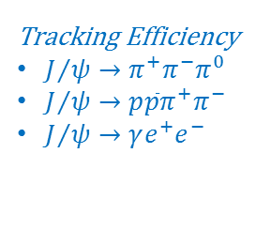
Systematic Error Study
Using 10B $J/ψ$ data, study of consistency of tracking efficiency, PID efficiency and photon reconstruction efficiency between data and MC are performed.
  Transverse momentum $p_{T}$, $cosθ$, $φ$, charge, data taking round
  Different particle species
Contributions to inconsistency
  Accuracy of simulation
  Reconstruction algorithm
  Research Methods
Provide reference to other data sets
Target: 0.5%
Tracking Efficiency
$J/ψ→π^{+}π^{−}π^{0}$
$J/ψ→p\overline{p}π^{+}π^{−}$
$J/ψ→γe^{+}e^{−}$
$$0.9<|cosθ|<0.92$$
$$\left|cosθ\right|>0.92$$

Slide 18
Application of Advanced Technology
Machine learning and deep learning to improve the performance of BESIII software
High statistic data sample is a dedicated advantage of high energy physics experiment
Take advantage of advanced technology to solve the problems of complicated correlation
dE/dx simulation
  Potential to achieve a perfect result
  Less steps compared with conventional method
Charged track reconstruction
  Noise rejection
  Track finding
Particle identification
  Combine information of all sub-detector
  Pure data sample is the key point

Slide 19
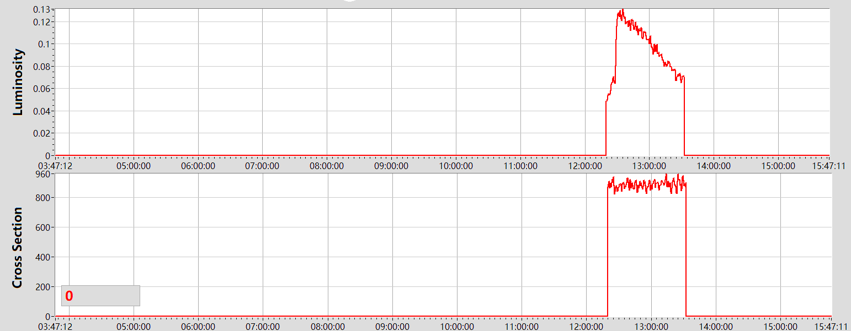
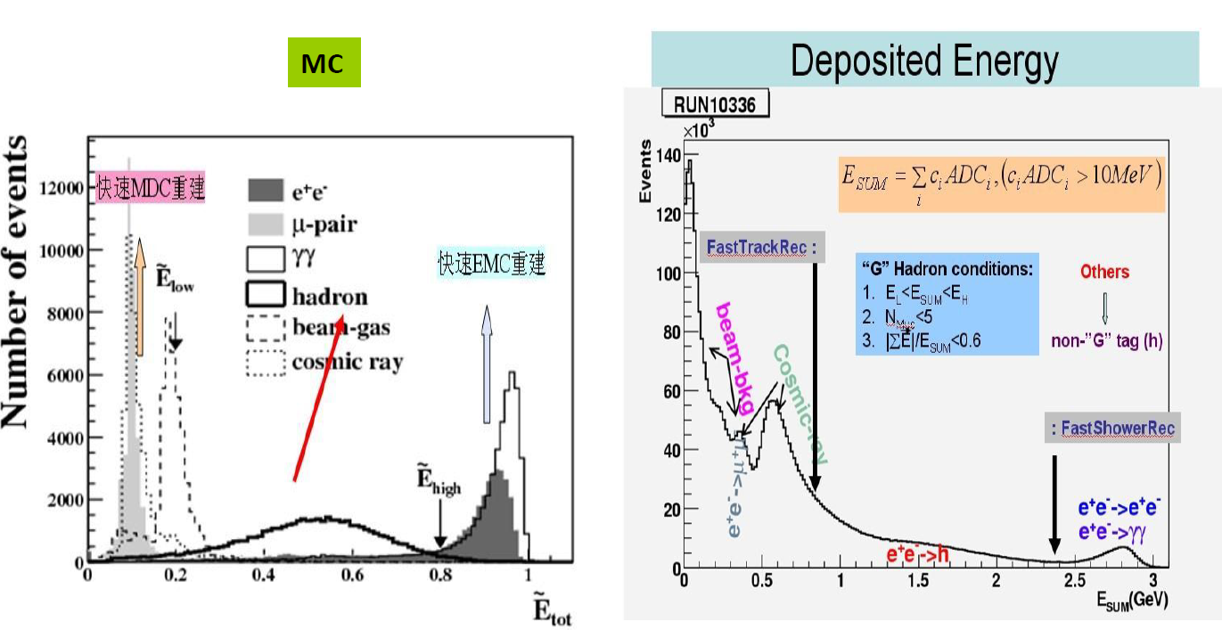
Online Event Filter
Important sub-system running on DAQ computer cluster
  Online data taking status monitoring: luminosity, hadron cross section
  Offline calibration sample
  A fast ( <5ms/event ) feedback without full event reconstruction
Typical event selection criteria
  EMC energy deposition: normalized at different energy points
  Fast reconstruction of charged tracks
Challenge and Plan
  Study of efficiency and cross section of QED processes (>5GeV)
  Optimize algorithms based on the status of background
  Real time monitoring, and tuning event selection criteria
Luminosity
Cross Section

Slide 20

BESIII Offline Software System (BOSS)
Underlying framework: GAUDI
Simulation: GEANT4
Other external libs: CERNLIB, CLHEP, ROOT, XercesC, GDML, ……
DataBase: MySQL
Software configuration management: CMT and CVS
Computer language: C++
Operation system: SL $→$ CentOS
Part of them stopped updating and maintaining.
Upgrade is NECESSARY for next 10 years.
Speed of Data Processing 1 time faster
Detector Upgrade
TopUp Pattern
Year | 2009 | 2010 | 2011 | 2012 | 2013 | 2014 | 2015 | 2016 | 2017 | 2018 | 2019 | 2020
BOSS 版本 | 6.5.1 | 6.5.2 6.5.3 6.5.4 6.5.5 | 6.6.0 6.6.1 | 6.6.2 | 6.6.3 6.6.4 6.6.4.p01 | 6.6.4.p03 | 6.6.5 7.0.0 | 7.0.1 7.0.2 | 7.0.3 | 7.0.4 | 7.0.5 7.0.3-g10 | 7.0.6
操作系统 | SL4 | SL5 | SL5 64-bit |  |  |  | SL6 |  |  |  | SL6 | SL7?
Gaudi | v19r4 |  | v21r6 |  |  |  | v23r9 |  |  |  | v27r1
Geant4 | 9.0 | 9.3 |  |  |  |  |  |  |  |  | 10.4
ROOT | 5.14 |  | 5.24 |  |  |  | 5.34 |  |  |  | 6.06

Slide 21
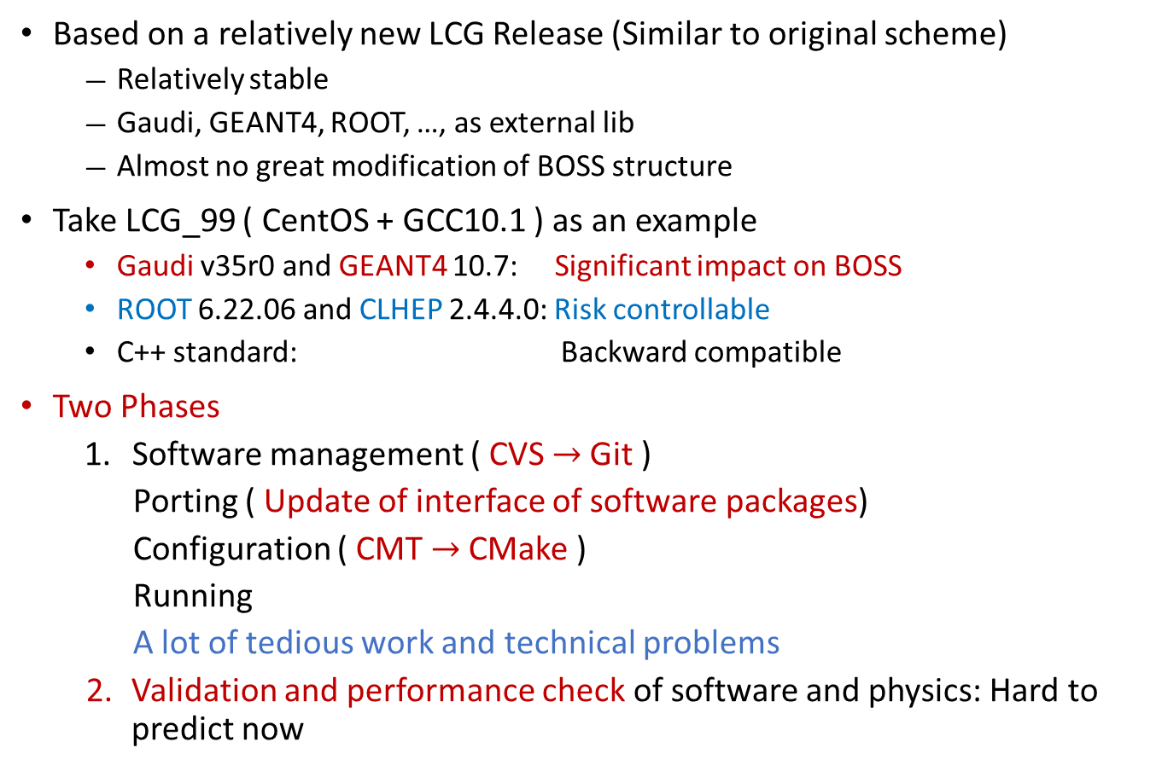
Proposal of BOSS Upgrade
Based on a relatively new LCG Release (Similar to original scheme)
  Relatively stable
  Gaudi, GEANT4, ROOT, …, as external lib
  Almost no great modification of BOSS structure
Take LCG_99 ( CentOS + GCC10.1 ) as an example
  Gaudi v35r0 and GEANT4 10.7: Significant impact on BOSS
  ROOT 6.22.06 and CLHEP 2.4.4.0: Risk controllable
  C++ standard: Backward compatible
Two Phases
  Software management ( CVS$→$ Git )
  Porting ( Update of interface of software packages)
  Configuration ( CMT $→$ CMake )
  Running
  A lot of tedious work and technical problems
  Validation and performance check of software and physics: Hard to predict now

Slide 22
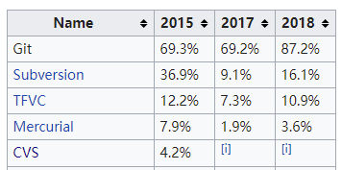
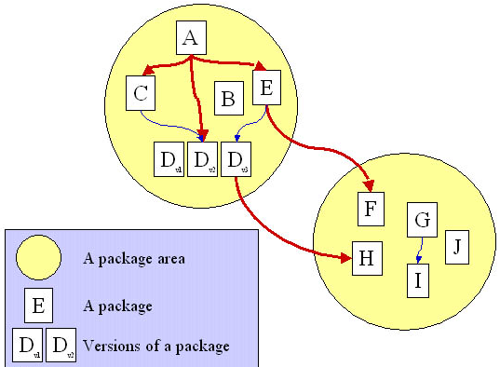
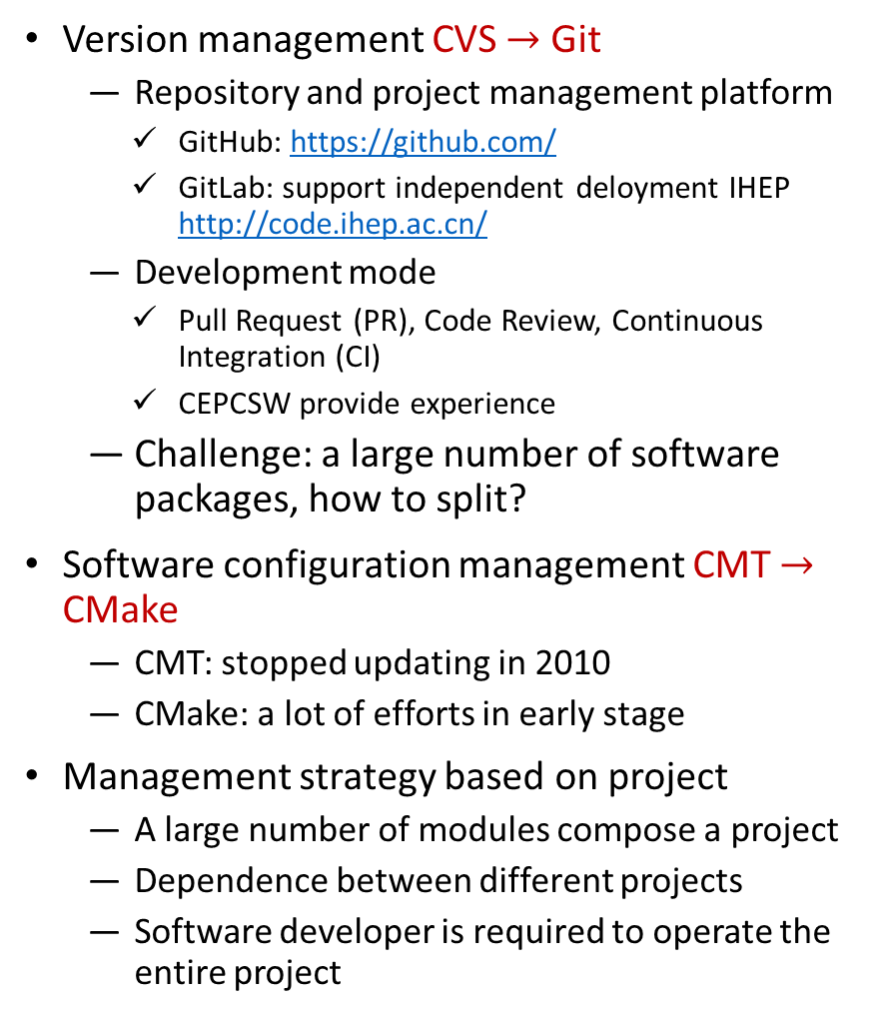
Proposal of BOSS Upgrade
Version management CVS $→$ Git
  Repository and project management platform
    GitHub: https://github.com/
    GitLab: support independent deloyment IHEP http://code.ihep.ac.cn/
  Development mode
    Pull Request (PR), Code Review, Continuous Integration (CI)
    CEPCSW provide experience
  Challenge: a large number of software packages, how to split?
Software configuration management CMT $→$ CMake
  CMT: stopped updating in 2010
  CMake: a lot of efforts in early stage
Management strategy based on project
  A large number of modules compose a project
  Dependence between different projects
  Software developer is required to operate the entire project
X
D
X
Project
A module
No version to modules

Slide 23
Requirement of Computing and Storage
Storage (actual available space)
  Raw Data: 2021-2024: 150TB/y; 2025-2030: 450TB/y
  DST Data: ratio of DST vs raw data is 1:2
  MC sample: ratio of MC and raw data is 1:1
  Analyses: 6 physics group and 1 software group, 200TB/group, 100TB/group/3 years
Computing
  2009-2019: data reconstruction and MC simulation: 3000 CPU cores/half year; physics analyses requires 6.7 times
  2021-2024: +1000 CPU cores/ year
  2025-2030: +2000 CPU cores/year

Slide 24
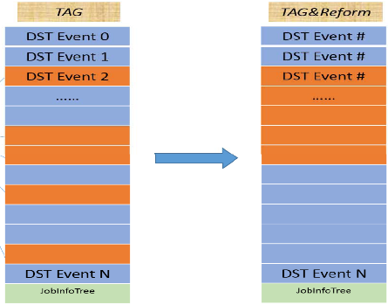
Improvement of Analyses Speed
For specific decay modes of physics analyses, most events in DST file could be excluded through very simple selection criteria, such as number of good charge track, tag of charm mason or baryon
In current physics analyses strategy, frequent disk access is the bottleneck block the improvement of analyses speed
This issue will become more serious with increasing of statistic of data sets.
Event tag provide a solution to access basic features of event without disk access
Tag-based analyses have been proved to accelate the physics analyses speed 20% -- 95%
Challenge:
  Selection of event features to satisfy each user’s requirement
  Drive users’ acceptance

Slide 25
Summary and Plan
Towards High Statistic, High Energy; High Noise/Background
Stable Operation of Detector and Software, High Efficiency and Precise Resolution, Accurate Simulation and Computing resource Utilization
➔ Correctness, Precision and Speediness of Physics Output
Current result of estimation of aging effect is acceptable, no ability to predict emergency situation.
Noise and background have serious impact on efficiency and resolution for each sub-detector, optimization of reconstruction algorithms are very important to achieve accurate physics results.
Software development and cosmic ray data analyses for CGEM-IT is in good progress.
Significant progress of systematic errors study, more efforts are expected to achieve systematic errors of tracking and PID 0.5%
Upgrade of BOSS has a high priority for stable operation in next 10 years.
  A complicated system project
  Program evaluation, Review and Implementation
Optimization and update of online event filter and online data quality monitoring.
An estimation of requirement of computing and storage for BEPC3 era.
Enhance cooperation
Thank you!

