Slide 1
Status from the LDT simulation
Ryuta
03/22/2021

Slide 2
Geometry Setting
・Barrel part : “default”
unless specified.
・Z max value
-- Coverage (of barrel part) ~ 80%
Using a formula:
Ω[sr] = 2π(1-cos(θ))
solid angle of a cone with half-angle θ
Ω/4π = (100-80%)/2 → cos(θ)=0.8 → Zmax=1800mm/tan(θ) = 2400 mm
・Radiation length value input
-- Change to 0.00001752 (X/X0/cm) for He:C3H8=6:4, as discussed during last Friday’s discussion

Slide 3
Momentum resolution
・R1.8m:
-- Change the R_{min}-R_{max} of DCH, while the others including SITs settings are kept the same. (I)
-- Change the R_{min}-R_{max} of SIT, with DCH (R_{min =} 900 mm, R_{max} = 1800mm ) (II)
-- Change the R_{min}-R_{max} of SIT/DCH (III)
・R1.8m <-> R1.5m
-- for R1.5m, DCH: 300-1500mm, 10cm cell size, 120layers. SET position is also shifted as well. (IV)

Slide 4
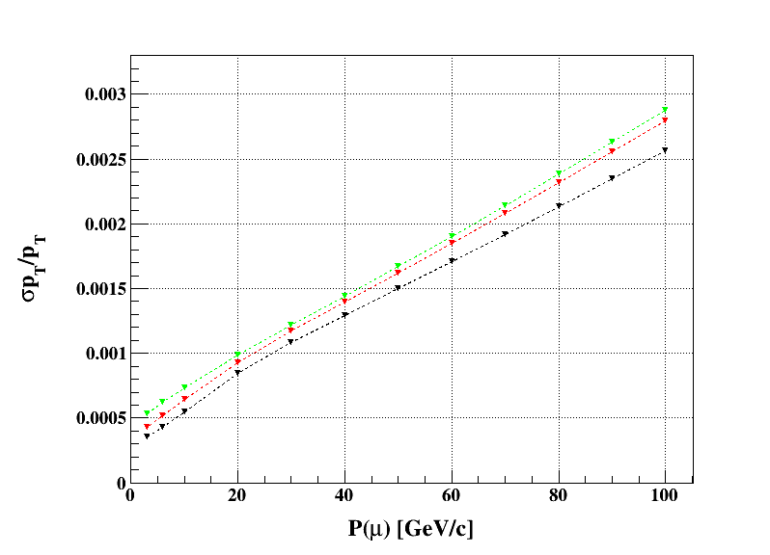
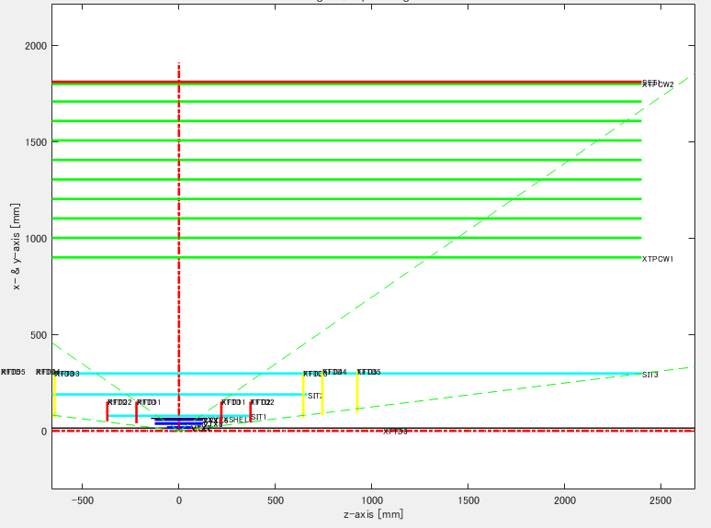
Momentum resolution (I)
-- Only change the range of DCH
 | DCH R
Black | 300-1800 mm
Red | 600-1800
Breen | 900-1800

Slide 5
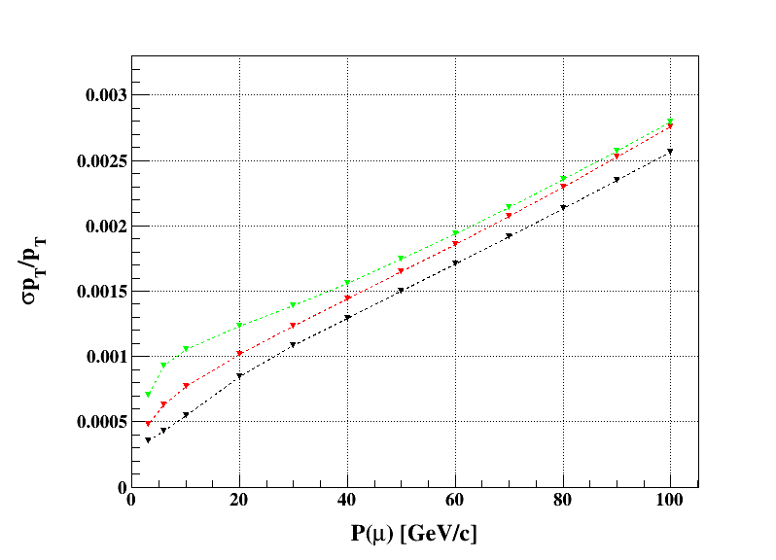
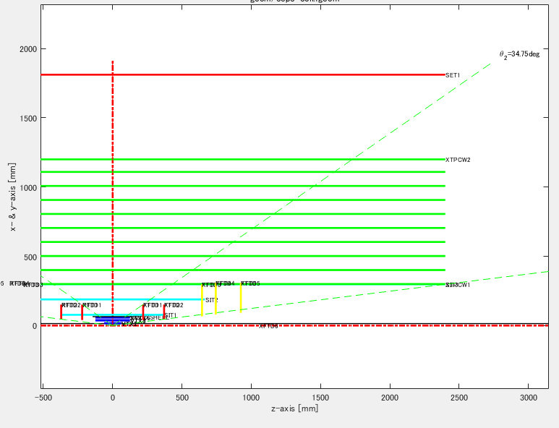
Momentum resolution (I’)
-- Only change the range of DCH
but cut from the outer side
 | DCH R
Black | 300-1800 mm
Red | 300-1500
Breen | 300-1200

Slide 6
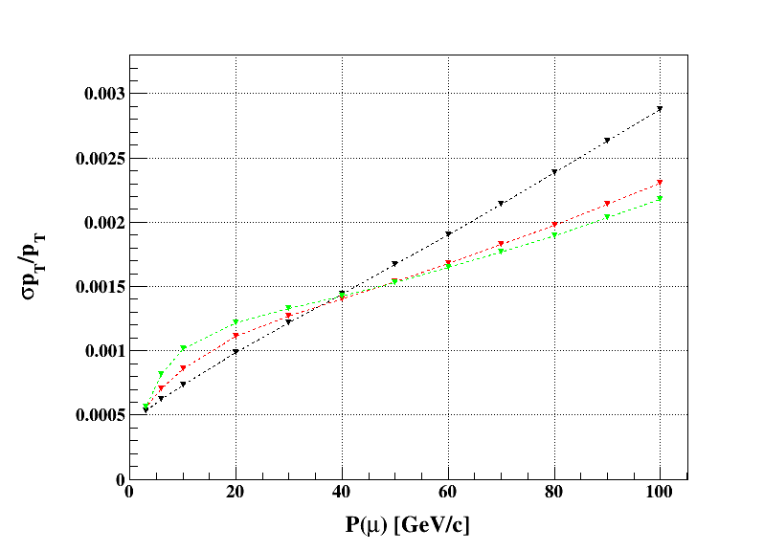
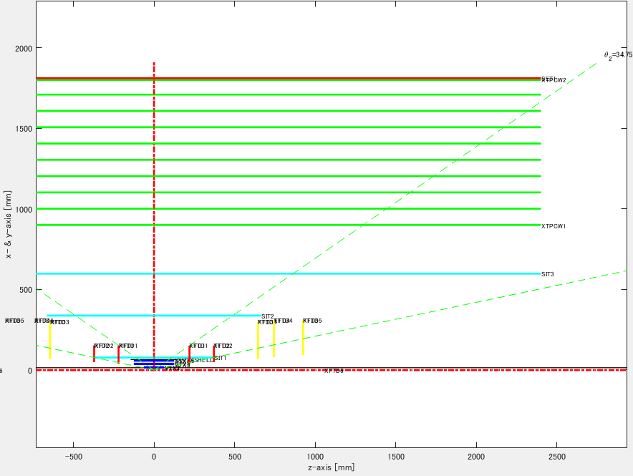
Momentum resolution (II)
-- Keep R_{min} of DCH as 900mm
-- Change the range of SITs
 | SIT R
Black | 78-298 mm
Red | 78-598
Breen | 300-898

Slide 7
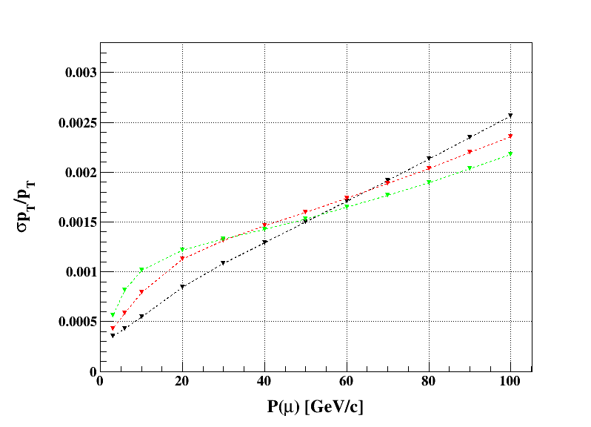
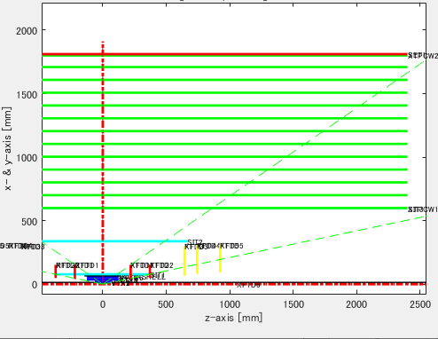
Momentum resolution (III)
-- Change both of SIT/DCH
 | SIT R
Black | 78-298 mm, DCH:300-1800
Red | 78-598, DCH:600-1800
Breen | 300-898, DCH:900-1800

Slide 8
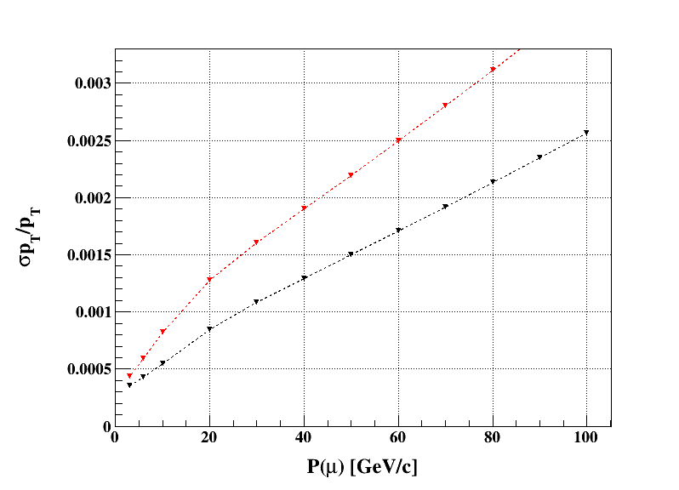
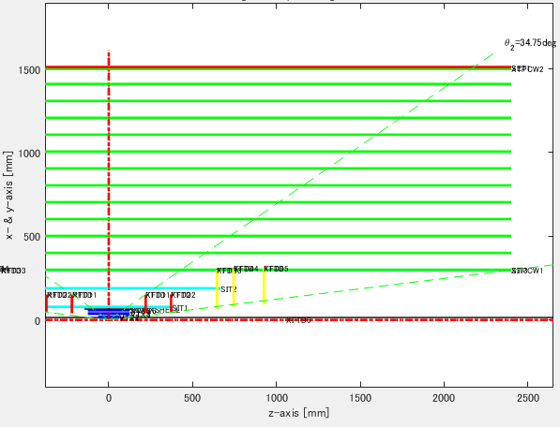
Momentum resolution (IV)
-- Change to R=1500mm
R=1500mm
R=1800mm
Would need to check the dependency of SET position, as well as this results.

Slide 9
Next
・ Number of hits layers vs injection angle ( cos(θ) )
・ Comparison of “a”, “b” terms, with different setup (i.e. R1.5m)
・ Something others, such as SET position dependence.
・ Effect of Gas mixture ratio (as shown in last slide by Lizi )

