Slide 1

Opportunities with fundamental neutron physics
童 欣
高能所
中子于粒子物理中的应用

Slide 2
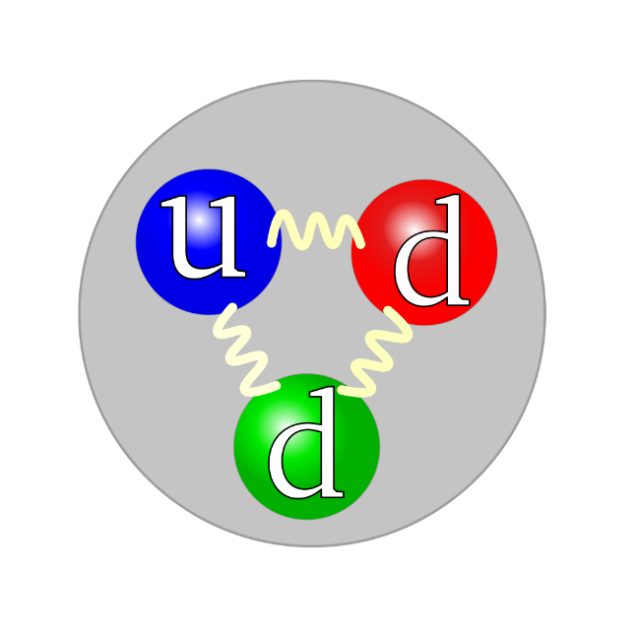
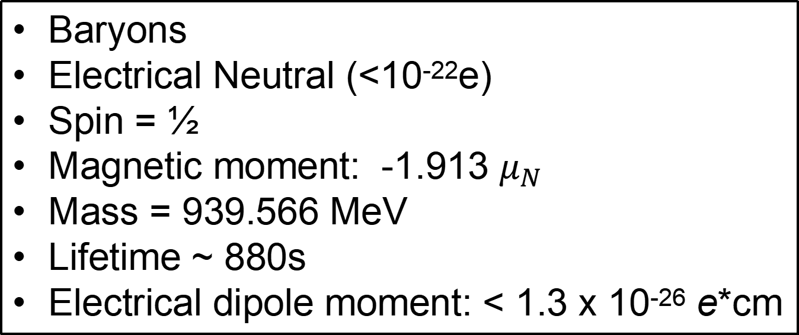
Neutron Properties
Baryons
Electrical Neutral (<10⁻²²e)
Spin = ½
Magnetic moment: -1.913 $μ_{N}$
Mass = 939.566 MeV
Lifetime ~ 880s
Electrical dipole moment: < 1.3 x 10⁻²⁶ e*cm
Difficult to handle, can’t accelerate/guide/focus
Destruction to detect
Low flux
Respond to all four forces, and possibly “fifth” force
Simpler compare to nucleus
Polarization is a unique feature

Slide 3
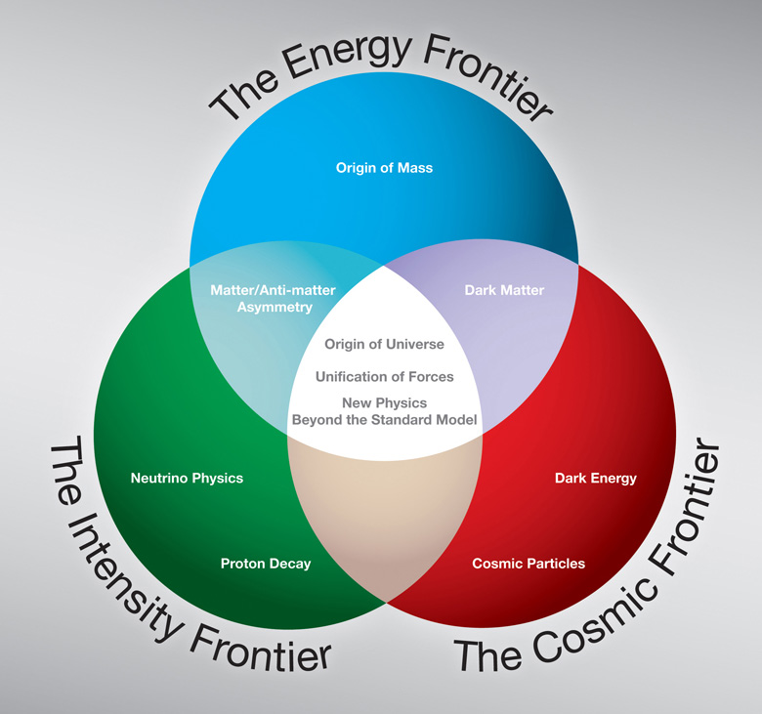
low energy (μeV-meV) neutron experiments

Slide 4
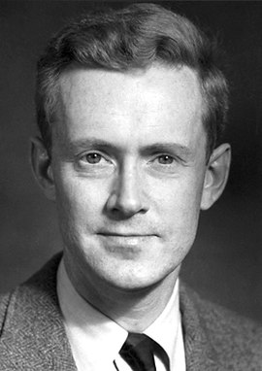
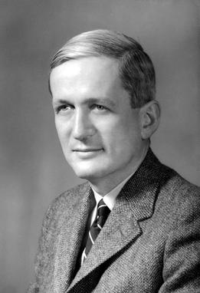
Neutron EDM
CP Violation, Baryogenesis
New Physics
Phys. Rev. Lett. 124, 081803 (2020)
Phys. Rev. Lett. 97, 131801 (2006)
Phys. Rev. 78, 807 (1950)

Slide 5
Neutron Lifetime Puzzle
Big Bang Nucleosynthesis, Fundamental forces inside neutron
Science 360, 6389 (2018)

Slide 6
Gravity
Gravity, quantum effect
Nature 415, 297(2002)

Slide 7
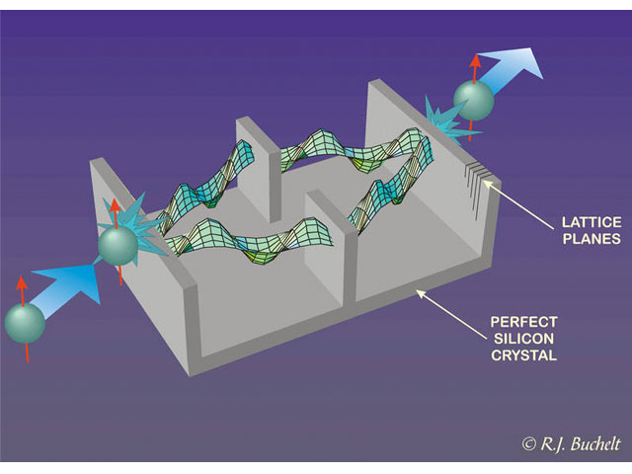
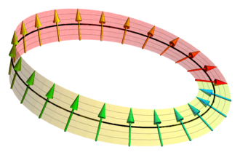
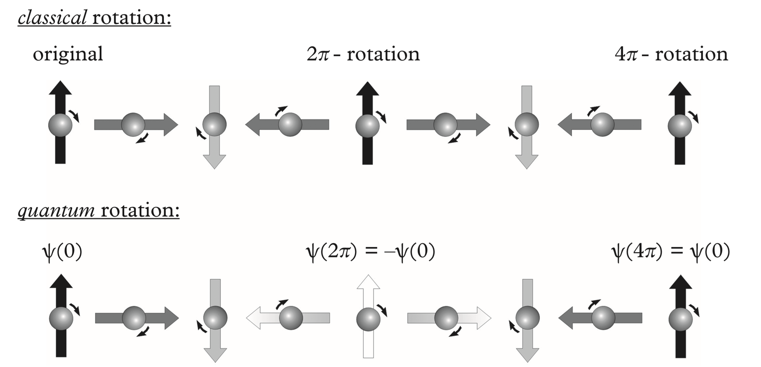
Neutron Entanglement
Quantum effect
Interferometry
H. Rauch, A. Zeilinger, et al, Phys. Lett., 54A, 425 (1975)

Slide 8
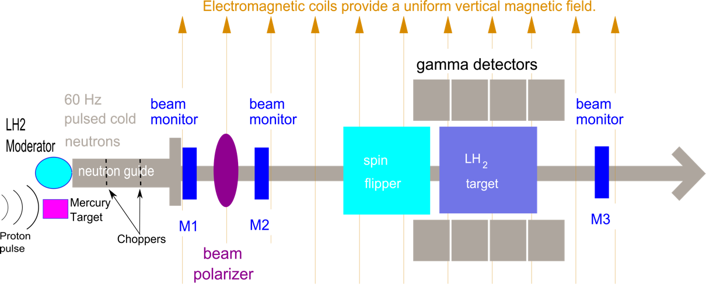
Weak Interaction
Asymmetry, P violation
Phys. Rev. Lett. 121, 242002 (2018)
Phys. Rev. Lett. 125, 131803 (2020)

Slide 9
Polarized neutron Beta decay
Left-right asymetry, neutrino asymmetry
Phys. Rev. Lett. 110, 172502 (2013)
Phys. Rev. Lett. 100, 151801 (2008)
Phys. Rev. Lett. 99, 191803 (2007)

Slide 10
An incomplete list of Fundamental neutron experiments
Neutron interaction with the Earth's gravitational field
Correlations in neutron decays
Limits on neutron charge
Determinations of neutron scattering lengths
Determinations of neutron magnetic moment
Limits on possible new short range interactions
Search of neutron anti-neutron oscillations
Search for other sources of time-reversal violation
Neutron's Weak coupling with nucleons
Search for a non-zero neutron electrical dipole moment
Determination of neutron lifetime
GRAVITY
WEAK INTERACTION
E&M
STRONG INTERACTION
E&M
???
BAU
CPT
WEAK INTERACTION
E&M, CPT
???

Slide 11
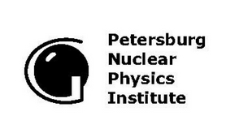

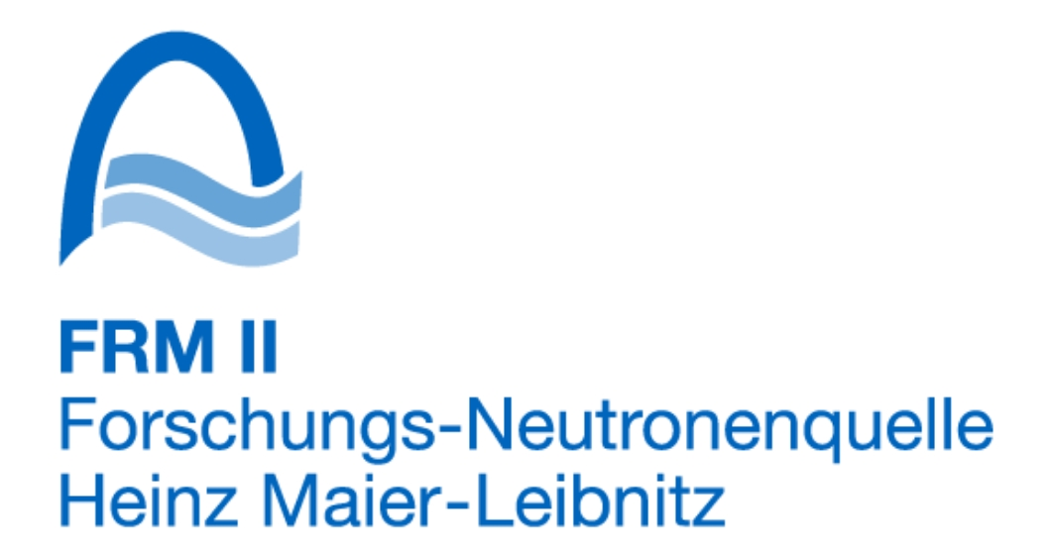
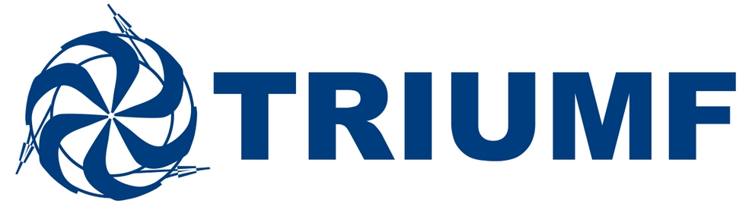
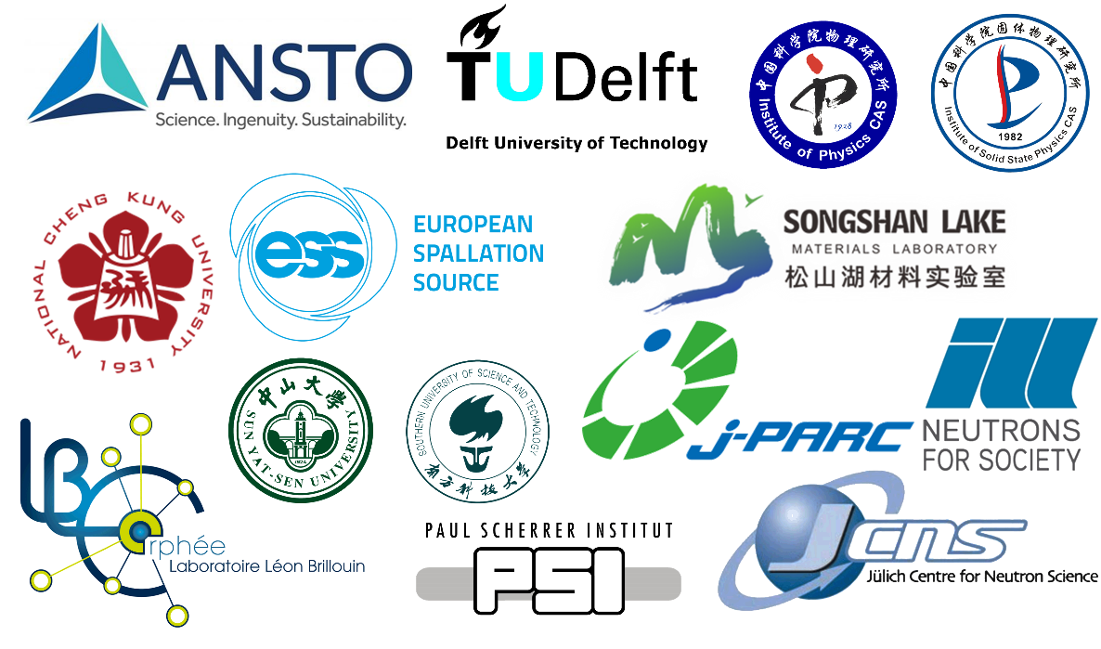
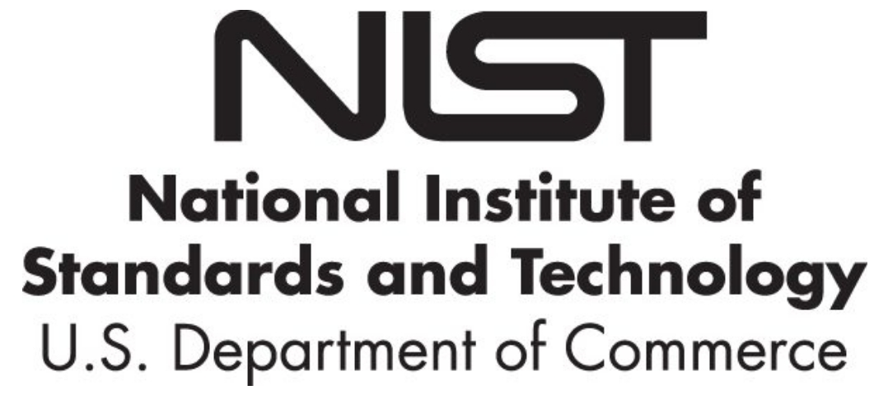
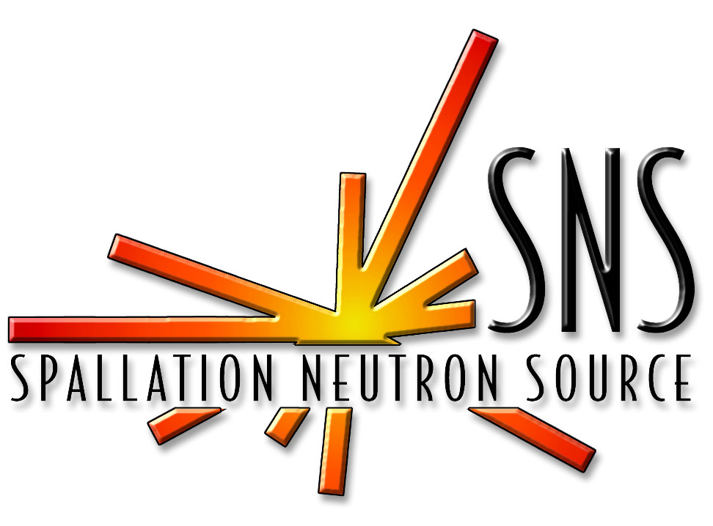

Facilities with fundamental neutron physics
estimated about 300 scientists in the community

Slide 12
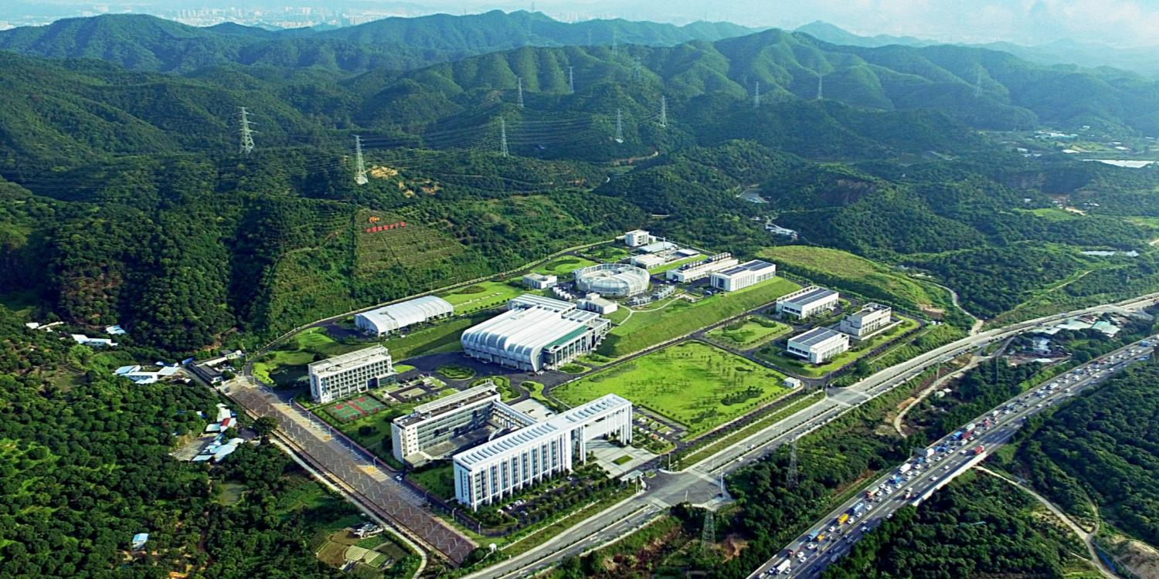
高能所东莞分部--中国散裂中子源--中子工厂
we should exploit its possbilities with particle physics

Slide 13
一个可以在散裂中子源做的粒子物理实验
possible of playing an important role

Slide 14
时间破坏实验 T-violation
CP violation --> T violation

Slide 15
Signal enhancement due to sp state mixing for ¹³⁹La

Slide 16
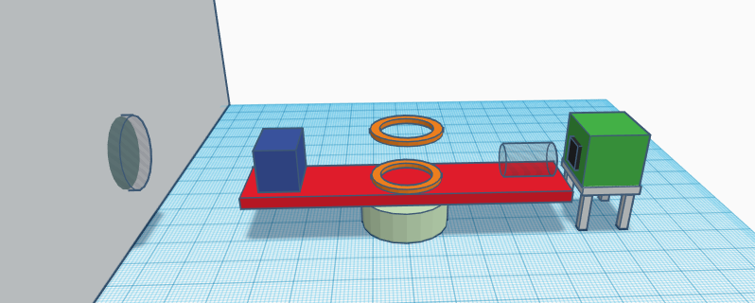
Experiment setup and hurdles，and progress
Polarized Nuclear Target
Current-Mode Detector
极化ev中子束
极化ev中子反转
极化固体/气体靶
中子束流时间
Neutron beam pipe
³He Polarizer
Spin Flipper
Rotation stage
完成了ev中子极化器的基础平台搭建
完成了ev中子翻转器的研制，效率>90%

Slide 17
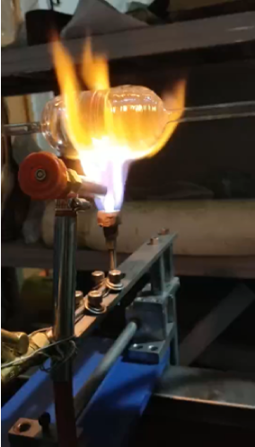
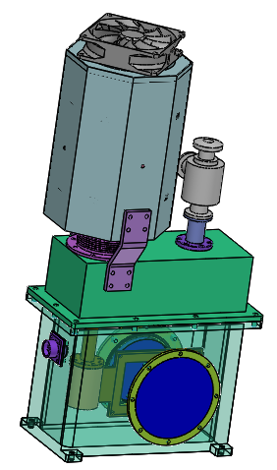
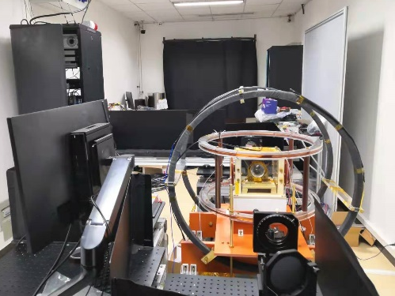
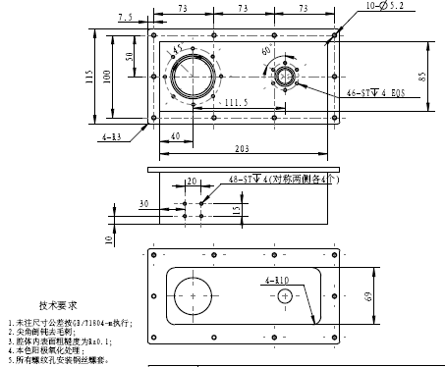
eV neutron polarizer
progress in details
eV neutron flipper
First 3He cell gas filling in China, successful
Highest 3He polarization achieved in China
Polarized neutron test beamline under construction
All techniques read for a 3He-based eV neutron polarizer
YBCO high Tc-SC based eV flipper
Shortest-possible eV flipper, ~10cm along the beam
Construction and tested in neutron beam
>90% flipping efficiency
Notes:
左边的是CSNS关于eV极化器（也就是氦三极化技术）的进展。过去一年，我们完成了国内的首个氦三容器灌制工艺，产生了国内最高的氦三极化率，正在建设一台极化中子测试束线，目前所有的制作eV中子极化器的技术都已经就绪。
右边是我们提出的利用YBCO高温超导薄膜研制的一台普适性极化中子反转器，具有效率高，占地小等优点，目前在研制过程中，预期2020年底可以完成样机测试。我们也针对此中子反转器申请并获批了专利。

Slide 18
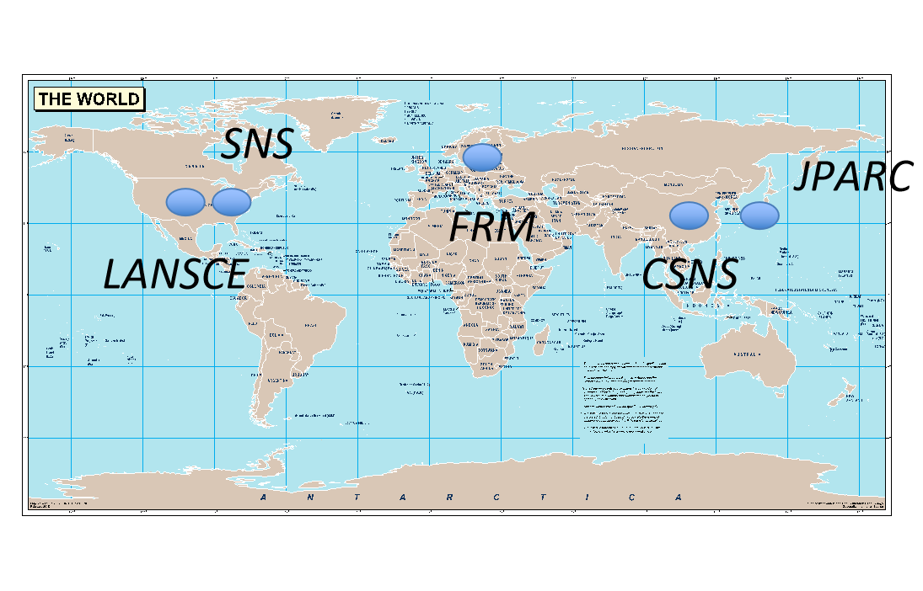
One needs measurements in many different systems
One experiment, 5 sources, different from nEDM experiment (carried out at individual source)
The Neutron OPtics Time Reversal Experiment (NOPTREX) experiment
Now a global collaboration with at least 30 institutions, spanning several neutron sources, aiming for a global proposal to be put together by December 2021
A proposal to build an instrument at JPARC BL07 submitted
Notes:
极化中子入射极化靶的过程中有P violation和T violation的component，但非常小，无法被测量。对于某些特殊的极化靶，例如139La，由于s-wave和p-wave的共振，可以提高这个component4-6个数量级，可以被测量到，其对应的CP violation level比现有的中子EDM测量还要高1-2个数量级。这也是NOPTREX collaboration的起源。
目前，整个collaboration包括美国、日本、欧洲、中国等国家30多个institution，计划的实验将在5个中子源同时进行。这不同于传统的nEDM实验，这将是一个collaborative实验，因为每个地方的数据都需要被整合在一起，对应于不同的T-violation channel。zhe'ye

Slide 19
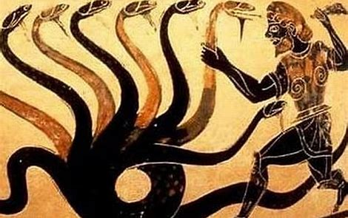
Neutrons for fundamentals
a small research area with a lot of potentials
All kinds of theories on particle physics and cosmology
Neutron physics
experimentalists

