Slide 1


Gravitational Wave Astronomy with the TianQin Observatory
Yi-Ming Hu, TianQin Center@ 21st July, 2021
Amaldi14

Slide 2
Outline
1. TianQin Basics
2. GW Astronomy
3. Progress
4. Summary

Slide 3
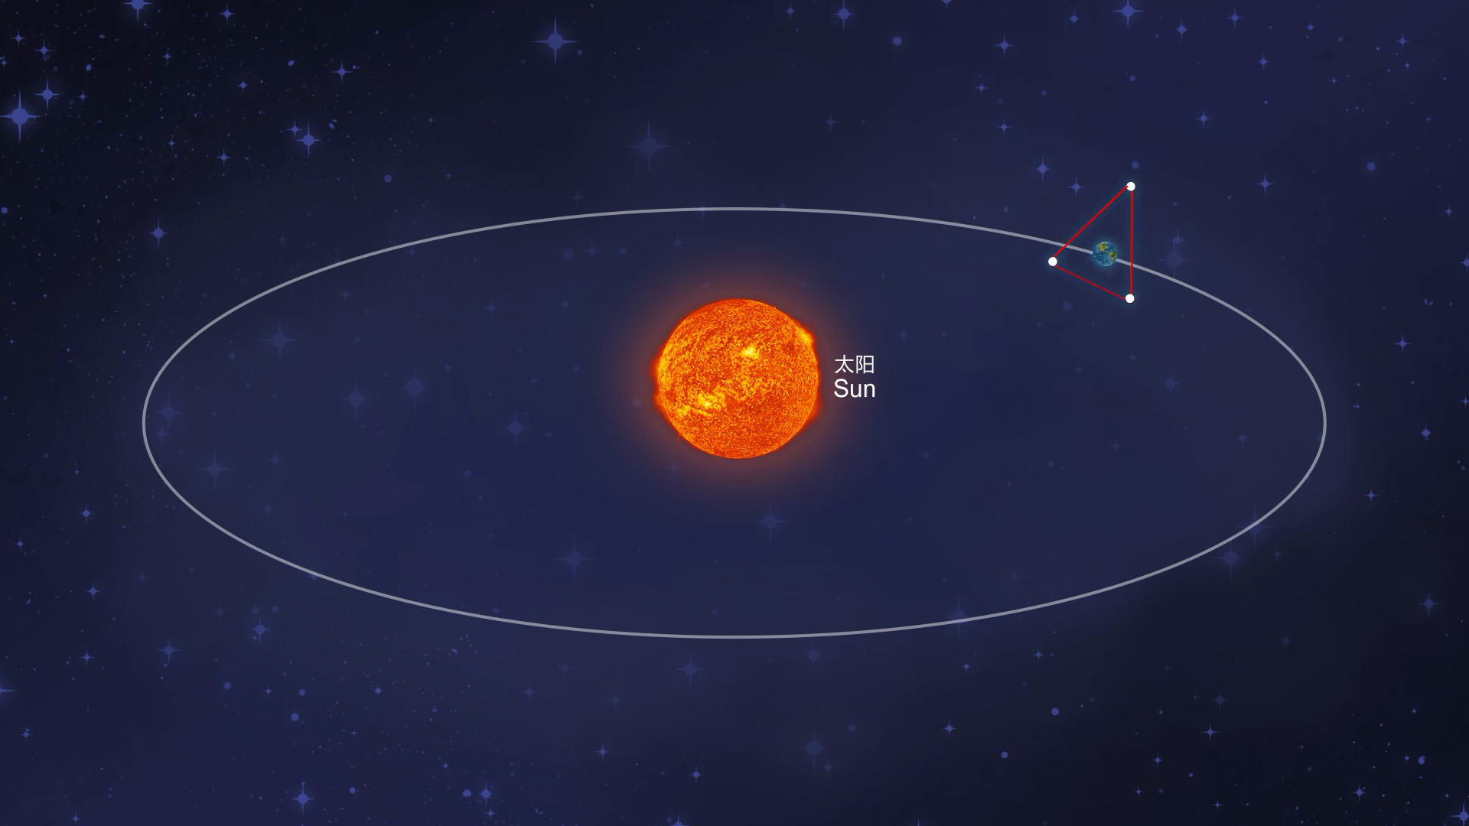
Basic concepts of TianQin
3

Slide 4
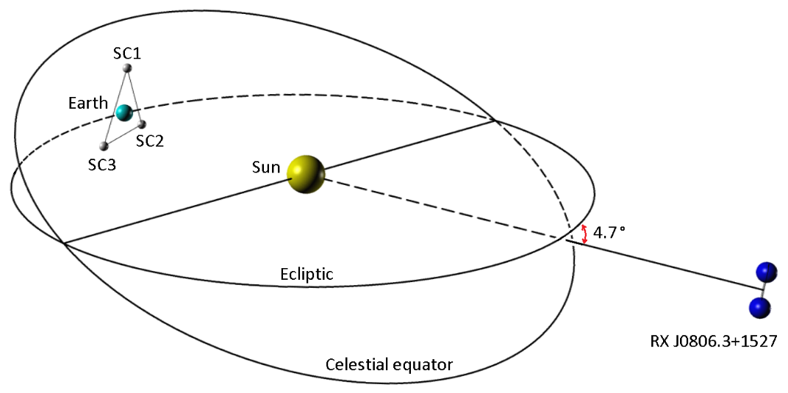
Basic concepts of TianQin
TianQin: a space-borne gravitational wave detector
Luo et al. 2016 CQG, Vol. 33, No. 3, 035010
Principle: laser interferometry
Orbit: Geocentric (Earth-orbiting)
Arm length: L~10⁵km
Luo et al CQG.33 (2016) no.3, 035010

Slide 5
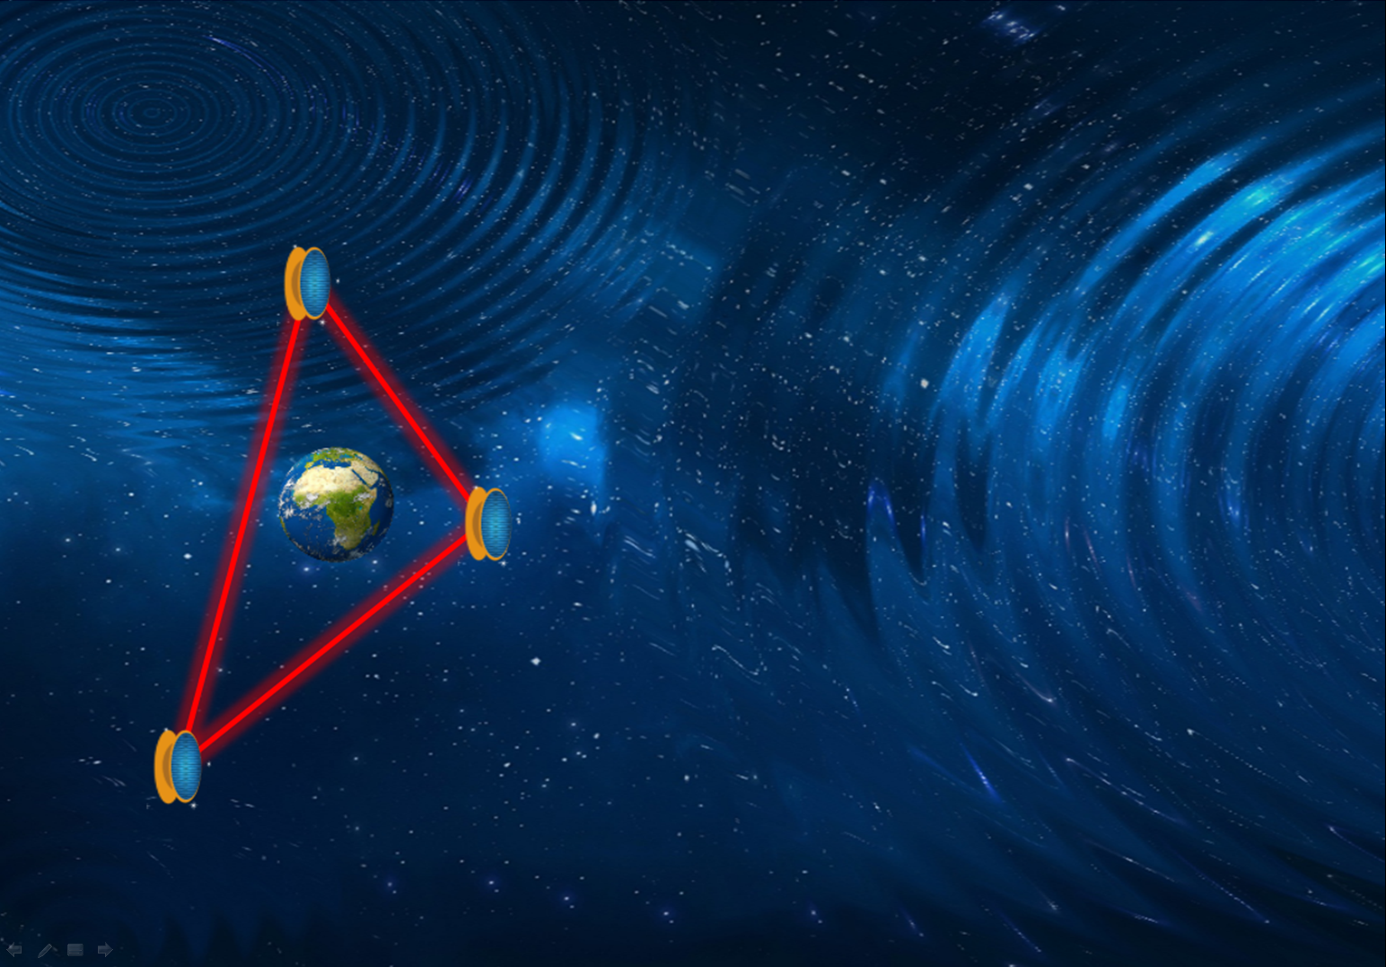
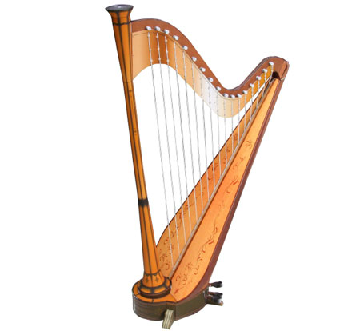
“天琴”TianQin
Tian（天）= Heaven
Qin（琴） = Harp
TianQin (TQ):
a Harp in Heaven that awaits a cosmic pluck of GW

Slide 6
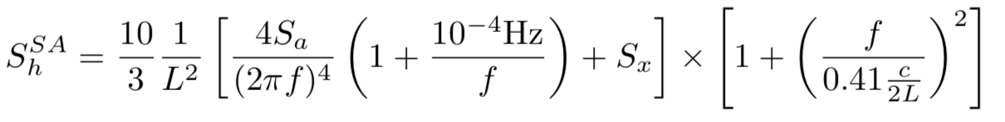
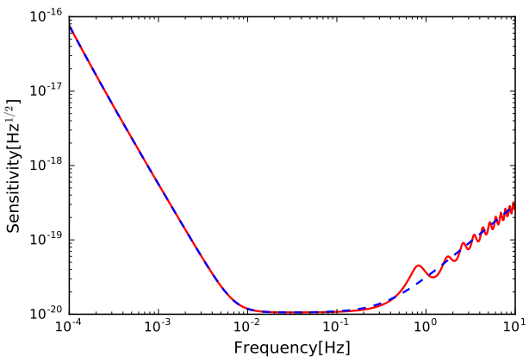


Noise (power spectrum density)
Armlength
Acceleration noise
Positional noise

Slide 7
Overview of TQ science objectives
astronomy, cosmology, and fundamental physics
TQ science objectives
Galactic compact binaries
Coalescence of massive binary BH
Inspiral of stellar mass BH binary
Stochastic background of astronomical origin
Cosmic expansion
Stochastic background of cosmological origin
Testing gravity
Testing BH
Other sources
Astronomy
Cosmology
Fundamental physics
Extreme mass ratio inspiral
Mei et al. PTEP, 2021, 059201

Slide 8
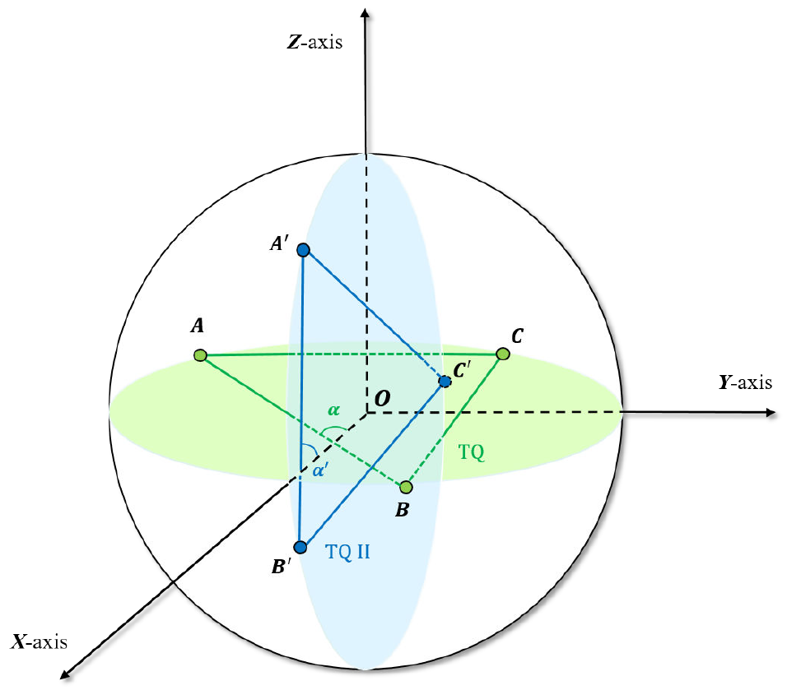
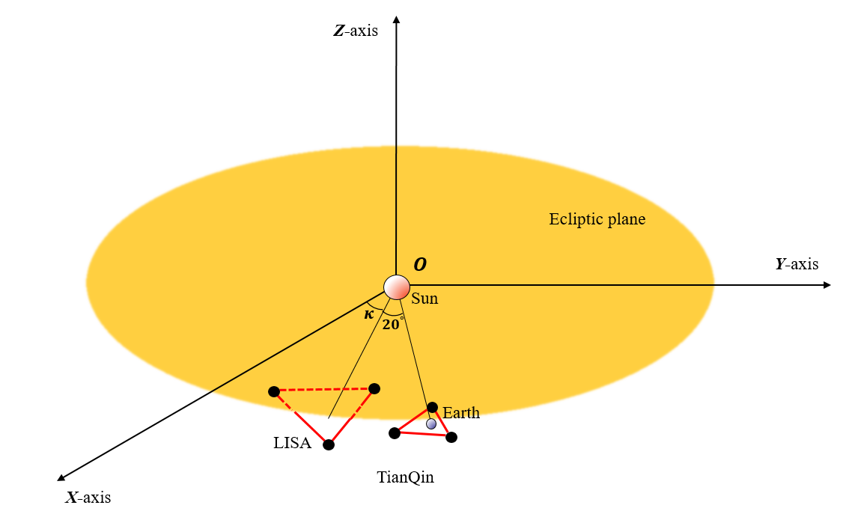
Configurations
Detectors and detector networks
TianQin I+II
TianQin + LISA

Slide 9
Galactic Binaries
Can help understand binary evolution
Different models (population synthesis) all predicts existence of large amount (~108) of compact binaries, dominated by binary white dwarfs

Slide 10
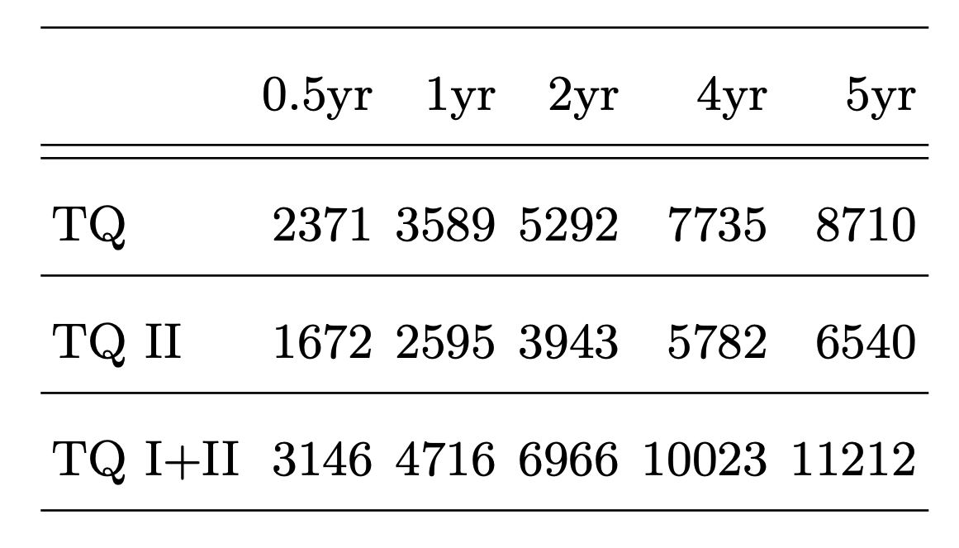
Galactic Binaries
How many?
Observed
Predicted

Slide 11
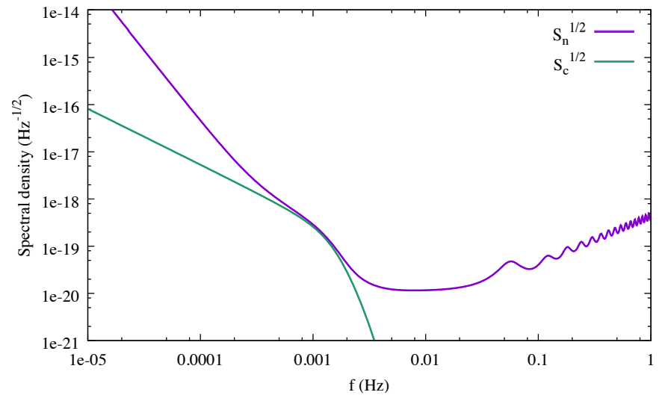

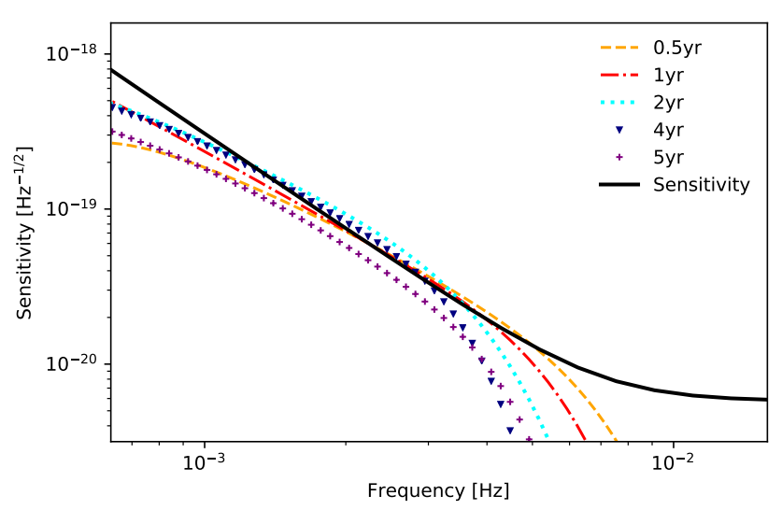
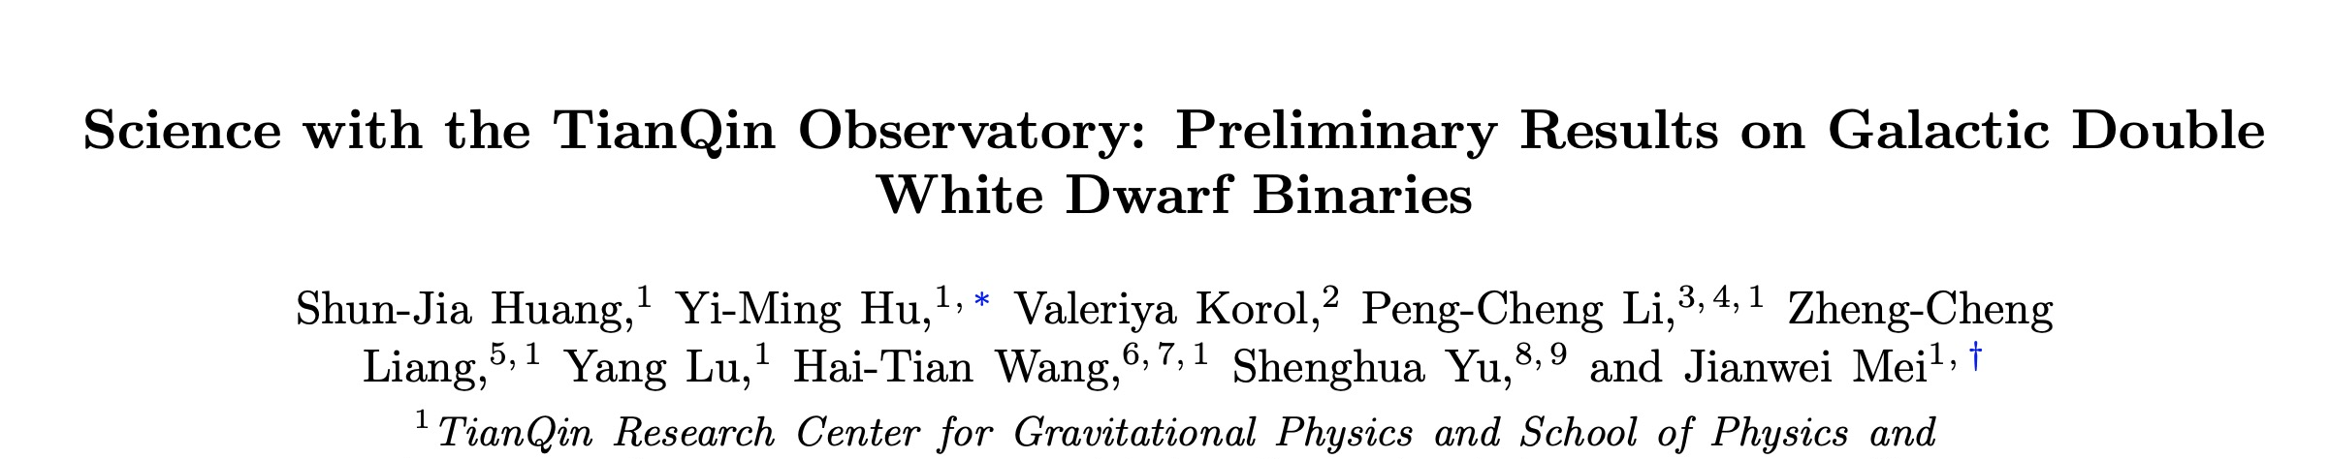
Galactic Binaries
Foreground
At some frequency LISA noise dominated by foreground
TianQin is not influenced
https://arxiv.org/pdf/2005.07889.pdf

Slide 12
Galactic Binaries
Parameter estimation
Can precisely determine parameters
Localize within 1 sq. deg.
Frequency determined to ~10⁻⁸

Slide 13
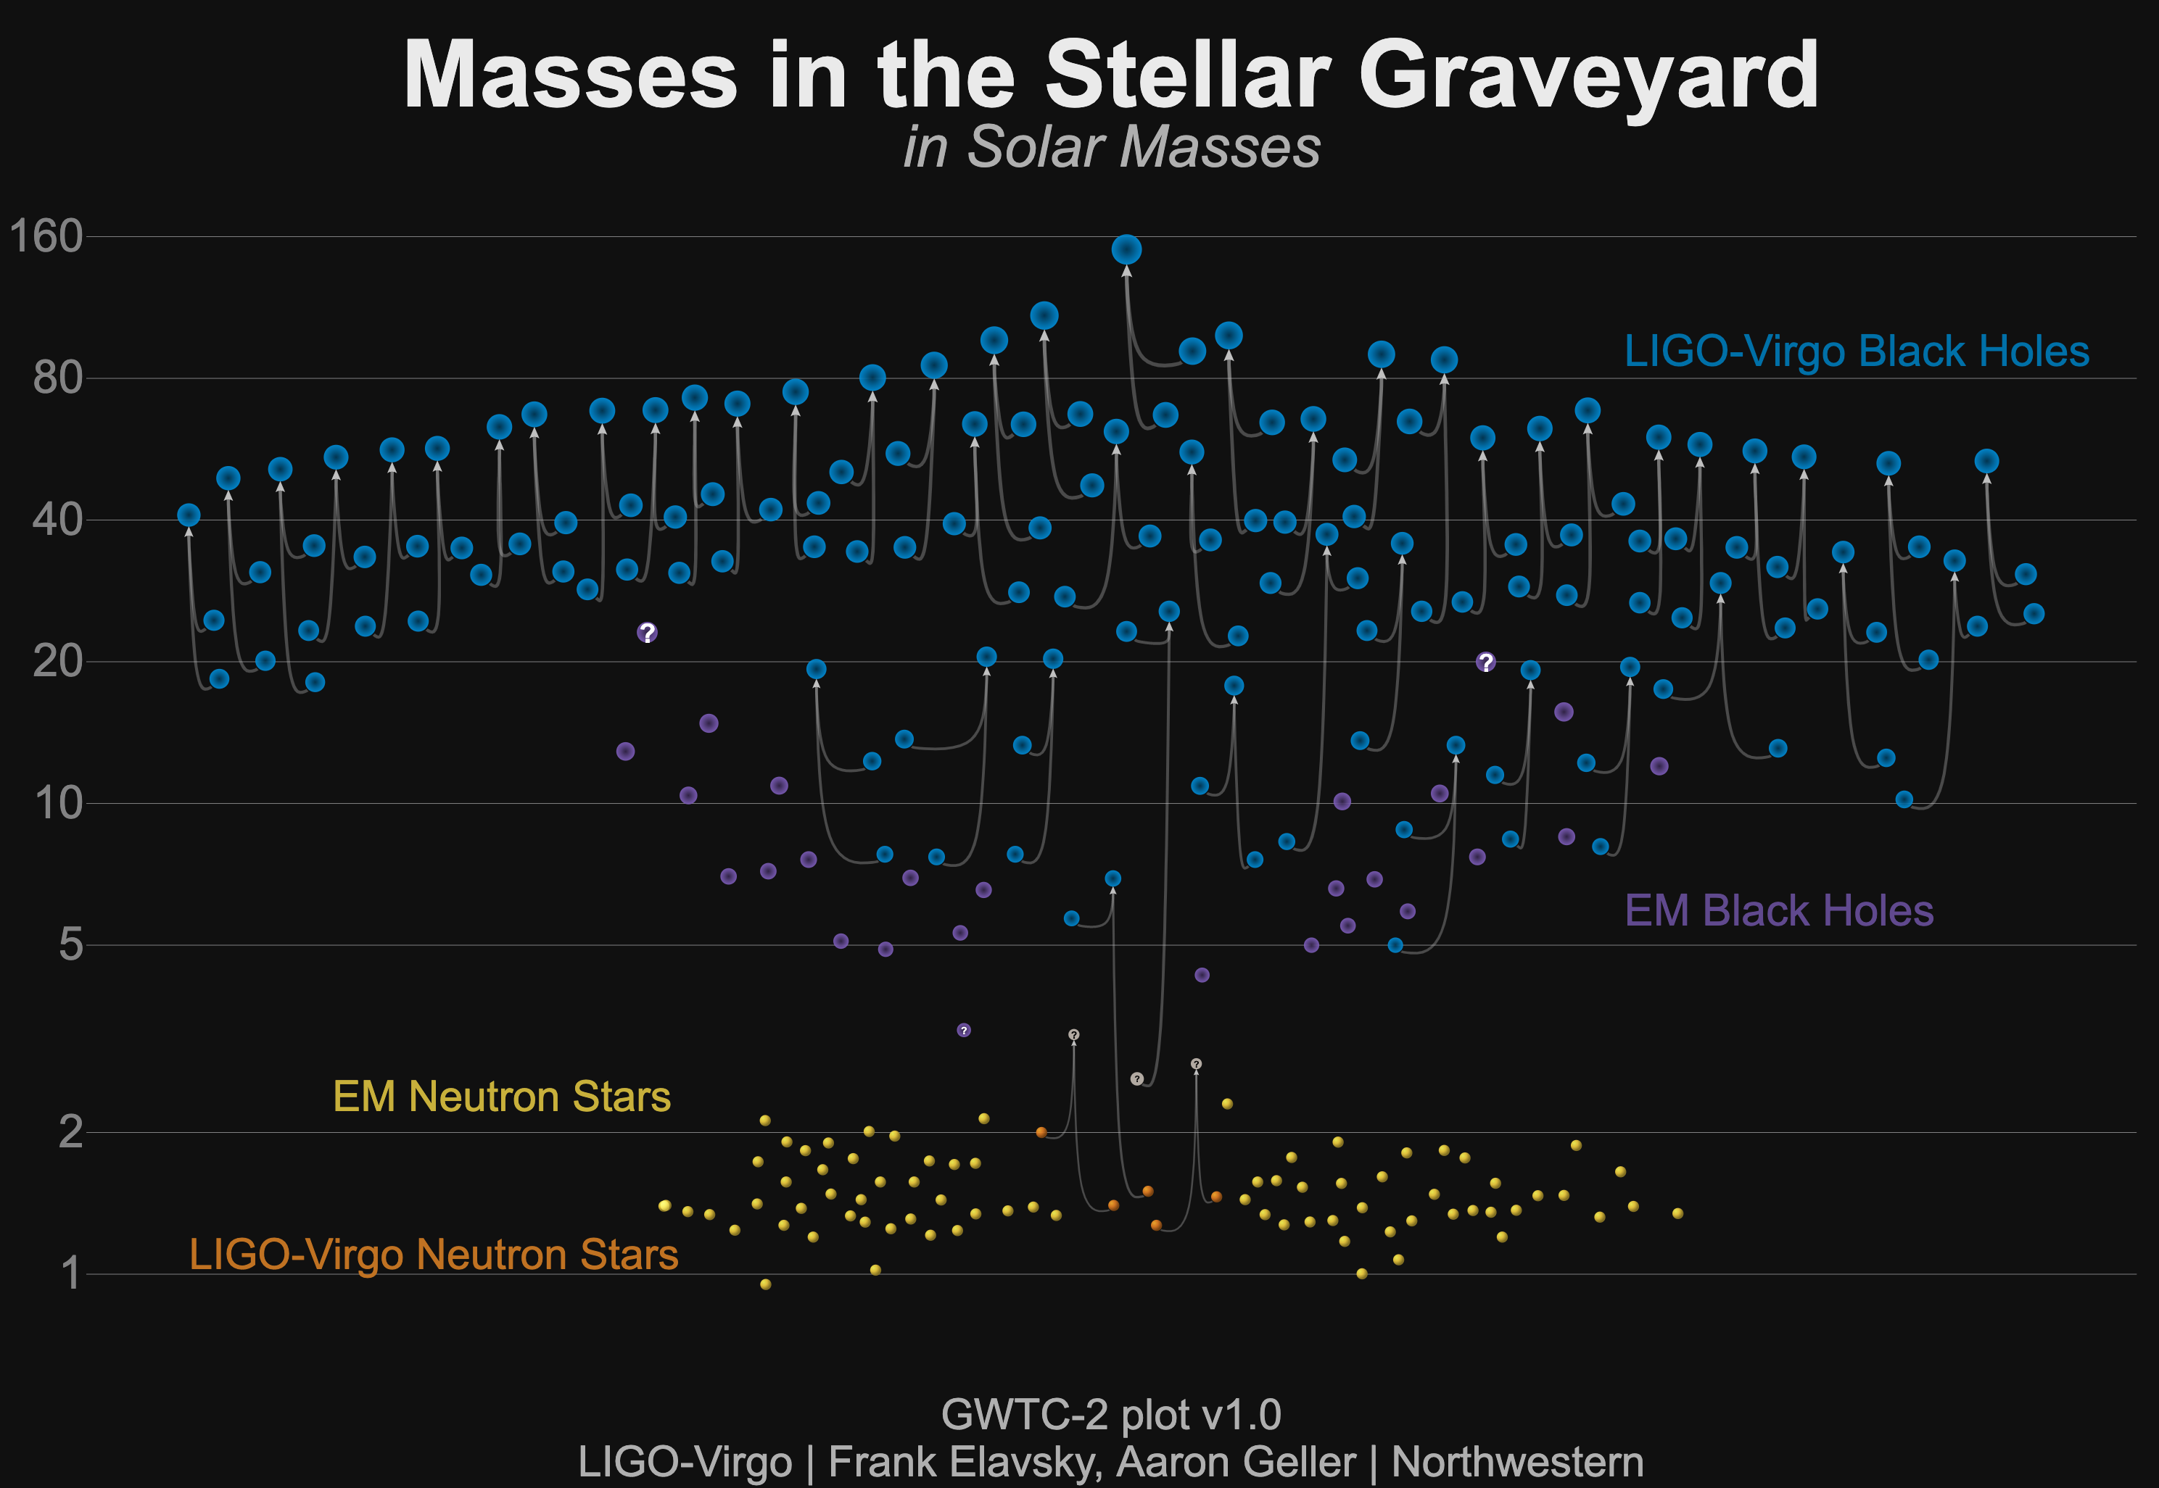
Stellar Mass BBH

Slide 14
Stellar Mass BBH
Multi-band GW astronomy
Can observe the early inspirals of BBHs, forming early warning before merger (plotted as 10 years before merger)
The possibility of multi-band GW observation opens a broad window of applications
Hu, Y.-M., Mei, J. & Luo, J. NSR, 4, 683 (2017)

Slide 15
Stellar Mass BBH
simulated catalogue
Distribution of rate/mass/mass ratio derived using events detected by ground based detectors (LIGO/Virgo)

Slide 16
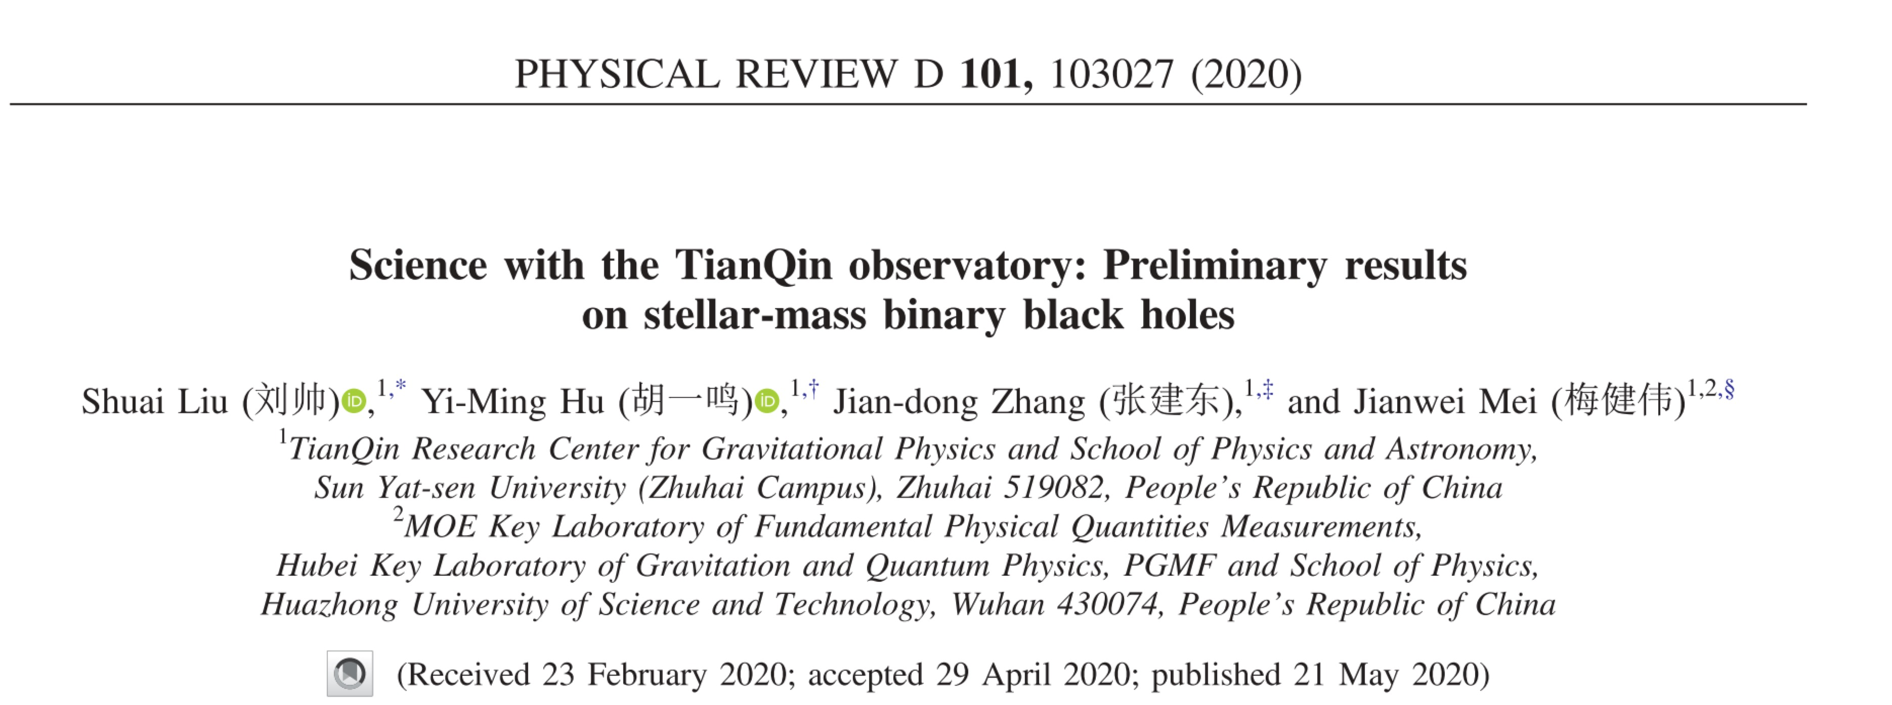

Stellar Mass BBH
detection rate

Slide 17
Stellar Mass BBH
PE precision
Timing <1s
Localisation <1deg²
Chirp mass <10⁻⁷
Mass ratio <0.1%
Distance <20%

Slide 18
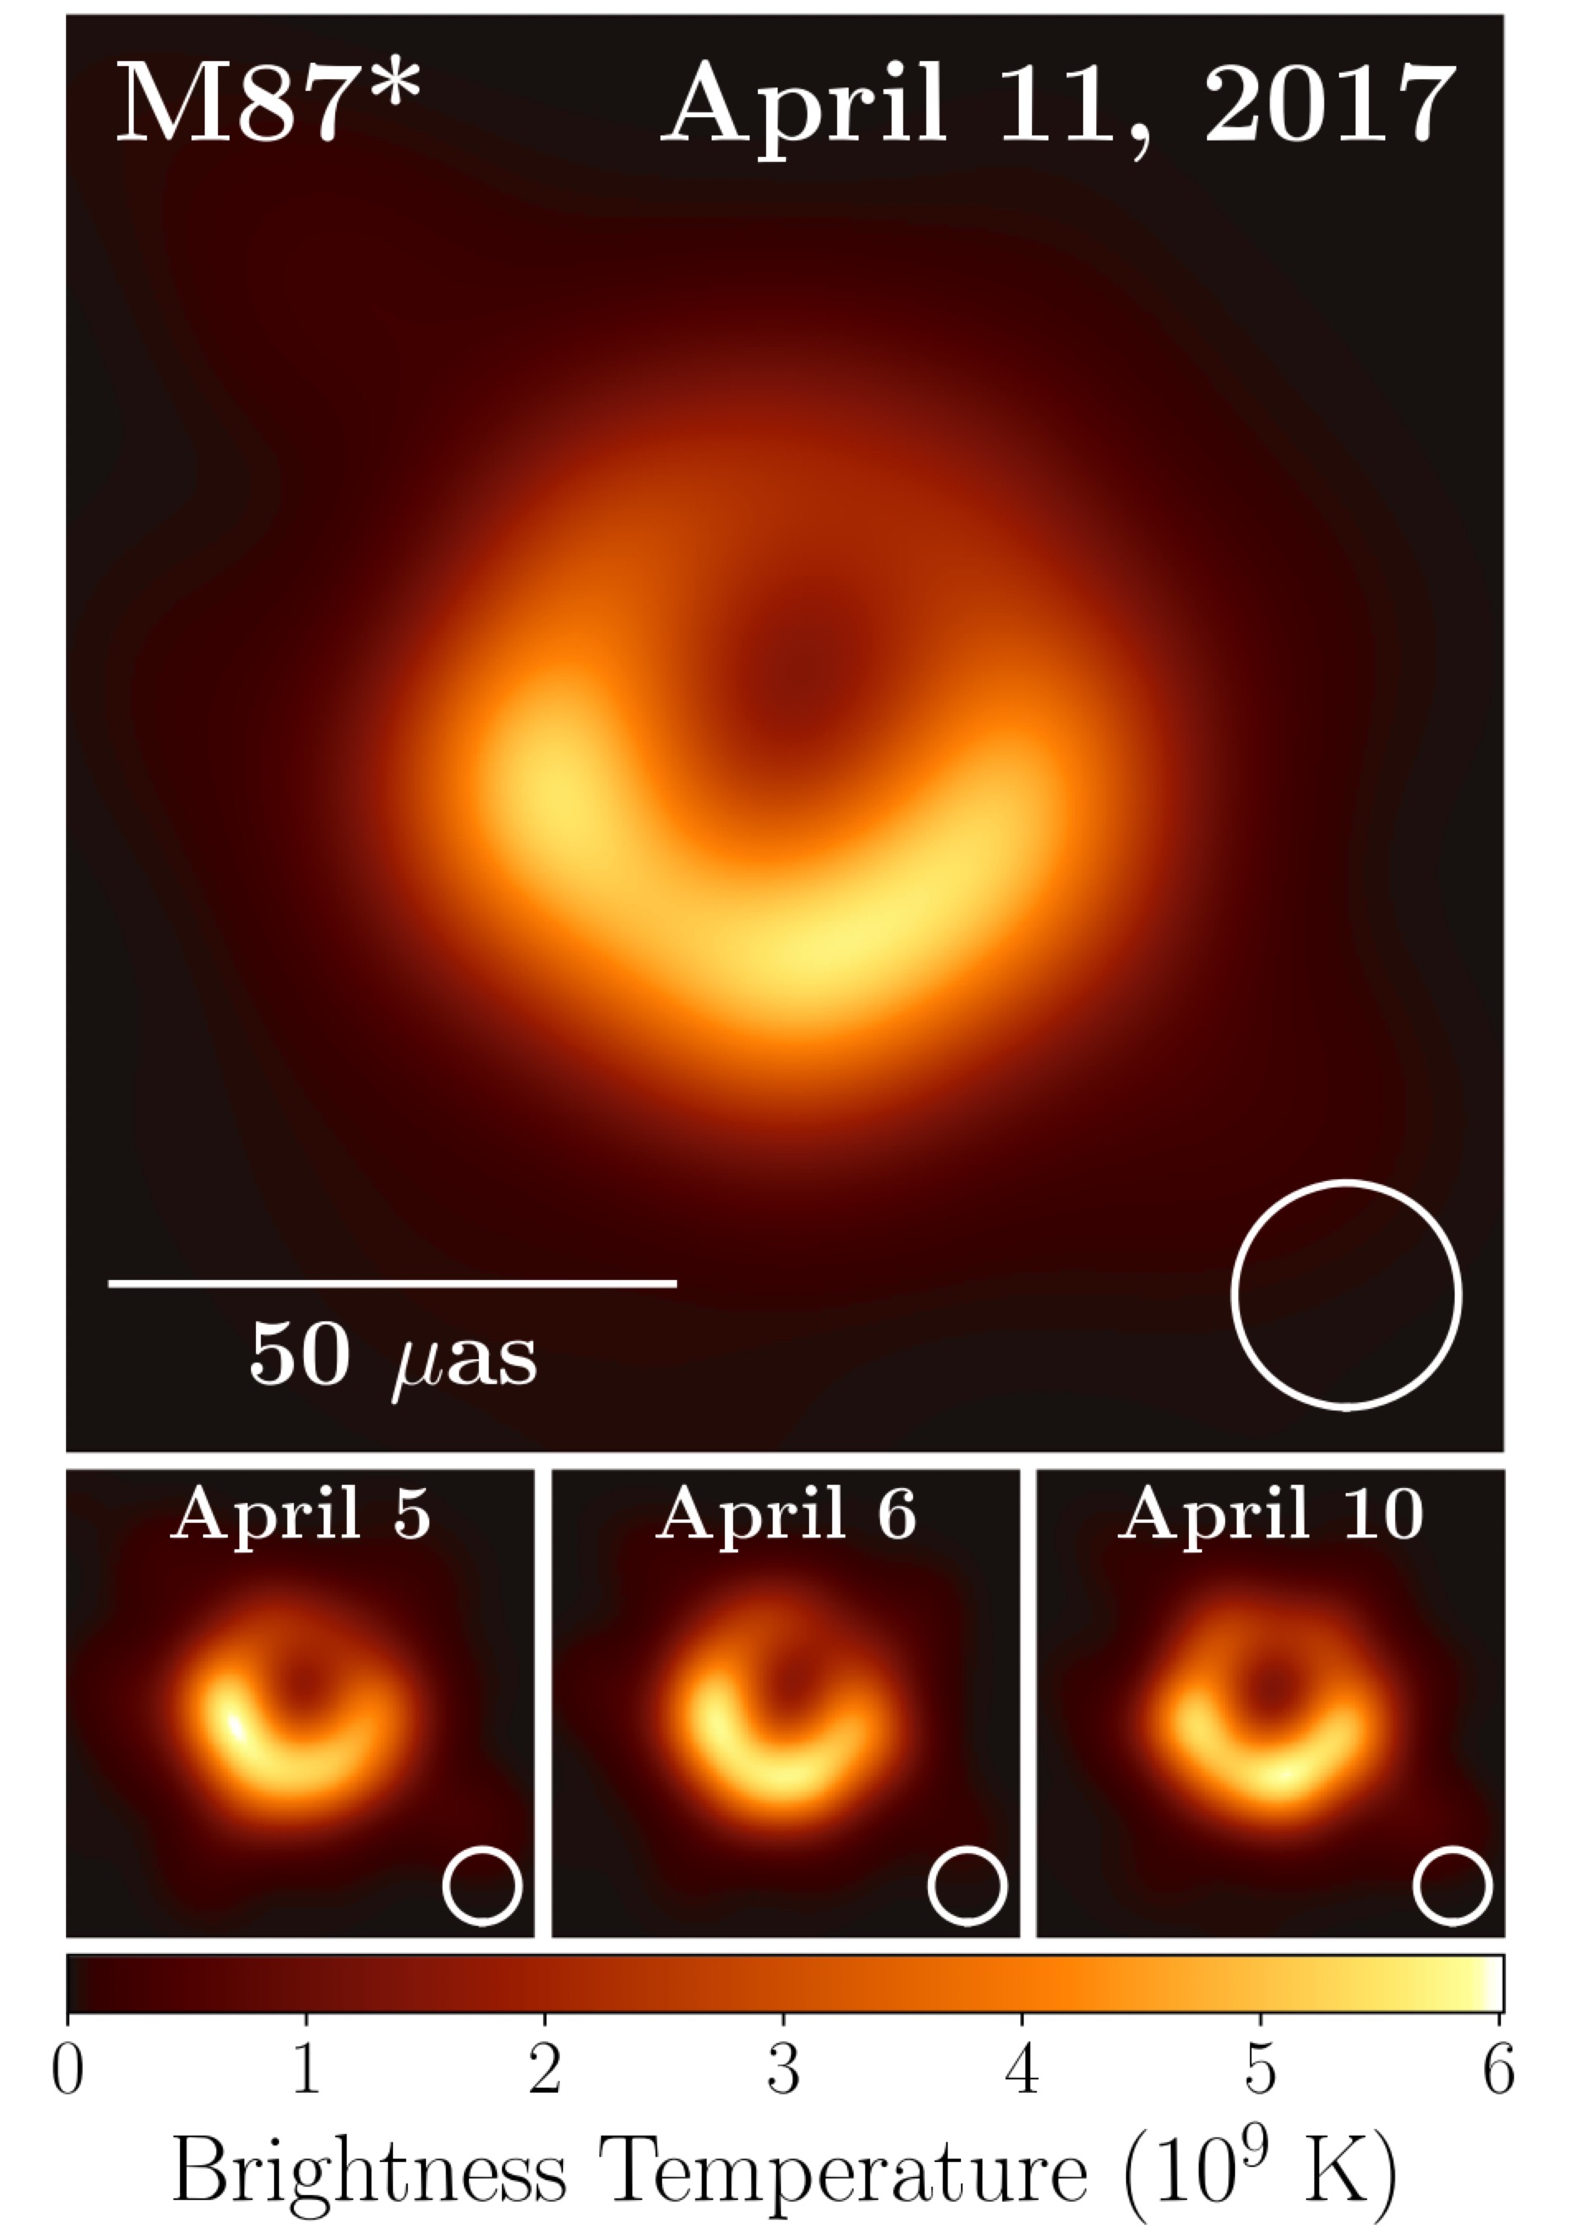
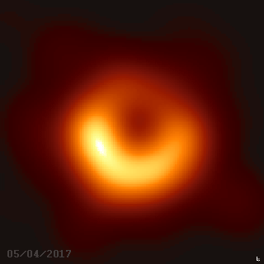
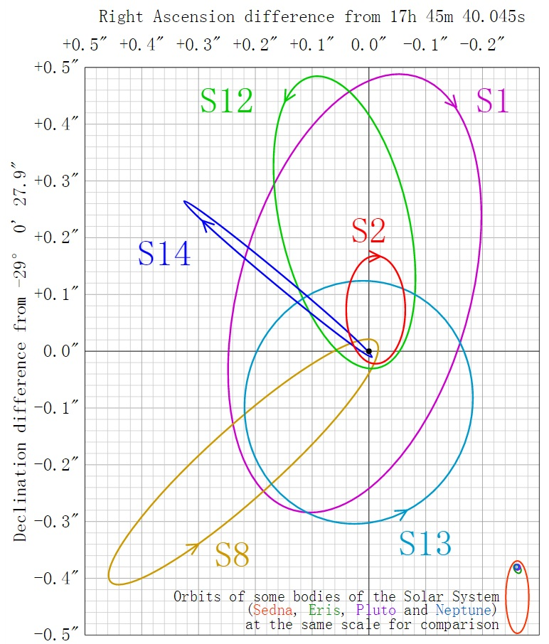
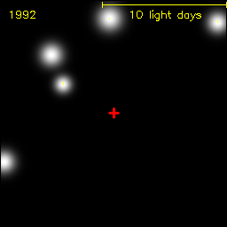
Massive black holes (MBH)
MBHs exist
EHT view on M87*
6.5 billion solar masses
Sagittarius A*: MBH in the Galaxy
About 4 million solar masses
Eisenhauer, F.; et al. (July 20, 2005). APJ 628 (1): 246–259. arXiv:astro-ph/0502129
The Event Horizon Telescope Collaboration, ApJ Lett., 875:L1

Slide 19
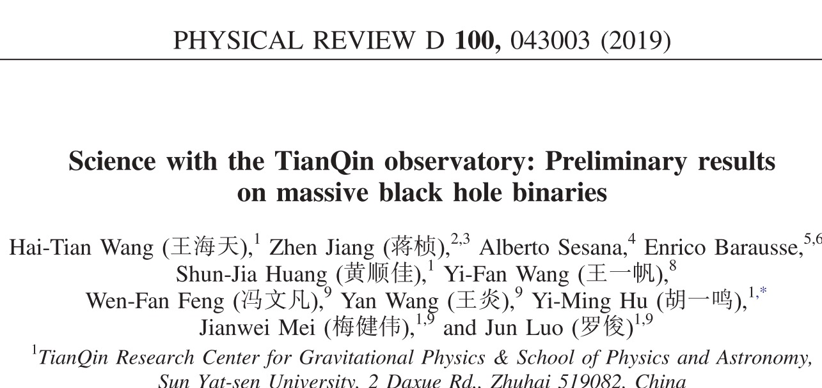
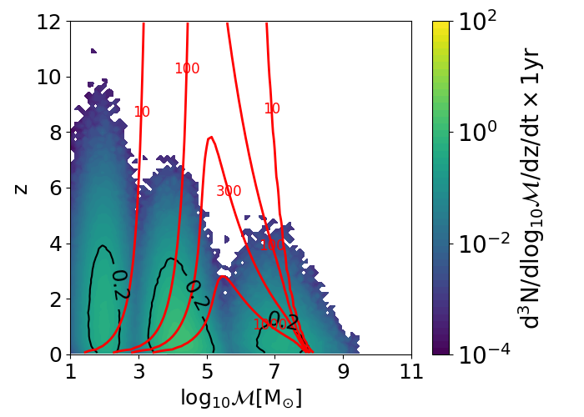
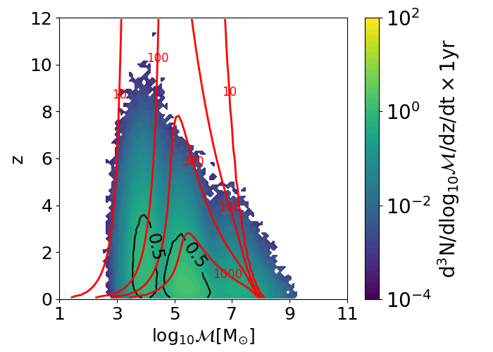

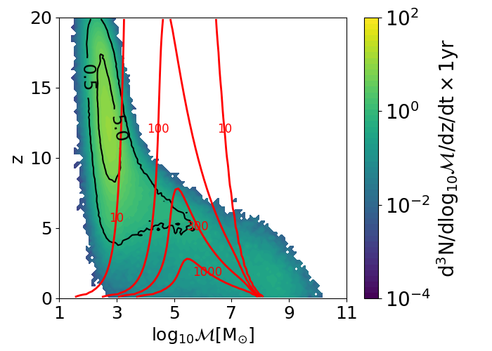
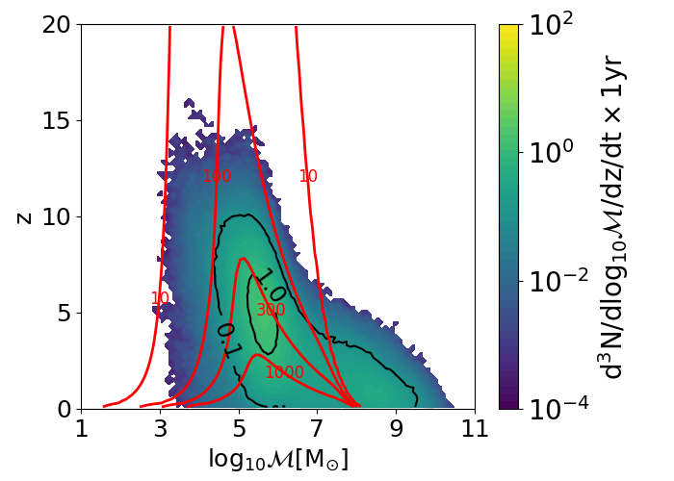
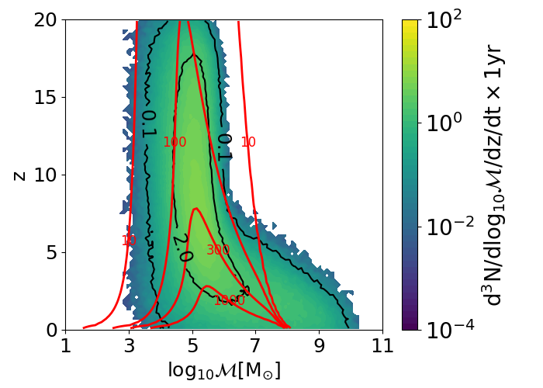
Massive black holes (MBH)
MBH merger history
L-seed
H-seed
popIII
Q3_nod
Q3_d

Slide 20
Massive black holes (MBH)
Rate: per year
With five years operation time
Model | TQ I | TQ I+II | Merger Rate
L-seed | 0.08 | 0.162 | 2.57
H-seed | 1.055 | 1.642 | 2.57
popIII | 10.58 | 22.60 | 174.70
Q3_d | 4.42 | 8.06 | 8.18
Q3_nod | 58.96 | 118.12 | 122.44

Slide 21
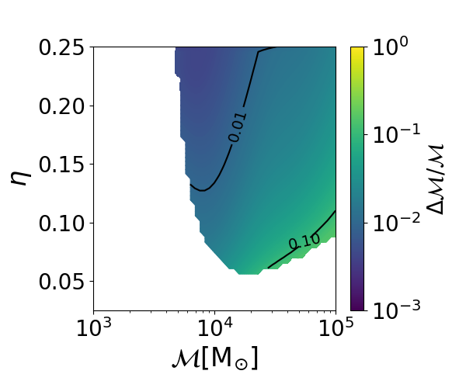
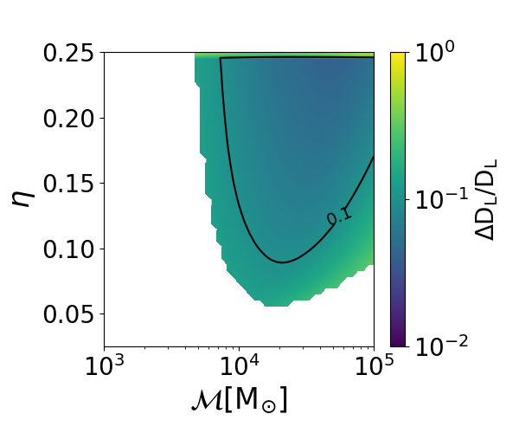
Massive black holes (MBH)
Parameter estimation
TQ can accurately determine parameters for far away events
Relative error of chirp mass
Relative error of sky localization

Slide 22
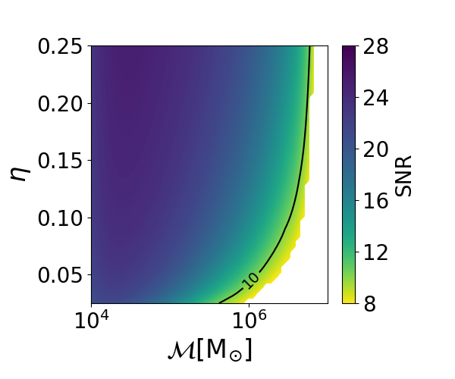
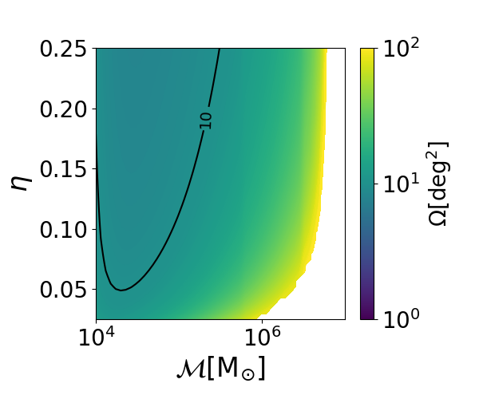
Massive black holes (MBH)
Parameter estimation
Issue early warning 24 hours before merger
Distribution of SNR
Sky localization

Slide 23

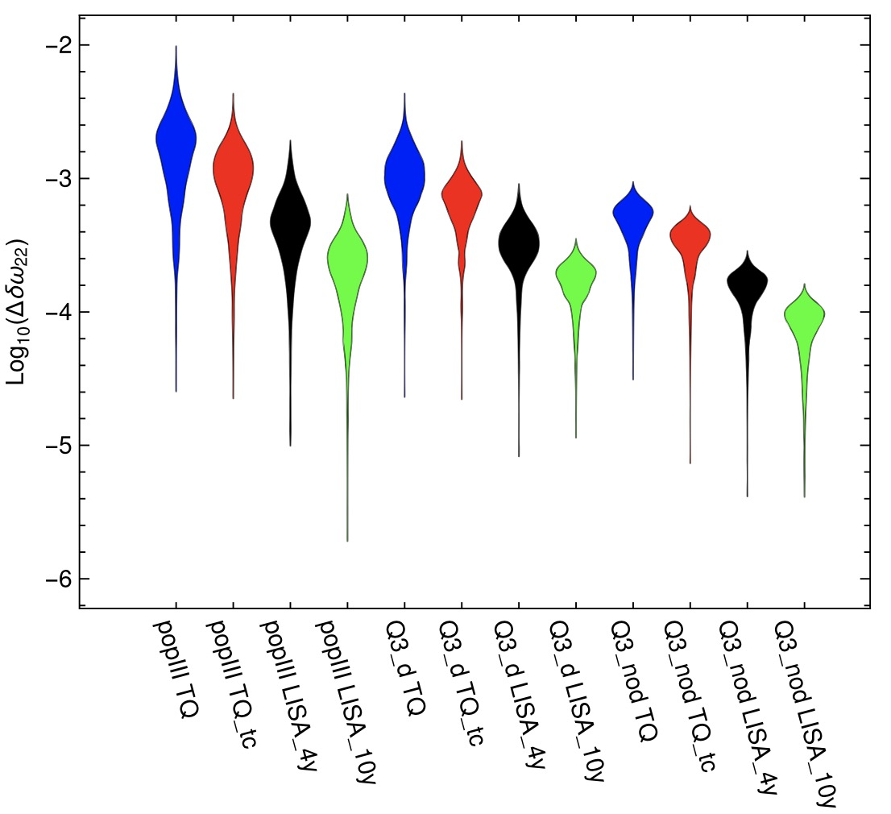
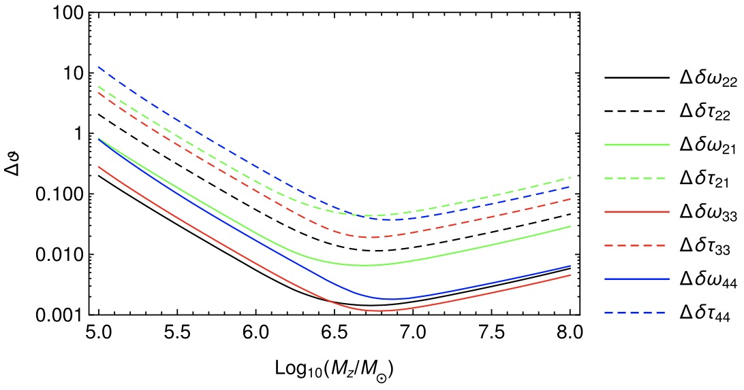
Massive black holes (MBH)
Testing no-hair theorem with ringdown
Measuring multiple QNM modes
Testing no-hair theorem through consistency check
Highest precision for 22, 33 modes
Can measure frequency with precision 10⁻³
Shi et al. PRD.100.044036
TQ precision for QNM frequencies
Precision under different networks/models

Slide 24

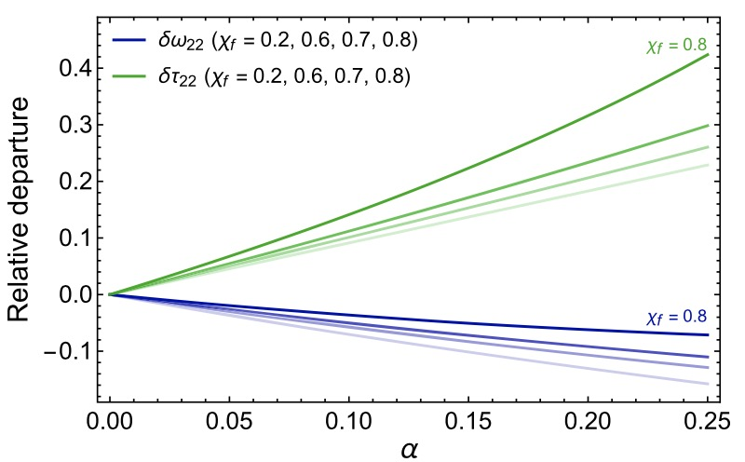
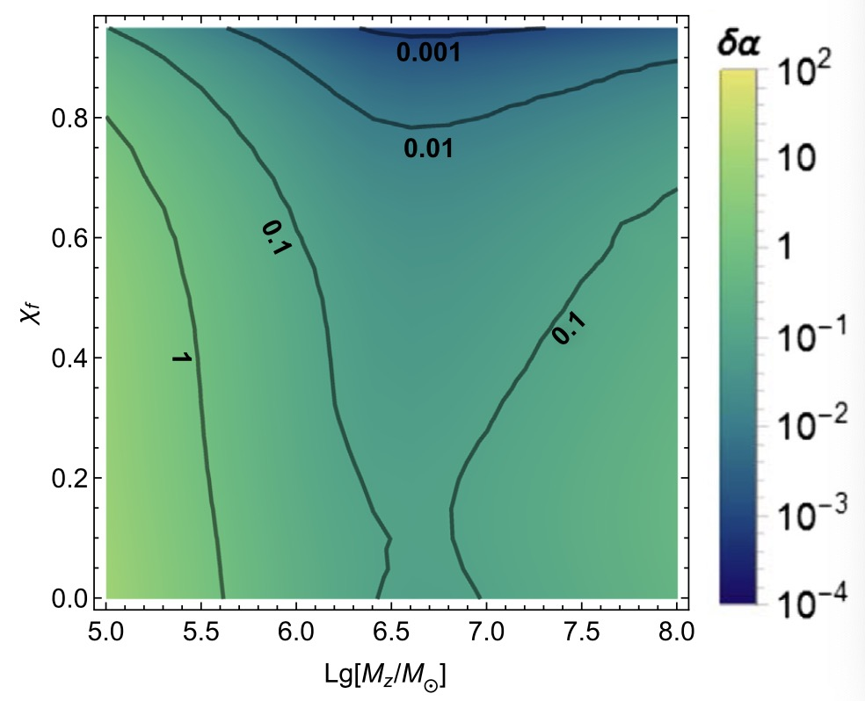
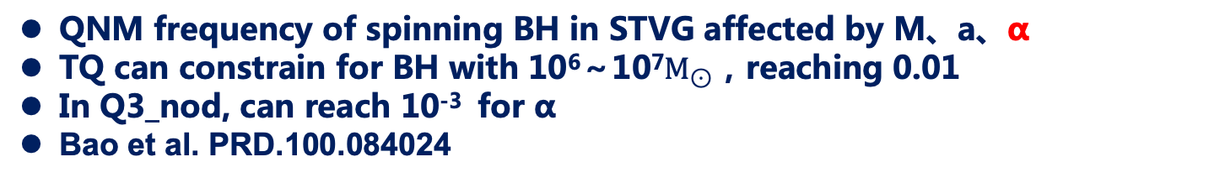
Massive black holes (MBH)
Tesing STVG theory with ringdown
QNM frequency of spinning BH in STVG affected by M、a、α
TQ can constrain for BH with 10⁶～10⁷$M_{⊙}$，reaching 0.01
In Q3_nod, can reach 10⁻³ for α
Bao et al. PRD.100.084024
f deviation and α in 22 mode
Constraining of α

Slide 25
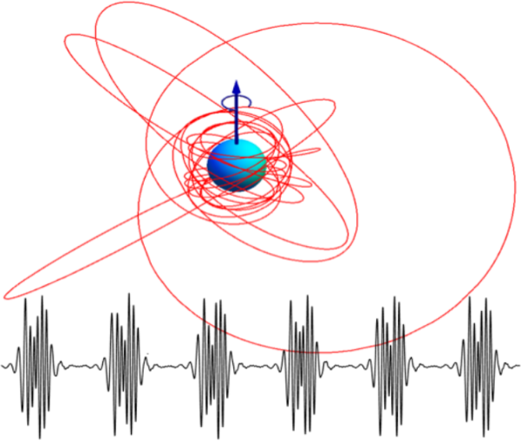
Extreme mass ratio inspiral (EMRI)
Window to study galactic nuclei
Capture of stellar mass compact object (black hole) with massive black holes
Rate highly uncertain, dependent on astronomical models
Waveform highly uncertain, challenging to produce accurate waveforms
V. Cardoso et al., arXiv:1908.11390

Slide 26



EMRI
Astronomical models
1.MBH Mass distribution：Barausse12
Gair10
2.MBH spin：
High a98
Flat 0<a<1
Zero a=0
3. M-σ relation
Gultekin09
KormendyHo13
GrahamScott13
$$t_{cusp} \sim 6Gyr$$
$$t_{cusp} \sim 10Gyr$$
$$t_{cusp} \sim 2Gyr$$
4. Capture rate of CO：
$R_{0}=3000(1+N_{p}) (\frac{m}{10M_{⨀}}){(\frac{M}{{10}^{6}M_{⨀}})}^{−0.19}$ $M_{⨀}{Gyr}^{−1}$
S. Babak and J. Gair, Phys. Rev D 95, 103012(2017)

Slide 27
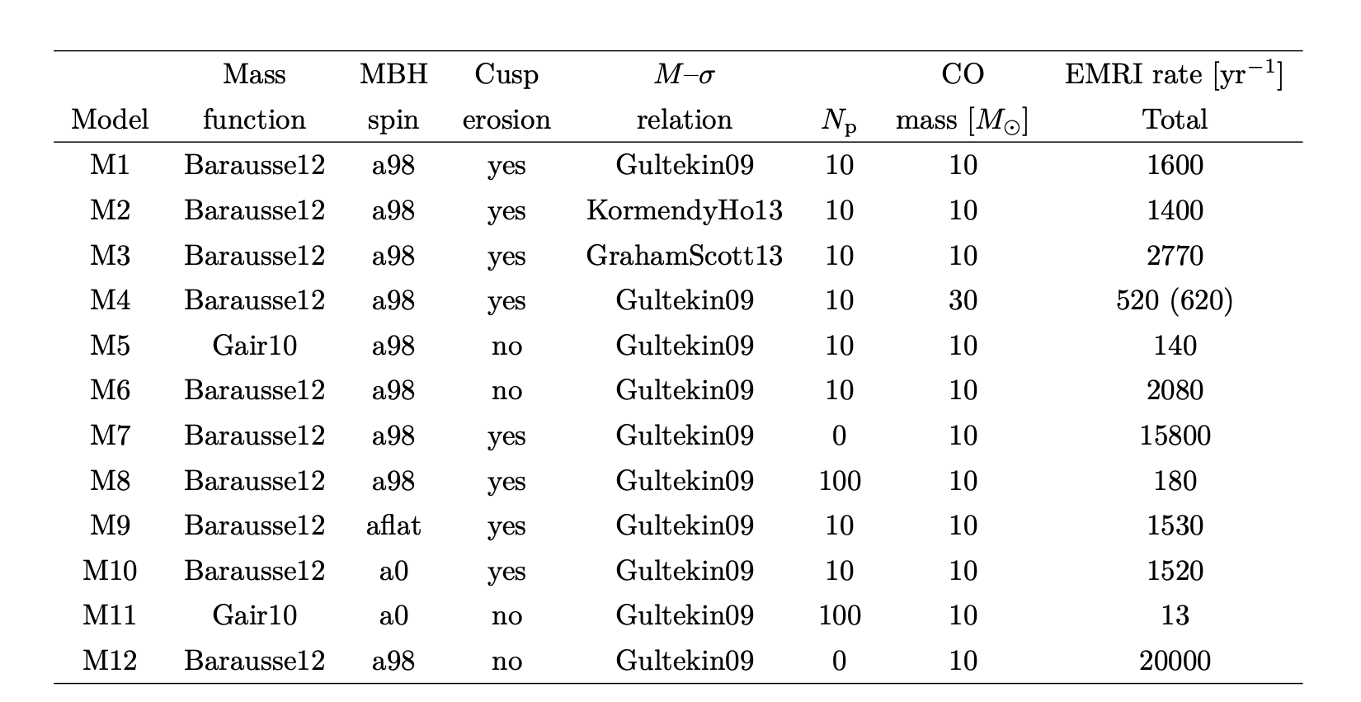
EMRI
12 combinations of assumptions
S. Babak and J. Gair, Phys. Rev D 95, 103012(2017)

Slide 28

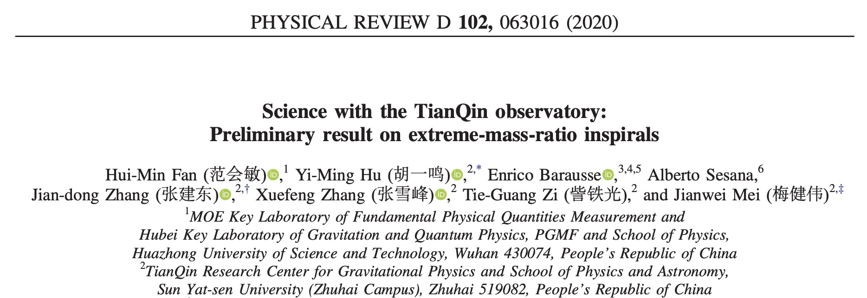
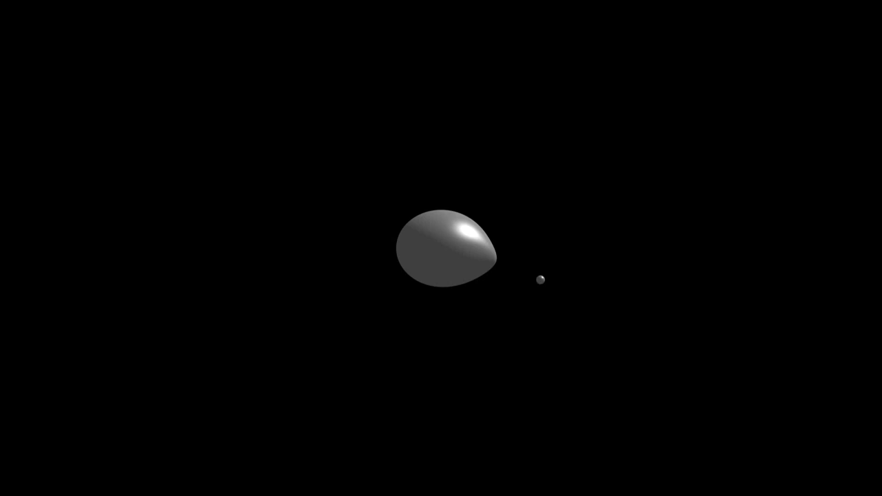
EMRI
Waveform：Analytical kludge
In analytical kludge (AK) waveform, EMRI system follow PN orbit, emitting GW following equation for elliptical orbit, and secular evolution using PN equations.
Cutoff condition：Schwarzschild ISCO (“AKS”waveform）or Kerr ISCO（ “AKK”waveform）。
Credit: Steve Drasco

Slide 29
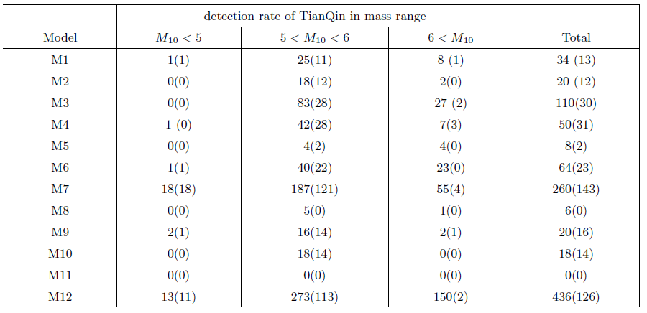
EMRI
AKK（AKS）rate

Slide 30
EMRI
PE precision for intrinsic parameters

Slide 31
EMRI
PE precision for extrinsic parameters

Slide 32

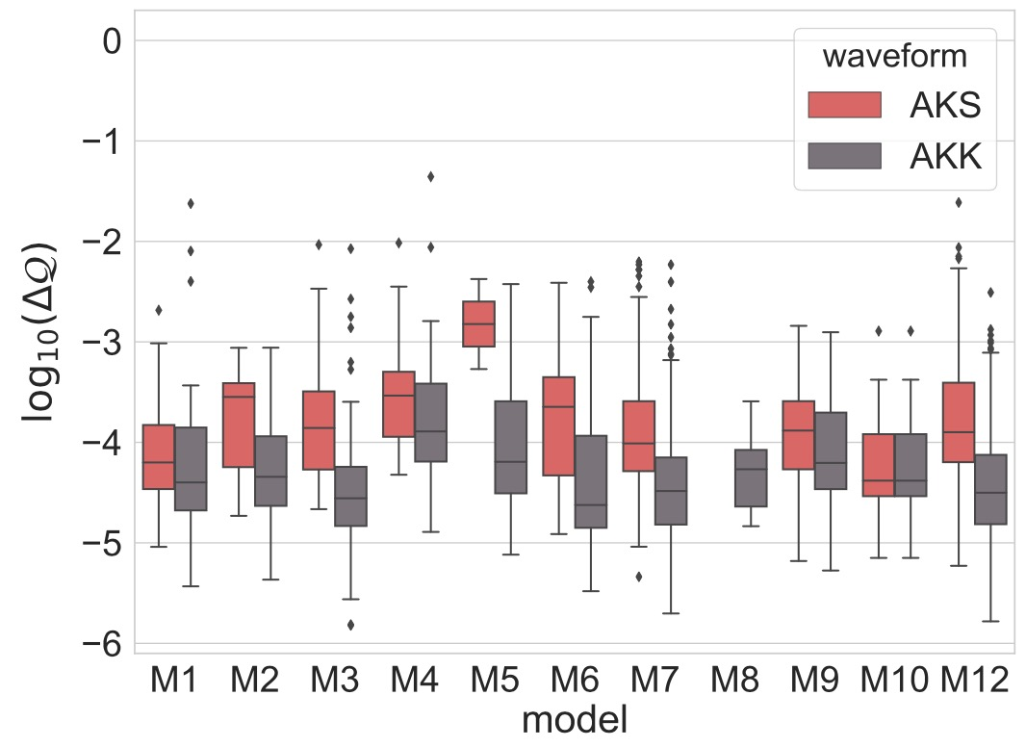
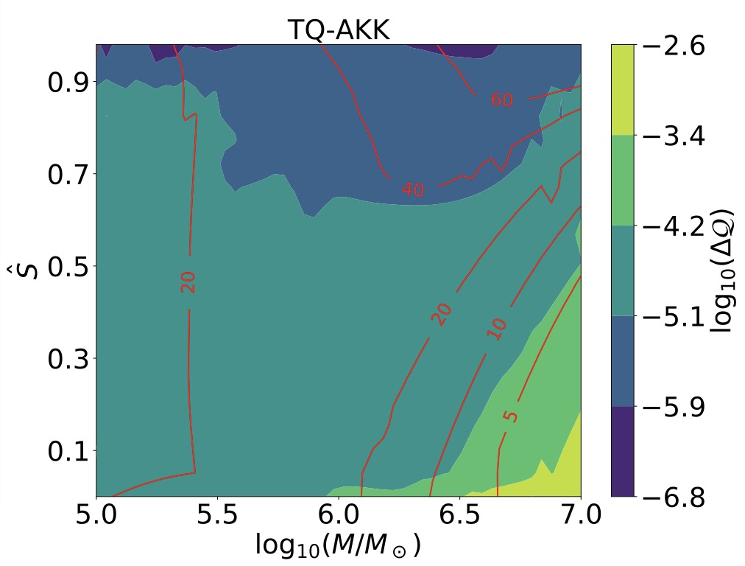
EMRI
Testing no-hair theorem with Q
Kerr BH: M_{l}+iS_{l}=M(ia)^{l}, M mass、Ma angular momentum、Ma² quadrupole moment
Can constrain quadrupole moment up to 10⁻⁴
Sensitive to M and Ma
Sensitive to choice of cutoff frequency
Zi et al. 2104.06047

Slide 33
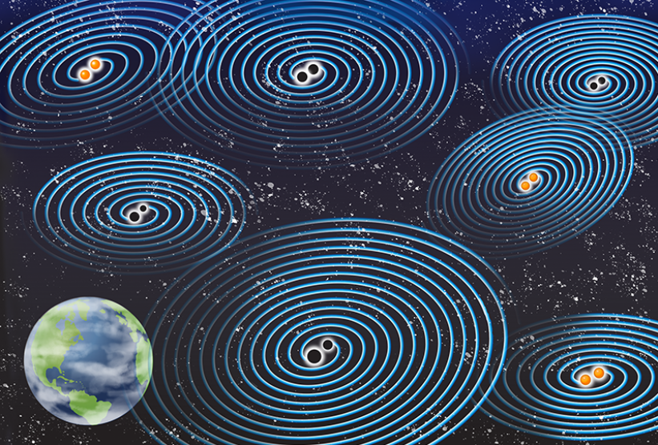
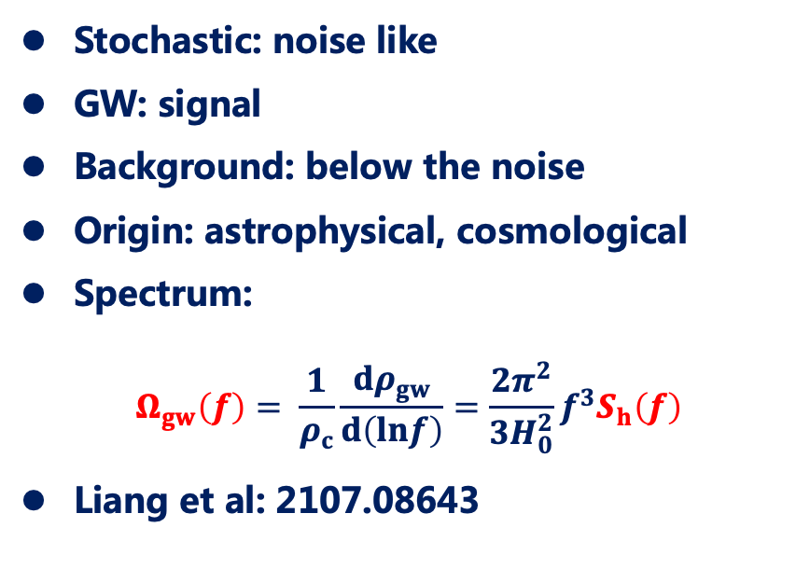
Stochastic GW Background
Definition
Stochastic: noise like
GW: signal
Background: below the noise
Origin: astrophysical, cosmological
Spectrum:
$$Ω_{gw}\left(f\right)= \frac{1}{ρ_{c}}\frac{dρ_{gw}}{d\left(lnf\right)}=\frac{2π^{2}}{3H_{0}^{2}}f^{3}S_{h}\left(f\right)$$
Liang et al: 2107.08643
Credit: APS/Carin Cain

Slide 34
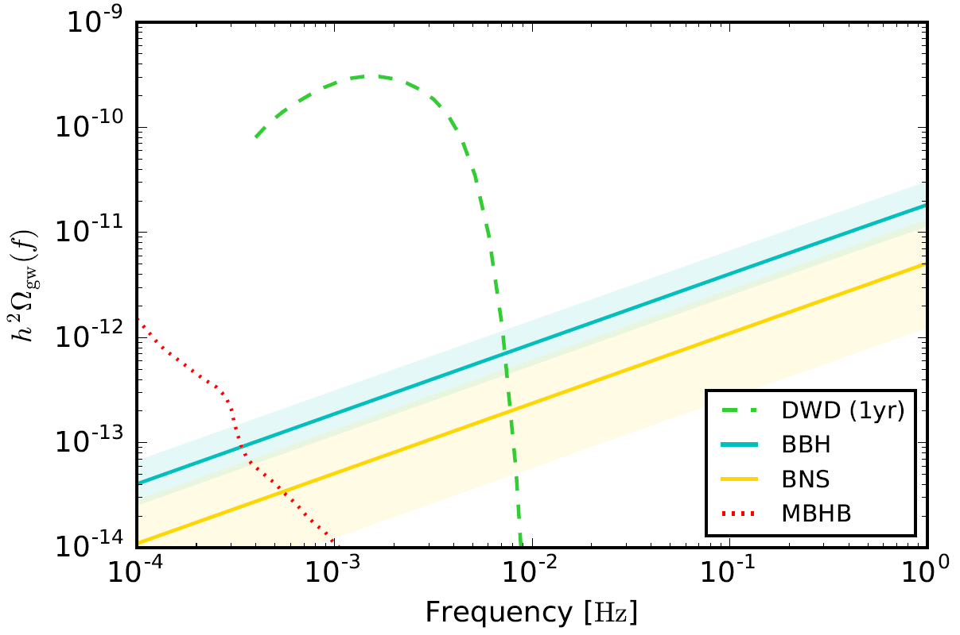
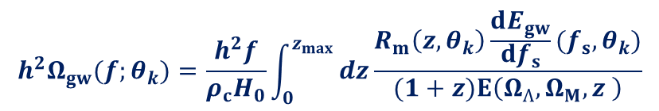


Stochastic GW Background
$${h^{2}Ω}_{gw}\text{(}f;θ_{k}\text{)}=\frac{h^{2}f}{ρ_{c}H_{0}}\int_{0}^{z_{max}}{dz\frac{R_{m}\left(z,θ_{k}\right)\frac{dE_{gw}}{{df}_{s}}(f_{s},θ_{k})}{(1+z)E\left(Ω_{Ʌ},Ω_{M},z \right)}}$$
Astrophysical SGWBs
Merger rate
Energy spectrum
$$R_{m_{BNS}}=320_{−240}^{+490}$$
$$R_{m_{BBH}}=23.9_{−8.6}^{+14.9}$$

Slide 35
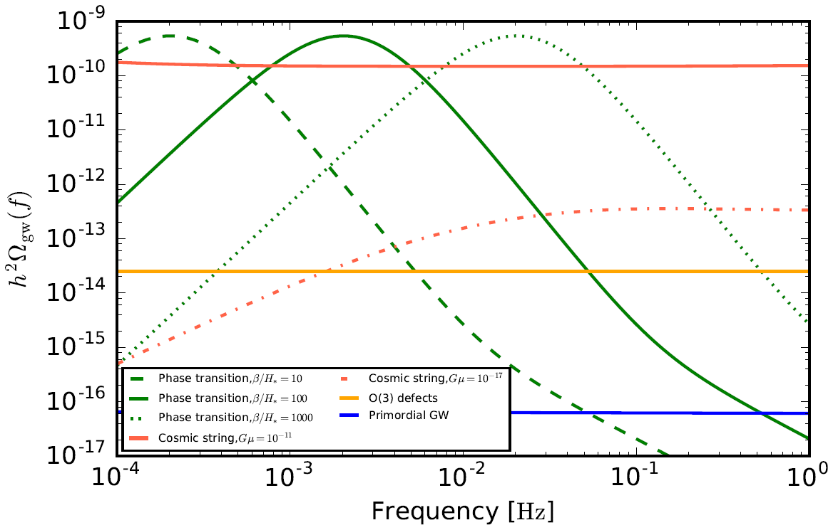
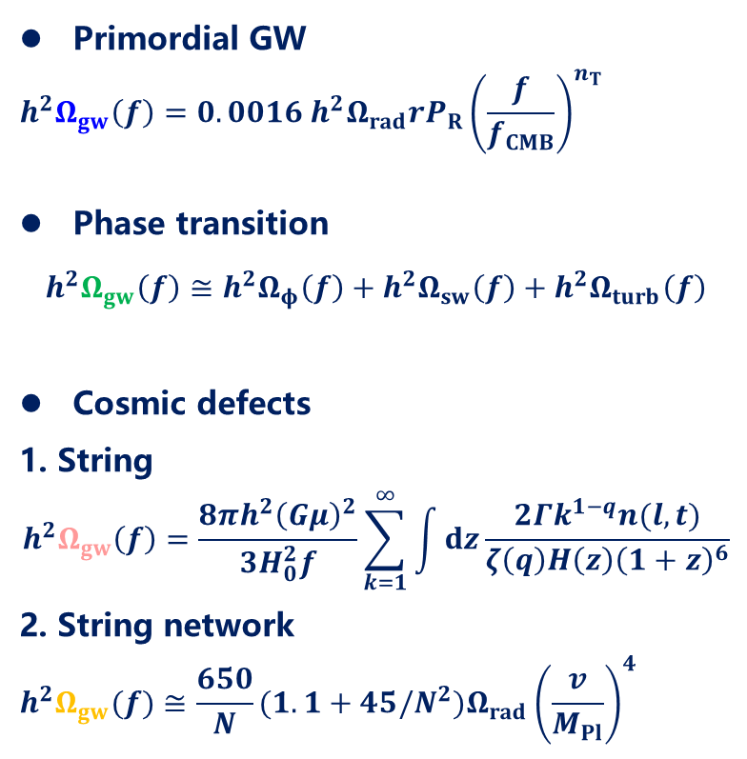
Stochastic GW Background
Cosmological SGWBs
Primordial GW
$$h^{2}Ω_{gw}\left(f\right)=0.0016 {h^{2}Ω}_{rad}rP_{R}{\left(\frac{f}{f_{CMB}}\right)}^{n_{T}}$$
Phase transition
$$h^{2}Ω_{gw}\left(f\right)≅{h^{2}Ω}_{φ}\left(f\right)+{h^{2}Ω}_{sw}\left(f\right)+{h^{2}Ω}_{turb}\left(f\right)$$
Cosmic defects
1. String
$$h^{2}Ω_{gw}\left(f\right)=\frac{8πh^{2}{\left(Gμ\right)}^{2}}{3H_{0}^{2}f}\sum_{k=1}^{∞}{\int{dz\frac{2Γk^{1−q}n(l,t)}{ζ\left(q\right)H\left(z\right){\left(1+z\right)}^{6}}}}$$
2. String network
$${h^{2}Ω}_{gw}(f)≅\frac{650}{N}(1.1+45/N^{2})Ω_{rad}{\left(\frac{v}{M_{Pl}}\right)}^{4}$$

Slide 36
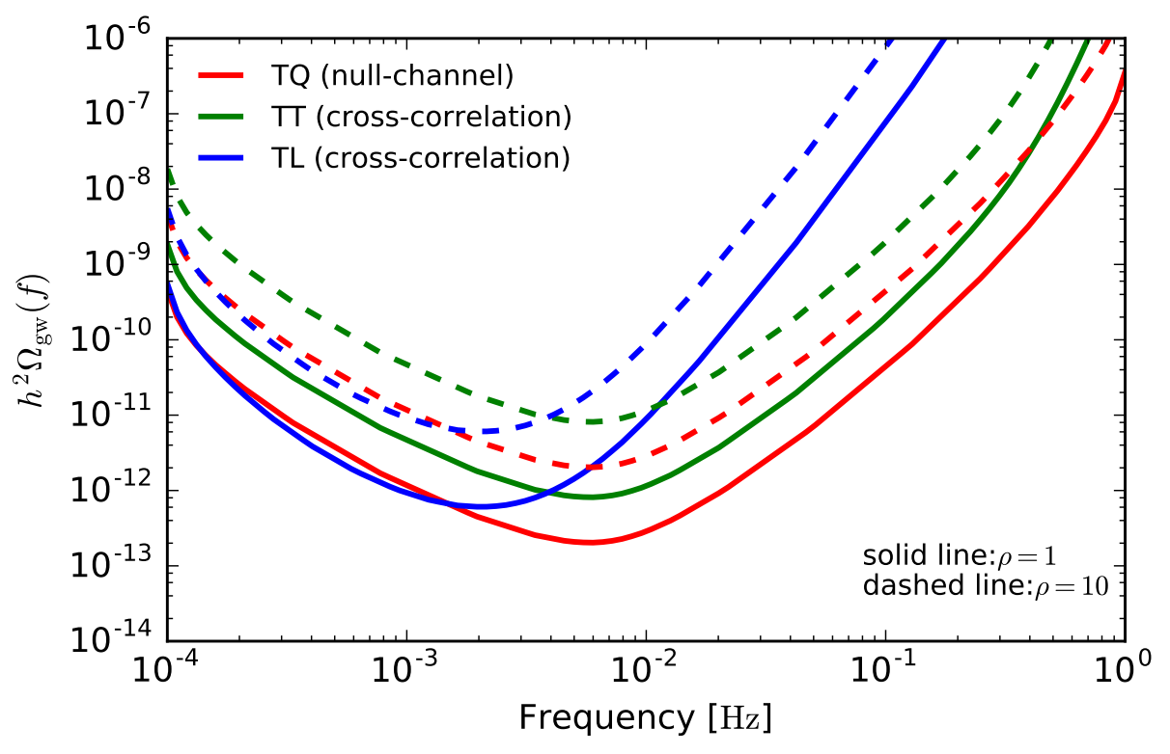
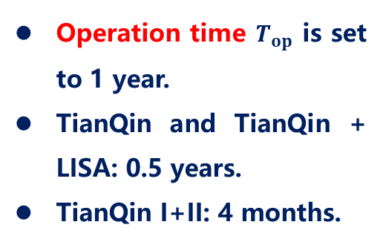
Stochastic GW Background
PI sensitivity curves
Operation time $T_{op}$ is set to 1 year.
TianQin and TianQin + LISA: 0.5 years.
TianQin I+II: 4 months.
PI sensitivity curves for different configurations

Slide 37
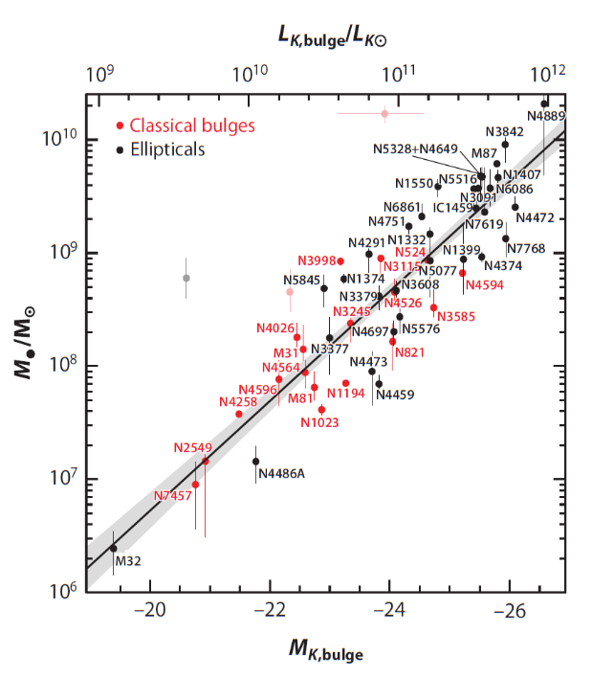
GW cosmology
GW sources as standard siren
TQ observation provides luminosity distance information
EM counterpart provides redshift information
Together can form standard siren to measure cosmology
If no EM counterpart, can use statistical information of galaxies to perform dark standard siren.
First time to use galaxy luminosity as proxy for weighting
Zhu et al. 2104.11956
A.W. Graham et al. MNRAS 379,711(2007);

Slide 38
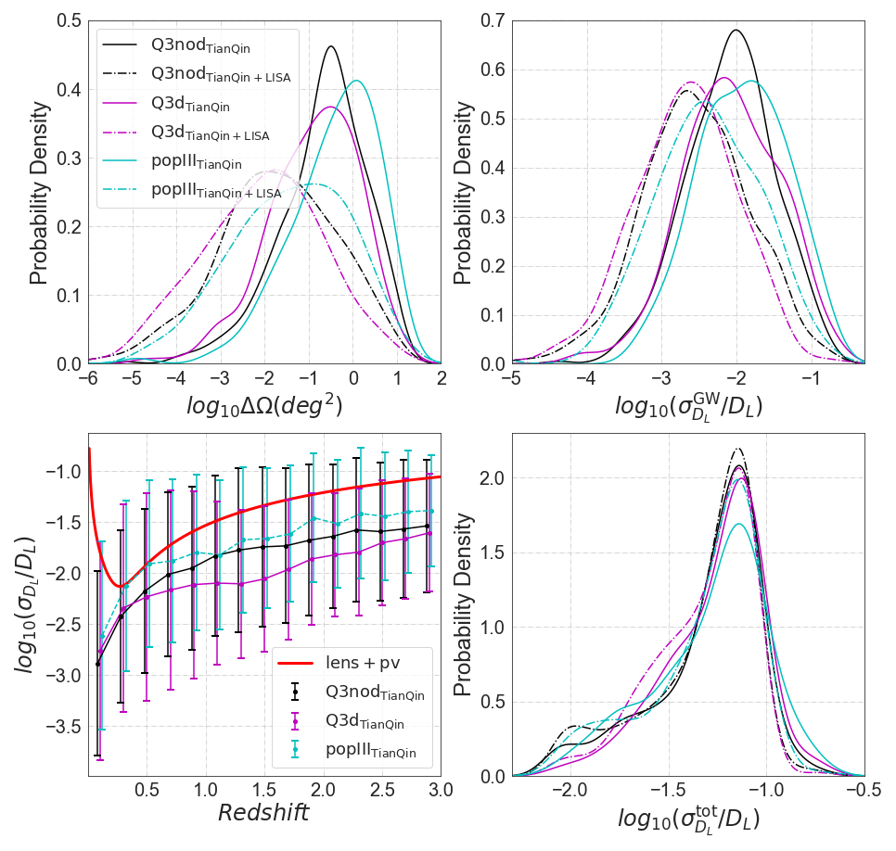
GW cosmology
PE from GW observation

Slide 39

GW cosmology
Redshift from galaxy catalog
No correction
Correct for Malmquist bias
Weighted by location/luminosity

Slide 40


GW cosmology
GW cosmology with TQ+LISA
MBHBmodel | $∆H_{0}/H_{0}$(%)
 | TianQin +LISA |  | TianQin I+II+LISA
 | uniform | weighted | uniform | weighted
popIII | 5.6 | 4.2 | 5.4 | 3.9
Q3d | 5.6 | 5.2 | 5.5 | 5.0
Q3nod | 4.8 | 2.5 | 4.7 | 2.4

Slide 41






Lunar laser ranging
Reflector
Zhuhai LLR observatory
Kunming LLR observatory
Loaded in Queqiao
17-cm corner reflector

Slide 42


TQ-1 progress

Slide 43



Advertisement
Faculty and Postdoc positions available!
Theoretical analysis and simulation
Space-based laser interferometry and laser ranging technology
Spacecraft and system technology
Contact: TianQin@sysu.edu.cn

Slide 44

TQ science objectives
Galactic compact binaries
Coalescence of massive binary BH
Inspiral of stellar mass BH binary
Stochastic background of astronomical origin
Cosmic expansion
Stochastic background of cosmological origin
Testing gravity
Testing BH
Other sources
Astronomy
Cosmology
Fundamental physics
Extreme mass ratio inspiral
Mei et al. PTEP, 2021, 059201

Slide 45

Thank you!

