Slide 1
Use machine learning to in the phenomenological study of VBS
Ji-Chong Yang（Liaoning Normal University）
Collaborator ：Yu-Chen Guo, Chong-Xing Yue
2021-07-19 北京

Slide 2
Outline
Use isolation forest to identify the signal of aQGCs
Use neural network to reconstruct the energy
1/22

Slide 3
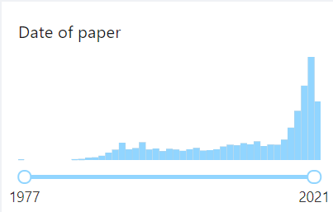
Machine learning algorithms has been widely used in HEP:
2/22

Slide 4
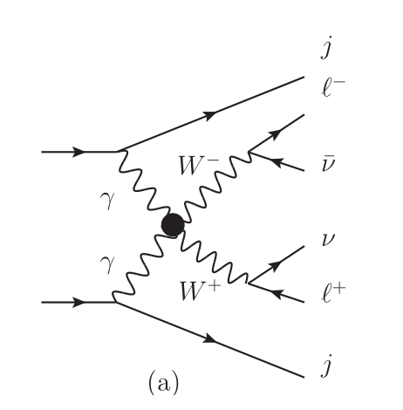
VBS and aQGCs
Introduce the arena
18 variables
3/22

Slide 5
need to spend a lot of time on kinematic analysis
4/22

Slide 6
Event selection strategy
(1) SM is successful
the signal of NP is few.
(2) In SMEFT, the signal events are induced by “new” interactions.
Signal events are kinematically different. Event selection strategy.
5/22

Slide 7
A common feature
Few
Different
6/22

Slide 8
Anomaly detection
Many machine learning algorithms
Auto-encode
…
…
Isolation forest
7/22

Slide 9
Isolation tree
Randomly choose a undivided leaf
Randomly choose a dimension
Divide
8/22

Slide 10
anomaly points are easier to isolate
0
01
0
01
01
01
01
0
0
00
0
00
00
00
00
0
1
10
10
100
100
10
100
100
1
10
10
10
101
1010
1
110
1010
110
10100
110
110
1101
1101
11
1
110
110
110
110
11
1100
1100
1
10
10
10
101
1011
1011
1011
1
111
111
111
111
111
111
1
11
10
10
10
10101
101
1010
1010
9/22

Slide 11
Tree -> forest
Isolation tree:
Isolation forest:
10/22

Slide 12
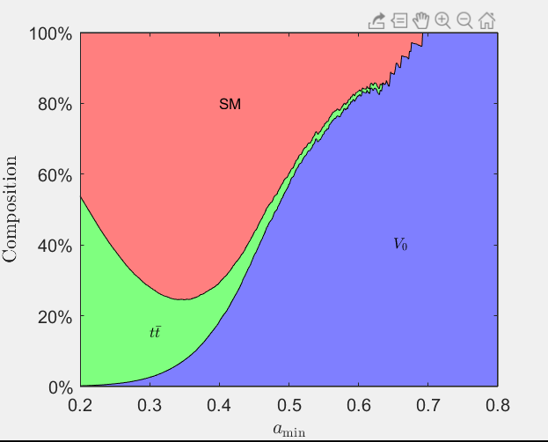
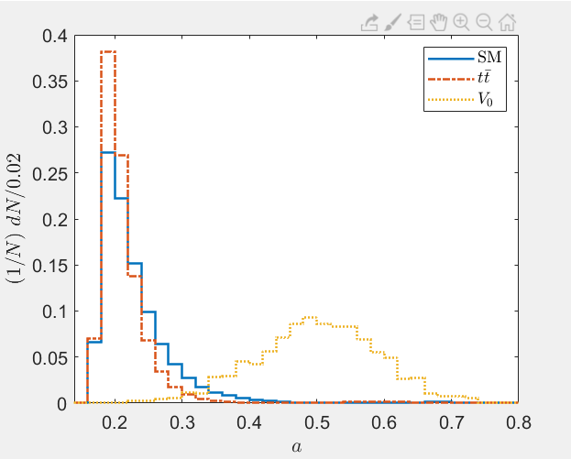
Result:
11/22

Slide 13
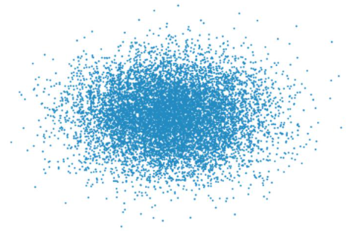
Transparent: just quantify “anomaly”
Independent of the operators
(automatic event selection strategy)
The anomaly points are important even when NP is absent
12/22

Slide 14
Another problem
13/22

Slide 15
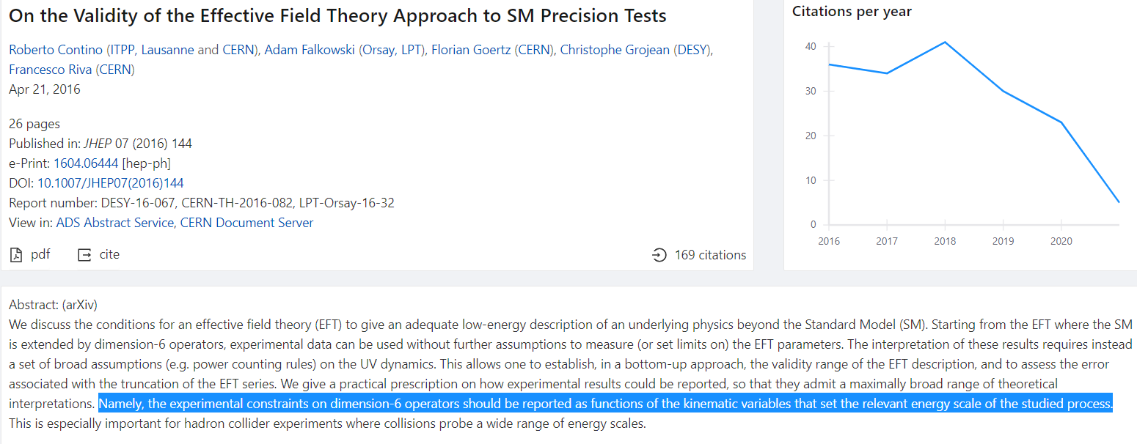
Energy is an important parameter in the study of an EFT
14/22

Slide 16
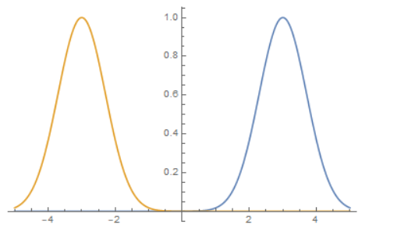
When digging for information one must ensure that there is indeed information to dig
(1) x+y=0
(2) x+y=0, and:
15/22

Slide 17
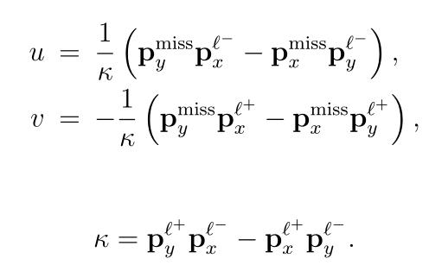
approximation
16/22

Slide 18
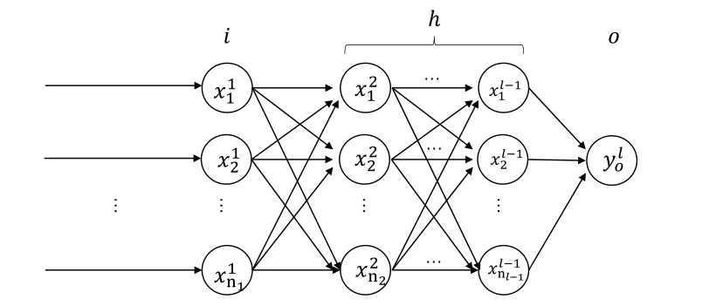
Artificial Neural Network (ANN)
17/22

Slide 19
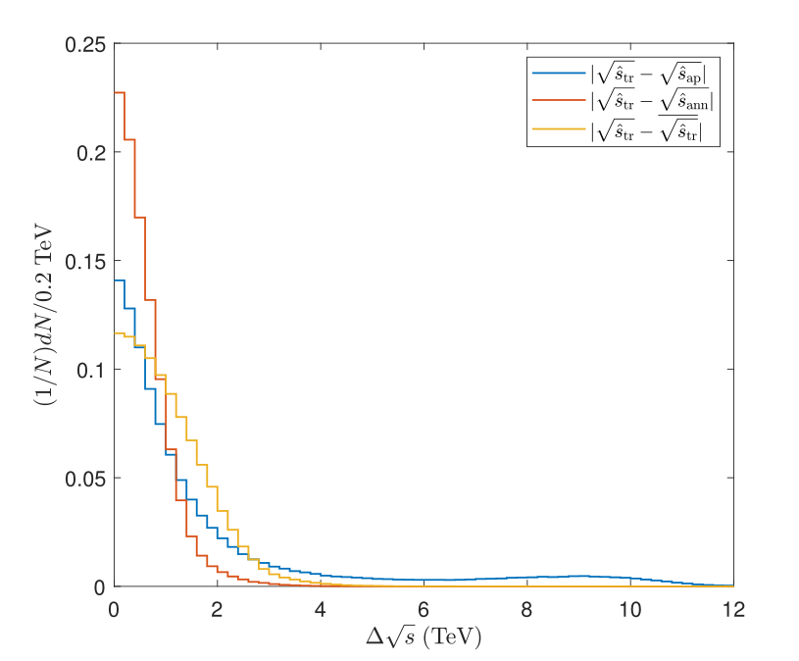
Results
Training dataset and
Validation dataset:
About 600,000 events
18/22

Slide 20
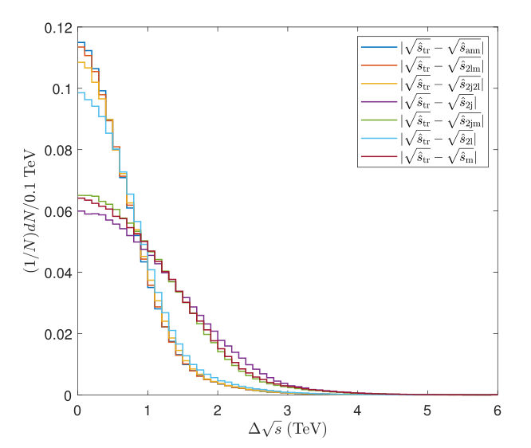
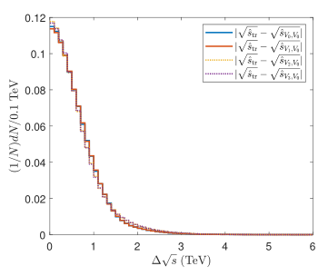
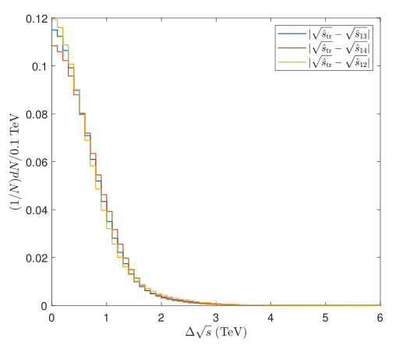
What information is used
19/22

Slide 21
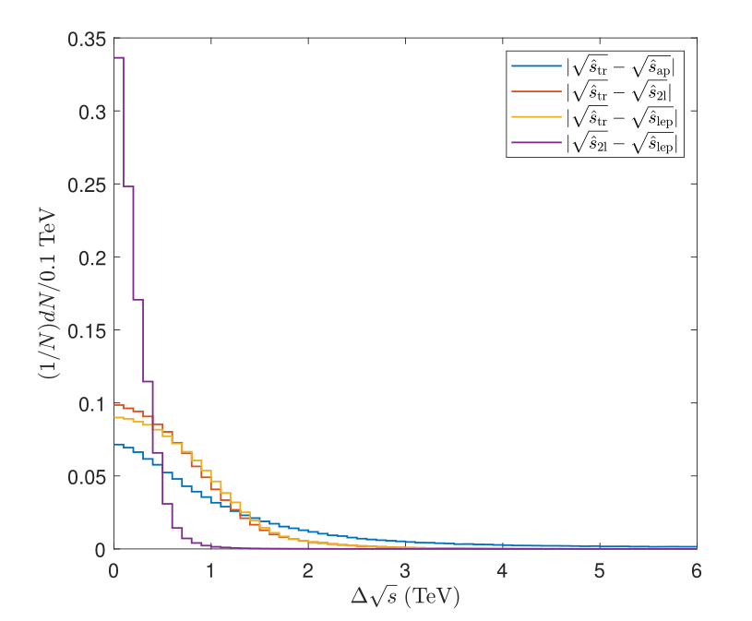
What we can do with ANN
find more understandable patterns
20/22

Slide 22
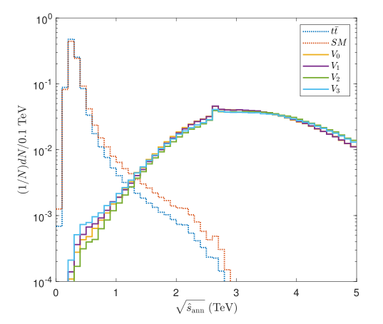
What we can do with ANN
Highlight signals
Unitarily bound
21/22

Slide 23
Summary
Isolation forest can be used to highlight the signal events of aQGCs. (2103.03151)
ANN can be used to study the energy of AA->WW, (will be on arXiv soon.)
Many has been done, more to do
Thank you!
22/22

