Slide 1


Probing Light Dark Matter from Boosted and Migdal Effects
Lei Wu （武雷）
2109.xxxxx, 2012.09751, 2006.11837, 1912.09904
15th TeV Physics Workshop @ Beijing
2021/7/18-21

Slide 2
Outline
A brief review of Direct Detection
Cosmic Ray Boosted Dark Matter
Migdal Scattering (Inelastic process)
Conclusions
15th TeV Physics Workshop @ Beijing
2021/7/18-21

Slide 3
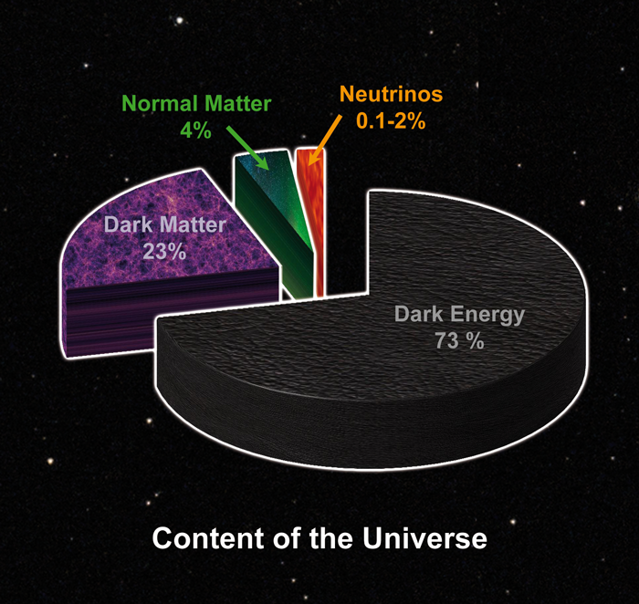
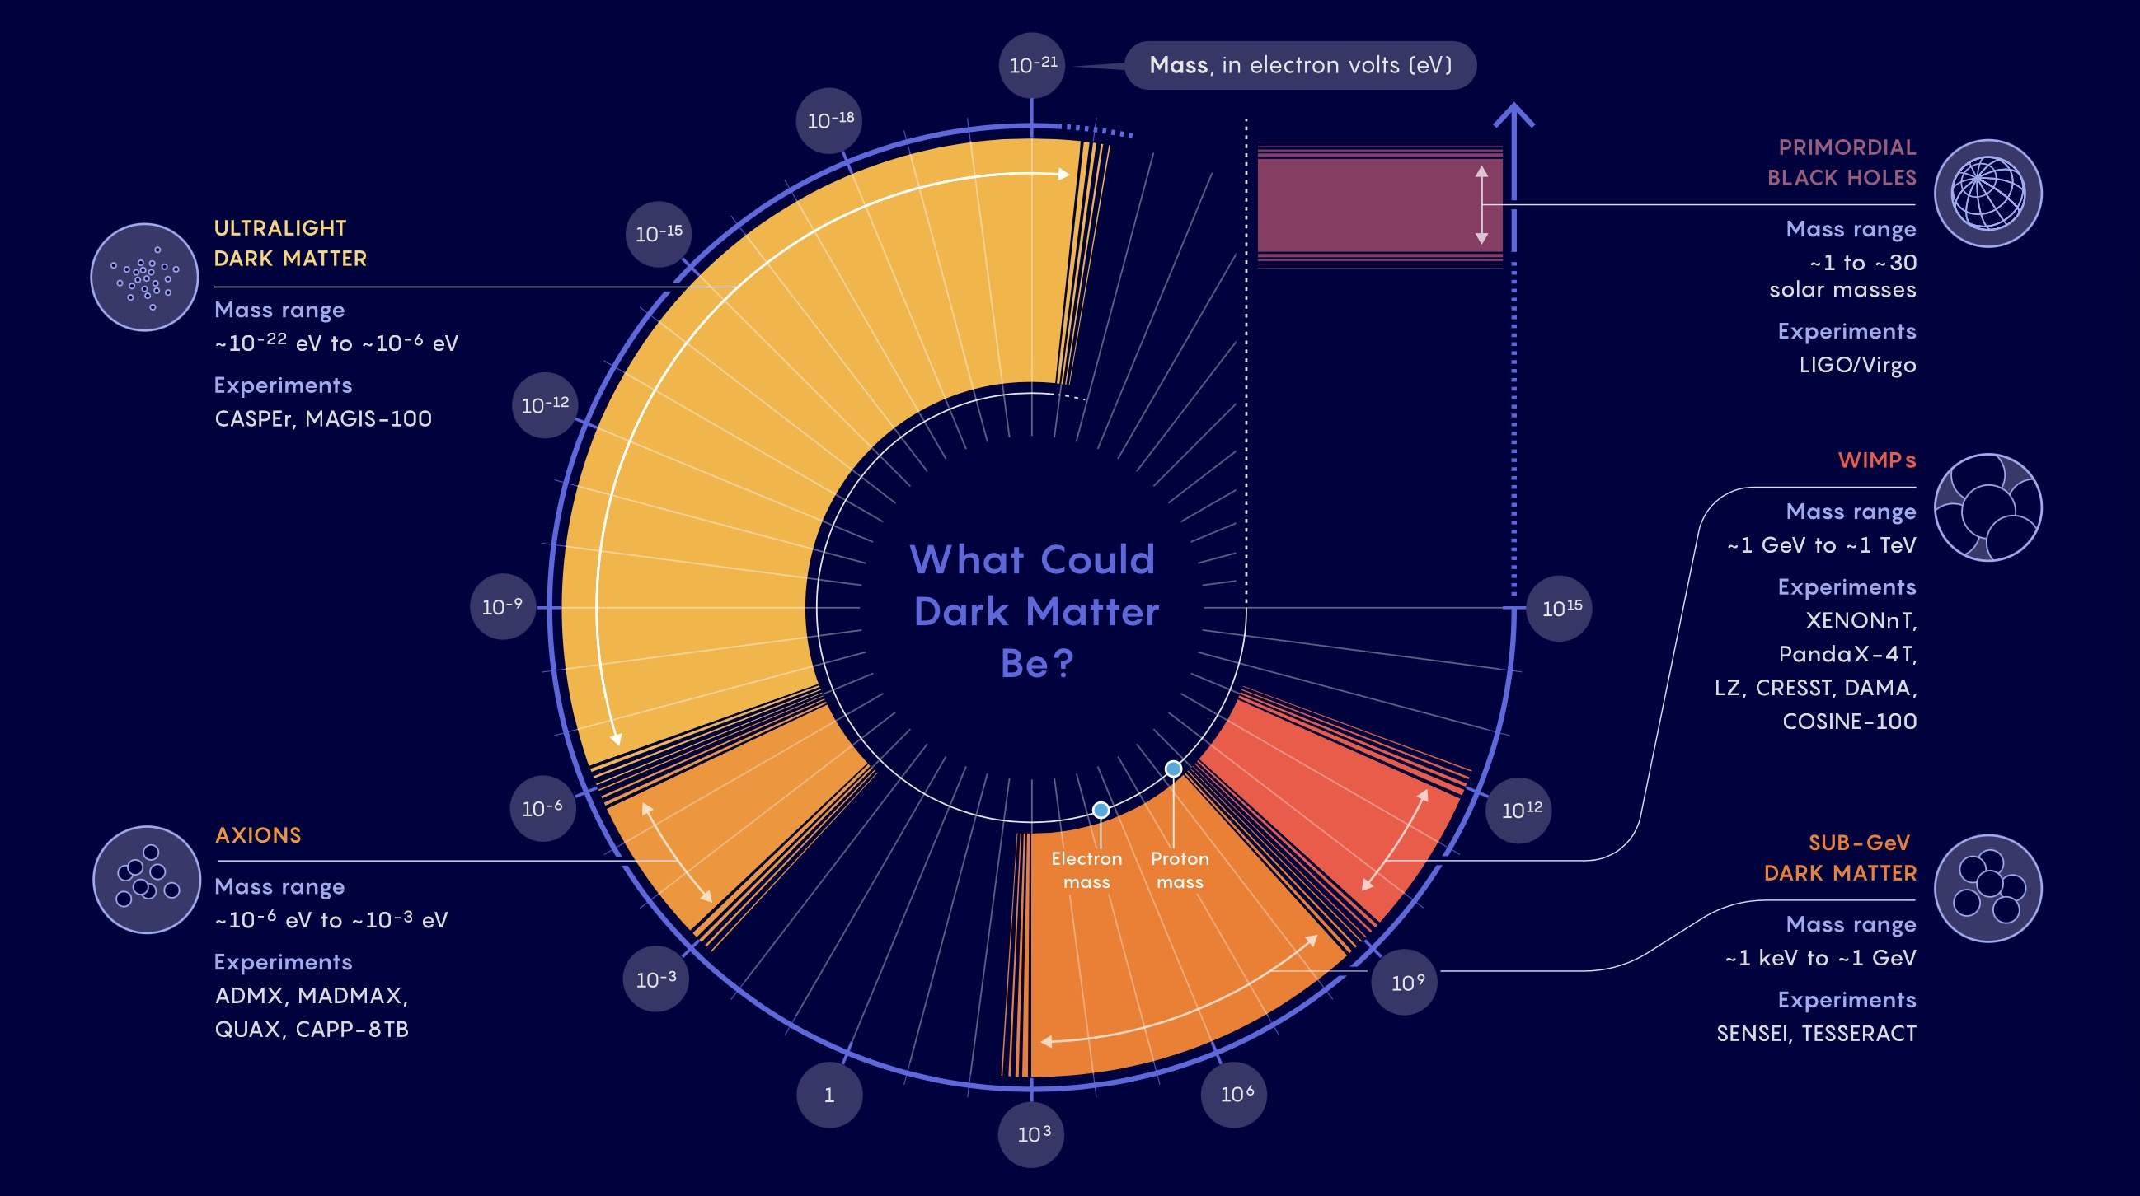
1. A brief review of Direct Detection
Mass range: ～10⁻²² eV to ～10 solar Mass

Slide 4
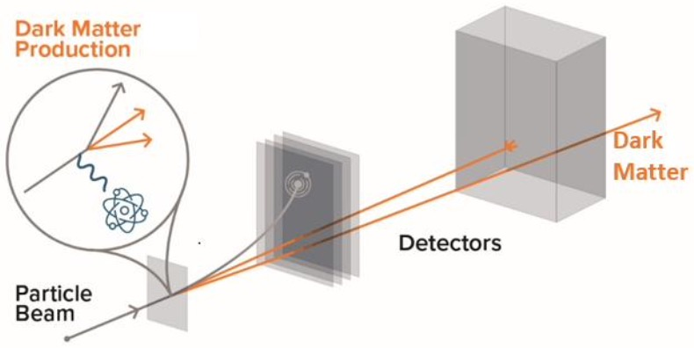
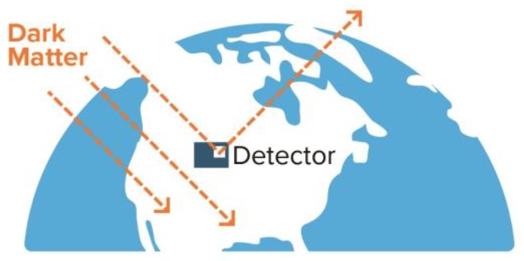
1. A brief review of Direct Detection
Accelerator
Direct Detection
Indirect Detection
Can only produce DM
Model dependent
Local DM Distribution
Background
Limited mass range
Astro uncertainties
DM distribution in halos
Product propagation

Slide 5
1. A brief review of Direct Detection
Quantum Precision
Gravitational Wave
At its infancy
Works for bosonic DM
(ALP, Ultralight scalar)
Cosmo uncertainties
Works for some DM
(PBH, Ultralight scalar)
Wave-like
The Search for Dark Matter Is Dramatically Expanding !

Slide 6
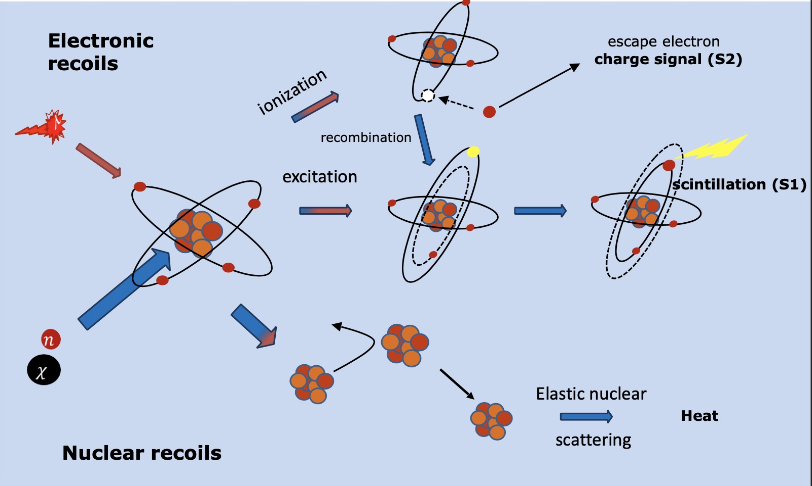
1. A brief review of Direct Detection

Slide 7
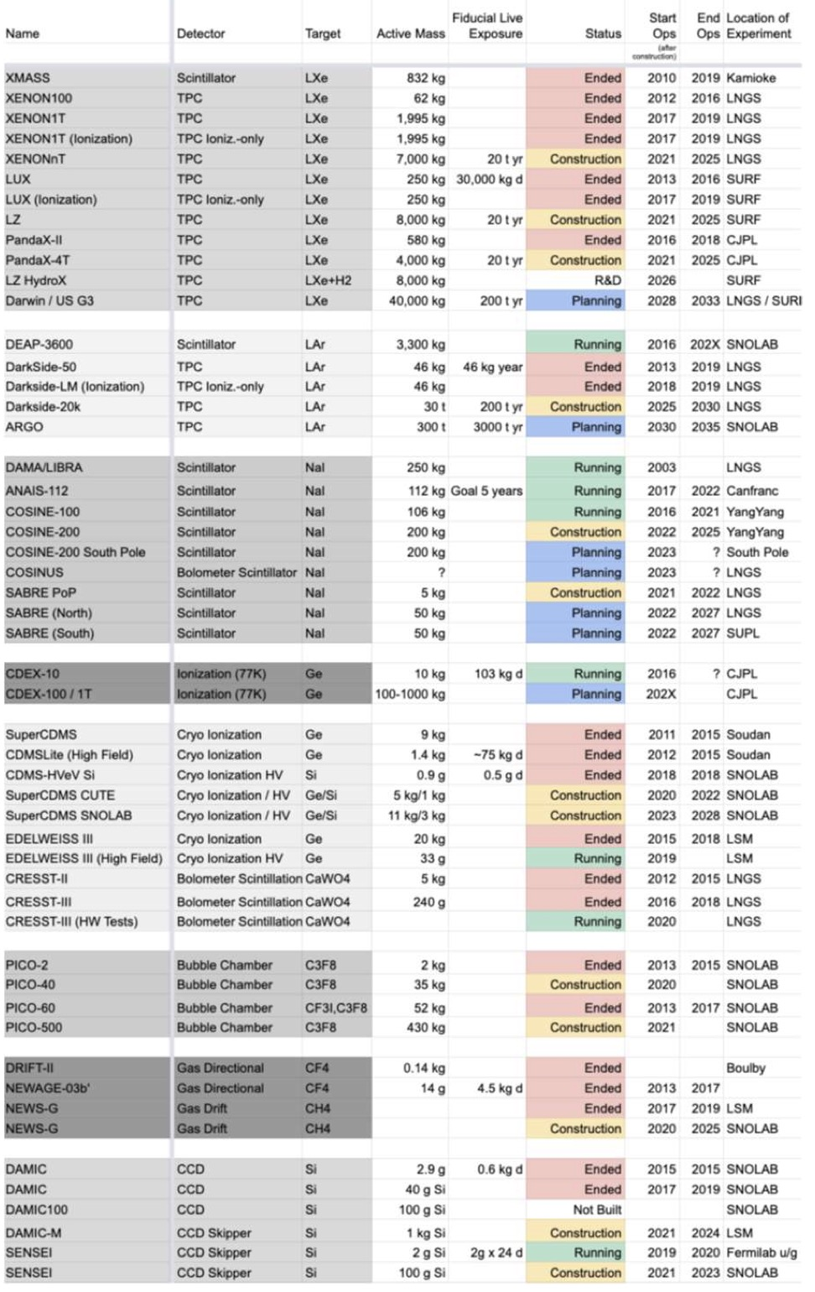
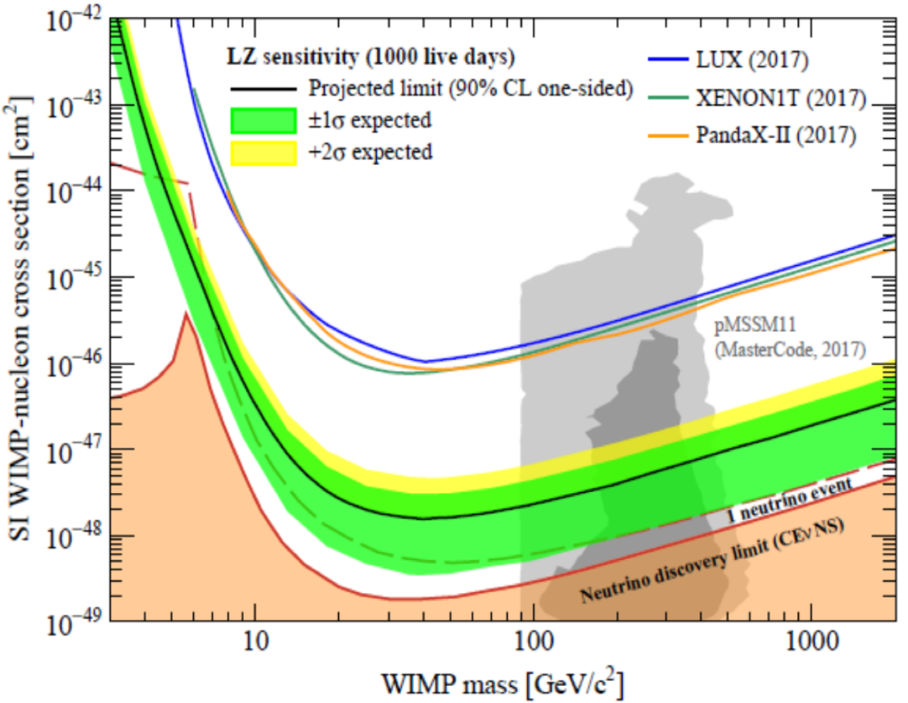
1. A brief review of Direct Detection
Ended: 22
Running: 8+1
Construction: 12
Planning: 7

Slide 8
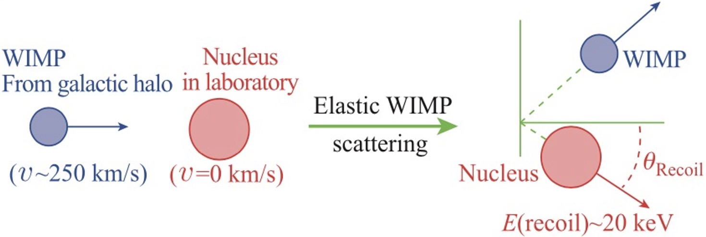

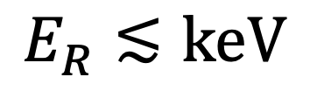
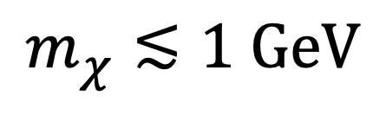
1. A brief review of Direct Detection
$$m_{χ}≲1 GeV$$
$$E_{R}≲keV$$

Slide 9
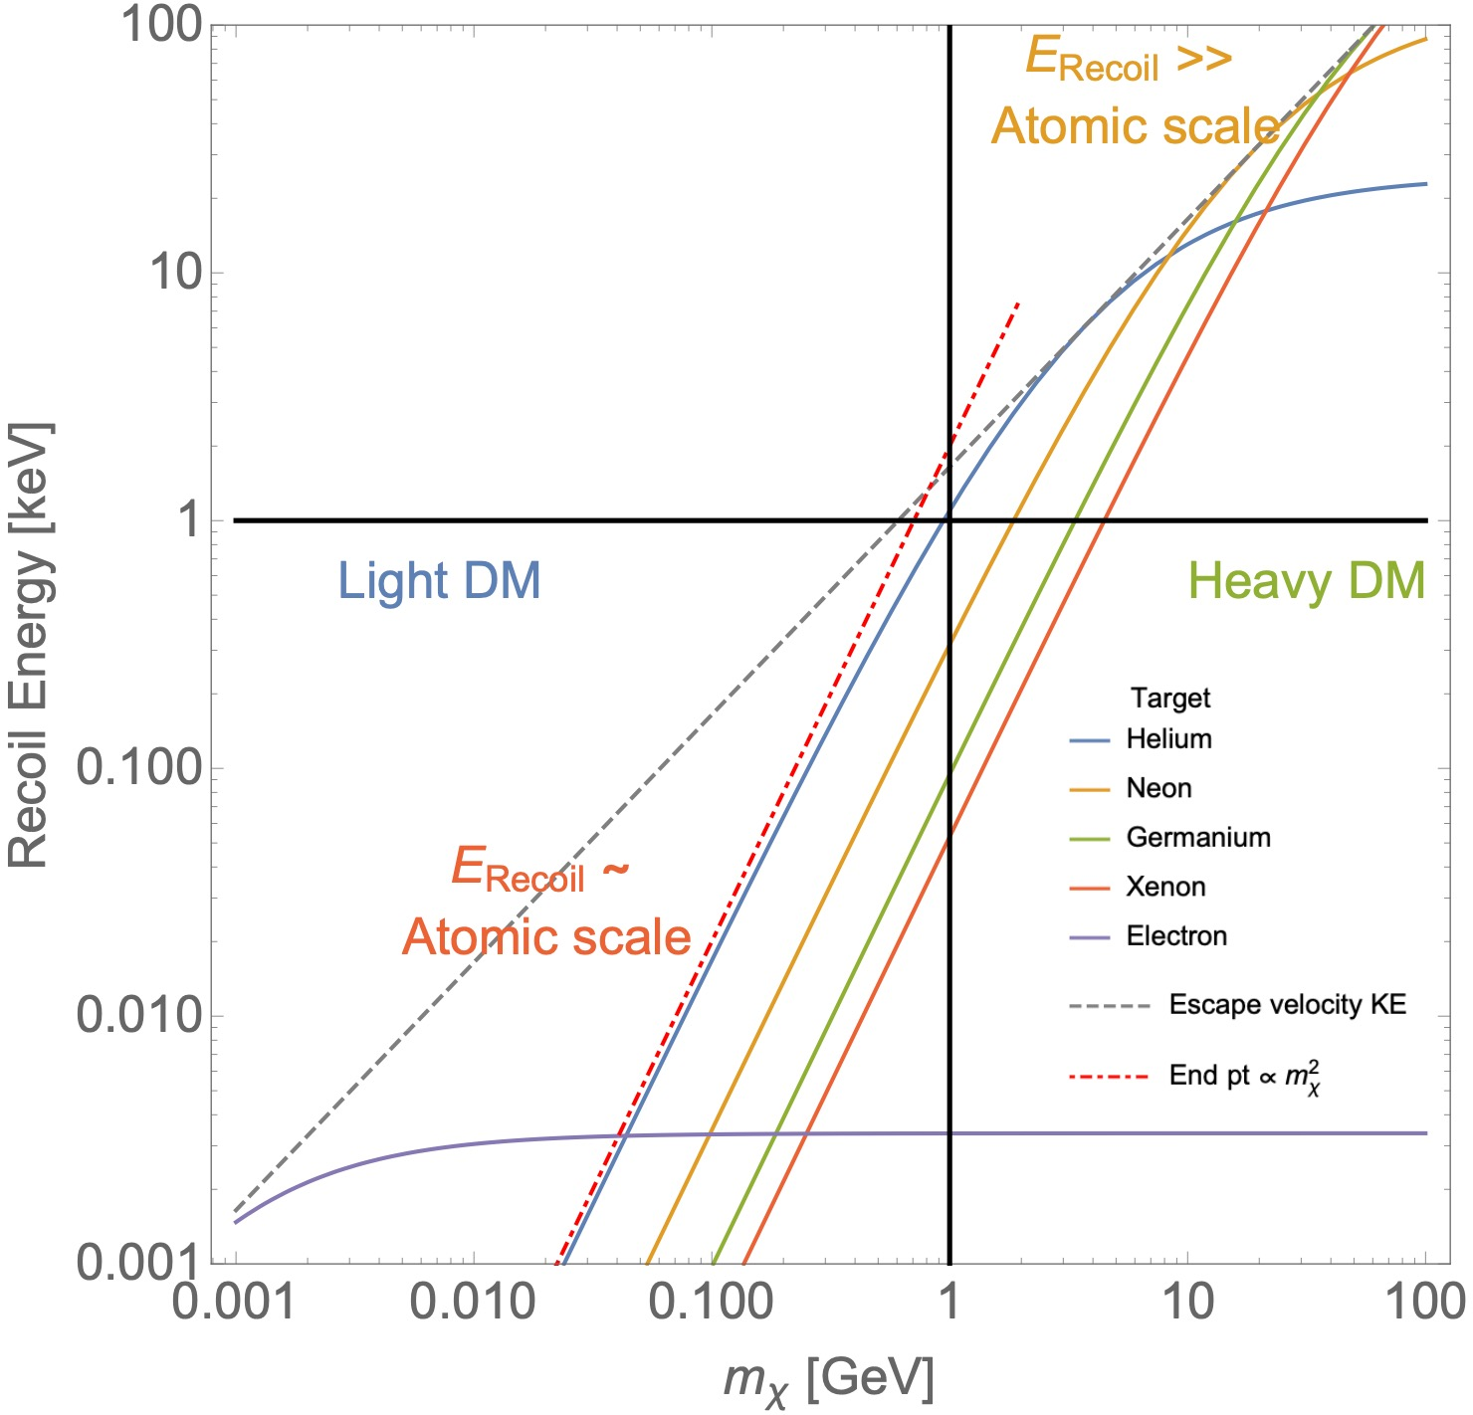

1. A brief review of Direct Detection
1. Extra Kinetic Energy
(Cosmic Rays, Sun…)
2. Inelastic Scattering
(Migdal, Bremsstrahlung…)

Slide 10



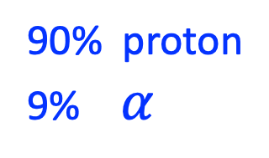
2. Cosmic Ray Boosted Dark Matter
Power law:
Components:
90% proton
9% $α$

Slide 11
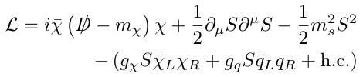
2. Cosmic Ray Boosted Dark Matter
Simplified Hadrophilic DM model
couple to quark
UV model, see e.g. 1507.00009, 1712.01847

Slide 12
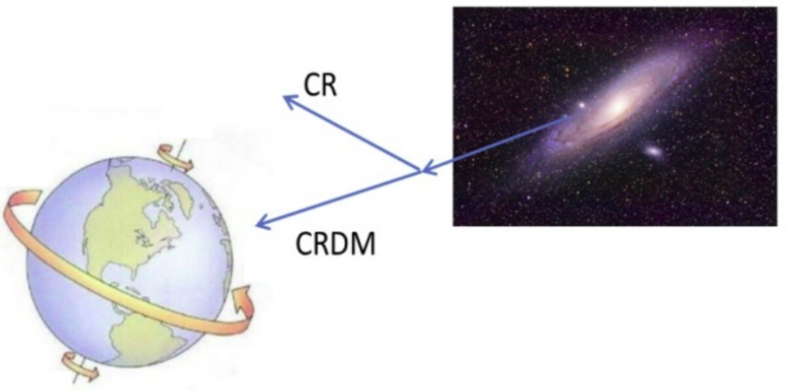
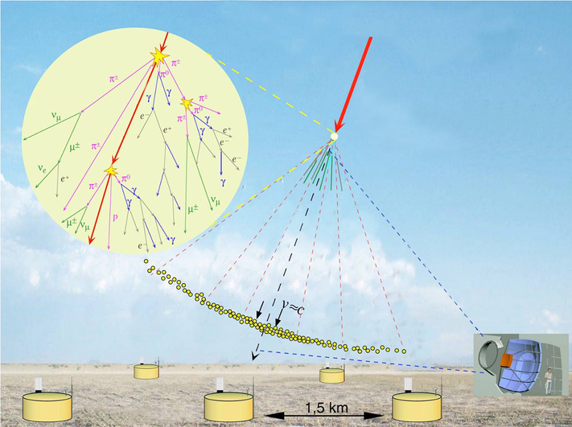
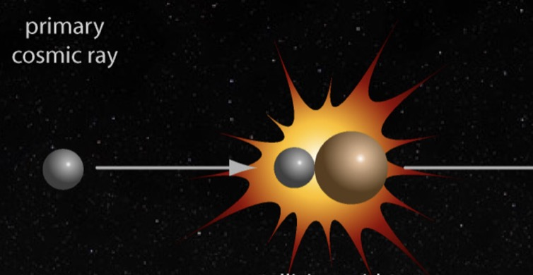
2. Cosmic Ray Boosted Dark Matter
CR scattering with DM
Beam-dump in the Sky
Astro-collider
CRDM, elastic scattering
1810.10543, Bringmann, Pospelov
ADM, inelastic scattering
2006.11837, Su, Wang, Wu, Yang and Zhu
Still thinking

Slide 13
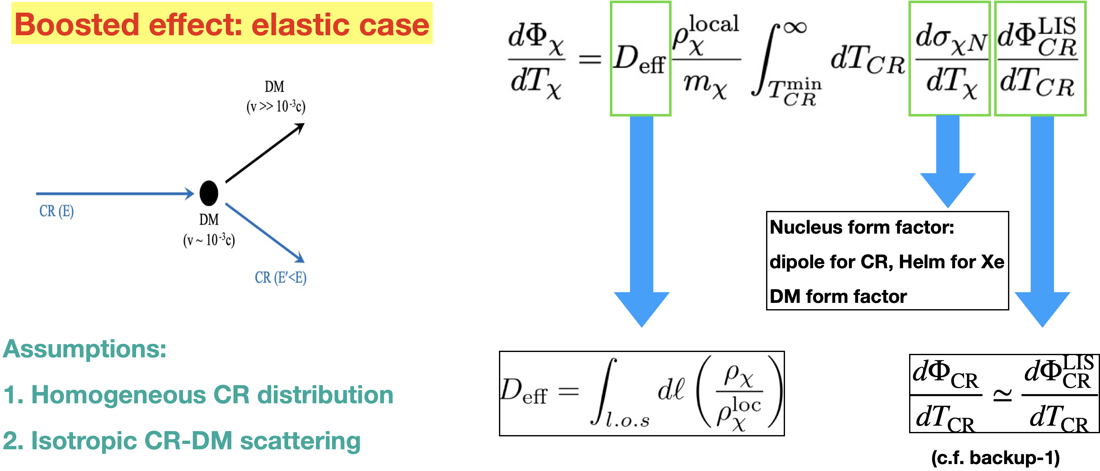
2. Cosmic Ray Boosted Dark Matter
Wang, Wu, Yang, Zhou, Zhu, 1912.09904

Slide 14
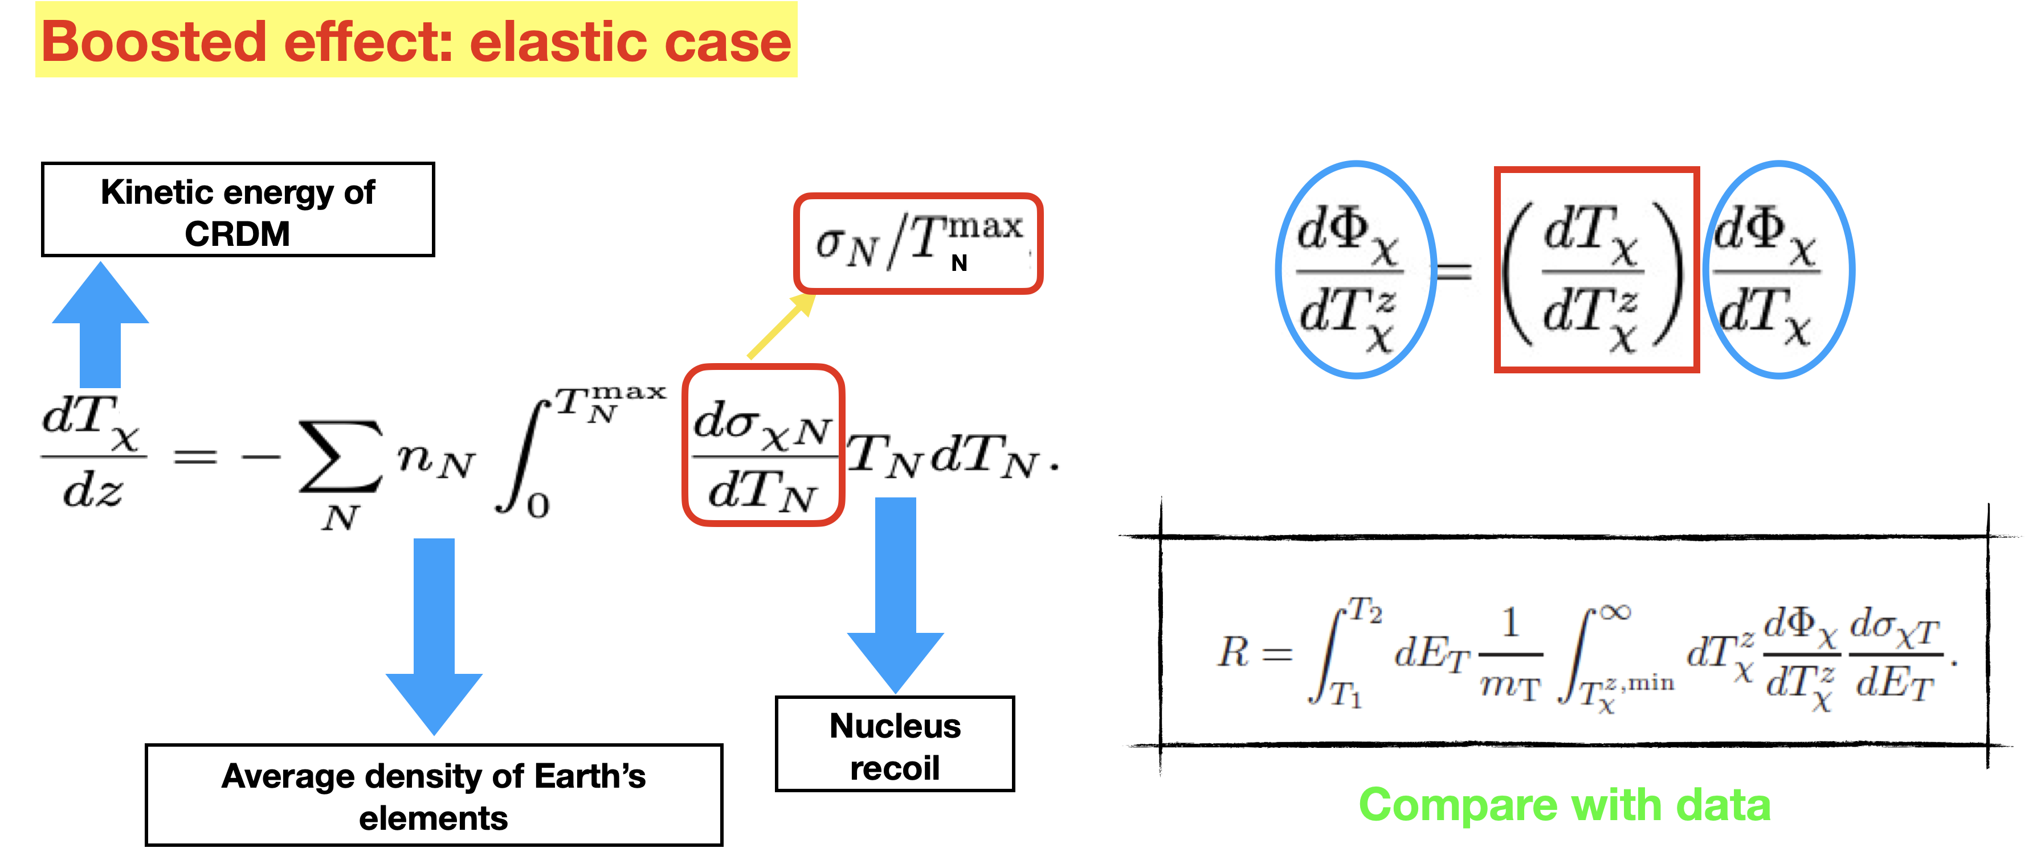
2. Cosmic Ray Boosted Dark Matter

Slide 15
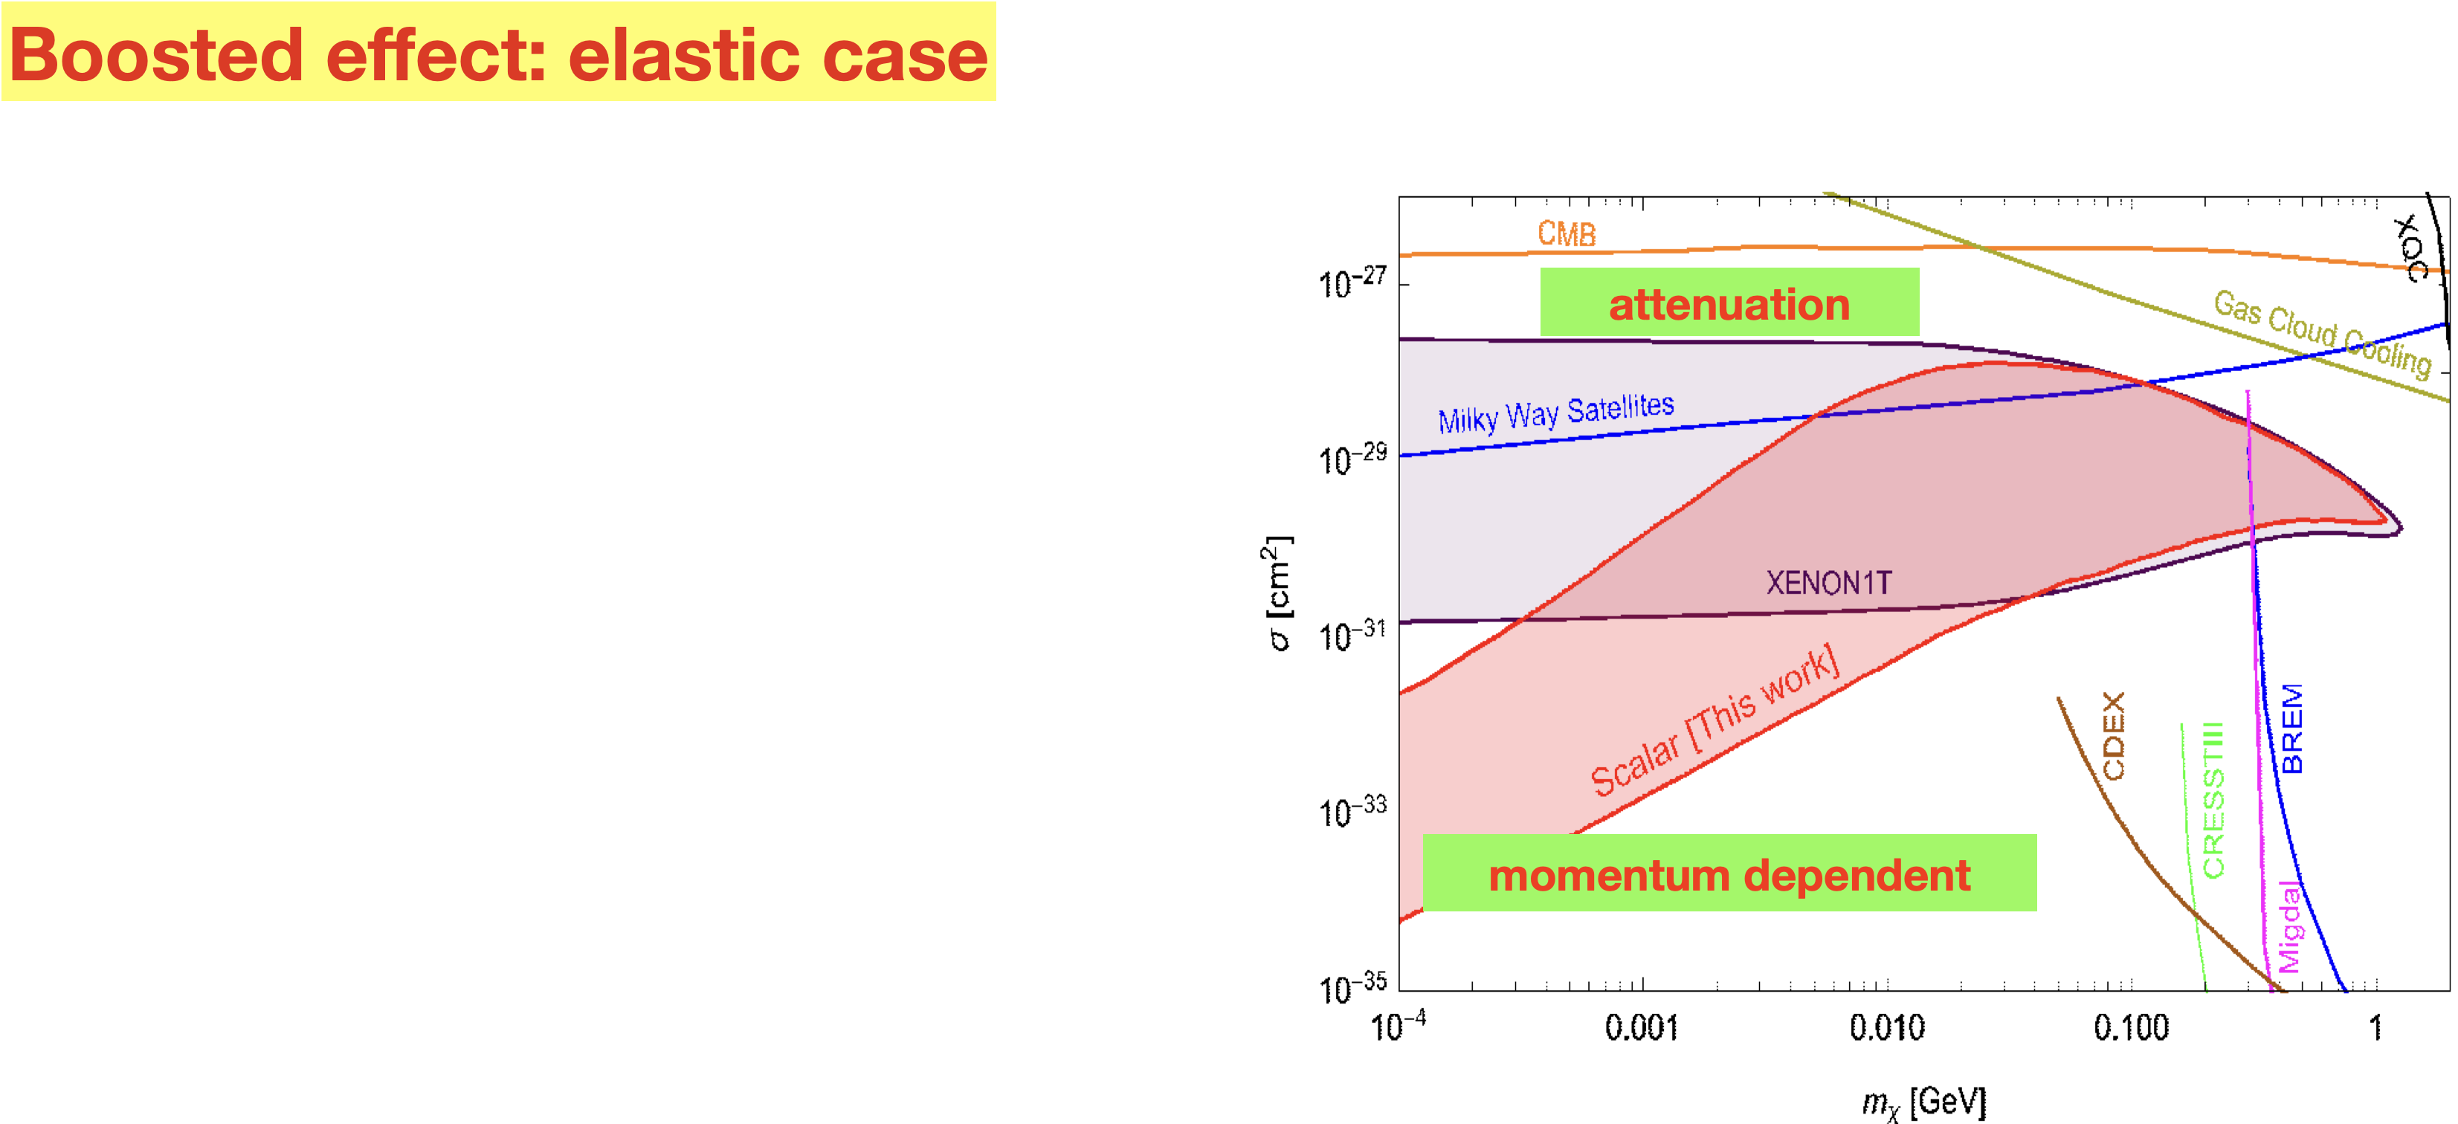
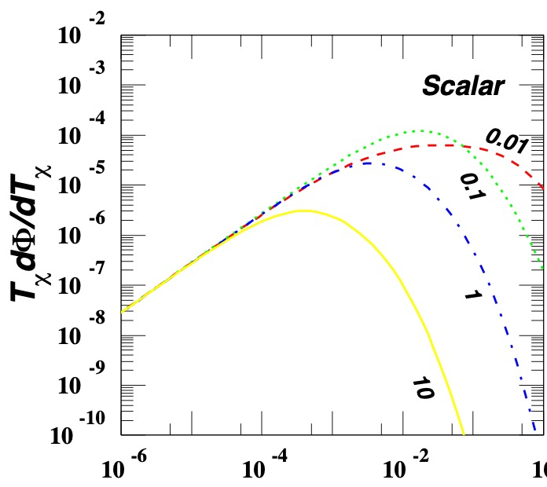
2. Cosmic Ray Boosted Dark Matter
Wang, Wu, Yang, Zhou, Zhu, 1912.09904

Slide 16
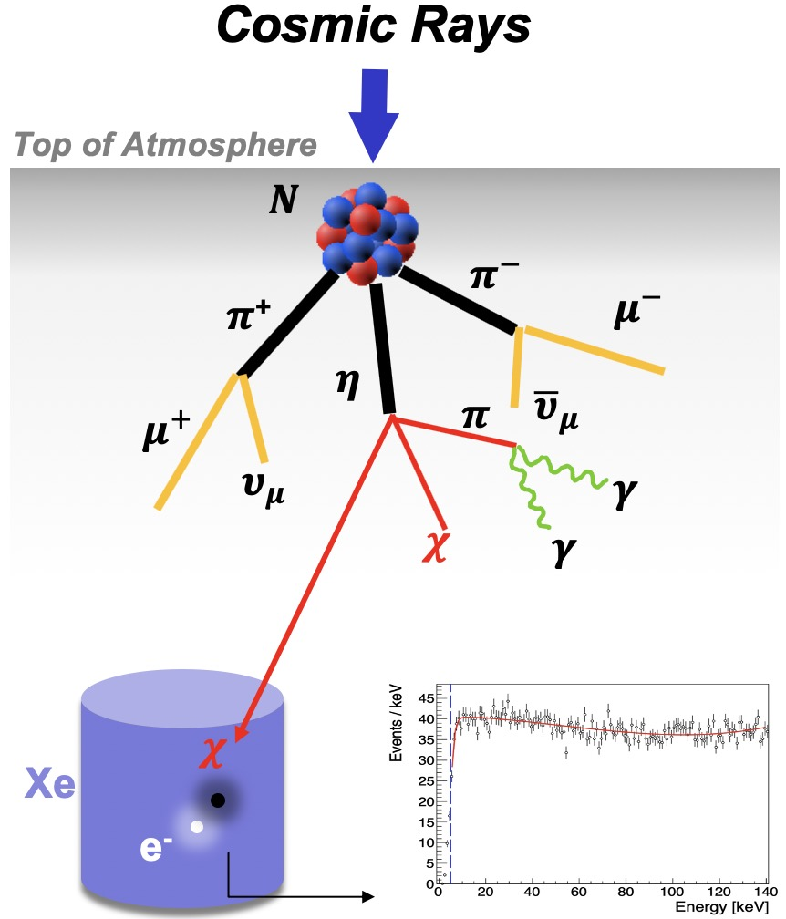
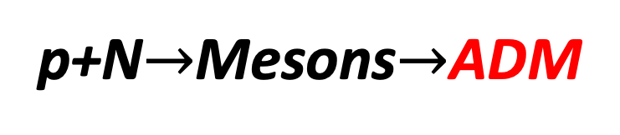
2. Cosmic Ray Boosted Dark Matter
Boosted effect: inelastic case
Wang, Su, Wu, Yang, Zhu, 2012.09751
Flambaum, Su, Wu, Zhu, 2006.11837
p+N$→$Mesons$→$ADM

Slide 17
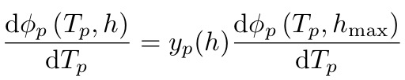
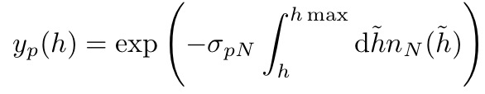


2. Cosmic Ray Boosted Dark Matter
Boosted effect: inelastic case
Step-1. Differential Cosmic Ray Flux
Dilution factor:
$$h_{max}=180km$$
CRMC: simulate the collision of incoming CRs with the nitrogen

Slide 18
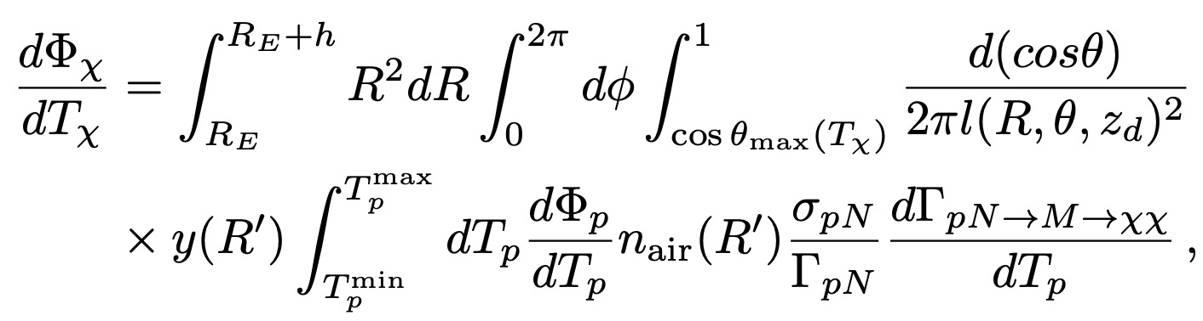





2. Cosmic Ray Boosted Dark Matter
Boosted effect: inelastic case
Backward
Step-2. attenuation of ADM flux
~1.4km
Forward
DM
$$ℓ$$
h
$$z_{d}$$
~6300km
$$ℓ_{E}$$
Detector
$$θ$$
$$R_{E}−z_{d}$$
P
Earth

Slide 19
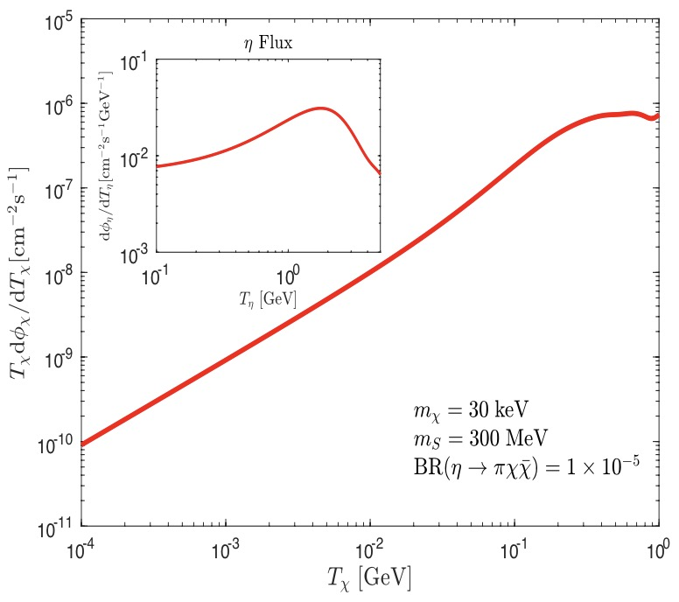

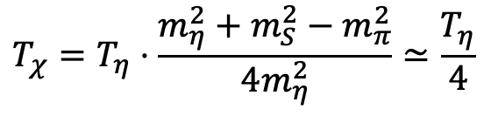

2. Cosmic Ray Boosted Dark Matter
Boosted effect: inelastic case
Power law of primary CRs
$$T_{χ}=T_{η}⋅\frac{m_{η}^{2}+m_{S}^{2}−m_{π}^{2}}{4m_{η}^{2}}≃\frac{T_{η}}{4}$$
$$pN→η→πS(→χ\overline{χ})$$

Slide 20
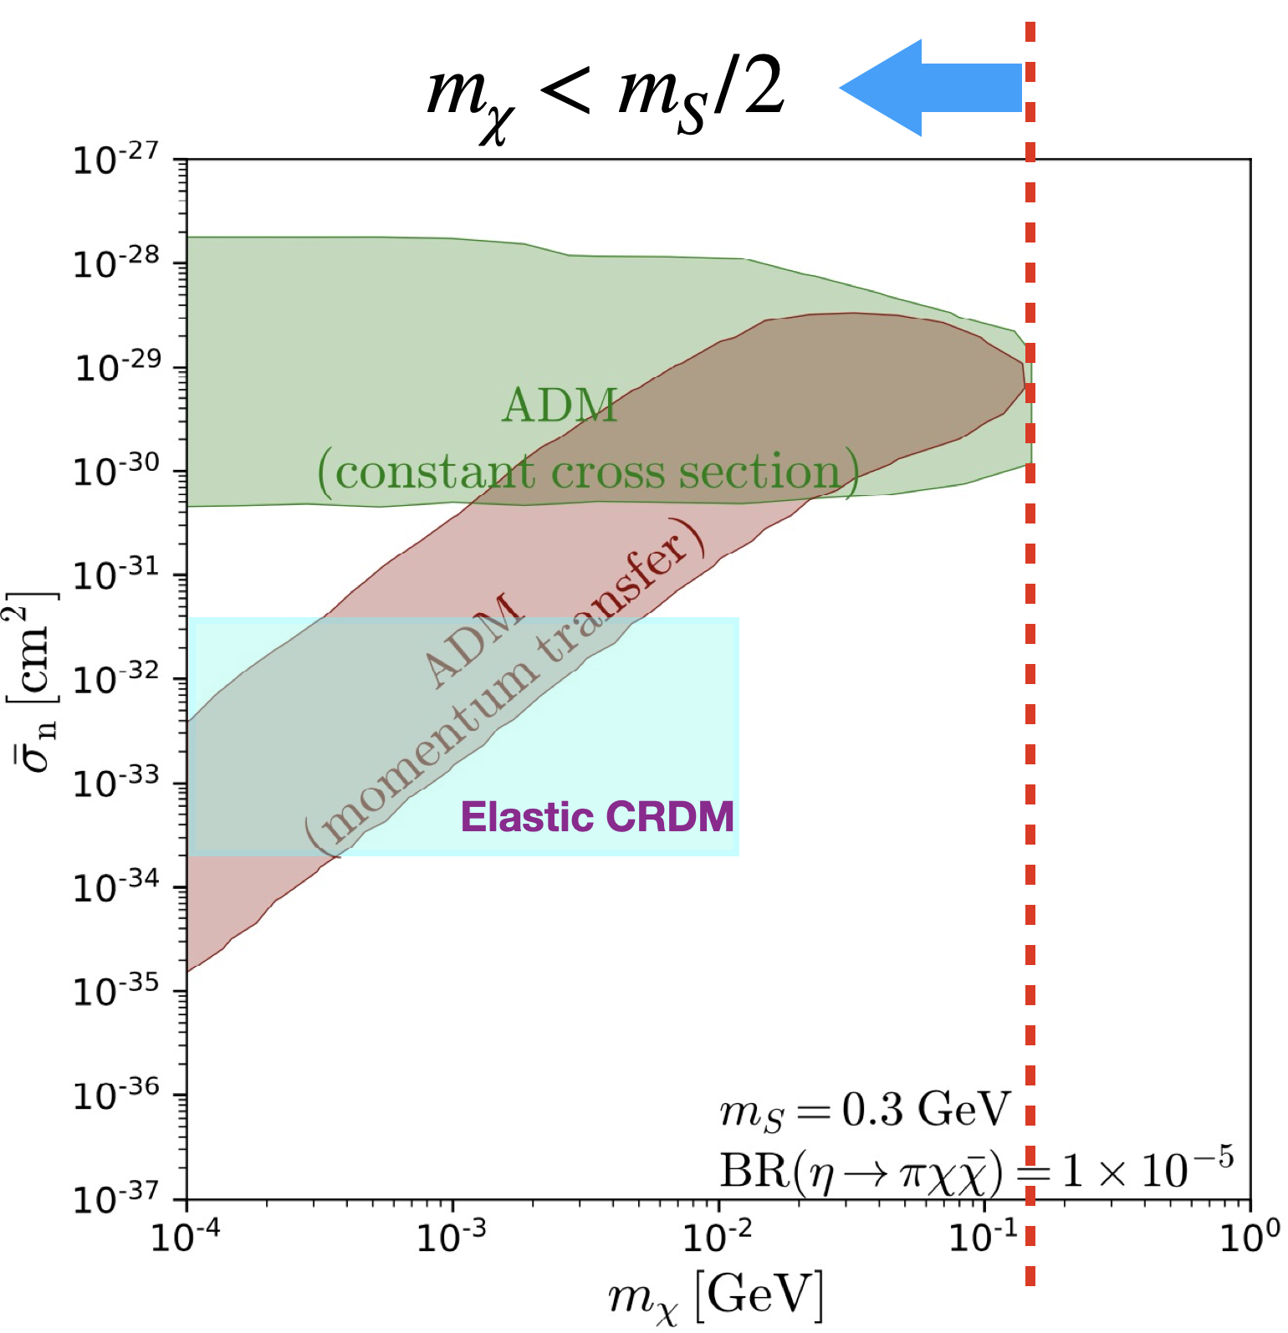
2. Cosmic Ray Boosted Dark Matter
Boosted effect: inelastic case

Slide 21
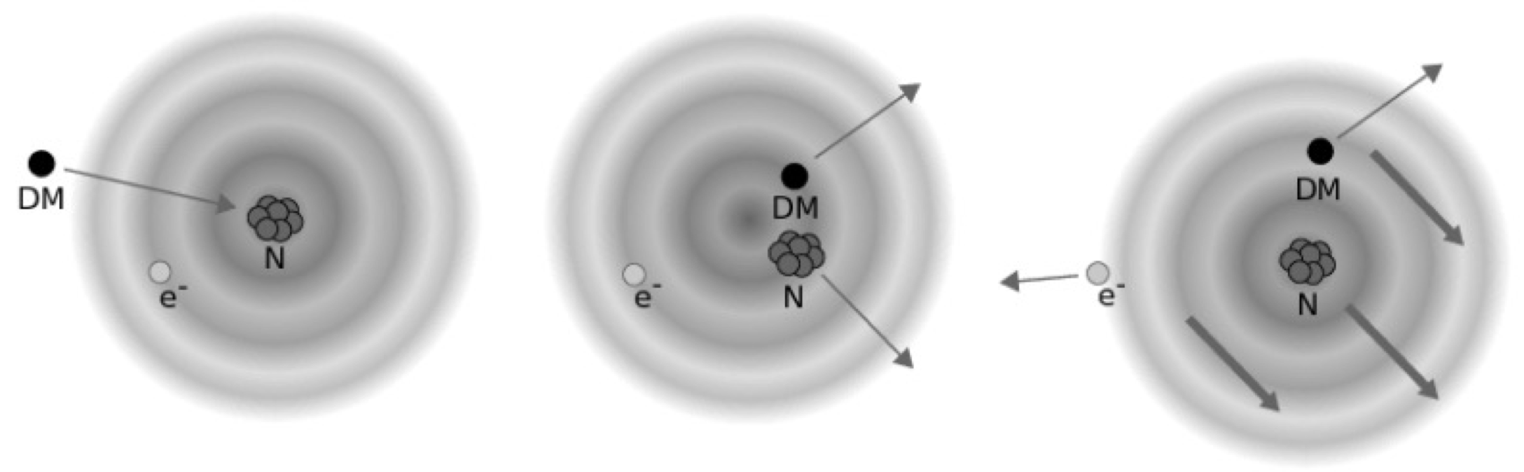
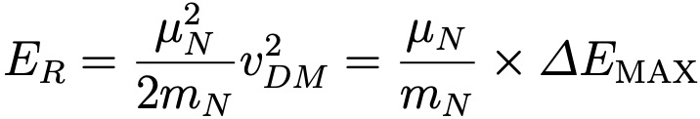
3. Migdal Scattering
Migdal effect is an ionization mechanism:
Electron cloud does not immediately follow with the scattered nucleus
Atomic recoil energy is smaller than the the electron transition energy.

Slide 22
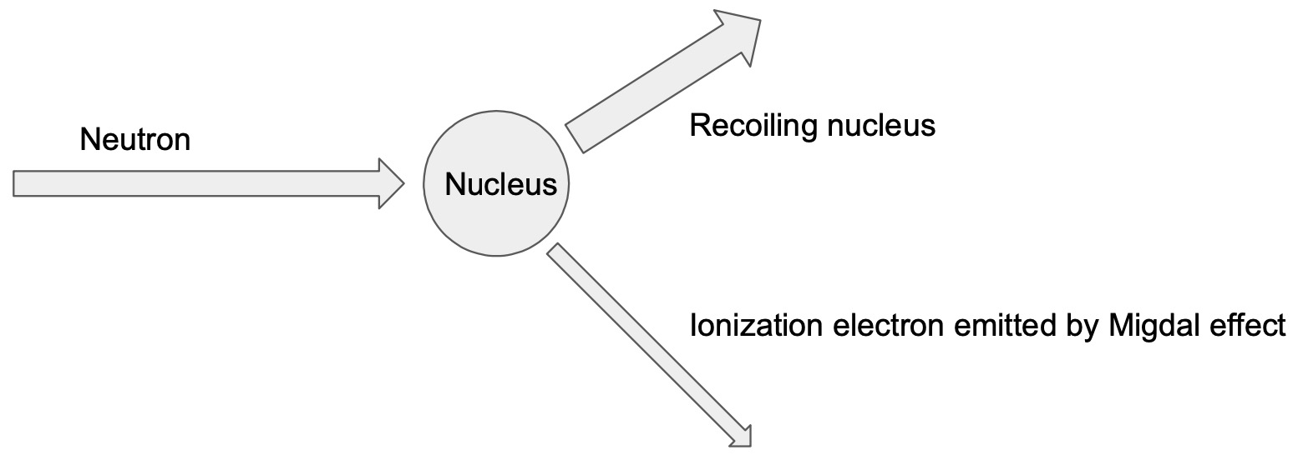
3. Migdal Scattering
Signal consists of two tracks that start from the same vertex:
Recoiling nucleus and Migdal ionization electron
DM

Slide 23
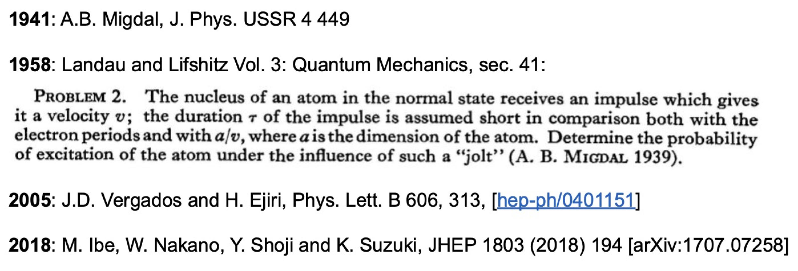
3. Migdal Scattering

Slide 24
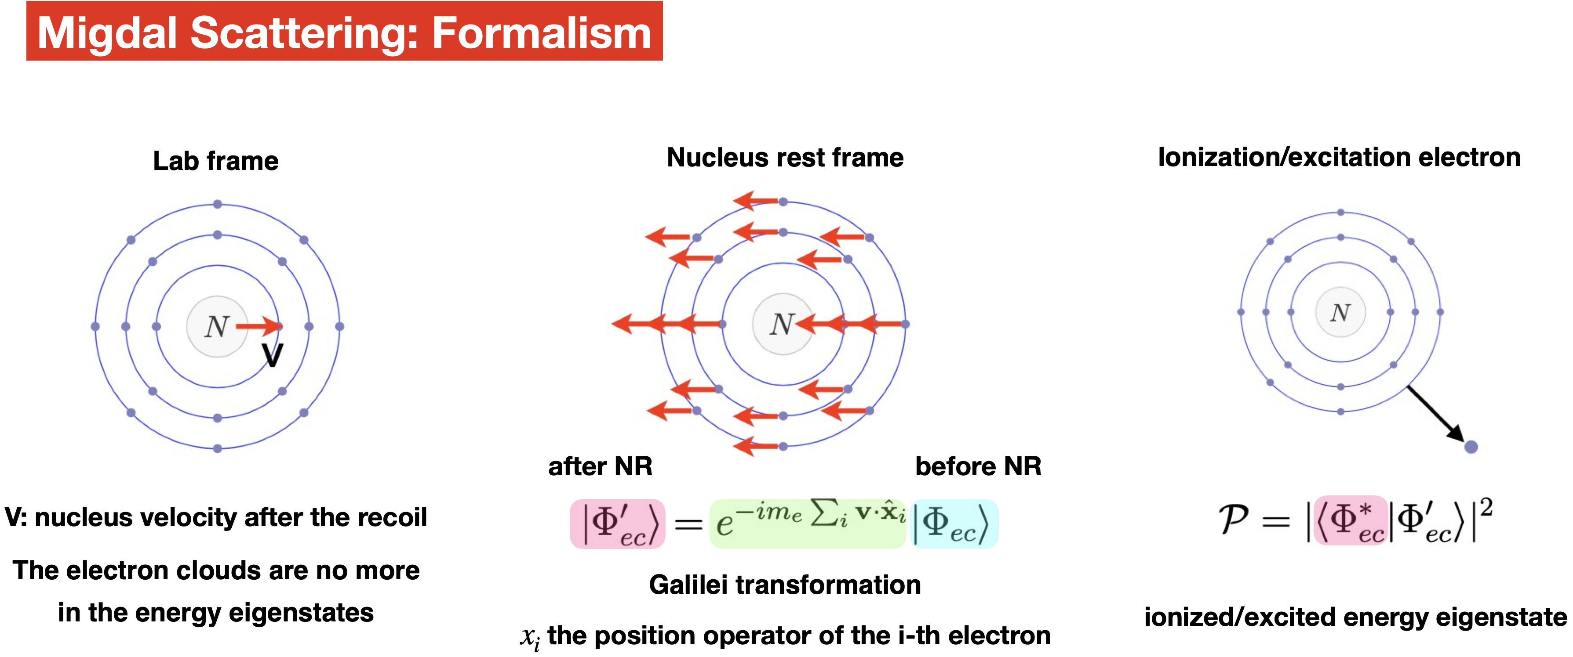
3. Migdal Scattering

Slide 25
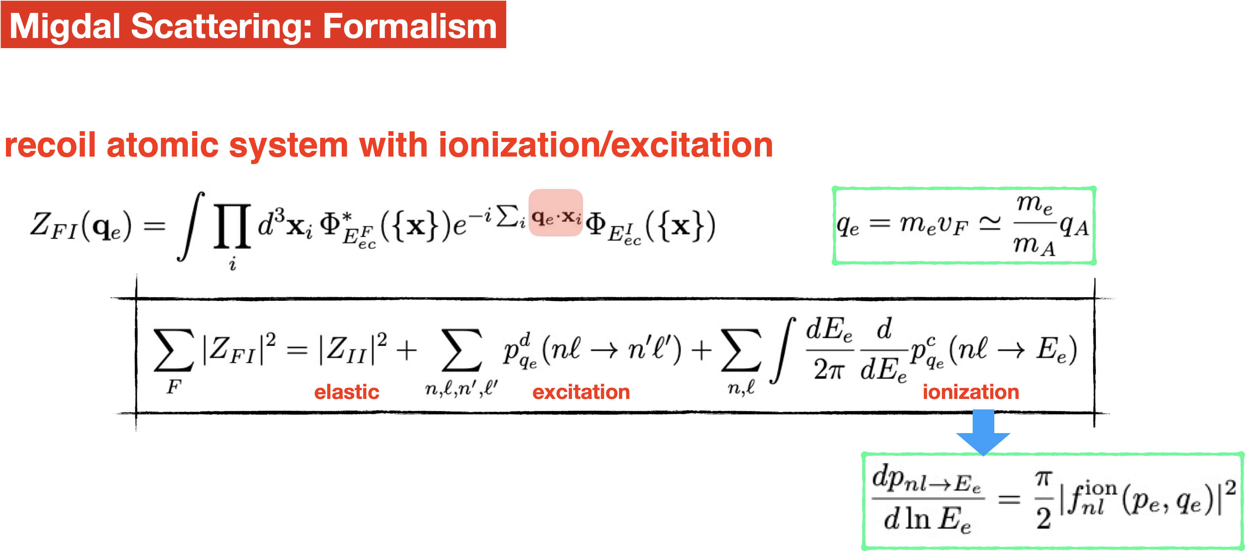
3. Migdal Scattering
Ionization factor

Slide 26
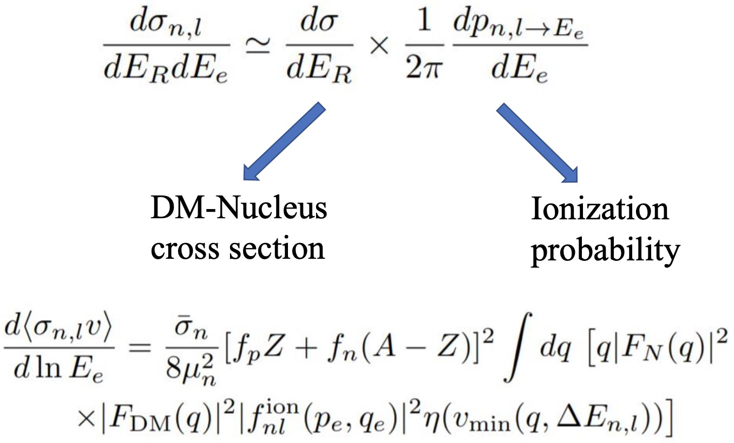
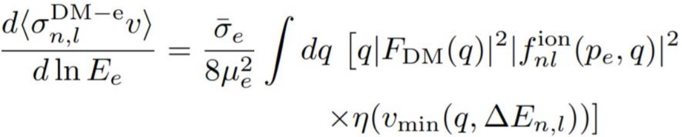
3. Migdal Scattering
Migdal Scattering: Formalism
DM-electron
coherent factor
Nucleus form factor
Ionization factor

Slide 27
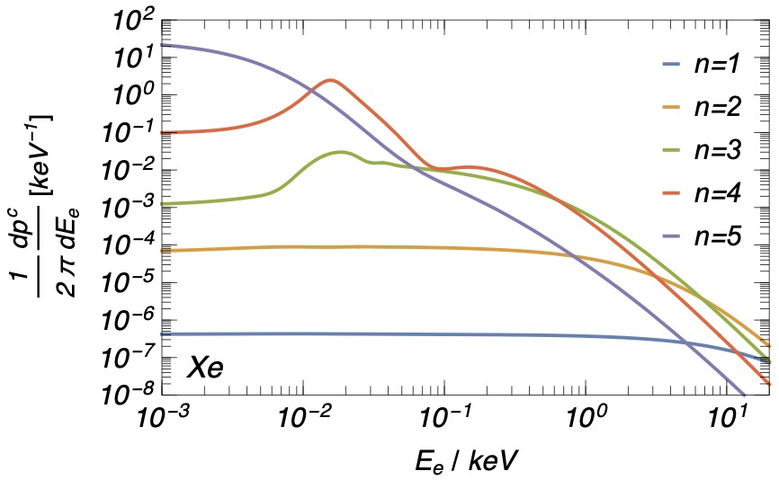
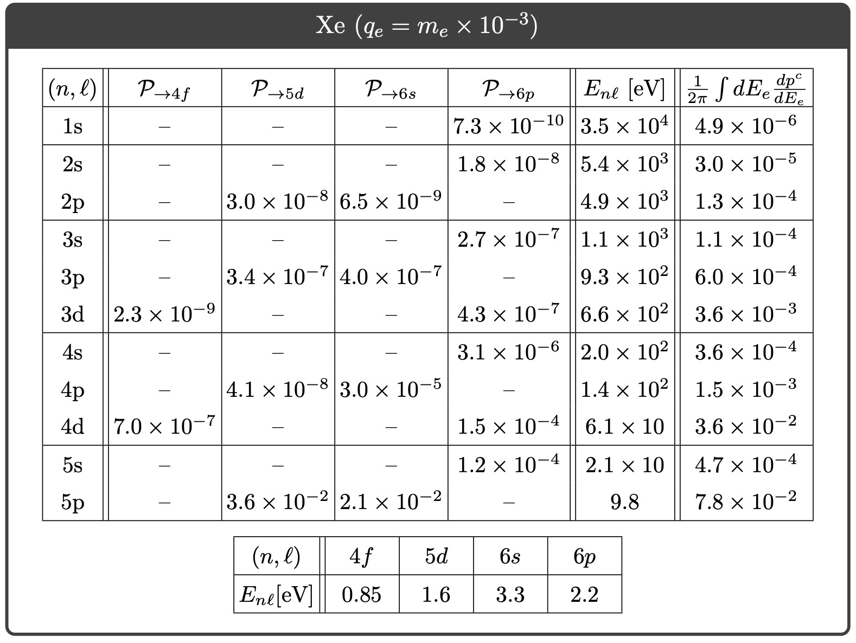
3. Migdal Scattering
Migdal Scattering: Formalism
Target dependent

Slide 28
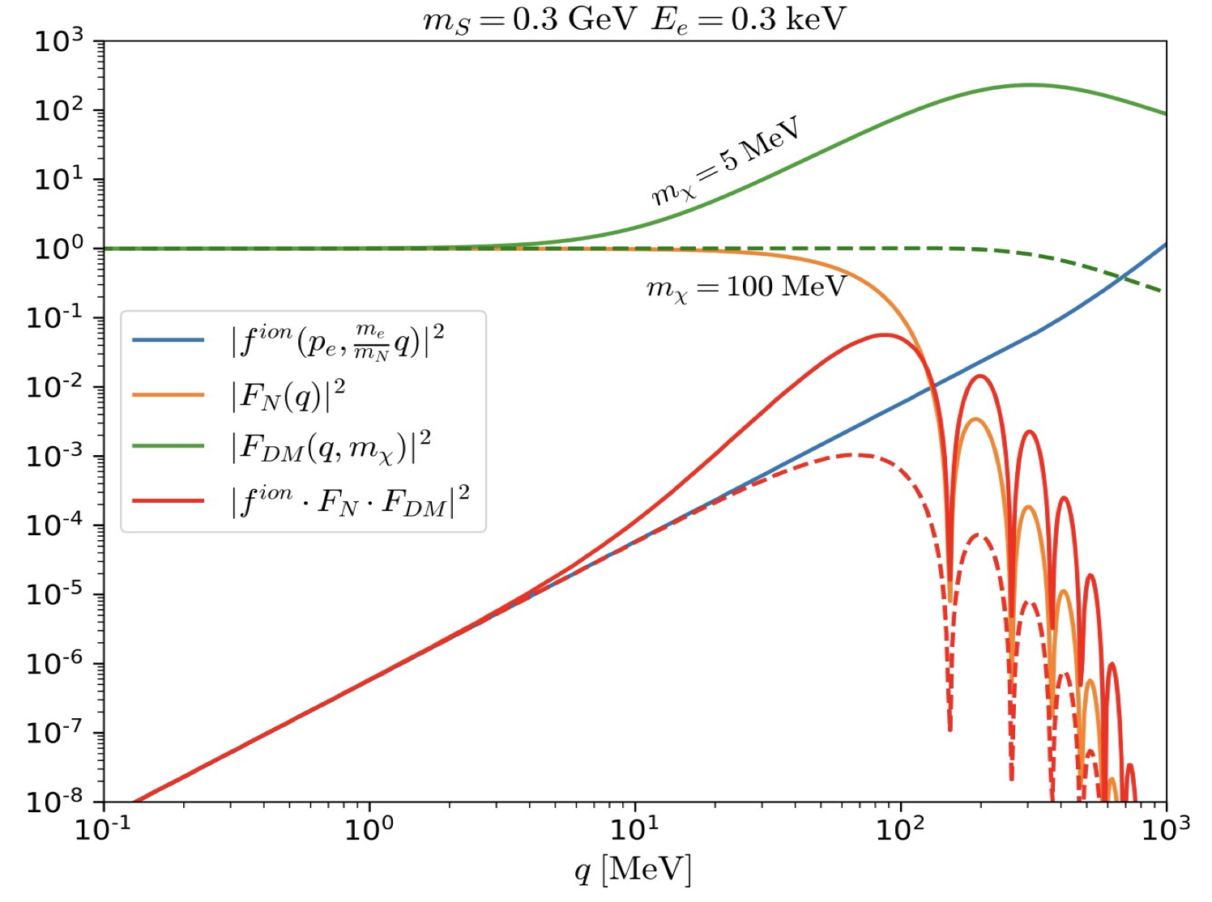
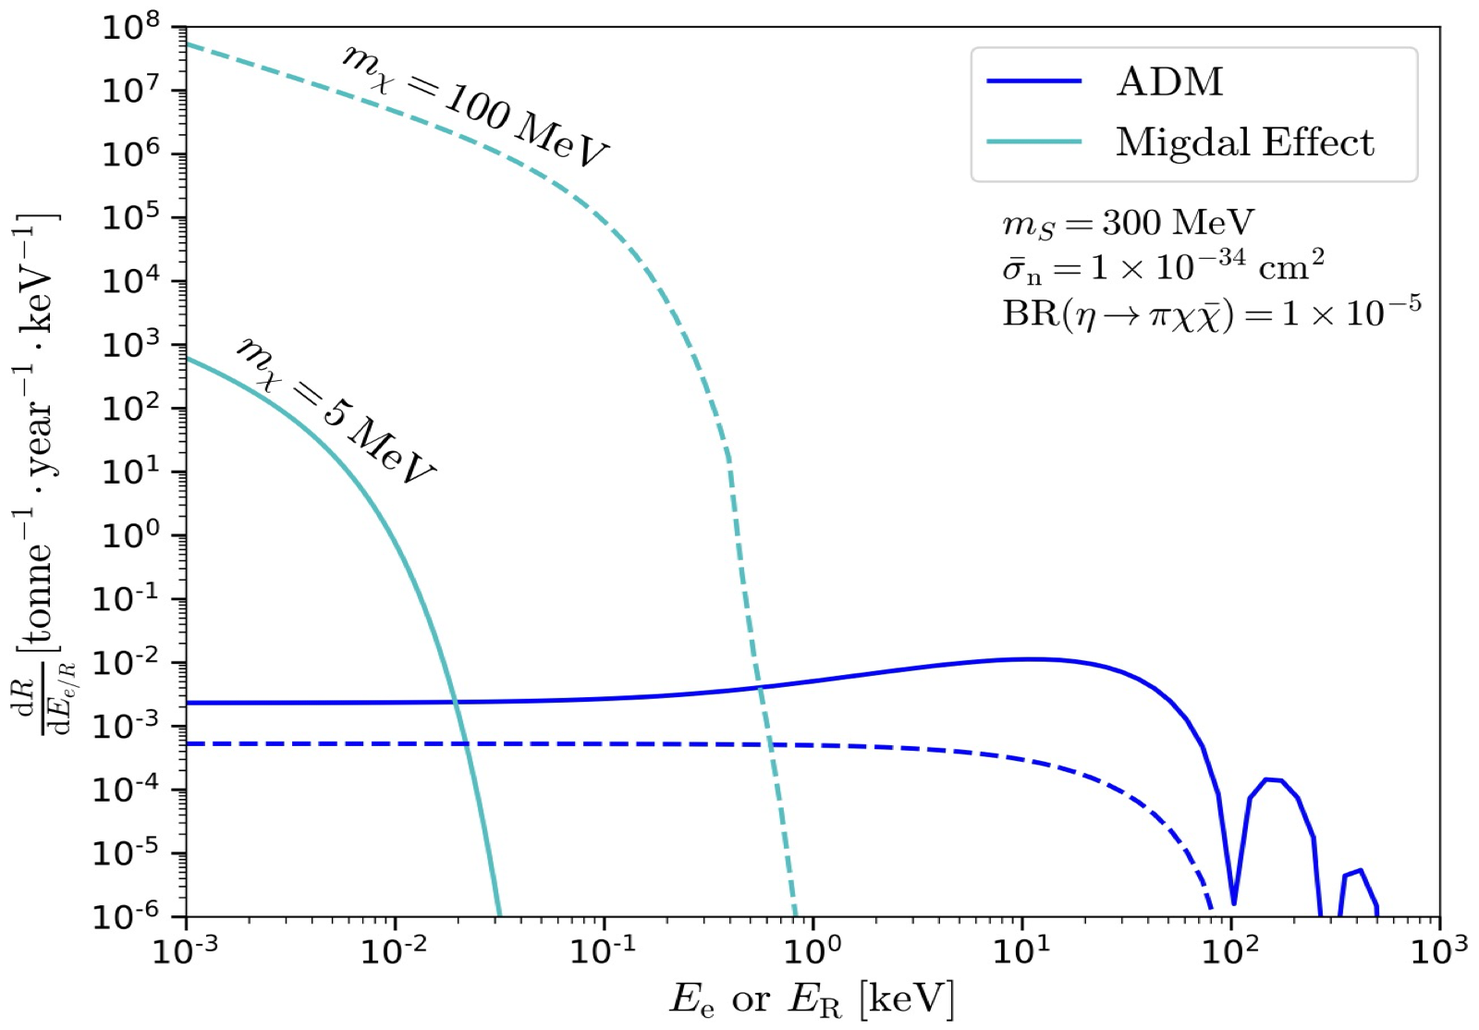
3. Migdal Scattering
Migdal Scattering:
Heavy: Migdal
Light: Boosted

Slide 29
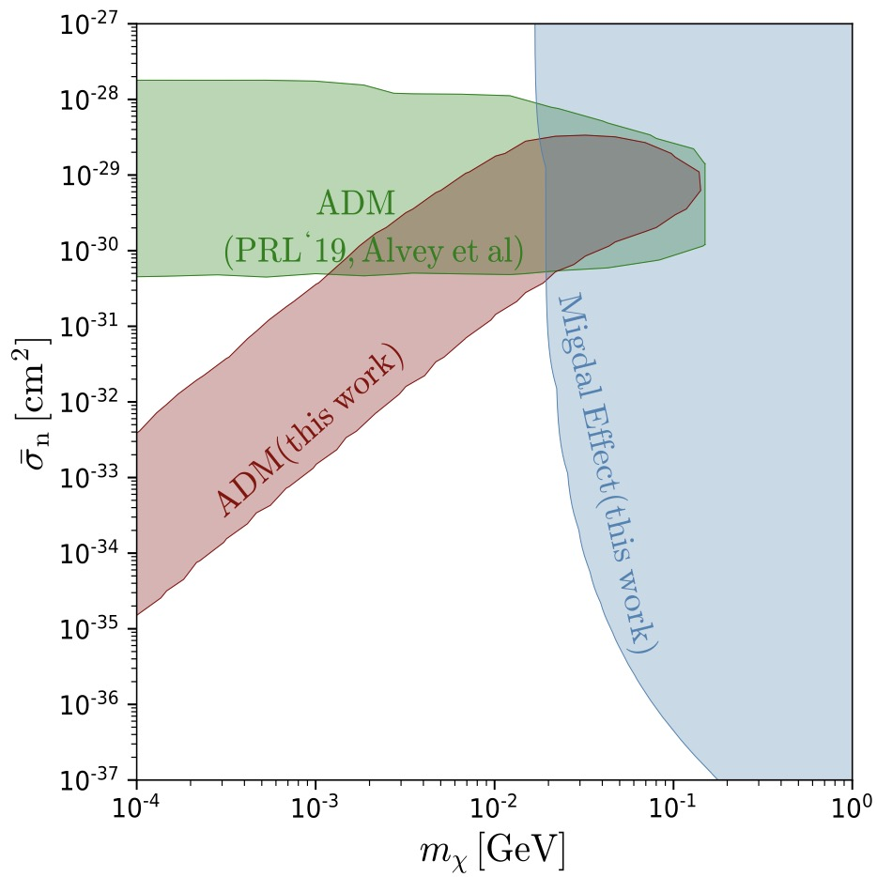
3. Migdal Scattering
Migdal Scattering:
Complementary

Slide 30
4. Conclusions
Boosted and Migdal effects:
extend the sensitivity of DM-nuclear interactions into MeV mass region
Sub-GeV DM:
Particle Physics, Astrophysics, Condensate matter …
More works:
Directionality, Deflection, Electron Structure …

Slide 31
Thank you very much!

Slide 32
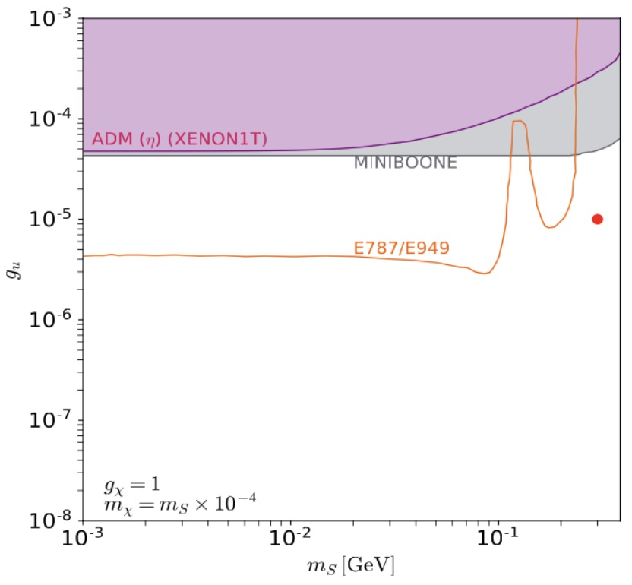
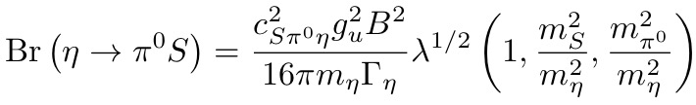





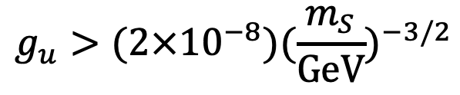
Constraints:
Pion decay:
$$Br(π→γχχ)≲{10}^{−7}$$
Kaon invisible decay @ E787/E949:
$$K→πν\overline{ν}$$
MiniBooNE (downstream):
$$pN→η→π^{0}S(→χ\overline{χ})$$
BBN:
$$g_{u}>(2×{10}^{−8})(\frac{m_{S}}{GeV})^{−3/2}$$
Xenon1T DM-nucleus scattering
$$2m_{χ}<m_{S}<m_{η}−m_{π}$$
$$∼{10}^{−5}$$

Slide 33
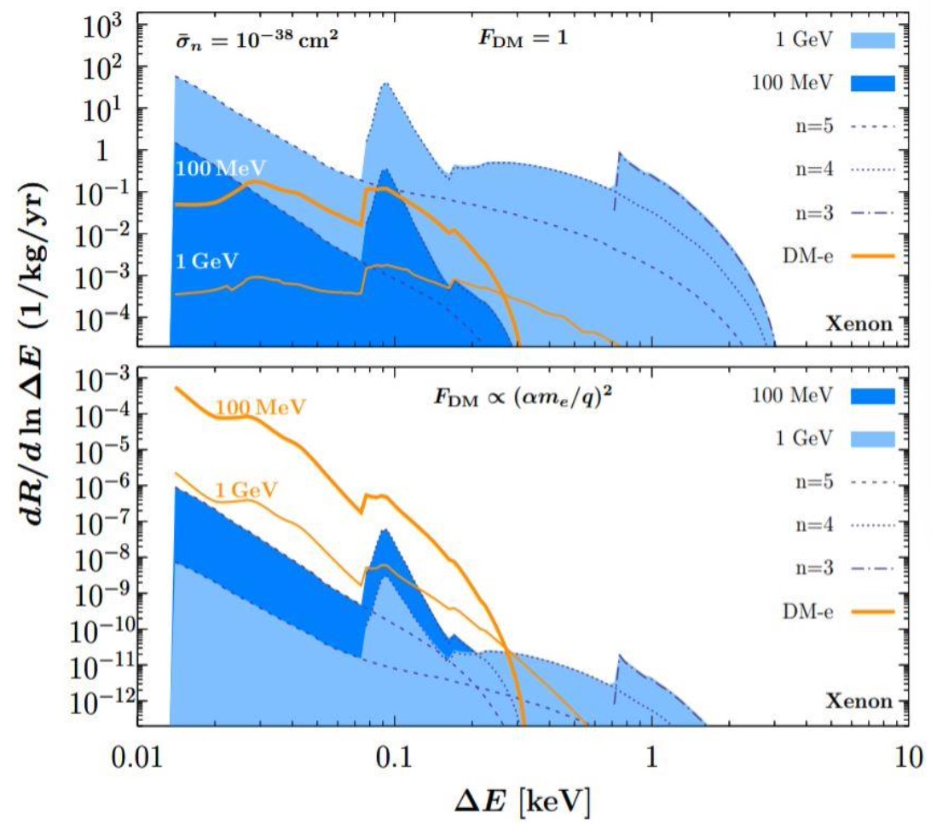
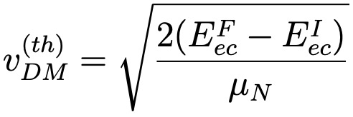
Xenon1T给的ER的阈值是
0.186keV

Slide 34
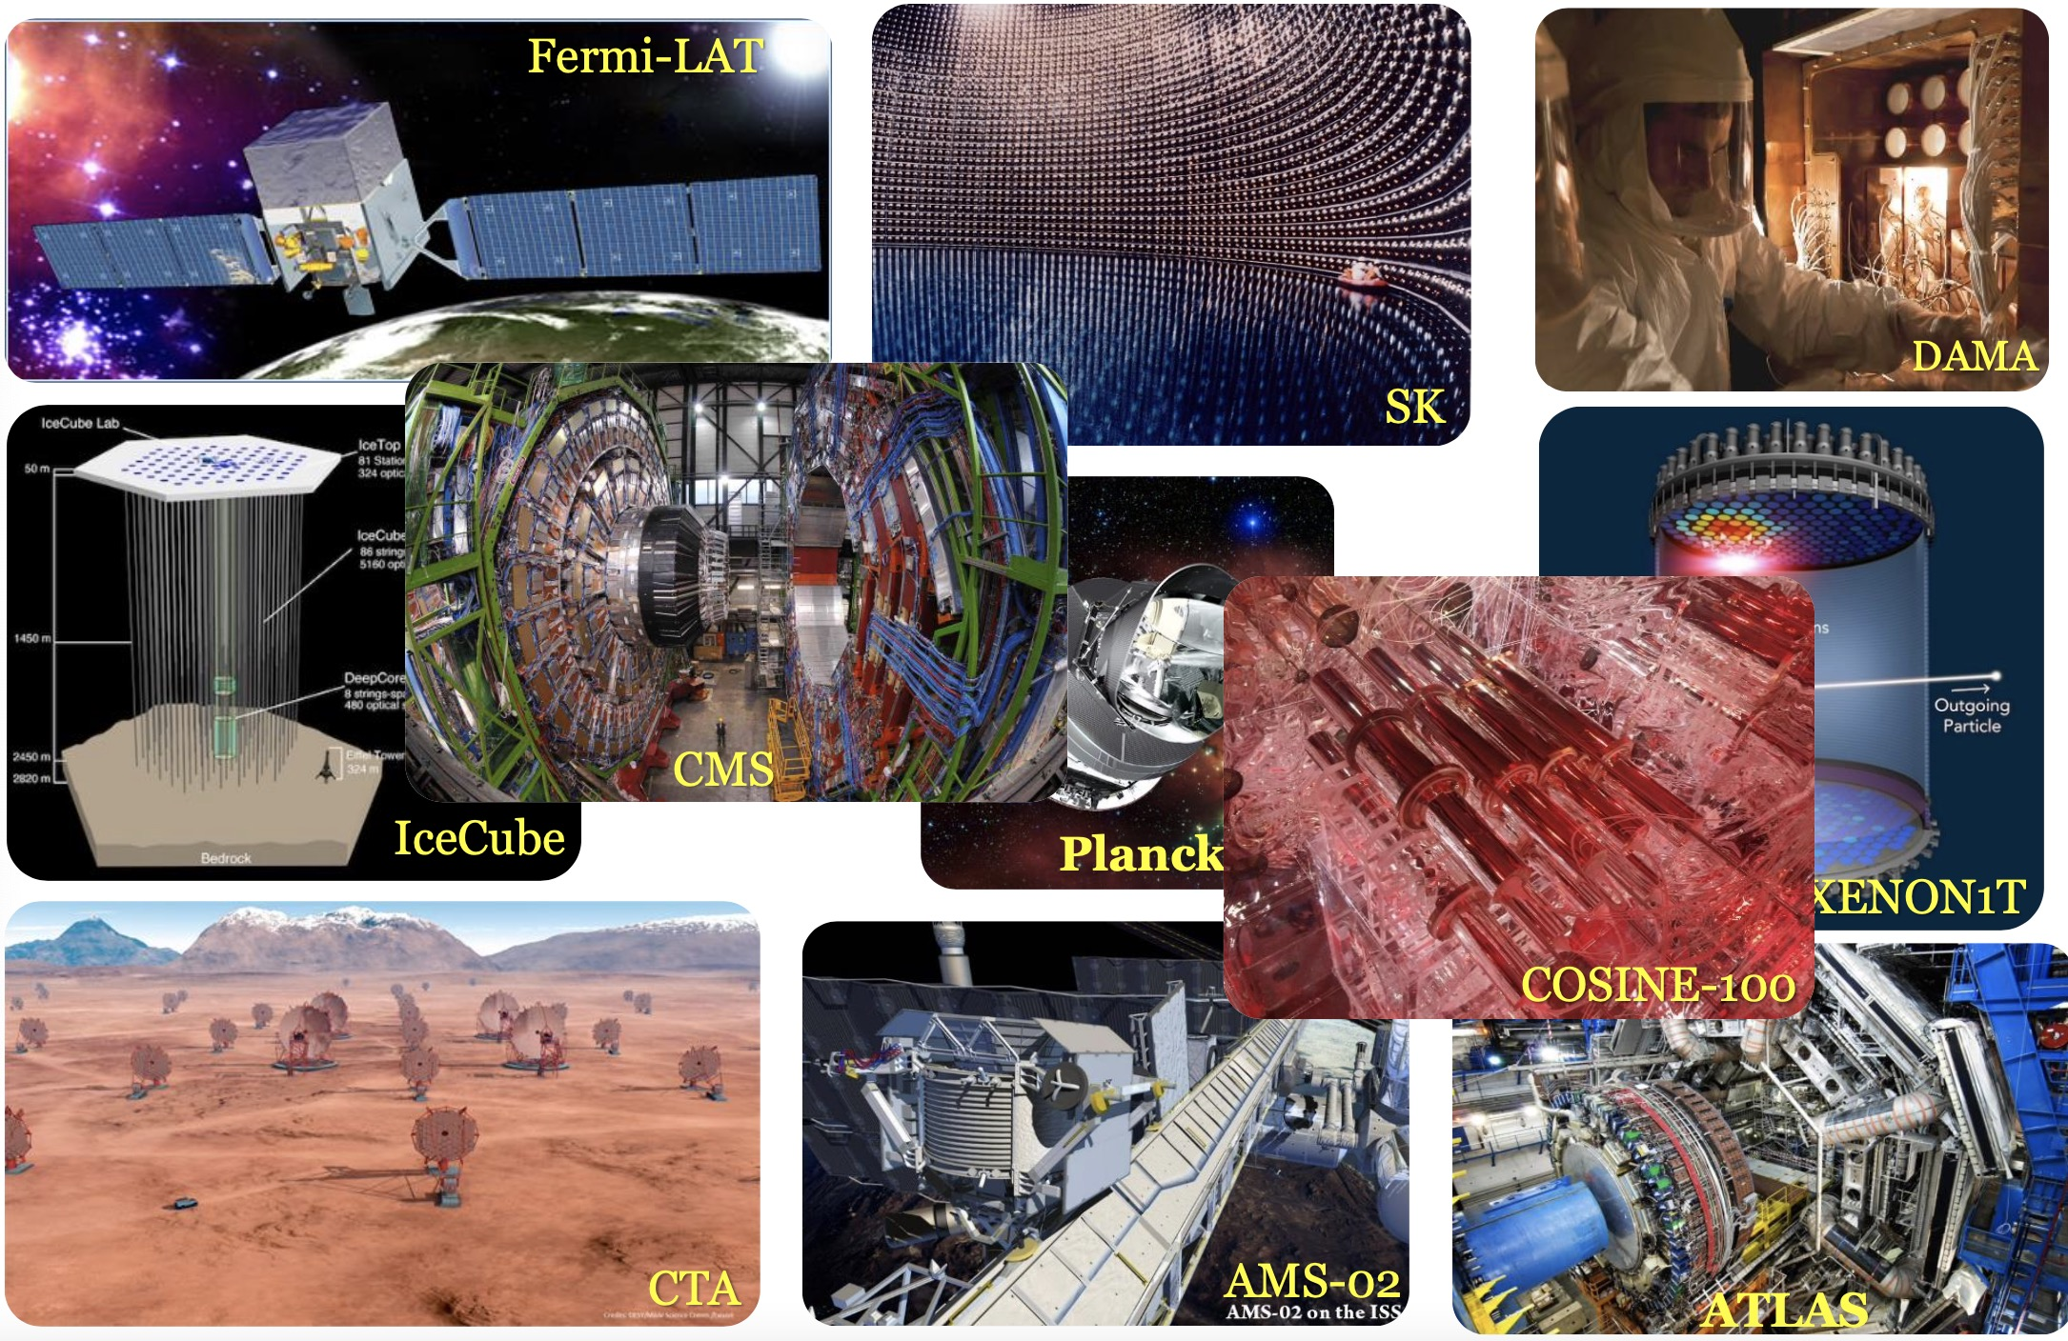
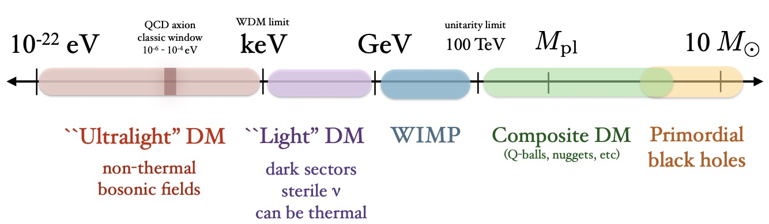

Slide 35
