Slide 1

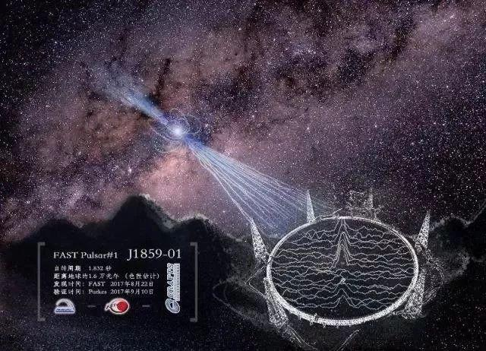
Gravitational wave and radio astronomy: Promising future of cosmology
Xin Zhang
Northeastern University
第十五届TeV物理工作组学术研讨会
2021年7月19日-22日
中国·北京

Slide 2
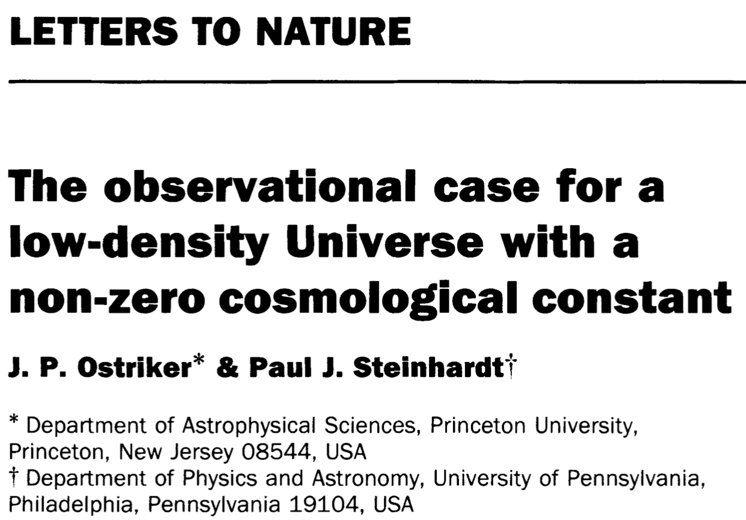
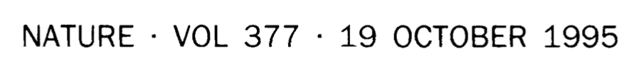
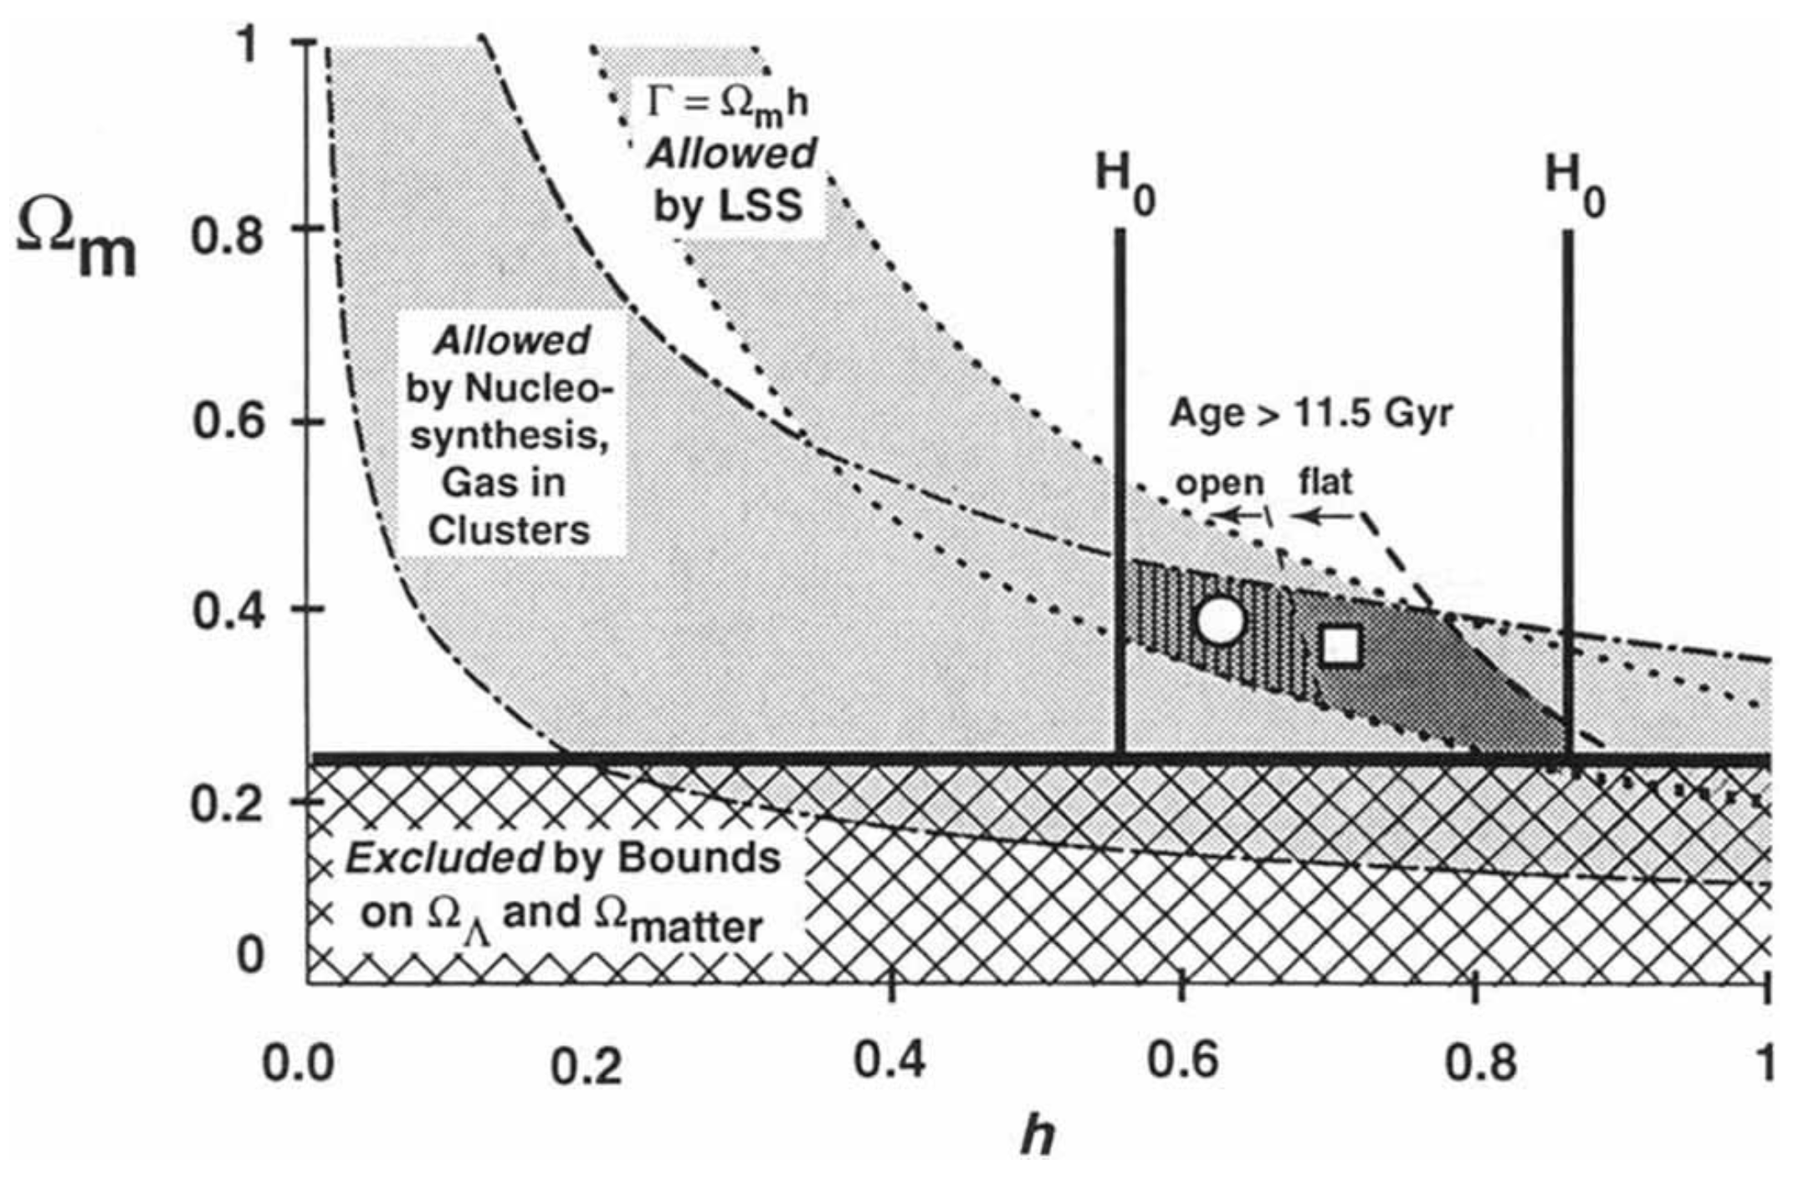
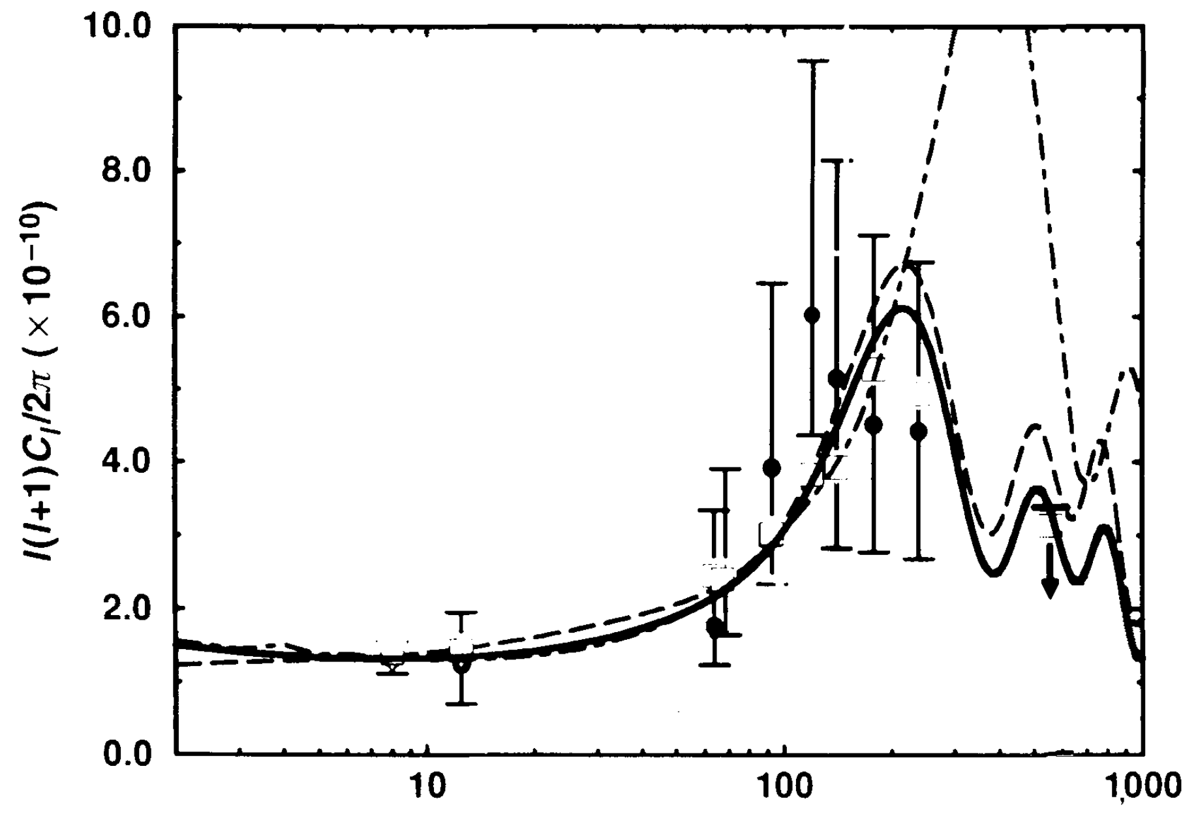
The cosmological constant & cosmic concordance
Crisis of cosmology in 1990s: inflation prediction (Ω=1) conflicts with low-density universe observations
As early as 1995 (pre-precision cosmology era, COBE), value of cosmological constant was speculated
Determining 𝛬CDM parameters (h=0.7, Ω_{m}=0.35)
Cosmic concordance! --- How important to combine multiple observations!
Concordance region: flat vs open
COBE: small scales favor flat model
l > 250 (10-30 arcmin)

Slide 3
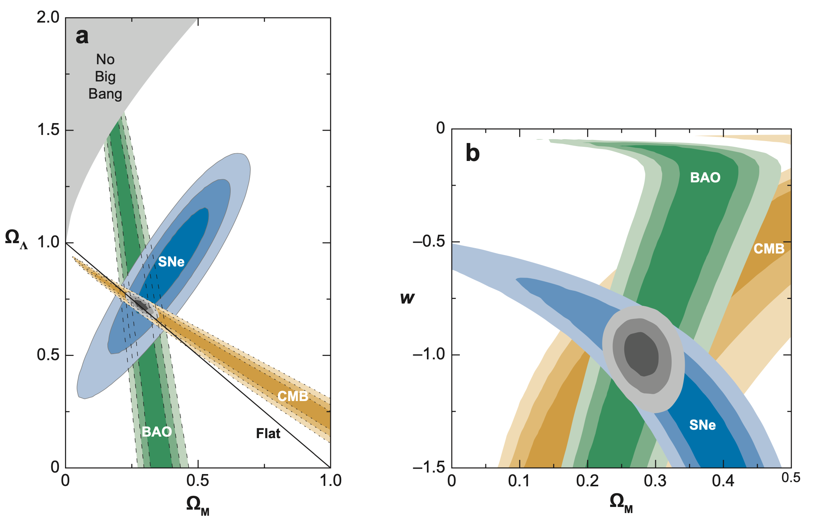
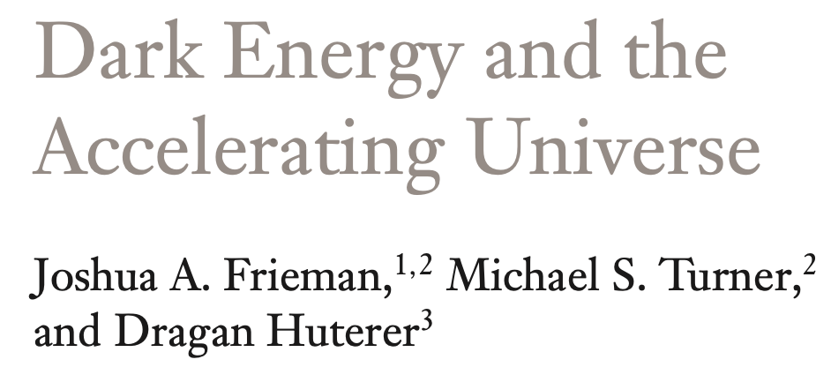

Precision cosmology
WMAP --- era of precision cosmology
SN Ia: cosmic acceleration; BAO: detected
Combined constraints --- breaking parameter degeneracies, precisely determining cosmological parameters
Concordance model of cosmology

Slide 4
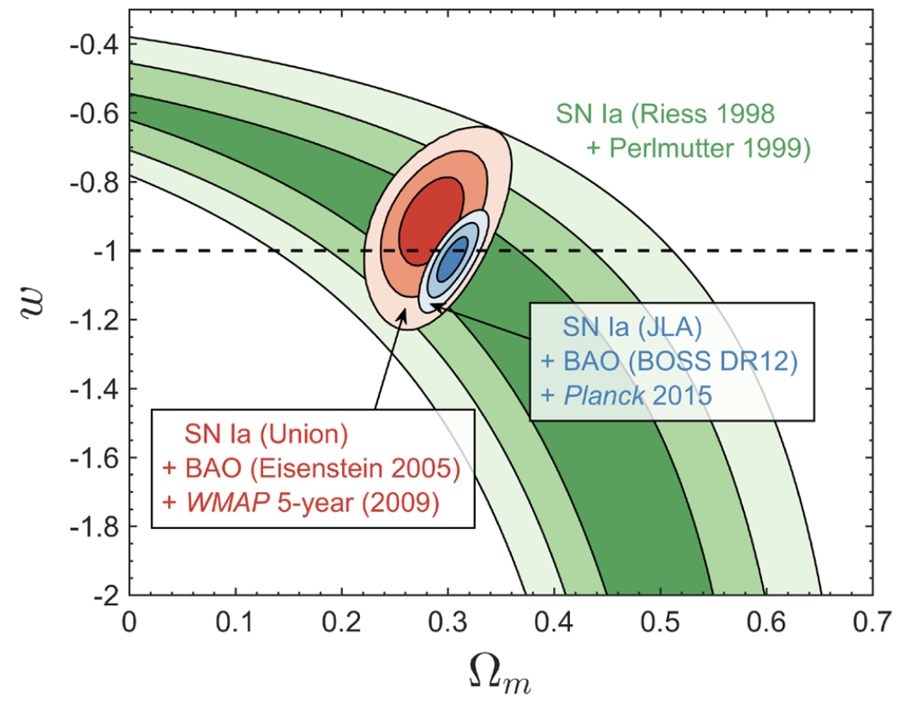
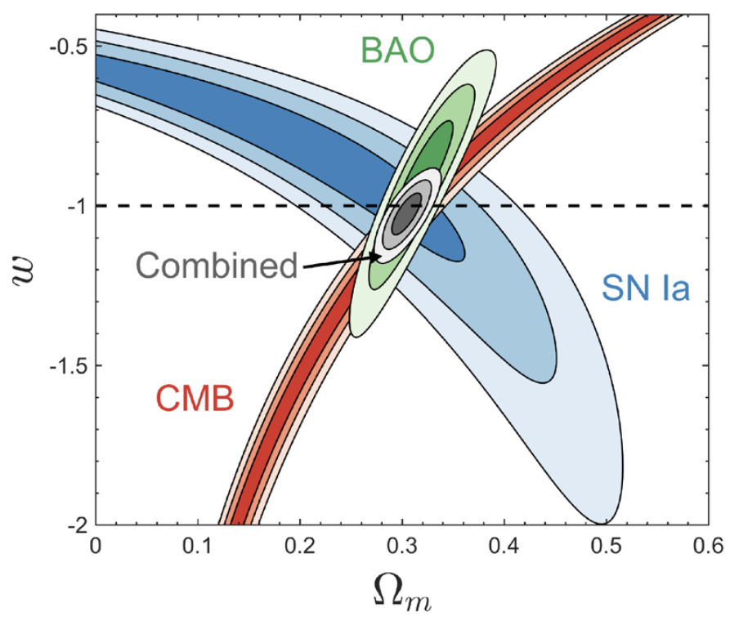
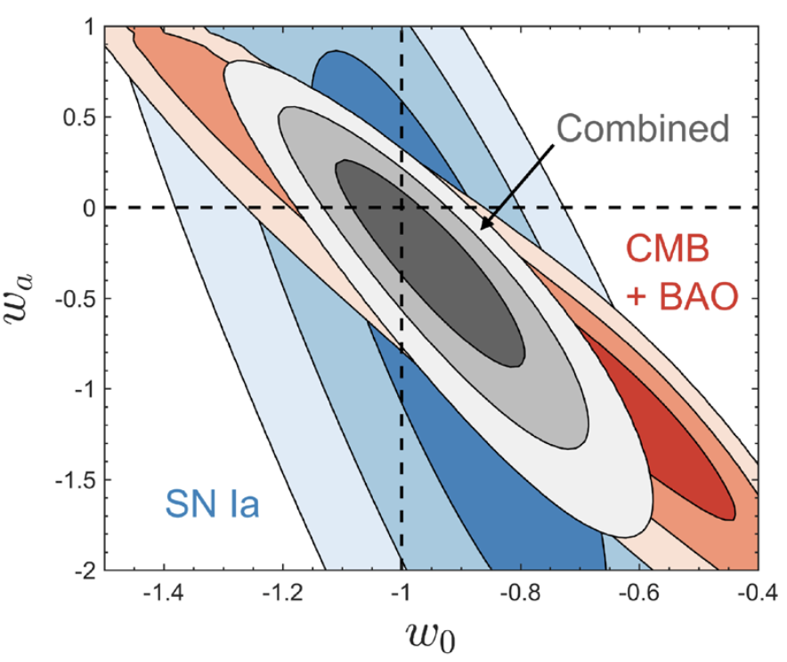
From WMAP to Planck
Huterer & Shafer, RPP 2018
Roughly a decade after discovery of cosmic acceleration (WMAP5 2009)
Nealy two decades after discovery (Planck 2015)
wCDM, w₀w_{a}CDM
Planck 2018, CBS (w. lensing): w precision 3% (wCDM); w₀ precision 8%, w_{a} error 0.3 (w₀w_{a}CDM)

Slide 5
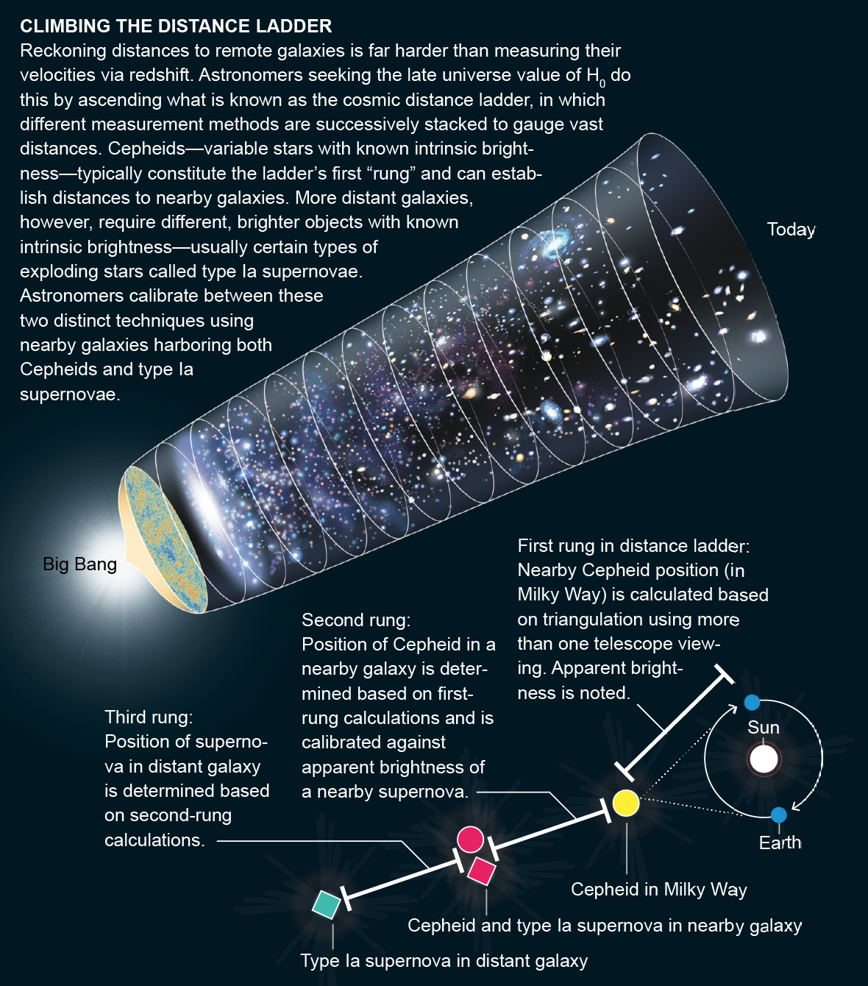
The Hubble constant
Cepheid-SNIa three-rung distance ladder
Freedman, NA 2017
Riess, ApJ 2019
2001, HST distance ladder: 72 ± 8
2003, WMAP1 result: 72 ± 5
Hints of tension appear: WMAP7, WMAP9
2013, Planck result shows the tension: 2.5σ
Now (74 vs 67), distance ladder precision 1.8%, CMB 0.7%, tension more than 4σ

Slide 6
Planck & Tensions
Planck 2013
Planck 2015
WMAP 9 result: 70.0 ± 2.2 km s⁻¹ Mpc⁻¹ (3.1%)
Planck 2013 result: 67.3 ± 1.2 km s⁻¹ Mpc⁻¹ (1.8%)
Riess 2011 distance ladder: 73.8 ± 2.4 km s⁻¹ Mpc⁻¹ (3.3%)
Matter density fluctuation σ₈ (rms fluctuation at 11 Mpc) higher: tension with cosmic shear and SZ cluster counts, 2-3σ

Slide 7
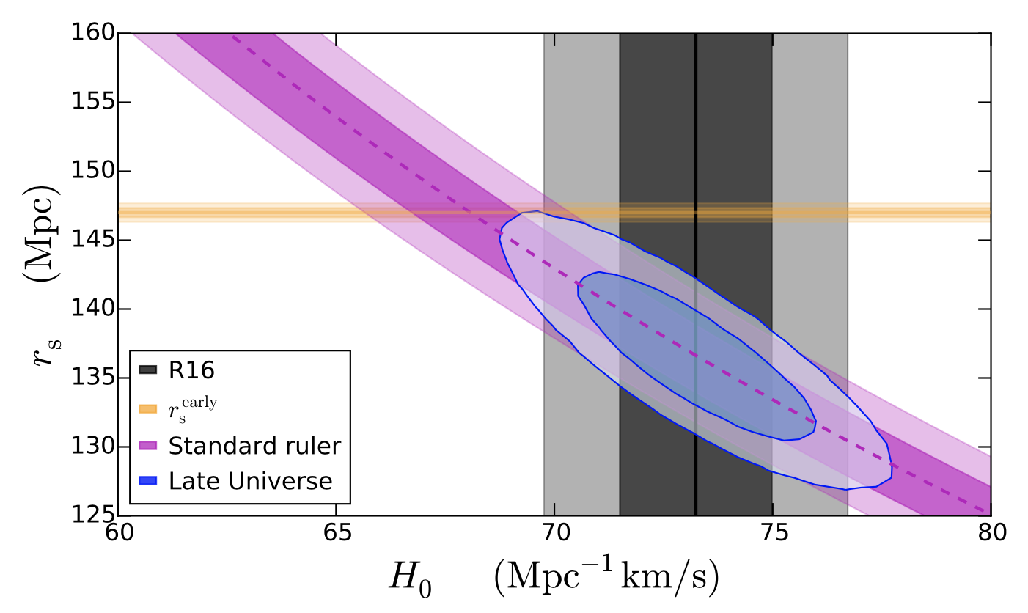
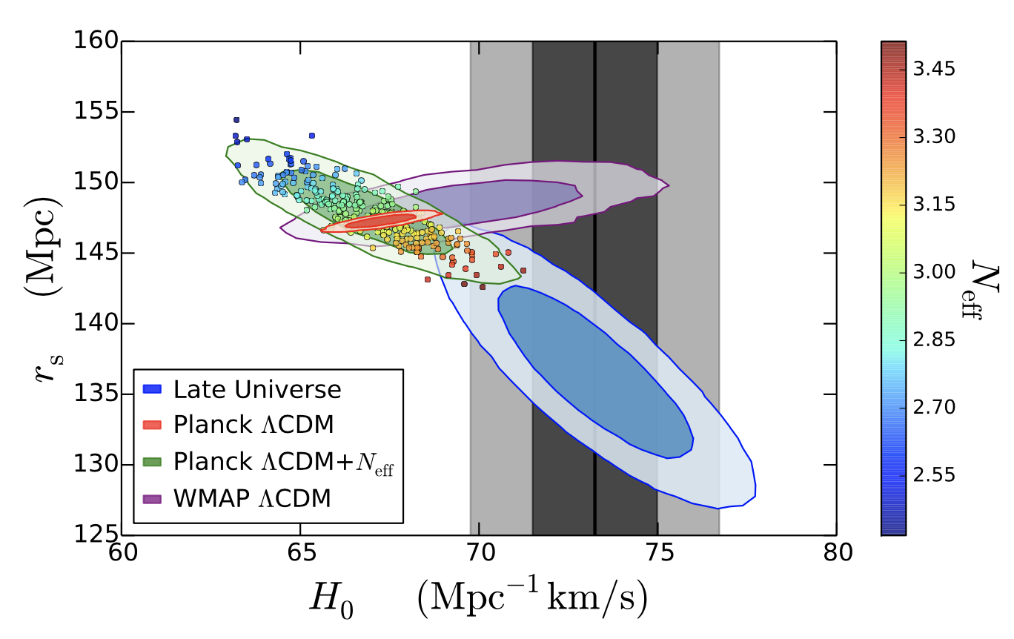
Tension between early and late universe: standard ruler
Bernal, Verde & Riess, JCAP 2016
BAO: H₀r_{s} degeneracy, cannot independently obtain H₀
CMB: r_{s} larger (147 Mpc), thus H₀ smaller
Late universe: H₀ local measurement obtains higher H₀, thus BAO standard ruler r_{s} smaller (136 Mpc)
Standard rulers from early and late universe differ by about 7%

Slide 8
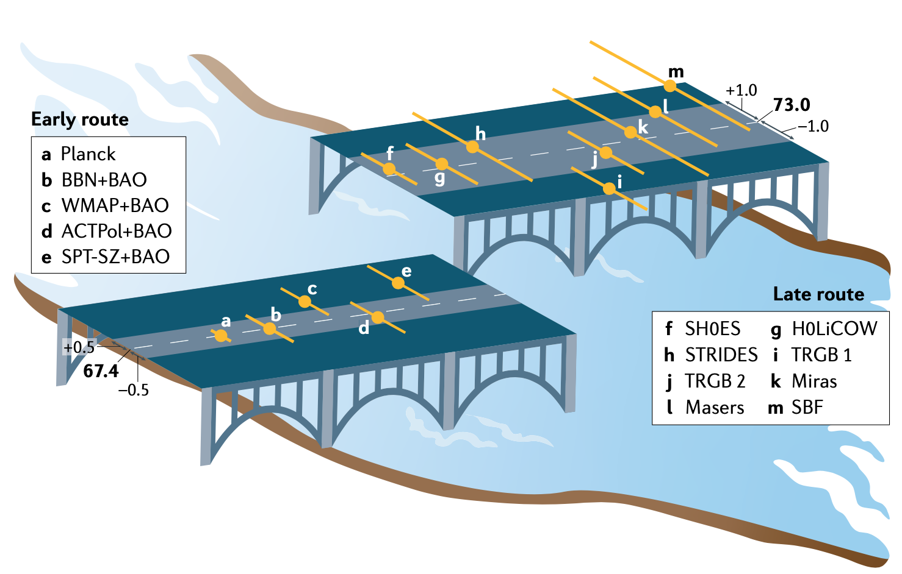
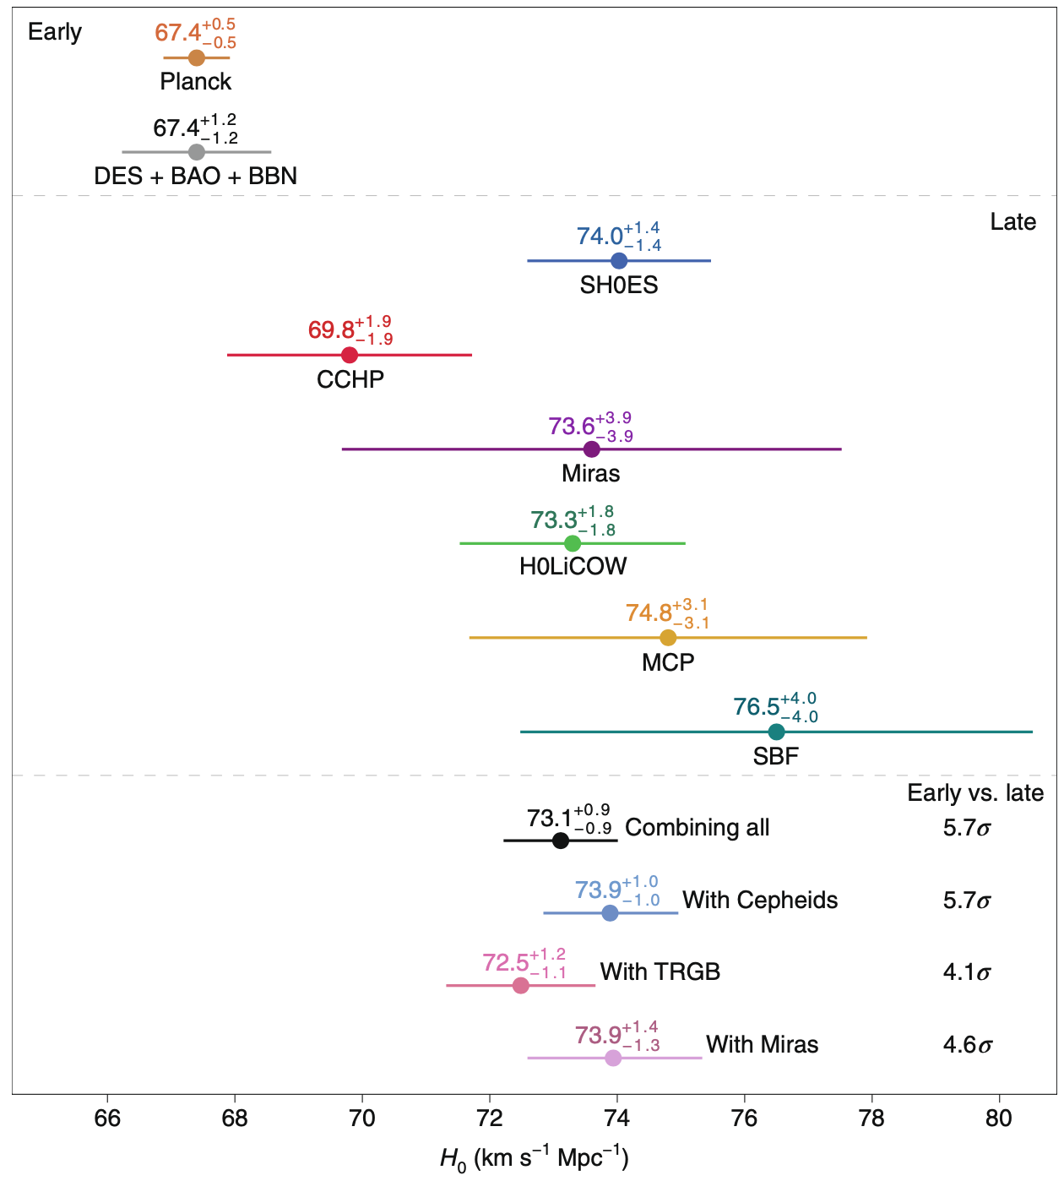
Tension between early and late universe
Planck: extremely precise, perfect
Late-universe measurements: different methods, but results consistent
Perhaps cannot simply attribute to systematics
Further steps in observation: Gaia, strong lensing, CMB polarization, standard sirens…
New physics beyond 𝛬CDM?
Verde, Treu & Riess, NA 2019
Riess, NRP 2020

Slide 9
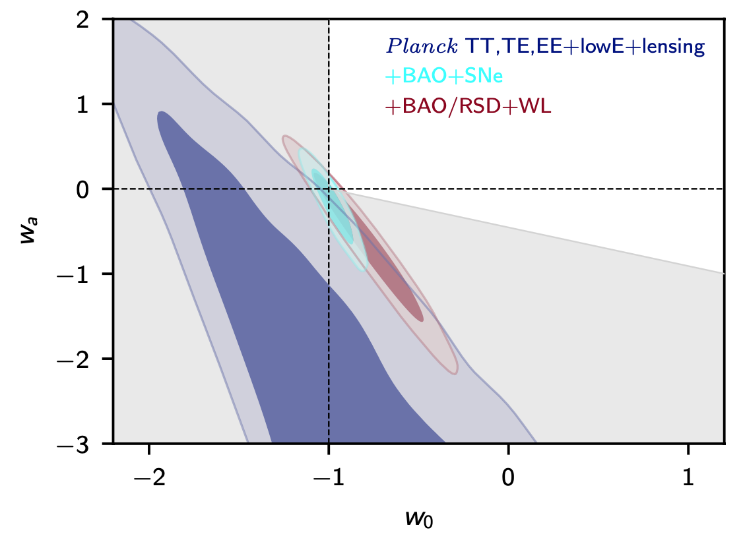
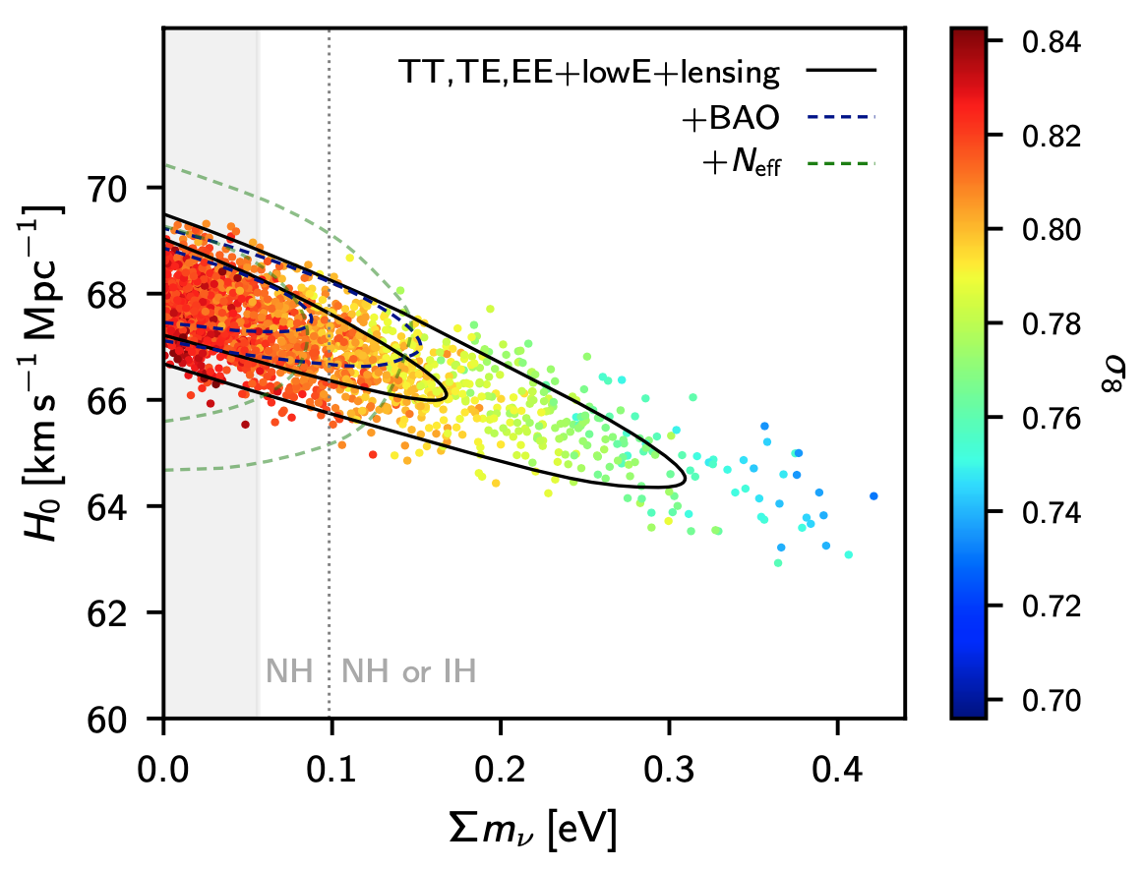
Extended models and parameter degeneracies
Planck 2018
Searching for new physics: extending model, for new concordance cosmology!
Problem: cosmological parameter degeneracies, difficult to precisely determine parameters (< 1%)
Developing new cosmological probes for late universe: exploring new physics, breaking parameter degeneracies, precisely measuring parameters
All for new cosmic concordance

Slide 10
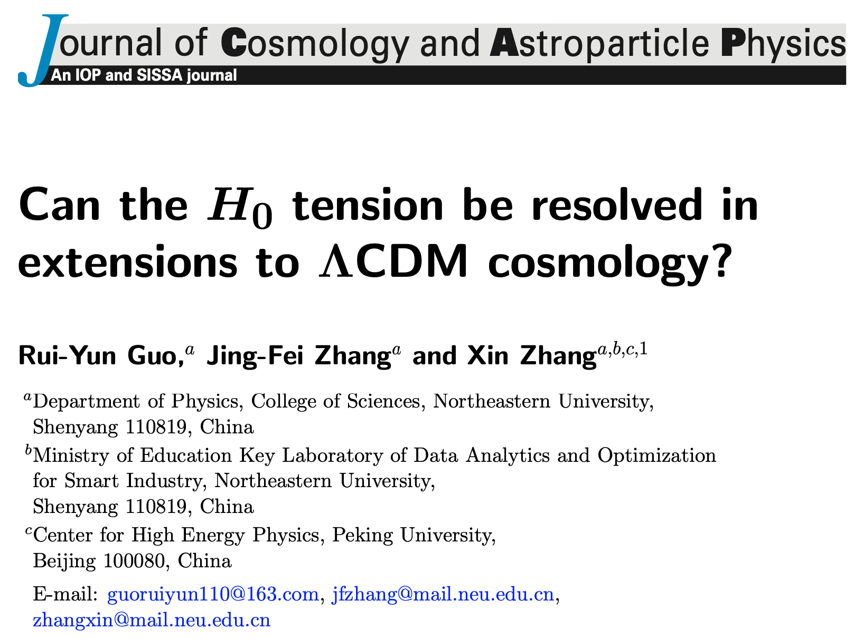
New physics beyond standard model
Extra (NP) parameters: correlated with H₀
Problem: current CMB+BAO+SN+H₀ data provide tight constraints
Simultaneously introduce more parameters (effects) to solve H₀ tension?
Principles in testing models: (1) fitting data better than SM (at least not worse); (2) cannot worsen other tensions
Guo, Zhang & XZ, JCAP 2019

Slide 11
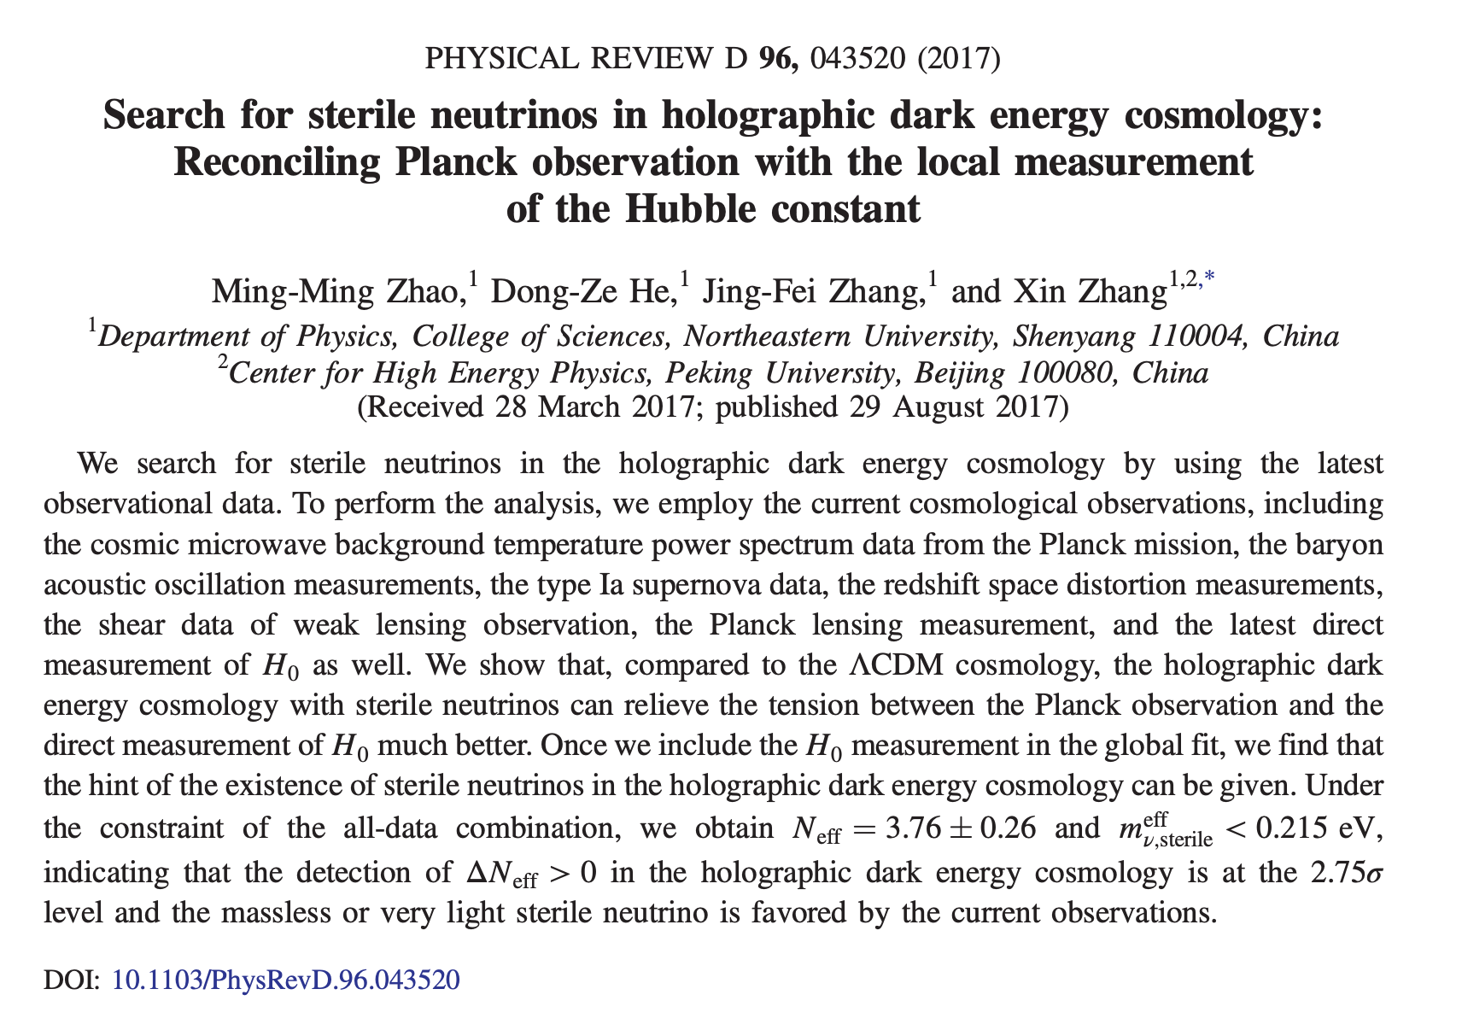
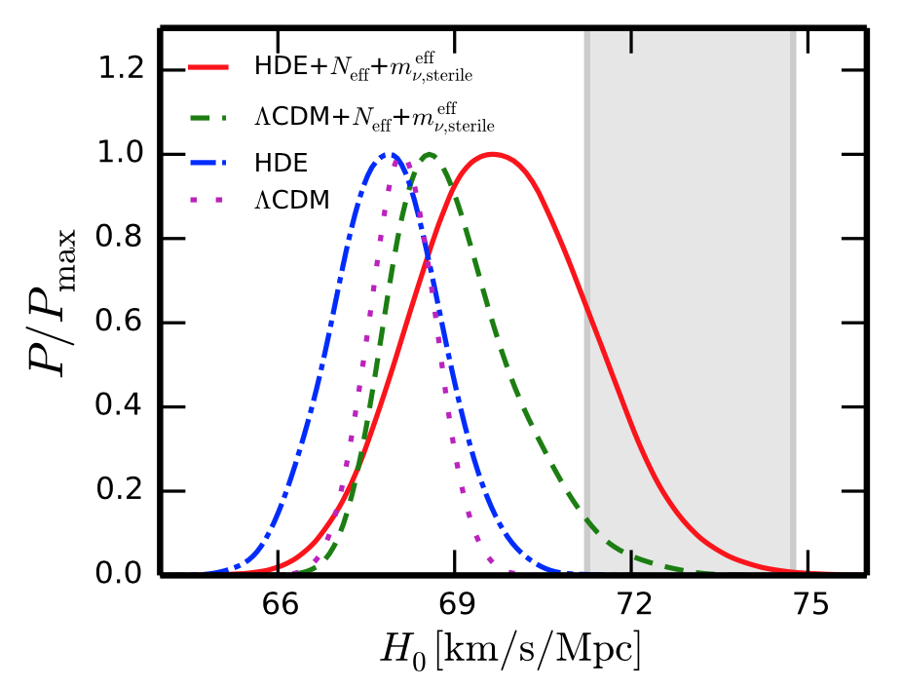
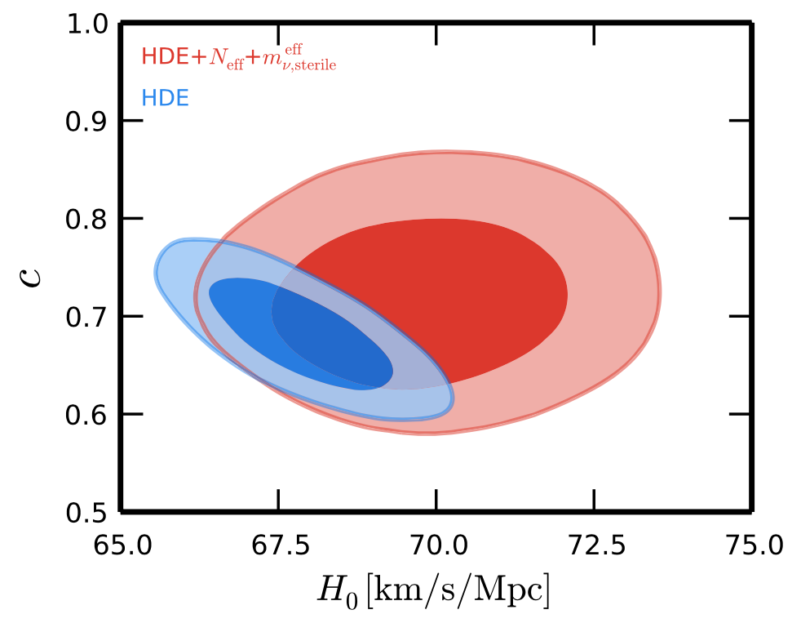
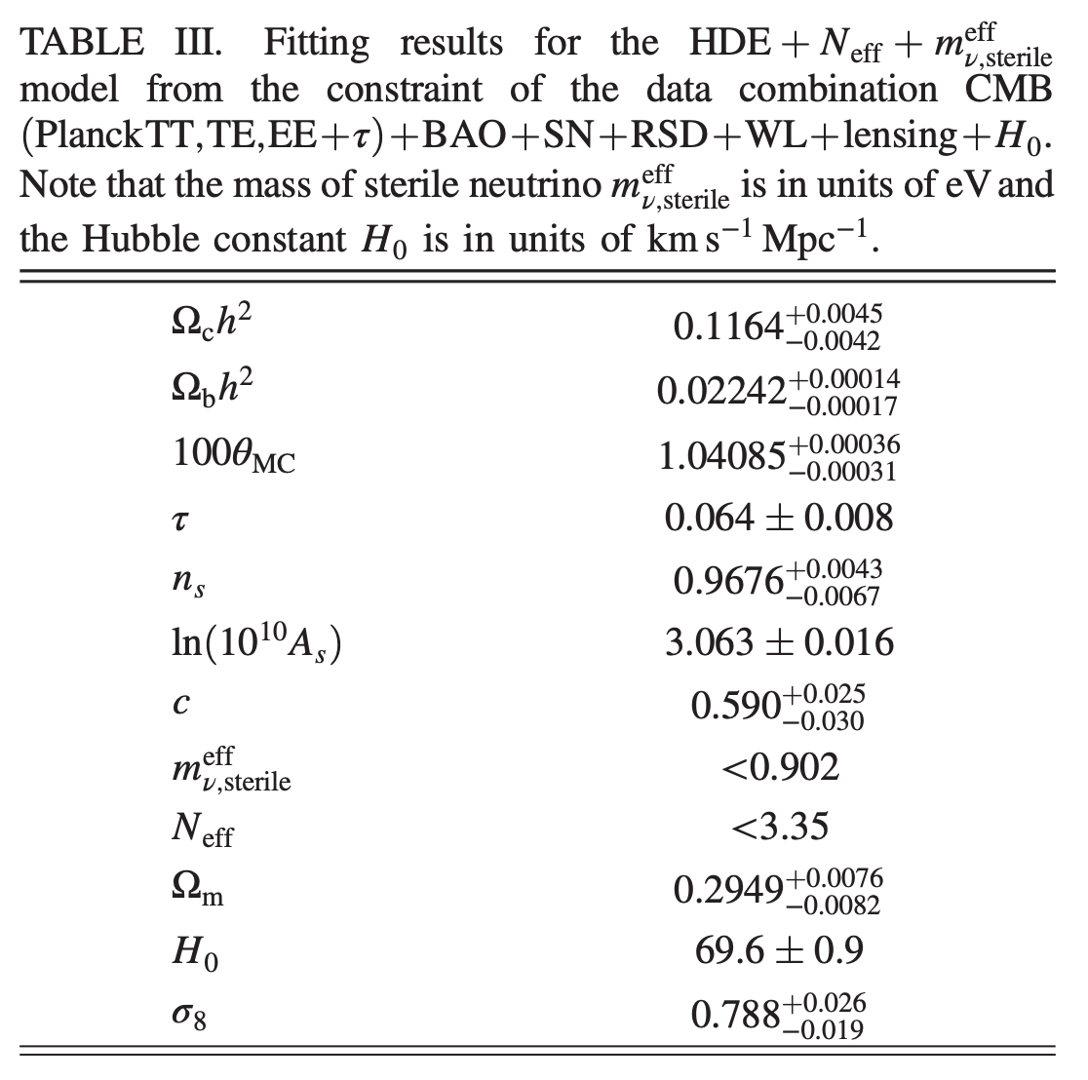
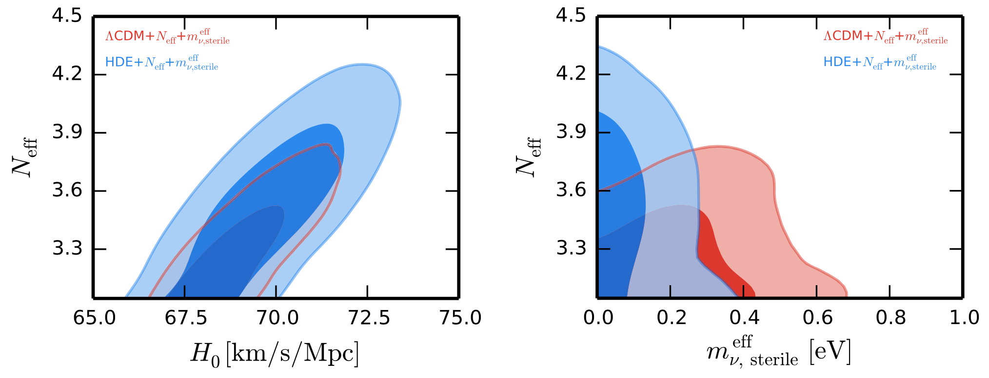
An example: dark energy + sterile neutrinos
Can effectively relieve H₀ and 𝜎₈ tensions
Increasing N_{eff,}, H₀ increased; increasing m^{eff}, 𝜎₈ decreased
But more parameters introduced, it should be punished (using information criteria)
Conclusion: fitting is worse than SM
Zhao, He, Zhang & XZ, PRD 2017

Slide 12
Extended models: test and comparison
H₀ = 73.00 ± 1.75 (Riess 16, 3.3σ)
Single-parameter & multi-parameter extensions
CMB+BAO+SN+H₀ (for obtaining a larger H₀)
For ΛCDM, still 3σ tension
HDE & HDE + sterile neutrino, can effectively alleviate tension (1.67σ and 1.11σ), but they are excluded by observations
ΛCDM + N_{eff}, looks the best one, 1.87σ, and it is favored by observations (ΔAIC=-0.242), but if H₀ data is not used, then 2.66σ tension
In addition, increasing N_{eff} can increase σ₈ (another tension)
Conclusion: among these extensions, no one can truly resolve the tension
Guo, Zhang & XZ, JCAP 2019

Slide 13
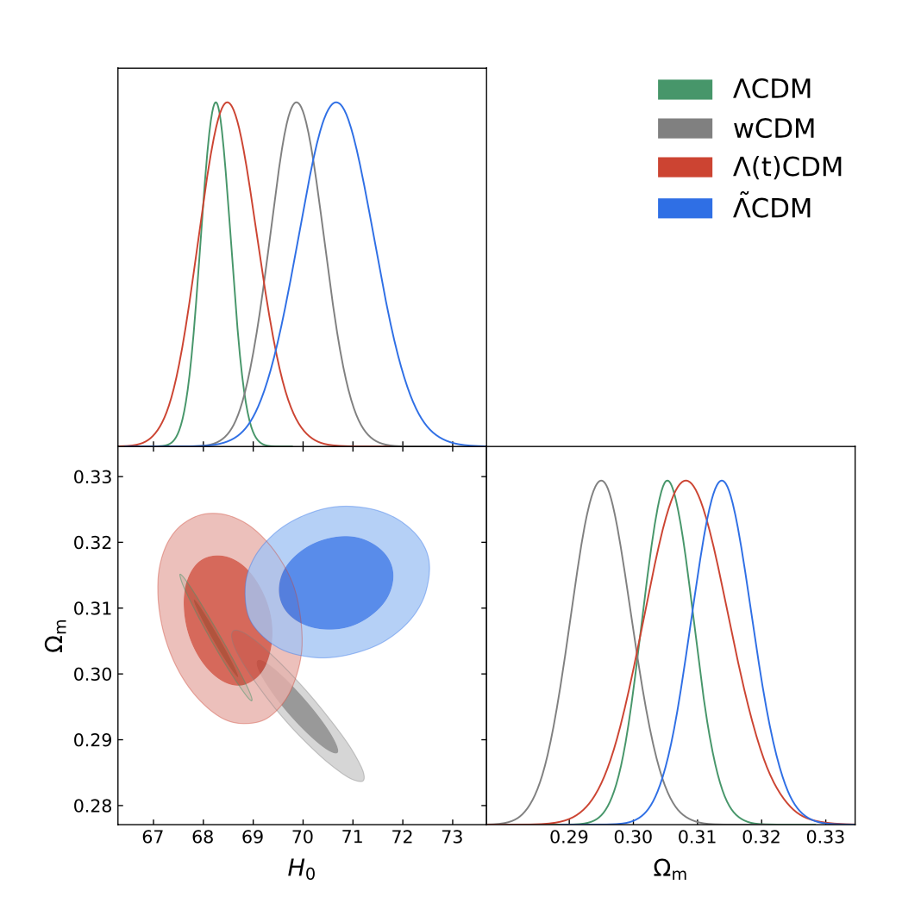
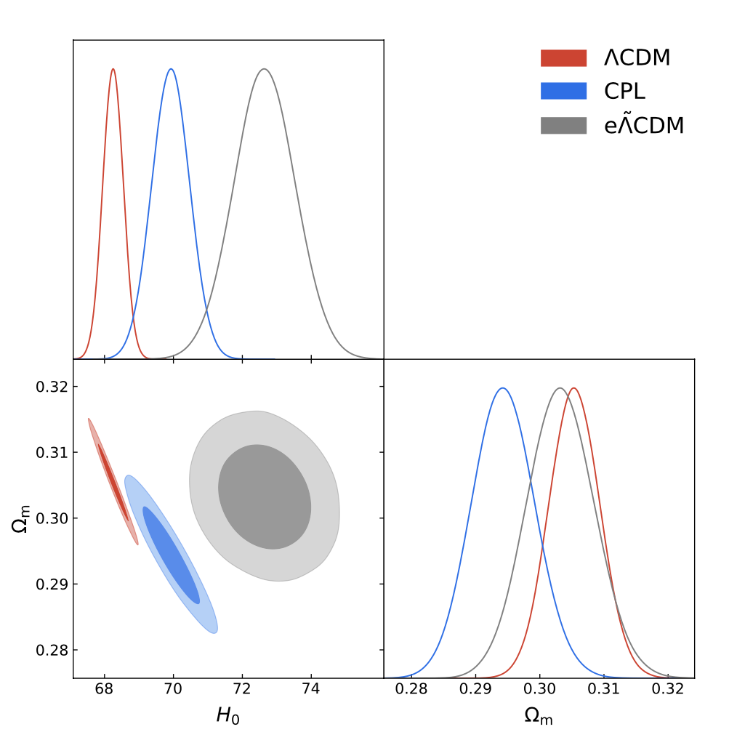
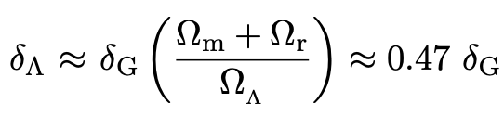
A new interacting dark energy model
Asymptotic safety of quantum field theory: densities (including CC) receive corrections
Can be viewed as an interacting vacuum energy model: vacuum energy interacts with matter and radiation
Using CBSH data to constrain models: effectively relieve the H₀ tension
Single-parameter extension: 1.88σ
Two-parameter extension: 0.71σ
Fit well: AIC & BIC smaller than SM
Much better than traditional IDE models in solving the H₀ tension
But: using only CBS cannot solve; very sensitive to H₀ local measurement
Still σ₈ problem
Single-parameter extension
Two-parameter extension
Gao, Zhao, Xue & XZ, JCAP 2021

Slide 14
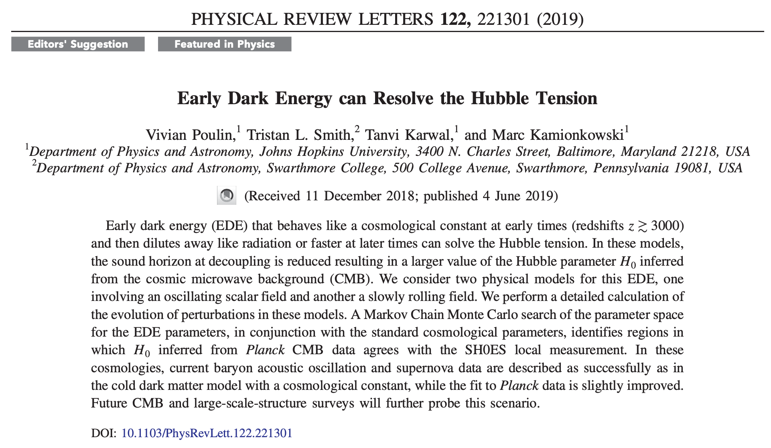
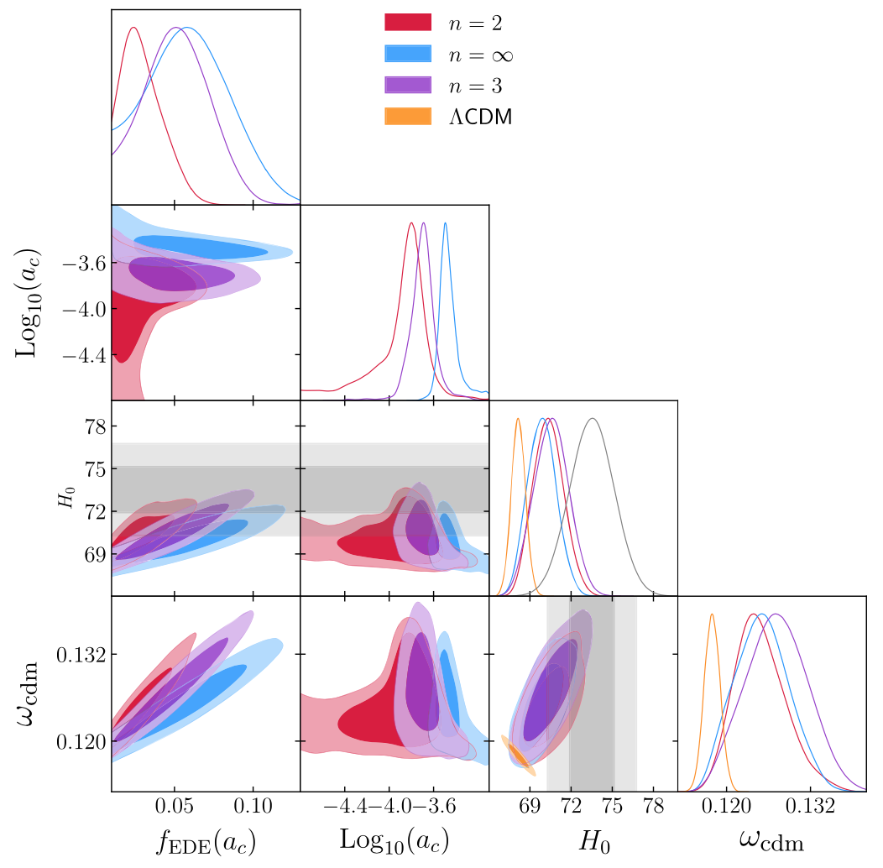
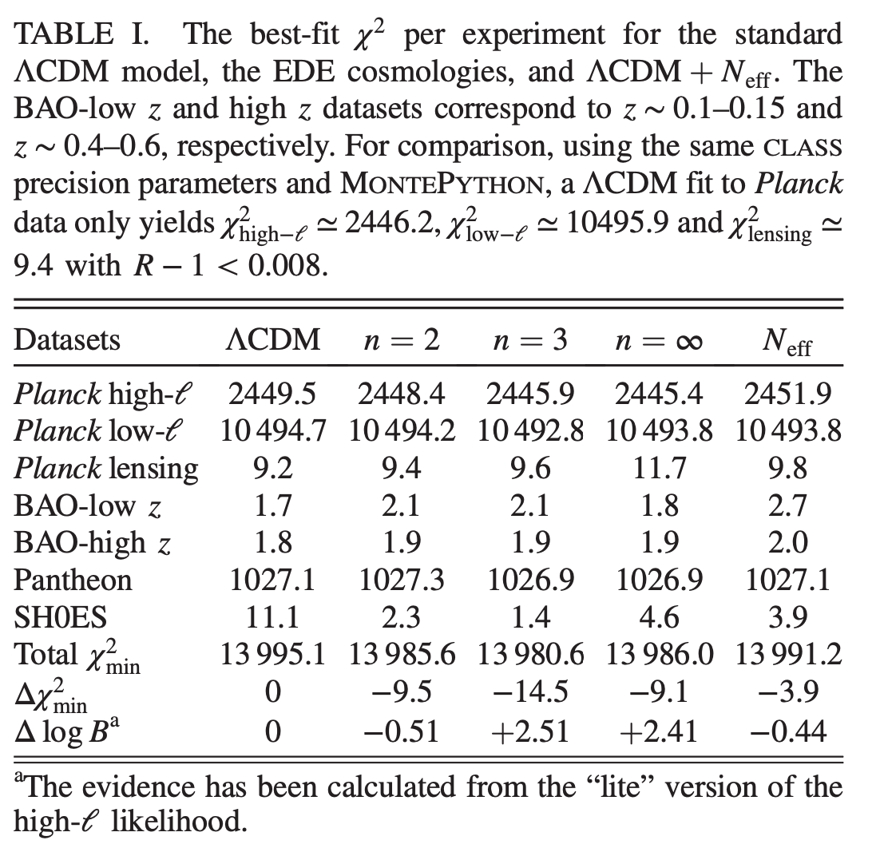
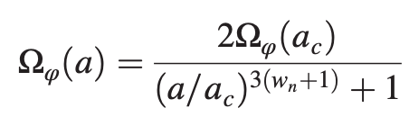
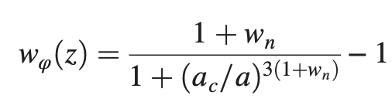
Early dark energy
Decreasing sound horizon (7%): early dark energy, after matter-radiation equality, before recombination
Early times like a cosmological constant, later rapidly dilutes away
Only affects physics before recombination
Fits better than SM and dark radiation (still σ₈ problem)
Needs to be further tested: CMB polarization, low-l measurements, etc.

Slide 15
Developing new cosmological probes
Optical surveys still very important --- 4th generation dark energy experiments
But still needs to develop new non-optical probes: larger survey volumes, avoiding systematics, breaking parameter degeneracies
GW detection opened a new window to probe universe
Initiated multi-messenger astronomy era
Ground-based (10-1000Hz), space-based (milli-Hz band), PTA (nano-Hz band)
Standard siren cosmology
Standard sirens (bright, dark) --- BNS, NS-BH, MBHB, SMBHB (inspiral), EMRI, …
Radio astronomy brings new opportunities
HI intensity mapping survey
FRB: new way (dispersion measure) to measure cosmic constitutes (baryon density) and expansion history
Redshift drift: real-time cosmology, optical (ET) + radio (SKA) --- EM multi-band observation
Supermassive black hole shadow --- new standard ruler?
Synergy: multi-messenger, multi-wavelength, combination

Slide 16
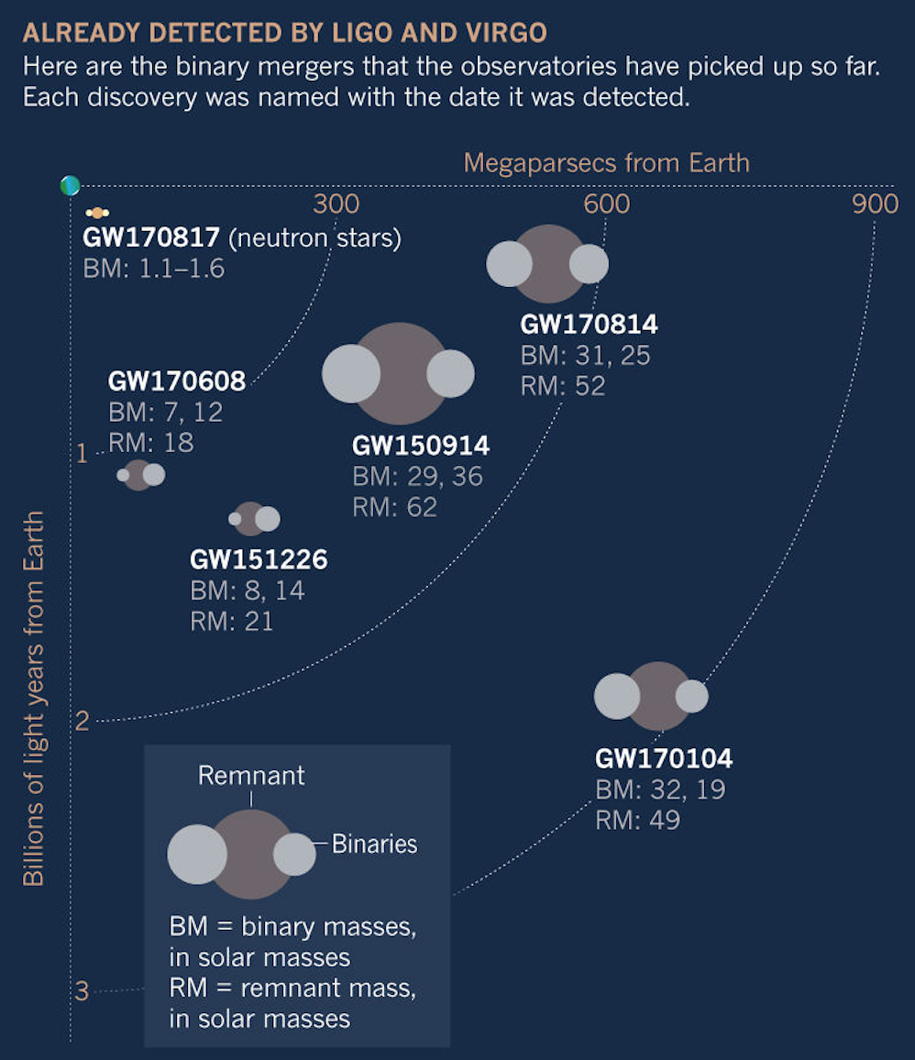
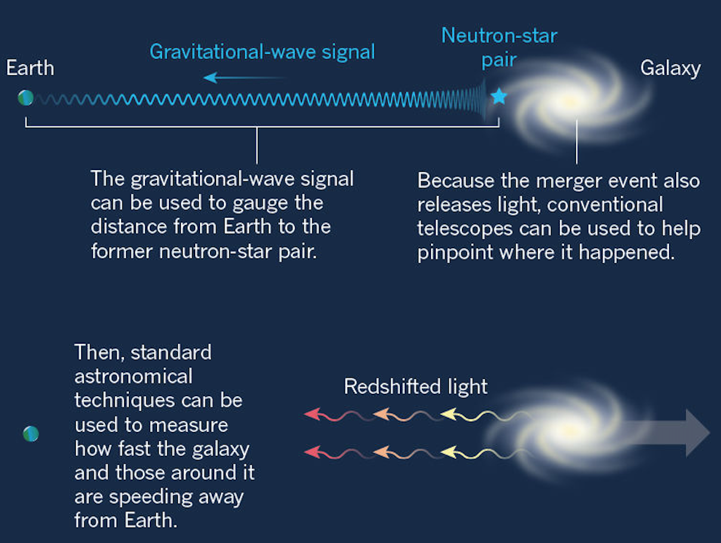
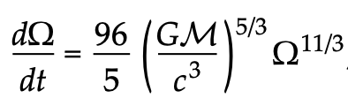
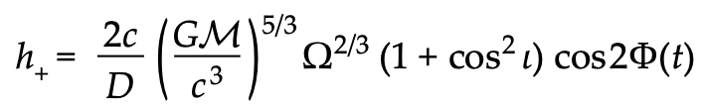
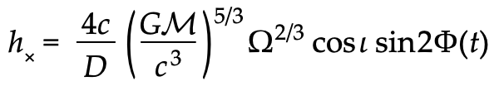

GW & multi-messenger astronomy
z=0.009
Standard siren: GW amplitude determines luminosity distance (degenerate with inclination)
Advantage: absolute distance measurement, self-calibration
Multi-messenger observation: GW170817 (BNS merger), redshift (low), independent measurement of the Hubble constant
Precision: about 15%, only one data point
Nature 2017

Slide 17
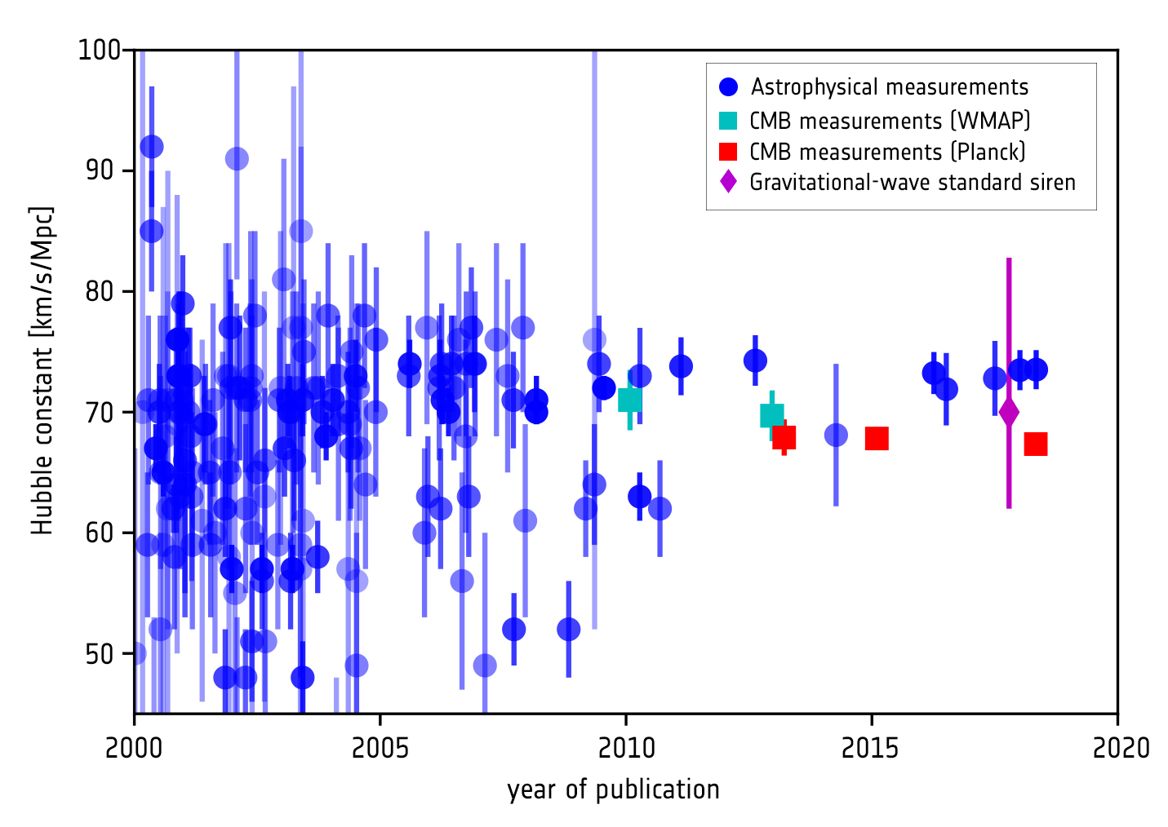
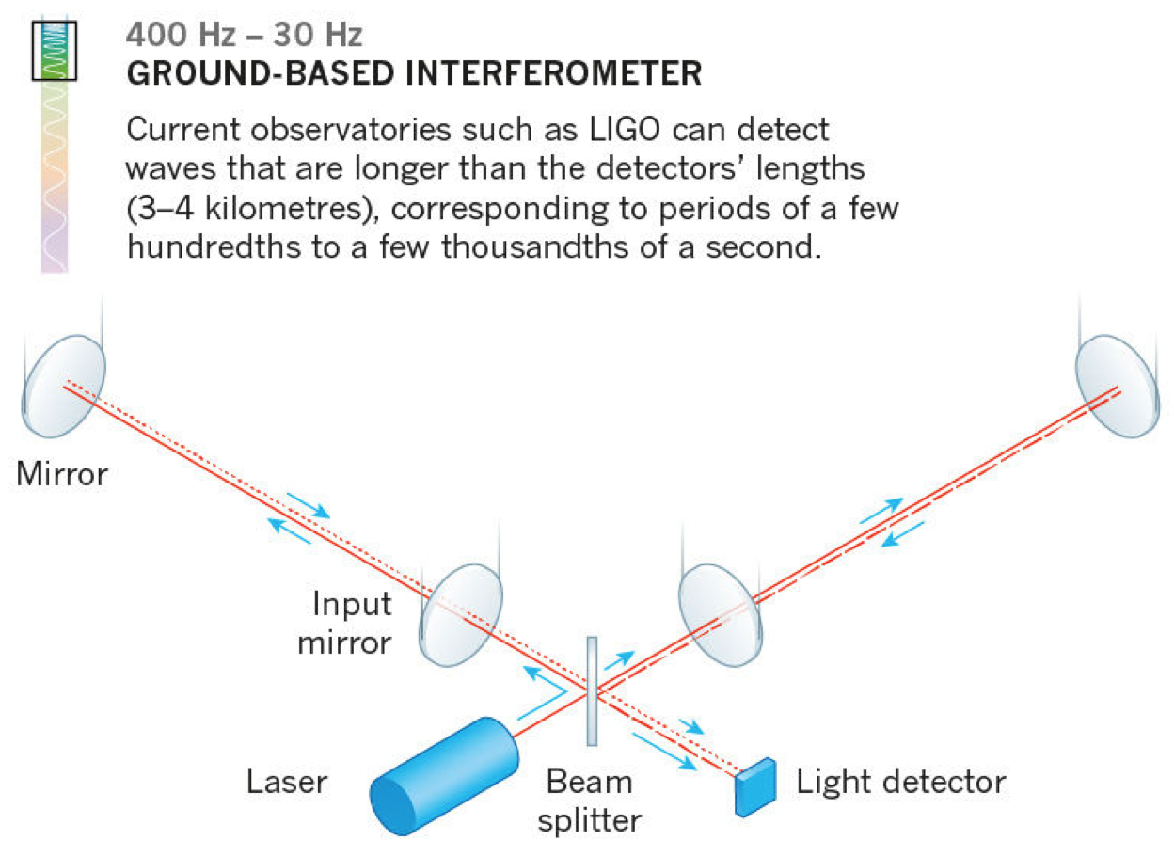
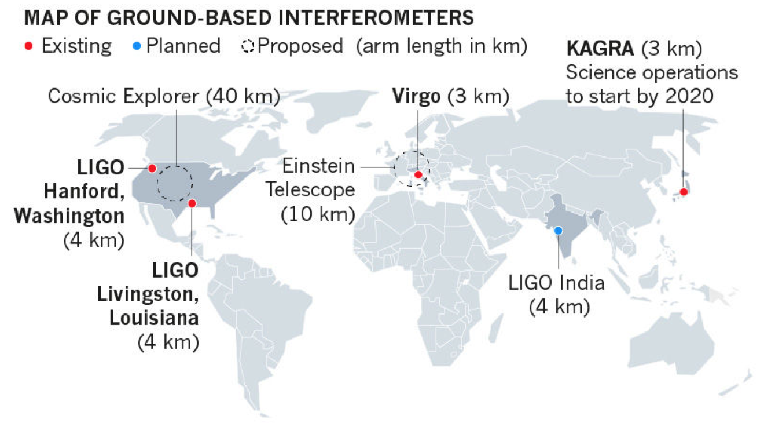
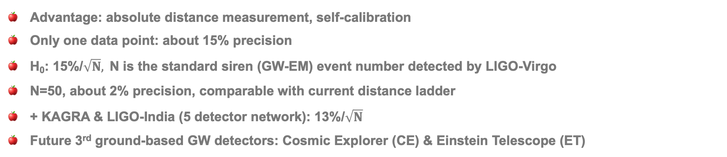
Standard sirens: can arbitrate the Hubble tension?
Advantage: absolute distance measurement, self-calibration
Only one data point: about 15% precision
H₀: 15%/$\sqrt{N},$N is the standard siren (GW-EM) event number detected by LIGO-Virgo
N=50, about 2% precision, comparable with current distance ladder
+ KAGRA & LIGO-India (5 detector network): 13%/$\sqrt{N}$
Future 3rd ground-based GW detectors: Cosmic Explorer (CE) & Einstein Telescope (ET)

Slide 18
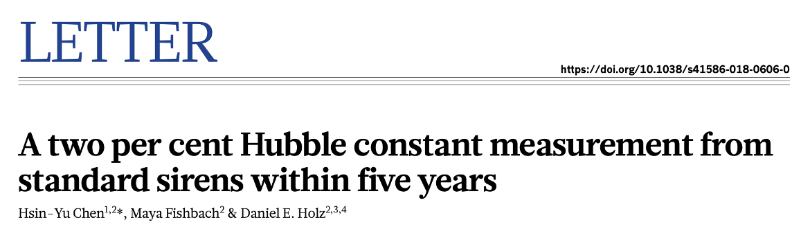
H₀ precisely measured by standard sirens: How long?
2% in 5 years, and 1% in 10 years
In 2023, 50 events, 2%; In 2026, 100 events, about 1.3%
BBH, no EM counterpart, but statistical method can be used
Nature 2018

Slide 19
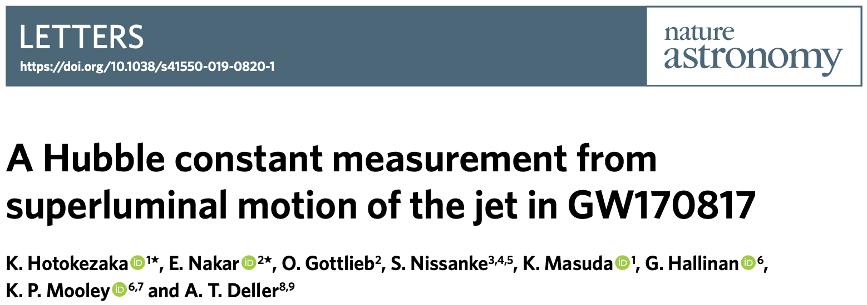
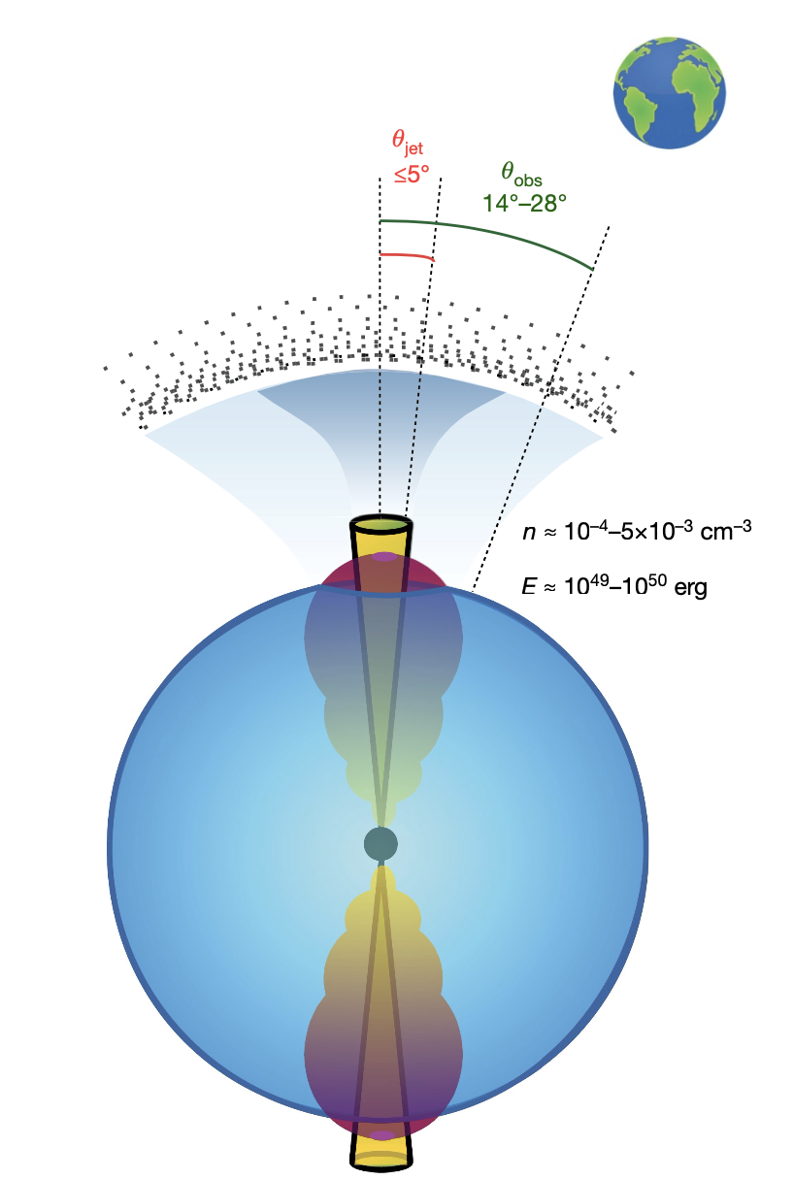
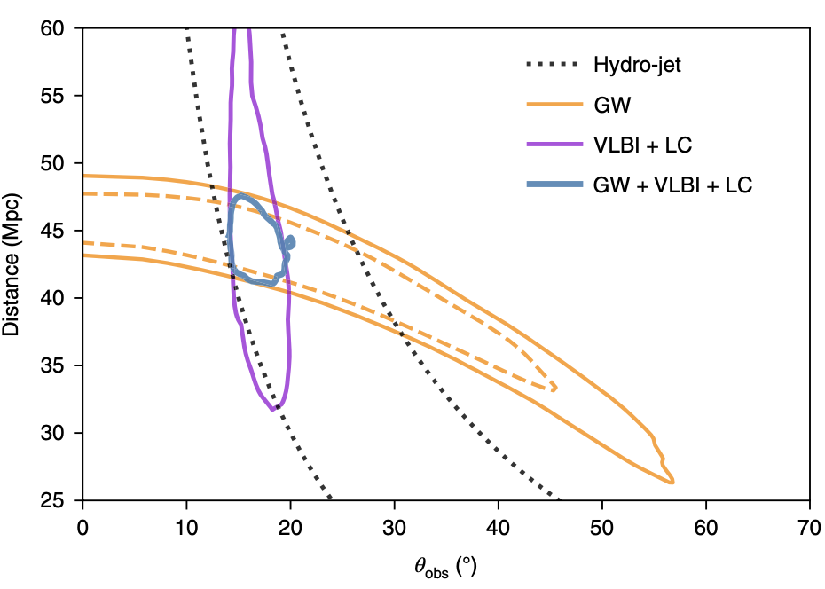
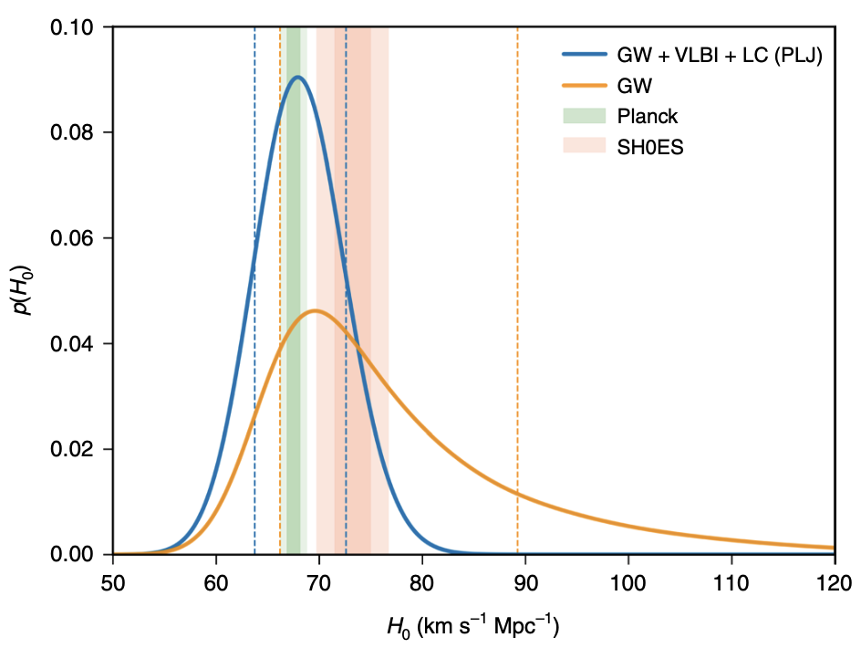
GW170817: superluminal motion of the jet
GW170817 new radio observation: VLBI, increase angular resolution
Improve H₀ measurement precision to about 7%
In future, only needs 15 data points (radio imagining & light curve), comparable with 50-100 GW-EM data
Mooley et al., Nature 2018
Hotokezaka et al., Nature Astronomy 2019

Slide 20
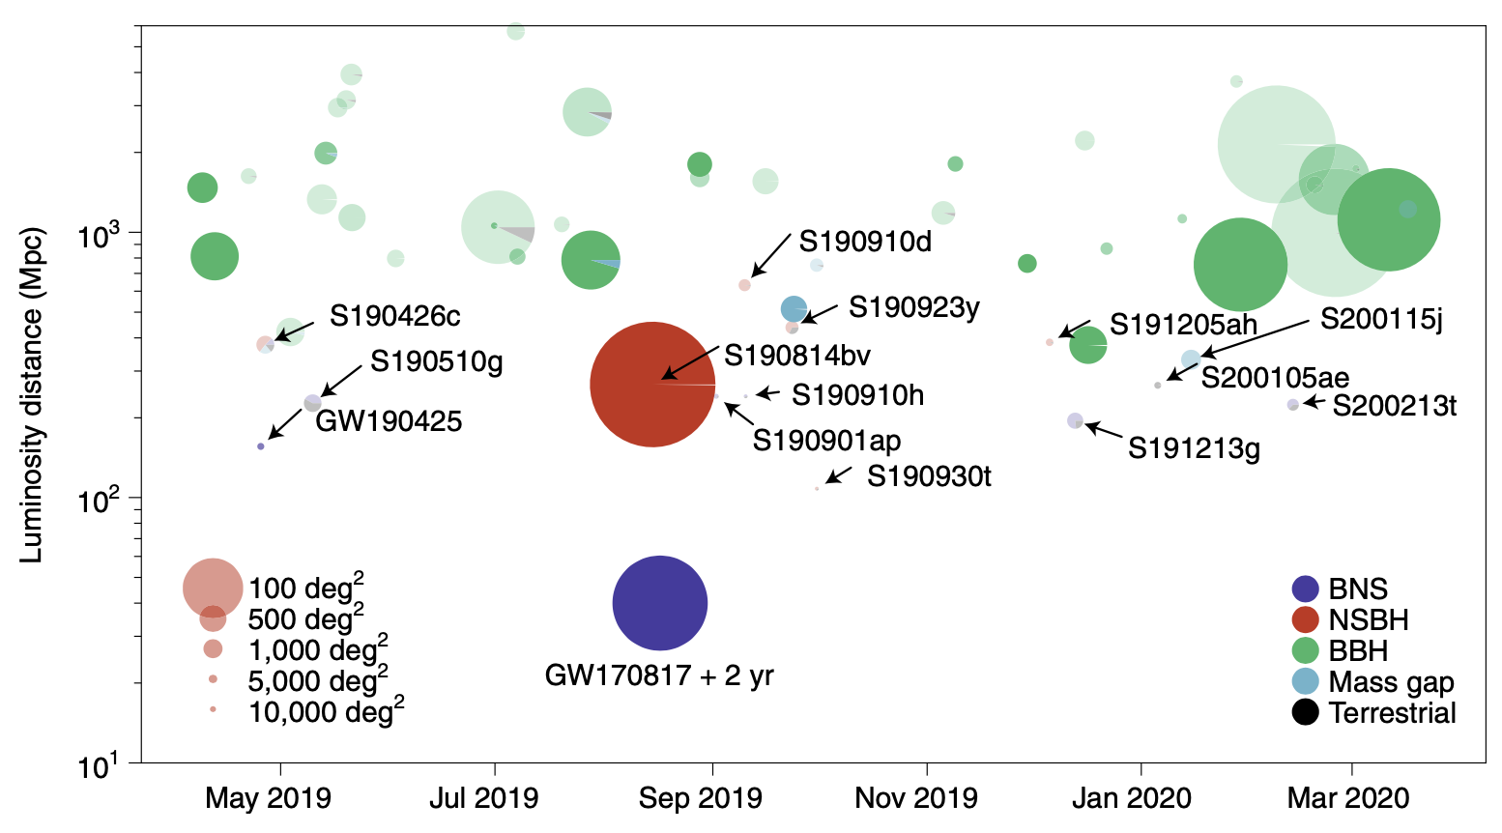
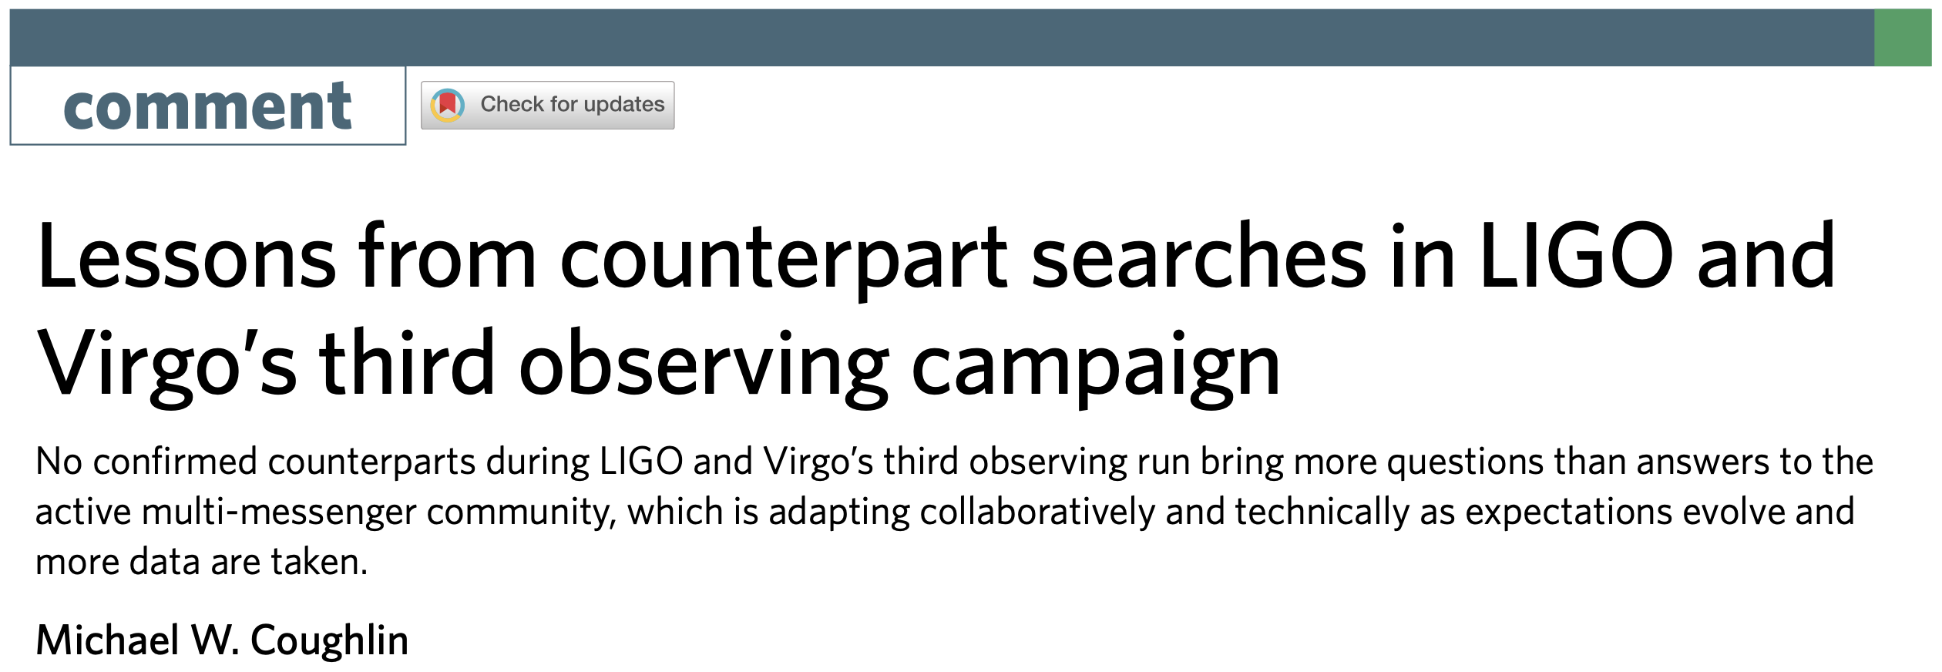
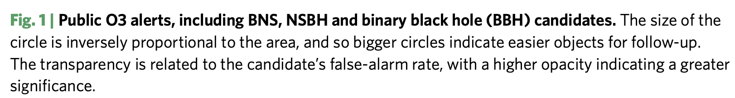
No other electromagnetic counterpart identified...
LIGO & Virgo’s third observing run (O3)
A second BNS merger event, GW190425, with a total mass of 3.4 solar masses (compared with 2.7 for GW170817), exceeds theoretical expectations; all possible EM counterparts are excluded
First possible NS-BH merger event, S190814bv, also has not identified an EM counterpart
8 NSBH & 6 BNS candidates and 388 candidate counterparts were announced
Nature Astronomy 2020
面积越大，定位越准
越不透明，置信度越大

Slide 21
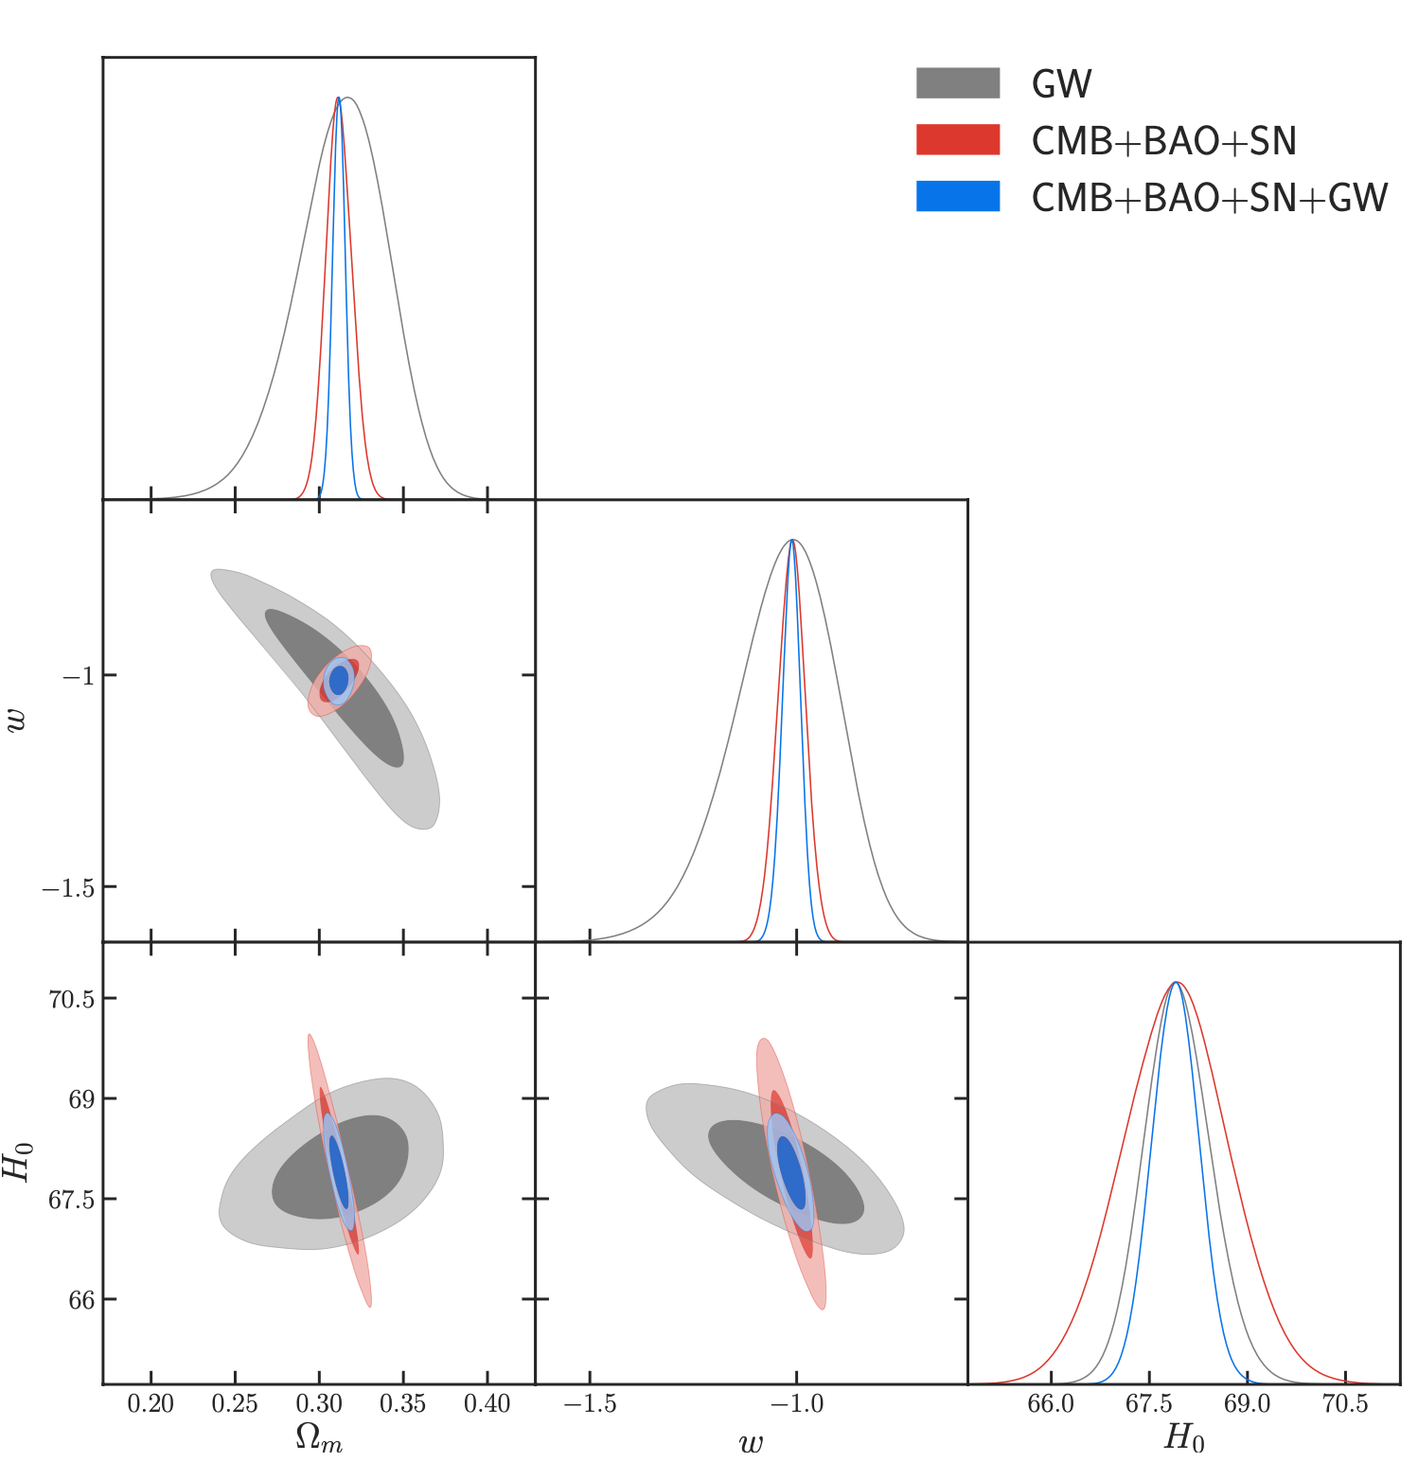
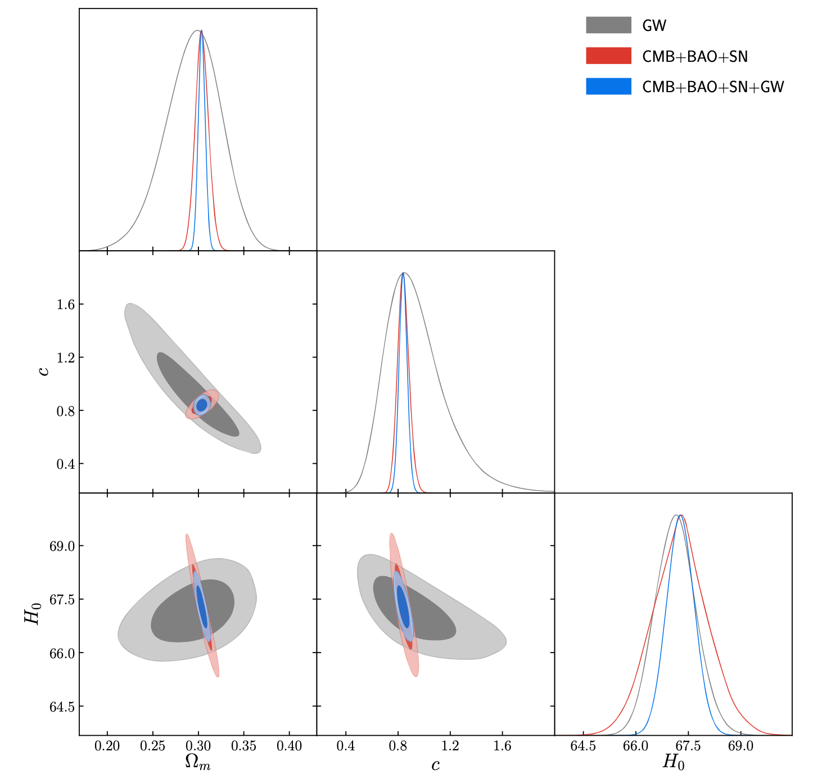
Future precise probe: forecast for cosmological parameter estimation with standard sirens
Third generation ground-based detectors: Einstein Telescope, as an example
1000 SS data for 10-yr observation
Tight constraints on H₀ (ΛCDM 0.5%, wCDM 0.8%) using solely GW, better than CBS
Constraints on other parameters: not good
But absolute distance measurement is rather important: breaking degeneracies of CBS
Complementary with CBS: orthogonal in parameter space
Constraints on w: GW-only not good (12%), CBS reaches < 4%; CBS+GW can nearly reach 1% (precision cosmology)
Zhang, Wang, Zhang & XZ, PRD 2019
Zhang, Zhang, Jin, Qi & XZ, JCAP 2020
Zhang, Dong, Qi & XZ, EPJC 2020
Li, He, Zhang & XZ, JCAP2020
wCDM
Holographic dark energy

Slide 22


Future new probe: forecast for cosmological parameter estimation with standard sirens
Jin, He, Xu, Zhang & XZ, JCAP 2020
Cosmic Explorer: standard siren observation
For various dark energy models, degeneracies of CBS can be broken
CE is better than ET in standard siren cosmology

Slide 23


Future new probe: constraints on neutrino mass using standard sirens
Wang, Zhang, Zhang & XZ, PLB 2018
GW can improve constraints on neutrino mass by about 10%
Also take ET as an example
Comparison: Planck+BAO+SN & Planck+BAO+SN+GW
GW can help reduce upper limits by 14%, 8%, and 10% for NH, IH, and DH, respectively
GW can also help break degeneracies between ∑m_{𝜈} and other parameters

Slide 24


Space-based GW observatories
Low-frequency (mHz-band): 10⁻⁴ Hz - 10⁻¹ Hz
MBHB mergers (total mass of 10⁴-10⁸ solar masses), EMRIs, white dwarf binaries in MW, …
China’s projects: Taiji & TianQin
3 models of MBHB population
EM counterparts: radio & optical bands (SKA, E-ELT)
Capability of constraining cosmological parameters weak --- few sources, weak lensing, …
But still can effectively break CMB degeneracies: useful for studying dark energy
Zhao, Wang, Zhang & XZ, Science Bulletin 2020

Slide 25




The LISA-Taiji network
Ruan, Liu, Guo, Wu & Cai, NA 2020
Accurate location of sources is important: host galaxy identification, redshift measurements, standard sirens
The network can effectively help to improve the sky location capability of GW sources (MBHB)
Configuration angle of 40 degrees can effectively help to locate GW sources quickly and accurately

Slide 26




The LISA-Taiji network
GW
GW-EM
The network is helpful in improving SNR and location accuracy, thus more EM counterparts detected (number doubled)
SNR is improved, thus higher-z events can be detected
Luminosity distance measurement accuracy improved
Wang, Jin, Zhang & XZ, SCPMA 2021

Slide 27


The LISA-Taiji network
Wang, Jin, Zhang & XZ, SCPMA 2021
Much tighter constraints, compared with solely using Taiji
H₀: using the network can reach nearly 1%, higher than using Taiji alone by 60%
w: CMB + network reaches 4%, comparable with CMB+BAO+SN
Even for constraining dark energy, the LISA-Taiji network can be comparable with BAO+SN

Slide 28












英文版：Science China Physics, Mechanics & Astronomy
影响因子5.122 , JCR物理综合类Q1区, 中国科学院文献情报中心期刊分区表物理综合类1区Top
Editor’s Focus栏目: 瞄准PRL录用水平, 快审快发
接受后实时在线预出版，优秀成果限时免费阅读
国内外公众媒体多渠道新闻宣传和精准推送
LISA-太极网络的标准汽笛宇宙学
2021年12月封面（设计中）
扫描二维码 关注期刊最新动态
中文版： 中国科学: 物理学 力学 天文学
创刊70年, 为华语科学界提供全面的科学研究动态成果
中文核心期刊, 并被ESCI, Scopus国际数据库收录
特色专题出版, 已组织专题(辑)70余期
主管：
主办：
出版：

Slide 29


Ground + space, GW + 21 cm IM
Jin, Wang, Wu, Zhang & XZ, 2021
GW & HI radio (21 cm IM) are two promising non-optical late-universe probes
Can the combination of the two achieve the standard of precision cosmology?
GW (ET+Taiji) + 21 cm (SKA): prospect of non-optical precision cosmology is worth expecting
H₀ reaches 0.3%, w reaches 2.5%, better than CMB+BAO+SN
GW+21 cm can provide a precise late-universe probe

Slide 30



Radio astronomy & 21 cm cosmology
SKA: Low (Australia), Mid (South Africa)
SKA1-low: 50 -- 200 MHz
21 cm wavelength stretched: Cosmic Dark Ages -- above 6.5 m (frequency below 45 MHz); Cosmic Dawn and Reionization -- between 1.5 and 6.5 m (45 -- 200 MHz)
All-sky averaged power (global spectrum) & 3D sky map (power spectrum, imaging, 21 cm forest)
SKA1-mid: 350 MHz–1.4 GHz
21 cm sky survey of neutral hydrogen: intensity mapping, large-scale structure of neutral hydrogen, redshift 0-3, baryon acoustic oscillations & redshift spatial distortion, dark energy studies
Tianlai (天籁, array), FAST (中国天眼, single dish)

Slide 31






21 cm IM experiments
CHIME (1024 units)
Tianlai (96 units)
FAST (19 beam)
HIRAX (1024 units)
BINGO (60-beam)
SKA-mid (197 antennas)

Slide 32


SKA HI cosmology: forecast
SKA HI 21 cm IM observation can play an important role in helping improve cosmological parameter estimation
Consider SKA1-MID and SKA2 simulated data (BAO)
CBS+SKA1: 𝜎(w₀)=0.08, 𝜎(w_{a})=0.25
CBS+SKA2: 𝜎(w₀)=0.05, 𝜎(w_{a})=0.18
SKA1: constraints on ∑m_{𝜈} are improved by 4%, 3%, and 10% for NH, IH, and DH, respectively
SKA2: constraints on ∑m_{𝜈} are improved by 7%, 7%, and 16% for NH, IH, and DH, respectively
Gao, He, Zhang & XZ, PLB 2019
Wang, Zhang & XZ, SCPMA 2020
Xu & XZ, SCPMA 2020

Slide 33




21 cm IM experiments: a comparison
Comparison: Tianlai cylinder array vs single dishes (BINGO, FAST, SKA1-mid)
Tianlai full-scale array (not the current pathfinder array)
BAO & RSD data simulated
Tianlai has some advantages
Zhang, Wang, Wu, Xu, Zhang & XZ, ApJ 2021

Slide 34


21 cm IM experiments: constraints on interacting dark energy
Tianlai data have advantages in constraining IDE model with Q = βHρc
For ILCDM, Tianlai-alone: σ(H₀) = 0.19 km s⁻¹ Mpc⁻¹, σ(Ω_{m}) = 0.0033 and σ(σ₈) = 0.0033, better than Planck + optical BAO
CMB-alone data can tightly constrain β, and Tianlai data can help further break degeneracy
For IwCDM, Planck+Tianlai: σ(β) = 0.00079 and σ(w) = 0.013 (w nears 1%)
Q = βHρc
Zhang, Wang, Wu, Xu, Zhang & XZ, ApJ 2021

Slide 35




SKA: redshift drift
SKA can measure low-z (0-1) 21 cm redshift drift
Complementary with high-z (2-5) Lyman-alpha redshift drift measured by E-ELT: break degeneracy
E-ELT+SKA redshift drift can further break degeneracy of CBS
Will play an important role in parameter estimation in the future
Liu, Zhang & XZ, EPJC 2020

Slide 36


H(z) measurements: a multi-messenger multi-wavelength strategy
Redshift drift: directly measure H(z), 2<z<5 (optical, ELT), 0<z<1 (radio, SKA)
Standard sirens: observer peculiar motion—luminosity distance dipole anisotropy, can measure H(z)
Dipole anisotropy: 0<z<3 (GW, DECIGO)
ELT+SKA1+DECIGO: 𝜎(w)=0.02, 𝜎(w₀)=0.03, better than CBS
Precise late-universe probe
Qi, Jin, Fan, Zhang & XZ, 2021

Slide 37



Fast radio bursts: can also be used to probe cosmic evolution
In the future, can observe large amounts of FRBs, a part of which can be precisely localized (identify host galaxies, determine redshifts)
FRB’s DM (Dispersion Measure) is related to cosmic evolution: Macquart relation
Using DM-z relation can explore the evolution history of the universe
DMs of MW and host galaxies can be estimated, small effects

Slide 38


Fast radio bursts: measuring baryon content
The missing baryon problem: at low redshifts, the observation can only account for about 50% of the baryons
Using ASKAP can locate 6 FRBs (4 new)
Using only 5 data of golden-standard sample obtains Ω_{b} = 0.05 (about 40%), consistent with CMB+BBN
Macquart et al., Nature 2020

Slide 39


Fast radio bursts: constraining dark energy
How many localized FRBs can be used to effectively constrain dark energy?
FRBs as a late-universe probe: break degeneracies of CMB
About 10⁴ FRBs (with redshifts): CMB+FRB better than CMB+BAO
GW+FRB as a precise late-universe probe: comparable with CMB+BAO
CMB+GW+FRB can provide tight constraints
Using SKA can observe a vast amounts of FRBs, important for cosmological parameter estimation
w约4%，H₀约1.7%
Zhao, Li, Qi, Gao, Zhang & XZ, ApJ 2020

Slide 40




Supermassive black hole shadows: new cosmological standard ruler?
The first image of supermassive black hole M87*: Event Horizon Telescope, VLBI
Angular radius of SMBH shadow: α_{sh} = 21.0 ± 1.5 μas
Tsupko et al: SMBH shadow has simple relation with angular diameter distance to BH, thus BH shadow can be a new standard ruler provided that BH mass can be independently measured
Of course, measurements of HB shadow and mass are both difficult
M87*: H₀ = 70 ± 9 km s⁻¹ Mpc⁻¹ (13%)
Needs 40 data to achieve accuracy 2%
Qi & XZ, CPC 2020

Slide 41


Supermassive black hole shadows: high-z cosmological application
Possible to measure angular size of SMBH in high-z (up to 10)
Necessary to reach angular resolution of 0.1 μas
VLBI: needs very long baseline, very short wavelength, future black technology
SMBH mass measurements: stellar and gas dynamics; mega-maser observations, reverberation mapping?
Rather challenging, highly uncertain
Simulation: 10 data, z ∈ [7, 9] , M ∈ [10⁹,10¹⁰] M⊙
Combination with SN OR low-z HB shadows (H₀)
Qi & XZ, CPC 2020

Slide 42


Limits of cosmology: role of the Moon
The lunar surface allows a unique way forward in cosmology, to go beyond current limits
Far side: radio-quiet environment --- probing dark ages
Dark ages: z = 25–75 (20–60 MHz)
Can access trillions of modes (10¹²) in the sky (access to small scales k ∼ 10 Mpc⁻¹)
Comparison: CMB (2d) 10⁶ modes, LSS (3d) 10⁸ modes, 21 cm dark ages from ground 10⁹ modes, 21 cm dark ages from space 10¹² modes
Important for precisely measuring primordial non-Gaussianity
Various mega-telescopes in lunar platform: radio, optical, IR, far-IR, GW interferometer, …
l = 14 000 k/Mpc
LSS: z=1; 21 cm ground: z=27; 21 cm space: z=50
Silk, Philosophical Transactions A 2020

Slide 43




鸿蒙计划：Discovering the Sky at the longest wavelength (DSL)
超长波天文观测阵列DSL
A micro-satellite formation flying mission
A lunar orbit array: A linear array (5-8) of satellites moving around the moon, take observation at the backside of the moon, then transmit data back at the front side of the moon
A mother satellite measures the position of the daughter satellites
1 MHz—30 MHz: the whole sky map
30 MHz–120 MHz: high precision global spectrum
Science cases
The first full-sky image at longest wavelength (The Unknown Unknowns)
Dark ages and cosmic dawn
The Milky Way and interstellar medium, origin and propagation of cosmic rays
Extragalactic radio sources
Solar activity and planet magnetic fields
IGM, SETI, ……
超长波射电观测是目前已知的唯一直接观测宇宙黑暗时代的手段，这一波段也是电磁频谱中最后一个空白

Slide 44

Lunar radio astronomy: some competitions
USA: The Earth-orbit SUNRise project
USA: Lunar Orbiter DARE/DAPPER project
USA: Lunar FARSIDE project
ESA: CoDex
India: PRATUSH project

Slide 45
Summary
Precisely measuring cosmological parameters is one of the keys to solving important scientific problems in cosmology
CMB’s advantage: precision cosmology; problem: redshift too high, parameter degeneracies (new physics)
Combination of CMB with low-redshift cosmological probes is very important
But tensions between early and late universe appear (the Hubble tension, etc.)
New physics (extended model): no consensus “new concordance model” appears
Observation: needs to develop new precise cosmological probes (low-redshift universe)
GW and radio astronomy will play important roles
Standard sirens: combined with CBS (breaking degeneracies), w nears 1%; combined with 21 cm IM, can provide late-universe probe, better than CBS
HI 21 cm IM: Tianlai full-scale array + CMB can precisely measure DE-DM coupling, w nears 1%
Redshift drift: radio + optical, complementary
Multi-messenger multi-wavelength strategy: ELT+SKA+DECIGO (optical+radio+GW) can provide late-universe probe, better than CBS
FRBs: 10⁴ localized FRBs can be used to constrain cosmological parameters, CMB+FRB better than CMB+BAO
GW+FRB can provide a late-universe probe: comparable with CMB+BAO
Future, optical + GW + radio can truly push the advance of cosmology

Slide 46
Thanks!

