Slide 1
First Results from PandaX-4T
Xiaopeng Zhou
Beihang University
On behalf of the PandaX Collaboration

Slide 2
Dark matter: “too” many possibilities
Samuel Velasco/Quanta Magazine

Slide 3
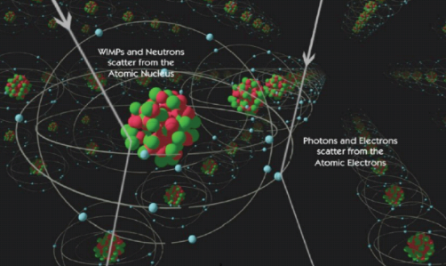
“Certain” dark matter candidates
χ
γ
χ
γ

Slide 4
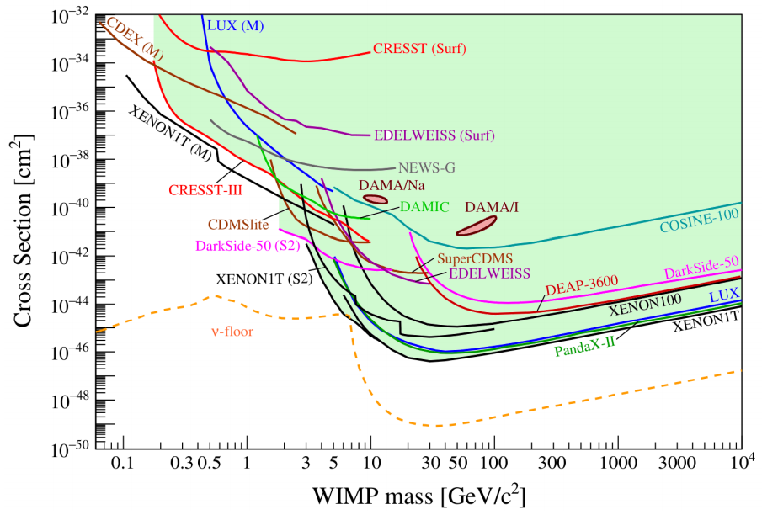
WIMP: hide and seek
2104.07634, APPEC report on dark matter direct detection
Elastic spin-independent cross section
a few evts/t/y

Slide 5
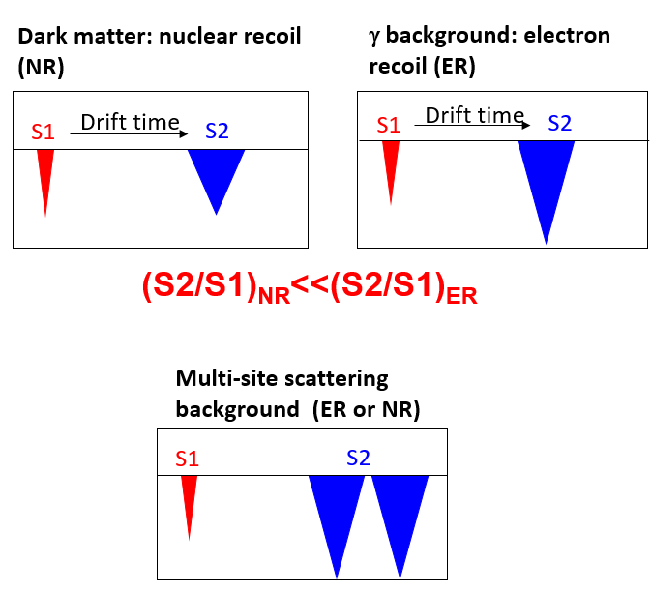
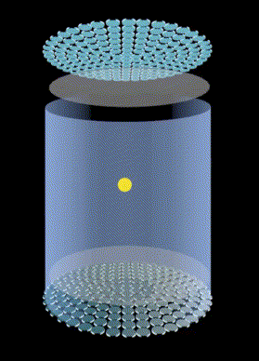
Dual phase xenon TPC
Detector capability:
Large monolithic target
3D reconstruction and fiducialization
Good ER/NR rejection
Calorimeter capable of seeing a couple of photons/electrons

Slide 6
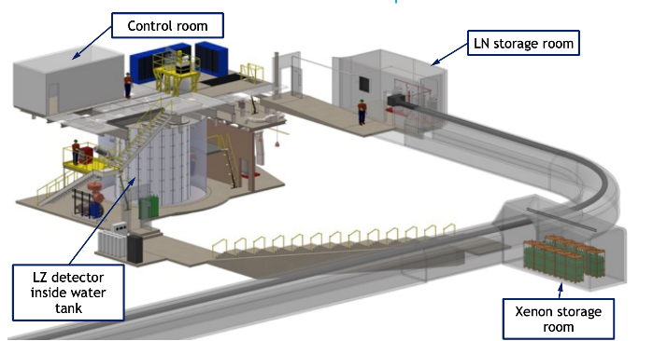
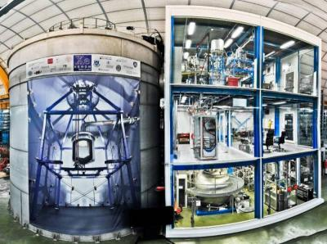
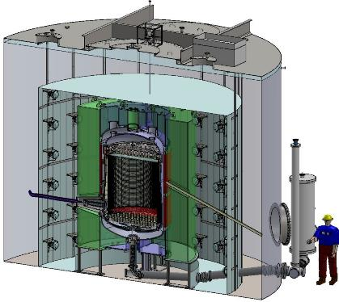
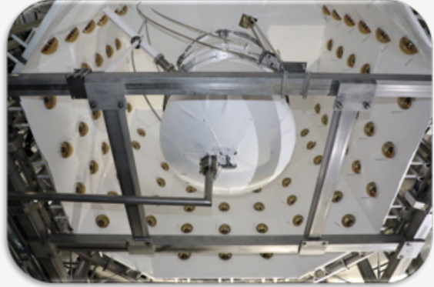
Multi-ton LXe Experiments
LZ, 7 ton,
Sanford Lab, US
XENONnT, 6 ton
LNGS, Italy

Slide 7
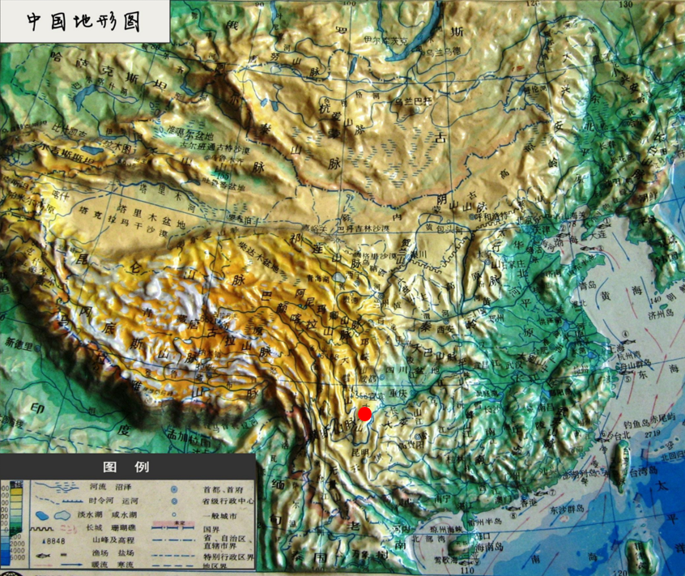
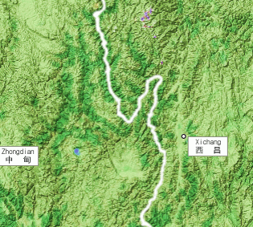
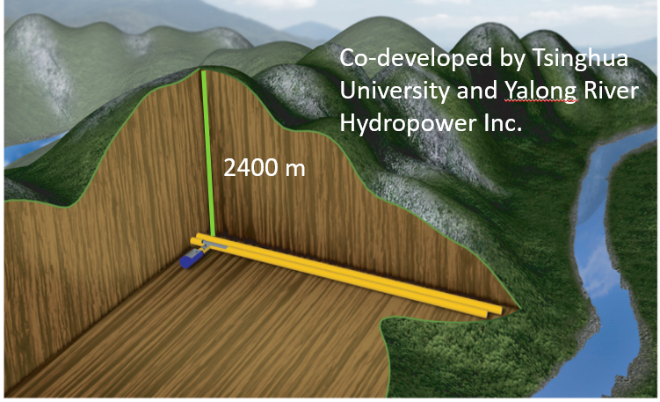
China Jinping underground Laboratory

Slide 8
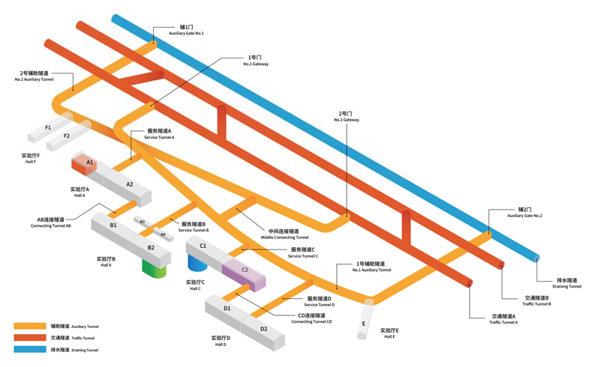
CJPL-II
Each experimental hall:
65 m (L) x 14 m (H) x 14 m (W)
JUNA
PandaX
CDEX

Slide 9
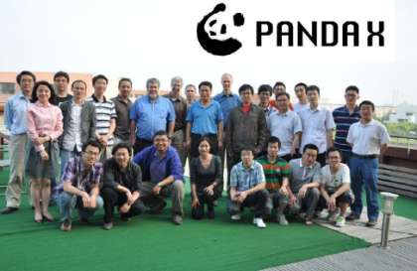
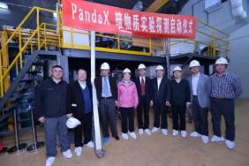
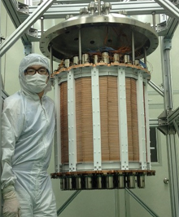
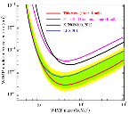
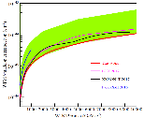
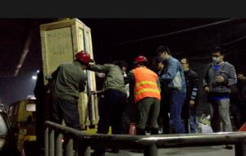
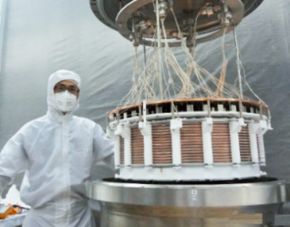
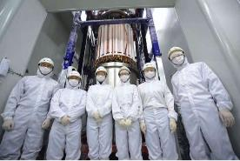
PandaX Experiments
Particle and Astrophysical Xenon Experiments
Collaboration formed
PandaX-II, 580 kg
operation
PandaX-I started
2012.7
2014.5-10
2019.8-
2009.3
2014.3
2016.7
-2019.7
PandaX-I apparatus moved to Jinping
PandaX-I, 120 kg
operation
PandaX-4T
moved to CJPL-II

Slide 10
PandaX Collaboration

Slide 11
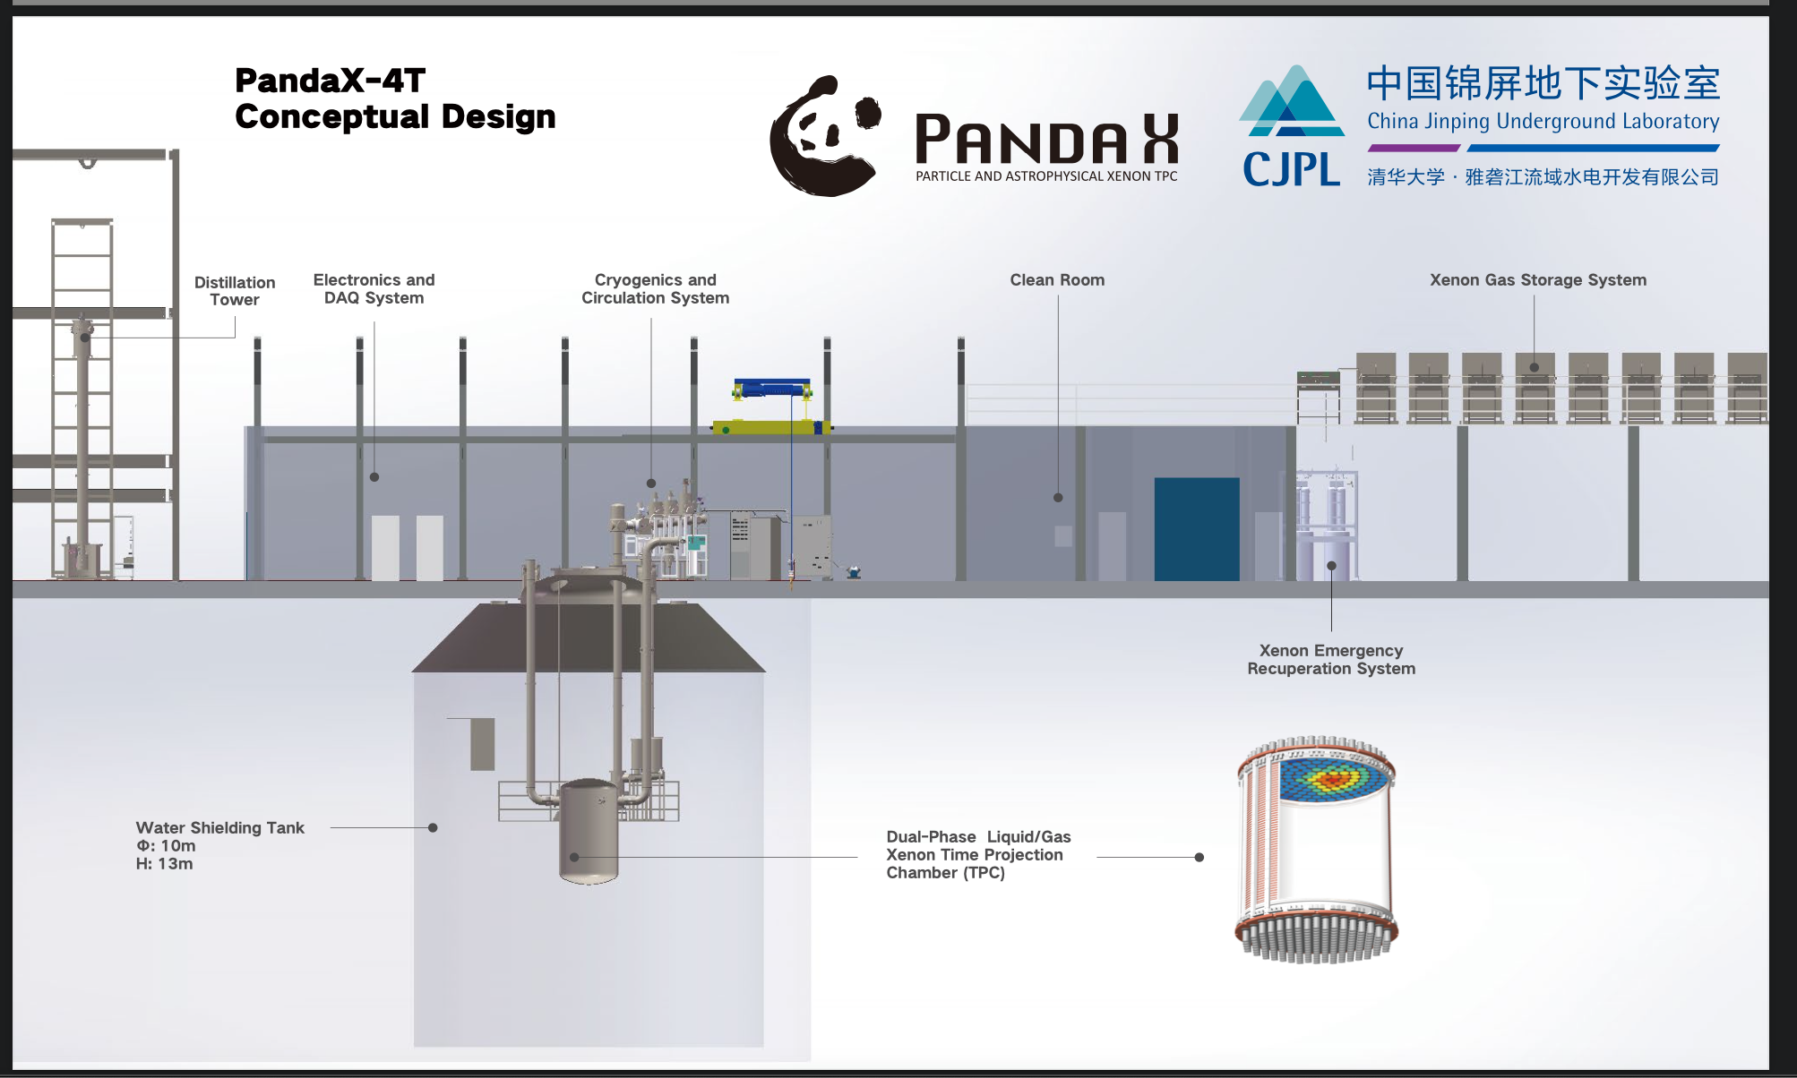
Ultrapure water shield: 13 m (H) x 10 m (D)～900 m³
TPC: 1.2 m (H) x 1.2 m (D), 3.7-tonne of LXe
3-in PMTs: 169 top/199 bottom

Slide 12
PandaX-4T major milestones
Apr. 2, 2018, permission from CJPL management to start construction in B2 hall
Aug. 19, 2019, infrastructure completed, detector installation in CJPL-II started
Mar 6, 2020, offline distillation of xenon completed
May 28, 2020, installation completed
Nov. 28, 2020 – Apr. 16, 2021, commissioning run

Slide 13
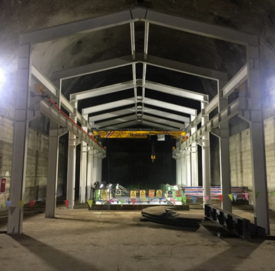
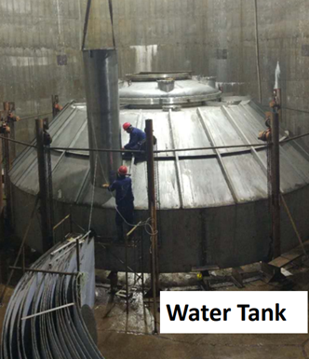
Infrastructure construction photos

Slide 14
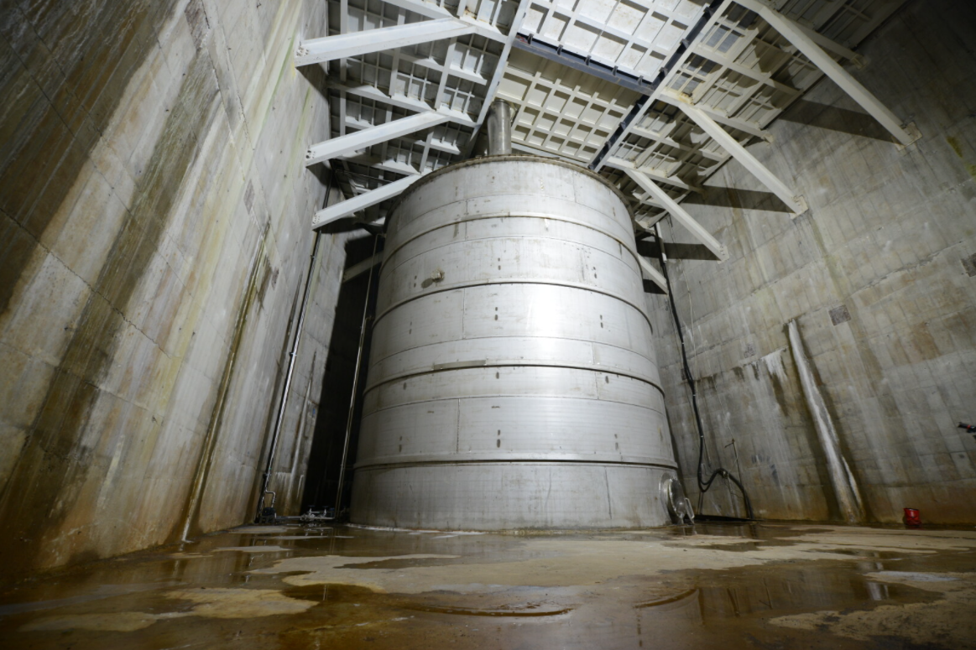

Slide 15
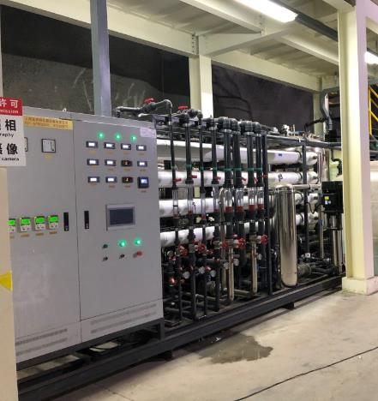
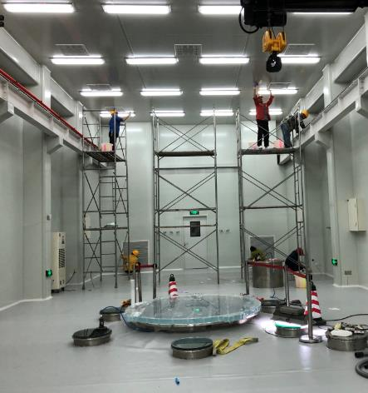
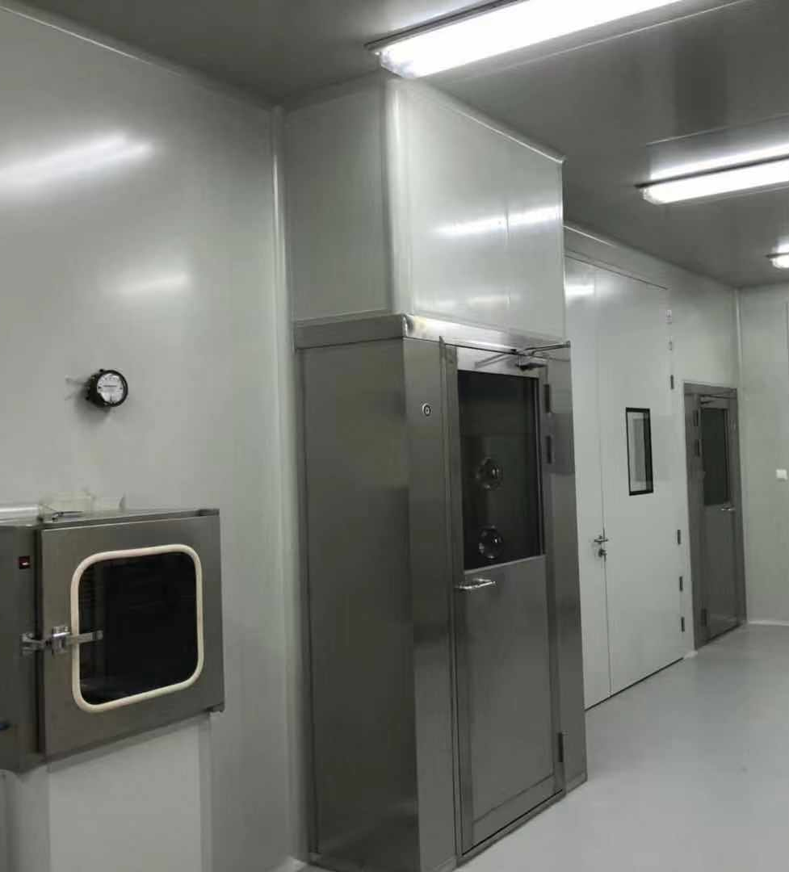
Infrastructure construction photos
Class 1000 cleanroom
Purified water system
Class 10000 cleanroom
Radon removal system

Slide 16
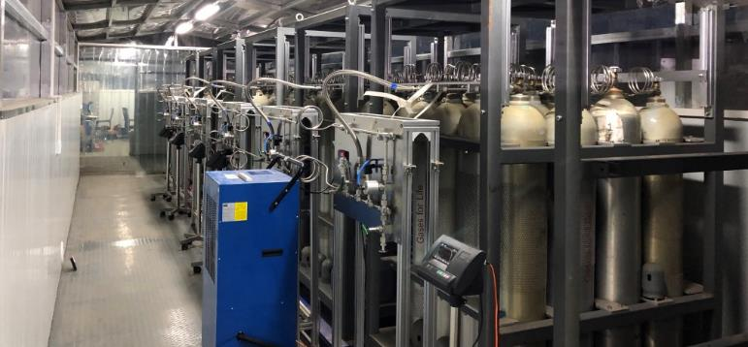
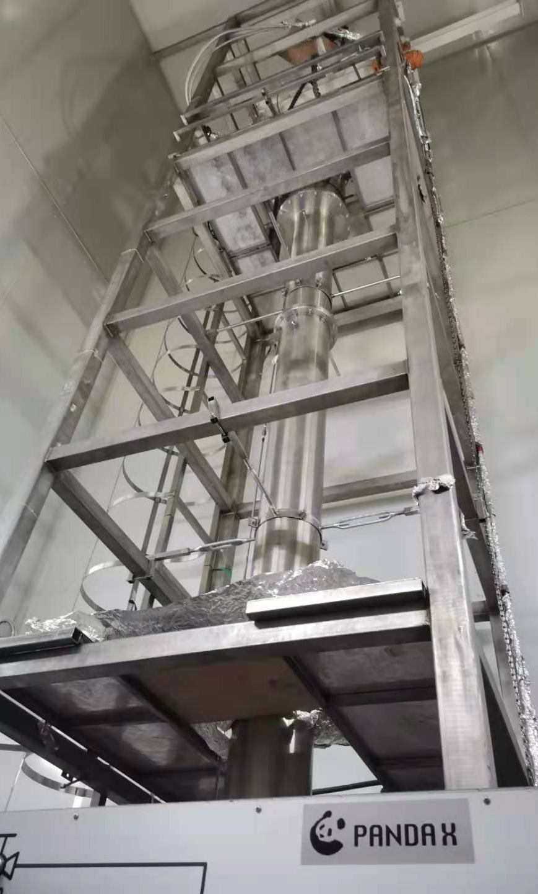
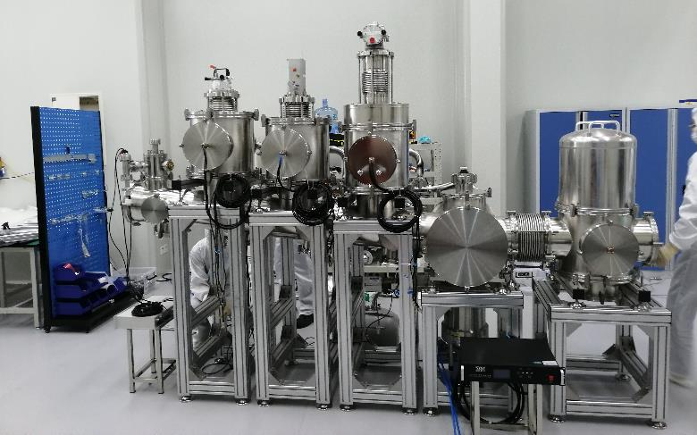
Gas, cryogenics, and distillation systems
Gas storage system
Cryogenics system
Kr distillation tower

Slide 17
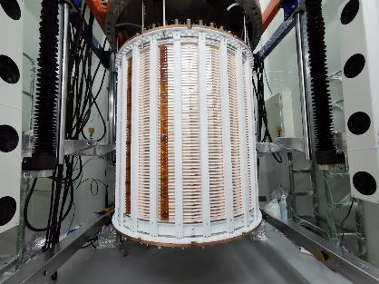
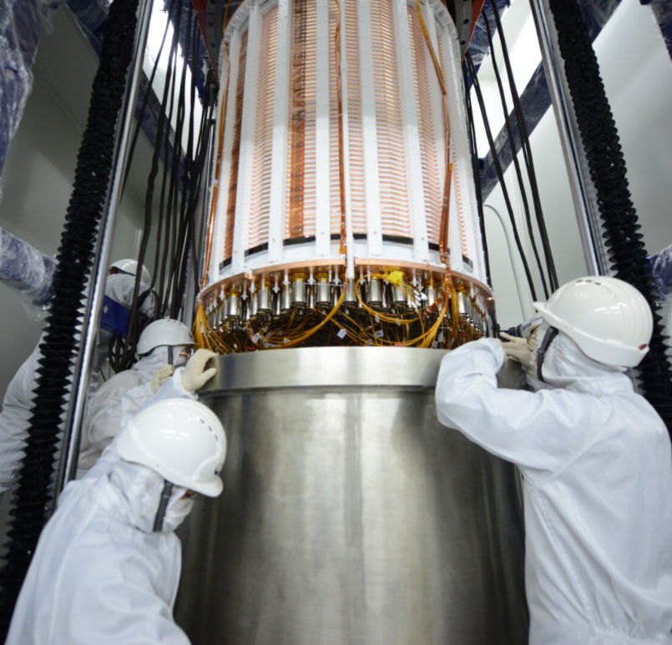
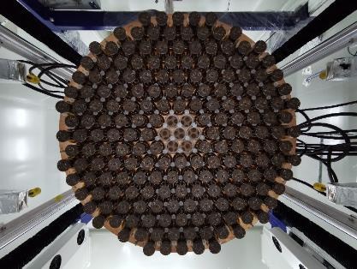
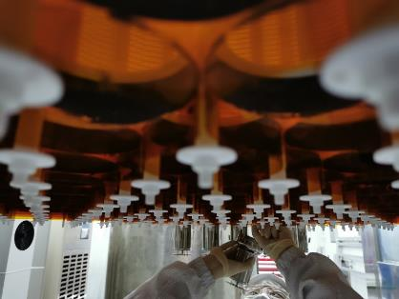
TPC installation

Slide 18
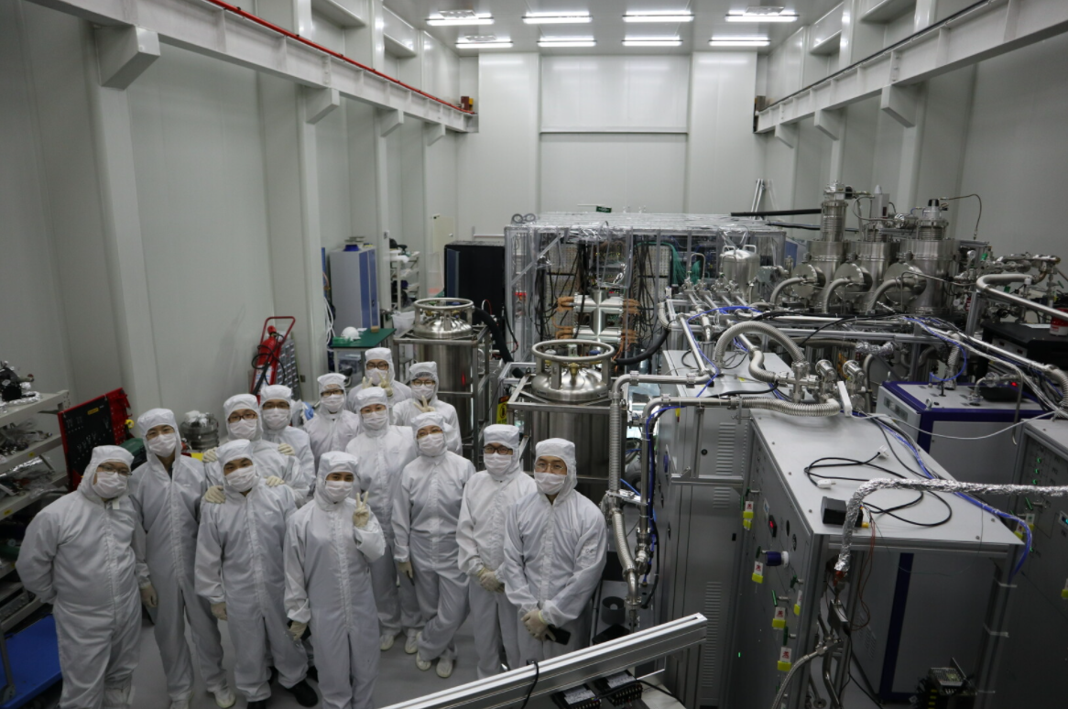
Instrumented clean room

Slide 19
Electronics hut

Slide 20
Ultrapure water filling

Slide 21
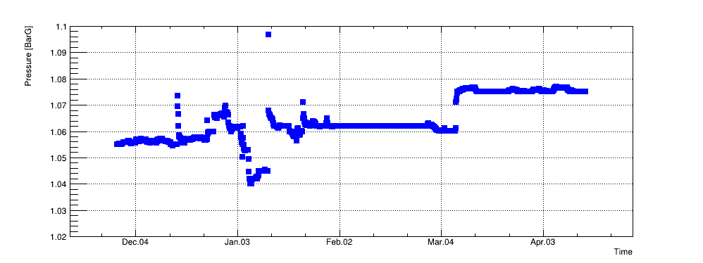
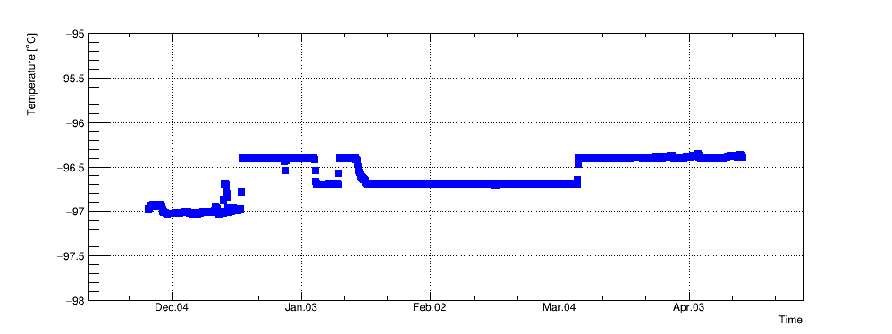
Cryogenics stability
Loop2 In
Adjust Coldhead
temperature
In the stable running period, the P and T are stable within 0.5% and 0.1K, separately.
Loop1 Maintenance
Parameters | Heating load (No purification) | Maximum Cooling Power | Purification flow rate | Outer Vacuum
Value | ~50W | ~580W | ~110 SLPM (40 kg/h) | <2E-4Pa

Slide 22
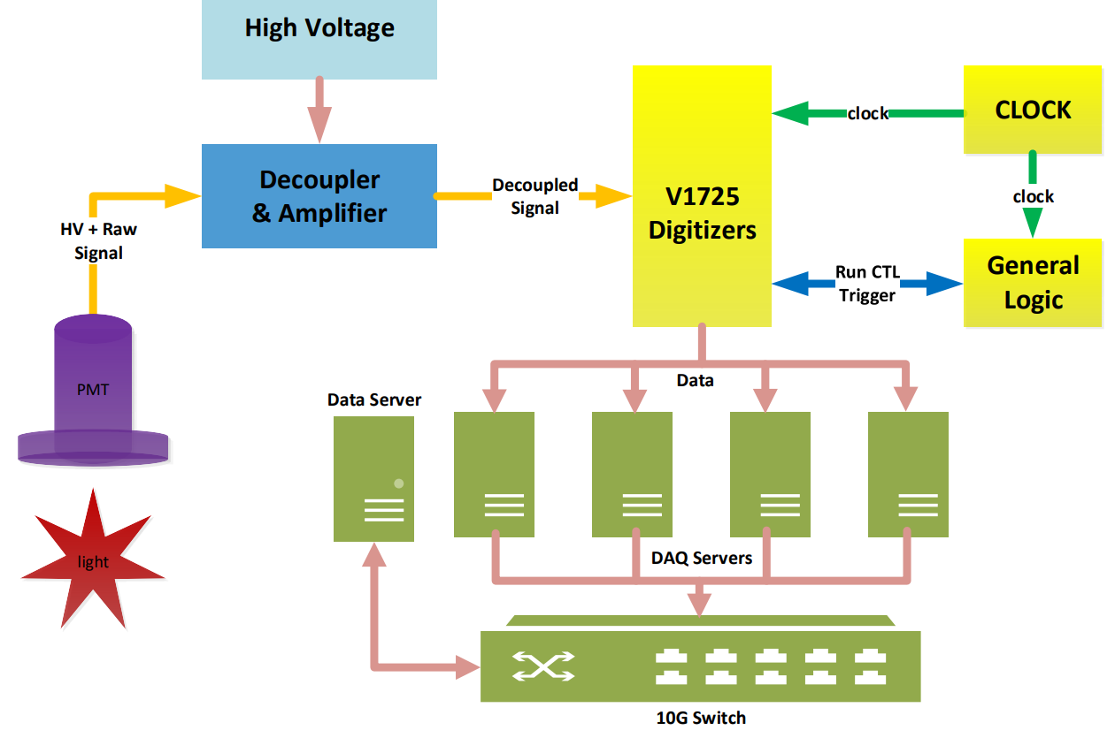
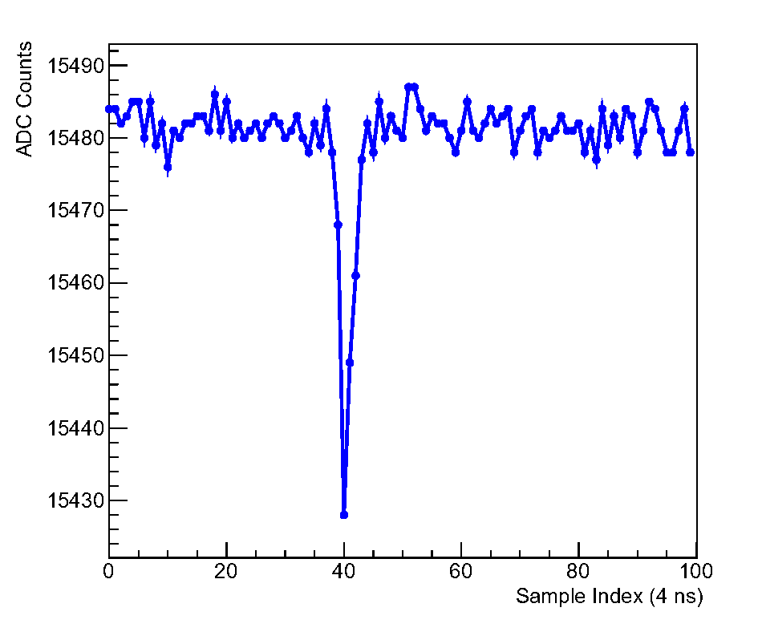
Electronics and DAQ
14 bits
250 MS/s
Typical single photon pulse
Trigger-less mode: read out pulses above 20 ADC (~ 1/3 PE)
Average single photon efficiency ~ 95%
DAQ maximum bandwidth 450MB/s

Slide 23
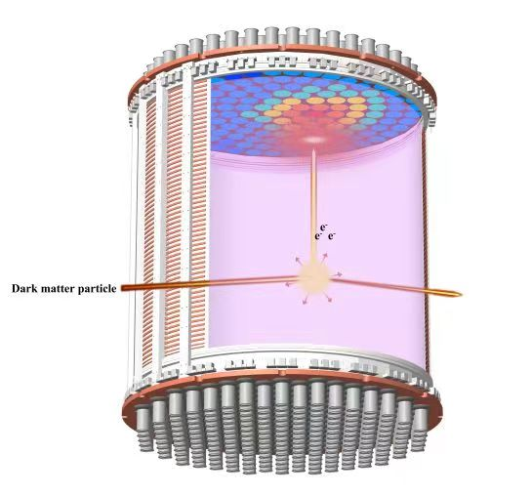
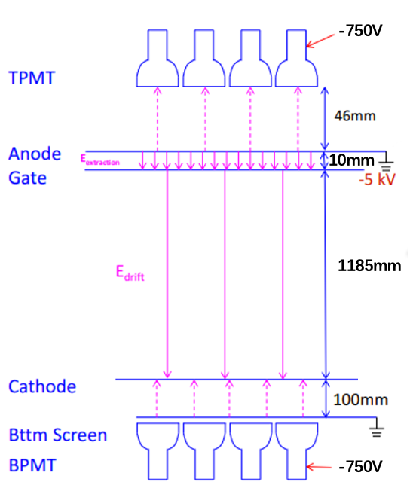
TPC operation conditions
 | Set1 | Set2 | Set3 | Set4 | Set5
Gate(kV) | -4.9 |  | -5 | -5
Cathode (kV) | -20 | -18.6 | -18 | -16
During the run, HV set at a few different values to avoid excessive discharges.

Slide 24
Data taking history
Electron lifetime: in situ S2 vertical uniformity calibration
Ref: the maximum drift time ~ 840 µs (field dependent)
Stable data running period: 95.0 calendar days

Slide 25
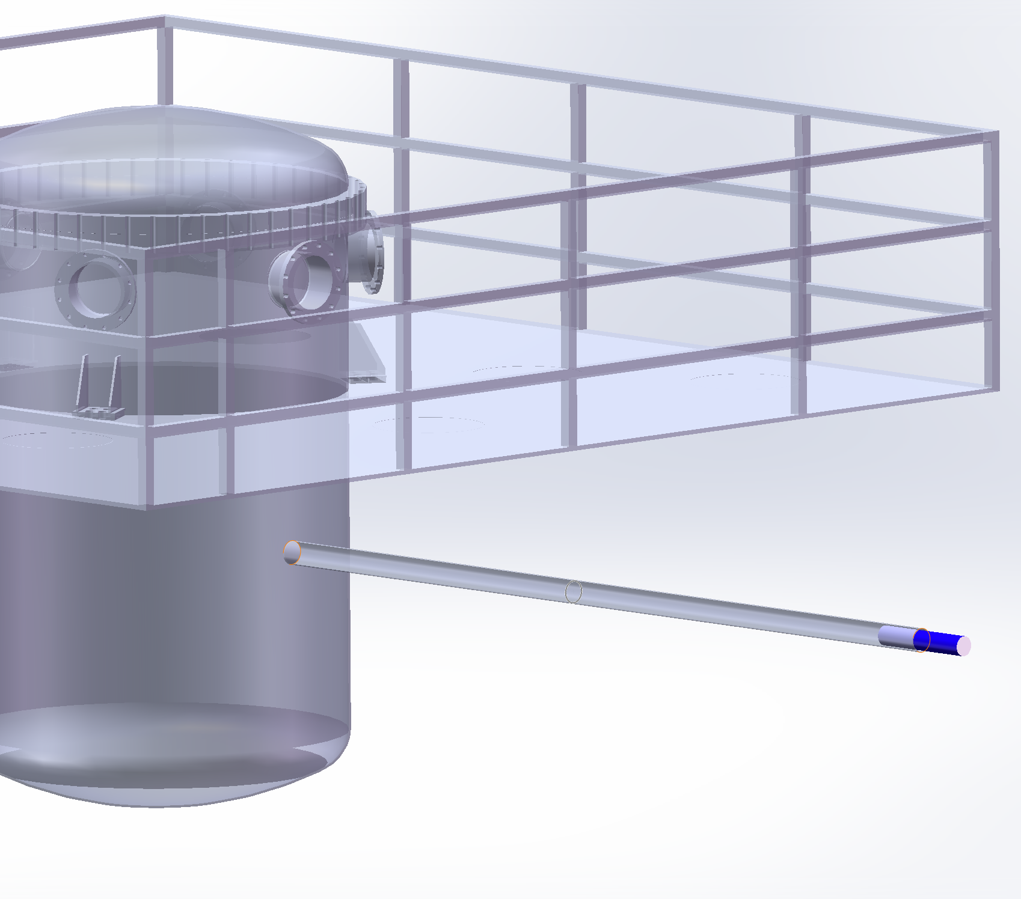
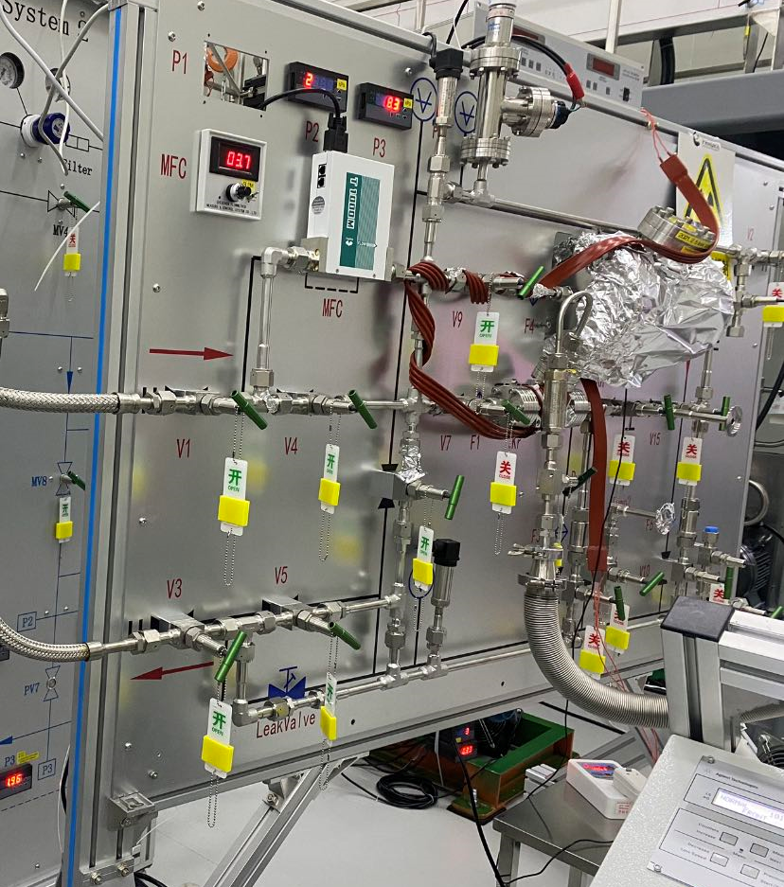
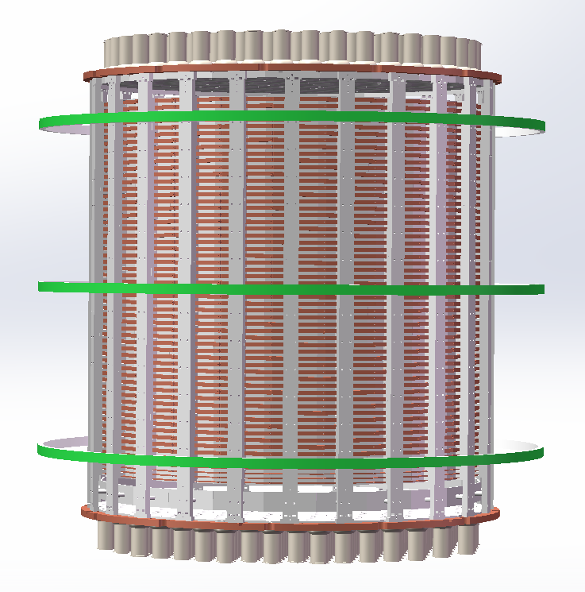
Calibration methods
Gaseous source injection panel
Calibration tubes
D-D generator
Calibration source | Position
^{83m}Kr/²²⁰Rn | Injected from gas panel
²⁴¹Am-Be | Calibration tubes
D-D neutron | Beam pipe

Slide 26
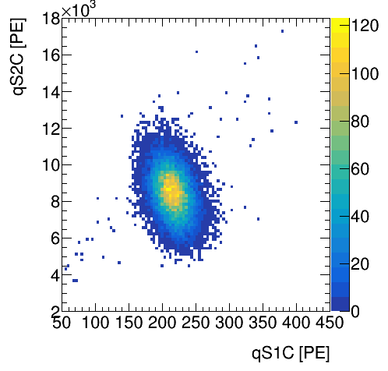
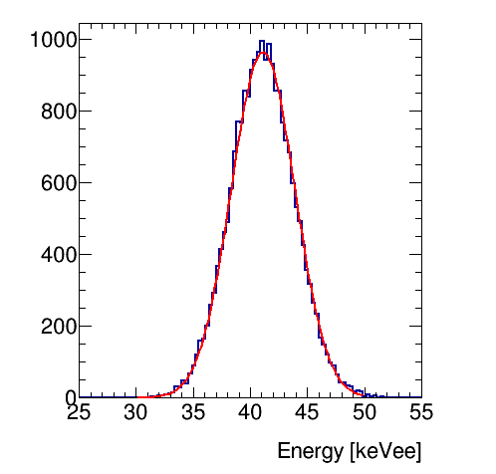
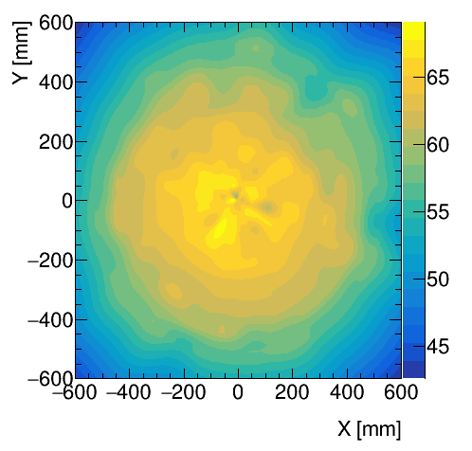
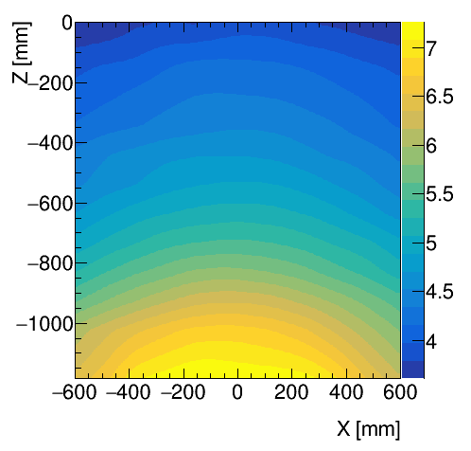
Uniformity correction with ^{83m}Kr (41.5 keV)
Energy resolution @ 41.5 keV: 6.8%
S2_{b}
S1
S2_{b} RMS in FV: 12%
S1 RMS in FV: 20%

Slide 27
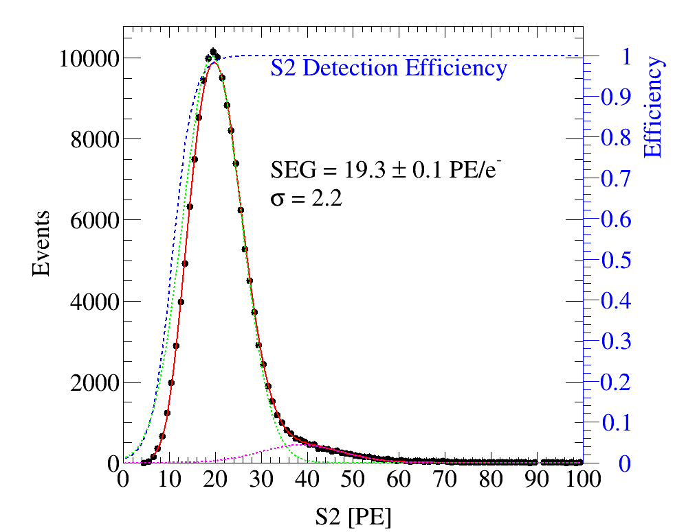
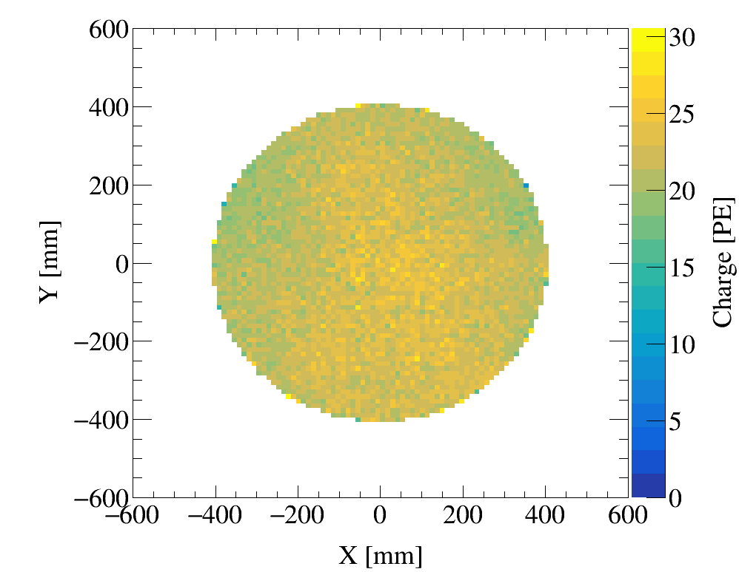
SEG and uniformity
RMS variation 13%
Mean=
S2/S2b ~ 4.2
SEG_{b} = 4.6 ± 0.1 PE/e

Slide 28
Energy reconstruction
¹³¹Xe*
¹²⁹Xe*
#Set | PDE [%]​ | EEE [%]​ | SEG [PE/e]​
1-2​ | 9.0±0.2​ | 90.2±5.4​ | 3.8±0.1​
3-5​ | 9.0±0.2​ | 92.6±5.4​ | 4.6±0.1​

Slide 29
164 keV (^{131m}Xe) evolution
shadow: 1σ systematic uncertainty band
Each data point represents about 4000 ^{131m}Xe events
Systematic uncertainty ~ 0.3%

Slide 30
Nuclear recoil calibration with DD neutrons
Head-on collision peak
Data used together with AmBe to tune the light, charge yield, as well as fluctuations in our signal model

Slide 31
Nuclear recoil calibration with AmBe neutrons
Data used together with DD to tune the light, charge yield, as well as fluctuations in our signal model

Slide 32
Electron recoil calibration with ²²⁰Rn
Measured leak ratio (below NR median) = 6/1393 = 0.43%±0.18%
Data and ER model agree well

Slide 33
Lower level data selection cuts
T-B asymmetry cut for S1
Time to previous large signals
Rejected
Diffusion cuts
Livetime fraction: 92.7%
Rate excursion cuts: 97.7%

Slide 34
Efficiencies obtained from calibration data
Same S1 and S2 efficiency obtained from the ER and NR data
Plateaued efficiency at 40 keV_{nr} ~78%.

Slide 35
ER background from detector materials
Top
Center
Bottom
Outer
Overall agreement between data and MC (>1MeV): 14%
Expected background: 33 ± 4 events

Slide 36
Rn background
Bi-Po events
(same S2)
²²²Rn
²¹⁸Po
²²²Rn
²¹⁸Po
²¹⁶Po
²¹⁶Po
²¹⁴Po
Rn background​ | Estimation method​ | Activity [µBq/kg]​
​ ²²²Rn | ²²²Rn alpha | ​4.8 (0.1)
 | ²¹⁸Po alpha | ​4.5 (0.1)
 | ²¹⁴Bi-²¹⁴Po coincidence​ | ​0.87 (0.01)
²²⁰Rn | ²²⁰Rn-²¹⁶Po coincidence | 0.07 (0.01)
Improved 6 times from PandaX-II!

Slide 37
²²²Rn level evolution
Set1
Set2
Set3
Set4
Set5
Set 3→4: online Kr distillation (10 SLPM)
Set 4→5: distillation off to reduce Rn emanation from the tower
Low background directly extracted: 347 ± 190 events

Slide 38
⁸⁵Kr
Waveform of ⁸⁵Kr's β-γ coincidence
Time separation between β-γ
Vertex distribution of β-γ candidates
Kr/Xe = 0.33(0.21) ppt (mol/mol), improved 20 times from PandaX-II!
Beyond sensitivity of our Kr assay system
Expected background:
53 ± 34 events

Slide 39
¹²⁷Xe (cosmogenically activated)
T1/2 = 35.86d (fit), 36.4d (theo)
DM search window
75.8 ± 17.1 events
Expected background (5 keV): 9 ± 2 events

Slide 40
Tritium background
Toy fit – only
Tritium + flat background
E_{rec} (keV)
Tritium spectrum identified in the data
Likely originated from a tritium calibration at the end of PandaX-II
Level floating in the final dark matter fit: ~ 5(0.3)x10⁻²⁴ (mol/mol)

Slide 41
Surface background (Rn progenies)
²¹⁰Po from PTFE wall
Surface events with larger qS2 (better reconstruction) are more suppressed by radial cut.
Expected background: 0.6 ± 0.2 events

Slide 42
Neutron background
Tags: multiscatters and captures
Both process benchmarked by neutron source calibration
Neutron background: 1.3 ± 0.6 events, including 30% "neutron-X" events (E deposition in the below-cathode region)

Slide 43
Accidental background
Single S1 rate: 9.5 Hz Temporal variation: 10.5%
Single S2 rate: 4.5×10⁻³ Hz
Temporal variation: 12.7%
Expected accidental background: 2.4 ± 0.5 events

Slide 44
FV determination
Based on background simulation (10 t-year)
Uniform ER (including tritium) normalization come from data
Define FoM = sqrt(B)/M
Best FV = 2.67 tonne
FV cuts in the data maintaining the same FV (correcting for reconstruction bias)

Slide 45
Background composition
Component | Nominal (evts)
³T (from fit to data) | 527 (50)
Flat ER* (18-30keV side band) | 492 (31)
Rn | 347 (190)
Kr | 53 (34)
Material | 33 (4)
Xe127 | 9 (2)
Neutron | 0.9 (0.4)
Neutron-X | 0.4 (0.2)
Surface | 0.6 (0.2)
Accidental | 2.4 (0.5)
B8 | 0.8 (0.4)
Sum | 1033 (59)
Expected below-NR-median events: 10.3 (1.0) evts
Flat ER (Rn+Kr+Material) is determined from side band in DM data
Background per unit target is improved from PandaX-II by 4 times (<10 keV)

Slide 46
Dark matter candidates
S1 = (2, 135) PE, S2_{raw} > 80 PE, S2 < 20000
In FV, 1058 candidates
6 below NR median line

Slide 47
Position distributions
Events uniformly distributed in the FV, expected if dominated by tritium and radon.

Slide 48
Spectral comparison
Fit data with unbinned likelihood with all signal/background PDFs in (S1, S2_{b})
No excess found, background-only p-value 0.7
Spectrum agrees with expected background

Slide 49
Likelihoods of the six below-NR events

Slide 50
WIMP-nucleon SI exclusion limits
Exposure: 0.63 tonne•year
Sensitivity improved from PandaX-II final analysis by 2.8 times (40 GeV/c²)
Our limit is ~1.3 times stronger than XENON1T around 40 GeV/c²
Dived into previously unexplored territory!
Approaching the “low E” neutrino floor
SUSY benchmark contours (MasterCode)
EPJC 78, no.3, 256 (2018), EPJC 78, 158 (2018)

Slide 51
Conclusion and outlook
PandaX-4T has completed its commissioning run
With a 0.63 tonne•year exposure, PandaX-4T produced the strongest WIMP-nucleon interaction constraint (arXiv shortly)
This demonstrates the physics potential of a highly sensitive multi-ton liquid xenon detector (dark matter, neutrinos, …)
PandaX-4T is currently performing an offline tritium removal campaign, aiming to reduce the electron recoil background by at least two-fold
In parallel, the collaboration is developing the plan for the next generation experiment at CJPL

Slide 52
More communication wanted
PandaX-4T实验已经开始试运行，获得了第一批数据，但国际竞争也异常激烈。为了探讨PandaX-4T上的暗物质、中微子物理方面的具体研究，我们拟于八月初召开PandaX-4T实验合作组会议（8月7-8日）、以及第二届“深地液氙暗物质、中微子研讨会”（8月9日）。会议的主要目的是PandaX的实验家和国内理论家深入讨论、碰撞，期望在新物理上确定一系列有科学意义的主攻方向，开展合作研究。
gesf@sjtu.edu.cn

Slide 53
Recent PandaX-II results
Finished total 132 ton-day exposure in 2019
Chin. Phys. C 44 125001
Chin. Phys. Lett. 38 011301
Phys. Rev. Lett. 126, 211803

Slide 54
Charge pattern of ^{83m}Kr event

