Slide 1
Experimental study of the higgs sector
Yanwen Liu
University of Science and Technology of China
Lecture at pre-school of “Higgs potential and BSM opportunity”, Nanjing(Virtual), 2021/8/27

Slide 2
Outline
Discovery of the H(125) at CMS and ATLAS
ATLAS and CMS experiments
Reconstruction and particle identifications
Statistical methods in HEP
Latest results related to H(125)

Slide 3
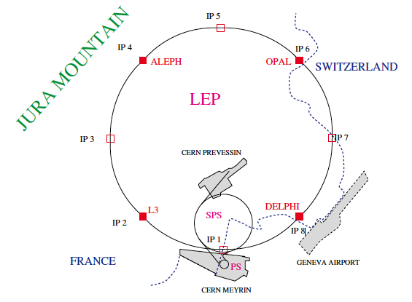
1990
1992 LHC Expression of Interest
1995.10 LHC Design report
1999.5 LEP reached Ecm = 192 GeV
2000 LEP reached Ecm = 200 GeV
2000.11.2 LEP shutdown
LEP : 1981 – 2000

Slide 4
LHC time line :
1992 : expressions of interest
1995.10 : LHC TDR published
2009.11: first pp collisons at CME=900 GeV
2010.2: first pp collisions at CME=7 TeV
2011: CMS and ATLAS recorded ~5/fb of data
2012: CMS and ATLAS ~20/fb at CME=8 TeV
2015 – 2018 data-taking at CME = 13 TeV

Slide 5
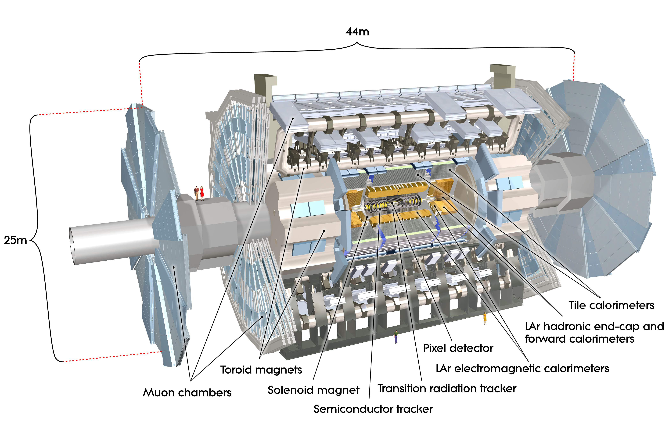

Slide 6
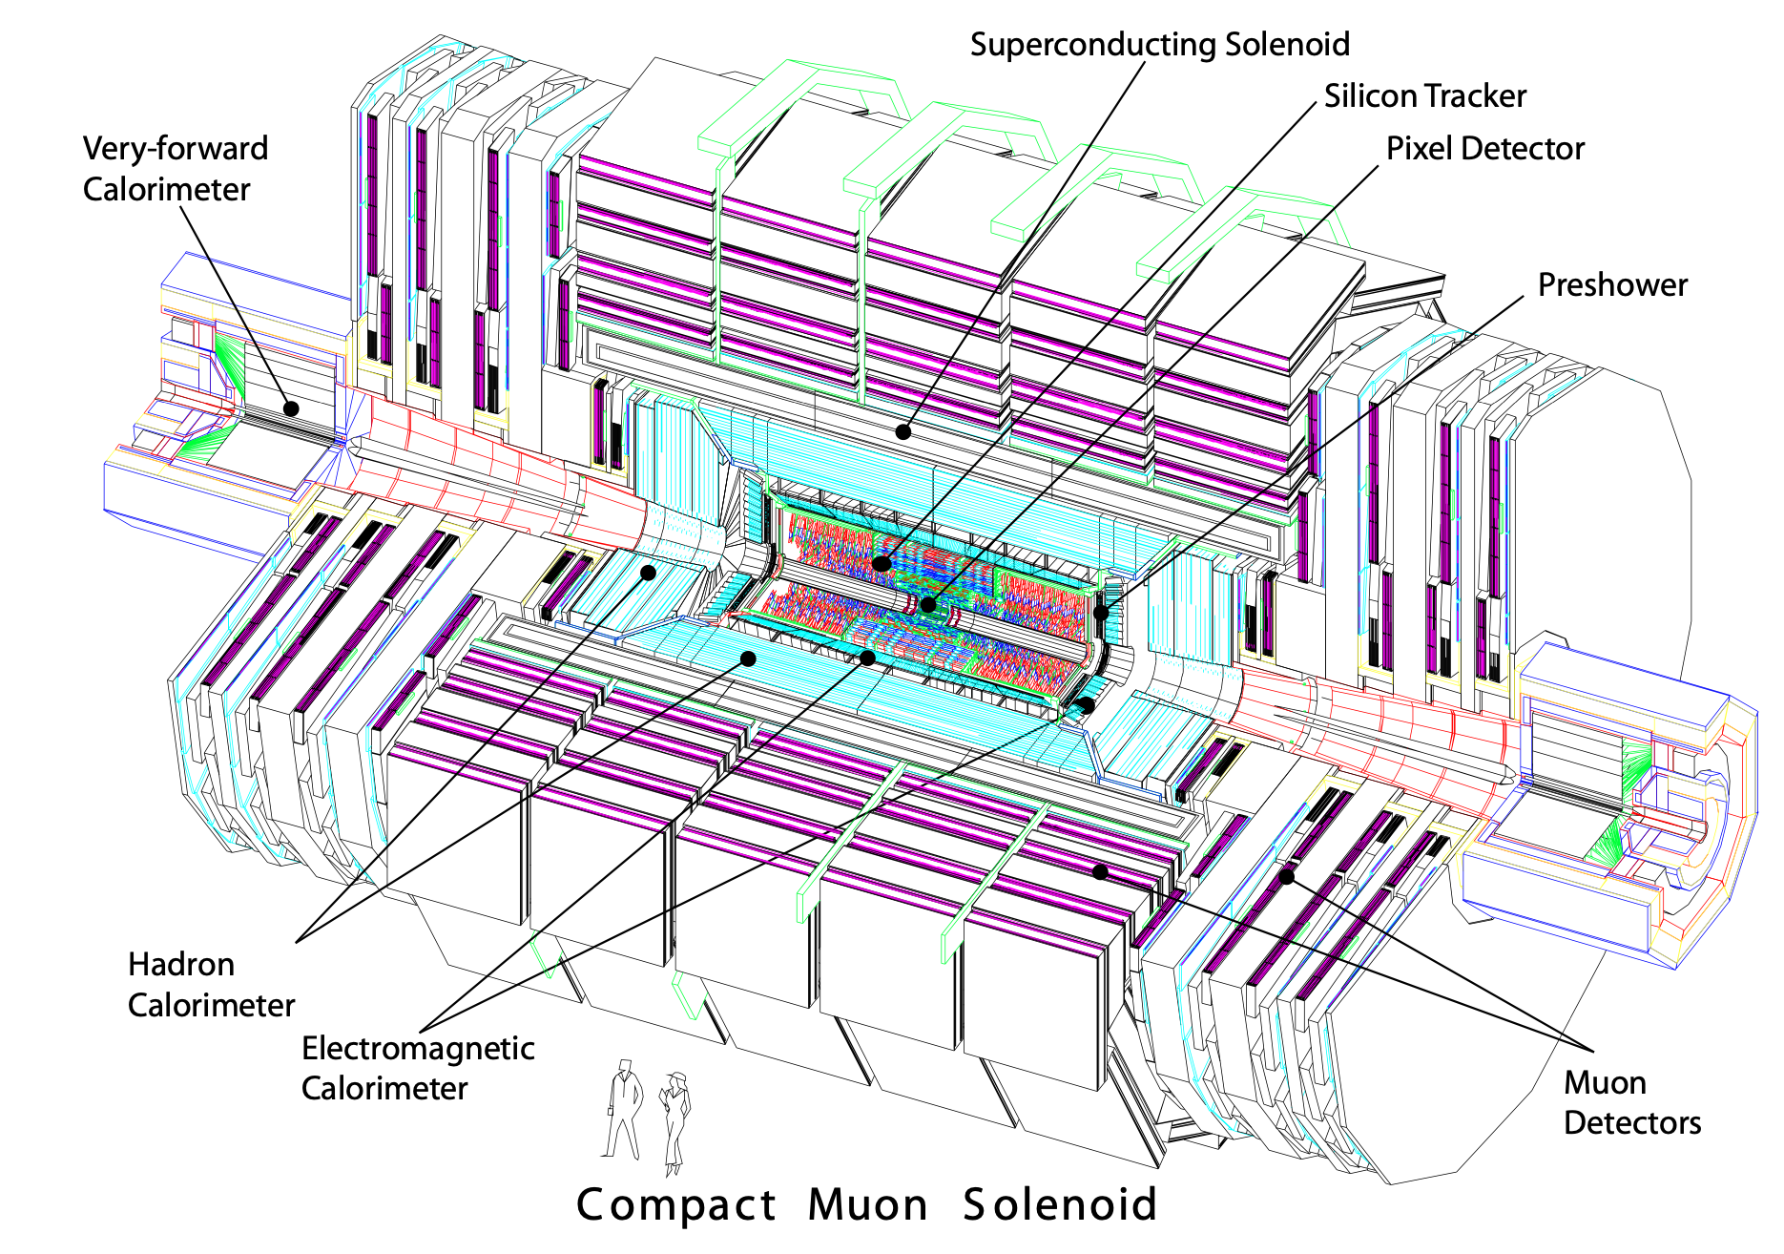
Diameter 14.6 m
Length 21. 6 m
Weight 12500 t

Slide 7
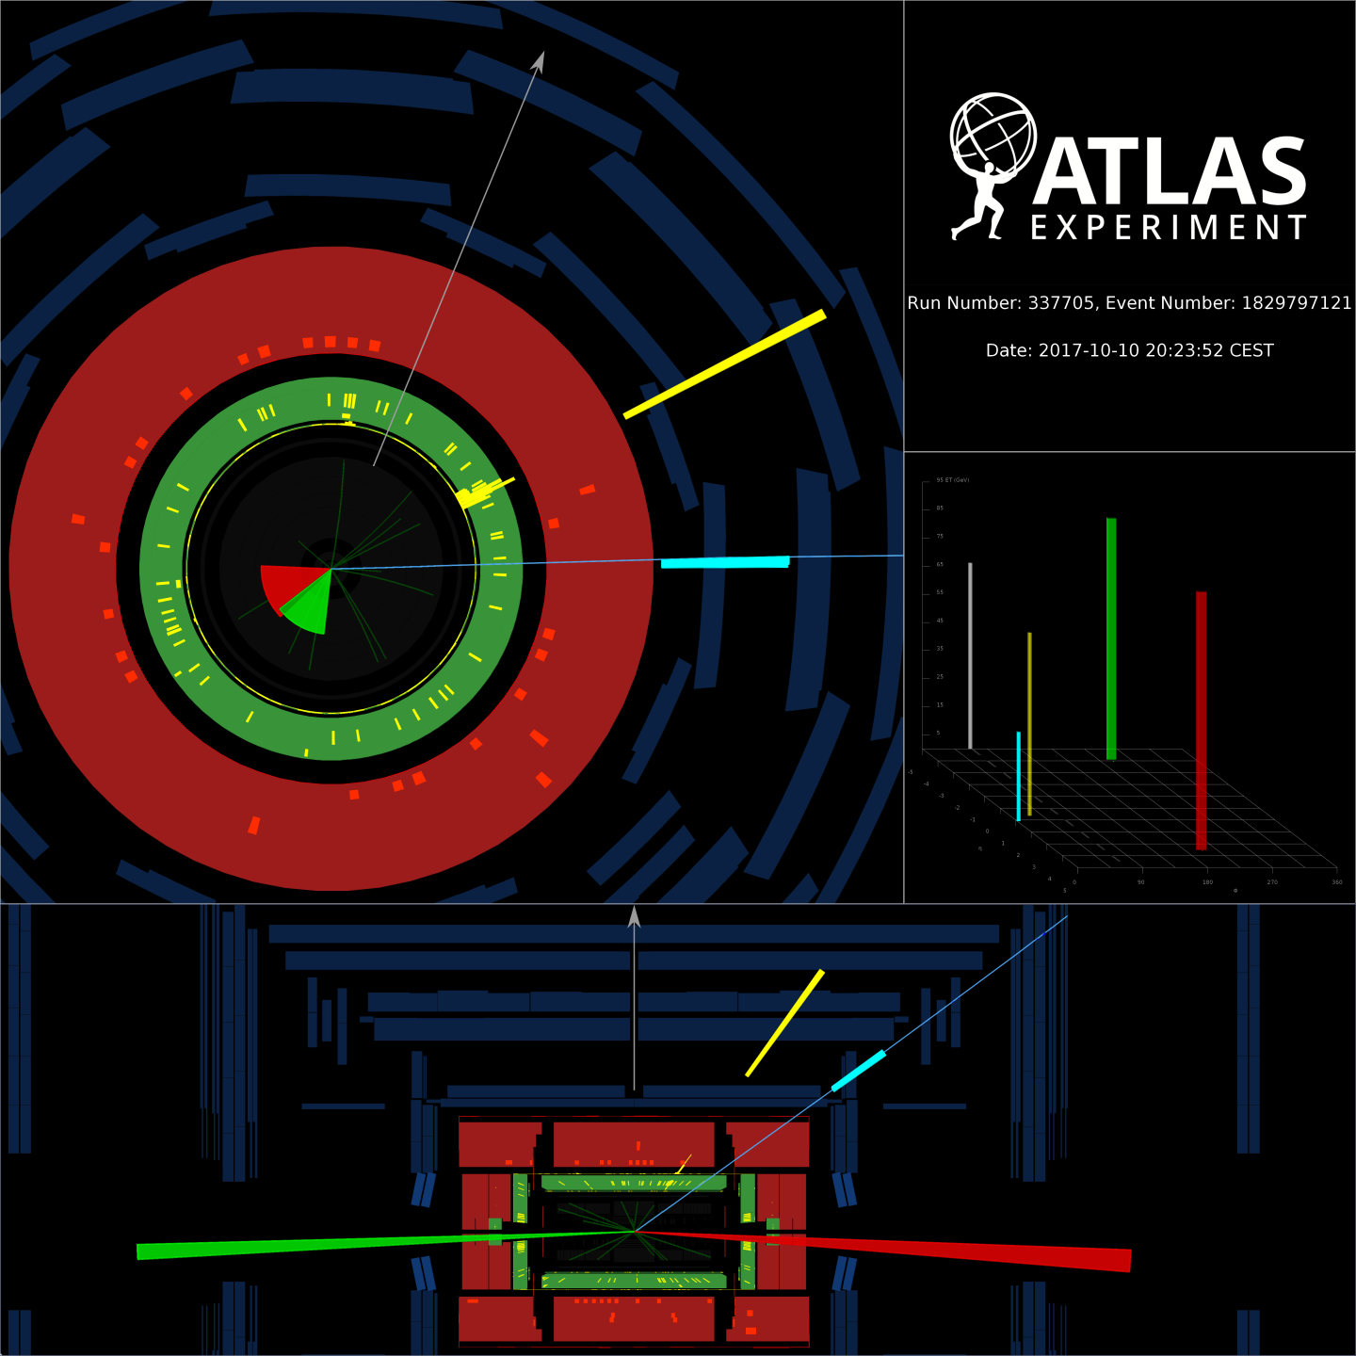
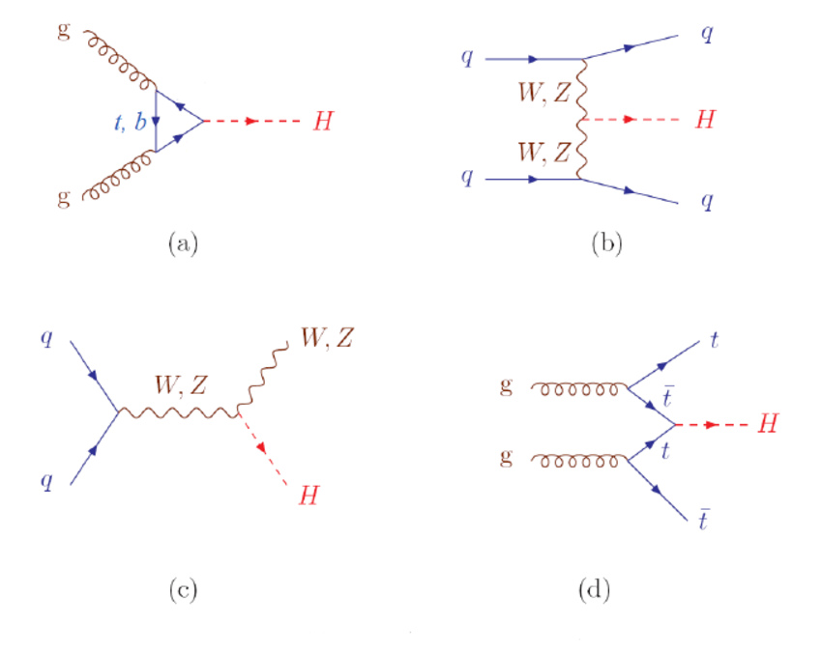
MET
electron
muon
An event display VBF H, H→W+W-
Jet
Jet

Slide 8
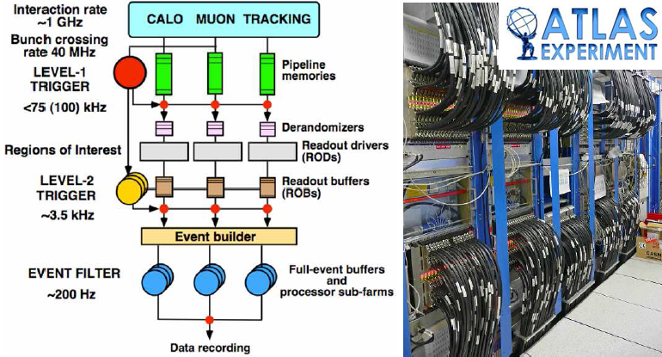
ATLAS Trigger and data acquistion

Slide 9
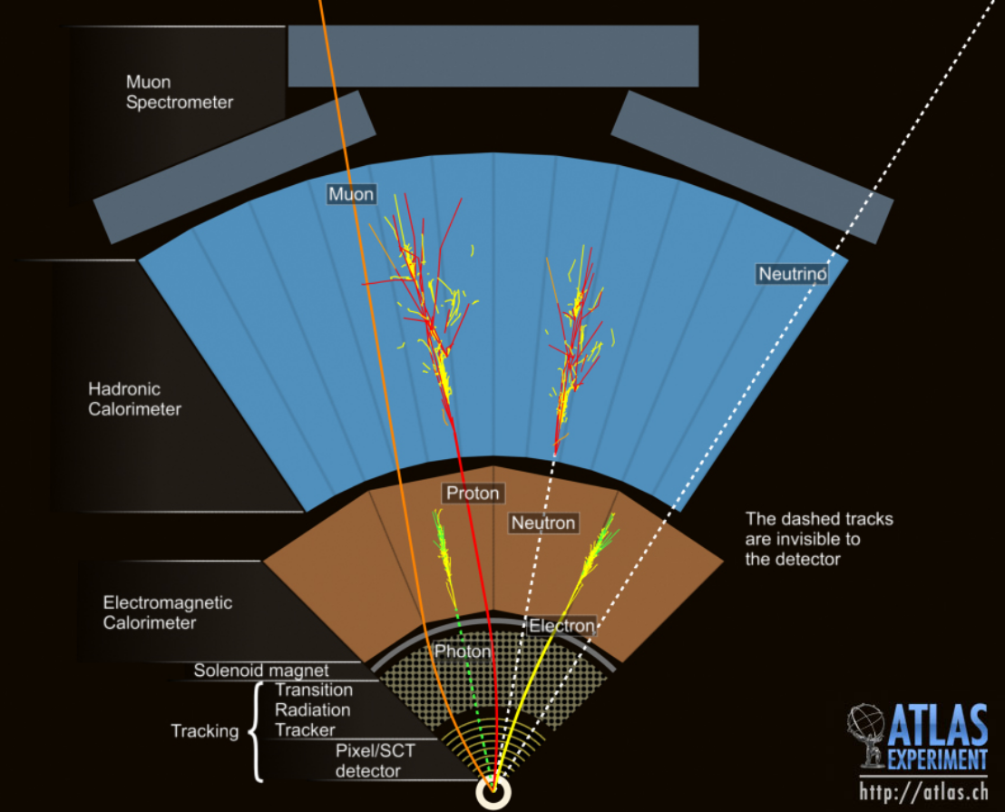
Final state signatures
Electron
Photon
Proton
Neutron
Neutrino

Slide 10
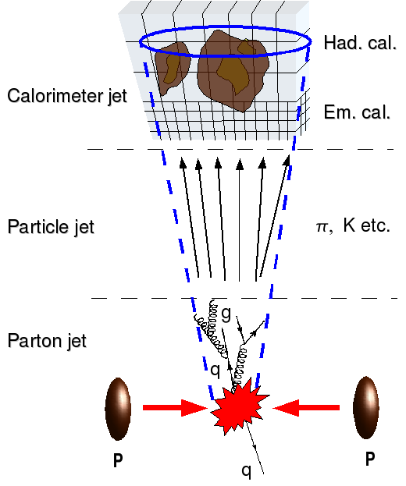
Jet algorithm

Slide 11
Jet finding algorithm (kT)
http://arxiv.org/abs/hep-ph/0512210v2

Slide 12
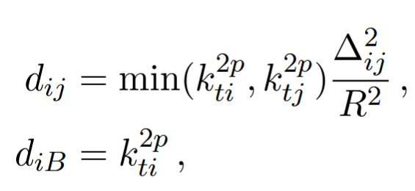
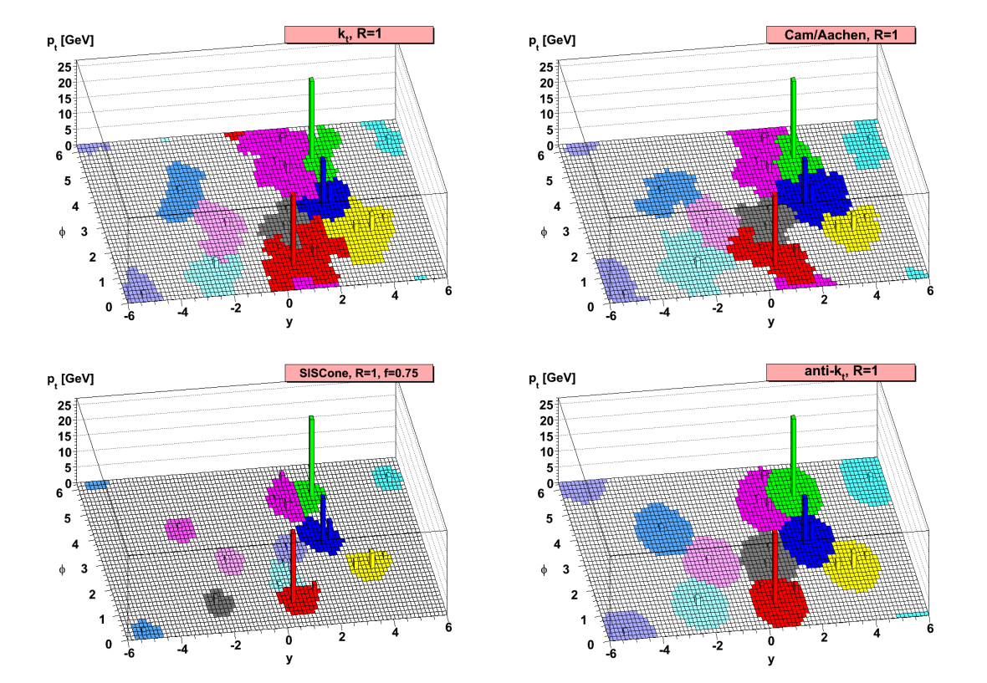
Generalizations (anti-kT, Cambridge/Aachen)
http://arxiv.org/abs/0802.1189v2
p=0 => CA
p=1 => kT
p=-1 => anti-kT

Slide 13
B-tagging

Slide 14
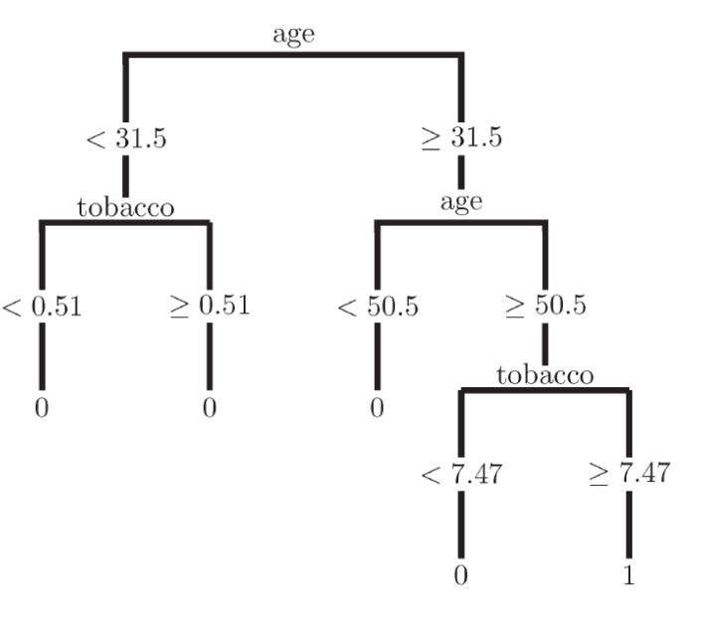
Boosted decision tree

Slide 15
混杂度

Slide 16
BOOST

Slide 17
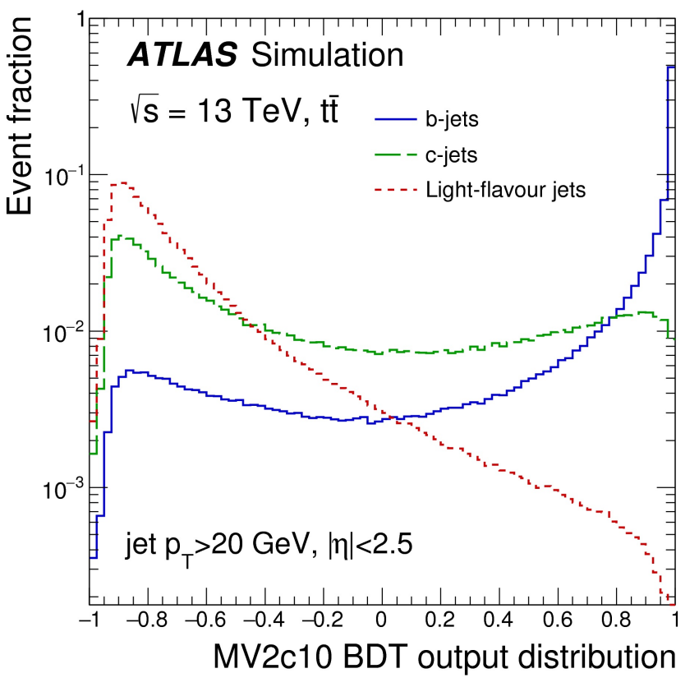
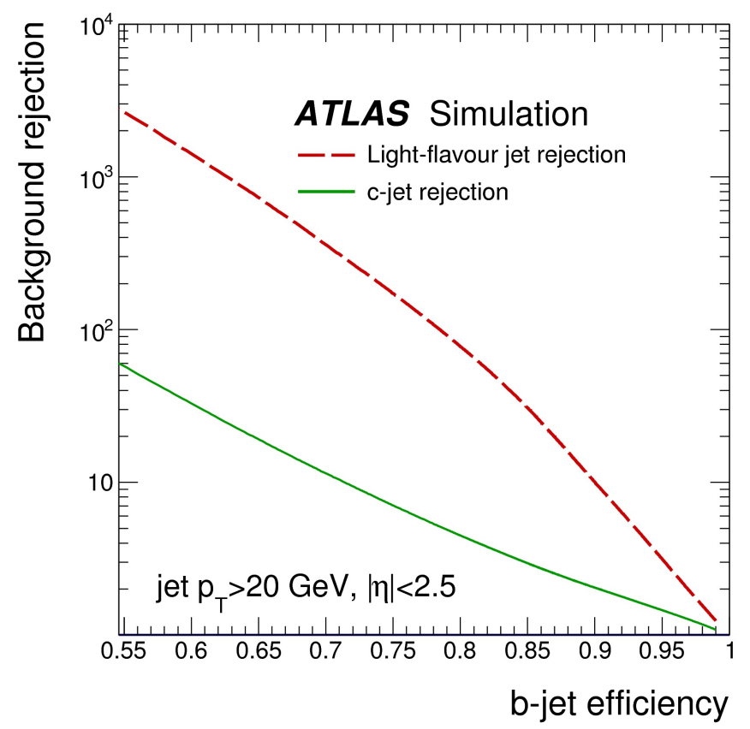
B-tagging performance

Slide 18
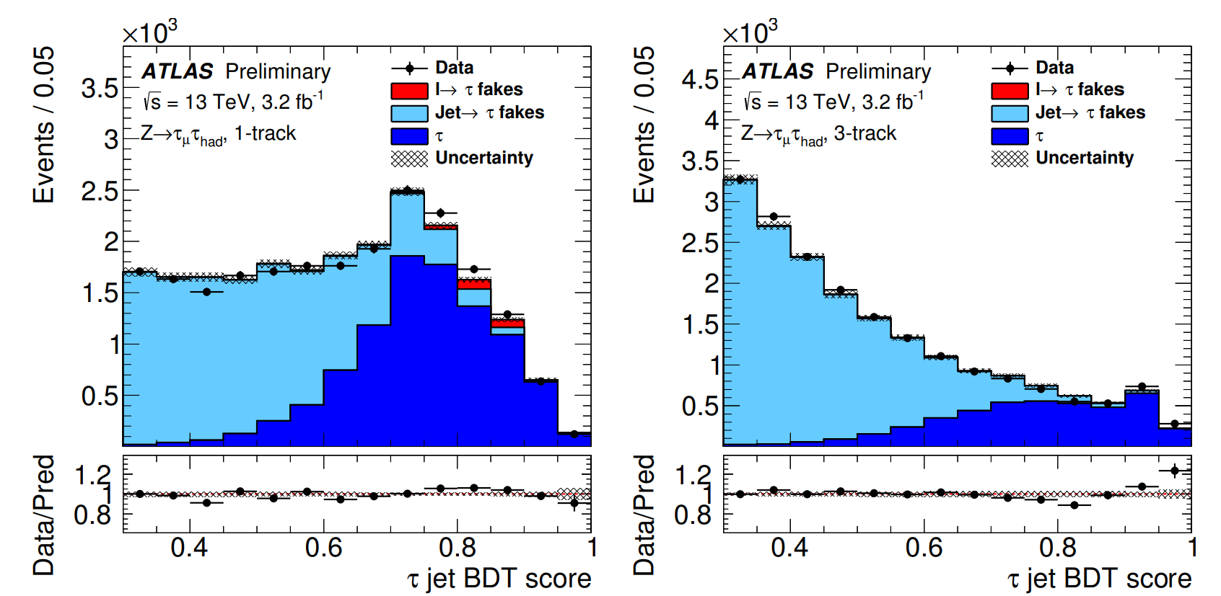
Tau Identification
ATLAS-CONF-2017-029

Slide 19
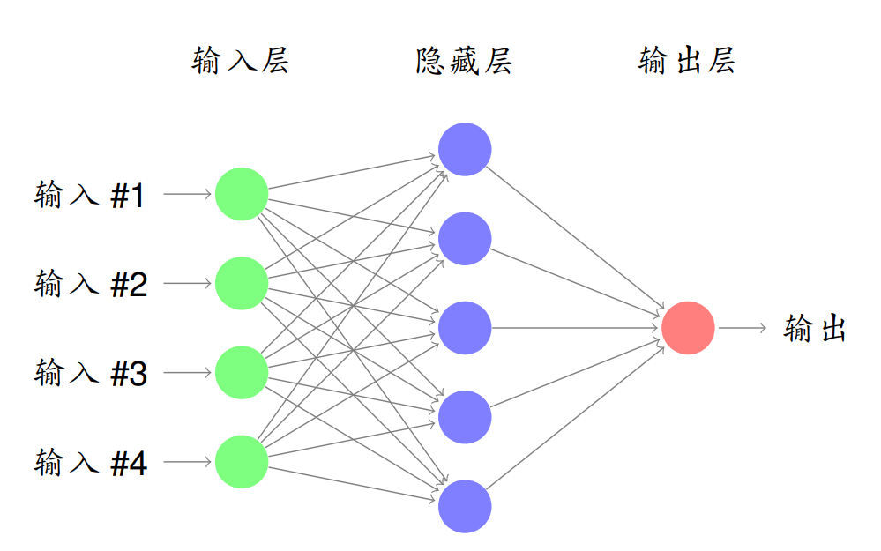
Artificial Neural net

Slide 20
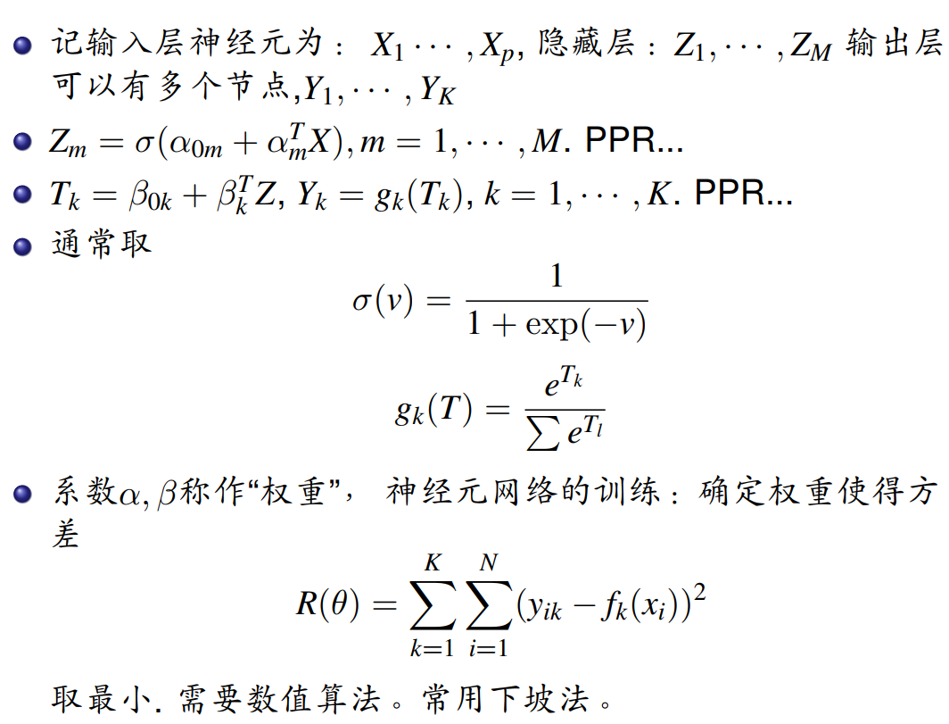
ANN math
Deep ANN b-tagger (ATLAS)

Slide 21
Discovery paper(ATLAS)
arXiv:1207.7214v2
Dataset | L(fb⁻¹) | Higgs decay channels
2011 7 TeV pp | 4.8 | ZZ*, WW*,bb,$ττ,$4-lepton(improved), $γγ$ (improved)
2012 8 TeV pp | 5.8 | ZZ*(4-lepton),$γγ,$WW* →$eυμν$
Notes:
第一类错误。 P-value, significance

Slide 22
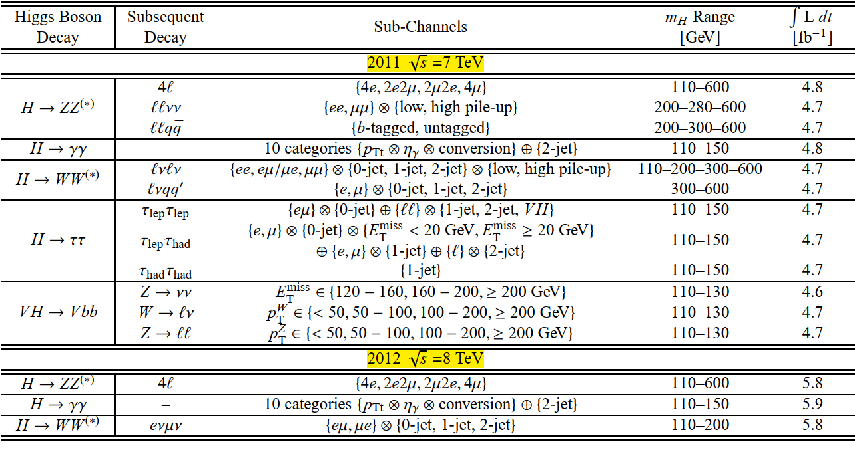

Slide 23
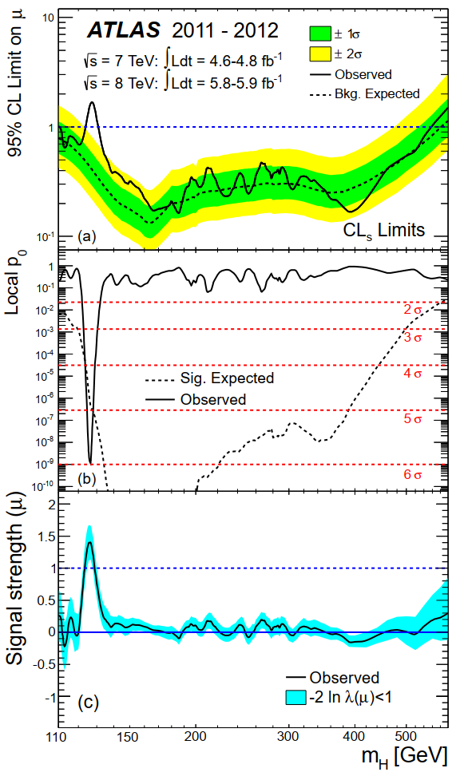
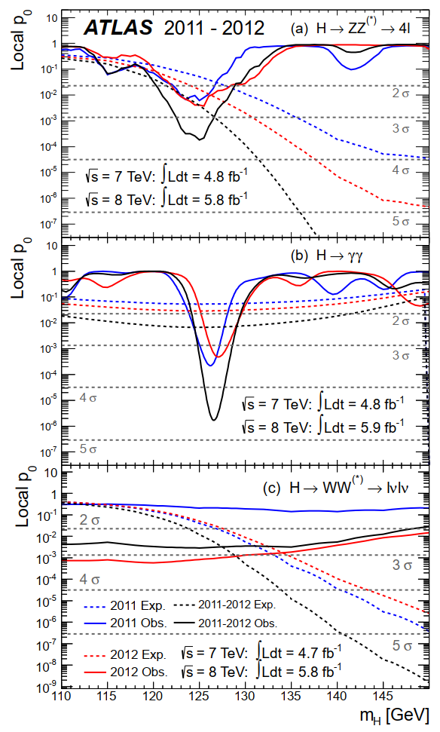
Notes:
Upper limits, p-value, signal strength, 不同道的信号显著性。

Slide 24
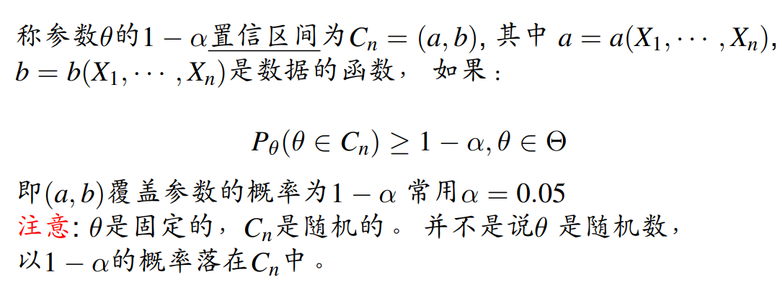
置信区间（误差的统计意义）

Slide 25
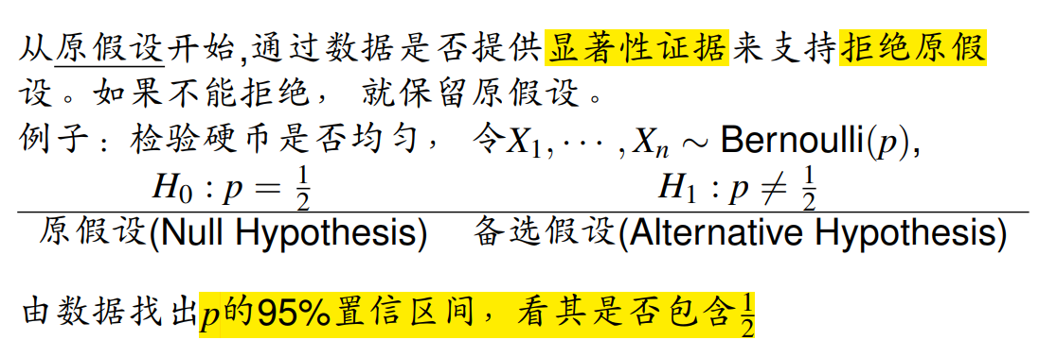
假设检验

Slide 26
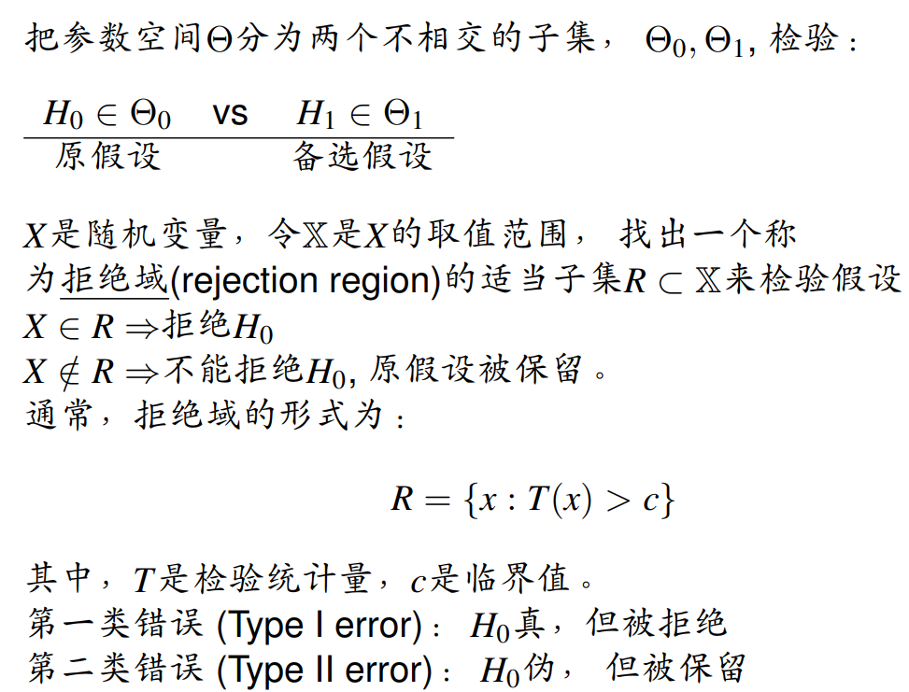
假设检验和新物理的寻找

Slide 27
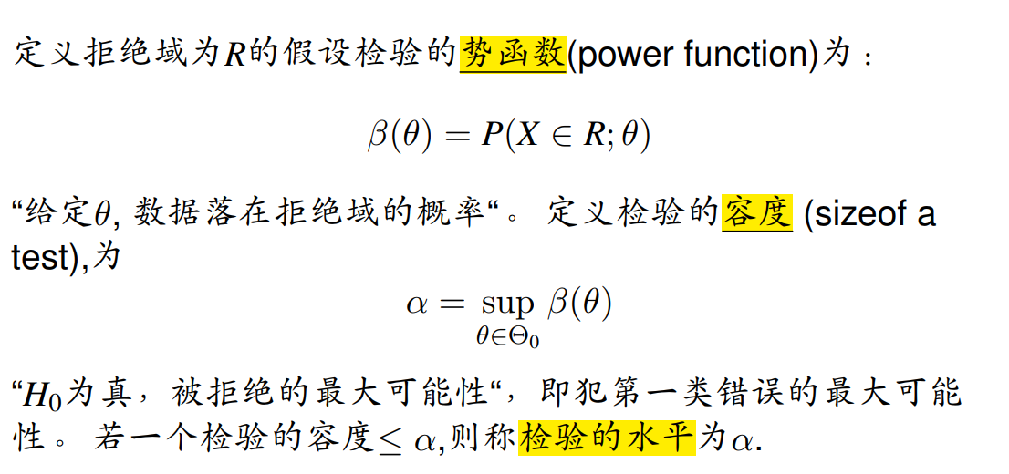
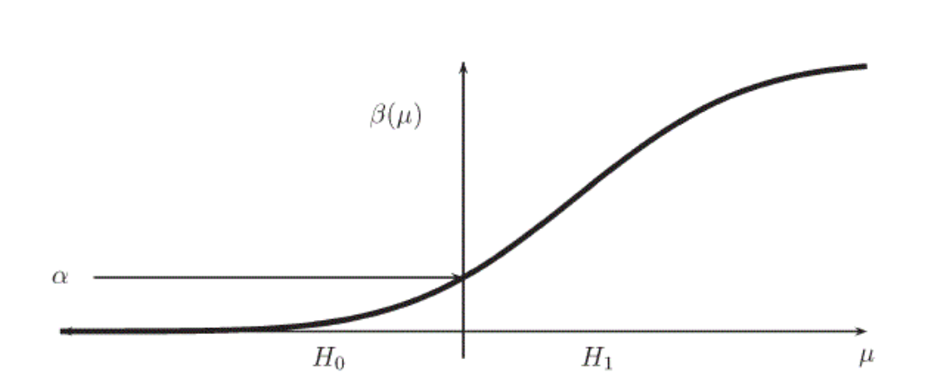
势函数、容度、检验水平(CL)

Slide 28
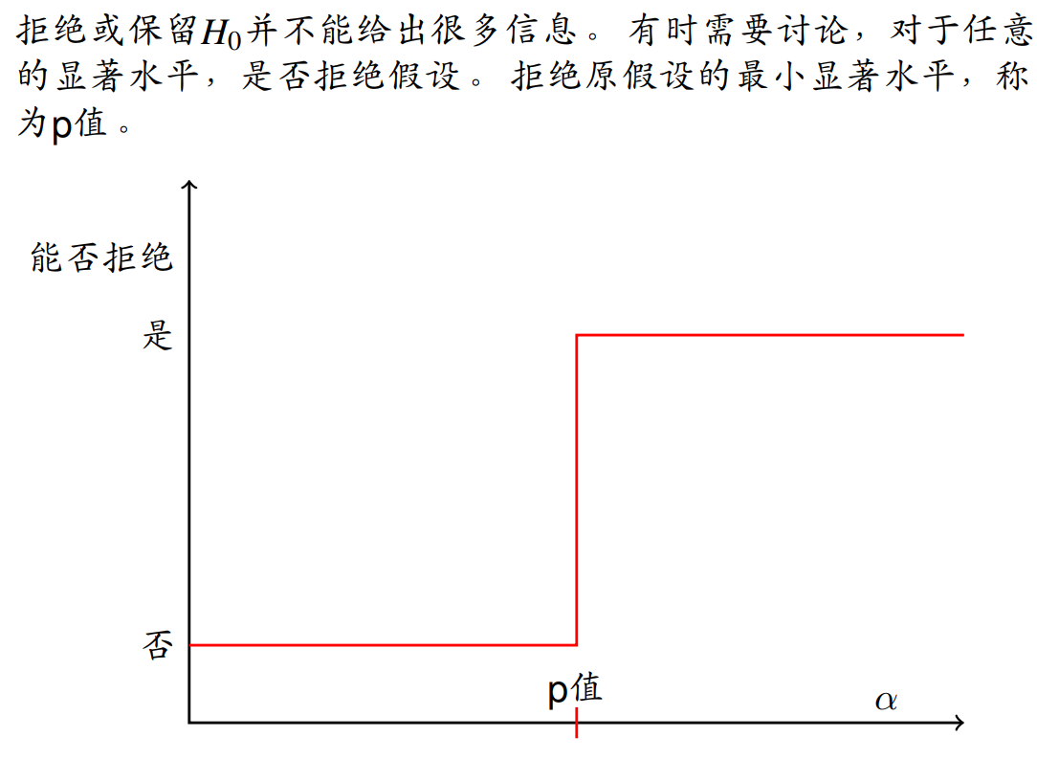
P-value

Slide 29
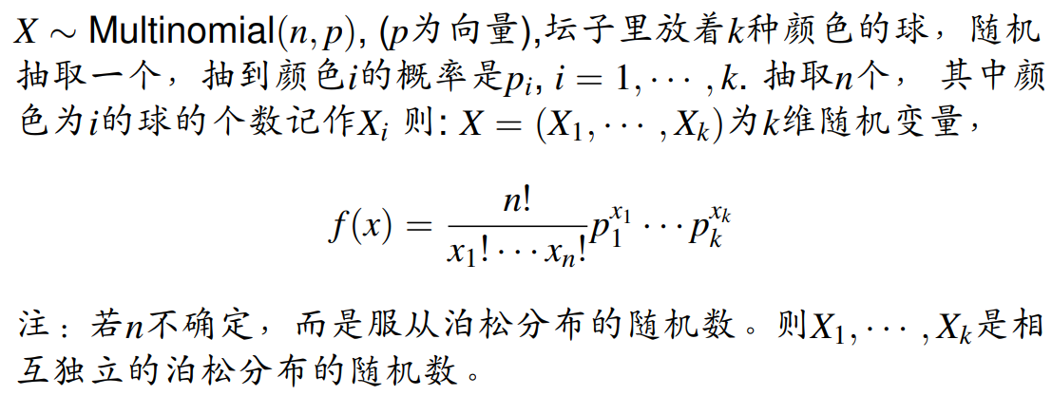
多项分布

Slide 30
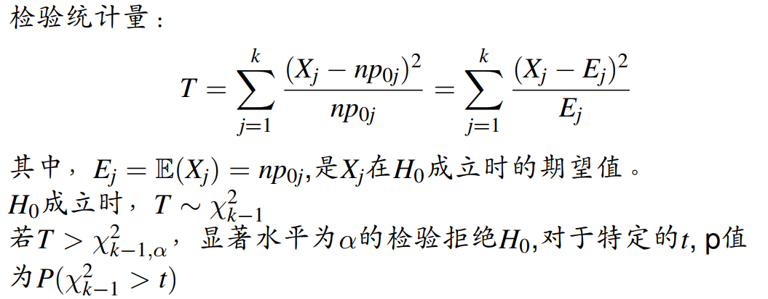
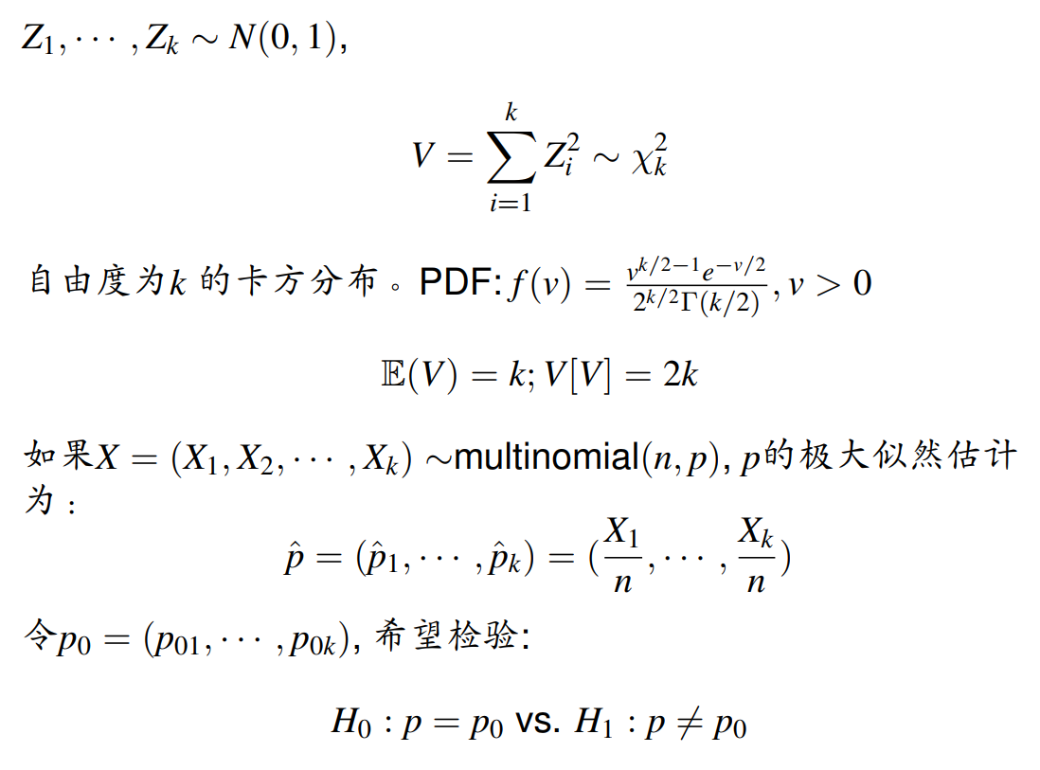
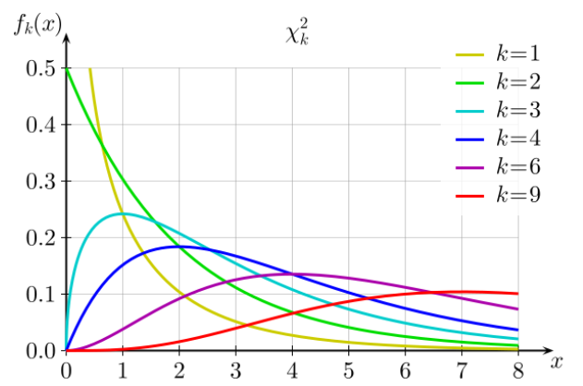
Pearson卡方检验

Slide 31
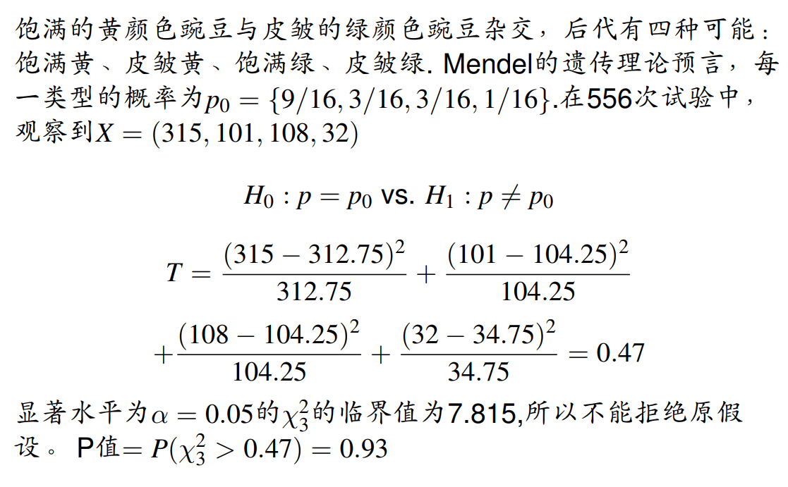
例：Mendel豌豆实验（卡方）

Slide 32
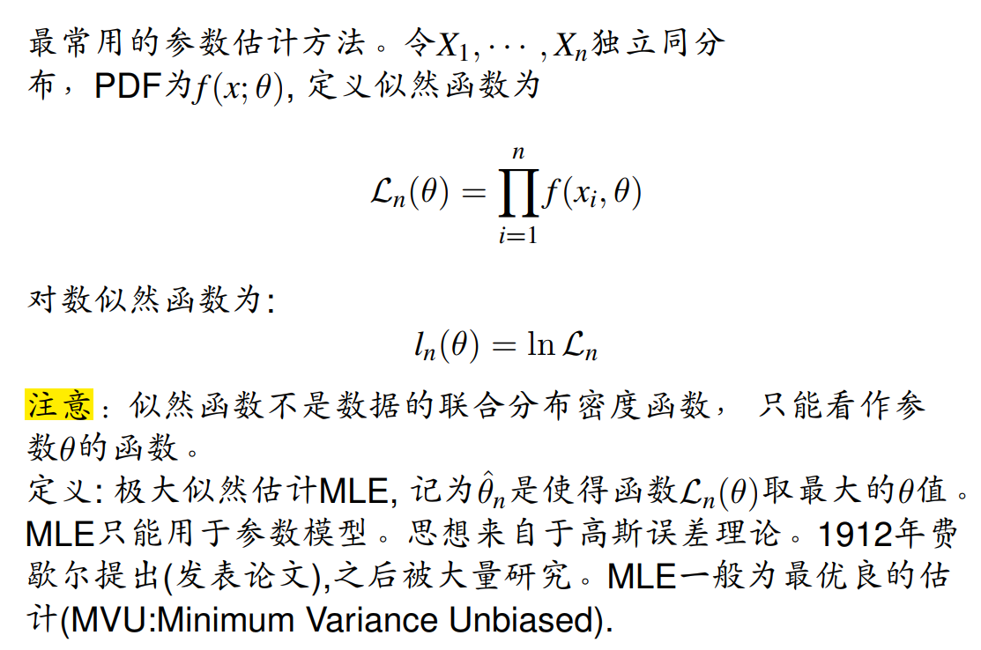
似然函数（极大似然估计）

Slide 33
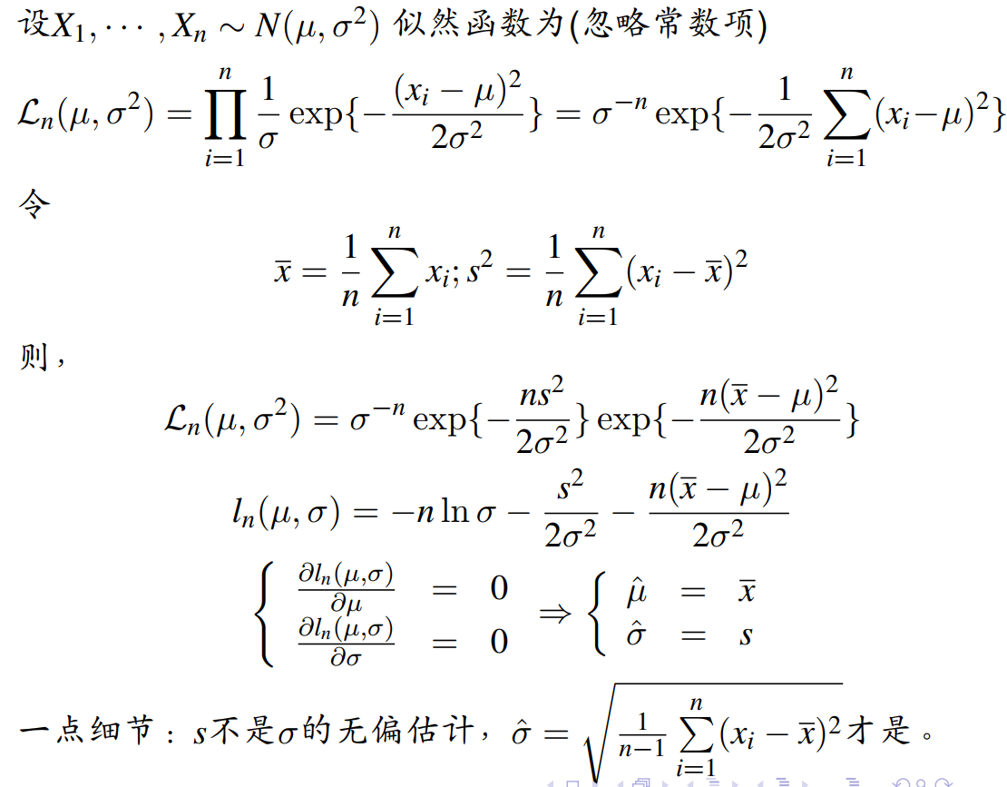
例：高斯分布的参数估计
“拟合”

Slide 34
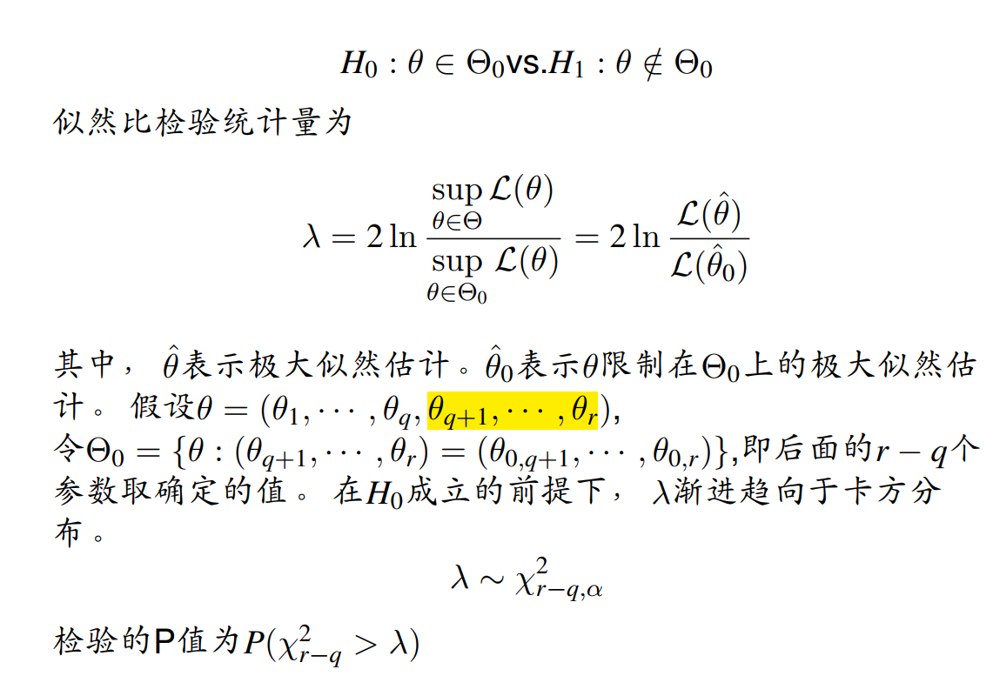
似然比检验

Slide 35
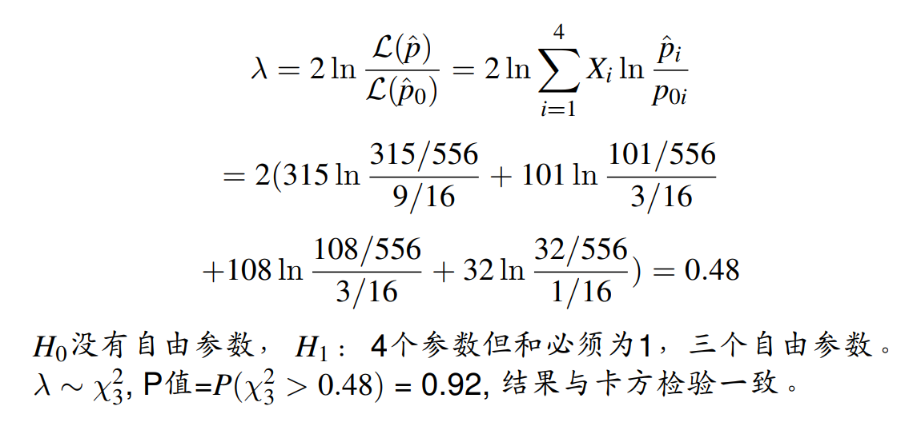
例：Mendel豌豆实验（似然比）

Slide 36
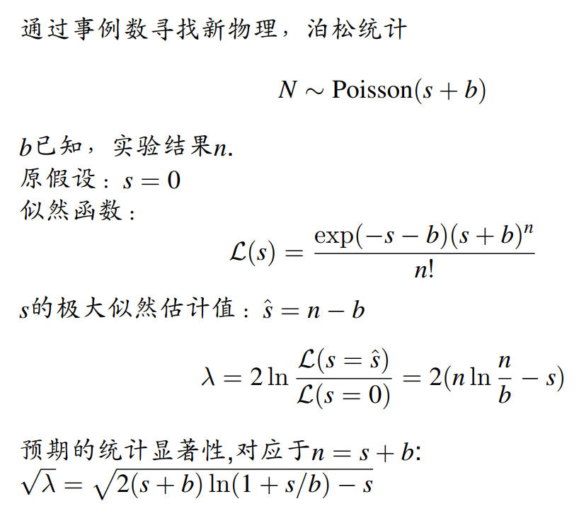
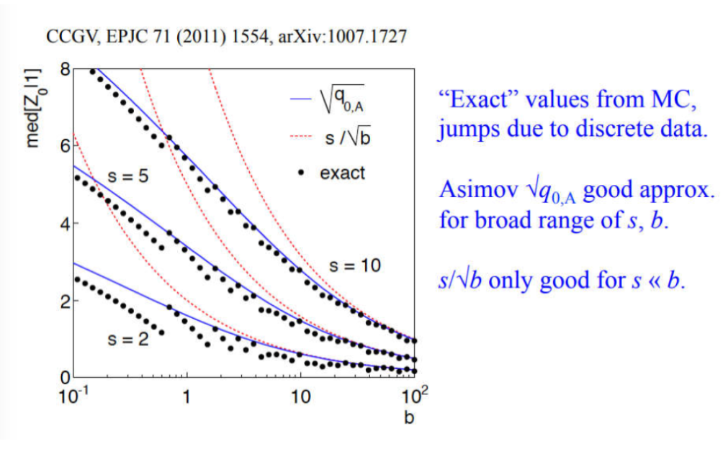
Counting experiment(Cowan formula)

Slide 37
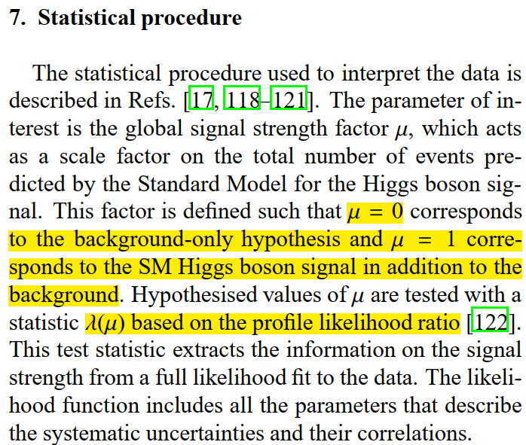

Slide 38
Likelihood function, and LLR

Slide 39
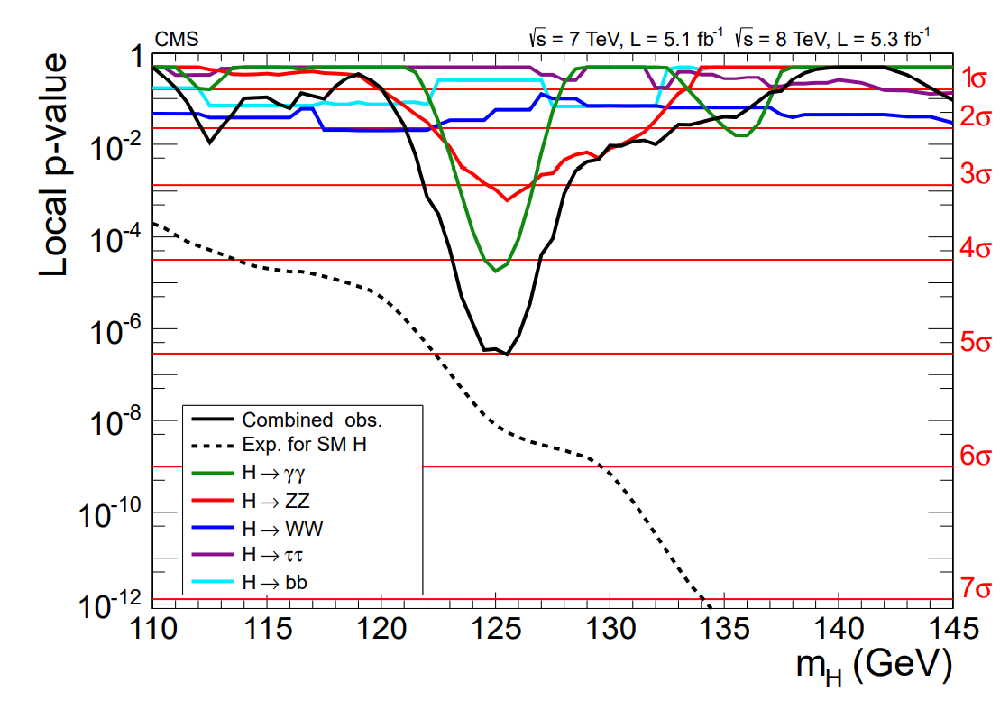

Slide 40
END OF PART 1

