Slide 1
AHCAL Design and Optimization
Yukun Shi
on behalf of the CEPC Calorimeter group
MOST CEPC 2021.4

Slide 2
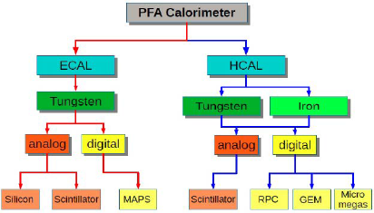

Background
Physics requirement for calorimeter
  Prototype
    Linearity:$±3\%$
    Resolution:$\frac{60\%}{\sqrt{E\left(GeV\right)}}⨁{3}\%$
  CEPC AHCAL
    Boson Mass Resolution :4%
CEPC baseline calorimeter options
BMR requirement from Manqi Ruan’s report

Slide 3
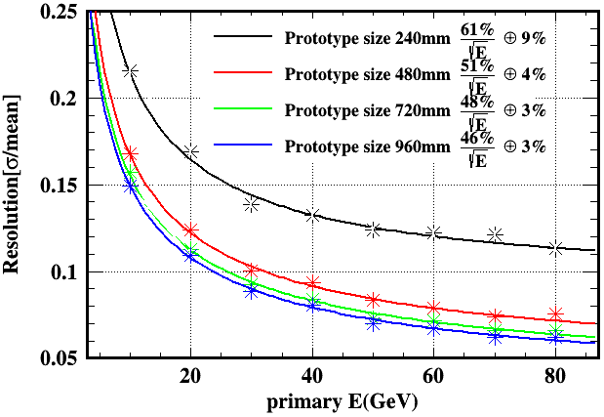
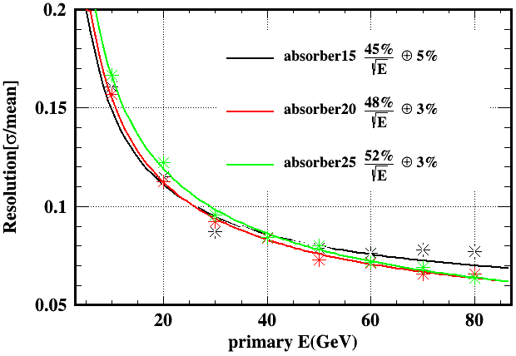
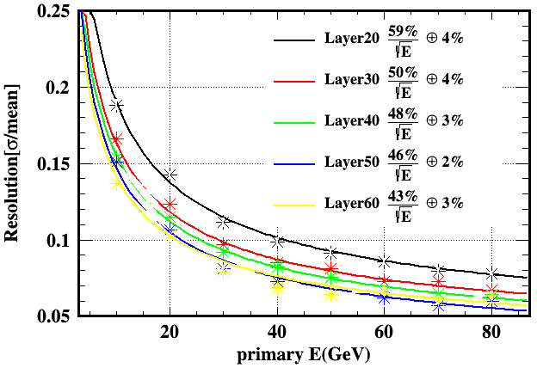
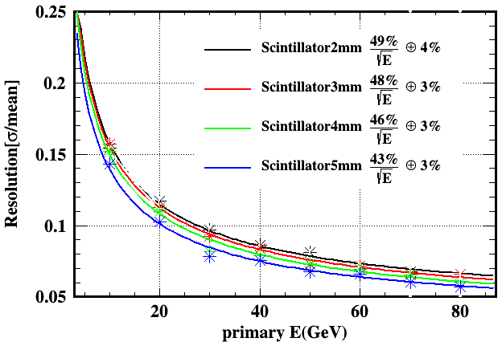
Prototype Simulation

Slide 4
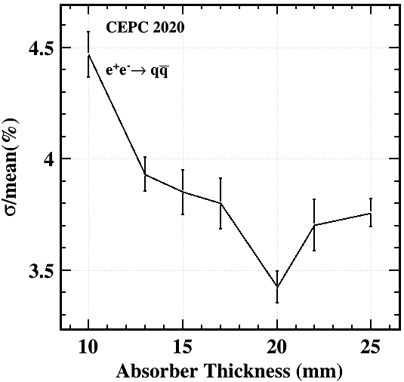
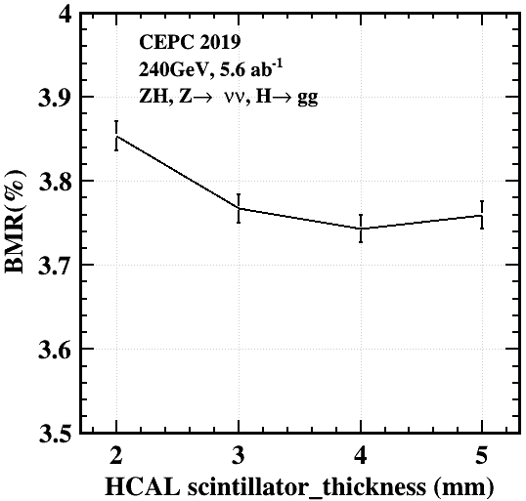
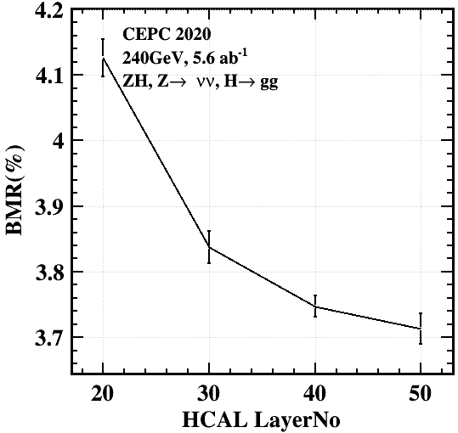
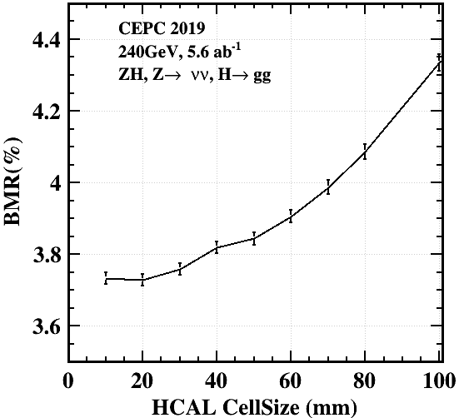
AHCAL Simulation
Absorber thickness
scintillator thickness
sampling layers
Cell size

Slide 5
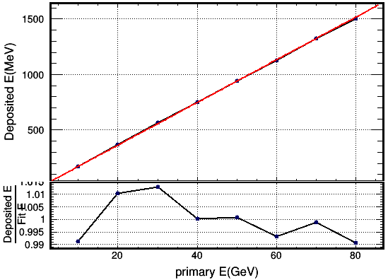
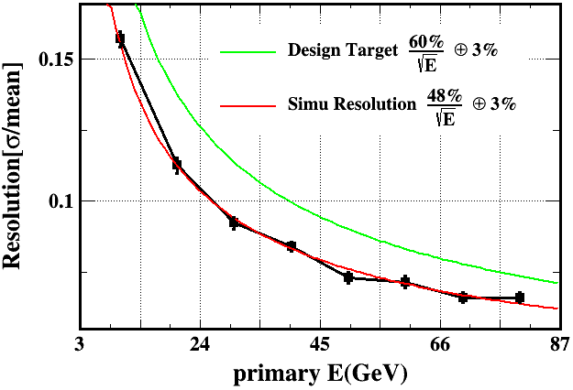
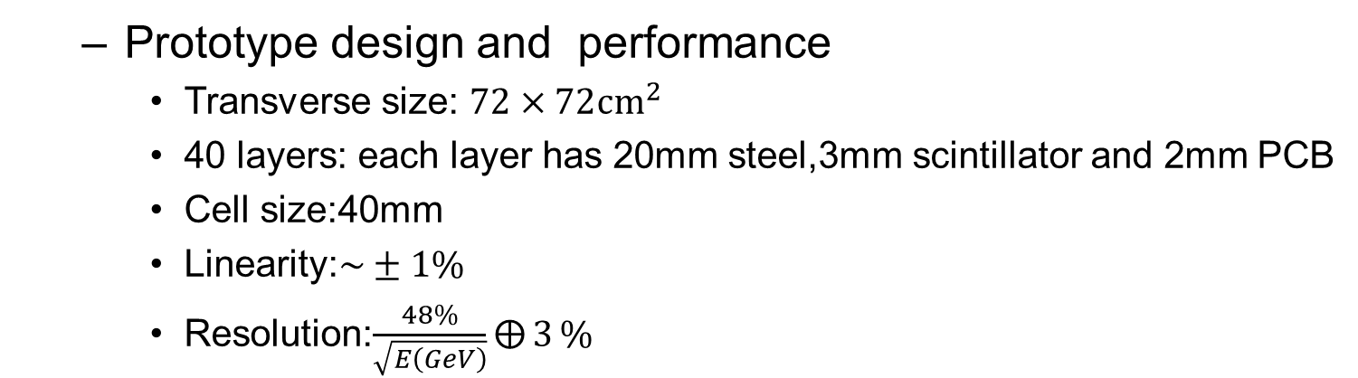
Prototype design
  Prototype design and performance
    Transverse size: $72×72{cm}^{2}$
    40 layers: each layer has 20mm steel,3mm scintillator and 2mm PCB
    Cell size:40mm
    Linearity:$\sim ±1\%$
    Resolution:$\frac{48\%}{\sqrt{E\left(GeV\right)}}⨁{3}\%$
Linearity and resolution for HCAL prototype

Slide 6
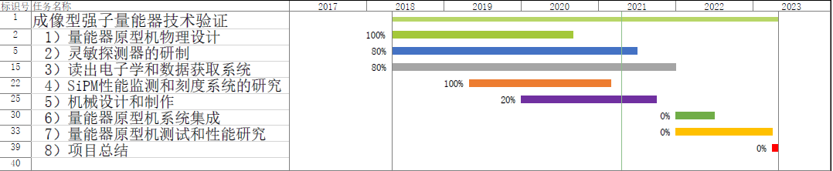
Time schedule
  Scintillators will be ready in July
  40 layers of HBU will be produced this year
  Mechanics are planned to be finished in February next year
  Prototype construction will be finished in the first half of next year

Slide 7
Back up

Slide 8
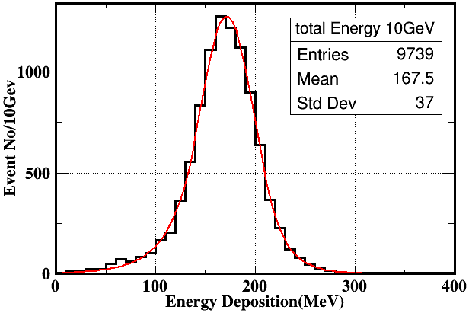
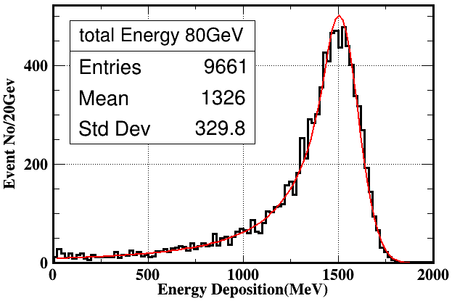

Prototype optimization
Simulation Setup
  CEPC Simplified Geometry
  Prototype Transverse size: $72×72{cm}^{2}$
  40 layers: each layer has 20mm steel,3mm scintillator and 2mm PCB
  Incident particle: Klong with energy from 10GeV to 80GeV
Energy deposition for 10GeV and 80GeV KL

Slide 9
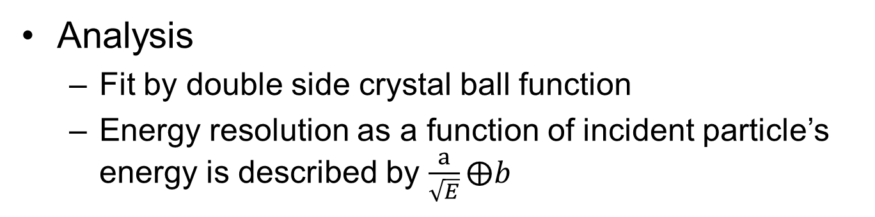
Prototype optimization
Analysis
  Fit by double side crystal ball function
  Energy resolution as a function of incident particle’s energy is described by $\frac{a}{\sqrt{E}}⨁b$
Linearity and resolution for HCAL prototype

Slide 10
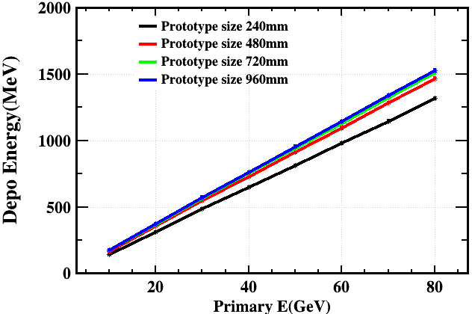
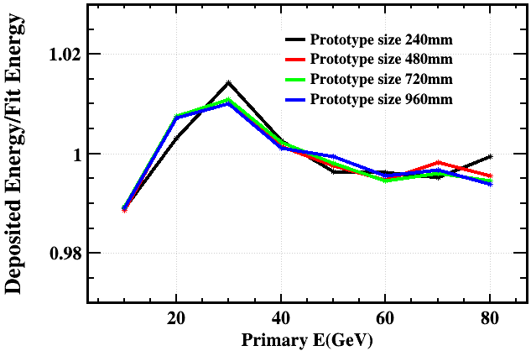

Prototype optimization
Prototype size optimization
  40 sampling layer, each layer has 20mm steel, 3mm scintillator and 2mm PCB
  The transverse prototype size ranges from 240mm to 960mm
  All have a linearity < $±3\%$
Linearity for different prototype transverse size

Slide 11
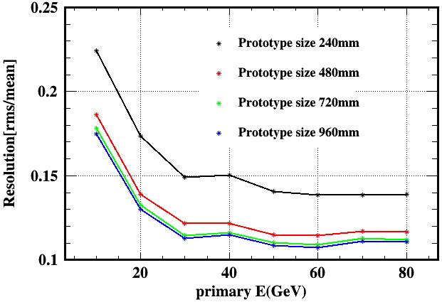
Prototype optimization
Prototype size optimization
  Larger prototype size has less energy leakage and better resolution
  Prototype size has a strong impact on the cost and power consumption of the prototype
  720mm is chosen to be the prototype transverse size
resolution for different Prototype size

Slide 12
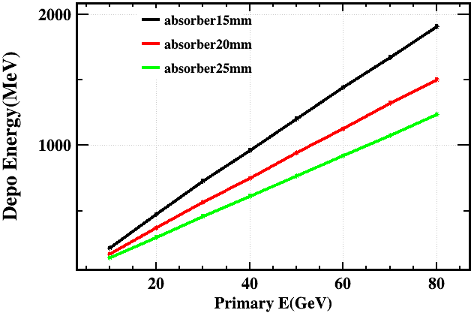
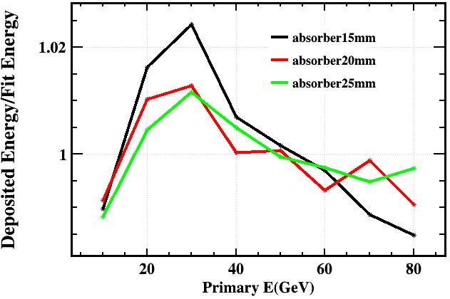

Prototype optimization
Absorber thickness optimization
  Prototype Transverse size: $72×72{cm}^{2}$
  40 sampling layer, each layer has 3mm scintillator and 2mm PCB
  Absorber thickness for each layer ranges from15mm to 25mm
  Total absorber thickness ranges from 3.8λ to 6.3λ
  All have a linearity < $±3\%$
Linearity for different absorber thickness

Slide 13
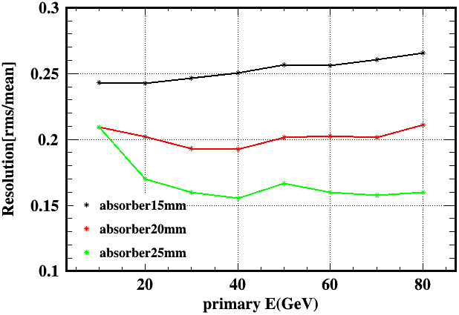
Prototype optimization
Absorber thickness optimization
  Thinner absorber has a better sampling ratio resulting a smaller statistical term
  Thinner absorber has larger leakage resulting a bigger constant term
  The 20mm absorber can satisfy our need
resolution for different absorber thickness

Slide 14
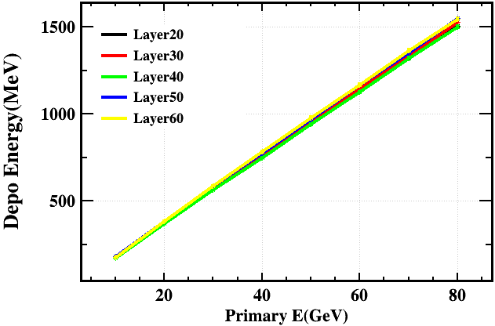
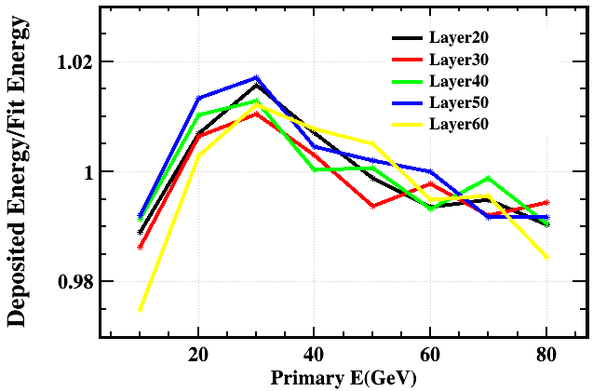

Prototype optimization
Sampling Layer optimization
  Prototype Transverse size: $72×72{cm}^{2}$
  Total absorber thickness is fixed as 800mm and total scintillator thickness is fixed as 120mm
  The thickness of PCB for each layer is 2mm
  The number of sampling layers ranges from 20 to 60
  All have a linearity < $±3\%$
Linearity for different sampling layers

Slide 15
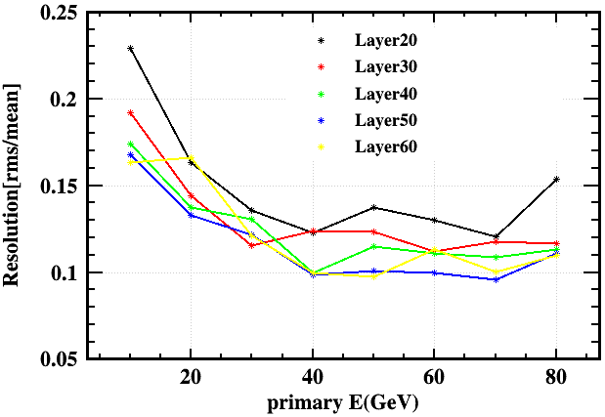
Prototype optimization
Sampling Layer optimization
  More sampling layers have less statistical fluctuation
  Since PCB thickness for each layer is fixed, it could be a problem for more sampling layers in the prototype
  40 layers is reasonable for the prototype
Resolution for different sampling layers

Slide 16
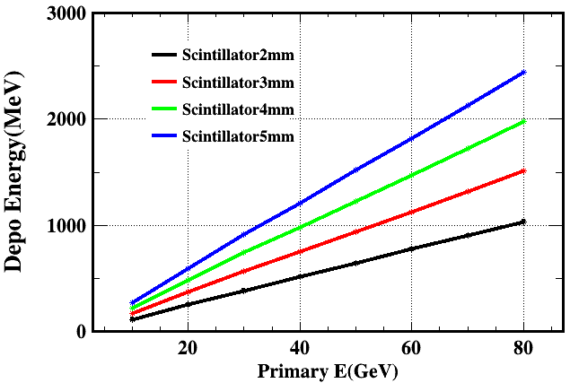
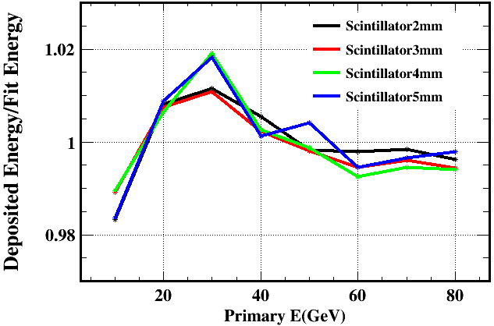
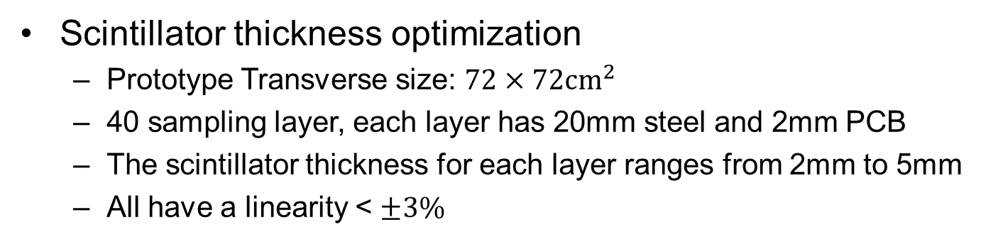
Prototype optimization
Scintillator thickness optimization
  Prototype Transverse size: $72×72{cm}^{2}$
  40 sampling layer, each layer has 20mm steel and 2mm PCB
  The scintillator thickness for each layer ranges from 2mm to 5mm
  All have a linearity < $±3\%$
Linearity for different scintillator thickness

Slide 17
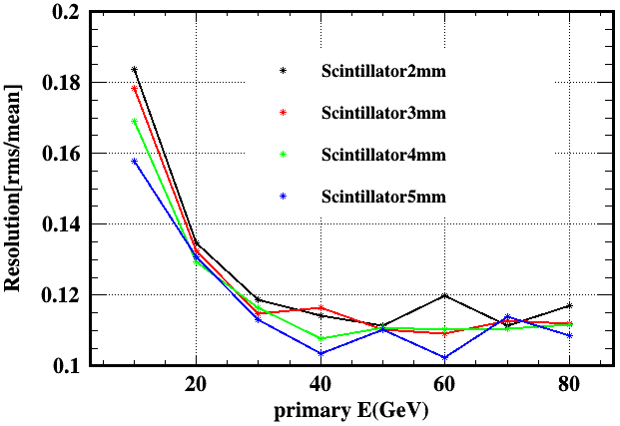
Prototype optimization
Scintillator thickness optimization
  Thicker scintillator has better resolution but the improvement isn’t obvious
  Thicker scintillator will increase total thickness and manufacture cost
  3mm scintillator is chosen for the prototype
Resolution for different scintillator thickness

Slide 18
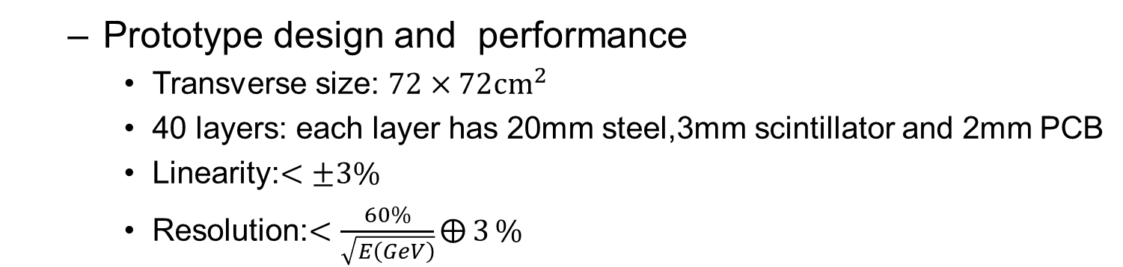
Prototype optimization
  Prototype design and performance
    Transverse size: $72×72{cm}^{2}$
    40 layers: each layer has 20mm steel,3mm scintillator and 2mm PCB
    Linearity:$<±3\%$
    Resolution:$<\frac{60\%}{\sqrt{E\left(GeV\right)}}⨁{3}\%$
Linearity and resolution for HCAL prototype

Slide 19
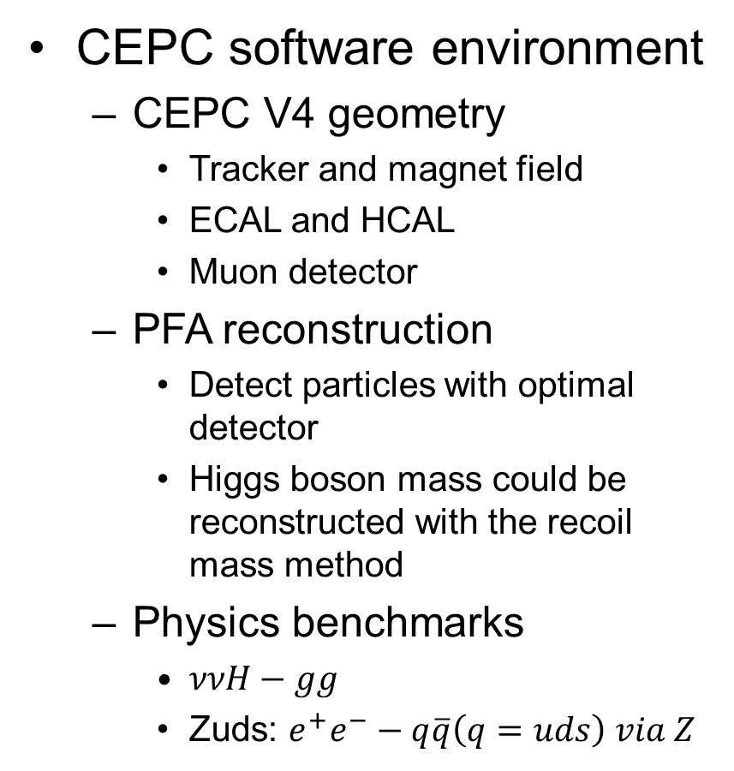
CEPC AHCAL optimization
CEPC software environment
  CEPC V4 geometry
    Tracker and magnet field
    ECAL and HCAL
    Muon detector
  PFA reconstruction
    Detect particles with optimal detector
    Higgs boson mass could be reconstructed with the recoil mass method
  Physics benchmarks
    $ννH−gg$
    Zuds: $e^{+}e^{−}−q\overline{q}\left(q=uds\right) via Z$

Slide 20
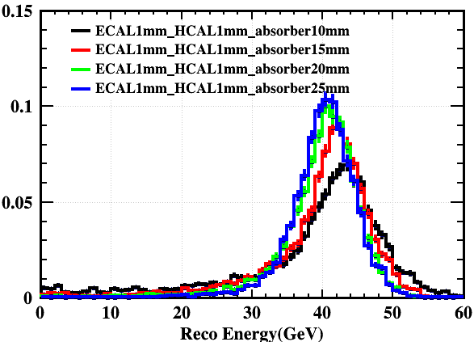
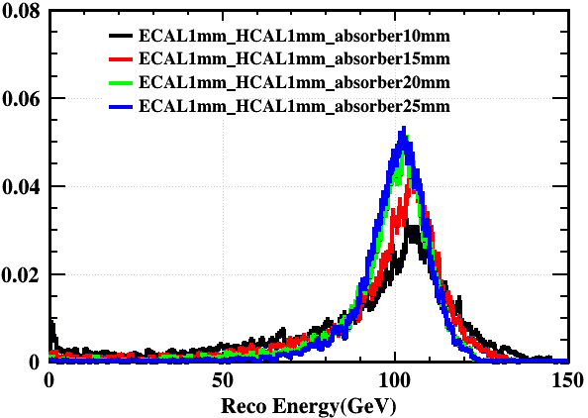
CEPC AHCAL optimization
Absorber thickness optimization
  Klong with energy from 10 to 100GeV
  Absorber thickness ranges from 10mm to 25mm
  KL energy is reconstructed from ECAL and HCAL energy
KL reconstructed energy at different absorber thickness

Slide 21
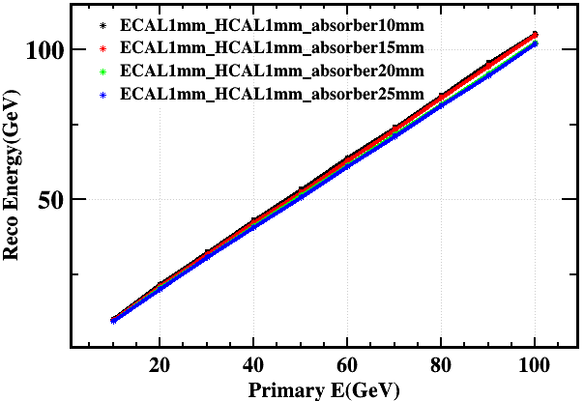
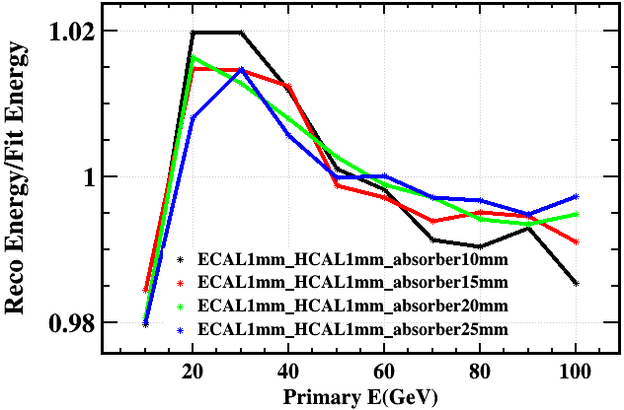

CEPC AHCAL optimization
Absorber thickness optimization
  Use crystal ball function as fitting function
  The linearities are all within $±3\%$ for different absorber thickness
KL Linearity at different absorber thickness

Slide 22
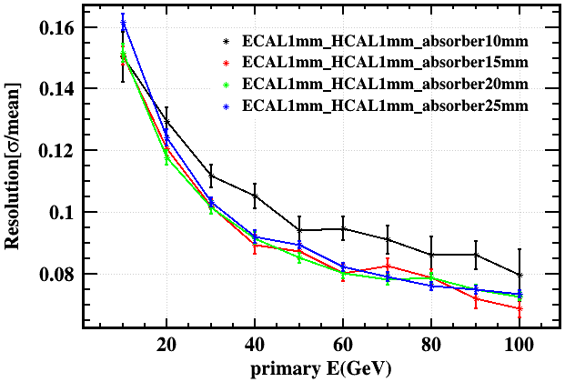
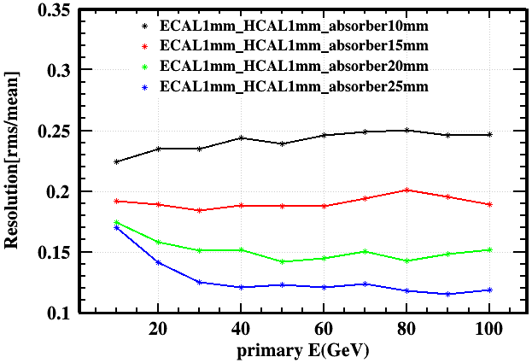
CEPC AHCAL optimization
Absorber thickness optimization
  ECAL introduce more material comparing to Simplified geometry
  The 10mm absorber has a worse resolution than others
  The rms/mean reflects the leakage for different absorber
KL resolution at different absorber thickness

Slide 23
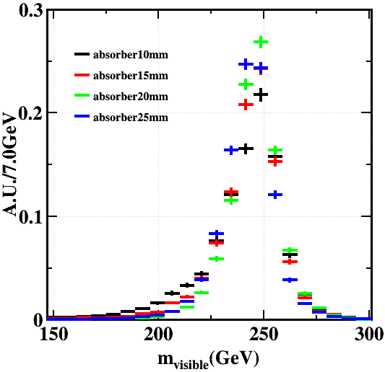

CEPC AHCAL optimization
Absorber thickness optimization
  The $m_{visible}$ is reconstructed for each Zuds event
  The resolution of $m_{visible}$ as a function of absorber thickness shows that 20mm is a turning point
Zuds events for different absorber thickness

Slide 24
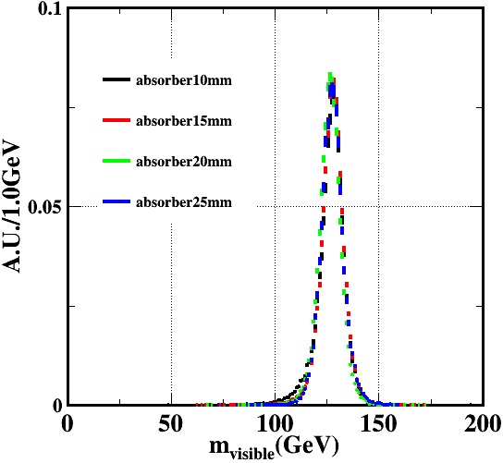
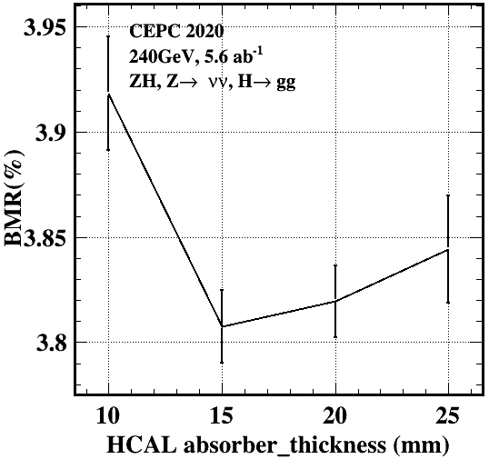

CEPC AHCAL optimization
Absorber thickness optimization
  The jets in$ννH−gg$ events have lower energy comparing to the jets in Zuds events
  The Higgs mass is reconstructed as $m_{visible}$ in $ννH−gg$ events
  The boson mass resolution(BMR) as a function of absorber thickness shows 15mm is the turning point
$ννH−gg$ events for different absorber thickness

Slide 25
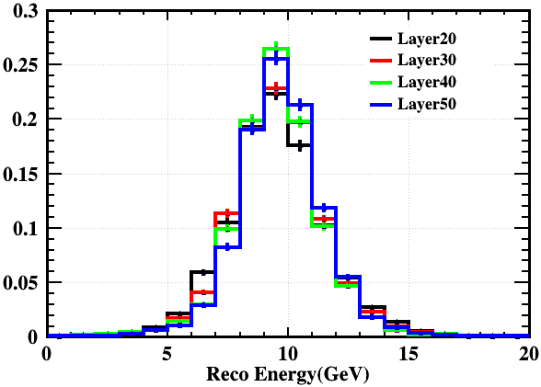
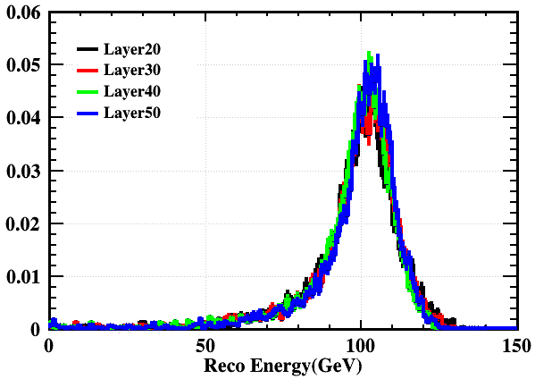
CEPC AHCAL optimization
Sampling Layer optimization
  Total absorber thickness is fixed as 800mm and total scintillator thickness is fixed as 120mm
  The thickness of PCB for each layer is 2mm
  The number of sampling layers ranges from 20 to 50
KL reconstructed energy at different sampling layers

Slide 26



CEPC AHCAL optimization
Sampling layer optimization
  The linearities are almost the same for different sampling layers
  The linearities are all within $±2\%$ for different sampling layers
KL Linearity at different sampling layers

Slide 27


CEPC AHCAL optimization
Sampling layer optimization
  More sampling layers have better energy resolution
KL resolution at different sampling layers

Slide 28


CEPC AHCAL optimization
Sampling layer optimization
  $ννH−gg$ events are reconstructed for different sampling layers
  30 sampling layers can satisfy the 4% BMR requirement but prototype needs 40 sampling layers to fulfill the design target
$ννH−gg$ events for different sampling layers

Slide 29


CEPC AHCAL optimization
Merge layer optimization
  The number of sampling layers is fixed as 40
  Combine the hits from adjacent layers to change the longitudinal segmentation without affecting the energy resolution
$ννH−gg$ events for different readout layers

Slide 30


CEPC AHCAL optimization
Scintillator thickness optimization
  40 layers: each layer has 20mm Steel and 2mm PCB
  Scintillator thickness for each layer ranges from 2 to 5mm
KL reconstructed energy at different scintillator thickness

Slide 31



CEPC AHCAL optimization
Scintillator thickness optimization
  The linearities are almost the same for different scintillator thickness
  The linearities are all within $±3\%$ for different scintillator thickness
KL Linearity at different scintillator thickness

Slide 32


CEPC AHCAL optimization
Scintillator thickness optimization
  Different scintillator thickness doesn’t have much difference on resolution
KL resolution at different scintillator thickness

Slide 33


CEPC AHCAL optimization
Scintillator thickness optimization
  $ννH−gg$ events are reconstructed for different scintillator thickness
  The difference of BMR is within 0.1%
  The 3mm scintillator is a reasonable choice
$ννH−gg$ events for different scintillator thickness

Slide 34


CEPC AHCAL optimization
Cell size optimization
  Cell size is the key parameter for PFA oriented HCAL
  Cell size has a strong impact on both detector performance and cost
  Careful optimization has been done to reconstruction parameter
Parameter optimization in terms of BMR

Slide 35

CEPC AHCAL optimization
Cell size optimization
  The relation between cell size and BMR has been studied
  Similar study has been done to CEPC DHCAL as comparison
  40mm is the final choice for AHCAL prototype
CEPC DCHAL(from Jiechen Jiang)
CEPC ACHAL cell size vs BMR

Slide 36

Summary and outlook
Summary
  The final design for the AHCAL prototype
    Prototype Transverse size: $72×72{cm}^{2}$
    40 sampling layers
    Each layer: 20mm absorber, 3mm scintillator and 2mm PCB
    Cell size: 40mm
  The performance for the AHCAL prototype
    Linearity: $±1.5\%$
    Resolution: $\frac{48\%}{\sqrt{E\left(GeV\right)}}⨁{3}\%$
Outlook
  The prototype will be constructed and tested to verify the design before the end of 2023
  Software work will be going on to improve the detector performance

Slide 37


Prototype optimization
Dynamic Range
  the SiPM saturation effect could be corrected
  The dynamic Range wouldn’t be a problem
max energy deposition in cells for 100GeV pion
energy resolution using different SiPM after saturation correction

Slide 38


Prototype optimization
SiPM Simulation
  NDL 15um SiPM is simulated
  Cross talk has limited influence on SIPM performance
Linearity and resolution w/wo crosstalk

Slide 39


HCAL prototype
Threshold for cells
  20mm absorber geometry with different threshold for cells
  It’s a nonnegligible parameter in terms of resolution
  It has a strong correlation with scintillator and SiPM
  0.5MIP threshold is applied in the following simulation
Energy deposition for 100GeV KL
Resolution for different threshold

Slide 40
HCAL prototype
Threshold for cells
  This parameter is a bridge between software and hardware
  0.5MIP isn’t a perfect value but it’s acceptable for present hardware and software settings
threshold
SiPM
Scintillator
Cell Size
Resolution
Shower separation

Slide 41


HCAL prototype
Comparison with different absorber thickness
  With leakage cut
  So what should be the principle for leakage cut
Resolution for different absorber(40 Layer) after leakage cut

Slide 42




ee-$q\overline{q}$ events
$m_{visible}$ reconstructed by the $q\overline{q}$ jets
Crystal ball function is used for fitting

Slide 43



ee-$q\overline{q}$ events
Resolution for $m_{visible}$
  Resolution1: fit sigma/peak
  Resolution2: histogram rms/peak

Slide 44




Parameter optimization
Absorber is 25mm for each layer
KL determines HCAL calibration constant
  KL energy ranges from 10 – 100GeV
  Minimum $χ^{2}$ method
  This constant doesn’t suit all kinds of hadrons
Scan HCAL constant in ee-$q\overline{q}$ events
  hadron response is more than KL response
  Optimize HCAL constant to correct this effect

Slide 45




ee-$q\overline{q}$ events
Resolution for $m_{visible}$
  After HCAL constant optimization
  Resolution1: fit sigma/peak
  Resolution2: histogram rms/peak

Slide 46
ee-$q\overline{q}$ events
$m_{visible}$ reconstructed by the $q\overline{q}$ jets
Crystal ball function is used for fitting

Slide 47
ee-$q\overline{q}$ events
Resolution for $m_{visible}$
  Resolution1: fit sigma/peak
  Resolution2: histogram rms/peak

Slide 48
Parameter optimization
Absorber is 25mm for each layer
KL determines HCAL calibration constant
  KL energy ranges from 10 – 100GeV
  Minimum $χ^{2}$ method
  This constant doesn’t suit all kinds of hadrons
Scan HCAL constant in ee-$q\overline{q}$ events
  hadron response is more than KL response
  Optimize HCAL constant to correct this effect

Slide 49
ee-$q\overline{q}$ events
Resolution for $m_{visible}$
  After HCAL constant optimization
  Resolution1: fit sigma/peak
  Resolution2: histogram rms/peak

Slide 50

CEPC AHCAL optimization
Cell size optimization
  The relation between cell size and BMR has been studied
  Similar study has been done to CEPC DHCAL as comparison
  40mm is the final choice for AHCAL prototype
CEPC DCHAL(from Jiechen Jiang)
CEPC ACHAL cell size vs BMR

Slide 51

Plan for simulation
Absorber thickness-linearity
  KL
  ee-$q\overline{q}$
Sampling Layer-hadron resolution
  KL
  nnH-gg
  Readout layer for nnH-gg-PFA separation power
Sensor thickness-hadron resolution
  KL
  nnH-gg
Sensor size-PFA separation power
  nnH-gg
  Different kinds of readout mode

