Slide 1
2018年国家重点研发计划项目
“高能环形正负电子对撞机关键技术研发和验证”项目2021年年度会议
课题一：高能环形正负电子加速器关键技术验证
池云龙
中国科学院高能物理研究所
2021年4月23日，北京

Slide 2
Outline
Overall progress
Important progress and achievements
Existing problems and solutions
Papers, patents and international conference talks
Use of personnel and funds
Summary

Slide 3
Task introduction
Task ： Verification of key techniques of high energy circular electron positron accelerator
Task budget ： 9.74 M RMB
Task in charge： IHEP, CAS
Task leader： Chi Yunlong
Number of participants ：18 （Senior 11，Other 7，4 Ph.D. students）
Task period: Jul.1, 2018~Jun.30, 2023
Main research ： Sub-Task1: High precision Low-field dipole magnet prototype
Sub-Task2: Vacuum pipe、RF shield bellows、NEG coating prototype
Sub-Task3: Electrostatic separator prototype
Sub-Task4: Z-pole Beam polarization design study

Slide 4
Present performance
 | Index | indicators | Mid term Performance | Present performance
Sub-task1 | Field precision | 0.1%@60Gs | Reached | 0.1%@30Gs (for sub-scale CT magnet)
 | Field reproducibility | 0.05%@60Gs | Reached | 0.05%@30Gs(for sub-scale CT magnet)
Sub-task2 | Vacuum pipe | 3×10⁻¹⁰Torr | 2×10⁻¹⁰Torr | 2.5×10⁻¹⁰Torr
 |  | Leak rate：3×10⁻¹⁰ Torr.L/s | 3×10⁻¹⁰Torr⋅L/s | 3×10⁻¹⁰ Torr.L/s
 | RF shielding bellow | Finger contact force：125±30g | 125±25g | 125±5g
Sub-task3 | Electric field strength | 2.0MV/m@±110kV (in design) | Reached | 2.9MV/m@±110kV (in design)
 | Good field region | (1‰)10×10 mm² (by simulation) | Reached | (1‰)46×22 mm² (by simulation)
 | Vacuum pressure | 2×10⁻¹⁰Torr (in design) | Reached | 1.0×10⁻¹⁰Torr (by test)
Sub-task4 | Polarization design | The parameter selection of polarization insertion devices and the working mode of the precise energy measurement are defined | Reached
 |  | The realization conditions of beam polarization > 50% are simulated. | Reached | Set up first version of spin rotator, optimization under way.

Slide 5
Outline
Overall progress
Important progress and achievements
Existing problems and solutions
Papers, patents and international conference talks
Use of personnel and funds
Summary

Slide 6
Low-field Booster dipole magnet R&D
Main Specifications of CEPCB dipole magnets
Quantity | 16320 | Magnetic Length (mm) | 4700
Minimum field (Gs) | 28 | Good field region (mm) | 55
Maximum field (Gs) | 338 | Field uniformity | 0.1%
Gap (mm) | 63 | Field reproducibility | 0.05%
Midterm target
Quantity | 1 | Magnetic Length (mm) | 1000
Minimum field (Gs) | 60 | Good field region (mm) | 55
Maximum field (Gs) | 338 | Field uniformity | 0.1%
Gap (mm) | 63 | Field reproducibility | 0.05%
Two kinds of the subscale prototype magnet with and without iron cores have been designed and developed. The field specifications of both magnets reach the midterm target @60Gs.

Slide 7
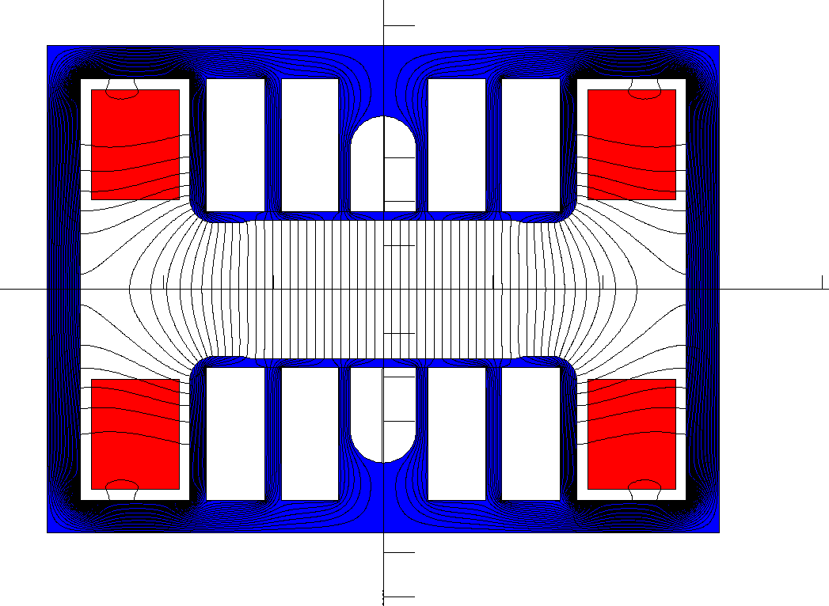
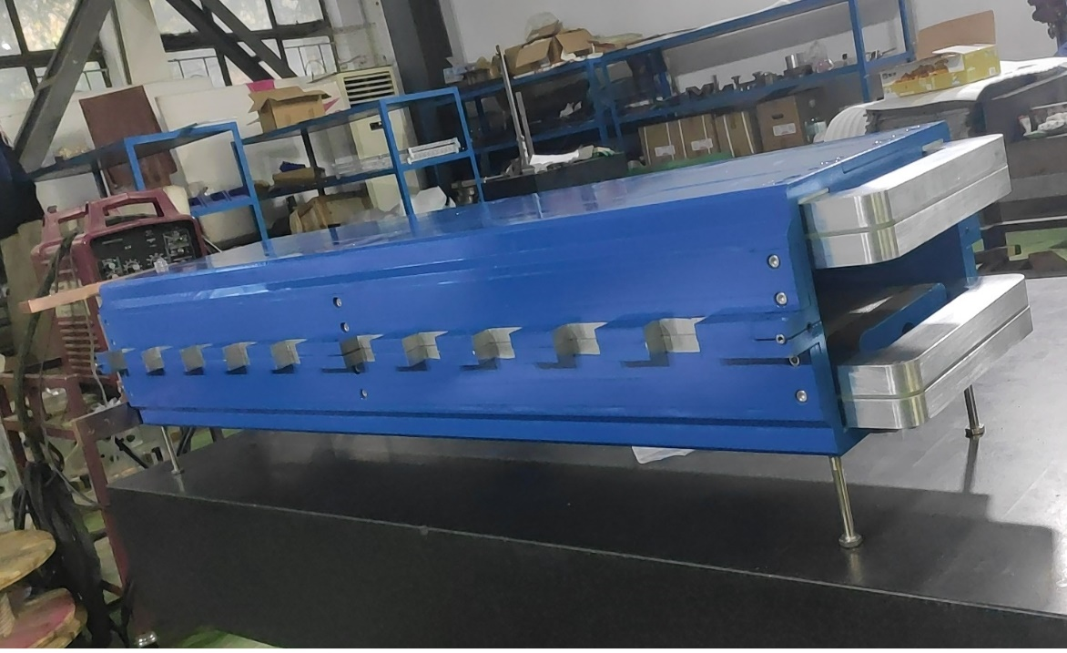
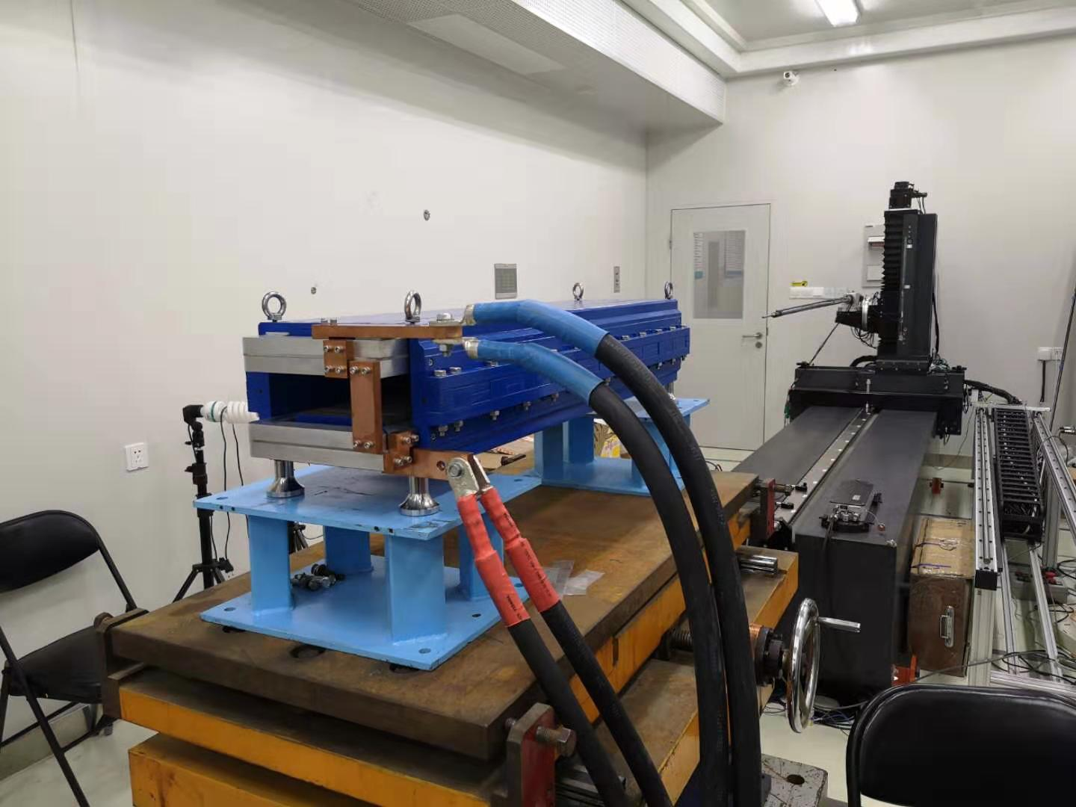
Low-field Booster dipole magnet R&D (with iron core) -Midterm
To increase field in the cores and decrease weight of the cores, the technology of core dilution is adopted.
To reduce the influence of the remnant field on the low field precision, the grain-oriented silicon steel laminations are used to stack the magnet cores due to their low coercive and remnant field.
The dipole magnet with iron core was tested in the lab.

Slide 8
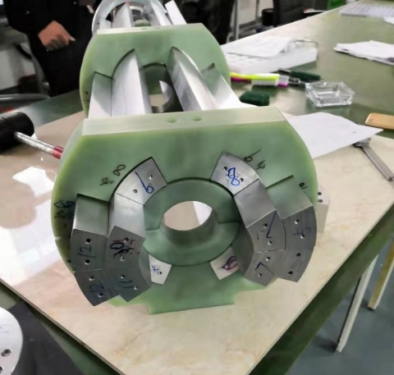
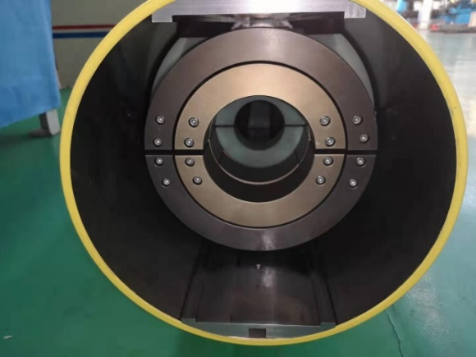
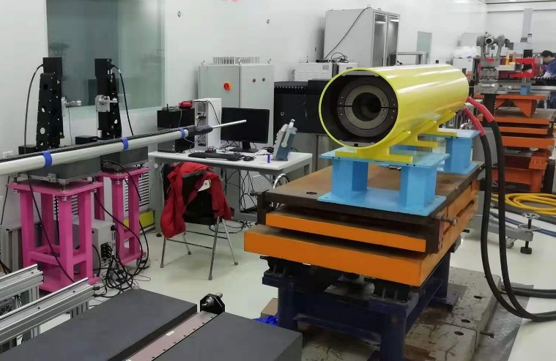
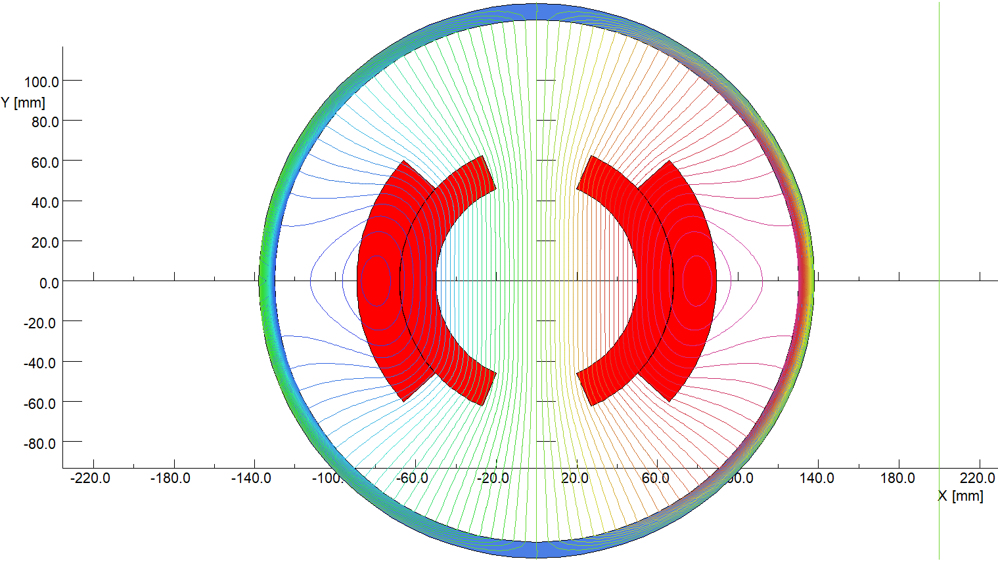
Low-field Booster dipole magnet R&D(w/o iron core) –mid term
The inner and outer conductors of the CT coils are directly fabricated from two aluminum tubes with the right diameters.
The shielding cylinder was made from a long iron tube with inner diameter of 300mm.
All the surfaces of the aluminum conductors were anodized for the insulation from turn to turn, the thickness of the anodized film is about 50 microns.
The final assembling errors of the CT coil dipole magnet were checked to be less than 50 microns.

Slide 9
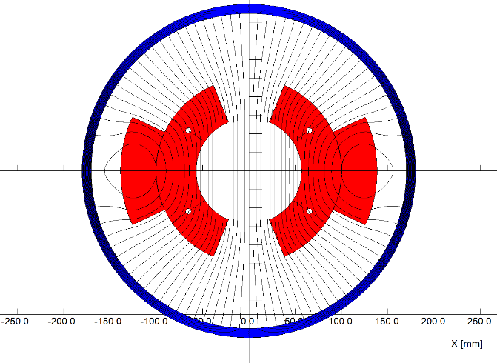
Design of the full-scale prototype CT coil dipole magnet -mid term
(The last choice)
On the base of good results from the subscale CT dipole magnet, the mechanical design of a full scale prototype CT dipole magnet was finished on the cooperation with 合肥 科烨 company. The production of the magnet will be begun in the coming month.
The total length of the magnet including the shielding tube is 5.1m.
The cooling tubes are inserted between the coil conductors to decrease temperature rise.
The touch resistance of the contacted surfaces of the conductors will be reduced by coated silver films.

Slide 10
Design of the full-scale prototype CT coil dipole magnet -detail
In order to reduce the production cost, the 4.7 long conductor is considered to be divided into 2 or more parts for convenient fabrication and then assembled together. Each part of the conductor can be precisely extruded and forged, the touch surface of the connection will be coated with the silver film to reduce the contact resistance.

Slide 11
Design of the full-scale prototype CT coil dipole magnet -detail
The designed parameters of the full-scale CT coil dipole magnet
Max. field (Gs) | 492 | Inner radius of inner coil(mm) | 57
Min. field (Gs) | 28 | Outer radius of inner coil (mm) | 100
Gap (mm) | 63 | Outer radius of outer coil (mm) | 138.46
Magnetic length (mm) | 4700 | Angle of inner coil(°) | 67.5
GFR (mm) | 55 | Angle of outer coil(°) | 24.8
Max. NI/pole(A) | 5160 | Resistance(mΩ) | 0.95
Min. NI/pole (A) | 288 | Max. power loss(W) | 2800
Turns/pole | 3 | Avg. power loss(W) | 1120
Max. current(A) | 1720 | Diameter of tube(mm) | 340/360
Min. current(A) | 96 | Weight of magnet(ton) | 1.4

Slide 12
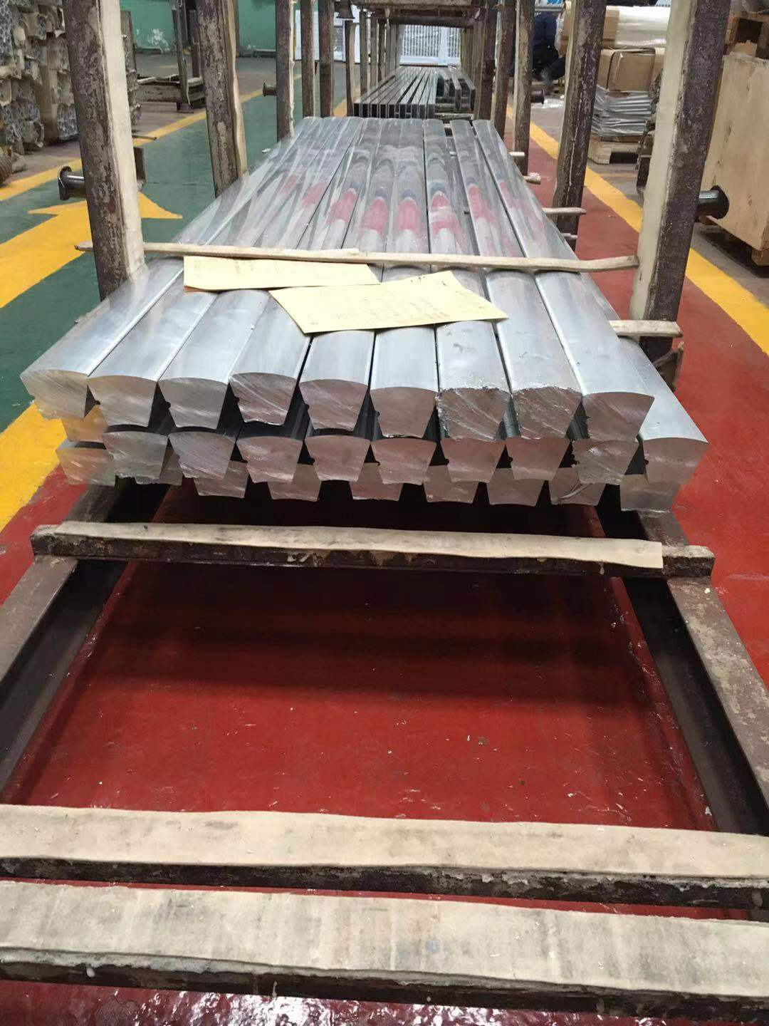
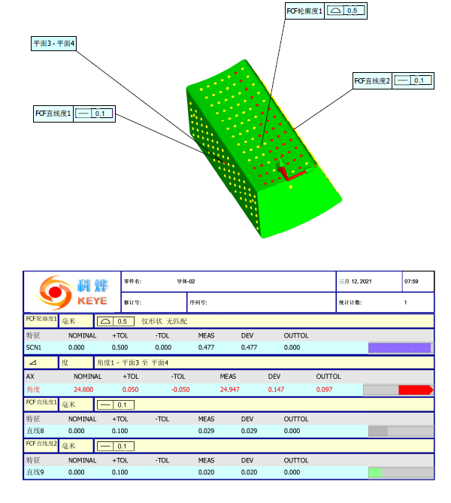
Production of the full-scale CT coil dipole magnet
The processing design of the magnet production was reviewed, 2.5m long conductor bars were roughly extruded, but the fabrication precision can not meet the requirements. So the bars will be pressed and extruded again to reduce the fabrication errors. The other components of the magnet are on the manufacturing.

Slide 13
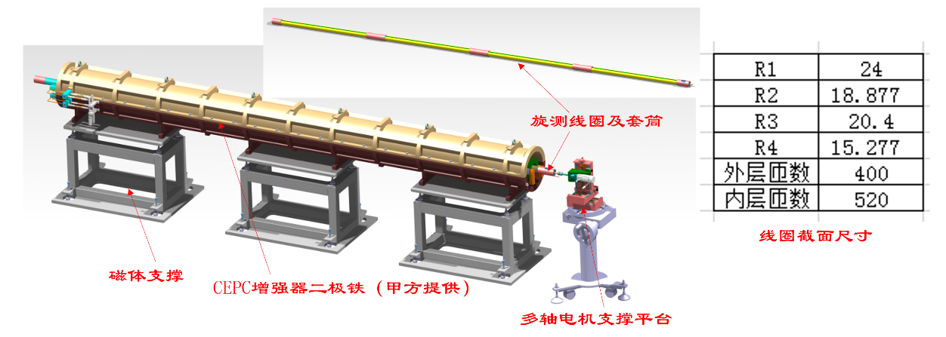
Design of the field measurement system
A 5.6m long rotating coil field measurement system will be used to measure the field of the full-scale CT magnet, it is composed of
1、Long coil
2、Motor and Driver
3、Encoder
4、Motor control
5、Signal acquisition device

Slide 14
Next stage working plan
In the July of 2021, complete the fabrication of the full scale CT coil prototype dipole magnet.
In the same time, design and set up the field measurement system for the full scale magnet.
In Sep. of 2021, complete the test of the full scale prototype dipole magnet.
In Dec. of 2021, make the field quality of the magnet meet the specifications by modifying and improving the structure of the magnet.

Slide 15
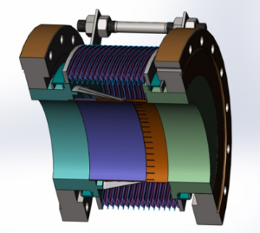
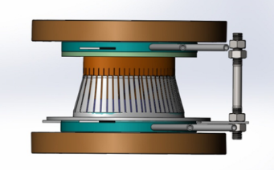
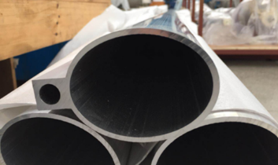
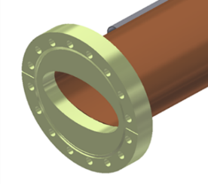
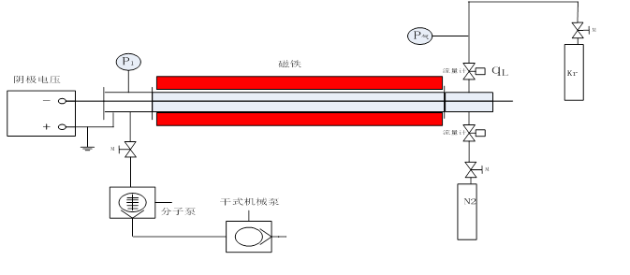
Vacuum sub-task
成果名称 | 成果 类型 | 考核指标² |  |  |  | 考核方式（方法）及评价手段⁴
 |  | 指标 名称 | 立项时已有指标值/状态 | 中期指标值/状态³ | 完成时指标值/状态
研制弯转真空盒、RF屏蔽波纹管和真空盒内表面镀吸气剂膜 | □新理论 □新原理 □新产品 □新技术 ■新方法 ■关键部件 □数据库 □软件 □应用解决方案 □实验装置/系统 ■工程工艺 □标准 □专利 ■论文 □其他 | 真空盒极限真空 | 5×10⁻¹⁰Torr | 设计指标：3×10⁻¹⁰Torr | 2×10⁻¹⁰Torr | 同行专家评审
 |  | 真空盒总漏率 | 5×10⁻¹⁰ Torr.L/s | 设计指标：3×10⁻¹⁰ Torr.L/s | 2×10⁻¹⁰ Torr.L/s | 同行专家评审
 |  | RF屏蔽波纹管接触力 | 125±50g | 设计指标：125±30g | 125±25g | 同行专家评审

Slide 16
Progress of R&D of RF shielding bellows
Total length: 140 mm
Inner and exterior diameter of bellows: 125mm/140mm
Expansion/contraction: 5mm/12mm
Offset: 2 mm
Bending: 50 mrad
Above technical specifications have been reached.

Slide 17
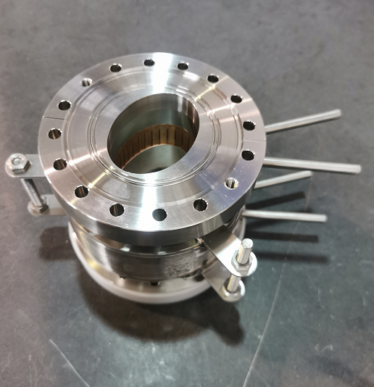
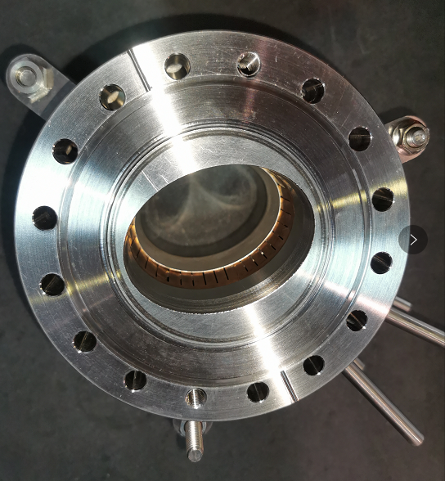
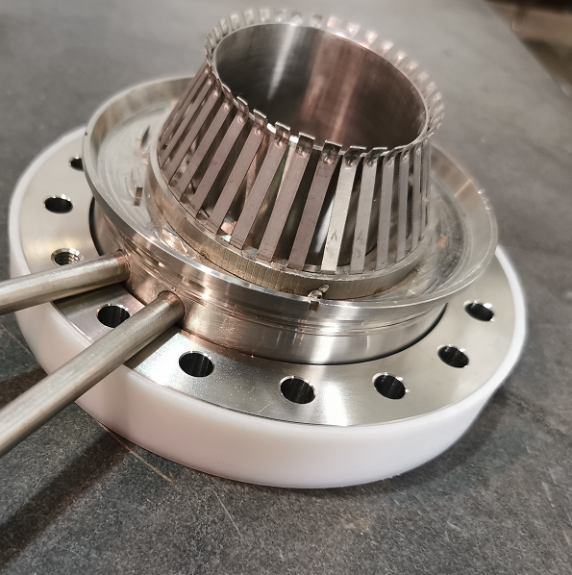
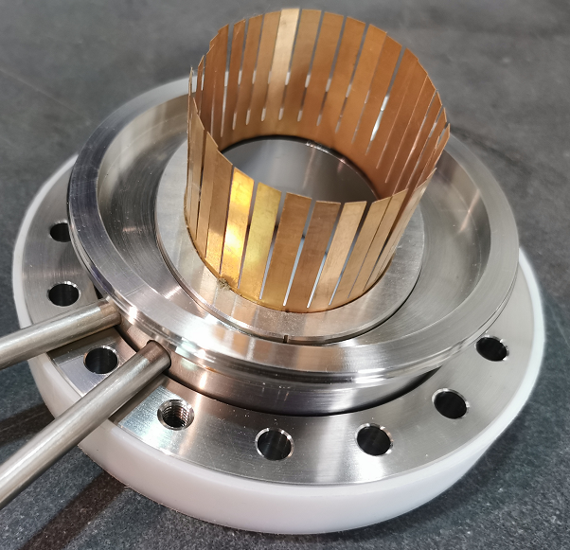
Porotype of RF shielding bellows
Optimization of spring fingers：27°pre-bending angle is chosen and which forces between the spring fingers and the contact fingers is uniformly from different fingers and is about 125±5g, which meets 125±25g.
Contact force is uniformly from different fingers and meets the target of 125±25g. Two prototypes of RF shielding bellows have been fabricated
Porotype I：
Porotype II：

Slide 18
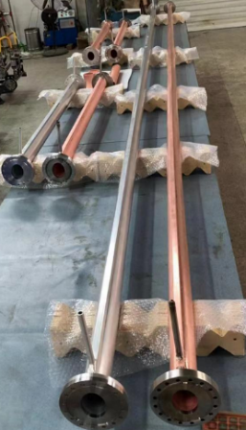
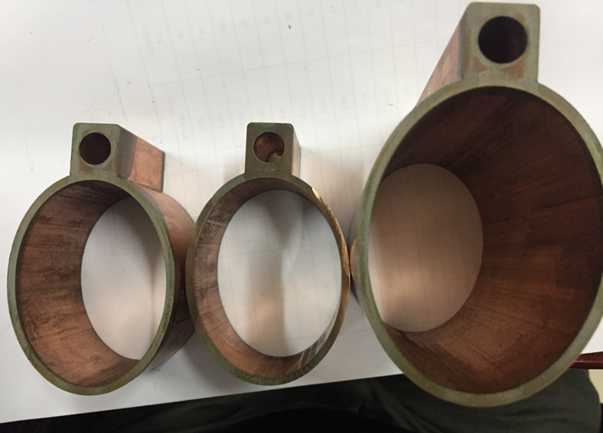
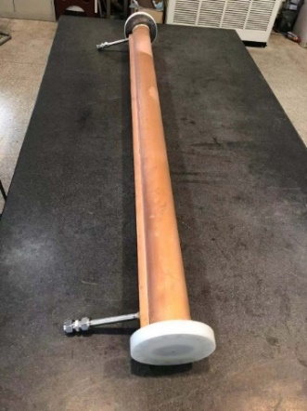
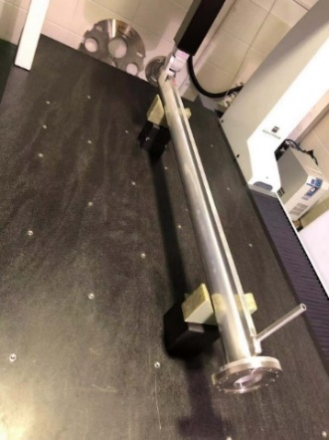
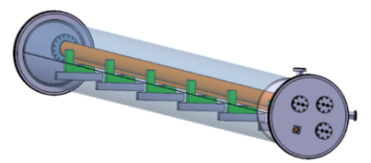
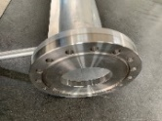
Cu and Al vacuum chamber prototypes
A 6 m long simple vacuum furnace is fabricated, which is used to weld the water cooling channels of Cu chambers through low temperature brazing solder.
The welding seams are checked by wire-electrode cutting. The welding joints are smooth and have good contacting.
The prototypes of copper & aluminum vacuum chambers with a length of 6 m have been fabricated and tested, which meet the engineering requirements.

Slide 19
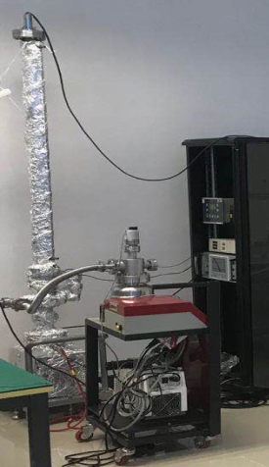
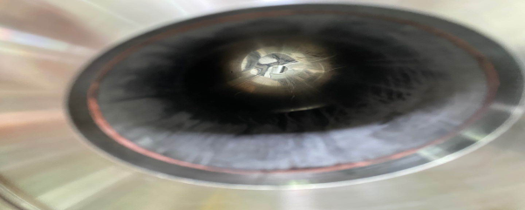
Ultimate vacuum test of NEG coating pipe
56×75×1500 NEG coating pipe:
180℃/24h activation 5.9-10mbar
200℃/24h activation 3.3-10mbar
Coating parameter | value
Magnetic(G) | 300
Substrate Temperature （℃） | 120
Vacuum of coating （Pa） | 1
Discharge current（A） | 0.4
Discharge voltage（V） | 300
Deposition time（h） | 10
Geometric diameter（mm） | 56×75×1500
After coating
Ultimate vacuum testing

Slide 20
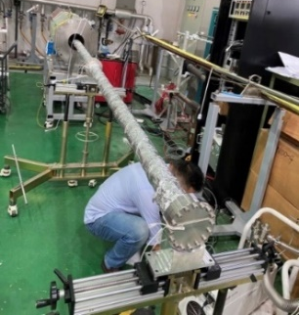
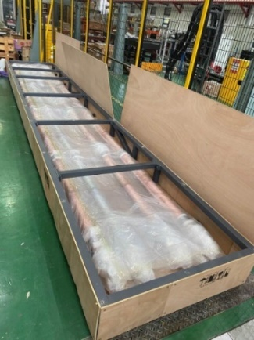
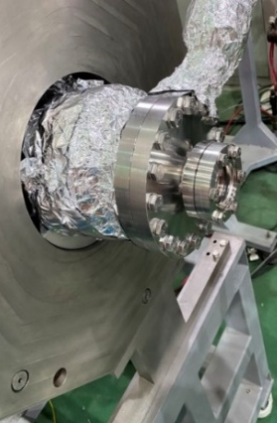
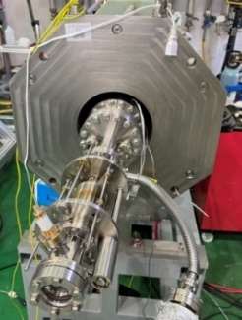
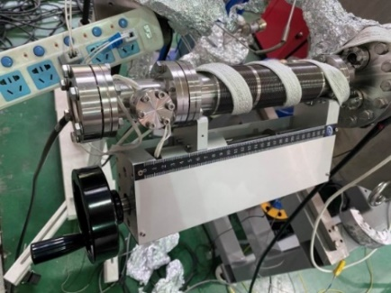
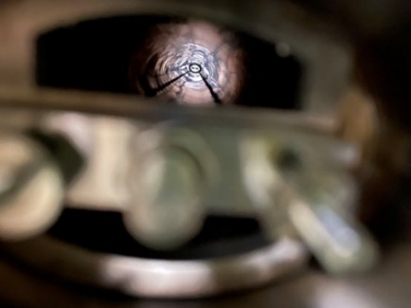
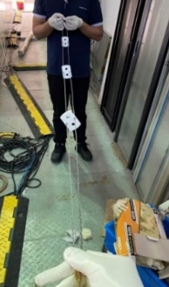
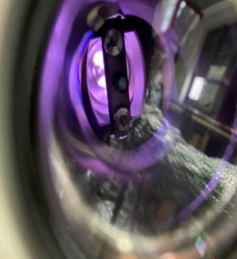
6 m vacuum pipe NEG coating
6 m vacuum pipe have been installed on the coating setup carefully, and there are two cathodes in it to uniform the thickness of film.
视窗位置
无支撑丝靶
调节波纹管优化
陶瓷支撑

Slide 21
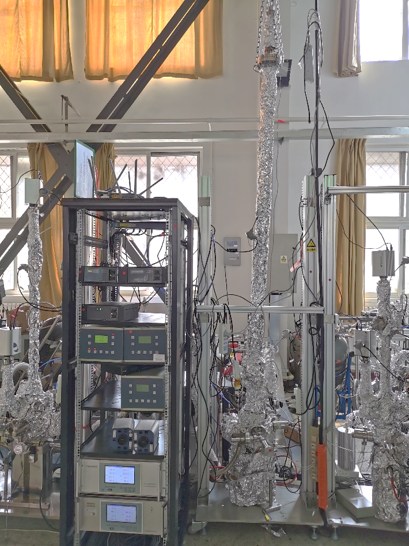
Pumping speed test of NEG coating
Pumping speed test of 2 meters long CEPC Cu pipe of NEG coating in Beijing

Slide 22
Next stage working plan
The prototypes of RF shielding bellows leakage and ultra vacuum will be tested.
6m long vacuum chambers will be coated and coating parameters need to be optimized, and ultra vacuum will be tested.
Surface treatment of copper vacuum chambers need to be done and optimized.

Slide 23
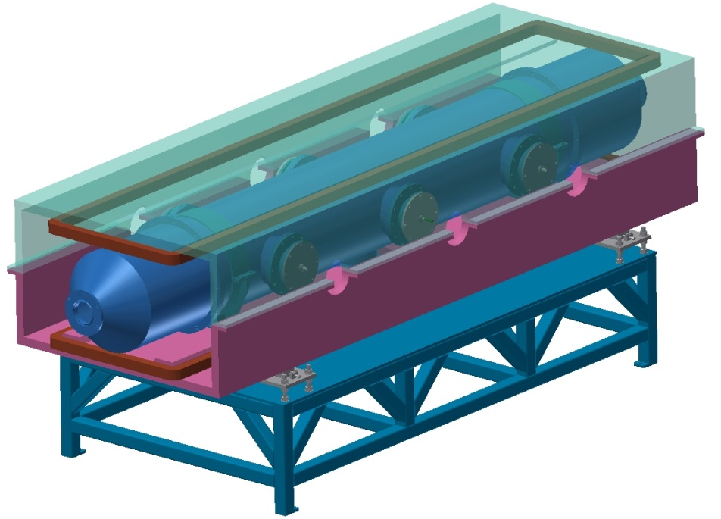
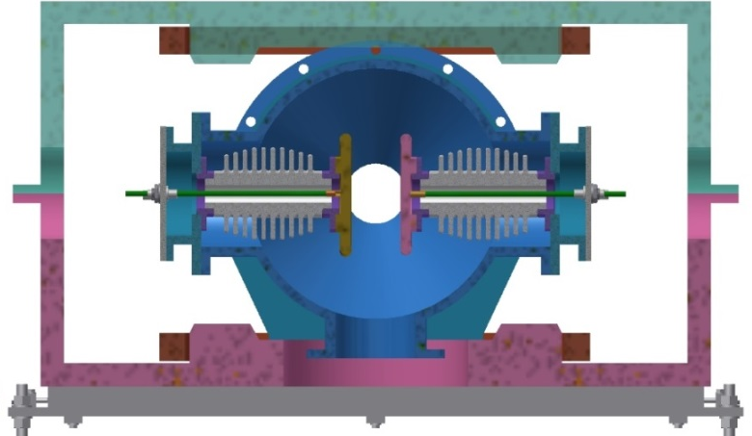
Electrostatic separator
  The Electrostatic-Magnetic Separator is a device consisting of perpendicular electric and magnetic fields.
  One set of Electrostatic-Magnetic Separators including 8 units, total 32 units needed for CEPC.
Separator length | 4.5m
Inner diameter of separator tank | 380mm
Electrode length | 4.0m
Electrode width | 180mm
Nominal gap | 75mm
Maximum operating field strength | 2MV/m
Maximum operating voltage | ±75kV
Maximum conditioning voltage | ±135kV
Good field region (0.5‰ limit) | 46mm ⅹ11mm
Nominal vacuum pressure | 2.7e-8 Pa
metal-ceramic support
high voltage feedthrough
UHV tank
Magnet
Support
coil
electrode

Slide 24
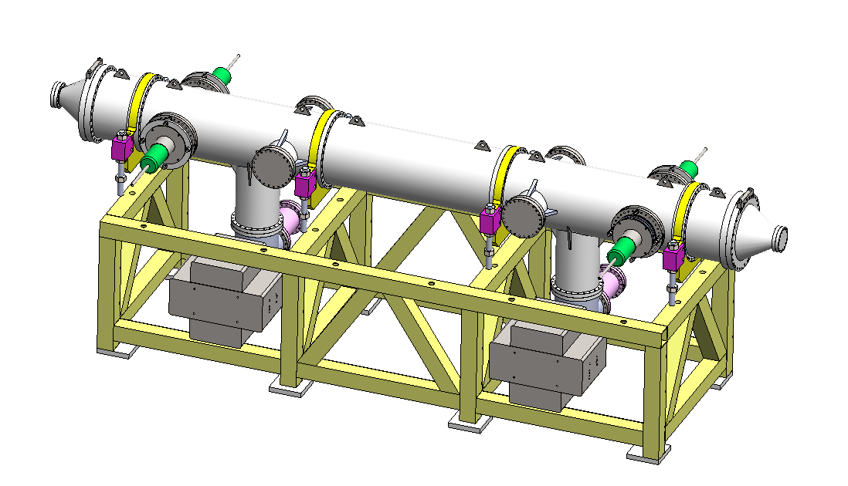
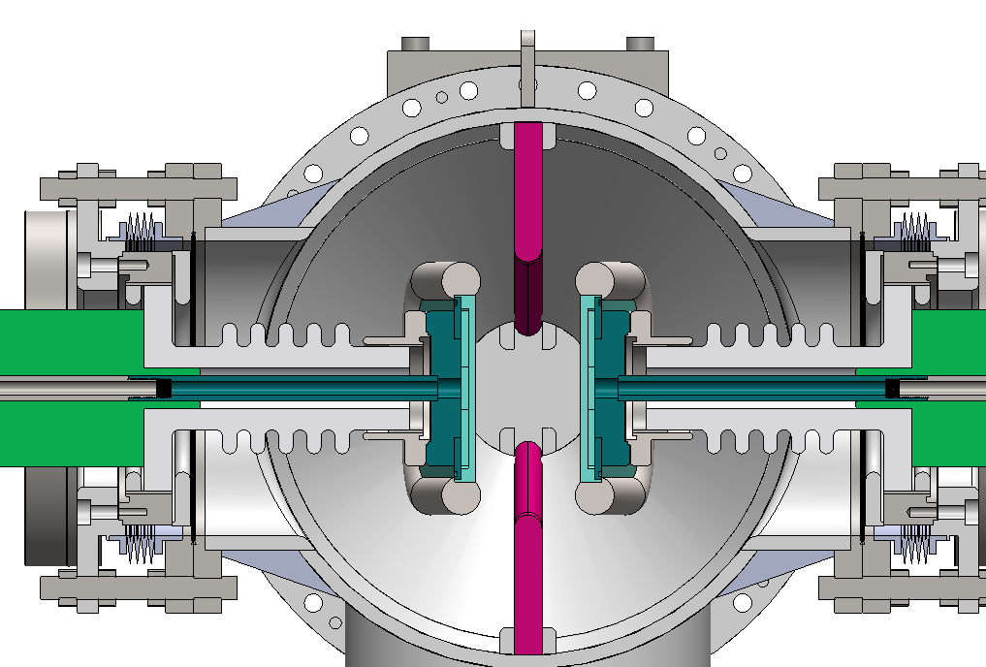
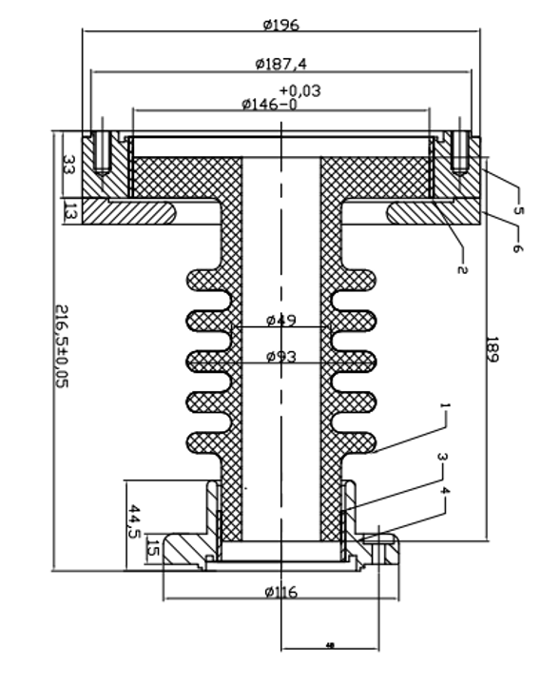
Prototype development of electrostatic separator
  A separator unit including: 1. Vacuum chamber (5 straight through chambers, 2 cone tubes and 2 pump chambers); 2. a pair of electrodes; 3. 2 ground electrodes; 4. 4 groups of insulation metal-ceramic support; 5. 4 groups of high voltage feedthrough; 6. 2 sets of vacuum system (including ion pump, sublimation pump and gauge); 7. support platform.

Slide 25
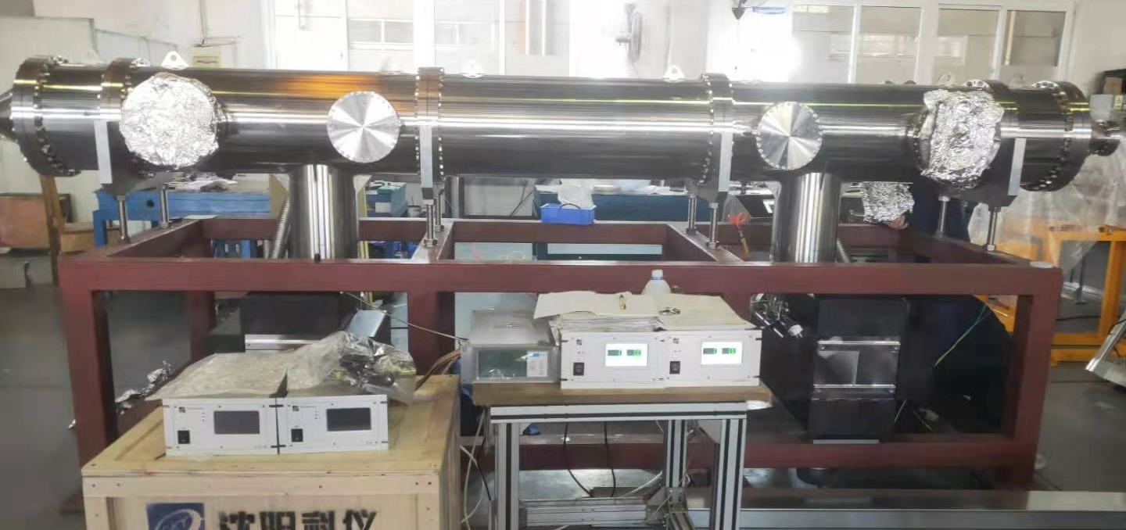
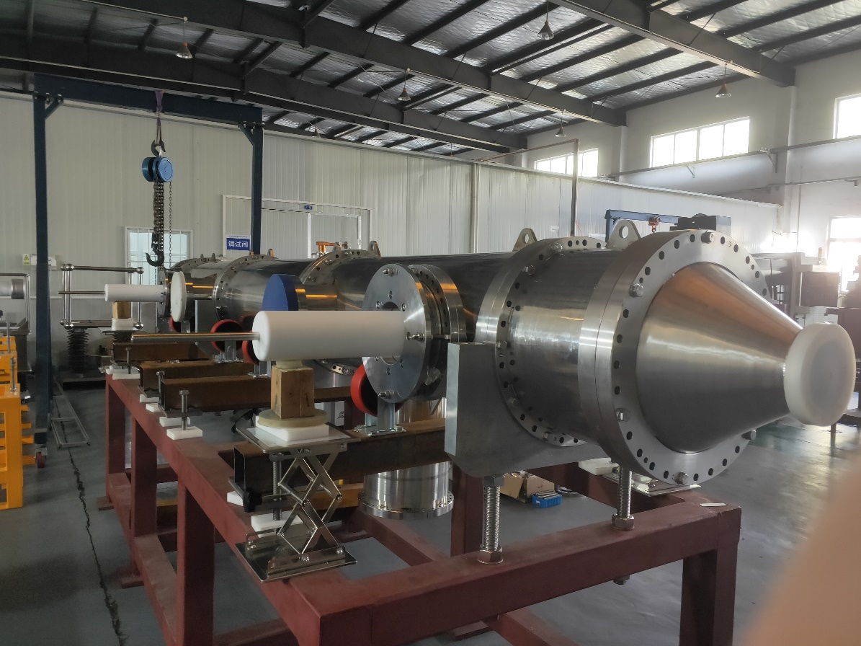
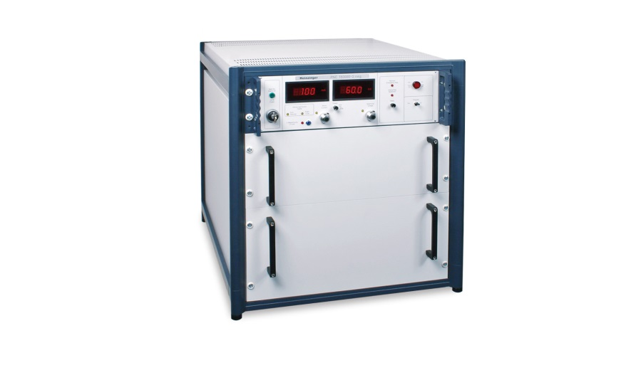
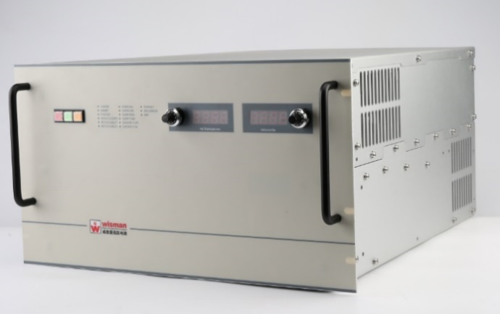
Prototype development of electrostatic separator
主要技术参数 | 技术参数期望目标 | 结果
整体真空漏率 | ≤1x10-10Pa.m3/s | 2×10-13Pa·m3/s
静态极限真空 | ≤5x10-8Pa(烘烤后) | 1.3×10-8Pa
调试电压 | ±135KV， 稳定工作8小时无故障打火， 真空度≤5x10-8Pa | －108KV ＋97.6KV

Slide 26
Next stage working plan
The electrostatic separator will be further experimented with high voltage, and the cooling system and high order mode absorption will be optimized.
Finally, finishing high voltage testing of the prototype, to achieve the final indicators.

Slide 27
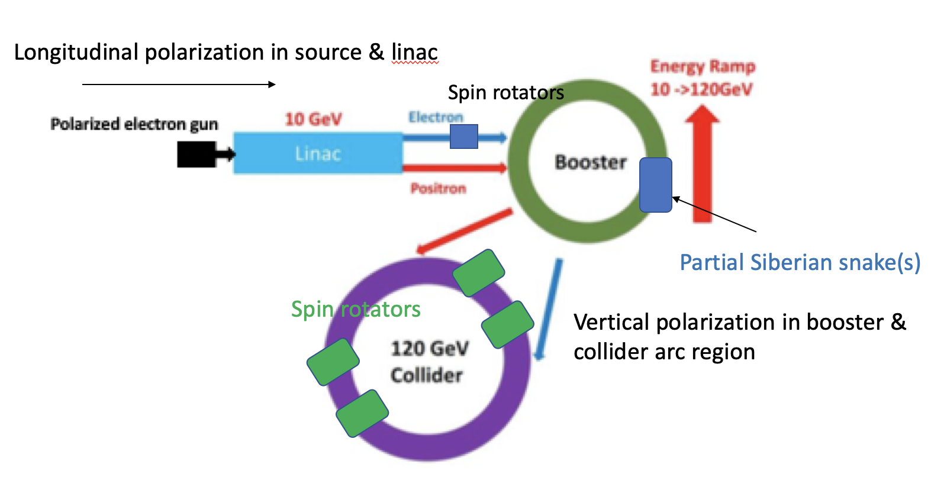
Z-pole Polarization: Where we are now?
  Final indicators
  Study and design polarized colliding beams, beam polarization > 50%, beam lifetime > 60 min.
  After mid-term review, we are focusing on
  Extensive simulations of the equilibrium beam polarization at Z-pole and beyond
  Design and optimization of spin rotators in the collider rings (till end of 2021)
  Design of Siberian snakes for the booster ring (yet to start, till end of 2022)

Slide 28
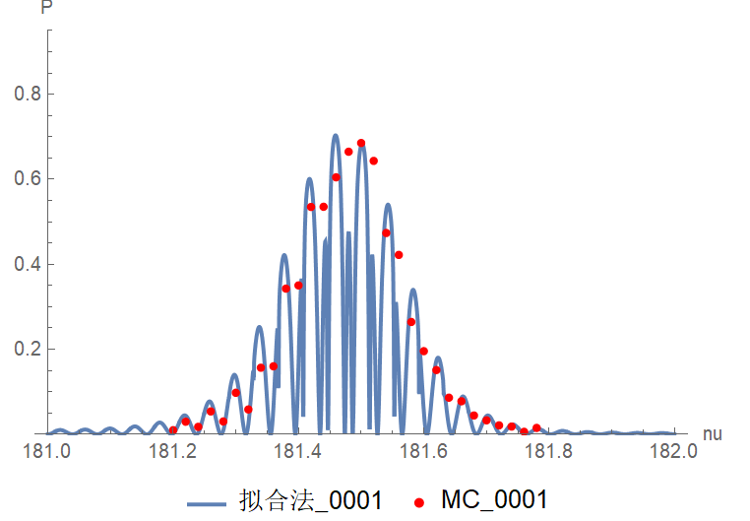
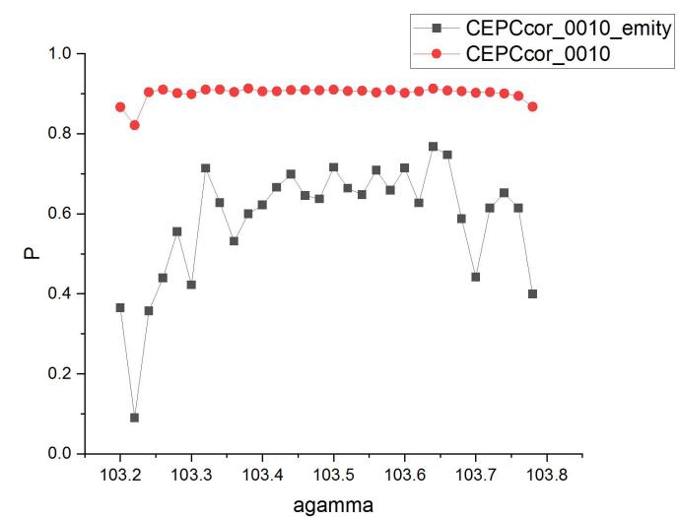
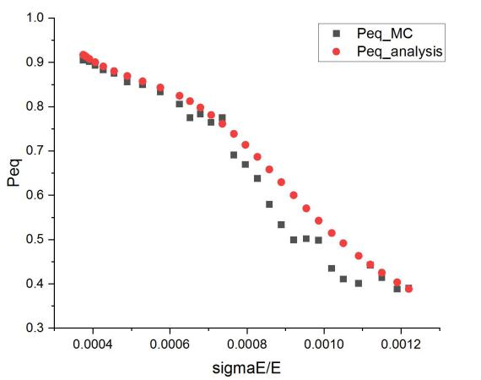
Z-pole polarization design
Equilibrium beam polarization simulations
There are still open questions in the theories, measurements and simulations of beam self-polarization in the ultra-high energy domain
  Compared Monte-Carlo simulation results against analytical formula from a simplified model
  Studied the dependence of equilibrium beam polarization on various parameters
  A journal paper is in preparation
45GeV, Polarization vs energy spread
via asymmetric wigglers
80GeV, MC vs analytical
45GeV, Polarization vs vertical emittance

Slide 29






Z-pole polarization
  Design of spin rotators in the CEPC CDR lattice
  Implemented solenoid spin rotators (~100 m each) into the first short straight sections near IR
  The spin rotators do rotate the spin direction as expected
  But the limited space results in a very compact design with superconducting quadrupoles
  The local contribution to the chromaticity is very large, no DA after insertion
Polarization direction w/ spin rotators

Slide 30



Z-pole polarization
  New design of spin rotators
  A new version of CEPC lattice is under development
    The geometric requirement for spin rotators is built-in
    A space of ~300m is reserved for each spin rotator, in a long straight section near IR
  A new modular design of spin rotator is also ongoing
    max gradient of quads is reduced by a factor of 10, SC quads are unnecessary
    The local chromaticity contribution (∝ K1* β) is still very large, further optimization is under way

Slide 31
Outline
Overall progress
Important progress and achievements
Existing problems and solutions
Papers, patents and international conference talks
Use of personnel and funds
Summary

Slide 32
Existing problems and solutions
Subtask 1- Low-field Booster dipole magnet :
  No
Subtask 2- Main ring vacuum system :
  No
Subtask 3- Electrostatic separator :
  Fabrication delayed due to difficulties of HV feedthrough fabrication, but schedule is still under control. The feedthrough fabrication will be finished in 3 weeks, then the separator will be delivered to the IHEP for testing.
  Two high voltage power supplies failed due to arc during high voltage test and have been returned to the factory for repair.
Subtask 4- Beam polarization design :
  Due to the Covid-19 pandemic, international travels have been delayed till indefinite future. This impedes collaborative studies of CEPC beam polarization with experts from BINP of Russian.
  Solution:
  Email exchanges and video discussions over key issues that BINP experts have more experiences
  Attempt to organize video mini-workshops at a later stage, to invite more discussions from international experts
  Plan travel if situation could improve next year

Slide 33
Outline
Overall progress
Important progress and achievements
Existing problems and solutions
Papers, patents and international conference talks
Use of personnel and funds
Summary

Slide 34
Papers, patents and international conference talks
Journal Paper:
[1] G. Y马永胜，杨雨晨，景泳淼，孙飞，董海义， 何平，陈双凯，张志伟，陈子林， 杨馥羽，刘佰奇，张磊. 薄膜缺陷研究进展综述[J]. 表面技术，2021,50（3）
[2] 马永胜,张沛,董海义.超导高频铜腔镀铌研究进展[J].真空科学与技术学报,2020, 40(03):255-261.
[3] Zhiwei Zhang, Yuchen Yang*, Yongsheng Ma, Xujian Wang, Baiqi Liu, Ping He. Deposition and characterization of Pd–Ti thin film by sublimation [J]. Radiation Detection Technology and Methods, 2020, 4(4): 465-71.
[4] Yang Yuchen*, Ma Yongsheng, Chen Shuangkai, Qi Tiezhu, Peng Xiaohua, Dong Haiyi, He Ping. Aging effect of non-evaporable getter coatings [J]. Radiation Detection Technology and Methods, 2020, 4(3): 372-6.
Conference Paper:
[1]
Conference talk:
[1] “W. Kang, Mei Yang, “CEPC Booster and Collider Ring Magnets R&D”, IAS Program on High Energy Physics, Hong Kong, Jan. 18-19, 2020.
[2] W. Kang, Mei Yang, “Progress of CEPC Magnet R&D”, IAS Online Program on High Energy Physics, Hong Kong, Jan. 14-21, 2021.
[3] Bin. Chen, “CEPC Electro-Magnetic Separator and Magnet Power supply R&D”, International Workshop on the Circular Electron Positron Collider, Shanghai, 2020.10.26
Seminar:
[1] Z. Duan,

Slide 35
Papers, patents and international conference talks
[1] 马永胜, 何平, 郭迪舟; 一种TiZrVHf四元吸气剂薄膜, 2020.01.10, 中国, CN108531877B （发明专利）
[2] 马永胜，黄涛,孙飞,刘佰奇,郭迪舟,何平 ,董海义;用于固定陶瓷的阴极丝固定绝缘加紧装置, 2021.02.05, 中国, CN 212476872 U （实用新型）
[3] 马永胜，孙飞,黄涛,刘佰奇,郭迪舟,何平 ,董海义;基于直流磁控溅射方法的狭缝镀膜装置, 2021.03.23, 中国, CN 212770928 U （实用新型）

Slide 36
Outline
Overall progress
Important progress and achievements
Existing problems and solutions
Papers, patents and international conference talks
Use of personnel and funds
Summary

Slide 37

Use of personnel and funds
1. 人员及经费投入情况
本课题批准的的专项经费为974万。
已累计支出约438.86 万元。
课题投入人员 18人，包括 11 名高级职称，7 名中级职称，另有4名博士：孙晓阳、马永胜（在职）、朱建斌、夏文昊。
2. 课题经费拨付情况
无

Slide 38
Comparison between Implementation and Budget until 2021/04/14
序号 | 预算科目名称 | Expense until 2021/4/14 | Total budget | Rate of expense/total budget | Budget until 2021/4/30 | Rate of expense/budget till 2021/4/14
2 | direct fee | 438.86 | 878.19 | 49.97% | 659.29 | 66.56%
3 | 1、device fee | 377.00 | 456 | 82.68% | 359.00 | 105.01%
4 | （1）purchase device | 122.35 | 140 | 87.39% | 113.00 | 108.27%
5 | （2）Trial device | 256.10 | 296 | 86.52% | 226.00 | 113.32%
6 | （3）modifed device | 0.00 | 20 | 0.00% | 20.00 | 0.00%
7 | 2、material fee | 7.98 | 116 | 6.88% | 93.00 | 8.59%
8 | 3、testing fee | 2.10 | 76.2 | 2.76% | 63.20 | 3.32%
9 | 4、power fee | 0.00 | 18 | 0.00% | 10.00 | 0.00%
10 | 5、travel/conference/international communication | 26.71 | 131.1 | 20.37% | 84.40 | 31.64%
11 | 6、publication | 2.60 | 20.29 | 12.81% | 16.49 | 15.76%
12 | 7、labor | 22.47 | 51 | 44.05% | 27.20 | 82.60%
13 | 8、consult | 0.00 | 9.6 | 0.00% | 6.00 | 0.00%

Slide 39
Outline
Overall progress
Important progress and achievements
Existing problems and solutions
Papers, patents and international conference talks
Use of personnel and funds
Summary

Slide 40
Summary- Magnet
Two kinds of the subscale prototype magnet with and without iron cores have been designed and developed. The performance of the CT coil dipole magnet without iron cores could meet the requirements.
On the basis of the experience of the subscale prototype magnet, the full-scale CT dipole magnet has been designed and the components of the magnet are on the production.
The rotating coil field measurement system is designed and developed to measure the field specifications of the full-scale prototype dipole magnet.
The magnet and its field measurement system will be finished in July.

Slide 41
Summary- Vacuum
The prototypes of copper & aluminum vacuum chambers with a length of 6 m have been fabricated and tested, which meet the engineering requirements. Surface treatment of copper is undertaking.
The key components experiments such as spring fingers and contact fingers have been carried out. Contact force is uniformly from different fingers and meets the target of 125±25g. The prototypes of RF shielding bellows have been fabricated.
2m long vacuum pipe have been coated to explore the coating parameter at geometrical shape of 56×75。 6m long vacuum chambers will be coated by moving the solenoid by a horizontal coating equipment .

Slide 42
Summary- Separator
  Improved the cooling loop of the electrodes.
  The structure of the insulation metal-ceramic support and of high voltage feedthrough is optimized and the electric field simulation is carried out.
  The overall installation of the separator was completed
  The factory test shows that the vacuum reaches the target
  Due to the arc of the high voltage test, two power supplies failed to be used. After the improvement by Feedthrough, they will be delivered to the IHEP for testing

Slide 43
Summary- Polarization
Equilibrium electron beam polarization were simulated for CEPC lattices, a journal paper is in preparation.
Solenoid-based spin rotators were implemented in CEPC CDR lattices.
A new modular design of spin rotators is under way, to address the issues of high quadrupole fields and large chromaticity contributions.
The overall work is on schedule. The spin rotator design concept can be partly reused in Siberian snake design.

Slide 44
Thank you for your attention！

