Slide 1






国家重点研发计划 • 项目年度会议
高能环形正负电子对撞机关键技术研发和验证
课题2：硅径迹探测器关键技术验证
报告人： 梁志均
项目负责人： João Guimarães da Costa
项目承担单位：中国科学院 高能物理研究所

Slide 2
国家重点研发计划 •项目年度会议
R&D and Verification of Key Technologies for a High Energy Circular Electron-Positron Collider
课题2：硅径迹探测器关键技术验证
报告人： 梁志均
项目负责人： João Guimarães da Costa
项目承担单位：中国科学院 高能物理研究所

Slide 3
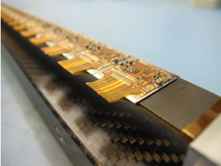
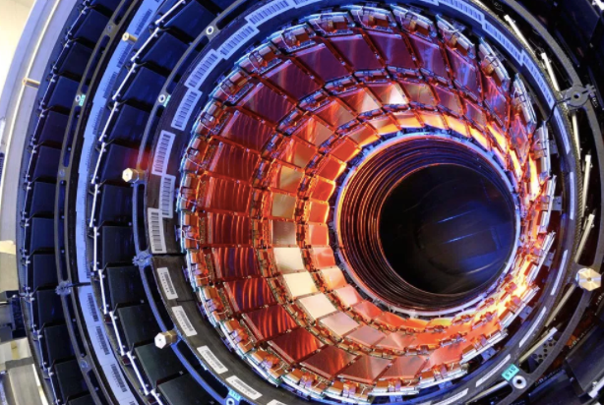

MOST2 vertex detector R & D: Research Goal
Typical module
Produce a world class vertex detector prototype
  Spatial resolution 3~5 μm (pixel detector)
  Radiation hard (>1 MRad)
Preliminary design of prototype
  Three layer, module ~1 cm × 12 cm²
Typical tracker
Resolution
ATLAS/CMS upgrade
（~15 μm）
Alice upgrade
（5~10 μm）
World
leading
This project（3~5 μm）
Notes:
General description highlighting major points and assessment indicators

Slide 4
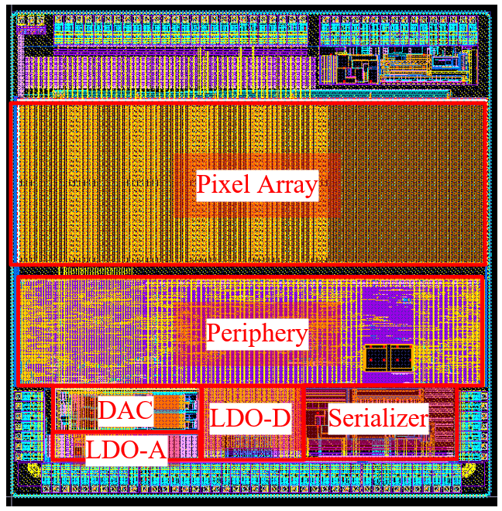
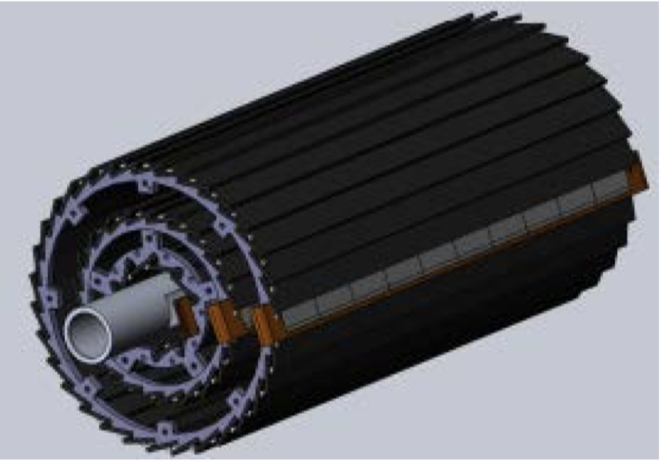
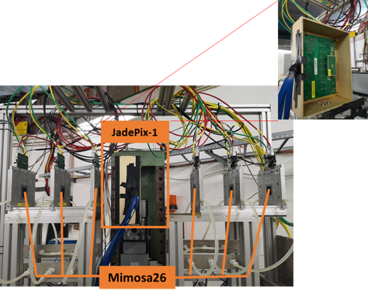
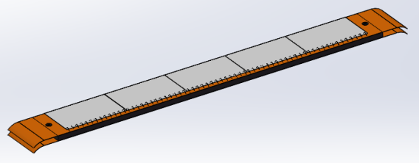
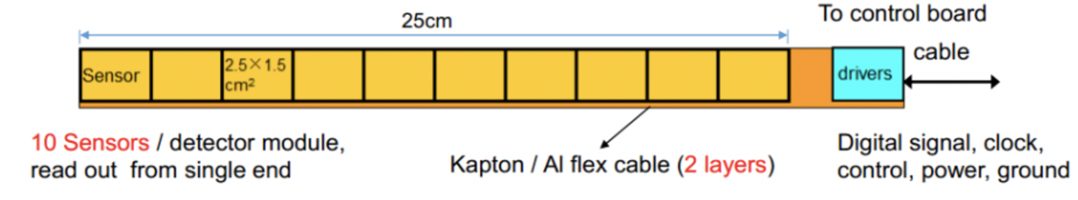
Overview of task2： vertex detector R & D
Can break down into sub-tasks:
  CMOS imaging sensor chip R & D
  Detector layout optimization, Ladder and vertex detector support structure R & D
  Detector assembly
  Data acquisition system R & D
CMOS imaging
sensor prototyping
Detector module (ladder)
Prototyping
Full size vertex detector Prototype
Beam test to
verify its spatial resolution
Notes:
Full size vertex detector

Slide 5
Research Team in task 2
4 institutes
课题2：IHEP - 中国科学院高能物理研究所
                SDU - 山东大学
                NJU - 南京大学
                NWU - 西北工业大学
Institutes | Tasks
IHEP | Full CMOS chip modeling, Pixel Analog, PLL block Detector module (ladder) prototyping Data acquisition system R & D Vertex detector assembly and commissioning
CCNU/IFAE | CMOS sensor chip: Pixel Digital
NWPU | CMOS sensor chip: Periphery Logic, LDO
SDU | CMOS sensor chip: Bias generation, TCAD simulation Sensor test board design
NJU | Irradiation, test beam organization
Notes:
Total 51, average age is 39
Acc: 39=703/18
Silicon: 39=866/22
HCAL: 40=440/11
Total: 39

Slide 6
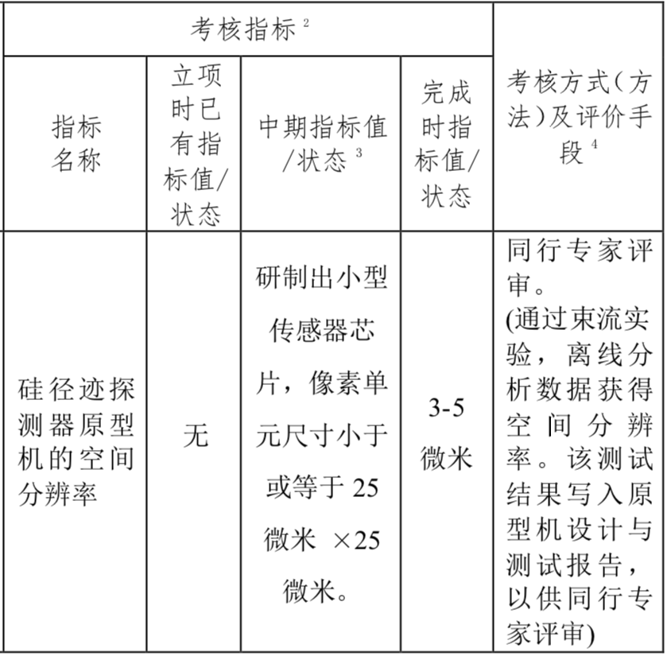
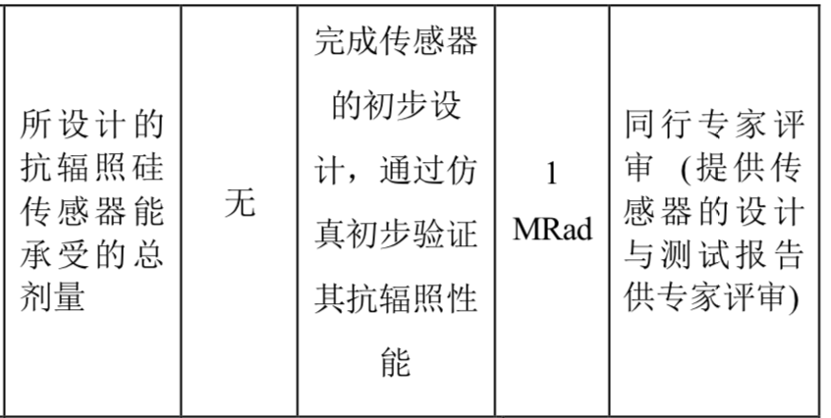
Achievement Presentation and Assessment Methods
Assessment index
Spatial resolution
  - Mid-term: produce 25*25 μm pixel size chip
  - Final : 3-5 μm resolution in Beam test
Silicon Detector
Radiation hardness
  - mid-term: verified by TCAD simulation
  - Final : Total ionization dose >1 Mrad

Slide 7
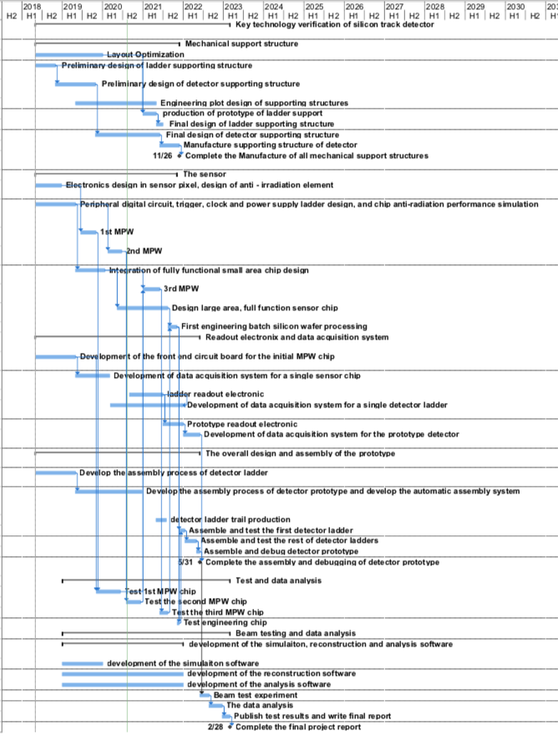
Overall plan of task2： Vertex detector R & D
3rd Year:
  3rd CMOS sensor fabricated and tested
    → skipped , since 2nd MPW chip is working well
  Final support structure engineering design completed
  Fabricated support structure prototype for ladders
4th Year:
  Competed R & D full-size TaichuPix sensor
  Manufactured the support structure for whole detector
  Assembling and installing the detector prototype
  Completed DAQ system for whole detector
5th Year:
  Completed detector assembly and commissioning
  Test beam and data analysis
  Finish assembling of prototype

Slide 8
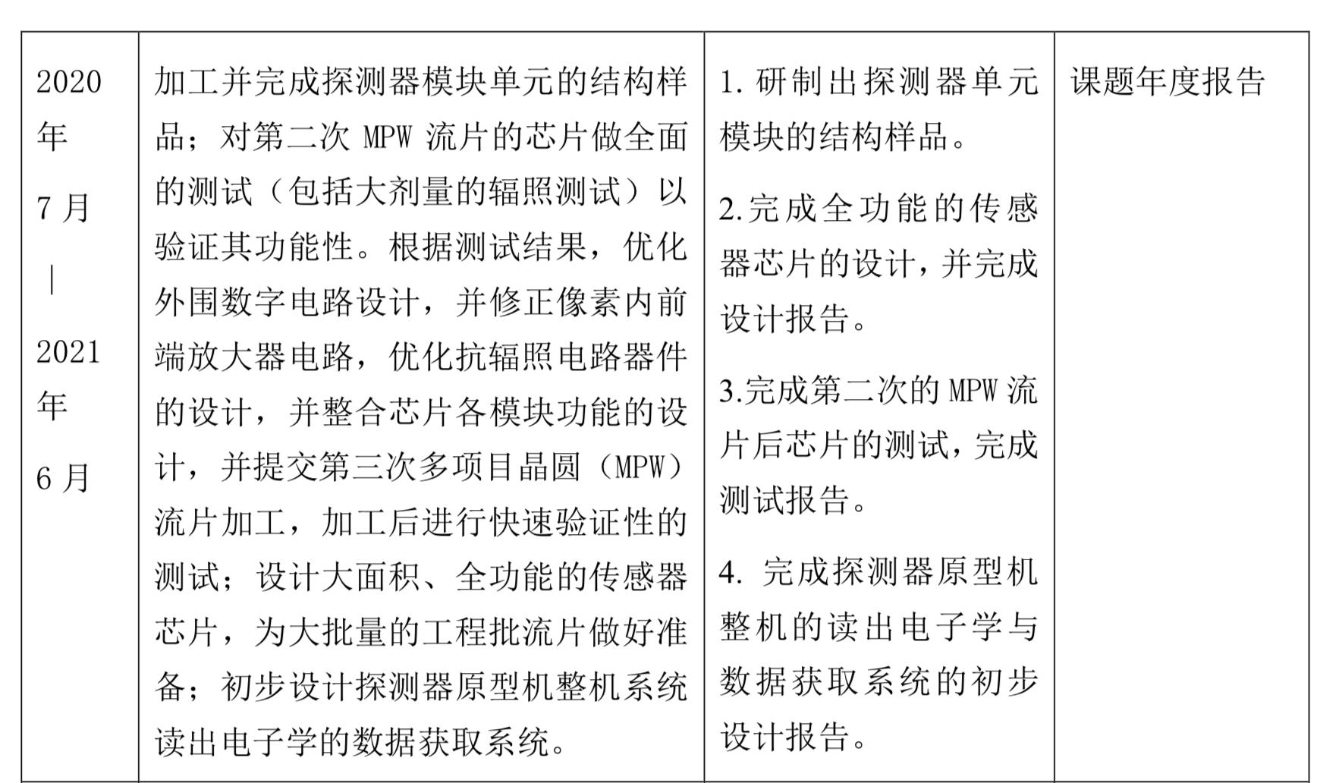
Goal for the third year(2020.7 –2021.6)
Achieve the target in task book for the 3rd years
  Build the support structure prototype for ladder
  Finalize the full-size sensor design , and write a design report
  Complete the testing of 2nd MPW Taichu chip, write a testing report
  Complete initial design of readout electronics and DAQ for vertex detector prototype

Slide 9
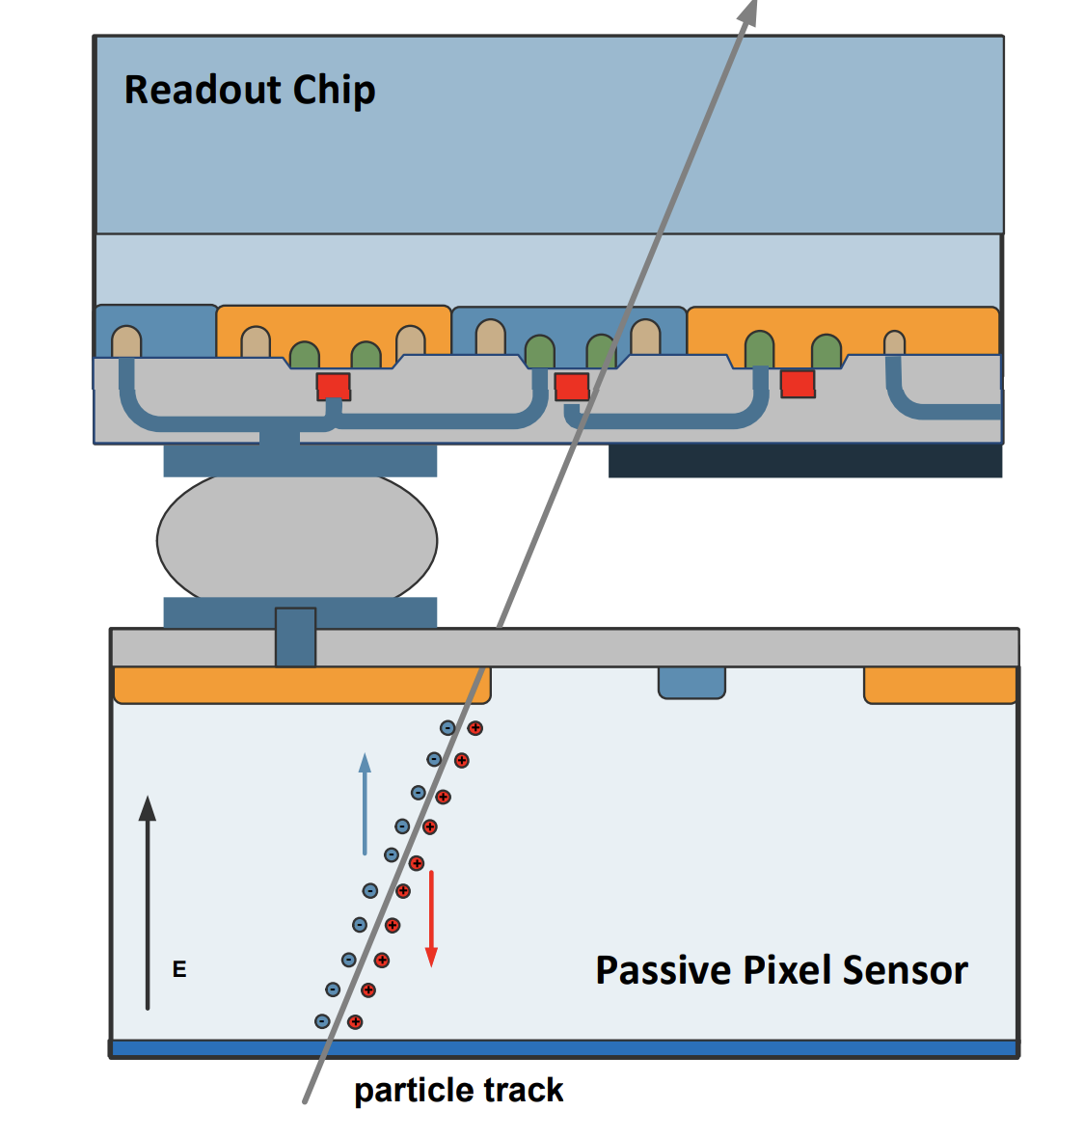
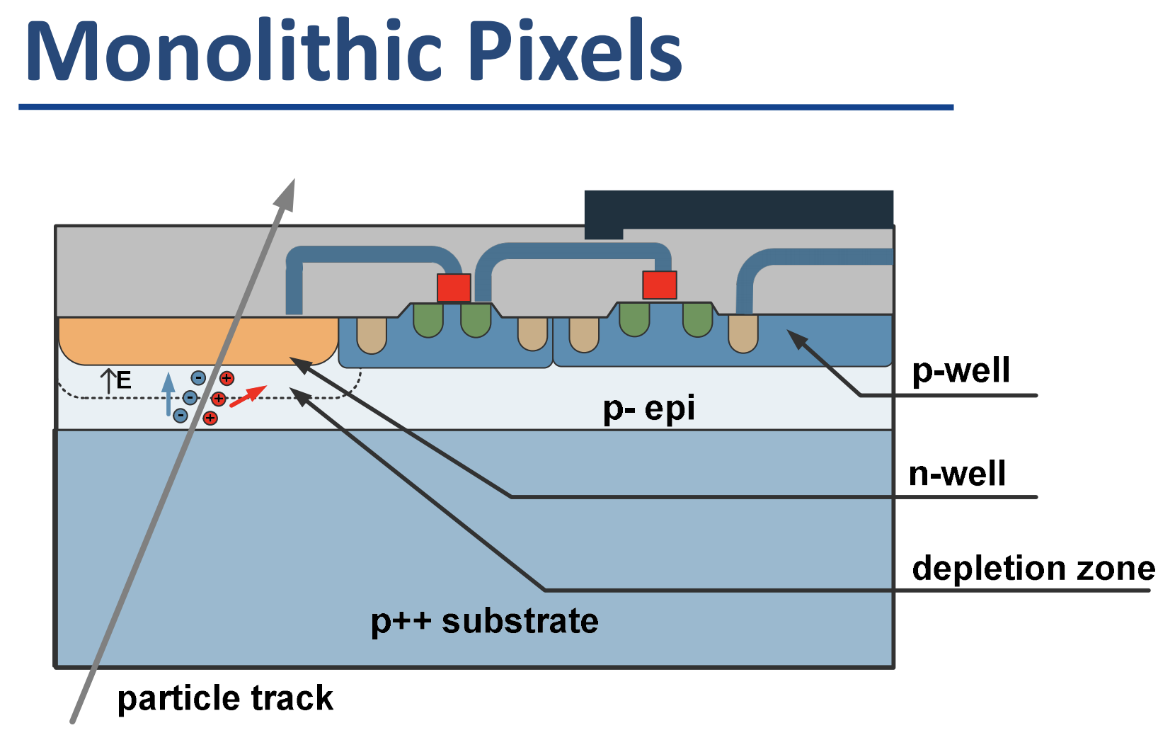
CMOS Monolithic pixel sensor
CMOS Monolithic pixel (CIS process) is ideal for CEPC application
  low material budget (can be thin down to 50μm)
  This project use TowerJazz CIS 180nm technology
Hybrid pixel technology developed by ATLAS and CMS
  Thickness of sensor is about 200~300 μm
  Need to bump bonding with readout ASIC (ASIC thickness is about 300μm)
  Material budget about silicon sensor is about 10 times larger than CIS process
Hybrid pixel

Slide 10
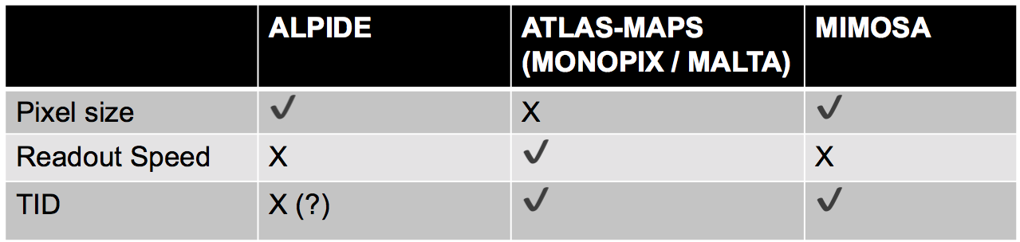
CMOS Sensor chip R & D
The existing CMOS monolithic pixel sensors can’t fully satisfy the requirement
Major Challenges for the CMOS sensor
    Small pixel size -> high resolution (3-5 μm)
    High readout speed (<500ns deadtime @40MHz at Z pole) -> for CEPC Z pole high lumi
    Radiation tolerance (per year): 1 MRad

Slide 11
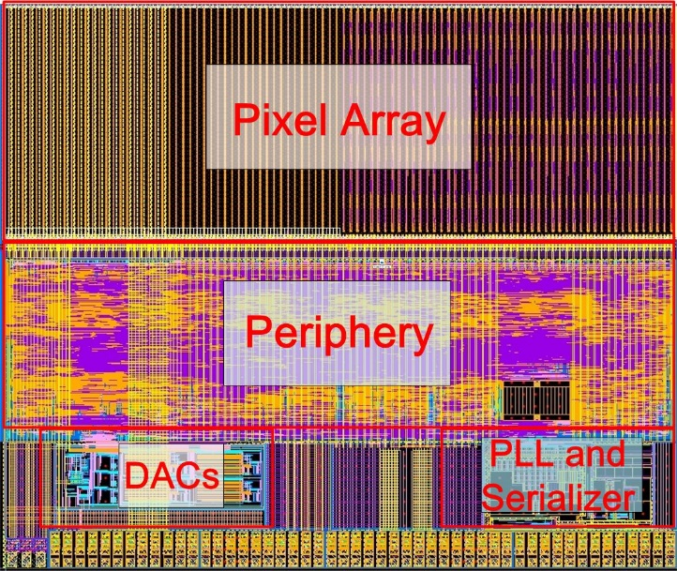
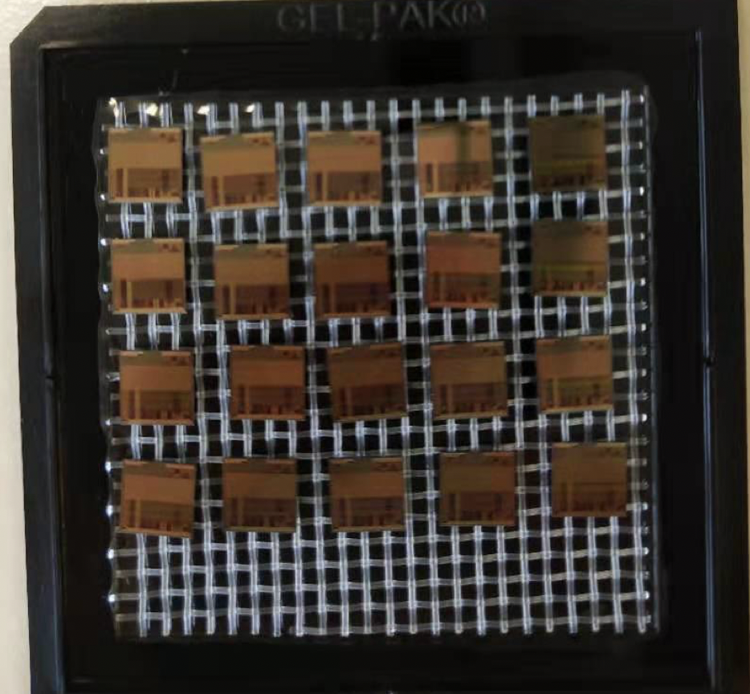
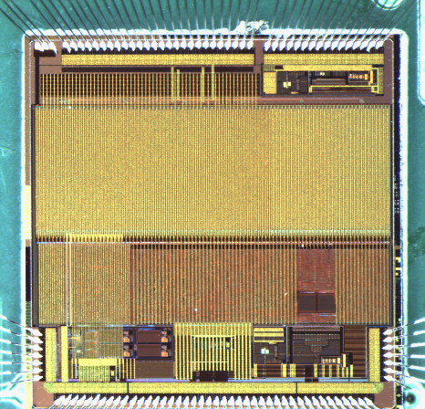
Sensor prototyping
Taichupix1
Chip size：5mm×5mm
Pixel size：25μm×25μm
Completed two round of sensor prototyping
  1st Multi-wafer project chip (Taichupix1)
    Submitted in June 2019, received in November 2019
  2nd Multi-wafer project chip(Taichupix2)
    Submitted in Feb 2020, received in July 2020
    Major bugs fixed in Taichupix1
    Radiation hard design (enclosed gate) in pixel analog
    A full functional pixel array (64×192 pixels)
    Periphery logics
      Fully integrated logics for the data-driven readout
      Fully digital control of the chip configuration
    Auxiliary blocks for standalone operation
      High speed data interface up to 4 Gbps
      On-chip bias generation
      Power management with LDOs
Taichupix2
Chip size：5mm×5mm
Pixel size：25μm×25μm
Taichupix2 on test board

Slide 12
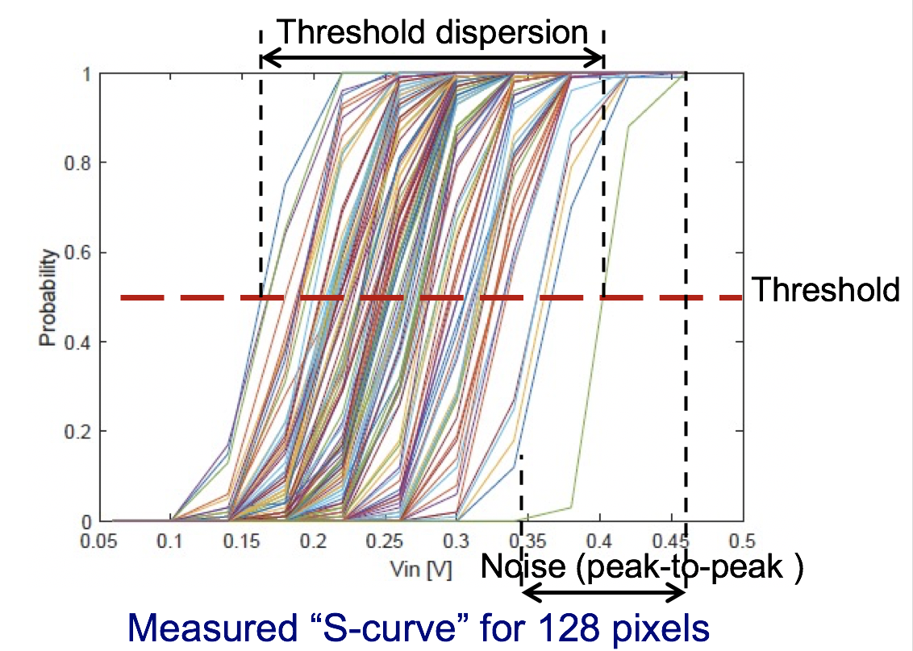
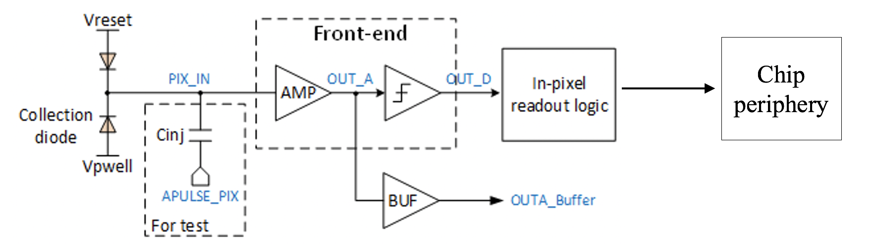
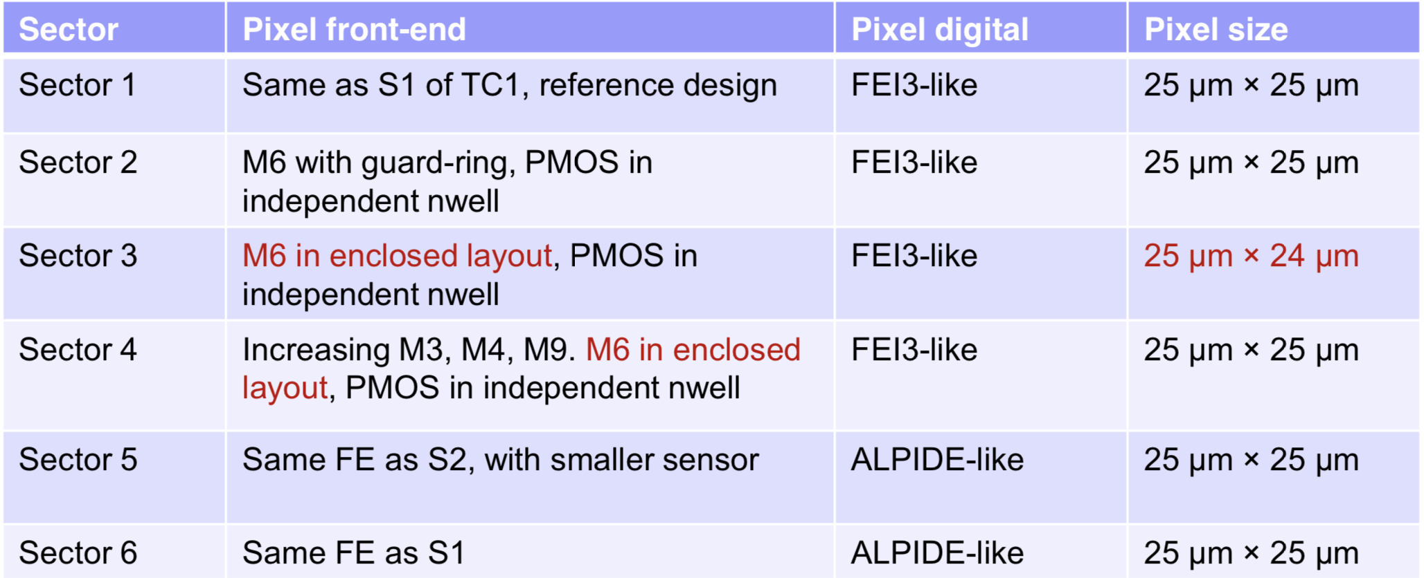
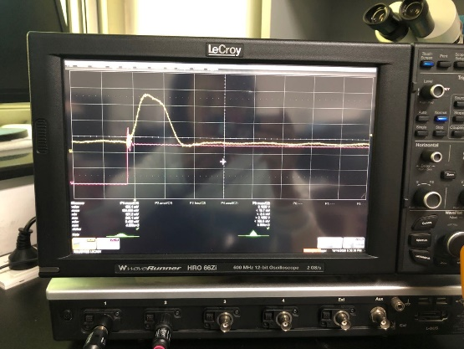
Electrical test
Electrical performance verified by injecting an external charge into pixel front-end
Analog output of a pixel @ Vin = 0.9 V

Slide 13
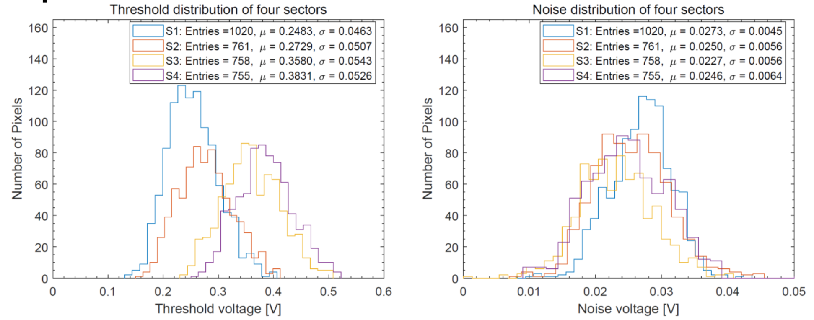
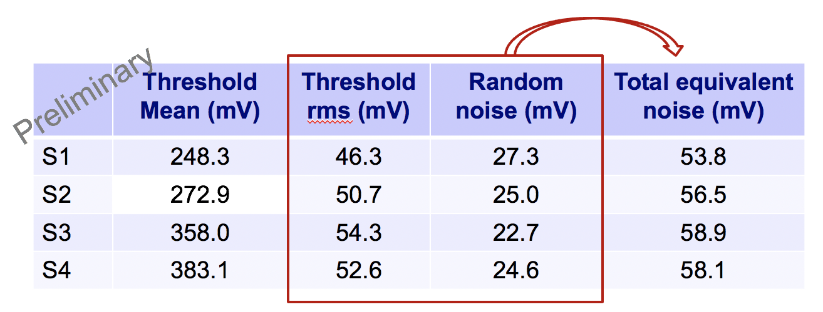
Electrical test （2）
Four sectors with FEI3-like digital logic works well
and show similar noise performance for 4 different pixel design.
S1 sector design shows the minimum threshold.

Slide 14
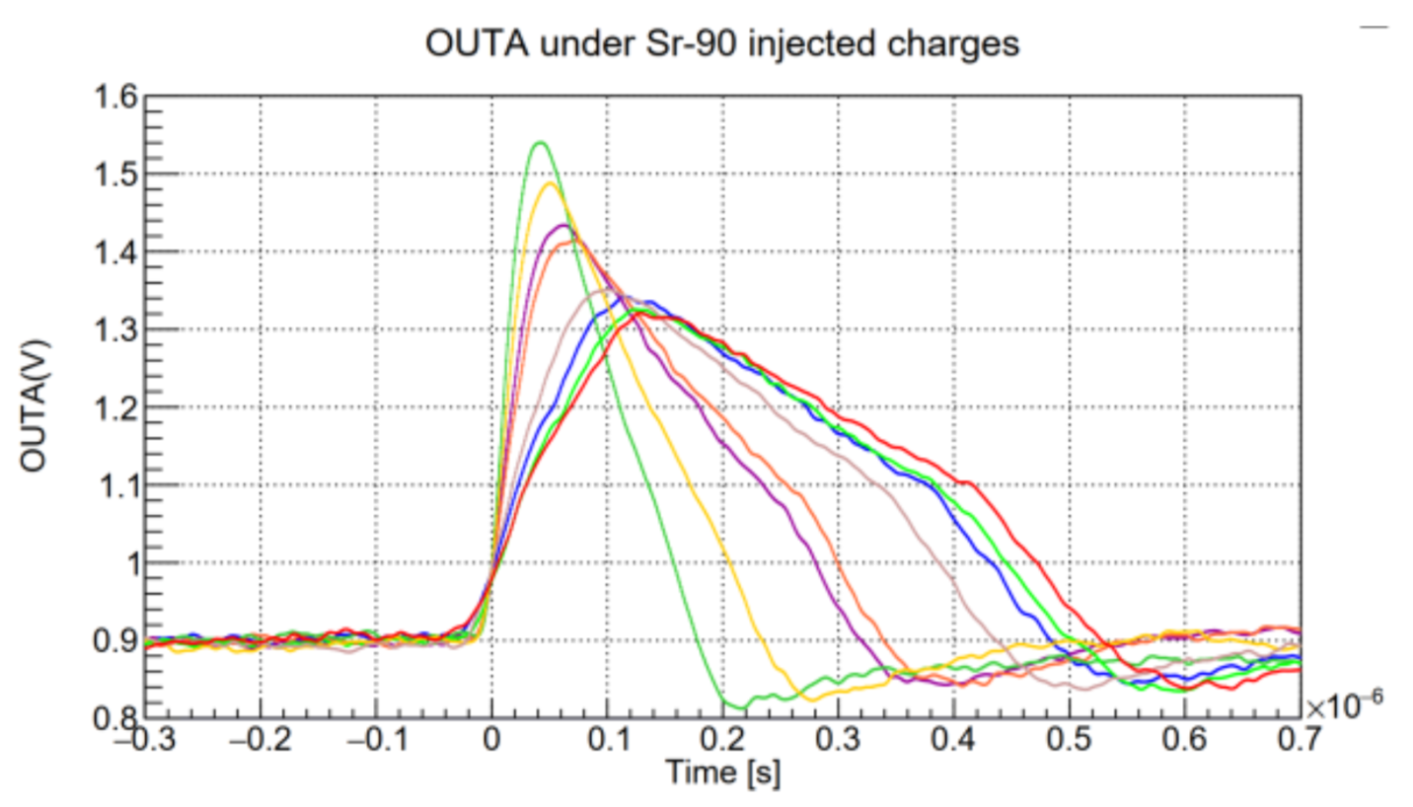
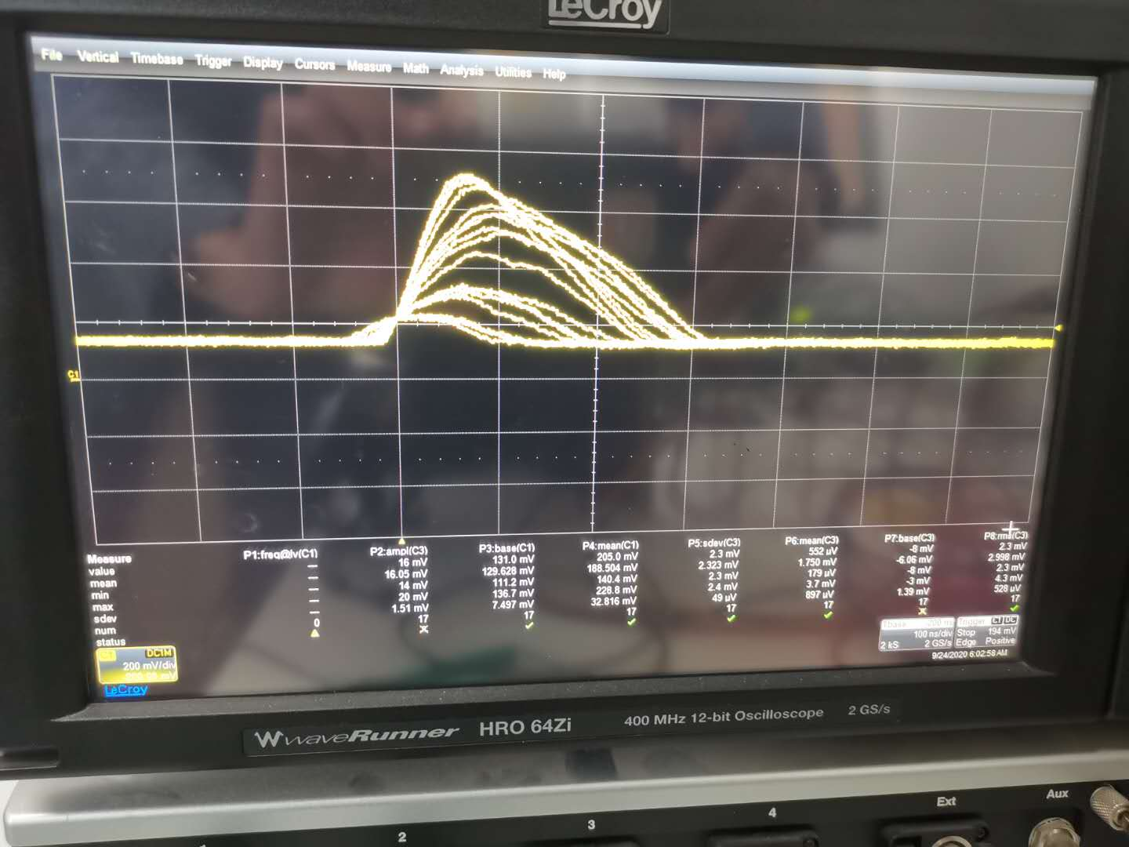
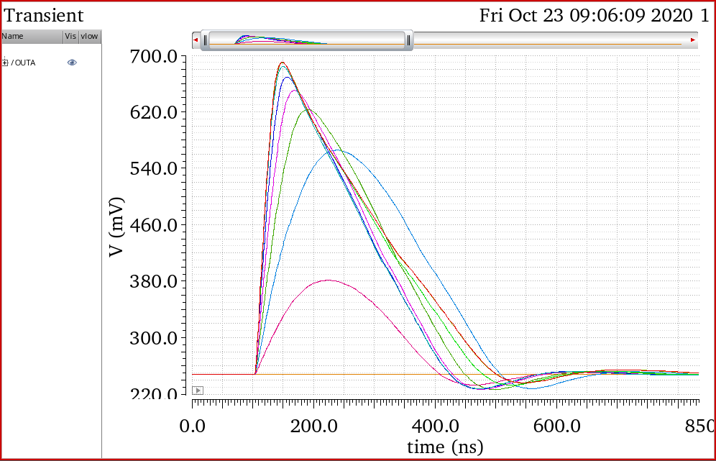
X ray tests and beta source tests
Beta source Tests
Analog output waveform agreed with the simulation
for the small signal, the S/N ratio was also good
X ray tube test

Slide 15
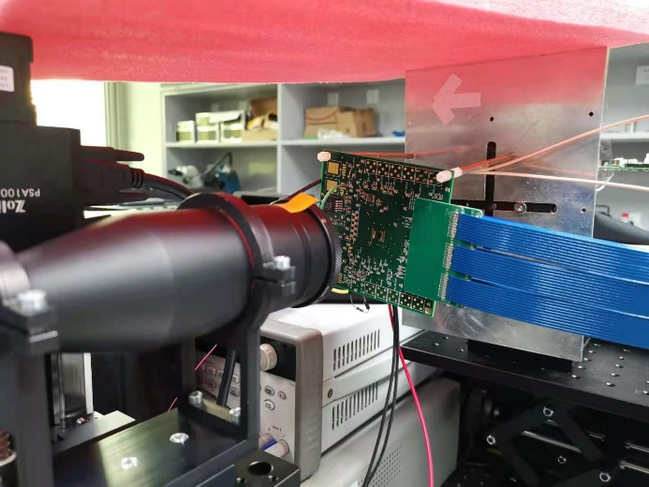
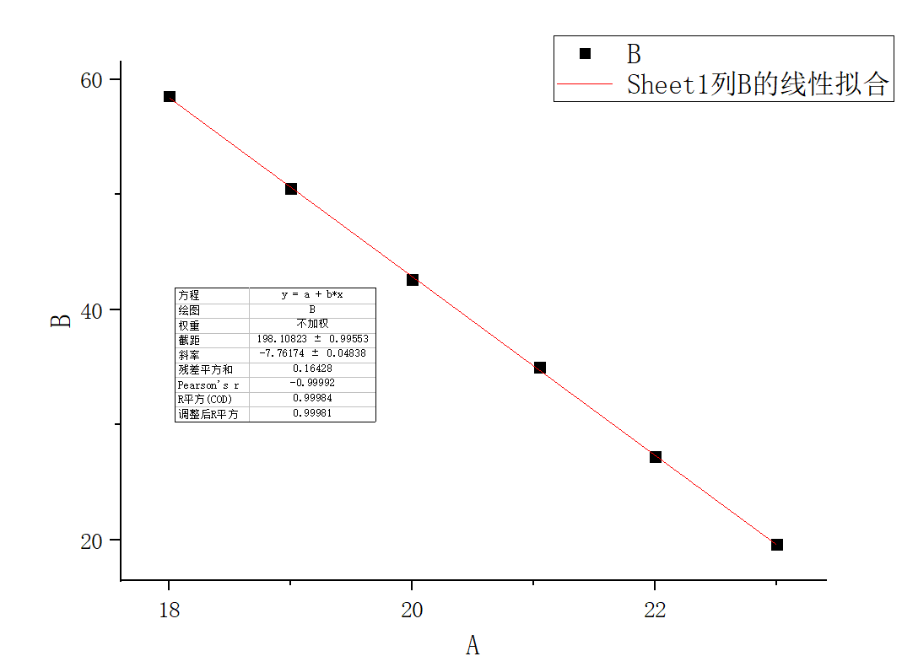
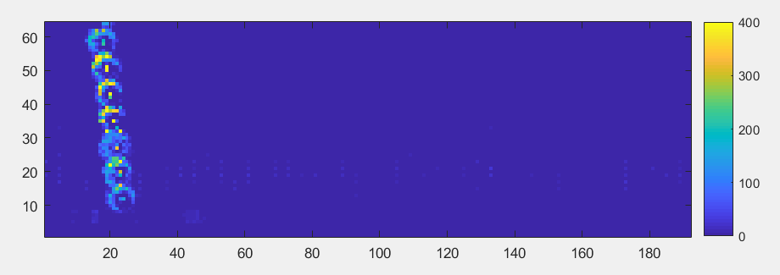
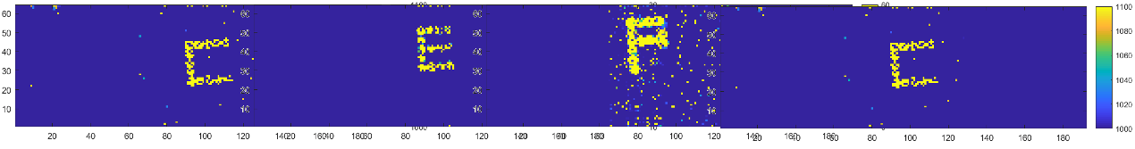
Laser test
Triggerless mode was used for the laser test → full readout chain verified
Measured positions from Taichupix is consistent with expected laser movements
Light spot fitting for laser moving in y-direction with step of 200 µm
Laser
(1064 nm)
TaichuPix-2

Slide 16
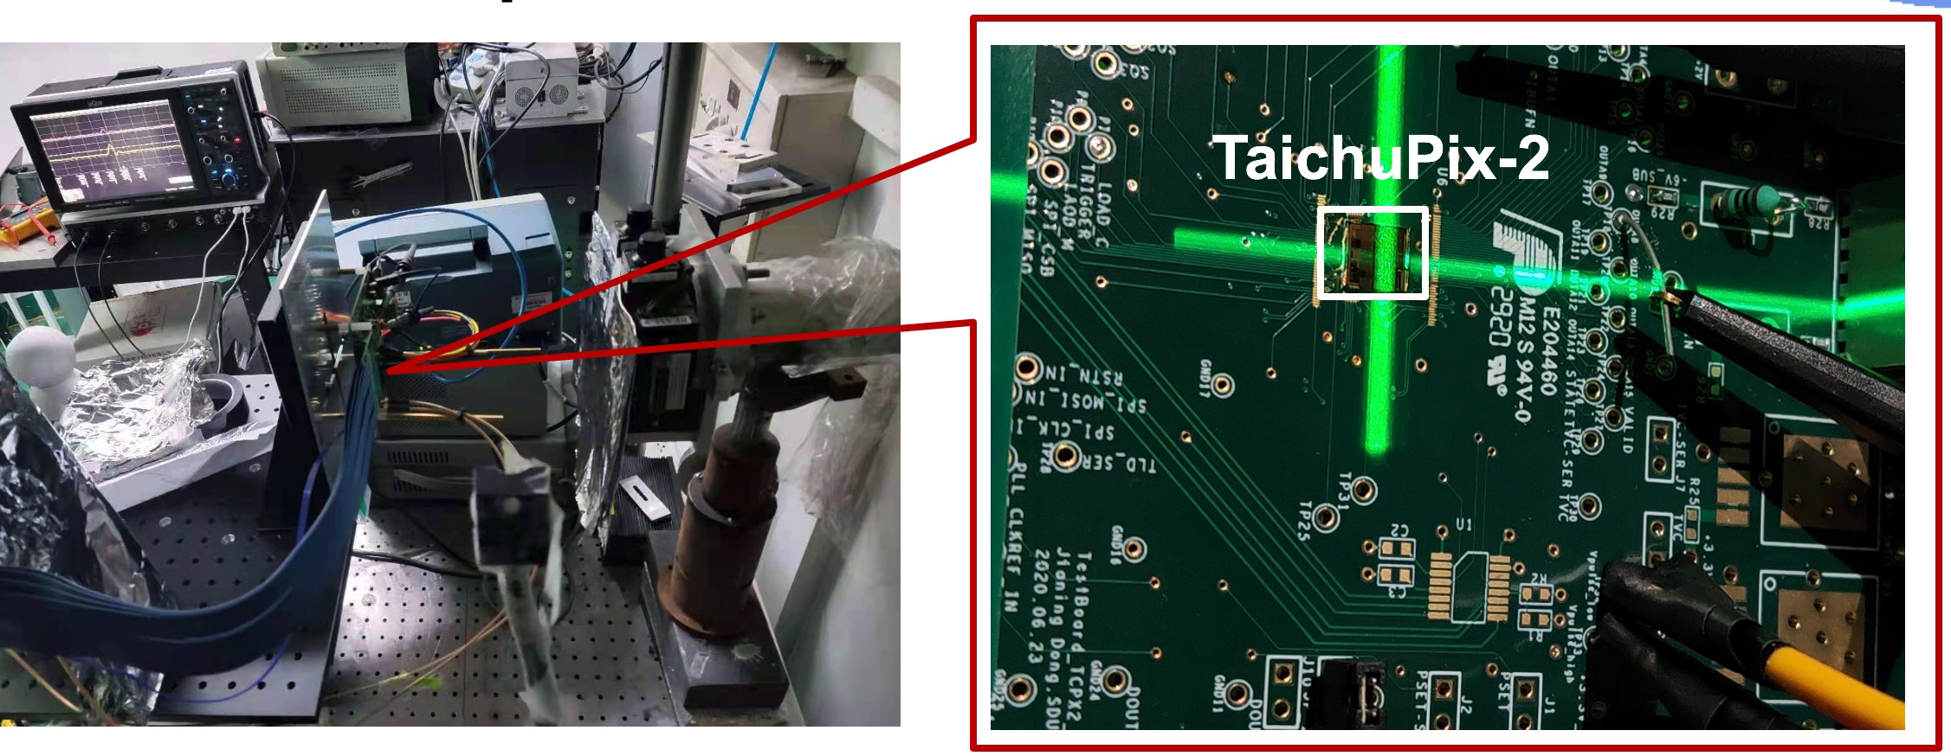
TaichuPix radiation test
Completed two round of CMOS sensor prototyping
  First Radiation test up to 30Mrad at BSRF , TaichuPix2 is still functional
  TaichuPix-2 irradiated at BSRF 1W2B beamline (6 keV X-ray)
    Dose rate ~17.63 krad/min for the first 2.5 Mrad
    then 211.56 krad/min for 51 min, then 1.24 Mrad/min for 15 min
    Dose rates were calibrated with an ion chamber before test
Radiation test at BSRF for 2nd MPW chip

Slide 17
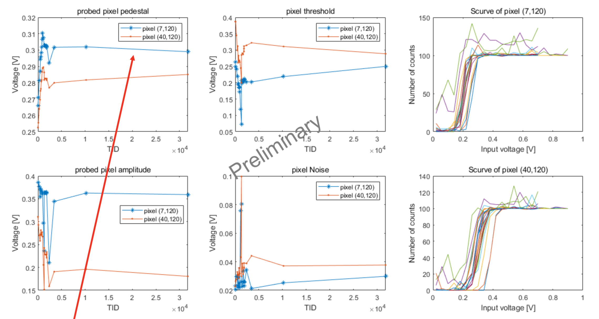
TaichuPix radiation test (2)
  Good chip function and noise performance proved to 2.5 Mrad,
  no deterioration observed when TID up to 30 Mrad.

Slide 18
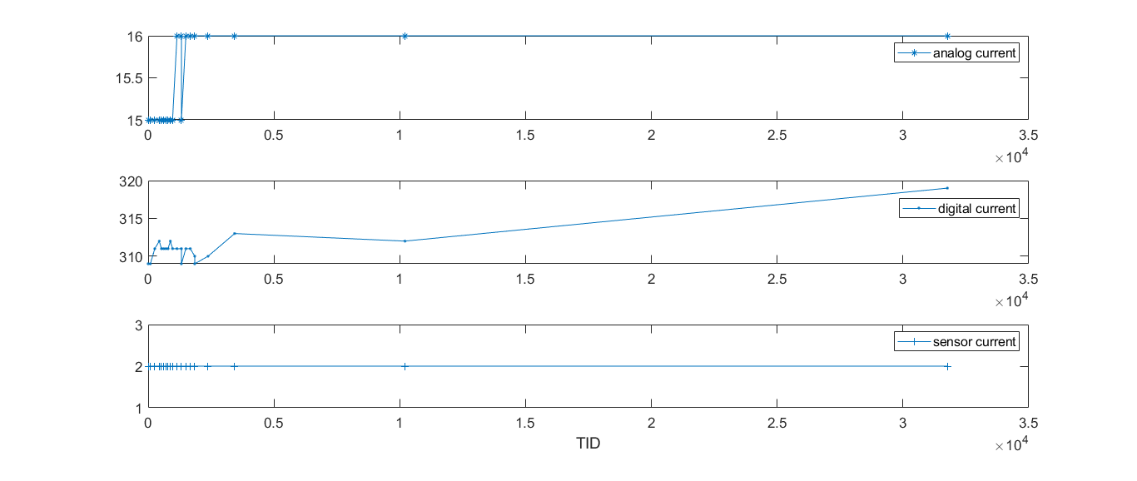
TaichuPix radiation test (3)
  No deterioration observed when TID up to 30 Mrad.
Current [mA]
Preliminary

Slide 19
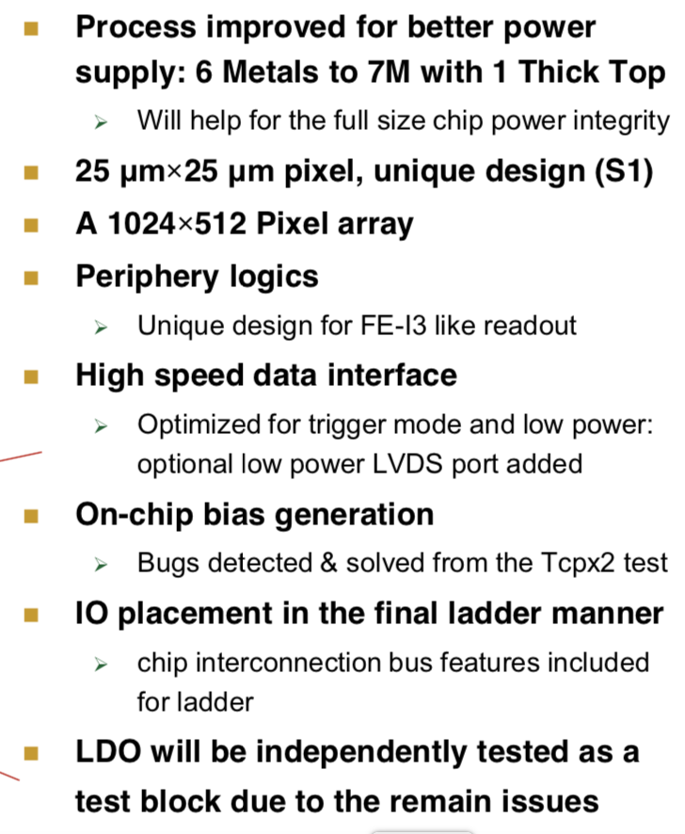
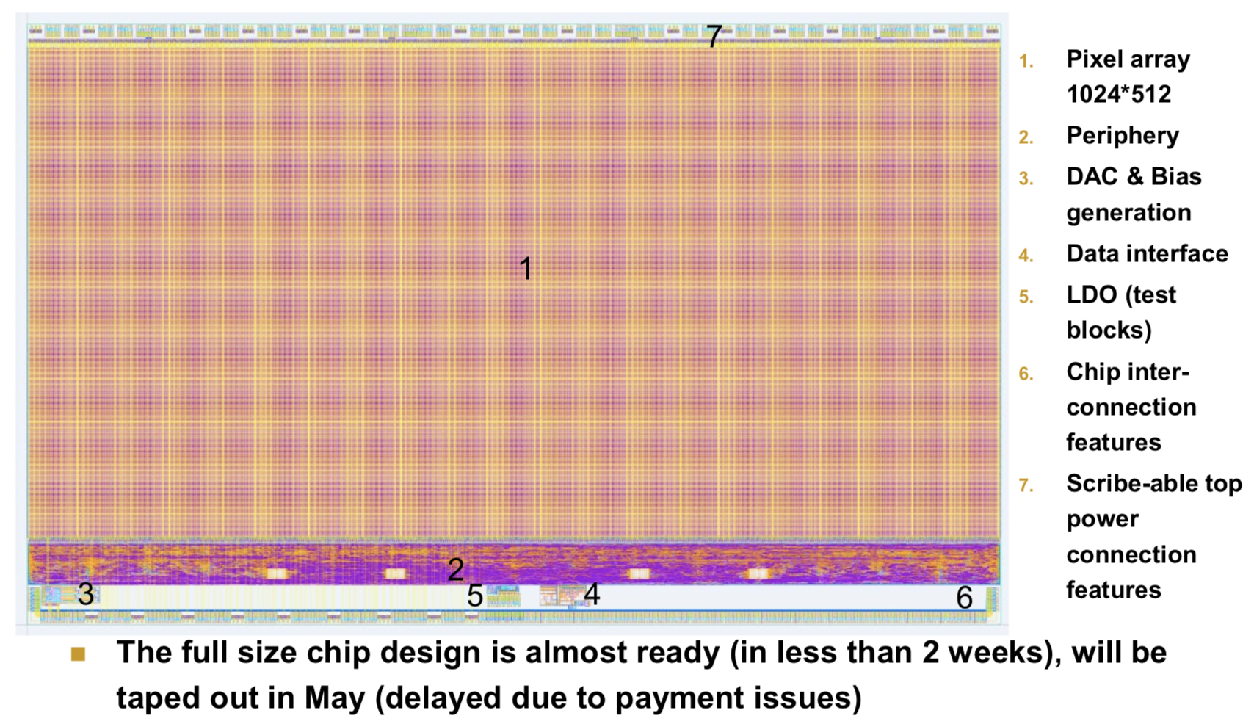
TaichuPix full-size sensor design status
Finalizing design of full-size sensor
  Plan to submit for engineering runs by middle of 2021
  Supply voltage and current from external input
    LDO is an independent test block , not ready for integration yet

Slide 20
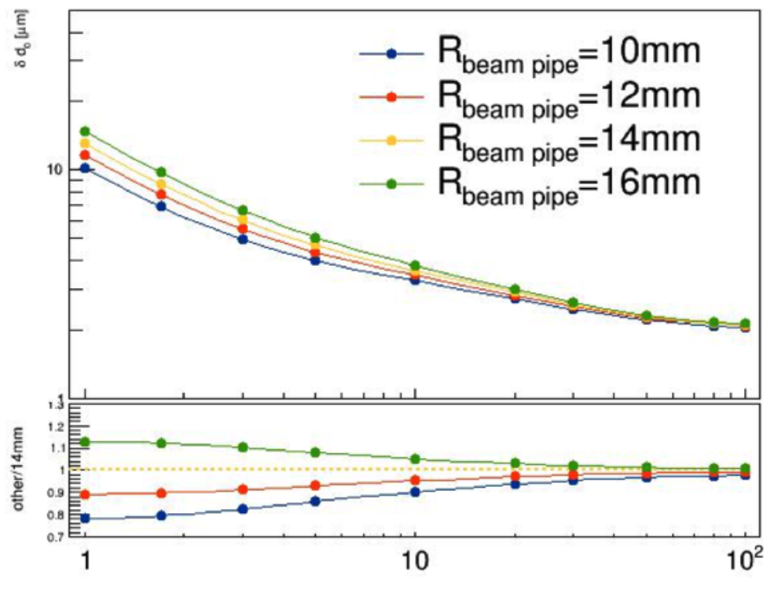
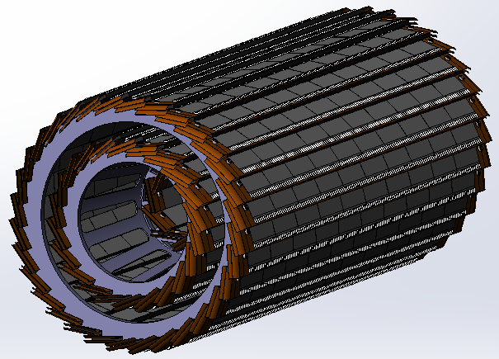
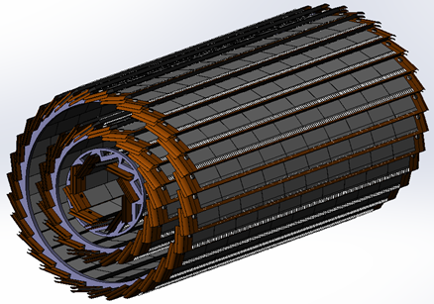
Vertex Detector Prototype R & D
Completed preliminary version of detector engineering design
  3 double layer barrel design
  7 modules in inner layer, 22 modules in 2nd layer, 32 modules in outer layer
Physics simulation to optimize vertex detector layout design.
  The length of inner layer pixel should be the same as other two layers
  Inner pixel radium should be as close to beam pipe as possible
Impact parameter resolution
Vs beam pipe radius
Old design
After optimization

Slide 21
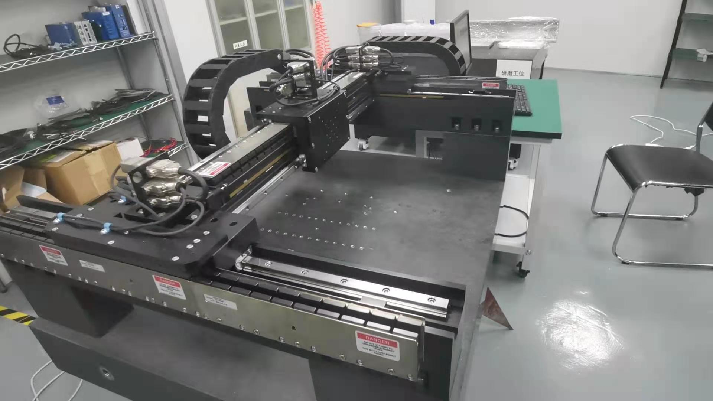
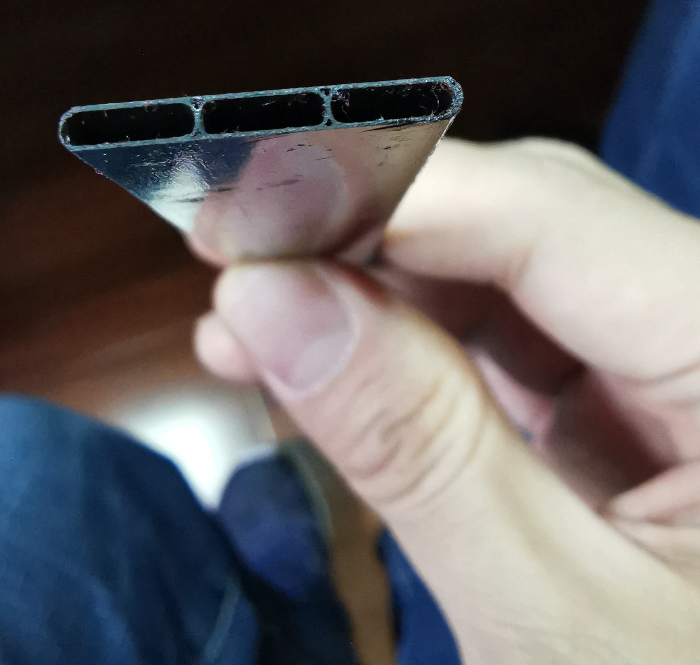
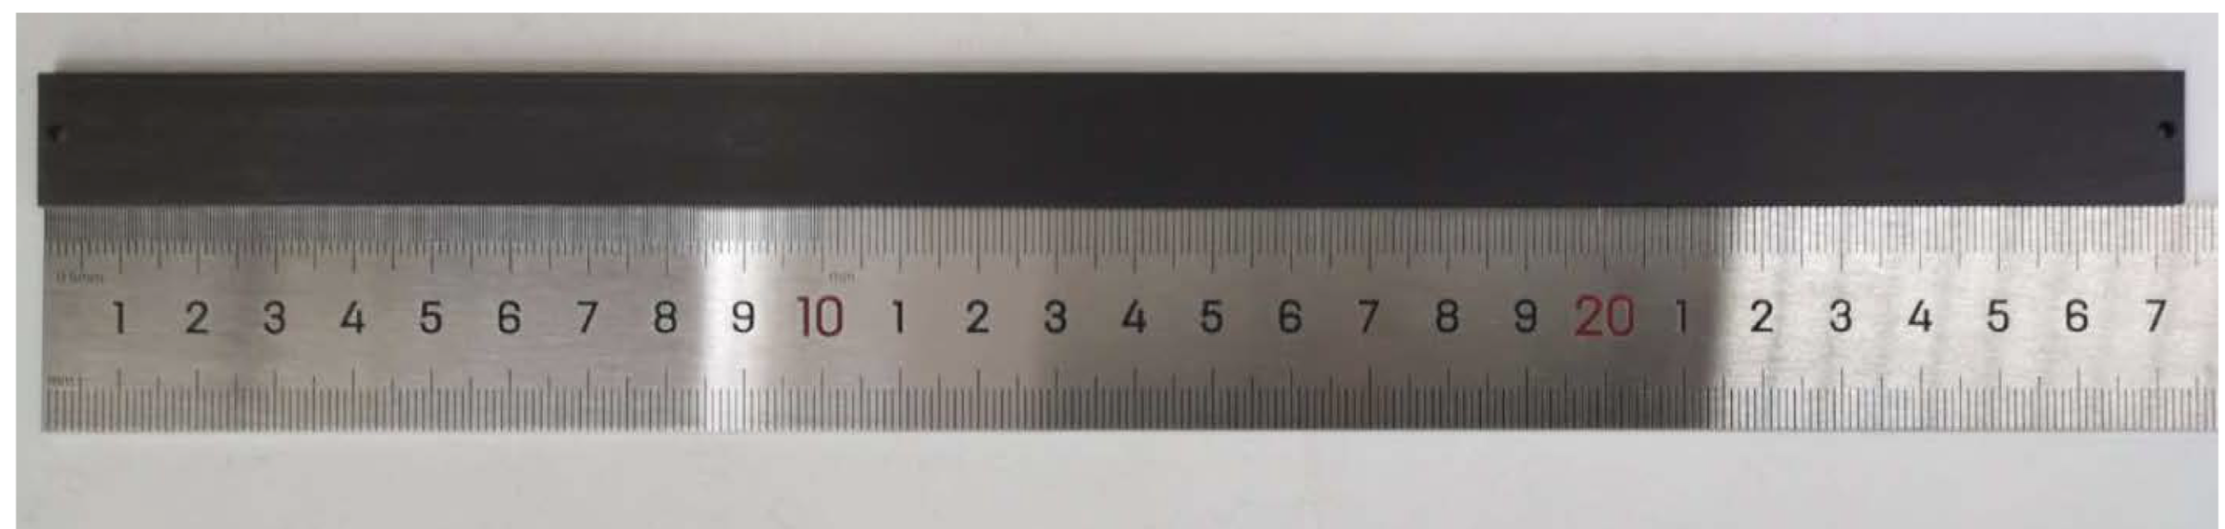
Support structure of the ladder
Fabricated first support structure prototype of the ladder:
  3 layer of carbon fiber, 0.15mm thick
  3 time thinner than conventional carbon fiber
R & D Gantry automatic module assembly.
Ladder support
prototype
Gantry automatic module assembly
samples of the full length ladder support prototype

Slide 22
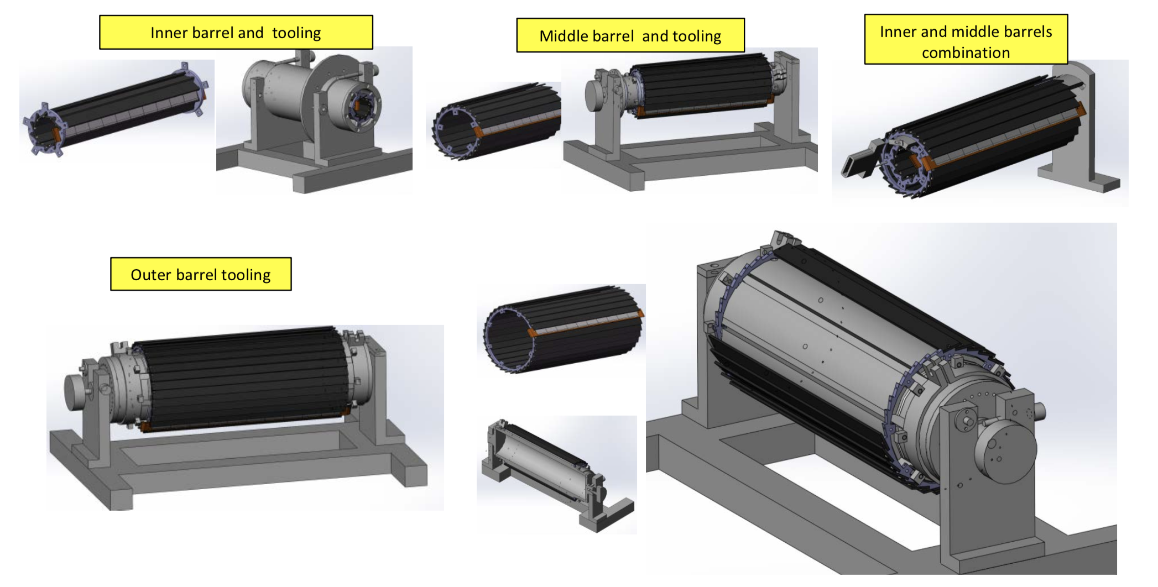
Tooling Design for Barrels Assembling
3 sets of tooling for 3 layer of barrel assembling.
Tooling and special tool for inner and middle barrels assembling.

Slide 23
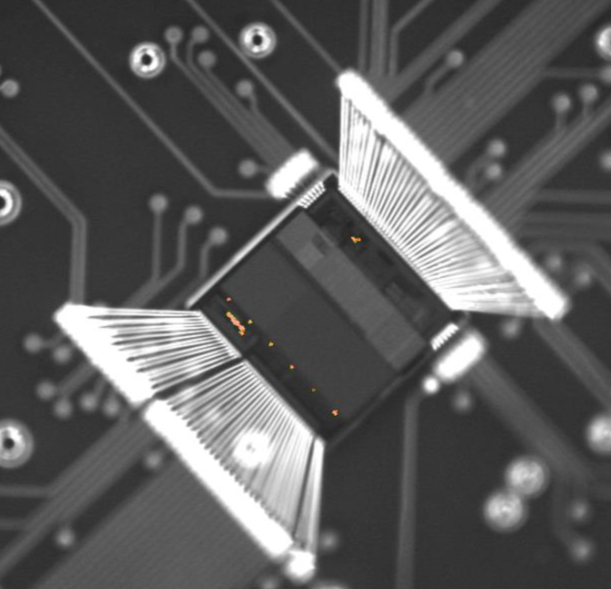
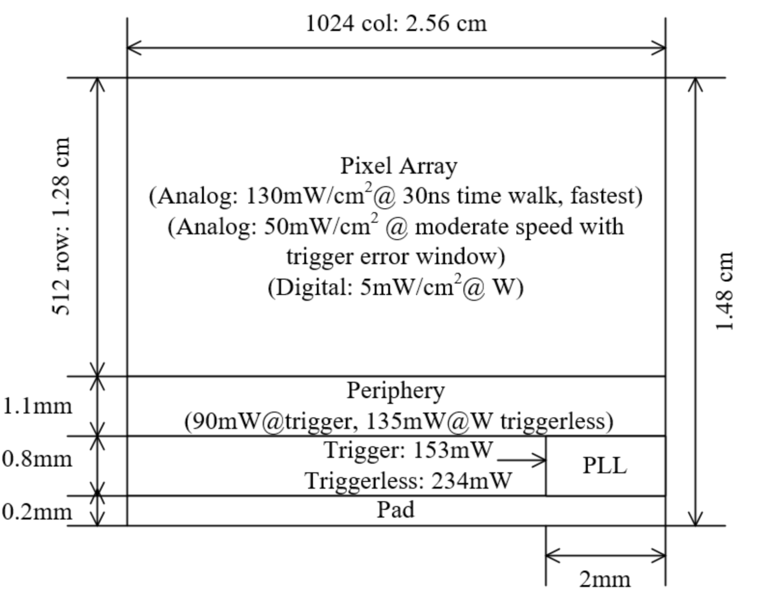
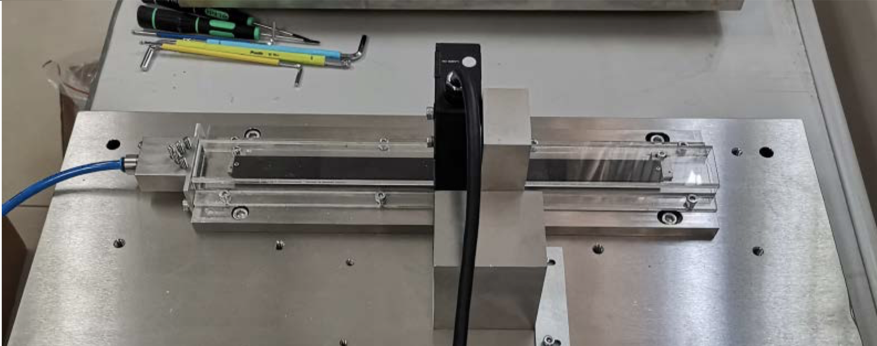
Cooling design
Air cooling is baseline design for CEPC vertex detector
Sensor Power dissipation:
  Taichupix : ≤ 150 mW/cm². (trigger mode)
  CEPC final goal : ≤ 50 mW/cm²
Cooling simulations of a single complete ladder with detailed FPC were done.
  Testbench setup has been designed and built for air cooling , vibration tests
The EMMI
(Emission Microscope)
For Taichupix2
Power consumption
Test setup prototype for ladder cooling
Use compressed air for cooling
Laser interferometer
Air flow
Ladder support

Slide 24
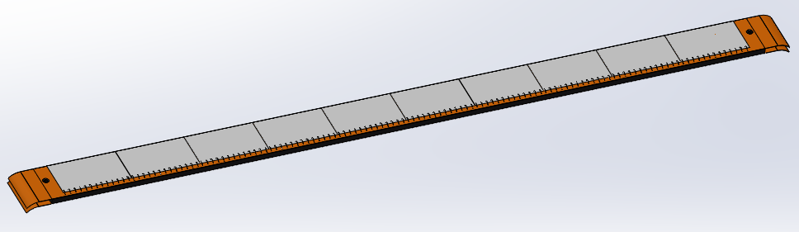
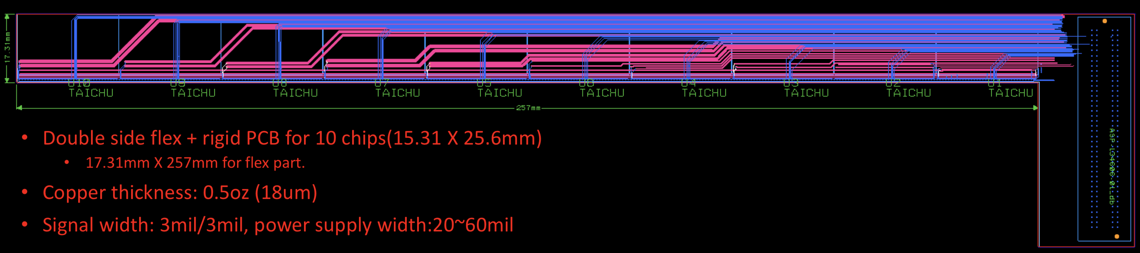
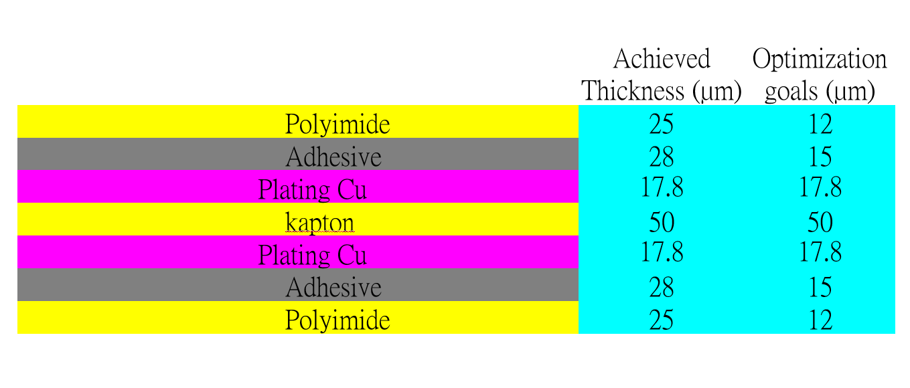
Detector module (ladder) R & D
Completed preliminary version of detector module (ladder) design
  Detector module (ladder)= 10 sensors + support structure+ flexible PCB+ control board
  Sensors will be glued and wire bonded to the flexible PCB
  Flexible PCB will be supported by carbon fiber support structure
  Signal, clock, control , power, ground will be handled by control board through flexible PCB
3D model of the ladder
Schematic of ladder electronics
Profile of flexible PCB
Design of Flexible PCB prototype

Slide 25
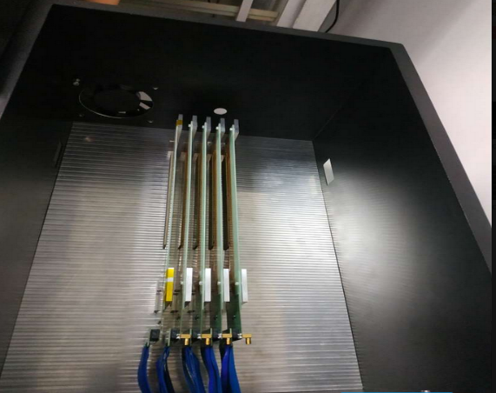
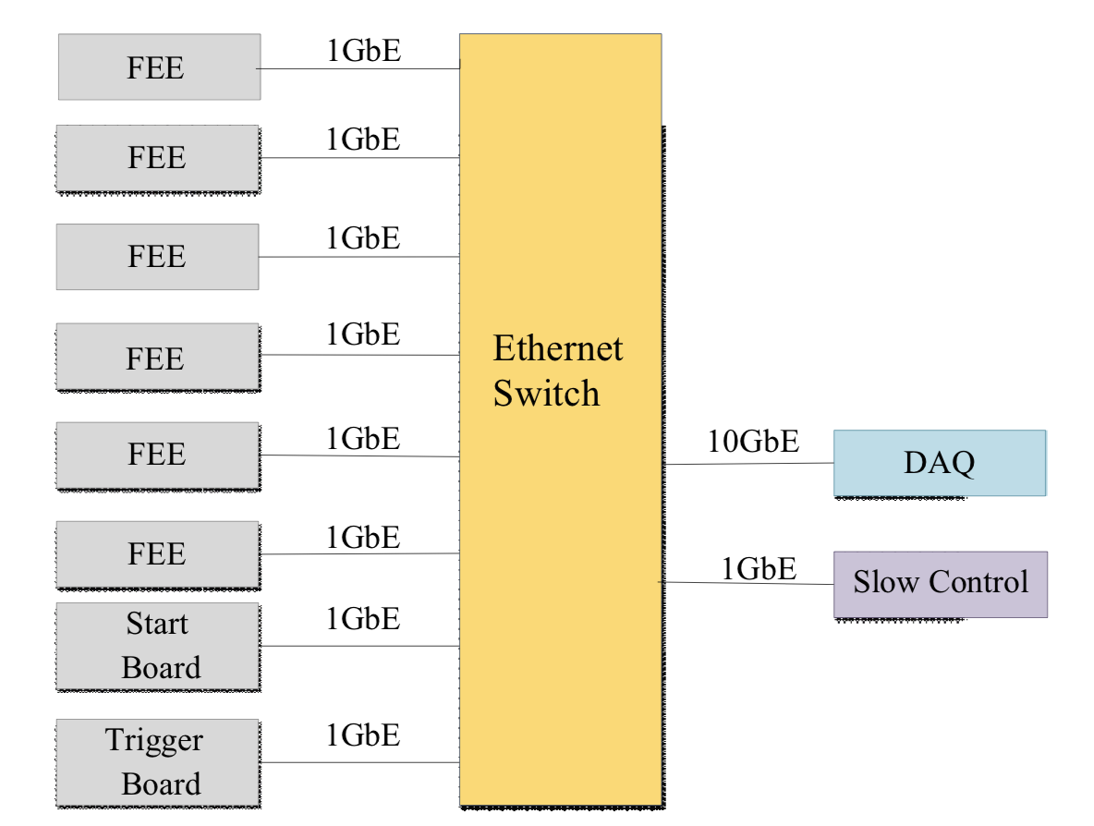

Data acquisition system
DAQ Tests with 5 MIMOSA chips
Preliminary design of data acquisition system(DAQ)
  Ladders are reader by readout boards
  All readout boards connected to computer through a switch
  User interface developed
  DAQ tested in five modules equipped with MIMOSA sensors
DAQ system data display
Tested with MIMOSA modules

Slide 26


Plan for test beam
Expect to perform beam test in DESY(3 - 7GeV electron beams)
  IHEP test beam facility as backup plan (a few hundreds MeV - 2.5GeV electrons )
Enclosure for detector with air cooling is developed for beam test
  Beam is shooting at one sectors of vertex detectors
Install one sector of ladder in vertex detector
Beam
Beam
Beam

Slide 27





Plan for test beam (2)
New opportunity in Beijing Synchrotron Radiation Facility (BSRF)
  High energy electron (1~2.5 GeV) leakage from BEPC
  High trigger rate (up to 50Hz/cm²)
  Can be used to vertex detector position resolution
Beam tests in BSRF

Slide 28
Risk
Risk: Impact of Cov-19
    → Limited impact for now :
      Manage to design the TaichuPix2 and full-size TaichuPix in time.
    → Expect larger impact to the future
      Testbeam at CERN or DESY will be limited (due to travel or acceciblility of CERN/DESY)
      Energy of electrons beam at IHEP is not high enough( 0.5GeV ~2.5GeV)
      → may not have 5μm resolution with low energy beam (due to multi-scattering effect)
Risk: May need another engineering run( risk for budget )
→ The first engineering run for full-size sensor will be submit in 1~2 months
In case it is not fully satisfactory , may need another engineering run (2M RMB)
No budget allocated for the second engineering run in this project.

Slide 29

Budget status
Implementation rate（执行率） is about 60% for first three years
Next major expense expected: Engineering run of full-size TaichuPix (~2M RMB)
Device fee: Gantry system will be available for automatic assembly in next 2~4 months

Slide 30

Outlook for the next year
  Competed R & D large area sensor
  Manufactured the support structure for whole detector
  Assembling and installing the detector prototype
  Completed DAQ system for whole detector

Slide 31
Summary
Progress of task 2 is as expected (按计划进行 ）
Sensor: Completed two round of CMOS sensor prototyping, finalizing full-size sensor design
  New readout architecture to reduce pixel size to 25μm*24μm
    → Reach midterm Assessment index (实现中期指标）
  First irradiation test up to 30 Mrad >1Mrad total ionization dose radiation
    → Reach final Assessment index (有望超额完成最终指标）
Mechanics: Build the support structure prototype for ladder
DAQ & readout electronics: initial design of flexible PCB and DAQ system
 | Mid-term | Final goal | Status
Spatial resolution | Pixel size less than 25*25 μm | Spatial resolution 3~5 μm | Reach mid-term goal
Radiation hardness | > 1MRad in simulation | >1MRad In radiation test | First test up to 30 Mrad. Chip is still functional

Slide 32

Test plans: from chip towards the ladder
df

Slide 33

Backup : Preparation for the full size engineering run
df

Slide 34

Backup : Preparation for the full size engineering run
df

Slide 35
Backup: International collaboration
IFAE(Spain): very active in CMOS Sensor design and testing
Liverpool (UK): Tracker mechanical design,
Oxford(UK): CMOS sensor design validation, thermal design
RAL(UK): Pixel module design
Queen Mary(UK): module mechanical design (Zero mass concept)
Strasbourg (FR): CMOS sensor design, Tracker mechanical design
University of Massachusetts (US): Tracker mechanical design, thermal design
  In 2019, we have one engineer visited Oxford and Liverpool for 4 weeks, learned a lots about silicon.

Slide 36


Main specs of the full size chip for high rate vertex detector
Bunch spacing
  CEPC Z+Higgs (240GeV): 680ns;
  WW threshold scan (160GeV): 210ns;
  CEPC Z pole runing (90GeV) Z: 25ns
High Hit density
  2.5hits/bunch/cm² for Higgs/WW runs
  0.2hits/bunch/cm² for Z pole running

Slide 37

New proposed readout architecture in TaichuPix
New readout architecture
→ reduce power consumption and reduce pixel size
CEPC readout time requirement:
  <500ns deadtime @40MHZ(Z pole)
Taichu-1 Column-drain readout
  Priority based data driven readout; time stamp at EOC
  Dead time: 2 CLK for each pixel (50ns @40MHz CLK)
  Two digital pixel designs: FEI3-like and ALPIDE-like design
2-level FIFO architecture
  L1: column level, to de-randomize injecting charge
  L2: chip level, to match in/out data rate between core and interface
Trigger readout:
  Coincidence by time stamp, matched event read out
df

Slide 38


Pixel Analog design
CEPC time stamping precision requirement:
  25-100ns, better to time stamping each collision at Z pole
Taichu-1 pixel analog design:
  50ns~150ns (based one standard CMOS MAPS tech.)
  Consider to use depleted CMOS MAPS

Slide 39

Backup: Ladder Mechanical testing
Detailed designs of platform and tooling for different test.
Static (different support and load cases)
Vibration and cooling + pressed air (different cases):
  Measure Deformation, temperature, air speed, flow rate, etc.
Goal: Measure vibration to 1μm level with air cooling with laser interferometer

Slide 40
Main specs of the full size chip for high rate vertex detector
Bunch spacing
  CEPC Z+Higgs (240GeV): 680ns;
  WW threshold scan (160GeV): 210ns;
  CEPC Z pole runing (90GeV) Z: 25ns
High Hit density
  2.5hits/bunch/cm² for Higgs/WW runs
  0.2hits/bunch/cm² for Z pole running

Slide 41

backup :
pixel threshold vs. TID
Mean threshold of a column vs. TID
pixel noise vs. TID
Mean noise of column vs. TID
Preliminary
  Good chip function and noise performance proved to 2.5 Mrad,

Slide 42

Backup:
Probed pixel pedestal vs. TID
S-curve of pixel (7, 120) in S1
Probed pixel amplitude vs. TID
S-curve of pixel (40, 120) in S3
  The threshold was initially set at the minimum level. After ~1 Mrad, the pedestal level was shifted to see noise floor in S-curves, so the threshold level was set higher.

Slide 43



Publications and International talks
Publication:
JINST 14 (2019) C12012
IEEE ICECS (doi: 10.1109/ICECS46596.2019.8965105.)
International conference talks:
  Joao Guimaraes Da Costa, CepC phys/detectors, Workshop on the Circular Electron-Positron Collider,EU Edition, April 15 - 17, 2019, Oxford, UK
  T. Wu , A full functional Monolithic Active Pixel Sensor prototype for the CEPC vertex detector, in proceeding of International Conference on Electronics Circuits and Systems, Nov. 27-29, 2019, Genova, Italy.
  Xiaomin Wei, High data-rate readout logic design for 1024*512 CMOS pixel array dedicated for CEPC experiment, International workshop on radiation imaging detectors, International workshop on radiation imaging detectors, July 2019, Crete, Greece
  Ying Zhang, Overview of the chip design for the MOST2 CEPC vertex project, Workshop on the Circular Electron-Positron Collider,EU Edition, April 15 - 17, 2019, Oxford, UK
  Wei Wei, Full size pixel chip for high-rate CEPC Vertex Detector，Workshop on the Circular Electron-Positron Collider,EU Edition, April 15 - 17, 2019, Oxford, UK

Slide 44


Task 2: Physics goal
Higgs precision measurement
  H → bb precise vertex reconstruction
  H → μμ (precise momentum measurement)
Main technology
  High spatial resolution technology → pixel detector
  Low-mass detector technology
  Radiation resistance technology
Need tracking detector with
high spatial resolution, low material

