Slide 1
R&D Progress of CEPC vacuum system
Ma Yongsheng, Dong Haiyi, Huang Tao, Wang Pengcheng, Liu Jiaming
4/22/2021

Slide 2
Contents
Introduction
R&D of RF shielding bellows
R&D of vacuum chambers
NEG coating inside of vacuum chambers
Summary

Slide 3
Targets from Most2
成果名称 | 成果 类型 | 考核指标² |  |  |  | 考核方式（方法）及评价手段⁴
 |  | 指标 名称 | 立项时已有指标值/状态 | 中期指标值/状态³ | 完成时指标值/状态
研制弯转真空盒、RF屏蔽波纹管和真空盒内表面镀吸气剂膜 | □新理论 □新原理 □新产品 □新技术 ■新方法 ■关键部件 □数据库 □软件 □应用解决方案 □实验装置/系统 ■工程工艺 □标准 □专利 ■论文 □其他 | 真空盒极限真空 | 5×10⁻¹⁰Torr | 设计指标：3×10⁻¹⁰Torr | 2×10⁻¹⁰Torr | 同行专家评审
 |  | 真空盒总漏率 | 5×10⁻¹⁰ Torr.L/s | 设计指标：3×10⁻¹⁰ Torr.L/s | 2×10⁻¹⁰ Torr.L/s | 同行专家评审
 |  | RF屏蔽波纹管接触力 | 125±50g | 设计指标：125±30g | 125±25g | 同行专家评审

Slide 4
Present status and problems
Targets of the finished and present status
Project | Targets of the finished | Present status | Remarks
The Leak rate of the vacuum chambers | 2×10⁻¹⁰Torr.L/s | 3×10⁻¹⁰Torr⋅L/s
The ultimate pressure of the vacuum chambers | 2×10⁻¹⁰ Torr | 2.5×10⁻¹⁰ Torr
The contact pressure of spring fingers for RF shielding bellows | 125±25g | 125±5g | Achieved
problems
There are no obvious problems found.

Slide 5
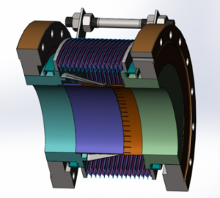
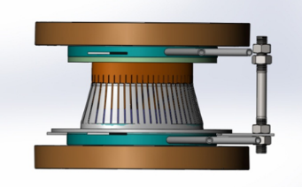
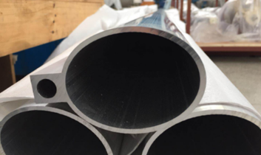
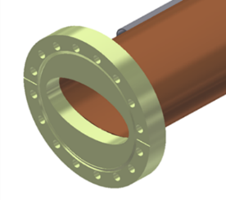
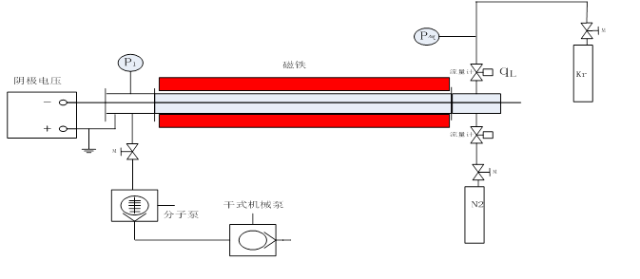
Introduction
Vacuum bellow modules are needed to compensate the mechanical misalignments of the vacuum chambers during installation and to absorb their thermal expansion during the bake-out. In order to reduce the beam impedance during operation with beams these modules are equipped with RF bridges to carry the image current.[1]
Aluminum chamber for electron ring, copper chamber for positron ring. Some technical challenges such as extrusion, machining and welding have been solved.
NEG coating coated inside of copper vacuum chamber is employed to suppress SEY. Setups have been built for a long vacuum chamber, and coating methods and parameters are being studied. The structure, composition, SEY and pumping speed of NEG film samples are measured.
[1]IPAC2015-WEPHA005

Slide 6
Progress of R&D of RF shielding bellows
Total length: 140 mm
Inner and exterior diameter of bellows: 125mm/140mm
Expansion/contraction: 5mm/12mm
Offset: 2 mm
Bending: 50 mrad
Above technical specifications have been reached.
Notes:
various types of vacuum bellow modules are needed to compensate the mechanical misalignments of the vacuum chambers during installation and to absorb their thermal expansion during the bake-out. In order to reduce the beam impedance during operation with beams these modules are equipped with RF bridges to carry the image current. They are usually made out of a copper tube insert at one side and Cu-Be RF fingers at the other end of the module. A spring is used to keep the contact between the RF fingers and the tube insert. The geometry and the choice of this spring become critical to ensure a good electrical contact.【1】
The electrical contact between the RF fingers and the tube insert depends on the geometry of both parts as well as on a spring, which assures the force to keep the contact [2] [3].
[1]IPAC2015-WEPHA005
[2] E. Metral et al., “Lessons learnt and mitigation measures for the CERN LHC equipment with RF fingers”, TUPWA042, IPAC’13, Shanghai, China.
[3] R. Veness et al., “Design aspects of the RF contacts for the
LHC beam PAC’01, Chicago, USA.

Slide 7
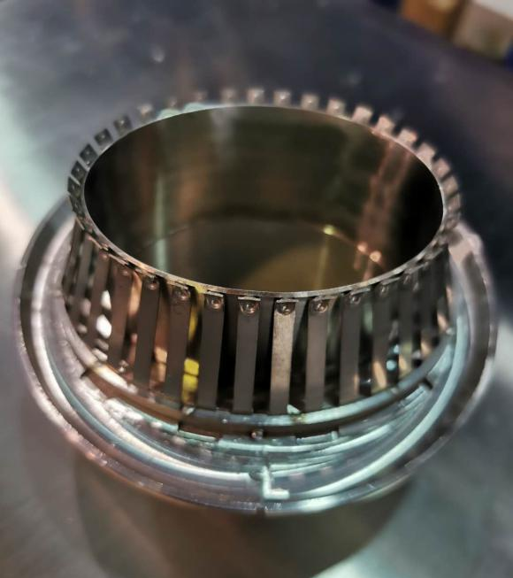
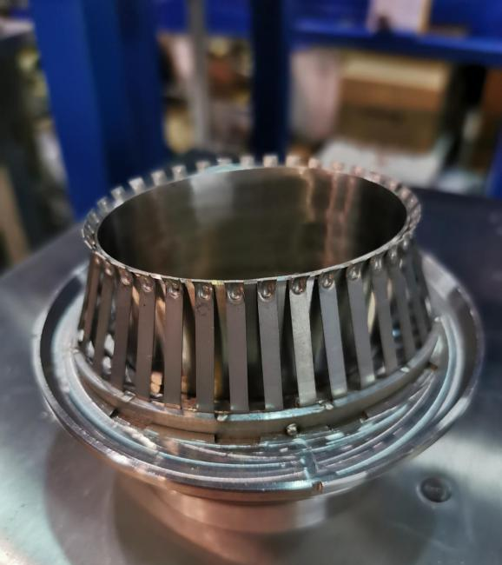
optimization of spring fingers
Contact force is determined by pre-bending angle of the contact fingers. Different pre-bending angles of 25°,26°,27°,31° have been tested which shows that 27°is best.
27°is chosen and which forces between the spring fingers and the contact fingers is uniformly from different fingers and is about 125±5g, which meets 125±25g.
Before weld
After weld
Notes:
1、弹簧指成型工艺
2、焊接工艺
根据近几次实验，确定了组合焊接工装以及弹簧指组件与端板的焊接方式，如图所示。
现阶段接触力测试结果：83-120g

Slide 8
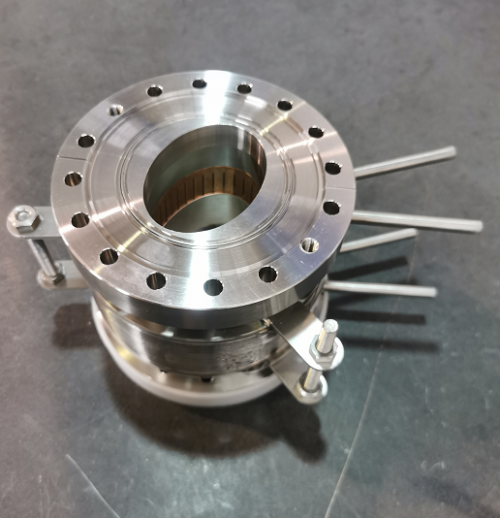
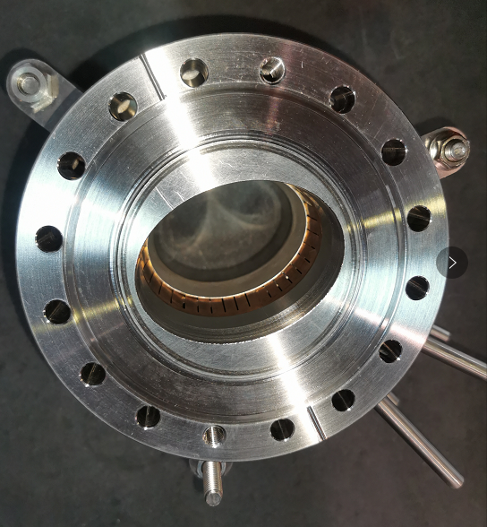
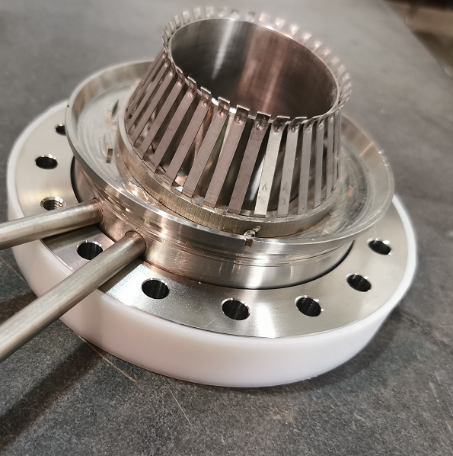
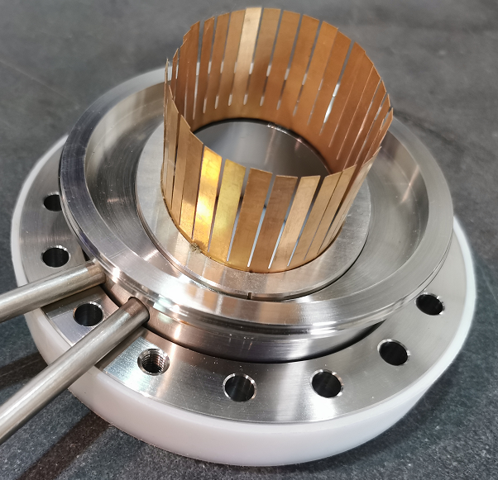
Porotype of RF shielding bellows
Porotype I：
Porotype II：
Contact force is uniformly from different fingers and meets the target of 125±25g. Two prototypes of RF shielding bellows have been fabricated

Slide 9
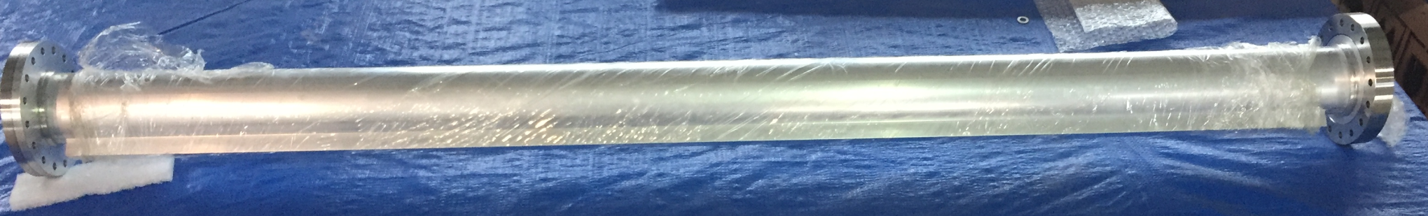
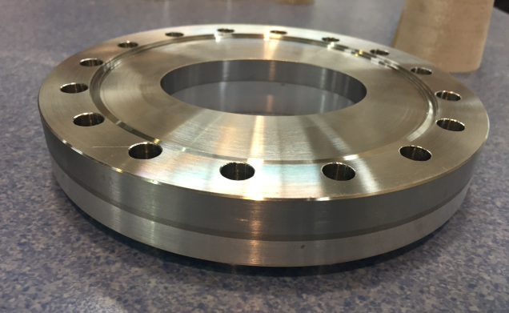
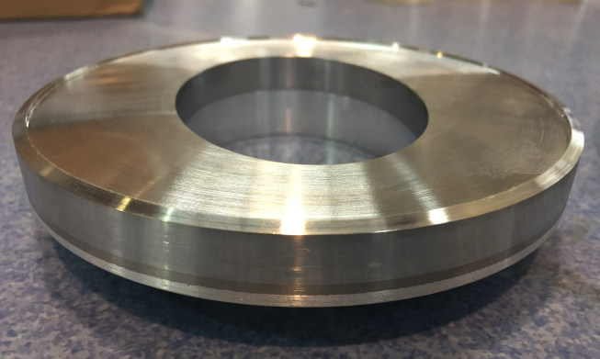
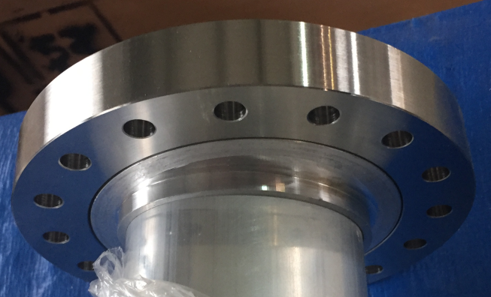
Progress R&D of Al vacuum chamber
Conflate flanges of S.S.-Al transition material
S.S.-Al transition plate are fabricated through explosion bonding in a domestic company.
Ultrasonic flaw detection is used before the flange will be machined.
Leak detection is carried out after the flanges has been machined.

Slide 10
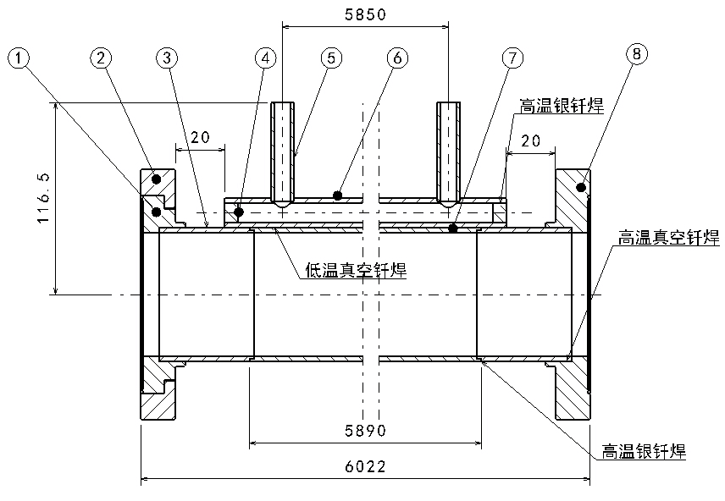
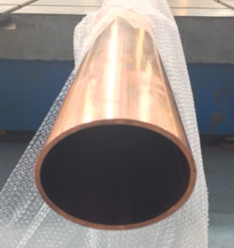
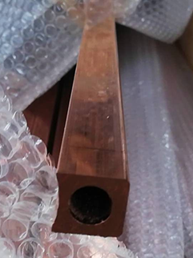
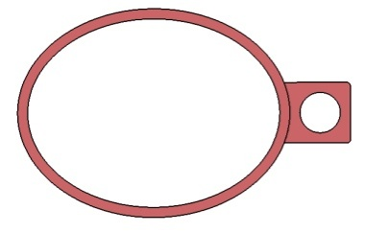
Progress R&D of Cu vacuum chamber
Cu beam pipe and water cooling channel are extruded respectively, and brazed together.
Stainless steel material is used for flanges, and there is a rotatable flange at an end of vacuum chamber.
The flanges and beam pipe are welded by high temperature brazing solder, and low temperature brazing solder are used between the beam pipe and water cooling channel as a 6 m long high temperature vacuum furnace is difficult to be found.
Vacuum chamber
Beam pipe +
Cooling channel
Notes:
过渡段铜管与正式段铜管采用火焰焊，氩弧焊也可以；基于强度考虑真空盒壁厚3mm；冷却水管采用低温钎焊防止高温引起退火，降低铜的强度；低温钎焊的温度是320℃（400℃ 焊料 也可以满足要求，暂时未采用）

Slide 11
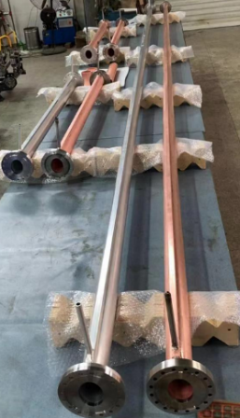
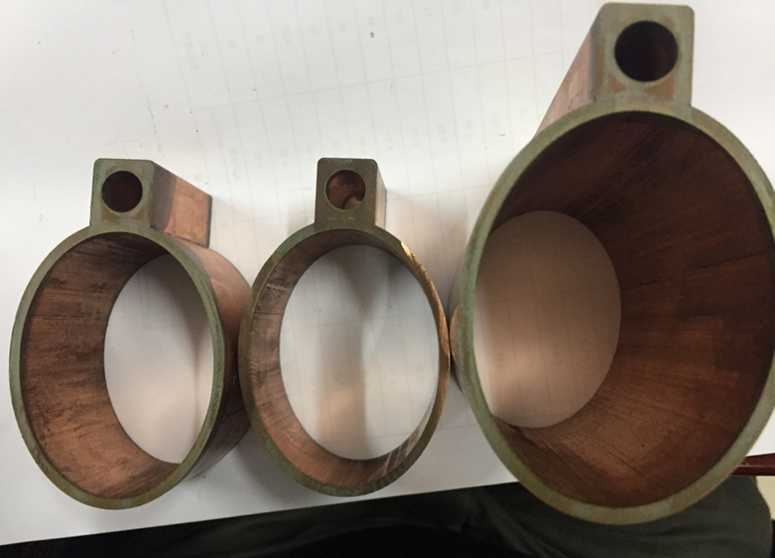
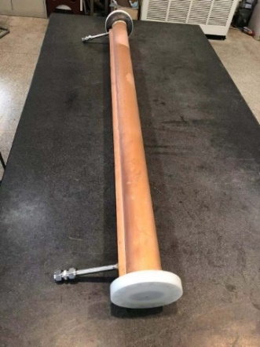
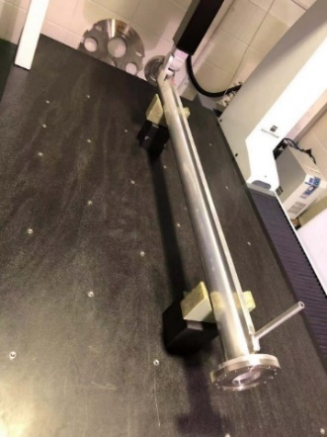
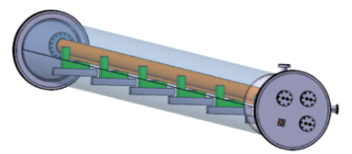
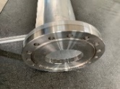
Cu and Al vacuum chamber prototypes
A 6 m long simple vacuum furnace is fabricated, which is used to weld the water cooling channels of Cu chambers through low temperature brazing solder.
The welding seams are checked by wire-electrode cutting. The welding joints are smooth and have good contacting.
The prototypes of copper & aluminum vacuum chambers with a length of 6 m have been fabricated and tested, which meet the engineering requirements.

Slide 12
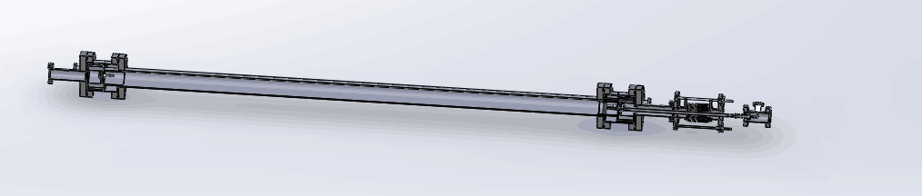
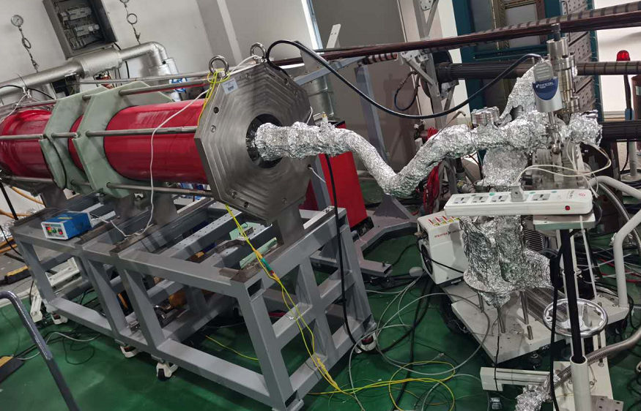
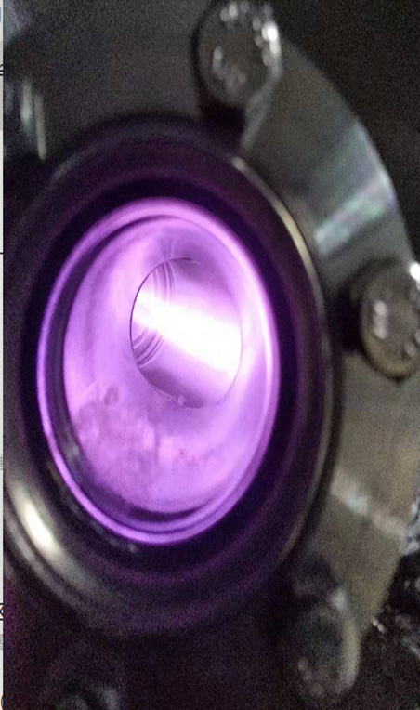
NEG coating
1.5m long vacuum pipe have been coated to explore the coating parameter at geometrical shape of 56×75.
Coating parameter | value
Magnetic(G) | 300
Substrate Temperature （℃） | 120
Vacuum of coating （Pa） | 1
Discharge current（A） | 0.4
Discharge voltage（V） | 300
Deposition time（h） | 10
Geometric diameter（mm） | 56×75×1500
NEG No. CF100-1500-0001

Slide 13
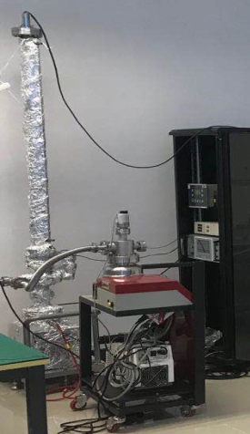
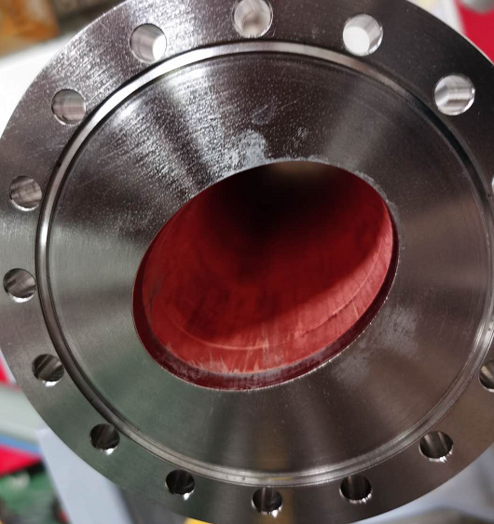
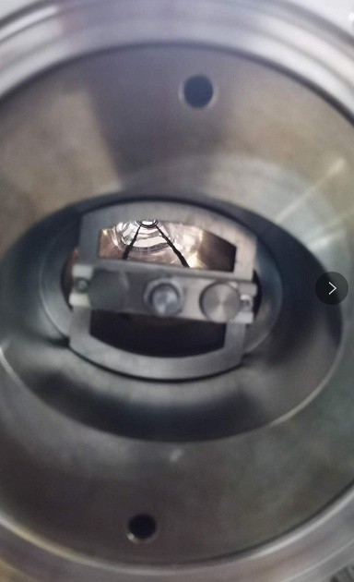
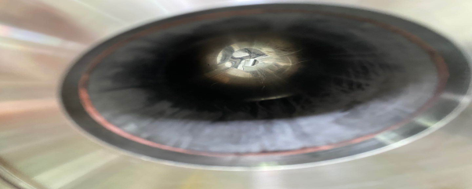
Ultimate vacuum test of NEG coating pipe
56×75×1500 NEG coating pipe:
180℃/24h activation 4.5×10⁻¹⁰ Torr
200℃/24h activation 2.5×10⁻¹⁰ Torr
Before coating
2 targets
After coating
Ultimate vacuum testing
Notes:
在东莞华远真空进行搭建性能测试场地，先期测量极限真空，后期具备条件后对氢气/CO进行抽速测试 （散裂实验室不能使用氢气/CO等危险气体）
1.5的样品管道，180℃/24小时激活，极限真空5.9-10mbar
1.5的样品管道，200℃/24小时激活，极限真空3.3-10mbar
镀膜工艺需要进一步优化

Slide 14
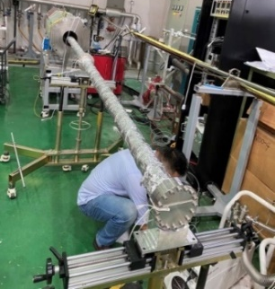
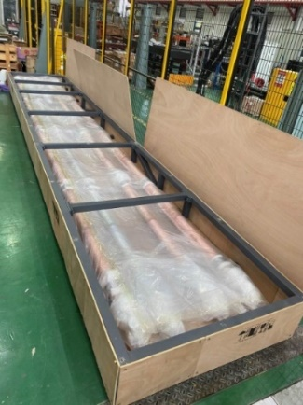
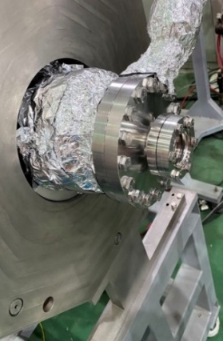
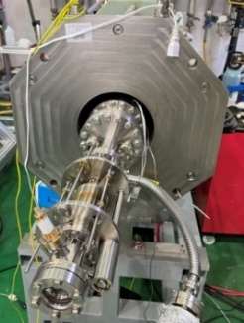
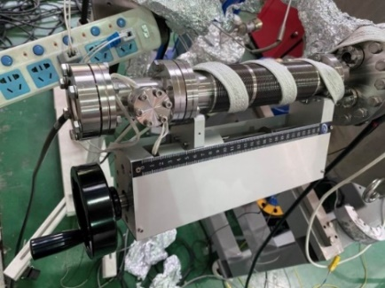
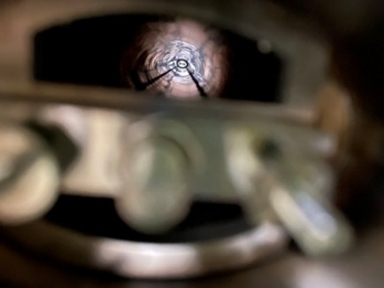
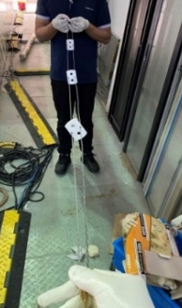
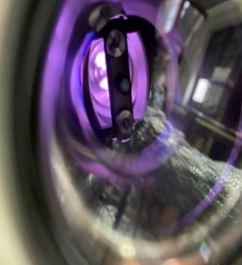
6 m vacuum pipe NEG coating
6 m vacuum pipe have been installed on the coating setup carefully, and there are two cathodes in it to uniform the thickness of film.
视窗位置
无支撑丝靶
调节波纹管优化
陶瓷支撑
Notes:
实验用6米和2米长椭圆截面铜管到货；
期间，采用双丝靶对椭圆截面2米长铜管镀膜进行了四次镀膜；
根据实验过程中遇到的问题对镀膜工装做了以下几点优化：
增加管道内部丝靶支撑，解决放电不稳易短路问题；
更换优化丝靶调节波纹管，便于预紧管内丝靶
优化视窗安装位置，直观观察放电 情况
改造之后镀膜系统能够实现稳定放电；

Slide 15
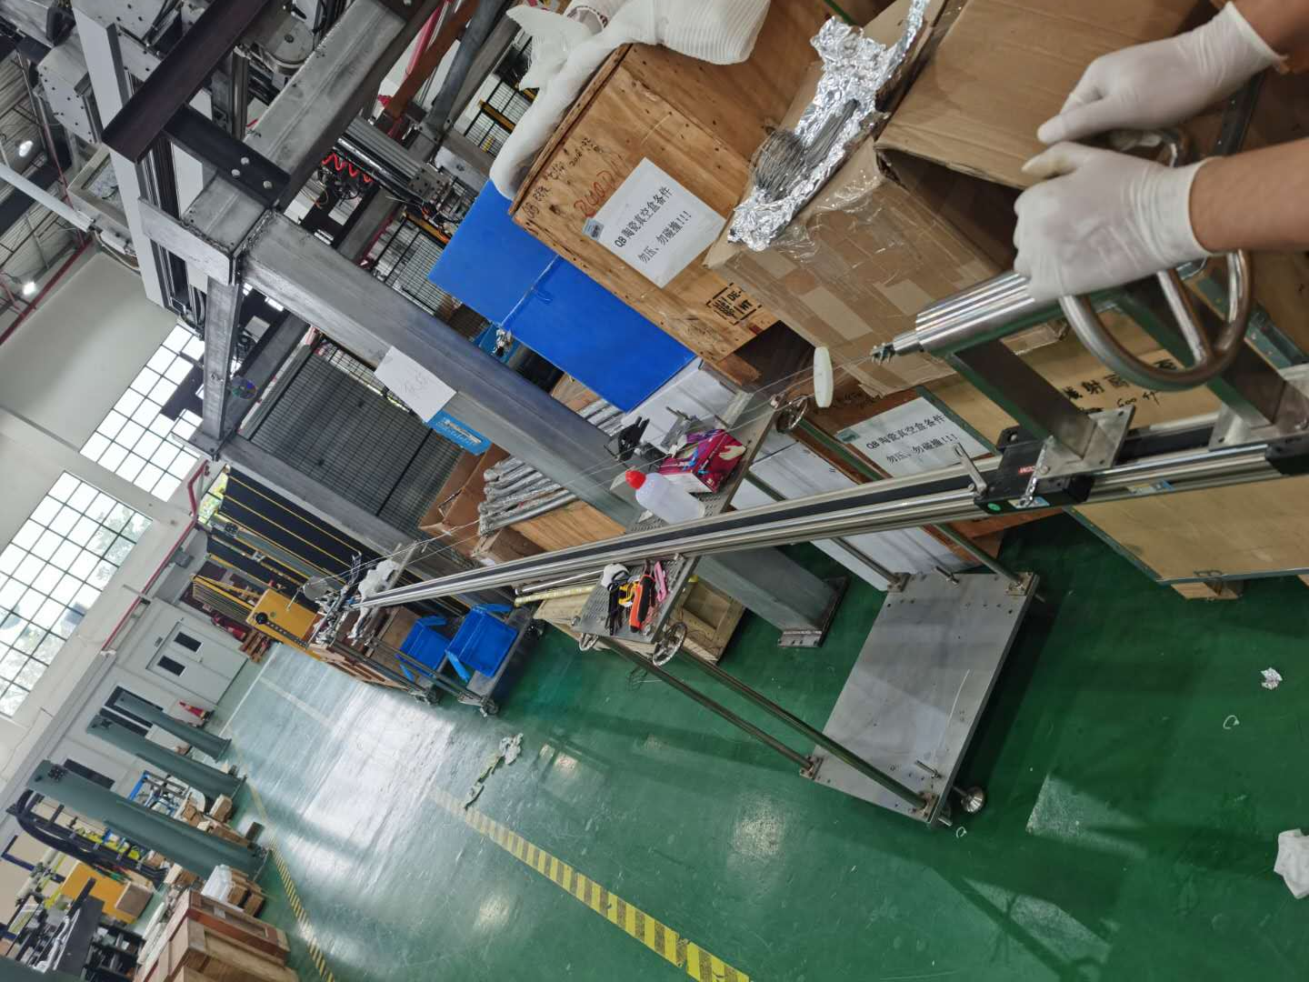
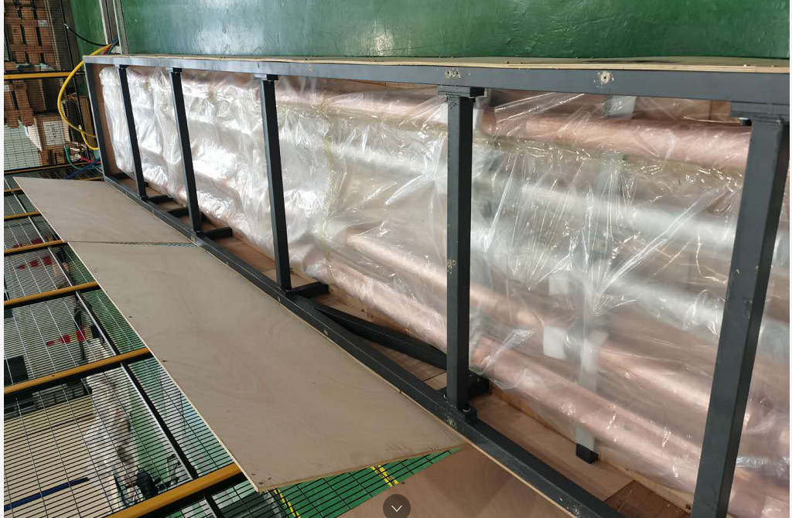
Preparation for NEG coating of 6 m pipe
Cathodes and vacuum pipes fabricated for NEG coating
It is very difficult to made a 6 m long cathode. The cathode were twisted by 3 wires of 1mm Ti, Zr ,V
Vacuum pipes will be degreasing, etching, passivation
Notes:
将3根外径1毫米的钛、锆、钒金属丝，绕制成一个6米的阴极靶丝
绕制过程中，克服了金属丝应力释放、绕制速度控制、金属丝缠绕等难题，成功绕制了2根6米的阴极靶丝
合肥科烨10月初将两个6米的试验管道，3根2米的短管道，清洗，抽真空，并发到东莞。
真空的6米管道，放置在合肥科烨，等待验收后发货

Slide 16
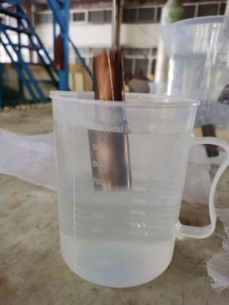
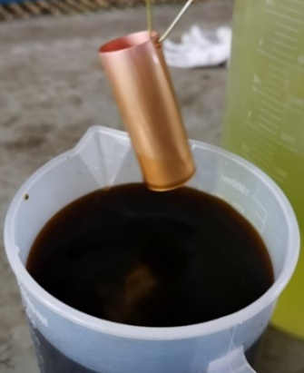
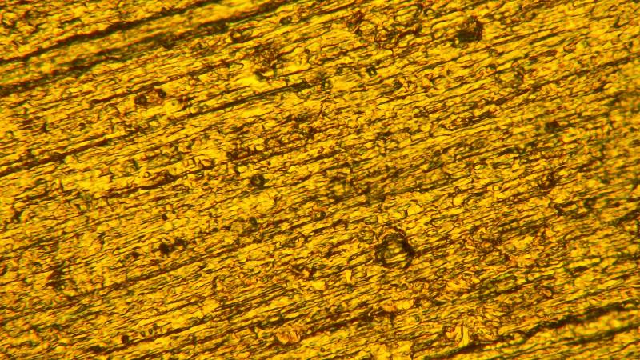
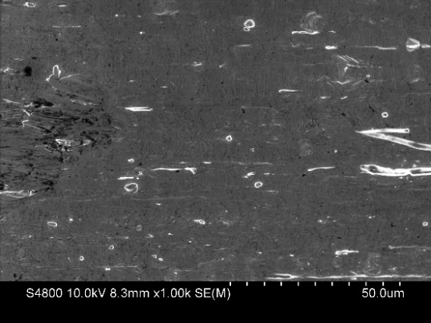

Preparation of Cu substrate for NEG coating
Vacuum pipes fabricated for NEG coating
5 um
etching
passivation
Vacuum pipes will be degreasing,
The content of oxygen decreases as depth of Cu surface
Notes:
Because of NEG coating, Preparation of Cu substrate is very important, which processing contains degreasing, etching about 30min to remove the oxidized layer of Cu surface, and the passivation by chromic acid to prevent oxidized again

Slide 17
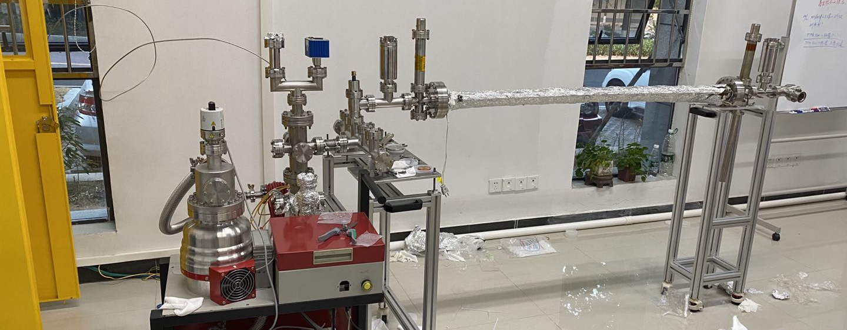
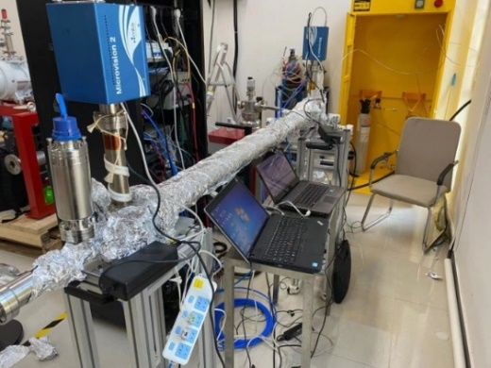
Pumping speed test setup in Dongguan
RGA2
RGA1
P2
P1
P3
氢气罐
小孔4mm
TMP
Rent one house from an enterprise near Dongguan, which can use H₂ and CO
Facility of pumping speed test have been finished
Currently, some tests have been carried out, and the platform hardware and test process need to be further optimized
Notes:
租用东莞周边一个企业的场地，可以使用氢气和CO
完成极限真空及薄膜抽速测试平台搭建
目前已进行了三次管道测试，平台硬件和测试流程有待继续优化

Slide 18
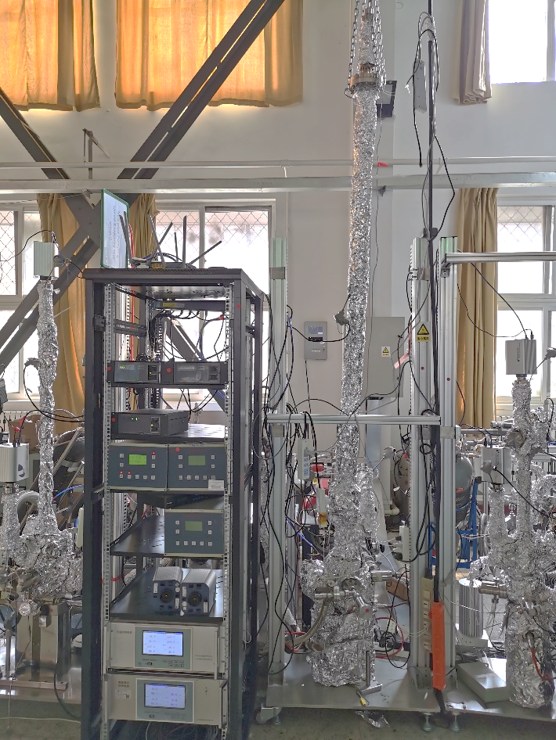
Pumping speed test of NEG coating
Pumping speed test of 2 meters long CEPC Cu pipe of NEG coating in Beijing

Slide 19
Next step
The prototypes of RF shielding bellows leakage and ultra vacuum will be tested.
6m long vacuum chambers will be coated and coating parameters need to be optimized, and ultra vacuum will be tested.
Surface treatment of copper vacuum chambers need to be done and optimized.

Slide 20
发表的文章与专利
发表的文章
马永胜，杨雨晨，景泳淼，孙飞，董海义， 何平，陈双凯，张志伟，陈子林， 杨馥羽，刘佰奇，张磊. 薄膜缺陷研究进展综述[J]. 表面技术，2021,50（3）
马永胜,张沛,董海义.超导高频铜腔镀铌研究进展[J].真空科学与技术学报,2020, 40(03):255-261.
Zhiwei Zhang, Yuchen Yang*, Yongsheng Ma, Xujian Wang, Baiqi Liu, Ping He. Deposition and characterization of Pd–Ti thin film by sublimation [J]. Radiation Detection Technology and Methods, 2020, 4(4): 465-71.
Yang Yuchen*, Ma Yongsheng, Chen Shuangkai, Qi Tiezhu, Peng Xiaohua, Dong Haiyi, He Ping. Aging effect of non-evaporable getter coatings [J]. Radiation Detection Technology and Methods, 2020, 4(3): 372-6.
申请或已获得的专利：
马永胜, 何平, 郭迪舟; 一种TiZrVHf四元吸气剂薄膜, 2020.01.10, 中国, CN108531877B （发明专利）
马永胜，黄涛,孙飞,刘佰奇,郭迪舟,何平 ,董海义;用于固定陶瓷的阴极丝固定绝缘加紧装置, 2021.02.05, 中国, CN 212476872 U （实用新型）
马永胜，孙飞,黄涛,刘佰奇,郭迪舟,何平 ,董海义;基于直流磁控溅射方法的狭缝镀膜装置, 2021.03.23, 中国, CN 212770928 U （实用新型）

Slide 21
Summary
The prototypes of copper & aluminum vacuum chambers with a length of 6 m have been fabricated and tested, which meet the engineering requirements. Surface treatment of copper is undertaking.
The key components experiments such as spring fingers and contact fingers have been carried out. Contact force is uniformly from different fingers and meets the target of 125±25g. The prototypes of RF shielding bellows have been fabricated.
2m long vacuum pipe have been coated to explore the coating parameter at geometrical shape of 56×75。 6m long vacuum chambers will be coated by moving the solenoid by a horizontal coating equipment .
There is no obvious problem could not be solved so far, all the studies of vacuum system is in plan.

Slide 22
Thank you！

