Slide 1
Progress of Prototype Dipole Magnet for CEPC Booster
Wen Kang
Annual Meeting on Apr. 22-23th
IHEP, 2021

Slide 2
Contents
Specifications and subscale prototype magnets
Design of the full-scale prototype CT coil dipole magnet
Production of the full-scale CT coil dipole magnet
Design of the field measurement system
Next stage working plan
Summary

Slide 3
Specifications and subscale prototype magnets
Main Specifications of CEPCB dipole magnets
 | BST-63B
Quantity | 16320
Minimum field (Gs) | 28
Maximum field (Gs) | 338
Gap (mm) | 63
Magnetic Length (mm) | 4700
Good field region (mm) | 55
Field uniformity | 0.1%
Field reproducibility | 0.05%

Slide 4
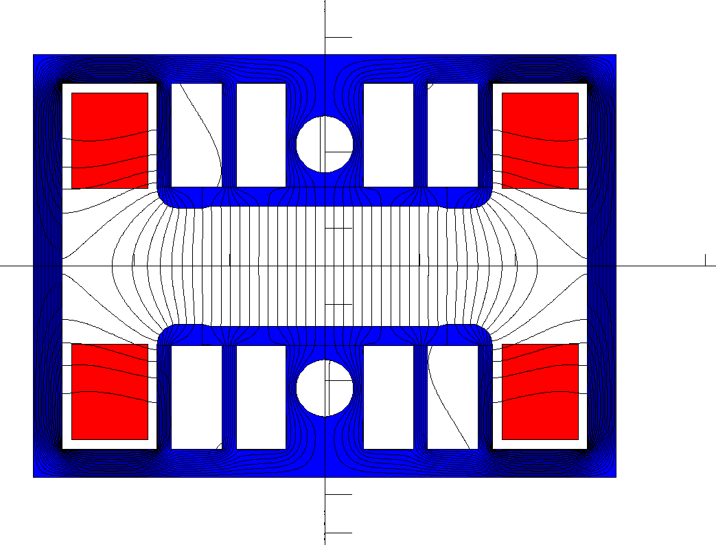
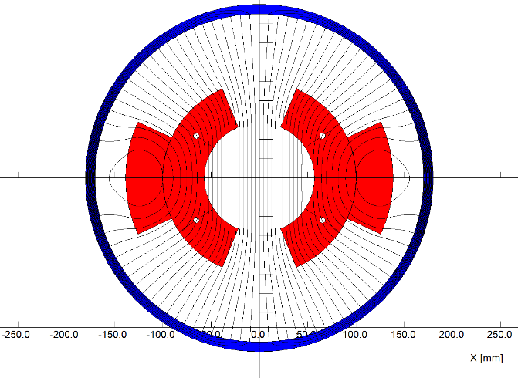
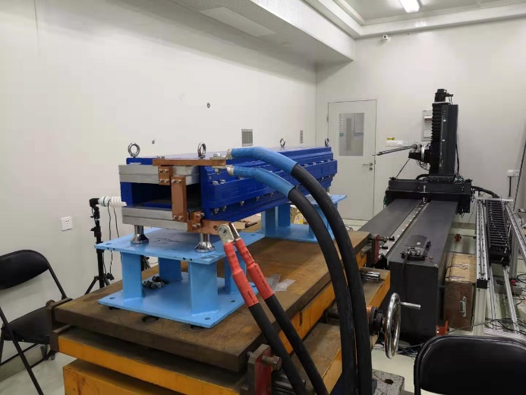
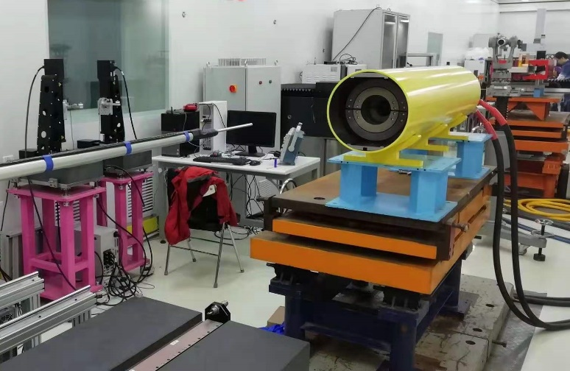
Specifications and subscale prototype magnets
In the past years, two kinds of the subscale prototype magnet with and without iron cores have been designed and developed. The low field performance of the magnet without iron cores could meet the requirements whereas the magnet with iron cores could not due to remnant field.

Slide 5
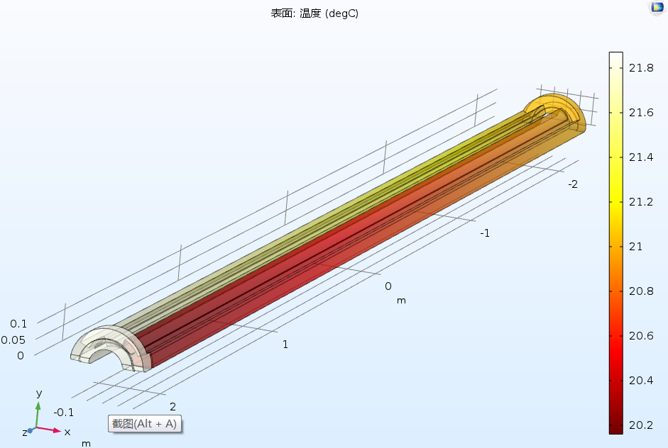
Design of the full-scale prototype CT coil dipole magnet
On the base of good performance for the subscale prototype CT dipole magnet, the mechanical design of a full scale prototype CT dipole magnet was finished. The production of the magnet on the way.
The total length of the magnet including the shielding tube is 5.1m.
The coil conductors will be made from pure aluminum, the cooling tubes will be inserted between the inner conductors to decrease temperature rise.
The touch resistance of the contacted surfaces of the conductors will be reduced by the coated silver films.

Slide 6
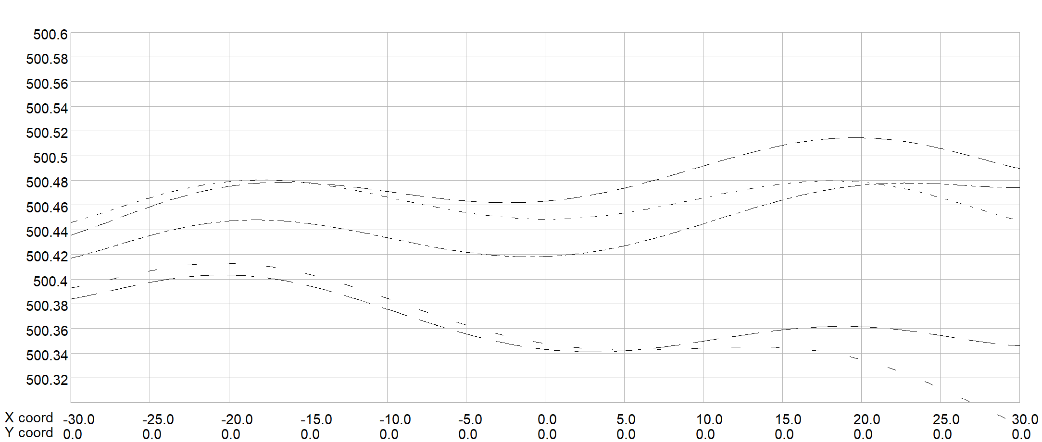
Design of the full-scale prototype CT coil dipole magnet
The CT coil magnet is composed of the upper and lower coils, each coil is formed by three conductors. The size and position tolerance of the conductors are the key factors for the precision of the field.
The field simulation shows,
The tolerance of size dimension for all conductors should be less than 0.05mm.
The position tolerance of the conductors should be less than 0.1mm in 4.7m longitudinal direction.

Slide 7
Design of the full-scale prototype CT coil dipole magnet
Each conductor is 4.7m long, for a good electrical connection, it is designed to be directly fabricated from a long aluminum bar, which will need large machining and surface anodizing facility, so the cost will be very high.

Slide 8
Design of the full-scale prototype CT coil dipole magnet
In order to reduce the production cost, the 4.7 long conductor is considered to be divided into 2 or more parts for convenient fabrication and then assembled together. Each part of the conductor can be precisely extruded and forged, the touch surface of the connection will be coated with the silver film to reduce the contact resistance.

Slide 9
Design of the full-scale prototype CT coil dipole magnet
To control the size and position precision of the conductors, the supporters every 415mm in longitudinal direction are fabricated and assembled in the shielding tube. The supporters at the connections of the conductors will have larger supporting surfaces to provide enough tightening forces.

Slide 10
Design of the full-scale prototype CT coil dipole magnet
After the coil conductors are produced, the whole assembly of the magnet will be done in the shielding tube, which can be opened into upper and lower parts. The positions of the shielding tube that support the supporters of the CT coils will be carefully and precisely machined.

Slide 11
Design of the full-scale prototype CT coil dipole magnet
The lower coil can be directly assembled in the lower half of the shielding tube, but the upper half coil should be assembled in the assembling tooling firstly, then be rotated 180 degree and put on the lower coil. At last, the upper half of the shielding tube will be assembled with the lower one by the same assembling tooling.

Slide 12
Design of the full-scale prototype CT coil dipole magnet
The designed parameters of the full-scale CT coil dipole magnet
Max. field (Gs) | 492 | Inner radius of inner coil(mm) | 57
Min. field (Gs) | 28 | Outer radius of inner coil (mm) | 100
Gap (mm) | 63 | Outer radius of outer coil (mm) | 138.46
Magnetic length (mm) | 4700 | Angle of inner coil(°) | 67.5
GFR (mm) | 55 | Angle of outer coil(°) | 24.8
Max. NI/pole(A) | 5160 | Resistance(mΩ) | 0.95
Min. NI/pole (A) | 288 | Max. power loss(W) | 2800
Turns/pole | 3 | Avg. power loss(W) | 1120
Max. current(A) | 1720 | Diameter of tube(mm) | 340/360
Min. current(A) | 96 | Weight of magnet(ton) | 1.4

Slide 13
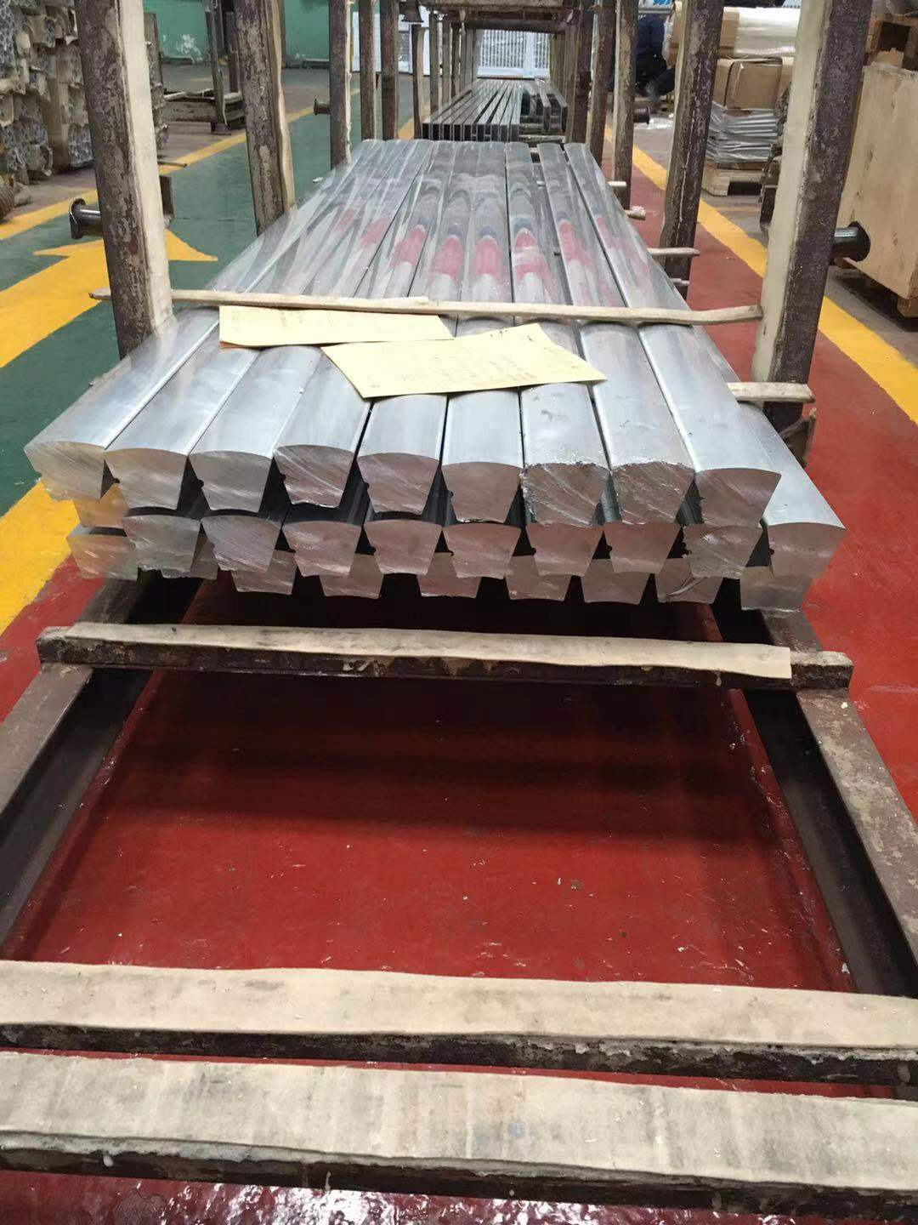
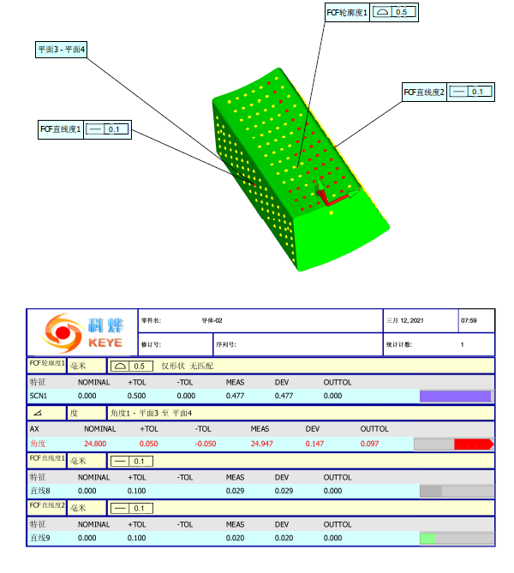
Production of the full-scale CT coil dipole magnet
The processing design of the magnet production was reviewed, 2.5m long conductor bars were roughly extruded, but the fabrication precision can not meet the requirements. So the bars will be pressed and extruded again to reduce the fabrication errors. The other components of the magnet are on the manufacture.

Slide 14
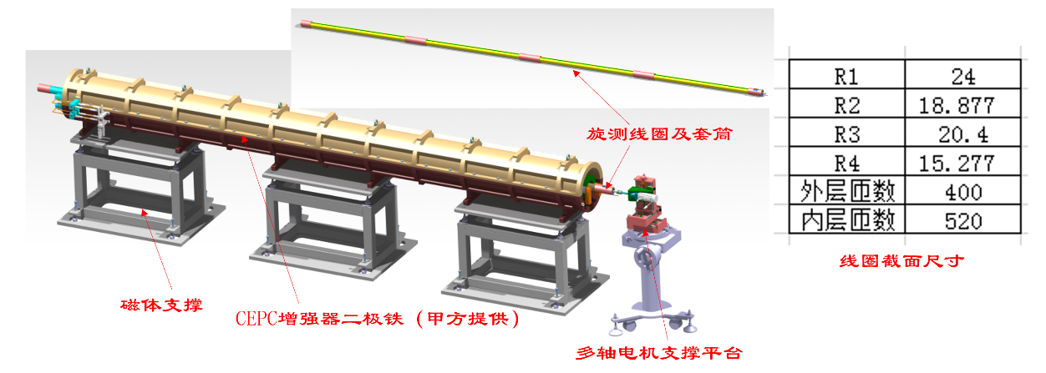
Design of the field measurement system
A 5.6m long rotating coil field measurement system will be used to measure the field of the full-scale CT magnet, it is composed of
1、Long coil
2、Motor and Driver
3、Encoder
4、Motor control
5、Signal acquisition device

Slide 15
Design of the field measurement system
The structure of the long rotating coil
The total length of the coil is 5.6m, which is installed in a supporting tube.
Since it is very difficult to manufacture a 5.6m long rotating coil, so the long coil will be assembled with 4 sub-coils. Each sub-coil is 1130 mm long, the connection components between the sub-coils are 250mm long.
The connection components have the self centering and self tightening structure, which can ensure the 4 sub-coils coaxial each other.

Slide 16
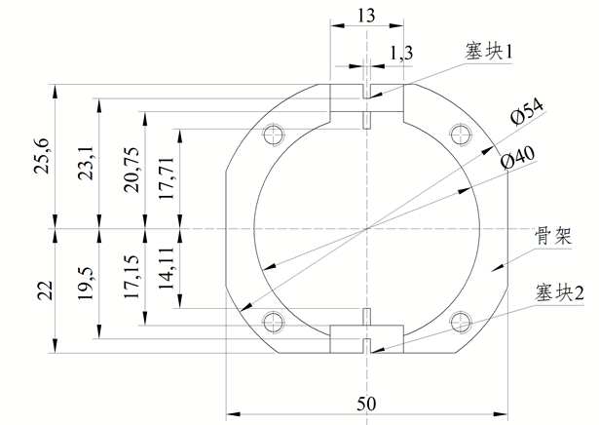
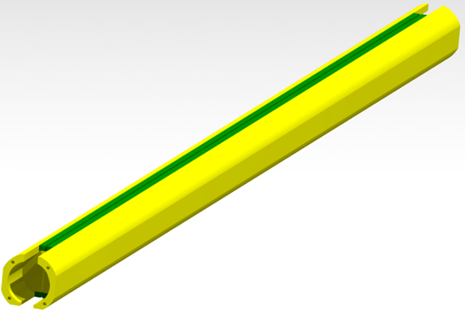
Design of the field measurement system
Each sub-coil has a main coil and bucking coil. The coil frame is made of G10 with a diameter of 54mm and the 20 strand enameled wire is selected to wind the coils.
Straightness of the coil frame is required to be less than 0.1mm. Position errors of the coils are required ≤± 0.02mm.

Slide 17
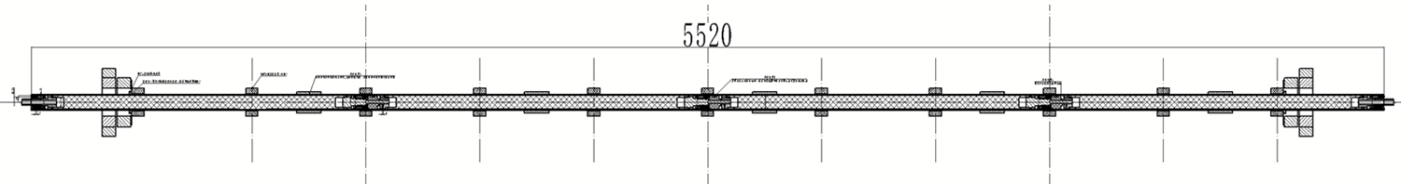
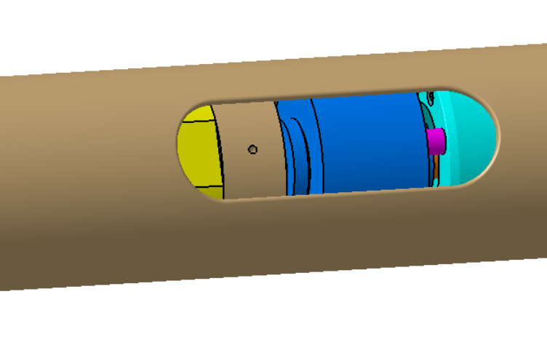
Design of the field measurement system
1
2
3
4
Slip ring
The signal wires of each sub-coil are led out from the supporting tube by a ceramic slip ring, and then the lead wire is led out of the magnet along the outer surface of the supporting tube.
The field of the magnet in different longitudinal positions can be measured by the 4 sub-coils respectively, and the field of the whole magnet can be measured by connecting the signals in series.

Slide 18
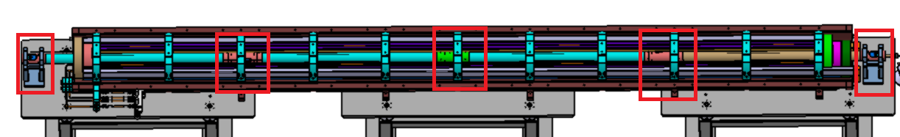
Design of the field measurement system
For installing the rotating coil, de-assemble and move the upper half magnet, put the coil on the 3 inner supporters of the lower half magnet and 2 auxiliary supporters at two ends, and then re-assemble the upper half magnet.
The coaxiality between the magnet and rotating coil will be ensured by the mechanical precision of the touch surfaces between the supporters and the rotating coil.
两端辅助及抗扭支撑
磁铁G10支撑
长线圈支撑套筒

Slide 19
Next stage working plan
In the Aug. of 2021, complete the fabrication of the full scale CT coil prototype dipole magnet.
In the same time, design and set up the field measurement system for the full scale magnet.
In Oct. of 2021, complete the test of the full scale prototype dipole magnet.
In Dec. of 2021, make the field quality of the magnet meet the specifications by modifying and improving the structure of the magnet.

Slide 20
Summary
Two kinds of the subscale prototype magnet with and without iron cores have been designed and developed. The performance of the CT coil dipole magnet without iron cores could meet the requirements.
On the basis of the experience of the subscale prototype magnet, the full-scale CT dipole magnet has been designed and the components of the magnet are on the production.
The rotating coil field measurement system is designed and developed to measure the field specifications of the full-scale prototype dipole magnet.
The magnet and its field measurement system will be finished in July.

Slide 21
Thank you for your attention.

