Slide 1
Status of Z-pole Beam Polarization Study
Zhe Duan
On behalf of CEPC Beam Polarization Working Group
2021. 04. 22

Slide 2
Outline
Introduction
Progress since mid-term
Summary

Slide 3
Outline
Introduction
Progress since mid-term
Summary

Slide 4
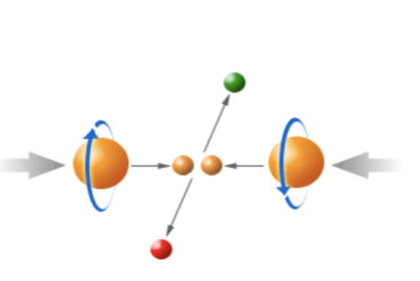
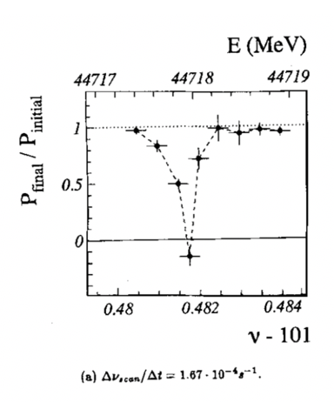
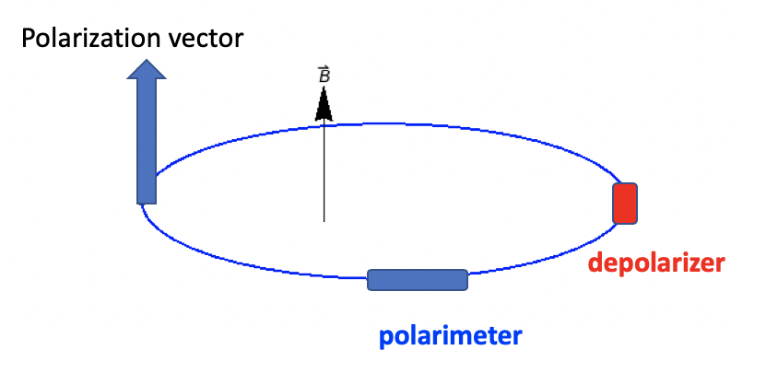
Motivation of CEPC Z-pole polarized beam program
Vertically polarized beams in the arc
  Beam energy calibration via the resonant depolarization technique
  Essential for precision measurements of Z and W properties
  At least 5% ~ 10% vertical polarization, for both e+ and e- beams
Longitudinally polarized beams at IPs
  Beneficial to colliding beam physics programs at Z, W and Higgs
  Figure of merit: Luminosity * f( Pe+, Pe- )
  ~50% or more longitudinal polarization is desired, for one beam, or both beams
L. Arnaudon, et al., Z. Phys. C 66, 45-62 (1995).
Final deliverable: a detailed design report of polarized beam operation @ Z-pole

Slide 5
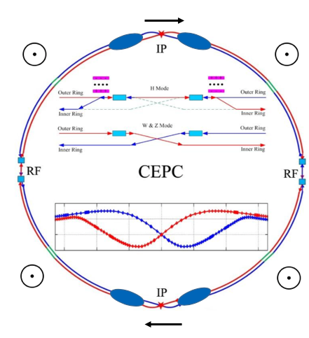
Wish list and key questions
Wish list
  A small fraction of non-colliding bunches with at least 5% vertical polarization in the arc, depolarize one-by-one to carry out resonant depolarization measurements
  All colliding bunches have > 50% time-averaged longitudinal polarization at IPs
  Luminosity is not significantly affected
  Beam lifetime is sufficient long so that top-up injection is feasible
Spin rotators
Key questions
  How to polarize the beams?
  How to adjust the polarization direction?
  How to reach a high luminosity, a high polarization and a reasonable beam lifetime?
Asymmetric wigglers
depolarizer
polarimeter

Slide 6
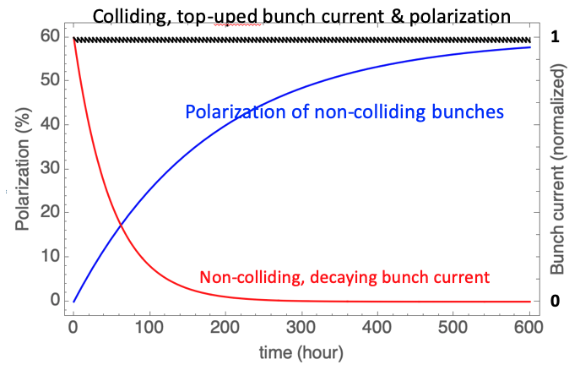
How to polarize the e+/e- beam?
 | Non-colliding bunches | Colliding bunches
Beam lifetime | 20~100 hours, a high bunch current is not necessary | ~2 hours
Injection frequency | Every 20~100 hours | Top-up injection, every ~ 10 seconds
Evolution of beam polarization | Exponential build-up Time scale ~ several hundred hours | Saw-tooth near the level of injected beam polarization
Usage | Resonant depolarization | Colliding beam experiments
Method to realize desired beam polarization | Use asymmetric wigglers to reduce self-polarization build-up time | Inject polarized beam

Slide 7
Basic operation scenario
Baseline assumptions:
  The injector can supply polarized e- beam (>50%), and unpolarized e+ beam
  Resonant depolarization requires a bunch polarization > 5%
Inject ~100 unpolarized non-colliding beams
Turn-on asym. wigglers to boost self-polarization
Turn-off asym. wigglers
Replenish one decayed unpolarized non-colliding bunch ~ every hour
Resonant depolarization
Resonant depolarization measurements
~2 hours
~10 min
Time of operation
Colliding beam
experiments
Top-up injection
~10 seconds
Inject ~ 12000 polarized e- and unpolarized e+ bunches
Start colliding beam experiments
each fill could last many hours
Unless hardware failure occurs

Slide 8
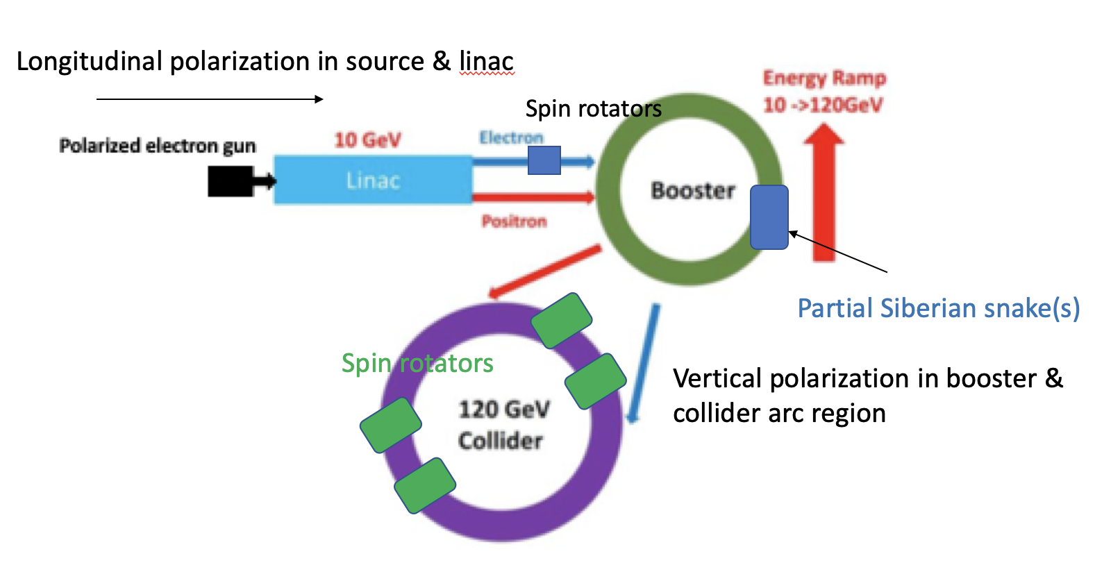
Injector chain to supply polarized beams
Parameters of CEPC polarized electron source
Gun type | Photocathode DC Gun
Cathode material | Super-lattice GaAs/GaAsP
HV | 150-200kV
QE | 0.5%
Polarization | ≥85% (90%???)
Electrons/bunch | 2×10¹⁰
Repetition rate | 100Hz
Drive laser | 780nm (±20nm), 10μJ@1ns
Parameter | ILC(TDR) | CLIC(3TeV) | CEPC
Electrons/microbunch | 2×10¹⁰ | 0.6×10¹⁰ | >0.94×10¹⁰
Charge / microbunch | 3.2nC | 1nC | 1.5nC
Number of microbunches | 1312 | 312 | 1
Macropulse repetition rate | 5 | 50 | 100
Average current from gun | 21μA | 15μA | 0.15μA
Polarization | >80% | >80% | >80%

Slide 9
Outline
Introduction
Progress since mid-term
Summary

Slide 10
Where we are now?
  Key items in Z-pole beam polarization design
  Design of the operation scheme for resonant depolarization-based energy calibration (mid-term indicator, done)
  The realization condition of beam polarization > 50% are simulated (mid-term indicator, done)
  Design of spin rotators for the collider ring (expected to be delivered by end of 2021)
  Design of Siberian snakes for the booster ring (expected to be delivered by end of 2022)
  After mid-term, we are focusing on
  Extensive simulations of the equilibrium beam polarization at Z-pole and beyond
  Design and optimization of spin rotators in the collider rings

Slide 11
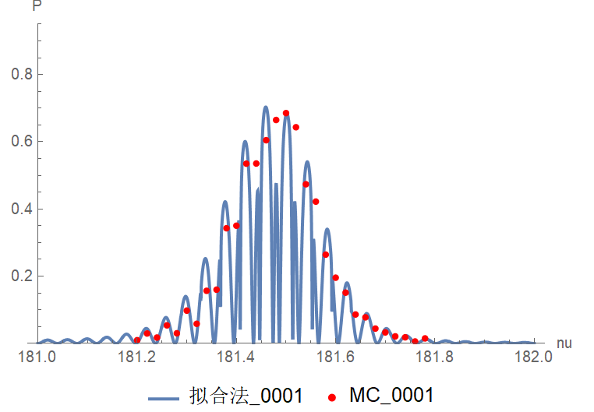
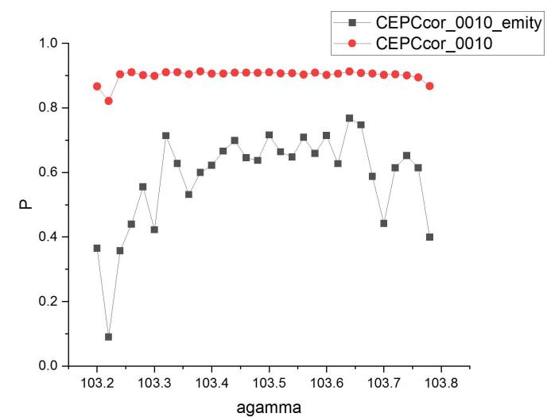
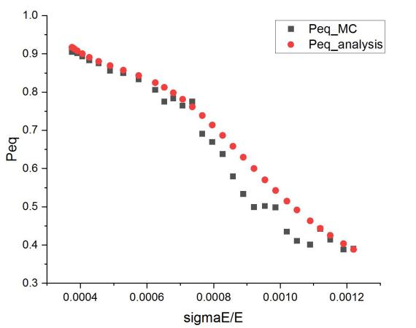
Simulation of the equilibrium beam polarization
There are still some open questions in the theories, measurements and simulations of beam self-polarization in the ultra-high energy domain
  We converted realistic imperfect CEPC lattices after correction from SAD to BMAD/PTC
  Compared Monte-Carlo simulation results against the results of analytical formula from a simplified model
  Studied the dependence of equilibrium beam polarization on various parameters, like vertical beam emittance, beam energy spread, beam energy, synchrotron tunes …
  These studies help deepen the understanding of, a journal paper is in preparation.
45GeV, Polarization vs energy spread
via asymmetric wigglers
80GeV, MC vs analytical
45GeV, Polarization vs vertical emittance

Slide 12
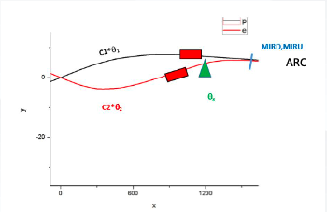
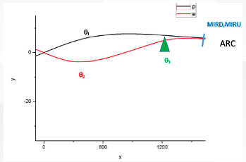
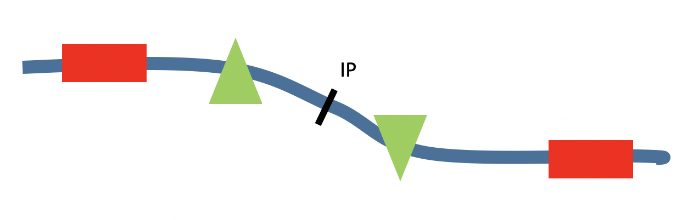

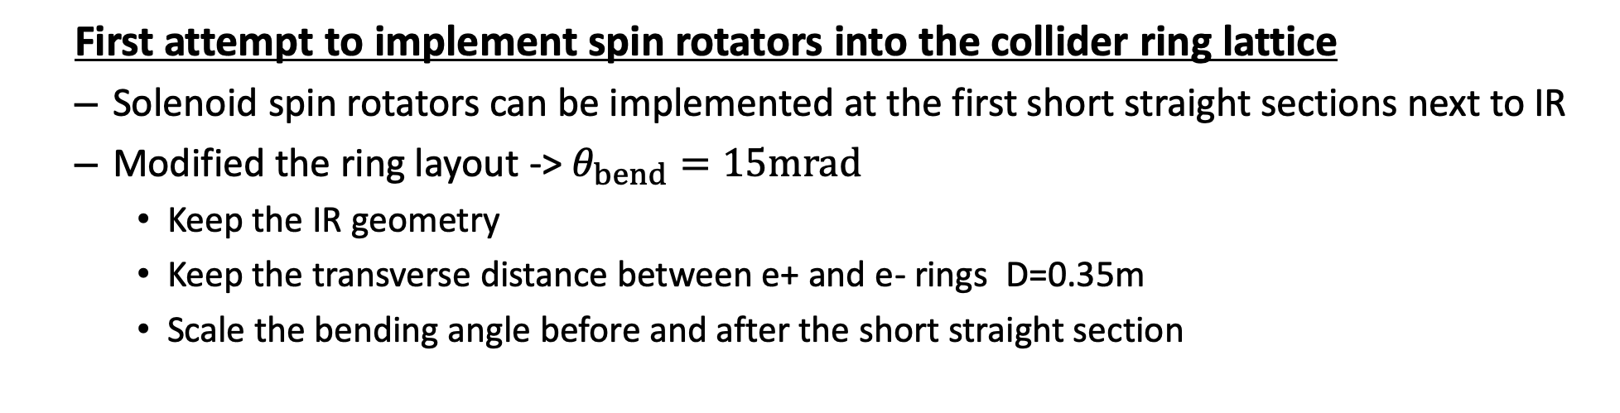
Spin rotators in the CEPC CDR lattice
  First attempt to implement spin rotators into the collider ring lattice
  Solenoid spin rotators can be implemented at the first short straight sections next to IR
  Modified the ring layout -> $θ_{bend}=15mrad$
    Keep the IR geometry
    Keep the transverse distance between e+ and e- rings D=0.35m
    Scale the bending angle before and after the short straight section

Slide 13
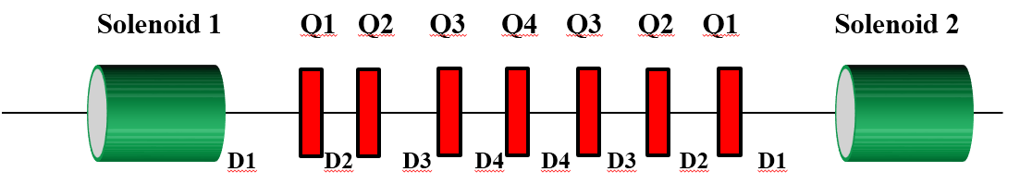
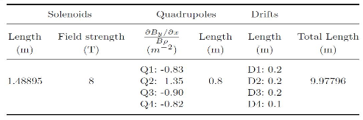
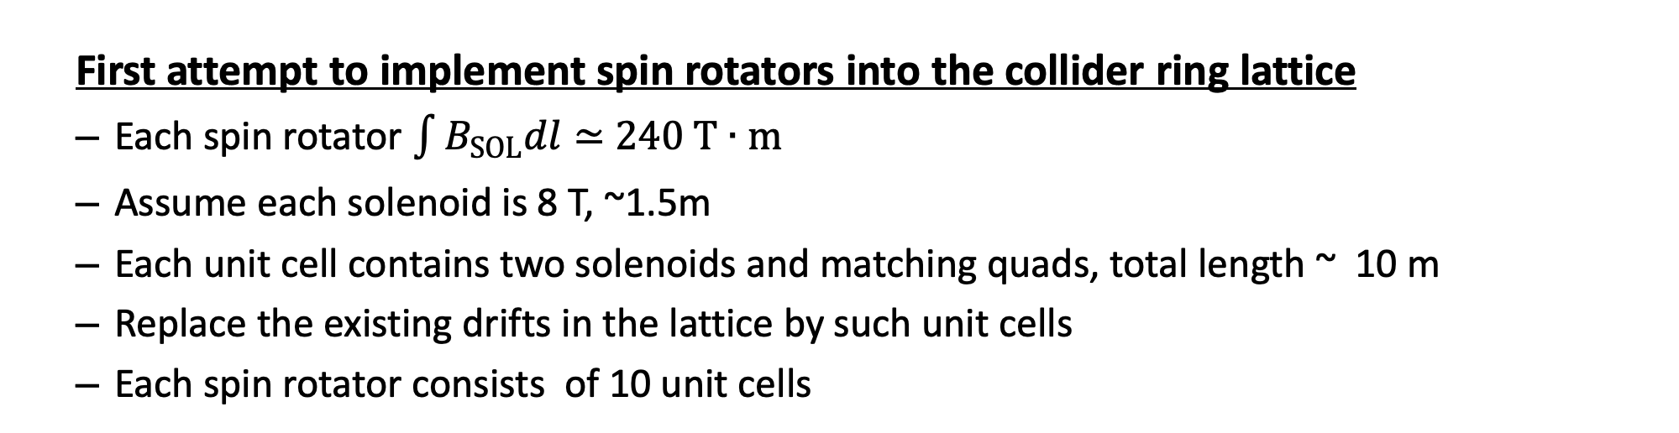
Spin rotators in the CEPC CDR lattice
  First attempt to implement spin rotators into the collider ring lattice
  Each spin rotator $\int{B_{SOL}dl}≃$ $240 T∙m$
  Assume each solenoid is 8 T, ~1.5m
  Each unit cell contains two solenoids and matching quads, total length ~ 10 m
  Replace the existing drifts in the lattice by such unit cells
  Each spin rotator consists of 10 unit cells

Slide 14
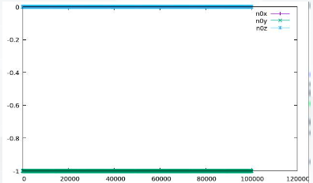
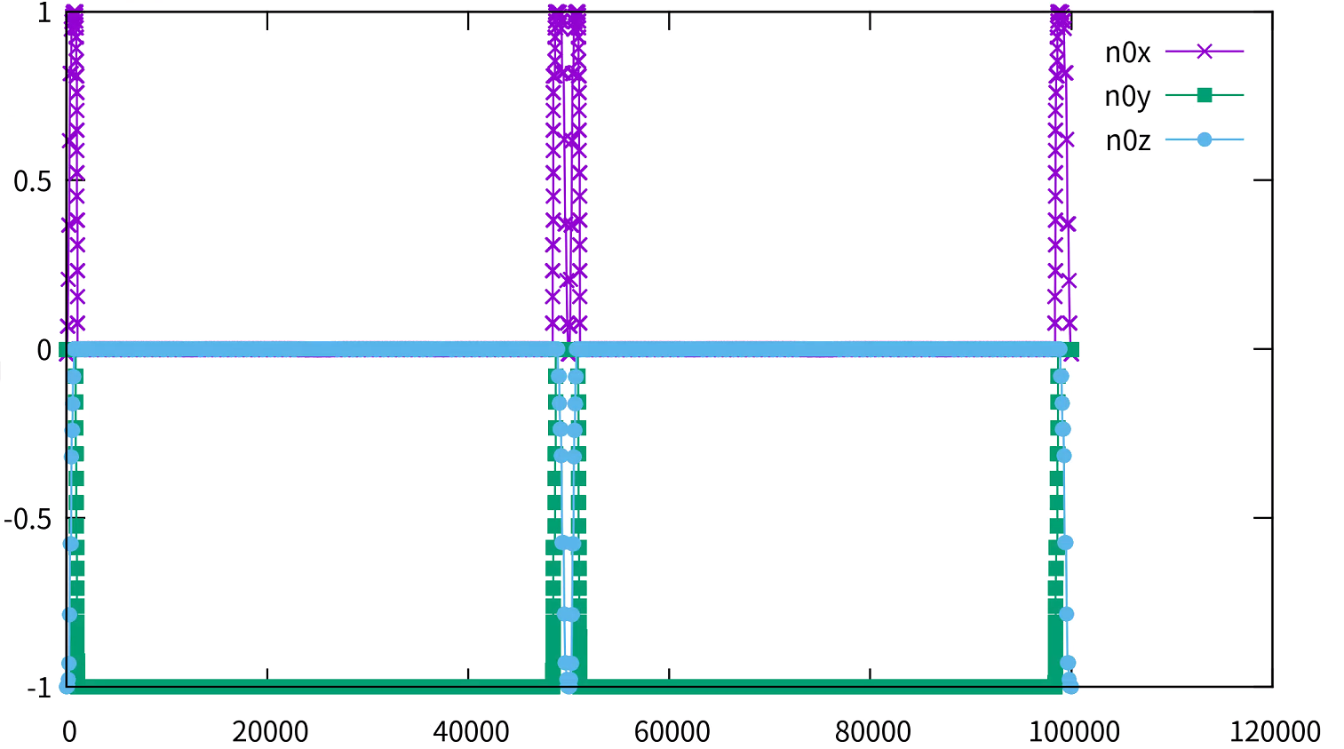
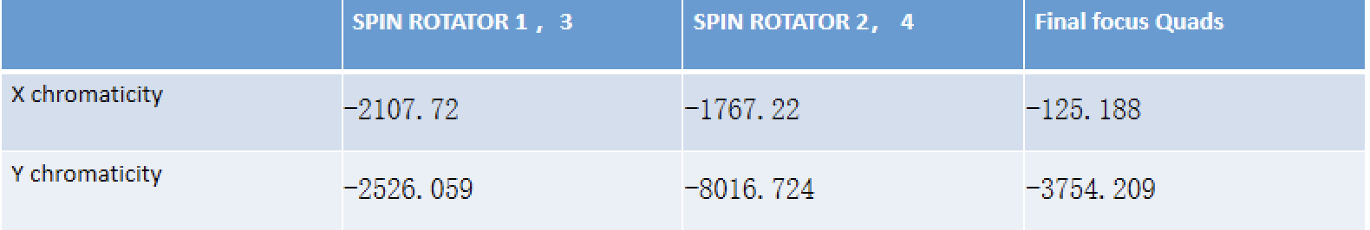
Spin rotators in the CEPC CDR lattice
  First attempt to implement spin rotators into the collider ring lattice
  The spin rotators do rotate the spin direction as expected
  But the limited space in CDR lattice requires a very compact design, superconducting quadrupole magnets are necessary
  The local chromaticity contribution from the spin rotator region is too large, and there is no dynamic aperture
w/o spin rotators
w/ spin rotators

Slide 15
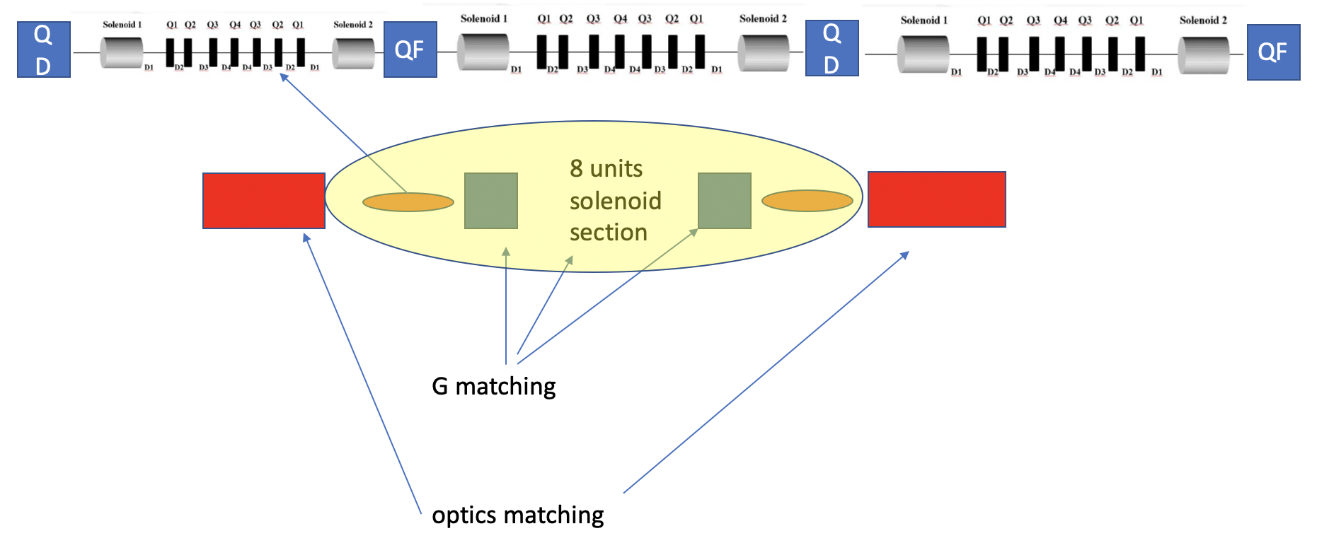
New design of spin rotators
  Redesign of the spin rotators and implementation into lattice
  A new version of CEPC lattice is under design
    The geometric requirement is built-in
    A space of ~300m is reserved for each spin rotator, in a long straight section near IR
  A new modular design of spin rotator is also under way

Slide 16
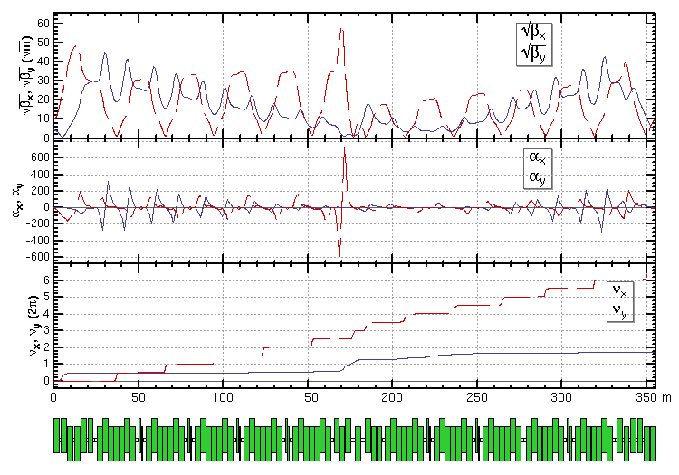

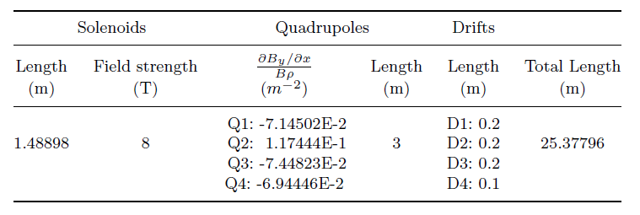
New design of spin rotators
  Redesign of the spin rotators and implementation into lattice
  Unit cell length is streched from 10 m -> 25 m
  max gradient of quads is reduced by a factor of 10
  Tuning the dedicated quads to realize spin matching
Spin matching conditon: G_{2×6}=0

Slide 17
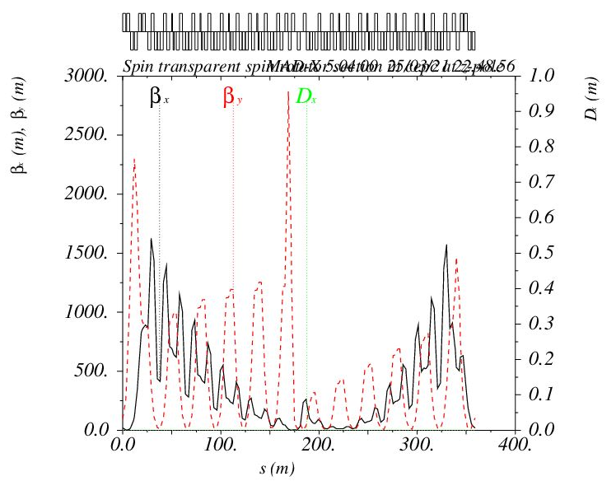
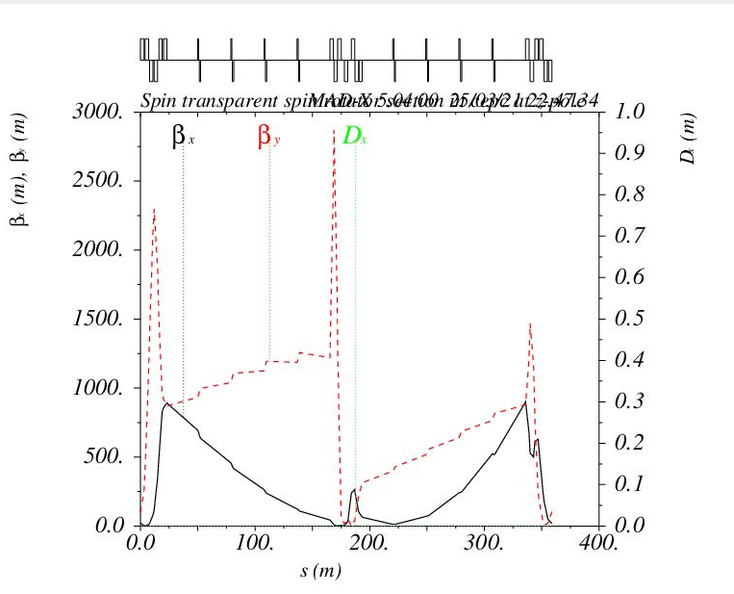
New design of spin rotators
  Redesign of the spin rotators and implementation into lattice
  Still, the local chromaticity contribution (∝ K1* β) is very large, related to large β-functions
  We are trying to optimize the variation of β-functions, perhaps the spin matching condition can be relaxed
Optics functions in spin rotator
Soleniod unit cell is replaced by transfer matrix
 | CHROMATICITY
X | -1810.049
Y | -3238.241

Slide 18
Outline
Introduction
Progress since mid-term
Summary

Slide 19
Summary
Extensive simulations of the equilibrium electron beam polarization for CEPC lattices have been launched, a journal paper on this work is in preparation.
Solenoid-based spin rotators were implemented in CEPC CDR lattices, they rotate the spin direction as expected, but the local chromaticity contribution is very large, this poses the major challenge in spin rotator design at such a high beam energy.
A new modular design of spin rotators with more relaxed quadrupole strengths and optimization towards smaller chromaticity contribution are under way. These will be implemented in the new CEPC lattice when it is available.
The overall work is on schedule, a more optimized spin rotator design is expected to be delivered before the end of 2021.
The Siberian snakes in the booster shall follow a similar design as the spin rotators, the current work will pave the way for the next tasks.

Slide 20
Backup

Slide 21

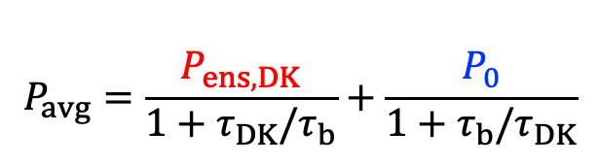
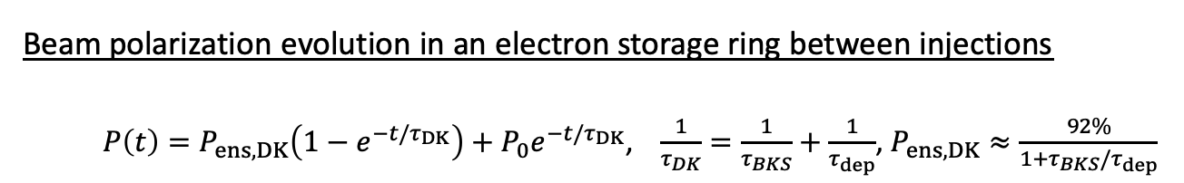
Formulas
Beam polarization evolution in an electron storage ring between injections
  $P\left(t\right)=P_{ens,DK}\left(1−e^{−t/τ_{DK}}\right)+P_{0}e^{−t/τ_{DK}}$, $\frac{1}{τ_{DK}}=\frac{1}{τ_{BKS}}+\frac{1}{τ_{dep}}$, $P_{ens,DK}≈\frac{92\%}{1+τ_{BKS}/τ_{dep}}$
Time-averaged beam polarization in an electron storage ring during top-up injection
Injected beam polarization
Self-polarization: equilibrium beam polarization in the ring
$$P_{avg}=\frac{P_{ens,DK}}{{1+τ}_{DK}/τ_{b}}+\frac{P_{0}}{{1+τ}_{b}/τ_{DK}}$$
Competition between beam decay/injection
and polarization build-up in the ring

Slide 22
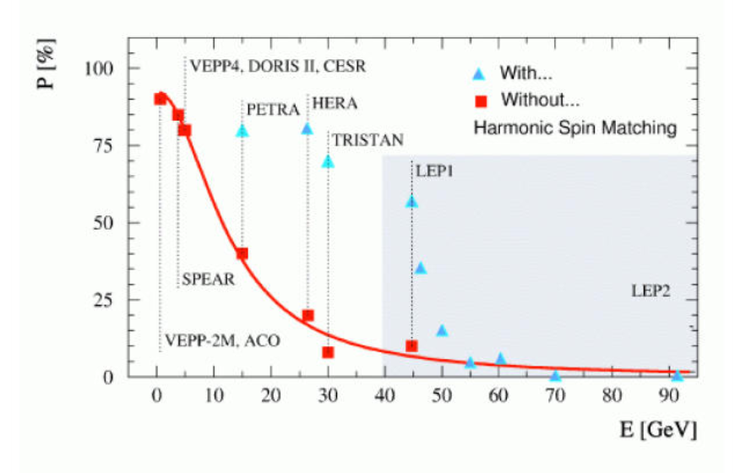
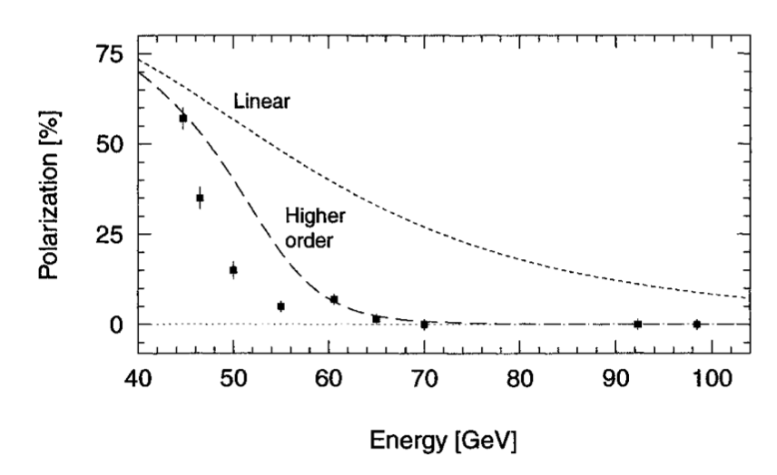


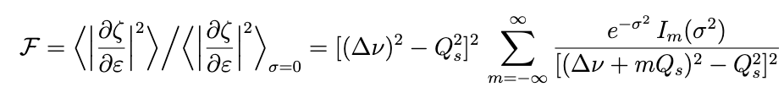

Scaling with beam energy
LEP measured beam polarization
R. Assmann, et al, AIP Conference Proceeding, 570, 169 (2001).
$σ=aγσ_{ε}/Q_{s}$ becomes remarkable at higher beam energy
[1] Derbenev, Kondratenko, Skrinsky, PA 9 247, 1979. [2]S. R. Mane, arXiv:1406.0561.
$$aγ$$

Slide 23
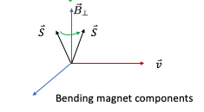
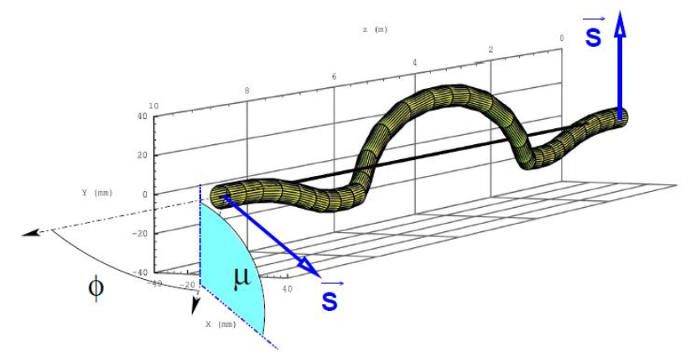
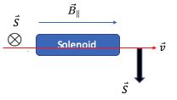
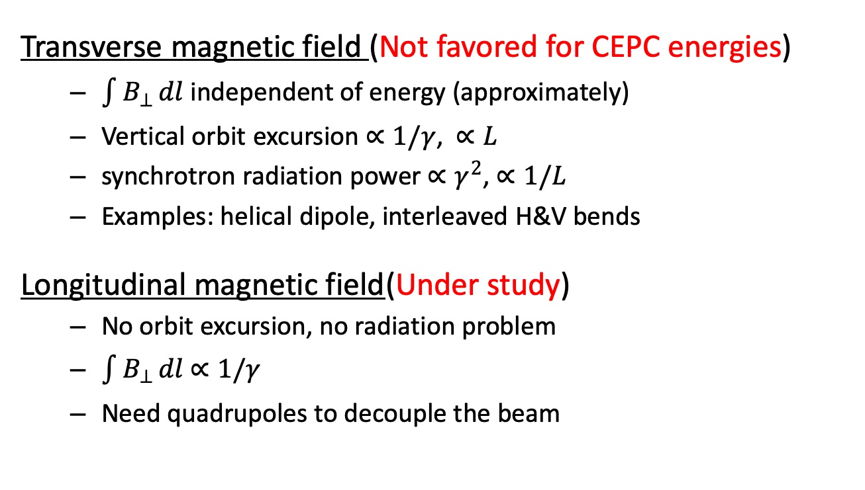
How to adjust the polarization direction?
Devices to rotate spin around a direction in horizontal plane by a certain angle θ
Transverse magnetic field (Not favored for CEPC energies)
  $\int{B_{⊥}}dl$ independent of energy (approximately)
  Vertical orbit excursion $∝1/γ$, $∝L$
  synchrotron radiation power $∝γ^{2}$, $∝1/L$
  Examples: helical dipole, interleaved H&V bends
Longitudinal magnetic field(Under study)
  No orbit excursion, no radiation problem
  $\int{B_{⊥}}dl$ $∝1/γ$
  Need quadrupoles to decouple the beam

Slide 24
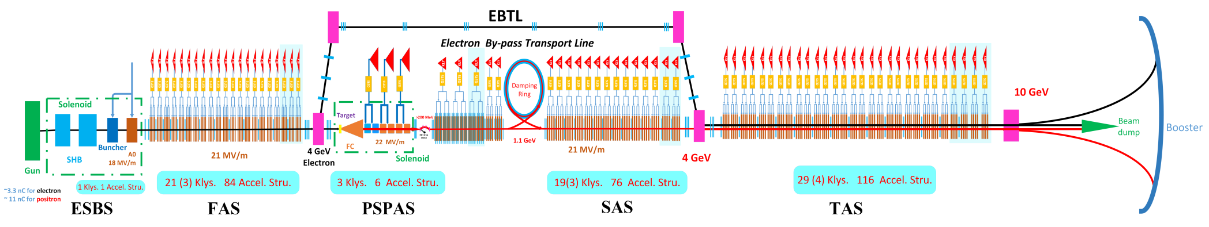
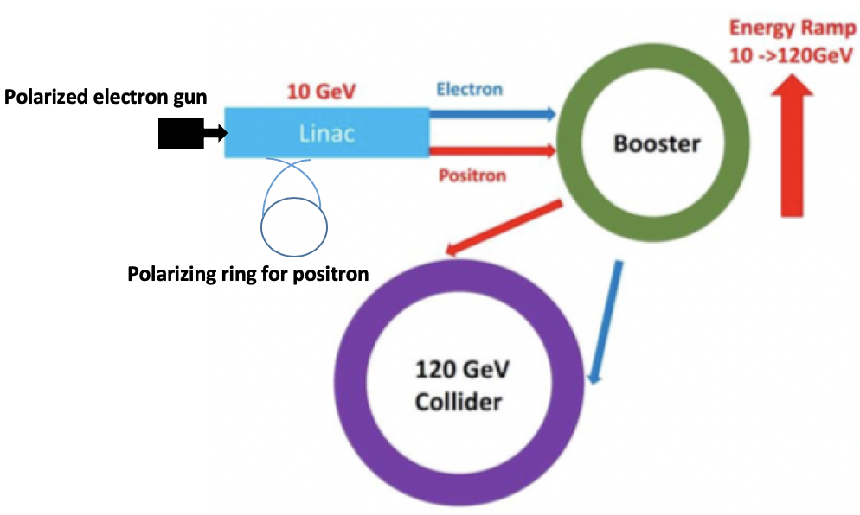
Polarized e+ beam preparation in CEPC
Courtesy of Meng C.
Spin rotators
Electron gun
Siberian snake
Siberian snake is necessary in the booster to maintain a decent polarization through acceleration
Replace the e+ damping ring by a e+ polarizing ring

