Slide 1
Progress of prototype of electrostatic separator for CEPC Bin Chen CEPC MOST2 Project 2021 Annual Meeting (Apr 22) 2021

Slide 2
Outline
Prototype development of electrostatic separator
Design improvements
Manufacturing process
Installation process
Precision High Voltage Power Supply
Factory test
Next plan
Summery

Slide 3
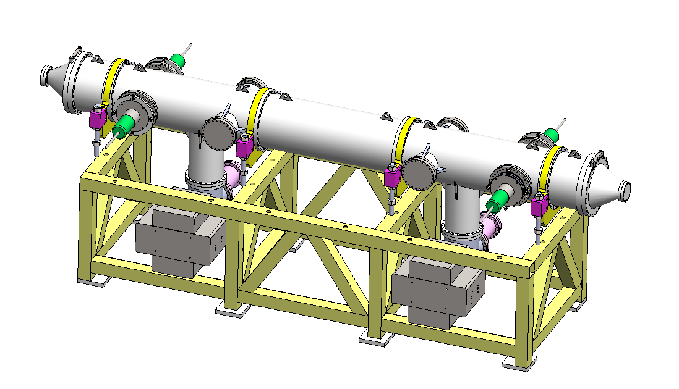
Prototype development of electrostatic separator
A separator unit including: 1. Vacuum chamber (5 straight through chambers, 2 cone tubes and 2 pump chambers); 2. a pair of electrodes; 3. 2 ground electrodes; 4. 4 groups of insulation metal-ceramic support; 5. 4 groups of high voltage feedthrough; 6. 2 sets of vacuum system (including ion pump, sublimation pump and gauge); 7. support platform.
structure drawing of Electrostatic Separator

Slide 4
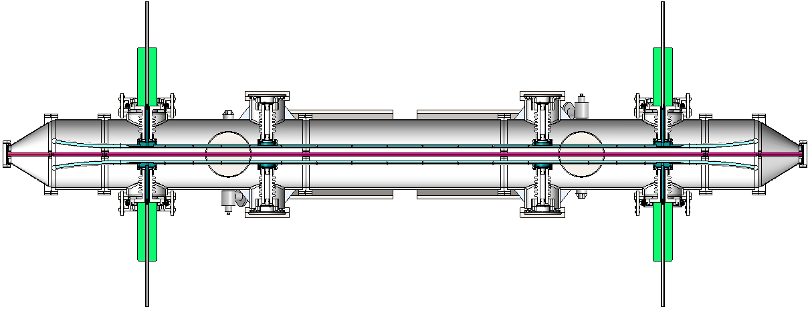
Prototype development of electrostatic separator
Design improvements

Slide 5
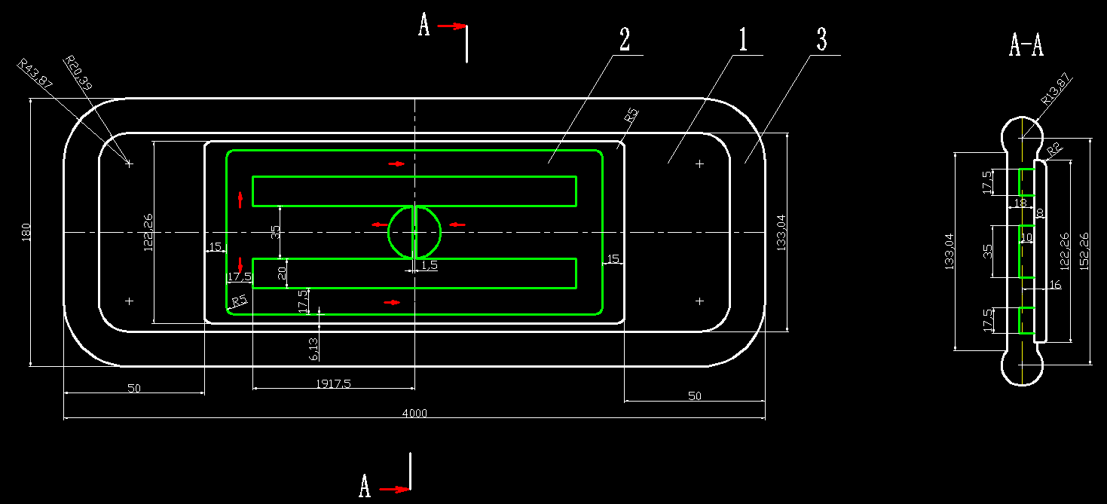
Prototype development of electrostatic separator
Coolant loop in electrode plate
In order to improve the cooling efficiency, the cooling circuit of the plate was improved.
Two groups of high voltage feedthrough are added.
The coolant feed pipe and high voltage feed pipe adopt the same pipe. Coolant comes in at one end and goes out at the other.

Slide 6
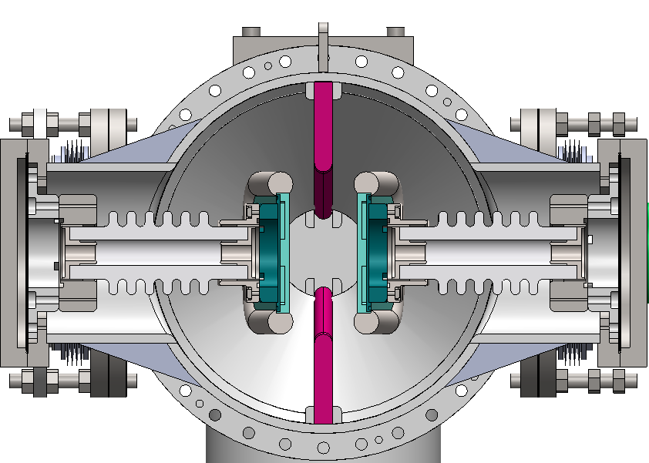
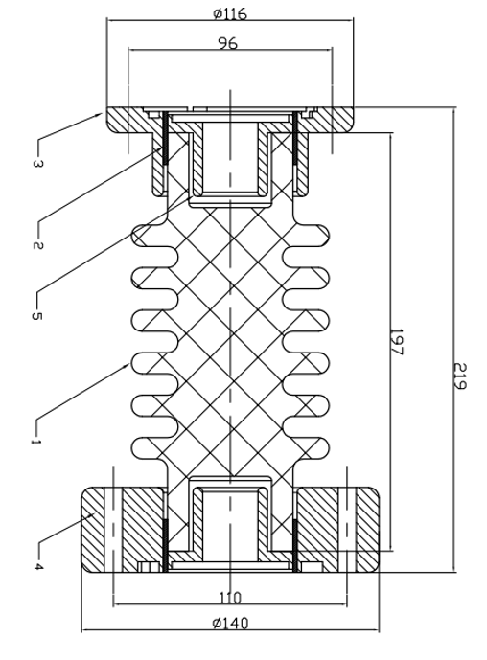
Prototype development of electrostatic separator
HV metal-ceramic support
The ceramic parts are made of 95% alumina ceramics.
The ceramic ends are metallized , and the pure titanium flanges are welded for fixation, which has the advantage of high mechanical strength.

Slide 7
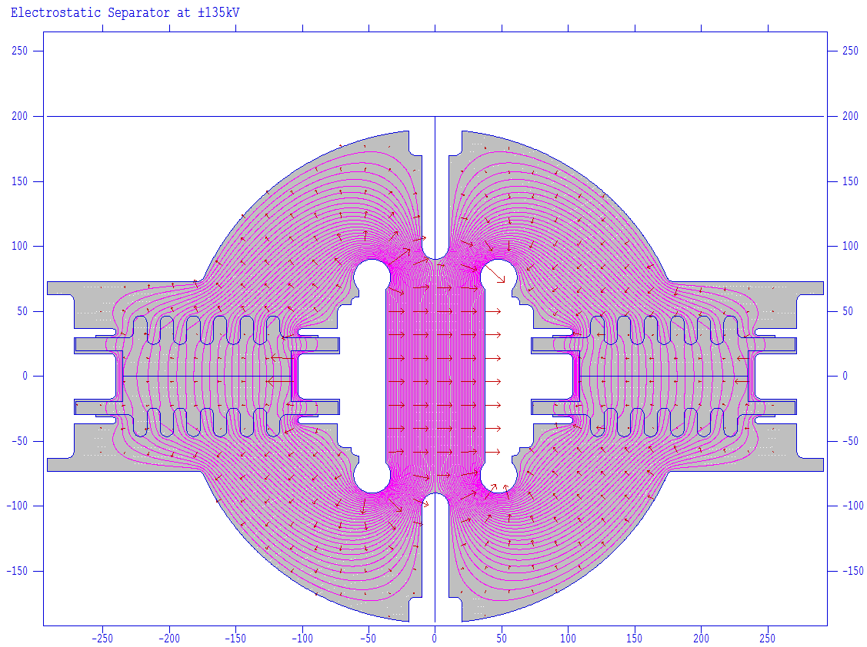
Prototype development of electrostatic separator
HV metal-ceramic support
The electric field design of ceramic-metal-vacuum triple point is the key point.
The electric field on the edge of the electrode is less than 80kV/cm, which belongs to the safe range in vacuum.
R13.87

Slide 8
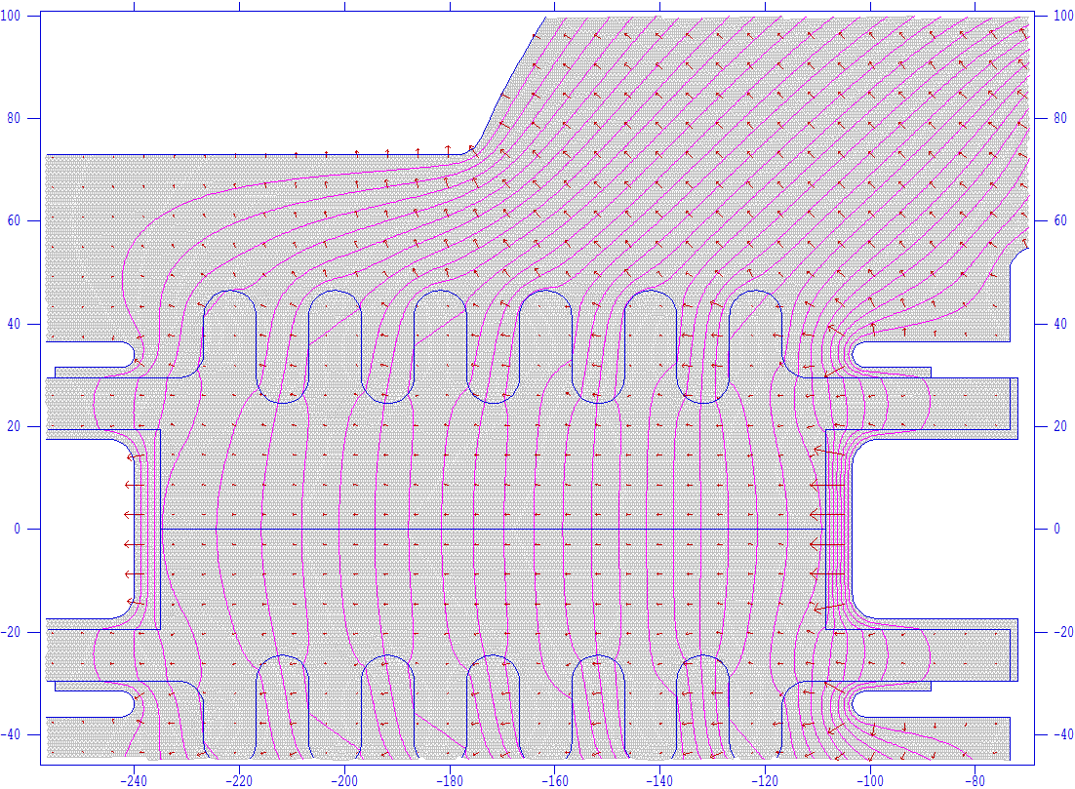
Prototype development of electrostatic separator
HV metal-ceramic support
The electric field of the triple point is less than 70kV/cm, which is belongs to the safe range. According to general experience, the average field intensity of flashover in atmosphere is about 3kV/cm, and it is greater than this value in vacuum. We take the insulation distance of ceramic surface as 50cm, which can reach 150kV.
Vacuum
UHV tank
（metal）
Triple point
Ceramic
Metal

Slide 9
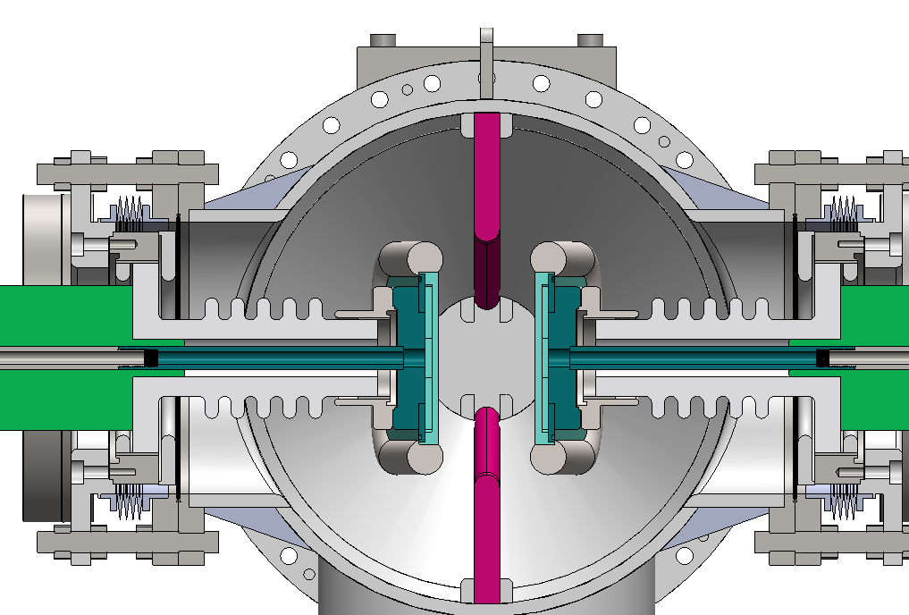
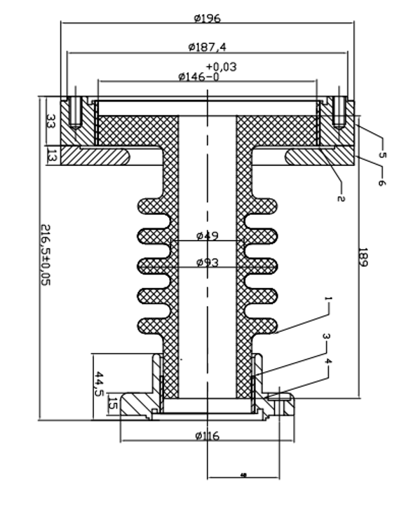
Prototype development of electrostatic separator
High voltage feedthrough
The insulating part is made of alumina ceramic, both ends are metallized, and the sleeve is sealed with pure titanium flange.
The coolant loop is machined on the main electrode for adequate cooling.

Slide 10
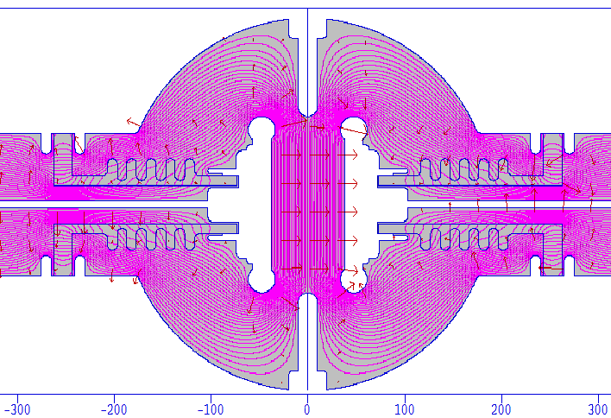
Prototype development of electrostatic separator
High voltage feedthrough
The maximum electric field (@±135kV) appears on the edge of the electrode, which is less than 80kV/cm. The electric field at the triple point is less than 78kV/cm, which is safe in vacuum. Ceramic surface creepage distance is also in the safe range.

Slide 11
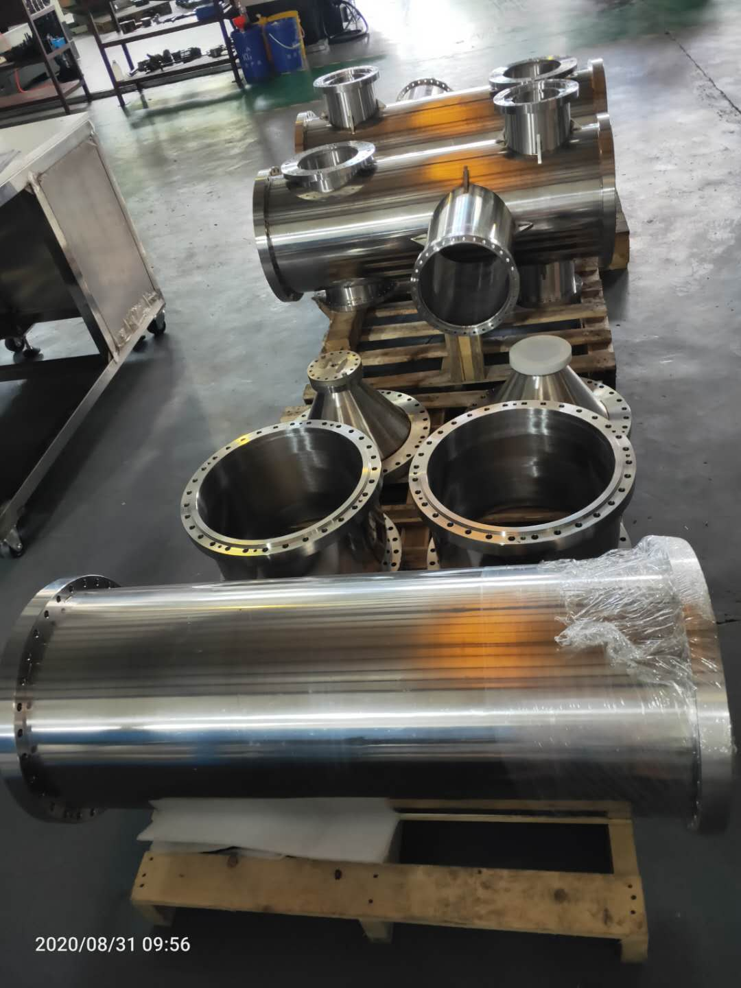
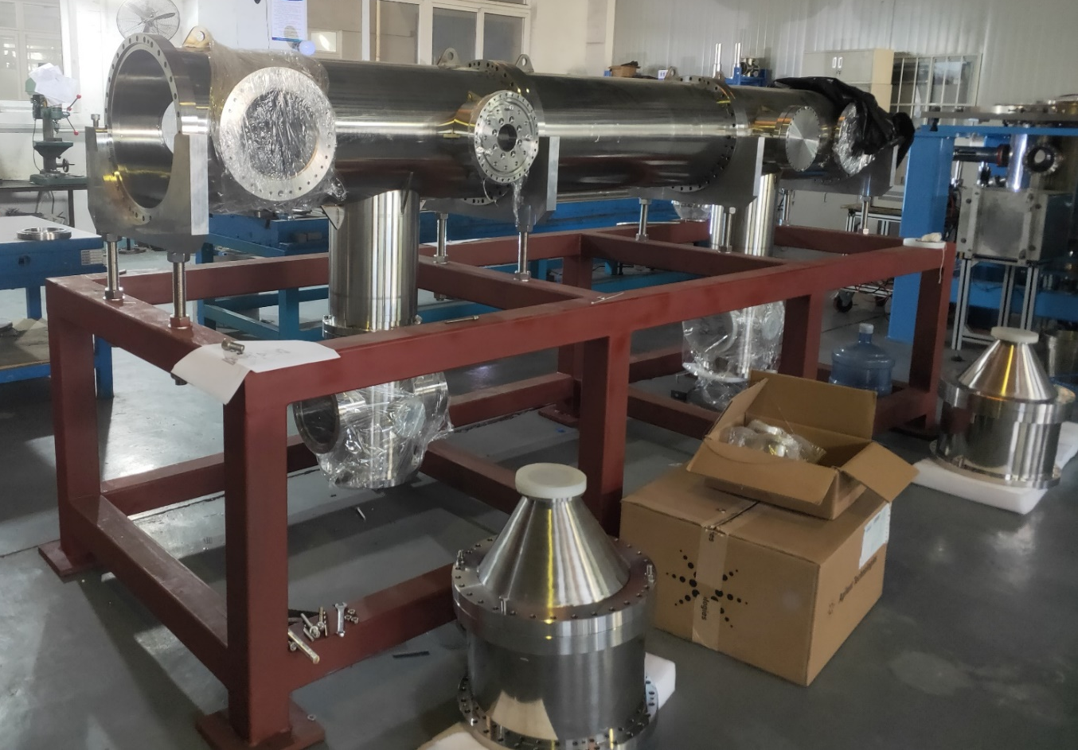
Prototype development of electrostatic separator
Manufacturing process - UHV tank
The vacuum chamber is polished and the leak detection is completed

Slide 12
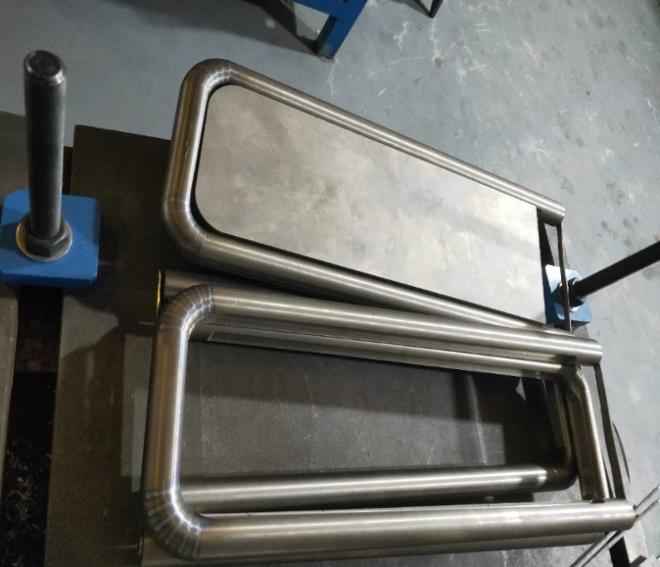
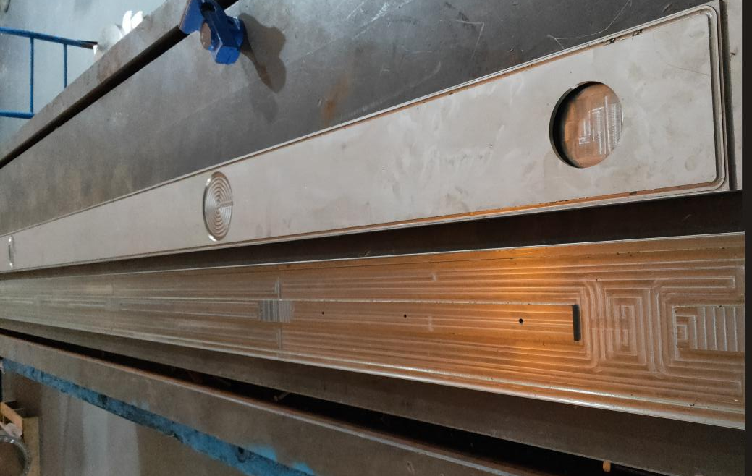
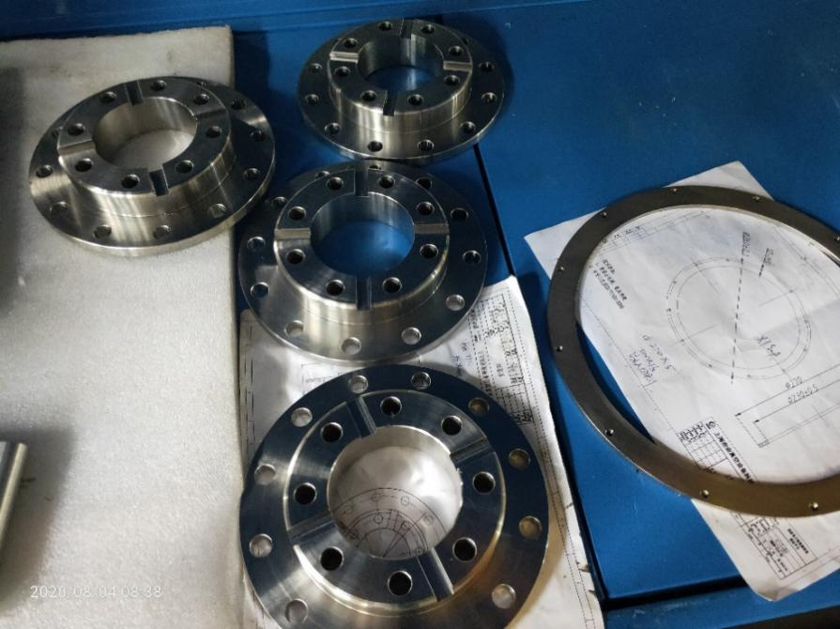
Prototype development of electrostatic separator
Manufacturing process – Electrode
Titanium rod
Ends of electrode
main electrode plate
Titanium mounting flange

Slide 13
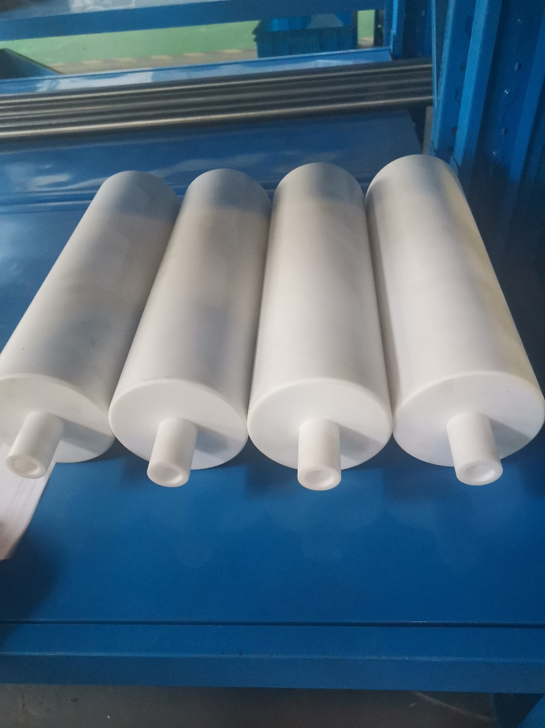
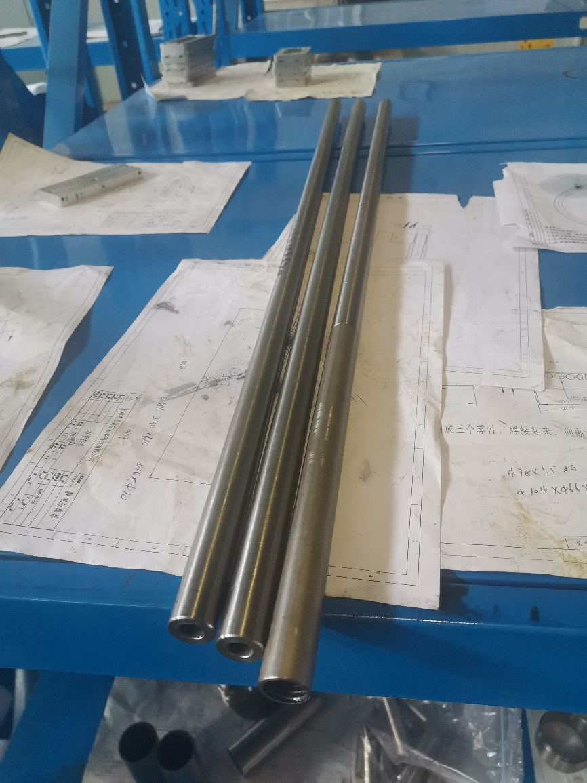
Prototype development of electrostatic separator
Manufacturing process – Electrode
Electrode probe outside insulated sleeve (Teflon)
Electrode probe

Slide 14
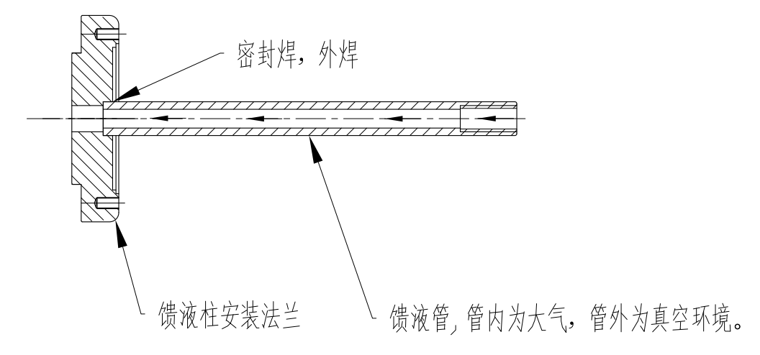
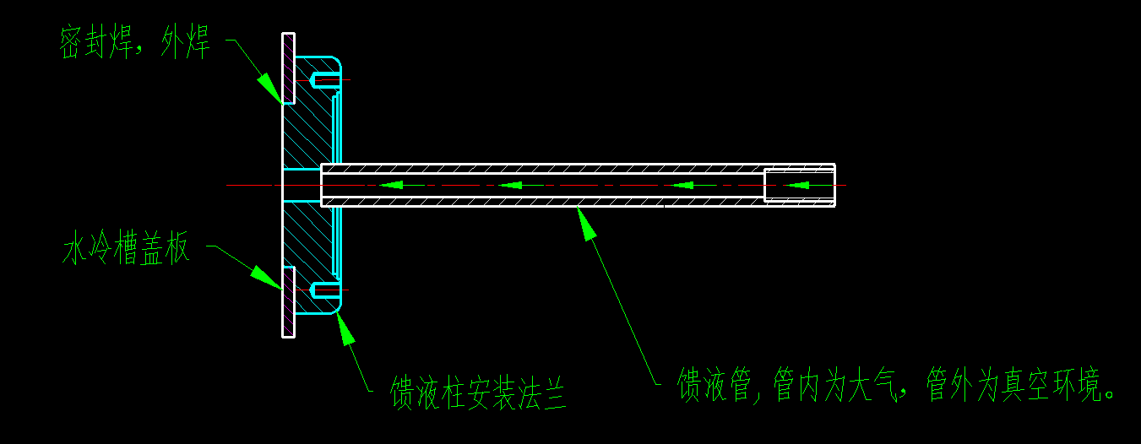
Prototype development of electrostatic separator
The welding procedure – Electrode
Welding the electrode probe with the installation flange, and check for leakage after welding.
The installation flange with probe is welded to the cover of the electrode plate.

Slide 15
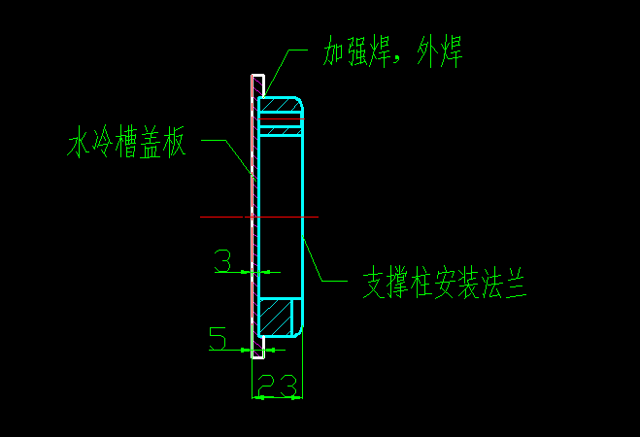
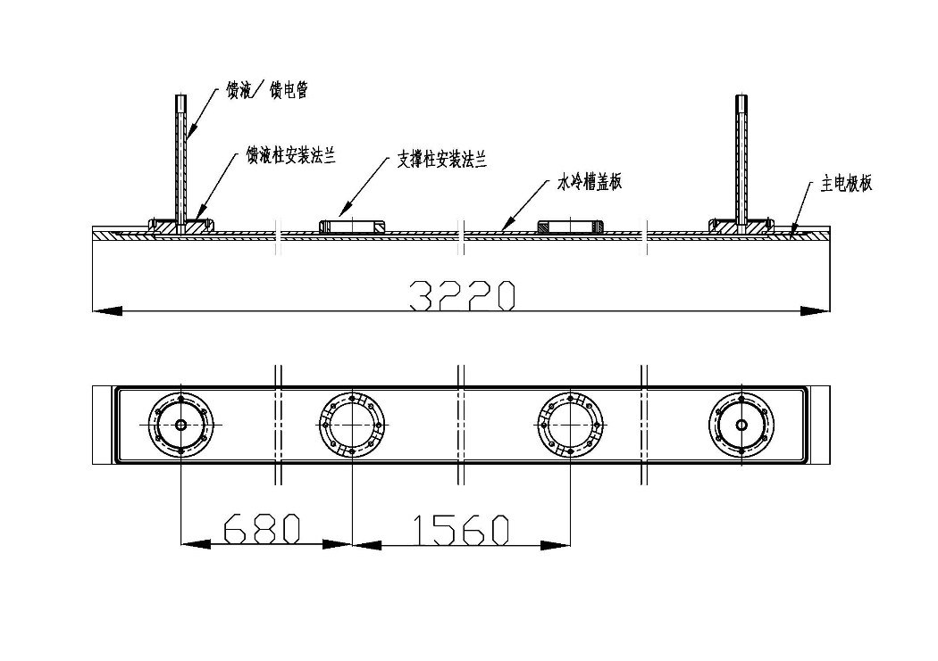
Prototype development of electrostatic separator
The welding procedure – Electrode
The installation flange of supports is welded to the cover of the electrode plate.
The main electrode plate and the cover are welded together, leakage detection.

Slide 16
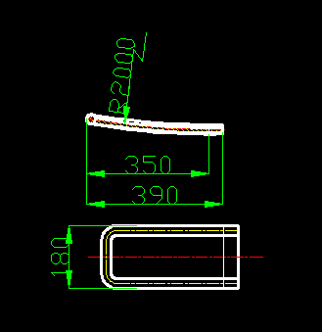
Prototype development of electrostatic separator
The welding procedure – Electrode
The main electrode plate was welded with the titanium rod.
The curved plate at both ends of the electrode is welded to the titanium rod, and the angle of the curved surface is corrected after welding.

Slide 17
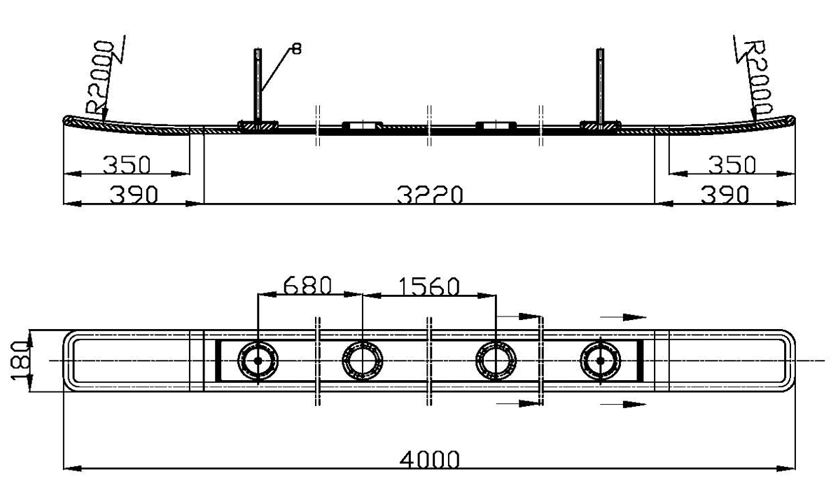
Prototype development of electrostatic separator
The welding procedure – Electrode
The curved plate at both ends is welded with the main electrode plate, and corrected after welding.
The whole electrode plate is polished

Slide 18
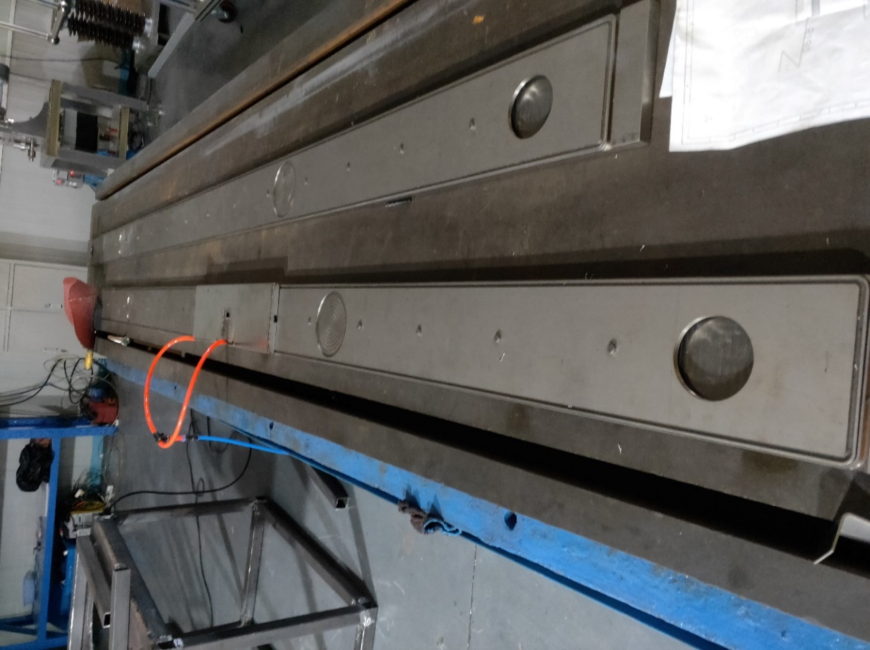
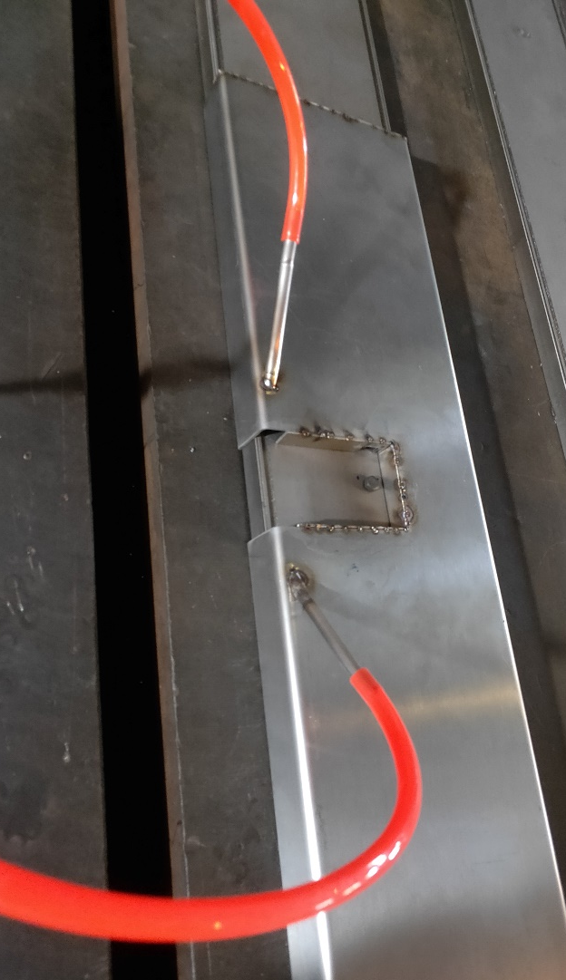
Prototype development of electrostatic separator
The welding procedure – Electrode
The main electrode plate and the cover plate was welded together, then leak detection and water pressure test.

Slide 19
Prototype development of electrostatic separator
The welding procedure – Electrode
The main electrode plate was welded with the titanium rod
The electrode probe was welded to the mounting flange on the main electrode plate and the leak detection was performed.

Slide 20
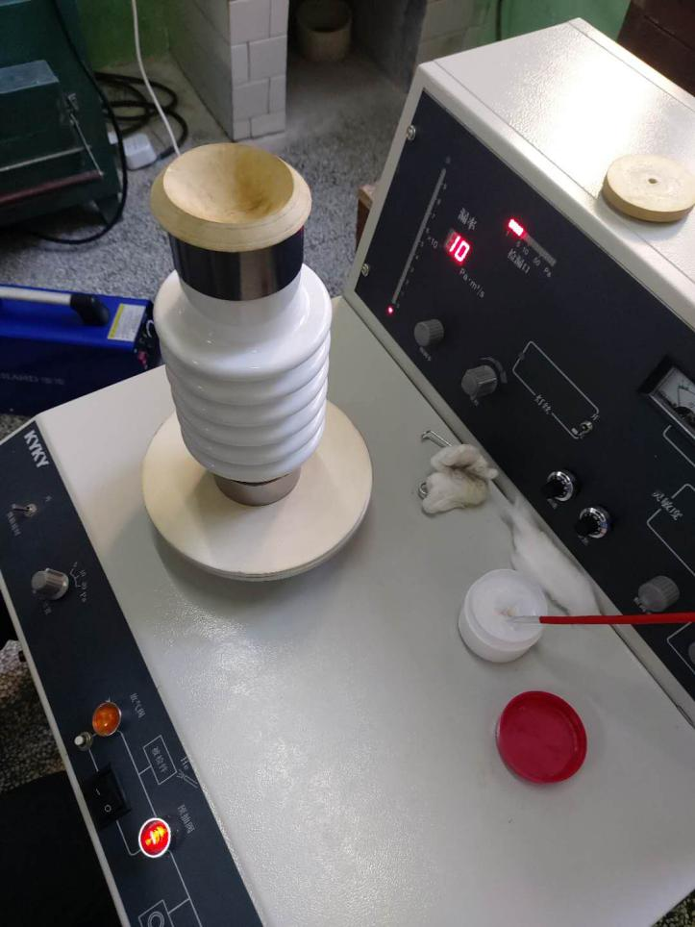
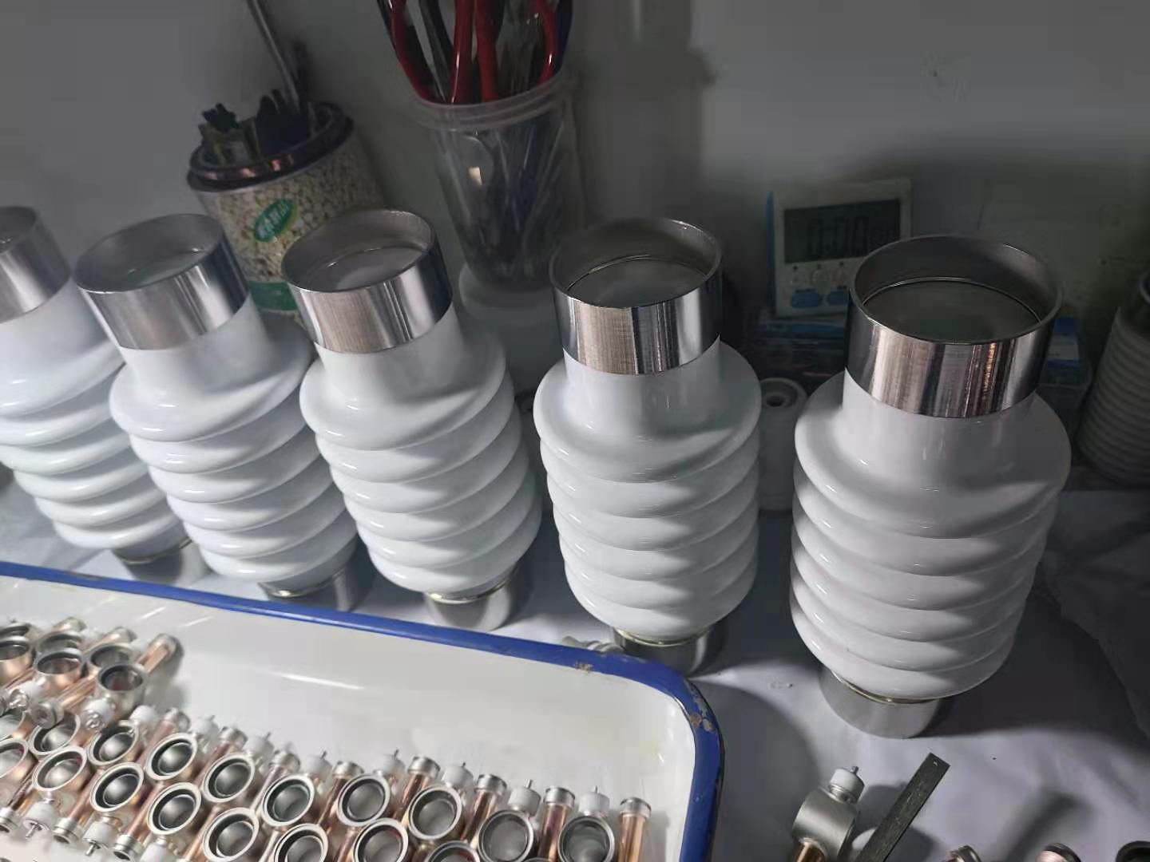
Prototype development of electrostatic separator
Ceramic processing
Ceramic processing is a major problem encountered in this project, and it is also the main factor leading to the delay of the project schedule.
The ceramic sintering, glazing, metallization and welding of the support parts were carried out smoothly.

Slide 21
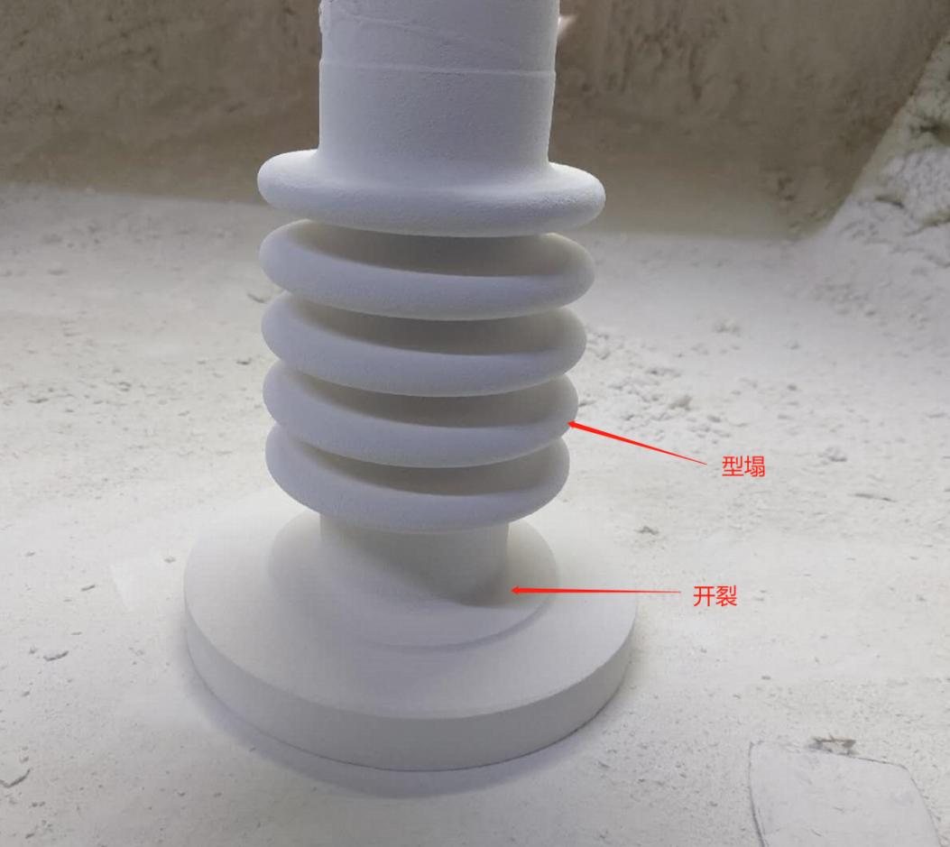
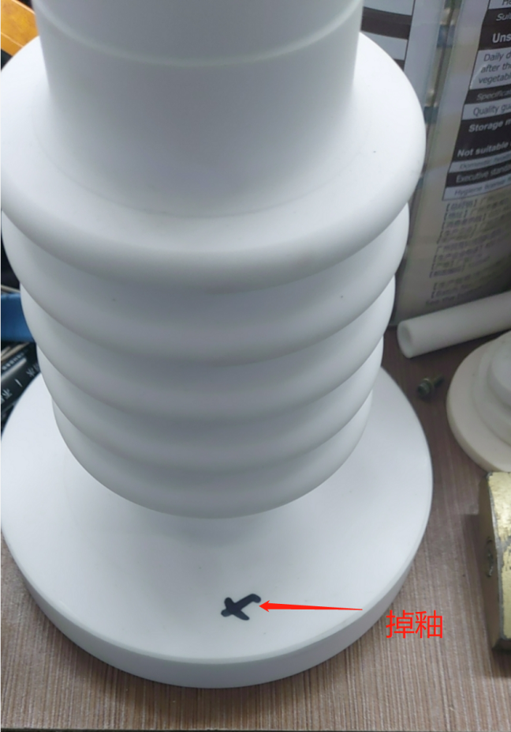
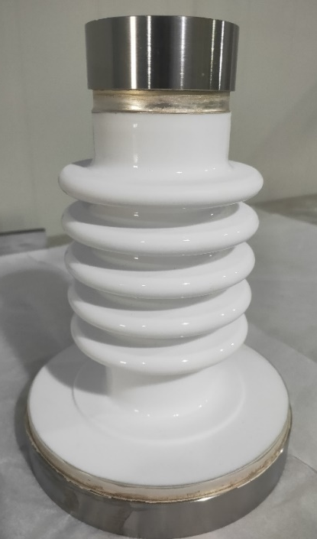
Prototype development of electrostatic separator
high voltage /coolant feedthrough ceramic column processing encountered many problems
(1) cracking: Ceramic root cracking occurs in the process of sintering, After many tests, sintering success.
(2) drop the glaze: Ceramics deglaze in the process of glazing.
(3) welding: after ceramic metallization, there is leakage after welding with titanium ring. After modifying the titanium ring, the welding is successful.

Slide 22
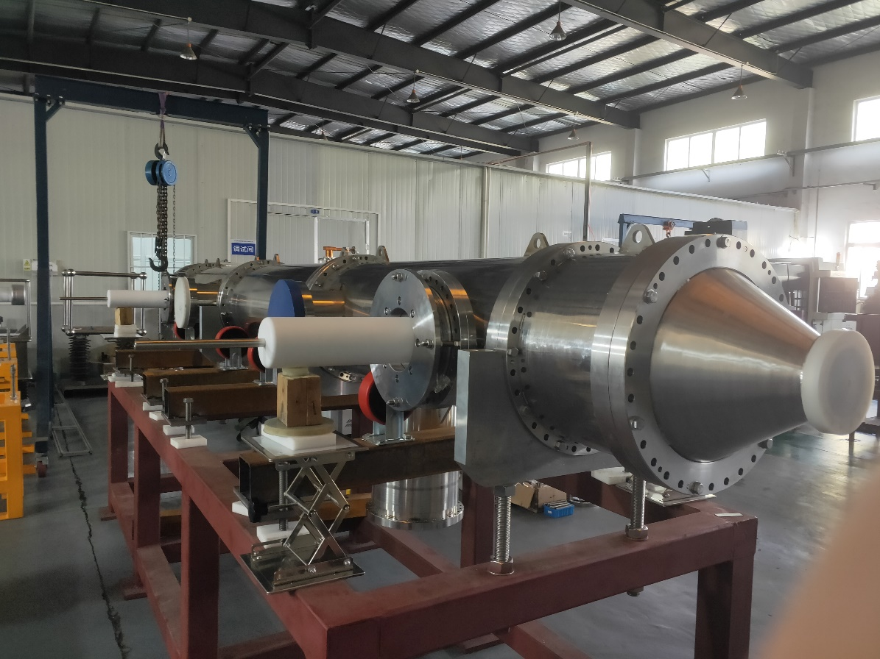
Prototype development of electrostatic separator
Installation process
Because the space in the vacuum chamber is very small. There are many components to be installed inside and the structure of the components is complex. So the overall installation of the equipment needs extra care. The installation steps are as follows:

Slide 23
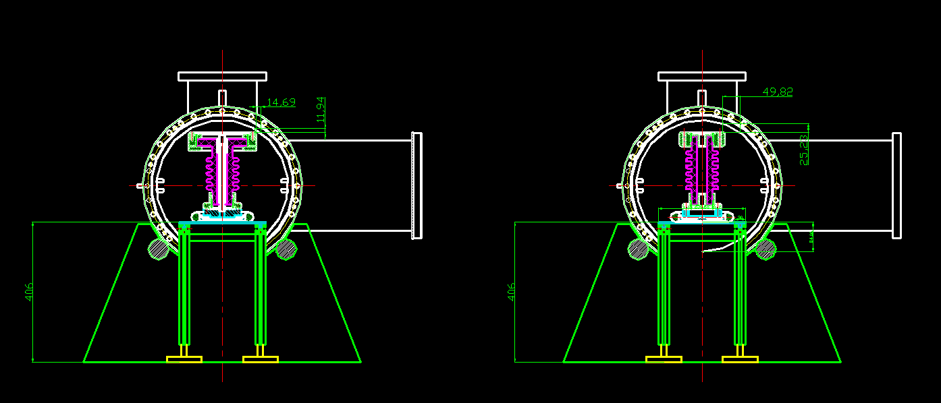
Prototype development of electrostatic separator
Installation process
1. Install main electrode plate 1, adjust and fix the position of the main electrode plate 1, as shown in the figure

Slide 24
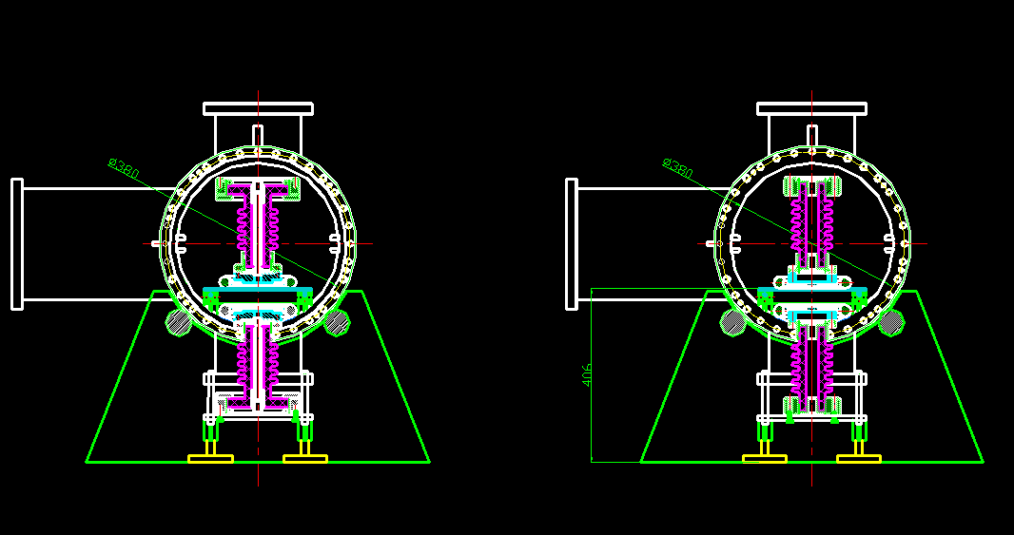
Prototype development of electrostatic separator
Installation process
2. The cavity body is reversed 180°, the main electrode plate 2 is installed, adjust and fix the position of the main electrode plate.

Slide 25
Prototype development of electrostatic separator
Installation process
3. The overall cavity is reversed by 180°, and the position of the electrode plate 1 is adjusted and fixed.

Slide 26
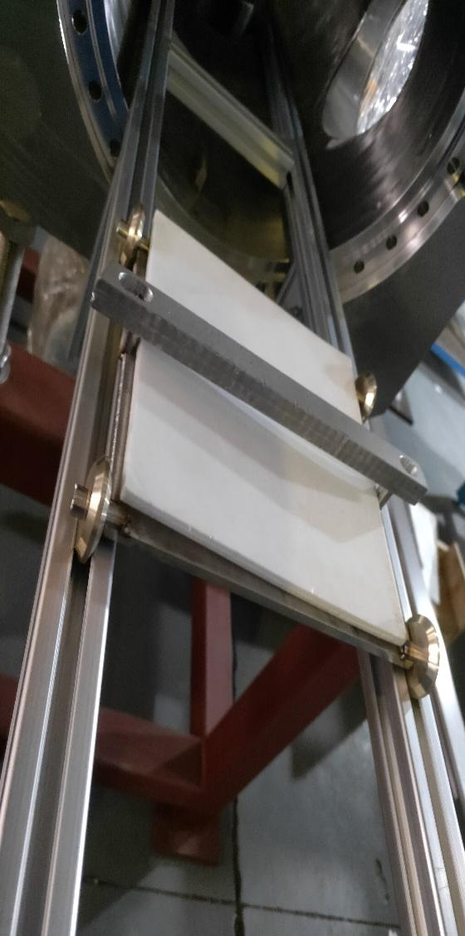
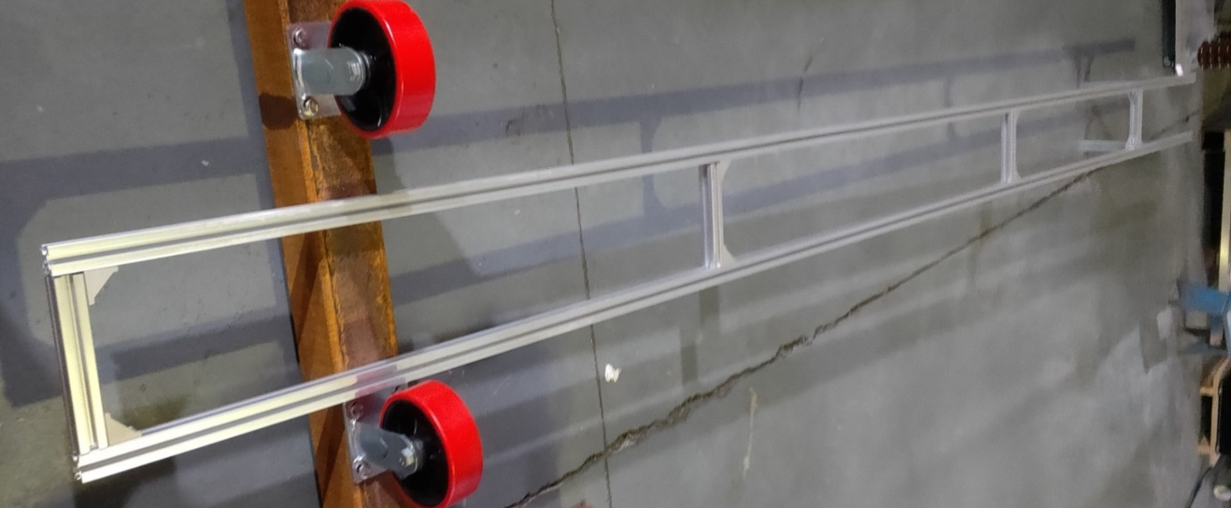
Prototype development of electrostatic separator
Installation process
Chamber rotary tooling
Main Plate mounting bracket and moving trolley

Slide 27
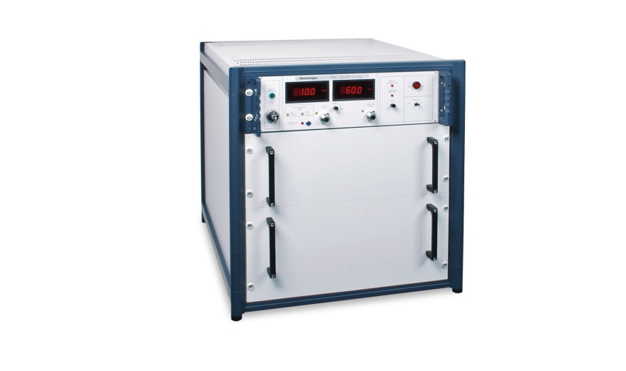
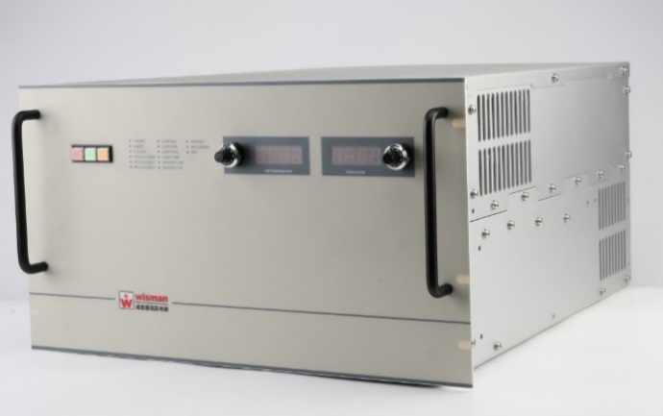
Precision High Voltage Power Supply
Including : two HV supplies of maximum 150kV– one positive and one negative polarity.
Voltage margin for conditioning
An imported high-voltage power supply was ordered in November 2019.
A domestic high voltage power supply was ordered in March 2020.
 | Unom | Inom | Residual ripple | Stability
Heinzinger import | 150kV | 1.5mA | 1ⅹ10⁻⁴ | 1ⅹ10⁻⁴
Wisman domestic | 150kV | 4mA | 1ⅹ10⁻⁴ | 1ⅹ10⁻⁴

Slide 28
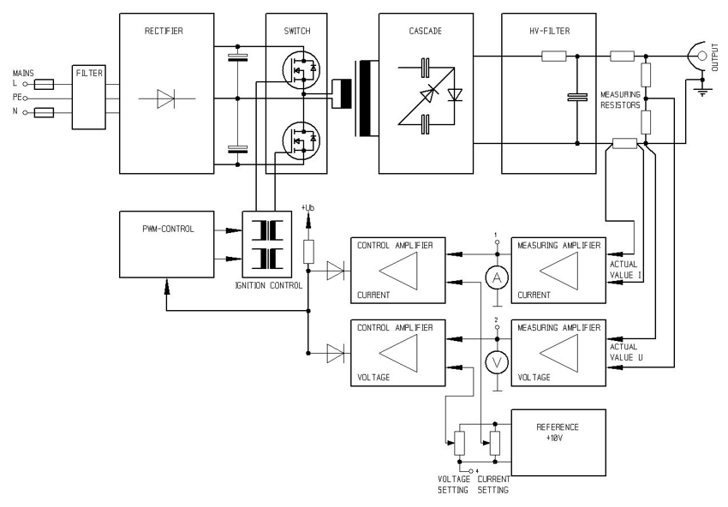
Precision High Voltage Power Supply
To generate the high voltage, the rectified mains voltage is converted to rectangular alternating current of approx. 20 kHz and fed into a high-voltage transformer. Afterwards the voltage is multiplied and rectified in a subsequent multi-stage converter cascade. The generated high voltage is corrected in a high-voltage filter.
Topology of high voltage power supply

Slide 29
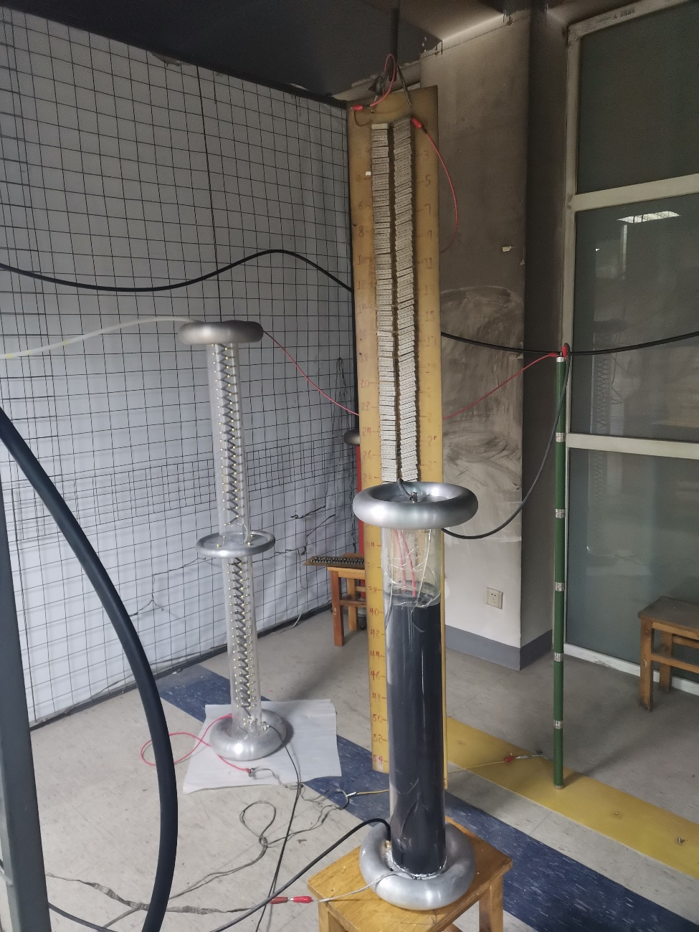
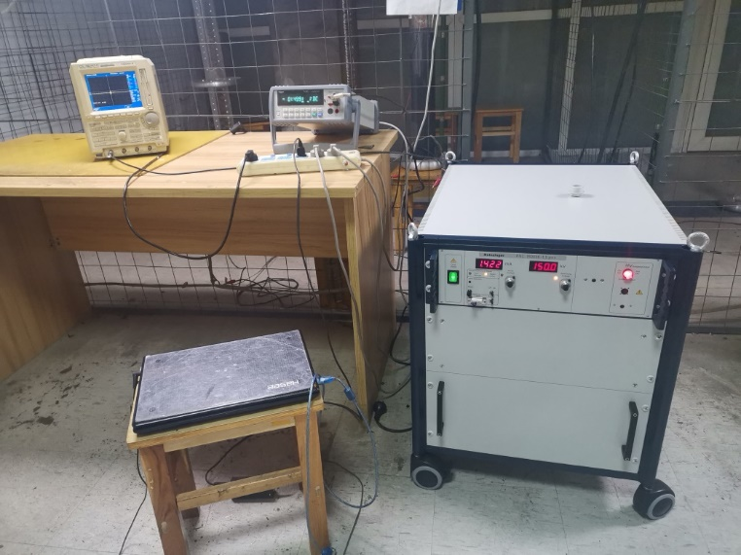
Precision High Voltage Power Supply
威思曼分压器RVD

Slide 30
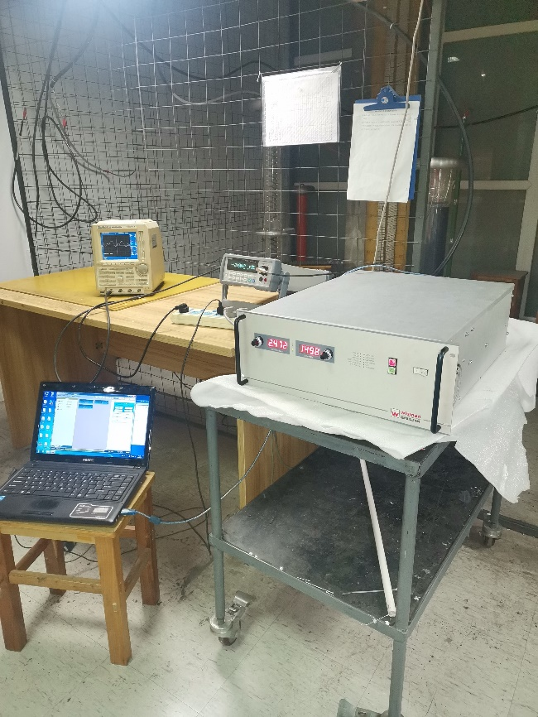
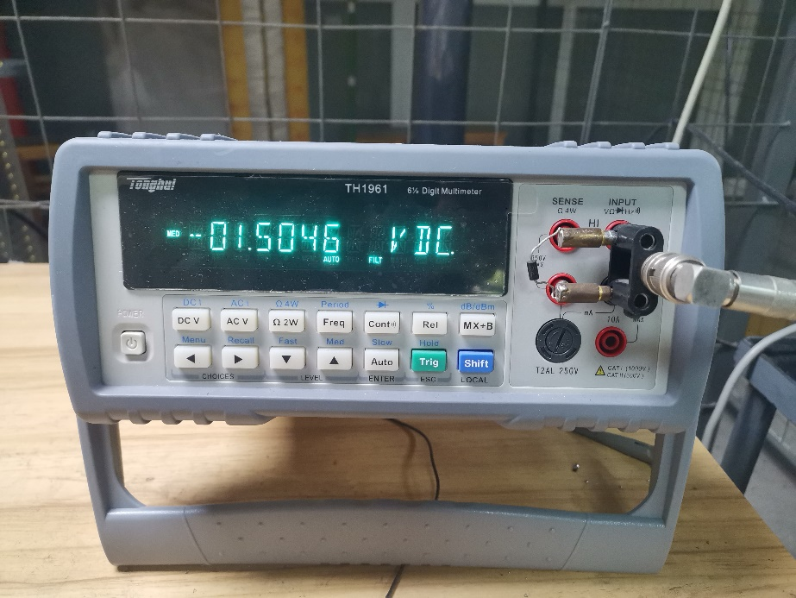
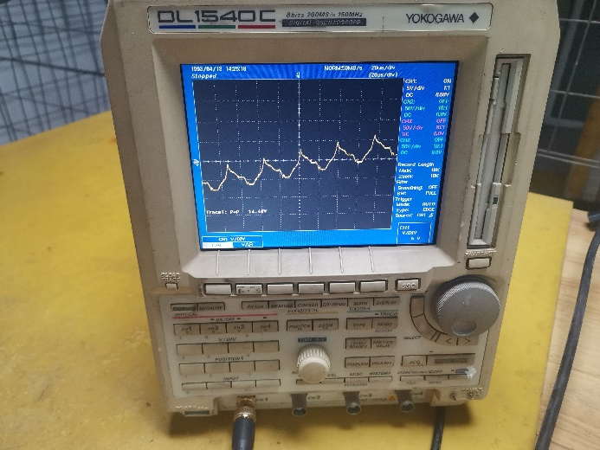
Precision High Voltage Power Supply

Slide 31
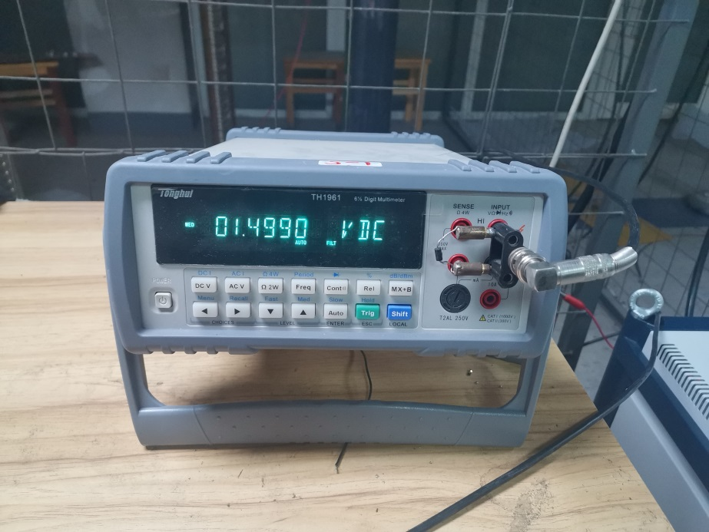
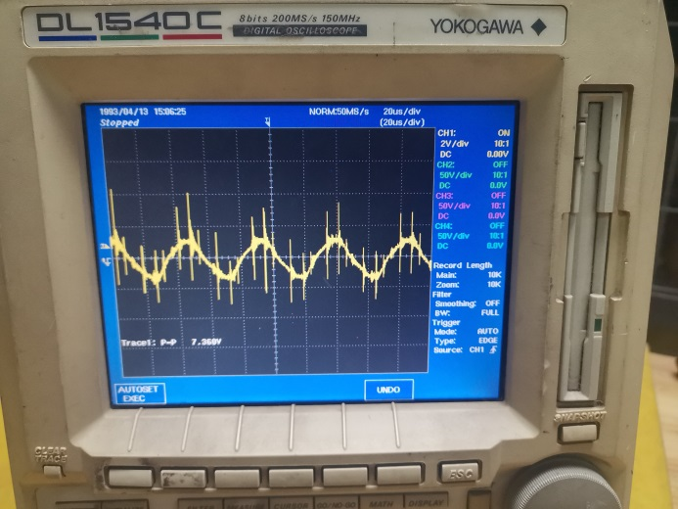
Precision High Voltage Power Supply

Slide 32
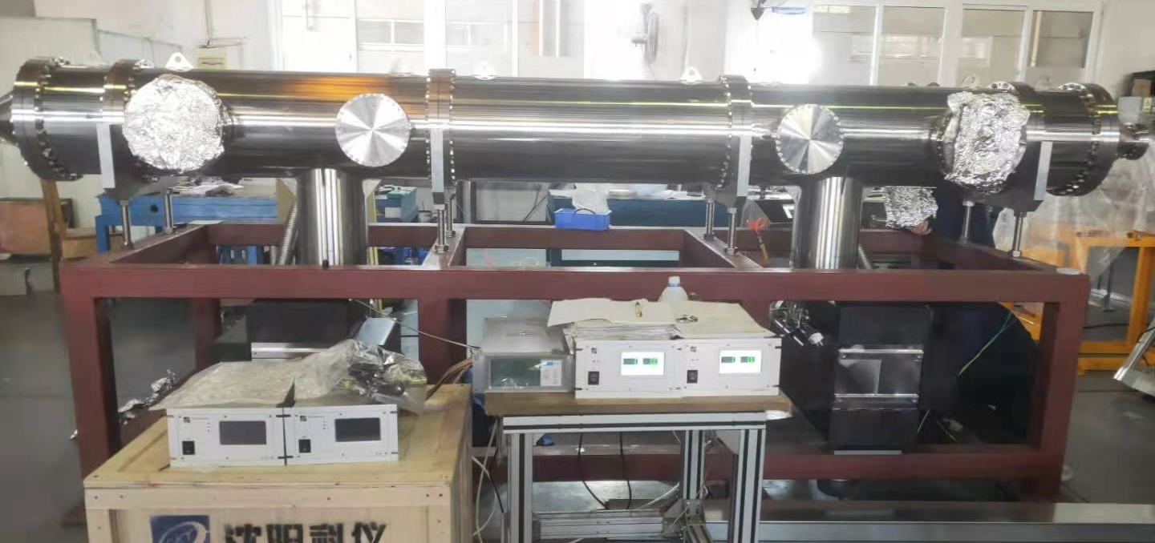
Prototype development of electrostatic separator
Factory test

Slide 33
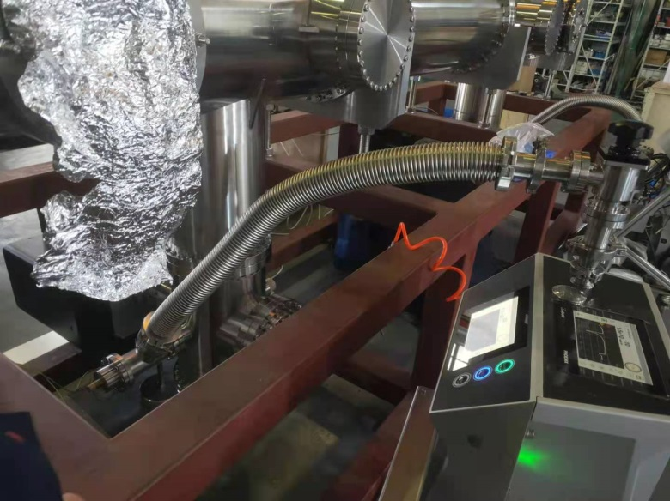
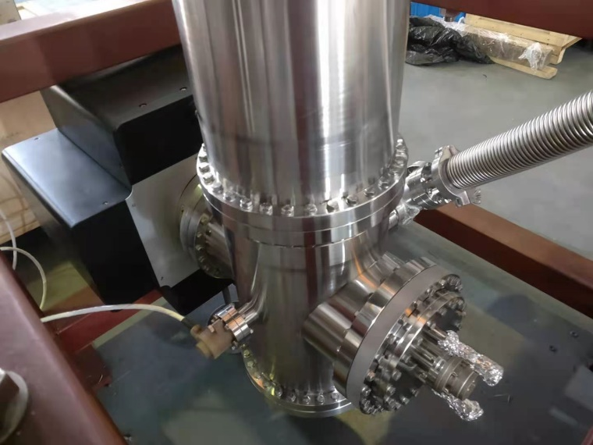
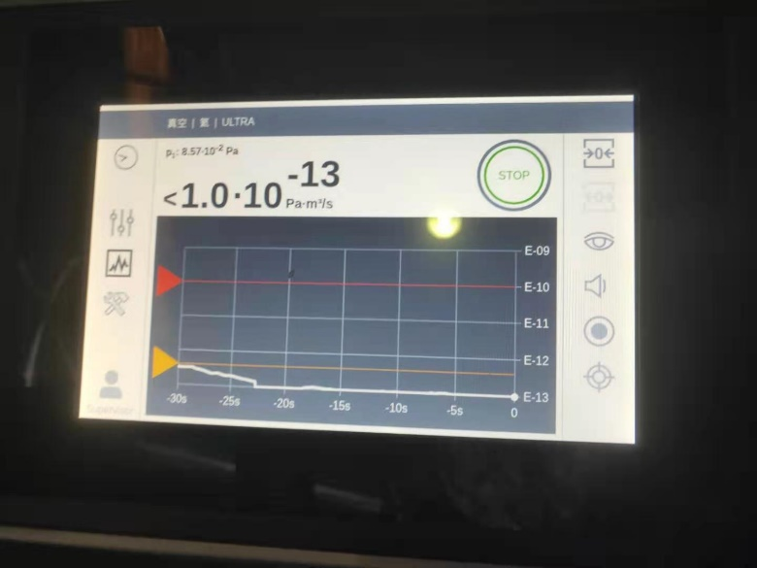
Prototype development of electrostatic separator
Factory test
System vacuum leak detection
vacuum leakage rate ≤2x10-13Pa.m3/s

Slide 34
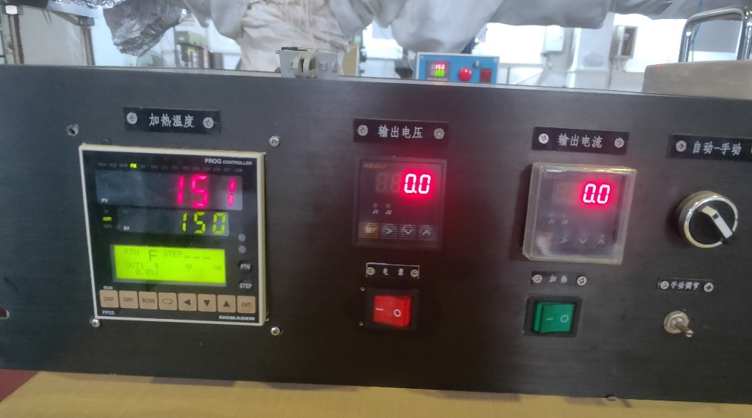
Prototype development of electrostatic separator
Factory test
The system was vacuum baked for a week (up to 150 ℃)

Slide 35
Prototype development of electrostatic separator
Factory test
The system was vacuumed after baking
vacuum pressure: 1.3x10-8Pa

Slide 36
Prototype development of electrostatic separator
Factory test
High voltage test
The voltage was increased to 108kV. Due to the arc occurred at the air side of feedthrough, two power supplies failed to use. The damaged power supplies have been returned to the factory for repair

Slide 37
Prototype development of electrostatic separator
Factory test
Reason: 1. The insulation performance decreases due to the high air humidity (70%) of the test site; 2. The ceramic surface is polluted during assembly, resulting in a decline in insulation performance.
Improvement scheme : 1. Carry out cleaning and sandblasting of ceramic parts; 2. carve annular groove on the outer surface of ceramic parts to increase the creepage distance; 2. Electrode probe is coated with insulation bushing and sealed to block the creepage path on the air side of the HV feedthrough.

Slide 38
Prototype development of electrostatic separator
Factory test results
 | Parameters | Target | Test results
1 | vacuum leakage rate | ≤1x10-10Pa.m3/s | 2×10-13Pa·m3/s
2 | Nominal vacuum pressure | ≤5x10-8Pa(烘烤后) | 1.3×10-8Pa 3.9×10-8Pa
3 | Maximum conditioning voltage | ±135KV，稳定工作8小时无故障打火，真空度≤5x10-8Pa | －108KV ＋97.6KV

Slide 39
Project next plan
After the improvement by Feedthrough, the separator will be delivered to the IHEP for testing.
The electrostatic separator will be further experimented with high voltage, and the cooling system and high order mode absorption will be optimized.
Finally, finishing high voltage testing of the prototype, to achieve the final indicators.

Slide 40
Summary
Improved the cooling loop of the electrodes.
The structure of the insulation metal-ceramic support and of high voltage feedthrough is optimized and the electric field simulation is carried out.
All the components of the separator have been machined.
The overall installation of the separator was completed
The factory test shows that the vacuum reaches the target
Due to the arc of the high voltage test, two power supplies failed to be used. After the improvement by Feedthrough, the separator will be delivered to the IHEP for testing.

Slide 41
Thank You!

