Slide 1




Status of readout electronics and HBU development
Zhongtao Shen
University of Science and Technology of China
On behalf of the CEPC calorimeter working group
MOST CEPC Project 2021 Annual Meeting
Beijing, April 2021

Slide 2
Outline
AHCAL prototype & Readout structure
ASIC selection & test
HBU design
DAQ system development
SiPM test platform

Slide 3
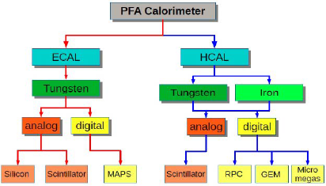
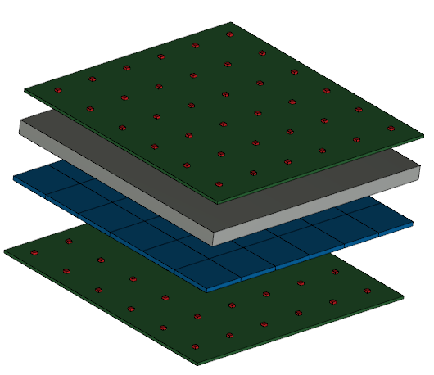
AHCAL prototype
The AHCAL prototype is task3 of MOST2, for exploring the techniques of CEPC PFA HCAL.
The prototype is optimized to a 40-layer sampling calorimeter. And each layer consists of one-layer 20 mm Fe as absorber, one-layer scintillators as sampler and one-layer PCB with SiPMs for signal readout.
Cross section of prototype: 72 cm x 72 cm
Scintillator cell size: 4 cm x 4 cm
There are 18 x 18 readout channels per layer and 12,960 channels for the prototype.
absorber
scintillator
PCB with SiPM

Slide 4
Readout structure
DAQ System
Data Interface
HCAL Base Unit

Slide 5
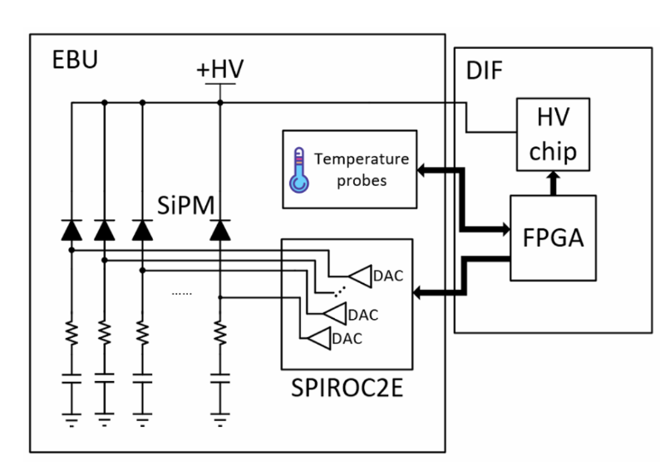
ASIC selection
Demands:
  Low power and high integration
  Dynamic range:
  30 fC ~ 150 pC (1 p.e. ~ 250 MIP)
  SiPM gain: 2 x 10⁵, L.Y. = 20 p.e./MIP
  Input voltage adjustment (Input DAC)
  Time measurement
  Digital output
ASIC
ASIC | Channel | Input DAC | Dynamic Range | Time Measure (bin/ps) | Output | Power （mW/ch）
SPIROC | 36 | Y | 30 fC~300 pC | 100 | Digital | 6.5
PETIROC | 32 | Y | 160 fC~400 pC | 37 | Digital | 6
CITIROC | 32 | Y | Up to 400 pC | -- | Analog | --
VATA64-HDR16 | 64 | Y | 5 fC~12 pC | -- | Analog | --
KlauS | 36 | Y | 13 fC~450 pC | 200 | Digital | 3.6
√
√

Slide 6
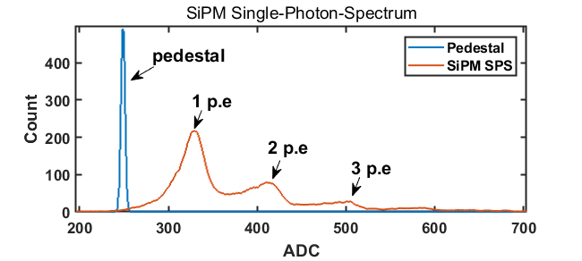
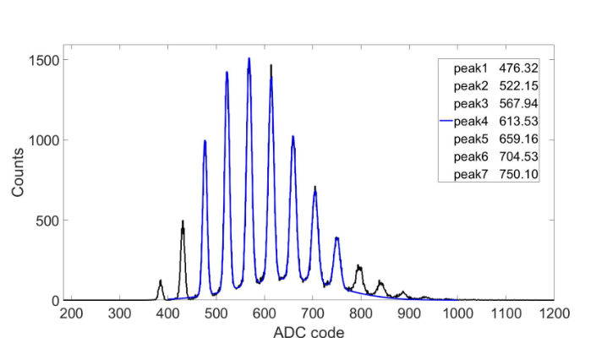
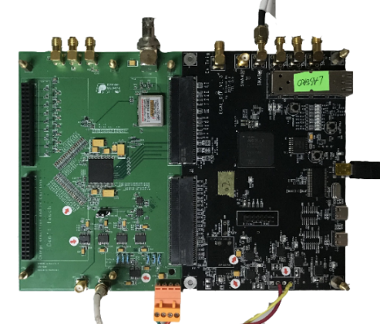
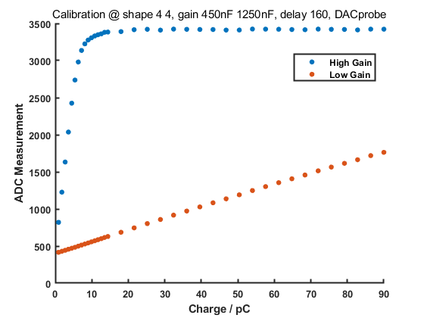
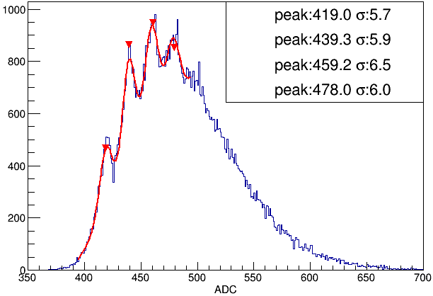
Spiroc-2E test board
A chip developed by Omega group for SiPM signal readout, especially for PFA calorimeter.
Developed a one-chip test board based on Spiroc-2E.
The function of the chip was learned and the performance was tested.
Tested with different SiPMs.
S.P. spectrum of S12572-025P
S.P. spectrum of S13360-1325PE
Board with one chip
High gain & Low gain response
S.P. spectrum of NDL 22-1313-15S

Slide 7
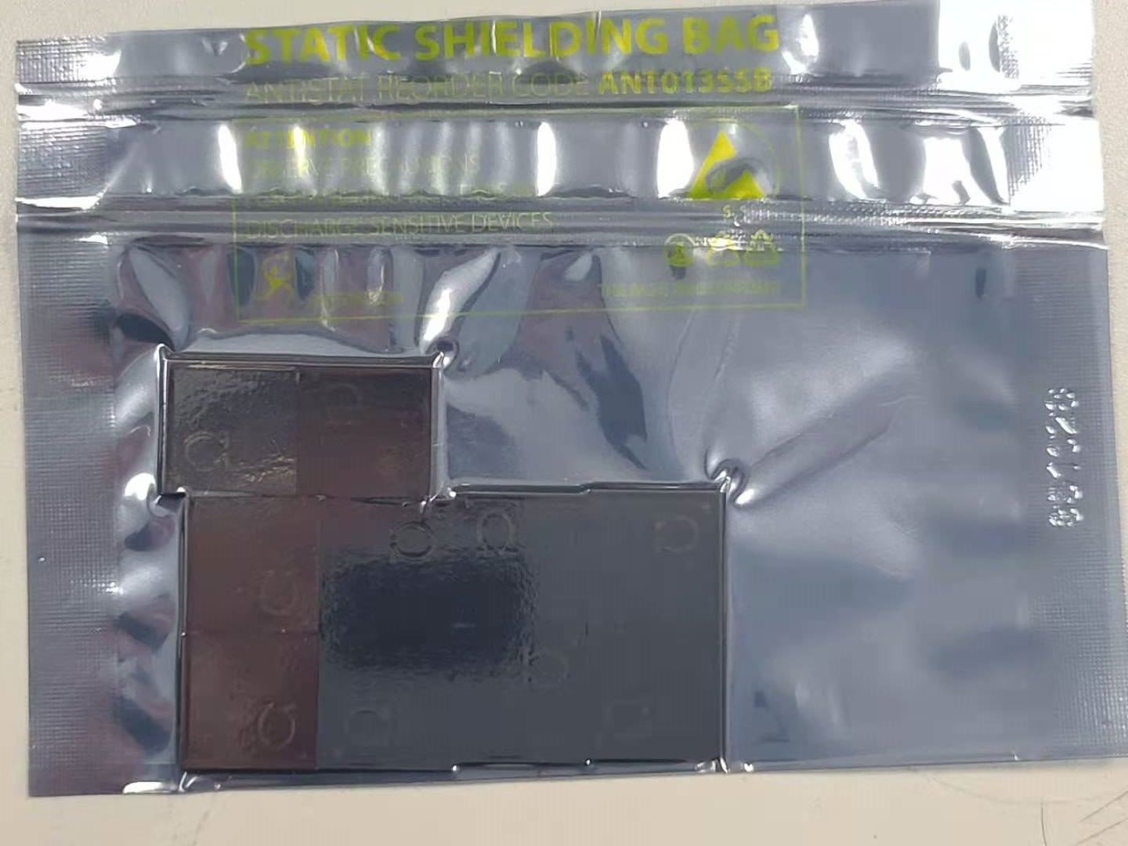
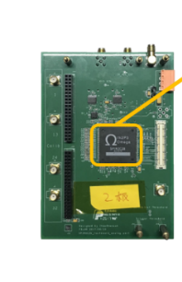
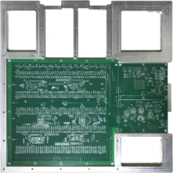

Spiroc-2E-based design
Based on Spiroc-2E, several readout systems have been successfully developed, including the ECAL prototype readout system and the batch test platform.
Spiroc-2E proves to be a good solution for AHCAL prototype and we have many experiences in using it. So it’s the baseline for AHCAL prototype readout system.
The Spiroc-2E supply was interrupted since 2019 for the packaging company went bankrupt. The Omega fixed the problem and resume providing chips in Nov. 2020. And 400 chips have been booked for AHCAL prototype, which will be shipped to china recently.
ECAL prototype readout system
Chips received in Nov. 2020

Slide 8
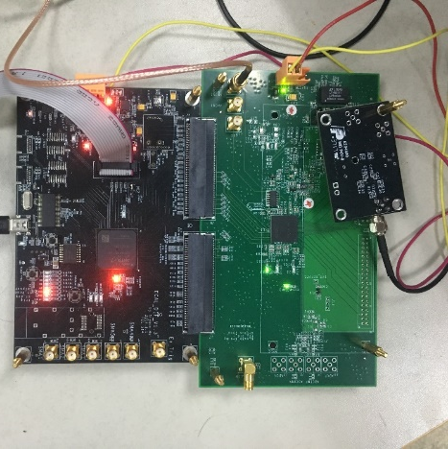
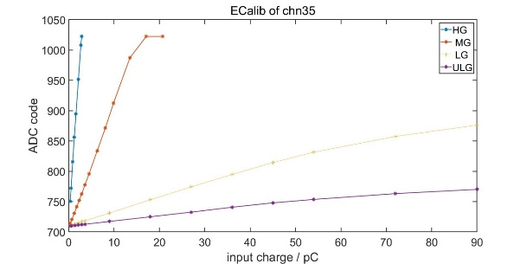
KLauS-5 test board
KLauS is an option for AHCAL thanks to its better noise performance and shorter dead time.
Developed a one-chip test board based on Spiroc-2E. The function of the chip was learned and the performance was tested.
Because the chip correction is complicated, we can’t use it to read SiPM signals now. (The chip developer is plan to come to China to help us solve the problem recently.)
Despite its advantages, the KLauS chip is not the mature one, so its only an option for AHCAL. Also expensive than Spiroc-2E.
KLauS
Board with one chip
High gain & Low gain response

Slide 9
HBU design
HBU
  Active area: 72 cm x 72 cm
  Scintillator size: 4 cm x 4 cm
  18 x 18 readout channel per layer
A PCB up to 72 cm x 72 cm is not able to be manufactured or soldered. HBU must be divided into several PCBs.
For the large PCB size, signal integrity, synchronization and mechanical design should be considered.

Slide 10
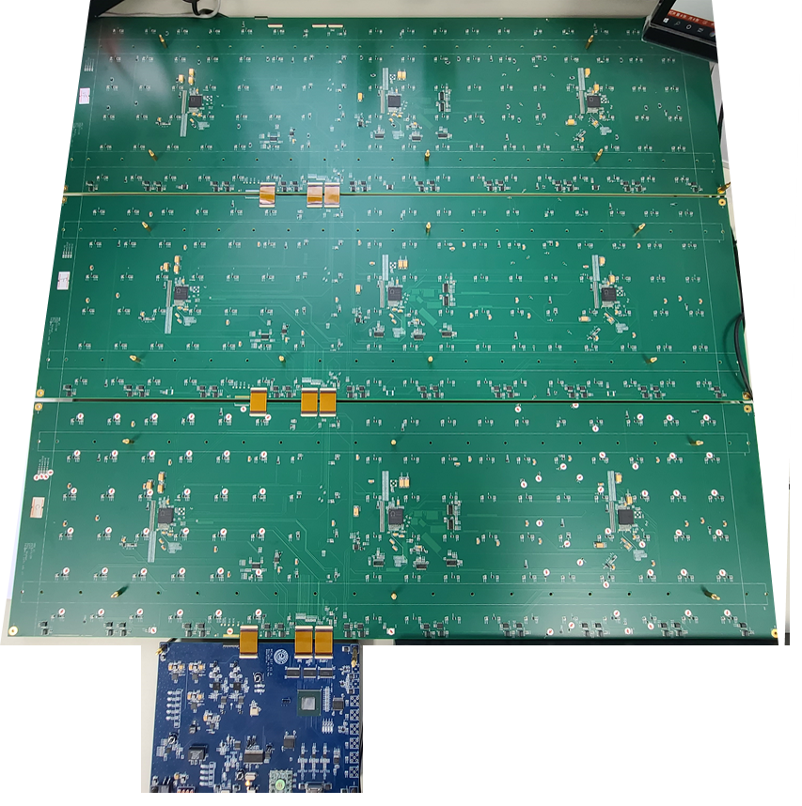
HBU design
HBU sub board
Frame of HBU board
  Divided to 3 sub boards(786mm x 240mm)
  Using flexible board to combine 3 sub board
  Every HBU board is coupled with 1 DIF
1
2
3
Flexible board
DIF board
Notes:
Design one type of PCB, with connect both on the left side and right side for cascading.
3 SP2E is mounted on one PCB and each chip is responsible for the area of 6 x 6 scintillators.

Slide 11
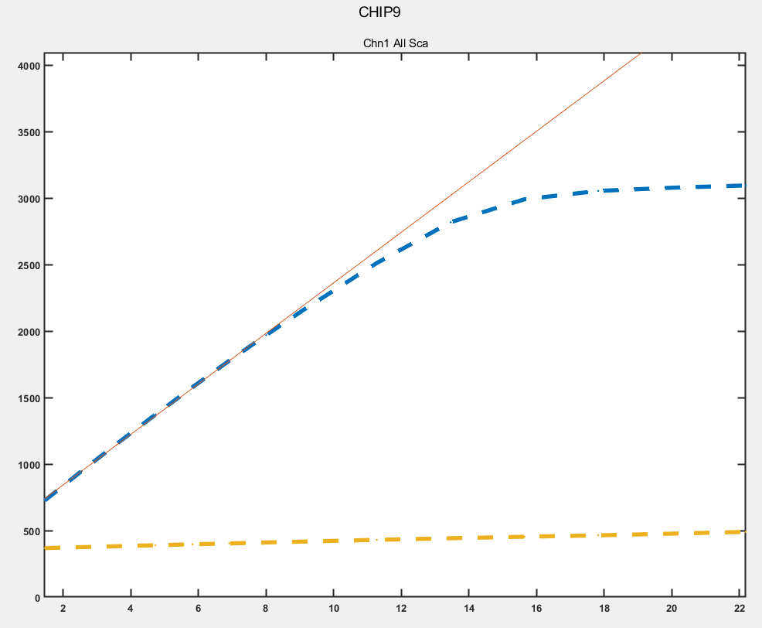
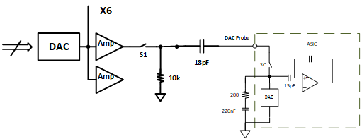
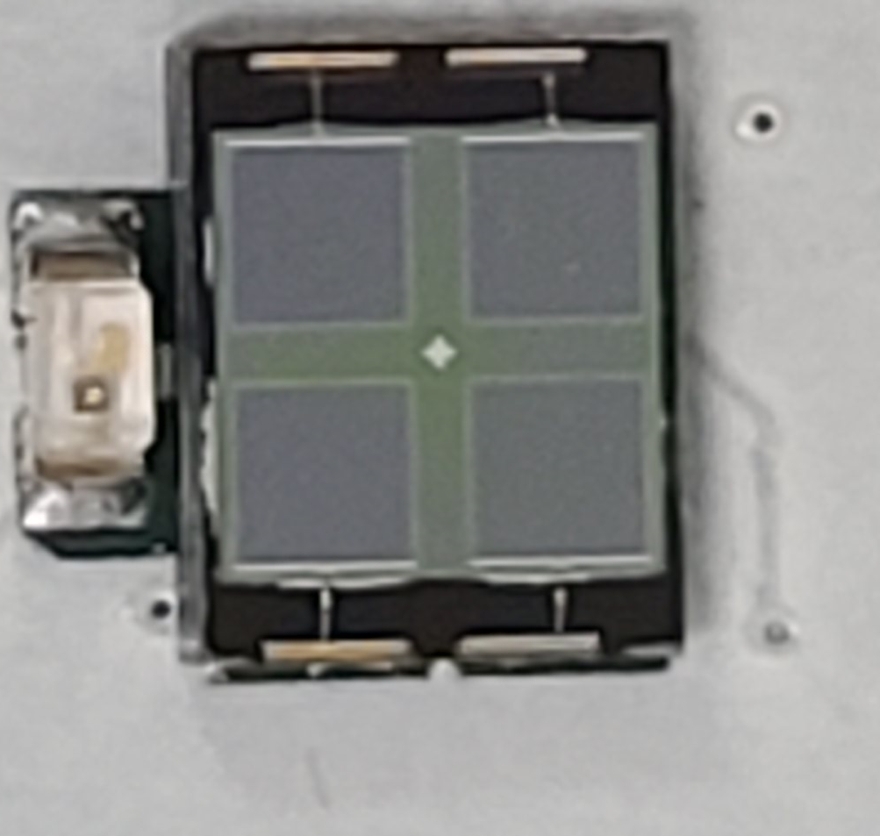
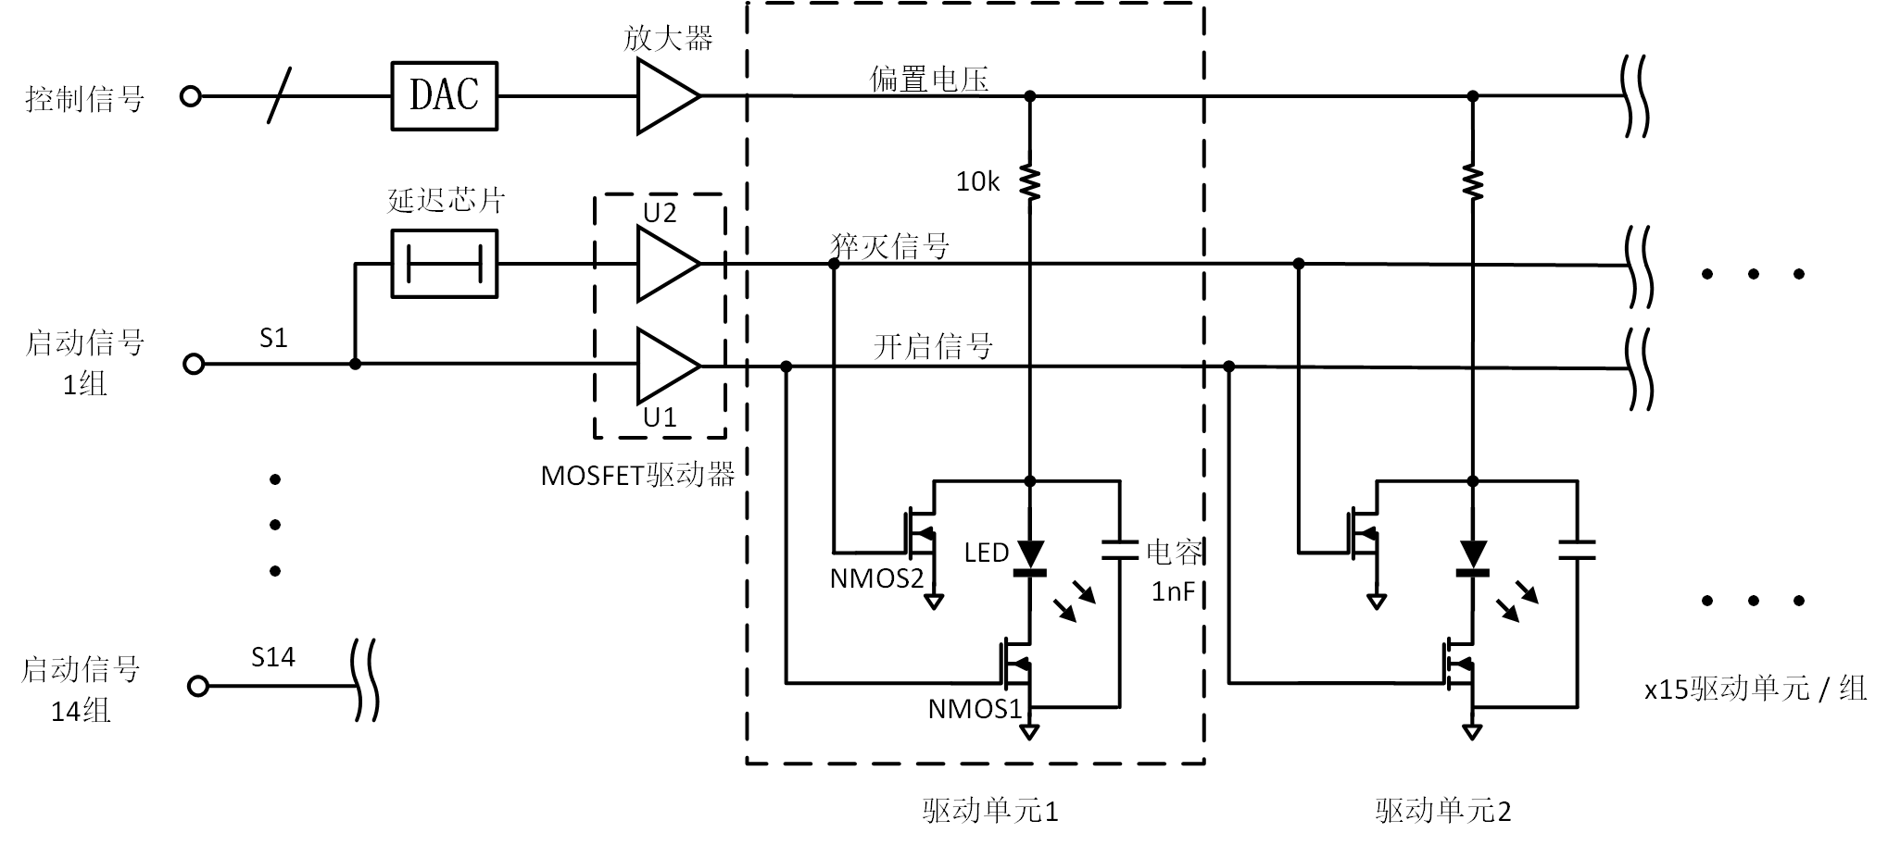
Electronic & LED calibration system
Besides the function of signal readout, electronics calibration, light calibration and temperature monitor is also implemented on HBU.
high gain
low gain
Electrical Calibration System
LED
SiPM
Light Calibration System

Slide 12
Signal Integrity and Synchronization
Using high output current buffer to
ensure single-ended signal integrity
buffer
Using fan out buffers to
ensure LVDS signal integrity
Select different delay line to
ensure signal synchronization

Slide 13
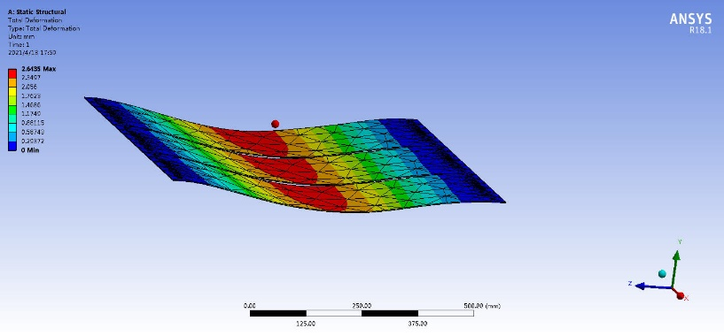
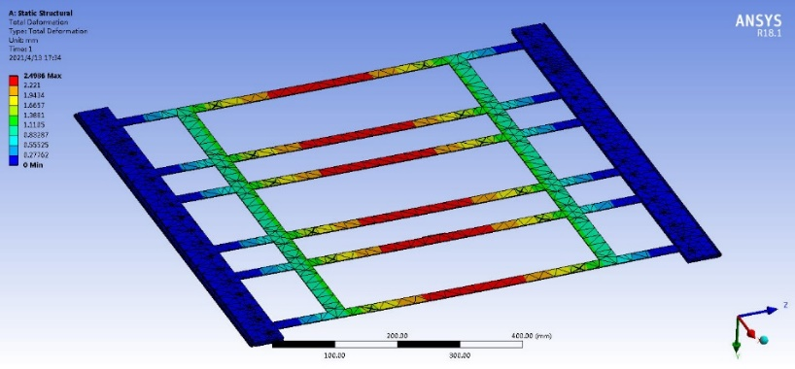
Mechanical support
Mechanical support should be used to avoid PCB warping.
Some mechanical simulation has been made. The thicker the rib is, the more support it can provide.
More support structure will be attempted. And a tradeoff will be made between the PCB warping and the rib thickness.
Thickness of rib/mm | Deformation/mm
5 | 0.51
6 | 0.34
7 | 0.2
8 | 0.13
9 | 0.099

Slide 14
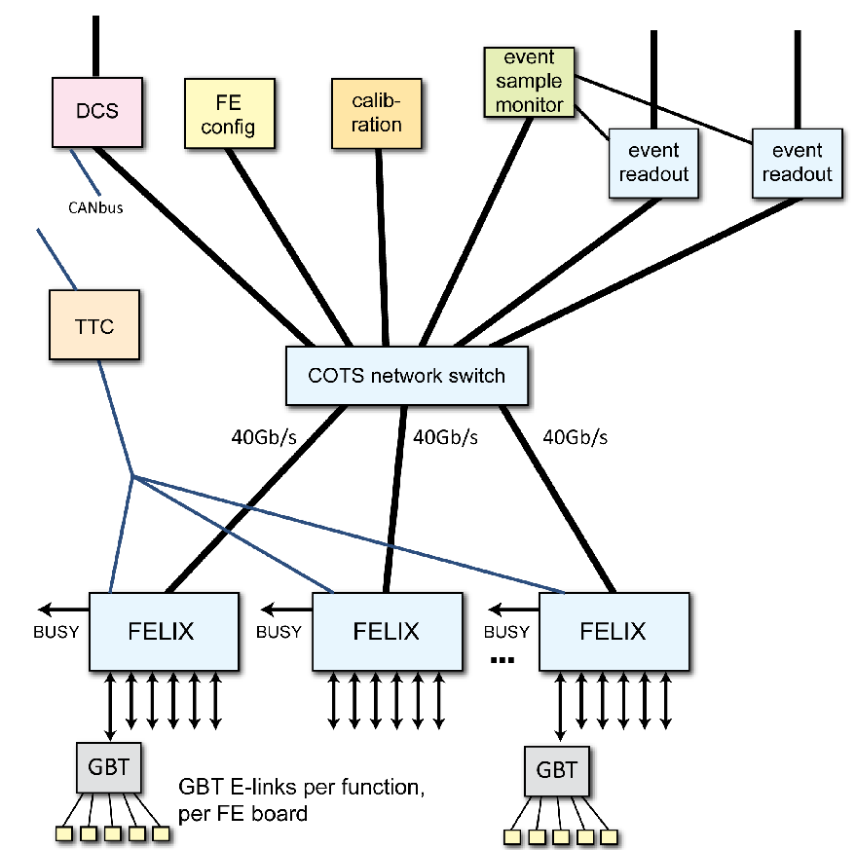
DAQ system development
FELIX（FrontEnd LInk eXchange）is the DAQ system used in the ATLAS upgrade. And EUDAQ is a DAQ system developed by CALICE group for PFA calorimeter.
Reference these two system, we developed a DAQ system friendly to the PFA calorimeters and successfully used in the ECAL prototype.
Structure of the FELIX system
ECAL DAQ system

Slide 15
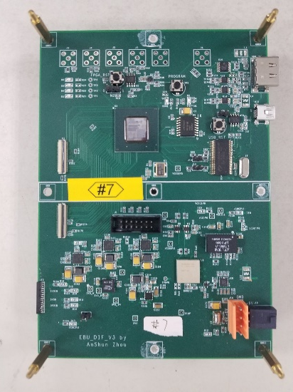
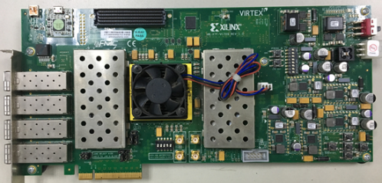
DAQ system development
The system consists of a FELIX card, the DAQ board, the DIF (Data Interface) boards and the end units (EBU or HBU).
The DAQ board, the DIF board, firmware and software are developed and successfully used in ECAL prototype.
FELIX Card (VC709)
DAQ board
DIF board

Slide 16
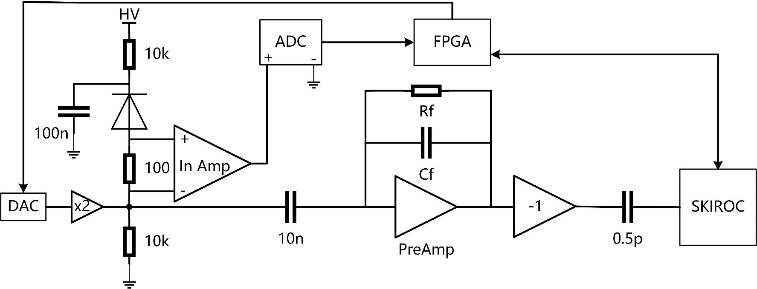
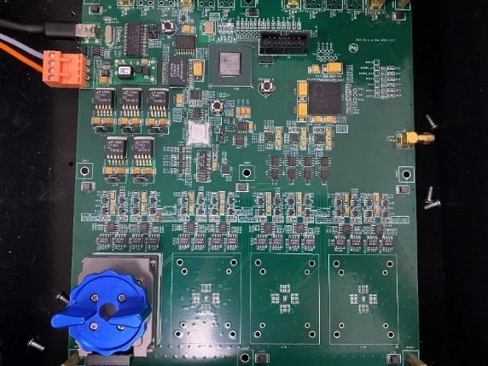
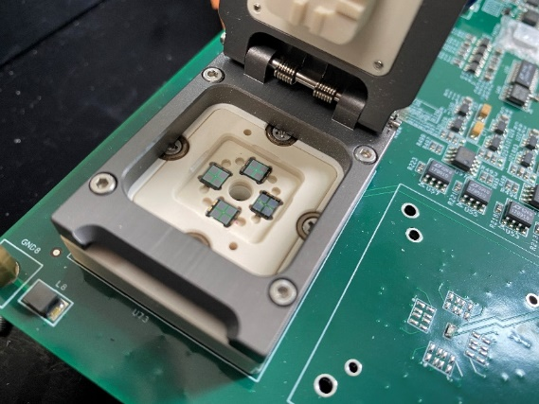
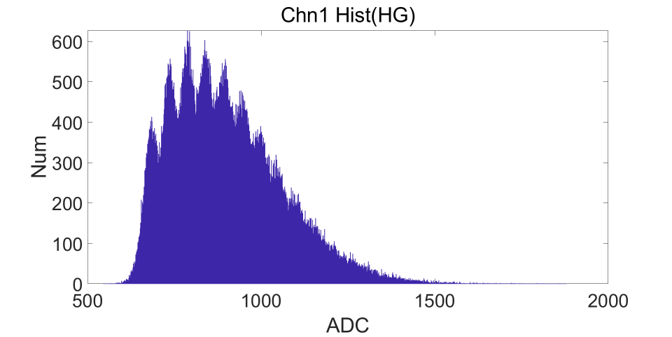
SiPM test platform
To test the SiPM performance, a batch test platform is develop.
Test item
  V-I curve
  Dark count rate
  LED spectrum measurement

Slide 17
Summary & plan
ASIC selection
  Finished.
  Spiroc-2E as baseline and KLauS-6 as option.
  400 Spiroc-2E has been booked for the prototype.
Readout electronics design
  The HBU_V1 has been designed and tested, and the electronics performance is good.
  Mechanical design is ongoing and plan to be finished in June.
  HBU_V2, which is suitable to the mechanical structure will be design and tested in Augest.
  Mass production will begin in September.
DAQ system design
  Finished.
  DAQ board, DIF board, Hardware and software are all finished and the system is verified in ECAL prototype.

