Slide 1
Study of the light pseudoscalar and axial-vector meson spectra
Meng-chuan Du (杜蒙川)
In collaboration with Prof. Qiang Zhao (赵强)
轻强子谱国际协同研究研讨会
2021年7月9日，高能所

Slide 2
Motivation
For $I=0, C=+$ states, the masses of $η(1295)$ and $f_{1}(1285)$ are degenerate. The masses of $η(1405/1475)$ and $f_{1}(1420)$ are degenerate.
$η(1405/1475)$ and $f_{1}(1420)$ can be both observed in $K \overline{K}π$, $ηππ$, $3π$ and $γV$ final states. The properties of $η(1405/1475)$ and $f_{1}(1420)$ are related by sharing some dynamics.
In quark model, the light axial vector mesons (A) are related by flavor SU(3) symmetry.
All of these states can couple to $K^{∗}\overline{K}$, e.g. $η\left(1405/1475\right)→K^{∗}\overline{K}+c.c.$ in P-wave and $A→K^{∗}\overline{K}+c.c.$ in S-wave. Their masses are close to the threshold.
The threshold effect, especially the triangle singularity, is significant.

Slide 3
Content
Kinematic singularity
The emergence of kinematic singularity
Singular behavior
$η(1405/1475)$
The $η(1405/1475)$ puzzle
Open P-wave $K^{∗}\overline{K}$ threshold and width effect
Combined analysis
$η(1295)$, $η\left(1405/1475\right)→γV$
Light axial vector mesons
Introduction
Open S-wave $K^{∗}\overline{K}$ threshold and TS
Combined analysis.
Conclusion and outlook

Slide 4
Content
Kinematic singularity
The emergence of kinematic singularity
Singular behavior
$η(1405/1475)$
The $η(1405/1475)$ puzzle
Open P-wave $K^{∗}\overline{K}$ threshold and width effect
Combined analysis
$η(1295)$, $η\left(1405/1475\right)→γV$
Light axial vector mesons
Introduction
Open S-wave $K^{∗}\overline{K}$ threshold and TS
Combined analysis.
Conclusion and outlook

Slide 5
The emergence of kinematic singularity
A typical loop integral:
$$I_{(\{p\})}=\int{\prod_{j=1}^{l}{\frac{d^{4}k_{j}}{{\left(2π\right)}^{4}}}\frac{1}{\prod_{i=1}^{N}{(q_{i}^{2}−m_{i}^{2})}}}=\int{\frac{\prod_{i=1}^{N}{dα_{i}}δ\left(∑α_{i}−1\right)}{{\left(Det a\right)}^{2}Δ^{N−2l}}}$$
$$N=5$$
$$l=1$$
$$f\left(s\right)=\int_{0}^{z}{dα\frac{1}{g(s,α)}}$$
As momentum changes, the singular points of the integrand approaches the integral contour.
The condition of the leading singularity is given by Landau equation.
$$\left\{\begin{matrix}q_{i}^{2}−m_{i}^{2}=0 \\ \sum_{each loop}^{ }{α_{i}q_{i}^{μ}}=0 (α_{i}>0)\end{matrix}\right.$$
L. D. Landau, Nucl. Phys. 13(1959)181
Notes:
所谓的运动学的奇异点是说对于费曼圈图而言，当运动学量具有某种关系时，圈图出现奇异。这种奇异的出现会在初末态的不变质量谱上形成增强，进而干扰我们对是否存在新的共振态结构的判定。我们称这种增强为“运动学”的，实际上是在强调其发生与否以及其典型的特征与具体的动力学机制一般来说没有关系，除了少数情况外。
对奇异点出现的条件的系统的研究是由朗道给出的。其出发点是考虑一个l圈N个传播子的圈积分。这里k是独立的积分变量，alpha则是费曼参数。费曼参数化后，分母可以写成一个有关积分变量k的二次型，而通过平移过后，这个二次型总是可以是齐次的。【介绍b,c,p】
重复使用这个式子积掉平移后的动量k’,则得到

Slide 6
Content
Kinematic singularity
The emergence of kinematic singularity
Singular behavior
$η(1405/1475)$
The $η(1405/1475)$ puzzle
Open P-wave $K^{∗}\overline{K}$ threshold and width effect
Combined analysis
Light axial vector mesons
Introduction
Open S-wave $K^{∗}\overline{K}$ threshold and TS
Combined analysis.
Conclusion and outlook

Slide 7
Singular behavior
For a given diagram with $l$ loops and N propagators
$M∼{\left(s_{0}−s\right)}^{2l−\frac{N+1}{2}}\ln{(s_{0}−s)}$ if $2l−\frac{N+1}{2}=m, m=0,1,2…$
$M∼{\left(s_{0}−s\right)}^{2l−\frac{N+1}{2}}$ other cases
$$N=2$$
$$N=3$$
$$N=4$$
$$N=5$$
$$2l−\frac{N+1}{2}=\frac{1}{2}$$
$$2l−\frac{N+1}{2}=0$$
$$2l−\frac{N+1}{2}=−\frac{1}{2}$$
$$2l−\frac{N+1}{2}=−1$$
$$\frac{1}{\sqrt{s_{0}−s}}$$
$$\frac{1}{s_{0}−s}$$
$$A∼ \sqrt{s_{0}−s}$$
$$\ln{(s_{0}−s)}$$
[1] L. D. Landau, Nucl.Phys. 13(1959)181
[2] V.N.Gribov, Y.Dokshitzer, J.Nyiri, Strong interactions of hadrons at high energies- Gribov
lectures on theoretical physics, Cambridge University Press, 2009
Notes:
如果粒子的质量合适，朗道方程就有解。这个解告诉我们当外线动量在某些值的时候，圈图会出现奇异。
但是奇异并不一定意味着发散，也可能是支点。朗道的这篇文章其实也给出了当外线运动学量，比如s趋近于奇异点$s_{0}$时，振幅是按照怎样的方式变得奇异的。
【介绍不同的N的情况，同时说明奇异性不会无休止上升】

Slide 8
Singular behavior
For a given diagram with $l$ loops and N propagators
$M∼{\left(s_{0}−s\right)}^{2l−\frac{N+1}{2}}\ln{(s_{0}−s)}$ if $2l−\frac{N+1}{2}=m, m=0,1,2…$
$M∼{\left(s_{0}−s\right)}^{2l−\frac{N+1}{2}}$ other cases
$$K^{∗}$$
$$K^{∗}$$
$$K$$
$$η, A$$
$$η, A$$
$$η, A$$
$$π$$
Vertex correction to $η\left(1405/1475\right),A→K^{∗}\overline{K}+c.c.$,
$$\overline{K}$$
$$\overline{K}$$
$${\overline{K}}^{∗}$$
Mass renormalization
$$η, A$$
$$K^{∗}$$
$$π$$
$$K$$
Vertex correction to $η\left(1405/1475\right),A→a_{0}π,f_{0}π,ρπ,φπ,ωπ$
$$\overline{K}$$
$$S,V$$
[1] L. D. Landau, Nucl.Phys. 13(1959)181
[2] V.N.Gribov, Y.Dokshitzer, J.Nyiri, Strong interactions of hadrons at high energies- Gribov
lectures on theoretical physics, Cambridge University Press, 2009

Slide 9
Content
Kinematic singularity
The emergence of kinematic singularity
Singular behavior
$η(1405/1475)$
The $η(1405/1475)$ puzzle
Open P-wave $K^{∗}\overline{K}$ threshold and width effect
Combined analysis
$η(1295)$, $η\left(1405/1475\right)→γV$
Light axial vector mesons
Introduction
Open S-wave $K^{∗}\overline{K}$ threshold and TS
Combined analysis.
Conclusion and outlook

Slide 10
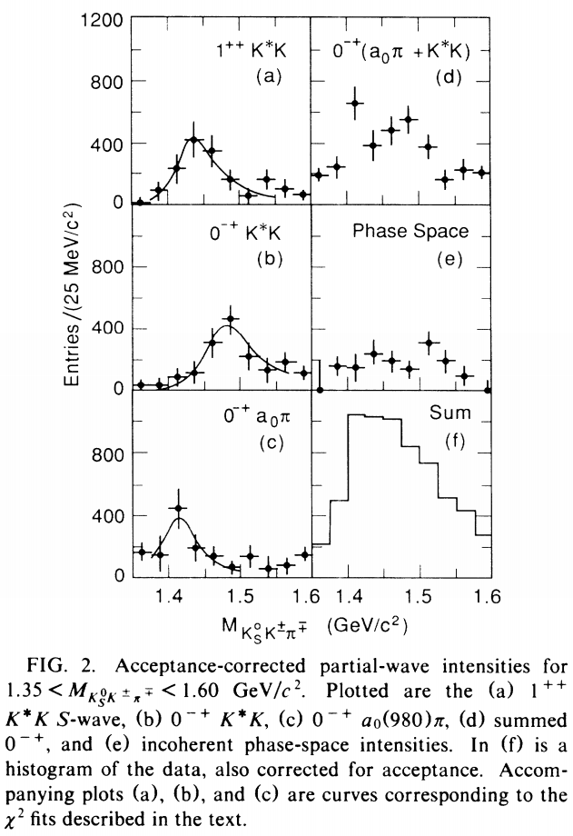
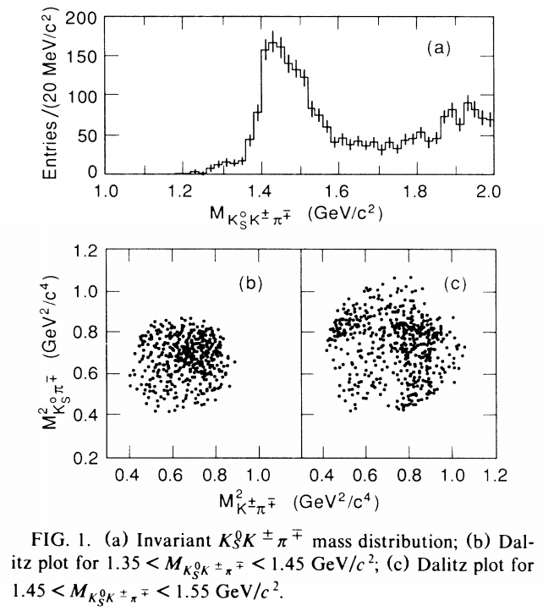
The $η\left(1405/1475\right)$ puzzle
MARKIII $J/ψ→γK_{s}^{0}K^{±}π^{∓}$
Z. Bai et al. (MARK-III Collaboration), Phys. Rev. Lett. 65,2507 (1990).

Slide 11
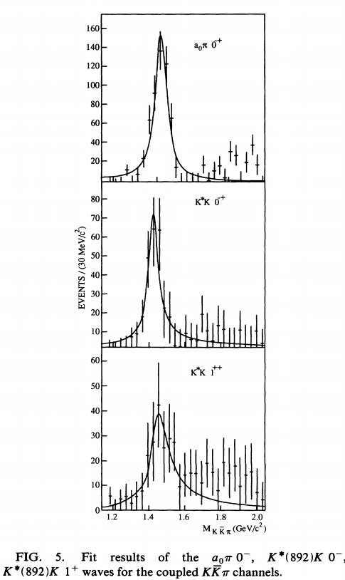
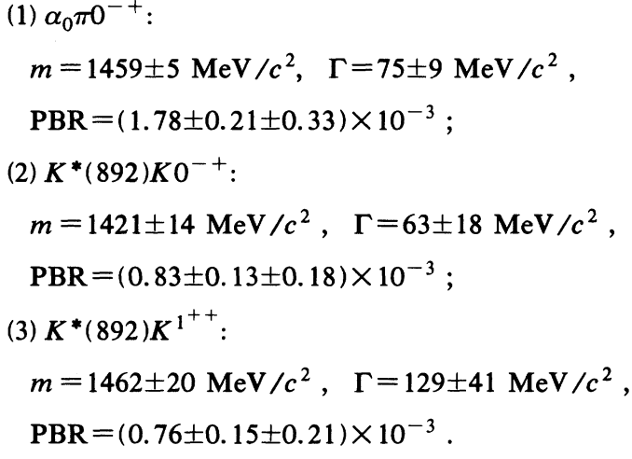
DM2 $J/ψ→γK_{s}^{0}K^{±}π^{∓}, K^{+}K^{−}π^{0}$
Fitting results from coupled $K \overline{K}π$ channels:
J. E. Augustin et al. (DM2 Collaboration), Phys. Rev. D 46,1951 (1992).

Slide 12
Other studies:
[1]J. E. Augustin et al. (DM2 Collaboration), Phys. Rev. D 42,10 (1990).
[2]A. Bertin et al. (OBELIX Collaboration), Phys. Lett. B 361,187 (1995).
[3]A. Bertin et al. (OBELIX Collaboration), Phys. Lett. B 400,226 (1997).
[4]C. Cicalo et al. (OBELIX Collaboration), Phys. Lett. B 462,453 (1999).
[5]J. Z. Bai et al. (BES Collaboration), Phys. Lett. B 594, 47(2004).
Low statistics and simple parametrization
In $0^{− +}$ wave, peak positions are different.
Contradiction, even in PDG.

Slide 13
$η(1405)$ as a candidate of pseudoscalar glueball[1-8]?
[1] L. Faddeev, A. J. Niemi, and U. Wiedner, Phys. Rev. D 70,114033 (2004).
[2] J. F. Donoghue, K. Johnson, and B. A. Li, Phys. Lett. 99B,416 (1981).
[3] F. E. Close and S. Monaghan, Phys. Rev. D 23, 2098 (1981).
[4] T. Barnes, F. E. Close, and S. Monaghan, Phys. Lett. 110B,159 (1982).
[5] F. E. Close, Rep. Prog. Phys. 51, 833 (1988).
[6] C. Amsler and N. A. Tornqvist, Phys. Rep. 389, 61 (2004).
[7] A. Masoni, C. Cicalo, and G. L. Usai, J. Phys. G 32, R293(2006).
[8] E. Klempt and A. Zaitsev, Phys. Rep. 454, 1 (2007).
LQCD calculated mass[9-14]
$$0^{++}: 1.5∼1.7$$
$$2^{++}:2.2∼2.3$$
$$0^{−+}:2.4∼2.6$$
[9] C. J. Morningstar and M. J. Peardon, Phys. Rev. D 60,034509 (1999).
[10] G. S. Bali, K. Schilling, A. Hulsebos, A. C. Irving, C.Michael, and P.W. Stephenson (UKQCD Collaboration),
Phys. Lett. B 309, 378 (1993).
[11] Y. Chen et al., Phys. Rev. D 73, 014516 (2006).
[12] A. Chowdhury, A. Harindranath, and J. Maiti, Phys. Rev. D91, 074507 (2015).
[13] C. M. Richards, A. C. Irving, E. B. Gregory, and C. McNeile(UKQCD Collaboration), Phys. Rev. D 82, 034501 (2010).
[14] W. Sun,L.-C.Gui,Y.Chen,M.Gong,C.Liu,Y.-B.Liu,Z.Liu,J.-P. Ma, and J.-B. Zhang, Chin. Phys. C 42, 093103 (2018).

Slide 14
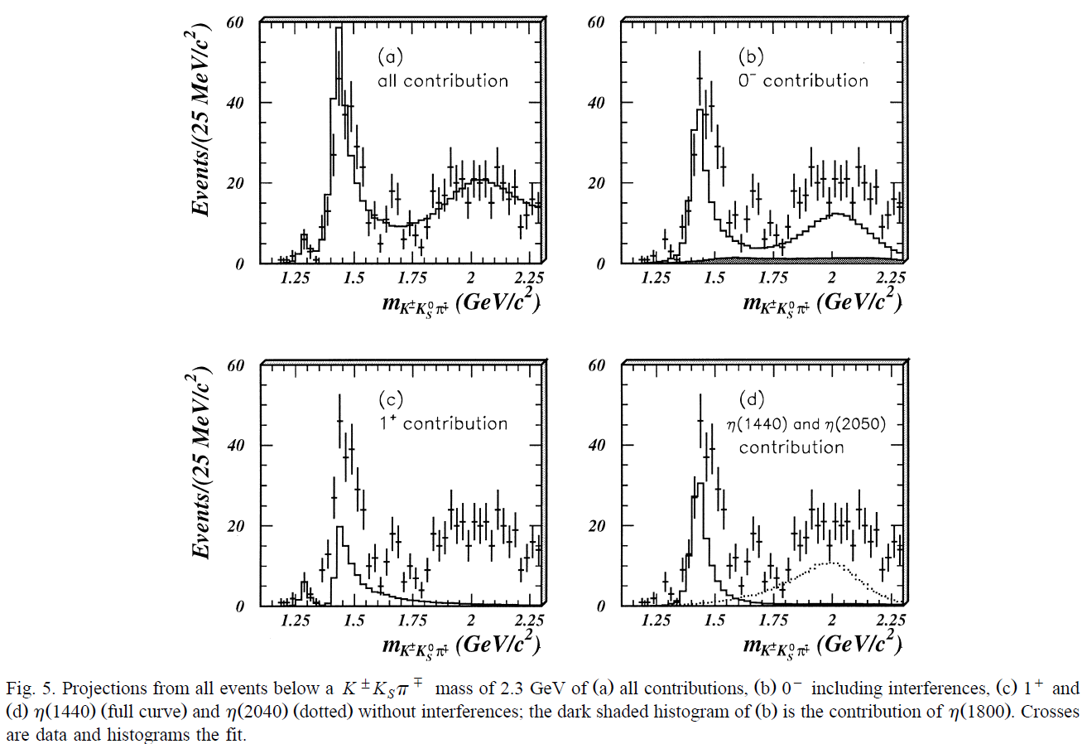
BES $J/ψ→γK_{s}^{0}K^{±}π^{∓}$[1]
Ref[2]
Ref[3]
[1] J.Z. Bai et al. (BES Collaboration), Phys. Lett. B 476, 25 (2000)
[2] J.Z. Bai et al. (BES Collaboration), Phys. Lett. B 446, 356 (1999)
[3] J.Z. Bai et al. (BES Collaboration), Phys. Lett. B 472, 207(2000)

Slide 15
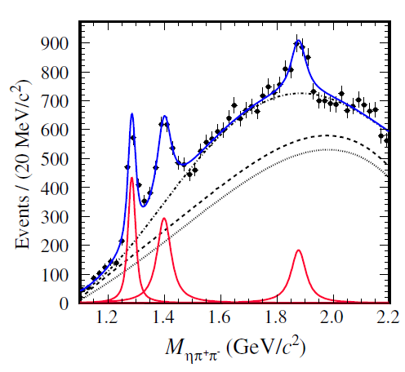
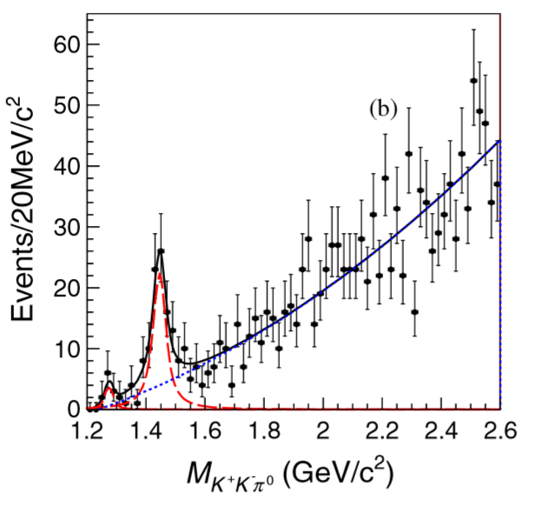
Data from BESIII
$J/ψ→ωηπ^{+}π^{−}$[1]
$ψ(2S)→ωK^{+}K^{−}π^{0}$[2]
It is possible to fit with one state with energy dependent width
Only one structure observed in every exclusive channel
Peak positions disagree in different channels.
[1] M. Ablikim et al. (BESIII Collaboration), Phys.Rev.Lett. 107, 182001 (2011)
[2] M. Ablikim et al. (BESIII Collaboration), Phys.Rev.D 87, 092006 (2013)

Slide 16
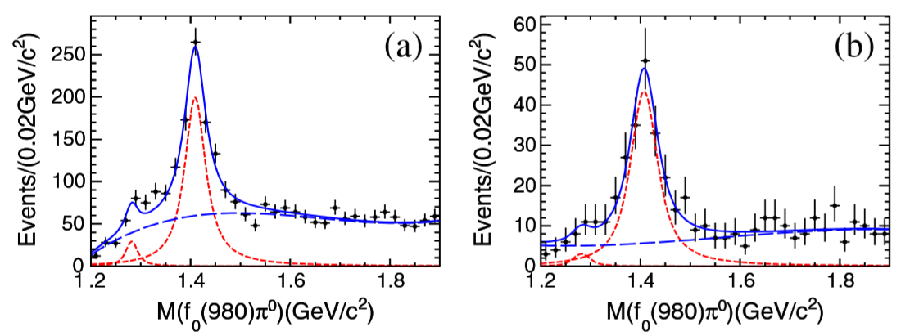
$$J/ψ→γf_{0}π→γ3π$$
Results of the fit to (a) the $f_{0}\left(980\right)\left(π^{+}π^{−}\right)π^{0}$ and (b) $f_{0}\left(980\right)\left(π^{0}π^{0}\right)π^{0}$ invariant mass spectra. The solid curve is the result of the fit. The dotted curve is the $f_{1}(1285)/η(1295)$ and $η(1405)$ signal. The dashed curves denote the background polynomial.
M. Ablikim et al., PRL 108, 182001 (2012)

Slide 17
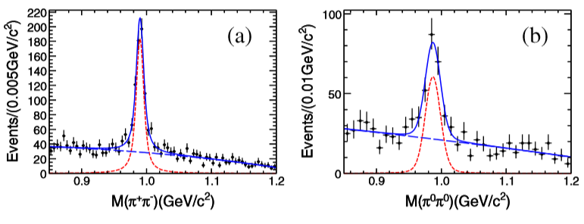
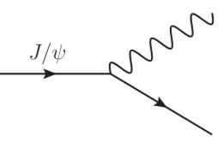
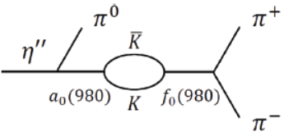
$$γ$$
$$η^{′′}$$
$$π^{0}$$
$$η^{′′}$$
$$π^{+}(π^{0})$$
$$f_{0}(980)$$
Fig. $π^{+}π^{−}$ and $π^{0}π^{0}$ spectrum from Ref[1].
$$\frac{BR(J/Ψ→γη^{′′}→γf_{0}π→γπ^{+}π^{−}π^{0})}{BR(J/Ψ→γη^{′′}→γa_{0}π→γηπ^{0}π^{0})}=(17.9±4.2)\%$$
$$π^{−}(π^{0})$$
Compare to $χ_{c1}$ decay [2,3]:
$$\frac{BR(χ_{c1}→a_{0}π^{0}→f_{0}π^{0}→π^{+}π^{−}π^{0})}{BR(χ_{c1}→a_{0}π^{0}→ηπ^{0}π^{0})}$$
$$=(0.31±0.16\left(stat\right)±0.14\left(sys\right)±0.03\left(para\right))\%$$
$$<1\% (90\%C.L.)$$
~$1\%[4]$
[1] M. Ablikim et al., PRL 108, 182001 (2012). [2] M. Ablikim et al., Phys. Rev. D 83, 032003 (2011).
[3] M. Ablikim et al., Phys. Rev. Lett. 121, 022001 (2018). [4]F. Aceti, W. Liang, E. Oset, J. Wu, and B. Zou, Phys. Rev.D 86, 114007 (2012)

Slide 18
Content
Kinematic singularity
The emergence of kinematic singularity
Singular behavior
$η(1405/1475)$
The $η(1405/1475)$ puzzle
Open P-wave $K^{∗}\overline{K}$ threshold and width effect
Combined analysis
$η(1295)$, $η\left(1405/1475\right)→γV$
Light axial vector mesons
Introduction
Open S-wave $K^{∗}\overline{K}$ threshold and TS
Combined analysis.
Conclusion and outlook

Slide 19
We are faced with
One $η(1405/1475)$ state, but the peak positions are different in different channels.
Large isospin violation
Narrow $f_{0}(980)$

Slide 20
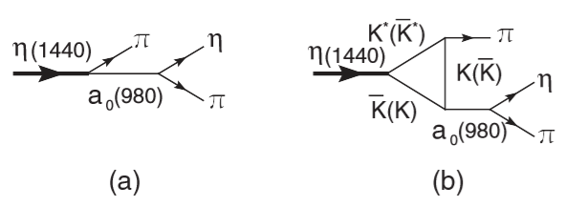
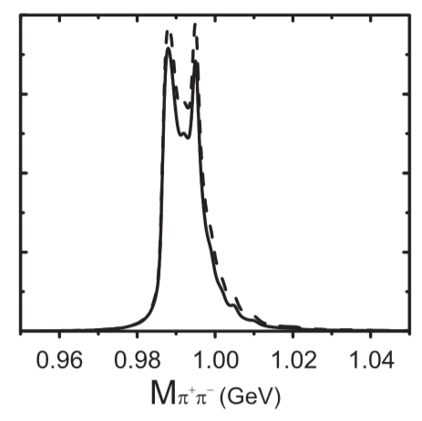
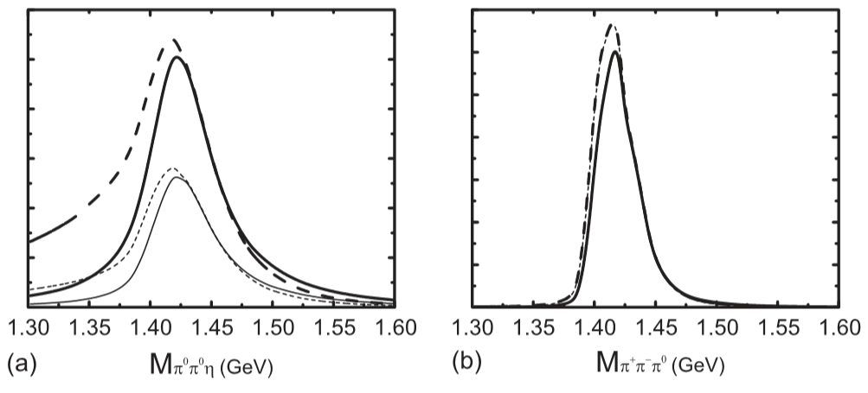
Open P-wave $K^{∗}\overline{K}$ threshold
Triangle diagrams can enhance the isospin breaking, produce narrow $f_{0}\left(980\right)$ and shift peaks
Diagrams for $η\left(1440\right)→f_{0}π→3π$
Diagrams for $η\left(1440\right)→a_{0}π→ηππ$
Calculated $π^{+}π^{−}, ηπ^{0}π^{0}$ and $π^{+}π^{−}π^{0}$ spectra.
Jia-Jun Wu, Xiao-Hai Liu, Qiang Zhao, Bing-Song Zou, Phys.Rev.Lett. 108, 081803 (2012);

Slide 21
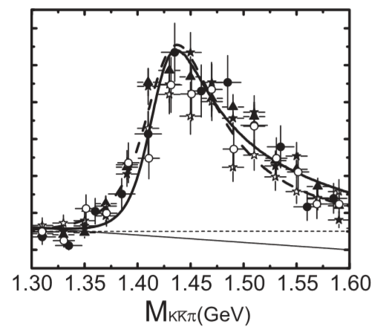
Interference between triangle and tree amplitudes can fit the spectrum [5]：
Feynman diagrams for $η\left(1440\right)→K\overline{K}π$, from Ref [5]
[5] Jia-Jun Wu, Xiao-Hai Liu, Qiang Zhao, Bing-Song Zou, PRL 108, 081803 (2012)
The ﬁt for invariant mass spectrum of $K\overline{K}π$ with a constant (thick solid) or energy-dependent (thick dashed line) width.
MARK III$\left(K_{s}K^{±}π^{∓}\right)$[1]
BES-I $\left(K_{s}K^{±}π^{∓}\right)$[2]
BES-I$\left(K^{+}K^{−}π^{0}\right)$[3]
DM2 $\left(K_{s}K^{±}π^{∓}\right)$[4]
DM2 $\left(K^{+}K^{−}π^{0}\right)$[4]
[1]Z. Bai et al. (MARK III Collaboration), Phys. Rev. Lett. 65, 2507 (1990). [2]J.Z. Bai et al. (BES Collaboration), Phys. Lett. B 476, 25 (2000).
[3]J.Z. Bai et al. (BES Collaboration), Phys. Lett. B 440, 217 (1998). [4]J.E. Augustin et al. (DM2 Collaboration), Phys. Rev. D 42, 10 (1990).

Slide 22
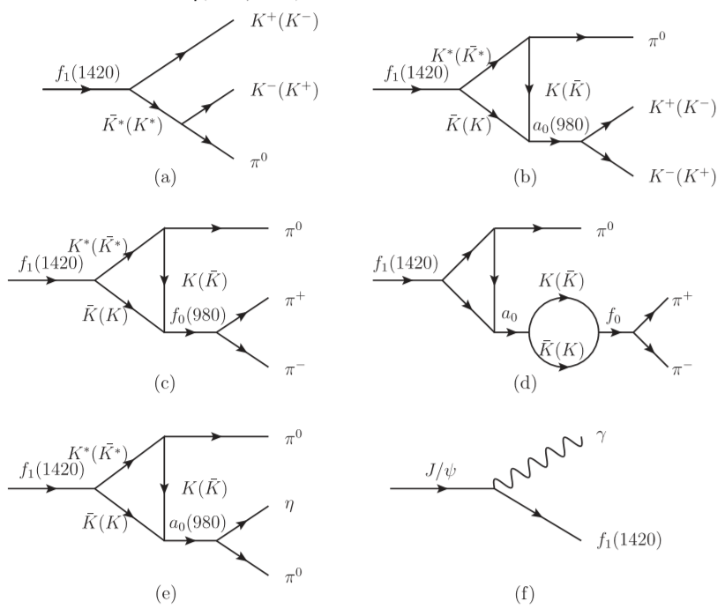
Contamination from $f_{1}(1420)$
In Ref [1], a systematic analysis is done concerning $f_{1}(1420)$
[1] Xiao-Gang Wu, Xiao-Hai Liu, Qiang Zhao, Bing-Song Zou, PR D87, 014023 (2013);

Slide 23
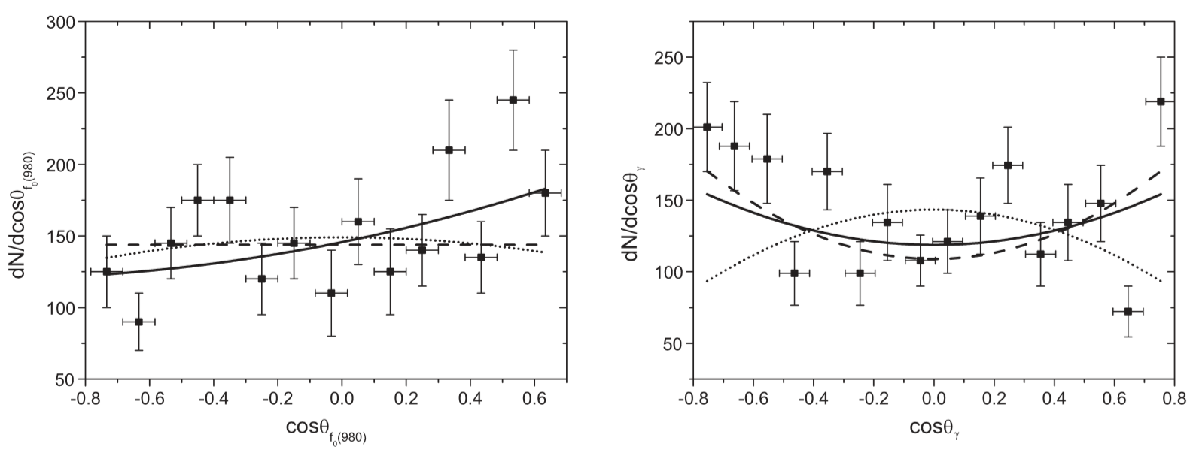
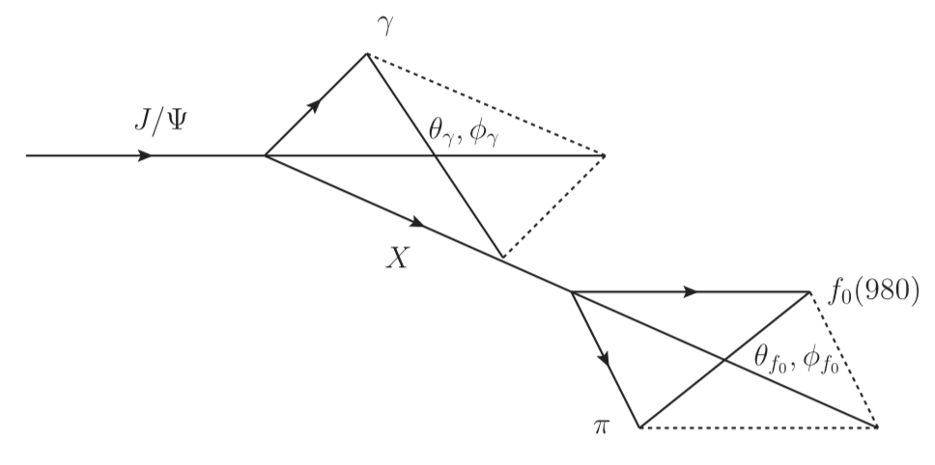
The angular distribution requires $f_{1}(1420)$
Fitting results of $\cos{θ_{f_{0}}}$ and $\cos{θ_{γ}}$[1]. The solid lines are from both $η(1440)$ and $f_{1}(1420)$. The dashed and dotted lines are with exclusive $η(1440)$ or $f_{1}(1420)$, respectively.
[1] Xiao-Gang Wu, Xiao-Hai Liu, Qiang Zhao, Bing-Song Zou, PR D87, 014023 (2013);

Slide 24
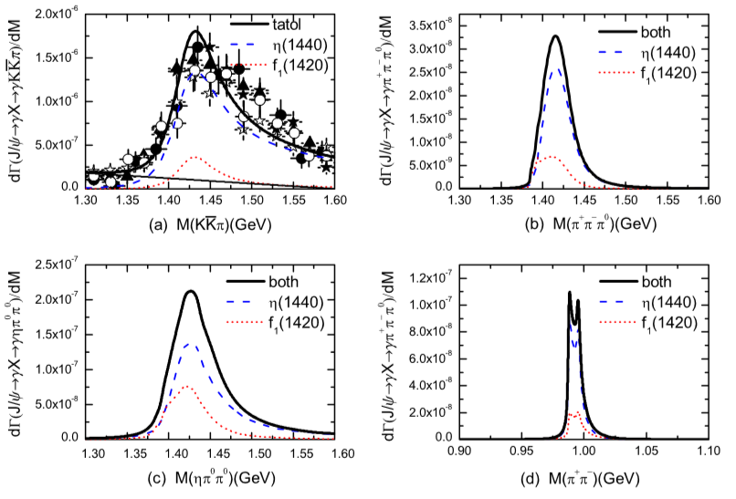
Calculated spectra from the extracted results from angular distribution analysis. The shift of peak position is observed. Adopted from Ref [1]
[1] Xiao-Gang Wu, Xiao-Hai Liu, Qiang Zhao, Bing-Song Zou, PR D87, 014023 (2013);

Slide 25
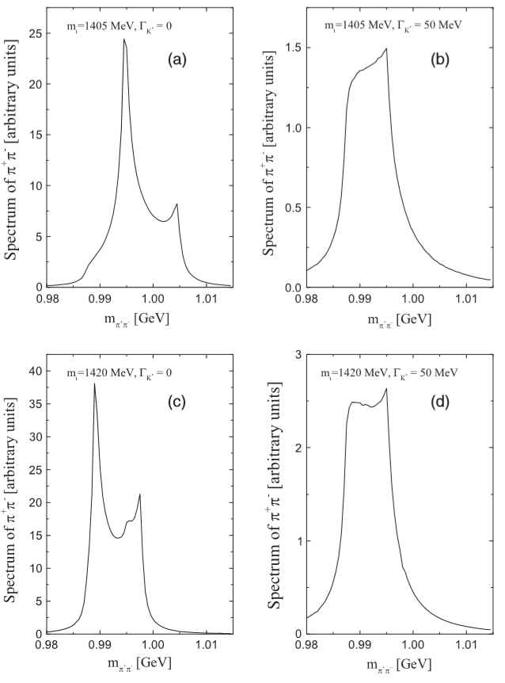
Finite width problem
$$K^{∗}$$
$$π^{0}$$
$$η(1440)$$
$$K$$
$$π^{+}$$
$$\overline{K}$$
$$f_{0}$$
$$π^{−}$$
The illustration of the influence of instability of the intermediate $K^{∗}$ meson on the $π^{+}π^{−}$ mass spectra in the decay $η\left(1440\right)→f_{0}π^{0}→π^{+}π^{−}π^{0}.$ The units are arbitrary but nevertheless the same for all $π^{+}π^{−}$ mass spectra in (a)-(d).
[1] N.N. Achasov, A.A. Kozhevnikov and G.N. Shestakov, Phys.Rev. D92, 036003 (2015)
[2] Meng-Chuan Du and Qiang Zhao, Phys.Rev.D 100, 036005 (2019)

Slide 26
Content
Kinematic singularity
The emergence of kinematic singularity
Singular behavior
$η(1405/1475)$
The $η(1405/1475)$ puzzle
Open P-wave $K^{∗}\overline{K}$ threshold and width effect
Combined analysis
$η(1295)$, $η\left(1405/1475\right)→γV$
Light axial vector mesons
Introduction
Open S-wave $K^{∗}\overline{K}$ threshold and TS
Combined analysis.
Conclusion and outlook

Slide 27
Combined analysis
$$η^{′′}→f_{0}\left(980\right)π^{0}→π^{+}π^{−}π^{0}$$
$Γ_{K^{∗}}=50$MeV
Unitarized propagators [4]
List of couplings needed in our calculation ：
Parameters | Values
$$g_{VPP}$$ | 4.52
$$g_{f_{0}K^{+}K^{−}}$$ | 5.92GeV
$$g_{f_{0}π^{+}π^{−}}$$ | 2.96GeV
$$g_{a_{0}K^{+}K^{−}}$$ | 2.24GeV
$$g_{a_{0}ηπ}$$ | 3.03GeV
$$g_{η^{′′}K^{∗}\overline{K}}$$ | $∼3.6$ Ref[3]
$$g_{η^{′′}a_{0}π}$$ | ?
$${\tilde{g}}_{η^{′′}a_{0}π}$$ | ?
$$\{φ_{a},φ_{b}\}$$ | ?
From $φ→K\overline{K}$ width
From KLOE experiment [1,2]
[1] A. Aloisio et al. [KLOE Col.], PL B 536, 209 (2002)
[2] A. Aloisio et al. [KLOE Col.], PL B537, 21 (2002)
Need an analysis on
$η^{′′}→a_{0}\left(980\right)π→ηππ$ and
$η^{′′}→\overline{K}Kπ$ channels
[3] Xiao-Gang Wu, Xiao-Hai Liu, Qiang Zhao, Bing-Song Zou, PR D87, 014023 (2013)；
[4] N. N. Achasov and A. V. Kiselev, PR D70, 111901 (2004)

Slide 28
$$η^{′′}→\overline{K}Kπ$$
$Br\left(η^{′′}→K^{∗}\overline{K}+c.c.\right)≃70\%$ [1]
$$η^{′′}→a_{0}π→ηππ$$
Form factor $F(q^{2})$ arises naturally in an effective theory:
$$I=\int{\frac{d^{4}q}{{\left(2π\right)}^{4}}\frac{{\left(2p_{1}−q\right)}_{μ}\left(−g^{μν}+\frac{q^{μ}q^{ν}}{q^{2}}\right){\left(q−2p_{2}\right)}_{ν}F(q^{2})}{(q^{2}−m_{1}^{2})({\left(q−p_{2}\right)}^{2}−m_{2}^{2})({\left(q−p_{2}−p_{3}\right)}^{2}−m_{3}^{2})}}$$
$$F\left(q^{2}\right)=\prod_{i=1}^{3}{\frac{Λ_{i}^{2}−m_{i}^{2}}{Λ_{i}^{2}−p_{i\left(q\right)}^{2}}}$$
$Λ_{i}=m_{i}+αΛ_{QCD}$, $α=1\sim 2$ and $Λ_{QCD}=250$MeV.
The result should be stable as $α$ varies. $F(q^{2})$ is safe when the physical result mostly arises from the region where $p_{i}^{2}=m_{i}^{2}$
[1] J.Z. Bai et al. (BES Collaboration), Phys. Lett. B 476, 25 (2000)

Slide 29
Experiment Constraints:
$$\frac{BR(J/Ψ→γη^{′′}→γf_{0}π→γπ^{+}π^{−}π^{0})}{BR(J/Ψ→γη^{′′}→γa_{0}π→γηπ^{0}π^{0})}=\frac{\left(1.50±0.11±0.11\right)×{10}^{−5}}{\left(8.40±1.75\right)×{10}^{−5}}=(17.9±4.2)\%$$
$$\frac{BR(J/Ψ→γη^{′′}→γf_{0}π→γπ^{+}π^{−}π^{0})}{BR(J/Ψ→γη^{′′}→γK\overline{K}π)}=\frac{\left(1.50±0.11±0.11\right)×{10}^{−5}}{\left(2.8±0.6\right)×{10}^{−3}}=\left(0.53±0.13\right)\%$$
$$Γ_{η^{′′}→a_{0}π→ηππ}+Γ_{η^{′′}→K\overline{K}π}∼50MeV$$
$$a_{0}π≪K\overline{K}π$$
$$a_{0}π≪K^{∗}\overline{K}$$
Meng-Chuan Du and Qiang Zhao, Phys.Rev.D 100, 036005 (2019)
Tab.1 Partial widths of $η^{′′}→a_{0}π→ηππ$, $η^{′′}→K\overline{K}π$ and $η^{′′}→f_{0}π→π^{+}π^{−}π^{0}$
The large isospin violation is results from (1) TS enhanced $f_{0}π$ production and (2) small $a_{0}π$ branching ratio.

Slide 30
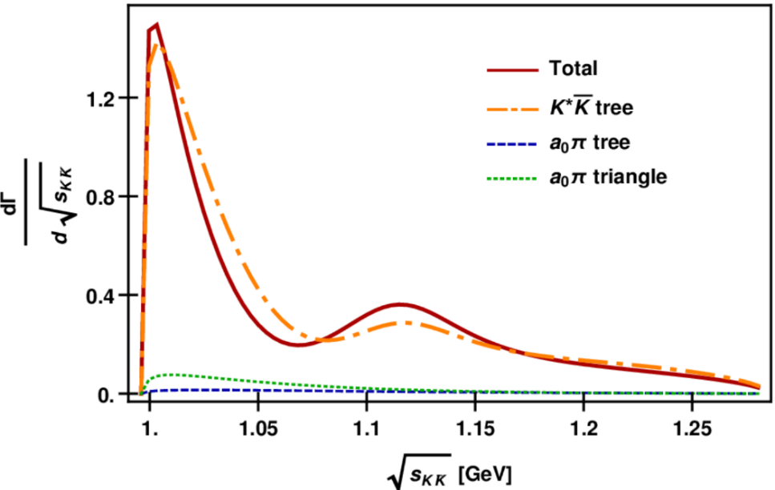
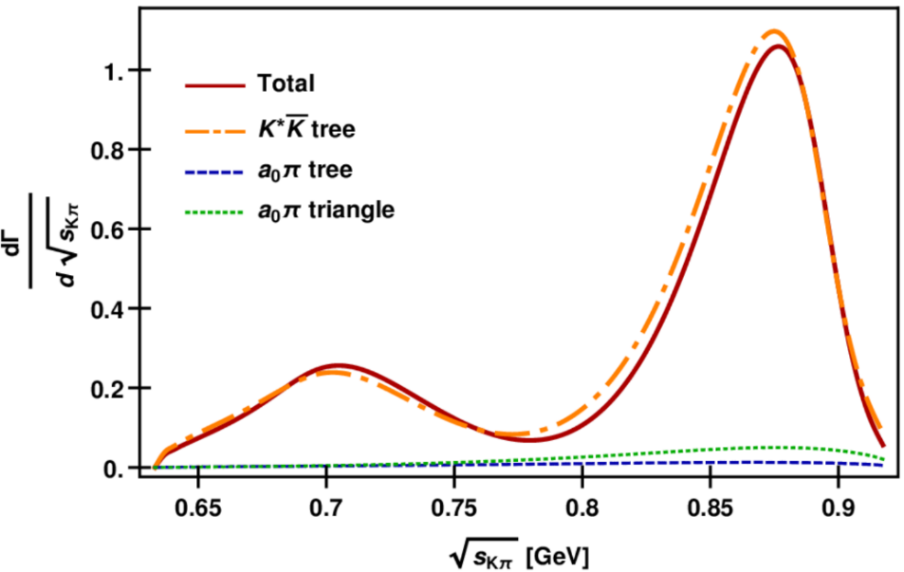
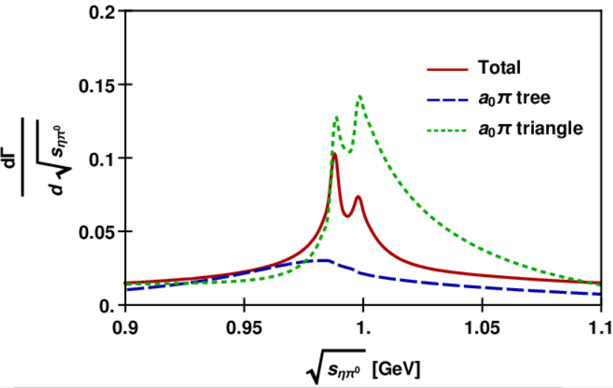
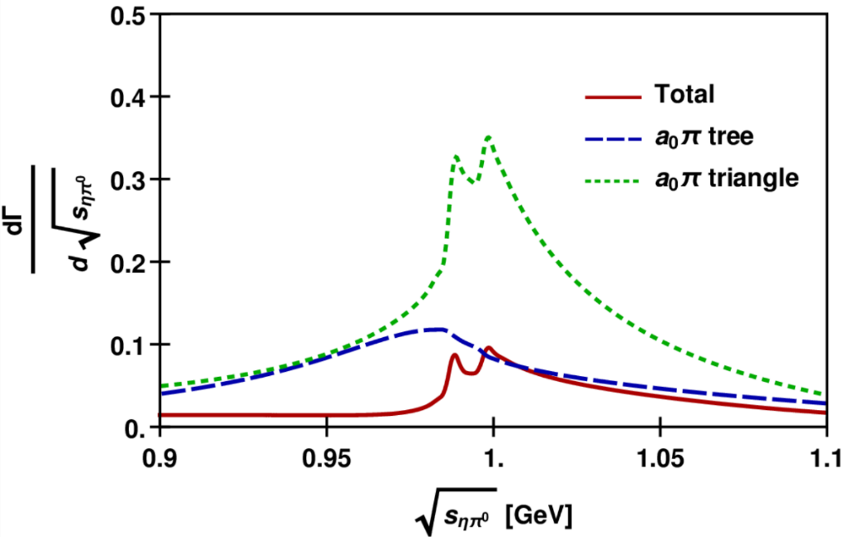
$$α=2$$
$$α=2$$
Fig.1 $K\overline{K}$ (left panel) and $Kπ$ (right panel) invariant mass spectra (red solid) at $\sqrt{s_{1}}=1.42$ GeV.
$$α=1$$
$$α=2$$
Fig.2 $ηπ^{0}$ invariant mass spectrum (red solid) at $α=1$ (left) and $α=2$ (right). The double-peak structure arises from the mass difference between the charged and the neutral loops.

Slide 31
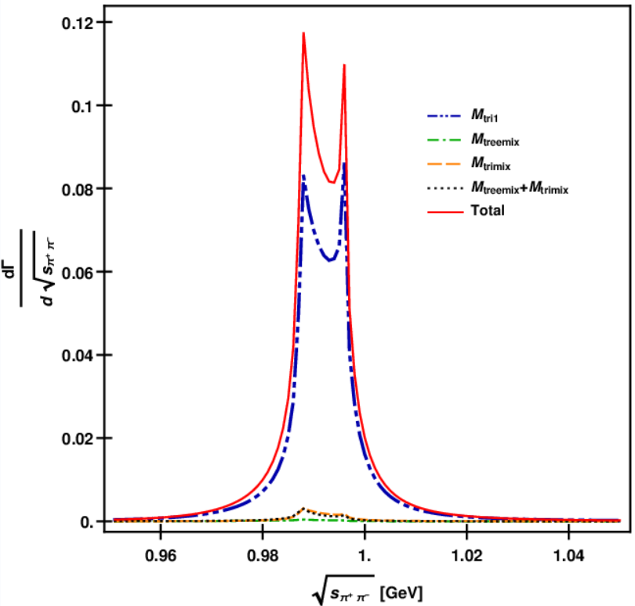
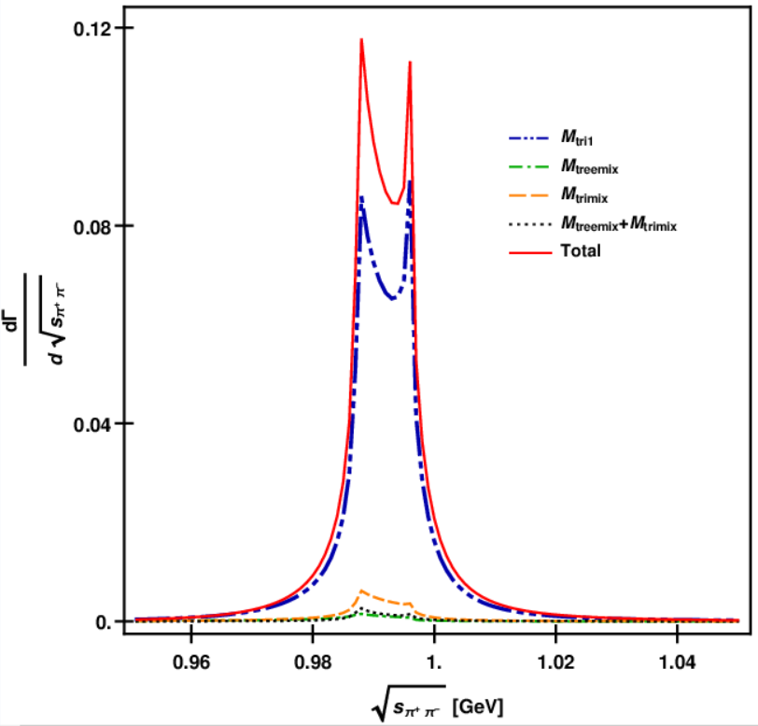
$$α=1$$
$$α=2$$
Fig.3 $π^{+}π^{−}$ invariant mass spectrum at $α=1$ (left) and $α=2$ (right).

Slide 32
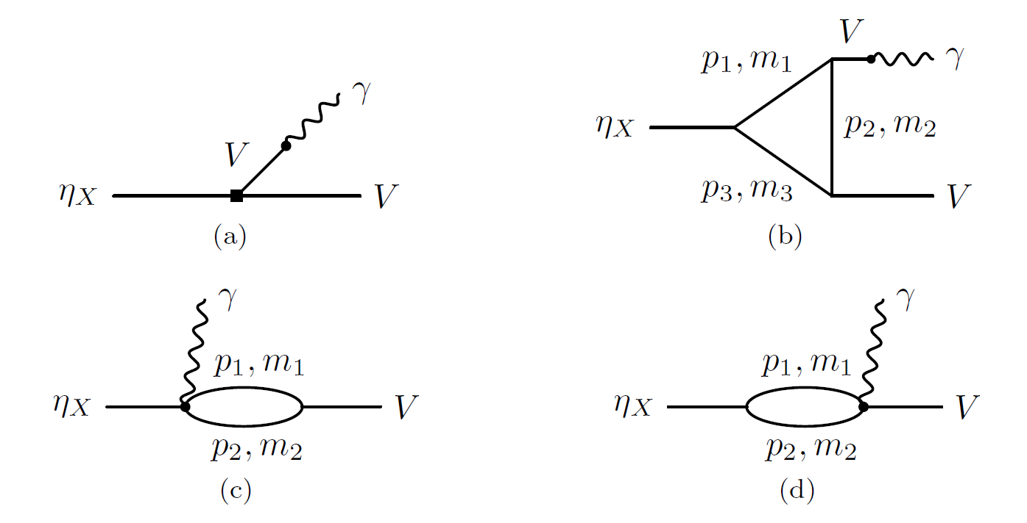
$$η\left(1405/1475\right),η\left(1295\right)→γV$$
The ratio $Γ(η(1405)→γρ)$ to $Γ\left(η(1405)→γφ\right)$ is consistent with taking them as the first radial excitation.
The ratio $Γ(η(1295)→γρ)$ to $Γ\left(η(1295)→γφ\right)$ is sensitive to hadronic loop transitions, which affects the mixing angle determined by this ratio ($δα={6^{∘}∼8}^{∘}$).
Yin Cheng, Qiang Zhao, arXiv:2106.12483

Slide 33
Content
Kinematic singularity
The emergence of kinematic singularity
Singular behavior
$η(1405/1475)$
The $η(1405/1475)$ puzzle
Open P-wave $K^{∗}\overline{K}$ threshold and width effect
Combined analysis
$η(1295)$, $η\left(1405/1475\right)→γV$
Light axial vector mesons
Introduction
Open S-wave $K^{∗}\overline{K}$ threshold and TS
Combined analysis.
Conclusion and outlook

Slide 34
Introduction
In quark model, the axial vector mesons (AVM) are states with $^{2s+1}P_{J}= ^{3}P_{1}$ and$^{1}P_{1}$
$$J^{PC}=1^{+−}$$
$$J^{PC}=1^{++}$$
In PDG, the assignments and masses are
States | Mass [MeV]
$$a_{1}(1260)$$ | $$1230±40$$
$$f_{1}(1285)$$ | $$1281.9±0.5$$
$$f_{1}(1420)$$ | $$1426.3±0.9$$
$$b_{1}(1235)$$ | $$1229.5±3.2$$
States | Mass [MeV]
$$h_{1}(1170)$$ | $$1166±8$$
$$h_{1}(1415)$$ | $$1416±8$$
$$K_{1}(1270)$$ | $$1253±7$$
$$K_{1}(1400)$$ | $$1403±7$$

Slide 35
Content
Kinematic singularity
The emergence of kinematic singularity
Singular behavior
$η(1405/1475)$
The $η(1405/1475)$ puzzle
Open P-wave $K^{∗}\overline{K}$ threshold and width effect
Combined analysis
$η(1295)$, $η\left(1405/1475\right)→γV$
Light axial vector mesons
Introduction
Open S-wave $K^{∗}\overline{K}$ threshold and TS
Combined analysis.
Conclusion and outlook

Slide 36
Open P-wave $K^{∗}\overline{K}$ threshold and TS
$f_{1}(1420)$ could be a $K^{∗}\overline{K}$molecule.
R.S.Longacre, PRD 42,874(1990)
S-wave $K^{∗}\overline{K}$ interaction can dynamically generate $f_{1}\left(1285\right), a_{1}\left(1260\right) ,h_{1}\left(1170\right),h_{1}\left(1415\right),b_{1}(1235)$ and $K_{1}(1270)$ states. It is found that $f_{1}(1420)$ and $K_{1}(1400)$ could not be accommodated by the molecule framework.
L.Roca, E.Oset and J.Singh PRD 72,014002(2005)
$f_{1}(1420)$ is a kinematic effect induced by the TS of $f_{1}(1285)$
V. R. Debastiani, F. Aceti, W. H. Liang and E. Oset, PRD 95,034015(2017)
$J/ψ→πb_{1},h_{1}\left(1170\right)η^{\left(′\right)},h_{1}\left(1415\right)η^{(′)}$ are studied treating these mesons as dynamically generated states by the pseudoscalar and vector S-wave couplings
W. H. Liang, S. Sakai and E. Oset, PRD 99,094020(2019)

Slide 37
Open P-wave $K^{∗}\overline{K}$ threshold and TS
TS mechanism for $J/ψ→γf_{1}(1420)→γ+3π$
X. G. Wu, J. J. Wu, Q. Zhao and B. S. Zou, Phys. Rev. D 87, 014023 (2013)
$a_{1}(1420)$ observed in $π^{−}p→p+f_{0}π^{−}→p+π^{+}π^{−}π^{−}$
C. Adolph et al. [COMPASS], PRL 115,082001(2015)
H. X. Cheng, E. L. Cui, W. Chen, T. G. Steele, X. Liu and S. L. Zhu, PRD 91,094022 (2015)
Qiang Zhao, Hadron-2013, Nara, Japan
M. Mikhasenko, B. Ketzer and A. Sarantsev, PRD 91,094015 (2015)
F. Aceti, L.R.Dai and E. Oset, PRD 94,096015(2016)
M. G. Alexeev et al. [COMPASS], arXiv:2006.05342(2020)

Slide 38
Content
Kinematic singularity
The emergence of kinematic singularity
Singular behavior
$η(1405/1475)$
The $η(1405/1475)$ puzzle
Open P-wave $K^{∗}\overline{K}$ threshold and width effect
Combined analysis
$η(1295)$, $η\left(1405/1475\right)→γV$
Light axial vector mesons
Introduction
Open S-wave $K^{∗}\overline{K}$ threshold and TS
Combined analysis.
Conclusion and outlook

Slide 39
Our scheme
The calculation based on the molecular-state picture is not fully consistent with experiment results.
In our study we simply take these states as quark model states. The mixing angles are introduced and the production and decay channels are constrained by SU(3) flavor symmetry.
We will then give a brief introduction to the mixing angle and the production mechanism. After that we will discuss the decay mechanism with the presence of TS.

Slide 40
Mixing angles
$h_{1},h_{1}^{′},f_{1},f_{1}^{′},K_{1A},K_{1B}$ are mixing objects of physical states.
$$\left(\begin{matrix}K_{1}(1270) \\ K_{1}(1400)\end{matrix}\right)=\left(\begin{matrix}\cos{θ_{K_{1}}} & \sin{θ_{K_{1}}} \\ −sin{θ_{K_{1}}} & \cos{θ_{K_{1}}}\end{matrix}\right)\left(\begin{matrix}K_{1B} \\ K_{1A}\end{matrix}\right)$$
$$\left(\begin{matrix}f_{1}^{′} \\ f_{1}\end{matrix}\right)=\left(\begin{matrix}\cos{θ_{f}} & −\sin{θ_{f}} \\ \sin{θ_{f}} & \cos{θ_{f}}\end{matrix}\right)\left(\begin{matrix}{\tilde{f}}_{8} \\ {\tilde{f}}_{1}\end{matrix}\right)=\left(\begin{matrix}\cos{α_{f}} & −\sin{α_{f}} \\ \sin{α_{f}} & \cos{α_{f}}\end{matrix}\right)\left(\begin{matrix}f_{n} \\ f_{s}\end{matrix}\right)$$
$$\left(\begin{matrix}h_{1}^{′} \\ h_{1}\end{matrix}\right)=\left(\begin{matrix}\cos{θ_{h}} & −\sin{θ_{h}} \\ \sin{θ_{h}} & \cos{θ_{h}}\end{matrix}\right)\left(\begin{matrix}{\tilde{h}}_{8} \\ {\tilde{h}}_{1}\end{matrix}\right)=\left(\begin{matrix}\cos{α_{h}} & −\sin{α_{h}} \\ \sin{α_{h}} & \cos{α_{h}}\end{matrix}\right)\left(\begin{matrix}h_{n} \\ h_{s}\end{matrix}\right)$$
$$α=θ+\arctan{\sqrt{2}}$$
$${\tilde{f}}_{8},{\tilde{h}}_{8}=\frac{u\overline{u}+d\overline{d}−2s\overline{s}}{\sqrt{6}};{\tilde{f}}_{1},{\tilde{h}}_{1}=\frac{u\overline{u}+d\overline{d}+s\overline{s}}{\sqrt{3}}; f_{n}, h_{n}=\frac{u\overline{u}+d\overline{d}}{\sqrt{2}}; f_{s},h_{s}=s\overline{s}$$
Gell-Mann-Okubo relation
$$θ_{f}, α_{f}$$
${|θ}_{K_{1}}|∼{34}^{∘} or {57}^{∘}$,
$\left|θ_{K_{1}}\right|<{45}^{∘}$is favored ,
$$α_{f}≃{84.5}^{∘}, α_{h}≃{91.8}^{∘}$$
$$|θ_{K_{1}}|$$
$$θ_{h}, α_{h}$$
H. Y. Cheng, PLB 707,116

Slide 41
Production in $e^{+}e^{−}$ annihilation
$f_{1}(f_{1}^{′})$ can be produced in $J/ψ→γf_{1}(f_{1}^{′})$
$$\frac{g_{f^{′}}}{g_{f}}=\frac{⟨f_{1}^{′}γ|\hat{H}|J/ψ⟩}{⟨f_{1}γ|\hat{H}|J/ψ⟩}=\frac{\sqrt{2}\cos{α_{f}}−\sin{α_{f}}}{\sqrt{2}\sin{α_{f}}+\cos{α_{f}}}$$
$$\left\langle {\left(s\overline{s}\right)}_{1^{++}}γ\left|\hat{H}\right|J/ψ\right\rangle ≃\left\langle {\left(u\overline{u}\right)}_{1^{++}}γ\left|\hat{H}\right|J/ψ\right\rangle =\left\langle {\left(d\overline{d}\right)}_{1^{++}}γ\left|\hat{H}\right|J/ψ\right\rangle$$
$J/ψ→γa_{1}$ is suppressed$. a_{1}$ can be searched in $ψ\left(3686\right)→γχ_{c1}→γπa_{1}→γ+4π$
$$B.R\left(ψ(2S\right)→γχ_{c1})=\left(9.79±0.2\right)\%$$
$b_{1}$ and $h_{1}(h_{1}^{′})$ can be searched in $J/ψ→πb_{1}$, and $J/ψ→η^{(′)}h_{1}^{(′)}$. They are constrained by SU(3) symmetry, i.e.
$$L_{ψBP}=g_{ψBP}ψ^{μ}⟨B_{μ}P⟩$$
$B.R\left(J/ψ→π^{±}b_{1}^{∓}\right)=\left(3±0.5\right)×{10}^{−3}$,
$B.R. \left(J/ψ→η^{′}h_{1}^{′}→η^{′}K^{∗}\overline{K}+c.c.\right)=\left(2.16±0.31\right)×{10}^{−4}$.
Double-OZI suppressed process is possible for $J/ψ→η^{(′)}h_{1}^{(′)}$

Slide 42
TS enhanced decay channels
There could be strong impact of TS in the following channels
$f_{1}\left(f_{1}^{′}\right)→a_{0}π→ηππ$,
$f_{1}\left(f_{1}^{′}\right)→a_{0}π→K\overline{K}π$,
$f_{1}\left(f_{1}^{′}\right)→f_{0}π→3π$,
$a_{1}→f_{0}π→3π$,
$b_{1}→φπ→K\overline{K}π$,
$h_{1}\left(h_{1}^{′}\right)→φπ→K\overline{K}π$,
$$K^{∗}({\overline{K}}^{∗})$$
$$π$$
$$A$$
$$K(\overline{K})$$
$$\overline{K}(K)$$
$$X$$
$I=0$ $K\overline{K}$ can couple to $f_{0}$ in S-wave, $φ$ and $ω$ in P-wave,
$I=1 K\overline{K}$ can couple to $a_{0}$ in S-wave, $ρ$ in P-wave.
There are tree level contributions for some of these channels.
Effective couplings of axial vector mesons are constrained by experiments and symmetry.

Slide 43
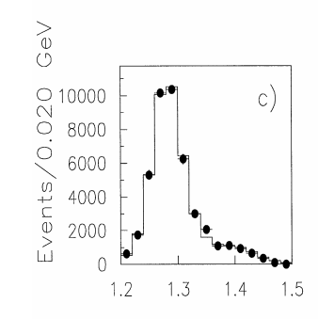
$$f_{1}\left(f_{1}^{′}\right)→a_{0}π→ηππ$$
$a_{0}π$ is one of the dominant decay channels of $f_{1}$
$$B.R.\left(f_{1}→a_{0}π→ηππ\right)=\left(38±4\right)\%$$
In PDG, $f_{1}^{′}→a_{0}π$ is “possibly seen”. The branching ratio of $f_{1}^{′}→a_{0}π$ is small.
There is weak signal of $f_{1}^{′}$ in $ηπ^{+}π^{−}$ final state in $pp$ scattering by WA102 collaboration [1].
$J^{PC}=1^{++}$ $a_{0}π$ wave of the $ηπ^{+}π^{−}$ spectrum in $pp→p_{f}\left(ηπ^{+}π^{−}\right)p_{s}$. The $0^{− +}$ wave is suppressed in central production.[1]
[1] D. Baberis et al. [WA102], PLB 440,252

Slide 44
$$f_{1}\left(f_{1}^{′}\right)→a_{0}π→ηππ$$
The interactions are given by
$L_{AVP}={ig}_{AVP}〈A^{μ}\left[V_{μ},P\right]〉$ $L_{VPP}=ig_{VPP}〈V^{μ}\left[P,∂_{μ}P\right]〉$
Matric elements of $A,V,P$ are fields of axial vector mesons $(J^{PC}=1^{++})$, vector mesons and psedoscalar mesons multiplets.
P-wave bare vertices of $f_{1}\left(f_{1}^{′}\right)→a_{0}π$ are given by the $|n\overline{n}〉$ component of $f_{1}(f_{1}^{′})$
$$L_{f_{1}a_{0}π}=g_{ASP}\sin{α_{f}} f_{1}^{μ}(π∂_{μ}a_{0}−a_{0}∂_{μ}π)$$
$$L_{f_{1}^{′}a_{0}π}=g_{ASP}\cos{α_{f}} f_{1}^{μ}(π∂_{μ}a_{0}−a_{0}∂_{μ}π)$$
$g_{ASP}$ and $g_{AVP}$ are pending determined

Slide 45
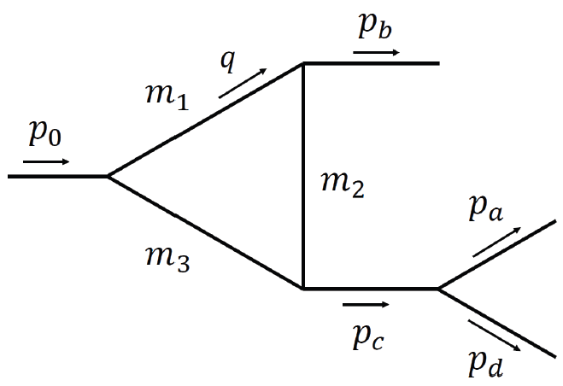
Loop integral for $A→SP$
P
For $A→SP$, the typical loop integral takes the following form
A
S
$$I^{μ}=\int{\frac{d^{4}q}{{\left(2π\right)}^{4}}\frac{\left(−g^{μν}+\frac{q^{μ}q^{ν}}{q^{2}}\right){\left(q−2p_{b}\right)}_{ν}F(q^{2})}{\left(q^{2}−m_{1}^{2}+im_{1}Γ_{1}\right)\left[{\left(q−p_{b}\right)}^{2}−m_{2}^{2}\right][{\left(p_{0}−q\right)}^{2}−m_{3}^{2}]}}$$
Monopole form factor is applied to cut the UV divergence of triangle diagrams,
$$F\left(q^{2}\right)=\prod{\frac{m_{i}^{2}−Λ_{i}^{2}}{p_{i}^{2}−Λ_{i}^{2}}}, Λ_{i}=m_{i}+βΛ_{QCD}$$
Unitarized propagator for $a_{0}$ and $f_{0}$ [1,2]
$$\frac{i}{D_{a_{0}}(k^{2})}=\frac{i}{k^{2}−m_{a_{0}}^{2}−i\sum_{ab}{g_{a_{0}ab}^{2}Π_{ab}(k^{2})}}$$
$$ab=\left\{ηπ, K^{0}{\overline{K}}^{0},K^{+}K^{−}\right\}$$
$$\frac{i}{D_{f_{0}}(k^{2})}=\frac{i}{k^{2}−m_{f_{0}}^{2}−i\sum_{ab}{g_{f_{0}ab}^{2}Π_{ab}(k^{2})}}$$
$$ab=\left\{π^{+}π^{−},π^{0}π^{0}, K^{0}{\overline{K}}^{0},K^{+}K^{−}\right\}$$
[1] N.N. Achasov, A.V. Kiselev, PRD 70, 111901(2004)
[2] N.N. Achasov, A.A. Kozhevnikov, G.N. Shestakov , PRD 92,036003

Slide 46
$$f_{1}\left(f_{1}^{′}\right)→K\overline{K}π$$
We know from experiments that
$f_{1}→K\overline{K}π$ is dominated by P-wave $f_{1}→a_{0}π$ channel
$f_{1}^{′}→K\overline{K}π$ is dominated by S-wave $f_{1}^{′}→K^{∗}\overline{K}$ channel
$$L_{f_{1}a_{0}π}=g_{ASP}\sin{α_{f}} f_{1}^{μ}(π∂_{μ}a_{0}−a_{0}∂_{μ}π)$$
In our scheme
$f_{1}→K^{∗}\overline{K}$ is suppressed by the phase space
The tree-level $f_{1}^{′}→a_{0}π$ is suppressed by mixing angle
For $f_{1}^{′}$ decay, the interference may lead to non-trivial structure in the low-mass region of $K\overline{K}$ spectrum
$$L_{f_{1}^{′}a_{0}π}=g_{ASP}\cos{α_{f}} f_{1}^{μ}(π∂_{μ}a_{0}−a_{0}∂_{μ}π)$$
To determine the couplings
$g_{AVP}$ can be estimated from $f_{1}^{′}→K\overline{K}π$
Given $g_{AVP}$, $g_{ASP}$ can be determined from $f_{1}→a_{0}π→ηππ$
The phase between $g_{AVP}$ and $g_{ASP}$ can be fixed by $f_{1}→K\overline{K}π$

Slide 47
$$f_{1}\left(f_{1}^{′}\right)→f_{0}π→3π$$
$$∼B_{n}−B_{c}$$
$$∼ε_{μ}(I_{n}^{μ}−I_{c}^{μ})$$
$$∼ε_{μ}(I_{n}^{μ}+I_{c}^{μ})(B_{n}−B_{c})$$
Similar mechanism has been applied to $η(1405/1475)$ decays [1]
The isospin violation is produced by
Direct $f_{0}$ production through triangle diagrams
$a_{0}−f_{0}$ mixing, which is enhanced by triangle mechanism
Model dependence is suppressed for
The dispersive parts cancel in the on-shell kinematic region.
The masses of $a_{0}$ and $f_{0}$ are very close to $K\overline{K}$ threshold.
[1]M. C. Du and Q. Zhao, PRD 100,036005(2019)

Slide 48
$$a_{1}→3π$$
The TS mechanism in $a_{1}(1260)$ decay has been studied in Ref[1,2]
The interaction of $a_{1}→ρπ, K^{∗}\overline{K}$ is related with $f_{1}^{′}→K^{∗}\overline{K}$ by SU(3) symmetry.
The tree level $a_{1}\left(1260\right)→f_{0}π$ is allowed, which serves as a probe to detect the structure of $f_{0}(980)$. It is not responsible for the production of $a_{1}(1420)$, but will interfere with the triangle diagram.
[1] M. Mikhasenko, B. Ketzer and A. Sarantsev, PRD 91, 094015 (2015)
[2] F. Aceti, L. R. Dai and E. Oset, PRD 94, 096015 (2016)

Slide 49
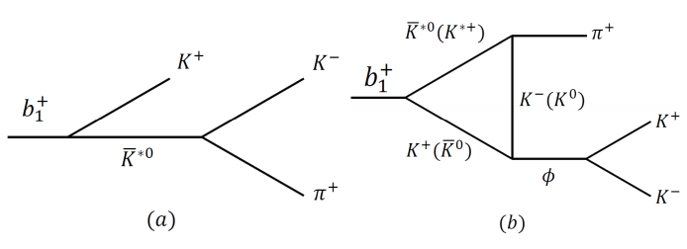
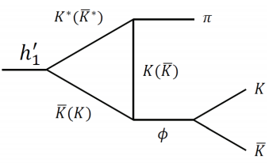
$$b_{1},h_{1}^{′}→φπ$$
OZI suppressed for $b_{1}→φπ$.
$B(1^{+ −})→VP$ is constrained by symmetry
$$L_{BVP}=g_{BVP}⟨B^{μ}\left\{V_{μ},P\right\}⟩$$
$g_{BVP}$ can be determined by $h_{1}→ρπ→3π$ ($α_{h}$ dep.) and $b_{1}→ωπ$ (S-wave, $α_{h}$ indep.).
$J/ψ→πK^{∗}\overline{K}+c.c. →φππ$ and $J/ψ→ηK^{∗}\overline{K}→ηφπ$ are studied in Ref. [1].
[1] H. J. Jing, F. K. Guo, B. S. Zou, PRD 100,114010(2019)
G parity is violated for $h_{1}(h_{1}^{′})→φπ$
The branching ratios of $J/ψ→π^{−}b_{1}^{+}+c.c. →φπ^{+}π^{−}$ and $J/ψ→ηh_{1}^{′}→ηφπ$ can be calculated.

Slide 50
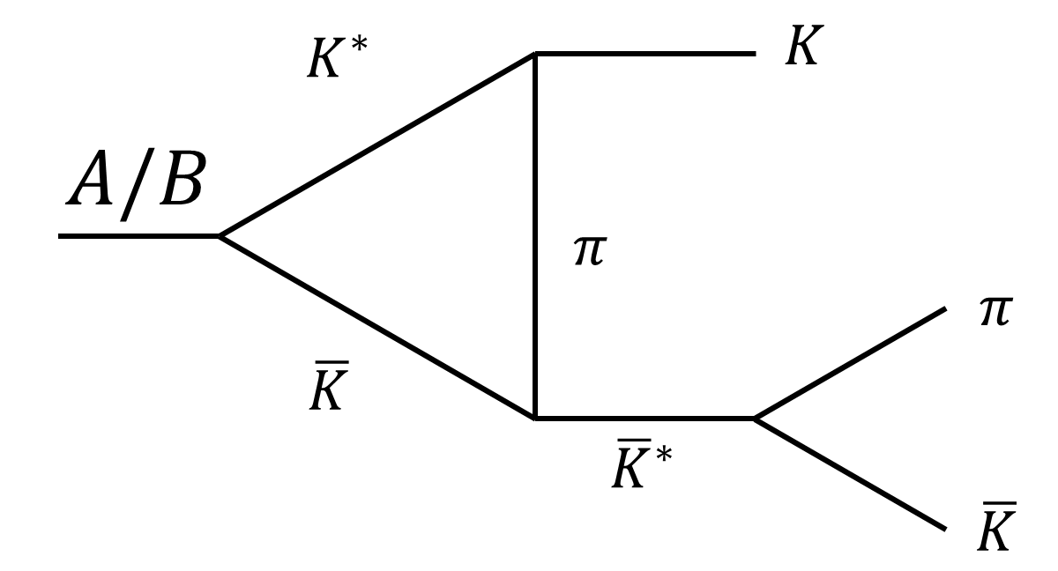
Loop integral for $B→VP$
P
$$M^{loop}∼ε_{μ}I^{μα}∗\frac{\left(−g_{αβ}+\frac{p_{cα}p_{cβ}}{p_{c}^{2}}\right)}{p_{c}^{2}−m_{φ}^{2}+im_{φ}Γ_{φ}}{\left(p_{a}−p_{d}\right)}_{β}$$
B
V
$$I^{μα}=\int{\frac{d^{4}q}{{\left(2π\right)}^{4}}∗\frac{\left(−g^{μν}+\frac{q^{μ}q^{ν}}{q^{2}}\right){\left(q−2p_{b}\right)}_{ν}{\left(p_{c}+2p_{b}−2q\right)}_{α}F(q^{2})}{\left(q^{2}−m_{1}^{2}+im_{1}Γ_{1}\right)\left[{\left(q−p_{b}\right)}^{2}−m_{2}^{2}\right]\left[{\left(p_{0}−q\right)}^{2}−m_{3}^{2}\right]}}$$
The same loop contributes to the vertex correction of $A/B→K^{∗}\overline{K}+c.c.$
In NR limit
Num.$∼4p_{b}^{μ}p_{b}^{α}−4p_{b}^{μ}q^{α}−2q^{α}p_{b}^{α}+2q^{μ}q^{α}$
Vertex correction to $A/B→K^{∗}\overline{K}+c.c.$ is weak due to insufficient phases space

Slide 51
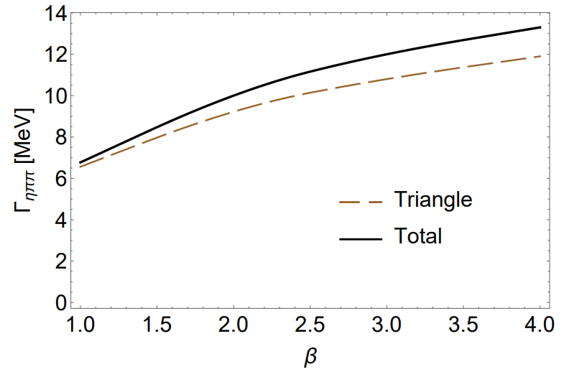
Partial widths of $f_{1}$ and $f_{1}^{′}$
Channels | $$f_{1}(1285)$$ | $$f_{1}(1420)$$
$a_{0}π→ηππ$ tree | $$7.5±1.7$$ | $$\left(1.7±0.4\right)×{10}^{−1}$$
$a_{0}π→ηππ$ tri. | $$\left(2.0±0.6\right)×{10}^{−1}$$ | $$9.2±3.0$$
$a_{0}π→ηππ$ total | $$9.7±2.4 (8.6±1.3)$$ | $$10±3.5$$
$a_{0}π→K\overline{K}π$ tree | $$\left(3.7±0.4\right)×{10}^{−1}$$ | $$\left(1.7±0.2\right)×{10}^{−2}$$
$a_{0}π→K\overline{K}π$ tri. | $$\left(2.4±0.5\right)×{10}^{−2}$$ | $$1.2±0.2$$
$a_{0}π→K\overline{K}π$ total | $$\left(5.0±0.5\right)×{10}^{−1}$$ | $$1.0±0.1$$
$$K^{∗}\overline{K}→K\overline{K}π$$ | $$\left(3.0±0.1\right)×{10}^{−1}$$ | $$49±1$$
$K\overline{K}π$ total | $$1.5±0.2(2.1±0.2)$$ | $$52±3$$
$f_{0}π→3π$ mixing | $$\left(3.6±1.2\right)×{10}^{−3}$$ | $$\left(9.0±2.9\right)×{10}^{−5}$$
$f_{0}π→3π$ tri. | $$\left(1.0±0.1\right)×{10}^{−3}$$ | $$\left(1.1±0.1\right)×{10}^{−1}$$
$f_{0}π→3π$ mixing via tri. | $$\left(1.4±0.4\right)×{10}^{−4}$$ | $$\left(8.0±2.6\right)×{10}^{−3}$$
$f_{0}π→3π$ total | $$\left(1.0±0.3\right)×{10}^{−2}$$ | $$\left(1.6±0.3\right)×{10}^{−1}$$
Couplings | Value
$$g_{f_{0}K^{+}K^{−}}$$ | $5.96±0.13$ GeV
$$g_{f_{0}π^{+}π^{−}}$$ | $2.96±0.12$ GeV
$$g_{a_{0}K^{+}K^{−}}$$ | $2.24±0.11$ GeV
$$g_{a_{0}ηπ}$$ | $3.02±0.35$ GeV
$$g_{AVP}$$ | $2.04$ GeV
$$g_{f_{1}a_{0}π}$$ | $$2.93$$
$$g_{f_{1}^{′}a_{0}π}$$ | $$0.282$$
$$g_{f_{1}K^{∗}\overline{K}}$$ | $1.24$ GeV
$$g_{f_{1}^{′}K^{∗}\overline{K}}$$ | $2.17$ GeV
$$g_{a_{1}K^{∗}\overline{K}}$$ | $2.04$ GeV
$$g_{a_{1}f_{0}π}$$ | $$2.93$$
Tab.2 Partial width in MeV, at $g_{AVP}=2.0$4 GeV , $β=2$. Only the uncertainties of $g_{VPP}$ and $g_{SPP}$ couplings are considered. The PDG averaged value are in round brackets.
Tab.3 Coupling constants in $1^{++}$ sector, where the $SPP$ couplings are adopted from Ref. [1,2].
Couplings | Value
$$g_{BVP}$$ | $3.03$ GeV
$$g_{h_{1}ρπ}$$ | $4.28$ GeV
$$g_{h_{1}^{′}ρπ}$$ | $0.13$ GeV
$$g_{h_{1}^{′}K^{∗}\overline{K}}$$ | $3.09$ GeV
$$g_{b_{1}K^{∗}\overline{K}}$$ | $3.03$ GeV
$$g_{b_{1}ωπ}$$ | $4.28$ GeV
$$g_{ψBP}$$ | $4.35×{10}^{−3}$ GeV
Tab.4 Coupling constants in $1^{+ −}$ sector
Fig.4 $β$ dependence of $Γ(f_{1}^{′}→a_{0}π→ηππ)$
[1] A.Aloisio et al. [KLOE], PLB537,21 (2002);
[2] A.Aloisio et al. [KLOE], PLB536,209(2002)

Slide 52
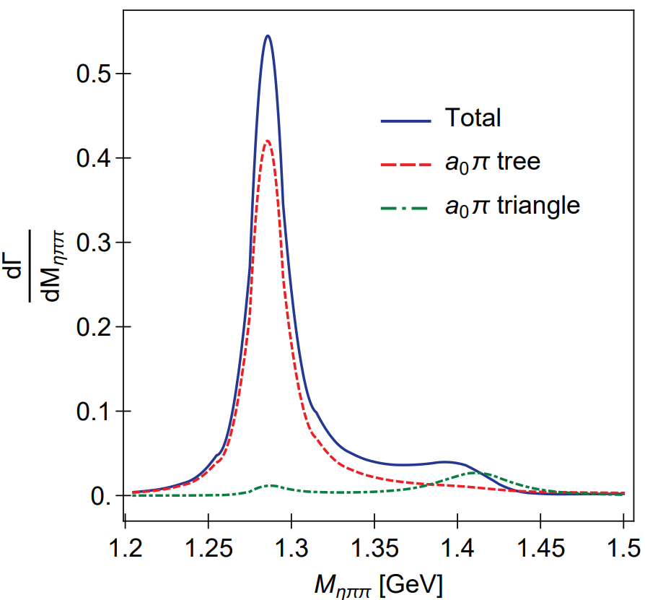
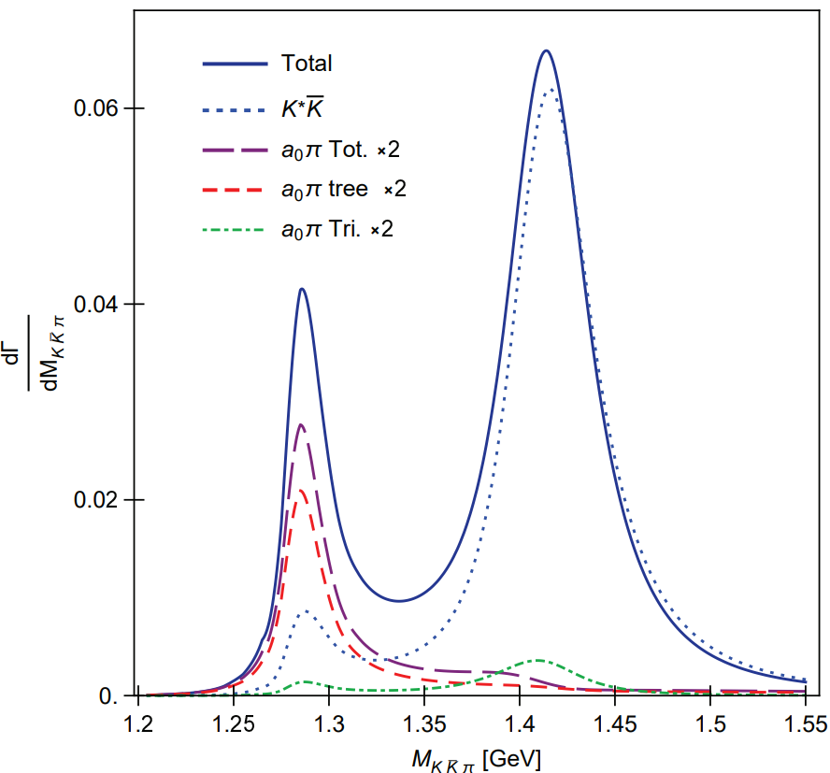
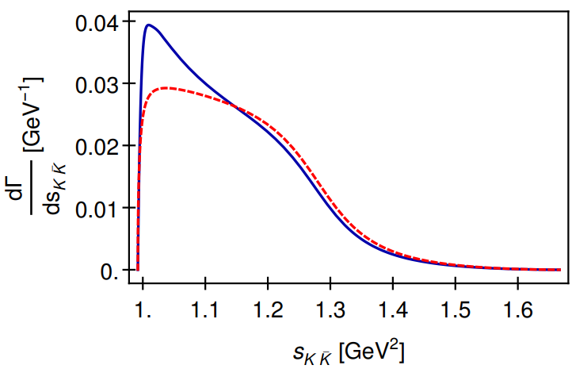
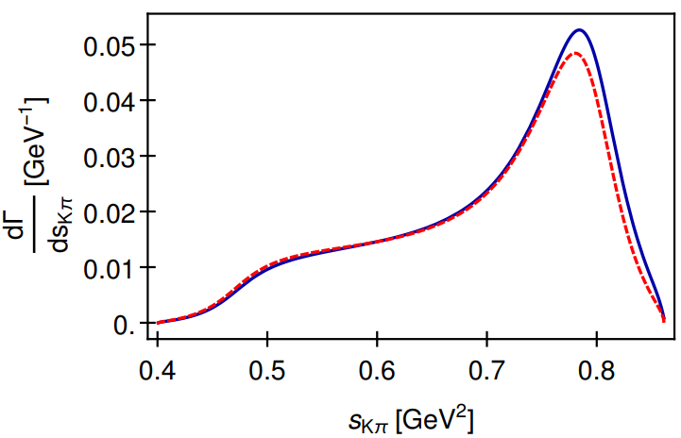
Spectra in $J/ψ$ decay
Fig.5 $ηππ$ (left) and $K\overline{K}π$ spectra of $J/ψ→γ\left(f_{1}+f_{1}^{′}\right)→γηππ,γK\overline{K}π$.
Fig.6 $K\overline{K}$ (left) and $Kπ$ (right) spectra of $f_{1}^{′}→K\overline{K}π$

Slide 53
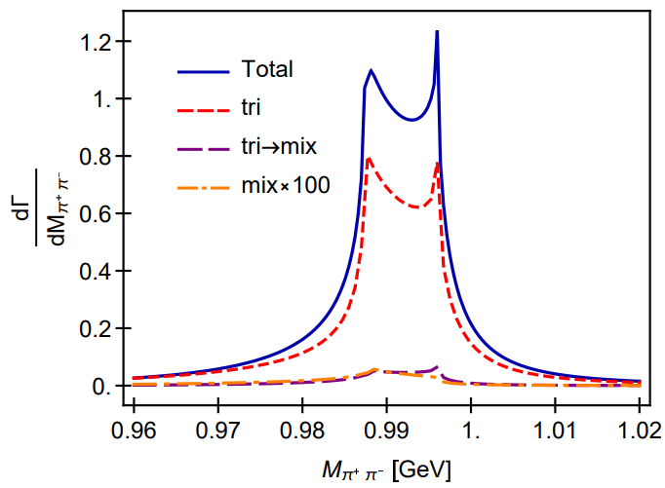
$$f_{1}(f_{1}^{′})→3π$$
$$R_{f_{1}→3π}^{total}=\frac{B.R.(f_{1}→f_{0}π→π^{+}π^{−}π^{0})}{B.R.(f_{1}→a_{0}π→ηπ^{0}π^{0})}∼0.3\%$$
$$R_{f_{1}→3π}^{mix}=\frac{B.R.(f_{1}→f_{0}π→π^{+}π^{−}π^{0})}{B.R.(f_{1}→a_{0}π→ηπ^{0}π^{0})}∼0.1\%$$
Our result is consistent with BESIII measurement [1]
$$R_{χ_{c1}→3π}=\frac{B.R.(χ_{c1}→a_{0}π→f_{0}π→π^{+}π^{−}π^{0})}{B.R.\left(χ_{c1}→a_{0}π→ηπ^{0}π^{0}\right)}$$
$$=\left(0.31±0.16\left(stat.\right)±0.14\left(sys.\right)±0.03\left(para.\right)\right)\%$$
The large isospin violation from Ref.[2] requires
$$R_{f_{1}→3π}=\frac{B.R.(f_{1}→π^{+}π^{−}π^{0})}{B.R.(f_{1}→a_{0}π→ηπ^{0}π^{0})}=\left(2.5±0.9\right)\%$$
Fig.7 $π^{+}π^{−}$ spectrum in $f_{1}^{′}→π^{+}π^{−}π^{0}$.
$R_{f_{1}^{′}→3π}=\frac{B.R.(f_{1}^{′}→f_{0}π→π^{+}π^{−}π^{0})}{B.R.(f_{1}^{′}→a_{0}π→ηπ^{0}π^{0})}∼5\%$.
Single specific mechanism ($a_{0}−f_{0}$ mixing, $κ\overline{K}$, $K^{∗}\overline{K}$ rescattering) cannot explain the large isospin violation of $f_{1}$ [3].
[1] M. Ablikim et al., PRD 83, 032003 (2011).
[2] V. Dorofeev et al., EPJ A47,68(2011).
[3] N.N. Achasov, G.N.Shestakov, Nucl.Part.Phys.Proc.287,89(2017).

Slide 54
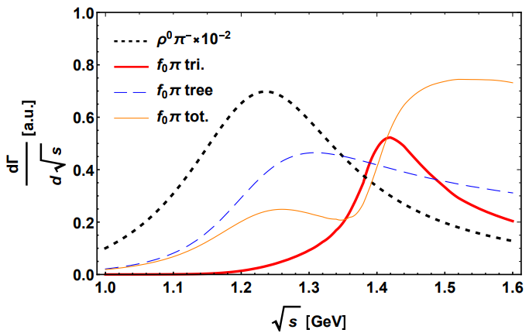
$$a_{1}→3π$$
Fig.8 $a_{1}$ spectrum of $χ_{c1}→πa_{1}$
$χ_{c1}→πa_{1}→4π$ can be factorized for the large momentum of the pion recoiling against $a_{1}$. The intensity and width of $a_{1}→f_{0}π$ through triangle mechanism are consistent with Ref. [1][2]
$$\frac{a_{1}→f_{0}π}{a_{1}→ρπ}≃0.6\%$$
$Γ≃150$ MeV
[1] M. Mikhasenko, B. Ketzer and A. Sarantsev, PRD 91,094015 (2015)
[2] F. Aceti, L.R.Dai and E. Oset, PRD 94,096015(2016)

Slide 55
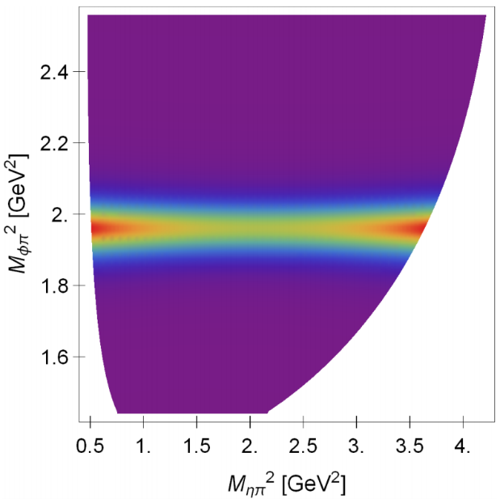
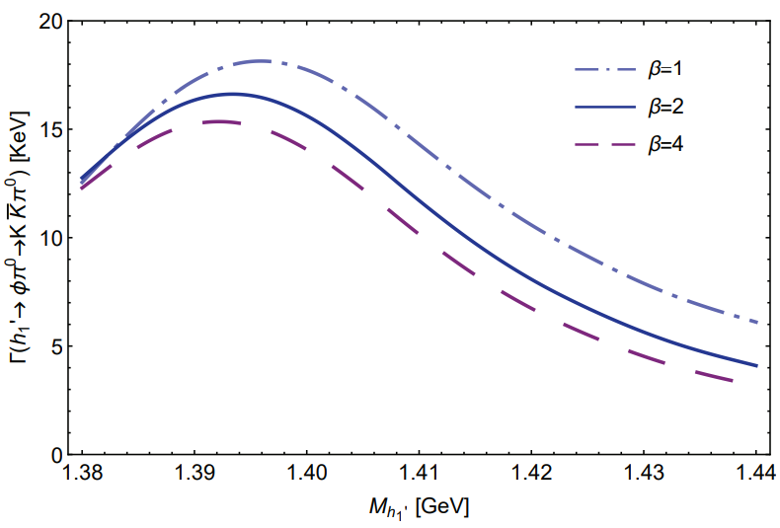
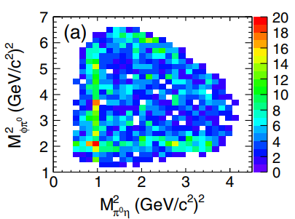
$$h_{1}^{′}→φπ$$
$$B.R.\left(J/ψ→h_{1}^{′}η→ηφπ\right)=6.3×{10}^{−8}$$
Fig.10 Dalitz plot of $J/ψ→ηh_{1}^{′}→ηφπ$ with the resonance of $h_{1}^{′}$
Fig.9 Partial width of $h_{1}^{′}→φπ^{0}→K\overline{K}π^{0}$ in unit of KeV
Fig.11 Dalitz plot of $J/ψ→ηφπ$ from Ref.[1]
[1] M. Ablikim, et al. PRL,121,022001(2018)
[2] H. J. Jing, F. K. Guo, B. S. Zou, PRD 100,114010(2019)
$$J/ψ→ηρ\left(1450\right)→ηφπ ?$$

Slide 56
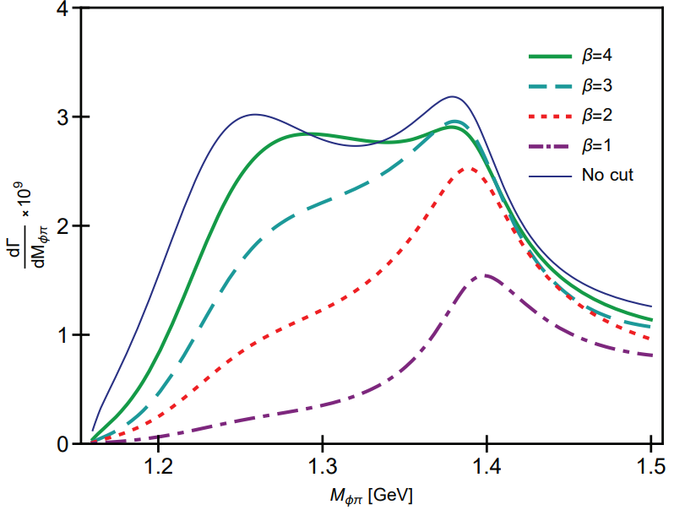
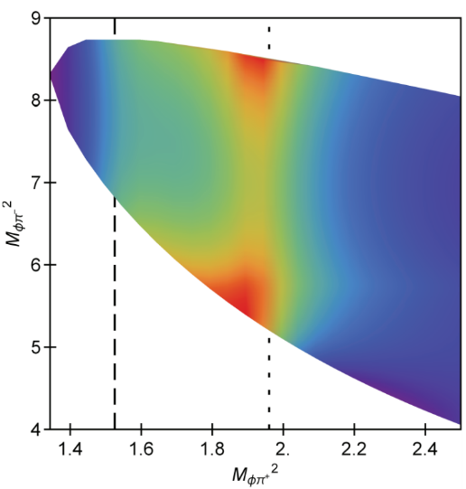
$$b_{1}→φπ$$
$$\sqrt{s}=m_{b_{1}}$$
$\sqrt{s}=1.4$ GeV
Fig.10 $K^{+}K^{−}$ spectra of $b_{1}^{+}→K^{+}K^{−}π^{+}$ evaluated at $\sqrt{s}=m_{b_{1}}$ (left) and $\sqrt{s}=1.4$ GeV (right). The $φπ^{+}$ signal is produced by OZI evading triangle mechanism.
On-shell branching ratio (at $β=2$)
$$\frac{B.R.(b_{1}^{+}→φπ^{+}→K\overline{K}π^{+})}{B.R.\left(b_{1}^{+}→ωπ^{+}\right)(S−wave)}=1.8×{10}^{−4}$$
Estimation without TS:
$$B.R.^{est.}\left(J/ψ→π^{±}b_{1}^{∓}→φπ^{+}π^{−}\right)≃1×{10}^{−6}$$
Actual branching ratio:
$$B.R.\left(J/ψ→π^{±}b_{1}^{∓}→φπ^{+}π^{−}\right)≃1×{10}^{−5}$$
Fig.13 $φπ^{+}$ spectrum (left) and the Dalitz plot (right) of $J/ψ→π^{±}b_{1}^{∓}→φπ^{+}π^{−}$

Slide 57
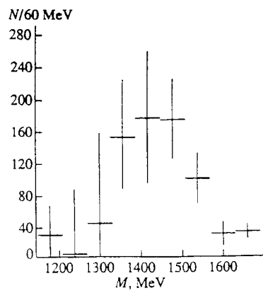
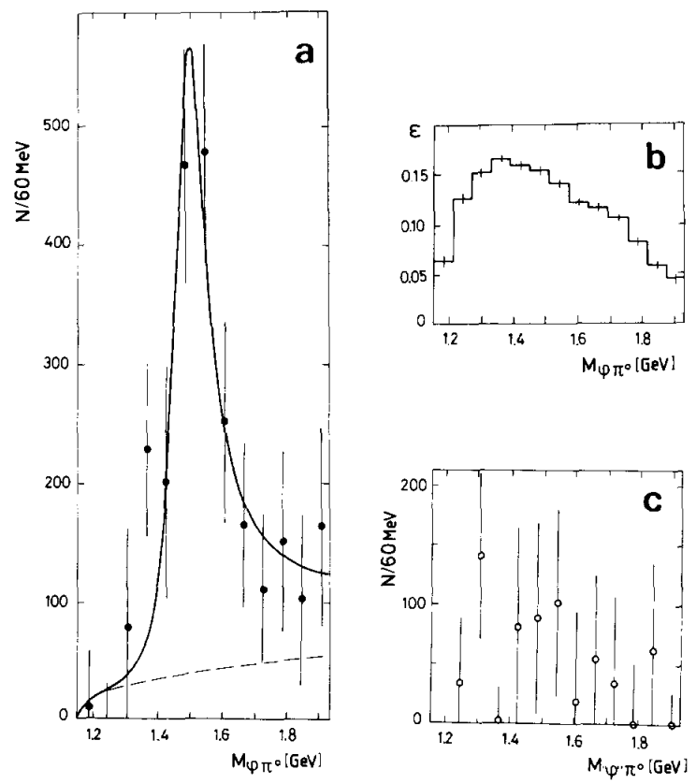
$$b_{1}→φπ$$
Fig.15 Effective mass spectrum of the $φπ^{0}$ system in the reaction $π^{−}p→φπ^{0}n$ (the results are weighted with detector efficiency) [2,3]. The “anti-OPE” selection $\left|t^{′}\right|>0.1 {GeV}^{2}$ is applied, which affects only slightly the efficiency for $π^{−}p→b_{1}n$ (not proceeding via OPE exchange), but which reduces the background from the OPE-mediated reaction $π^{−}p→C\left(1480\right)n$ by a factor of 5 [2,3].
Fig.14 (a) The acceptance-corrected $φπ^{0}$ mass spectrum in $π^{−}p→φπ^{0}n$. (b) The acceptance of the Lepton-F spectrometer for $φπ^{0}$ events. (c) The false “$φ$”$π^{0}$ mass spectrum [1].
“C(1480)” is reported with $I=1$ $J^{PC}=1^{−−}$, by OPE.
$M=1480±40$ MeV, $Γ=130±60$ MeV [1]
[1] Bityukov S.I. et al. Phys. Lett. B 118,383 (1987)
[2] V. A. Viktorov et al. Phys. Atom. Nucl. 59,1184 (1996)
[3] S.V. Golovkin et al. Z. Phys. A 359,435 (1997)

Slide 58
Content
Kinematic singularity
The emergence of kinematic singularity
Singular behavior
$η(1405/1475)$
The $η(1405/1475)$ puzzle
Open P-wave $K^{∗}\overline{K}$ threshold and width effect
Combined analysis
$η(1295)$, $η\left(1405/1475\right)→γV$
Light axial vector mesons
Introduction
Open S-wave $K^{∗}\overline{K}$ threshold and TS
Combined analysis.
Conclusion and outlook

Slide 59
Conclusion
The LQCD results do not support the ground-state-glueball assignment. Only one $η(1405/1475)$ state is observed in every single channel.
Open P-wave $K^{∗}\overline{K}$ for $η(1405/1475)$ leads to triangle singularity, which weakly affects $K \overline{K}π$ (only for $K$ exchange), but strongly affects $ηππ$ and $3π$ channels.
TS enhances $η\left(1405/1475\right)→a_{0}π→ηππ$ channel, a small branching ratio of this channel calls for a destructive interference.
The large isospin violation is due to two aspects, i.e. the smallness of $η\left(1405/1475\right)→a_{0}π$ and the enhanced $η\left(1405/1475\right)→f_{0}π$ by TS.
The analysis on radiative decays of $η(1405/1475)$ and $η(1295)$ is consistent with taking then as radial excited states. Irrespective of loop effects, the determined mixing angle is different form the real one, typically $δα=6^{∘}\sim 8^{∘}$.

Slide 60
Conclusion
Our combined study taken into account the TSM is consistent with taking the axial vector mesons as quark model states
Particularly, in our study, only TSM of $f_{1}(1285)$ cannot account for $f_{1}(1420)$, but the TSM of $a_{1}(1260)$ can produce $a_{1}\left(1420\right)$.
TSM produces non-trivial features in the spectra of $J/ψ→γ\left(f_{1}+f_{1}^{′}\right)→γηππ$ and $γK\overline{K}π$, in both the three-body and the two-body distributions.
TSM also plays a role in $C=−1$ sector, i.e. $b_{1}$ and $h_{1}$, where we predicted the branching ratio of OZI suppressed $J/ψ→b_{1}π→φππ$ and isospin violated $J/ψ→h_{1}\left(1415\right)η→φπη$ induced by TSM.

Slide 61
Thank you for your attention
Outlook
There are some channels which are not considered in this analysis, e.g. $κ\overline{K}$, $ση$ and $f_{0}η$.
The mechanism of the isospin violation of $f_{1}(1285)$ is pending studied.
The description of scalar meson states leads to strong model dependence. A consistent study should be worked out in one frame work.
The $π$ exchange in axial vector decays is weak, but is not well studied for $η(1405/1475)$. To what extent the pion exchange can dress the $η\left(1405/1475\right)→K^{∗}\overline{K}$ vertex and then affect the $K\overline{K}π$ spectrum needs to be studied.
A combined analysis on hadronic decays including $η(1295)$ is needed.

