Slide 1
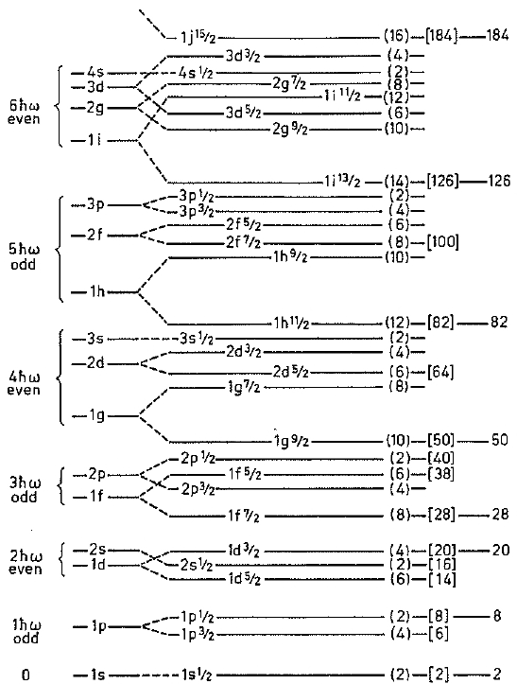
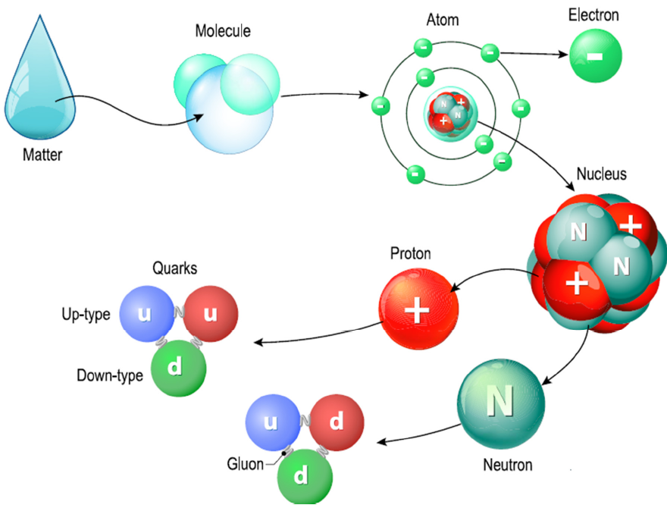
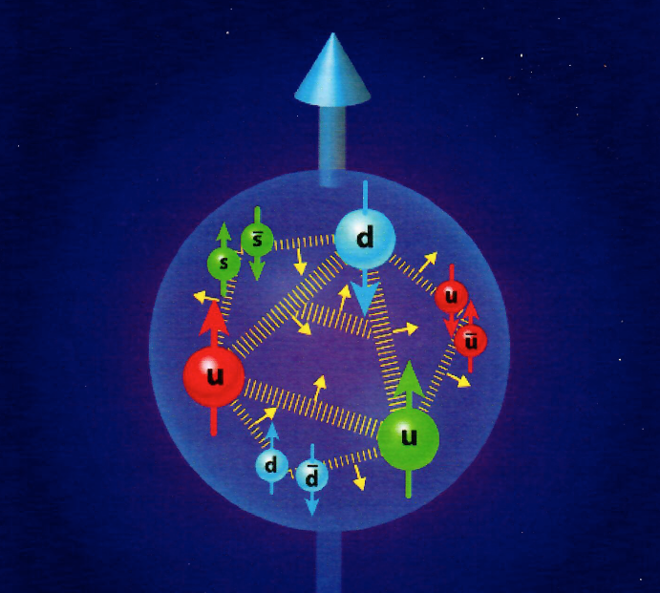
Importance of Approximate Symmetries in Nuclear Physics
Low-Energy (QED) Discoveries!
High-Energy (QCD) Challenges?
Strong QCD
Teleworkshop
NJU-INP
Legacy Shell Models ...
(LSM)
21st Century
Cross Over
... Femto-Science World
(FSW)
²⁰Ne
82
- QCD - Quantum
Chromo
Dynamics
50
Two forces – strong color force and the electromagnetic force – are responsible for holding the fundamental pieces – quarks & gluons plus electrons together ...
28
20
8
2
Where LSM (QED) & FSW (QCD) meet!
PIs: Jerry P. Draayer, Kristina D. Launey, Tomas Dytrych, Feng Pan
GAs: David S. Kekejian & Grigor Sargsyan
__________________________________________________
U.S. NSF & DOE & LSU & SURA Sponsored Research
Notes:
1

Slide 2
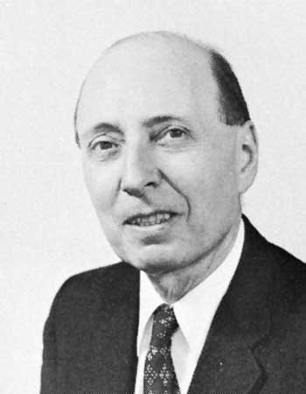
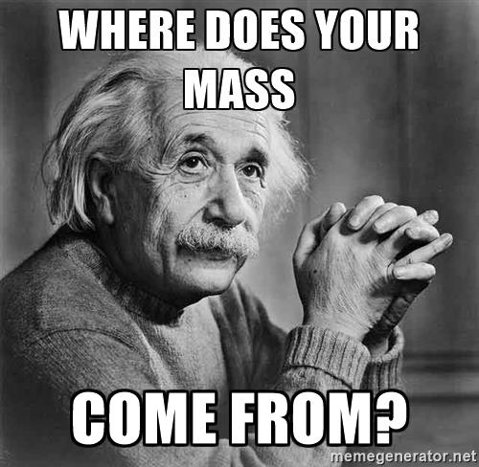
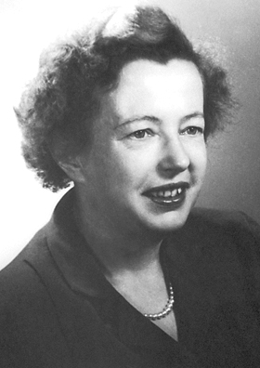
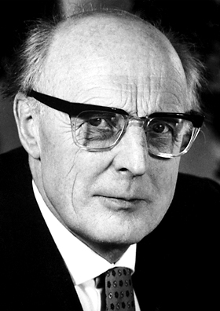
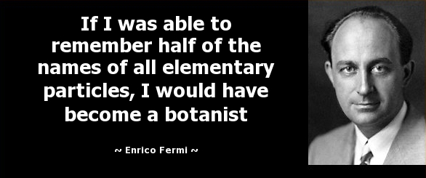


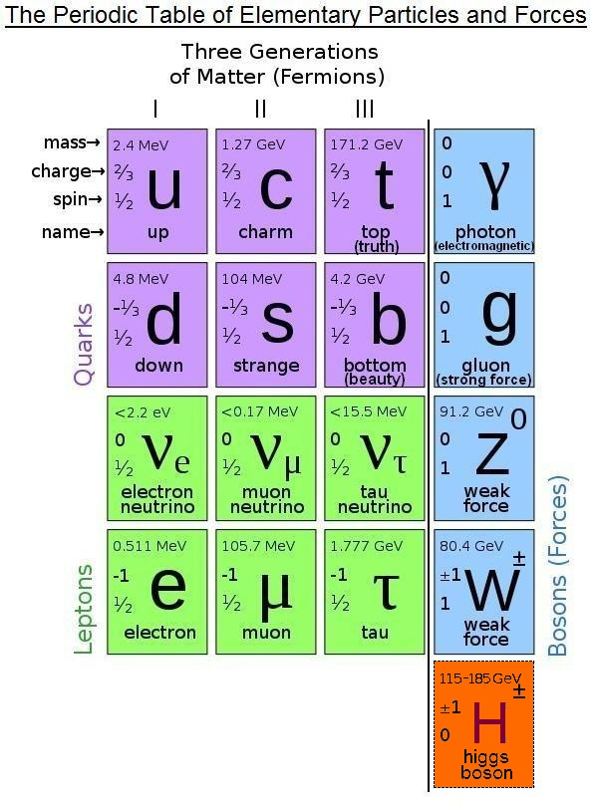

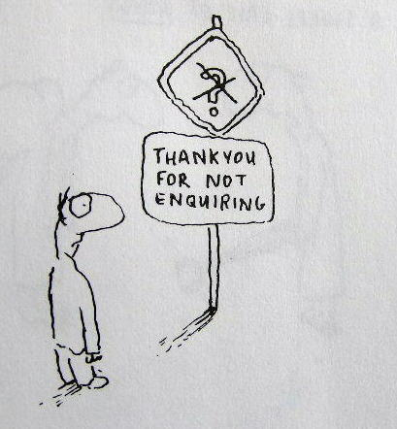
Overarching Historical Perspectives
Nuclear (LE-QED) Discoveries!
Particle (HE-QCD) Challenges?
?
...
Maria Goeppert Mayer & Hans Jansen
Won Nobel Prize (1963) “...for their discoveries (late 1940s) concerning nuclear shell structure”
Eugene Wigner
?
Simplicity within Complexity
?
Standard Model?
Numerous Follow-on Developments:
Single-particle Models
SP plus Pairing Modes
Many-body Approaches
Collective Models (BH)
Geometrical Theories
Quasi-particle Models
Algebraic Approaches
Effective Interactions
- 60 -
Years
Higgs?
Show me Something Mister!
Where’s the Mass, Man?
Numerous Follow-on Developments:
Confinement – Long & Short Range
What is Mass, or a Quantum?
1990s – HPC – 2000s
Dynamic Mass Generation
Lattice or Continuum (Strong) QCD
1990s – HPC – 2000s
?
Group
Theory & Therapy
?
No-Core Shell Model (NCSM)
Non-compact Symplectic Model
Symplectic Symmetry & EFT Roots*
*Sp(3,R) -> SU(3) is the Dynamical Symmetry Group of the 3D Oscillator!
“The Next Few Generations may Cross the Standard Model’s Final Frontier!” … Sir Craig D Roberts (2021)

Slide 3
No-Core (Regular & Symplectic) Shell Model
*
*
No-Core Shell Model (NCSM)
(Vary, Navratil, & Barrett, ~2000 to present)
Symplectic Shell Model (Sp-NCSM)
(Rowe & Rosensteel, ~1980s to present)
...
“No Big Deal” to “Major Action”
Typical Vertical Symplectic Excitation (Multiple 1p-1h / )
Reorganize
Shell-Model
Space
Cluster & Collective (Natural Subspaces)
-------------
–
+2hω
Sp(3,R)
A Raising
(L = 0 & 2)
Symmetry
Adapted Basis
(Special Features)
Canonical & unitary
Organized by shapes
Quadratic in x’s & p’s
Band-heads ➔ np-nh
Spurious free bands
Captures collectivity
No effective charges
Deformation dominates
Algebraic framework
EFT known & natural
1p-1h
–
–
+2hω
+2hω
SU(3)
–
2p-2h
0hω
–
+2hω
Sp(3,R)
B Lowering
(L = 0 & 2)
...
np-nh
–
+nhω
–
-2hω
*Realistic interaction (local or not; NN, NNN, …)
In principle, exact solutions, up to N_{max} cutoff
Successful descriptions to date through ¹⁶O
*Simple logical algebraic underpinning
Elliott SU(3) if no symplectic modes
Sp(3,R) add monopole & quadrupole
EFT: Symplectic Symmetry is the Dynamical Extension of the Harmonic Oscillator!

Slide 4





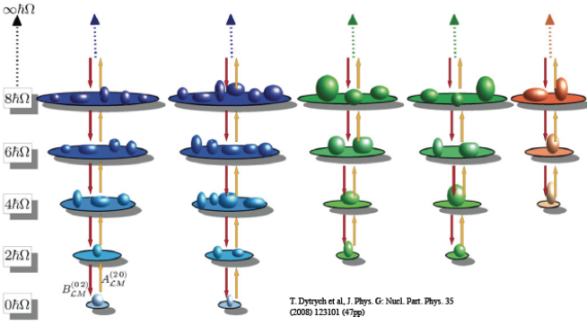
Symplectic Symmetry / Spectrum Generating Algebra
Realized by 21 generators of the Sp(3,R) symplectic algebra – all distinct quadratic forms in coordinates (q_{i}) and momenta (p_{i})
Spherical Oblate Prolate
Quadrupole (Shape)
“Tensor” (6)
Kinetic Energy
“Tensor” (6)
Orbital Angular
Momentum Operator (3)
Deformation Flow
“Circulation / Vorticity” (6)
Moment of Inertia
“Circulation / Vorticity” (6)
Internal Dynamics
“Circulation / Vorticity” (6)
Symplectic Symmetry is the Dynamical Symmetry Group of the Harmonic Oscillator ... !
Every configuration is labeled by the SU(3) (lambda, mu) quantum numbers of the Elliott Model (1958), which in turn defines the shape of the so-called “band head” configuration.)
David Kekejian – Graduate Student (JPD#20 PhD Expected 12/2021) from Armenia

Slide 5
Symmetry Adapted NCSM (SA-NCSM) Campaign
(Going on 20 years … 2001 - 2021)
Timeline: 5 (2002-06)
+ 5 (2007-2011)
+ 5 (2012-16)
Goal –
Reproduce and predict properties of heavy as well as light nuclei, starting with and building upon QCD/EFT informed and inspired interactions …
Plan –
Exploit existing capabilities to evaluate probability of success and level of effort required to develop a full-blown symmetry adapted NCSM
Develop a symmetry adapted no-core shell model code that capitalizes on exact and approximate (partial) symmetries of nuclei (SA-NCSM)
Study the emergence of collective phenomena, tracking their evolution to and from fundamental (ab initio) features of the interaction
Exploit existing NCSM technology to prove efficacy of method, revealing (or not) any inherent limitations
Explore need (or not) for renormalization, winnowing space to physically relevant and tractable subspaces
Evaluate extensibility of theory and its characteristics vis-à-vis current/emerging computational resources
Apply the theory to study of extreme processes known to be important to understanding nuclei and nuclear systems
Develop a user-friendly desktop version of code for simple applications as well as educational and training purposes
Extend theory to include coupling to the continuum, and apply to the result to the study of nuclear reactions

Slide 6
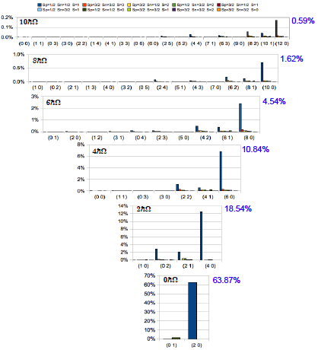
Results for ⁶Li with N_{max} = 10
(Proof of Principle)
… Proof of Principle …
> 99% of Physics
In < 1% of the
“reorganized” space
JISP16* bare interaction in Nmax = 10 space with
ħω = 20 MeV
… Team Work …
Many “helps” along the way … e.g., James Vary making his NCSM available to us, Mark Caprio (ND) visiting LSU on a sabbatical, along with quality input from Anna Hayes of LANL, various collaborators from Bulgaria, China, Mexico, and so on. Also, to NSF for a PetaApps award, and DOE for an EPSCoR grant, plus SURA for release time and financial assistance with postdoc team!
?
Simplicity
within
Complexity
?
*Bonn, Argonne, Idaho,
N3LO (optimized), etc.
... yield similar results ...
Typically
60% - 90%
Leading Sp-IR

Slide 7
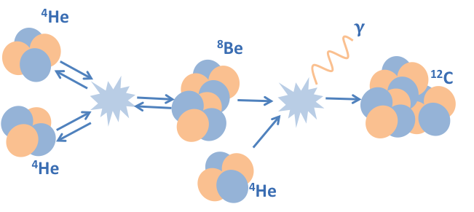
Creation of ¹²C in Hot Stars / Nucleosyntheses
… The Elusive Hoyle State …

Slide 8
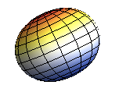
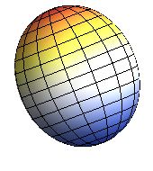
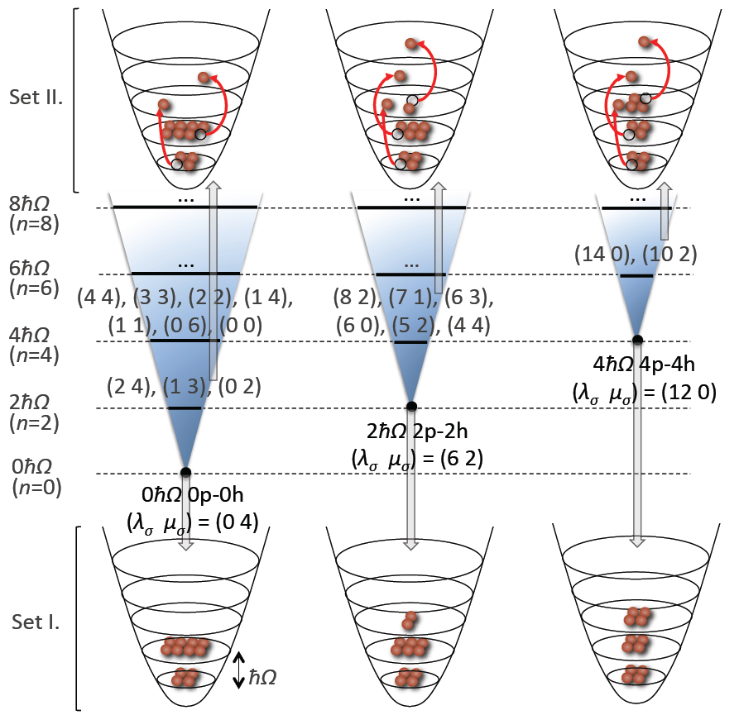
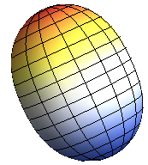
Three Primary “Slices” in NCSpM Description
0p-0h
¹²C
2p-2h
(0 4) Bandhead (Oblate)
(6 2) Bandhead (Prolate)
4p-4h
(12 0) Bandhead (More Prolate)
Intertwining
Shell & Alpha
Cluster Pictures

Slide 9
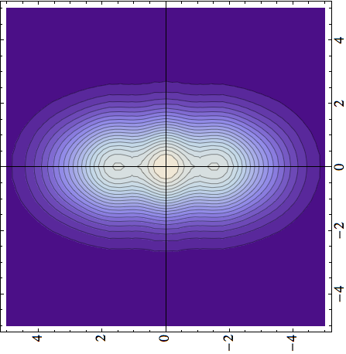
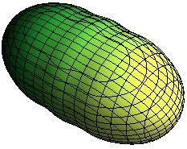
¹²C Systematics as a Function of N_{max}
2hω
(N_{max} = Total Number of Excitations above Ground State)
2⁺
0⁺
4p4h
Hoyle state
0⁺
NCSM
2p2h
2⁺
0p0h
Full
Plus
NCSpM
NCSpM

Slide 10
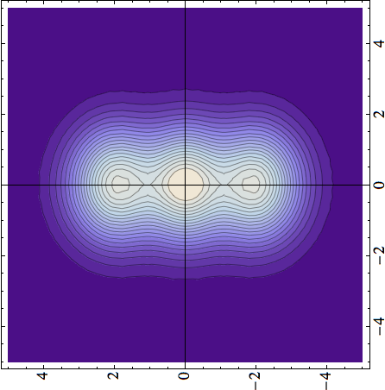

¹²C - Cluster Formations
(Now with mixing at the band-head level turned on ... !)
Density [fm^{–3}]
z [fm]
x [fm]
x [fm]
x [fm]
Hoyle state
Hoyle state
0⁺
0⁺
4⁺
2⁺
model space (major shells)
Standard ab initio NCSM
*(NCSpM & Band Mixing)

Slide 11
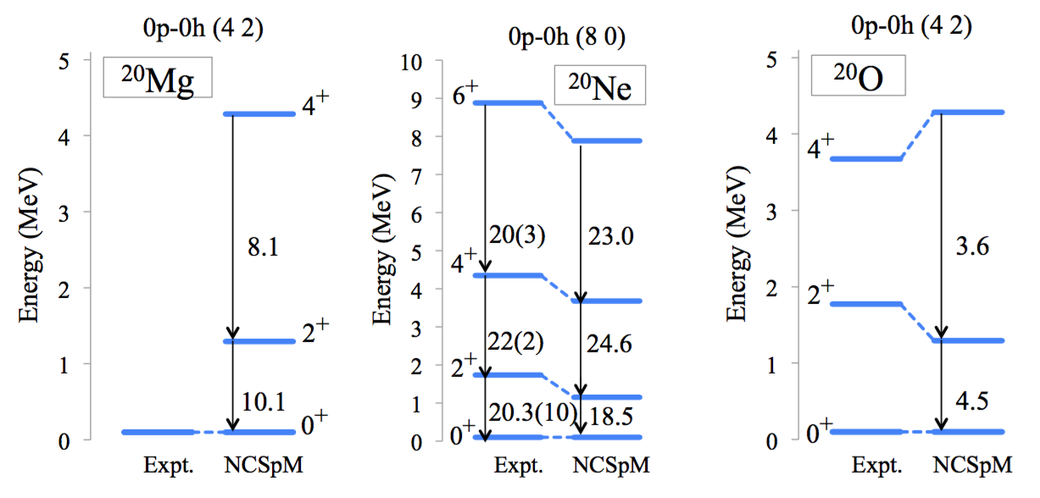
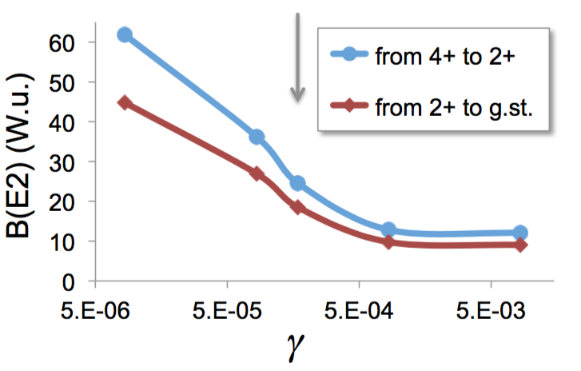
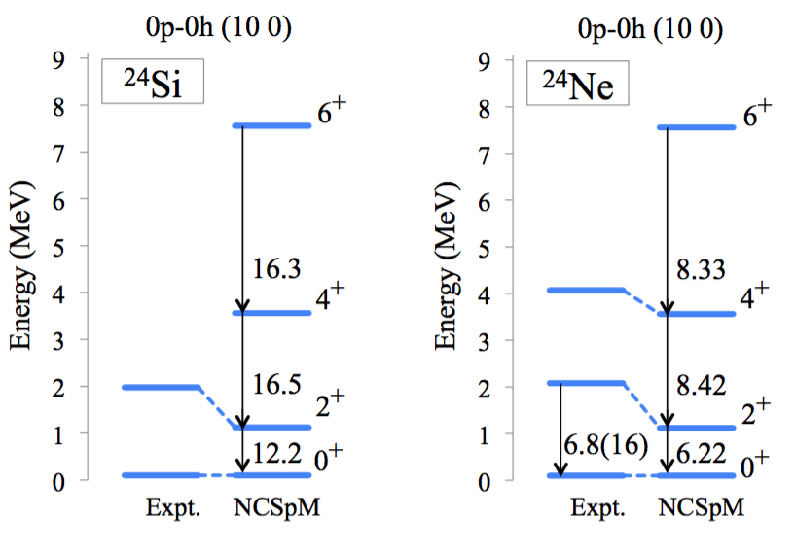
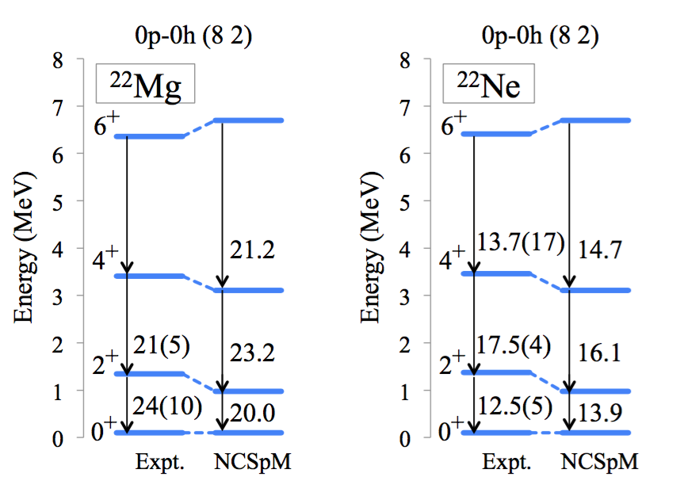
Medium Mass Nuclei (Gegory Tobin / REU Student)
Almost “Laptop” Level Calculations!
Ne-20: grey arrow is gamma used

Slide 12
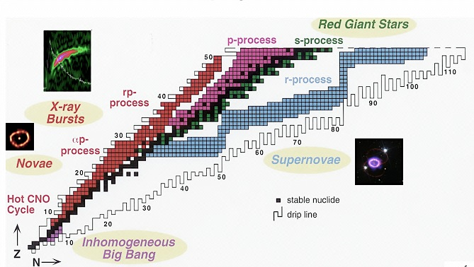
Further sd-shell Results (Robert Baker - GS)
²⁴Si
Selected (pre-thesis) Examples
(Now onto Beta Decay)
²²Mg
³²Ne
²⁰Ne
… nuclei… elements… stars…
¹⁹Ne
²⁴Ne
Ab initio description (converged selected spaces) (NNLO_{opt}, ħΩ=15 MeV, 13 HO shells)

Slide 13
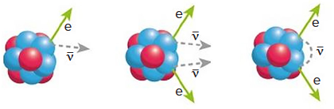
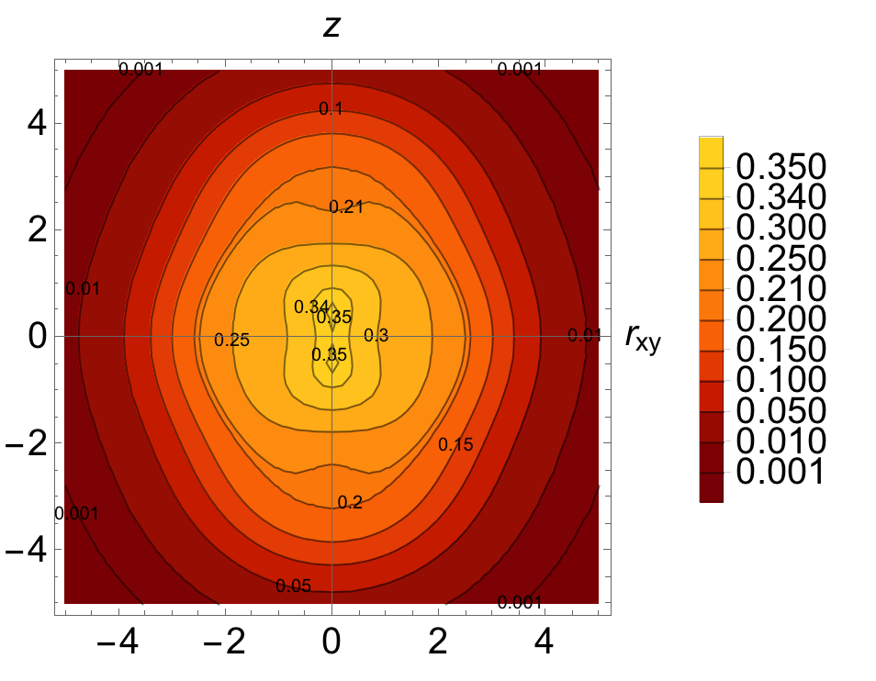
Plus fp-shell Results (Grigor Sargsyan - GS)
⁴⁸Ca
⁴⁸Sc
⁴⁸Ti
⁴⁸Ca
⁴⁸Ti
Neutrinoless ββ decay
8 shells, N2LOopt
0⁺
SA-NCSM (selected): ........................ 966,152
Complete model space: ....... 3,162,511,819 2⁺
SA-NCSM (selected): ................... 3,055,554
Complete model space: ..... 14,522,234,982
8 shells, N2LOopt
0⁺
SA-NCSM (selected): ......................... 602,493
Complete model space: ..... 24,694,678,414
2⁺
SA-NCSM (selected): ..................... 1,178,834
Complete model space: .... 113,920,316,658
⁴⁸Ti, Q(2⁺) [e fm²]
--------------------------
Experiment ..................... -17.7
8 shells ............................ -19.3
(no effective charges)

Slide 14
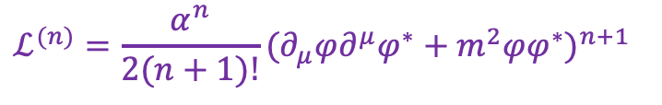
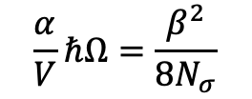
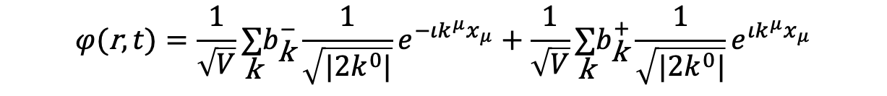
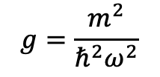

Constructing an Effective Field Theory (David Kekejian - GS)
Generic (Scalar) Field Theory
Quantum (Scalar) Field Theory
canonical
quantization
$ℒ=\frac{1}{2}(∂_{μ}φ)(∂^{μ}φ)+\frac{1}{2}m^{2}φ^{2}$ $H=\underset{\text{k}}{∑}E_{\text{k}} (b_{\text{k}}^{+}b_{\text{k}}^{−}+\frac{1}{2})$
$$φ(\text{r},t)=\frac{1}{\sqrt{V}}\underset{\text{k}}{∑}b_{\text{k}}^{−}\frac{1}{\sqrt{|2k^{0}|}}e^{−ιk^{μ}x_{μ}}+\frac{1}{\sqrt{V}}\underset{\text{k}}{∑}b_{\text{k}}^{+}\frac{1}{\sqrt{|2k^{0}|}}e^{ιk^{μ}x_{μ}}$$
Paper in Preparation
David Kekejian (Thesis - LSU 4Q2021)
$$ℒ^{(n)}=\frac{α^{n}}{2(n+1)!}(∂_{μ}φ∂^{μ}φ^{∗}+m^{2}φφ^{∗})^{n+1}$$
$$ℋ^{(n)}=\frac{α^{n}}{2(n+1)!}(\overset{·}{φ}{\overset{·}{φ}}^{∗}−φ^{′}⋅φ^{′∗}+m^{2}φφ^{∗})^{n}((2n+1)\overset{·}{φ}{\overset{·}{φ}}^{∗}+φ^{′}⋅φ^{′∗}−m^{2}φφ^{∗})$$
$$H^{(n)}∼(\frac{α}{V}ℏΩ)^{n}×(g^{2}Q⋅Q)^{n},(K⋅K)^{n},(gQ⋅K)^{n},(gK⋅Q)^{n}$$
$$\frac{α}{V}ℏΩ=\frac{β^{2}}{8N_{σ}}$$
$$g=\frac{m^{2}}{ℏ^{2}ω^{2}}$$
Symplectic symmetry emerges naturally from quantum effective field theory!

Slide 15
… Here’s the Deal …
Nuclear (LE-QED) Discoveries!
Particle (HE-QCD) Challenges?
20th Century Subatomic Physics
-----------------------------
Great Minds and Creative Models
Numerous Prestigious Awards Won
Major New Facilities Commissioned
Simplicity within Complexity Good
Analytic Solutions Well Regarded
------
Physics Changed Technology
1990s – HPC/ERA – 2010s
Technology Changed Physics
------
21st Century Subatomic Physics
-----------------------------
Bigger Computers! -> Better Results?
- 100 -
Years
- 100 -
Years
<-------- NCSM Lattice QCD ------>
<--------SpNCSM Continuum QCD ------>
Simpler Picture! -> Cleaner Results?
Partial Symmetries Expose Coherent Features
Lunch (5 years back) at JLab: “Is the nucleon deformed (round)?”

