Slide 1
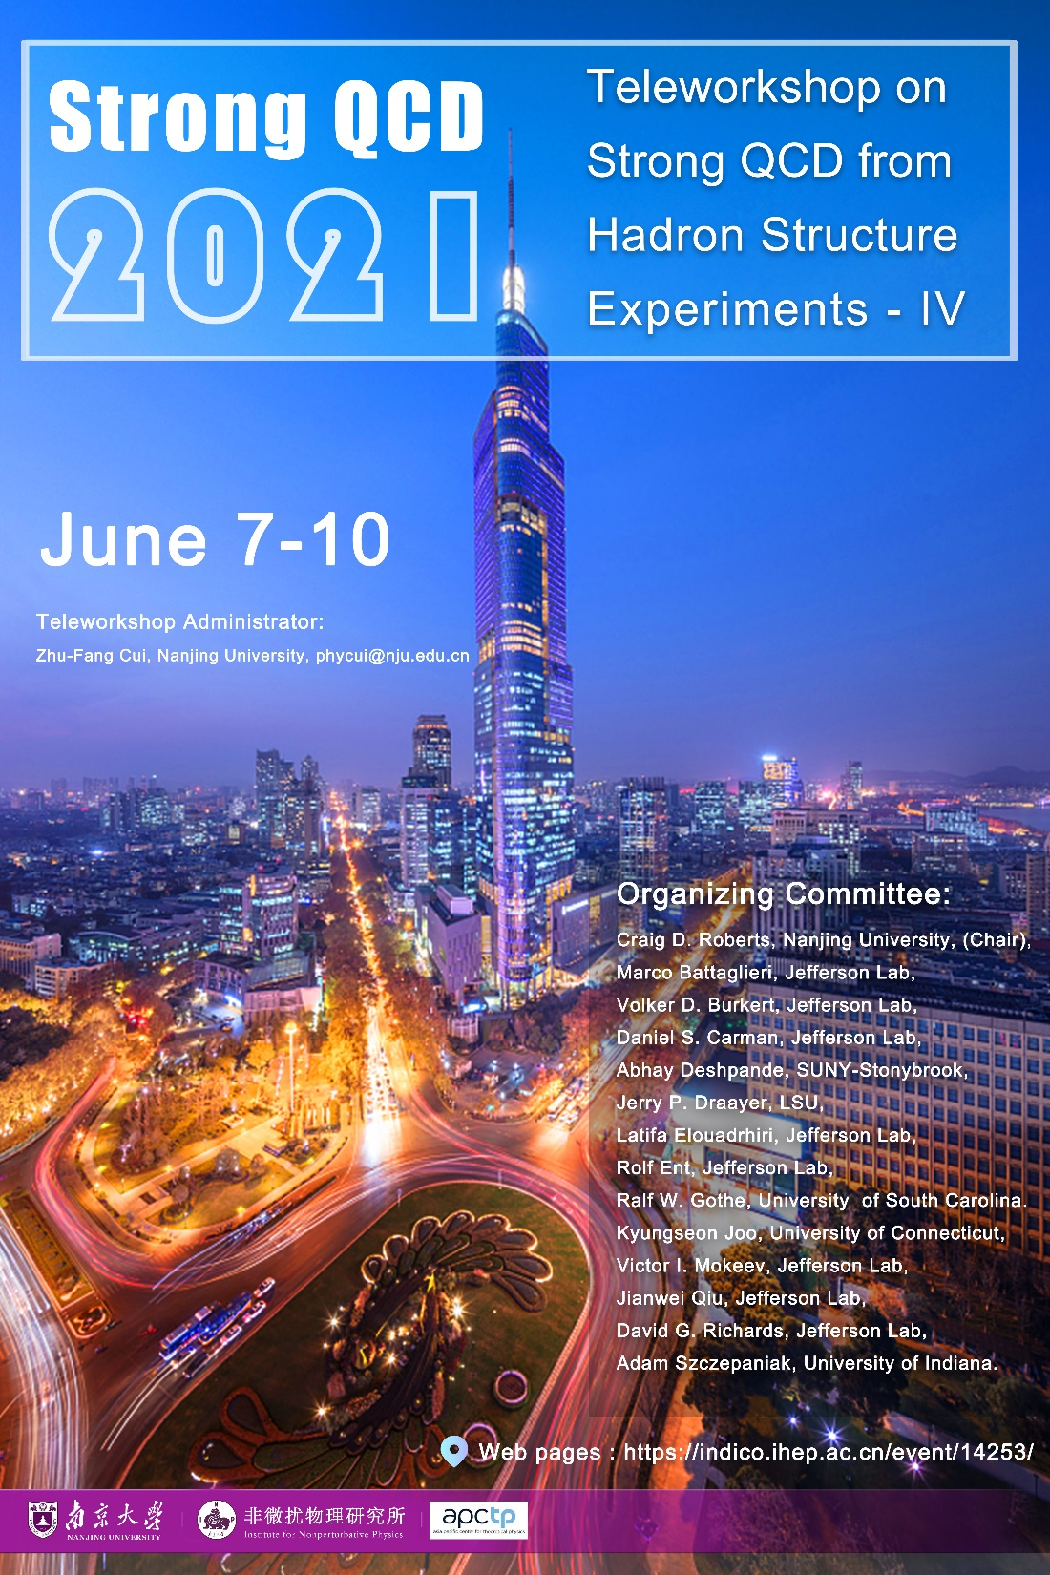
Craig Roberts … http://inp.nju.edu.cn/
Prospects for Continuum Theory and Phenomenology

Slide 2
Needs for Strong QCD
Entered the 12 GeV era at JLab & planning upgraded and new facilities worldwide using electromagnetic and hadronic probes
World has embarked on an ambitious program of experiments to determine
Hadron elastic and transition form factors
Hadron structure functions, e.g., DFs, GPDs, and TMDs
therewith reveal the one- and three-dimensional structure of hadrons.
Therefore, imperative to develop phenomenology and theory that can convert the data into insights that will expose the character of interaction dynamics at the strong QCD frontier
QCD's running-coupling and -masses become large
hadrons and atomic nuclei are generated.
Full capitalization requires
truly fruitful interactions between experiment + phenomenology + theory

Slide 3
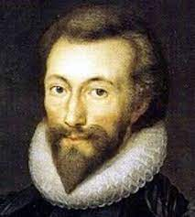
Needs for Strong QCD
Entered the 12 GeV era at JLab & planning upgraded and new facilities worldwide using electromagnetic and hadronic probes
World has embarked on an ambitious program of experiments to determine
hadron elastic and transition form factors
Structure functions, GPDs, and TMDs
therewith reveal the one- and three-dimensional structure of hadrons.
Therefore, imperative to develop phenomenology and theory that can convert the data into insights that will expose the character of interaction dynamics at the strong QCD frontier
QCD's running-coupling and -masses become large
hadrons and atomic nuclei are generated.
Full capitalization requires
truly fruitful interactions between experiment + phenomenology + theory
No man is an island, entire of itself;
every man is a piece of the continent, a part of the main;
if a clod be washed away by the sea, Europe is the less, as well as if a promontory were, as well as if a manor of thy friend’s or of thine own were;
any man’s death diminishes me, because I am involved in mankind, and therefore never send to know for whom the bell tolls; it tolls for thee.

Slide 4
Progress in Strong QCD
Hadron radii from precise, low-Q2 e-scattering data ... Daniele BINOSI
Resonance electroproduction Michael DOERING
From strong QCD to atomic nuclei ... Jerry DRAAYER
Analysis of inclusive electron scattering in the resonance region ... Astrid HILLER-BLIN
3D Structure of the nucleon ... Xiangdong JI
GPDs and PARTONS ... Herve MOUTARDE
Production of hybrids and exotics ... Alessandro PILLONI
EHM and the meson spectrum ... Presented by Sixue QIN
3D structure of mesons ... Khepani RAYA
Insights into EHM using pion and kaon targets Craig ROBERTS
Faddeev equation and resonance electrocouplings ... Jorge SEGOVIA
New baryon states in quark models ... Elena SANTOPINTO
As we’ve seen in the past few days, continuum phenomenology and theory provide
QCD Rigour for lower-n-point Schwinger functions
Process-independent running coupling
Running gluon and quark masses
Indispensable bridges between empirical data and QCD-calculable Schwinger functions
QCD-based and/or QCD-connected models for insightful interpretation of more complex phenomena involving higher-n-point functions
Foundation for estimates essential in planning new-generation experiments
“targets” begging for validation/falsification using ab initio methods in QCD

Slide 5
Promises from 2019 November @ JLab
Chapter VIII. RECOMMENDATIONS ON FUTURE JOINT ACTIVITIES BETWEEN EXPERIMENT, PHENOMENOLOGY, AND THEORY
Progress with dynamical coupled channels models and reaction theory
New insights into spectra of mesons and baryons
Predictions for nucleon elastic form factors on the entire domain accessible to JLab
Predictions for DFs of valence, sea and glue in the pion and kaon
Predictions for mass and pressure distributions within the pion and kaon
Extensions to strong QCD in heavy-flavour physics

Slide 6
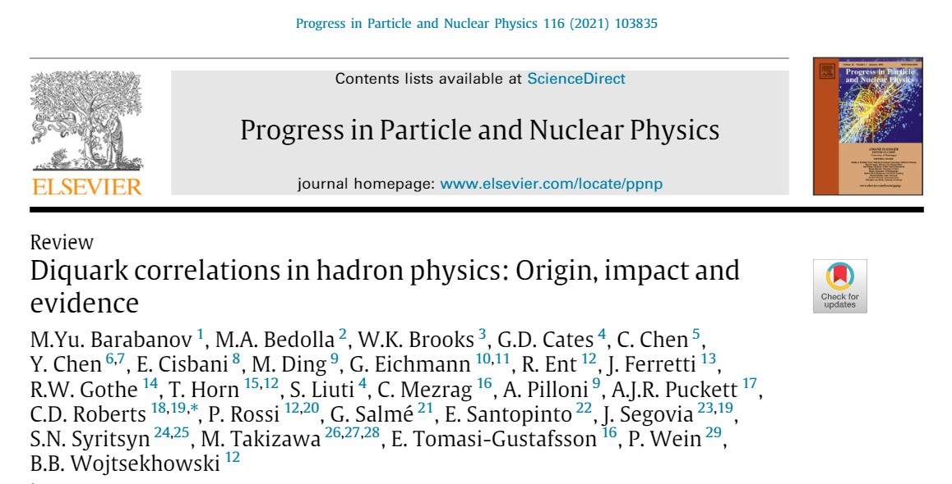
Promises from 2019 November @ JLab
Representation of baryons as containing pointlike and/or interaction-inert diquark correlations is no longer tenable
Nucleon contains 0⁺, 1⁺ diquark correlations that are active in every interaction allowed by their quantum numbers
Above ground state, negative parity qq correlations play a measurable, even decisive role in baryon structure
Critical analysis of experimental, phenomenological, and theoretical evidence for the existence of diquark correlations in baryons
First calculations of diquark structure as expressed in distribution amplitudes
Predictions for nucleon axial-vector and pseudoscalar form factors of use, e.g., in analysis and prediction of neutrino-nucleus cross-sections
Related prediction for pi+N+N coupling constant and form factor
Nearing completion of predictions for N(940) → N*(1535) (1/2)– , including entire array of admissible diquark correlations: 0⁺, 1⁺, 0– , 1–

Slide 7
Highlights in Planning for Next-Generation Facilities
Selected Science Opportunities for the EicC, Xurong Chen, Feng-Kun Guo, Craig D. Roberts and Rong Wang, NJU-INP 022/20, arXiv:2008.00102 [hep-ph], Few Body Syst. 61 (2020) 4, 43/1-37. Invited contribution to the Special Issue: "New Trends in Hadron Physics: a Few-Body Perspective"
Insights into the Emergence of Mass from Studies of Pion and Kaon Structure, Craig D. Roberts, David G. Richards, Tanja Horn and Lei Chang, NJU-INP 034/21, arXiv: 2102.01765 [hep-ph], Prog. Part. Nucl. Phys. (2021) “on line”
Revealing the structure of light pseudoscalar mesons at the Electron-Ion Collider, John Arrington et al., NJU-INP 036/21, arXiv: 2102.11788 [nucl-ex], J. Phys. G 48 (2021) 7, 075106
Continuing series of Workshops: Perceiving Emergence of Hadron Mass via AMBER @ CERN
Synergistic efforts joining experiment, phenomenology, theory in drive to new era with accessible meson targets

Slide 8
Future of Continuum Strong QCD
Notwithstanding the progress made in QCD theory, the complexity and diversity of strong interaction phenomena ensure that phenomenology, and the construction and use of QCD-inspired models remain an essential part of the worldwide theory effort.
Such methods enable connections to be drawn between the results of ab initio computations and experimental data.
More importantly, they enable the rapid development of insights and intuition regarding complex systems and reactions, providing the information that is very often necessary for grasping the key elements of new discoveries and planning next sensible steps.
Take what is phenomenology now, and move it into the realm of rigorous theory
E.g., gluon running-mass function was phenomenology when notion introduced
Rigorous result of continuum and lattice
theory now

Slide 9
Strong QCD – IV B
2022 June NJU INP

