Slide 1
Progress on CEPC IP Superconducting Magnet
Yingshun Zhu, Xiangchen Yang, Ran Liang, Chuang Shen
Institute of High Energy Physics, Chinese Academy of Sciences
May 12, 2021

Slide 2
Outline
Introduction
Status of IP magnets in CDR scheme
Status of IP magnets in high luminosity scheme
Summary

Slide 3
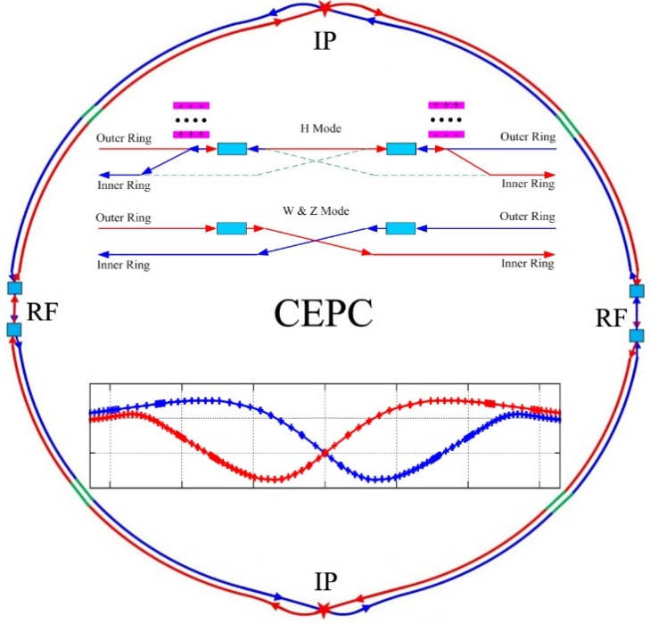
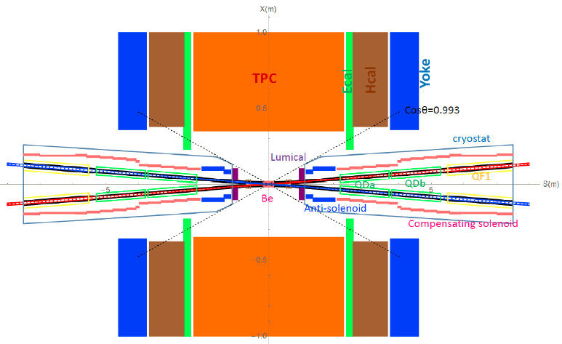
Introduction
CEPC is a Circular Electron Positron Collider with a circumference about 100 km, beam energy up to 120 GeV proposed by IHEP.
Most magnets in CEPC Accelerator are conventional magnets.
To greatly squeeze the beam for high luminosity, compact high gradient final focus quadrupole magnets are required on both sides of the IP points in CEPC collider ring.
Sketch of CEPC Collider ring
CEPC MDI layout

Slide 4
Introduction
The CDR requirements of the Final Focus quadrupoles (QD0 and QF1) are based on L* of 2.2 m, beam crossing angle of 33 mrad.
QD0 and QF1 magnets are operated inside the field of Detector solenoid magnet with a central field of 3.0 T.
To cancel the effect of the longitudinal detector solenoid field on the accelerator beam, anti-solenoids before QD0, outside QD0 and QF1 are needed.
The total integral longitudinal field generated by the detector solenoid and accelerator anti-solenoid is zero; Local net solenoid field in the region of quadrupole is close to zero.
Table 1: CDR requirements of Interaction Region quadrupole magnets for Higgs
Magnet | Central field gradient (T/m) | Magnetic length (m) | Width of GFR (mm) | Minimal distance between two aperture beam lines (mm)
QD0 | 136 | 2.0 | 19.6 | 72.6
QF1 | 110 | 1.48 | 27.0 | 146.20

Slide 5
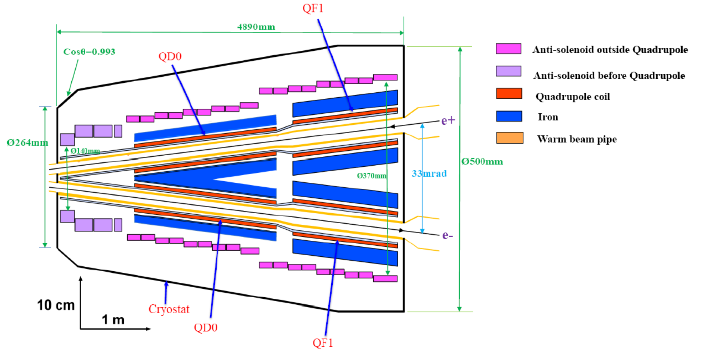
Introduction
CEPC MDI SC Magnets start at z=1.12m, including: superconducting QD0,QF1, anti-solenoid on each side of the IP point.
Inner radius of beam pipe is 10 mm in CDR; Checked by HOM heating load calculation.
QD0, QF1, and anti-solenoid coils are in the same cryostat.
Schematic layout of QD0, QF1, and anti-solenoid

Slide 6
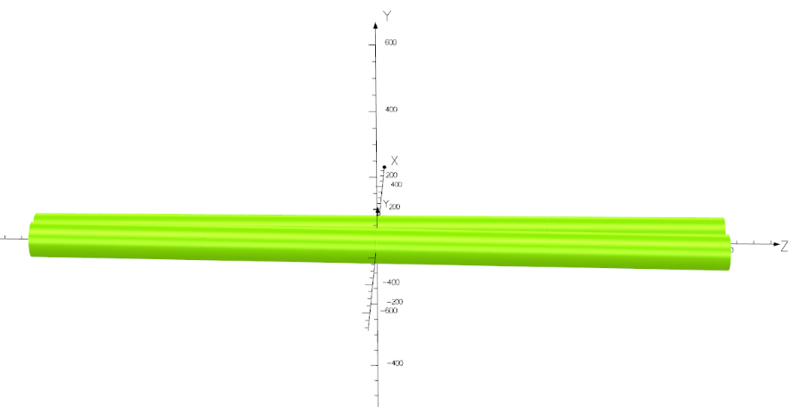
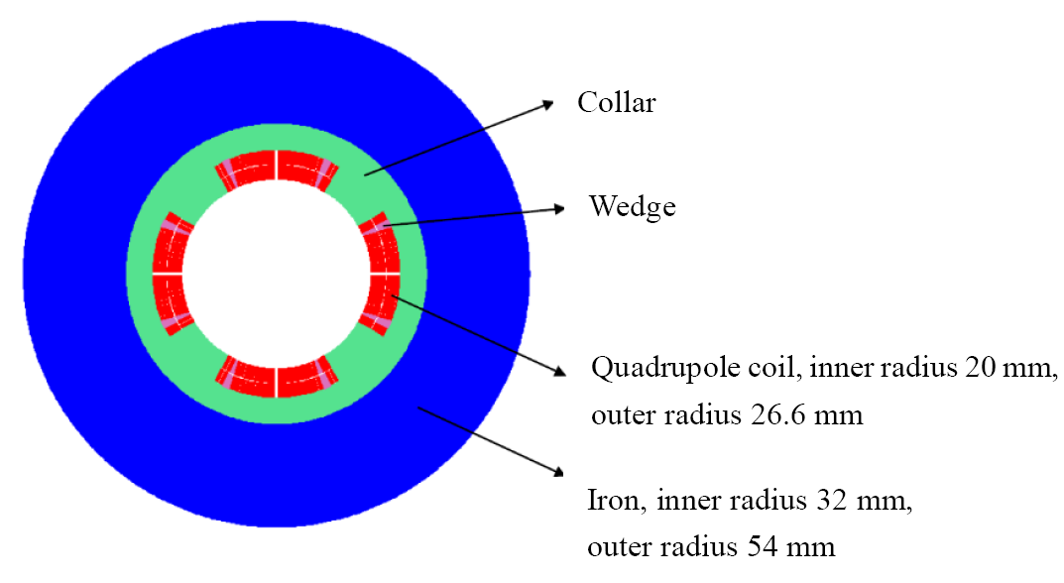
Status of IP magnets in CDR scheme
Design of QD0 iron option:
Collared cos2θ quadrupole magnet with shared iron yoke and crossing angle between two aperture centerlines. In practice, can it be fabricated and really meet the requirement?
So far, there is no cos2θ superconducting quadrupole magnet in China.
In the R&D, the first step is to study and master main key technologies of superconducting quadrupole magnet by developing a short QD0 model magnet with 0.5m length (near IP side).

Slide 7
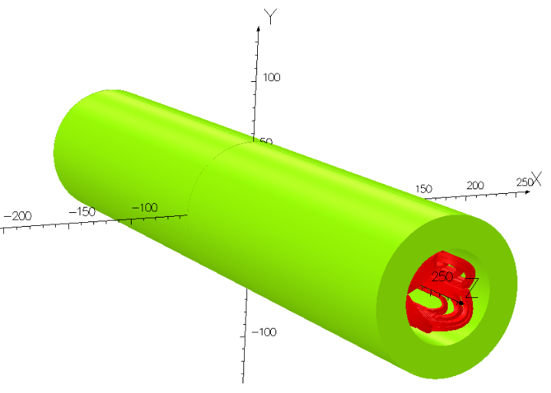
2.1Fabrication status of 0.5m single aperture QD0 short model magnet
Research on some key technologies of 0.5m single aperture superconducting quadrupole magnet QD0 in CEPC IR has started (LTS NbTi, 136T/m), in collaboration with HeFei KEYE Company.
Including: quadrupole mechanical design, coil winding technology, fabrication procedure of quadrupole coil with small diameter, stress applying and monitoring, quadrupole magnet assembly and measurement technology, etc.

Slide 8
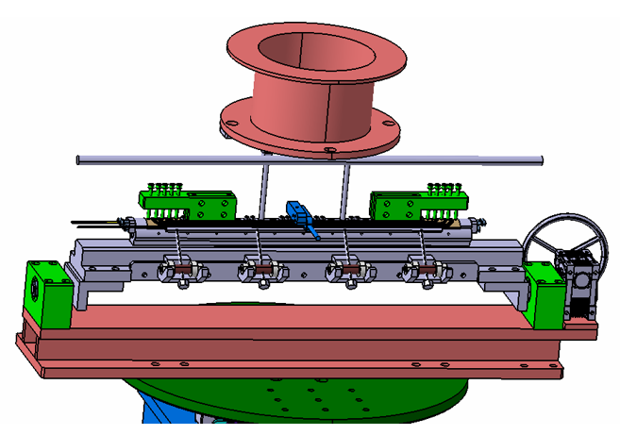
Mechanical design of QD0 short model magnet
Mechanical design of the 0.5m single aperture magnet and quadrupole coil winding machine has been finished.
Coil winding machine

Slide 9
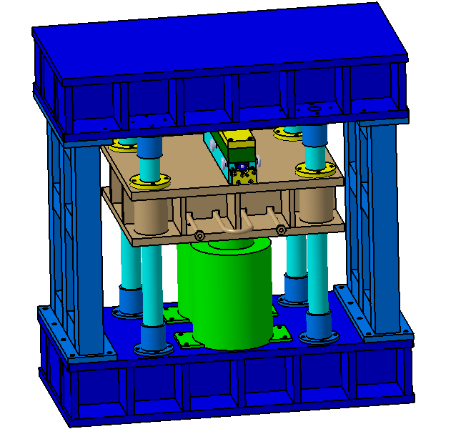
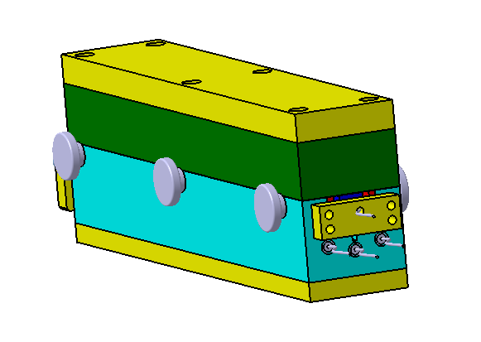
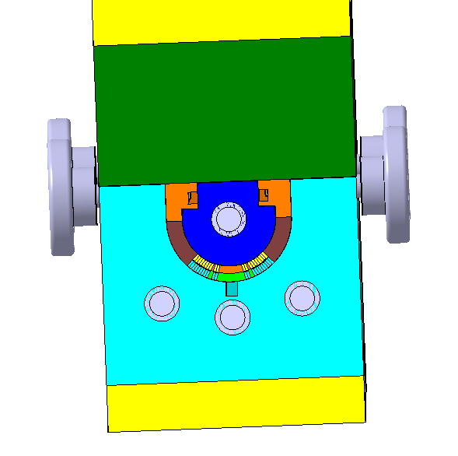
Mechanical design of coil heating and curing system
After the winding process, the quadrupole coil will be heated and cured inside a curing mold.
Mechanical design of Superconducting quadrupole coil heating and curing system is completed.

Slide 10
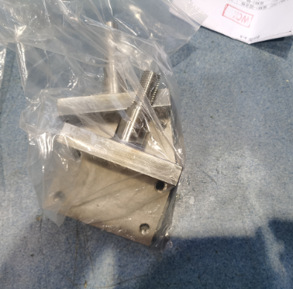
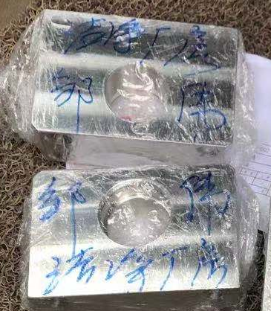
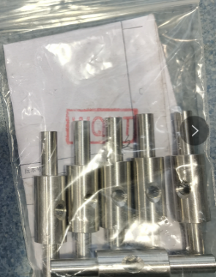
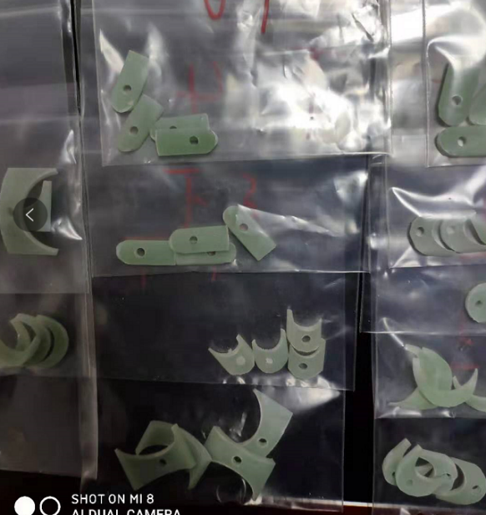
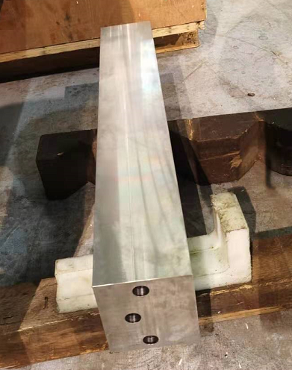
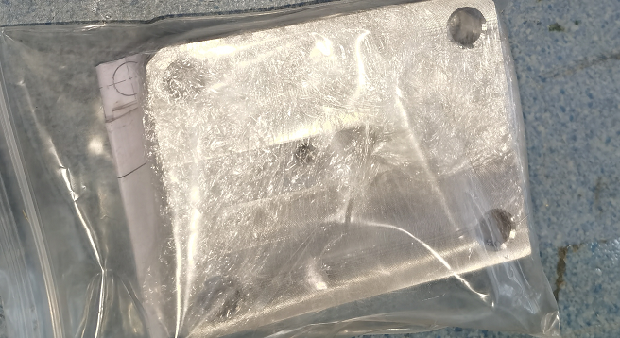
Status
Some components of winding machine and coil heating and curing system :

Slide 11
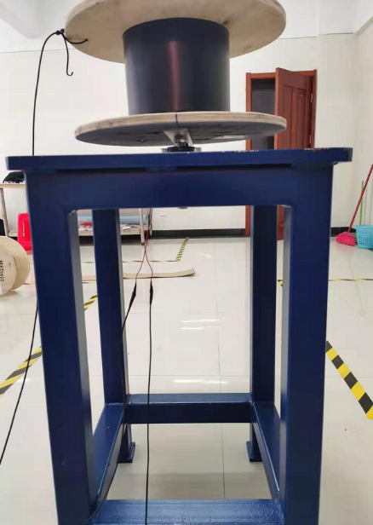
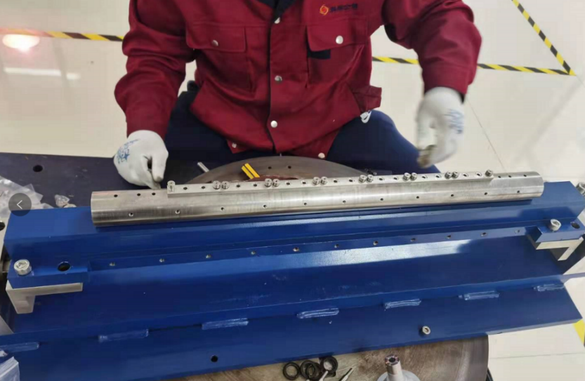
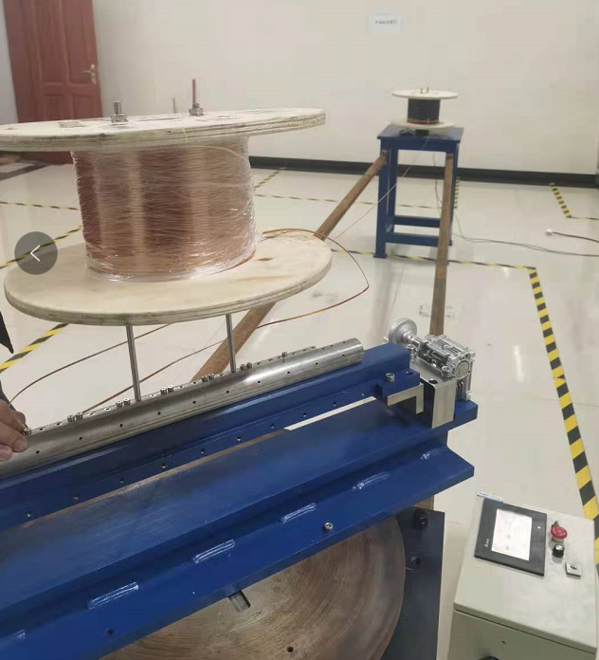
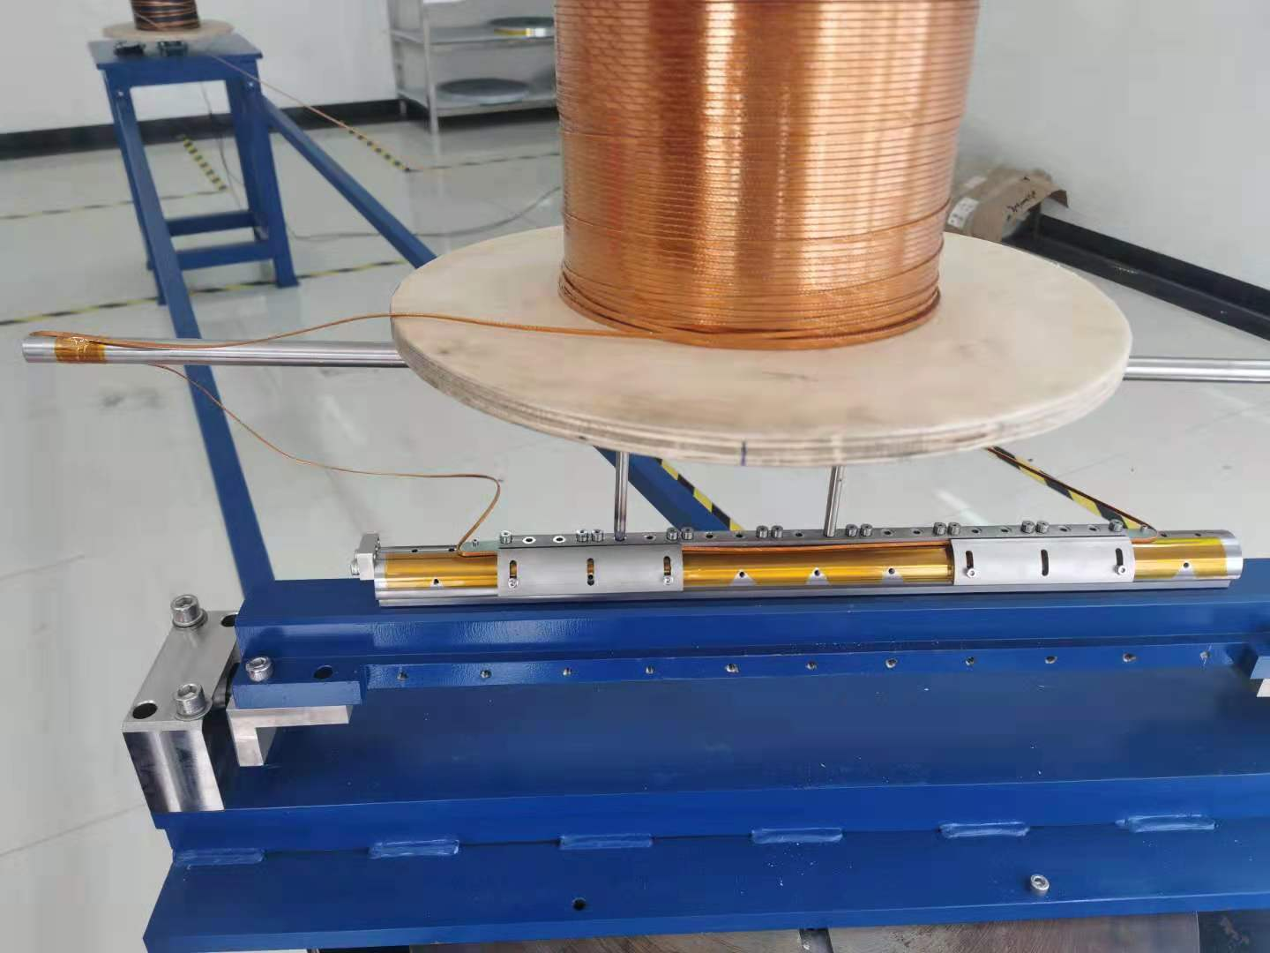
Status
Test winding of 0.5m single aperture quadrupole model has begun (Cu cable):

Slide 12
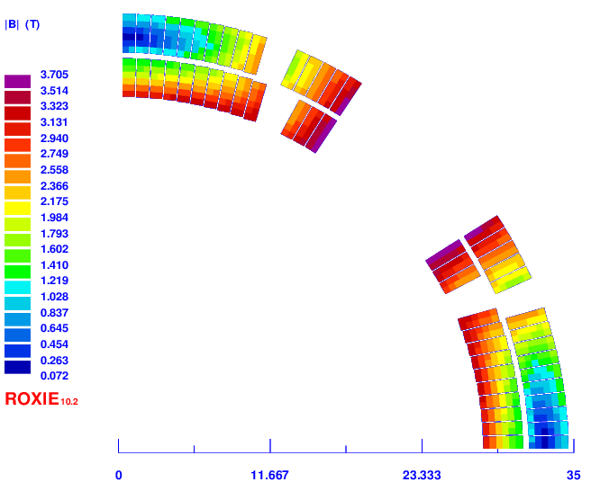
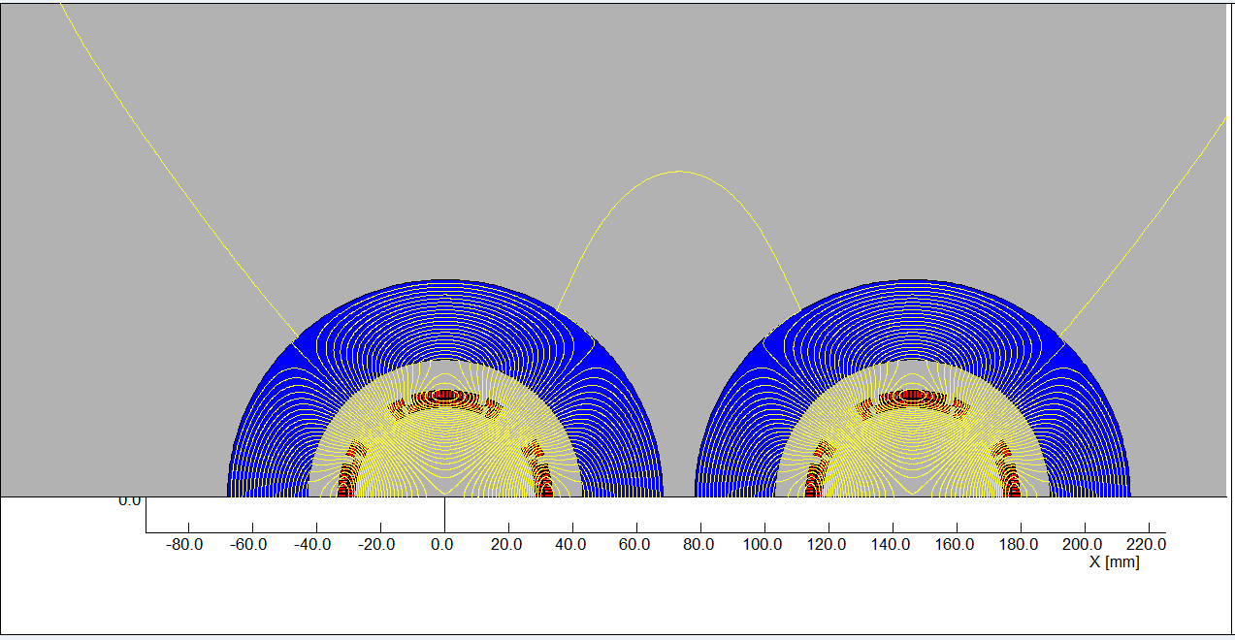
2.2 Design of superconducting quadrupole magnet QF1
QF1 is based on two layers cos2θ quadrupole coil using NbTi Rutherford cable with iron yoke.
After optimization by ROXIE, the QF1 coil consists of four coil blocks in two layers separated by wedges, and there are 28 turns in each pole. Current: 2280A.
Since the distance between the two apertures is much larger, the field cross talk between the two apertures of QF1 is not a problem.
2D field calculation model

Slide 13
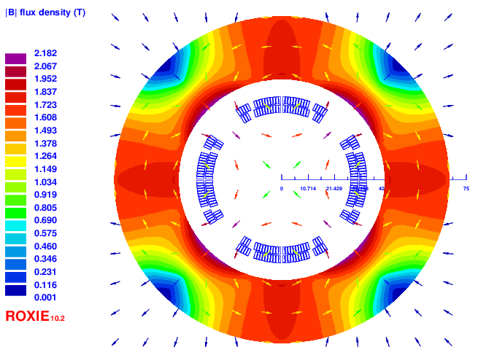
Design of superconducting quadrupole magnet QF1
Table 2: 2D field harmonics of QF1 (unit, 1×10⁻⁴)
n | B_{n}/B₂@R=13.5mm
2 | 10000
6 | -0.32
10 | -0.49
14 | 0.002
Coil cross section of single aperture QF1

Slide 14
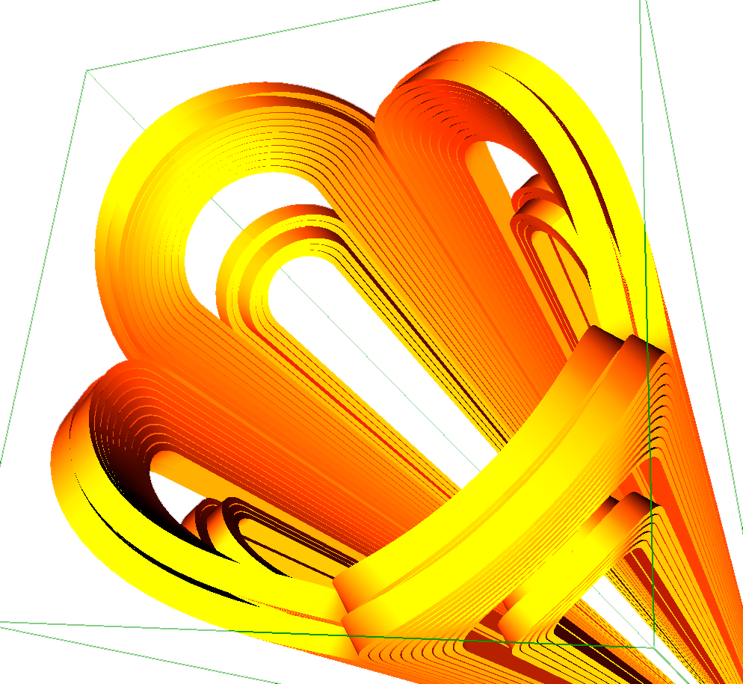
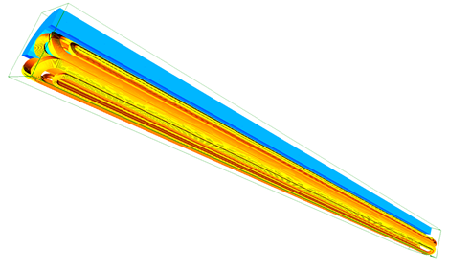
Design of superconducting quadrupole magnet QF1
3D magnetic field optimization
The detailed coil end shape and conductors group is determined by field simulation using ROXIE.
The field gradient, magnetic length meet the design requirement.
Each systematic field harmonics is smaller than 1 unit (1×10⁻⁴).
3D design of QF1

Slide 15
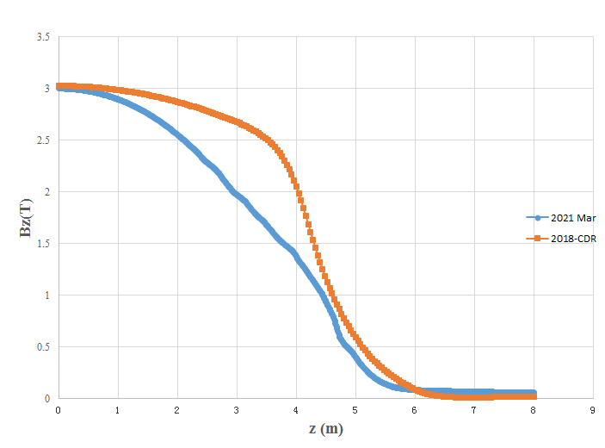
2.3 Design progress of superconducting anti-solenoid
Recently, the design of Detector solenoid is modified, so the design of Accelerator anti-solenoid is updated.
Old vs new Detector solenoid field distribution

Slide 16
The design requirements of the anti-solenoids in the CEPC Interaction Region are summarized below:
1) The total integral longitudinal field generated by the detector solenoid and anti-
solenoid coils is zero.
The longitudinal field inside QD0 and QF1 should be smaller than a few
hundred Gauss at each longitudinal position.
The distribution of the solenoid field along longitudinal direction should meet
the requirement of the beam optics for emittance.
The angle of the anti-solenoid seen at the collision point satisfies the Detector
requirements.
The design of the anti-solenoid fully takes into account the above requirements. The anti-solenoid will be wound of rectangular NbTi-Cu conductor.

Slide 17
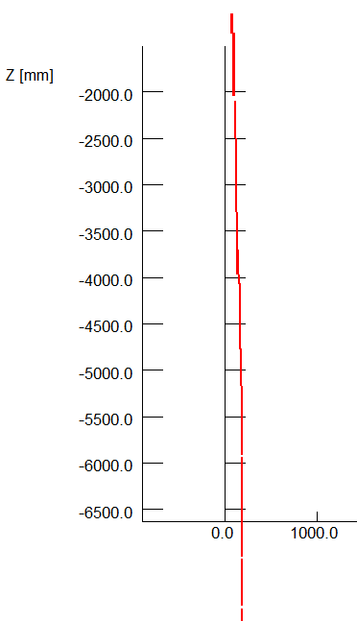
The magnetic field of the Detector solenoid is not constant, and it decreases slowly along the longitudinal direction.
In order to reduce the magnet size, energy and cost, the anti-solenoid is divided into a total of 29 sections with different inner coil diameters.
These sections are connected in series, but the current of some sections of the anti-solenoid can be adjusted using auxiliary power supplies if needed.
The anti-solenoid along longitudinal direction:
1) 4 sections, from IP point to QD0;
2) 12 sections, QD0 region;
3) 6 sections, QF1 region;
4) 7 section, after QF1 region.
To reduce the length of the cryostat, the sections of
anti-solenoid after QF1 region with low field will be
operated at room-temperature.

Slide 18
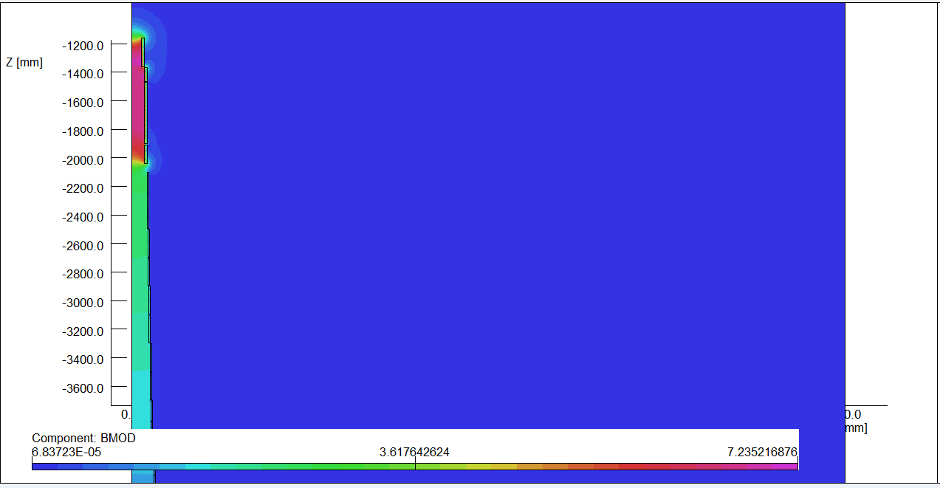
Magnetic field calculation and optimization is performed using axi-symmetric model in OPERA-2D.
The central field of the first section of the anti-solenoid is the strongest, with a peak value of 6.8T (The old one is 7.2T).
2D flux lines
Magnetic flux density distribution

Slide 19
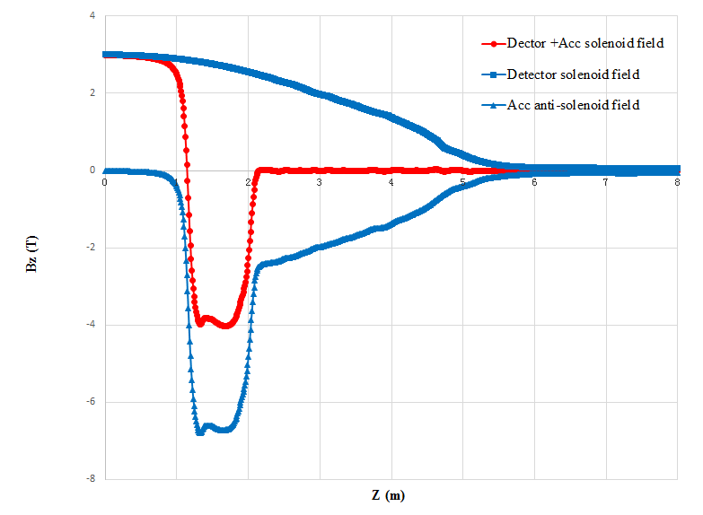
Combined field of Anti-solenoid and Detector solenoid with linear superposition.
The net solenoid field inside QD0 and QF1 at each longitudinal position is smaller than 300 Gs.
The total integral solenoid field generated by the detector solenoid and anti- solenoid coils is zero.

Slide 20
Status of IP magnets in high luminosity scheme
The requirement of the CEPC Final Focus quadrupoles is recently updated for high luminosity with L*=1.9m in 2020.
Design considerations
The field gradient of quadrupoles is stronger compared to that in CDR, and the available bore space for the coil is smaller.
The development of Q1a is the most challenging.
Design of quadrupoles and anti-solenoid is similar to that in CDR.
Corrector coils will be inside the bore of Q1b and Q2 quadrupole coil.
Iron yoke is used to eliminate the field crosstalk between the two apertures.
Inside Q1a, inner beam pipe diameter is around 18 mm.
Table 3: Updated Requirements of final focus quadrupole magnets for Higgs
Magnet | Central field gradient (T/m) | Magnetic length (m) | Width of GFR (mm) | Minimal distance between two aperture beam lines (mm)
Q1a | 141 | 1.21 | 15.21 | 62.71
Q1b | 84.7 | 1.21 | 17.92 | 105.28
Q2 | 94.8 | 1.5 | 24.14 | 155.11

Slide 21
3.1 Conceptual design of HTS final focus quadrupole coils in CEPC IR
NbTi technology similar to that in CDR can be use for Q1a in high luminosity scheme.
In addition, feasibility of HTS superconducting magnet technology is being considered for CEPC IR superconducting magnets.
Advantage: Large critical current (expected), light weight of magnet
heat load resistant
High operating temperature.
Disadvantage: HTS conductor not mature now, expensive
Poor mechanical properties
HTS coil manufacture needs heat treatment
Large diameter of superconductor filament or layer.

Slide 22
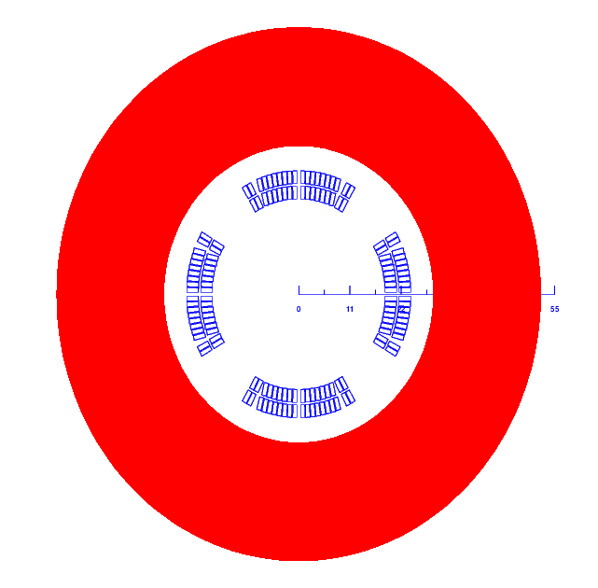
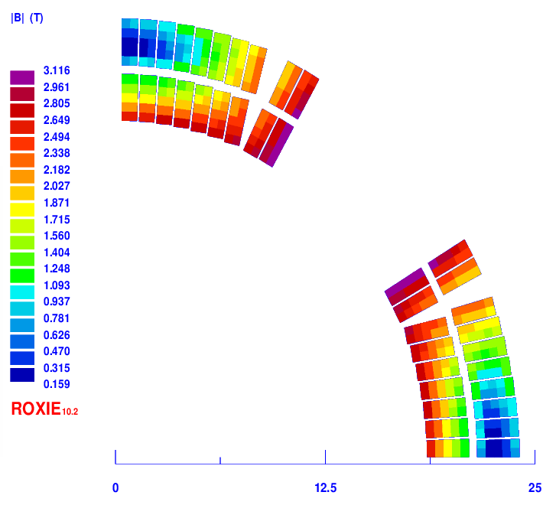
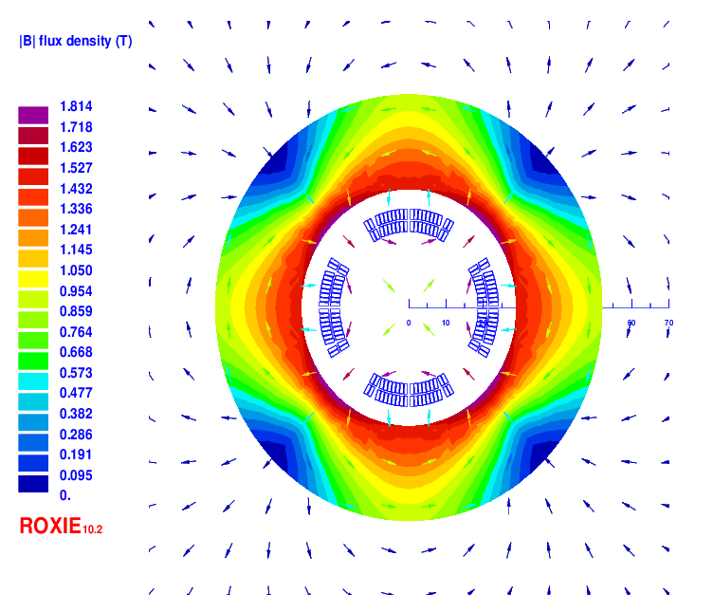
Conceptual design of Q1a for high luminosity with L*=1.9m
1) Cos2θ option of Q1a
HTS Bi-2212 round 0.5mm wire or other conductor.
The design of Q1a is based on two layers cos2θ quadrupole coil using Rutherford cable with iron yoke. The inner diameter of the coil is 37mm.
Single aperture cross section is optimized with four coil blocks in two layers separated by wedges, using ROXIE.
The width of the cable is 2.5mm, and there are 19 turns in each pole.
The excitation current of Q1a is 1970A, and each multipole field in single aperture is smaller than 1×10⁻⁴.
2D model (single aperture)
Magnetic flux density distribution

Slide 23
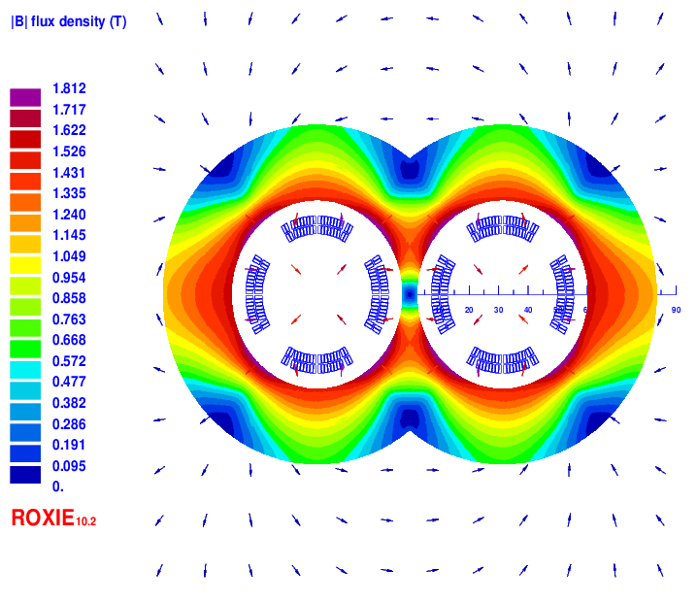
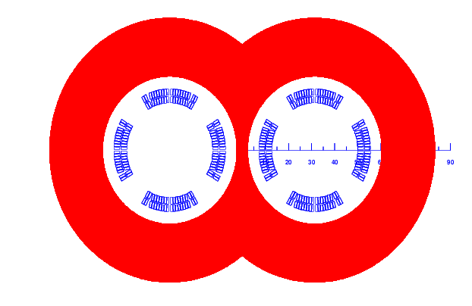
Cos2θ option of Q1a
Field cross talk of the two apertures
2D field cross talk of Q1a two apertures near the IP side, where the distance between two aperture centerlines is minimum.
Iron yoke width in the middle is very limited; the field harmonics as a result of field crosstalk is smaller than 0.5×10⁻⁴.
The dipole field in each single aperture as a result of field crosstalk is smaller than 5 Gs. Magnetic field cross talk between two apertures is negligible.
Double aperture model
2D Flux lines

Slide 24
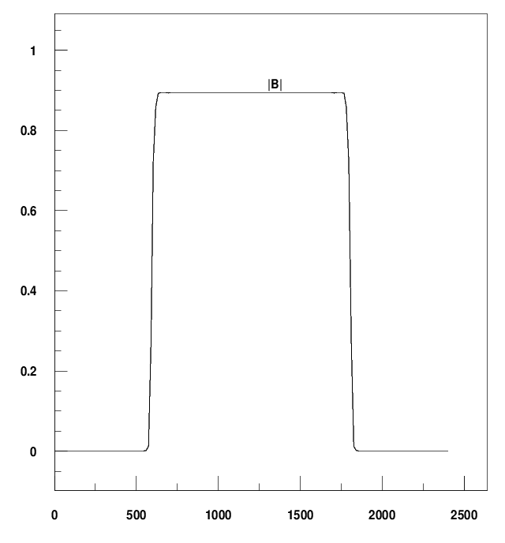
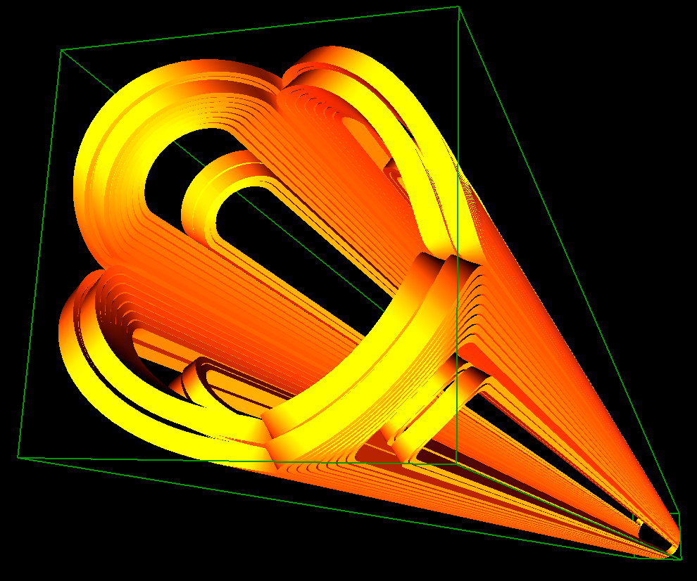
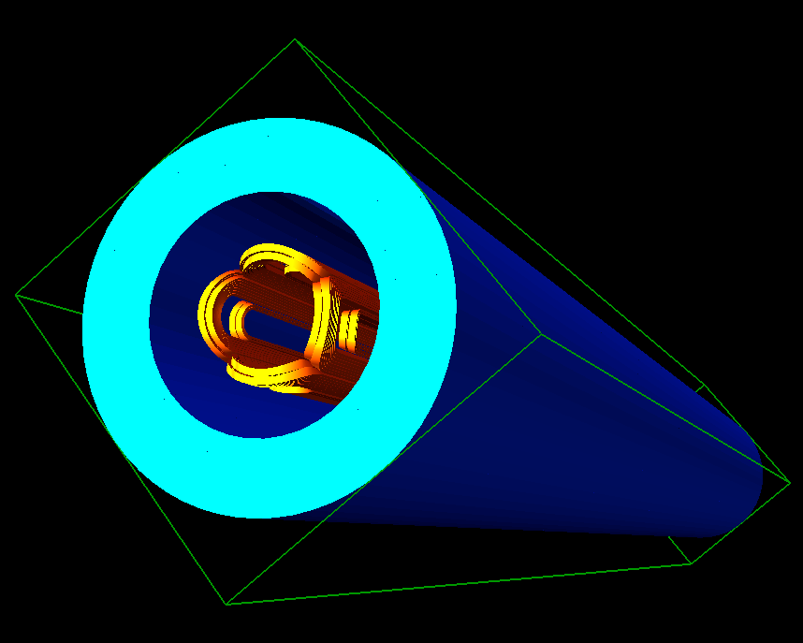
Cos2θ option of Q1a
3D design of Q1a
3D magnetic field is modeled and analysed using ROXIE.
Coil end detailed shaped is optimized and determined.
Field gradient 142T/m, each integrated field harmonics is smaller than 1×10⁻⁴.
The 3D magnetic field performance meets requirement.
Single aperture model in 3D

Slide 25
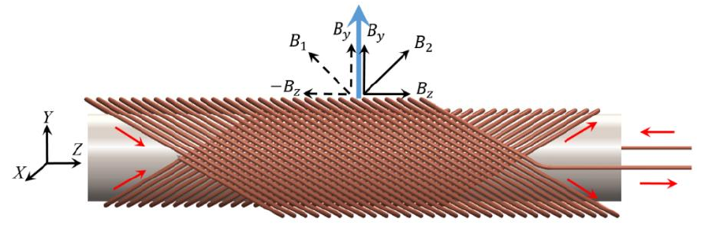
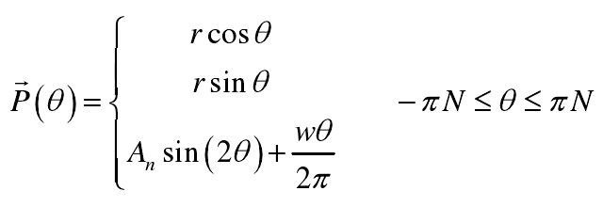
Conceptual design of Q1a for high luminosity with L*=1.9m
2) CCT option of Q1a
CCT : Canted cosine theta
The CCT design is based on a pair of conductors wound and powered such that their transverse field components sum up and their solenoid fields cancel.
In practice, the conductor is wound on a pre-cut groove in a supporting hollow cylinder or mandrel.
CCT dipole
CCT quadrupole

Slide 26
CCT option of Q1a
CCT option of Q1a, conceptual design
HTS Bi-2212 0.8mm round wire or other conductor.
The design of Q1a is based on two layers CCT quadrupole coil. The inner radius of the spar is 18.5mm.
Outer radius of single aperture coil: 29mm.
Groove on the spar: 2×3mm; 6 wires in a groove.
Conductor canted angle: 30 deg
The excitation current of Q1a is 1342A,
Each integrated multipole field in single aperture is smaller than 1×10⁻⁴.

Slide 27
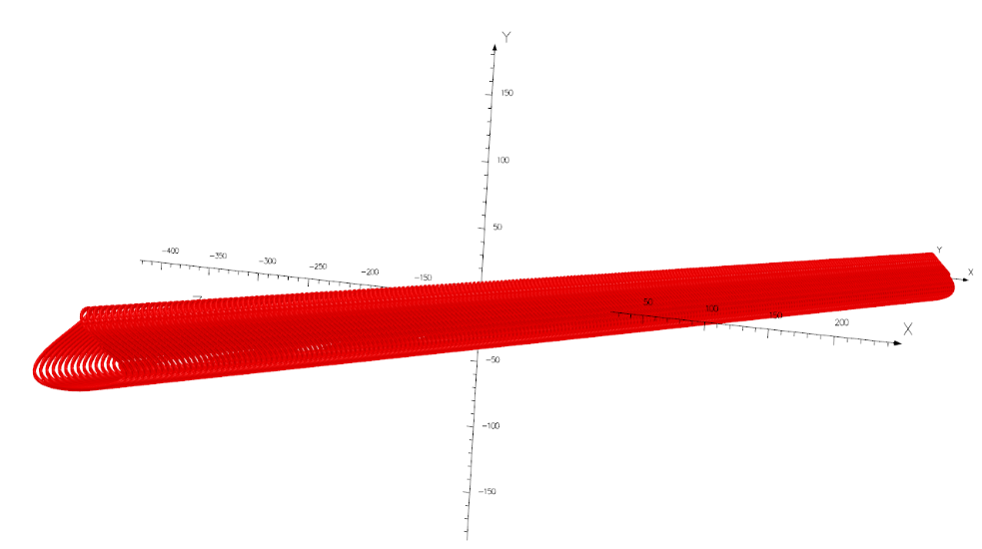
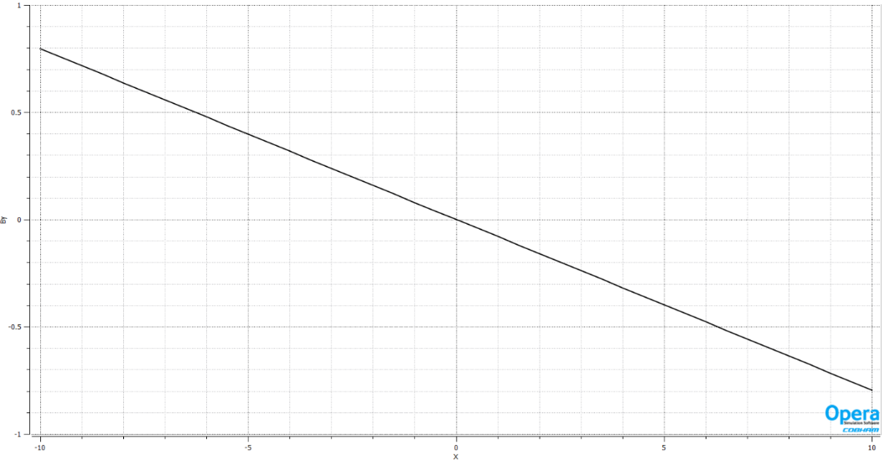
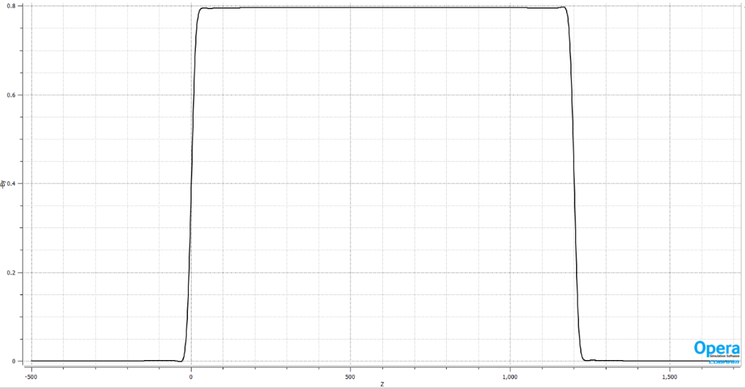
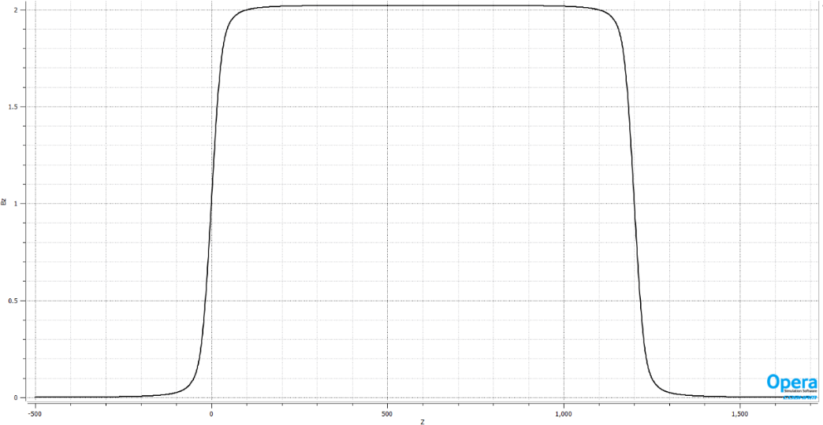
CCT option of Q1a
1st layer CCT coil of Q1a: consists of many small conductors
By along z
Solenoid field along z

Slide 28
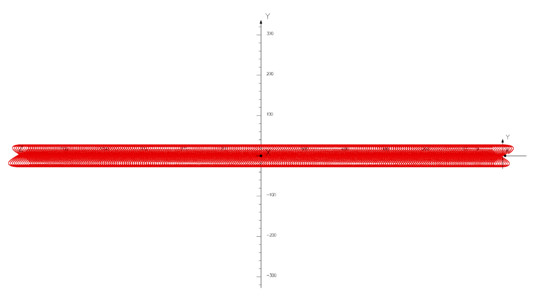
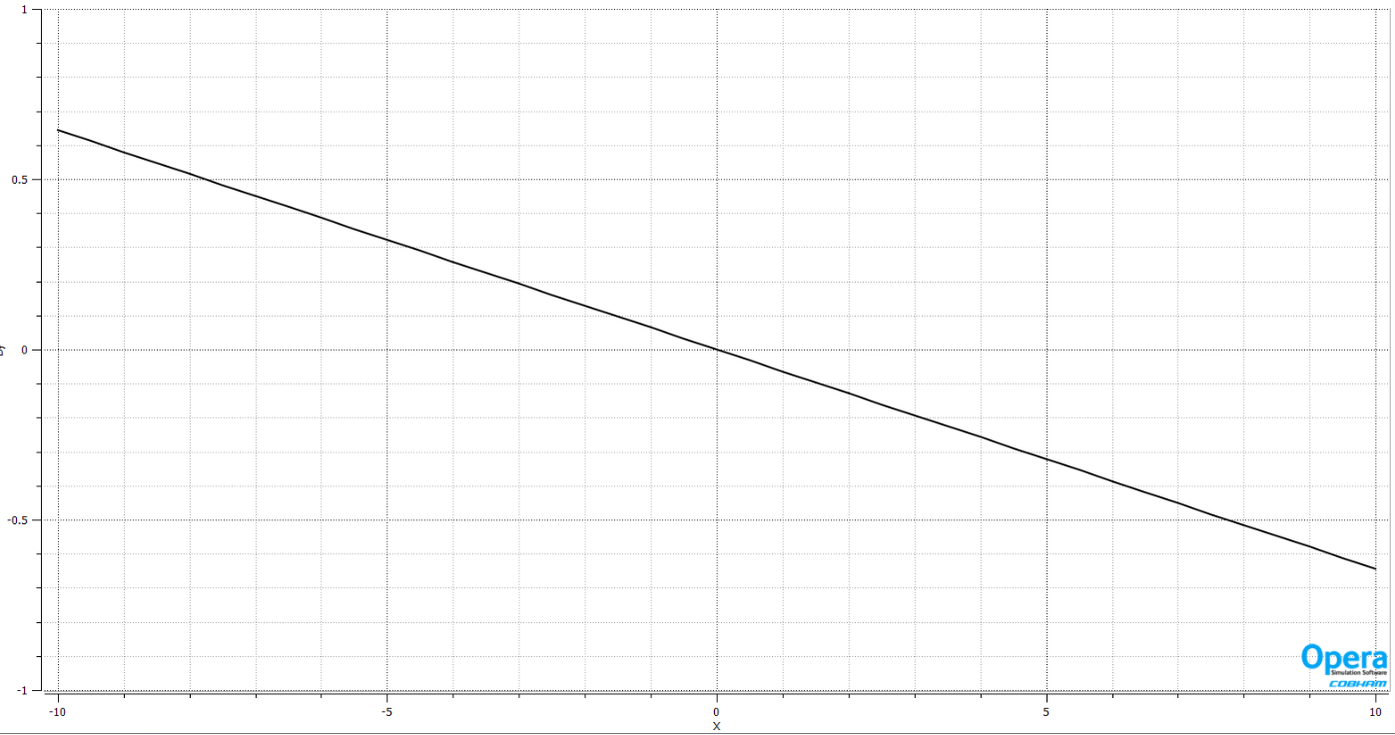
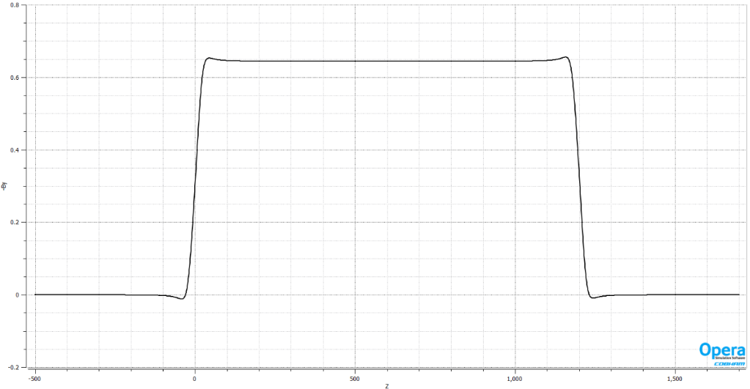
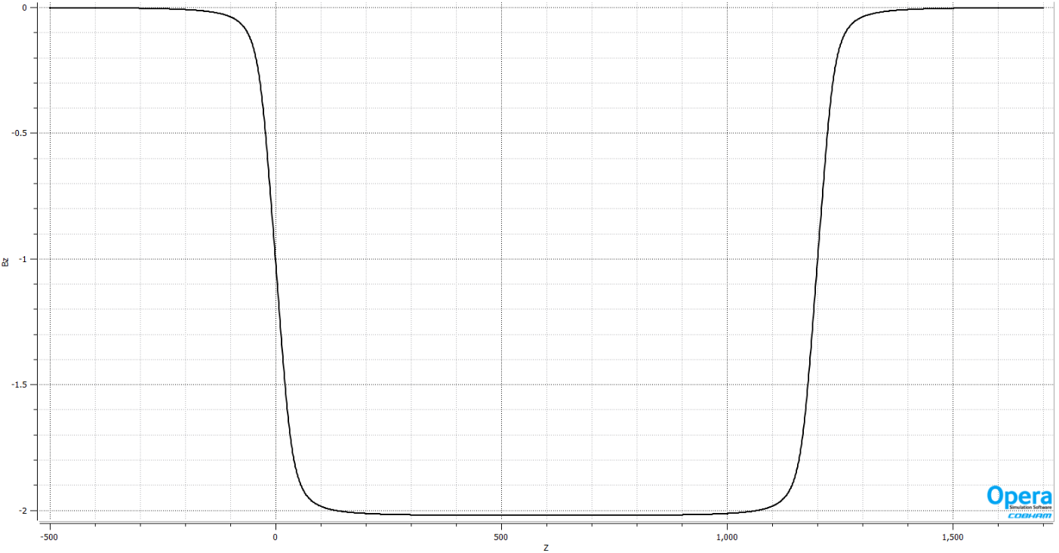
CCT option of Q1a
2nd layer CCT coil of Q1a
By along z
Solenoid field along z

Slide 29
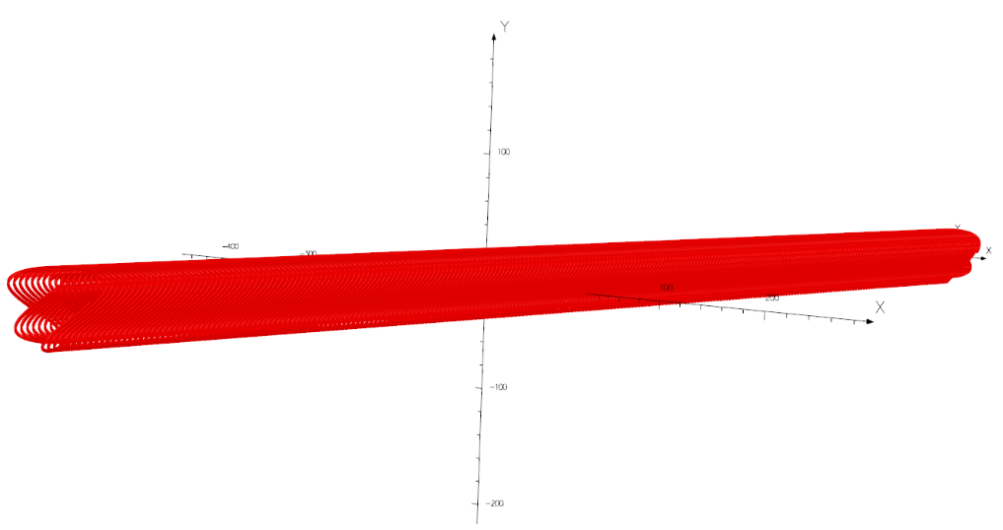
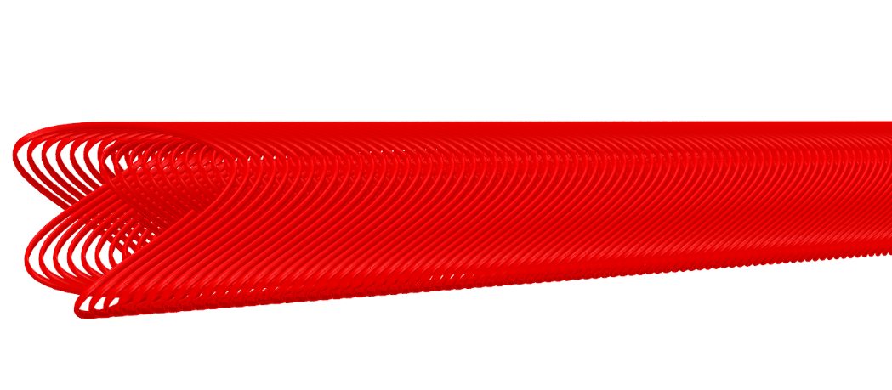
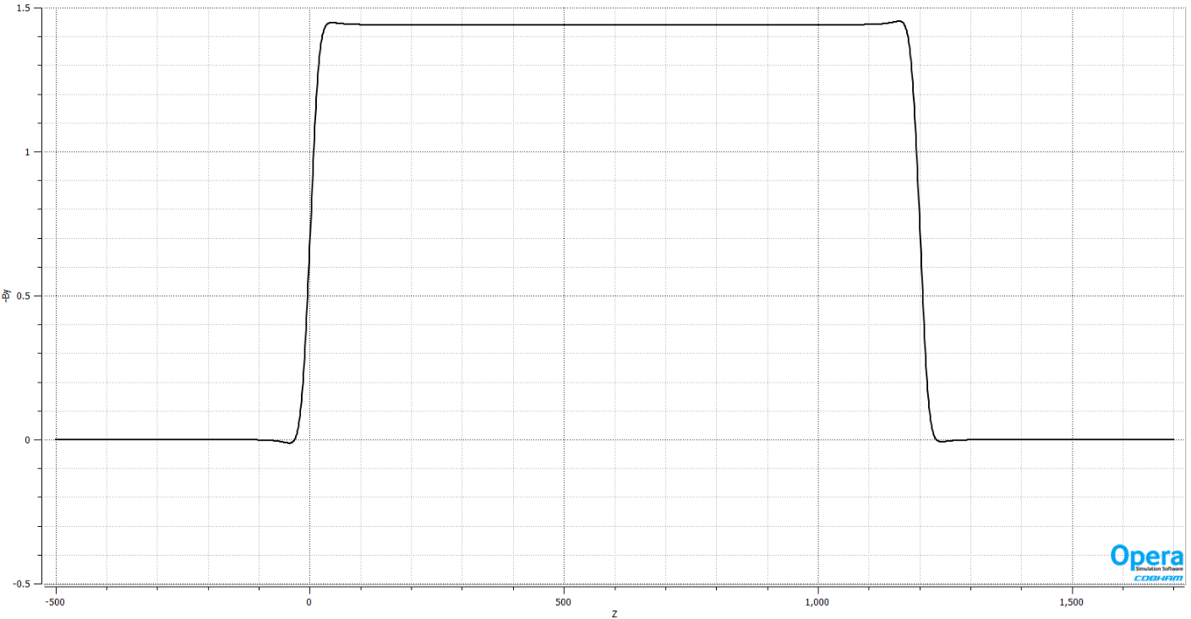
CCT option of Q1a
Double layer CCT coil of Q1a: Most of the solenoid fields of two layers cancel out. Field gradient and field harmonics meets the requirement.
By along z
Solenoid field along z

Slide 30
Conceptual design of Q1a for high luminosity with L*=1.9m
Comparison of two HTS design options of Q1a (141T/m)
From the comparison, Cos2θ coil has the higher magnetic efficiency, lowest needed Engineering current density;
The current carrying capacity of Bi-2212 conductor is close to the requirement.
Cos2θ coil as baseline design, CCT coil as alternative design.
Option | Excitation current (A) | Needed Engineering current density J_{E} on wire (A/mm2) | Bmax on coil (T) | Possible Conductor
Cos2θ (with iron) | 1970 | 1004 | 3.2 | Bi-2212
CCT | 1342 (940 with iron) | 2670 (1870 with iron) | 3.8 | Bi-2212

Slide 31
3.2 Optimization the weight of Q1a quadrupole magnet
Option 1: Iron DT4, reduce weight.
Field gradient: 141T/m.
Field cross talk between two apertures can be negligible with more iron.
19 turns in each pole, excitation current 1970A.
Relax the dipole field requirement of crosstalk to <30Gs.

Slide 32
Iron yoke: DT4
Dipole <30Gs, radius of the iron: 44mm, weight 96.9kg. (67% of r=52mm)

Slide 33
Option 2: Iron yoke FeCoV
Option 3: Iron FeCoV
The saturation magnetic induction of FeCoV is about 2.35T (highest in all materials), and the magnetic shielding effect is better.
Compared with DT4, the thickness of the iron core can be further reduced.
BH curve of DT4 and FeCoV

Slide 34
Iron yoke: FeCoV
Iron yoke material: FeCoV
Dipole field <30Gs, radius of the iron: 40.5mm.
Weight: 78.9Kg (55% of r=52mm)

Slide 35
Iron yoke: FeCoV
Iron yoke material: FeCoV; radius of the iron: 40.5mm

Slide 36
Option 3: one layer coil
Option 3: one layer coil
Iron yoke material: FeCoV; one layer coil, HTS round 0.5mm Bi-2212.
<30Gs Dipole field, radius of the iron: 36.5mm.
Weight: 60.2Kg (42% of r=52mm)
9 turns in each pole, excitation current 3585A.
Large current carrying capacity of conductor is required; working current doubled, the cryogenic system and power supply will be affected.
After five years, the current carrying performance of Bi-2212 may meet the requirement.

Slide 37
Option 3: one layer coil
One layer coil Layout
Iron yoke material: FeCoV.

Slide 38
Design options comparisons and recommendation
HTS Bi-2212 0.5mm wire or other conductor; Field gradient 141T/m.
Recommendation
Option 3 as baseline design, Option 2 as alternative design.
 | Main features | Performance | Weight (kg) | Remark
Option 1 | 2 layers coil, DT4 iron | Meet all requirements (Dipole <30Gs) | 96.9 | Largest weight
Option 2 | 2 layers coil, FeCoV iron | Meet all requirements (Dipole <30Gs) | 78.9 | Manufacture cost increases slightly
Option 3 | 1 layer coil, FeCoV iron | Meet all requirements (Dipole <30Gs) | 60.2 | Double current carrying capacity, 5 years later

Slide 39
Summary
Superconducting magnets are key devices for CEPC. The design of IP superconducting magnets meets the requirement.
Despite of limited space, field crosstalk effect between two apertures in QD0 is negligible using iron yoke.
Study and research on key technologies of 0.5m single aperture QD0 short model (LTS NbTi) is in progress in collaboration with KEYE Company.
Two HTS options have been studied for the Q1a magnet using high luminosity parameters with L*=1.9m: Cos2θ coil, CCT coil. Both options are feasible. Cos2θ coil has the higher magnetic efficiency.
With relaxed dipole field and use FeCoV yoke, the weight of Q1a magnet is optimized and can be significantly reduced.

Slide 40
Thanks for your attention!

