Slide 1


Status of CEPC Booster Ring
Dou Wang (IHEP)
on behalf of CEPC AP group
CEPC International Accelerator Review Committee Meeting, May 11-12, 2021. IHEP.

Slide 2
outline
Status of the CDR Scheme
TDR Progress
Key Technical System Status
Summary

Slide 3
outline
Status of the CDR Scheme
TDR Progress
Key Technical System Status
Summary

Slide 4
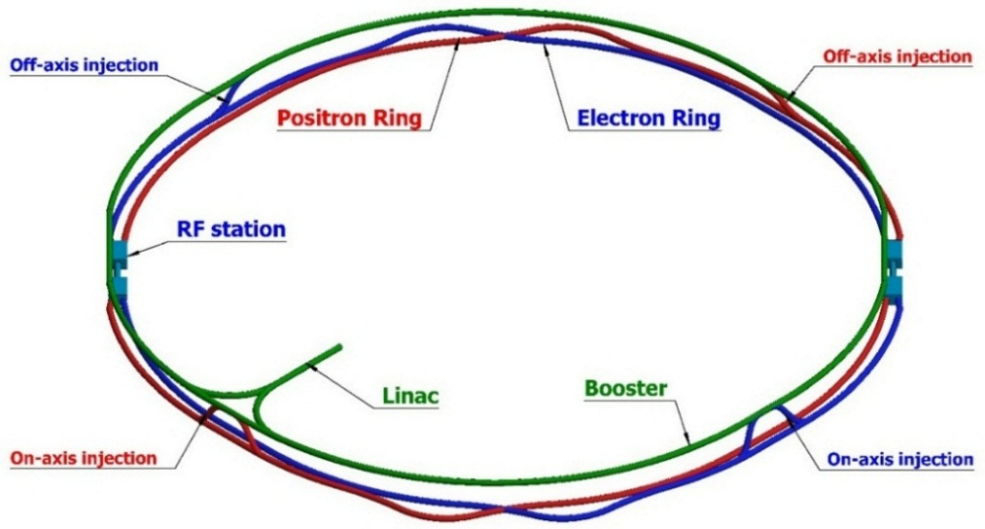
CEPC injector chain
100km
Injection energy: 10GeV
10 GeV linac provides electron and positron beams for booster.
Top up injection for collider ring ~ 3% current decay
Booster is in the same tunnel as collider ring, above the collider ring.
Booster has the same geometry as collider ring except for the two IRs.
Booster bypasses the collider ring from the outer side at two IPs.

Slide 5
Design requirements for CEPC booster
Parameters | Design goals
Beam current (mA) | <1.0 mA(Higgs), 4.0 mA (W), 10 mA(Z)
Emittance@ 120GeV (nm rad) | <3.6
Dynamic aperture @10GeV(σ, normalized by linac beam size) | >4σ+5mm
Dynamic aperture @120GeV | >6σx+3mm, 49σx+3mm
Energy acceptance | >1%
Coupling | <0.5%
Booster transfer efficiency | >92%
Total transfer efficiency (inc. inj. & ext.) | >90% (99%*92%*99%)
Timing | Meet the top-up injection requirements
Beam current threshold in booster is limited by RF power.
The diameter of the inner aperture is selected as 55mm for high current injection.
Budget for transfer efficiency 90%: 92% for booster (3% beam loss due to quantum lifetime + 5% beam loss during ramping process) + 99% for transport lines.
Emittance@120GeV <3.6nm, energy acceptance >1%
Coupling <0.5%: requirement of Higgs on-axis injection scheme
DA@10GeV: BSC region, DA@120GeV:on-axis injection (V) & quan. lifetime (H)

Slide 6
Booster CDR parameters @ injection
 |  | H | W | Z
Beam energy | GeV | 10
Bunch number |  | 242 | 1524 | 6000
Threshold of single bunch current | μA | 25.7
Threshold of beam current (limited by coupled bunch instability) | mA | 100
Bunch charge | nC | 0.78 | 0.63 | 0.45
Single bunch current | μA | 2.3 | 1.8 | 1.3
Beam current | mA | 0.57 | 2.86 | 7.51
Natural Energy spread | % | 0.0078
Synchrotron radiation loss/turn | keV | 73.5
Momentum compaction factor | 10⁻⁵ | 2.44
Natural emittance | nm | 0.025
Natural chromaticity | H/V | -336/-333
RF voltage | MV | 62.7
Betatron tune ν_{x}/ν_{y}/ν_{s} |  | 263.2/261.2/0.1
RF energy acceptance | % | 1.9
Damping time | s | 90.7
Bunch length of linac beam | mm | 1.0
Energy spread of linac beam | % | 0.16
Emittance of linac beam | nm | 40

Slide 7
Booster CDR parameters @ extraction
 |  | H |  |  | W | Z
 |  | Off axis injection | On axis injection |  | Off axis injection | Off axis injection
Beam energy | GeV | 120 |  |  | 80 | 45.5
Bunch number |  | 242 |  | 235+7 | 1524 | 6000
Maximum bunch charge | nC | 0.72 |  | 24.0 | 0.58 | 0.41
Maximum single bunch current | μA | 2.1 |  | 70 | 1.7 | 1.2
Threshold of single bunch current | μA | 300
Threshold of beam current (limited by RF power) | mA | 1.0 |  |  | 4.0 | 10.0
Beam current | mA | 0.52 |  | 1.0 | 2.63 | 6.91
Injection duration for top-up (Both beams) | s | 25.8 |  | 35.4 | 45.8 | 275.2
Injection interval for top-up | s | 47.0 |  |  | 153.0 | 504.0
Current decay during injection interval |  | 3%
Energy spread | % | 0.094 |  |  | 0.062 | 0.036
Synchrotron radiation loss/turn | GeV | 1.52 |  |  | 0.3 | 0.032
Momentum compaction factor | 10⁻⁵ | 2.44
Emittance | nm | 3.57 |  |  | 1.59 | 0.51
Natural chromaticity | H/V | -336/-333
Betatron tune ν_{x}/ν_{y} |  | 263.2/261.2
RF voltage | GV | 1.97 |  |  | 0.585 | 0.287
Longitudinal tune |  | 0.13 |  |  | 0.10 | 0.10
RF energy acceptance | % | 1.0 |  |  | 1.2 | 1.8
Damping time | ms | 52 |  |  | 177 | 963
Natural bunch length | mm | 2.8 |  |  | 2.4 | 1.3
Injection duration from empty ring | h | 0.17 |  |  | 0.25 | 2.2

Slide 8
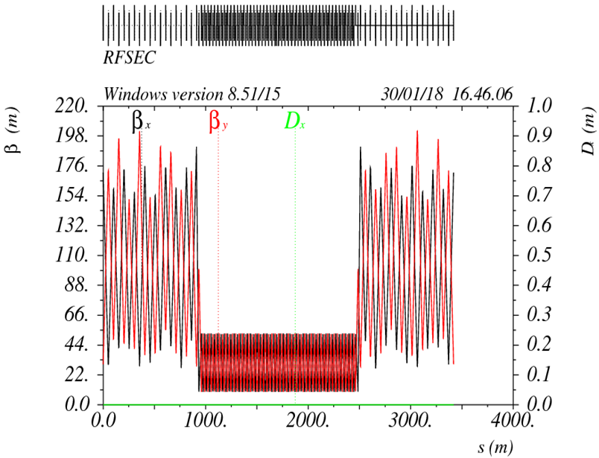
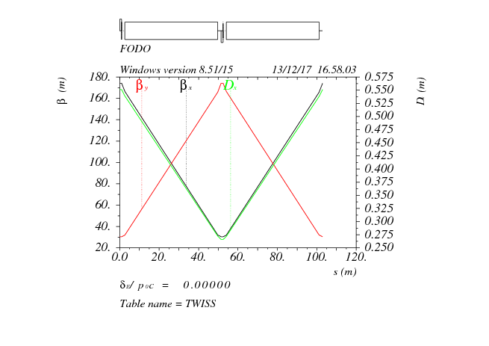
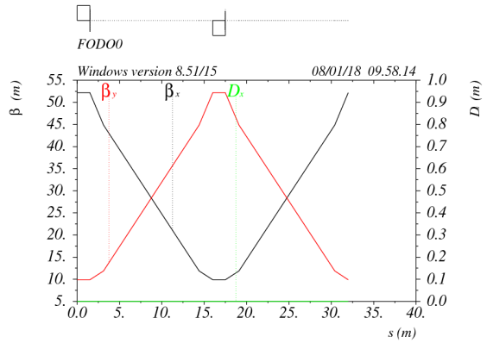
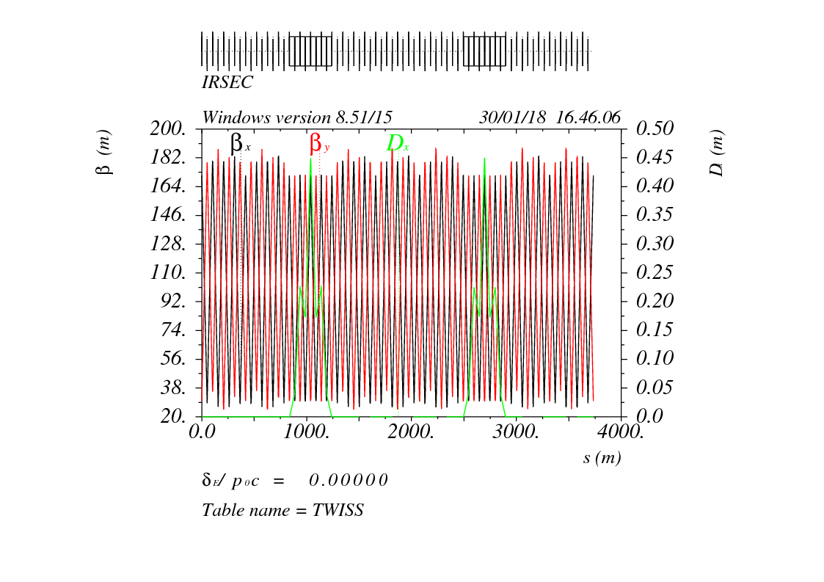
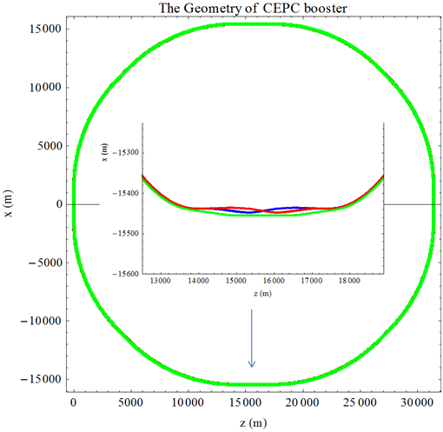
Booster optics (CDR)
90°/ 90° FODO cell
2 cells @ booster = 3 cells @ collider
Noninterleave sextupole scheme
Low average beta to reduce the multi-bunch instability
RF
FODO cell
Exact geometry match for three rings
- error=±0.17m
IR: booster bypasses the collider.
25m separation:
IR
- civil engineering
radiation protection
Synchroneity w collider

Slide 9
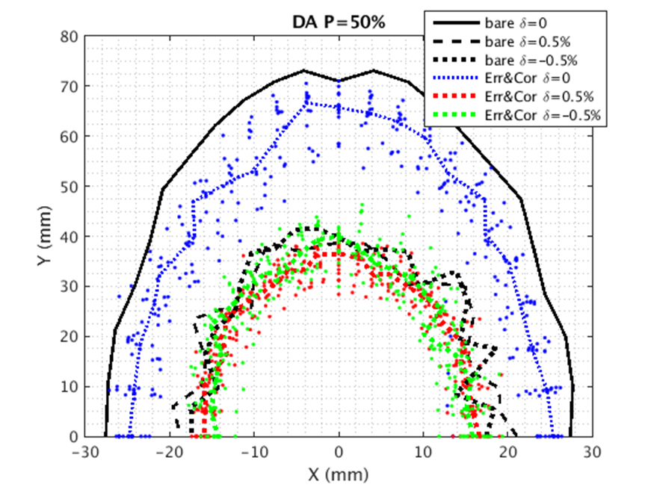
Error correction for CDR lattice
D. H. Ji
 | Dipole | Quadrupole | Sextupole
Transverse shift X/Y (μm) | 100 | 100 | 100
Longitudinal shift Z (μm) | 100 | 150 | 100
Tilt about X/Y (mrad) | 0.2 | 0.2 | 0.2
Tilt about Z (mrad) | 0.1 | 0.2 | 0.2
Nominal field | 1e-3 | 2e-4 | 3e-4
 | Accuracy (m) | Tilt (mrad) | Gain | Offset w/ BBA(mm)
BPM(10Hz) | 1e-7 | 10 | 5% | 30e-3
 | Amount
HCorrector | 1053
VCorrector | 1054
BPM | 2108
*Gaussian distribution and cut-off at 3σ
Almost impossible to obtain the initial closed orbit naturally
  Start from sextupole off
Orbit correction (COD)(100 Seeds)
  Response matrix method(RM)
  SVD method
  3 Iterations
Optics correction(15 Seeds) (1/8 quadrupoles)
  Response matrix method
  LOCO code
  Dispersion corrected
  3 Iterations
 | DA requirement |  | DA results
 | H | V | H | V
10GeV (ε_{x}= ε_{y} =40nm) | 4σ_{x} +5mm | 4σ_{y} +5mm | 22.5σ_{x} +5mm | 24.6σ_{y} +5mm
120GeV (ε_{x}=3.57nm, ε_{y}= ε_{x*}0.005) | 6σ_{x} +3mm | 49σ_{y} +3mm | 8.9σ_{x} +3mm | 346σ_{y} +3mm
DA fulfill the requirement after COD+Optics Correction.

Slide 10
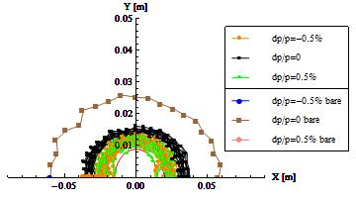
Multipole errors @ booster
10GeV
dipole | quadrupole | sextupole
B1/B0 ≤ 3×10⁻⁴
B2/B0 ≤ 2×10⁻⁴ | B2/B1 ≤ 4×10⁻⁴
B3/B0 ≤ 2×10⁻⁵ | B3/B1 ≤ 1×10⁻⁴ | B3/B2≤ 1×10⁻³
B4/B0 ≤ 8×10⁻⁵ | B4/B1 ≤ 1×10⁻⁴ | B4/B2 ≤ 3×10⁻⁴
B5/B0 ≤ 2×10⁻⁵ | B5/B1 ≤ 1×10⁻⁴ | B5/B2 ≤ 1×10⁻³
B6/B0 ≤ 8×10⁻⁵ | B6/B1 ≤ 5×10⁻⁵ | B6/B2 ≤ 3×10⁻⁴
B7/B0 ≤ 2×10⁻⁵ | B7/B1 ≤ 5×10⁻⁵ | B7/B2 ≤ 1×10⁻³
B8/B0 ≤ 8×10⁻⁵ | B8/B1 ≤ 5×10⁻⁵ | B8/B2 ≤ 3×10⁻⁴
B9/B0 ≤ 2×10⁻⁵ | B9/B1 ≤ 5×10⁻⁵ | B9/B2 ≤ 1×10⁻³
B10/B0 ≤ 8×10⁻⁵ | B10/B1 ≤ 5×10⁻⁵ | B10/B2 ≤ 3×10⁻⁴
Reference radius: 27.5mm
w/o optics correction
Uniformity requirement for the dipoles @10GeV: <0.1%
BSC=4σinj+5mm

Slide 11
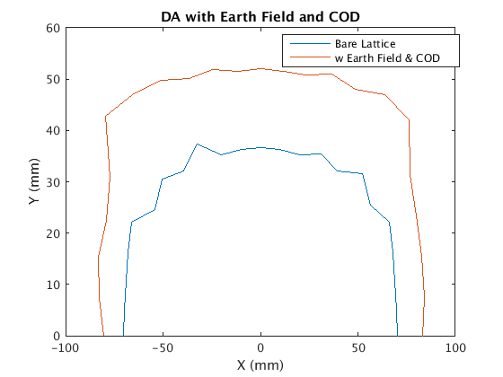
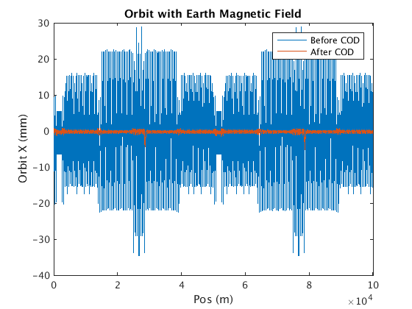
Effect of earthfield @10GeV
D. H. Ji, D. Wang
~20% vacuum pipe (drift) is exposed in earthfield directly.
treat drifts as week dipole to simulate the effect of earthfield
Assume earthfield: 0.3~0.6 gauss (simple model: perpendicular component only )
Working point can be corrected by weaken the dipoles systematically (-0.07%)
Global COD correction was tested for 0.3 gauss earthfield.
DA is acceptable after COD correction.
0.3 gauss
first turn trajectory

Slide 12
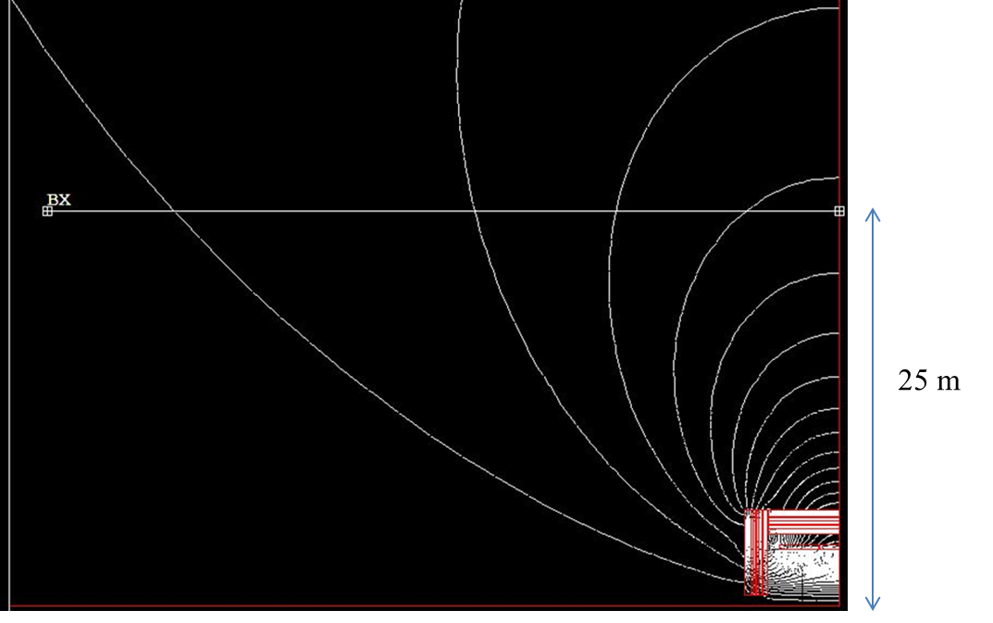
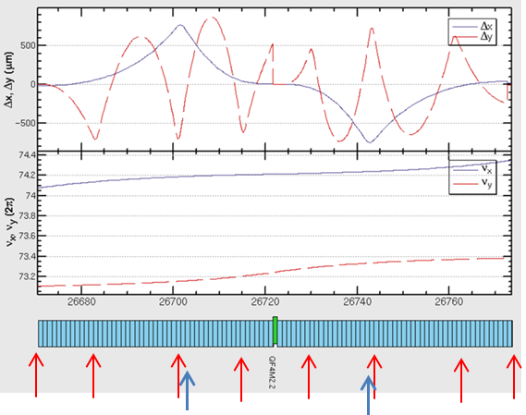
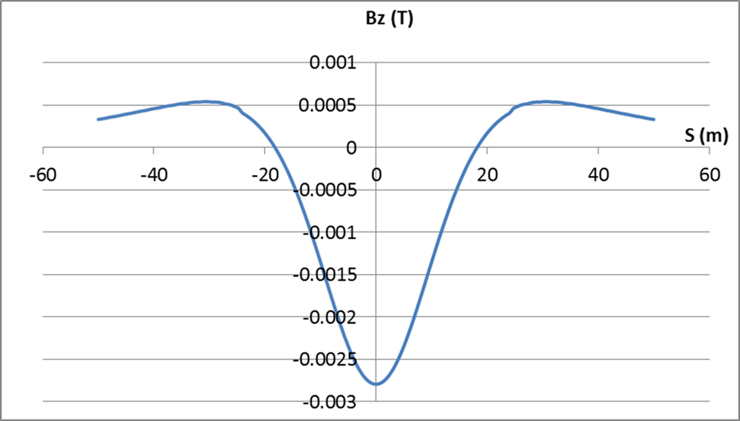
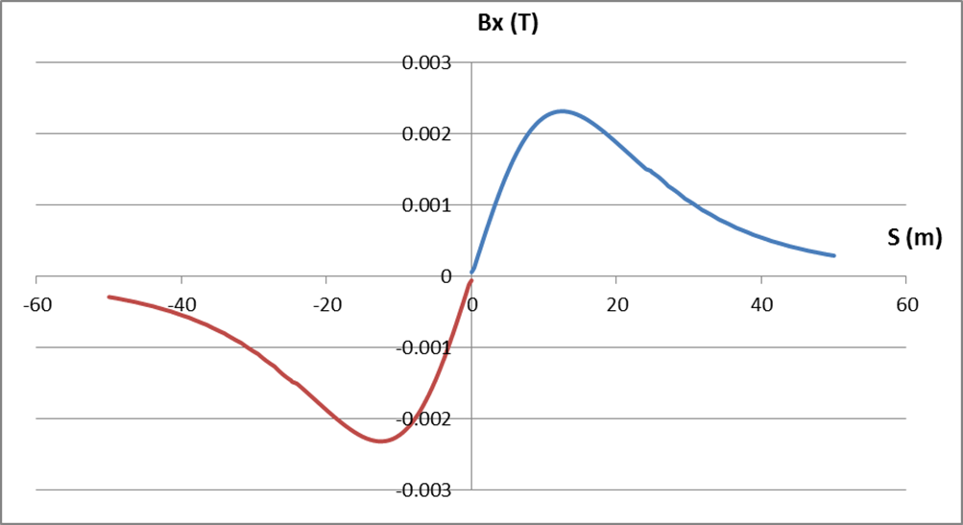
Impacts/solution of Detector Stray Field
Bz=28Gs Bx=23Gs By=2.3 Gs (separation=25m)
D. Wang, Y. Zhang, D. H. Ji
Longitudinal field is modeled as solenoid.
Transverse field is modeled as dipoles.
100 slices (-50m ~ 50m): simulate the real distribution of detector field.
Bx
Bz
Booster
Beam dynamics effects of detector field is strongest at 10 GeV.
Vertical orbit distortion due to Bx is dominant effect (tor.<1Gs).
Local orbit correction is essential (8 v correctors+ 2 h correctors)
No influence to booster DA after orbit correction @10GeV
Collider
Extra SR loss < 1%, critical energy <5% @(180GeV)
Coupling=0.0012

Slide 13
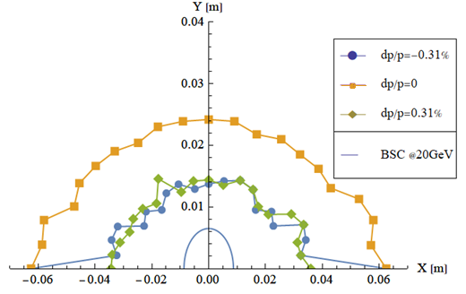
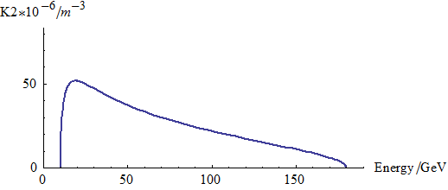
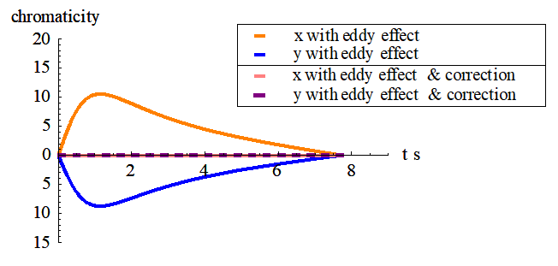
Eddy current effect and correction
D. Wang, Y. Chen, Wen Kang
During ramping, parasitic sextupole field is induced on beam pipe inside dipoles due to eddy current.
Dedicated ramping curve to control the maximum K2.
Analytical study was done – deeper understanding about eddy current
New formula created → agree with simu.*
Dipole w core → multipole field
Dipole w/o core → No multipole field
K2 reaches max at 20GeV.
Small DA reduction @ 20GeV with dynamic chromaticity correction
Max K2=0.000052 (m⁻³)
* Yuan Chen, et al., https://arxiv.org/abs/1910.09781

Slide 14
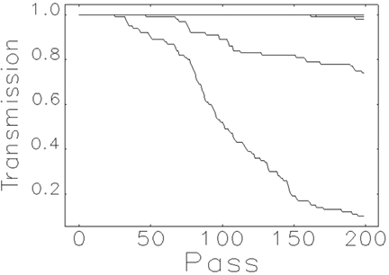
Dynamic simulation with errors during ramping
D. Wang, X. N. Wang, Z. Duan…
Dynamic simulation with orbit correction
Consistent simulation for orbit correction and ramping process (elegant)
No close orbit before orbit correction
Two steps of orbit correction
- Sex off → sex open
Transmission efficiency: 100%
Study for track precision/synchronization tolerance
Add random strength errors for dipoles, quadrupoles, sextupoles and correctors after COD correction at 10GeV
Ramping simulation for first 200 turns
100 random seeds and 100 particles
The worst 10% cases are rejected.
Track precision/synchronization requirement: ~ 3×10⁻⁴ (RMS)
amplitude=3.0e-4

Slide 15
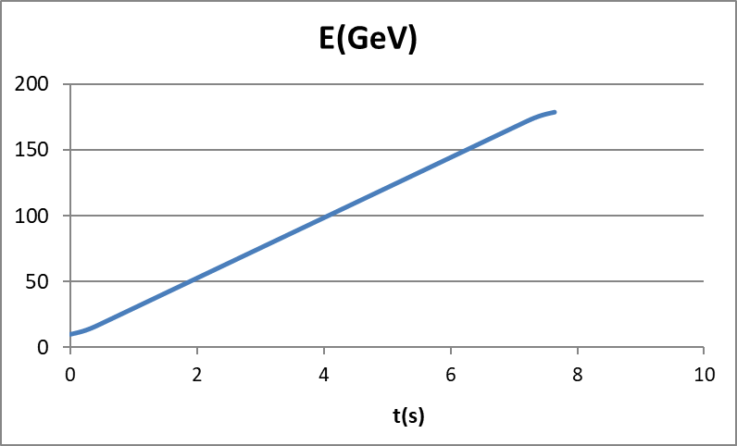
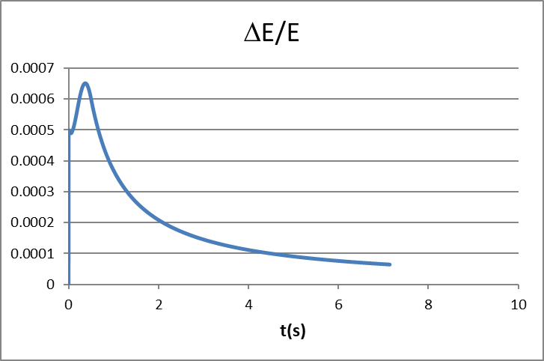
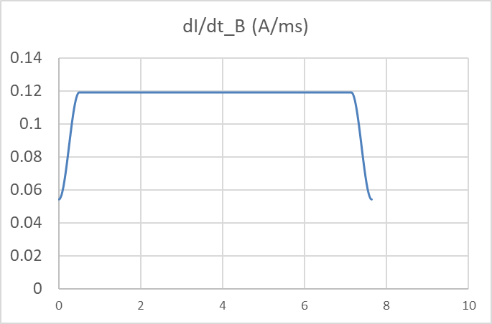
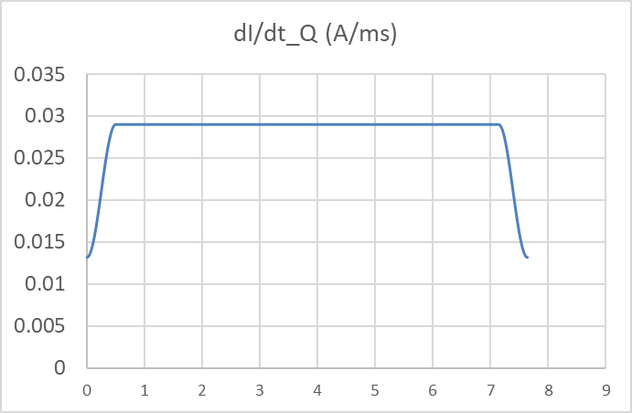
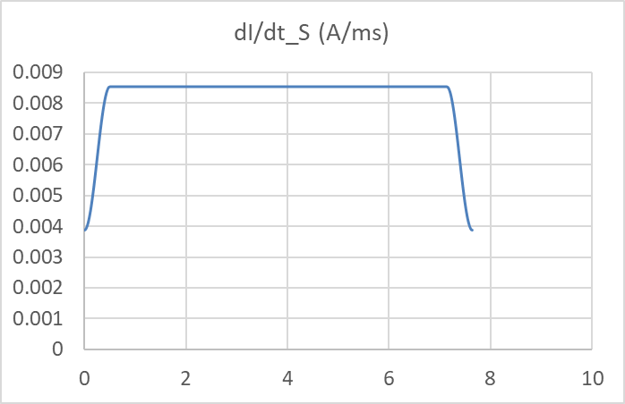
Table ramping scheme
D. Wang, C. Meng, B. Chen
There is some waiting time without ramping for CEPC booster and the duty factor is different for four energy modes.
Tracking precision and synchronization of power supplies need to be controlled.
Primary ramping table design is considered.
Ramping step : 0.5ms
Clock frequency: 2kHz
Points number: ~16000*2
Energy precision: < 0.07%
dipole
quadrupole
sextupole

Slide 16
outline
Status of the CDR Scheme
TDR Progress
Key Technical System Status
Summary

Slide 17
Booster TDR parameters
Injection energy: 10GeV → 20GeV
Max energy: 120GeV → 180GeV
Lower emittance ─ new lattice
Extraction
Injection
*Diameter of beam pipe is 55mm for instability estimation.

Slide 18
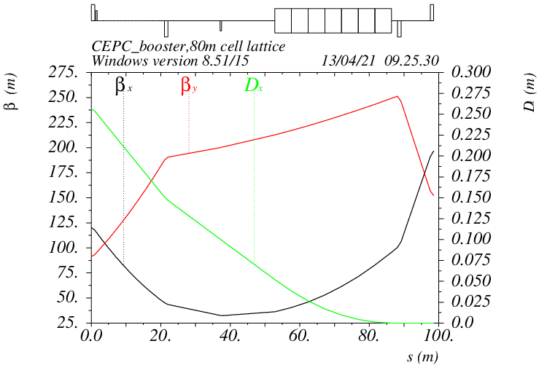
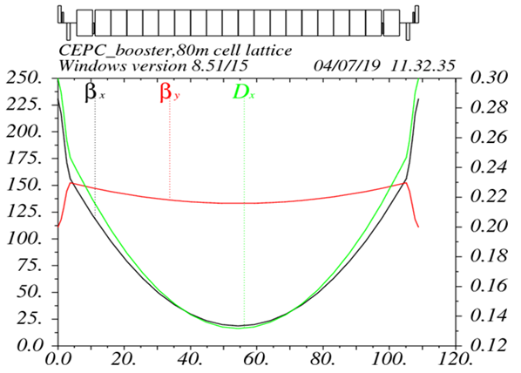
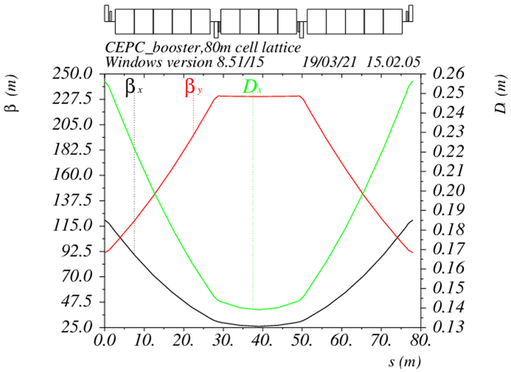
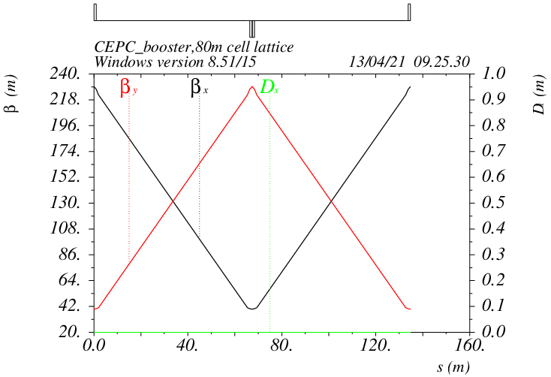
Booster TDR optics
D. Wang, C. H. Yu, Y. M. Peng…
TME like structure (cell length=80m)
Overall idea: uniform distribution for the Q
Combined magnet (B+S) scheme possible
Emittance = 1.26 nm@120GeV
Energy spread = 0.001
αp = 1.12×10⁻⁵
Interleave sextupole scheme
Phase advance/cell: 100°/28°
Dispersion sup.
TME 0
TME 1
Straight sec.

Slide 19
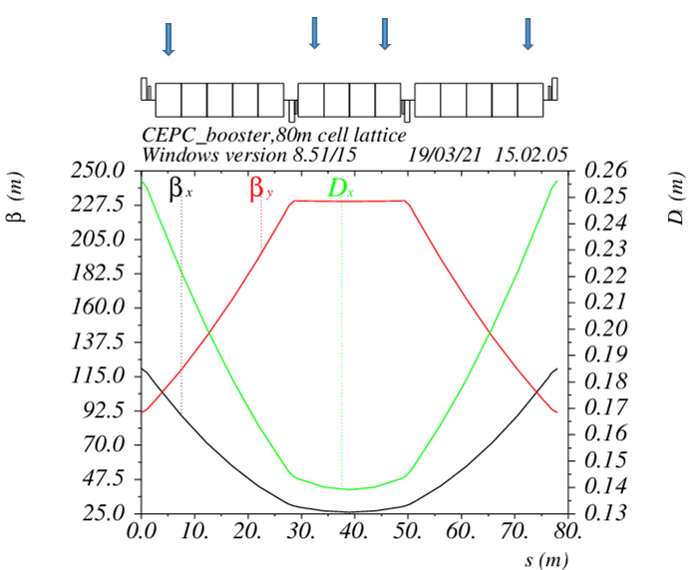
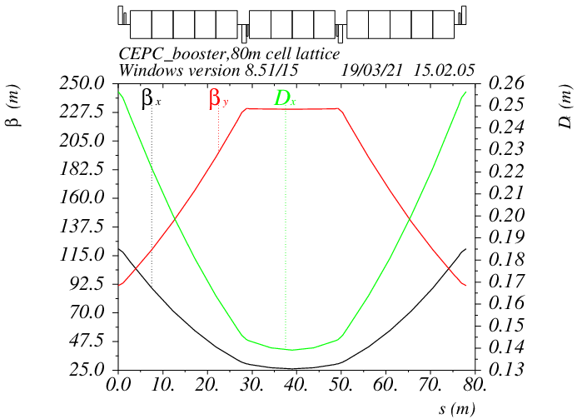
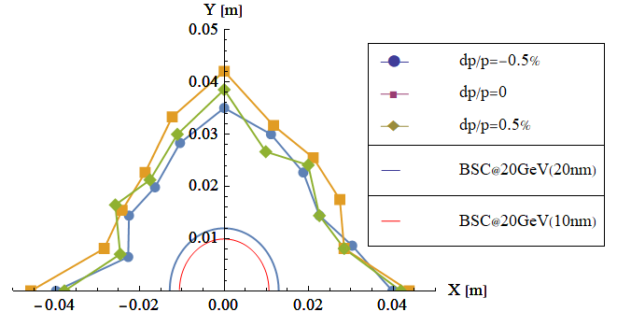
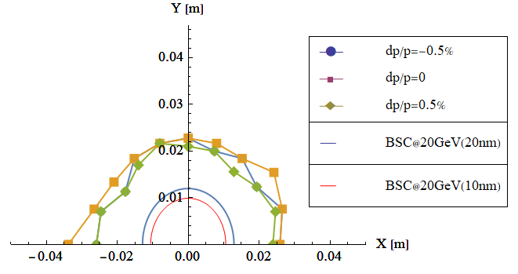
DA results @20GeV
TME 1.1: independent magnets
TME 1.2: combined magnets (B+S)

Slide 20
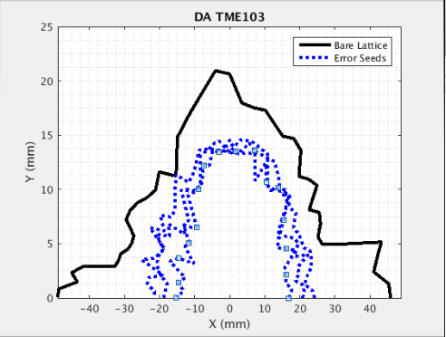

Error correction for TDR lattice (preliminary)
D. H. Ji
 | Dipole | Quadrupole | Sextupole
Transverse shift X/Y (μm) | 100 | 100 | 100
Longitudinal shift Z (μm) | 100 | 150 | 100
Tilt about X/Y (mrad) | 0.2 | 0.2 | 0.2
Tilt about Z (mrad) | 0.1 | 0.2 | 0.2
Nominal field | 1e-3 | 2e-4 | 3e-4
 | Accuracy (m) | Tilt (mrad) | Gain | Offset w/ BBA(mm)
BPM(10Hz) | 1e-7 | 10 | 5% | 30e-3
DA > requirement @20GeV
-- BSC=4σ_{inj}+5mm (H: 11mm, V: 7.5mm)
Almost impossible to obtain the initial closed orbit naturally
  Start from sextupole off
Orbit correction (COD)(3 Seeds)
  Response matrix method(RM)
  SVD method
Optics correction(3 Seeds) (1/8 quadrupoles)
  Response matrix method
  LOCO code
  Dispersion corrected
DA TME 1.1

Slide 21
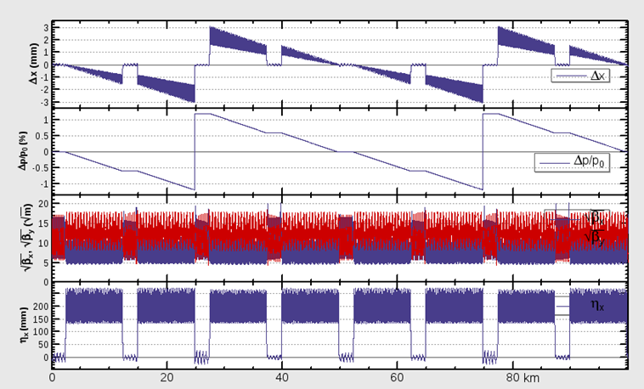
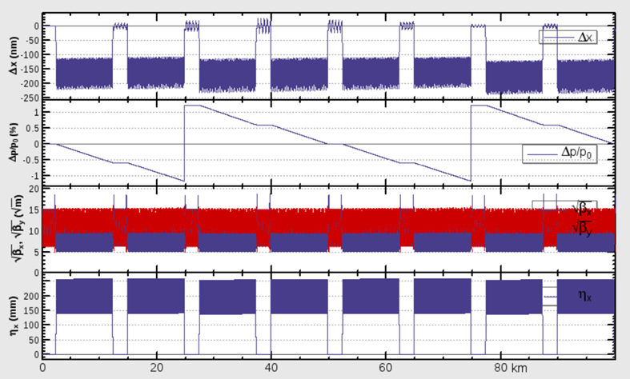
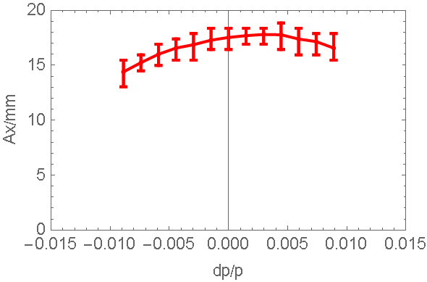
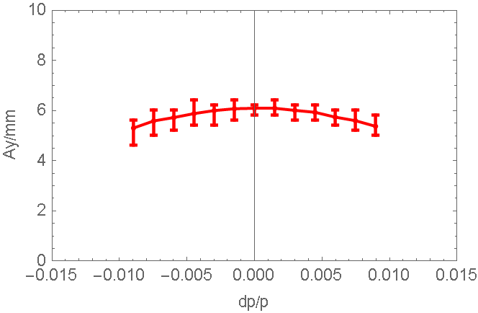
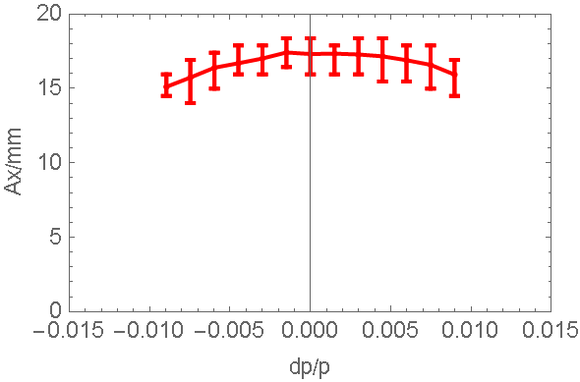
SR & Sawtooth effect@180GeV
D. Wang, D. H. Ji
2 RF stations
Maximum sawtooth orbit: 3 mm
Energy deviation: 1.1%
Emittance growth: ~2.9%
DA reduction due to strong SR (especially for vertical)
Combined effects of sawtooth and magnets’ errors will be studied:
Taper dipoles in 8 sections
No need to taper the quad and sext
Orbit (optics) correction
W/O taper
W taper
DA tracking (50 seeds, 100 turns)
DA > requirement (injection)
- DA_X=5σx+3mm=7.0mm
- DA_Y=39σy+3mm=4.3mm
Sawtooth orbit was corrected by tapering
No DA reduction due to sawtooth orbit

Slide 22
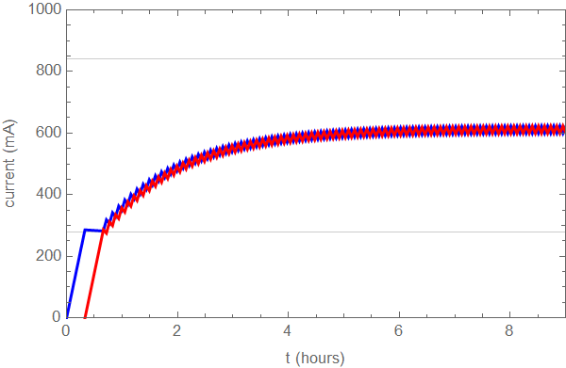
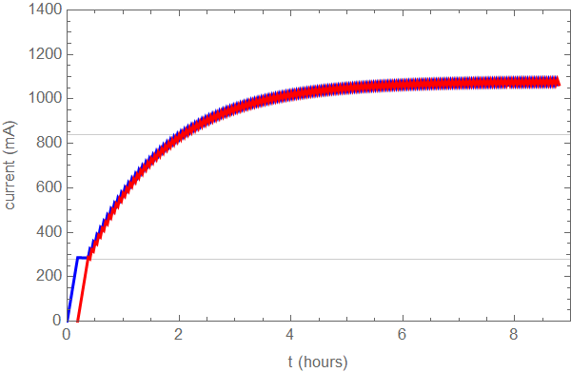
Injection time structure for high lum. Z
Top up injection
Full injection
Current requirement in collider: 840mA
Bootstrapping from 280mA
3 cycles
Interval requirement for top up injection: 153.5s
Top up injection time with CDR Linac: (38.3s+1.6s+1.6s)×6=249s
Injection time is dominated by the injection from Linac.
Injection speed of Linac needs to be improved.
CDR Linac (100Hz)
faster Linac (×2)
e.g., Linac speed×2, (19.16s+1.6s+1.6s)×6=135s
4 bunches in damping ring
Linac injection must to speed up.
Two bunches/pulse
Double repetition: 200Hz

Slide 23
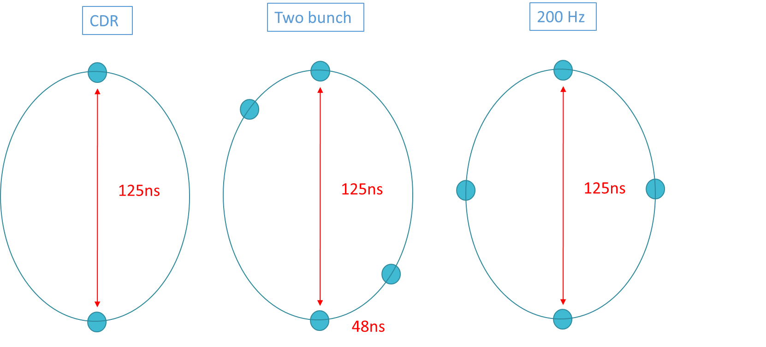
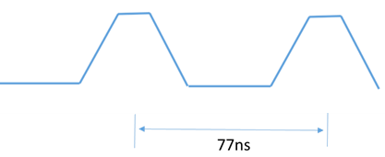
Injection scheme with faster Linac
Booster LE inj.
D. Wang, X. H. Cui, J. H. Chen
Damping ring inj./ext.
200Hz ─ bunch by bunch
- Kicker repetition: 200Hz
Two bunch scheme ─ bunch by bunch
Bunch spacing: 77ns
Kicker repetition: 100Hz
Stagger trigger
One kicker + two Pulse power supplies
two kickers + two Pulse power supplies
 | inj(Z_CDR) | inj(Z_new) 200Hz | inj(Z_new) Two bunch
Energy (GeV) | 1.1 | 1.1 | 1.1
Bunch number | 2 | 4 | 4
Bunch separation (ns) | 125 | 62.5 | 20
Inj/ext scheme | Bunch by bunch | Bunch by bunch | Two by two
Bunch number/train |  |  | 2
Train number |  |  | 2
Train separation (ns) |  |  | 48
Kicker repetition (Hz) | 100 | 200 | 100
Kicker pulse duration (ns) | 250 | 125 | 173
Kicker flat top (ns) |  |  | 77
Kicker speed for rise up/down (ns) | <125 | <62.5 | <48
Timing delay (ns) | <125 | <62.5 | <125
Kicker angle (mrad) | 1.5 | 1.5 | 1.5
Kicker integrated strength (T.m) | 0.006 | 0.006 | 0.006
 | inj(Z_CDR) | inj(Z_new) 200Hz | inj(Z_new) Two bunch
Energy (GeV) | 10 | 10 | 10
Bunch number | 6000 | 5750 | 5750
Bunch separation (ns) | 25 | 20 | 20
Inj/ext scheme | Bunch by bunch | Bunch by bunch | Bunch by Bunch
Bunch number/train | 80 | 77 | 77
Train number | 75 | 75 | 75
Train separation (us) | 2.46 | 2.46 | 2.46
Kicker repetition (Hz) | 100 | 200 | 100
Kicker pulse duration (ns) | 50 | 40 | 60
Kicker speed for rise up/down (ns) | 25 | 20 | 38
Timing delay (us) | <2.46 | <2.46 | <2.46
Injection time (s) | 60 | 28.75 | 28.75
Kicker angle (mrad) | 0.11 | 0.11 | 0.11
Kicker integrated strength (T.m) | 0.004 | 0.004 | 0.004

Slide 24
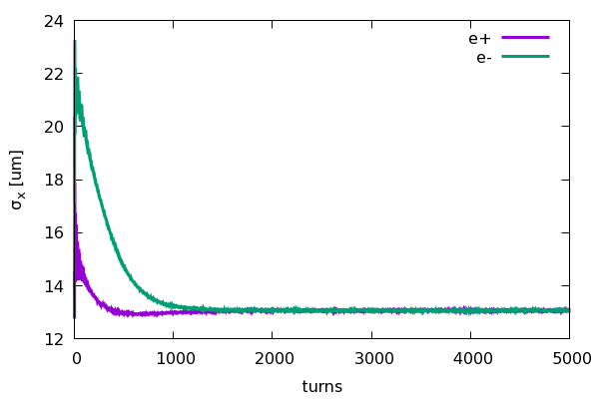
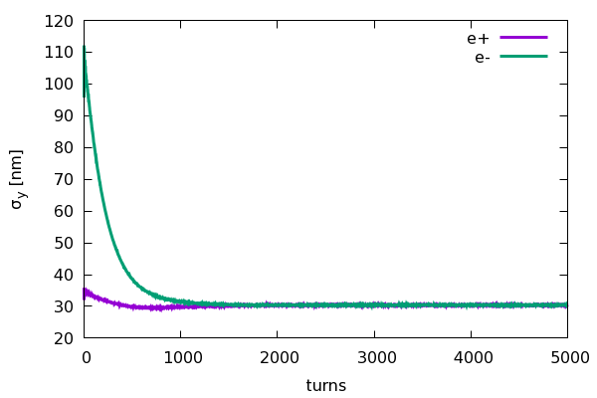
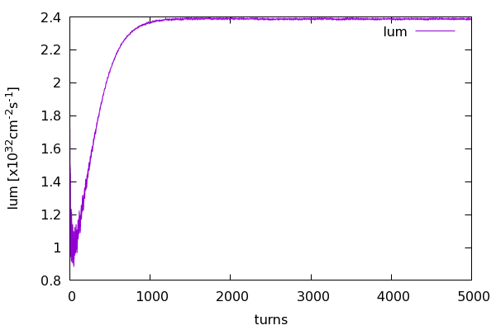
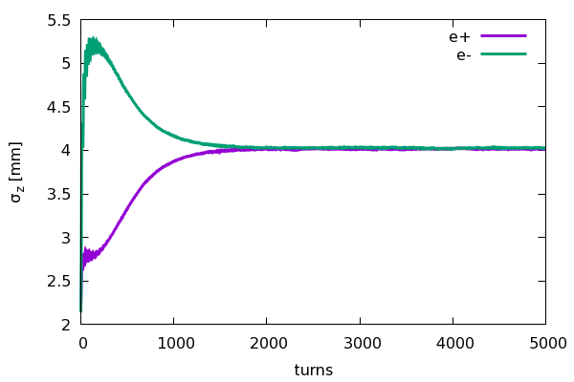
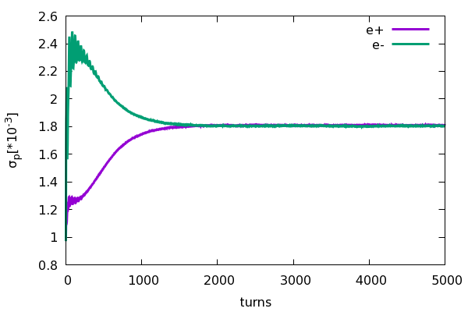
Beam beam instability for on-axis injection
Yuan Zhang
Collision stability check for on-axis injection scheme at 120GeV
e- (Ne=14×10¹⁰)
e+ (Ne=14×10¹⁰)
• Emittance X = 1.26nm
• Energy spread = 0.1%
• Bunch length=2.1mm
• Coupling=1.0%
• Emittance X = 0.68nm
• Energy spread = 0.1%
• Bunch length=2.25mm
• Coupling=0.2%

Slide 25
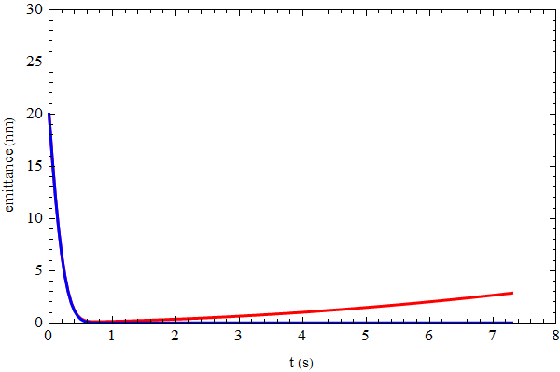
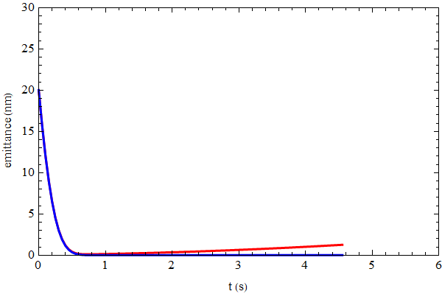
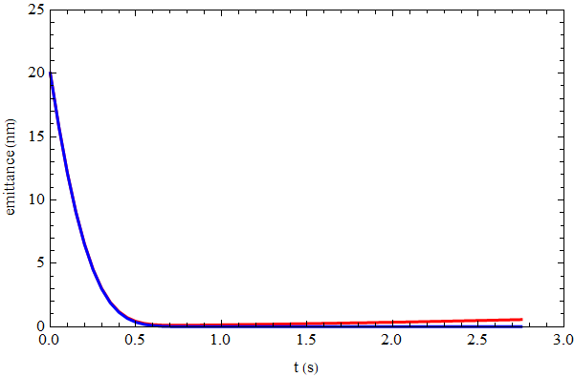
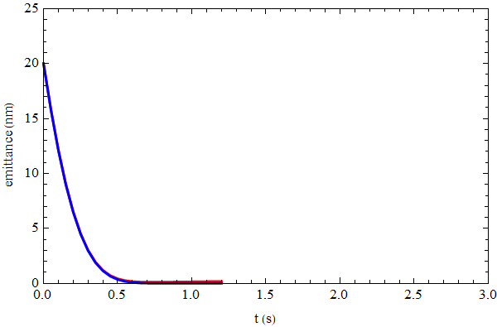
Emittance evolution
Assume injection emittance: 20nm @20GeV
5s damping time (CDR) for Z can be canceled.
tt
H
W
Z

Slide 26



RF ramping curve
Different RF ramping curve for each energy mode
νs for tt: 0.13
νs for Higgs: 0.083
νs for W & Z: 0.069
tt
Max RF voltage @tt determined by longitudinal quantum lifetime.
η_{RF}: ~ 9 ×δ
VRF (180GeV)=9.3GV
Higgs
W &Z

Slide 27




Eddy current effect and correction
Dedicated ramping curve to control the maximum K2.
Small DA reduction @ 30GeV with dynamic chromaticity correction
K2 reaches max at 30GeV.
Max K2=0.000037 (m⁻³)

Slide 28
Dipole reproducibility requirement@20Gev
Increase/decrease the strength of all the dipoles by the same amount.
Evaluate the influence: working point, closed orbit, DA, energy acceptance
Working point should not pass through the lower order resonance
Small shrink for dynamic aperture
Reproducibility requirement for dipoles: ~0.04%
Stability requirement for power supply: ~0.01%
Dipole field error tolerance loser than 10GeV
 | original | +0.01% | -0.01% | +0.03% | -0.03% | +0.05% | -0.05%
nux | 321.271 | 321.234 | 321.308 | 321.158 | 321.383 | 321.084 | 321.458
nuy | 117.193 | 117.166 | 117.220 | 117.112 | 117.274 | 117.058 | 117.328
Δx (um) | 0 | -26 | 26 | -77 | 77 | -130 | 130
DA (%) | 100 | 95 | 100 | 97 | 95 | 97 | 95

Slide 29


Effect of earthfield @20GeV
D. H. Ji, D. Wang
~20% vacuum pipe (drift) is exposed in earthfield directly.
treat drifts as week dipole to simulate the effect of earthfield
Assume earthfield: 0.6 gauss (simple model: perpendicular component only )
Working point can be corrected by weaken the dipoles systematically (-0.07%)
Earthfield problem can be solved by global orbit correction.
first turn trajectory

Slide 30





Alternative lattice design based on FODO
90°/ 90° FODO cell
FODO length: 70m~80m
Noninterleave sextupole scheme
Similar structure as CDR
70m FODO
arc cell
80m FODO (emit=1.9nm)
70m FODO (emit=1.29nm)
dis. supressor

Slide 31
outline
Status of the CDR Scheme
TDR Progress
Key Technical System Status
Summary

Slide 32


Specifications and subscale prototype dipole magnets
Main Specifications of CEPCB dipole magnets
W. Kang
Quantity | 16320 | Magnetic Length (mm) | 4700
Minimum field (Gs) | 28 | Good field region (mm) | 55
Maximum field (Gs) | 510 | Field uniformity | 0.1%
Gap (mm) | 63 | Field reproducibility | 0.05%
Two kinds of the subscale prototype magnet with and without iron cores have been designed and developed (L=1m).
The core magnet can not meet the requirement of field uniformity at 10GeV.
The core magnet is our first choice with the concern of cost and power consumption.
0.35%@10GeV, 0.06%@20GeV

Slide 33

Design of the full-scale prototype CT dipole magnet
W. Kang
The mechanical design of a full scale prototype CT dipole magnet was finished. The production of the magnet on the way. A serious problem of CT magnet is the temperature rise of the coils at the high energy region.
The total length of the magnet including the shielding tube is 5.1m.
The coil conductors will be made from pure aluminum, the cooling tubes will be inserted between the inner conductors to decrease temperature rise.
The touch resistance of the contacted surfaces of the conductors will be reduced by the coated silver films.

Slide 34









CEPC Injection/Extraction Hardware design
J. H. Chen
There are 9 injection and extraction sub-systems in CEPC accelerator complex. The types of all inj./ext. components are figured out.
So far, the kickers and the Lambertson septas preliminary designs for the damping ring, the booster low energy inj. system are completed. The kickers for high energy ext. sub-systems are also being designed.

Slide 35

SC RF system
Space for additional cavities of ttbar has been reserved both for collider and booster.
Cavities/cryomodules design for high lum. Z need to be upgraded.
For high lum. Z, the max beam current is limited by RF HOM power.
-- RF HOM power: 5W → 45W
HOM scheme redesign
-- larger beam pipe
-- HOM absorber between cavities @ 80K
-- Room temperature HOM absorber at the ends
* Detail is in Jiyuan’s presentation.

Slide 36





1.3 GHz SRF Technology for CEPC Booster
J. Y. Zhai
High Q 1.3 GHz 9-cell cavities and double-window variable input couplers reach CEPC spec.
1.3 GHz 8 x 9-cell cryomodule construction started. Assembly and horizontal test in 2022.

Slide 37



Feedback system status
J. Yue, Y Sui et al.
Feedback system is essential.
Damping time@10 GeV: 90s
Growth time (T) @10 GeV: ~20ms
Growth time (L) @10 GeV: ~60ms
Transverse feedback design
Damping time: 7.5ms
4-tap filter
2 amplifiers, 300W for each
Longitudinal feedback design
Damping time: 50ms
20-tap filter
4 amplifiers, 250W for each
R&D of components
Signal processing module
transverse kicker
frontend/backend electronics

Slide 38
Summary
Booster CDR design was refined. Accelerator physics design satisfy the requirements of geometry, beam dynamics and key hardware.
Booster energy range is enlarged in TDR. (10GeV/120GeV → 20GeV/180GeV)
Explore new booster design with smaller emittance in TDR─ prepare/support for CEPC new high lum. scheme
Two kinds of lattice: TME & FODO
DA of bare lattice is ok. Error study is going on…
Booster parameters update ─ consistent with CEPC new parameters at 4 energy
High lum. Z → Injection scheme update → Linac upgrade
R&D for Booster hardware systems progress well, with the goal of TDR at the end of 2022.

