Slide 1


  Status of CEPC collider ring
Yiwei Wang
for the CEPC Accelerator Physics Group
The Institute of High Energy Physics, Chinese Academy of Sciences
The 2021 CEPC international accelerator review committee meeting
May 11-12, 2021, IHEP

Slide 2


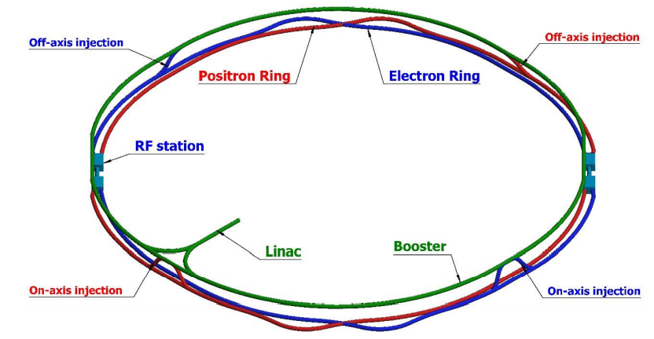
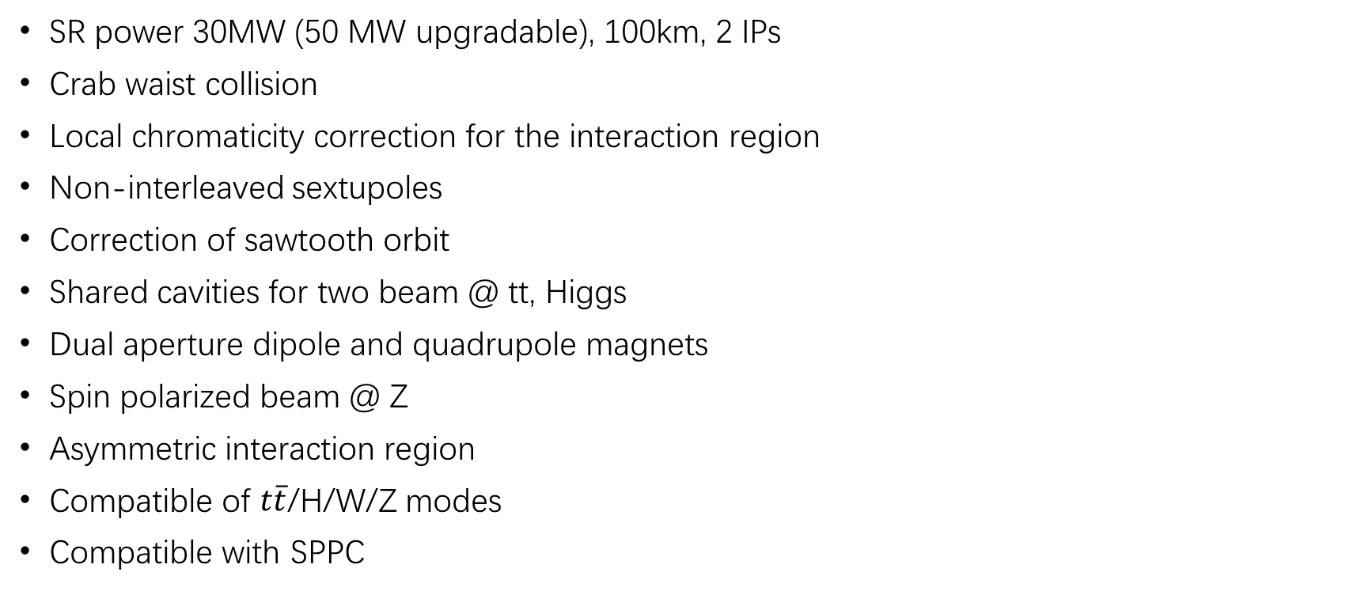
Design requirement of the CEPC collider ring
SR power 30MW (50 MW upgradable), 100km, 2 IPs
Crab waist collision
Local chromaticity correction for the interaction region
Non-interleaved sextupoles
Correction of sawtooth orbit
Shared cavities for two beam @ tt, Higgs
Dual aperture dipole and quadrupole magnets
Spin polarized beam @ Z
Asymmetric interaction region
Compatible of $t\overline{t}$/H/W/Z modes
Compatible with SPPC

Slide 3
Status of the CDR scheme

Slide 4
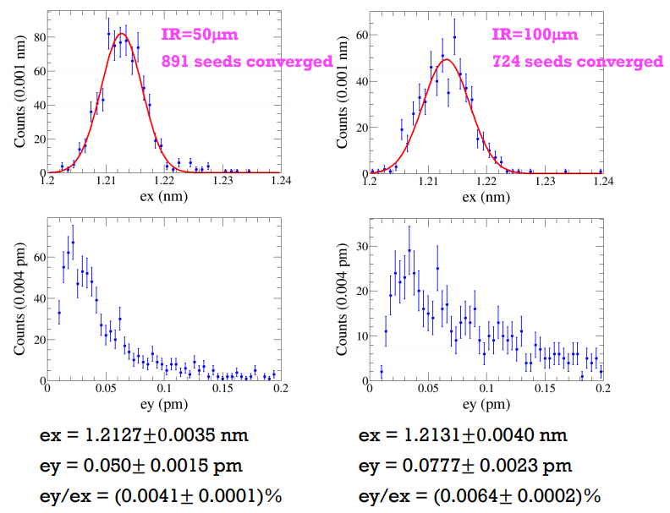
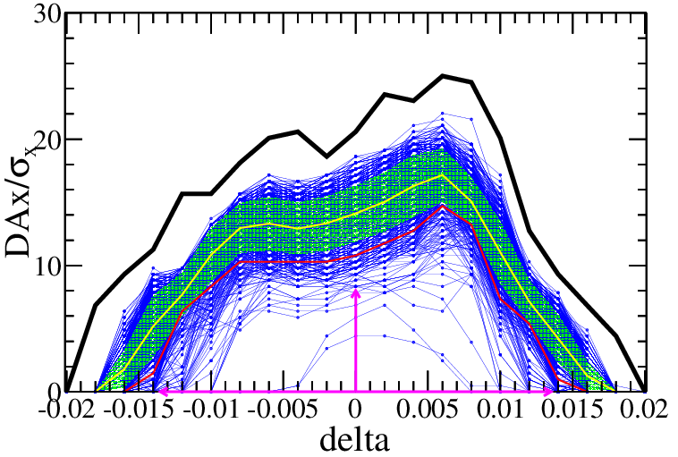
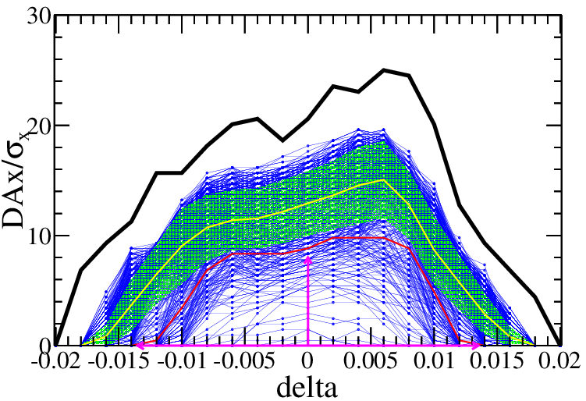
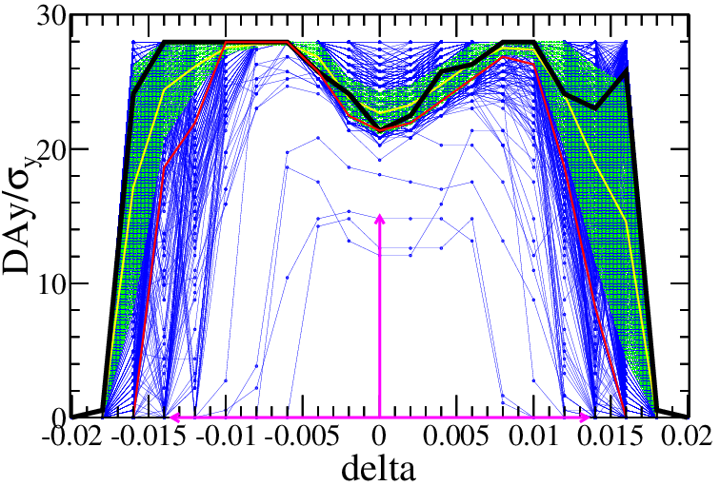
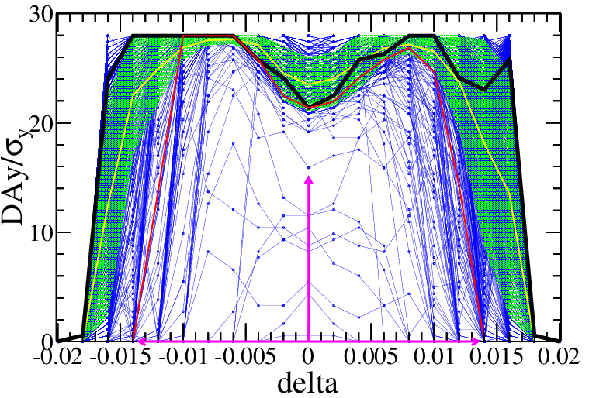
  Error Correction
More robust correction of error effects
B. Wang, Y. Y. Wei
IR=50μm
IR=100μm
Component | Δx (mm) | Δy (mm) | Δθ_{z} (mrad) | Field error
Dipole | 0.10 | 0.10 | 0.1 | 0.01%
Arc Quadrupole | 0.10 | 0.10 | 0.1 | 0.02%
IR Quadrupole | 0.05 | 0.05 | 0.05
Sextupole | 0.10 | 0.10 | 0.1
Component | Δx (mm) | Δy (mm) | Δθ_{z} (mrad) | Field error
Dipole | 0.10 | 0.10 | 0.1 | 0.01%
Arc Quadrupole | 0.10 | 0.10 | 0.1 | 0.02%
IR Quadrupole | 0.10 | 0.10 | 0.10
Sextupole | 0.10 | 0.10 | 0.1
89% seeds survival
72% seeds survival
—DA of bare lattice
—DA of each seed
—mean value
—statistic errors
—lower limits at 90%

Slide 5
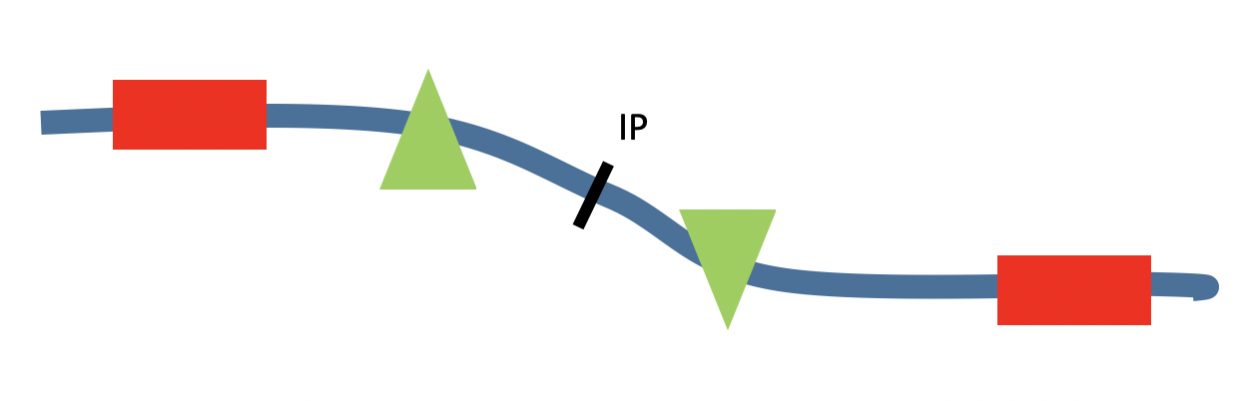
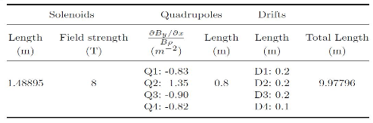

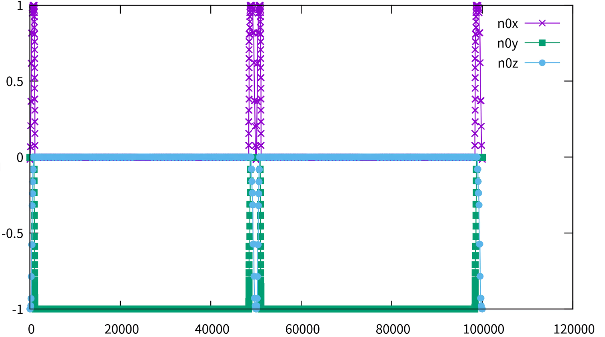
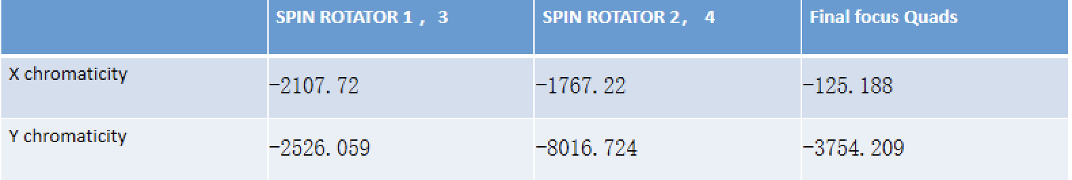
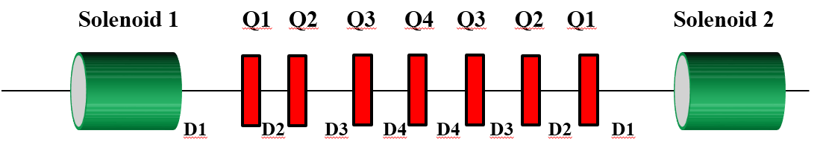
  Z-pole polarization
W.H. Xia, Z. Duan, Y. W. Wang, J. Gao
  Design of spin rotators in the CEPC CDR lattice
  Implemented solenoid spin rotators (~100 m each) into the first short straight sections near IR
  The spin rotators do rotate the spin direction as expected
  But the limited space results in a very compact design with superconducting quadrupoles
  The local contribution to the chromaticity is very large, no DA after insertion
  A new modular design of spin rotator is ongoing to reduce the quarupole strength and chromaticity.
Polarization direction w/ spin rotators

Slide 6
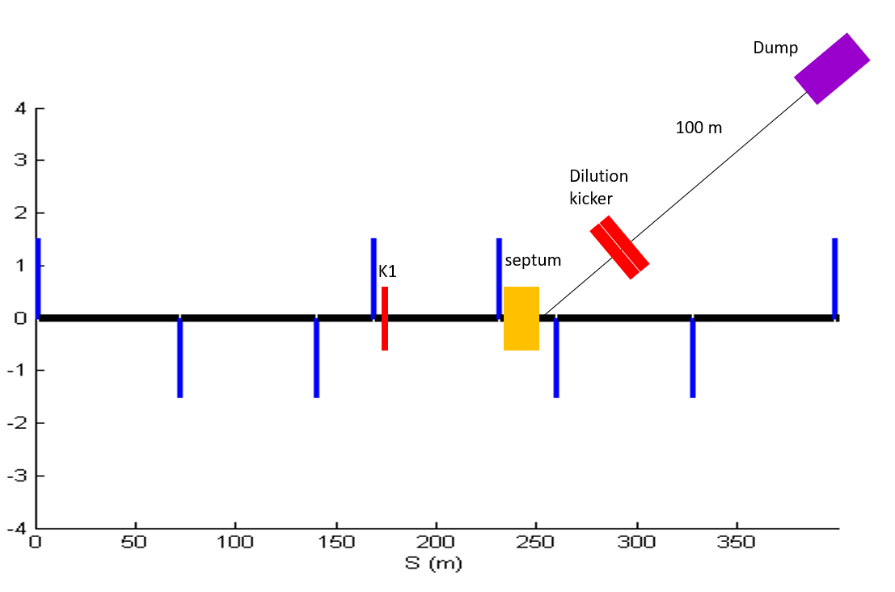
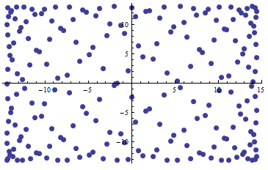
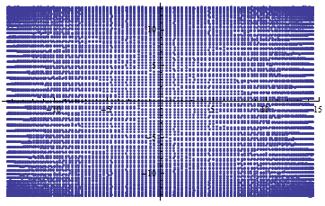
  Beam dump
X. H. Cui, Z. J. Ma, G. Y. Tang et al
One Dump for each of the electron and positron collider ring;
Use one kicker and one septum to get the beams into the dump line, so all bunches can be dumped in one turn;
Horizontal and vertical dilution kickers are used to change the position of different bunches at the dump, in order to reduce the beam damage to the dump.
The Bunch distribution on the dump surface is first assumed to be 25cm x 25cm; Each bunch 2D-Gaussian: 𝜎_𝑥~3𝑚𝑚, 𝜎_𝑦~0.3𝑚𝑚
Dilution kicker strength vibrate in 1e5 Hz.
bunch distributions at the dump for Higgs mode, and Z mode

Slide 7
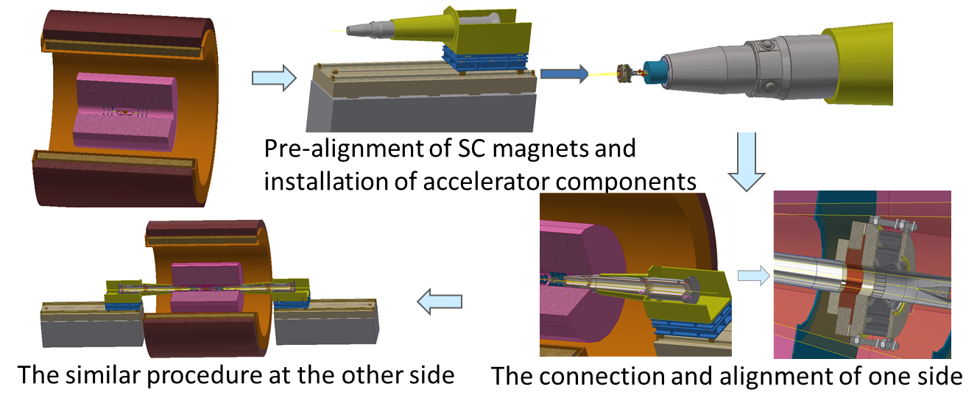
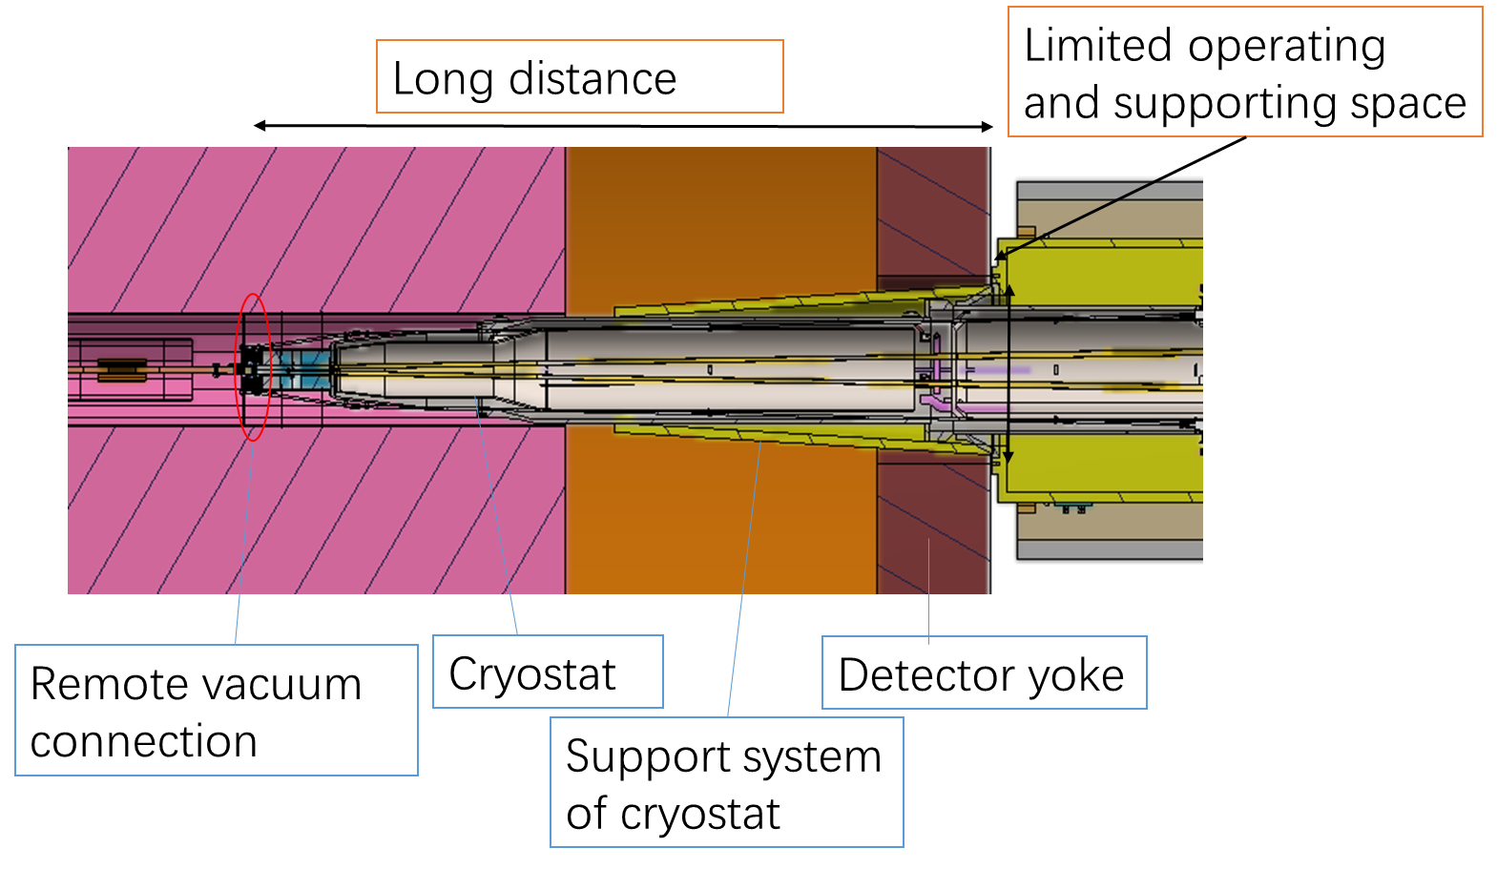
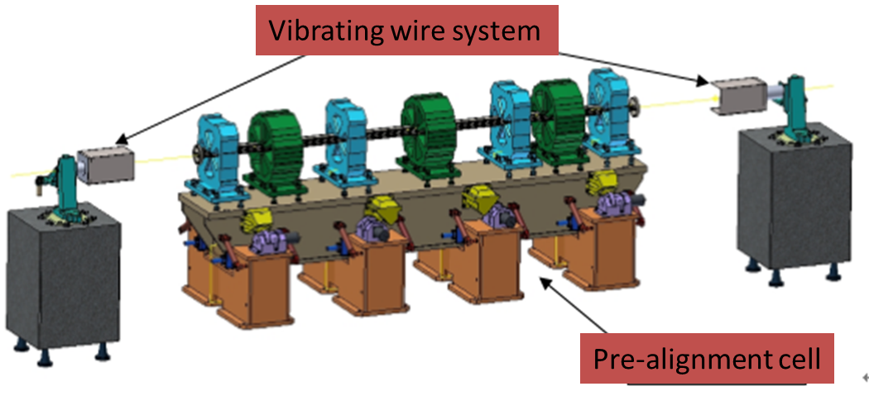
MDI integration and alignment
by H. J. Wang, S. Bai et al
Alignment scenario:
Pre-align the SC magnets using vibrating wire system to “certain location” to compensate the effect of loads.
Align the SC magnets in two cryostats using optical system.
Measure misalignment using SSW and adjust by corrector magnets meet the alignment requirements.
SSW: single stretched wire
VWS is a candidate pre-alignment method, accuracy of magnet centers: ≤10 μm

Slide 8
Status of the high luminosity scheme

Slide 9
  Key parameters of high luminosity scheme
C. Yu, Y. W. Wang, Y. Zhang, S. Bai, Y. Zhu, D. Wang, J. Gao et al
Key parameters of CDR scheme for Higgs
L*=2.2m, θc=33mrad, βx*=0.36m, βy*=1.5mm, Emittance=1.2nm
  Strength requirements of anti-solenoids B_{z}~7.2T
  Two-in-one type SC quadrupole coils (Peak field 3.8T & 136T/m)
Key parameters of high luminosity scheme for Higgs
L*=1.9m, θc=33mrad, βx*=0.33m, βy*=1.0mm, Emittance=0.64nm
  Strength requirements of anti-solenoids B_{z}~7.2T (6.8T with a shorter solenoid)
  Two-in-one type SC quadrupole coils (Peak field 3.8T & 141T/m) with room temperature vacuum chamber & Iron yoke
Reduction of the length from IP to 1st quadrupole without changing the front-end position of the FD cryo-module
To make the lattice robust and provide good start point for DA

Slide 10
Status of beam parameters
 | ttbar | Higgs | W | Z
Number of IPs | 2
Circumference [km] | 100.0
SR power per beam [MW] | 30
Half crossing angle at IP [mrad] | 16.5
Bending radius [km] | 10.7
Energy [GeV] | 180 | 120 | 80 | 45.5
Energy loss per turn [GeV] | 9.1 | 1.8 | 0.357 | 0.037
Piwinski angle | 1.21 | 5.94 | 6.08 | 24.68
Bunch number | 35 | 249 | 1297 | 11951
Bunch population [10^10] | 20 | 14 | 13.5 | 14
Beam current [mA] | 3.3 | 16.7 | 84.1 | 803.5
Momentum compaction [10^-5] | 0.71 | 0.71 | 1.43 | 1.43
Beta functions at IP (bx/by) [m/mm] | 1.04/2.7 | 0.33/1 | 0.21/1 | 0.13/0.9
Emittance (ex/ey) [nm/pm] | 1.4/4.7 | 0.64/1.3 | 0.87/1.7 | 0.27/1.4
Beam size at IP (sigx/sigy) [um/nm] | 39/113 | 15/36 | 13/42 | 6/35
Bunch length (SR/total) [mm] | 2.2/2.9 | 2.3/3.9 | 2.5/4.9 | 2.5/8.7
Energy spread (SR/total) [%] | 0.15/0.20 | 0.10/0.17 | 0.07/0.14 | 0.04/0.13
Energy acceptance (DA/RF) [%] | 2.3/2.6 | 1.6/2.2 | 1.2/2.5 | 1.3/1.7
Beam-beam parameters (ksix/ksiy) | 0.071/0.1 | 0.015/0.11 | 0.012/0.113 | 0.004/0.127
RF voltage [GV] | 10 | 2.2 | 0.7 | 0.12
RF frequency [MHz] | 650 | 650 | 650 | 650
HOM power per cavity (5/2/1cell)[kw] | 0.4/0.2/0.1 | 1/0.4/0.2 | -/1.8/0.9 | -/-/5.8
Longitudinal tune Qs | 0.078 | 0.049 | 0.062 | 0.035
Beam lifetime (bhabha/beamstrahlung)[min] | 81/23 | 39/18 | 60/717 | 80/182202
Beam lifetime [min] | 18 | 12.3 | 55 | 80
Hour glass Factor | 0.89 | 0.9 | 0.9 | 0.97
Luminosity per IP[1e34/cm^2/s] | 0.5 | 5.0 | 16 | 115
Y. W. Wang, D. Wang, Y. Zhang, J. Y. zhai et al

Slide 11
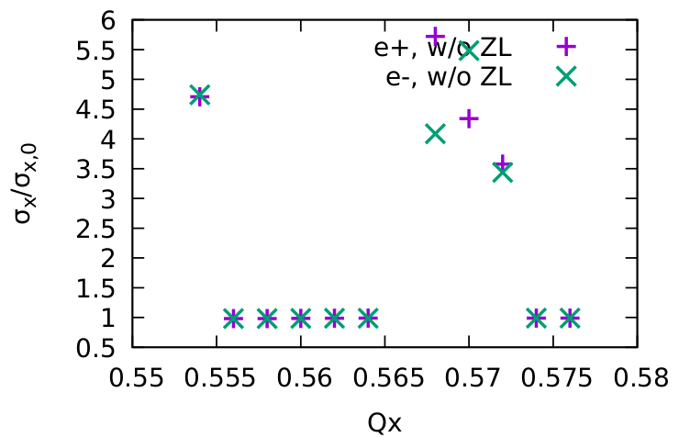
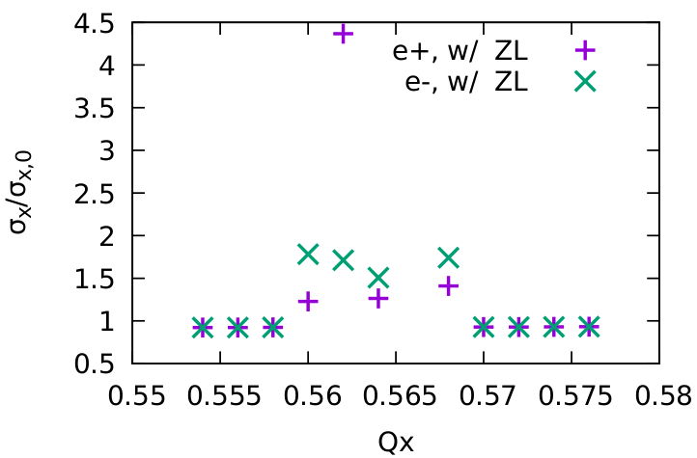
Beam-beam simulation
Y. Zhang
ttbar:
  even with strong SR damping, 3D flip-flop appear easily without CW and longitudinal impedance
  Real lattice design should consider asymmetric energy distribution (ref: K. Oide)
Higgs: Ne=14e10 is preferred considering beamstrahlung lifetime
Z: Stable tune area with both beam-beam and impedance is significant smaller than the case with beam-beam only.
More check should be done, including code itself (especially ttbar)
Z(CW=1), w/o ZL
Z(CW=1), w/ ZL

Slide 12
  Design of high luminosity lattice
Shorter cell length to squeeze the emittance from CDR 1.2nm to 0.64nm
Maximization of bend filling factor to minimize the synchrotron radiation
Optimization of the quadrupole radiation effect (QD0 2m to 2.5m)
Better correction of energy dependent aberration
Reduction of dynamic aperture requirement from injection
Reduction of the length from IP to 1st quadrupole without changing the front-end position of the FD cryo-module (2.2m to 1.9m)

Slide 13
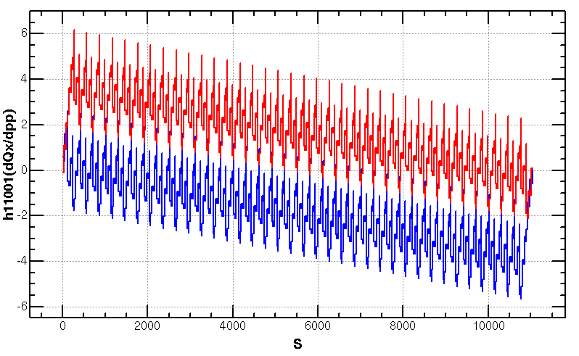
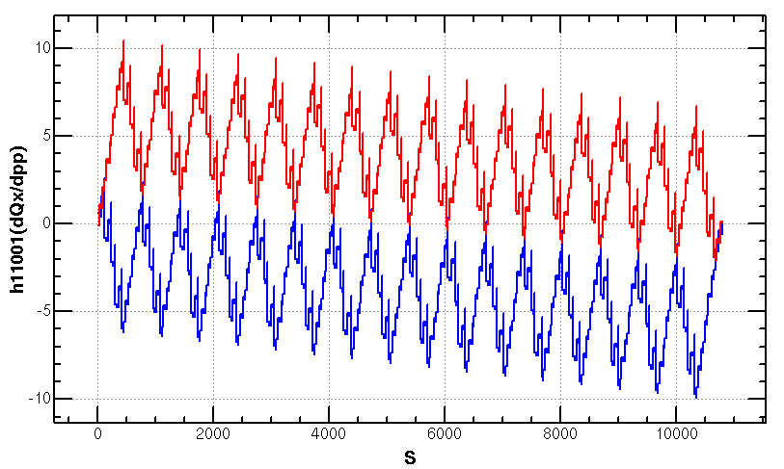
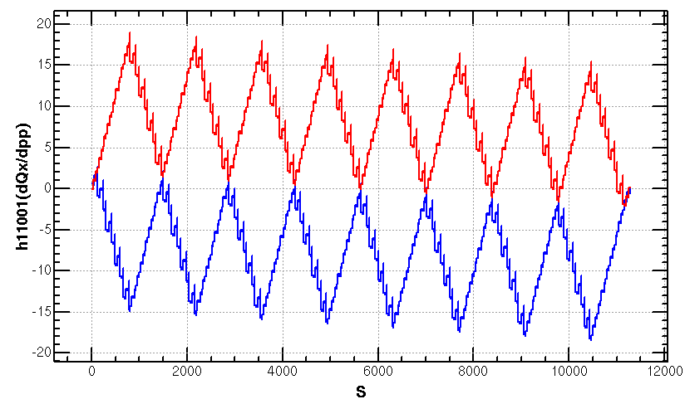
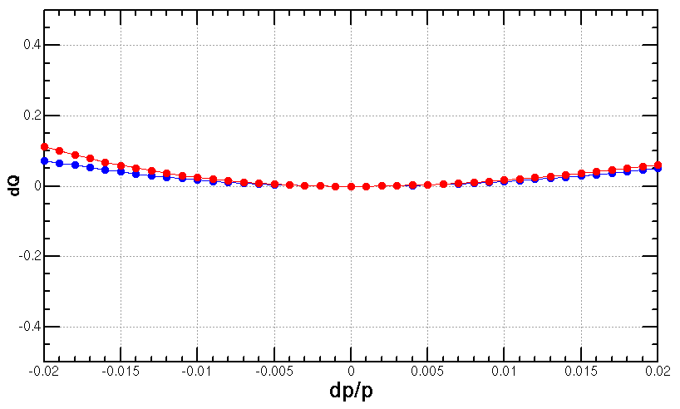
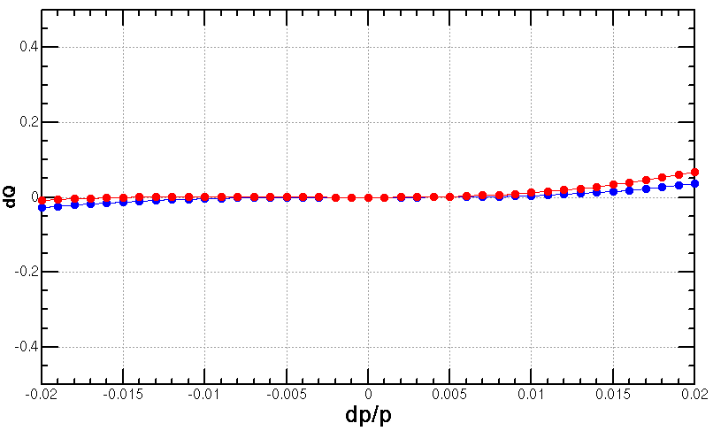
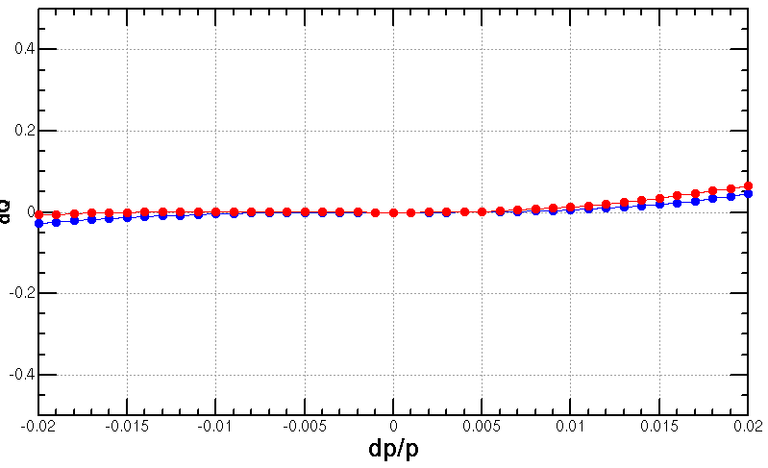
Optimization of the ARC aberration
2nd order chromaticity is a main aberration for the optimization of momentum acceptance with 2-repeated sextupole scheme.
  In previous versions, 2nd order chromaticity generated in the ARC region are corrected with IR knobs (phase advance or K1).
  However, the IR knobs will generate distortions at IP (beta, alfa and dispersion) especially for the horizontal plane.
A lattice with 4-repeated sextupoles
  much less 2nd order chromaticity for the horizontal plane
  not too sensitive to the errors
Q’’=313, 410
Q’’=8, 139
Q’’=9, 145
Scheme with 2 repeated sextupoles
Proposed by K. Oide
Scheme with 4 repeated sextupoles
Proposed by Yiwei Wang
Scheme with 8 repeated sextupoles
Proposed by Tianjian Bian

Slide 14
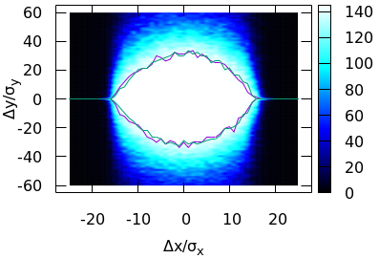
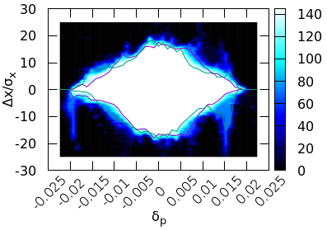


Dynamic aperture optimization
With better correction of energy dependent aberration and shorter L* (without changing the front-end position of the final doublet cryo-module)
Further optimization with algorithm of multi objective differential evolution (by J. Wu, Y. Zhang, Y. W. Wang)
Dynamic aperture w/o error at Higgs energy fulfills the requirements.
Achieved (w/o error): $16σ_{x}×32σ_{y}×1.9\%$
Goal (w/ error): $8σ_{x}×15σ_{y}×1.6\%$

Slide 15
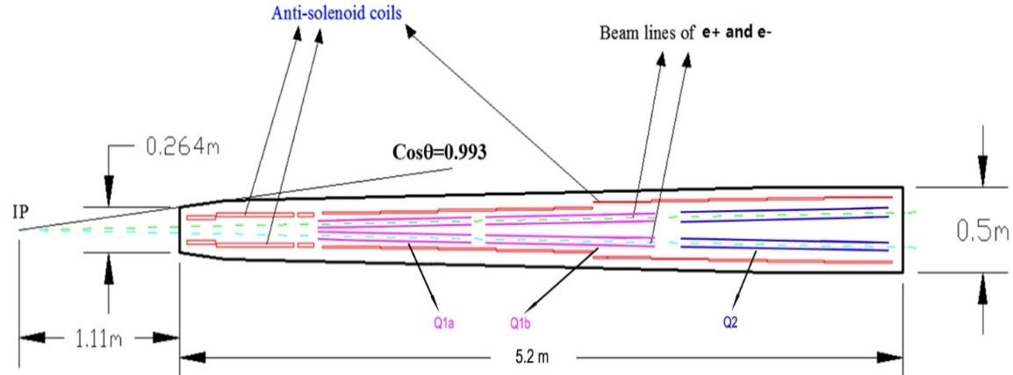
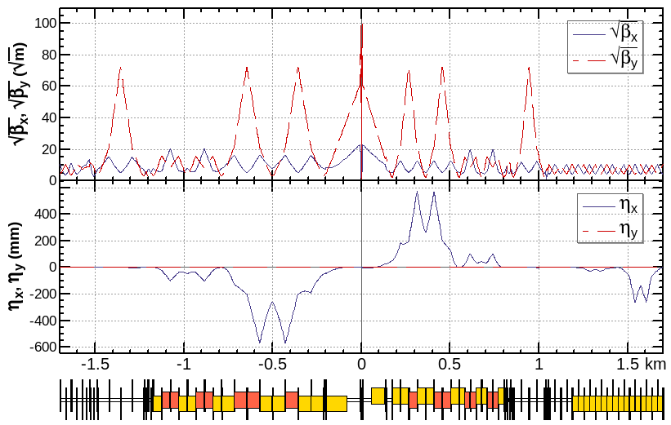
  Interaction region for all modes
  For the interaction region, the IP beta functions are refitted with the different combination of final doulets and the matching quadruples.
By Y. Zhu, S. Bai, C. Yu
 | QD | QF
Z | Q1a | Q1b+Q2
W/H | Q1a+Q1b | Q2
ttbar | Q1a+Q1b+Q1c | add quads
Higgs: L*=1.9m, LQ1A=1.22m, LQ1B=1.22m, LQ2=1.5m, d=0.3m, GQ1A=142T/m, GQ1B=96T/m, GQ2=56T/m
beam
matching section
Final doublet

Slide 16
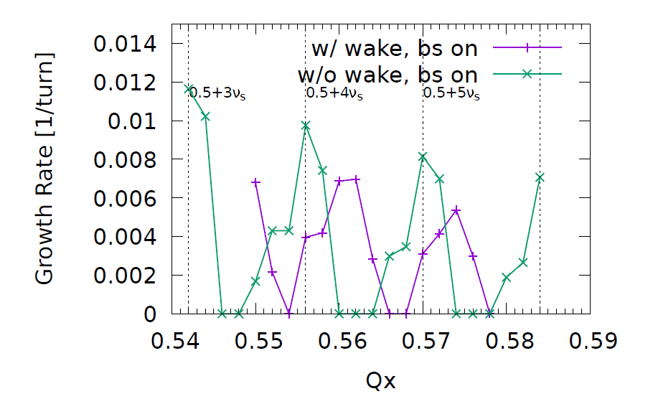
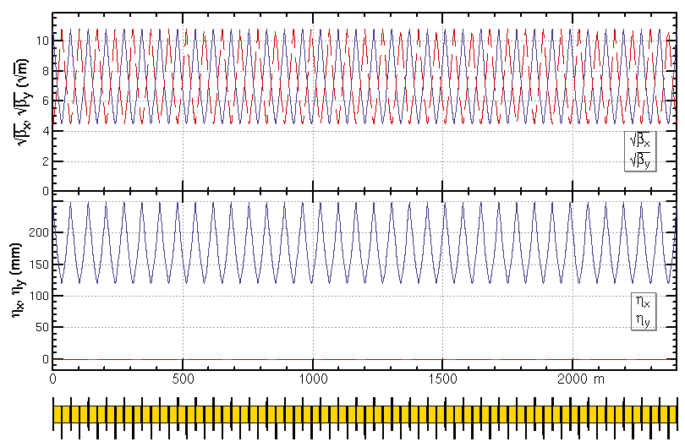
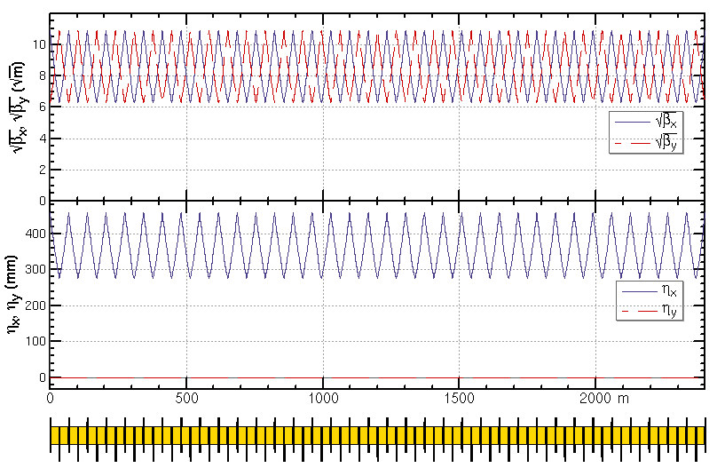
ARC region for all modes
Z and W modes need larger momentum compaction factor αp and thus larger emittance εx, Qs
  To suppress the impedance instability at Z mode
  To increase stable tune area if considering beam-beam effect and impedance consistently at W and Z modes
Microwave instability
stable tune area with both beam-beam and impedance (Z mode 90/90)
Na Wang,
CEPC Day, March 2020
Yuan Zhang
Transverse mode coupling instability
  Phase advance reduced from 90° to 60° and 29% additional sextupoles for W and Z modes
    H/tt mode 90°/ 90°
    W/Z mode 60°/ 60°

Slide 17
Magnets comparison
SC magnet in IR | Higgs (CDR) | Higgs (high lumi.)
SC QD0 and QF1 | L*=2.2m, d=0.6m, QD0: 2.0m, 136T/m QF1: 1.48m, 111T/m | L*=1.9m, d=0.3m, QD0: 2.5m, 142T/m, 96T/m QF1=1.5m, 56T/m
SC anti-solenoids | maximum 7.2T | maximum 7.2T
SC sextupoles | VSIRD: 0.6m, 1308 T/m^2 HSIRD: 0.8m, 1506 T/m^2 VSIRU: 0.6m, 1250 T/m^2 HSIRU: 0.6m, 1600 T/m^2 | VSIRD: 0.6m, 1209 T/m^2 HSIRD: 0.8m, 1679 T/m^2 VSIRU: 0.6m, 1548 T/m^2 HSIRU: 0.6m, 1130 T/m^2 (safety factor 20% for strength )
Main magnets in ARC | Higgs (CDR) Quantity, length and field | Higgs (high lumi.) Quantity, length and field
Dipoles (dual aperture) | 2320, 28.686 m, 373 Gs | 2944, 21.7 m, 390 Gs (Quant +27%, total length -4%)
Quadpoles (dual aperture) | 2320, 2 m, 8.4 T/m | 2944, 3 m, 10.6 T/m (Quant +27%, total length +90%)
Sextupoles (single aperture) | SF: 896, 0.7 m, 506 T/m^2 SD: 896, 0.7 m*2, 506 T/m^2 | SF: 1024, 0.7 m, 1100 T/m^2 SD: 1024, 0.7 m*2, 1129 T/m^2 (Quant +14%, total length +14%)

Slide 18
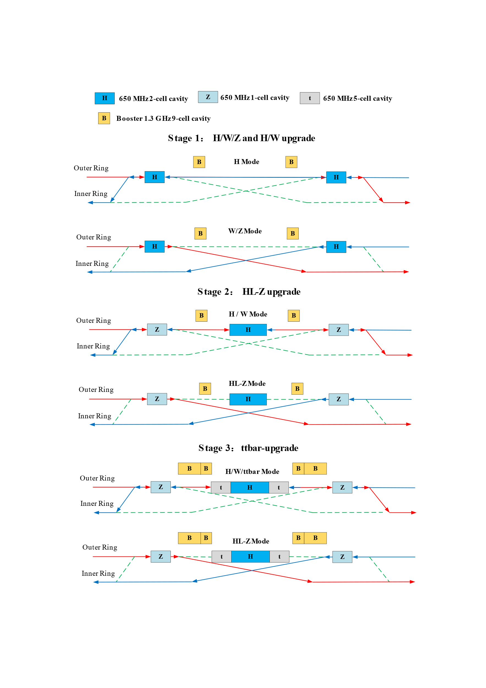
  RF staging for compatible modes
1st priority of the Higgs running and flexible switching
Low cost at early stage
Get high luminosity for all modes
Stage 1 (H/W run)
Layout and parameters are same with CDR except longer central part
Medium or low luminosity at Z
Stage 2 (HL-Z upgrade)
Move Higgs cavities to center and add high current Z cavities.
By-pass low current H cavities.
Stage 3(ttbar upgrade)：
Add ttbar cavities (low current, high gradient, high Q)
Nb3Sn@4.2 K or others to significant reducing the cost of cryo-system and AC power.
by J. Y. Zhai, Yiwei Wang

Slide 19
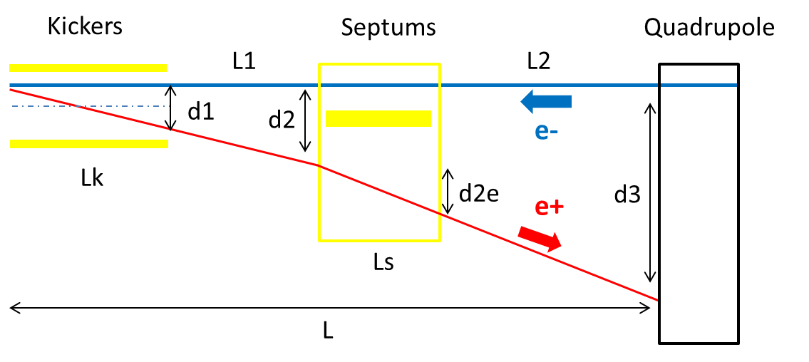
Alternative separation scheme at RF region
With kicker instead of electro-static separator to reduce the impedance contribution (proposed by Jinhui Chen)
Study on the field stability is undergoing.
 | Kicker | Septum
Integrated strength BL [T*m] | 0.1624 | 1.4
Strength B [Guass] | 203 | 1000 | Field for up to 182.5GeV. Septum is weak to suppress emittance growth.
Effective length Leff [m] | 8 | 14
Half width of good field region Hgf/Vgf [mm] | 10.1/3.8 @ 5E-4 | 18.9/3.8 @ 5E-4 | Kicker: 18σx+3mm+d1/2, 18σy+3mm Septum: 18σx+3mm+d2e/2, 18σy+3mm
Half width of beam stay clear Hbsc/Vbsc [mm] | 9.6/3.6 | 9.2/3.6 | 18σx+3mm, 18σy+3mm
Septum width width [mm] | - | 5

Slide 20
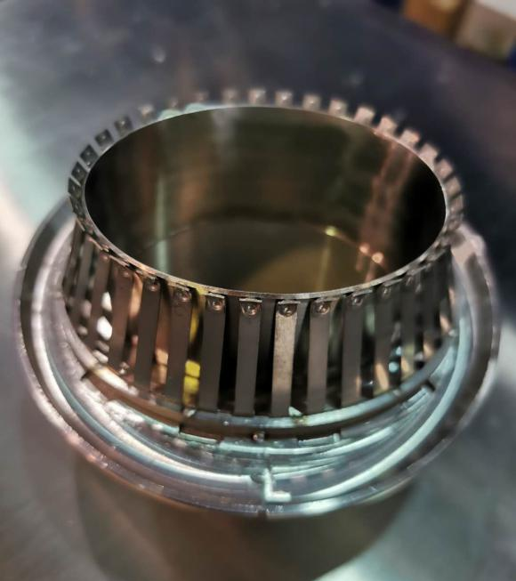
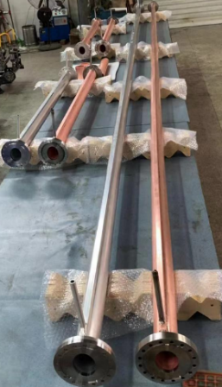
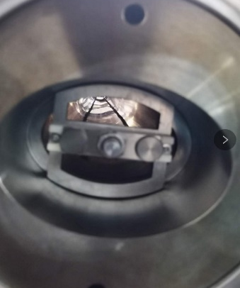
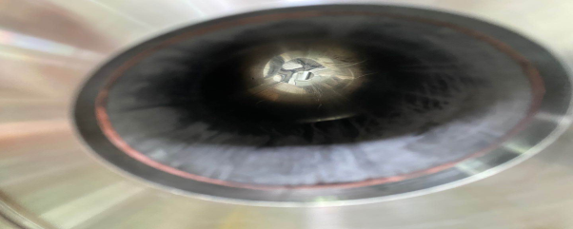
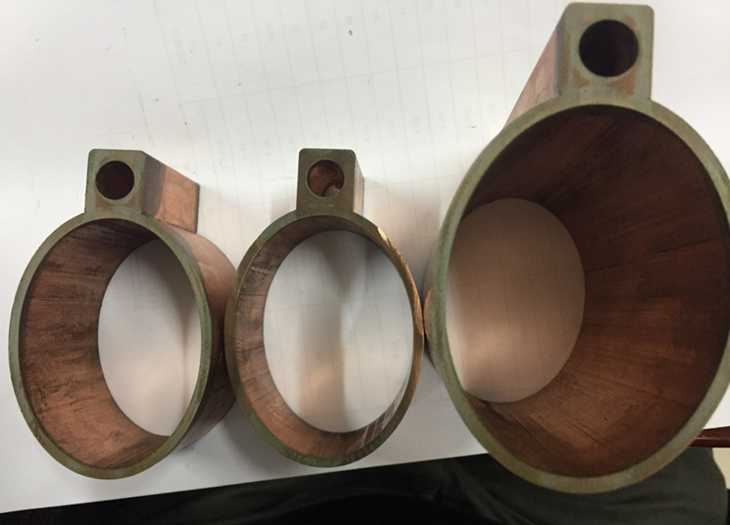
R&D Progress of CEPC vacuum system
Y. S. Ma et al
RF shielding bellows：Contact force is uniformly from different fingers and meets the target of 125±25g. Two prototypes of RF shielding bellows have been fabricated.
NEG coating：2m long vacuum pipe have been coated to explore the coating parameter at geometrical shape of 56×75. 6m long vacuum chambers will be coated by moving the solenoid by a horizontal coating equipment .
Vacuum chamber：The prototypes of copper & aluminum vacuum chambers with a length of 6 m have been fabricated and tested, which meet the engineering requirements.

Slide 21
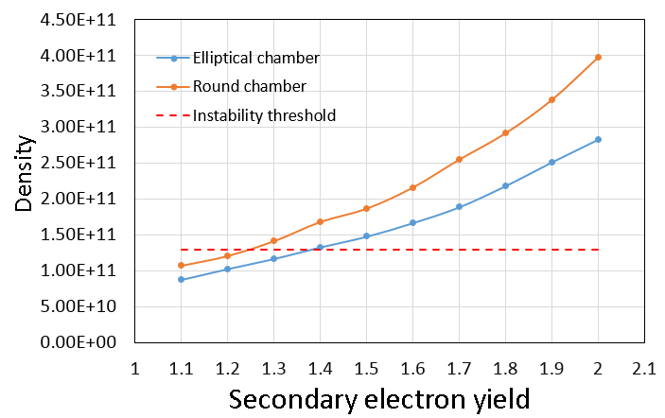
Modification on chamber shape
Y. D. Liu, Na Wang
Beam physics:
Solution on quadrupole wakes and betatron tune shift
Electron cloud density increased
  can be controlled by NEG coating
Serious instability caused by resistive wall impedance
  strictly limit NEG coating thickness < 200nm
Technique on vacuum, magnets and power supply:
Easier manufacture of vacuum chamber
Lower power consumption of magnets
28mm
Elliptical chamber: SEY<1.3
Round chamber: SEY<1.2
37.5mm
from elliptical to round

Slide 22
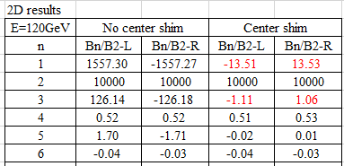
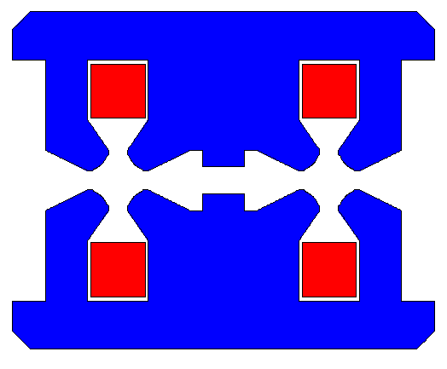
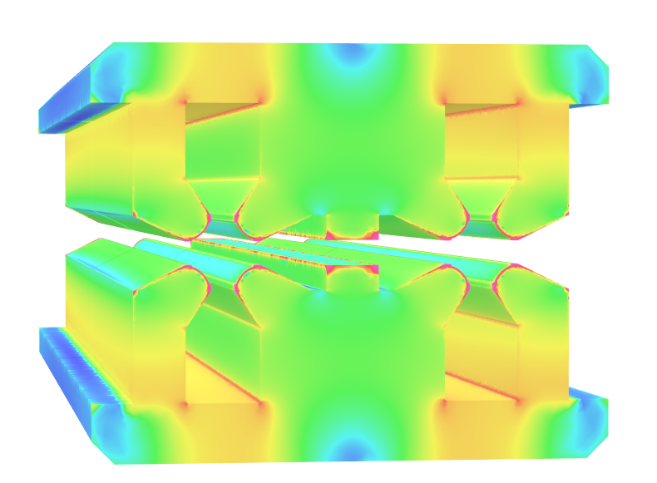
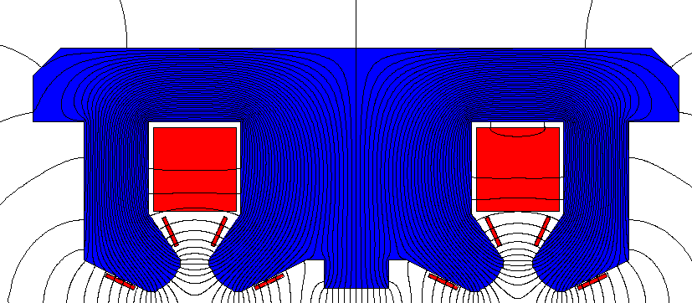
Optimization of the dual-aperture quadrupole
M. Yang
Add a shim at the center
  The b1 and b3 component can reduce a lot.
  The harmonics varies a little at different energy.
  No large variation introduced by the trim coil.
F/D design
F/D design with trim coils
3D bmod

Slide 23
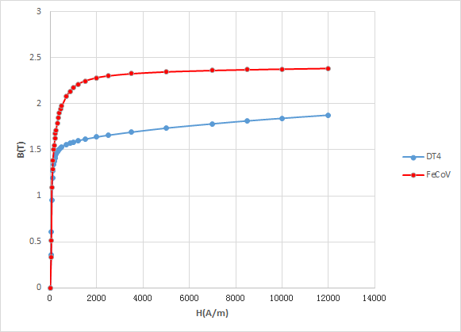
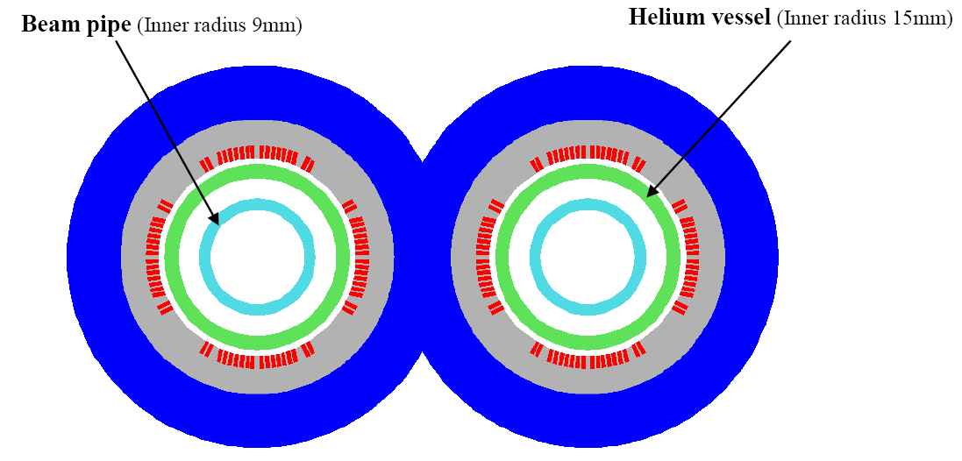
Optimization the final quadrupoles
Y. S. Zhu
Different design options of CEPC Q1a have been studied and compared.
With relaxed dipole field requirement (< 30 gauss) and use FeCoV yoke, the magnet weight can be significantly reduced (55% of origin).
Using one layer coil, magnet weight can be further reduced. (42% of origin)
Recommendation:
Baseline design: 2 layers coil, FeCoV yoke;
Alternative design: 1 layer coil, FeCoV yoke.
BH curve of DT4 and FeCoV

Slide 24
Summary
  The collider ring design of CDR scheme is more solid and the R&D based on the CDR scheme is undergoing.
  The high luminosity scheme of CEPC collider ring with 5×10³⁴cm⁻²s⁻¹ & 30MW has been designed by mainly squeezing the βy* and emittance.
    New aberration correction scheme in ARC region
    Dynamic aperture w/o error at Higgs energy fulfills the requirements.
    Phase advance reduced from 90° to 60° for W/Z mode to suppress impedance instability and increase stable tune area
    New RF staging scheme
    Alternative separation scheme at RF region to reduce the impedance contribution
    Lower injection emittance from booster
    The vacuum shape from elliptical to round solve the quadrupole wakes effects
    For dual-aperture quadrupole, b1 and b3 component can reduce a lot with shim at the center
    QD0 weight can be reduced to 42% of origin by relaxed dipole field requirement, FeCoV yoke and 1 layer coil
  More work to be done for high luminosity scheme

Slide 25
Backup

Slide 26
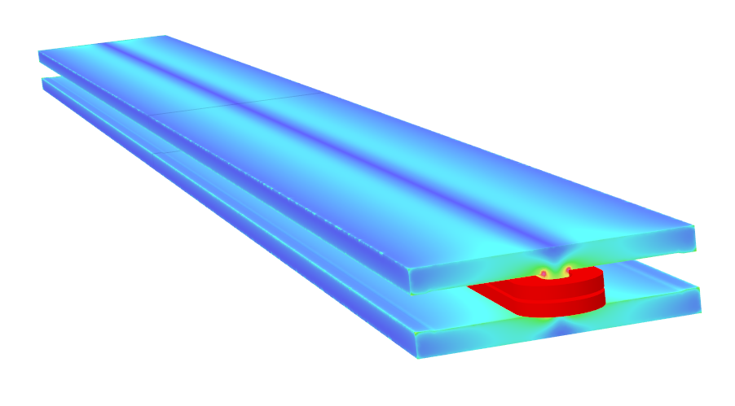
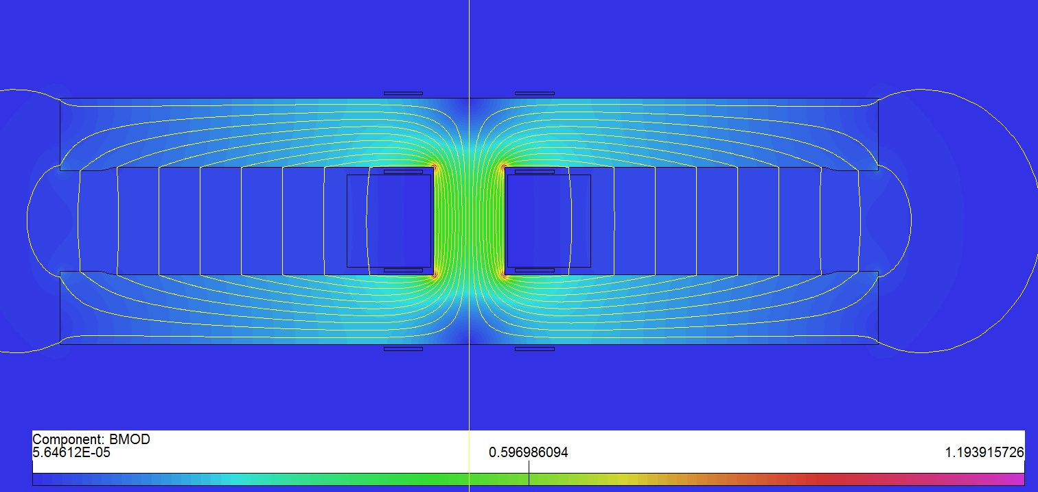
Long dual-aperture dipole design
M. Yang
As the magnetic length is up to 28.7m, a 5.7m pure dipole model will be built to check the field quality, mechanical strength and deformation.
  Solid iron with DT4;
  Two turns of aluminum busbars with cooling hole;
  Anodizing treated insulation coil;
  Silvered contact face to reduce contact resistance.
3D Bmod of DAD
Mechanical design of DAD
Cross section of long DAD

Slide 27
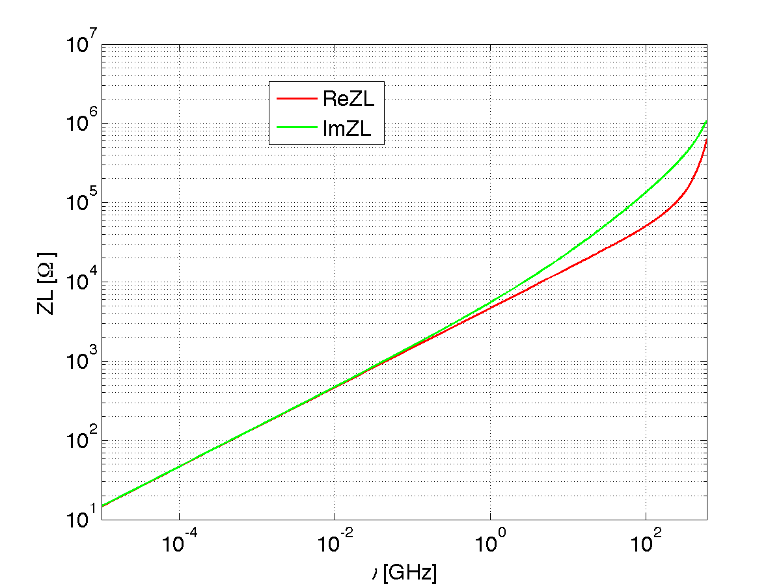




Challenge and Response : Resistive wall impedance instability
Resistive wall impedance
  Round pipe of Copper (3mm) with NEG coating (200nm)
N. Wang’s talk on last CEPD Day
Coupled bunch instability
Instability growth time 1.7ms, more efficient feedback for its suppression
High luminosity Z operation:
Bunch lengthening 90%;
Energy spread increasing 4%
Strictly control on the coating thickness for impedance source to restrain the instability!

Slide 28


MDI vacuum layout
by MDI group
All the accelerator components are within the detective angle of acos0.99.

