Slide 1
Progress on MDI design
Sha Bai
for CEPC MDI group
CEPC IARC meeting
2021-05-11

Slide 2
Outline
MDI design for High Luminosity Higgs
CDR → TDR optimization for MDI
Summary

Slide 3
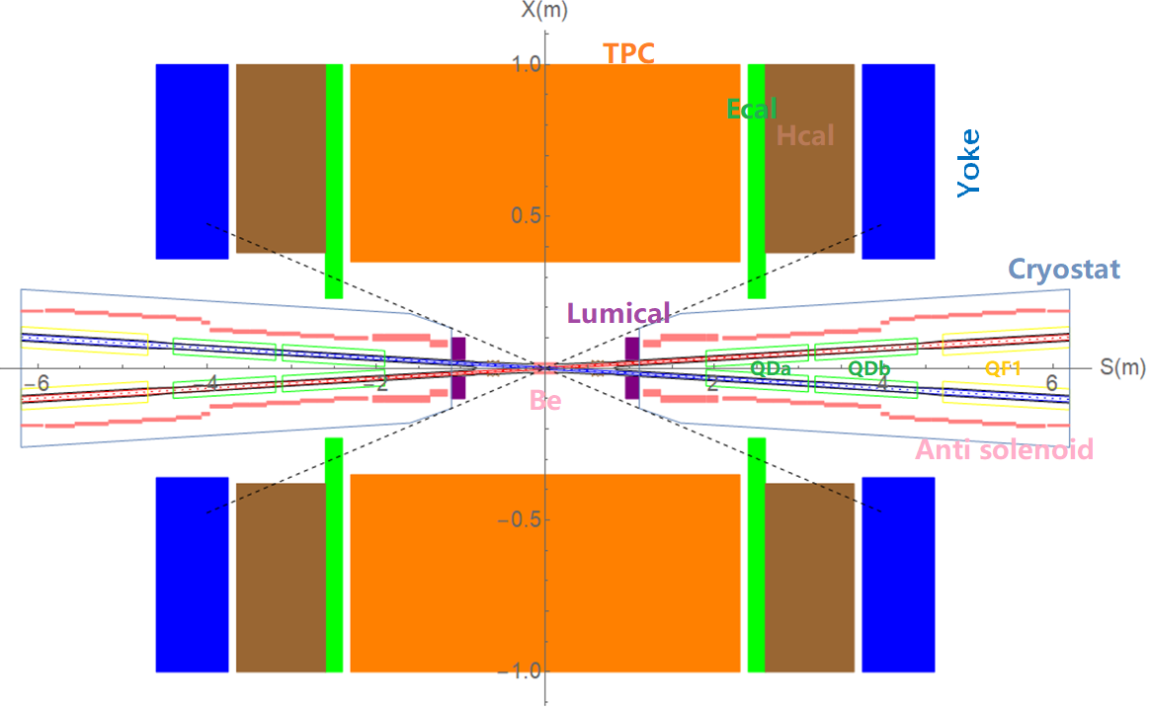
MDI layout and IR design
The Machine Detector Interface (MDI) of CEPC double ring scheme is about ±7m long from the IP.
The CEPC detector superconducting solenoid with 3T magnetic field and the length of 7.6m.
The accelerator components inside the detector without shielding are within a conical space with an opening angle of cosθ=0.993.
The e+e- beams collide at the IP with a horizontal angle of 33mrad and the final focusing length is 1.9m.

Slide 4
MDI parameters
 | range | Peak filed in coil | Central filed gradient | Bending angle | length | Beam stay clear region | Minimal distance between two aperture | Inner diameter | Outer diameter | Critical energy (Horizontal) | Critical energy (Vertical) | SR power (Horizontal) | SR power (Vertical)
L* | 0~1.9m |  |  |  | 1.9m
Crossing angle | 33mrad
MDI length | ±7m
Detector requirement of accelerator components in opening angle | 8.1˚
QDa/QDb |  | 3.2/2.8T | 141/84.7T/m |  | 1.21m | 15.2/17.9mm | 62.71/105.28mm | 48mm | 59mm | 724.7/663.1keV | 396.3/263keV | 212.2/239.23W | 99.9/42.8W
QF1 |  | 3.3T | 94.8T/m |  | 1.5m | 24.14mm | 155.11mm | 56mm | 69mm | 675.2keV | 499.4keV | 472.9W | 135.1W
Lumical | 0.95~1.11m |  |  |  | 0.16m |  |  | 57mm | 200mm
Anti-solenoid before QD0 |  | 7.2T |  |  | 0.8m |  |  | 120mm | 390mm
Anti-solenoid QD0 |  | 3T |  |  | 2.5m |  |  | 120mm | 390mm
Anti-solenoid QF1 |  | 3T |  |  | 1.5m |  |  | 120mm | 390mm
Beryllium pipe |  |  |  |  | ±120mm |  |  | 28mm
Last B upstream | 64.97~153.5m |  |  | 0.77mrad | 88.5m |  |  |  |  | 33.3keV
First B downstream | 44.4~102m |  |  | 1.17mrad | 57.6m |  |  |  |  | 77.9keV
Beampipe within QDa/QDb |  |  |  |  | 1.21m |  |  |  |  |  |  | 1.89/2.04W
Beampipe within QF1 |  |  |  |  | 1.5m |  |  |  |  |  |  | 3.34W
Beampipe between QD0/QF1 |  |  |  |  | 0.3m |  |  |  |  |  |  | 26.7W

Slide 5
QDa/QDb, QF1 physics design parameters β_{y}*=1mm, β_{x}*=0.33m
QDa/QDb | Horizontal BSC 2（18σ_{x}+3） | Vertical BSC 2（22σ_{y}+3） | e+e- beam center distance
Entrance | 9.15/12.41 mm | 12.89/15.22 mm | 62.71/105.28mm
Middle | 10.37/14.84 mm | 14.61/14.88 mm | 82.84/125.41mm
Exit | 12.13/17.92 mm | 15.21/13.87 mm | 102.64/145.21mm
Good field region | Horizontal 12.13/17.92 mm; Vertical 15.21/15.22 mm
Effective length | 1.21 m
Distance from IP | 1.9/3.19 m
Gradient | 141/84.7 T/m
QF1 | Horizontal BSC 2（18σ_{x}+3） | Vertical BSC 2（22σ_{y}+3） | e+e- beam center distance
Entrance | 19.66 mm | 13.21 mm | 155.11 mm
Middle | 23.02 mm | 12.00 mm | 179.87 mm
Exit | 24.14 mm | 11.60 mm | 204.62 mm
Good field region | Horizontal 24.14 mm; Vertical 13.21 mm
Effective length | 1.5 m
Distance from IP | 4.7 m
Gradient | 94.8 T/m

Slide 6
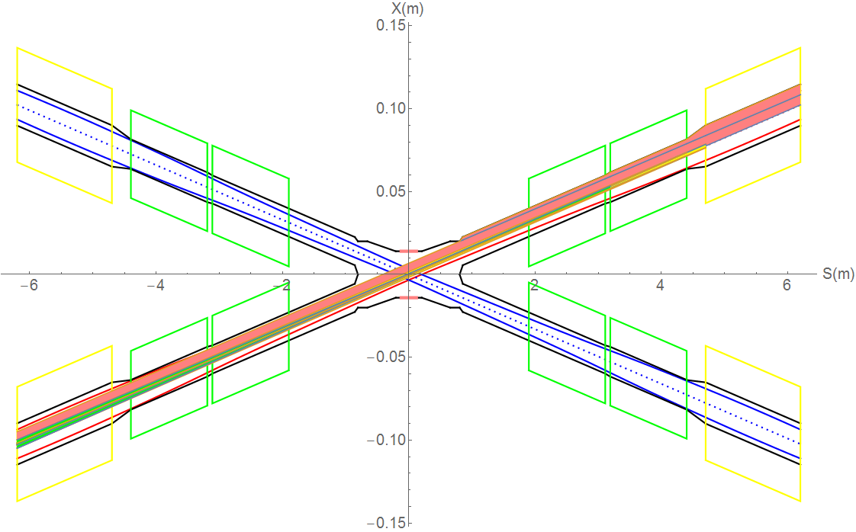
SR on IR beam pipe from last bend upstream and Final Doublet
There is no SR photons hitting the central beam pipe in normal conditions.
Single layer beam pipe with water cooling, SR heat load is not a problem.
QF1
Region | SR heat load | SR average power density
0~805mm | 0 | 0
805mm~855mm | 12.5W | 69.4W/cm²
855mm~1.9m(QDa entrance） | 1.06W | 0.28W/cm²
QDa | 1.19W | 0.27W/cm²
QDa~QDb | 3.73W | 12.95W/cm²
QDb | 1.31W | 0.3W/cm²
QDb~QF1 | 26.5W | 4.9W/cm²
QF1 | 2.39W | 0.44W/cm²
QDb
QDa

Slide 7
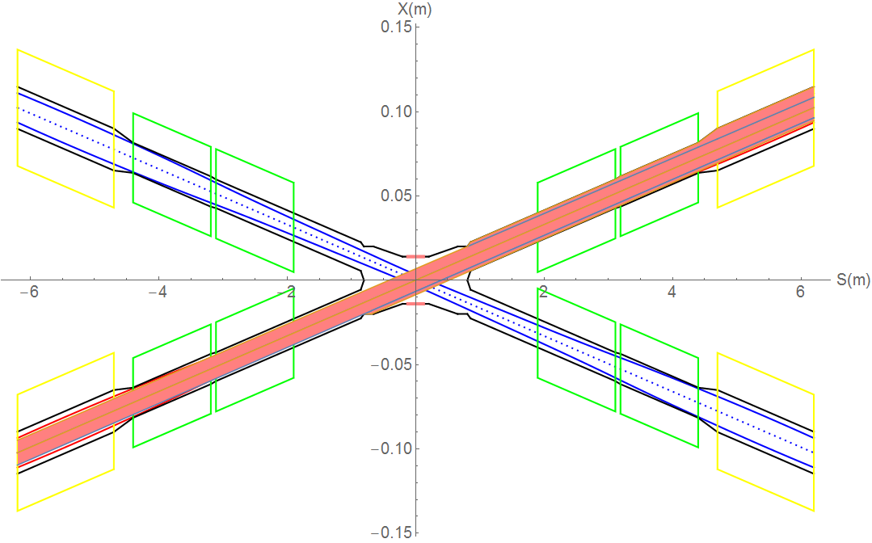
SR from last bending magnet upstream of IP
Abnormal condition
SR photons hitting the bellows under the extreme beam conditions, temperature rise ~1⁰C
Extreme condition, eg, if a magnet power is lost, a large distortion will appear immediately for the whole ring orbit. The beam will be lost when exceeded.
In extreme cases ~ at least 10 times per day. The beam will be stopped within 0.5ms when abnormal. It is not afraid of this 0.5ms for other material beam pipe except beryllium pipe.
The background of the detector should not be considered under abnormal conditions.
It is not necessary to care about whether the beam orbit deviation will affect detector operation, since the high background part will be removed when data analysis is carried out.
SR will enter into the bellows (no cooling):
IP~677mm, no SR heat load.
-677~-805mm beam pipe, SR power ~14.65W, APD~ 31.8W/cm².
-805~855mm beam pipe, SR power~12.96W, APD~72W/cm².
Temperature rise ~1⁰C

Slide 8
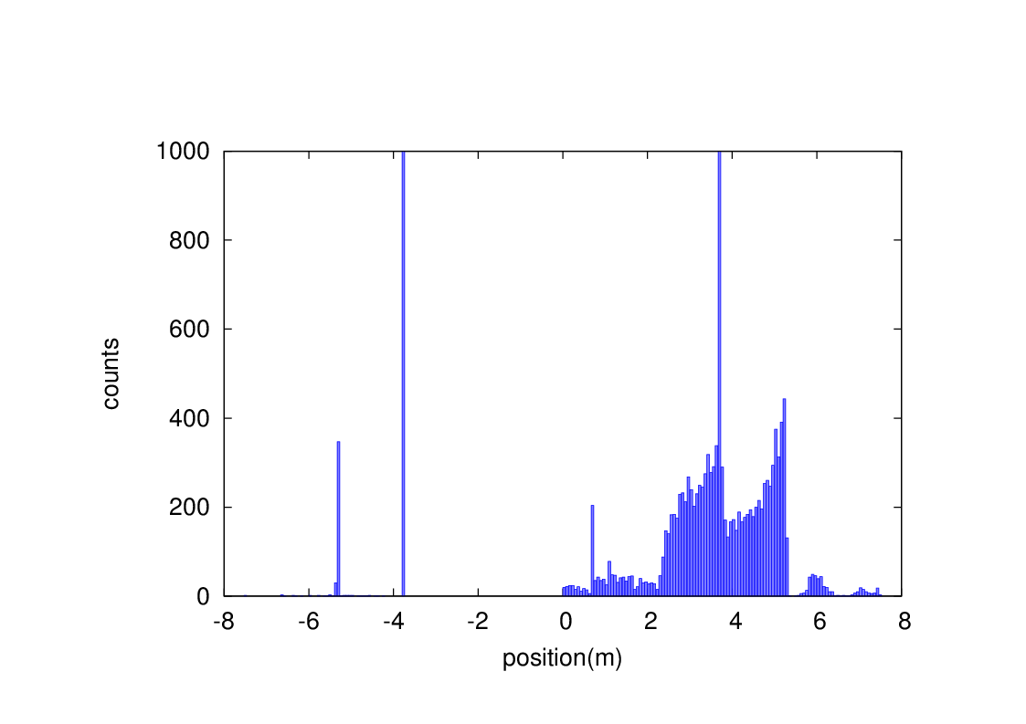
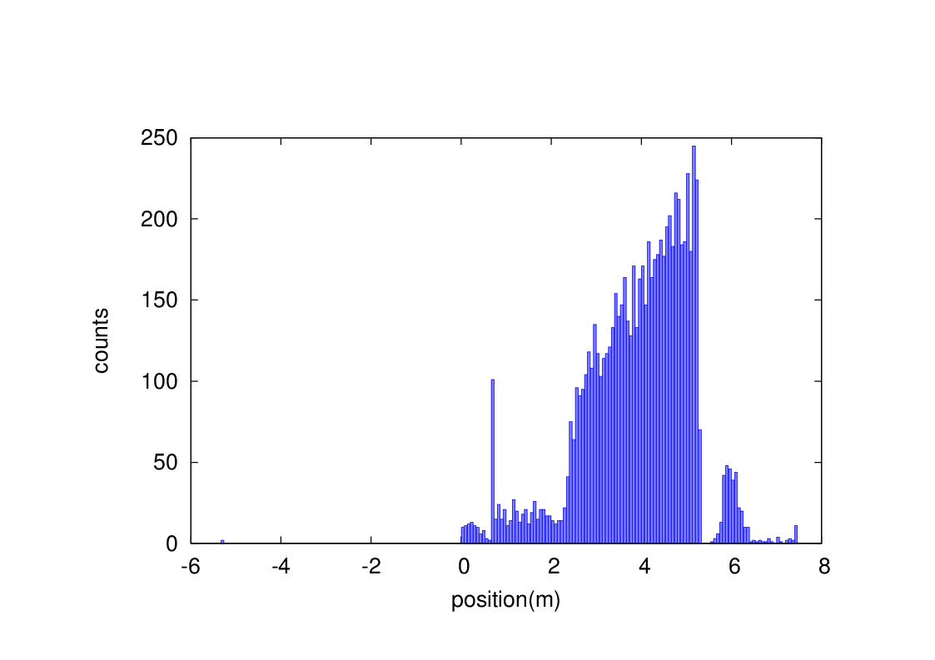
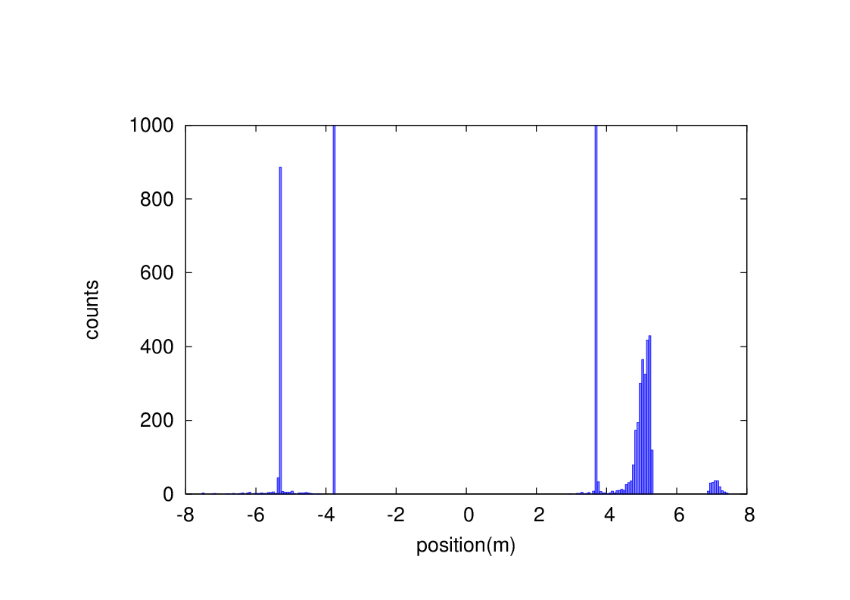
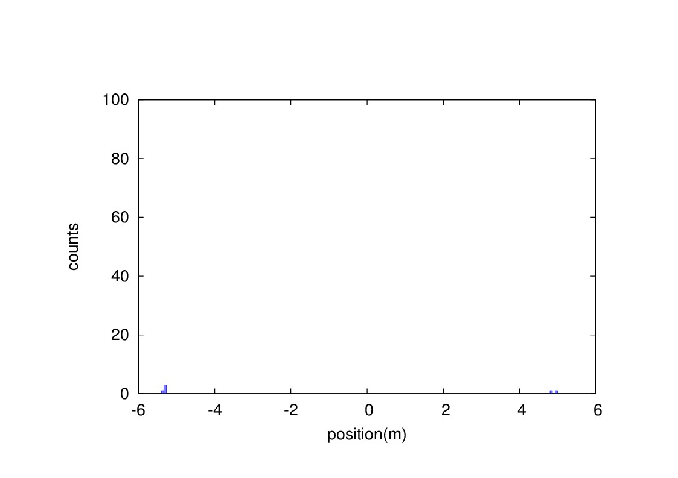
Beam loss from RBB and BS
Without collimator
With collimator
Radiative Bhabha scattering
Without collimator
With collimator
Beamstrahlung

Slide 9
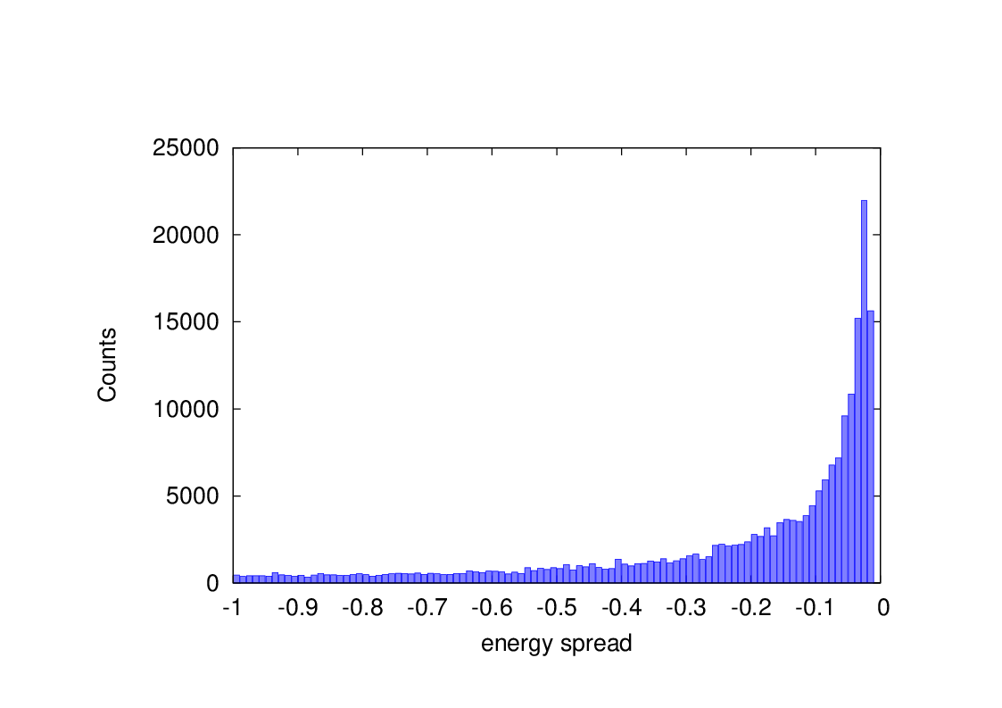
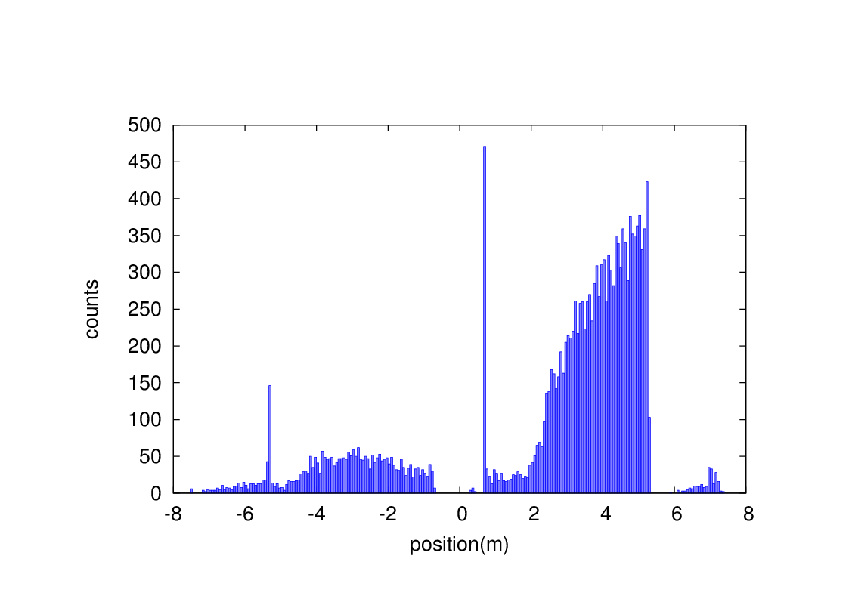
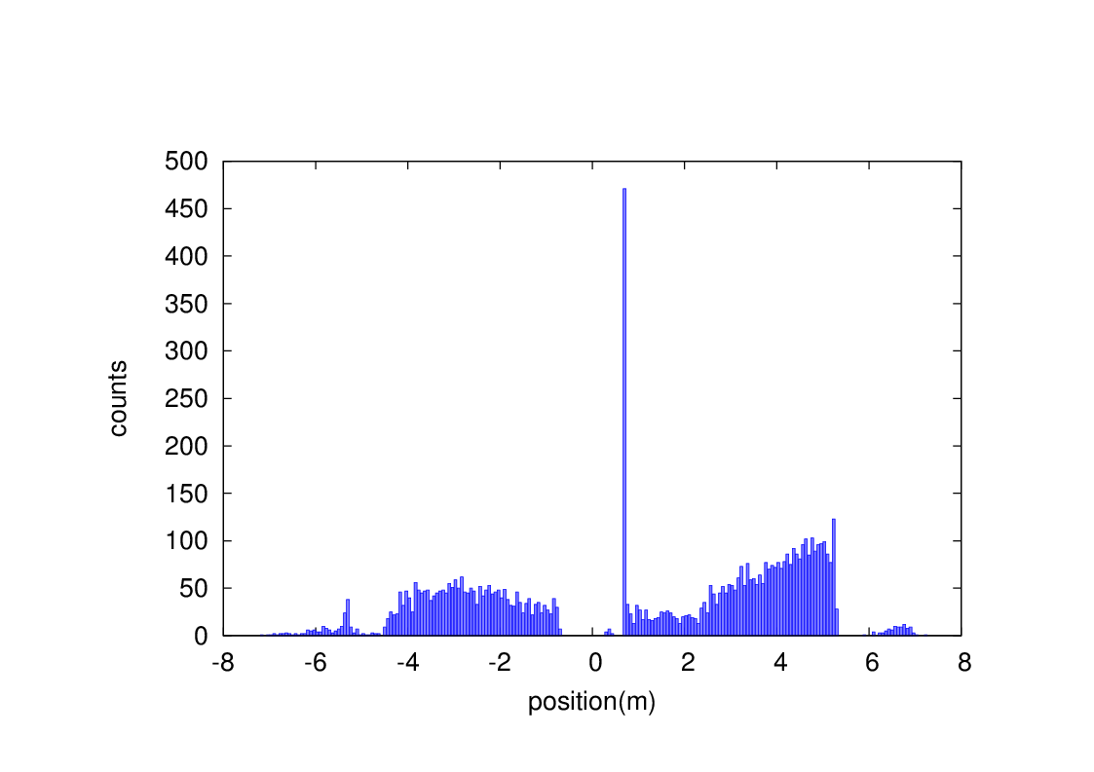
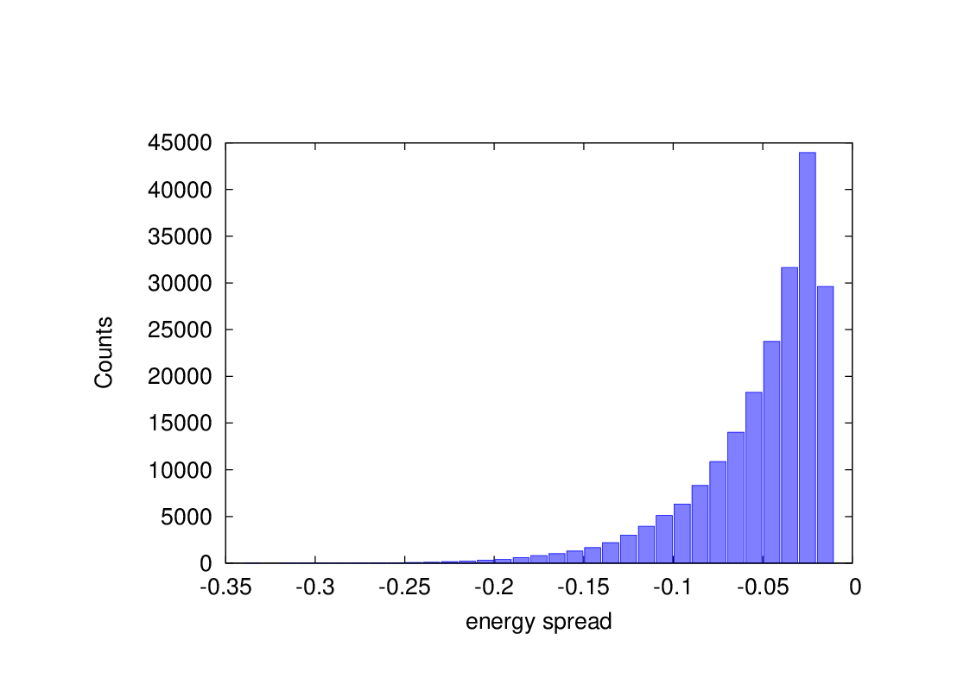
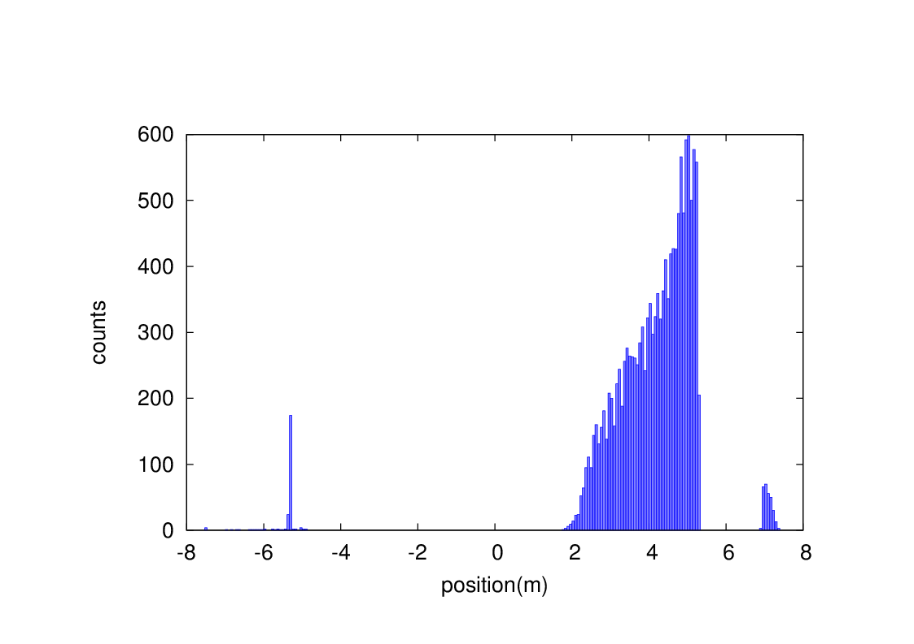
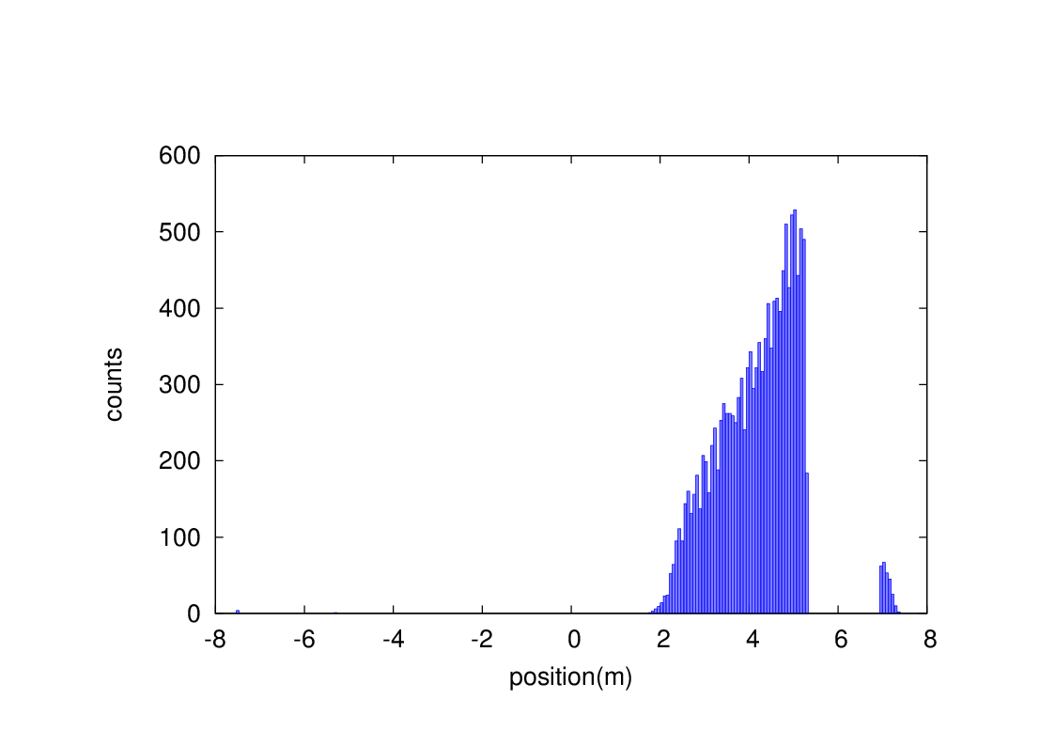
Beam loss from Beam-gas bremsstrahlung and Beam thermal photon scattering
events
Without collimator
With collimator
BG
events
Without collimator
With collimator
BTH

Slide 10
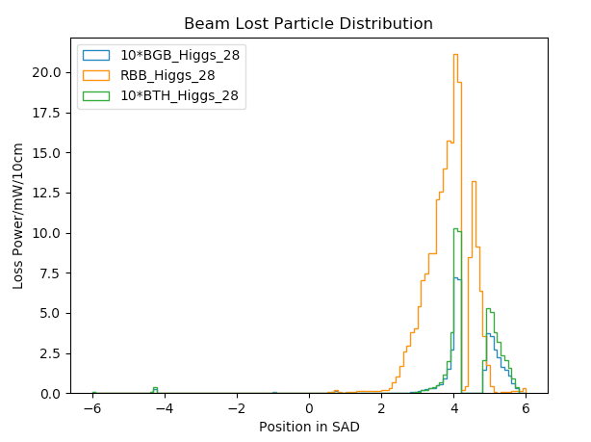
Radiation background
Including Radiative Bhabha, Beam-Gas, Beam Thermal Photon. Almost No Beamstrahlung.
Normalized to loss power in mW(one beam).
Higgs mode in CDR.
Higgs Backgrounds on 1st layer of Vertex.
With a safety factor of 10.
Background type | Hit Density($cm^{−2}⋅BX^{−1}$) | TID($krad⋅yr^{−1}$) | 1 MeV equivalent neutron fluence ($n_{eq}⋅cm^{−2}⋅yr^{−1}$)
Pair production | 1.91 | 526.11 | $1.05×{10}^{12}$
Synchrotron Radiation | 0.026 | 15.65
Radiative Bhabha | 0.34 | 592.66 | $1.44×{10}^{12}$
Beam Gas | 0.9607 | 1235.9 | $$3.37×{10}^{12}$$
Beam Thermal Photon | 0.02 | 22.31 | $6.20×{10}^{10}$
Total | 3.2567 | 2392.63 | $$5.922×{10}^{12}$$

Slide 11
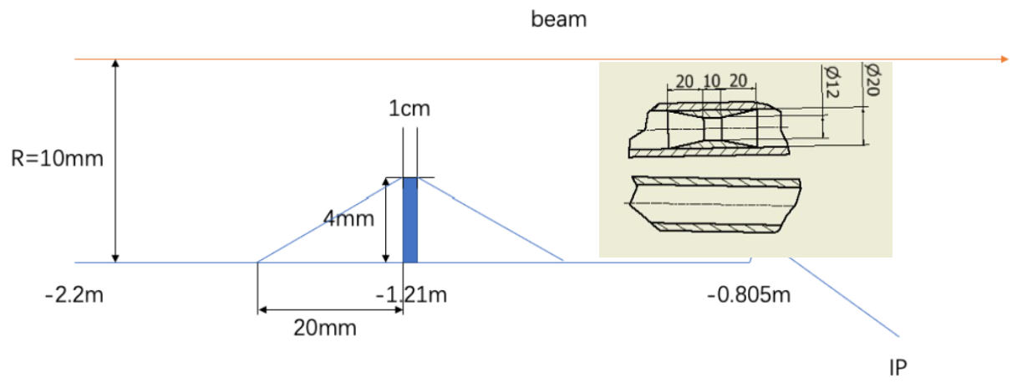
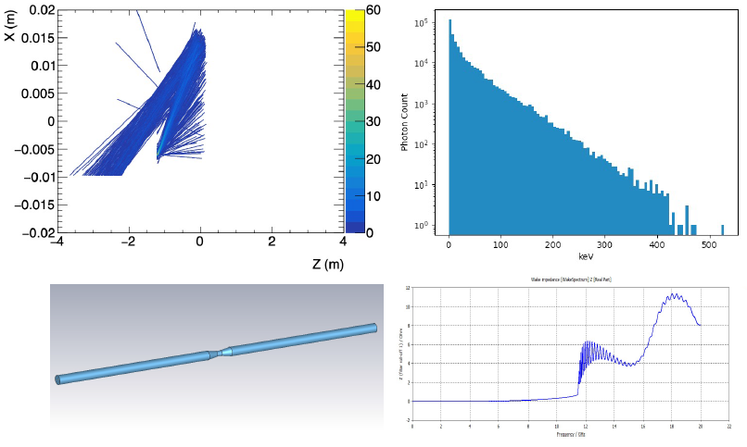
SR mask
New mask design:
Tungsten
4mm height
10mm long
Locates at -1.21m
Original mask at ~-4.2m with 0.6mm height
Lots of photons are secondaries, generated within QD0
Photons reduced by an order of magnitude
~300 photons/BX could hit Be, with a.e. ~100keV
~1.44x10⁻⁸ W on Be beampipe
Mask length(mm) | Loss factor Trap by mask(V/pc) | Higgs(w) | W(w) | Z(w) | High lumi Z(w)
50 | 0.1997 | 0.063 | 0.238 | 0.984 | 2.964

Slide 12
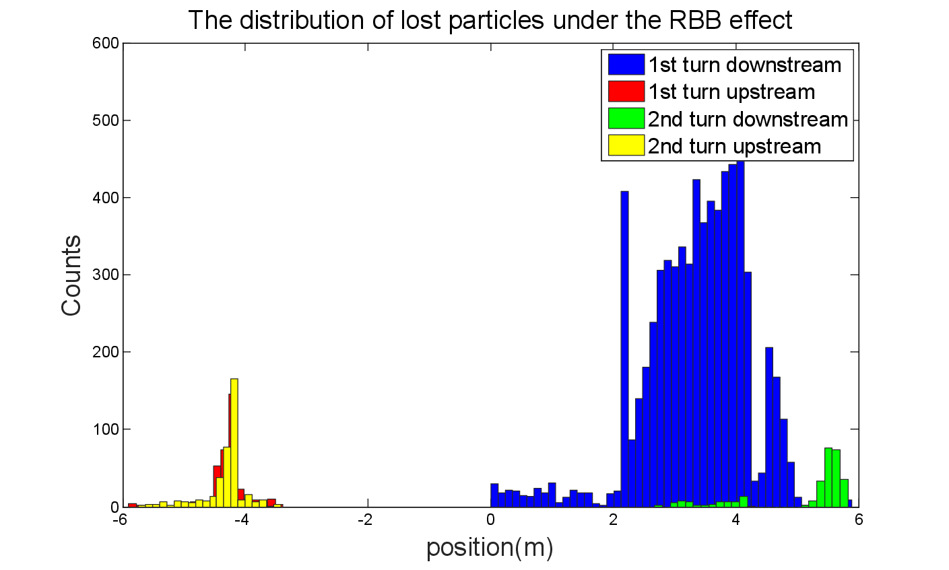
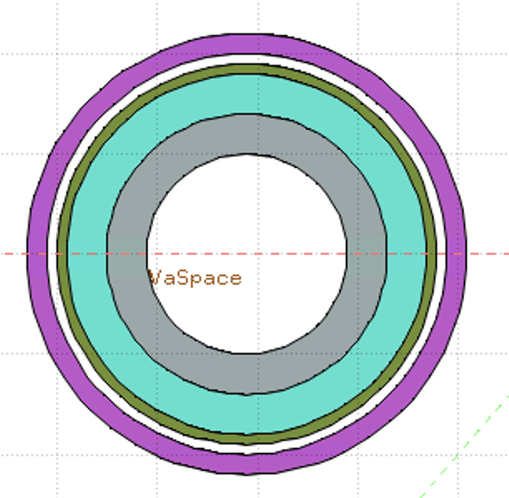
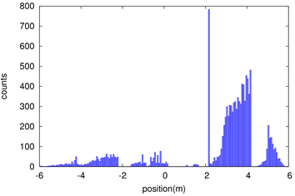
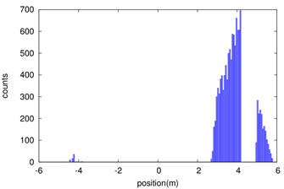
Shielding
Beam loss in the downstream IR with a large amount, due to the process of radiative bhabha scattering, beamstrahlung, beam-gas scattering, beam thermal photon scattering.
Radiation dose may damage the SC magnet coil and the detector.
solution
1. Tungsten IR beam pipe,
2. Combined iron and tungsten yoke of SC magnet
Key Issues on Calculation and Simplification of Beam pipe model
Pure tungsten IR beam pipe with 3mm thickness without cooling taken into account, simulate the Absorbed Dose on Coil (Region)
Only Beam-Gas beam loss is taken into account until now
Take the loss rate calculated by SAD into account:
~0.00166 Gy/s(0.166rad/s)
~14.35 Gy/day
~36662.49 Gy/lifetime(Higgs plans to run 7 years)
Limit is 100000 Gy/lifetime
White: Vacuum
Gray: Tungsten Pipe
Light Green: Helium
Heavy Green: Stainless Steel Vassel
Pink: Coil

Slide 13
Heat load in IR from beam loss
Region | SR heat load from RBB | SR heat load from BS | SR heat load from BG | SR heat load from BTH
Berryllium pipe | 6.7mW | 0 | 0 | 0
Detector beam pipe | 0.024W | 0 | 4.8uW | 1.2uW
Accelerator beam pipe before QDa | 0.17W | 0 | 4.2uW | 1.2uW
QDa~QDb | 2.13W | 3.8uW | 5.9uW | 1.8uW
QDb~QF1 | 0.01W | 3.8uW | 0.5uW | 0.6uW
QF1 | 0.26mW | 0 | 3.7uW | 0.66uW
Heat load in IR from beam loss background is so small, compared to synchrotron radiation and HOM.

Slide 14
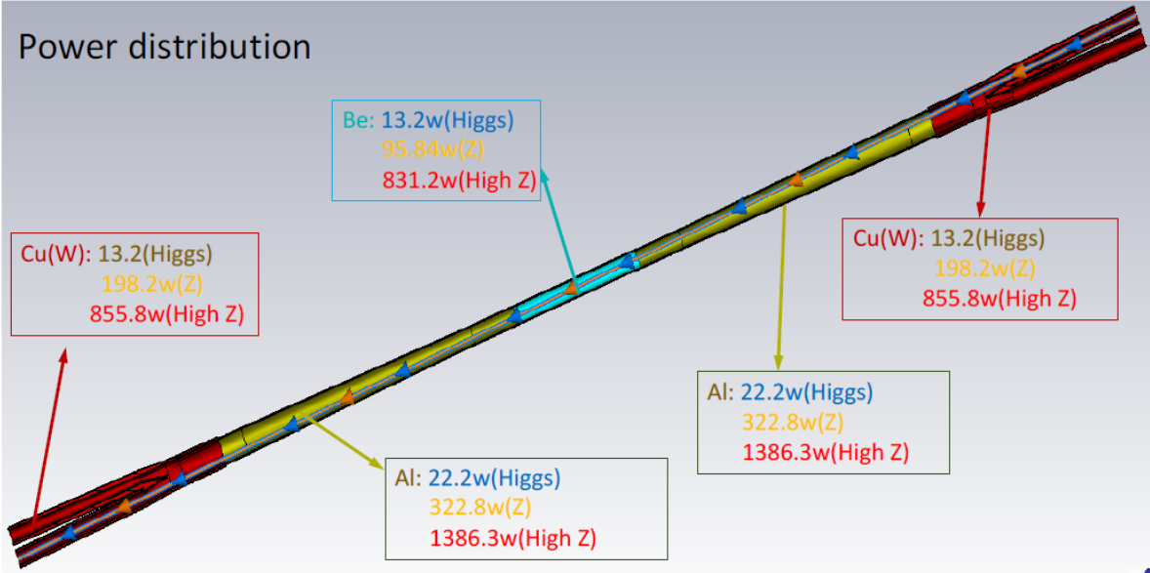
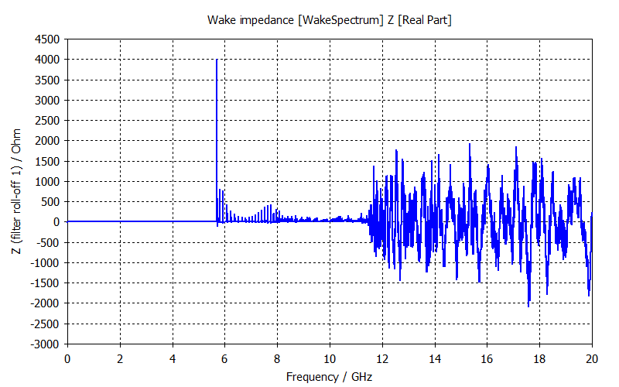
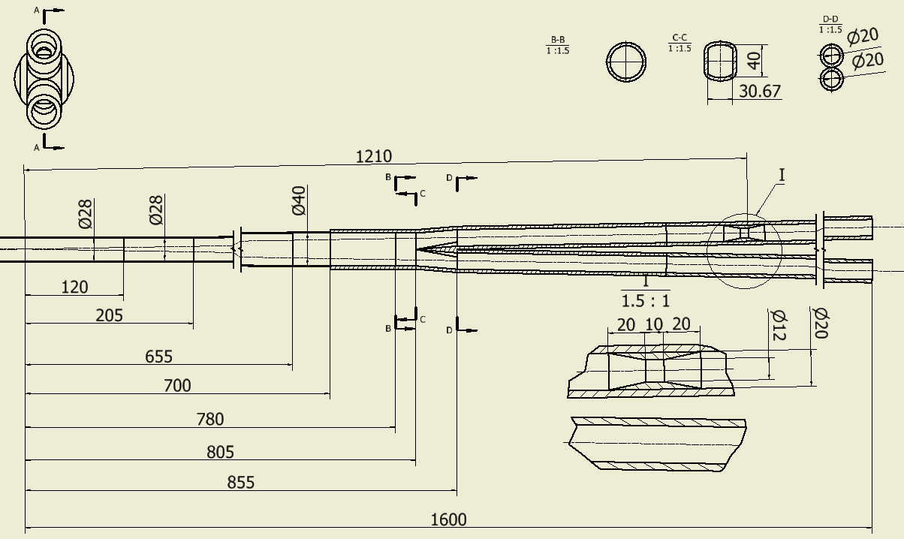
HOM power distribution
Cut off Frequency of SCQ Pipe(φ20mm): 11.474GHz
Cut off Frequency of photon masker(φ12mm): 19.123GHz
Cut off Frequency of Be pipe (φ28mm): 8.1957GHz
σ_{z}=5mm: Two beam in the IR
Loss factor Trap by masker @k_trap: 0.1997v/pc
P_{trap}: H/W/Z/Z(High Lum): 175w/657w/2.71kw/8.17kw
Position | Length(mm) | Higgs(w) | W (w) | Z(w) | High Luminosity Z(w)
Be pipe (w) | 120 | 6.28 | 23.51 | 97.12 | 292.52
Al: Be pipe transition(w) | 85 | 4.45 | 16.65 | 68.79 | 207.20
Al: Transition pipe (w) | 495 | 44.05 | 164.71 | 680.25 | 2048.9
Cu: Y-shape crotch (w) | 155 | 13.79 | 51.57 | 213 | 641.58
Al: Y crtothch to masker | 325 | 19.25 | 72.01 | 297.40 | 895.77
Cu：masker(w) | 50 | 0.063 | 0.238 | 0.984 | 2.964
Al: maser to pipe end | 370 | 0.47 | 1.76 | 7.28 | 21.93
Total | 1600 | 88.353 | 330.448 | 1364.824 | 4110.864

Slide 15
Beam pipe structure
Berryllium (central) and Aluminum(forward) beam pipes
From IP(mm) | Shape | Inner diameter(mm) | Material | Inner surface area(mm²) | Marker
0-120 | Circular | 28 | Be | 10556
120~205 | Circular | 28 | Al | 7477
205~655 | Cone | 28~40 | Al | 48071 | Taper: 1.75
655~700 | Circular | 40 | Al | 5655

Slide 16
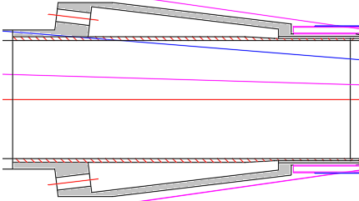
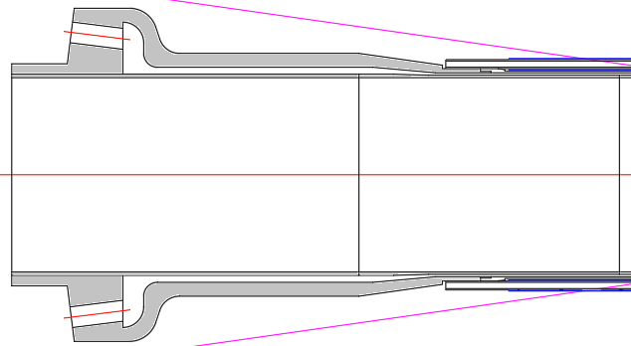
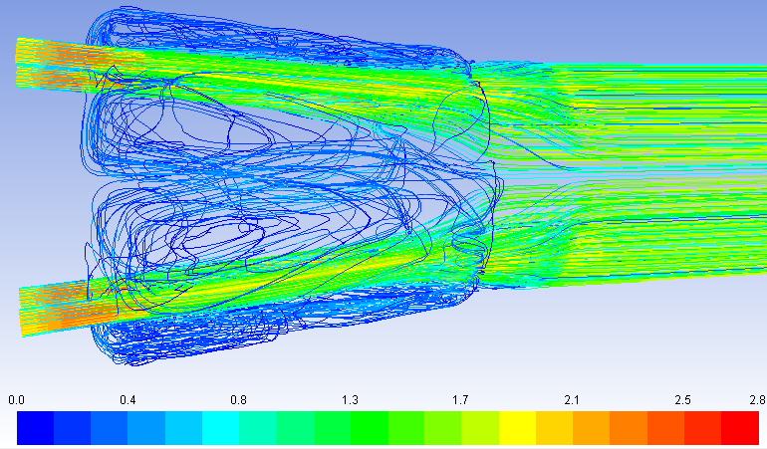
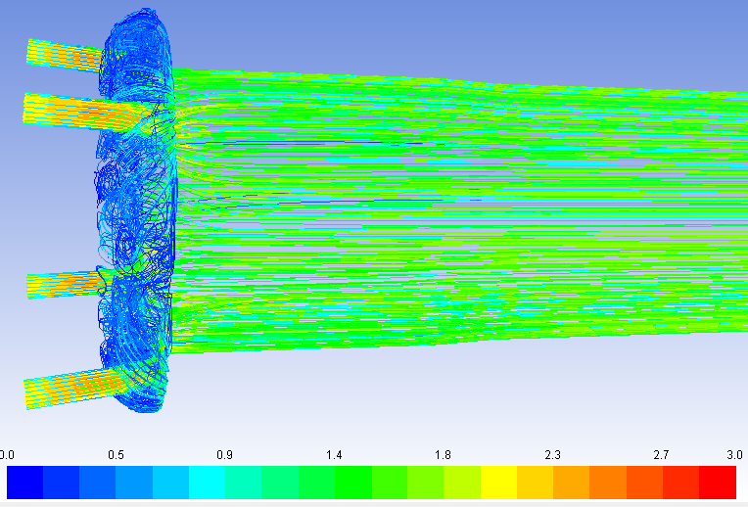
Optimization of central beampipe
Cone structure
Ladder structure
Optimization of
enlarged cooling channel
Old
New
Simulation analysis shows:
Under the ladder structure, the vortex
is smaller and fewer, and the flow field
is more stable.
Structural comparison design drawing
Conclusion:
The improved ladder structure will greatly
reduce the vibration of the beam pipe
caused by unsteady flow
Old
New
Streamline comparison chart

Slide 17
Beam pipe thermal analysis I (CDR Z)
Al(Coolant: H₂O)
Be(Coolant: paraffin)
Al(Coolant: H₂O )
Be pipe parameters:
length: 240 mm
Inner Be THK: 0.5 mm
Outer Be THK: 0.35 mm
Gap: o.5 mm
outlet
0
outlet
inlet
inlet
Inlet of Be pipe:
TEMP: 23℃
Velocity: 1.3 m/s
Coolant: paraffin
Inlet of Al pipe:
TEMP: 23℃
Velocity: 1.0 m/s
Coolant: H₂O
Calculation model:
laminar
Result:
TEMP rise of Be pipe : 3.2 ℃ (between the inlet and the outlet)
TEMP rise of transition: 13.3 ℃
TEMP rise of Al pipe : 6.3 ℃
Pressure drop of Be pipe : 19.8 kPa
Pressure drop of Al pipe : 19.3 kPa
Maximum TEMP of outer surface of Al pipe: 29.3℃
Conclusion:
Temperature rise and pressure drop are in a safe range.
Maximum TEMP of outer surface of Be pipe: 26.2 ℃
Maximum TEMP of transition: 36.3℃
Temperature distribution Cloud

Slide 18
Beam pipe thermal analysis II (High Lumi Z)
Al(Coolant: H₂O)
Be(Coolant: paraffin)
Al(Coolant: H₂O )
Be pipe parameters:
length: 240 mm
Inner Be THK: 0.5 mm
Outer Be THK: 0.35 mm
Gap: o.5 mm
outlet
outlet
inlet
inlet
Inlet of Be pipe:
TEMP: 23℃
Velocity: 2.0m/s
Coolant: paraffin
Inlet of Al pipe:
TEMP: 23℃
Velocity: 1.5 m/s
Coolant: H₂O
Calculation model:
laminar
Result:
TEMP rise of Be pipe : 6.2 ℃(between the inlet and the outlet)
TEMP rise of transition: 33.6 ℃
TEMP rise of Al pipe : 18.3 ℃
Pressure drop of Be pipe : 31.9 kPa
Pressure drop of Al pipe : 37.7 kPa
Maximum TEMP of outer surface of Al pipe: 41.6℃
Conclusion:
Although the temperature rise and pressure drop have increased,
they are still in the safe range of mechanical properties, and there is
a possibility of optimization.
Maximum TEMP of outer surface of Be pipe: 29.2 ℃
Maximum TEMP of transition: 56.6℃
Temperature distribution Cloud

Slide 19
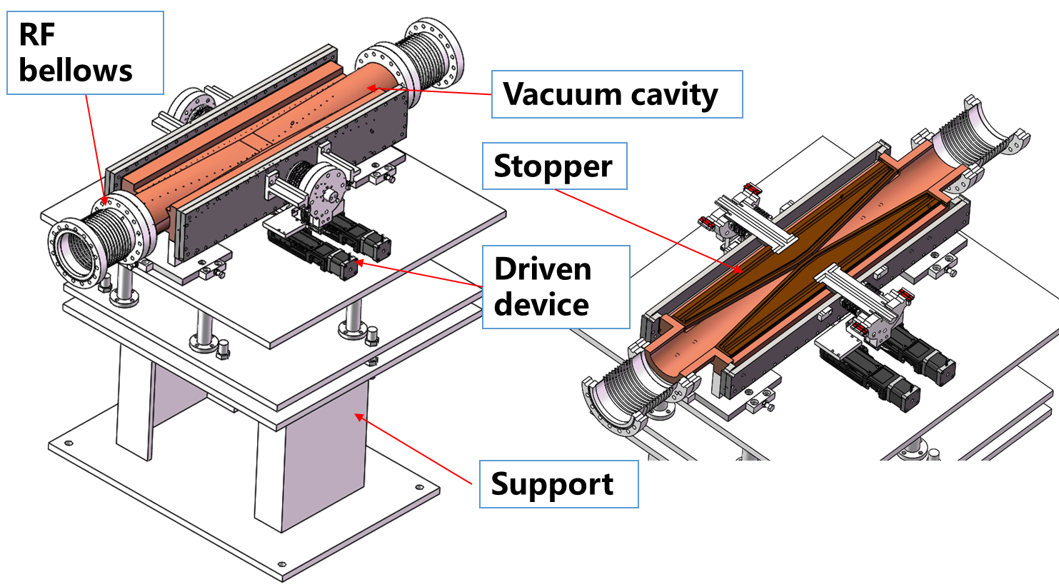
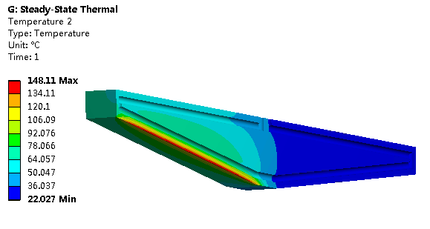
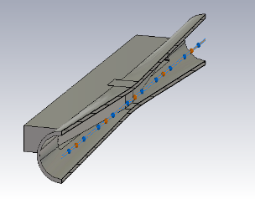
Movable collimators
Located in straight section between two dipoles, the length is 800 mm.
SR power: 7700W @120GeV, 30MW
Highest temperature: 148 ℃
Loss-Factor: 0.045V/pC
P_{loss}: 18.8w(Higgs)/76.1w(W)/265.8w(Z)

Slide 20
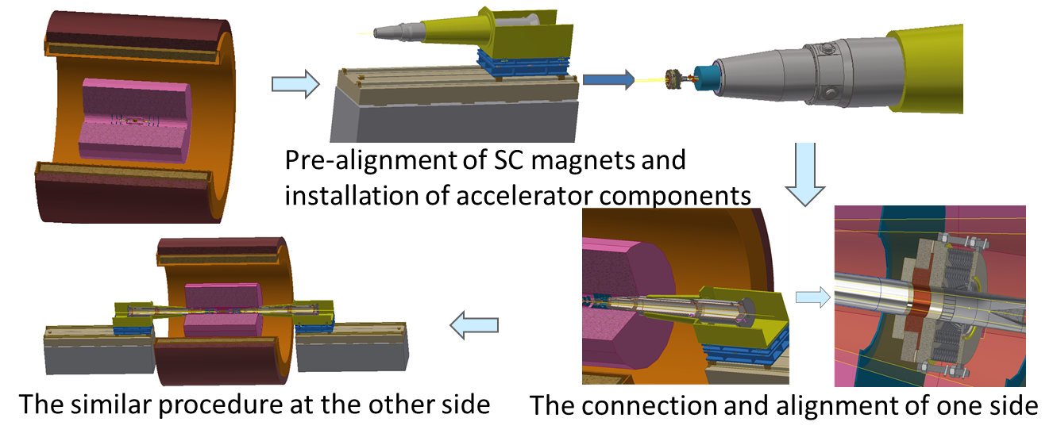
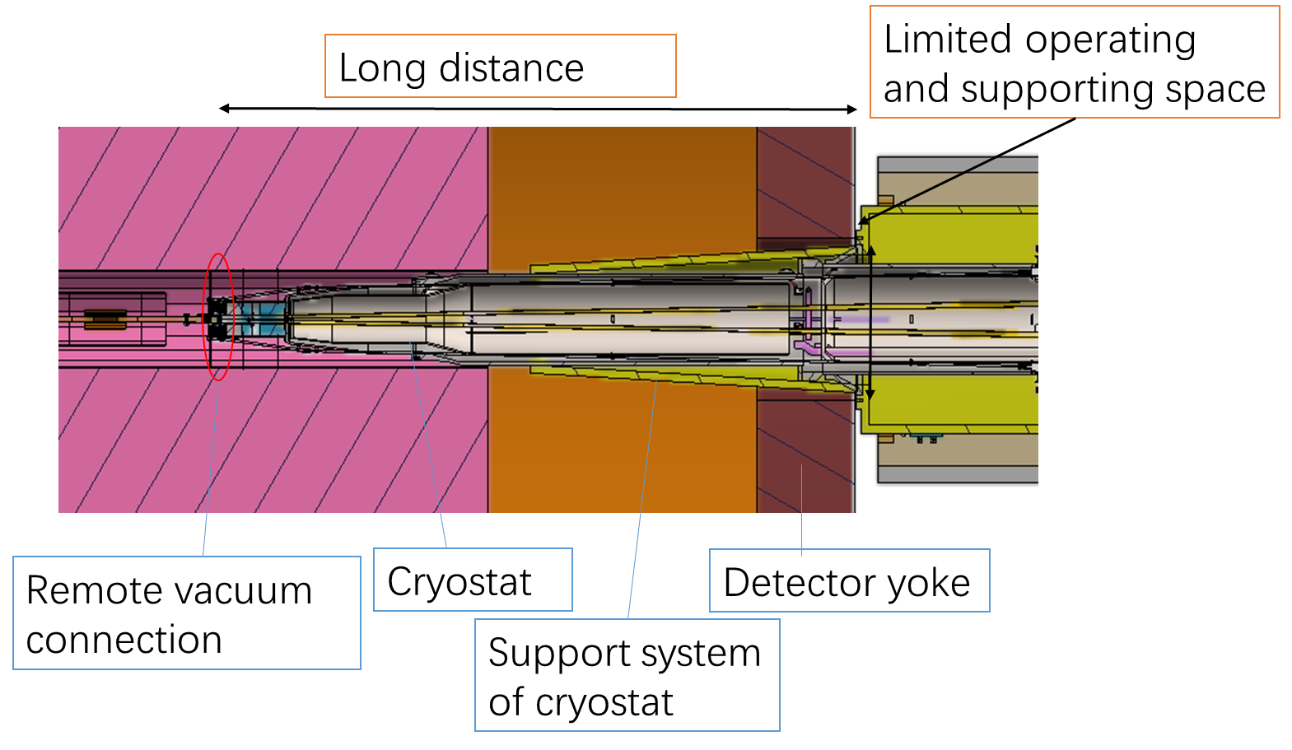
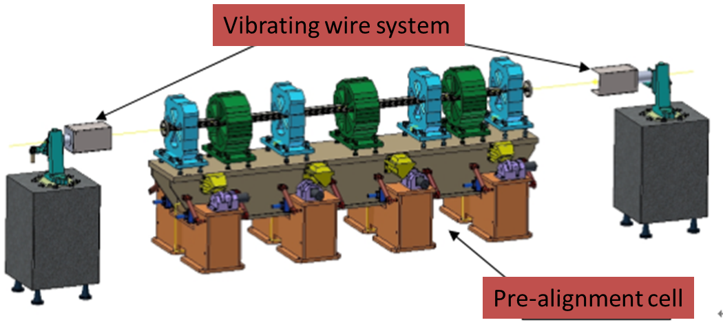
MDI integration and alignment
Alignment scenario:
Pre-align the SC magnets using vibrating wire system to “certain location” to compensate the effect of loads.
Align the SC magnets in two cryostats using optical system.
Measure misalignment using SSW and adjust by corrector magnets meet the alignment requirements.
VWS is a candidate pre-alignment method, accuracy of magnet centers: ≤10 μm

Slide 21
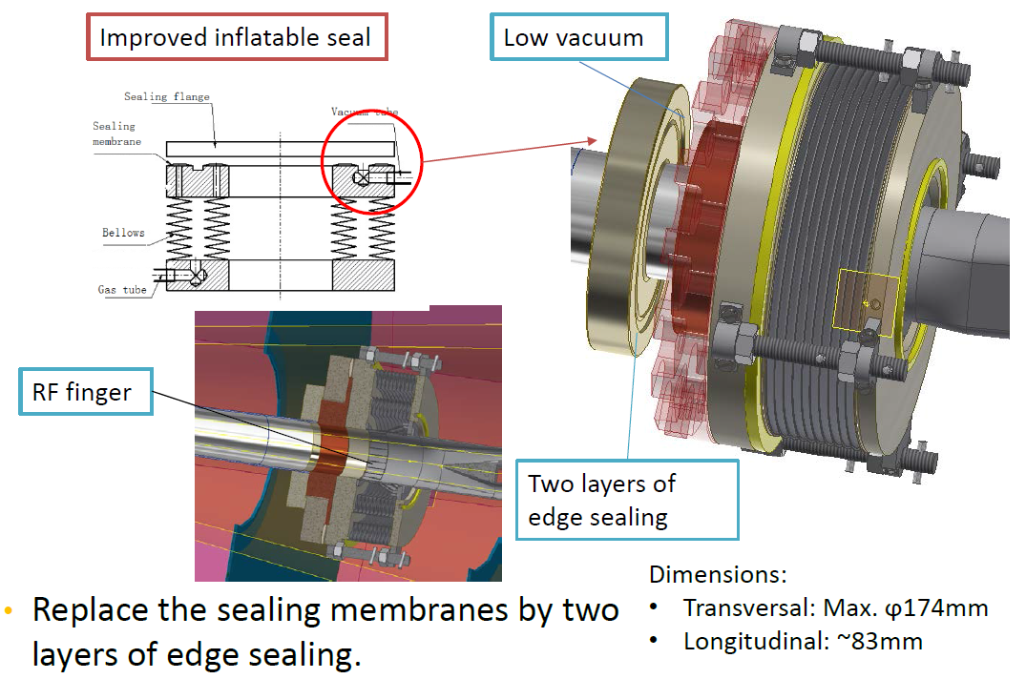
Remote vacuum connector
Difficulties:
Transversal space: All the structure should be within detection angle.
Leak rate requirement: Ultra-high vacuum. Leak rate requirement: ≤2.7e-11Pa.m³/s
Longitudinal space: Bellows should absorb deformation when baking. →Add Z-direction support, length has been decreased to 83mm.
Minimize thermal loads: The thermal loads mainly includes SR power and HOM power.→ Avoid SR power by layout design, and decrease HOM power by RF finger.
Cooling: It is hard to dissipate the heat at RF finger which is thin, low thermal conductivity and far from the coolant.→ FEA

Slide 22
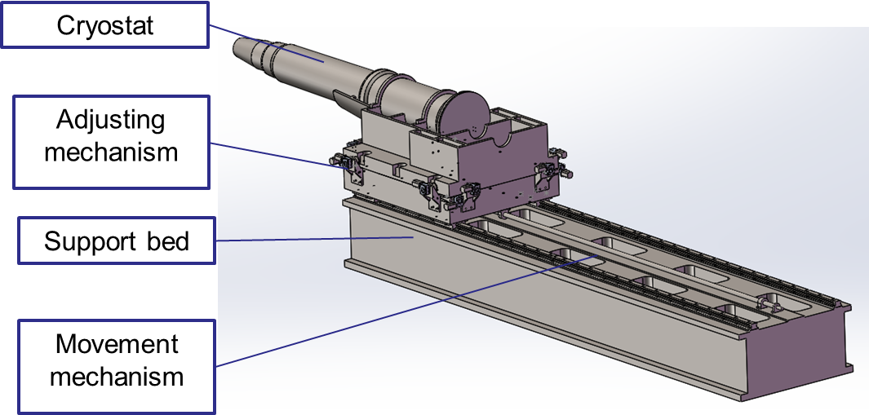
SC magnet supports
Cantilever length was 3.6 m, based on the yoke length of 9.2 m.
The cryostat was 5 meters long with18 mm thick stainless wall. The maximum deformation was 190 um.
Only the cryostat vacuum vessel weighting 2 tons was considered.
Key points
Stability (static and modal)
Accuracy
Easy-operating
Dimensions
conflict
High stiffness for stability Flexibility for high accuracy.
Studies on support stiffness is on-going.
Motor driven wedges jacks for high stiffness and accuracy.
Auxiliary support, high damping material/structure are also in consideration

Slide 23
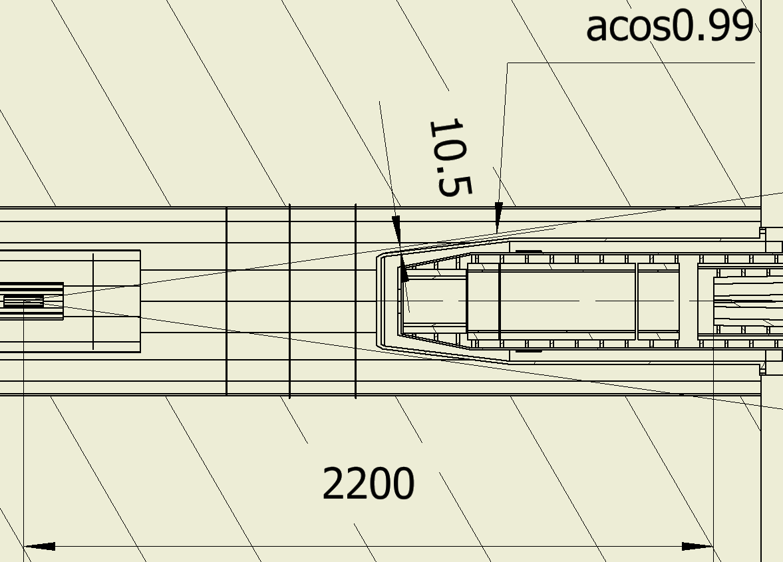
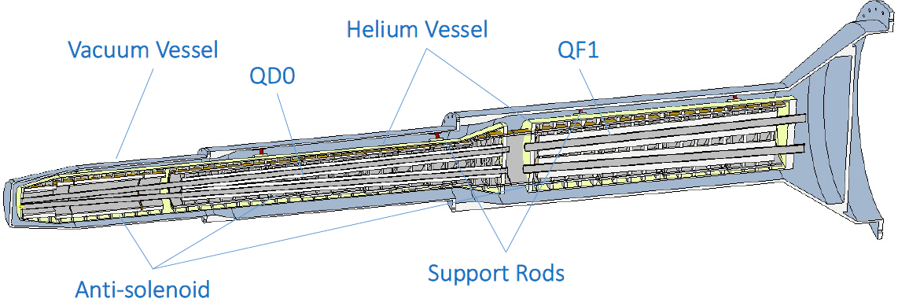
Structure optimization within cryostat
The model has been upgraded.
Total length: 5486 mm. Position along Z direction: 1125mm~6611mm.
Min. distance to acos0.99 angle: 10.5 mm
The tungsten shielding is not been considered yet.
IP

Slide 24
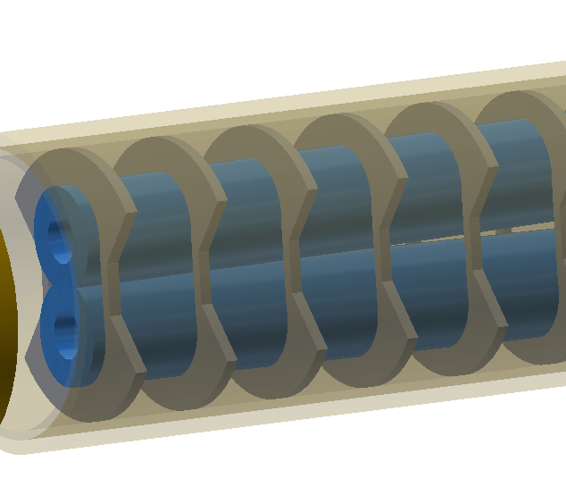
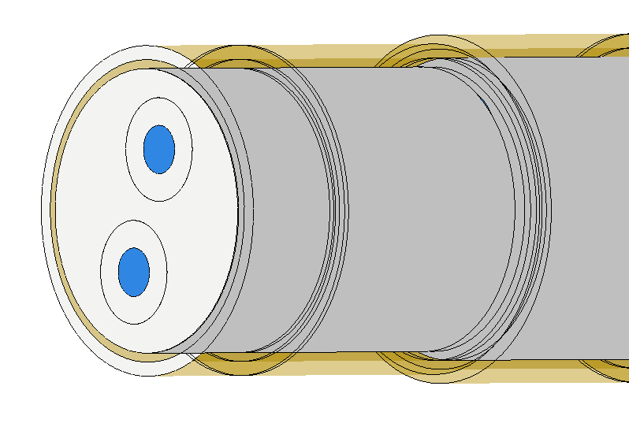
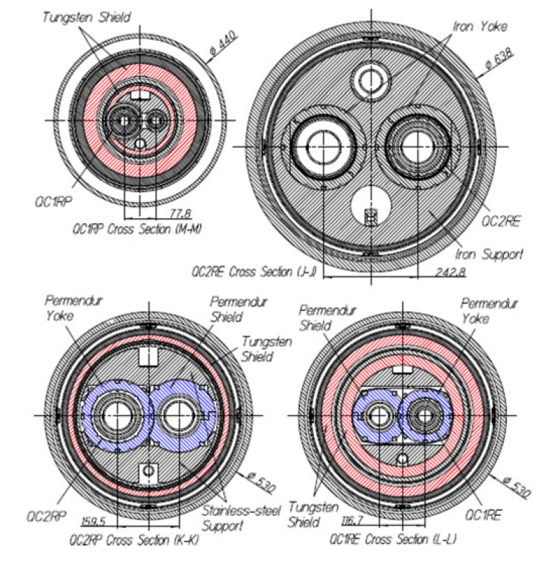
Structure optimization within cryostat
Cooling shields are neglected in the analyses.
The magnets are supported to the helium vessels.
Two kinds of magnet supports are considered.
Solid support similar to SKEKB.
Skeleton support to minimize weight.
The position accuracy of SC magnets is 100 um. If the uneven deformation is less than 20 um, it has no big effect on other requirement.
The solid support of QD0/QF1 has the minimized uneven deformation.
There should be a skeleton support with less weight and comparable stiffness, saving some space for shielding structure.
Iron support of SKEKB
Sketch of solid support
Sketch of skeleton support

Slide 25
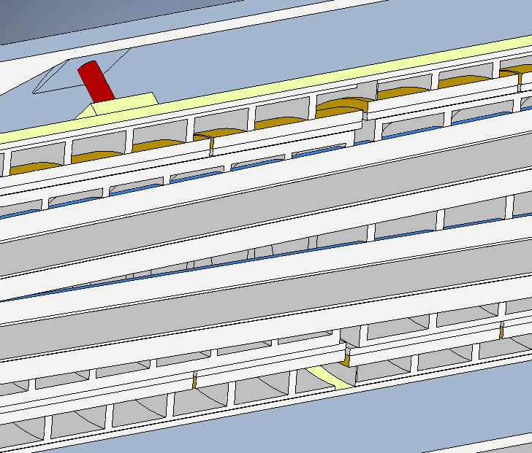
Static and stability of cryostat
Effect of magnet supports
Add outer ring to enhance stiffness
Add inner ring to enhance stiffness (equals to enlarge outer diameter of QD0/QF1)
Outer ring
S-o support: skeleton support with outer ring
Add an outer ring decrease the uneven deformation largely.
Magnet support | uneven deformation in QD0 (um) |  | uneven deformation in QF1 (um) |  | Total weight (kg) | Frequency of 1st mode (Hz)
 | Vertical | Horizontal | Vertical | Horizontal
Skeleton | 44 | 5 | 0.6 | 0.2 | 3244 | 12.7
Solid | 7.3 | 0.6 | 0.3 | 0.2 | 5041 | 11.3
S-o support | 27 | 1.6 | 0.7 | 0.5 | 3477 | 13.7

Slide 26
Summary
Preliminary physics design of MDI in High Luminosity Higgs.
Single layer beam pipe with water cooling, SR heat load is not a problem.
Hit density on first layer of vertex detector is low from radiation background.
New mask is designed and photons hitting Be reduced by an order of magnitude.
Preliminary design of shielding
Highest temperature on collimators from SR and HOM is 148 ℃
HOM heat load updated with revised beam pipe shape.
Central beampipe with cooling structures optimized; FEA thermal analysis to verify the design.
MDI alignment system is preliminary considered and designed.
Sealing of remote vacuum connector is optimized.
Structure optimization within cryostat and stability is analyzed.

Slide 27
Thanks

