Slide 1
The Scintillating Glass AHCAL Simulation
Yukun Shi
USTC

Slide 2
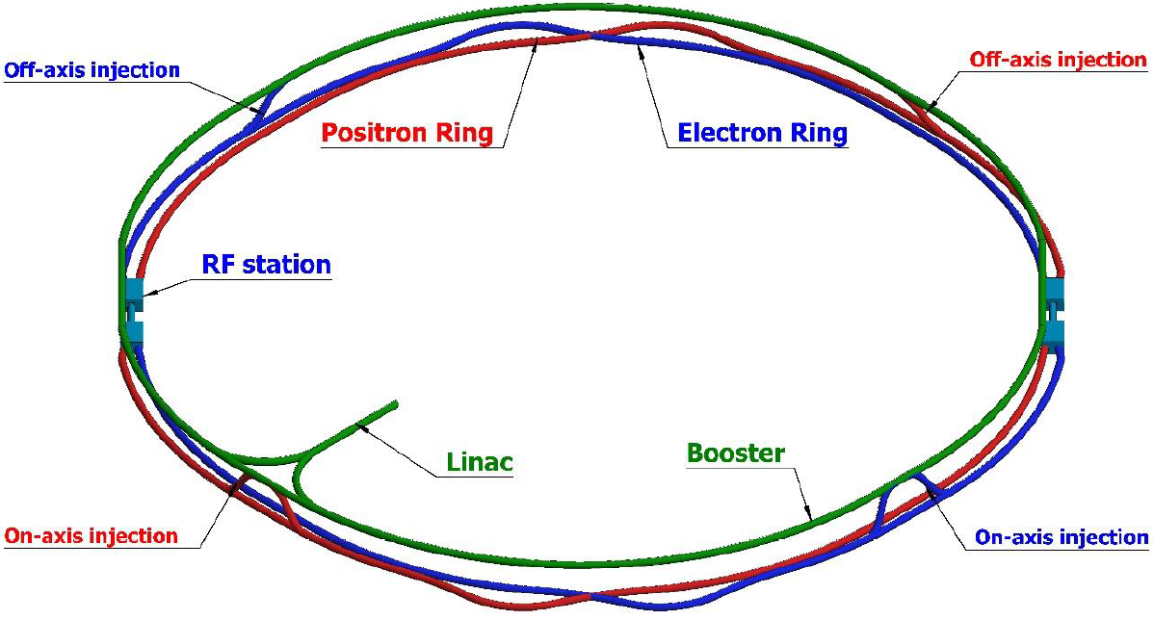
Background and motivation
Circular electron positron collider
  The CEPC is designed as the Higgs factory
  The baseline detector option for the CEPC is guided by the particle flow algorithm(PFA)
Design of the CEPC Accelerator
CEPC baseline detector

Slide 3
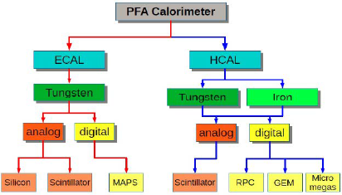
Background and motivation
The high granularity AHCAL composed of millions channels plays an important role in the PFA reconstruction
The scintillating glass has large density comparing to the plastic scintillator, thus it can improve the AHCAL resolution
Scintillating Glass
HCAL resolution is the 2nd largest factor contributing to the BMR(Yuexin Wang)

Slide 4
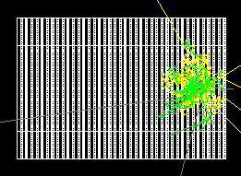
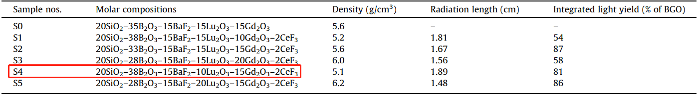
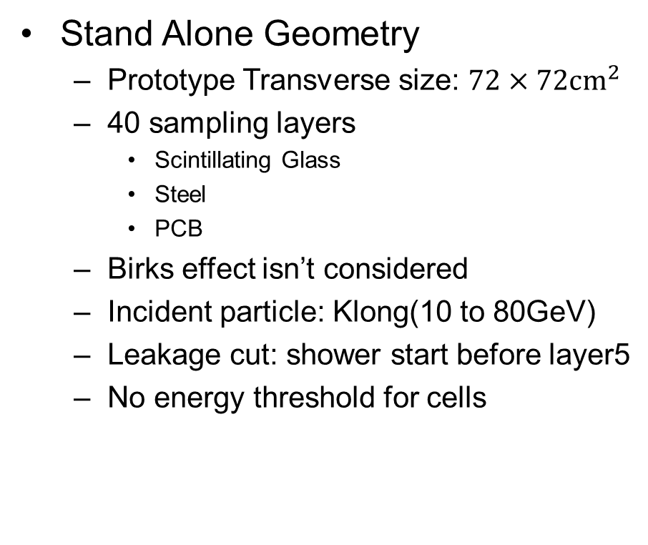
Simulation Setup
Stand Alone Geometry
  Prototype Transverse size: $72×72{cm}^{2}$
  40 sampling layers
    Scintillating Glass
    Steel
    PCB
  Birks effect isn’t considered
  Incident particle: Klong(10 to 80GeV)
  Leakage cut: shower start before layer5
  No energy threshold for cells
Event display: 1 GeV KL
Single KLong event
Wang, Qian, et al. "High light yield Ce3+-doped dense scintillating glasses." Journal of alloys and compounds 581 (2013): 801-804.

Slide 5
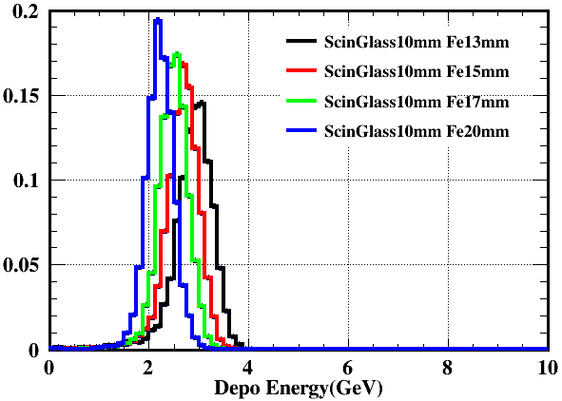
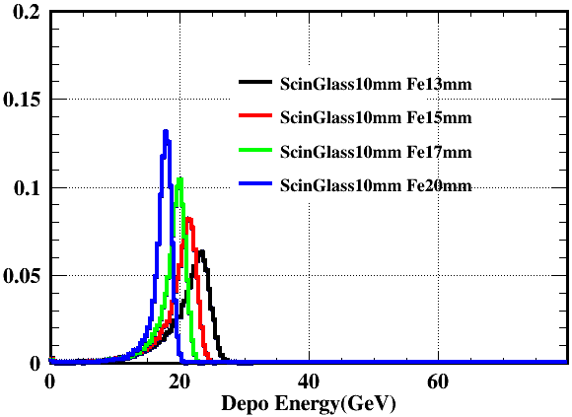
Simulation
Energy deposition
  Sampling ratio is around 30% while plastic scintillator AHCAL is 2%
Energy deposition: 10 and 80 GeV KL

Slide 6
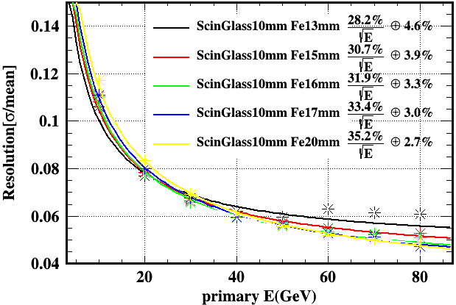
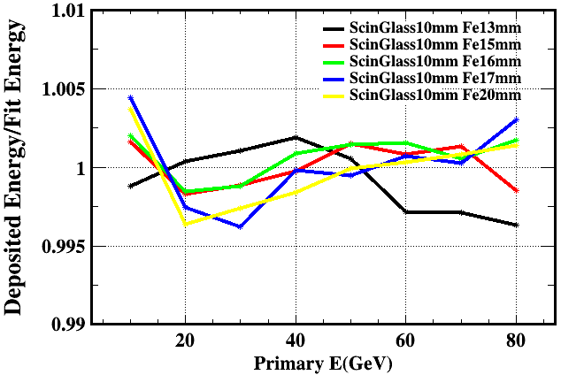
Simulation
Different Steel thickness
  Lineaity are all within $±1\%$
  Resolution has a statistical term around 30%
Energy resolution and linearity: different Steel thickness

Slide 7
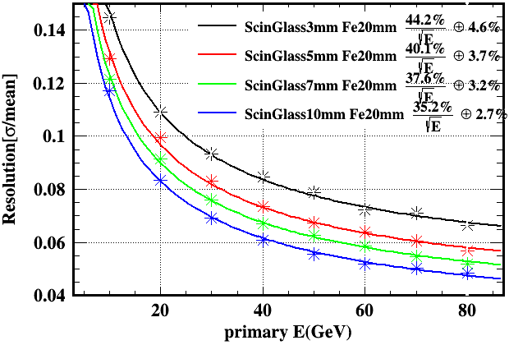
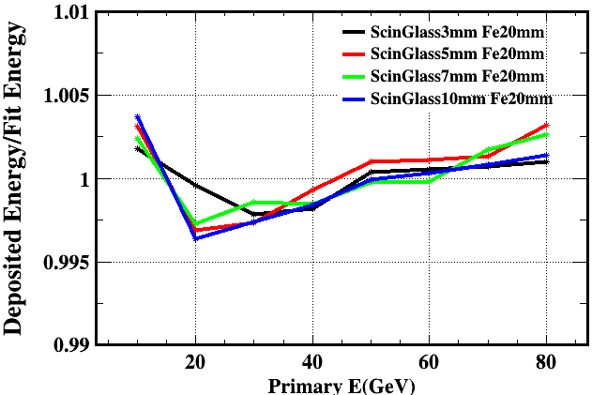

Simulation
Different glass thickness
  Lineaity are all within $±1\%$
  The statistical term for resolution changes obviously

Slide 8
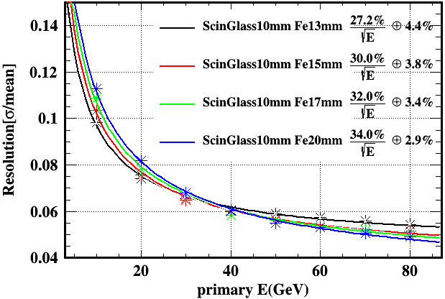
Scintillating Glass 5
Scintillating Glass 5 has the largest density
Differences are not obvious
scintillating glass 4
scintillating glass 5

Slide 9
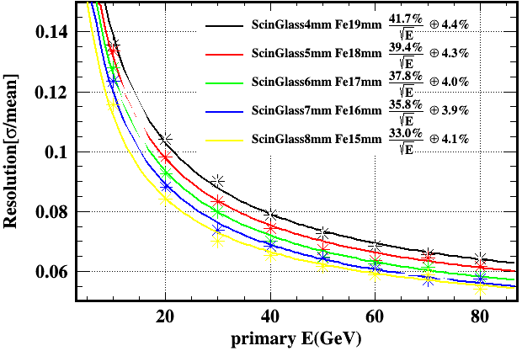
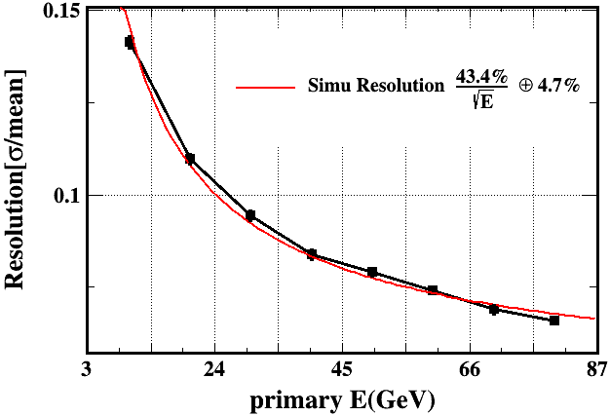
comparison
Total thickness fixed as 23mm(sensitive material+absorber)
Scintillator glass have advantage on the statistical fluctuation
scintillating glass AHCAL
Plastic scintillator AHCAL

Slide 10
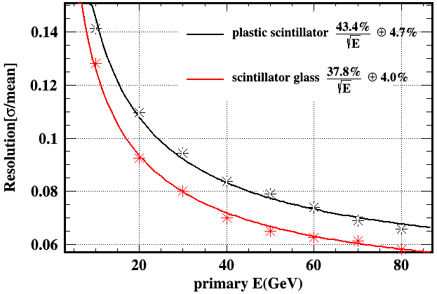
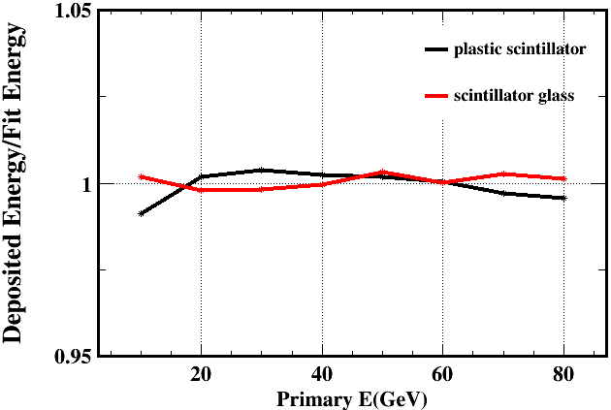
Plastic and glass
6mm glass + 17mm Fe VS 3mm plastic + 20mm Fe
The scintillating glass configuration is obviously better
It should be mentioned that the scintillating glass configuration hasn’t considered the birks effect and any thresholds
Resolution
Linearity

Slide 11
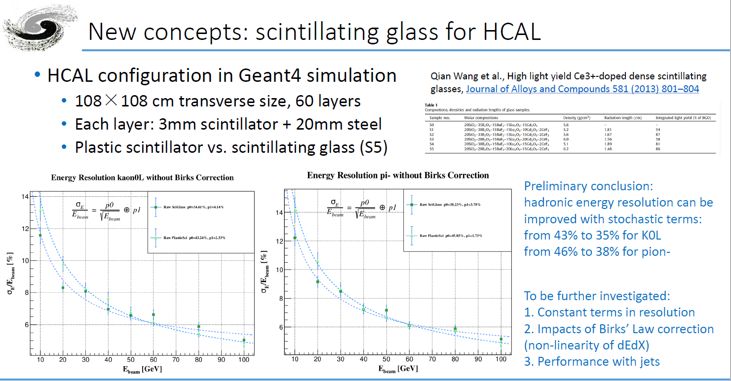
Results from Yong Liu

Slide 12
Summary and outlook
The scintillating glass ACHAL has better resolution
More simulation based on CEPC environment will be done to see the benefit on physics benchmarks

Slide 13
backup

Slide 14
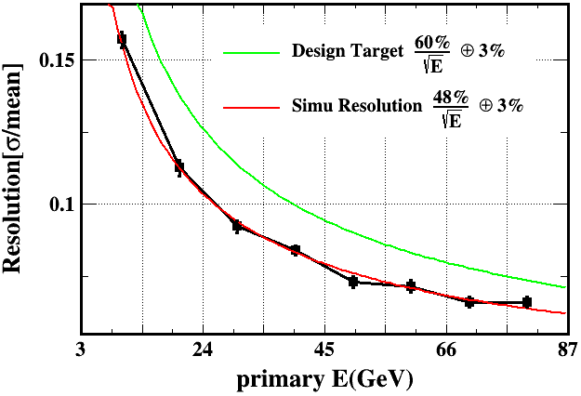
comparison
The scintillating glass has advantage on statistical term
The scintillating glass’s constant term is not good especially the Birks effect is not considered for the scintillating glass
scintillating glass AHCAL
Plastic scintillator AHCAL

Slide 15
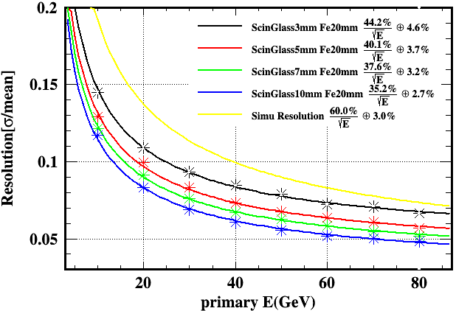
comparison
The 3mm scintillating glass seems similar to plastic scintillator
Thicker scintilling glass has better performance but increases the total calorimeter thickness
scintillating glass AHCAL
Plastic scintillator AHCAL

Slide 16
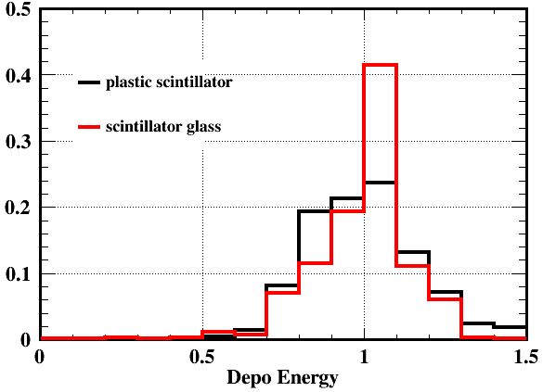
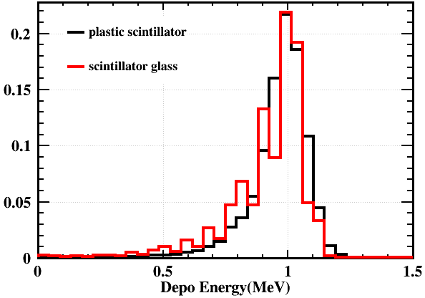
Plastic and glass
6mm glass + 17mm Fe VS 3mm plastic + 20mm Fe
Energy deposition is scaled
10 GeV KL
80 GeV KL

Slide 17
