Slide 1
Requirements on the CEPC SC sextupoles from accelerator physics
Yiwei Wang
for the CEPC Accelerator Physics Group
CEPC day, 21 May 2021

Slide 2
Outline
Distribution and strength of the SC sextupoles
Why the distribution and strength?
Summary

Slide 3
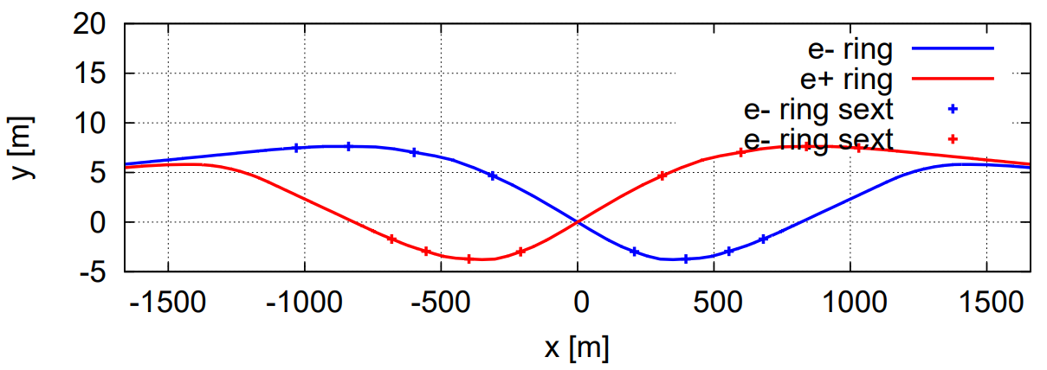
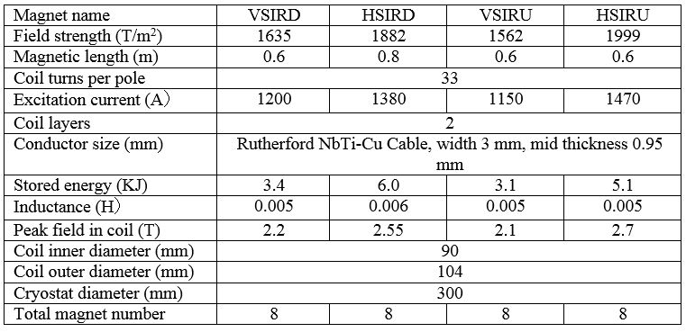
Distribution and strength of the SC sextupoles
HSIRU
HSIRU
VSIRU
VSIRU
IP
HSIRD
VSIRD
HSIRD
VSIRD
Design parameters of sextupole magnets at Higgs operation
Field strength factor for tt/W/Z: 1.5/0.67/0.38
by Y. Zhu

Slide 4
Why the strength?
If lower strength:
Longer sextupole => larger tune shift => larger aberration after correction => smaller energy acceptance => short beam lifetime
Larger dispersion => larger synchrotron radiation power => lower luminosity or higher power cost
Actually, the strength of the sextupoles have been reduced with factors of 2 or 2.7 due to magnet technology which will hurt the beam lifetime.
Name | Quant | Ape[mm] | Fmax[T/m | Fop(tt)[ | Fop(H)[T | Fop(W)[T | Fop(Z)[T | Leff[mm] | Rgf[mm] | Harm.er | Ftip[T] | TwinAper | DbRing
VSIRD | 8 |  | -4769.04 | -4769.04 | -3270.2 | -2180.13 | -1239.95 | 300 | 8.5079 | 3.00E-04 |  | N | Y
HSIRD | 8 |  | 7315.734 | 7315.734 | 5016.503 | 3344.335 | 1902.09 | 300 | 14.9474 | 3.00E-04 |  | N | Y
VSIRU | 8 |  | 4555.833 | 4555.833 | 3124 | 2082.666 | 1184.516 | 300 | 8.5079 | 3.00E-04 |  | N | Y
HSIRU | 8 |  | -5829.14 | -5829.14 | -3997.12 | -2664.75 | -1515.57 | 300 | 15.4117 | 3.00E-04 |  | N | Y
Design parameters of sextupole magnets at Higgs operation
Field strength factor for tt/W/Z: 1.5/0.67/0.38

Slide 5
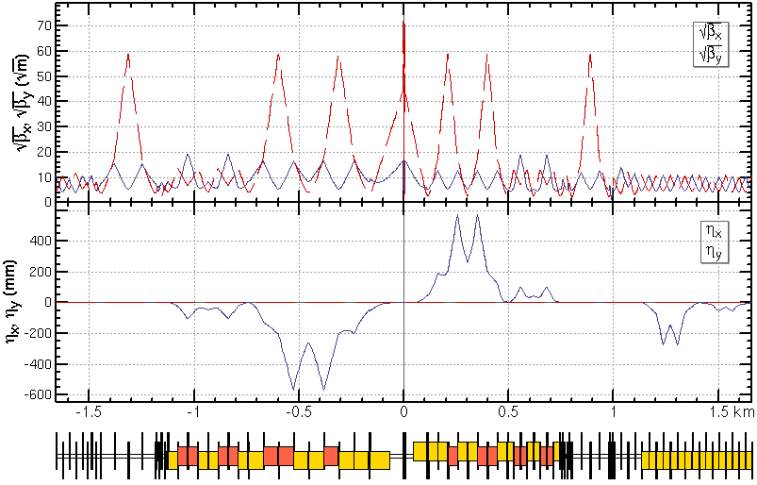
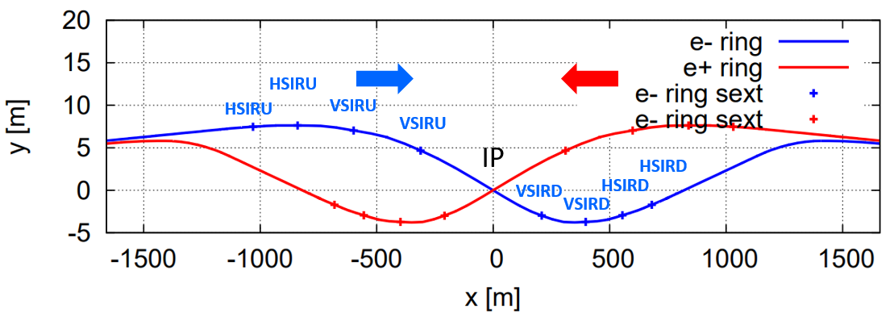
Why the distribution?
Background of the detector: compacter IR => compacter final telescope => shorter final bend => stronger synchrotron radiation to the detector
No bends in the last 70 m from upstream of IP. The SR critical energy is less than 45 keV within 150 m and 120 keV within 400 m.
no bends in the last 50 m from downstream of IP. The critical energy is less than 97 keV within 100 m and 300 keV within 250 m.
(-1km,+0.7km)

Slide 6
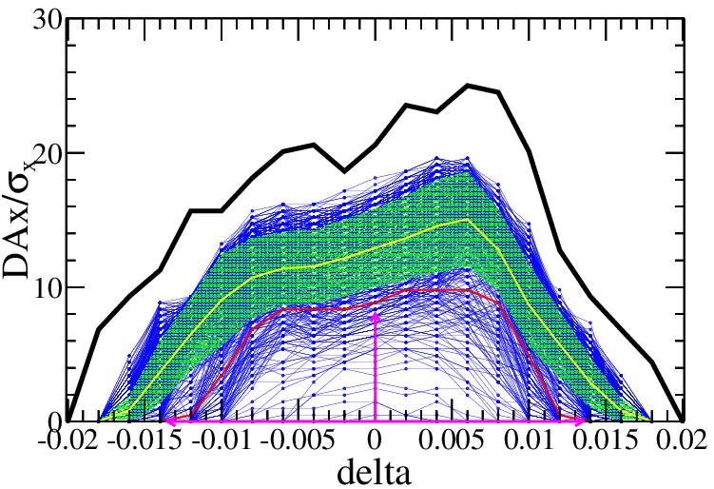
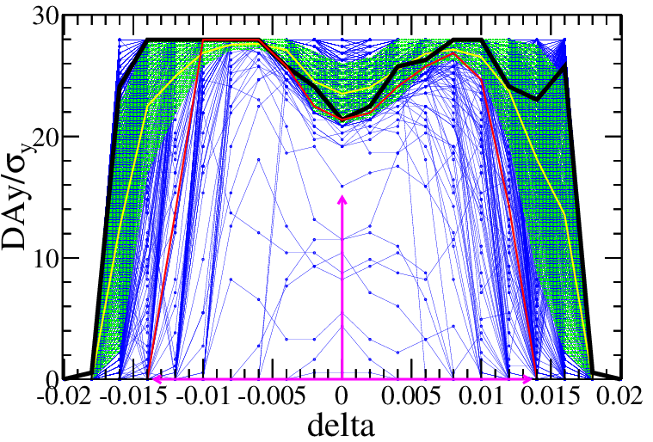
Why the distribution? (cont.)
Error tolerance: compacter IR => stronger magnets => more sensitive to errors => tighter requirement of magnet error and alignment
Component | Δx (mm) | Δy (mm) | Δθ_{z} (mrad) | Field error
Dipole | 0.10 | 0.10 | 0.1 | 0.01%
Arc Quadrupole | 0.10 | 0.10 | 0.1 | 0.02%
IR Quadrupole | 0.10 | 0.10 | 0.10
Sextupole | 0.10 | 0.10 | 0.1
by B. Wang, Y. Wei, Y. Wang
IR=100μm

Slide 7
Summary
The CEPC superconducting sextupoles locate at region of (-1.0km,+0.7km) around the interaction point with a pole-tip field up to 2.7 Tesla.
The strength of the sextupoles have been reduced with factors of 2 or 2.7 due to magnet technology. Further widely reduction will hurt the energy acceptance significantly.
A compacter sextupole distribution will lead to stronger synchrotron radiation to the detector and tighter error tolerances.

Slide 8
backup

Slide 9
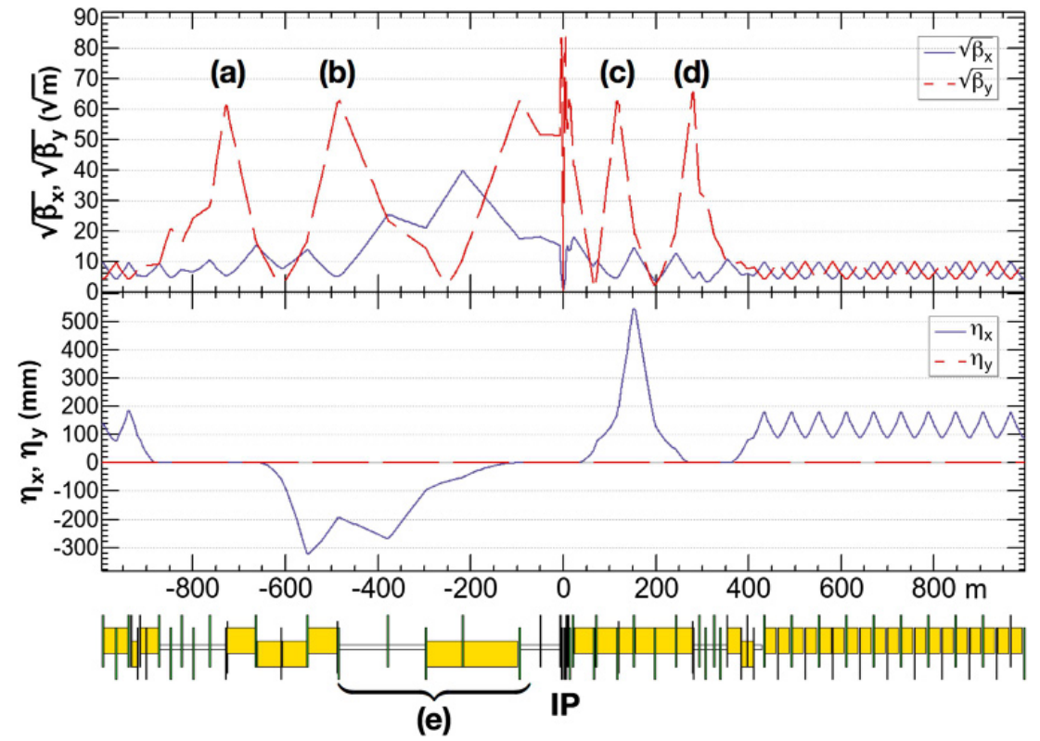
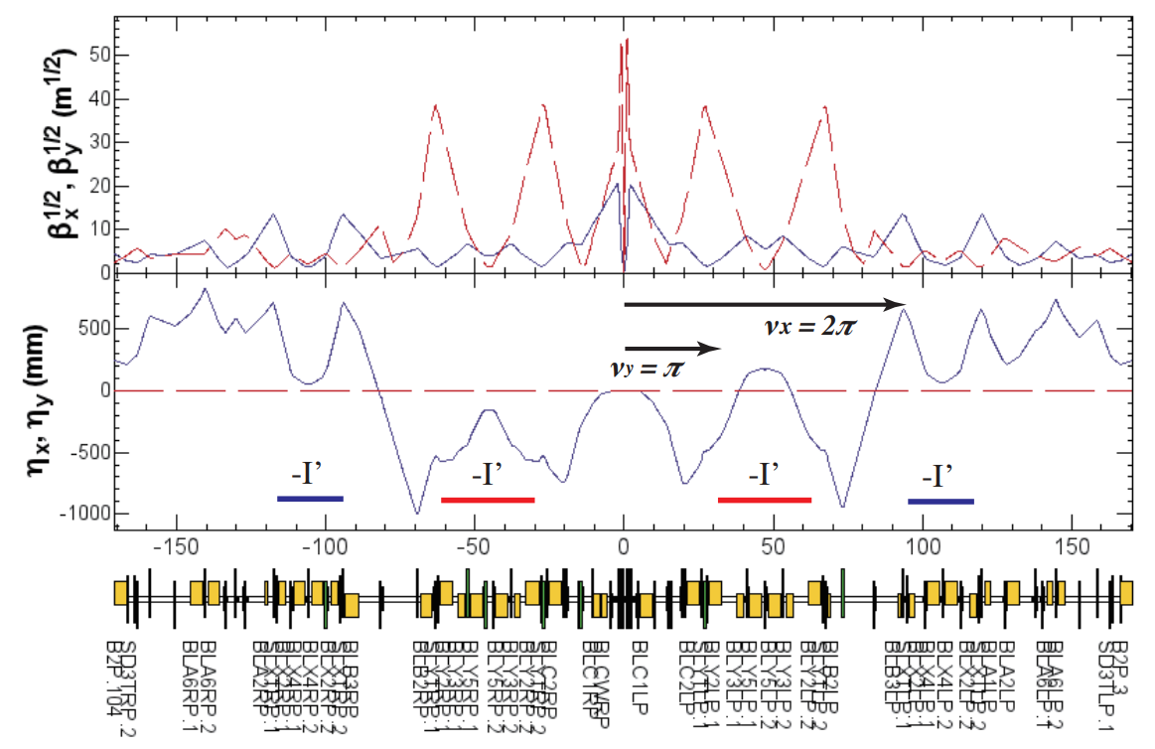
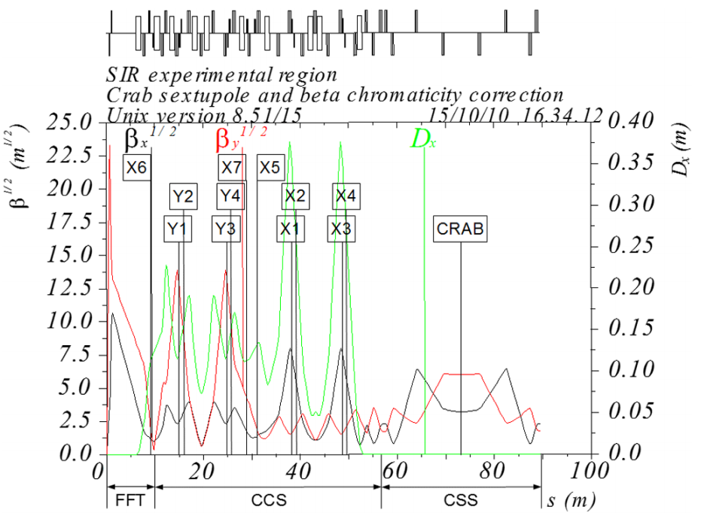
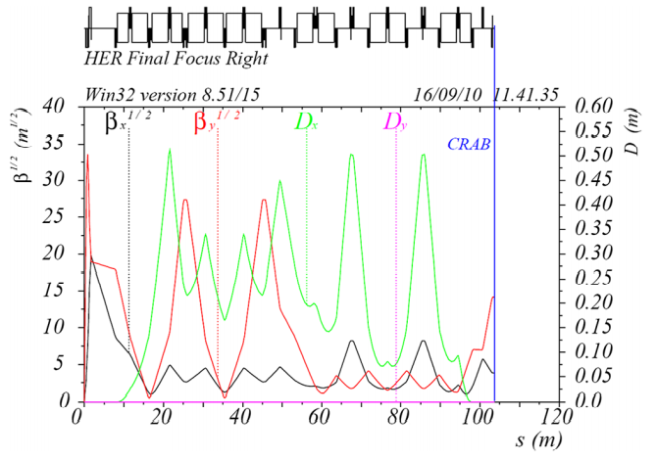
Lattice design of Interaction region for colliders
High luminosity for circular colliders: local chromaticity correction + crab waist scheme
SuperKEKB
LER
FCC-ee
SuperB
Super Charm-Tau Factory
BINP

Slide 10
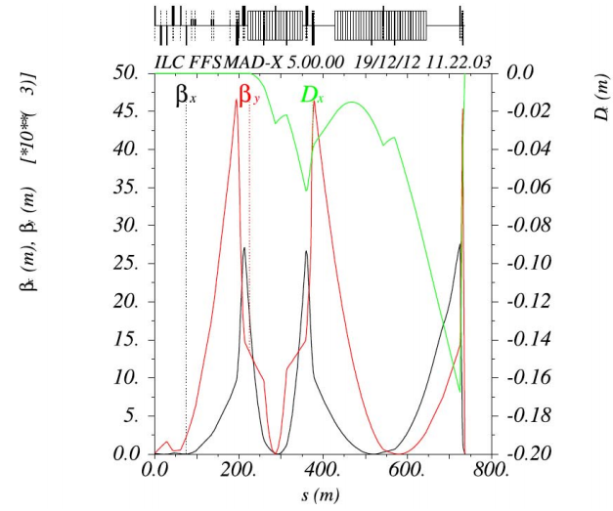
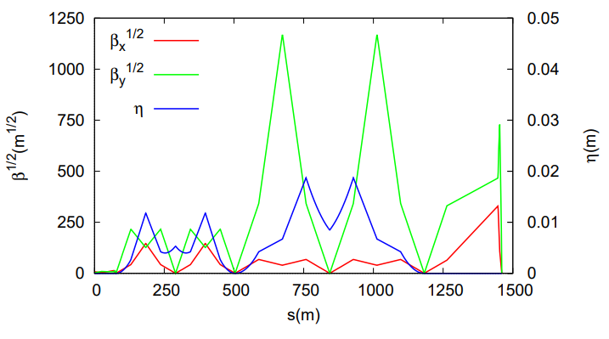
Lattice design of Interaction region for colliders
High luminosity for linear colliders: local chromaticity correction + crab cavity
ILC 500GeV
βx/βy = 15/0.4 mm
CLIC

Slide 11
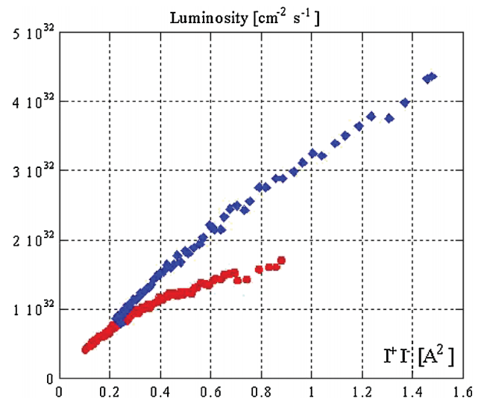
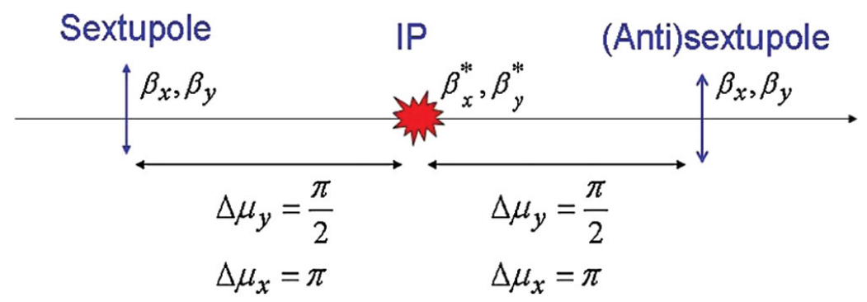
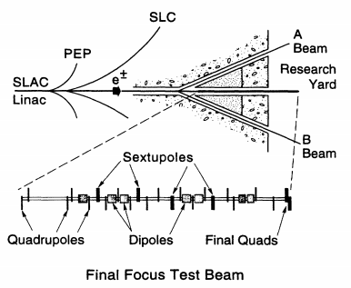
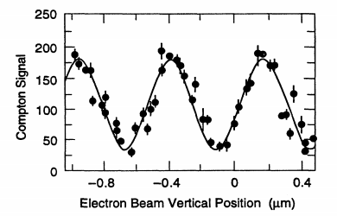
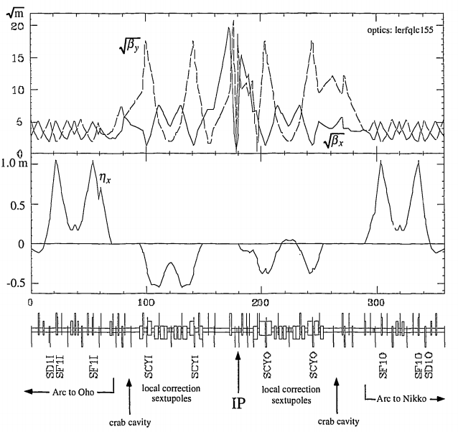
Luminosity frontier
Crab waist collision: proposed and proved on DAFNE
Flat beam + large Piwinski angle + crab sextupole
M. Zobov et al, PRL 104, 174801 (2010)
w/ crab waist
w/o crab waist
Local chromaticity correction for the interaction region: FFTB proposed for linear collider and 1st applied to circular collider on KEKB
Bunch height 73nm
KEKB LER
V. Balakin et al, Vol 74, Num 13 PRL, 1995
KEKB DR

Slide 12
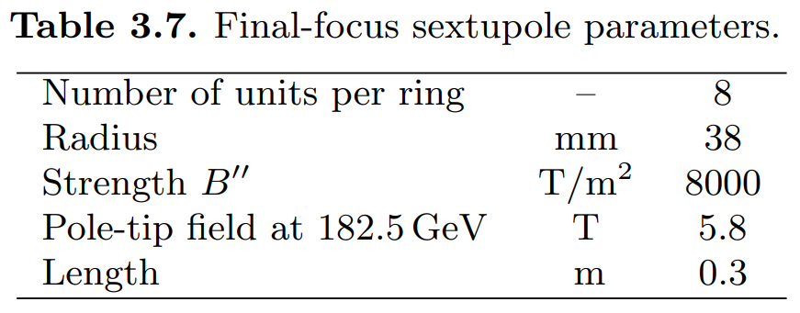
FCC-ee
No CCX: risk of machine tuning
Even Stronger sextupole: magnet technology

Slide 13
Magnets comparison
SC magnet in IR | Higgs (CDR) | Higgs (high lumi.)
SC QD0 and QF1 | L*=2.2m, d=0.6m, QD0: 2.0m, 136T/m QF1: 1.48m, 111T/m | L*=1.9m, d=0.3m, QD0: 2.5m, 142T/m, 96T/m QF1=1.5m, 56T/m
SC anti-solenoids | maximum 7.2T | maximum 6.8T
SC sextupoles | VSIRD: 0.6m, 1308 T/m^2 HSIRD: 0.8m, 1506 T/m^2 VSIRU: 0.6m, 1250 T/m^2 HSIRU: 0.6m, 1600 T/m^2 | VSIRD: 0.6m, 1209 T/m^2 HSIRD: 0.8m, 1679 T/m^2 VSIRU: 0.6m, 1548 T/m^2 HSIRU: 0.6m, 1130 T/m^2 (safety factor 20% for strength )

